Slide 1

ECR/Documents for Information and Approval
Silvia Schuh for BE-EA, 2021-08-24

Slide 2
LIST OF DOCUMENTS
For Information for EATM – upcoming ECRs
Installation of the Water Cerenkov Test Experiment in the T09 beamline | 2618347 | PSZ-J-EC-0001 v.0.1 | Dipanwita Banerjee
MoEDAL MAPP mQP detector in UA83 | 2617044 | v0.1 | Francois Butin Evelyne Dho James Devine
For Approval by EATM
New Experimental Area for PUMA | 2151516 | AD-LJ-EC-0011 v.0.4 | Francois Butin

Slide 3
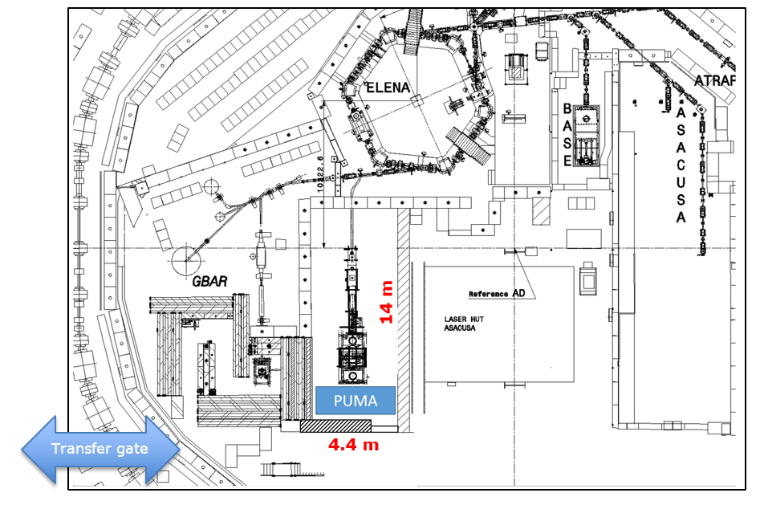
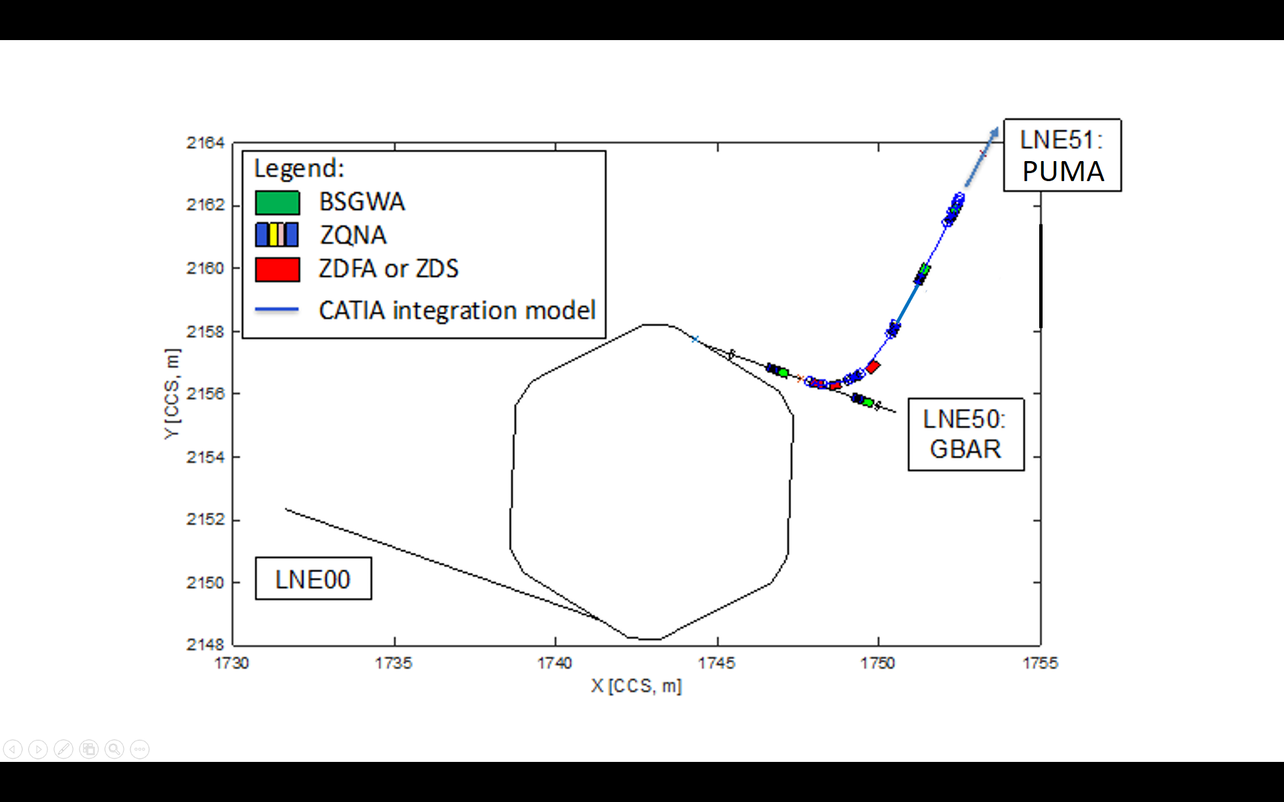
New Experimental Area for PUMA
Francois BUTIN
2151516 v.0.3 | AD-LJ-EC-0011 v.0.4
It is proposed to set up an experimental area at AD for the new PUMA experiment.
The experiment proposed includes a set-up at AD to accumulate antiprotons in a superconducting magnetic trap. The trap will be transportable so that it can be installed on an ISOLDE ion line for nuclear physics.
The LNE51 experimental area proposed for PUMA is ideally dimensioned and optimized with respect to the specific case of PUMA as a movable experiment: it is indeed the closest location to the transfer gate allowing easy and fast transfers, minimizing the risks.
Differences v0.3 & v0.4:
Editorial changes
Shielding wall - a passage for cables (40 cm x 20 cm) will be kept at ground level. OK for RP.
Add: MADX survey files have already been produced, integrated and shared via email discussion with J.F. Fuchs et al. in early Nov 2020.
Budget code changes: 89800 for the exp area & exp infrastructure. 89801 for the LNE51 (was 89954 for all)
Already approved v0.3 by EATM: 2021/01/26
Initial intention: wait for ISOLDE ECR to be ready; cannot wait any longer
Seeking final approval from EATM
S. Schuh, EATM Meeting, 2021/08/24

Slide 4
Thank you!
S. Schuh, EATM Meeting, 2021/08/24

