Slide 1
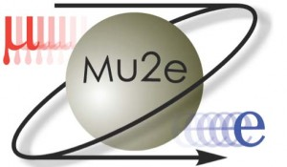


Convolutional Neural Networks in
Mu2e
by
Billy Li

Slide 2
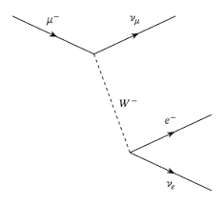
A Normal Mu2e interaction

Slide 3
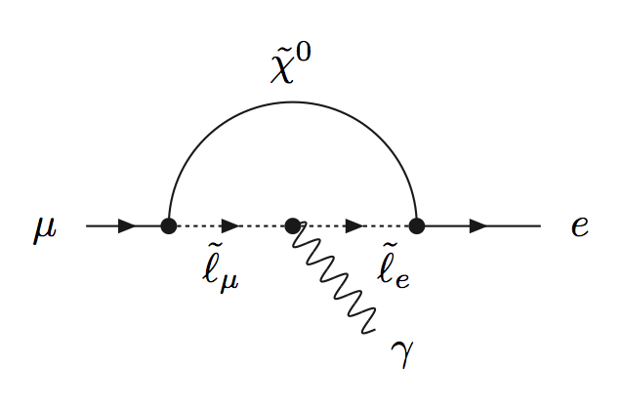

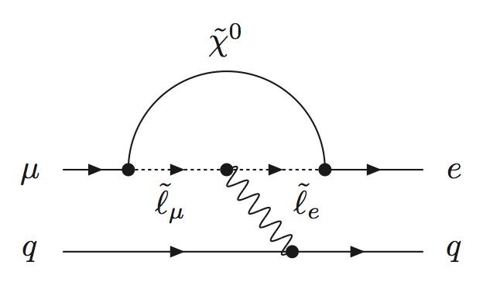

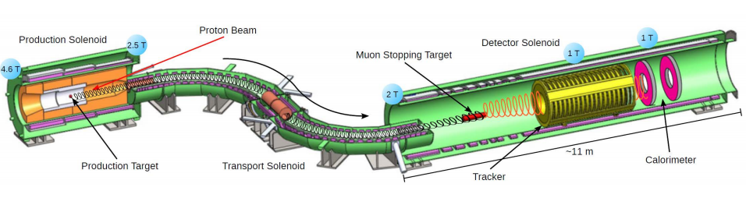

Mu2e: Looking for Charged Lepton Flavor Violation (CLFV)
$\overline{e}$

Slide 4
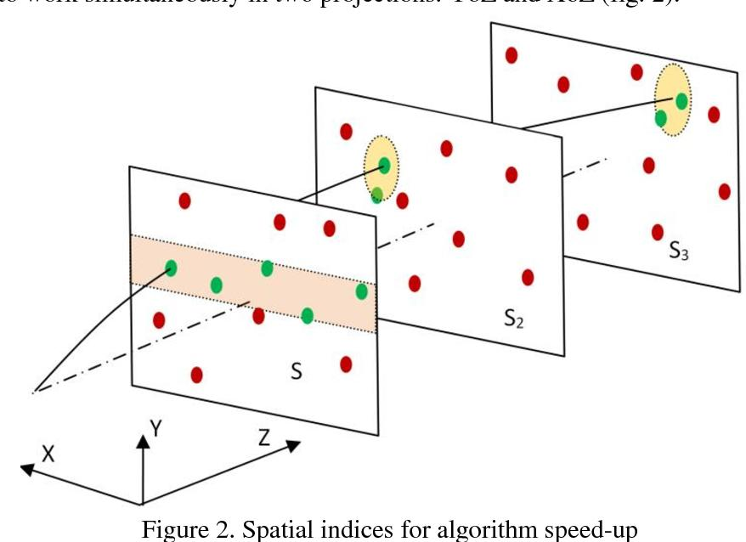
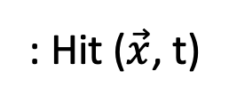
Particle Track Reconstruction (Tracking)
: Hit ($\vec{x}$, t)
: Possible Area

Slide 5
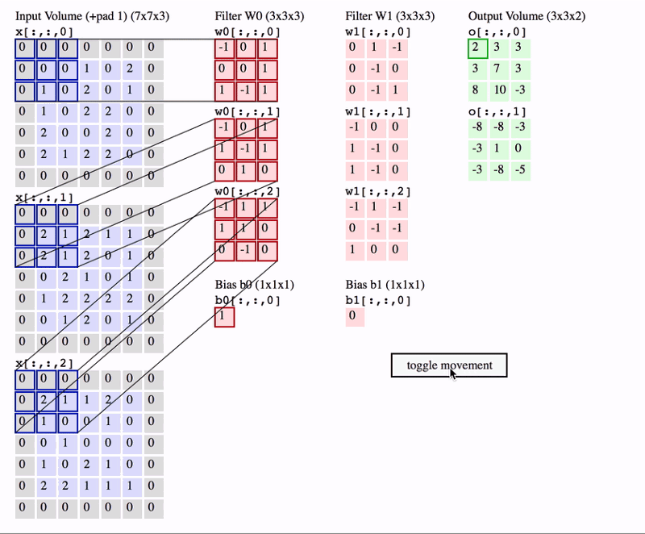
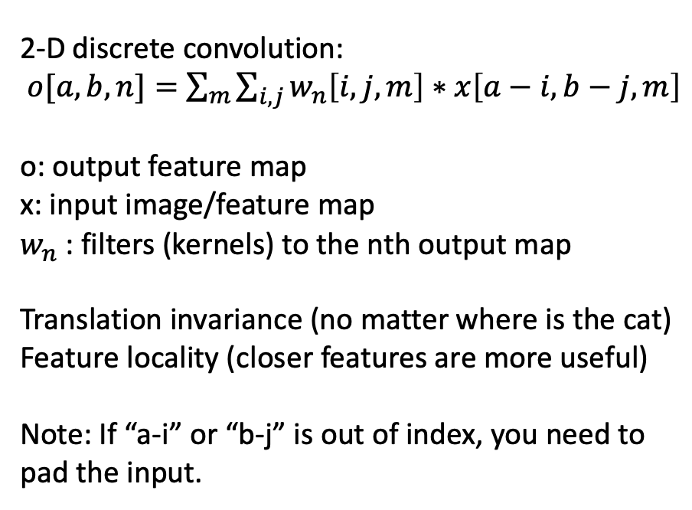
Artificial Neural Networks: Convolution
2-D discrete convolution:
$o[a, b,n]=$ $\sum_{m}{\sum_{i,j}{w_{n}\left[i,j,m\right]∗x\left[a−i, b−j, m\right]}}$
o: output feature map
x: input image/feature map
$w_{n}$: filters (kernels) to the nth output map
Translation invariance (no matter where is the cat)
Feature locality (closer features are more useful)
Note: If “a-i” or “b-j” is out of index, you need to pad the input.
Notes:
translation invariance in image classification

Slide 6
ImgTrk
A Computer Vision Approach to Particle Track Reconstruction
a
Notes:
Then we use an object detection model to sample areas from the image.
Each area contains an intact track and the segments from extraneous tracks. This part is called track detection.
The object segmentation model is then applied to each sampled area. The model extracts the intact track from other tracks’ segments. This part is called track extraction.

Slide 7
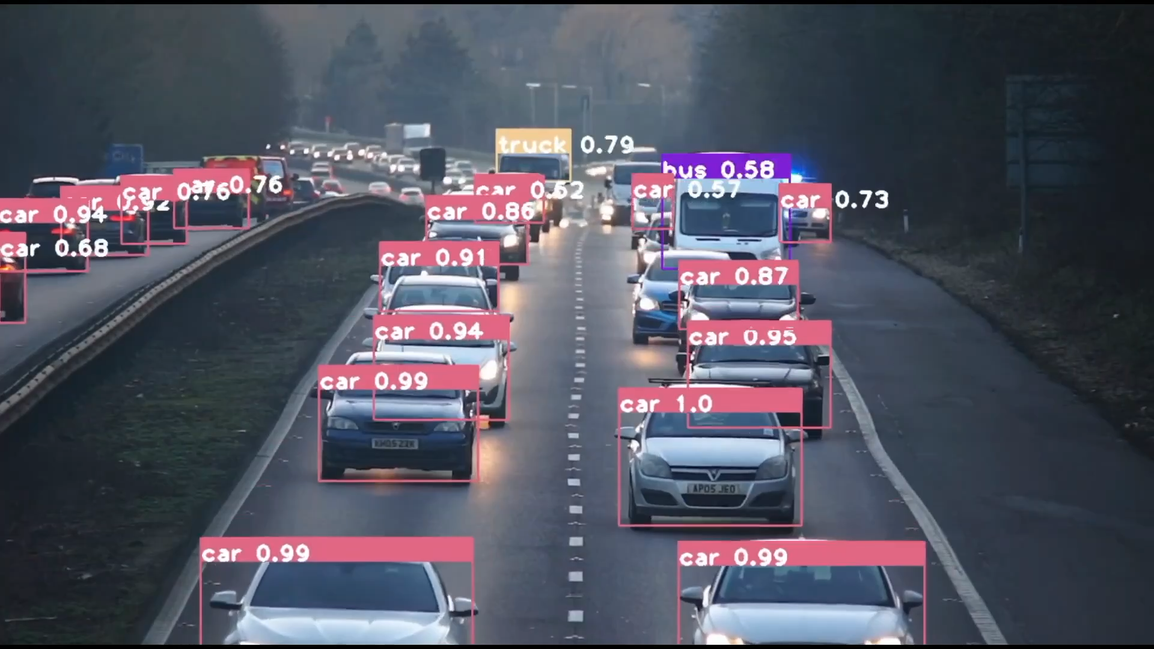
Inspiration: Object Detection
a
Notes:
Then we use an object detection model to sample areas from the image.
Each area contains an intact track and the segments from extraneous tracks. This part is called track detection.
The object segmentation model is then applied to each sampled area. The model extracts the intact track from other tracks’ segments. This part is called track extraction.

Slide 8
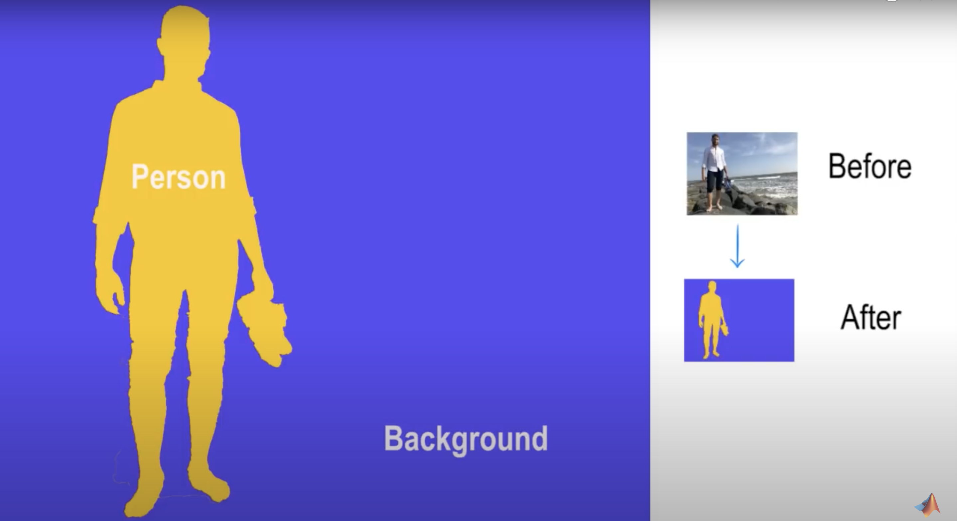
Inspiration: Semantic Segmentation
a
Notes:
Then we use an object detection model to sample areas from the image.
Each area contains an intact track and the segments from extraneous tracks. This part is called track detection.
The object segmentation model is then applied to each sampled area. The model extracts the intact track from other tracks’ segments. This part is called track extraction.

Slide 9
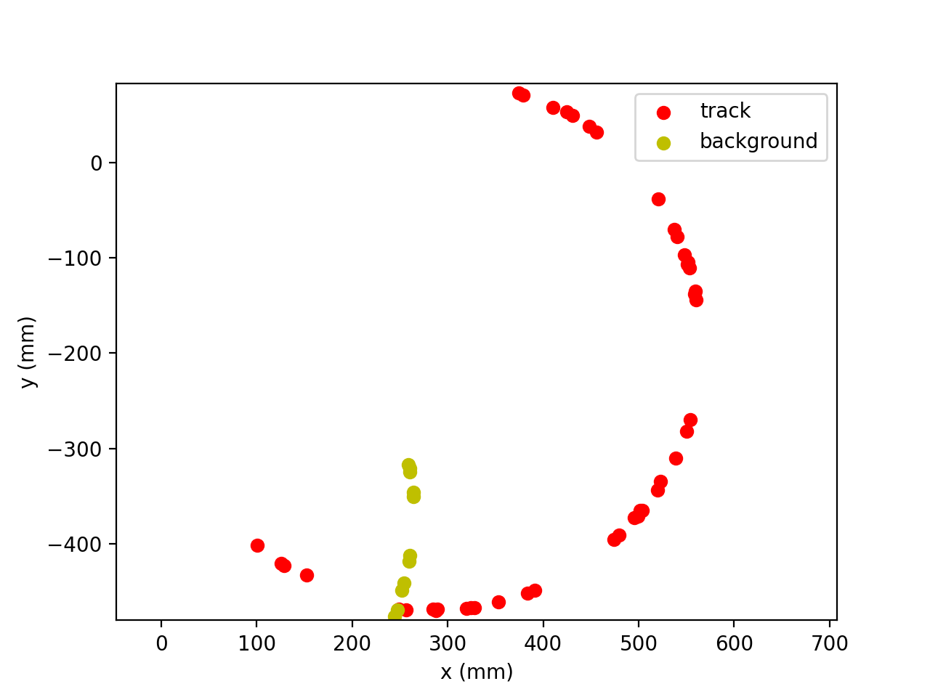
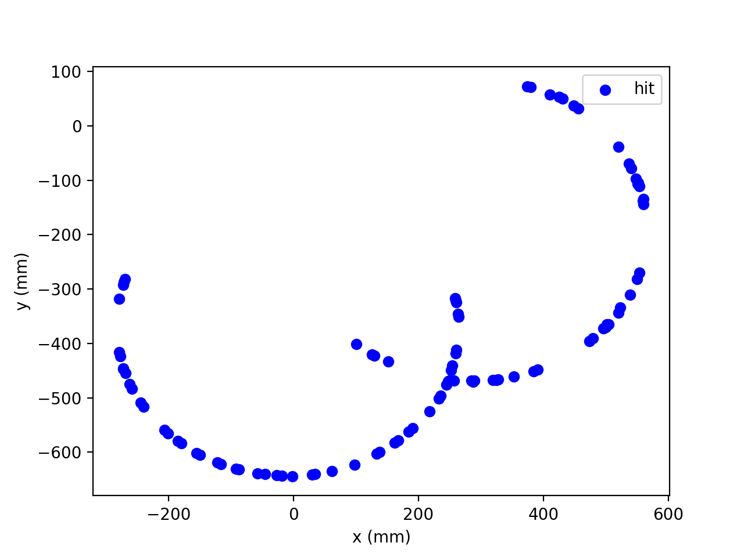
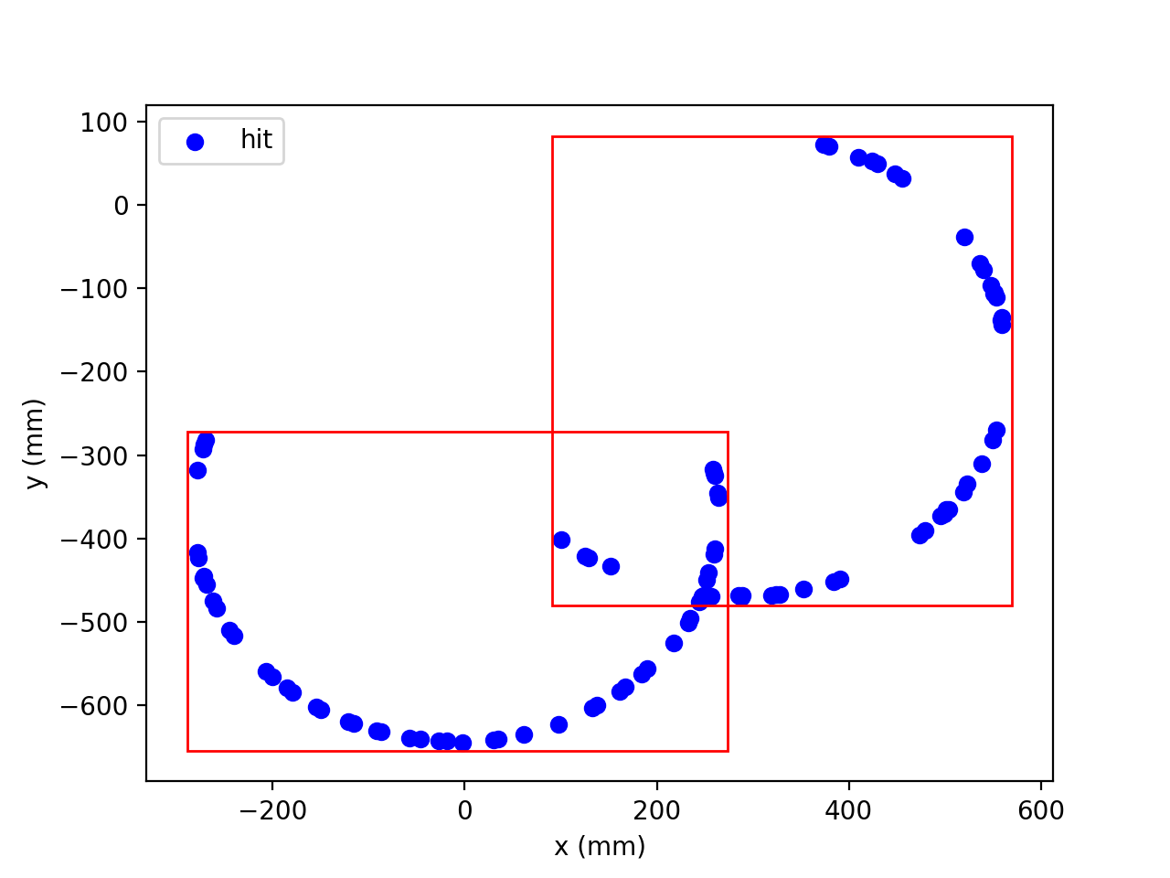
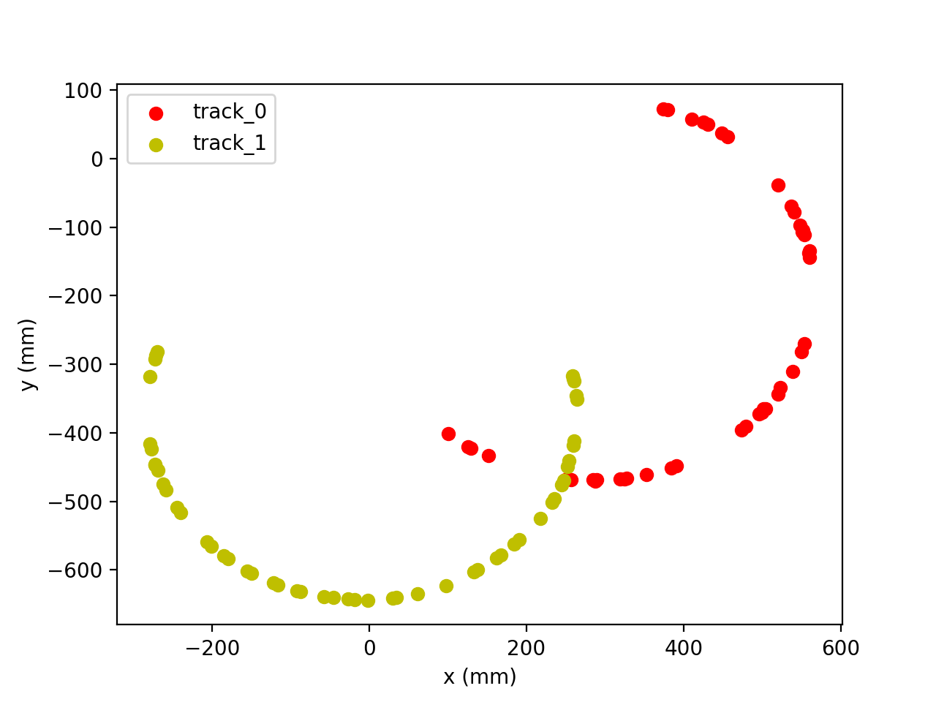
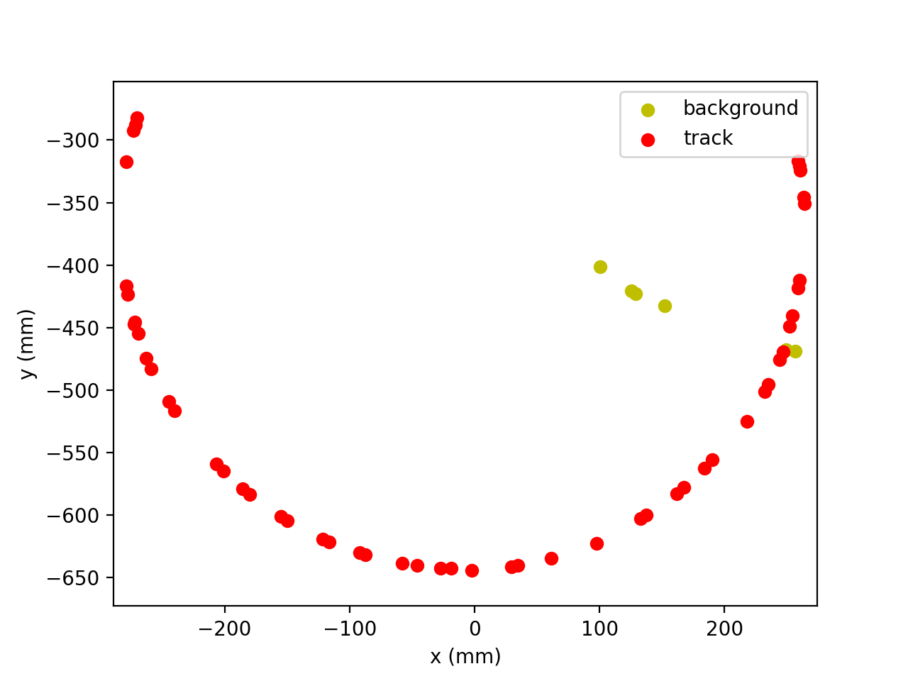
ImgTrk: A Decomposition Approach to Particle Track Reconstruction
a
1. Projection
2. Track Detection
3. Track Extraction
4. Assemble Tracks
Notes:
Then we use an object detection model to sample areas from the image.
Each area contains an intact track and the segments from extraneous tracks. This part is called track detection.
The object segmentation model is then applied to each sampled area. The model extracts the intact track from other tracks’ segments. This part is called track extraction.

Slide 10
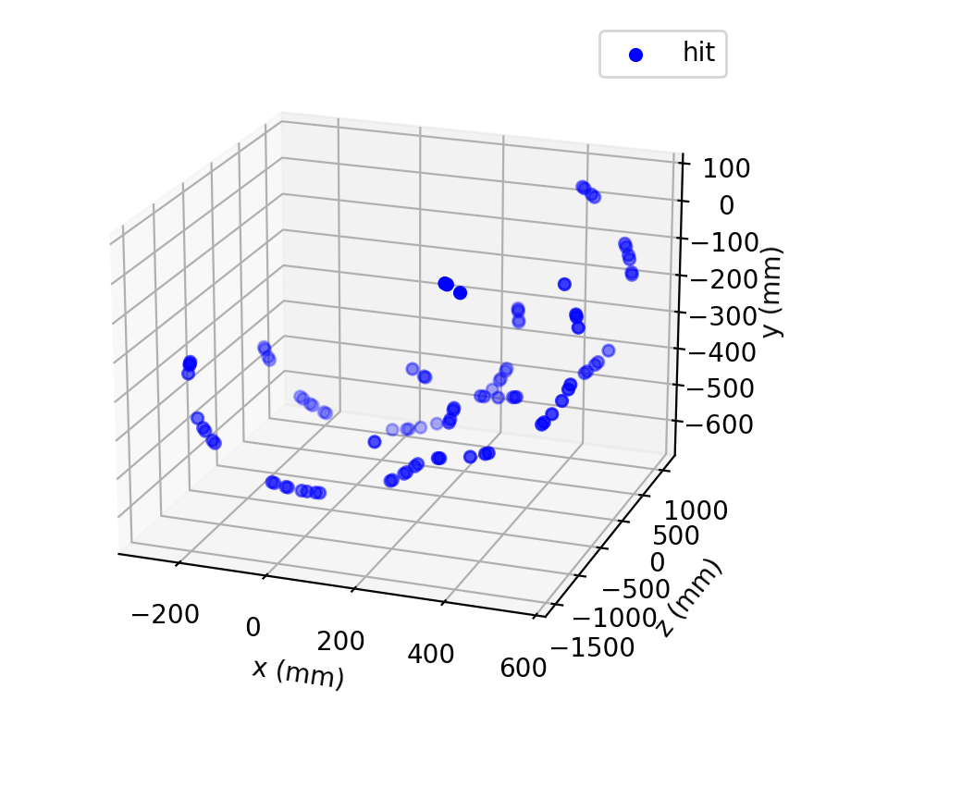
A Decomposition Approach to Particle Track Reconstruction
a
1. Projection
Notes:
Then we use an object detection model to sample areas from the image.
Each area contains an intact track and the segments from extraneous tracks. This part is called track detection.
The object segmentation model is then applied to each sampled area. The model extracts the intact track from other tracks’ segments. This part is called track extraction.

Slide 11
A Decomposition Approach to Particle Track Reconstruction
a
2. Track Detection: Drawing bounding box around tracks
Notes:
Then we use an object detection model to sample areas from the image.
Each area contains an intact track and the segments from extraneous tracks. This part is called track detection.
The object segmentation model is then applied to each sampled area. The model extracts the intact track from other tracks’ segments. This part is called track extraction.

Slide 12
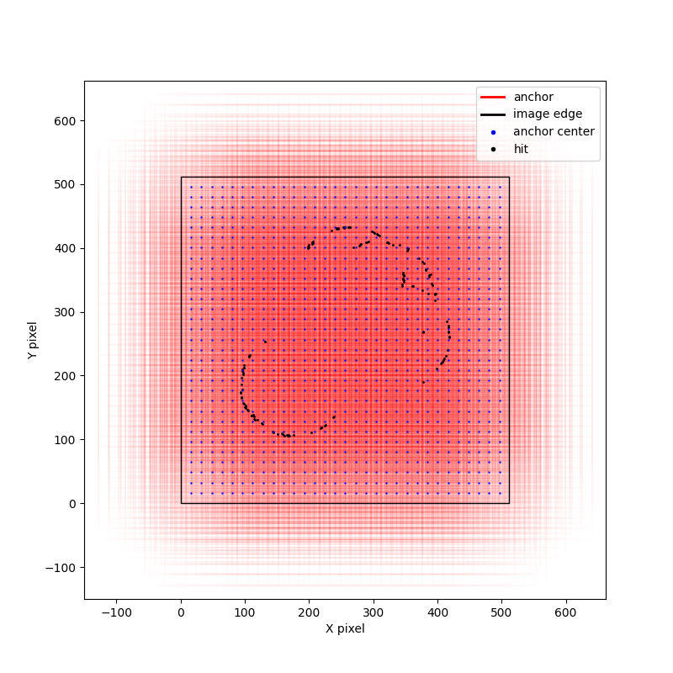
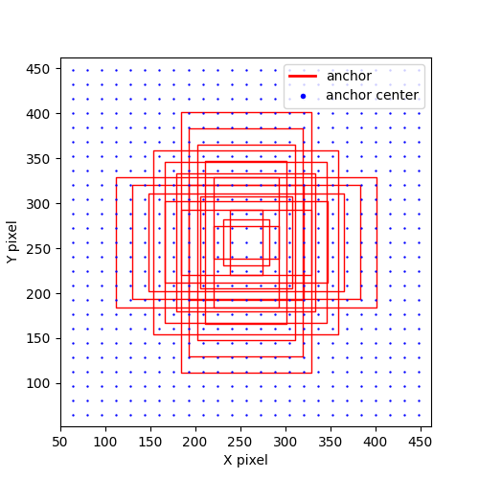
ImgTrk: Track Detection Using Faster R-CNN

Slide 13
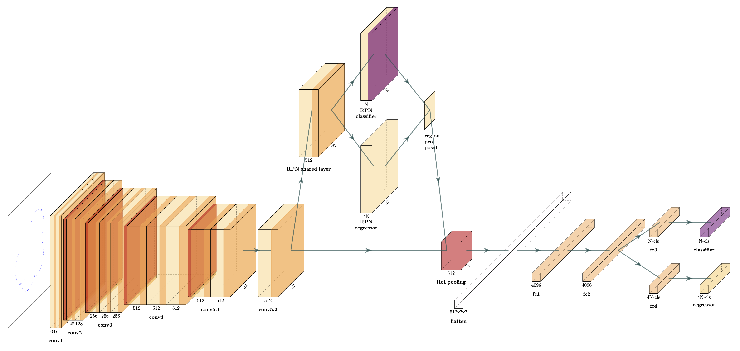
ImgTrk: Track Detection Using Faster R-CNN

Slide 14
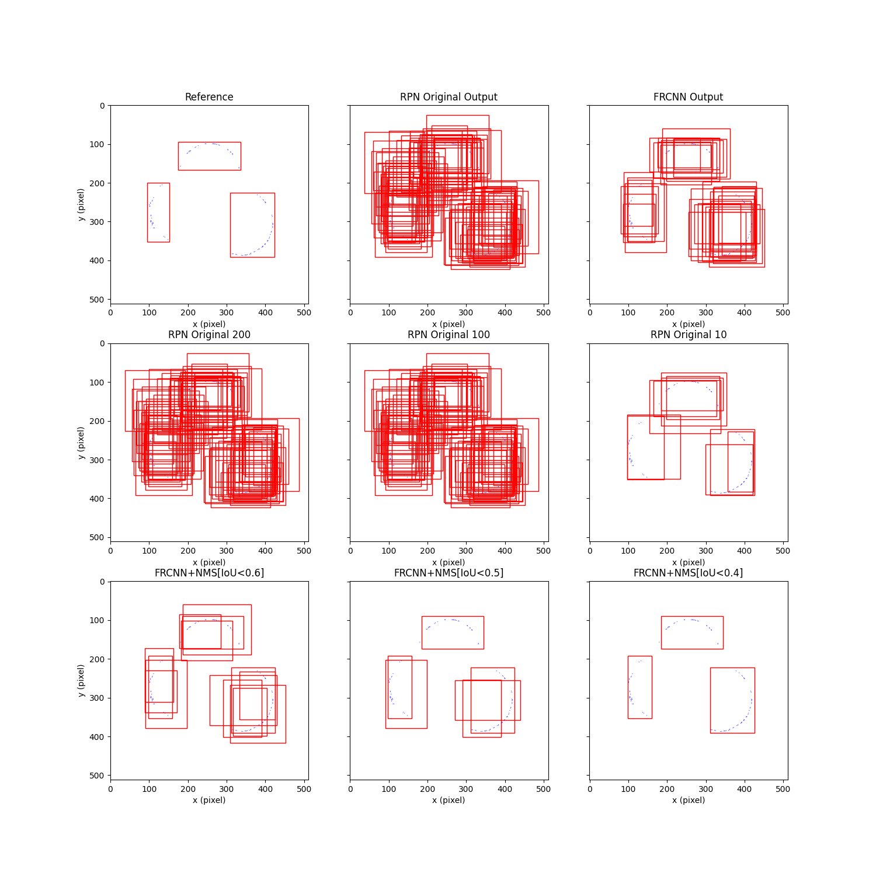
ImgTrk:
Track Detection
Using
Faster R-CNN
want
get

Slide 15
A Decomposition Approach to Particle Track Reconstruction
a
3. Track Extraction: Extract the most complete track from every bounding box
Notes:
Then we use an object detection model to sample areas from the image.
Each area contains an intact track and the segments from extraneous tracks. This part is called track detection.
The object segmentation model is then applied to each sampled area. The model extracts the intact track from other tracks’ segments. This part is called track extraction.

Slide 16
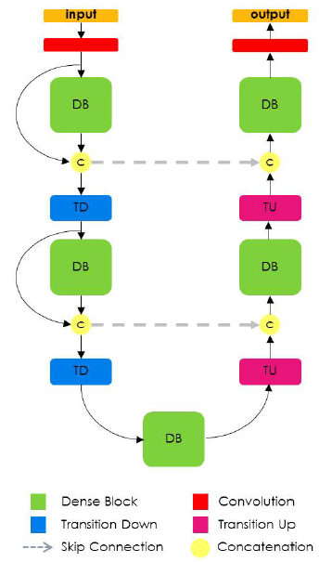
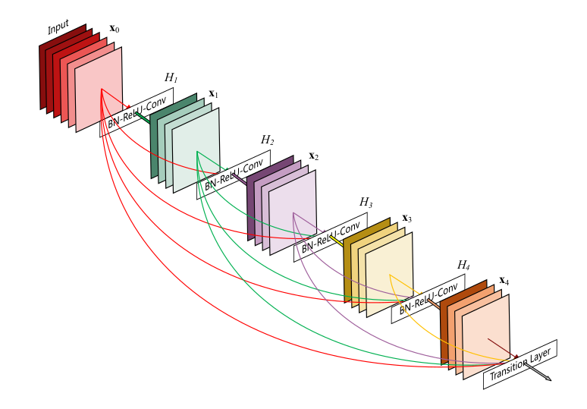
ImgTrk: Track Extraction Using FC-DenseNet
Dense Block

Slide 17
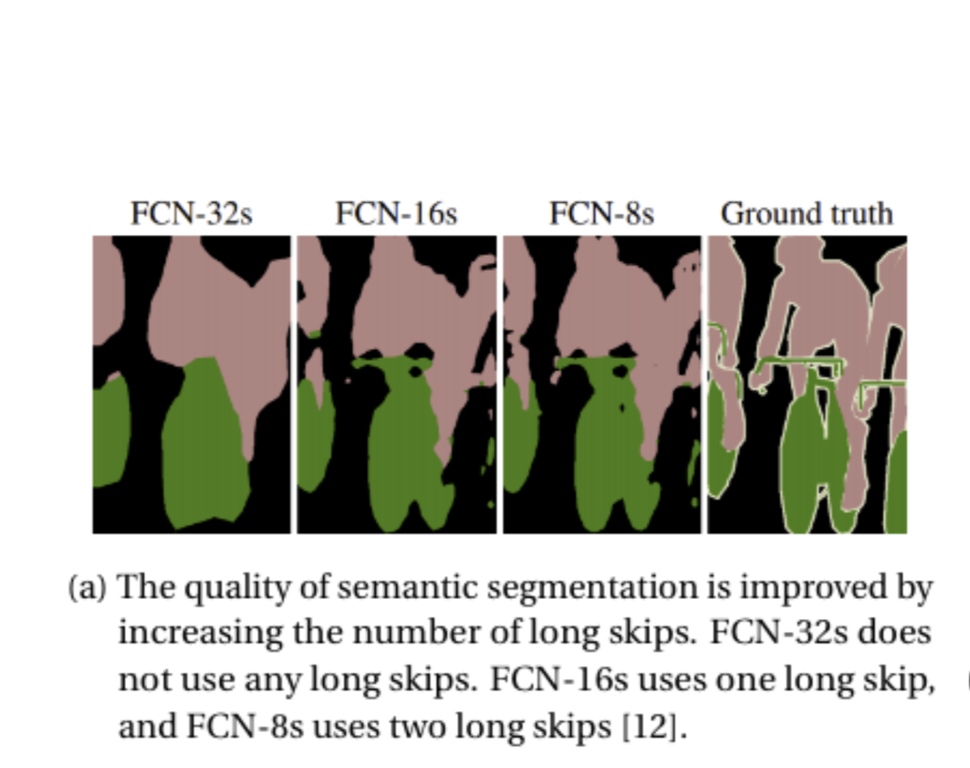
FC-DenseNet: Using Long Skips

Slide 18

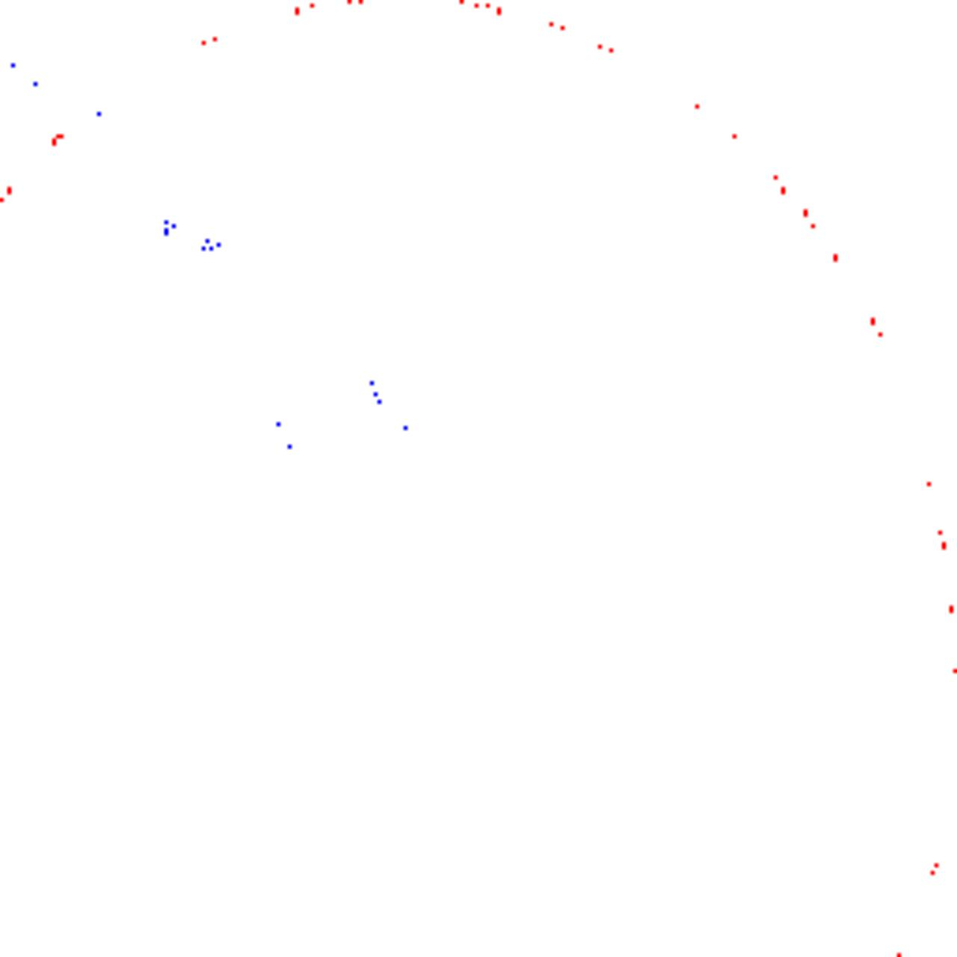
ImgTrk: Track Extraction Using FC-DenseNet
Input
Output
Red: hit members of the intact track
Blue: hit members of other tracks’ pieces
Grey scale: hit density

Slide 19
A Decomposition Approach to Particle Track Reconstruction
a
4. Assemble the complete tracks, and ... You are done!
Notes:
Then we use an object detection model to sample areas from the image.
Each area contains an intact track and the segments from extraneous tracks. This part is called track detection.
The object segmentation model is then applied to each sampled area. The model extracts the intact track from other tracks’ segments. This part is called track extraction.

Slide 20
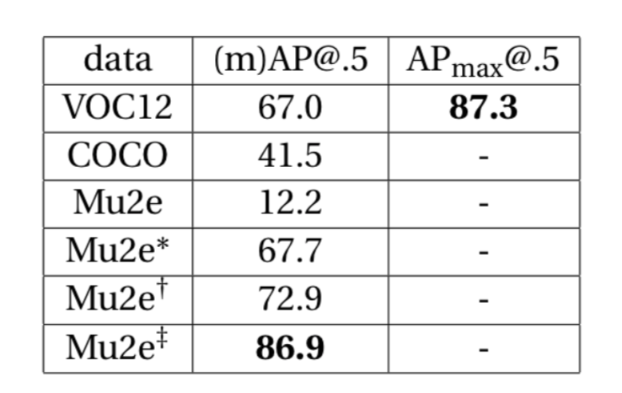
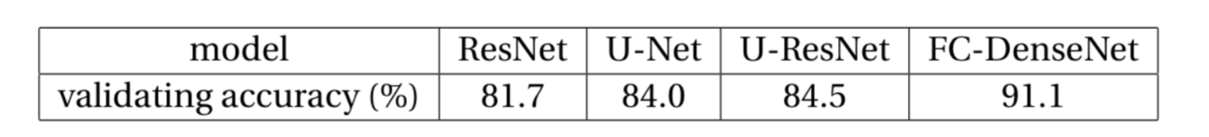
Performance

Slide 21
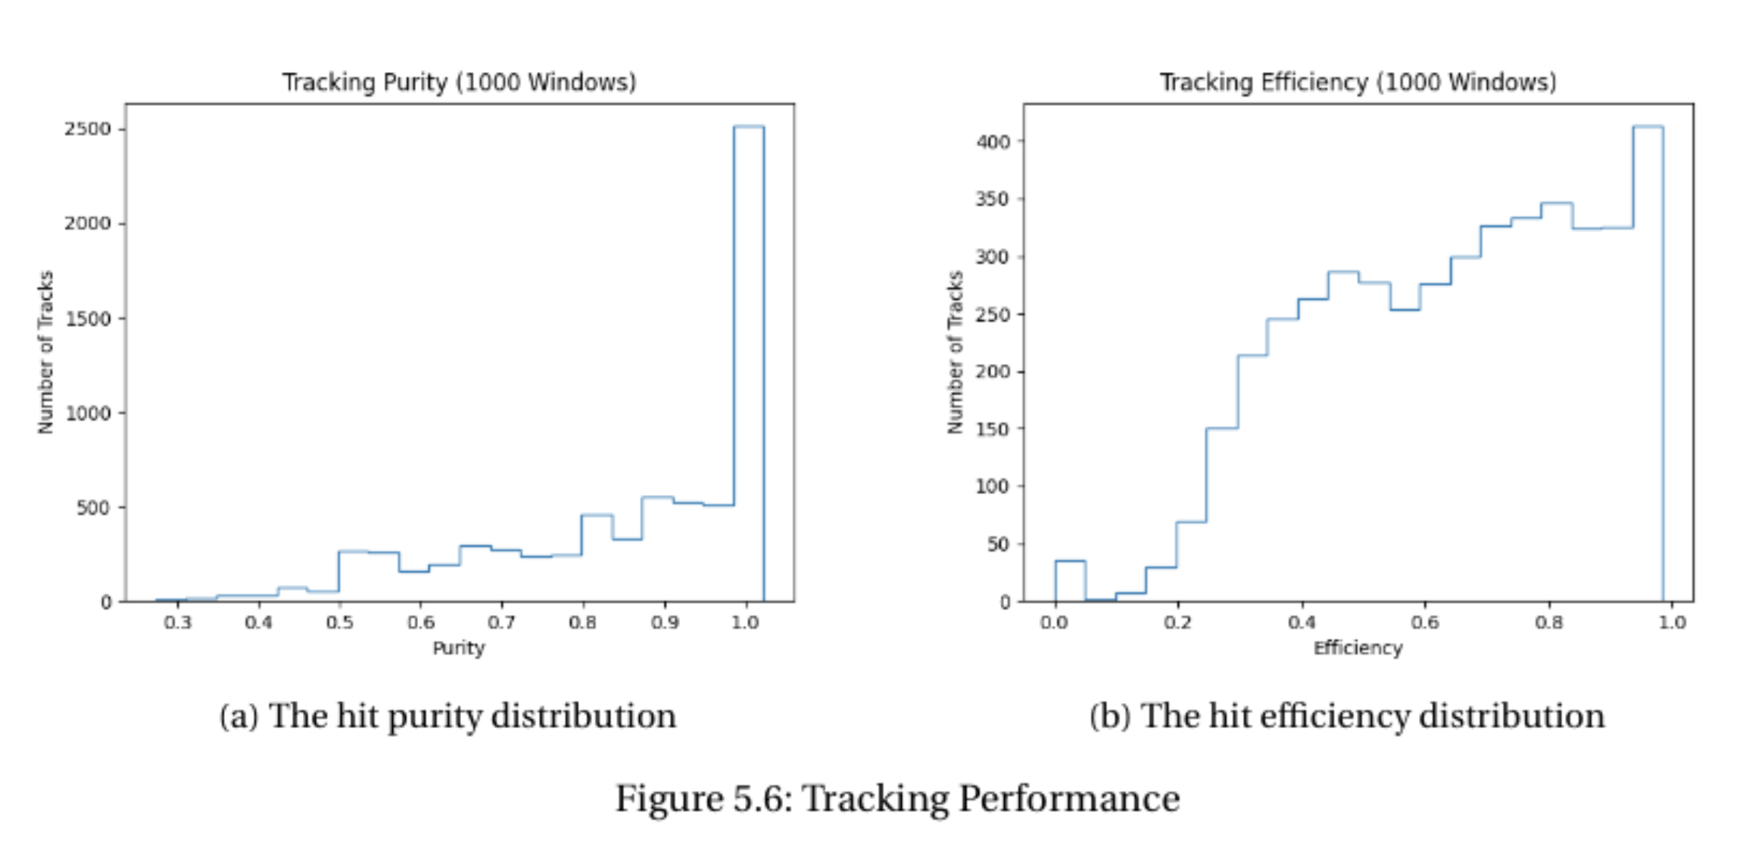
Performance

Slide 22
Thank You!

