Slide 1
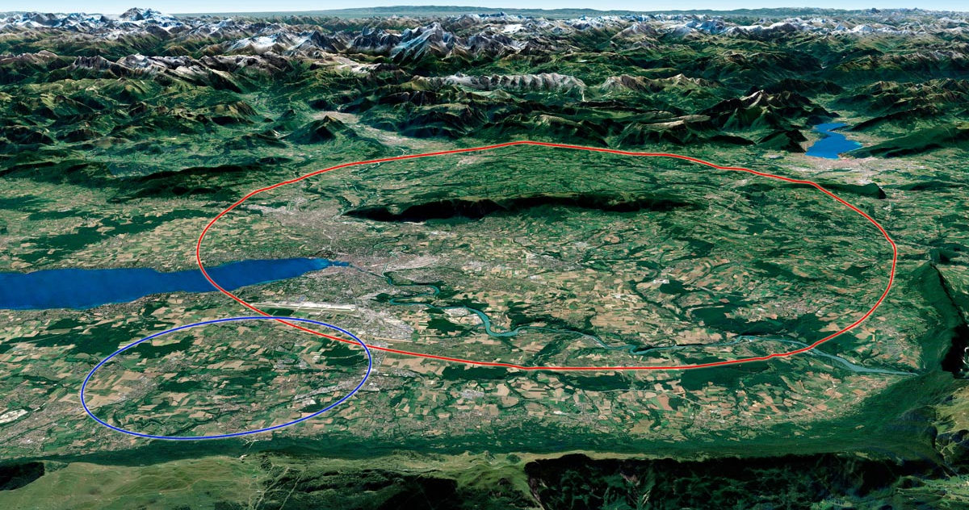


FCC baseline V1.0 and fallback scenarios
P. Boillon (Cerema), J. Gutleber (CERN), P. Laidouni (CERN), V. Mertens (CERN)
This project has received funding from the European Union's Horizon 2020 research and innovation programme under grant agreement No 951754.
Artist’s impression of LHC (left) and FCC (right)

Slide 2
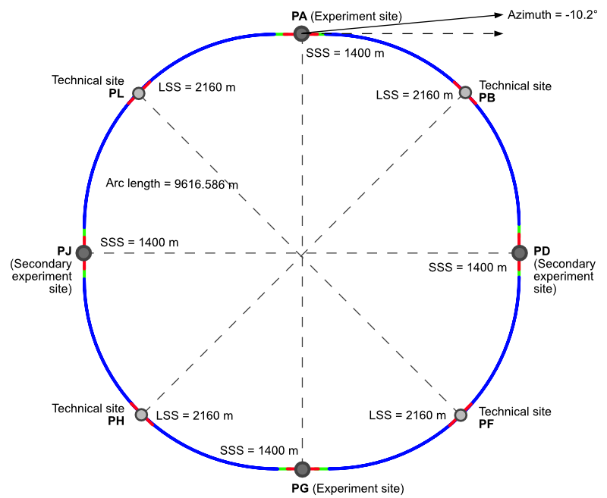
Parameters of baseline scenario PA31-1.0
Number of surface sites | 8
Number of arc cells | 42
Arc cell length | 213.045 m
SSS@IP (PA, PD, PG, PJ) | 1400 m
LSS@TECH (PB, PF, PH, PL) | 2160 m
Azimuth @ PA (0 = East) | -10.75°
Arc length | 9 616.586 m
Sum of arc lengths | 76 932.686 m
Total length | 91 172.686 m
Note: Azimuth indicated by FFE tool with positive number is a counterclockwise rotation. By convention documented in the configuration management plan, as implemented in GIS environment it should be a negative number! Also, rotation is around origin (PA). ToT still assumes center point of layout.

Slide 3
PA31-1.1 & 1.6 fallback alternatives
Scenario | PA31-1.0 | PA31-1.1 | PA31-1.6
Number of surface sites | 8 (potential additional small access shafts at CERN or for ventilation at sites with long access tunnels, e.g. PF)
Number of arc cells | 42
Arc cell length | 213.04636573 m
SSS@IP (PA, PD, PG, PJ) | 1400 m | 1400 m | 1410 m
LSS@TECH (PB, PF, PH, PL) | 2160 m | 2100 m | 2110 m
Azimuth @ PA (0 = East) | -10.75° | -10.45° | -10.2°
Sum of arc lengths | 76 932.686 m
Total length | 91 172.686 m | 90 932.686 m | 91 052.686 m

