Slide 1
AWAKE synchronisation jitter
Ivan Karpov
With input from Arthur Spierer, Ben Woolley, Giulia Papotti
Andy Butterworth, Philippe Baudrenghien, Kevin Shing Bruce Li
LIU-SPS Coordination Meeting, 11 Aug. 2021

Slide 2
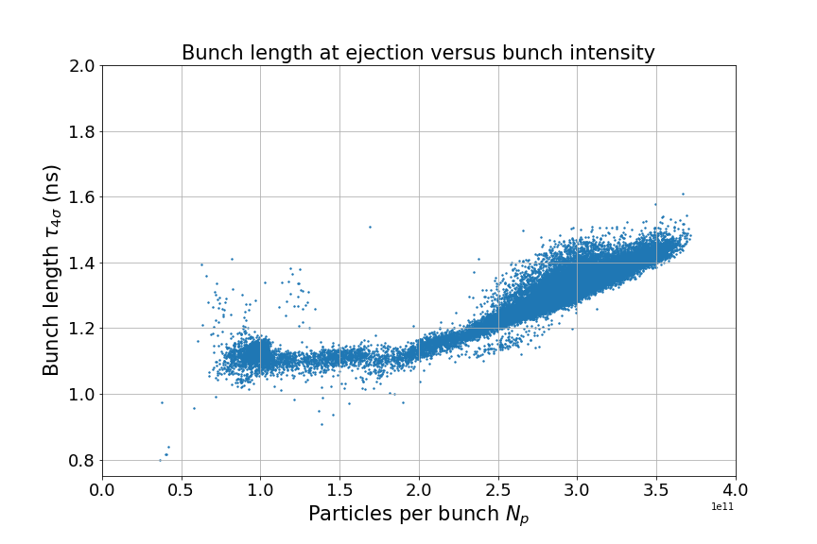
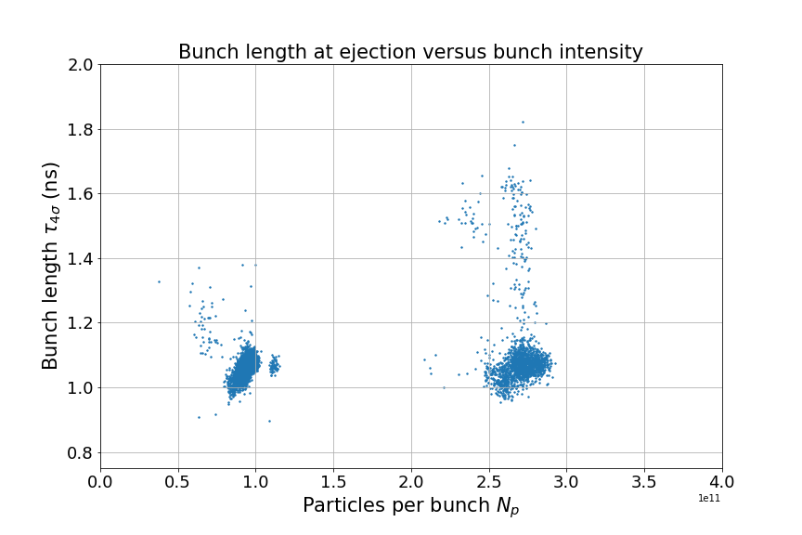
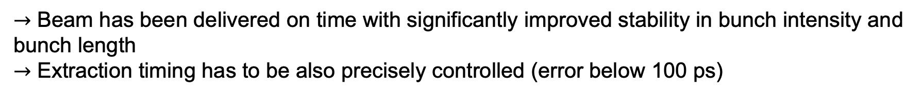
AWAKE 2018 vs 2021
Shot-by-shot reproducibility is necessary to study electron-seeding of self-modulation of a proton bunch in plasma.
2018
2021
Test w/o bunch rotation
bunch rotation only
$→$ Beam has been delivered on time with significantly improved stability in bunch intensity and bunch length
$→$ Extraction timing has to be also precisely controlled (error below 100 ps)

Slide 3
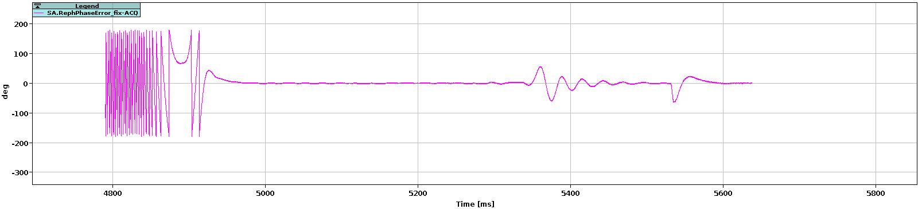
Synchronisation jitters
Extraction to AWAKE is synchronised thanks to rephasing
Screenshot from RF APP ALL
3. Fine re-phasing (phase locked loop)
1. Set frequency
2. Cogging
If the phase error is close to $±180$ bunch can jump $±1$ 400MHz bucket in phase 3 $→$ 2.5 ns jitter
Phase loop gain is reduced during phase 3, so any phase error will not be suppressed $→$ 100 ps jitter

Slide 4
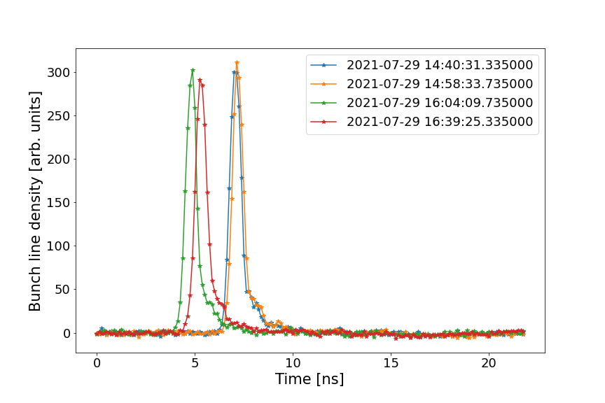
Synchronisation jitters
Extraction to AWAKE is synchronised thanks to rephasing
SPS.BQM:RAW_WAVEFORM_FLATTOP
Screenshot from RF APP ALL
3. Fine re-phasing (phase locked loop)
1. Set frequency
2. Cogging
If the phase error is close to $±180$ bunch can jump $±1$ 400MHz bucket in phase 3 $→$ 2.5 ns jitter
Phase loop gain is reduced during phase 3, so any phase error will not be suppressed $→$ 100 ps jitter

Slide 5
Synchronisation jitters
Extraction to AWAKE is synchronised thanks to rephasing
Screenshot from RF APP ALL
3. Fine re-phasing (phase locked loop)
1. Set frequency
2. Cogging
If the phase error is close to $±180$ bunch can jump $±1$ 400MHz bucket in phase 3 $→$ 2.5 ns jitter
Phase loop gain is reduced during phase 3, so any phase error will not be suppressed $→$ 100 ps jitter

Slide 6
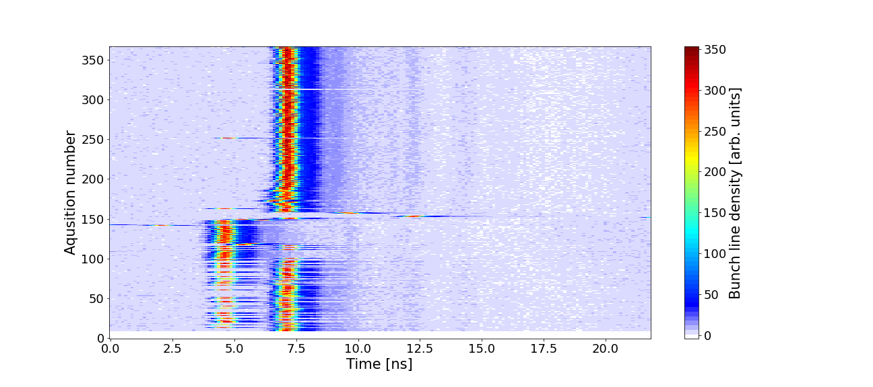
2.5 ns jitter
SPS.BQM:RAW_WAVEFORM_FLATTOP
$→$ Jitter was removed after firmware upgrade on Thursday 29th of July; compensation of the drift between the Fc (non-stabilized fibre) and 400MHz (stabilized fibre)

Slide 7
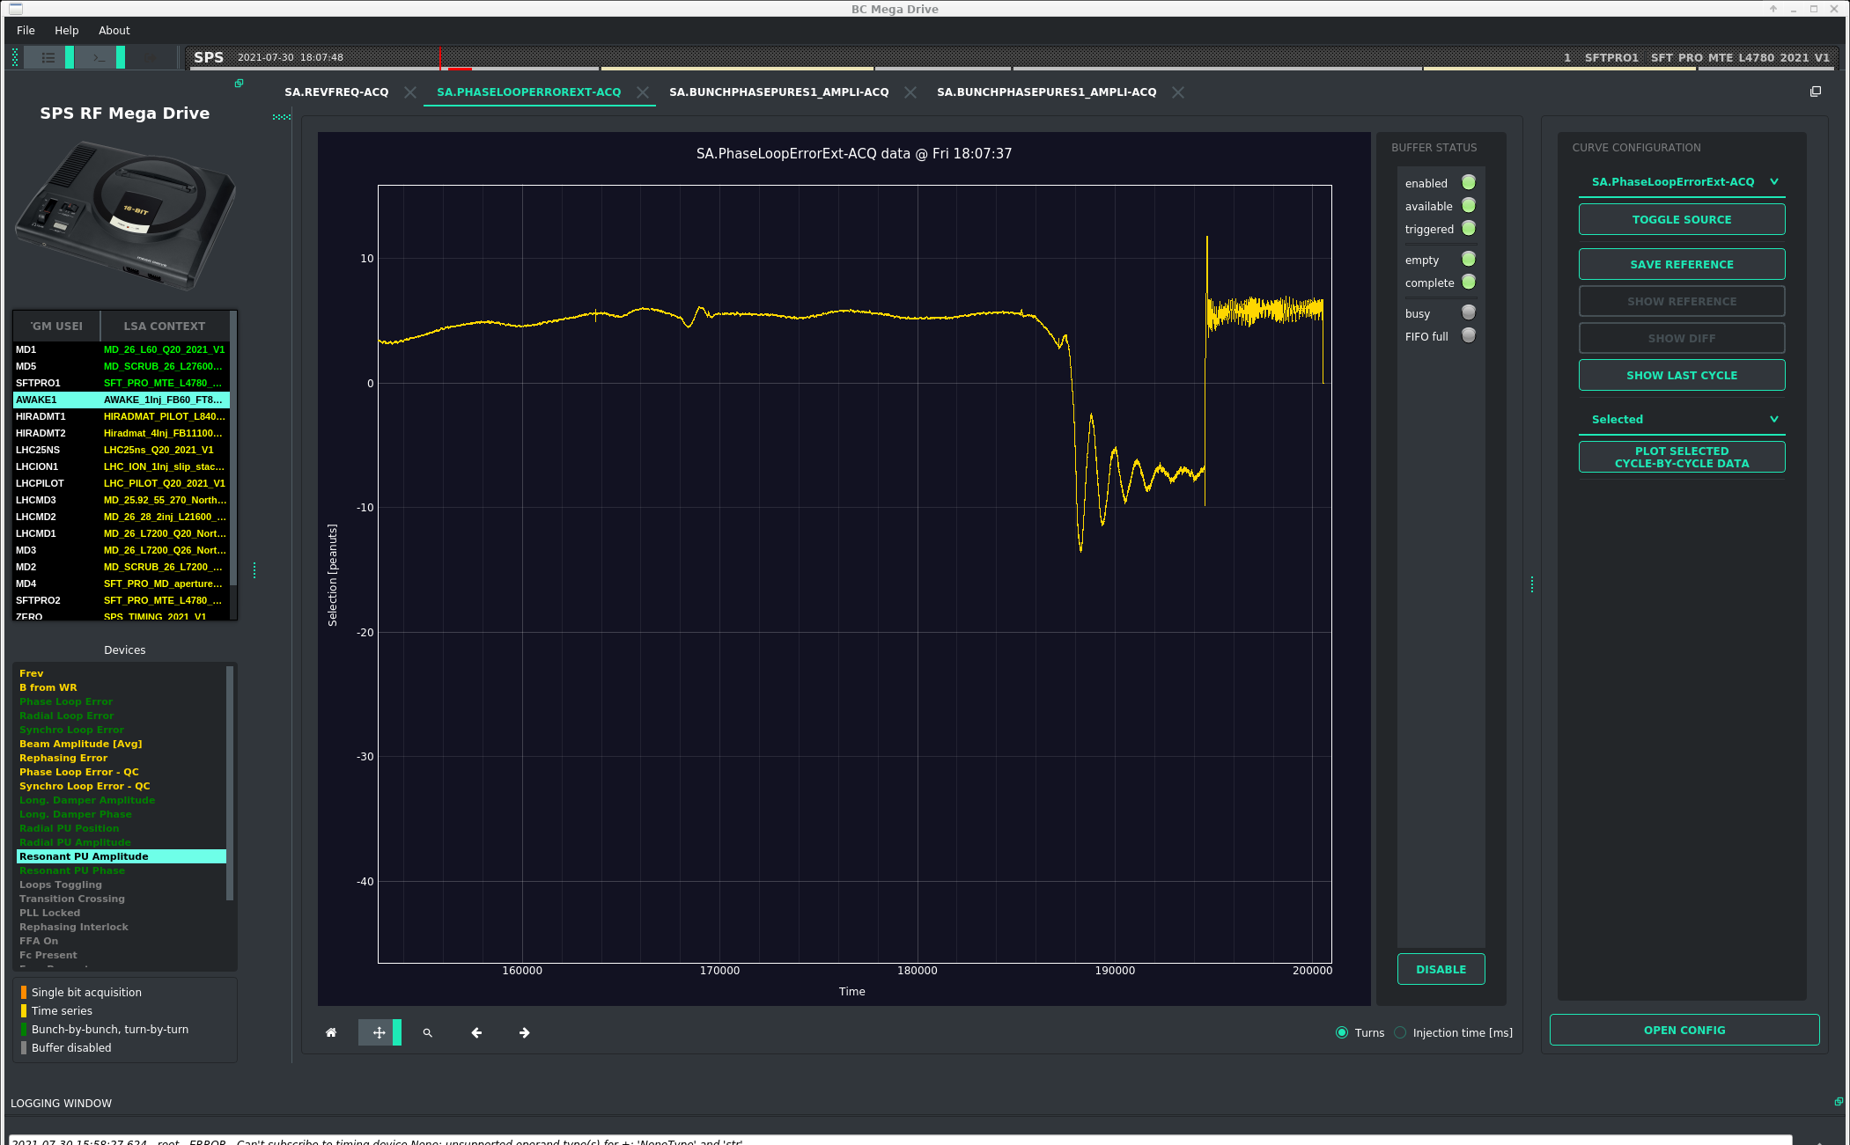
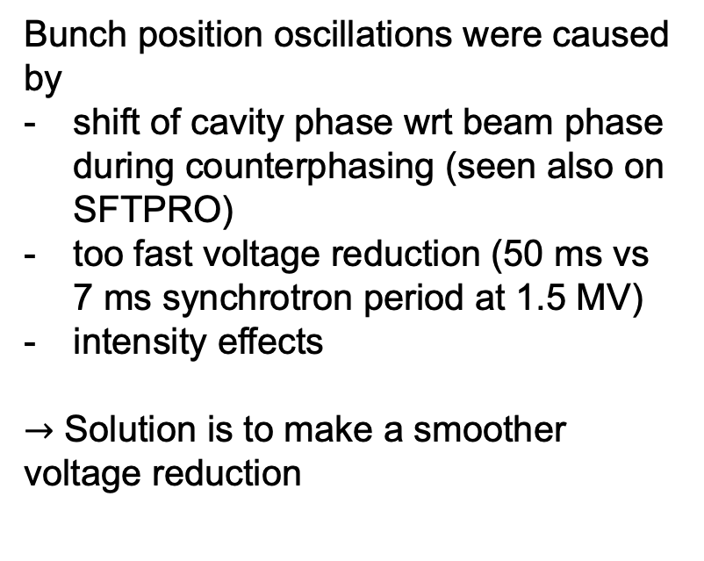
100 ps jitter
Bunch position oscillations were caused by
shift of cavity phase wrt beam phase during counterphasing (seen also on SFTPRO)
too fast voltage reduction (50 ms vs 7 ms synchrotron period at 1.5 MV)
intensity effects
$→$ Solution is to make a smoother voltage reduction (osc. amplitude reduced by factor of 5)

Slide 8
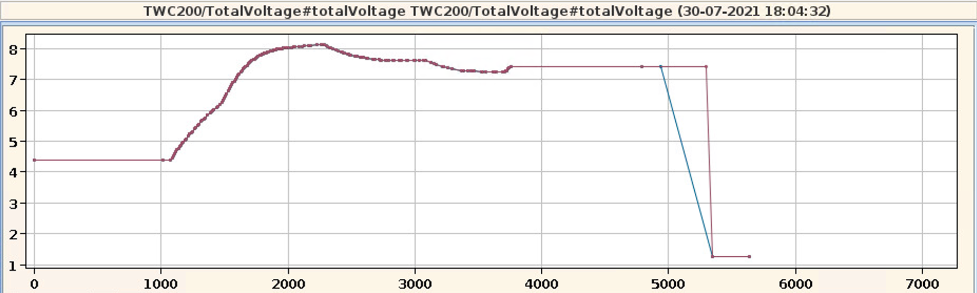

100 ps jitter
Bunch position oscillations were caused by
shift of cavity phase wrt beam phase during counterphasing (seen also on SFTPRO)
too fast voltage reduction (50 ms vs 7 ms synchrotron period at 1.5 MV)
intensity effects
$→$ Solution is to make a smoother voltage reduction (osc. amplitude reduced by factor of 5)
But potential impact on rephasing due to changing voltage)

Slide 9
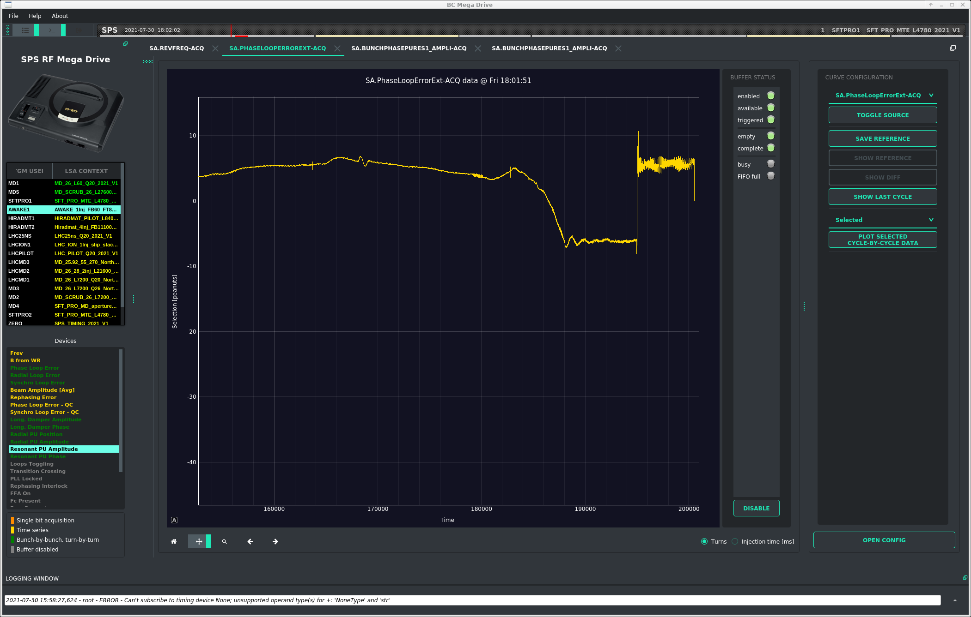
100 ps jitter
Bunch position oscillations were caused by
shift of cavity phase wrt beam phase during counterphasing (seen also on SFTPRO)
too fast voltage reduction (50 ms vs 7 ms synchrotron period at 1.5 MV)
intensity effects
$→$ Solution is to make a smoother voltage reduction (osc. amplitude reduced by factor of 5)
Stable extraction of Friday and Sunday.
Unfortunately, this jitter came back on Tuesday afternoon and difficult to trace back based on BQM data

Slide 10
Summary
AWAKE requires very good reproducibility of bunch parameters
2.5 ns jitter was solved thanks firmware upgrade on Thursday 29th of July
100 ps was initially solved by adjusting RF voltage programmes, but unfortunately came back on Tuesday 3rd of August, which is not yet understood
Next steps:
Fine tune PL and PLL gains
Adjust voltage programmes
Logging of rephasing data
extraction interlock by the BQM / Beam control

Slide 11
Thank you for your attention!

Slide 12
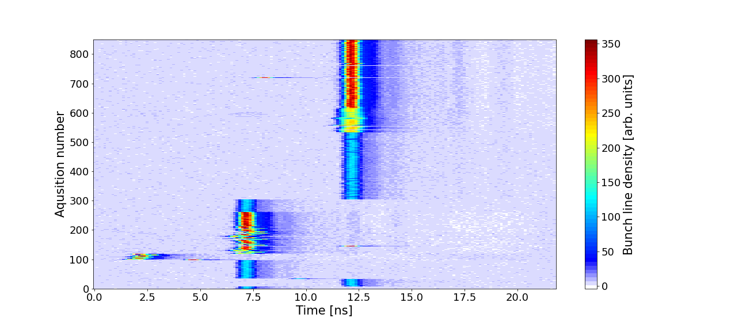

5 ns jitter
$→$ Injection in the wrong bucket in the SPS

