Slide 1
SPS machine report
H. Bartosik for the SPS team

Slide 2
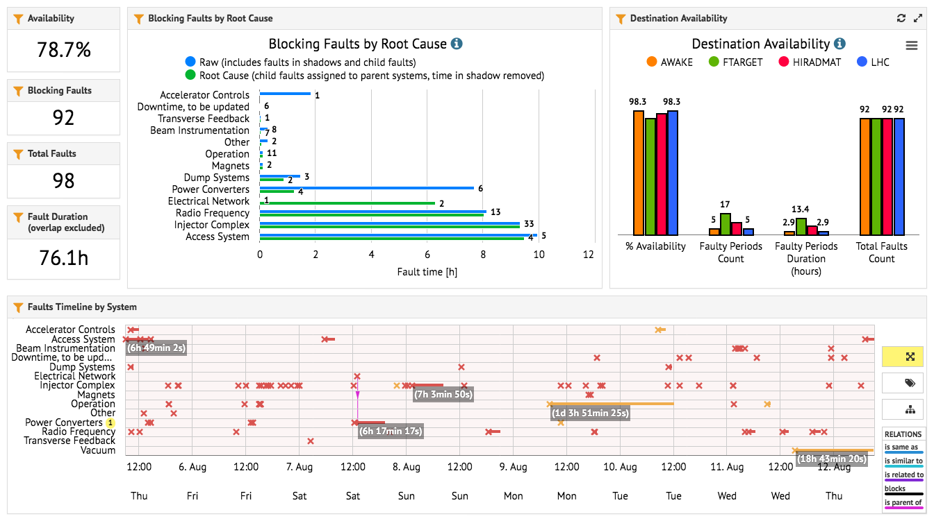
Availability

Slide 3
SFTPRO
Increased intensity on Friday
  from 1e+13 ppp to 1.9e+13 ppp (instead of 3e+13 ppp due to vacuum pump issue on T6 TBIU)
  intensity on T4 nominal, less intensity on T6
Ongoing investigations on transmission to T10 target
  identified and fixed issue with calibration of target instrumentation
  further investigations under discussion in collaboration with EA physicists
Progress on 100 Hz correction on the spill
  issue understood, experts are working on implementation of the fix
Dedicated MD to study splitting efficiency
  unfortunately all the available time was spent on beam preparation, before the extractions had to be stopped in view of the planned access in the afternoon
  vacuum pump issue on the T6 TBIU resolved during access yesterday in the last part of dedicated MD slot
This morning, access card exchange and repair of 400 kV transformer

Slide 4
HiRadMat
End of last week until Monday devoted to preparations
  Consolidation of extraction settings
  Beam preparation
First extractions to experiments on Tuesday
Scrubbing in parallel to NA physics during the night Tuesday to Wednesday to allow acceleration of 288 bunches
Very good progress until Wednesday afternoon, then stopped due to vacuum leak on beam window

Slide 5
Plans for the coming days
Later this week
  increase intensity of SFTPRO beam
  repair/exchange of beam window in HiRadMat if spare is ready (validation ongoing)
  See if / how the HiRadMat program can be completed
Next week
  LIU MD week: reduced duty cycle for NA during daytimes (8:00-18:00)
  Wednesday dedicated MD (8:00-18:00) – no NA beam

