Slide 1
August 19,2021
2021 ATLAS US SUPER
Jacob Borison, Dr. KK Gan, Dr. Suyog Shrestha, Zachary Pollock

Slide 2
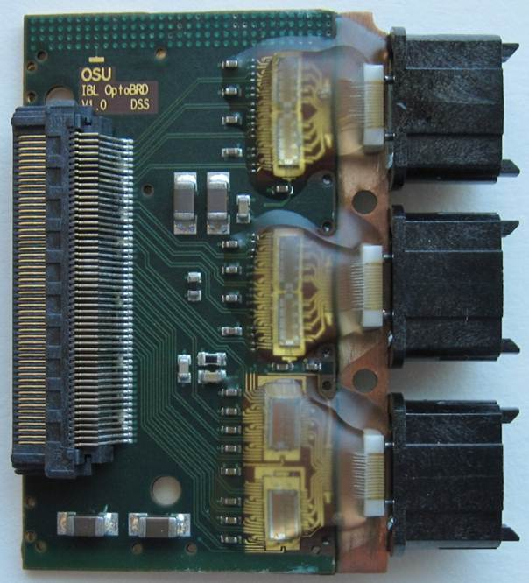
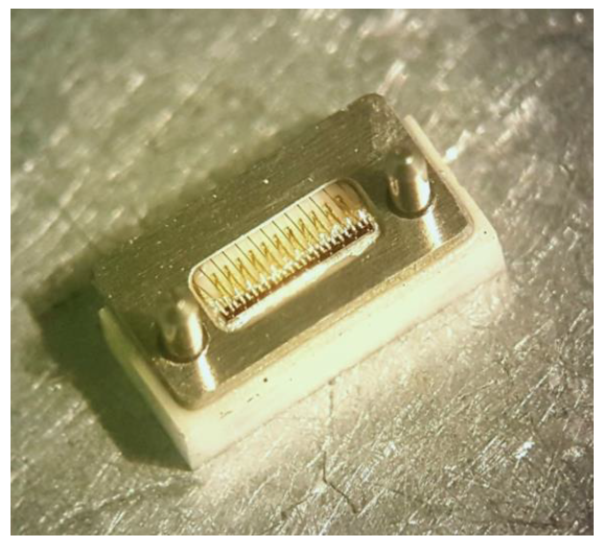
Group Summary
Opto-board production used with PIN/VCSEL arrays for optical communication
Convert optical signals to electrical (PINs) and vice versa (VCSELs)
Inner 7 channels (of 12) in use
VCSEL
VCSEL
PIN
Notes:
optical communication between the pixel detector and the counting room

Slide 3
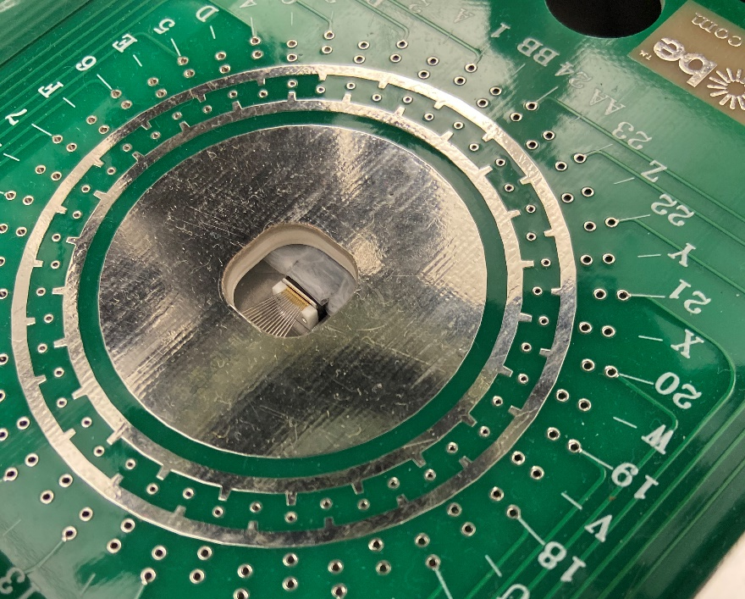
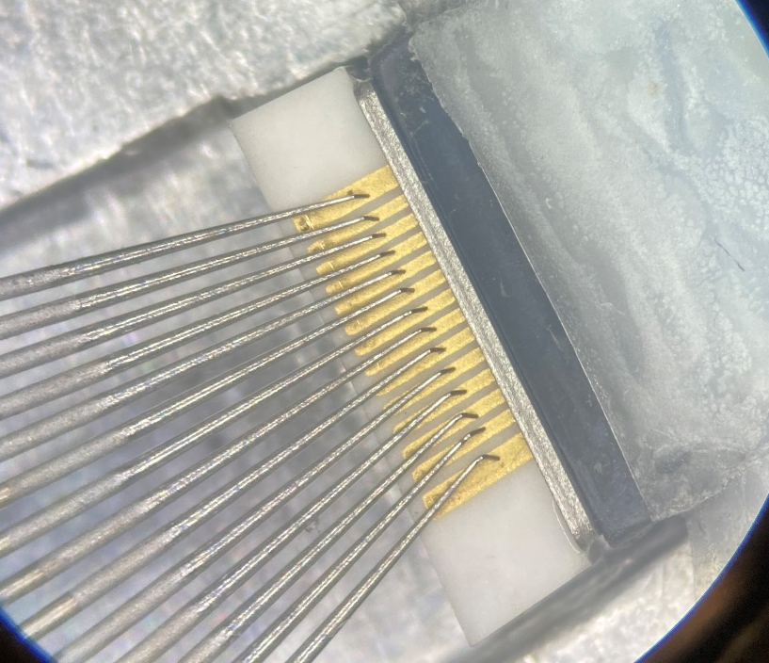
QA Data Collection
VCSELs are QA’ed before and after burn-in process (PINs not burned in)
VCSELs: Reference PIN measures light emitted from VCSEL under 6 mA of current

Slide 4
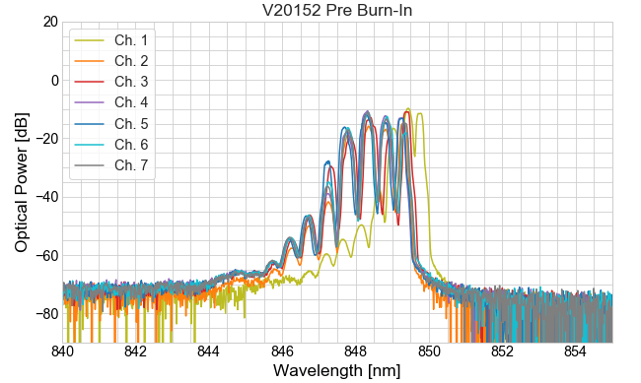
OSA Shifts
Optical spectrum plotted for each VCSEL, channel
Shifts in wavelength of one or more channels during burn-in indicates imminent VCSEL failure
Shifts had previously been determined visually
Notes:
Optical Spectrum analyzer

Slide 5
Summer Objectives
Summer Objectives:
Develop software to automatically fit peaks in OSA spectra to Gaussians
Use Gaussian means before and after VCSEL burn-in to detect significant spectral shifts
Note and recall VCSELs with detected spectral shifts after additional inspection

Slide 6
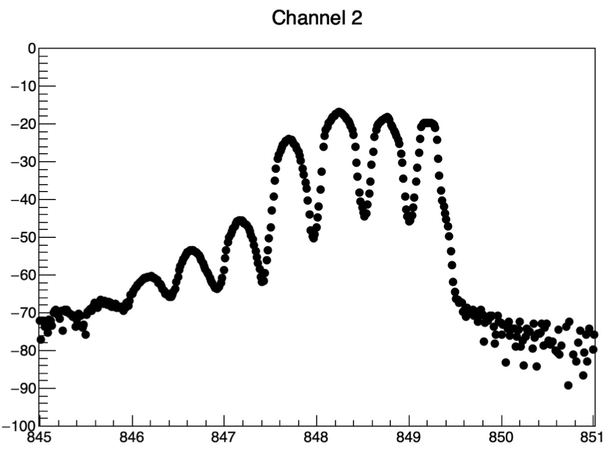
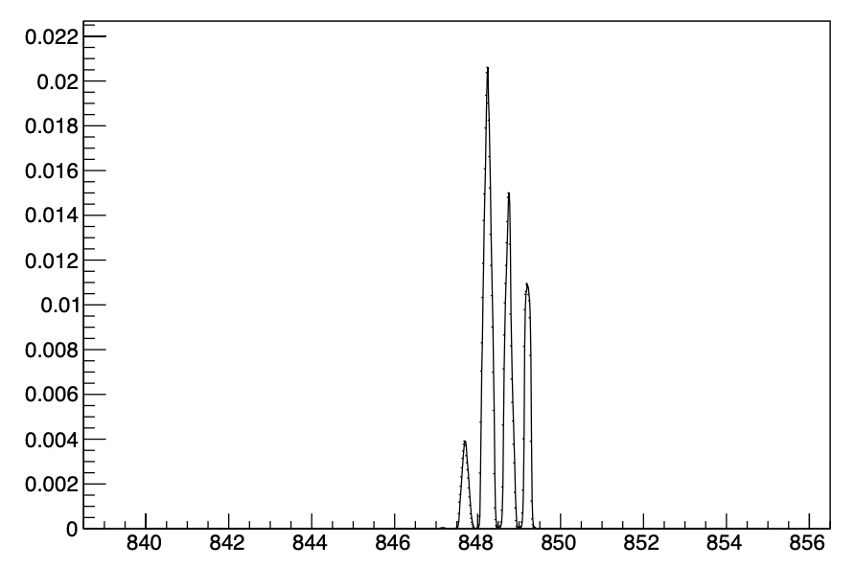
Plan of Attack
Familiarize with Root
Upload data, begin using RootFit
Fit single data peak to Gaussian
Logarithmic scale
Background noise
Notes:
Start by looking at one channel in specific
Background is over emphasized in the logarithmic scale (visuals in log)

Slide 7
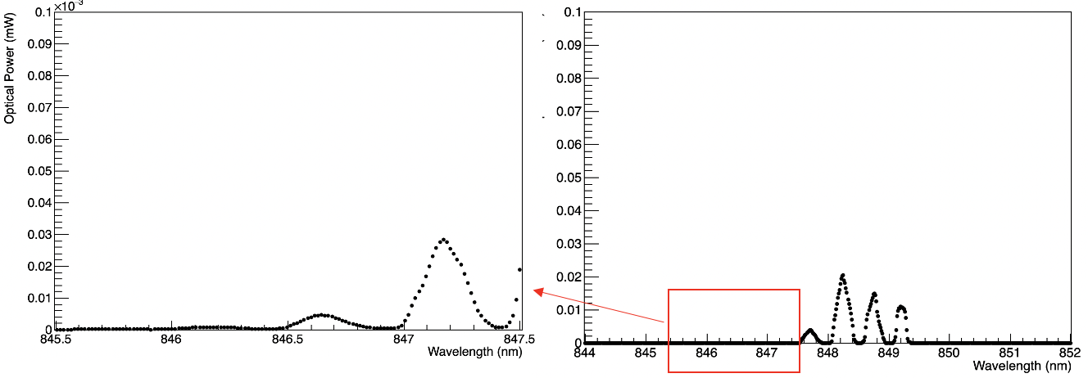
Logarithmic Scale Issue
First peaks are ~1000x smaller than last 4
8th ”background” peak is disregarded
”Background peak”
7th Peak

Slide 8
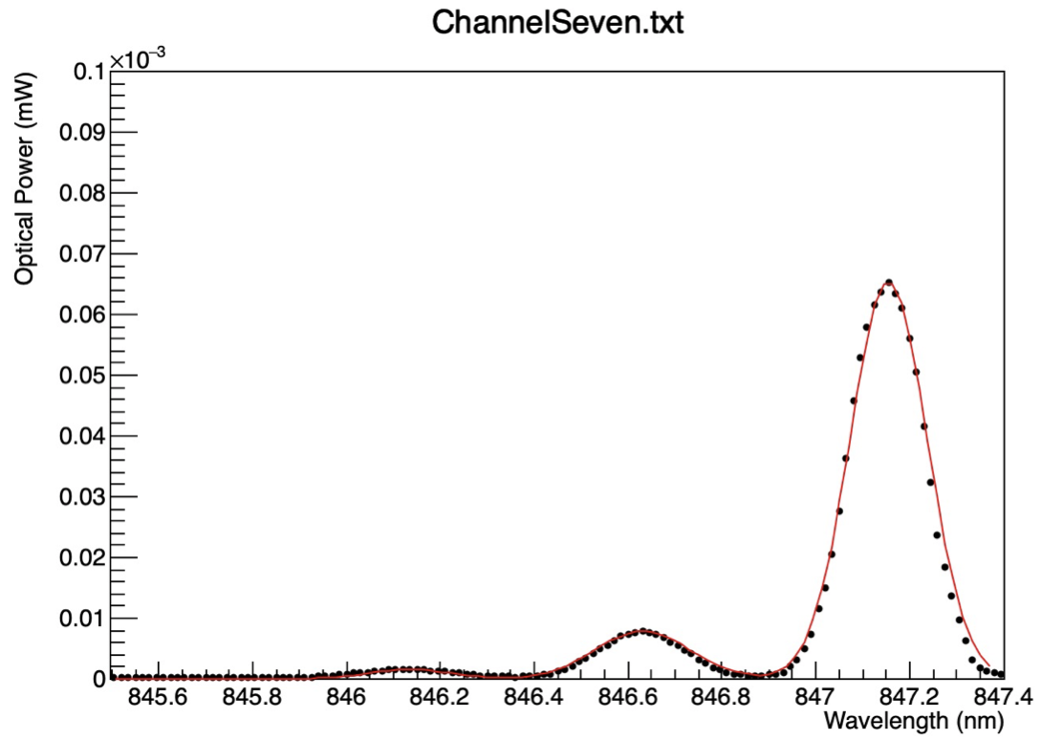
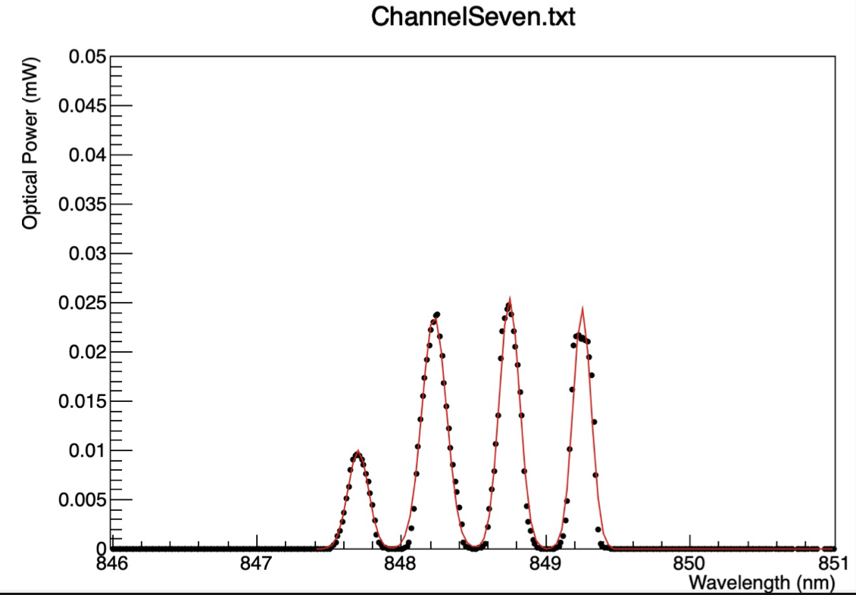
Plan of Attack cont.
Fit multiple/all peaks on a channel
Iterated fitting: individual peak fit, 3 + 4 Fit Method
Begin automation

Slide 9
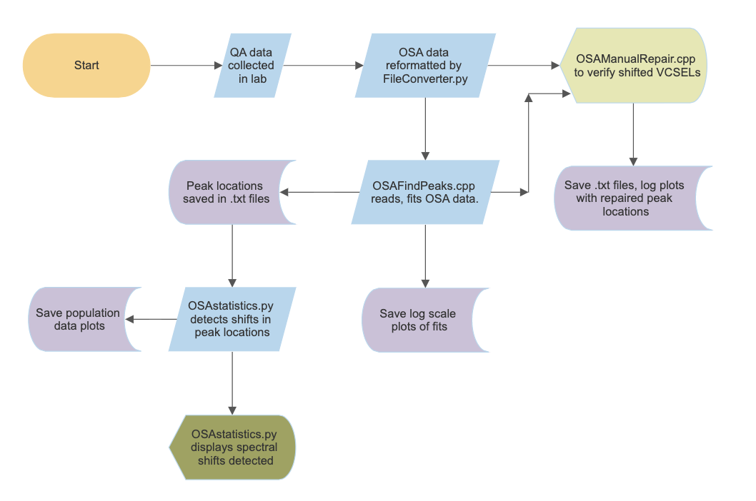
Automation Flowchart

Slide 10
Data Reformatting
nm | mW | dBm
20534Pre1.txt
840 | 1e-21 | -210
840.015 | 3.330e-8 | -74.776
840.03 | 1.415e-8 | -78.493
. . . | . . . | . . .
855 | 1e-21 | -210
V20534_PreBurnIn-OSA.xlsx
20534Pre2.txt
Wavelength (nm) | Power (dBm) | VCSEL | Channel | Measurement
840 | -210 | V20534 | 1 | Pre Burn-in
840.015 | -74.776 | V20534 | 1 | Pre Burn-in
840.03 | -78.493 | V20534 | 1 | Pre Burn-in
. . . | . . . | . . . | . . . | . . .
855 | -210 | V20534 | 1 | Pre Burn-in
840 | -210 | V20534 | 2 | Pre Burn-in
. . . | . . . | . . . | . . . | . . .
840 | 1e-21 | -210
840.015 | 2.734e-8 | -75.632
840.03 | 1e-21 | -210
. . . | . . . | . . .
855 | 1.415e-8 | -78.493
.
.
.

Slide 11
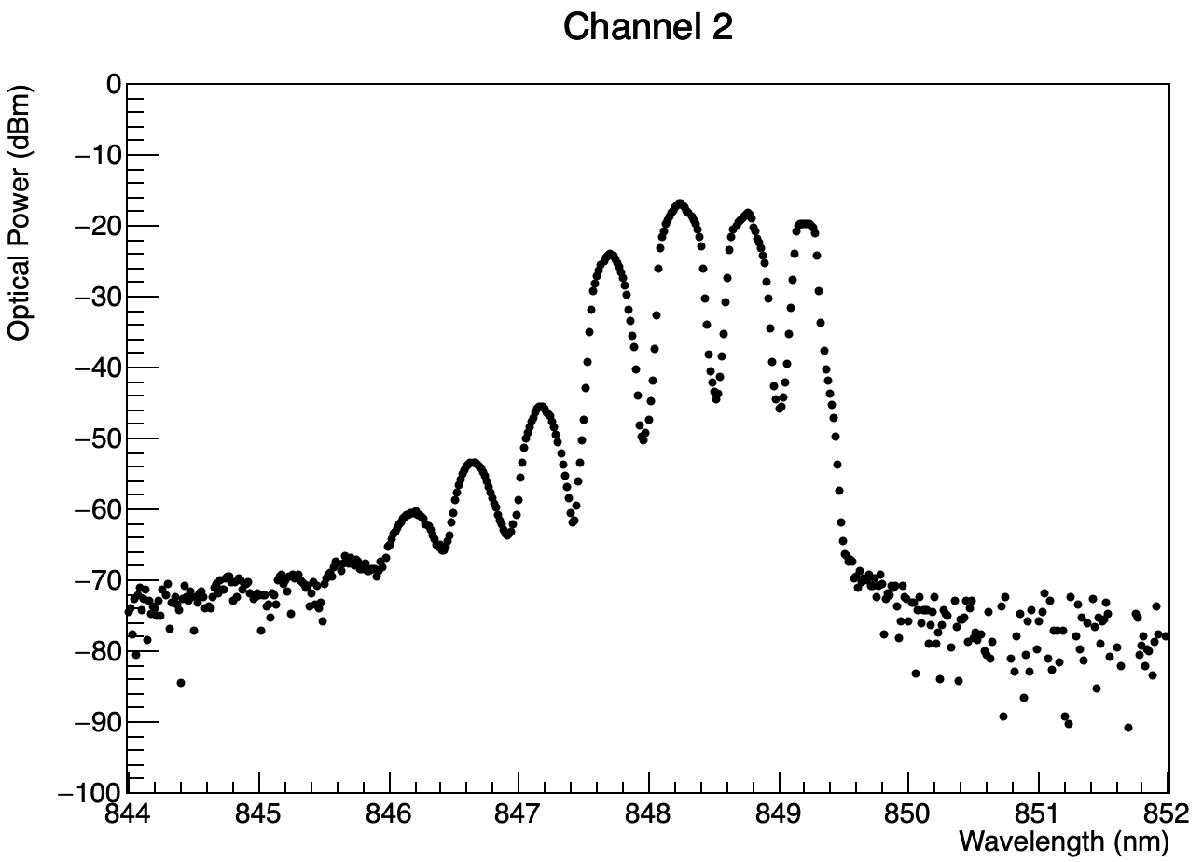

Peak Location
FindPeaks()
Channel max
x6
Automatically detect peaks
Channel max is recorded as peak
Minima are located on either side of peak, data is erased in range
Repeated until 7 peaks located
Notes:
Visually inputting seeds for fit before now, develop software.
Plot is log to see, actually performed in linear scale

Slide 12
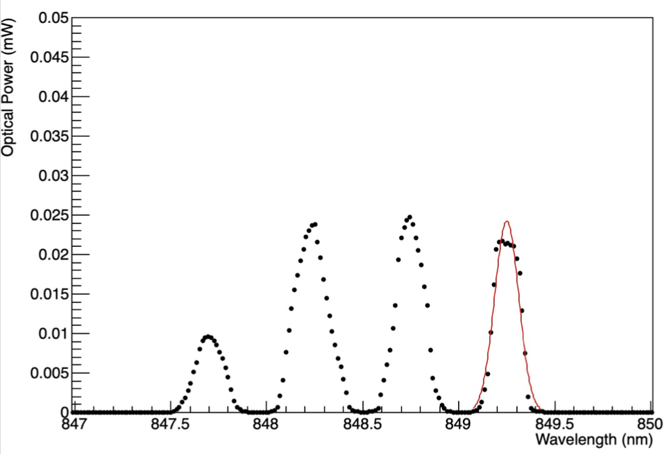
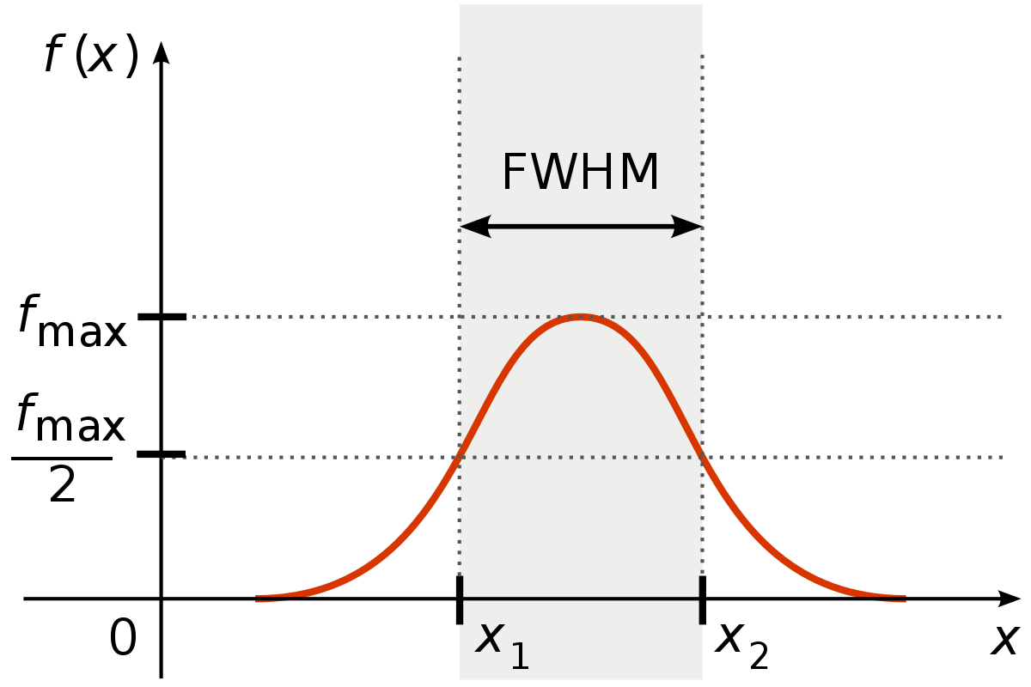
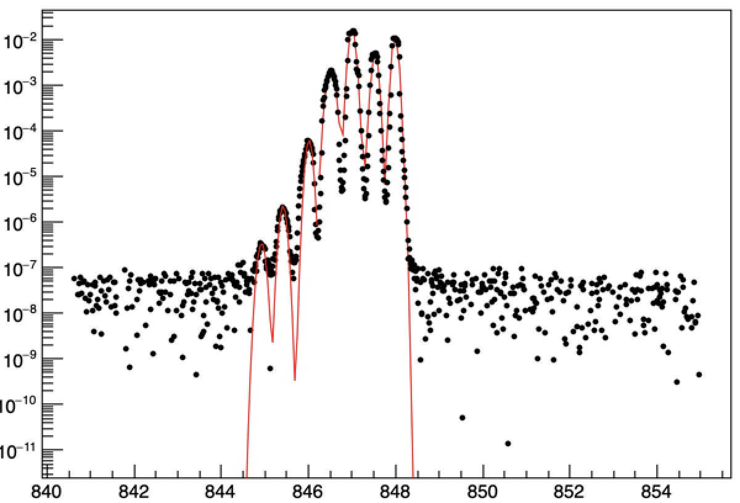
Statistical Analysis
Individual peak fits
3 + 4 fit (combined)
Notes:
Plot is log to see, actually performed in linear scale
FWHM = 2.3548*sigma

Slide 13
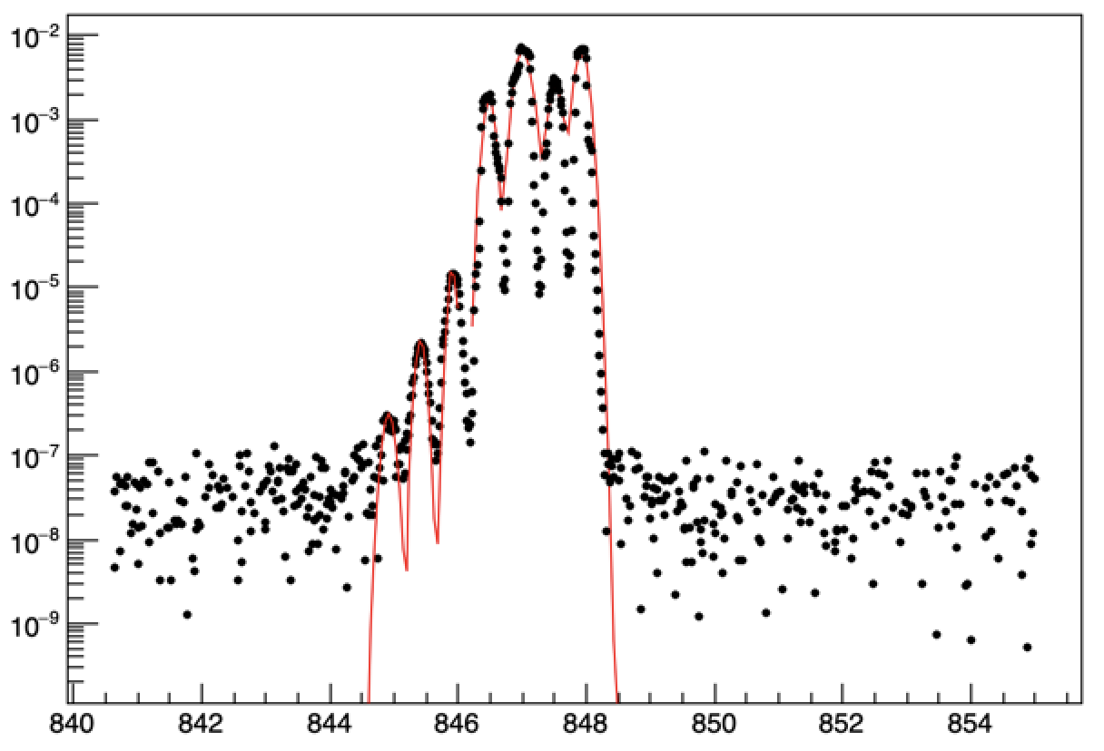
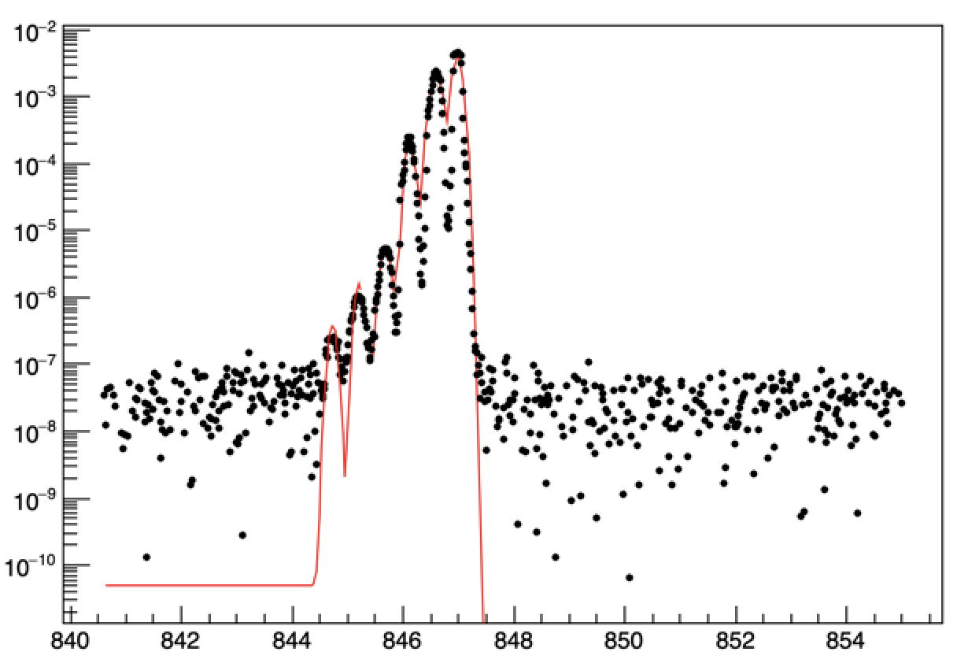
Quantifying Spectral Shifts
Pre Burn-In
Post Burn-In
Read .txt files with saved peak locations (from OSAFindPeaks)
Compare pre/post burn-in peak locations to measure shifts
Averages peak shifts on channel to quantify overall channel shift

Slide 14
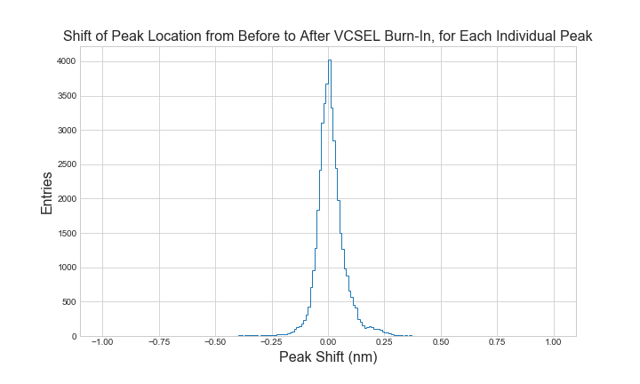
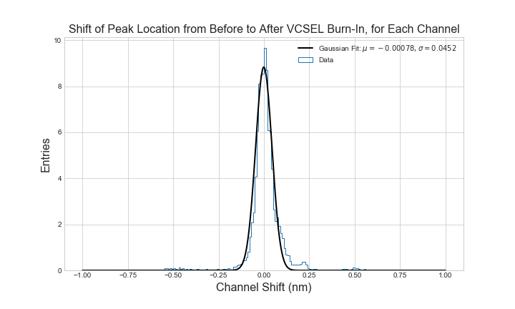

Population Data
Rejections to be made past $±4σ$
Secondary peak ~.2 caused by special sample; under investigation
  Excluded from fit

Slide 15
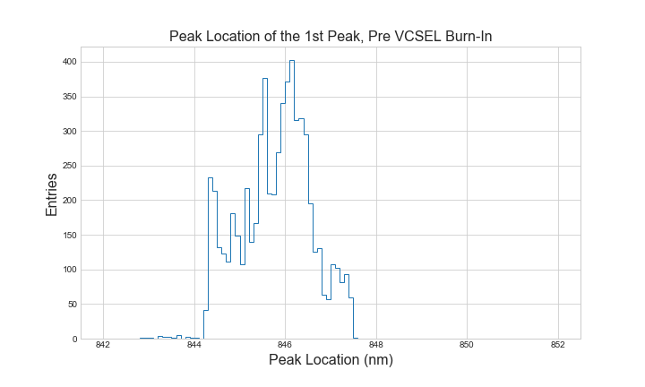
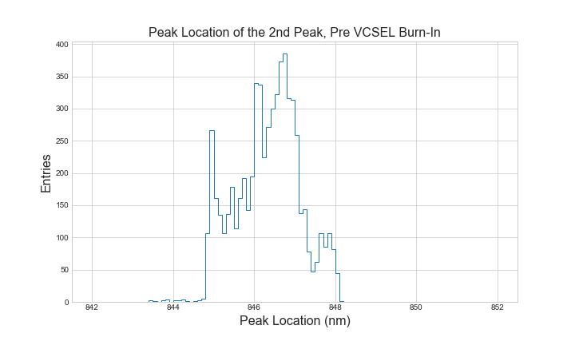
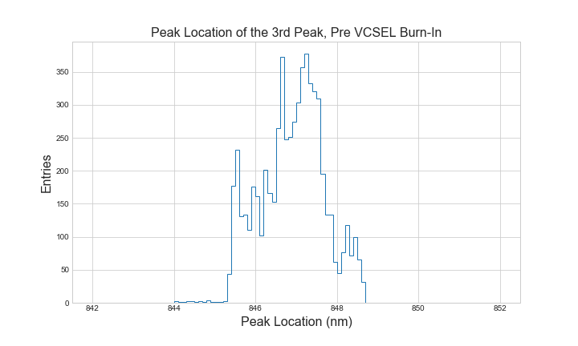
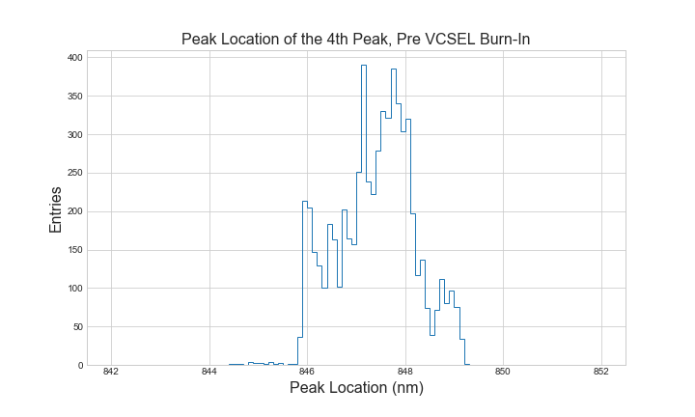
Population Data Cont.
Notes:
Side peaks likely caused by peak misidentification

Slide 16
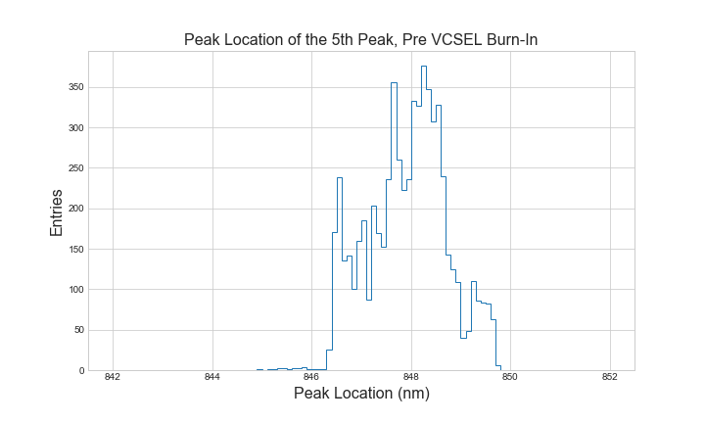
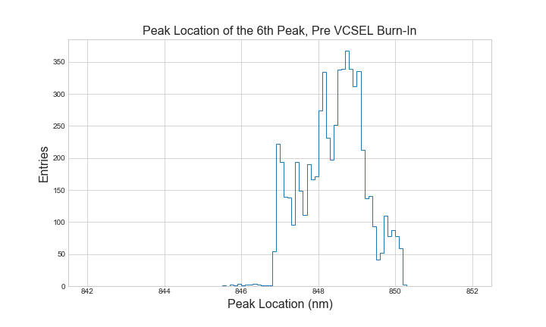
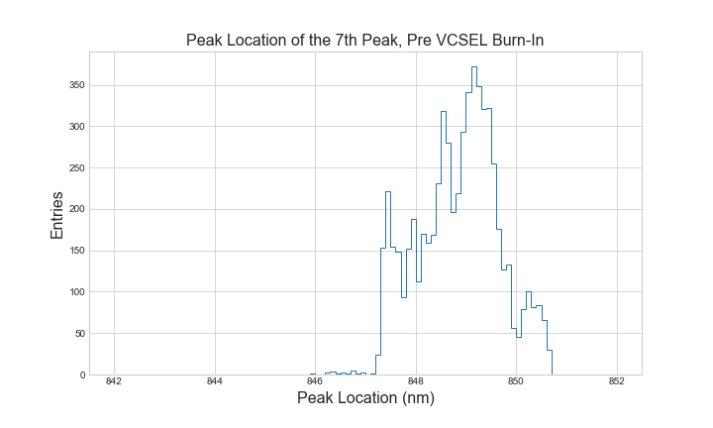

Slide 17
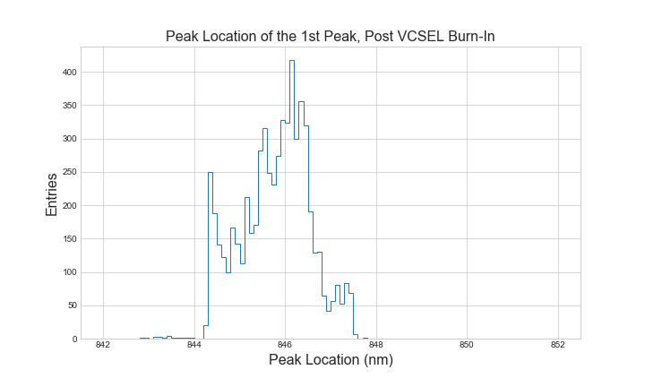
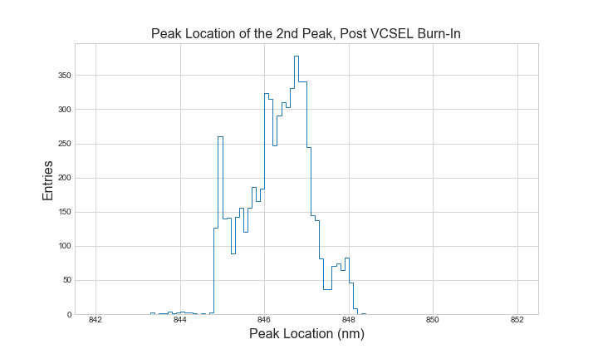
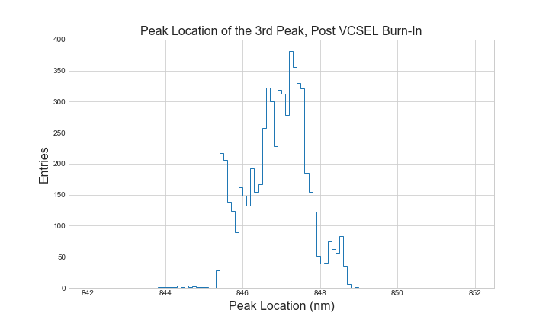
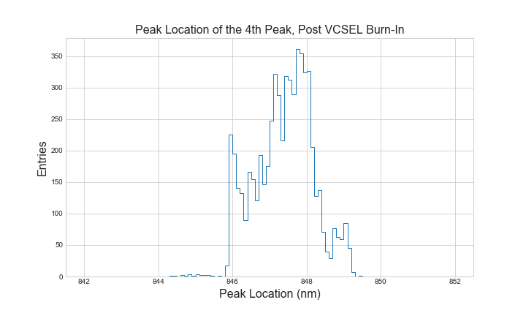
Population Data Cont.

Slide 18
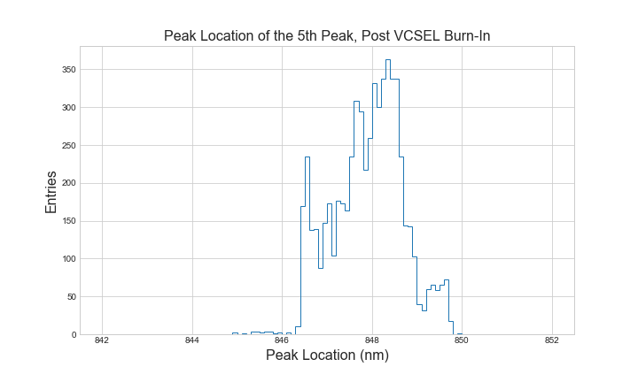
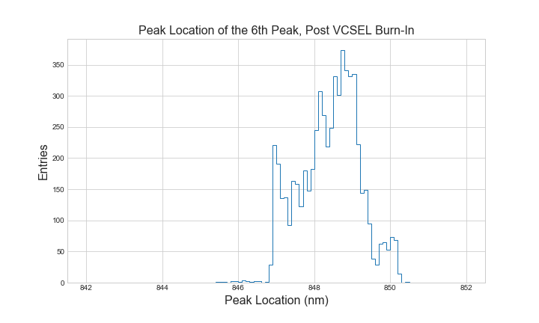
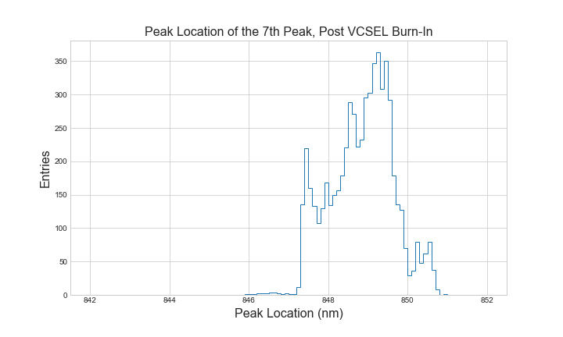

Slide 19
Notes:
Initially ran OSAstatistics and found issues, code might miss something due to data variability

Slide 20
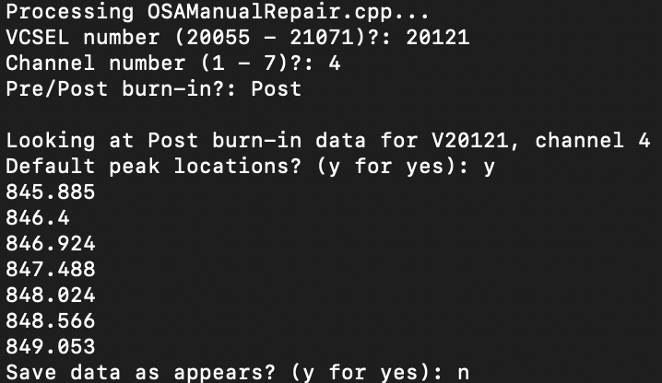
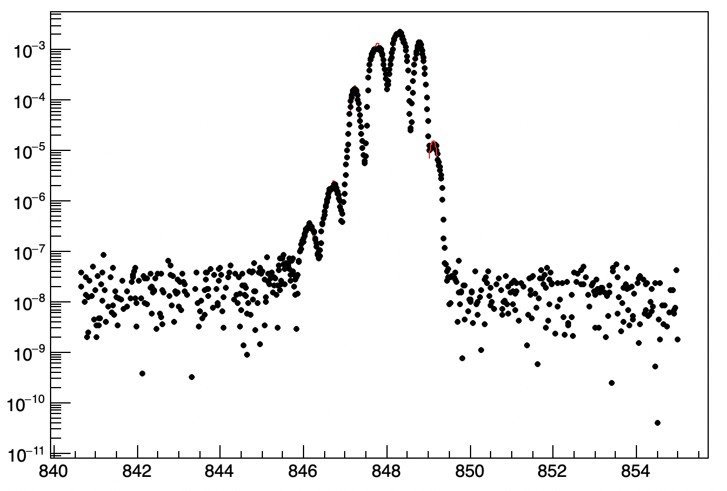
OSAManualRepair.cpp
User input selected VCSEL, Channel, burn-in time
Manually choose peaks for fitting, saving
Individual peak fit only
Fit range can be altered for problematic data

Slide 21
Failed VCSELs
VCSELs with Spectral Shifts Detected (After Repair)
*installed
V20060 CH7 (-0.618 nm)
V20065 CH4 (-0.825 nm)
V20066 CH4 (-0.361 nm)
V20072 CH4 (-0.314 nm)
V20073 CH4 (-0.367 nm)
V20074 CH4 (-0.384 nm)
V20103 CH7 (-0.303 nm)
V20104 CH7 (-0.322 nm)
V20105 CH7 (-0.372 nm)
V20118 CH1 (0.434 nm)
V20118 CH 4 (0.601 nm)
V20119 CH4 (0.341 nm)
V20121 CH4 (0.575 nm)
V20125 CH4 (0.430 nm)
V20128 CH3 (0.852 nm)
V20129 CH3 (0.333 nm)
V20130 CH3 (0.339 nm)
V20132 CH3 (0.320 nm)
V20135 CH7 (-0.342 nm)
V20159 CH2 (-0.341 nm)
V20160 CH2 (-0.335 nm)
V20347 ALL (.355 nm ave.)
V21042 CH1 (0.490 nm)
V21042 CH2 (0.310 nm)
Notes:
Installed have had no issue yet in detector, Lower numbers, early in production -> manually switching fibers using fan out cable

Slide 22
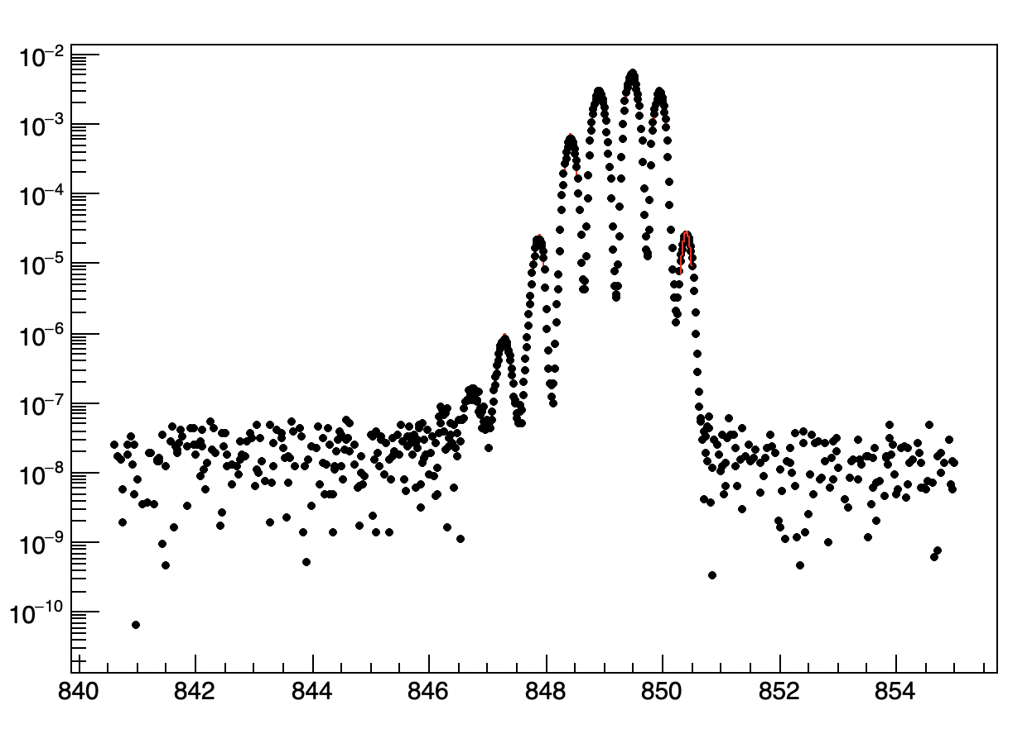
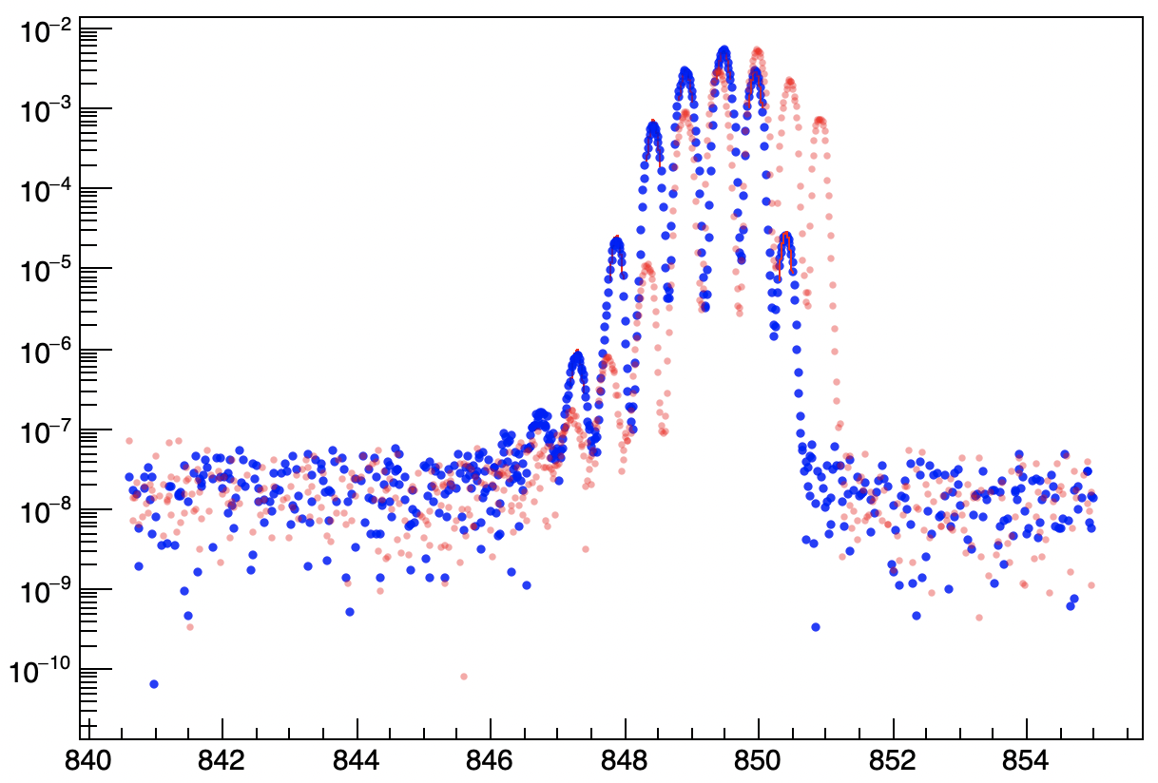
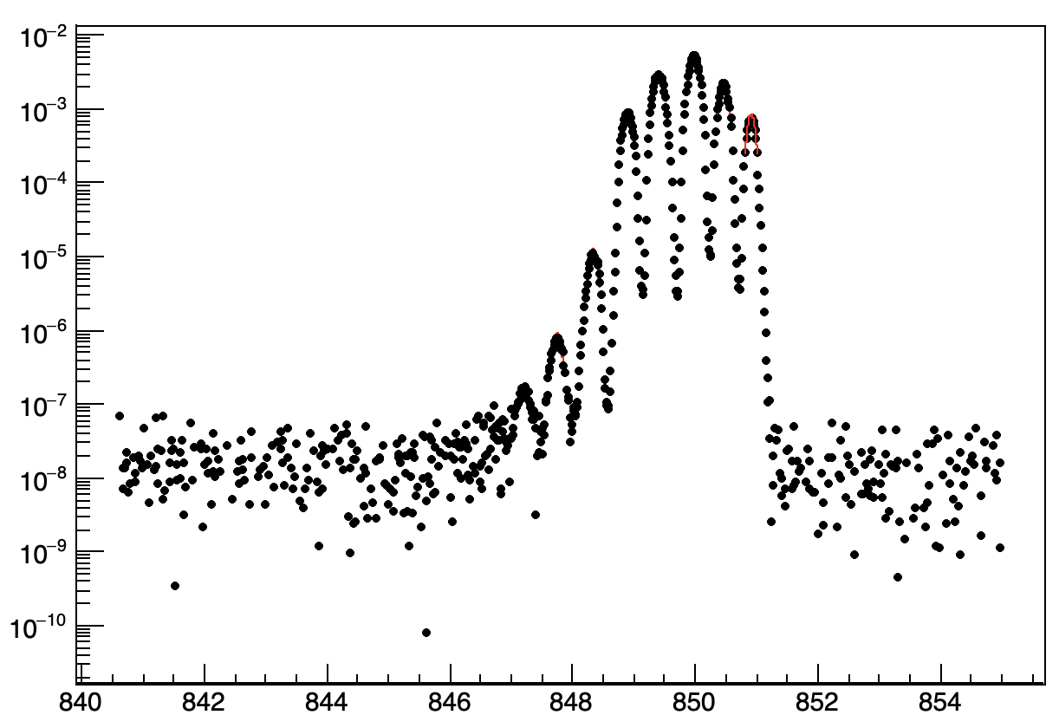
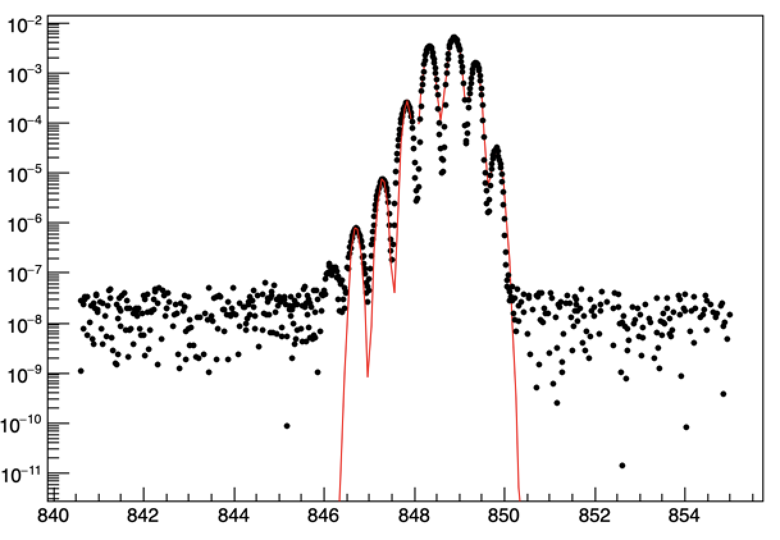
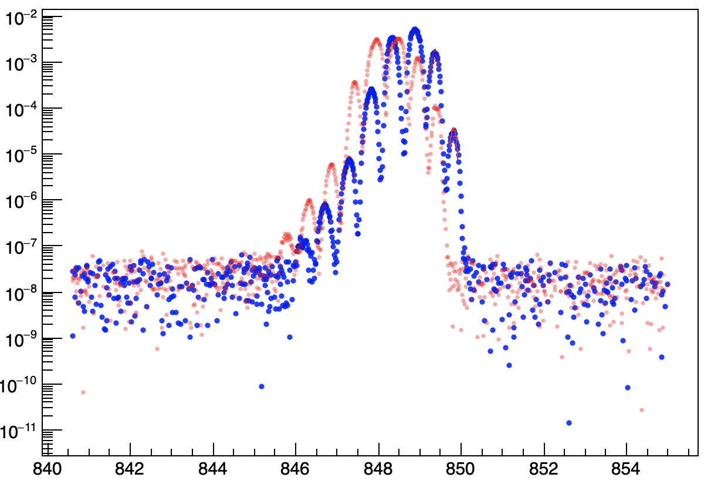
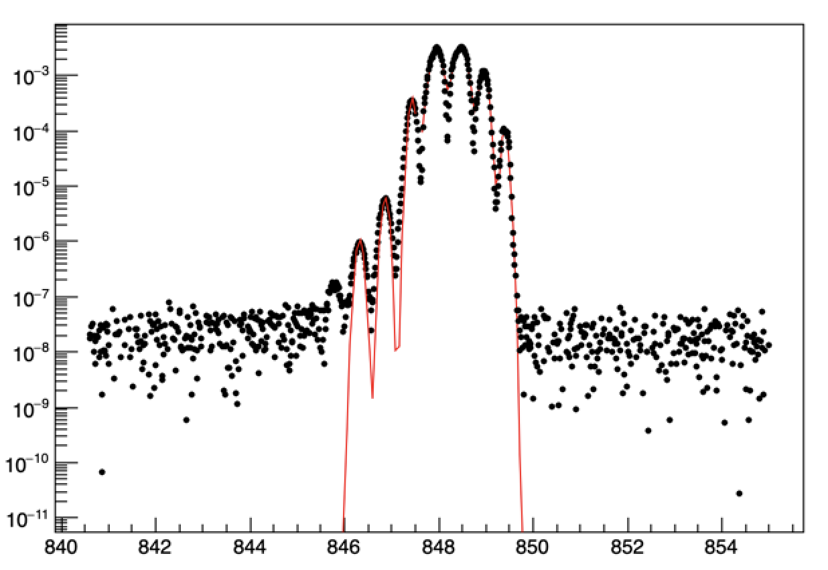
Example Shifts Detected cont.
Pre Burn-In
V21042 CH1 (0.490 nm)
Post Burn-In
847.29 nm
850.399 nm
847.751 nm
850.912 nm
Pre Burn-In
V20347 CH1 (-0.406 nm)
Post Burn-In
846.708nm
849.826
846.322 nm
849.402 nm

Slide 23
Automation Issues
Biggest Automation Roadblocks:
Peak detection
  Fake peak rejection
Variation in the data
  Peak location, size, number of peaks, dead channels
Pre/Post burn-in data
Processing time
Notes:
CVS -> txt -> root - - Python/ROOT subscripts
Cutoff line, background -> 14 Booleans -> maxima

Slide 24

Thank You!
Conclusion
Joe Haley, Verena Martinez, and Michael Hance for this meaningful opportunity
Professor KK Gan, and Suyog Shrestha for virtually mentoring me throughout the project, overseeing my progress
Zachary Pollock, in-person and virtually guiding day to day, regular coding help
Questions?
Jacob A. Borison
1935 Indianola Ave, Columbus, OH 43201
(216) 633-3882
Borison.3@Buckeyemail.osu.edu

