Slide 1

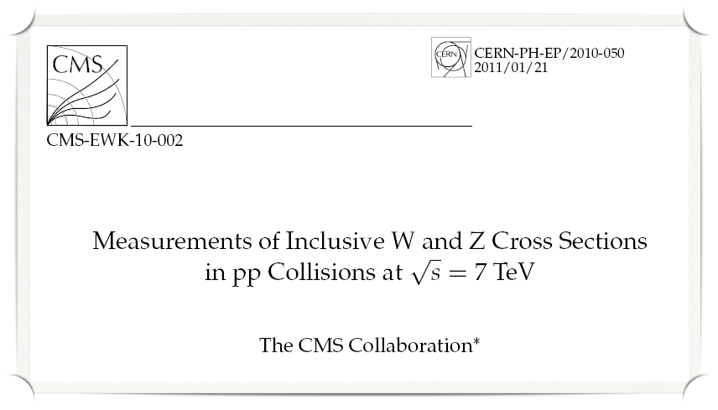
CLASHEP 2011
Angela Romano on behalf of Group A

Slide 2
Group A Collaboration
Group Leader
  E. Fraga
Argentina
  G. Sborlini
Brazil
  C. Baesso
  E. Basso
  A. Custódio
  M. Griep
  M. Martins Jr
  A. Santos
Chile
  S. Oliveras
Colombia
  N. Quintero
Germany
  M. Backes
Italy
  A. Romano
Mexico
  M. Rodriguez
Peru
  E. Calvo
United Kingdom
  A. Larner
  T. Hampson

Slide 3
Motivations
The study of electroweak gauge bosons is an important part of the physics program at the LHC
Determination of the electroweak parameters M_{W} and sin² θ_{W}
Test of NNLO pQCD calculations at 7 TeV
Prerequisite for many beyond the standard model physics searches
Measurements provide valuable feedback on the detector performance
Calibration of the lepton energy / momentum scales
Uniformity of the electromagnetic calorimeter
Tracker alignment

Slide 4
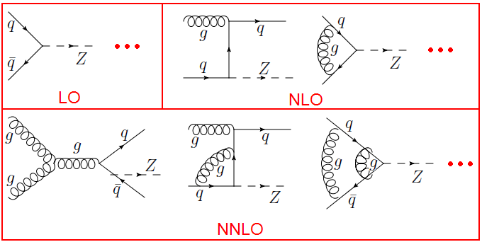
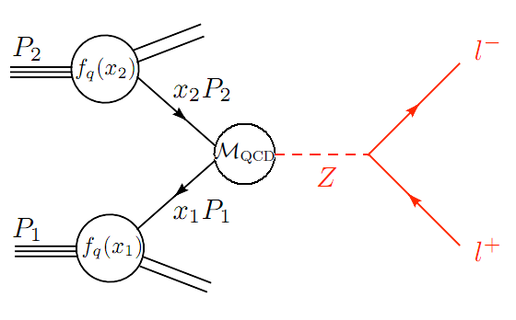
Drell-Yan Process
Hadronic cross section (see G. Zanderighi QCD lectures)
Partonic cross section

Slide 5
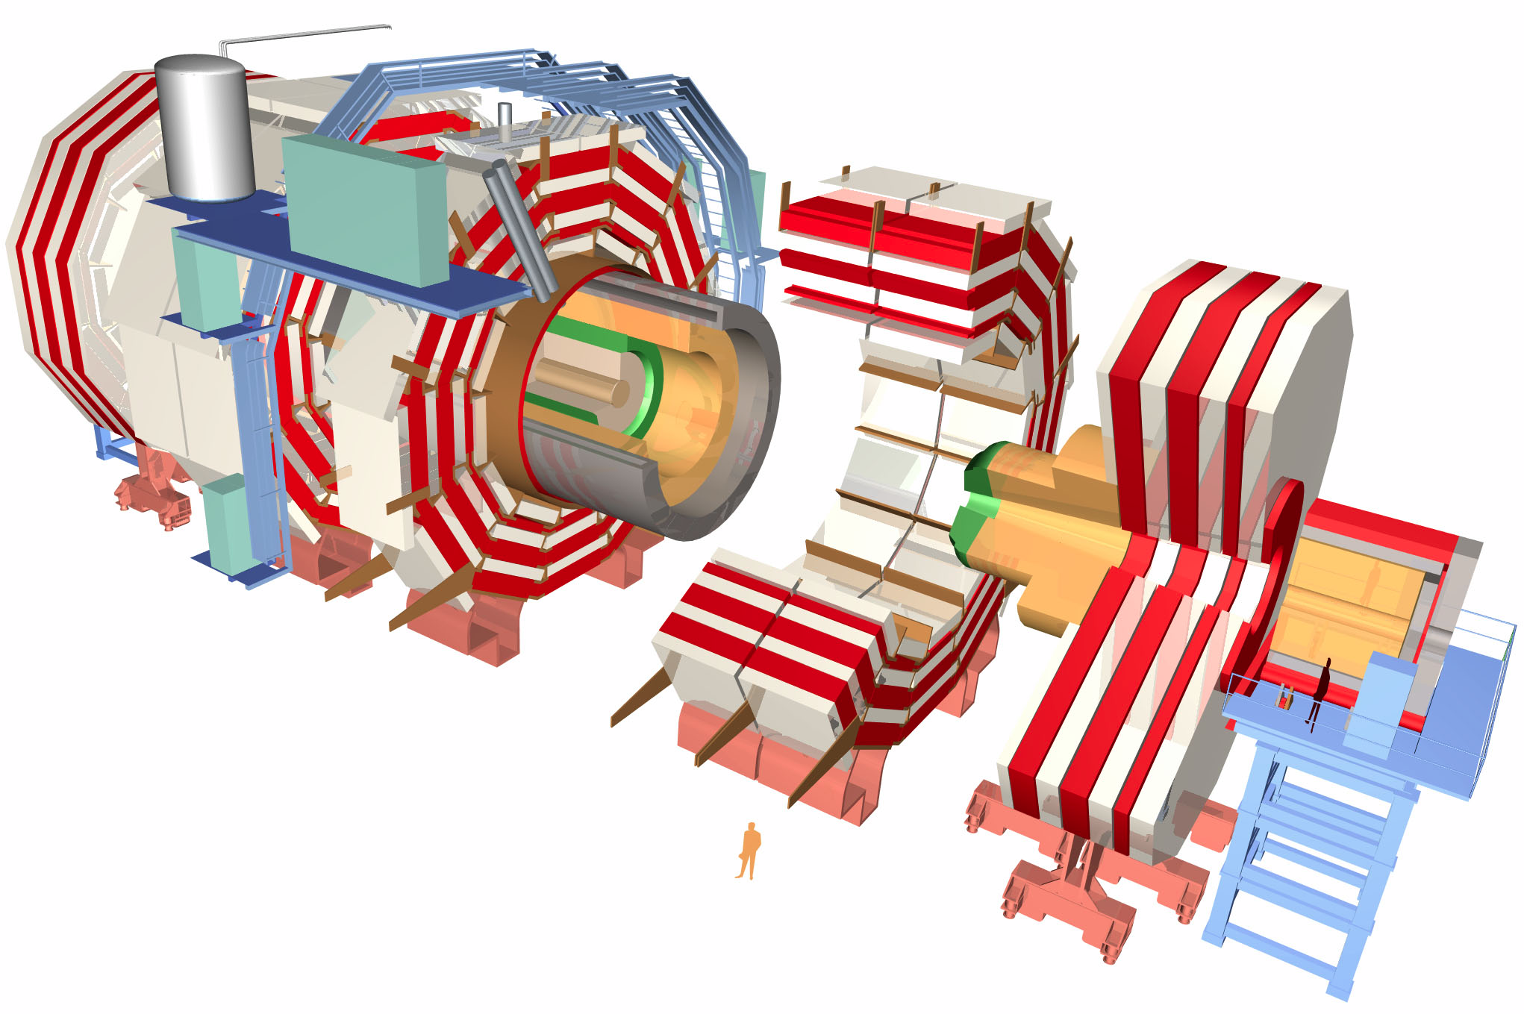
The CMS Detector
≈

Slide 6
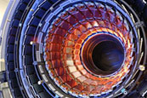
The CMS Detector – Inner Tracker (IT)
Pseudorapidity range of |η| < 2.5
Impact parameter resolution about 15 μm
Transverse momentum resolution about 1% at 40 GeV/c
The tracker can reconstruct the paths of high energy muons, electrons and hadrons and also the decay of short-lived particles
≈

Slide 7
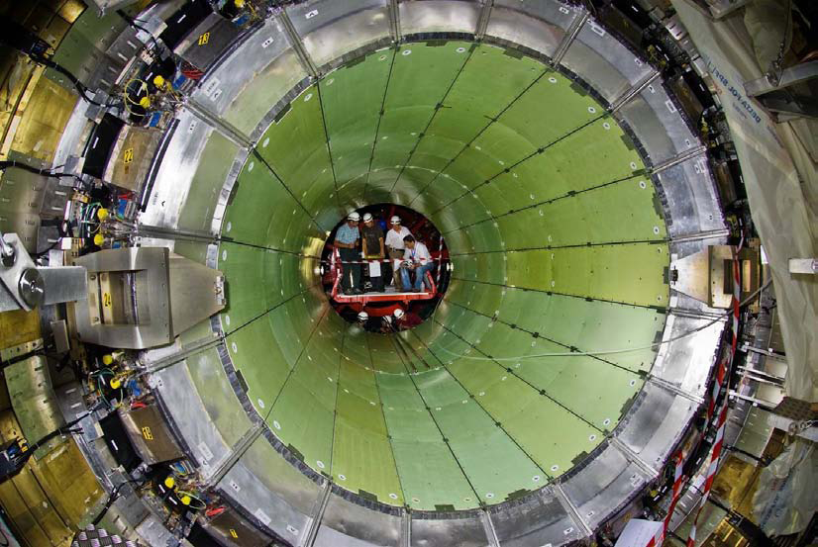
The CMS Detector – ECAL (EB + EE)
Hermetic homogeneous detector
76000 lead tungstate (PbWO₄) crystals closed by 7324 crystals in each of the two endcaps
Rapidity range:
  |η| < 3.0 (EB)
  1.479 < |η| < 3.0 (EE)
Energy resolution
  Better than 0.5% for unconverted photons (ET > 100 GeV)
  Better than 3% for the range of electron energies
Sampling preshower detector (crystal length 3X₀)
≈

Slide 8
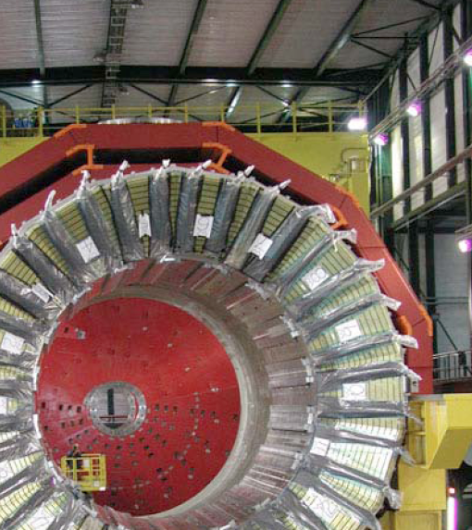
The CMS Detector – HCAL
≈
Sampling calorimeter
Pseudorapidity range |η| < 1.3
Absorber: 40 mm of steel followed by 50.5 mm of brass and 75 mm of steel
Active medium:
70 000 scintillator tiles with WLS fibers

Slide 9
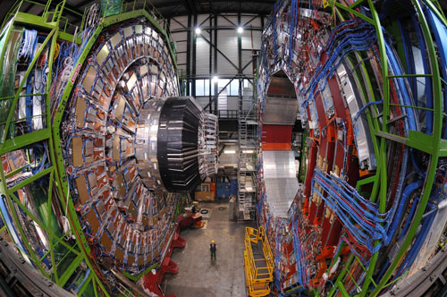
The CMS Detector – Muon System
The main tasks of the muon system are:
  Muon identification
  Momentum measurement
  Triggering
Pseudorapidity range
|η| < 2.4
Angle coverage:
  Φ: full range
  10º < θ < 170º
≈

Slide 10
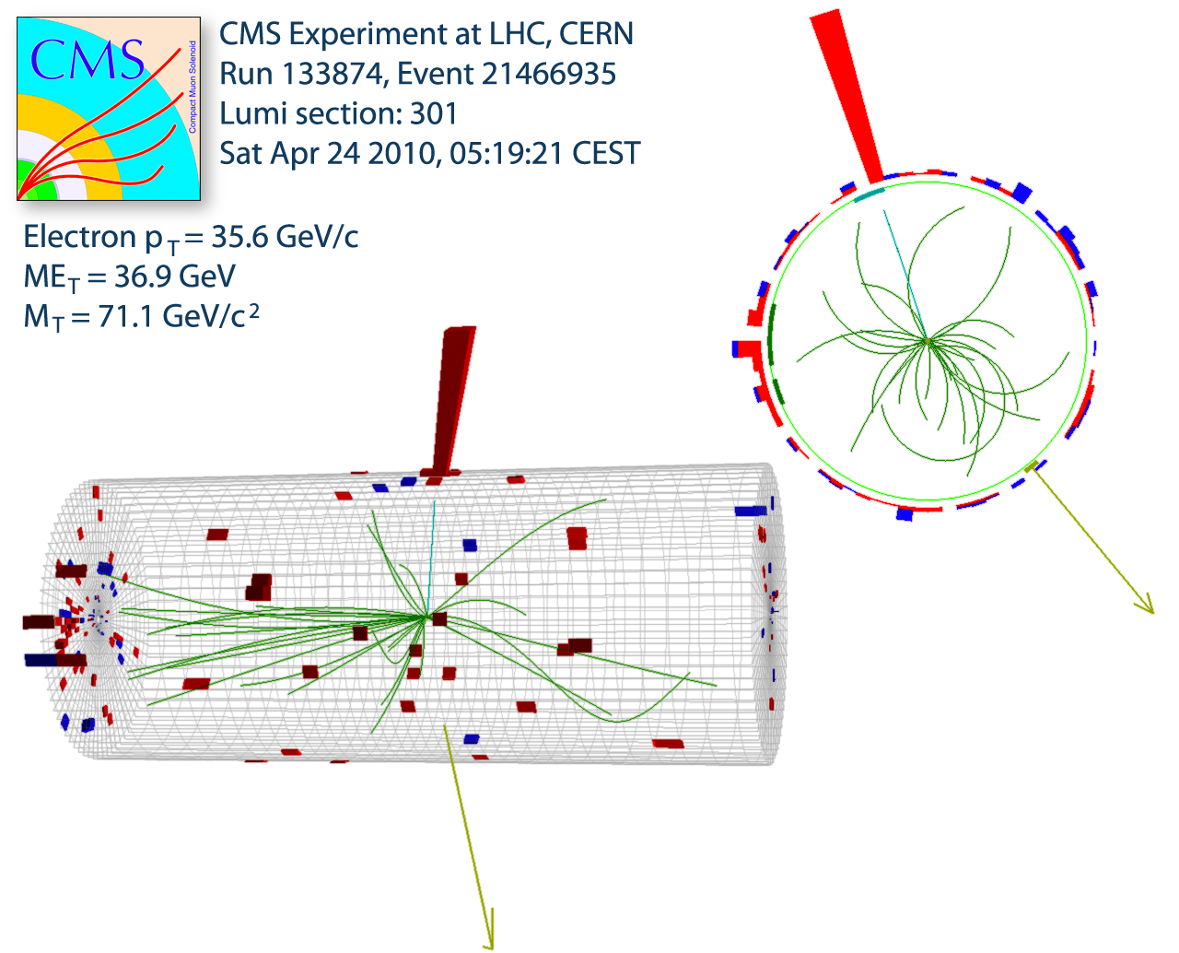
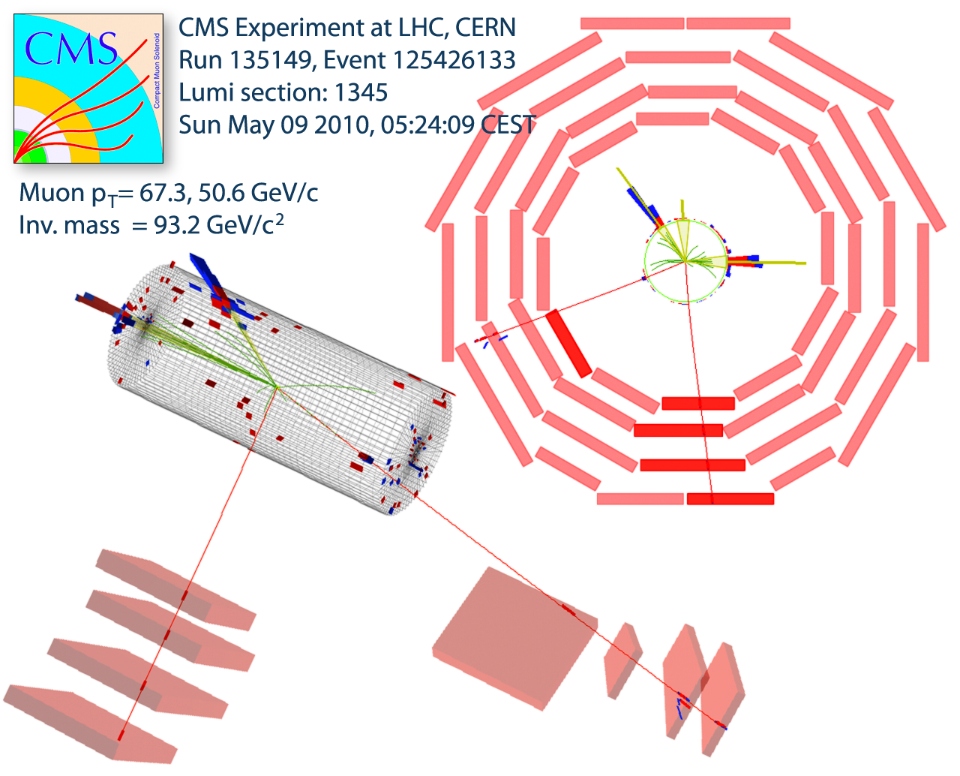
Lepton Reconstruction and Identification
Missing Transverse Energy
Electrons
HLT trigger with cluster E_{T} threshold > 15 GeV
Fiducial range |η| < 2.5, calorimeter crack (1.44 < |η|< 1.57) removed
Bremsstrahlung correction
Shower shape requirements
Hadronic leakage
Track-cluster matching
Require one hit in IT innermost pixel layer
Calorimeter and track isolation
Muons
HLT trigger with combined muon track p_{T} > 9 GeV
Fiducial range |η| < 2.1
Global muons (stand alone + tracker muon)
Signal in at least 2 muon stations
Track-fit quality requirement
IP < 2 mm from nominal beam axis (rejection of cosmic backgrounds)
Calorimeter and track isolation
W candidate
Missing transverse energy
Combination of reconstructed objects according to particle type (particle flow techniques, see J. Alcaraz’s lecture)
Calorimeter noise removal
Z candidate

Slide 11
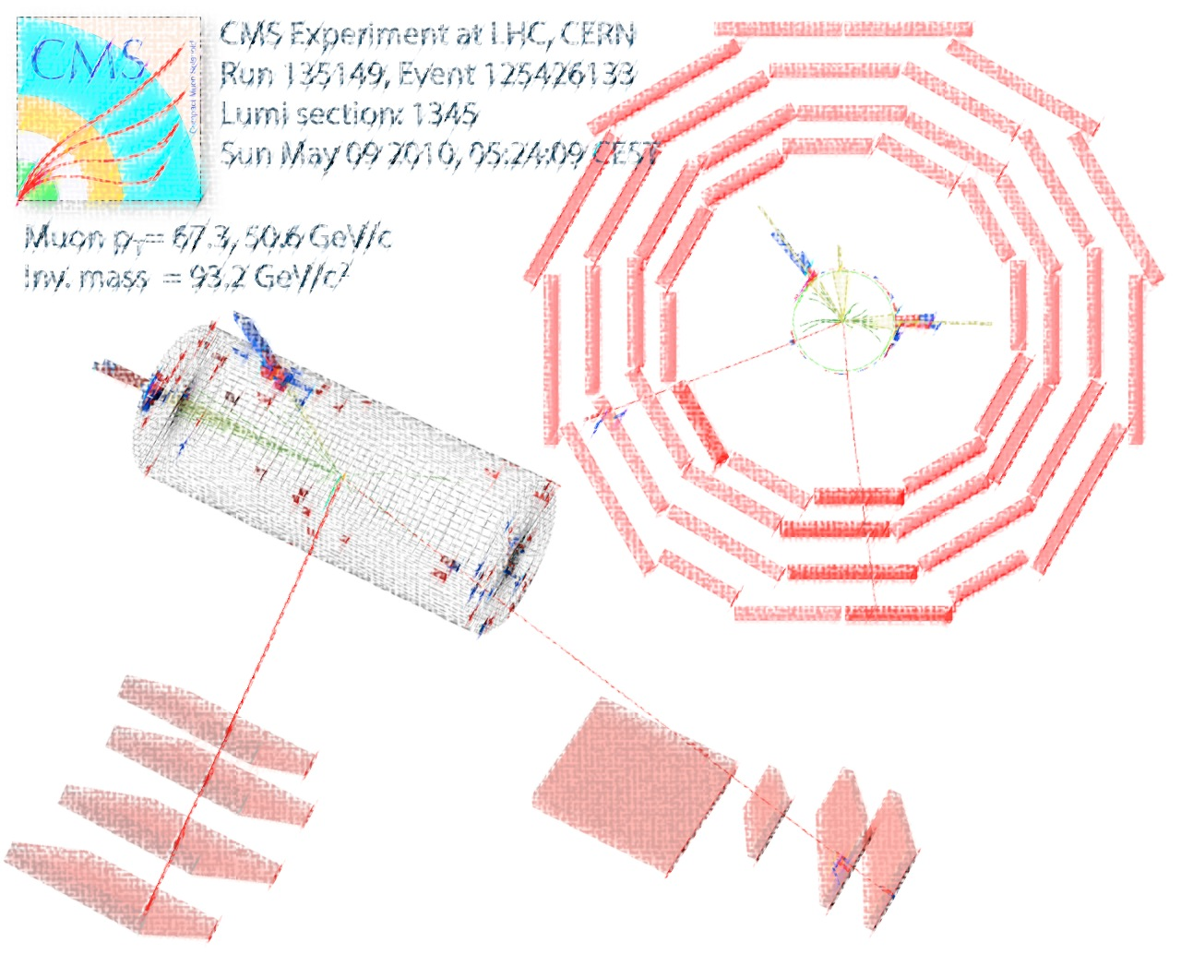
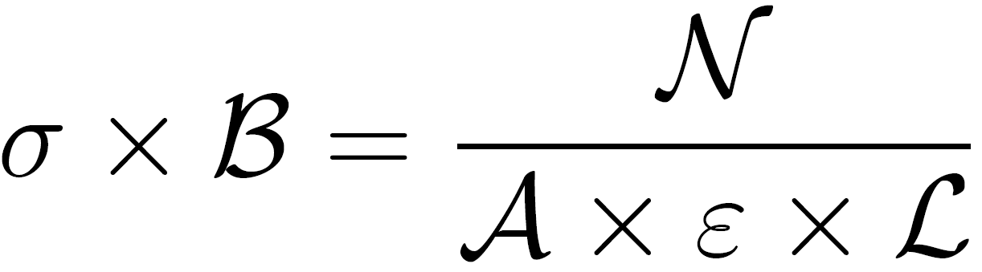
Cross Section Measurement
N = number of signal events
A = fiducial and kinematic acceptance
ε = selection efficiency for events in acceptance
L = integrated luminosity

Slide 12
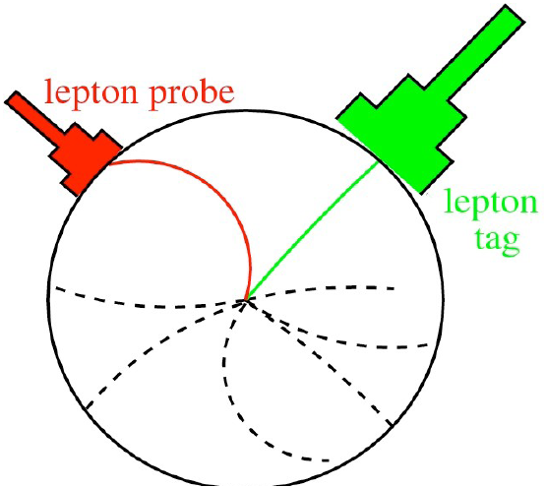
Lepton Selection Efficiencies
Efficiencies for lepton reconstruction, identification, isolation and trigger are obtained from data with a
“Tag-and-Probe” (T&P) method
(J. Alcaraz lecture)
Methodology:
Two lepton candidates:
1) The “Tag” ➔ tight ID and ISO requirements
2) The “Probe” ➔ selection criteria depending on the efficiency being measured
See J. Alcaraz’s lecture
Correction factors are obtained as the ratio of the efficiencies from simulation and data
Lepton Selection Efficiencies
ε_{sel} = ε_{rec} . ε_{iso} . ε_{tr}

Slide 13
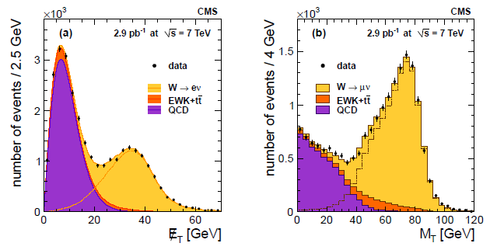

W Boson Selection
Electron Selection
1 electron:
E_{T} > 20 GeV
Muon Selection
Signal shape from MC
QCD modelled using Rayleigh distribution
QCD shape from inverted isolation region
Signal and EWK background from simulation
Veto if second muon: p_{T} > 10GeV
1 muon p_{T} > 20 GeV
Veto if second loose lepton: E_{T} > 20 GeV
Main backgrounds
QCD suppressed by lepton isolation
Drell-Yan suppressed by second lepton veto
Signal extraction
Electron Channel: Extracted from unbinned maximum likelihood fit
Muon Channel: Extracted from binned maximum likelihood fit
Rayleigh distribution:
Transverse Mass:

Slide 14
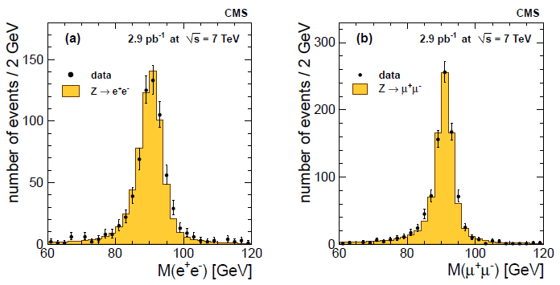
Z Boson Selection
Electron Selection
2 electron:
E_{T} > 20 GeV
Muon Selection
Z mass peak shift correction
At least one muon must fulfill trigger requirement
Tag muon must satisfy isolation and identification criteria
Invariant mass:
(60 < M < 120) GeV
Main backgrounds
Almost negligible
Electron: QCD estimated from data
Muon: QCD background shape from polynomial and exponential function, EW estimated from simulation
Signal extraction
Electron Channel: Extracted by counting selected events and small bkg correction
Muon Channel: Extracted from likelihood fits to mass spectra
Invariant mass:
(60 < M < 120) GeV

Slide 15
Systematics Uncertainties
Integrated Luminosity
  11 % in all channels (now is 4%!)
Lepton reconstruction & identification efficiencies
  Uncertainties from “tag & probe” measurements on data
  (≤ 5.9%)
Momentum scale & resolution
  Corrections from observed shift of the Z-mass peak
  ( ≤ 2.0%)
Missing transverse energy scale & resolution (W channel)
  Uncertainties from data / simulation comparisons
  ( ≤ 1.8%)
Background subtraction / modeling
  Uncertainties from comparison of different background estimation techniques ( ≤ 2.0%)
PDF uncertainty for acceptance
  Event reweighting according to different PDF set assumptions (≤ 1.2%)
Theoretical Uncertainties
  Initial / final state radiation, renormalization and factorization scale assumptions (≤ 1.6%)

Slide 16
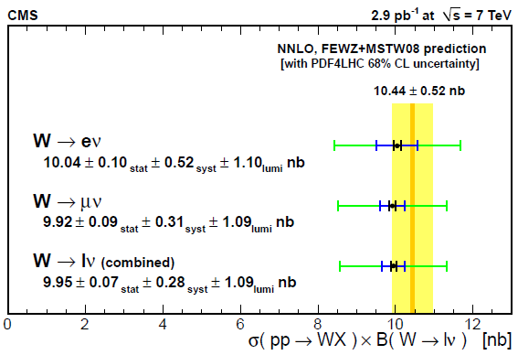
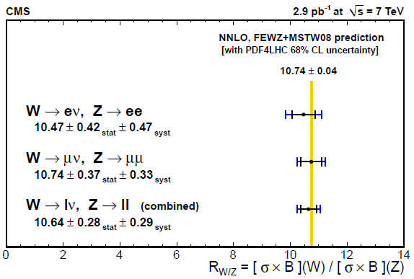
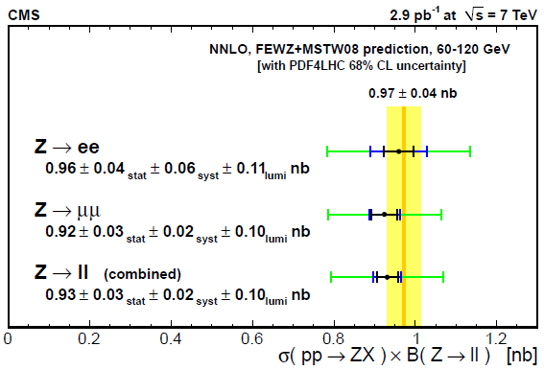
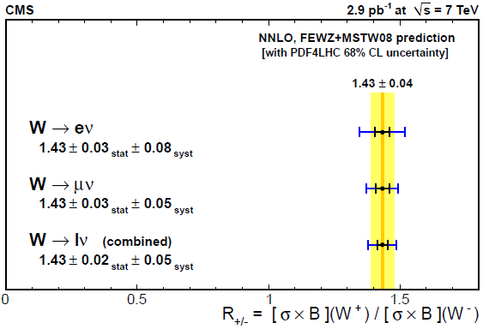
Results: σ x B for W and Z

Slide 17
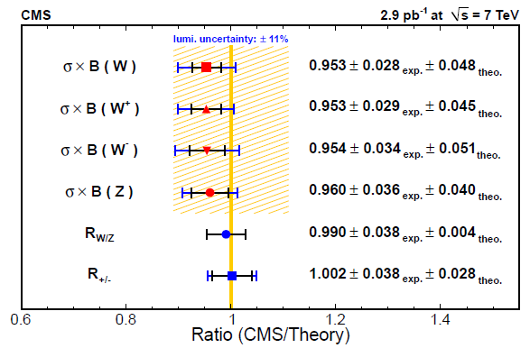
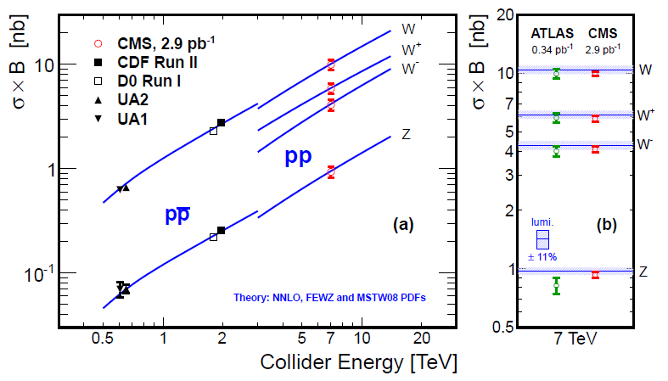
Comparing Results with Theory
Measurement agrees with theoretical predictions
Luminosity uncertainty shown by yellow area
Results from
ATLAS and CMS
are consistent
σ x B increases with energy

Slide 18
Conclusion
Inclusive W and Z boson production cross section is consistent with the theoretical results
Compatible measurements in the electron and muon channels
The experimental uncertainties are smaller than the theoretical ones
With larger amount of data and a better understanding of the CMS detector, it is expected that systematic and statistical uncertainties will decrease

Slide 19
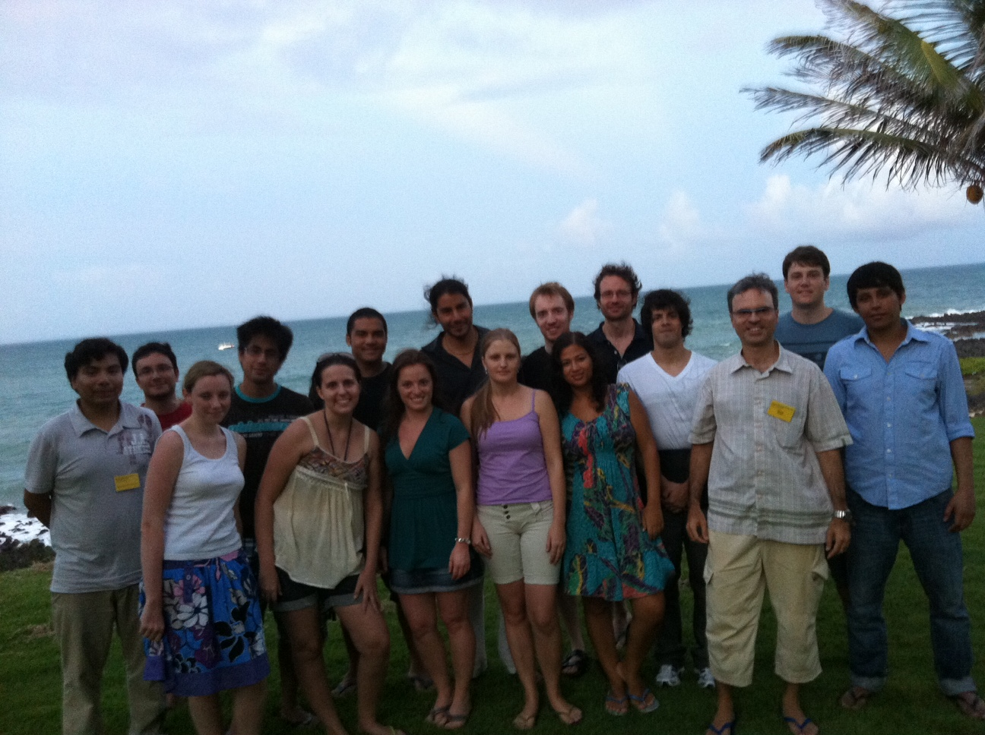
Thank you!

Slide 20
Thank you!

Slide 21
Backup slides

Slide 22
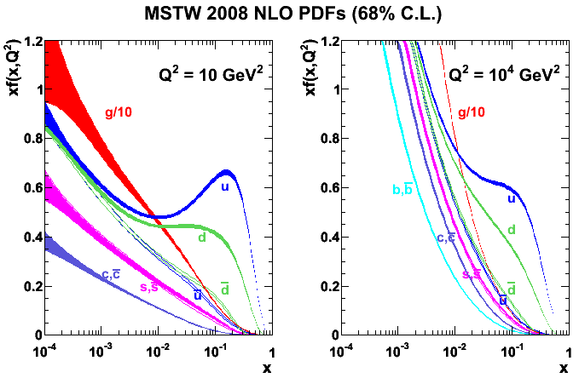
Some Comments
Information related to the QCD contribution to the partonic cross section is encoded in tensor H, while leptonic interaction is related with tensor L.
Takes into account the finite width of the intermediate particle
Computation performed with FEWZ plus MSTW 2008 PDFs

Slide 23
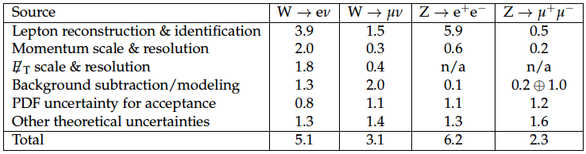
Systematics Uncertainties

Slide 24
Lepton Isolation
Isolation Variables:
Where E_{T} = E sin(θ) and the sum is computed in a region around the lepton candidate fulfilling the condition:
Excluding the energy deposit and momentum of the lepton candidate. We also define a combined isolation variable:

Slide 25
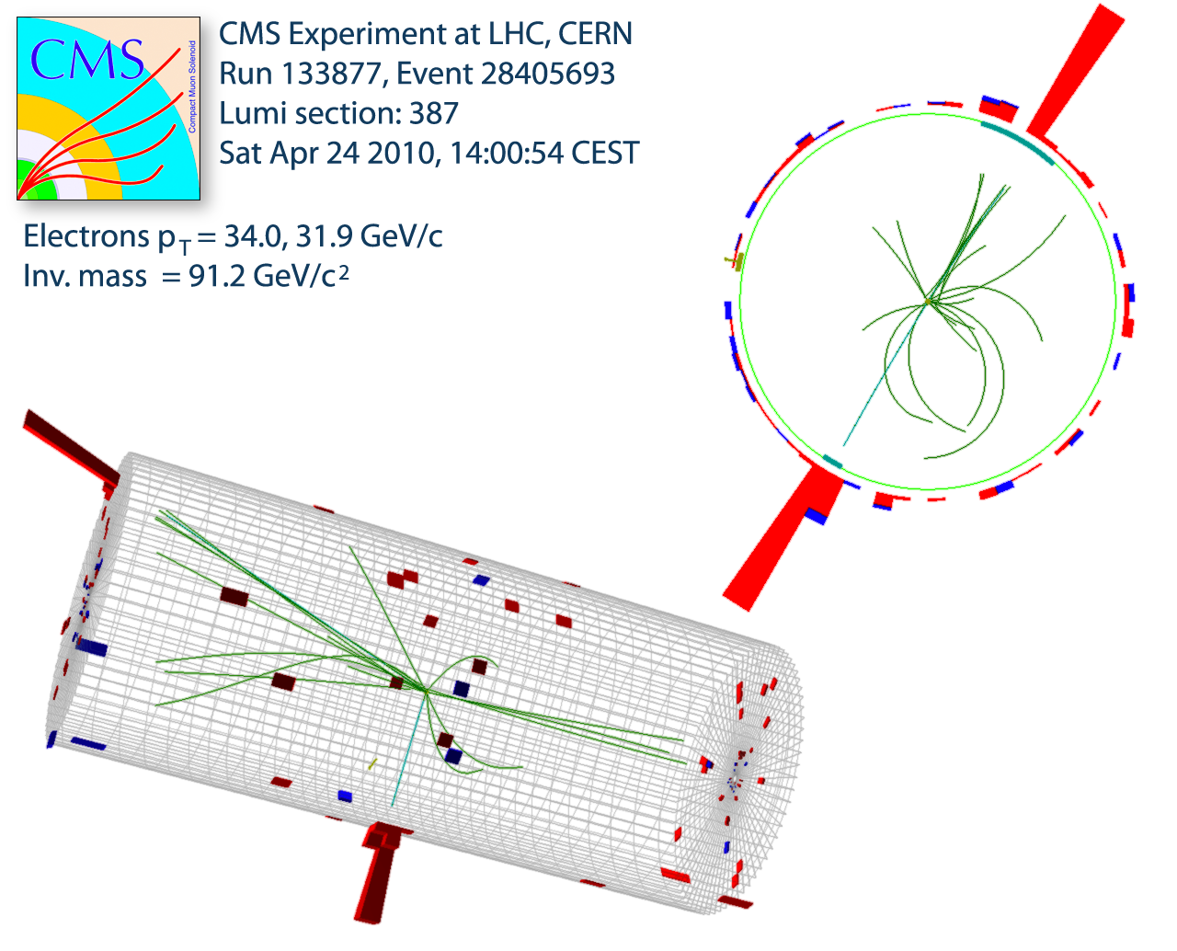
Electron Reconstruction and Identification
Offline Reconstruction of High-E_{T} electrons
ECAL clusters energy > 20 GeV
Match to reconstructed track in silicon tracker (IT)
|η| < 1.44 (EB clusters)
1.57 < |η| < 2.50 (EE clusters)
Reconstruction algorithm (accounts for Brem)
Background Suppression
Match HCAL energy in a cone (ΔR < 0.15) around ECAL cluster
Require ONE hit in IT innermost pixel layer
Demand electron isolation:
EB region:
EE region:
Electron Candidate > 20 GeV ECAL clusters + momentum direction of associated track
W candidate
Z candidate

Slide 26
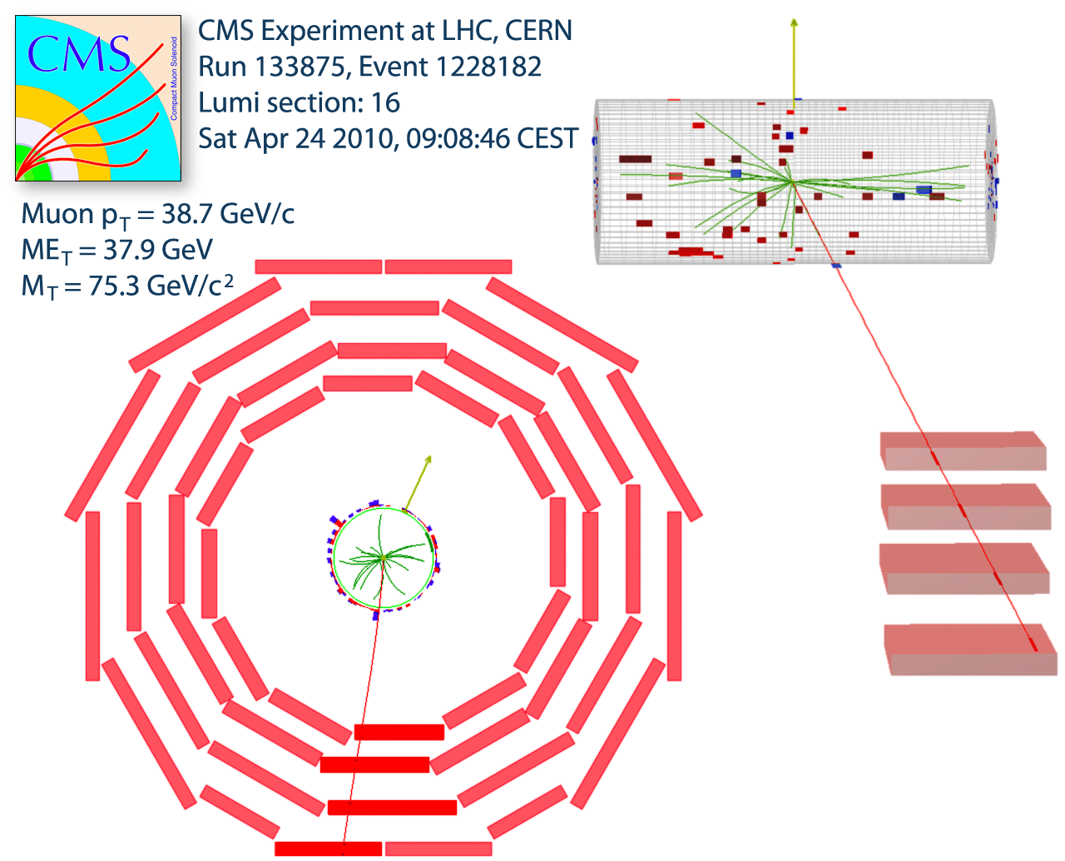
Muon Reconstruction and Isolation
The main contamination is from
  Hadronic jets
  Real leptons from decays
  Cosmic rays
Online
  L1 muon trigger
  Reconstructed muon candidate in inner tracker and muon chambers
  HLT pT > 9 GeV for muon in range |η| < 2.1
W candidate
Offline
  Global muons (stand alone + tracker muon)
  Signal in at least 2 muon stations
  Rejection of cosmic BG: IP < 2 mm from nominal beam axis
  .
Z candidate

