Slide 1
Events on 1st September
N. Catalan Lasheras
Z Charifoulline et al.

Slide 2
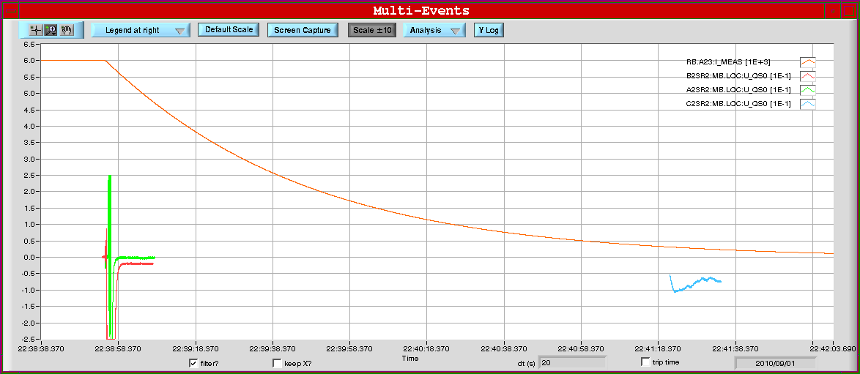
1.09.10, RB.A23 switch test
Routine switch-opening test on RB.A23 in order to verify slow temperature recovery
4 magnets quenched as a consequence of the test at 6kA
5700 A
B23R2 (22:38:55.196)
400 A
C23R2 (22:41:19)
A23R2 (22:38:55.704)
(B22R2)

Slide 3
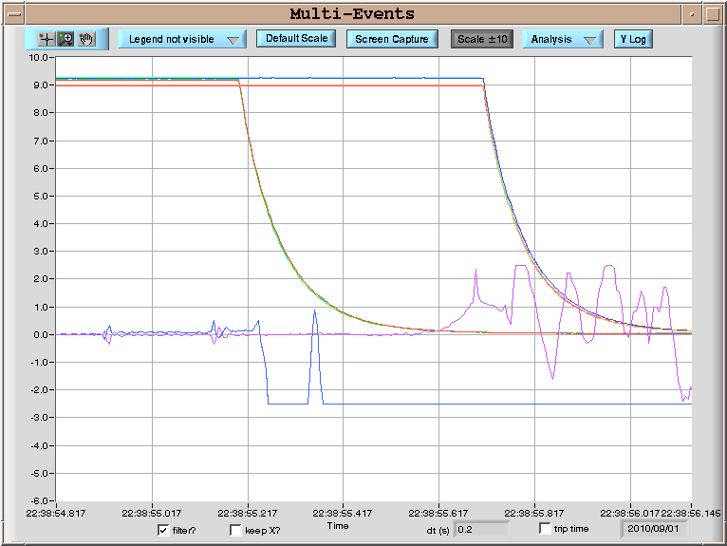
First two events triggered by old QPS
U_HDS:
B23R2
A23R2
~500 ms
1st switch
2nd switch
U_QS0:
A23R2 resistive transition

Slide 4
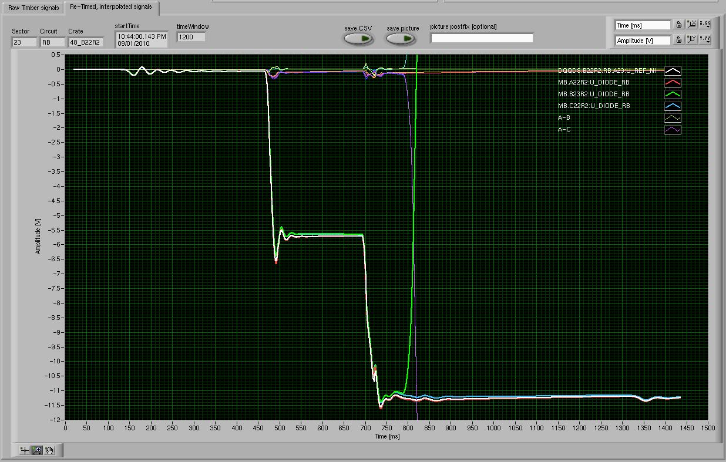
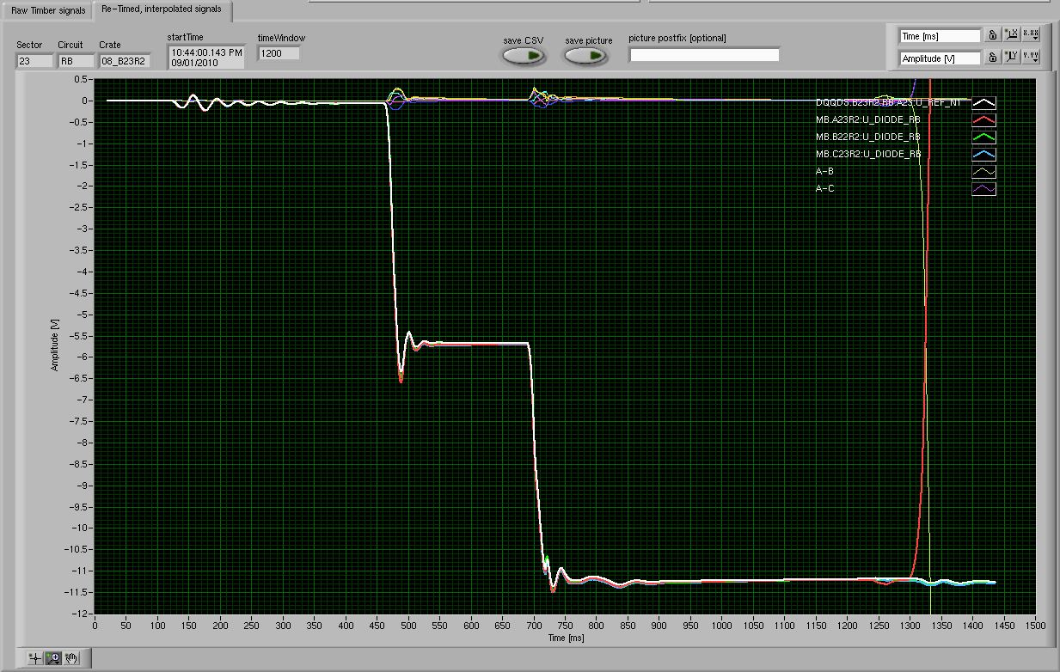
nQPS buffers show the two quenches

Slide 5
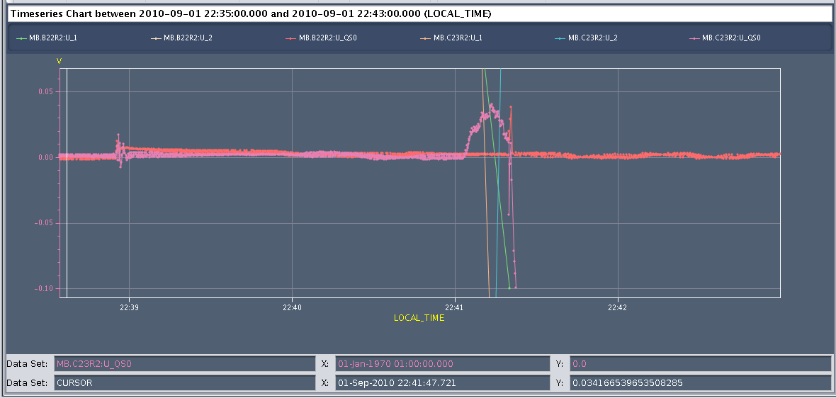
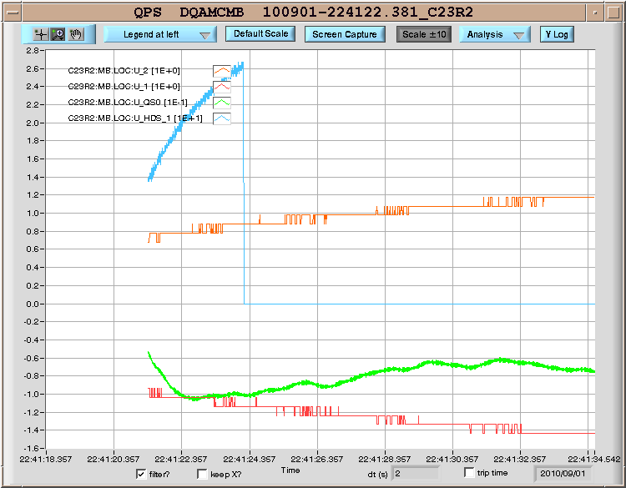
Last two events triggered by nQPS
C23R2
Heater firing created an old QPS signal above threshold
PostMortem file

Slide 6
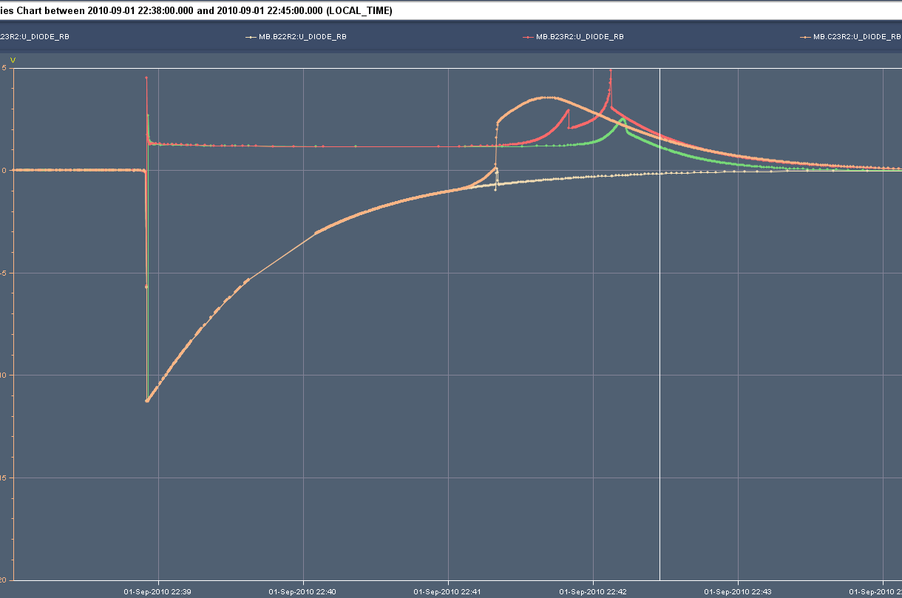
Symmetric quench in C23R2

Slide 7
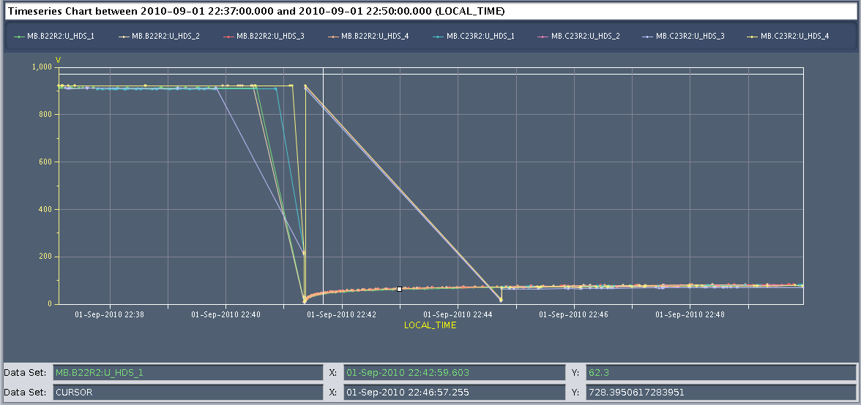
Last two events triggered by nQPS
B22R2
No Post Mortem file but QH discharge visible in logging database

Slide 8
Summary
B23R2 at 22:38:55.196 @ ~6 kA
Elec. perturbation of 2nd switch triggers old QPS (board B)
A23R2 at 22:38:55.704 @ ~5.7 kA
500 ms later, little understood propagation phenomenon
C23R2 at 22:41:19 @ ~400 A
symmetric quench by thermal propagation
B22R2 (at 22:41:19) @ ~400 A
heaters fired as 3 neighbors were quenched

Slide 9
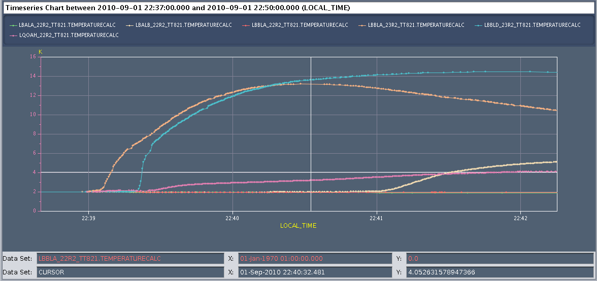
Thermal propagation hypothesis
B23R2 does not have a working TT821 sensor
Very fast propagation after the first two quenches (20 s)
QPS symmetric quench properly working
(B23R2)
C23R2
A23R2
C22R2
Q23R2
(B22R2)

Slide 10
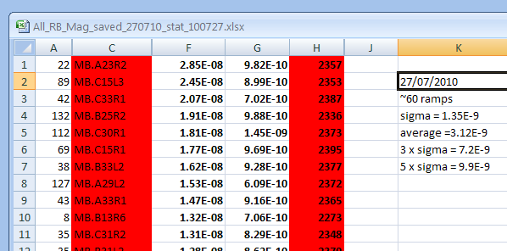
A23R2
Quench in A23R2 not quite understood
Magnet A23R2 has the highest resistance over LHC.
The value found by analyzing of U_MAG (nQPS)
signals during 3.5TeV ramps is 29±1nΩ.
(statistical approach on about 60 ramps, 27/07/2010)

Slide 11
Splice resistance (ELQA)
R_{app1} = 15.9nΩ
R_{app2} = 12.9nΩ
R_{extJoint} = 1.8nΩ
U_QS0 = (U_1 - U_2)
Board A:
U_1: EE112 <-> EE211
U_2: EE211 <-> EE213
R_{U_QS0} =
(R_{app1} + R_{extJoint}) - R_{app2} =
(15.9 + 1.8) - 12.9 = 4.8nΩ
R_{total} =
R_{app1} + R_{extJoint} + R_{app2} =
15.9 + 1.8 + 12.9 = 30.6nΩ

Slide 12
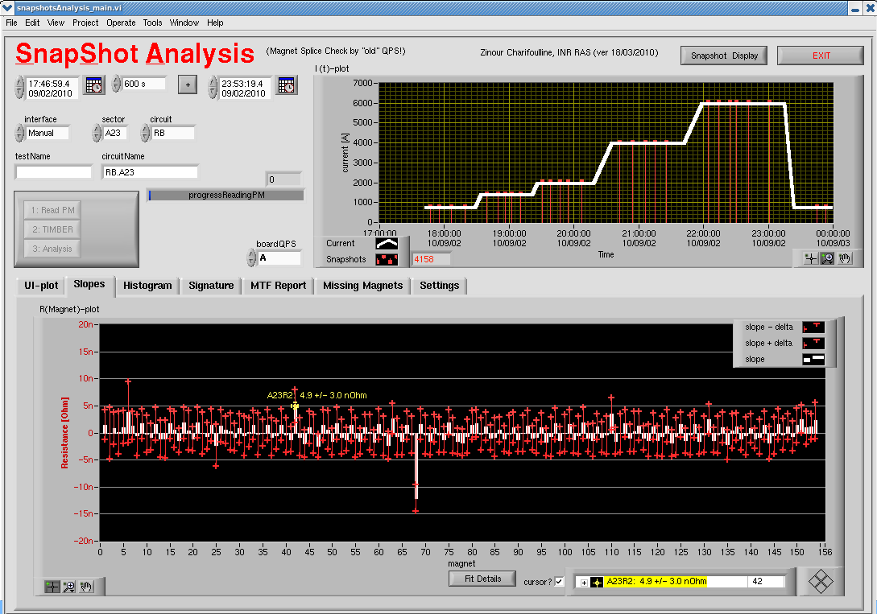
Old QPS measurments

Slide 13
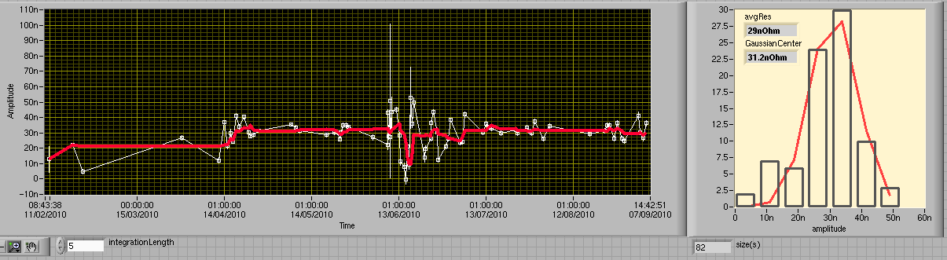
nQPS measurements
A23R2: R = 29 ± 1 nΩ
The A23R2 internal splice resistance evaluated from PXI direct measurements, U_MAG(nQPS) and from U_QS0(QPS) are consistent
Excess resistance is almost equally distributed between apertures and stable

Slide 14
Conclusions
Two magnet quench as a result of the energy extraction transient
Not excluded by the last QPS modifications but minimized
nQPS symmetric quench properly working
Inside splices stable even after quench

Slide 15
Thanks for your attention

Slide 16
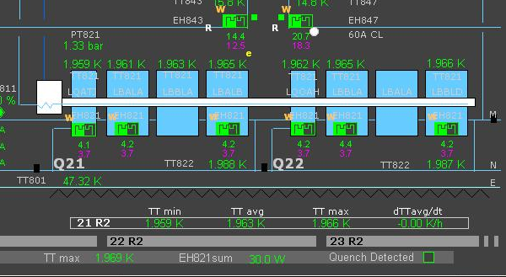
The same
4
2
1
3

