Slide 1
Industry events@CERN
Anders Unnervik
ILO Forum, 21 September 2021

Slide 2
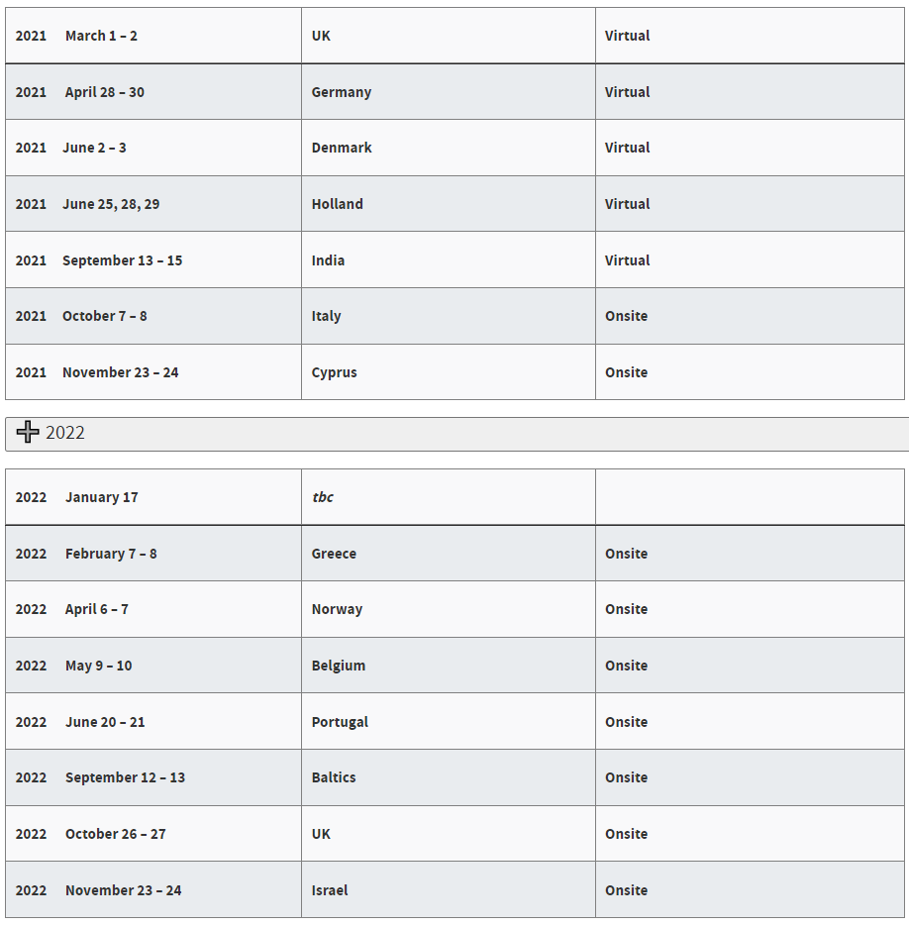
Current situation
Heavy organizational work load
Difficult to meet the requests from all Member States (incl. Associate Member States)
Difficult to establish rules for the allocation of slots (level of contribution, industrial return, time between events, new associate Member State, etc…?)
Perceived feeling of saturation among CERN personnel
Etc..

Slide 3
Proposal
Replace the national industry events by thematic industry events, e.g:
  Electrical engineering;
  Electronics & RF;
  ICT;
  Mechanical engineering & high-precision machining;
  Vacuum & cryogenics;
  Etc..
Ensure that the events correspond to future procurements, if possible
Allow industry from all Member States to participate (with priority given to new potential suppliers and suppliers from very poorly balanced Member States, if restrictions are needed)
Limit the number of events to 2-3 per year
Allow new Associate Member States to organize one national event in the beginning of their association with CERN

Slide 4
Expected benefits
Thematic industry events ensure more interest from CERN’s technical departments and, hence, more relevant B2B meetings
Allows industry to get up-to-date information about CERN’s requirements in each technical area over the near-to-mid-term future
The planning of thematic areas will take into account CERN’s future needs and ensures that companies may receive price enquiries and invitations to tender relatively soon after the events.
Your comments/ideas are welcome.

