Slide 1
The North Area Consolidation Project Procurement Plan
Daniel Schoerling
IPT-PI
On behalf of the NA-CONS Team

Slide 2
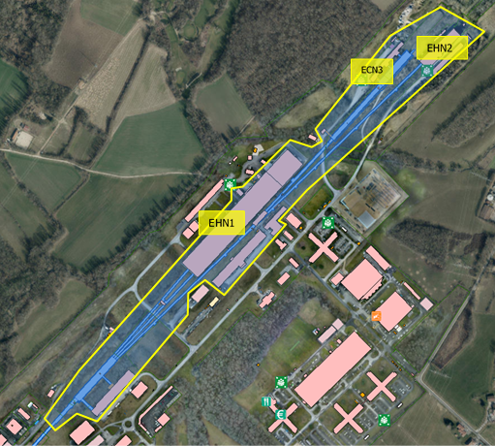
North Area Consolidation
Renovation of the Fixed Target Experimetal Area at the CERN Prevessin site, after 45 years of wear-and-tear + fantastic physics
Recover the availability and reliability of the beam- facility
Correct safety concerns and non-conformities
Be prepared for new projects and test beams in next decades

Slide 3
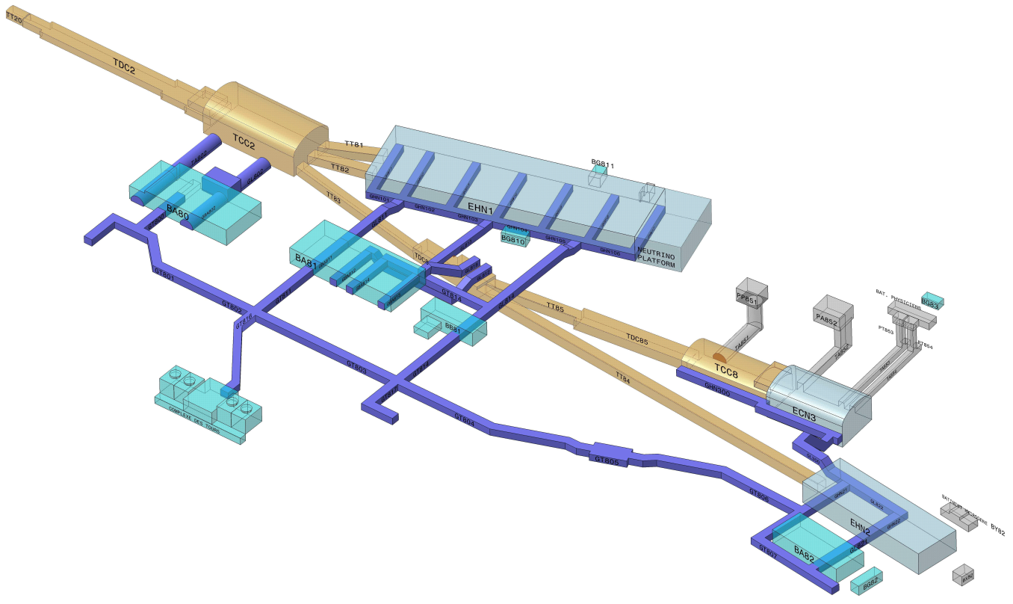
Schematic view of the North Area
A few numbers:
Overall surface 60000 m²:
  underground 16600m²,
  experimental halls 31000 m²,
  service buildings: 12000 m²
6 beam lines, ~ 6.3 km cumulated
~ 1500 visitors / year
300 m
Secondary beam area
1250 m
Primary beam area
Underground
beam tunnels,
caverns
Underground
Technical galleries
Service
buildings
Exp. Halls

Slide 4
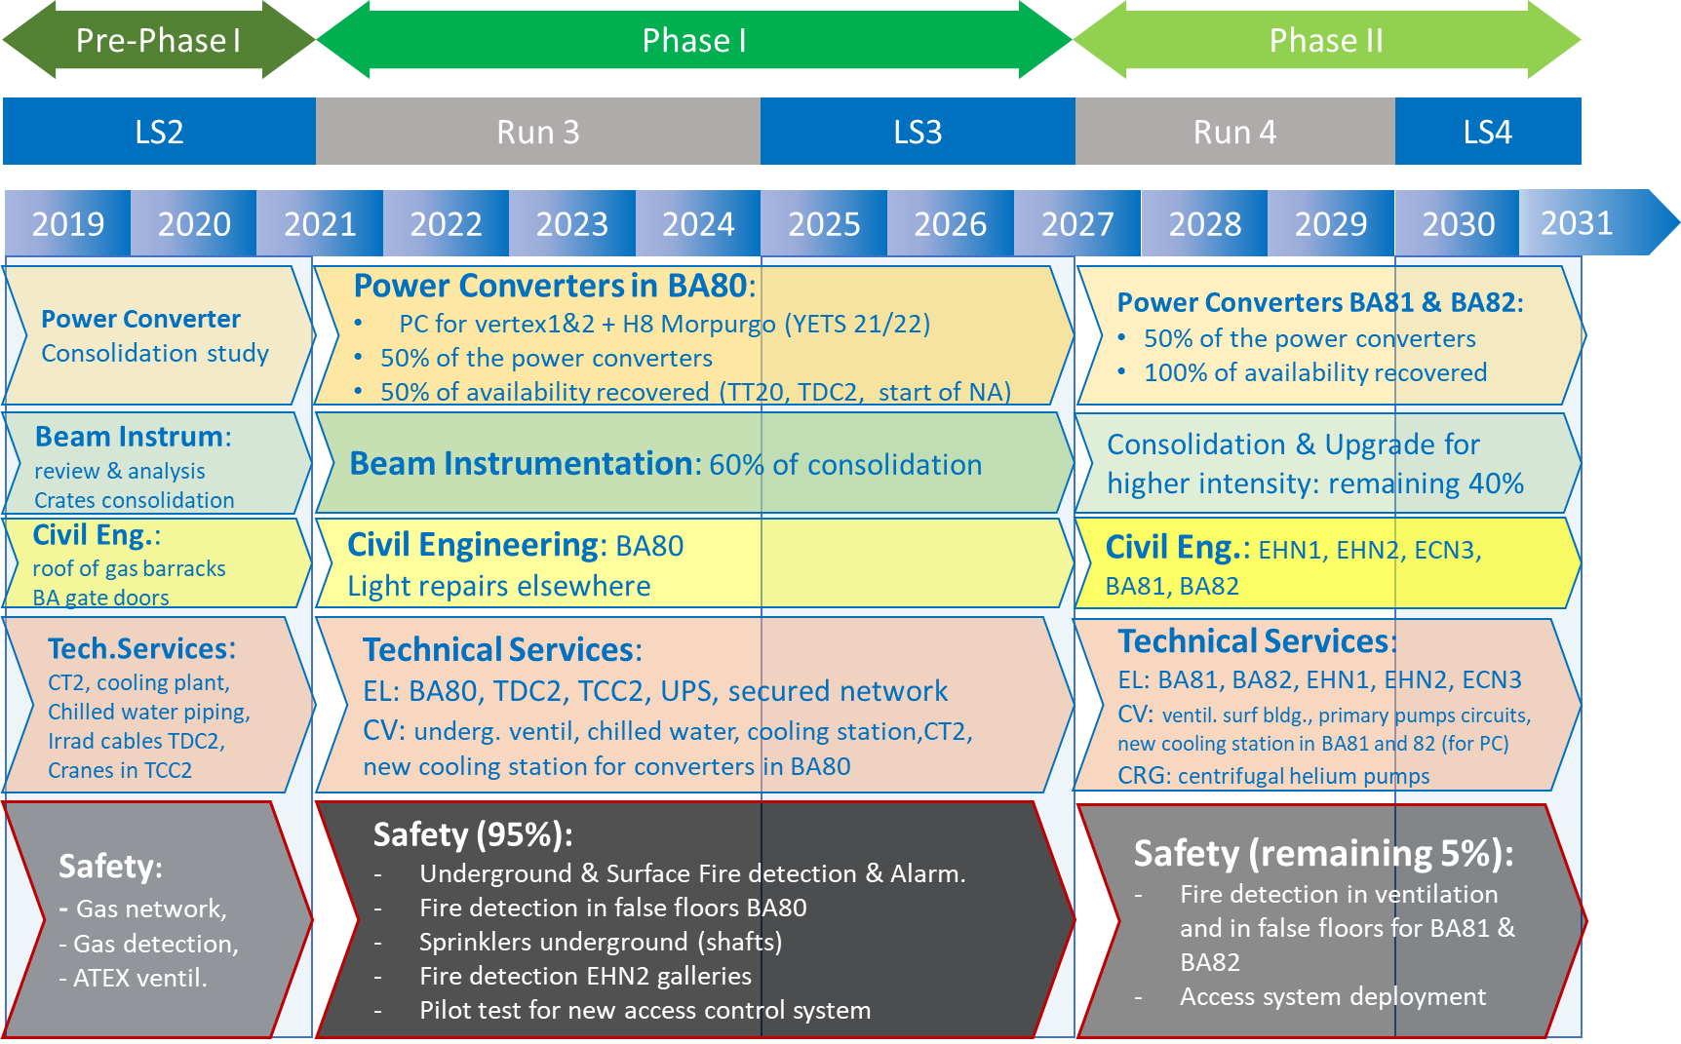
Project Timeline/Roadmap
Concluded
Budget approved
Planned

Slide 5
Cumulated budget
Nota: without EL-CONS (~ 20 MCHF)

Slide 6
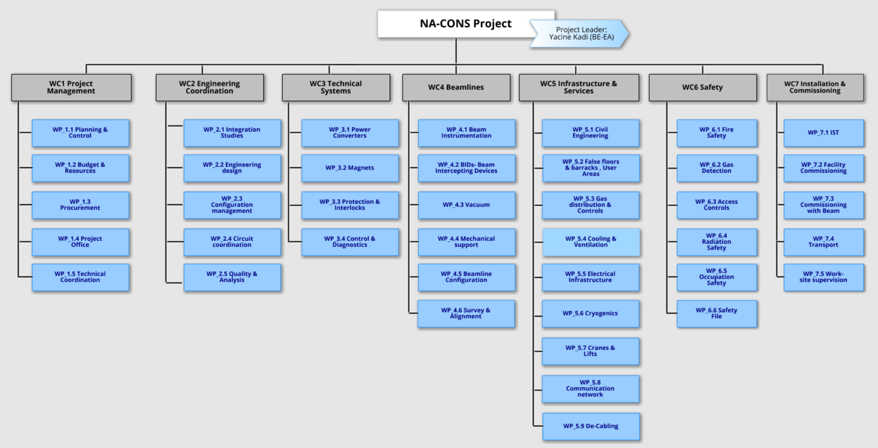
Procurement plan: WP

Slide 7
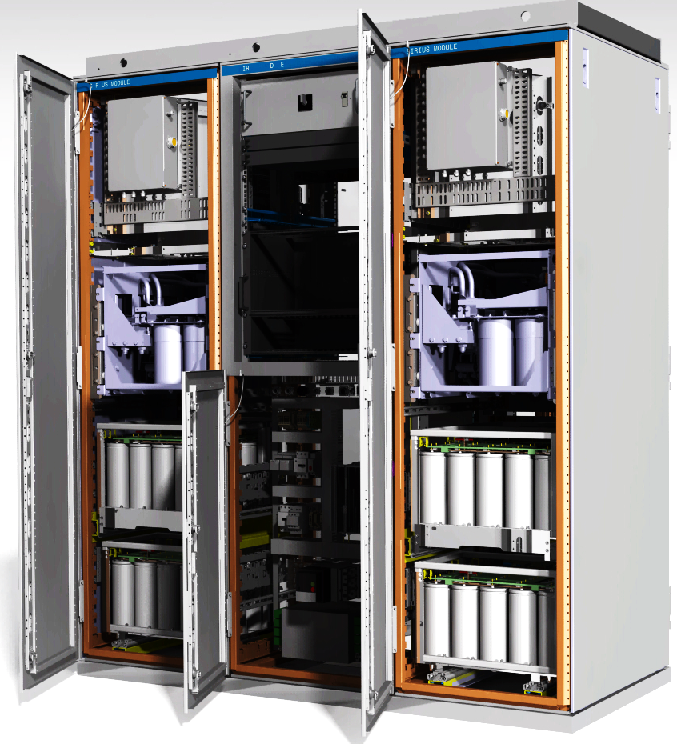

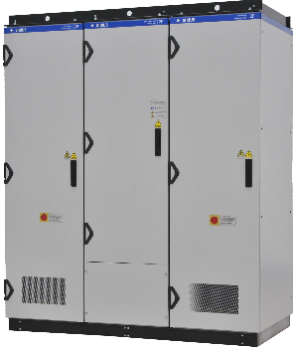
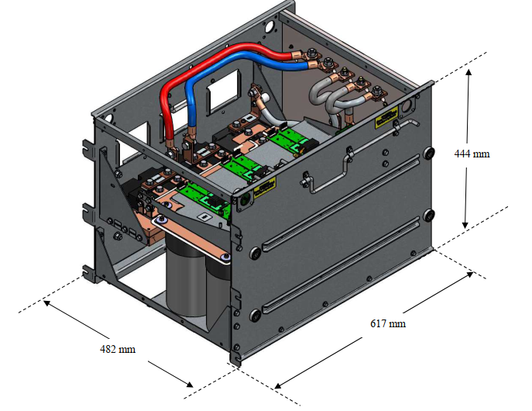
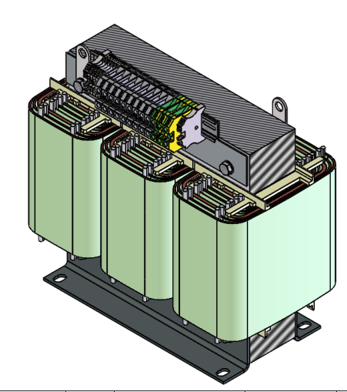
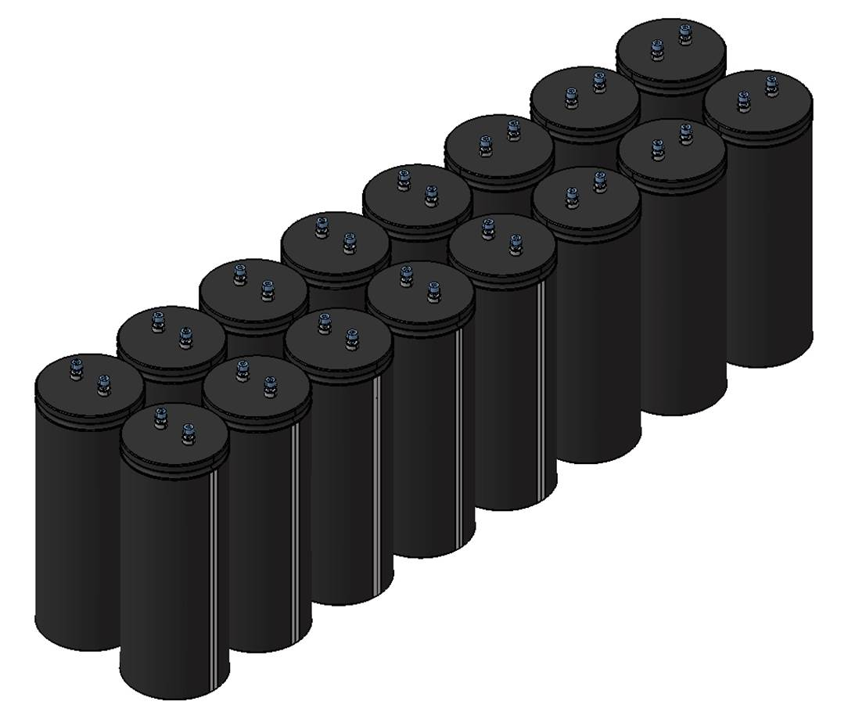
POLARIS Highlights
PHASE I – LS3: commit for qty / contracts in 2022/23
396 POLARIS to deliver
PHASE II – LS4: use optional qty / re-order in 2027/28
188 units
All new IT contracts
Contracts: 5 years (+2)
208 units
IT Manufacturing
IT Power Stacks
IT Magnetics
IT ELCO Capacitors
188 units
Cat. C
438 units
Cat. B
438 units
Cat. B
13 400 units
Cat. B
200 units
Cat. C
496 units
Cat. B
496 units
Cat. B
14 000 units
Cat. B
360 V / 2000 Apk
CONTRACT 1
CONTRACT 2
CONTRACT 4
CONTRACT 7
Standard off-the-shelf capacitors

Slide 8
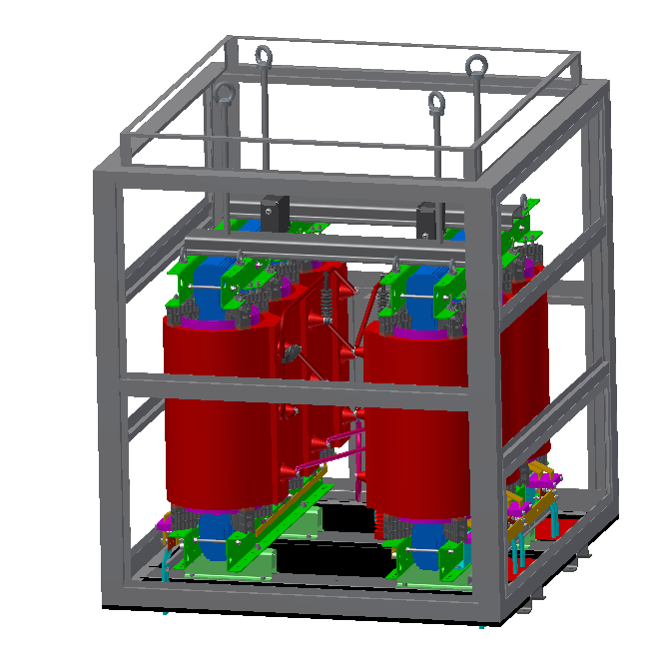
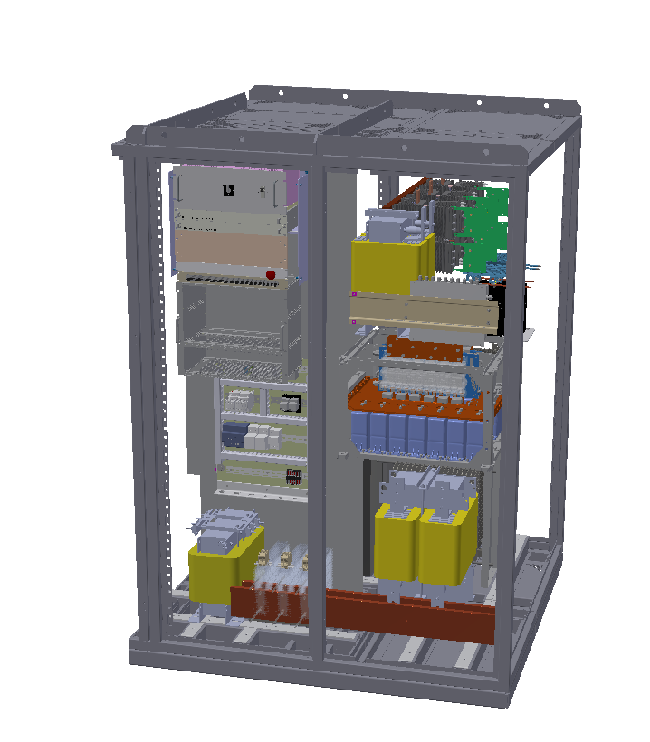

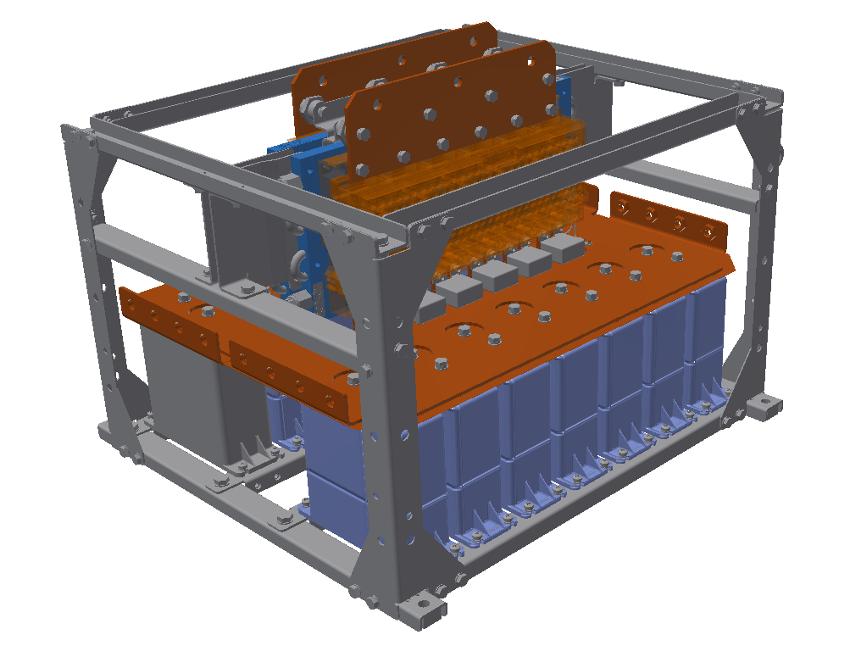
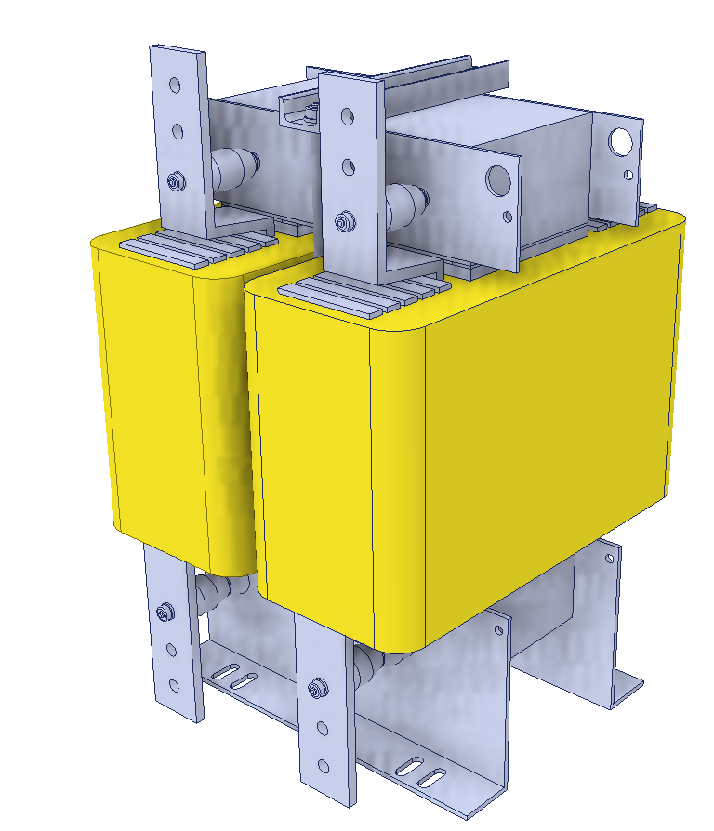
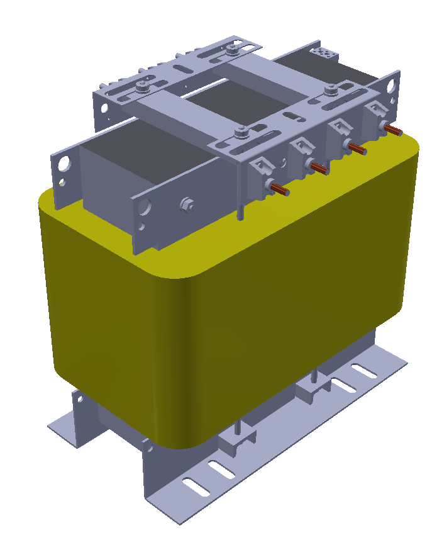
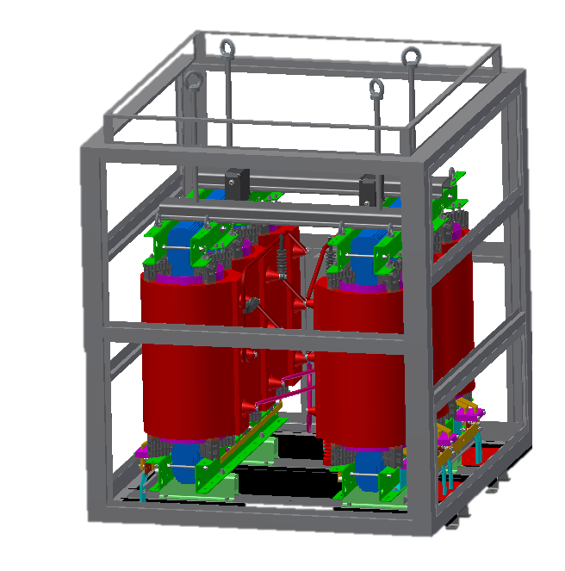
BOREAL Highlights
PHASE I – LS3: commit for qty / contracts in 2022/23
17 BOREAL to deliver
PHASE II – LS4: use optional qty / re-order in 2027/28
Existing + DO + IT
Contracts: 5 years (+2)
9 units
8 units
Manufacturing
IT Power Stacks
DO Magnetics
IT MV Transformer
9 conv / 28 racks
Cat. A
21 units
Cat. A
21 units
Cat. A
21 IP00 + IP3x enclosures
Cat. A
8 conv / 33 racks
Cat. A
28 units
Cat. A
28 units
Cat. A
28 IP00 + IP3x enclosures
Cat. A
320 V / 6000 Apk
EXISTING CONTRACT
CONTRACT 3-a
CONTRACT 5-a
CONTRACT 6

Slide 9
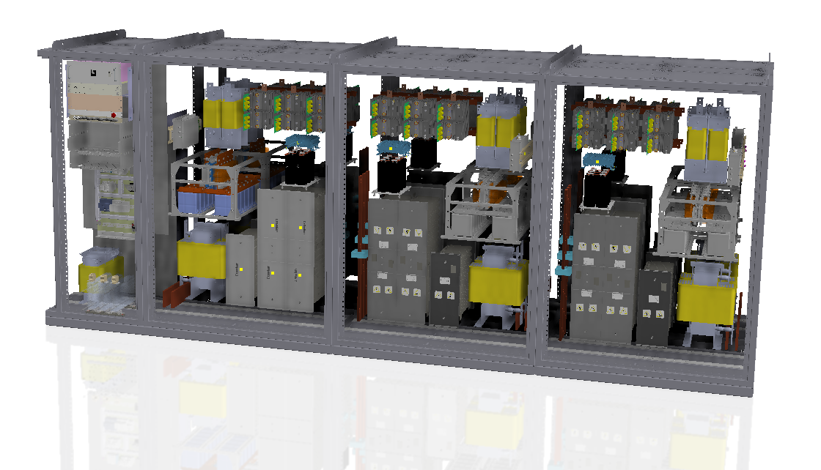
NEPTUNE Highlights
PHASE I – LS3: contracts in 2022/23
PHASE II – no deliverables
2 NEPTUNE to deliver
Existing + IT
2 units
Manufacturing
IT Power Stacks
IT Magnetics
-
2 conv / 18 racks
Cat. A
22 units
Cat. A
22 units
Cat. A
-
-
-
120 V / 24000 Apk
EXISTING CONTRACT
CONTRACT 3-b
CONTRACT 5-b

Slide 10
Phase I: Power converter consolidation
2021
2022
2023
2024
2025
2026
2027
PROJECT DEFINITION
CONVERTER PROTOTYPING
COMPONENTS TENDERING
PRE-SERIES COMPONENTS
SERIES COMPONENTS
Market Survey, IT,
Finance Committee
Contract signature
Design Approval
Production & FATs
Test with Converter Prototype
Production & FATs
Test with Series Converters
MANUFACTURING TENDERING
PRE-SERIES CONVERTER
SERIES CONVERTERS
Market Survey, IT,
Finance Committee
Contract signature
Production & FATs
Test at CERN platform
Production & FATs
Tests at CERN Platform
INSTALATION COMISSIONING

Slide 11
Other requirements
BID (beam intercepting devices) and components & Beam Instrumentation
  ~50 devices need to be consolidated or replaced, foreseen within the next 2 years
Vacuum Components
  Existing/renewed contracts (service & supply)
Civil Engineering
  Mainly roof & envelope renovation
Cooling and ventilation installations
  Consolidation of the existing infrastructure (using existing/renewed service contracts)
Electrical installation (cabling)
  Consolidation of the existing infrastructure (transformers, switchgears, cables, UPS, etc), using existing/renewed service contracts
Fire safety
  Analysis on-going and actions planned to be done with service contracts
Fire and gas detection system
  Existing/renewed service contracts
Magnets and magnet components
  In-house consolidation in CERN workshops with existing/renewed CERN service & supply contracts
Access control system
  Existing/renewed service contracts

