Slide 1
Election of ILO Forum Chair
Anders Unnervik
ILO Forum, 21 September 2021

Slide 2

Appointment procedure
Current ILO Forum Chair mandate March 2018 – March 2022 (Hakan Kiziltoprak, TR)
Vice-Chair (Ole Petter Nordahl, NO)
To allow the new ILO Forum Chair to take office in March of 2022:
Step 1 – The upcoming appointment procedure shall be announced and described at the ILO Forum March 2021.
Step 2 – A call for nomination of candidates shall be sent electronically to all ILO Forum delegates by the current Chair at the latest by March 31st 2021.
Step 3 – ILO Forum delegates wishing to be candidates shall submit their candidacy electronically to the current Chair at the latest by June 30th 2021.
Step 4 – The list of candidates shall be sent electronically to all ILO Forum delegates by the current Chair at the latest by September 1st 2021.
Step 5 – At the September meeting 2021, the appointment procedure shall be followed.

Slide 3
Appointment procedure
For the selection of a single candidate, open ballots are held and after each ballot the candidate (or, in the case of an equal number of votes, candidates) polling the lowest number of votes shall withdraw his/her (their) candidacy(ies), until one candidate obtains the absolute majority of the Member and Associate Member States represented and voting (abstentions not counted).
Each Member and Associate Member State represented shall have one vote.
The selected candidate shall thereafter be considered formally elected ILO Forum Chair. Election by consensus shall be desirable.
Postal or e-mail votes not accepted. However, Member and Associate Member States may give proxy votes to a representative attending the meeting.
Term:
The term shall be two years, renewable once. A period of 6 months between the election of the Chair (at the September meeting) and the formal start of the appointment period (at the following March meeting) will insure continuity and flow in the work of the ILO Forum.
Vice-Chair:
A Vice-Chair shall be appointed by the ILO Forum Chair. The term of office of the Vice-Chair shall be the same as for the ILO Forum Chair. For a smooth hand-over, the previous Chair is often appointed as Vice-Chair.

Slide 4
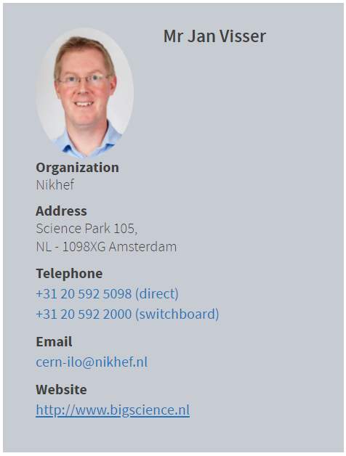
The candidate

