Slide 1
Numerical simulation of gaseous detectors using
Garfield++
Supratik Mukhopadhyay
Saha Institute of Nuclear Physics
Workshop on Advanced Radiation Detector and Instrumentation in Nuclear and Particle Physics (RAPID2021)

Slide 2
Outline
Motivation and background
Simulation of gaseous ionization detectors
Introduction to the Garfield++ simulation framework
Simple Garfield++ how-tos
Summary and outlook

Slide 3
Disclaimer
Device physics of particle detectors is a vast subject in itself, touching almost all the aspects of classical physics, glimpses of quantum mechanics and quite some amount of chemistry. As a result, the simulation tools are complex and varied in nature.
Large number of tool options are available. We will, naturally, touch upon only some of the more common ones, prejudiced by my own exposure to the subject.
Some of the slides are for later use and will not be discussed in detail during the presentation, to save time.

Slide 4
Motivation and background

Slide 5
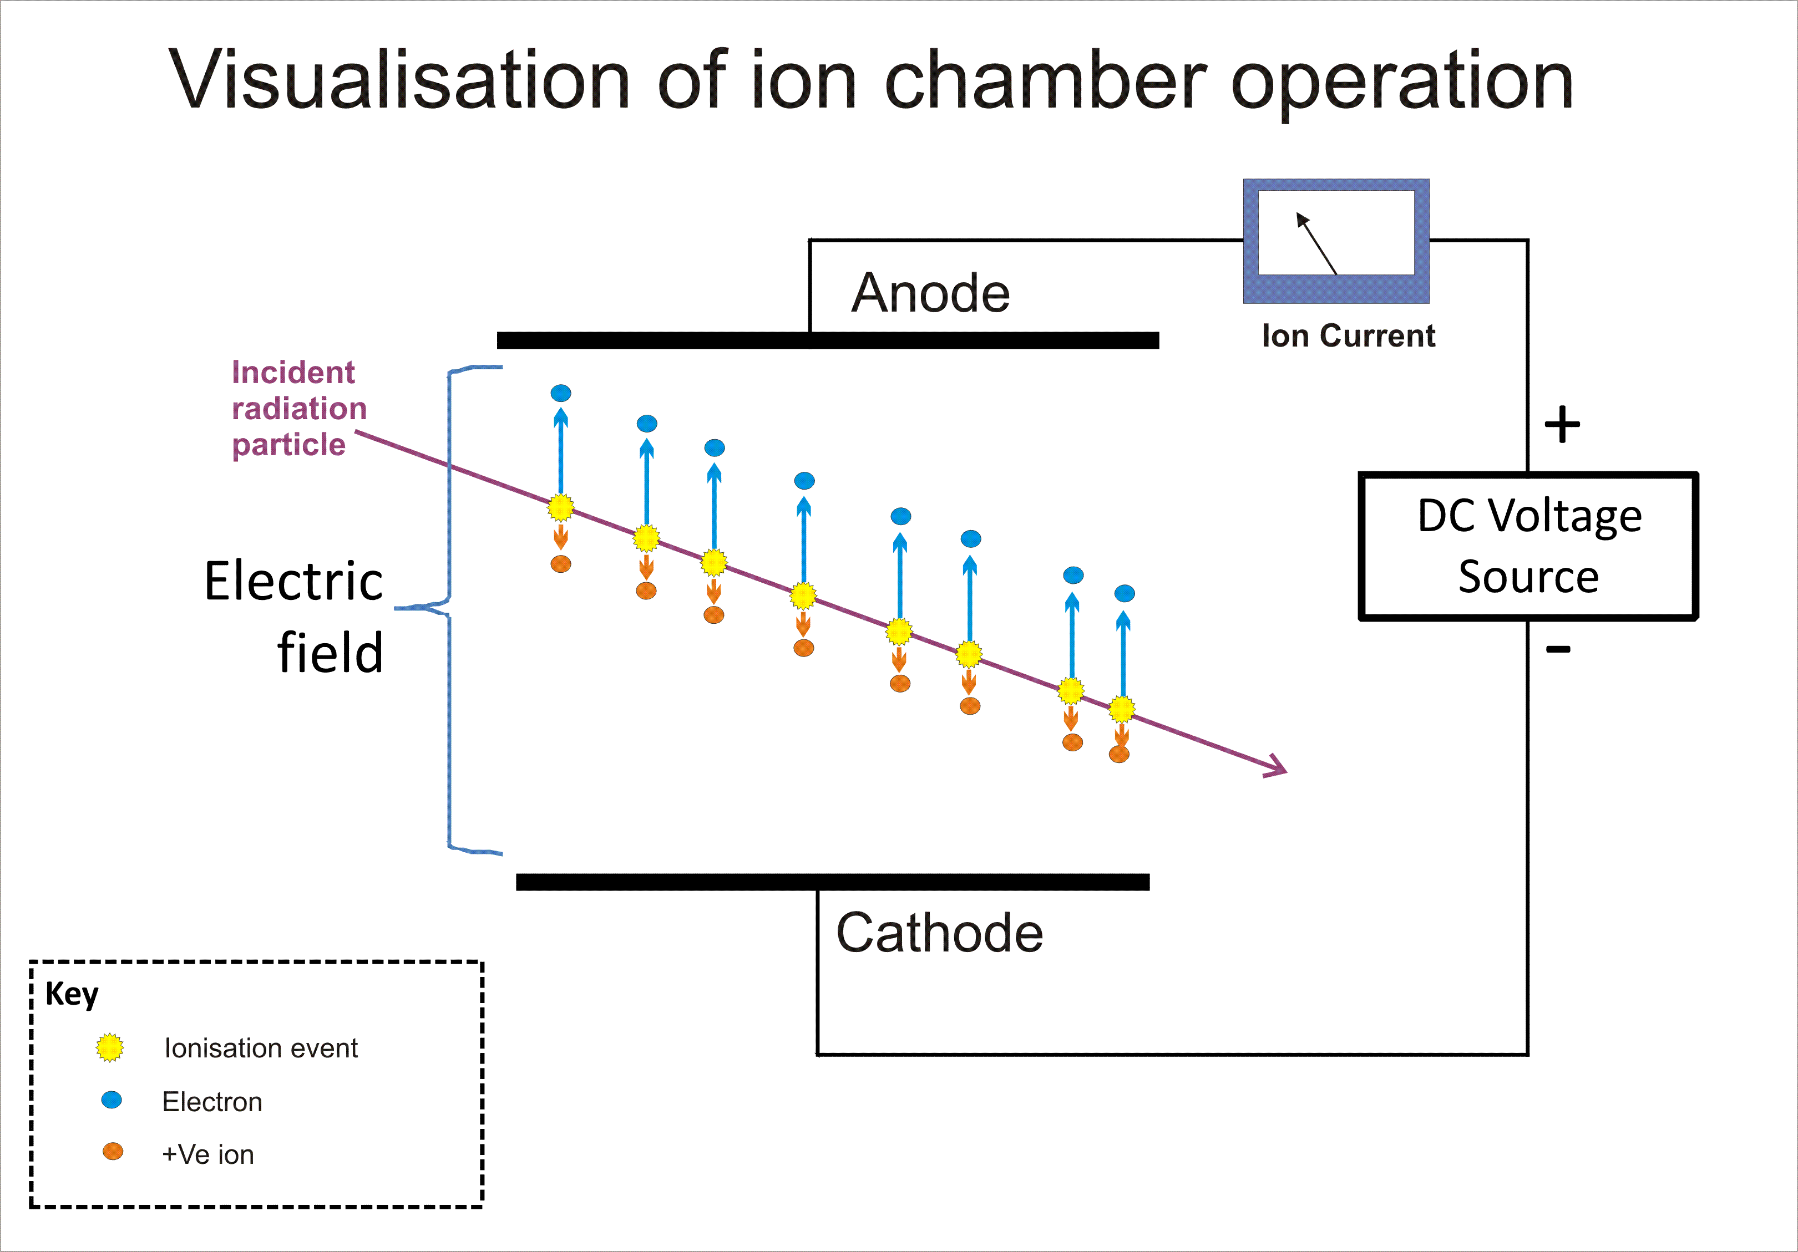
Ionization detectors
Detectors that depend on ionization of the media and its registration
Gas / Liquid Detectors: Electron - Ion pairs
Geiger-Mueller counter, Proportional counter, Single / Multiple Wire chambers, Drift chambers, Time Projection Chambers, Resistive Plate Chambers, Micro-Pattern Gas Detectors
Solid State Detectors: Electron – Hole pairs
Silicon detectors, Diamond detectors
They can both be used as Tracking detectors in which you need to know the position to varied degrees of precision.
A charged particle passing through a gas-filled counter will ionize the gas along its path .The applied voltage V between the electrodes will attract the positive and negative charges toward the respective electrodes causing a charge Q to be induced on readout electrodes.
The equation governing the ionization process is the well-known Bethe-Bloch formula:
Here, we are interested in Gaseous ionization detectors

Slide 6
Operating principle
Charged particle passes through a volume of a gas or noble liquid exciting and ionizing the molecules: primary electron-ion pairs are created.
The electrons, if energetic enough through the first interaction, can lead to secondary ionization.
Electric field is applied by suitably placed electrodes: electrons and ions drift to them
If the electric field is sufficiently high, the drifting electrons can further ionize the gas (proportional counters)
At even larger field strengths, electrons emit UV light on the anode (Geiger-Muller counter)
The movements of electrons and ions induce electronic signal at the readout electrodes. These can be segmented, or otherwise designed to yield information related to position, time etc.

Slide 7
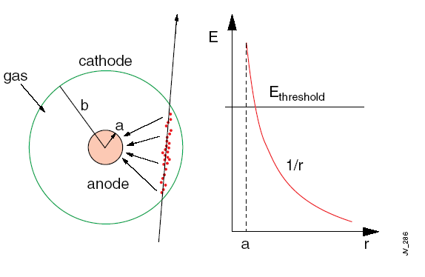
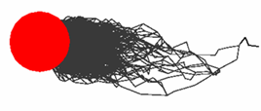
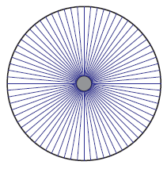
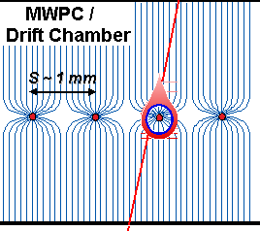
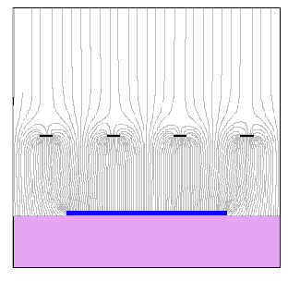
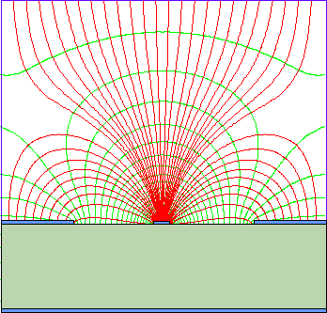
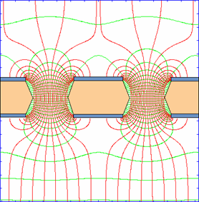
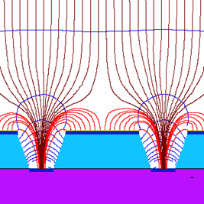
Single Wire Proportional Chamber
Electrons liberated by ionization drift towards
the anode wire.
Electrical field close to the wire (typical wire Ø
~few tens of μm) is sufficiently high for electrons
(above 10 kV/cm) to gain enough energy to ionize
further → avalanche – exponential increase of
number of electron ion pairs.
C – capacitance/unit length
anode
e⁻
primary electron
Rate capability limited by space charge defined by the time of evacuation of positive ions
Fortunately, cylindrical geometry is not the only one able to generate strong electric field:
wire
mwpc
parallel plate
strip
hole
groove/well

Slide 8
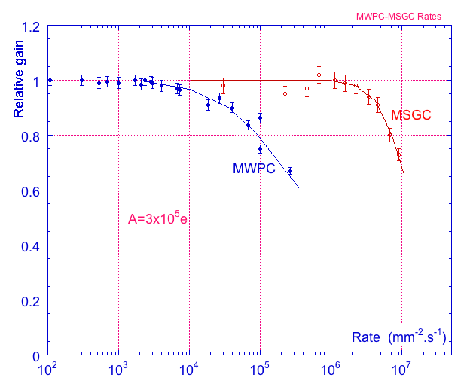
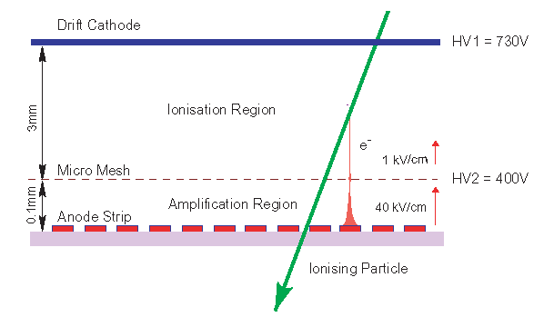
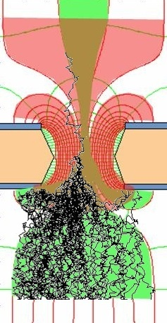
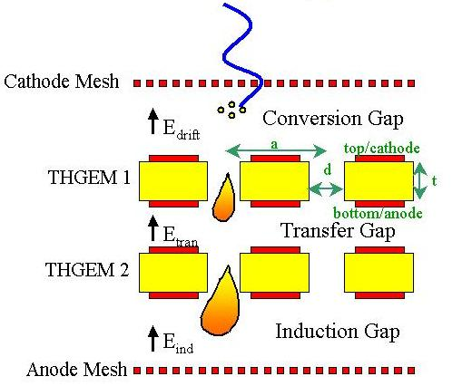
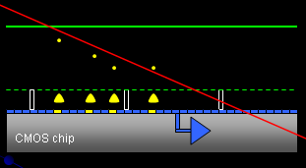
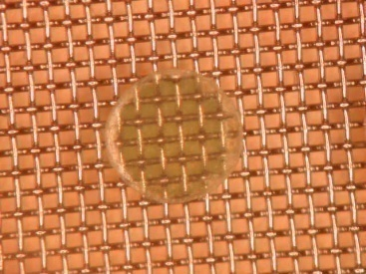
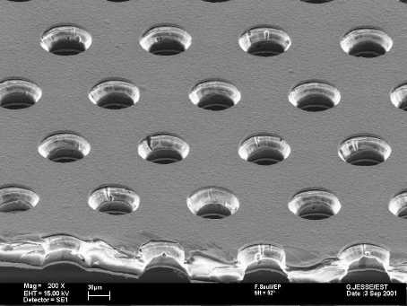
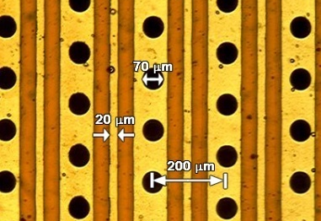
Micro-Pattern Gas Detectors (MPGD)
Printed Circuit Board (PCB) technology allowed micro-structures to be patterned.
In the 1990s
Photolithography
Etching
Coating
And later silicon wafer post-processing allowed to go further in small patterns
Rate Capability Comparison for MWPC and MSGC
Ions
40 %
60 %
Electrons
Micromegas
GEM
THGEM
MHSP
Ingrid
8

Slide 9
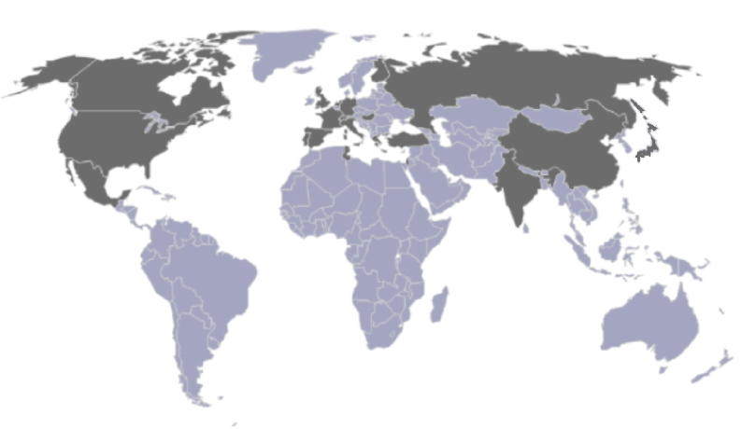
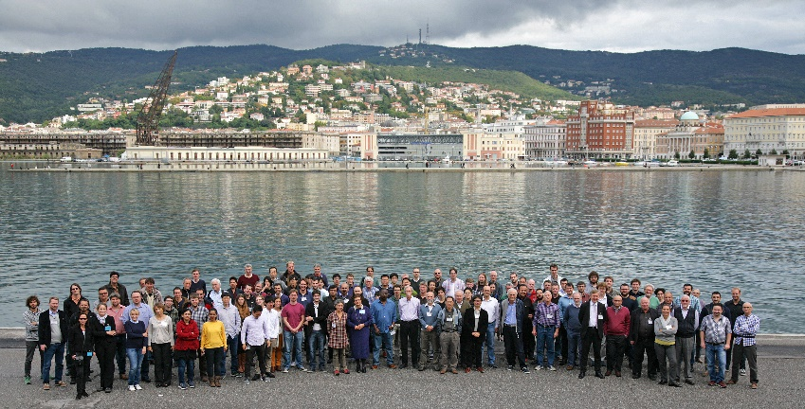
RD51 Collaboration
To advance technological development of MPGDs
http://rd51-public.web.cern.ch/rd51-public/
WG4
Modelling of physics processes and development of relevant software Tools
~100 institutes
~ 500 people involved
Representation (Europe, North America, Asia, South America, Africa)
“RD51 aims at facilitating the development of advanced gas-avalanche detector technologies and associated electronic-readout systems, for applications in basic and applied research”
Trieste, Italy, September 2015
RD51 contributes to the LHC upgrades, BUT, the most important is:
RD51 serves as an access point to
MPGD “know-how” for the world-wide community

Slide 10
Simulation of Gaseous Ionization Detectors

Slide 11
Device Physics Simulation why is it important, especially for MPGDs
Insight
  Optimization of experimental parameters, including environmental ones
  Accurate interpretation of data
  Better designs for future detectors
Complications
  Multiple aspects of complex physics and chemistry
  Coexistence of large and small length-scales
  Coexistence of large and small time-scales

Slide 12

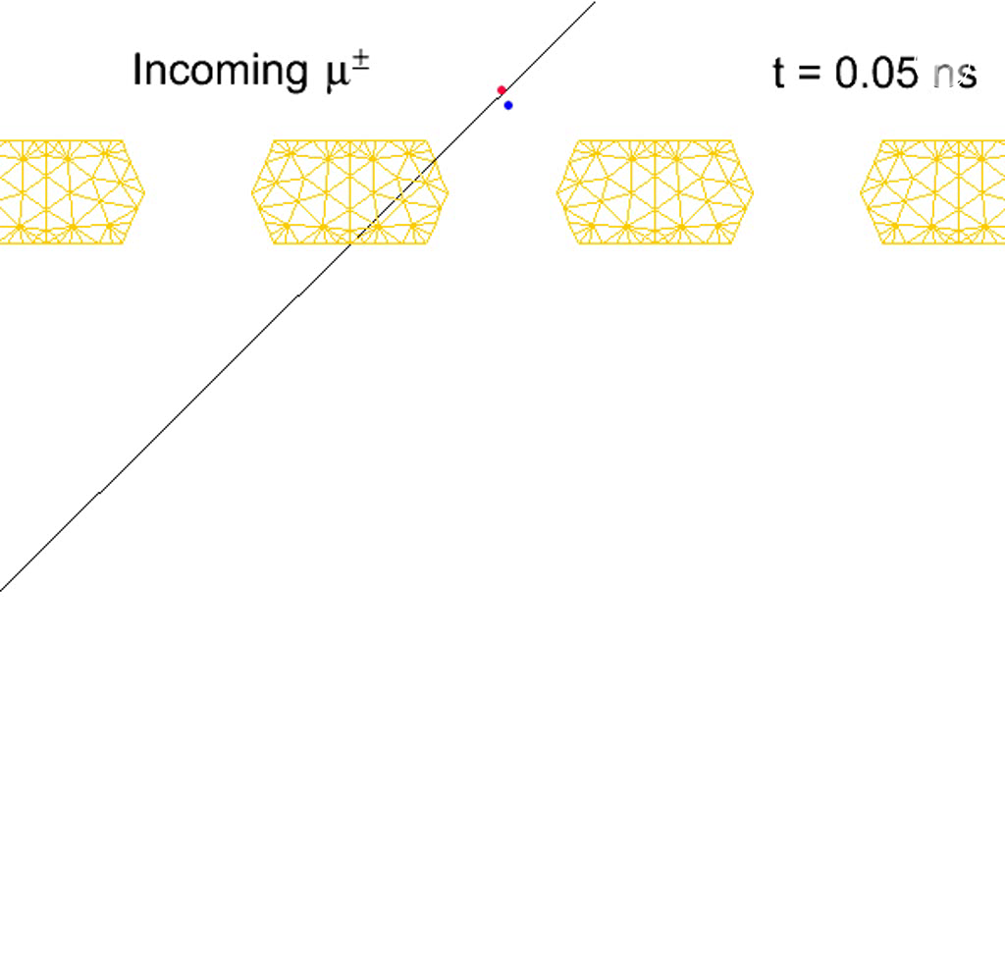
Processes occurring in a gaseous detector
Radiation Source
Ionization
Drift Volume
Drift and Diffusion
of Electrons
Amplification Gap
Amplification
Transfer Gap
Transport and
Diffusion
Readout Pads
Pad Response
Signal

Slide 13
Important aspects of a detector
  Gas mixture
  Geometry of detector components and the electromagnetic configuration
  Detector materials and their surface properties (possibility of charging up, roughness, photoionization efficiency)
  Fabrication expertise, availability of infrastructure
  Readout, DAQ, Post-processing
  …

Slide 14
(1) Gas mixture
Primary production: easily ionisable
Townsend and attachment coefficients: amplifying, not attaching: doesn't swallow electrons
Photon quenching: preserves spatial localization, avoids streamers / discharges
Transport (drift velocity, transverse and longitudinal diffusion): fast, less diffusing
Uncomfortable issues such as flammability, toxicity: neither flammable, nor explosive, nor toxic
Ageing characteristics: less polymerization, free-flowing
Environmentally friendly: minimizes carbon foot-print
Affordability: keeps costs within limits

Slide 15
(2) Geometry, electromagnetic configuration
Determines, for a given gas mixture,
The mode of operation
Gain
Resolutions (spatial, temporal, energy)
Rate handling capability
Charging up effects
Space charge effects
Charge dispersion effects
Spark probability
Signal induction
…

Slide 16
Introduction to the Garfield++ Simulation Framework

Slide 17
Possible approaches
Geant4 / FLUKA / SRIM look at the larger picture
  Important, without doubt, but may be a bit coarse for our purposes.
Device physics simulation inspects processes occurring at the microscopic detector component level
  Lumped element (circuit) simulation (Zero dimensional; can extend to realistic problems in combination with other models)
  Analytic (mostly valid for 1D models)
  Semi-analytic (1D; certain aspects of more realistic problems)
  Two-dimensional, axi-symmetric (close to realistic geometries)
  Three-dimensional (real device, complicated, time consuming)
  Hydrodynamic (continuum, Euler) model
  Particle (discrete, Lagrangian) model

Slide 18
RD51 simulation framework
Drift, Diffusion,
Avalanche
3. Induced signal using Weighting field
Gas, Particle Type,
Energy
1.Heed
Primary
Ionization
3.Garfield++
Transport Parameters
Field Map
Weighting Field Map
Gas, Temperature,
Pressure
2.Magboltz
4.neBEM
Geometry, Material,
Boundary Conditions
Field Map
Please note that neBEM is one among many possible field solvers.
Each and every component is open-source and free
neBEM is integrated with Garfield++
Garfield++: garfieldpp.web.cern.ch, Heed: heed.web.cern.ch, Magboltz: magboltz.web.cern.ch, neBEM: nebem.web.cern.ch

Slide 19

1. Ionization: PAI and Relaxation (PAIR)
  The transverse distribution of initial ionization aside from the track can be important, but it cannot be obtained from Photo-Absorption and Ionization (PAI). PAI does not discriminate the shells absorbing the energy and does not estimate the range of δ-electrons (ionizing photo-electrons and Auger electrons) knocked out from the atoms.
  The cross section of the PAI model was modified, which resulted in shell separation and gave the possibility to model atomic relaxation cascades and the paths of delta-electrons and fluorescent photons.
The improved model is called Photo-Absorption Ionization and Relaxation (PAIR) model.
First complete, widely available, computer program:
  Heed: Igor Smirnov, Modeling of ionization produced by fast charged particles in gases, NIM A 554 (Aug 2005), 474-493.

Slide 20
2. Maxwell-Boltzmann Transport
The MAGBOLTZ program computes drift gas properties by “numerically integrating the Boltzmann transport equation” - i.e., simulating an electron bouncing around inside a gas. By tracking how far the virtual electron propagates, the program can compute the drift velocity. By including a magnetic field, the program can also calculate the Lorentz angle. It can just as easily compute transverse diffusion coefficients, electron mobilities and other parameters.
In order to find macroscopic parameters like the drift velocity, MAGBOLTZ needs to know about the microscopic nature of each gas under study. The most important quantities are the scattering cross sections, which measure how likely collisions are to occur, and the energy loss per collision.
Magboltz: Steve Biagi, NIM A 421 (1999) 234-240

Slide 21
3. Garfield++ the framework
Provides a uniform user-interface to all the necessary components.
Integrates results from the all the components and put them to respective use.
Does an enormous amount of job in addition - keeps track of primary ionization, drift, diffusion, amplification, loss, signal induced and further post-processing.
https://garfieldpp.web.cern.ch/garfieldpp/documentation/UserGuide.pdf
Veenhof, R. (1998) Garfield, Recent Developments. NIM A, 419, 726-730.

Slide 22
4. nearly exact Boundary Element Method
(neBEM)
A new formulation based on green’s function that allows the use of exact close-form analytic expressions while solving 3d problems governed by Poisson’s equation. It is very precise even in critical near-field regions, and microscopic length scale.
It is easy to use, interface and integrate neBEM
Stand-alone
A driver routine
An interface routine
Post-processing
Garfield / Garfield++
Garfield prompt
Garfield script / C++ with Garfield++
Charge density at all the interfaces
Potential at any arbitrary point
Field at any arbitrary point
Capacitance, forces on device
components properties can be
obtained by post-processing
S Mukhopadhyay and N Majumdar, Computation of 3D MEMS electrostatics using a nearly exact BEM solver EABE 30 (8), 687-696, 2006

Slide 23
Simple Garfield++ how-tos

Slide 24
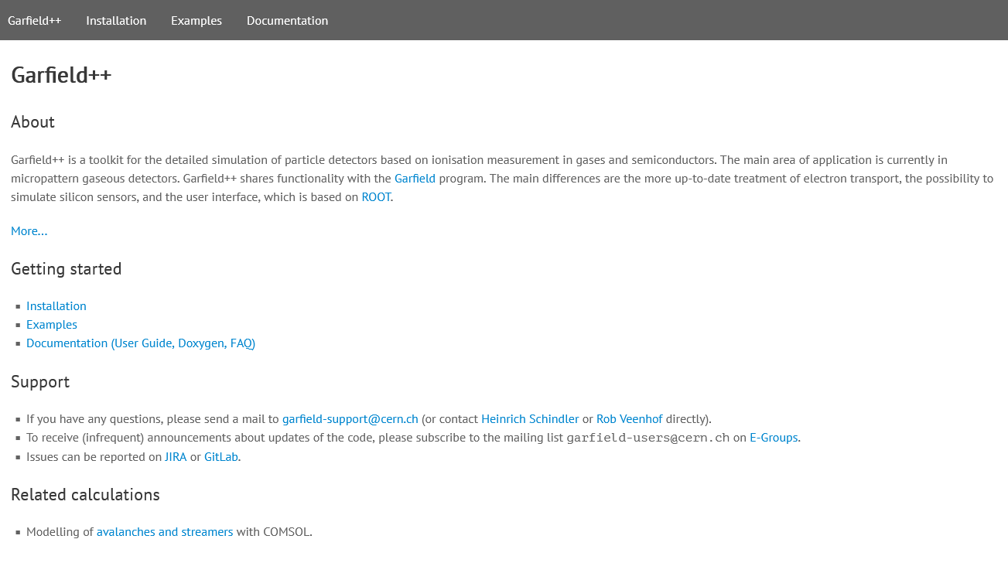
Garfield++ webpage https://garfieldpp.web.cern.ch/garfieldpp/

Slide 25
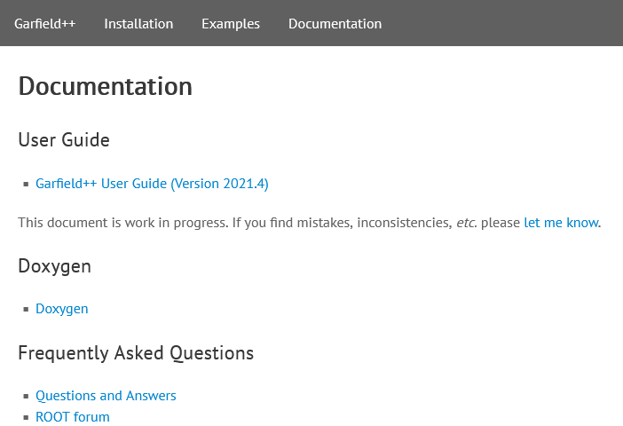
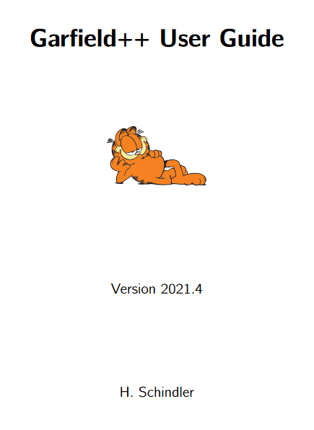
Garfield++ documentation

Slide 26
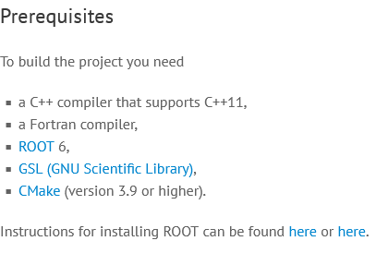
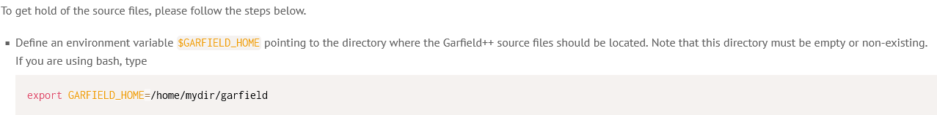

Prerequisites, installation

Slide 27
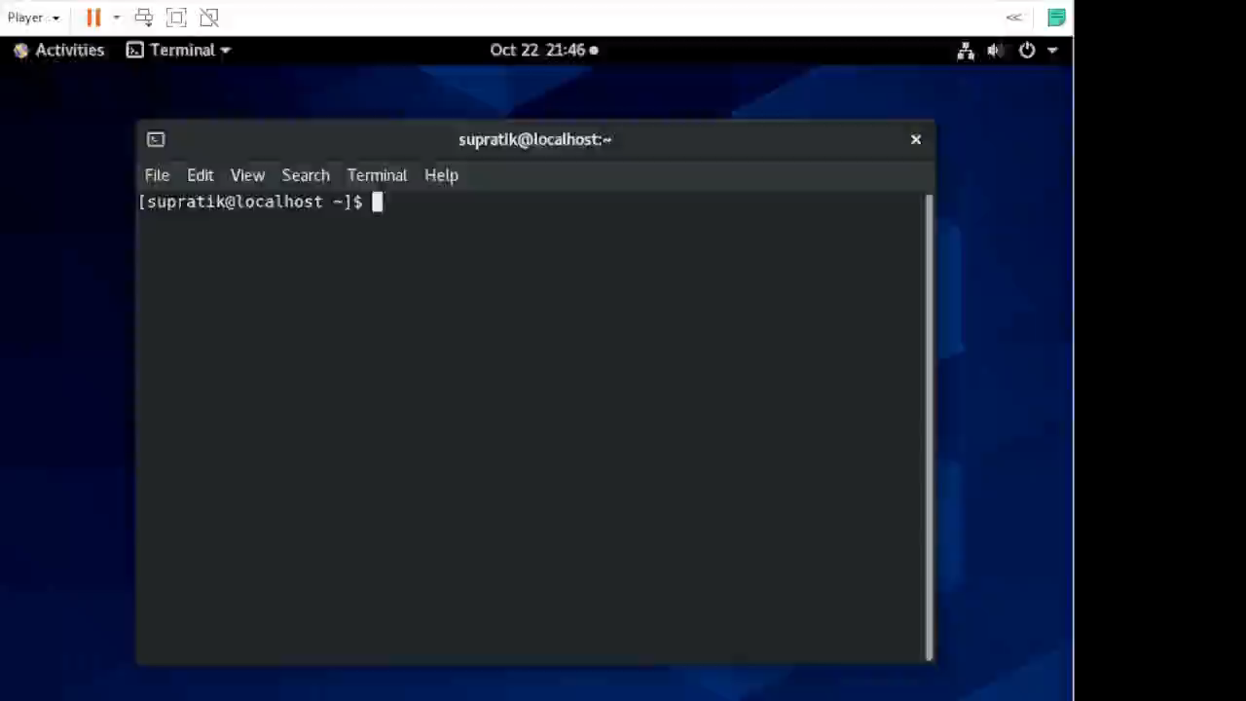
Get the code from Git

Slide 28
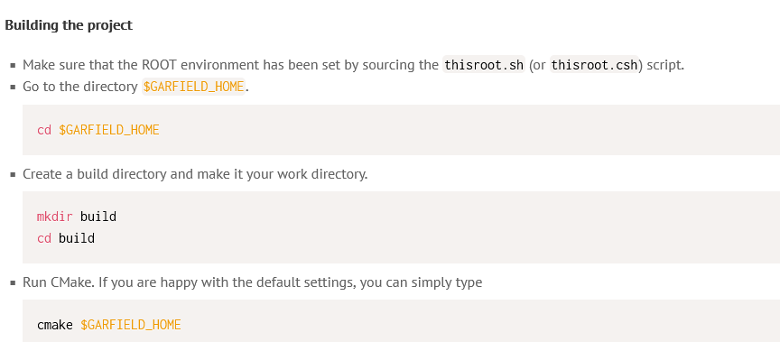
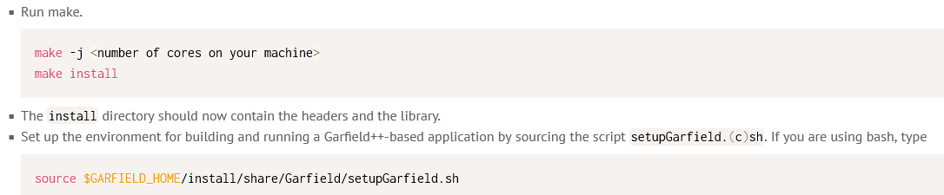
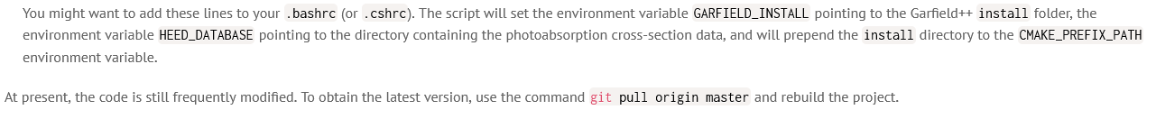
Installation

Slide 29
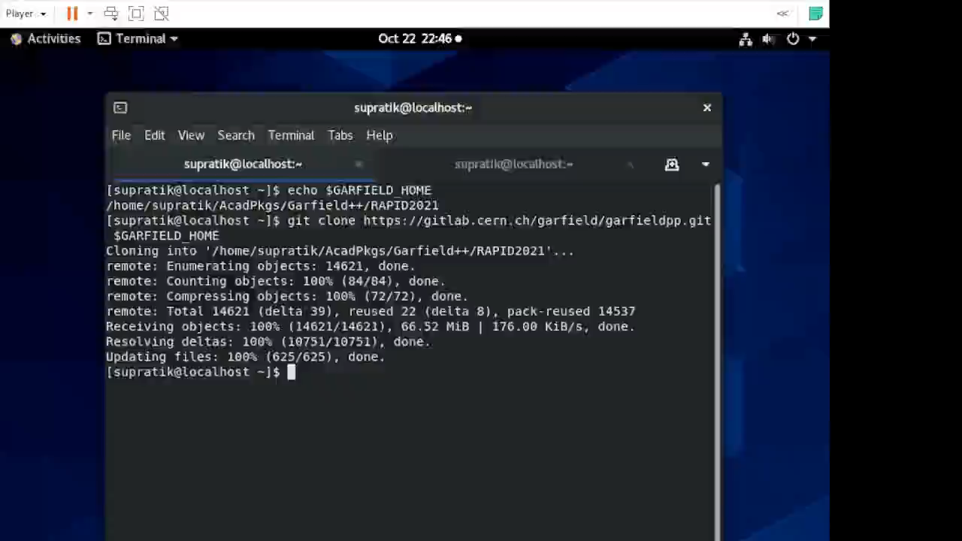
Build Garfield++

Slide 30
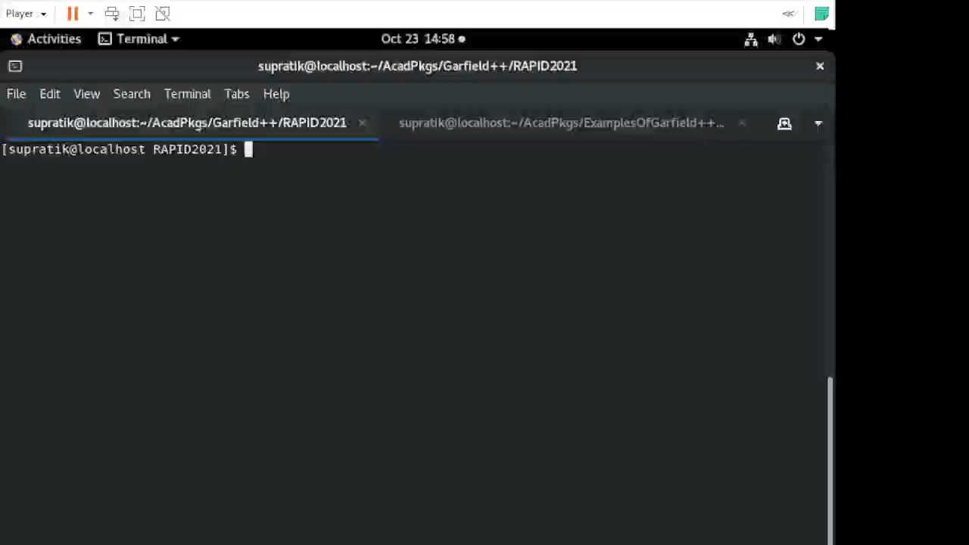
Directory structure

Slide 31
Examples
Standalone generation of transport properties
  Magboltz
Standalone primary generation
  Heed, Srim, Trim
Field-solvers
  Analytic, Ansys, Comsol, CST, Elmer, neBEM
Gaseous detectors
  Drift tube, Gem, Micromegas, RPC
Studies
  Paschen curve, gain fluctuation, signal generation
Silicon detectors
  Standalone, TCAD interfaces

Slide 32
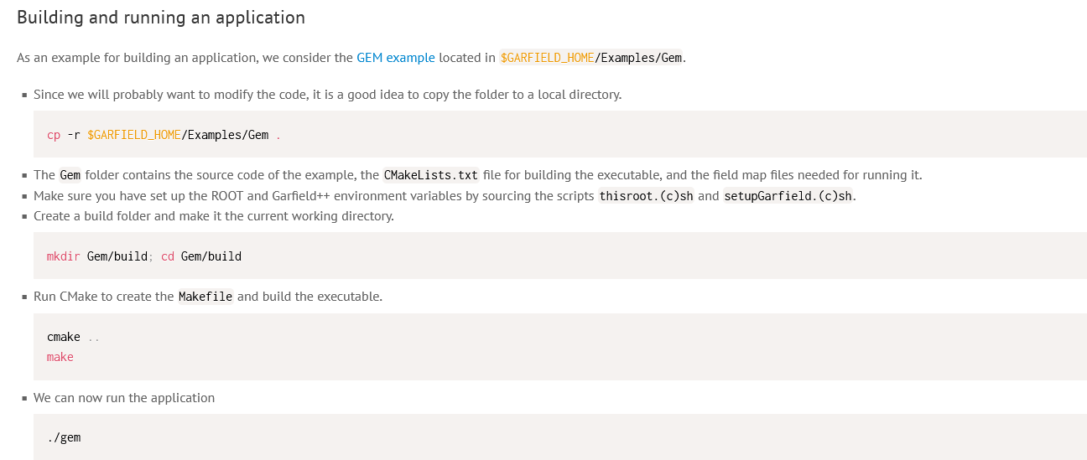
Building and running the examples

Slide 33
Garfield++ coding
Generate transport properties for a chosen gas mixture
Create device geometry, assign material properties, voltages on different electrodes
  Generate physical field maps
  Generate weighting field maps
Define sensor related details
Define avalanche process
Start Event loop
  Generate primaries
  Transport primaries and their subsequent amplifications till they are attached or goes beyond the gas volume
  Compute induced signal
Carry out other necessary analysis
Plots can be generated on the fly using ROOT and other interfaces.

Slide 34
Check out the first step transport properties
Analyse related example codes
Build them
Execute one that generates a file containing transport properties in a gas mixture
=======================================
#include <iostream>
#include "Garfield/MediumMagboltz.hh"
#include "Garfield/FundamentalConstants.hh"
using namespace Garfield;
int main(int argc, char * argv[]) {
const double pressure = 3 * AtmosphericPressure;
const double temperature = 293.15;
// Setup the gas.
MediumMagboltz gas;
gas.SetComposition("Ar", 93., "CO2", 7.);
gas.SetTemperature(temperature);
gas.SetPressure(pressure);
// Set field range to be covered by gas table
const size_t nE = 20;
const double emin = 100.;
const double emax = 100000.;
// Flag to request logarithmic spacing.
constexpr bool useLog = true;
gas.SetFieldGrid(emin, emax, nE, useLog);
const int ncoll = 10;
// Run Magboltz to generate the gas table.
gas.GenerateGasTable(ncoll);
// Save the table.
gas.WriteGasFile("ar_93_co2_7.gas");
}

Slide 35
Build and execute

Slide 36
Micromegas using Garfield++
Transport properties for Ar-CO₂ (93:7)
Micromegas geometry, assign material properties, voltages on different electrodes
  physical field maps using neBEM
  weighting field maps using neBEM
One continuous anode for signal
Monte-Carlo avalanche process
Muon event loop
  primaries due to an one GeV muon
  Transport charges
  Induced signal on the anode
Check results
Plots using ROOT

Slide 37
Transport properties
// Define materials
// Conducting medium
MediumConductor Cu;
// Gas mixture
MediumMagboltz *gas = new MediumMagboltz();
const double pressure = 760.;
const double temperature = 293.15;
gas->SetTemperature(temperature);
gas->SetPressure(pressure);
gas->SetComposition("Ar", 93., "CO2", 7.);
gas->LoadGasFile("../93Ar_7CO2.gas");

Slide 38
Device
The Micro-mesh Gaseous Structure (Micromegas) is a popular MPGD.
Invented in early 1990-s by Ioannis Giomataris, George Charpak et al.
Successfully employed in various experiments including COMPASS, T2K and proposed in several future ones, such as ATLAS.
Excellent position and energy resolution.
Can be made extremely fast (less than 25 ps has been achieved by the PICOSEC collaboration).
High efficiency, low ion back-flow.
Very low material budget.
Can be discharge prone.
Giomataris, Y.; Rebourgeard, Ph.; Robert, J.P.; Charpak, G. (1996).. NIM A 376 (1): 29–35.

Slide 39
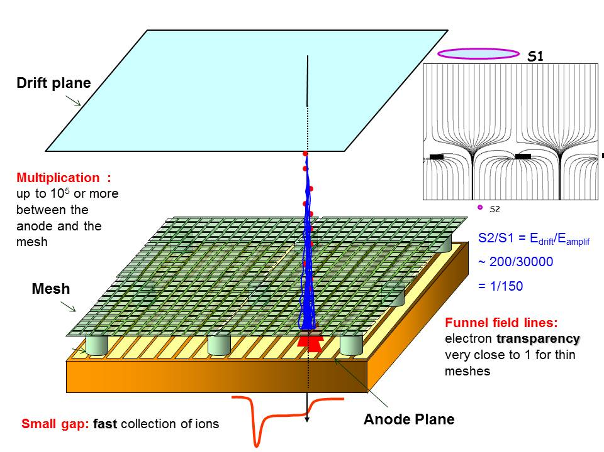
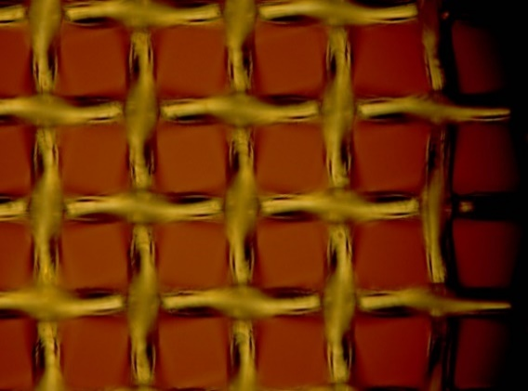
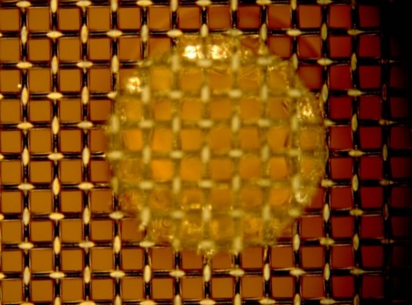
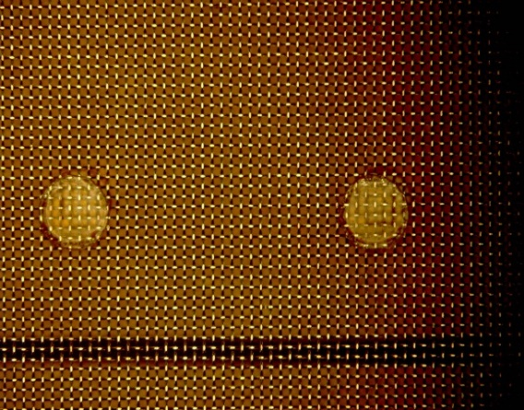
Bulk Micromegas
Mesh Hole ~ 45μm
Pitch ~ 63μm
Spacer Diameter ~ 400μm
Specifications
Active area: 10x10 cm² to several meters
Amplification gap: 64 /128 / 192 / 220 μm
SS wire diameter: 18 μm, pitch 63 / 78 μm
Spacer diameter: 400 μm, pitch 2 mm
Pitch ~ 2 mm

Slide 40
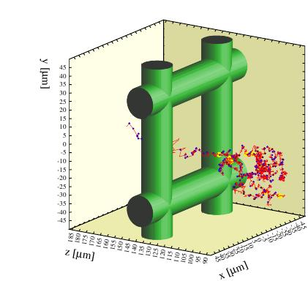
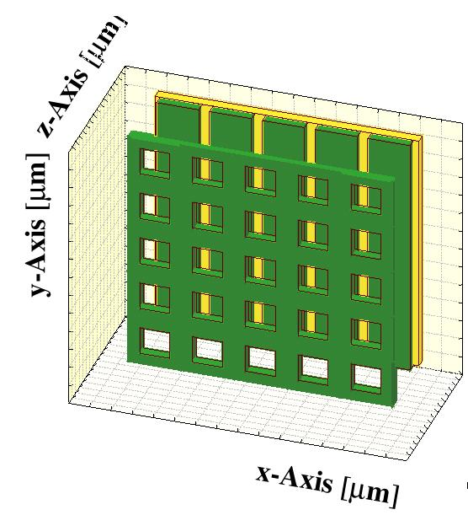
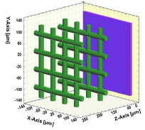
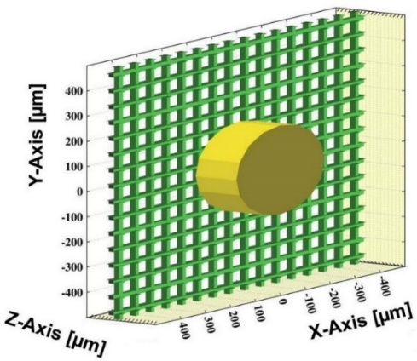
Numerical Bulk Micromegas
Model using Garfield-neBEM
A drift plane
One micromesh, or two, or more
Anode, continuous, or strips
A dielectric substrate
Spacer(s), if needed
Voltages
Notes:
40

Slide 41
Device geometry, material properties, voltage configuration
// Geometry.
GeometrySimple geo;
geo.SetMedium(gas);
// Dimensions
const double x0 = 0., y0 = 0., z0 = 0.;
const double dia = 18.0e-4, pitch = 63.0e-4;
const double ampgap = 128.0e-4, driftgap = 2000.0e-4;
const double anodeLZ = 1000.0e-4, cathodeLZ = 1000.0e-4;
double LX = 2*pitch, LY = LX;
double LZ = anodeLZ + ampgap + 2.0*dia + driftgap + cathodeLZ;
// Potentials
const double anodeV = 0., meshV = -500., cathodeV = -700.0;
// Create device
// Note that up down boxes shifted in z to weakly mimic the weaving pattern
SolidBox anode(x0, y0, z0+anodeLZ/2, LX/2, LY/2, anodeLZ/2);
anode.SetBoundaryPotential(anodeV);
anode.SetLabel("anode");
geo.AddSolid(&anode, &Cu);

Slide 42
Code for creating a Micromegas
SolidBox left(x0-pitch/2, y0, z0+anodeLZ+ampgap+dia/2, dia/2, LY/2, dia/2);
left.SetBoundaryPotential(meshV);
geo.AddSolid(&left, &Cu);
SolidBox right(x0+pitch/2, y0, z0+anodeLZ+ampgap+dia/2, dia/2, LY/2, dia/2);
right.SetBoundaryPotential(meshV);
geo.AddSolid(&right, &Cu);
SolidBox up(x0, y0+pitch/2, z0+anodeLZ+ampgap+dia+dia/2, LX/2, dia/2, dia/2);
up.SetBoundaryPotential(meshV);
geo.AddSolid(&up, &Cu);
SolidBox down(x0, y0-pitch/2, z0+anodeLZ+ampgap-dia+dia/2, LX/2, dia/2, dia/2);
down.SetBoundaryPotential(meshV);
geo.AddSolid(&down, &Cu);
SolidBox cathode(x0, y0, z0+anodeLZ+ampgap+2.0*dia+driftgap+cathodeLZ/2, LX/2, LY/2, cathodeLZ/2);
cathode.SetBoundaryPotential(cathodeV);
geo.AddSolid(&cathode, &Cu);

Slide 43
neBEM computations
// Parameters for neBEM calculations
double tgtElSize = 10.e-4;
int minEl = 3, maxEl = 7;
int xcopy = 20, ycopy = 20, zcopy = 0;
ComponentNeBem3d nebem;
nebem.SetGeometry(&geo);
nebem.SetNumberOfThreads(2);// Set no. of threads
nebem.SetTargetElementSize(tgtElSize);
nebem.SetMinMaxNumberOfElements(minEl, maxEl);
nebem.SetPeriodicityX(LX);
nebem.SetPeriodicityY(LY);
nebem.SetPeriodicCopies(xcopy, ycopy, zcopy);
nebem.UseLUInversion();
nebem.Initialise();

Slide 44
Sensor details
// Create the sensor.
Sensor* sensor = new Sensor();
sensor->AddComponent(&nebem);
sensor->AddElectrode(&nebem, "anode");
sensor->SetArea(x0-LX, y0-LY, z0+anodeLZ, x0+LX, y0+LY, z0+LZ-cathodeLZ);
// Prepare to draw signal
ViewSignal* signalView = new ViewSignal();
signalView->SetSensor(sensor);

Slide 45
Avalanche processes
// Create the charge multiplication method
AvalancheMC* avalMC = new AvalancheMC();
avalMC->SetSensor(sensor);
avalMC->EnableSignalCalculation();
avalMC->EnablePlotting(driftView);

Slide 46
Heed details
// Setup HEED
TrackHeed* track = new TrackHeed();
track->SetSensor(sensor);
track->EnableElectricField();
track->SetParticle("muon"); // Incident particle
track->SetKineticEnergy(1.0e9); // KE of the particle in eV
track->EnablePlotting(driftView);

Slide 47
Event loop
for(Int_t iEvent=0; iEvent<nEvent;iEvent++) {
clust_id = 0;
sensor->ClearSignal(); // Reset signals and free the sensor
track->NewTrack(track_x, track_y, track_z, tMin, track_dx, track_dy, track_dz);
bool clust_present=0;
do { // Loop over all the cluster positions along the track
// number of electrons in present cluster and info of each electron
int nel;
double xele, yele, zele, tele, eele, dxele, dyele, dzele;
clust_present=track->GetCluster(xcls, ycls, zcls, tcls, nel, ecls, extra);
for(int j = 0; j < nel; j++) { // Loop over all electrons in a cluster
track->GetElectron(j, xele, yele, zele, tele, eele, dxele, dyele, dzele);
avalMC->AvalancheElectron(xele, yele, zele, tele);
}
clust_id++;
} while(clust_present!=0);
…
}

Slide 48
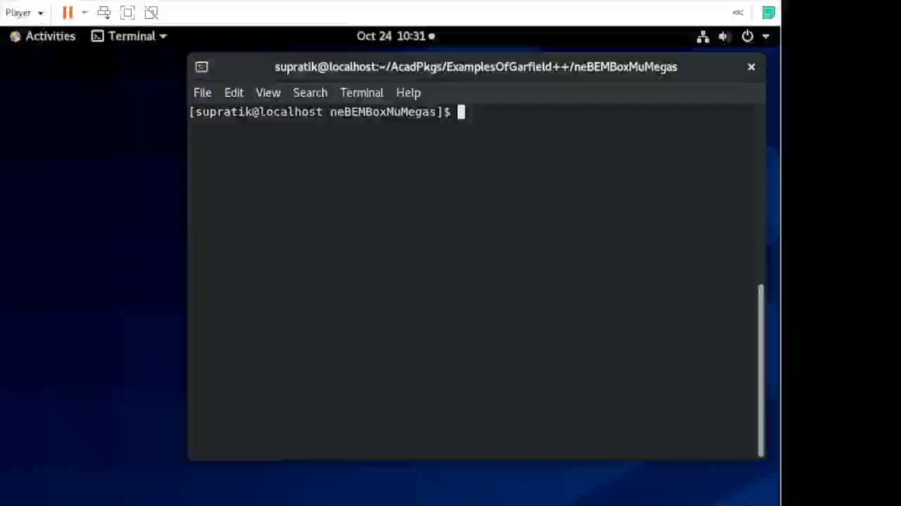
Build and execute

Slide 49
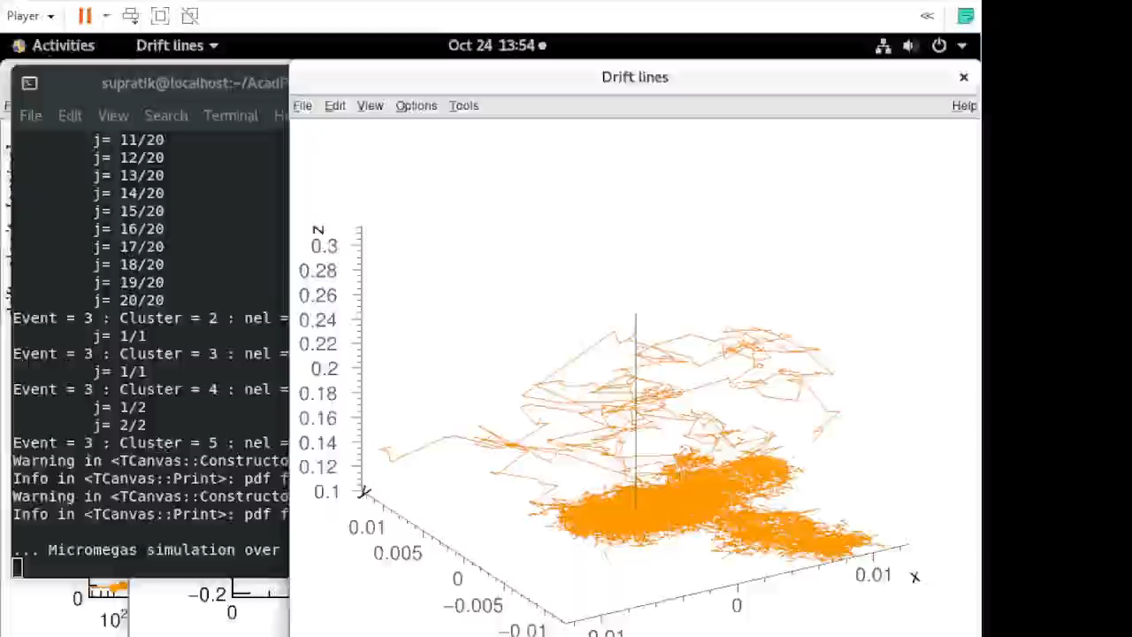
How does it end?

Slide 50
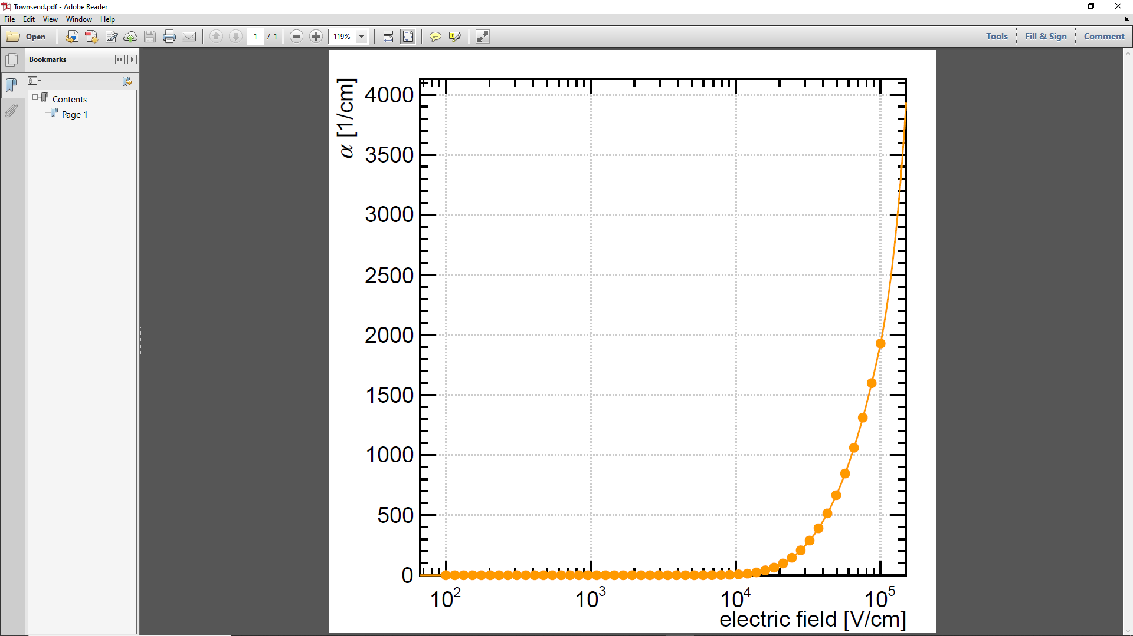
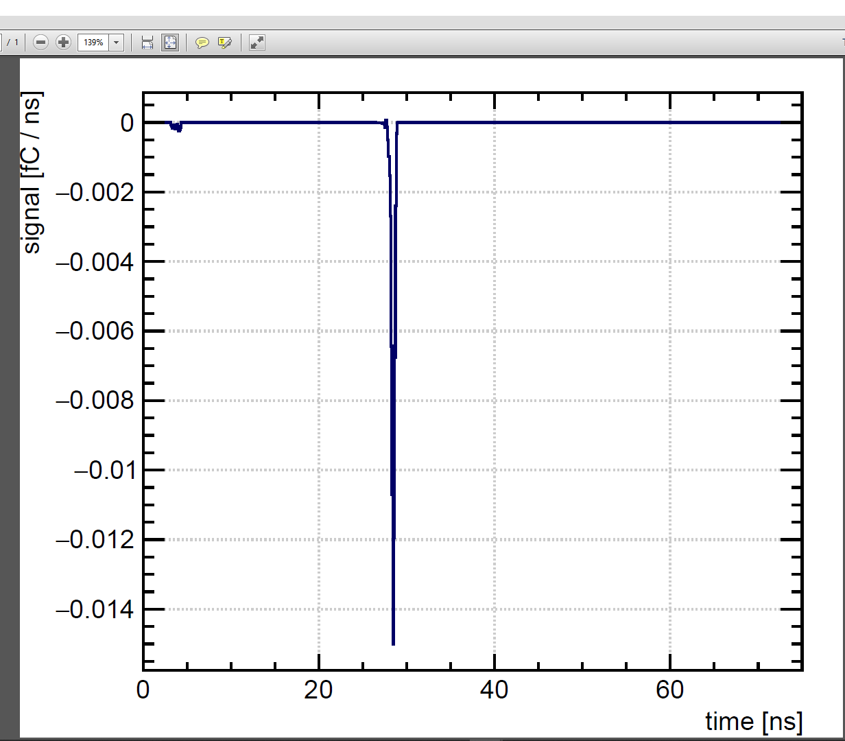
Results
Lot more data can be generated and analyzed, either offline, or within Garfield++

Slide 51
Summary and outlook

Slide 52
Summary
Numerical simulation has been introduced in the context of design and interpretation of gaseous detectors.
Attempts have been made to get an overview of some of the ways Garfield++ can be used to simulate ionization detectors.
Various components of the simulation framework have been briefly mentioned.
Garfield++ installation process has been illustrated.
Simple gas file example has been built and executed.
Signal generation of a Micromegas detector has been simulated.

Slide 53
Outlook
Calculations for gaseous detectors are steadily becoming more detailed. However, much effort is necessary to improve understanding and interpretation.
Despite the limitations, the tools are mature enough for design purposes. Please note that there are a lot more to explore in and contribute to each of these tools and large number of other options available (next slide).
Major improvements in physics modelling and computational techniques are necessary to handle more realistic problems.
Multi-Physics issues can make the work more complex, but rewarding.
Exciting times ahead!

Slide 54
Major Problems looking for Solutions
Volume and surface currents
  current through solid-state, dielectric materials, simulation of the VI curve
Charging up, Space charge
  distortion of field; reduction of ionization probability
Discharges
  causing permanent damage to detectors, electronics
Resistive layers
  spark protection, improved spatial resolution
Ageing
  insulating deposit on anodes and cathodes; formation of strong dipoles, field emissions and micro-discharges – Malter effect

Slide 55
Materials Collected From
Atsuhiko Ochi
Blum, Rolandi, Riegler
Heinrich Schindler
Igor Smirnov
Paulo Fonte
Rob Veenhof
Steve Biagi
Werner Riegler
Many others …

Slide 56
The TEAM
Deb Sankar Bhattacharya (SINP, IOP, U. Wurzburg)
Purba Bhattacharya (SINP, NISER, Weizmann, INFN, Cagliari, Calcutta University, Adamas University)
Sudeb Bhattacharya (SINP, Retd)
Tanay Dey (VECC)
Jaydeep Dutta (SINP, Univ. Libre de Bruxelles, Brussles)
Abhik Jash (SINP, NISER, Weizzmann)
Raviindrababu Karanam (IITM / TIFR)
Anil Kumar (IOP / SINP)
Vishal Kumar
Nayana Majumdar
Supratik Mukhopadhyay
Pralay Das
Prasant Kumar Rout
Project students
Promita Roy
Subhendu Saha
Mohammed Salim (AMU / TKM College of Arts & Science)
Sandip Sarkar
Muzamil Ahmad Teli (KU)
Sridhar Tripathy (SINP, York College, City Univ, NY)
Beyond SINP: Rob Veenhof, Heinrich Schindler and members of the RD51 collaboration

Slide 57
Thanks a lot!

