Slide 1
Simulating the response of a liquid scintillation detector to gamma and neutrons
RAPID 2021 workshop
by
Sudipta Das
NISER, HBNI
OUTLINE:
Motivation
Geant4: The simulating platform
Simulating gamma & neutron response to EJ-301 detector
Unfolding of Am-Be neutron spectra
Summary

Slide 2
Motivation
In dark matter detection experiment or in any rare event search experiment, it is necessary to understand the background signals.
Neutrons are one of the most important contributors to background signals. They can easily mimic WIMP(Weakly Interacting Massive Particle) signal. Hence It is important to understand the neutron background thoroughly.
In our neutron detector laboratory at NISER, we have liquid scintillation detector that can detect fast neutrons.
This work aims for the complete simulation of the liquid scintillation detector, comparing results with experiments and unfolding the neutron spectra.
1/14

Slide 3
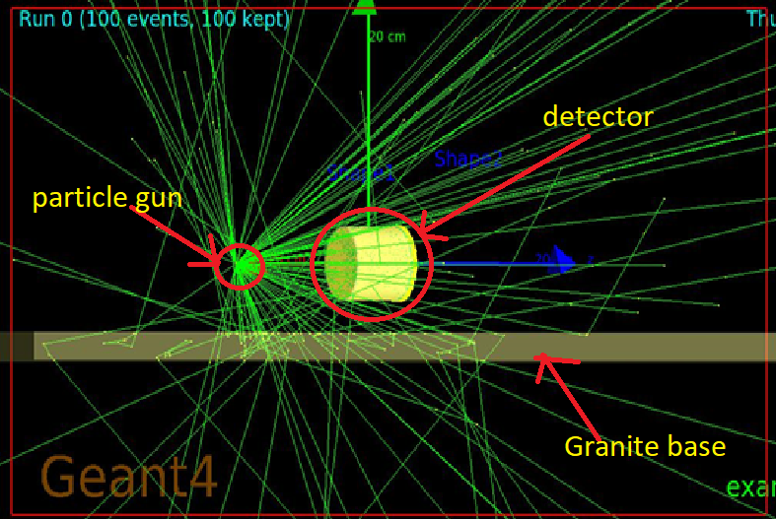
GEANT 4: The simulating platform
GEANT4 --> toolkit for the simulation of the passage of particles through matter.
Cover wide variety of particles and wide energy range.
Application area--> High energy physics and nuclear experiments, medical, accelerator and space physics studies etc.
Run
Events
Track
Complete simulation process
Step
Trajectory of each particle in an event
Changes under reflection, refraction, scattering etc
Multiple events =1 run
2/14

Slide 4
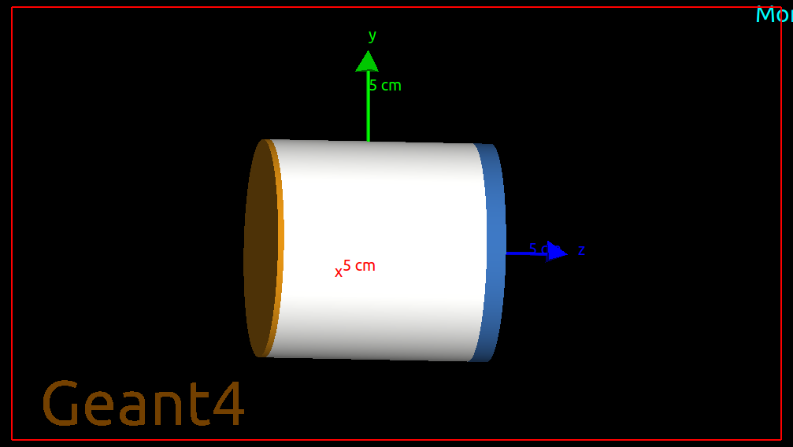
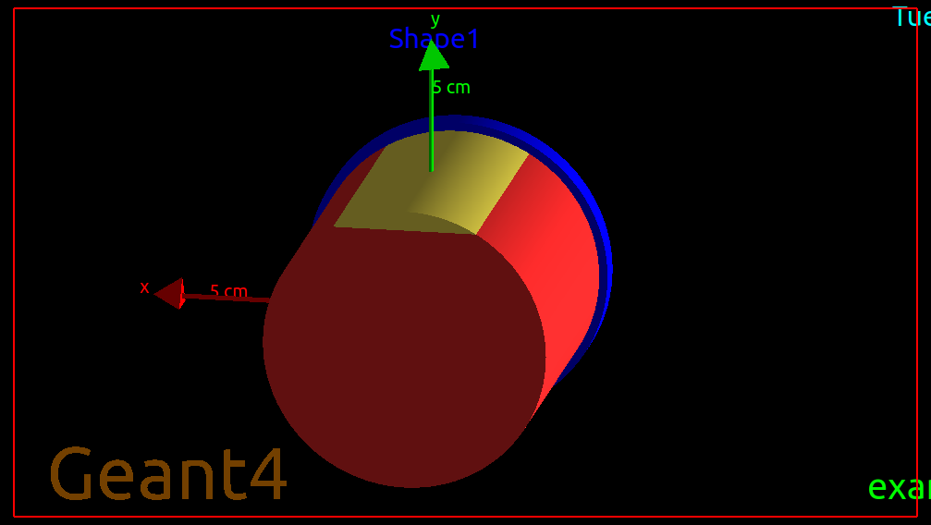
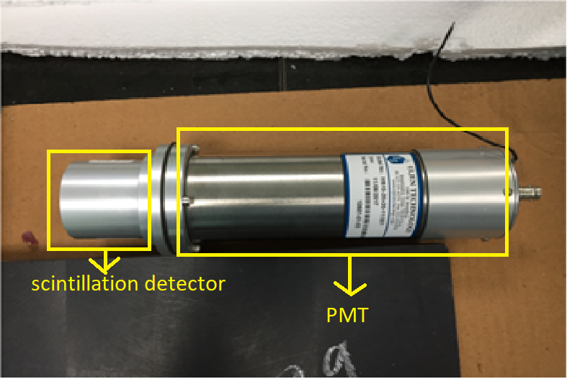
Constructing EJ-301 detector geometry in Geant4
Scintillation detector : Based on the scintillation(optical photon generation) properties of material.
The Liquid scintillation detector we are using is manufactured by Eljen technology. Commercial name: EJ-301
Inner radius(R1)=25.5mm
Outer radius(R2)=27 mm
Height(H)=50.8 mm
Front side Al cap width=1.5mm
Glass window width=4.8 mm
Liquid scintillation material(97%)
Argon (3%)
Real detector (EJ-301) coupled to PMT
3/14

Slide 5
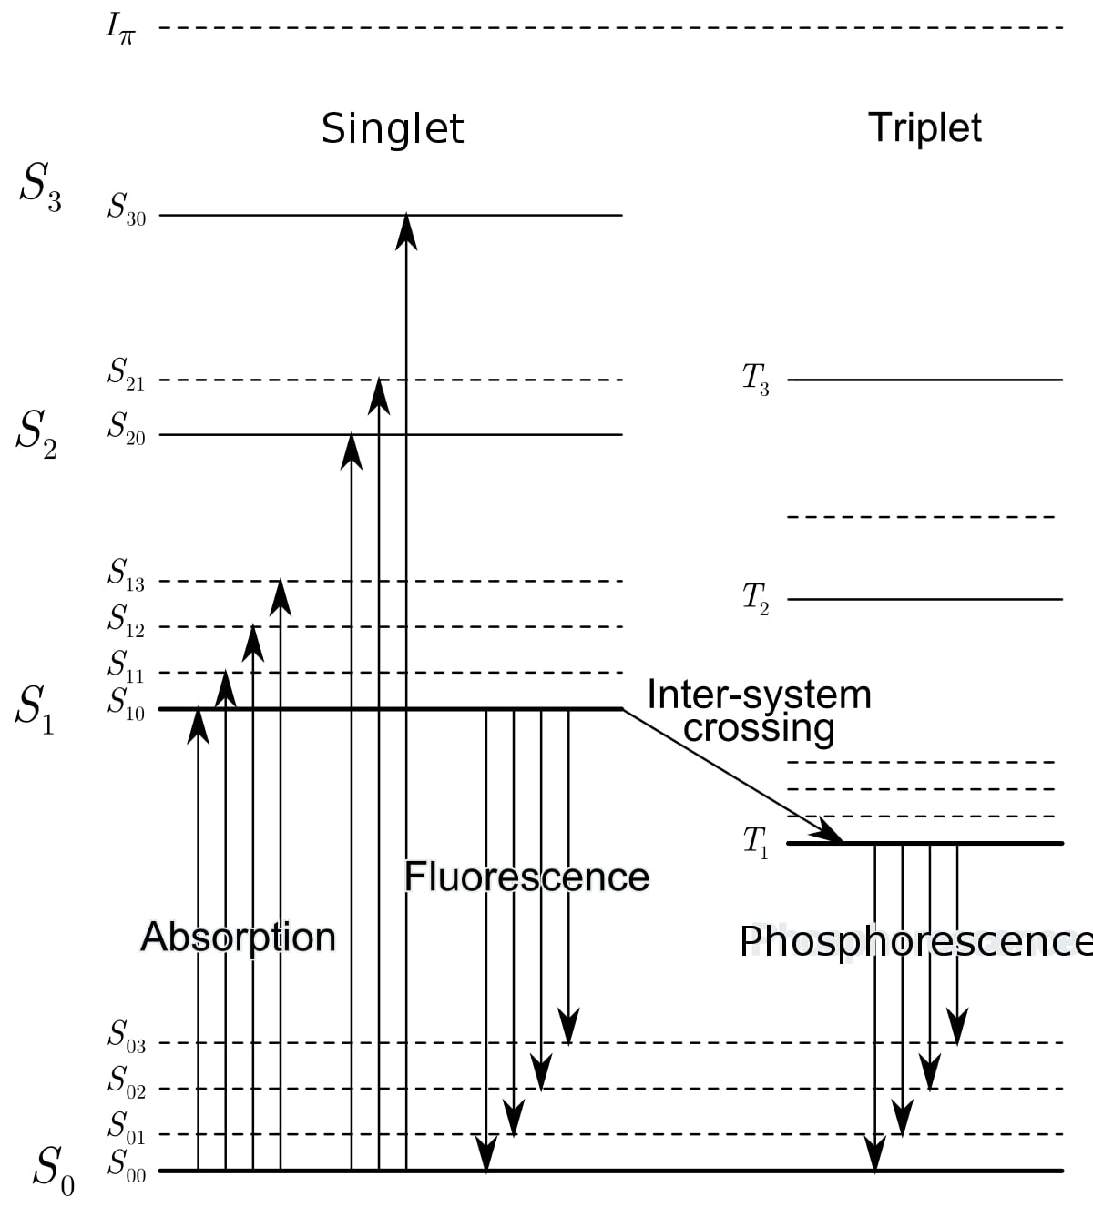
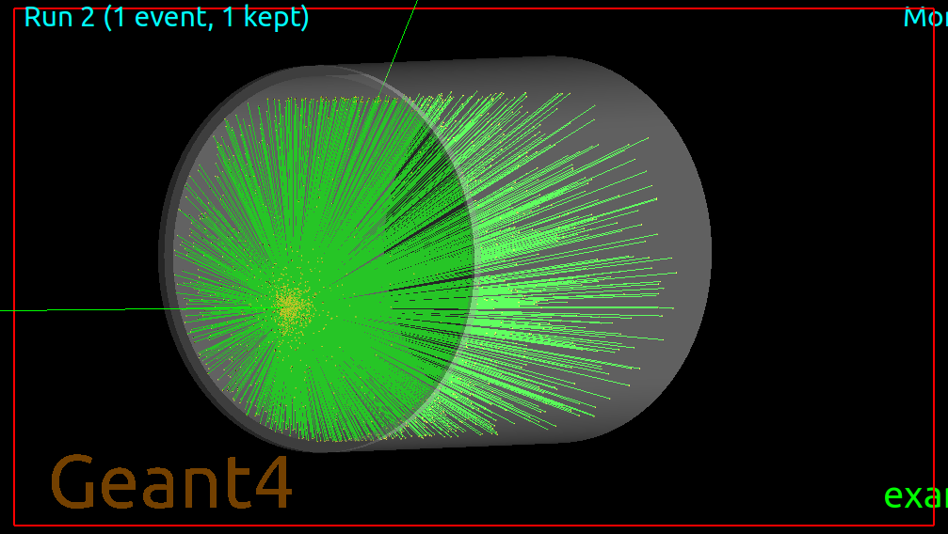
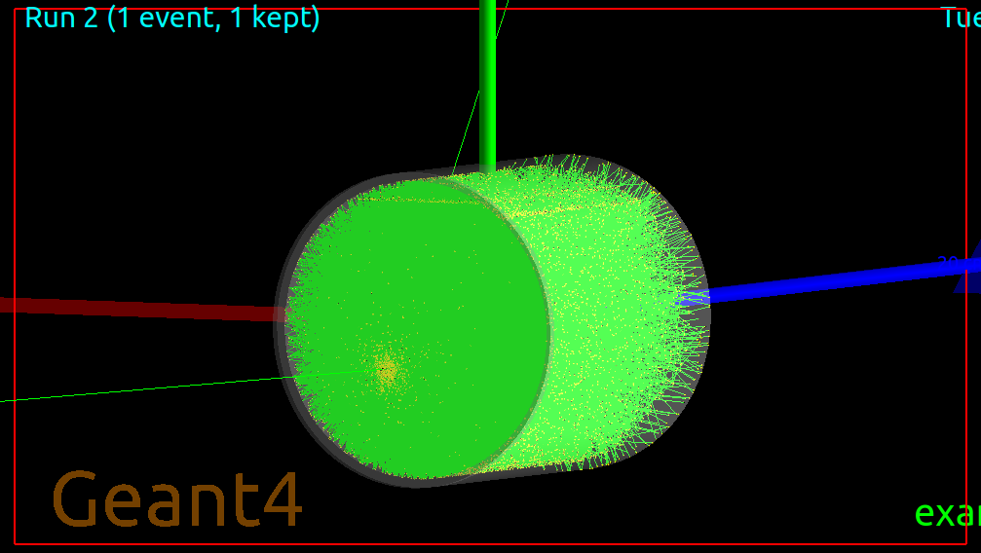
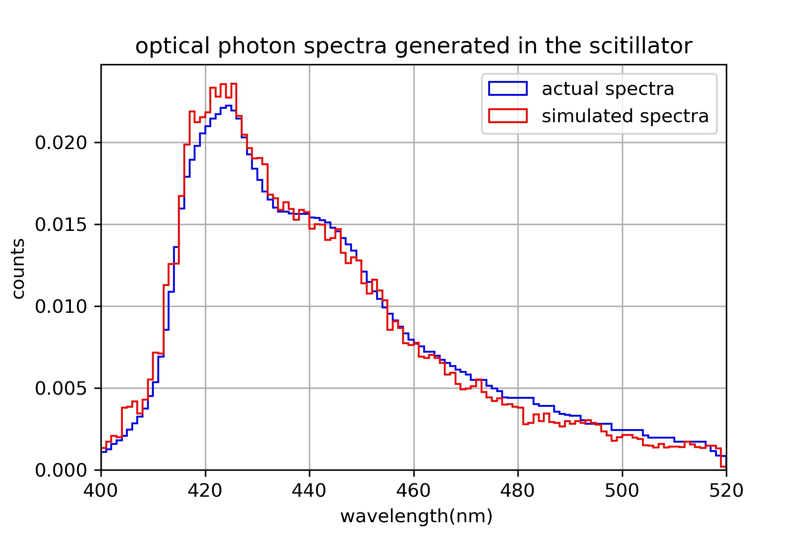
Invoking physics of scintillation
DOI:10.13140/RG.2.2.25287.29605
Scintillator: deposited energy--> excitation of electrons--> de-excitation
-->optical photons(12000 photons/MeV)
Resolution of material.
Adding boundary properties:
Cylinder-Scintillator (metal-dielectric), Disc-Scintillator(metal-dielectric), Scintillator-Argon (dielectric-dielectric), Argon-Cylinder (metal-dielectric)
G4OpticalPhysics() used to simulate optical photons
Without surface property
With surface properties
4/14

Slide 6
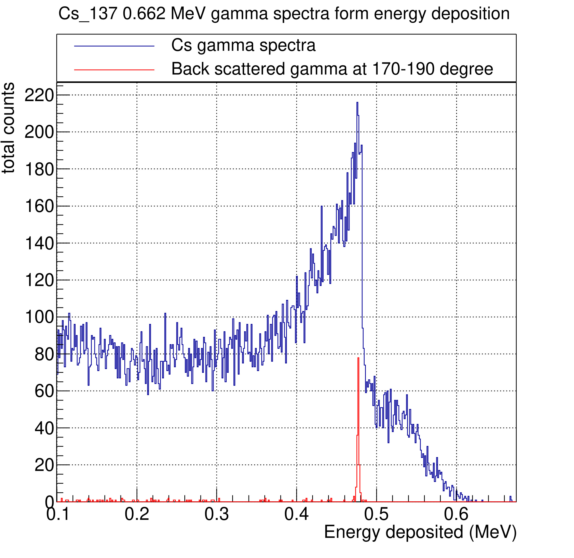
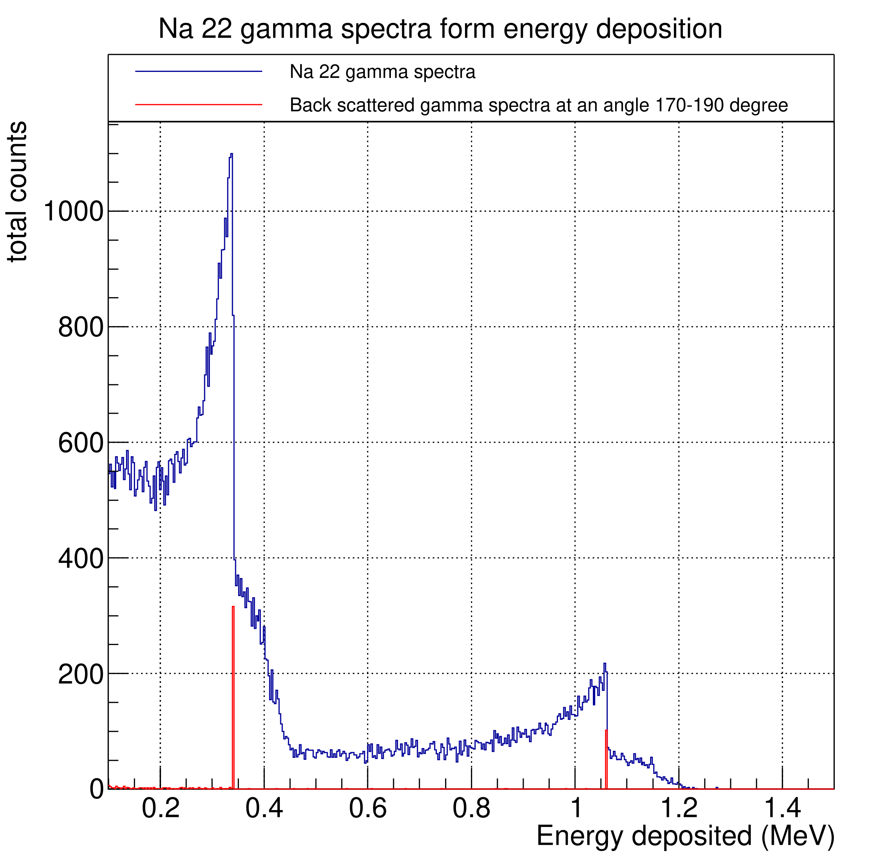
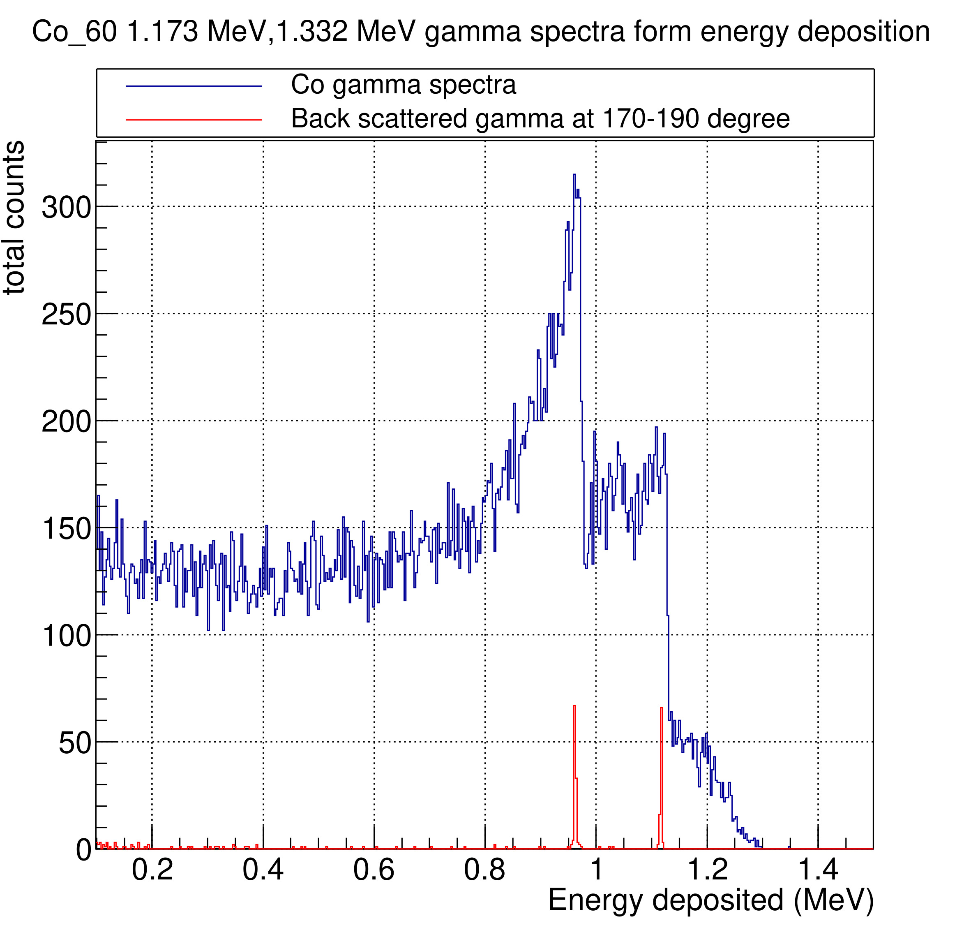
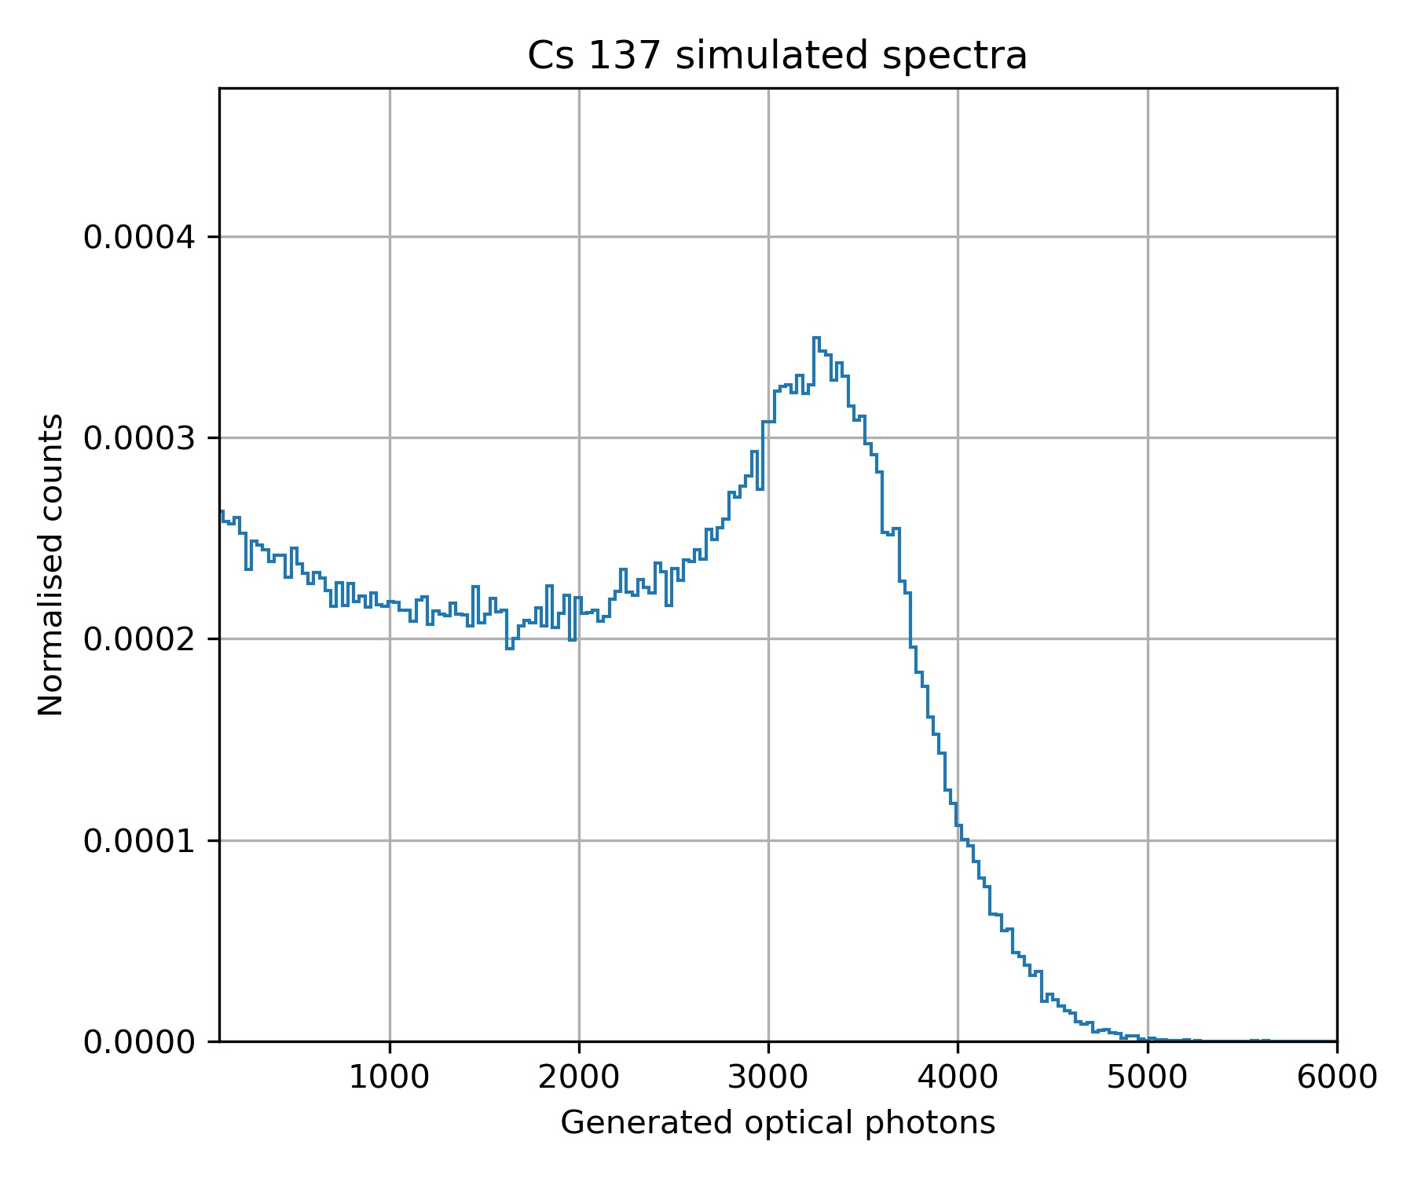
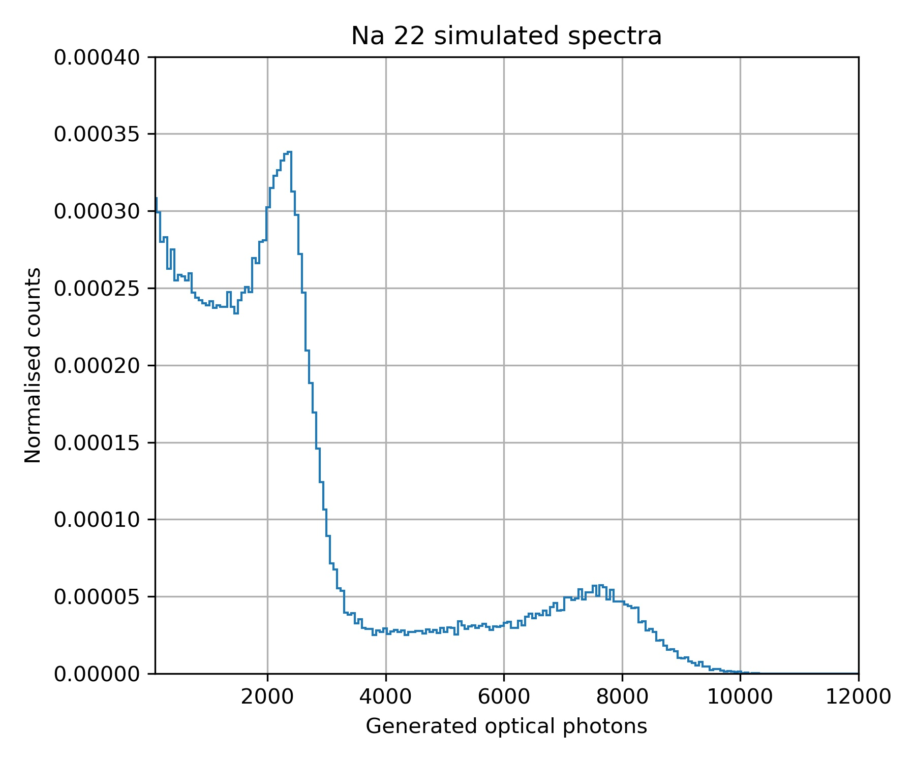
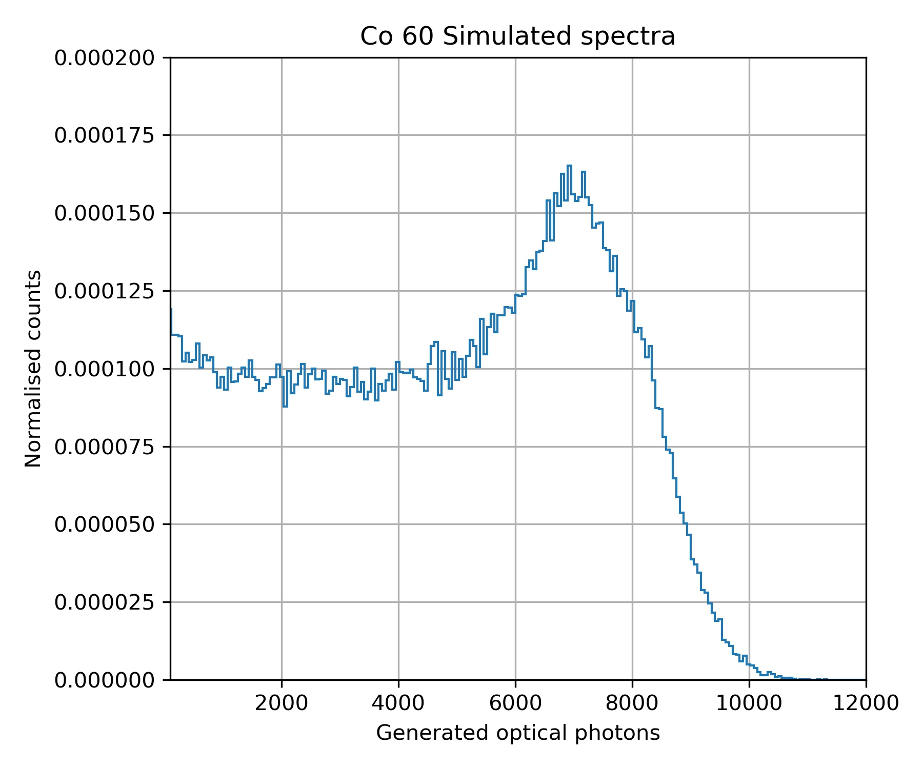
Simulated gamma spectra for Cs 137, Co 60 and Na 22
Simulated gamma spectra from energy deposition:
Simulated gamma spectra due to optical photon generation:
In real detector we see such smeared spectra instead of sharp Compton edge due to resolution of scintillator.
5/14

Slide 7
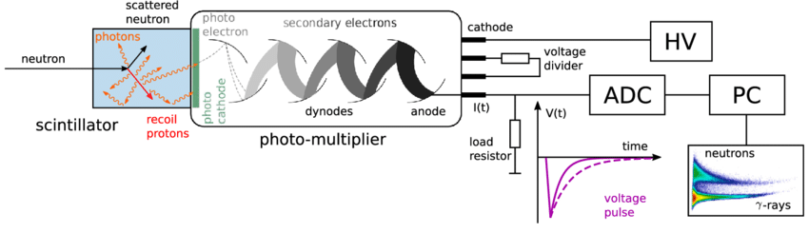
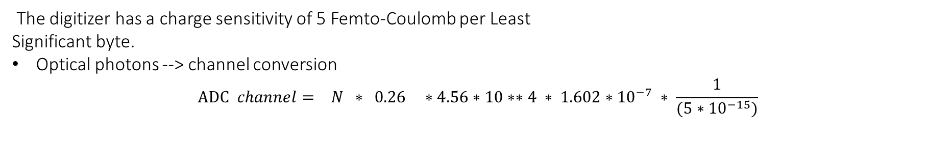
Digitization of spectra
Collected photons
Photo cathode(Quantum efficiency 26 %)
Undergoes through dynodes
1 e- ≡ 4.56*10**4 e-
Accumulation of charge
14 bit ≡ (2**14 -1) =16383 channel
Digitization
Total charge (in pC)
DOI:10.1007/s10894-019-00212-w
The digitizer has a charge sensitivity of 5 Femto-Coulomb per Least
Significant byte.
Optical photons --> channel conversion
$$ADC channel= N ∗ 0.26 ∗4.56∗10∗∗4 ∗ 1.602∗{10}^{−7} ∗ \frac{1}{(5∗{10}^{−15})}$$
=optical counts*0.38
Optical counts in an event
Dynodes
multiplication
Charge conversion in
pC
Charge sensitivity
Quantum efficiency
6/14

Slide 8
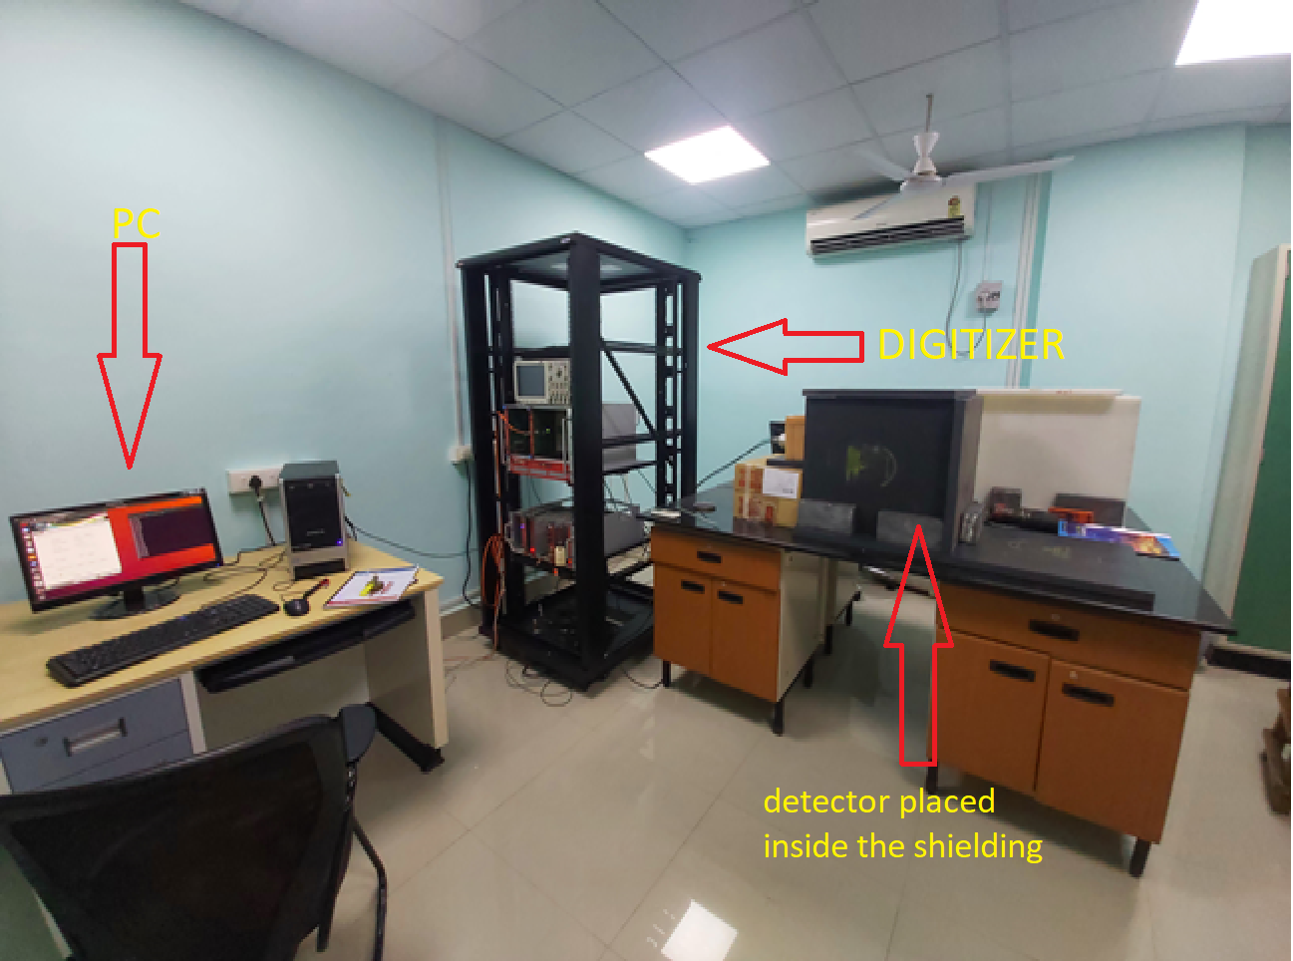
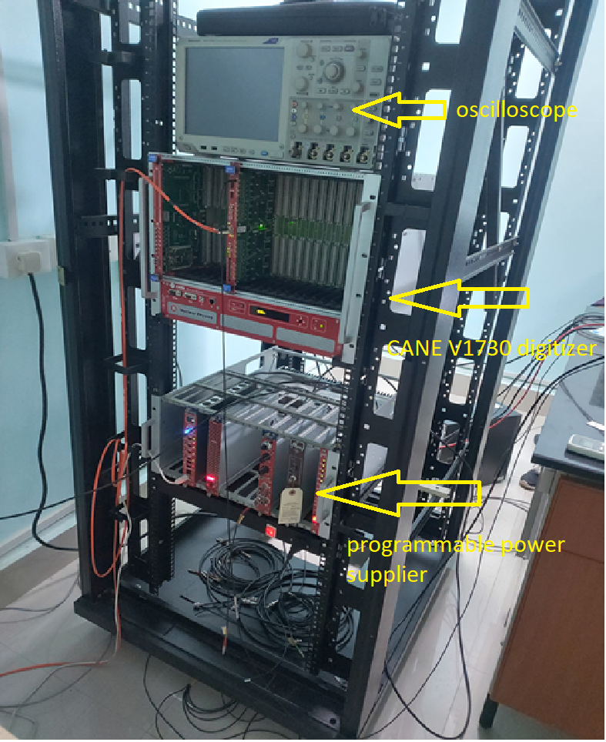
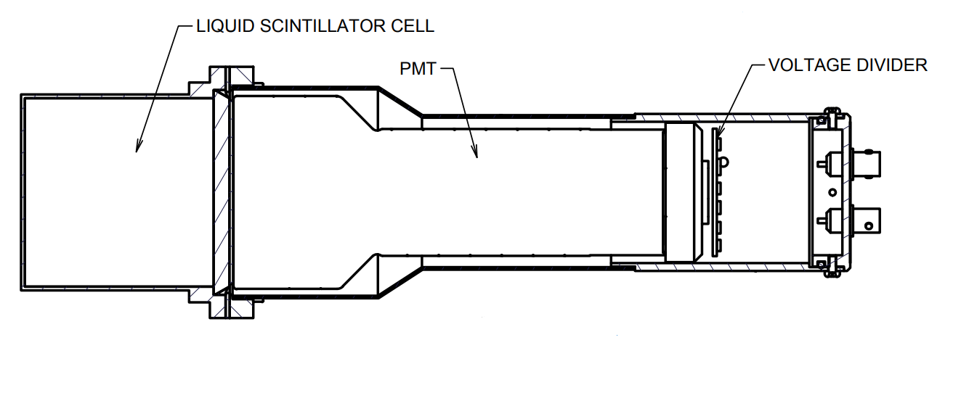
Experimental setup
\
https://eljentechnology.com/19-products/liquidscintillator
7/14

Slide 9
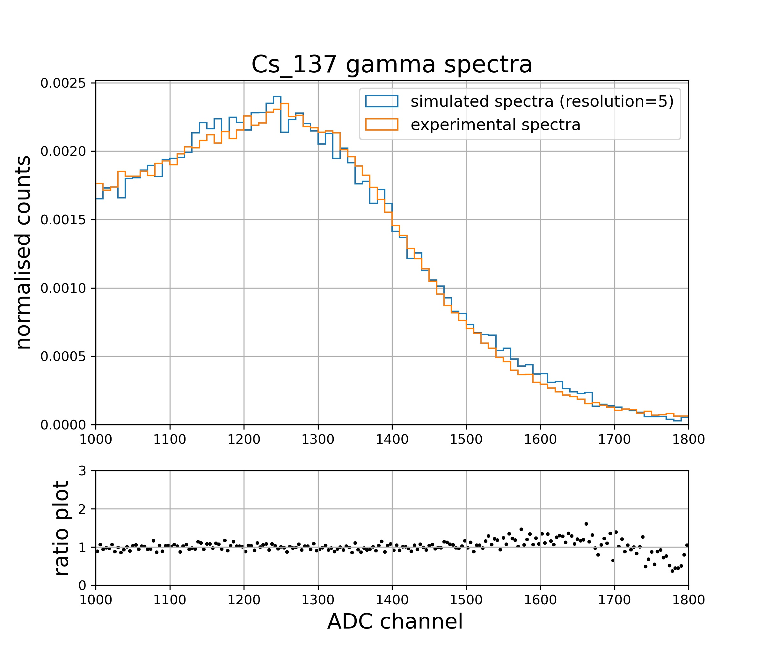
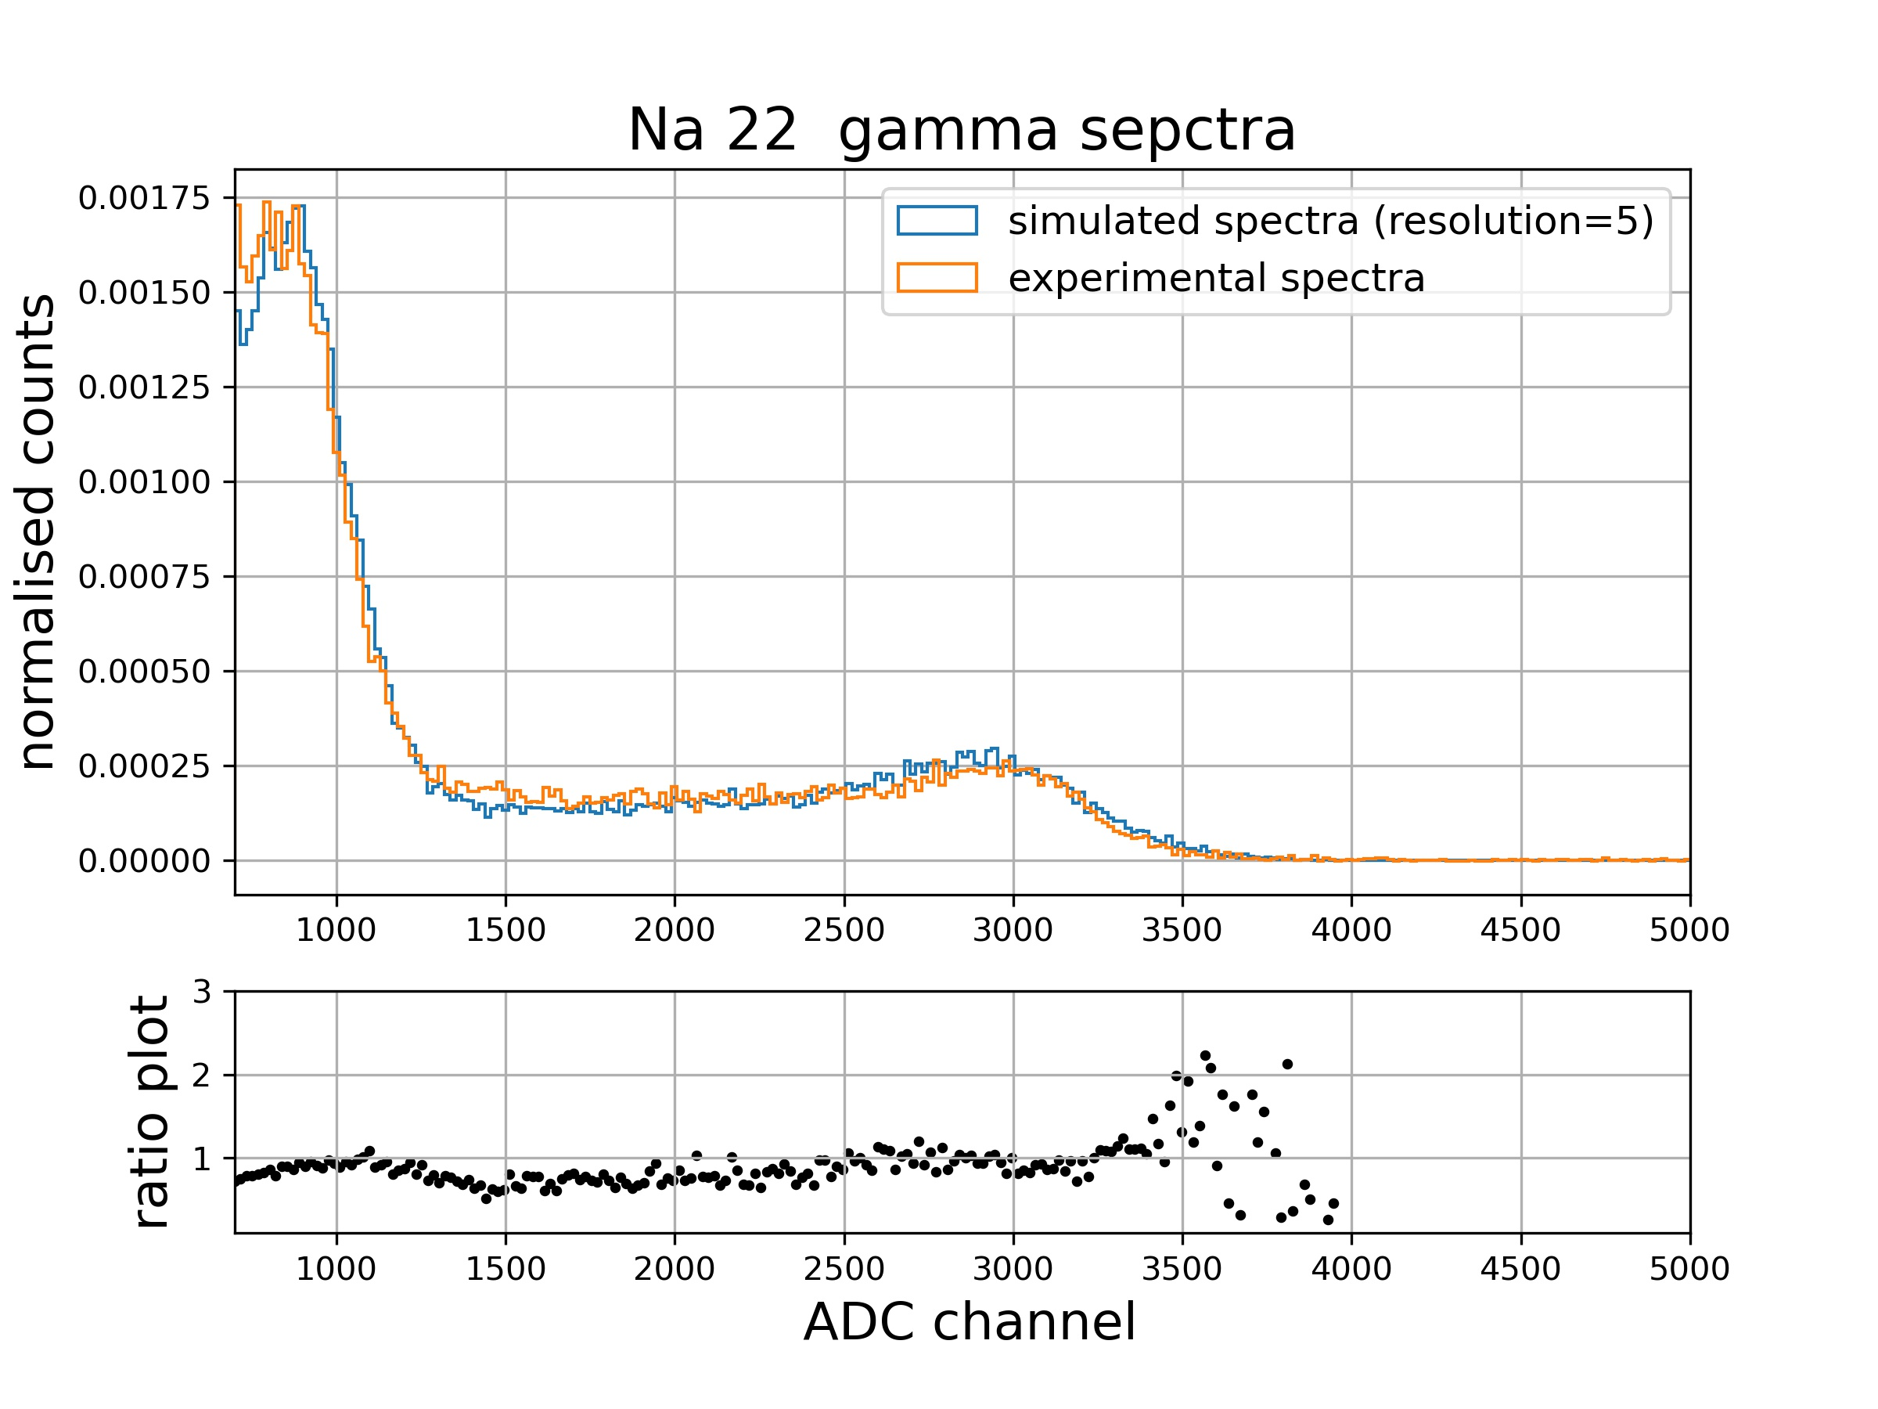
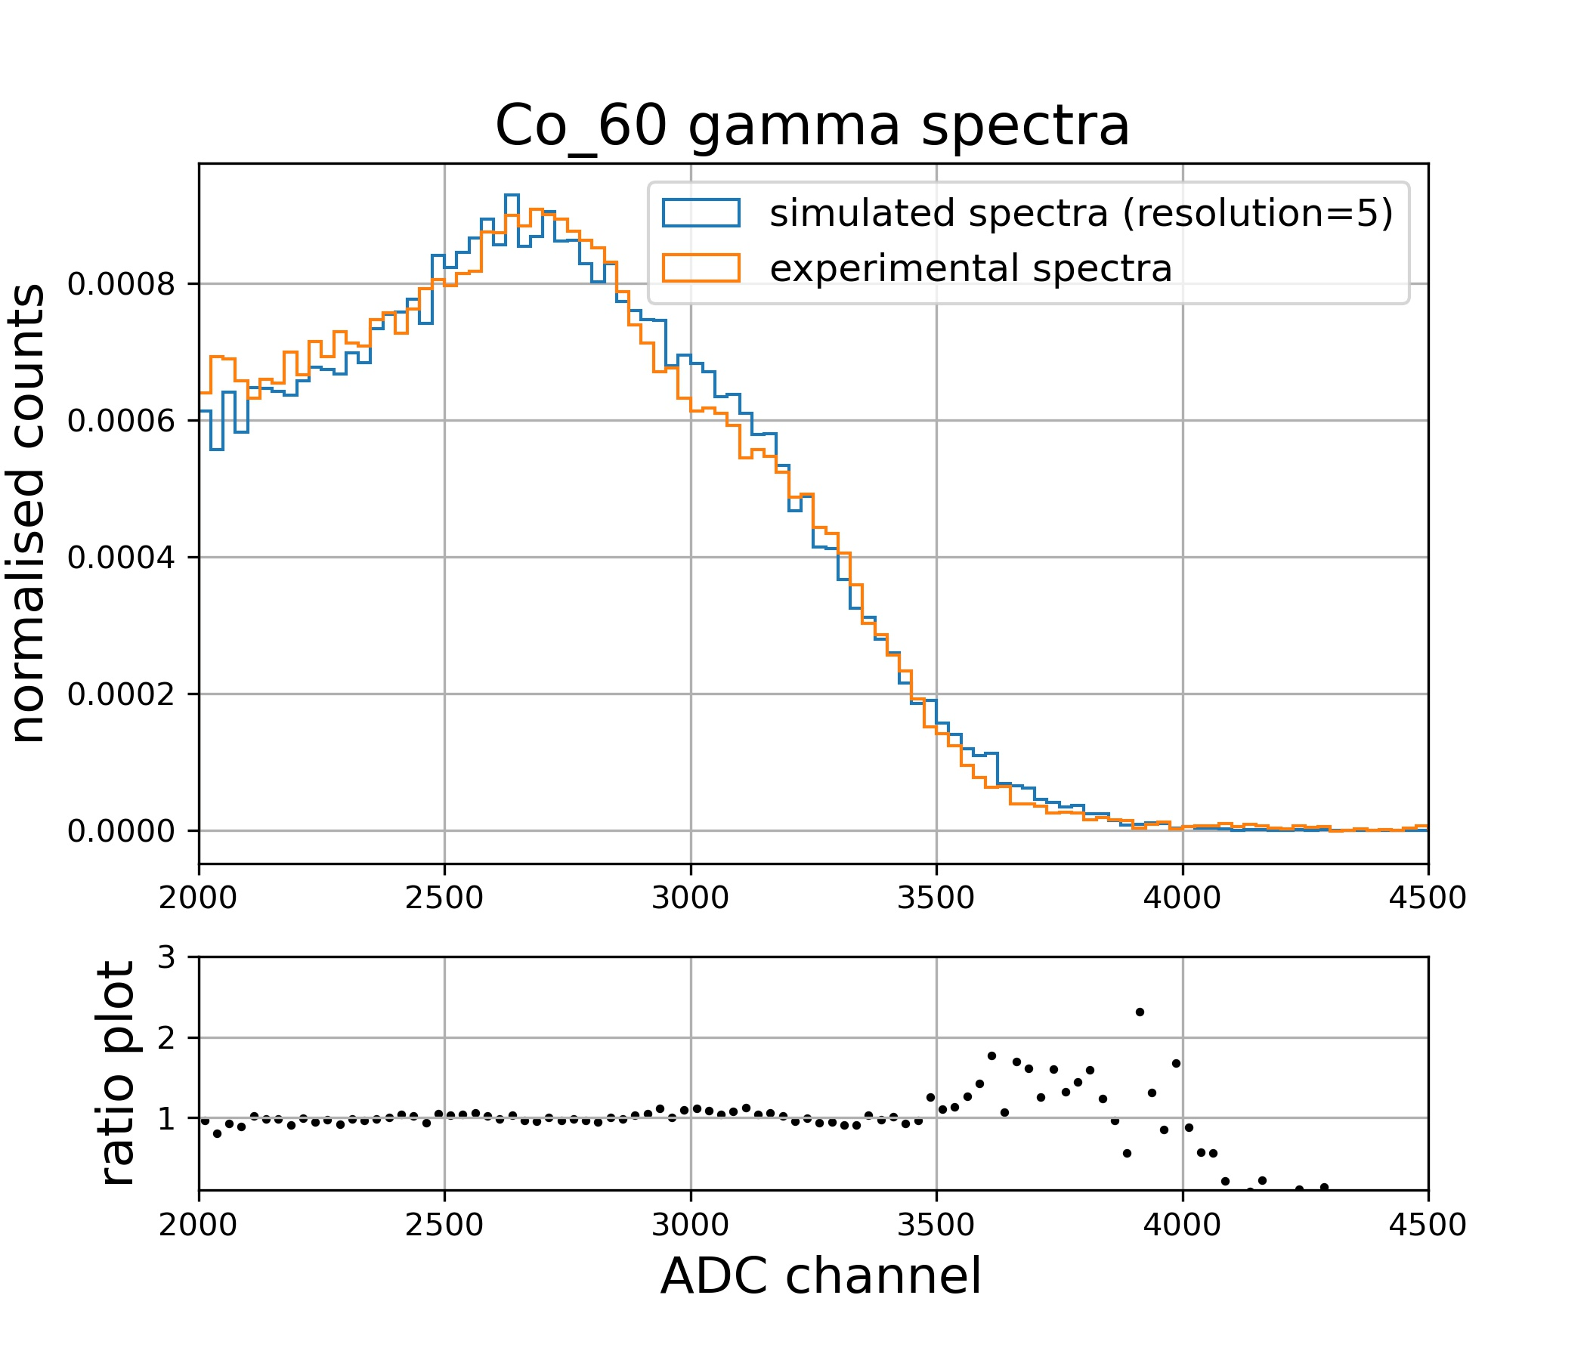
Comparing simulated and experimental gamma response
Excellent agreement between simulated and experimental spectra
8/14

Slide 10
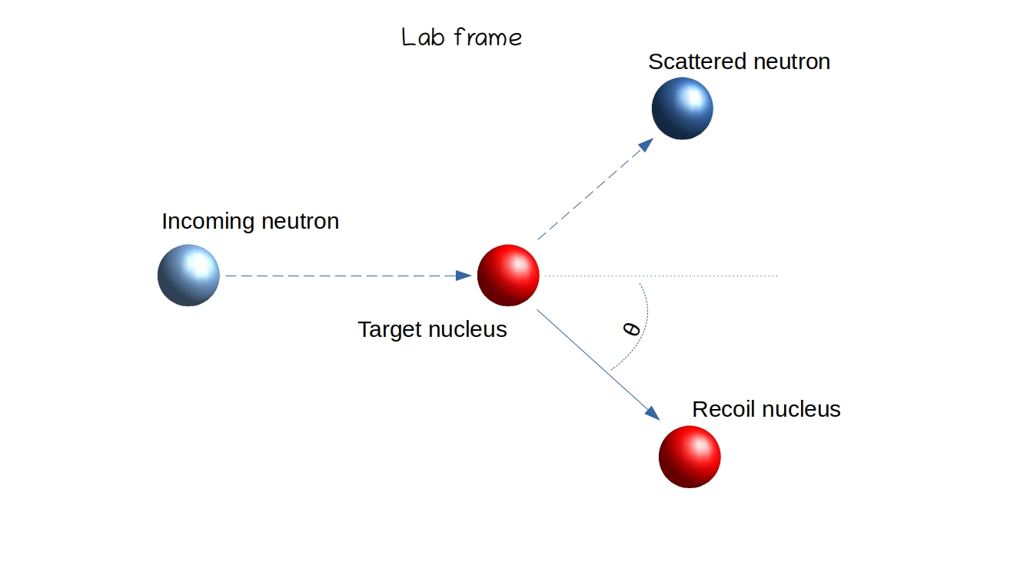
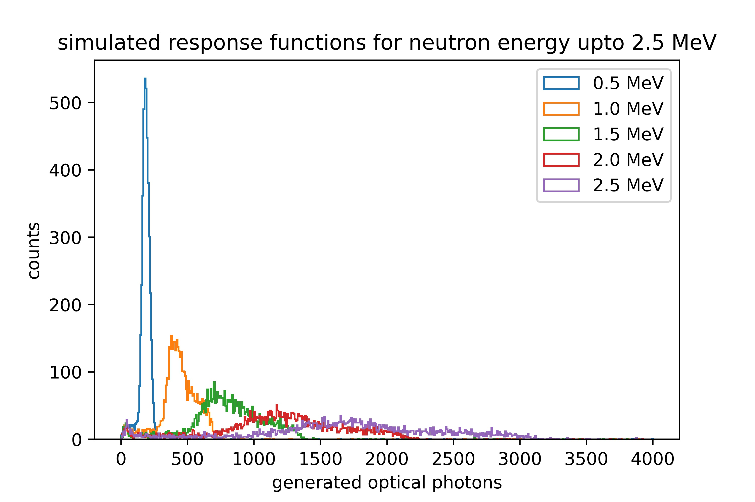

Simulating mono-energetic neutron response
Neutron → collides with detector nuclei → recoiled nuclei deposit energy in scintillator → excitation of molecular electron → optical photon generated
Scatters both elastically and inelastically with matter
Inelastic collision(>1MeV neutrons) --> excitation of detector nuclei--> production of gamma rays
Max energy transfer→ $m_{n}=m_{p}$ → This is why hydrocarbon is taken as scintillator (abundances of proton)
Data driven model
Hadronic physics: G4HadronPhysics()
High precision neutron physics : G4NEUTRONHP()
Higher the neutron energy --> more number of physics process ( elastic, inelastic, electromagnetic, radioactive decay )--> more the spread in optical photons counting
9/14

Slide 11
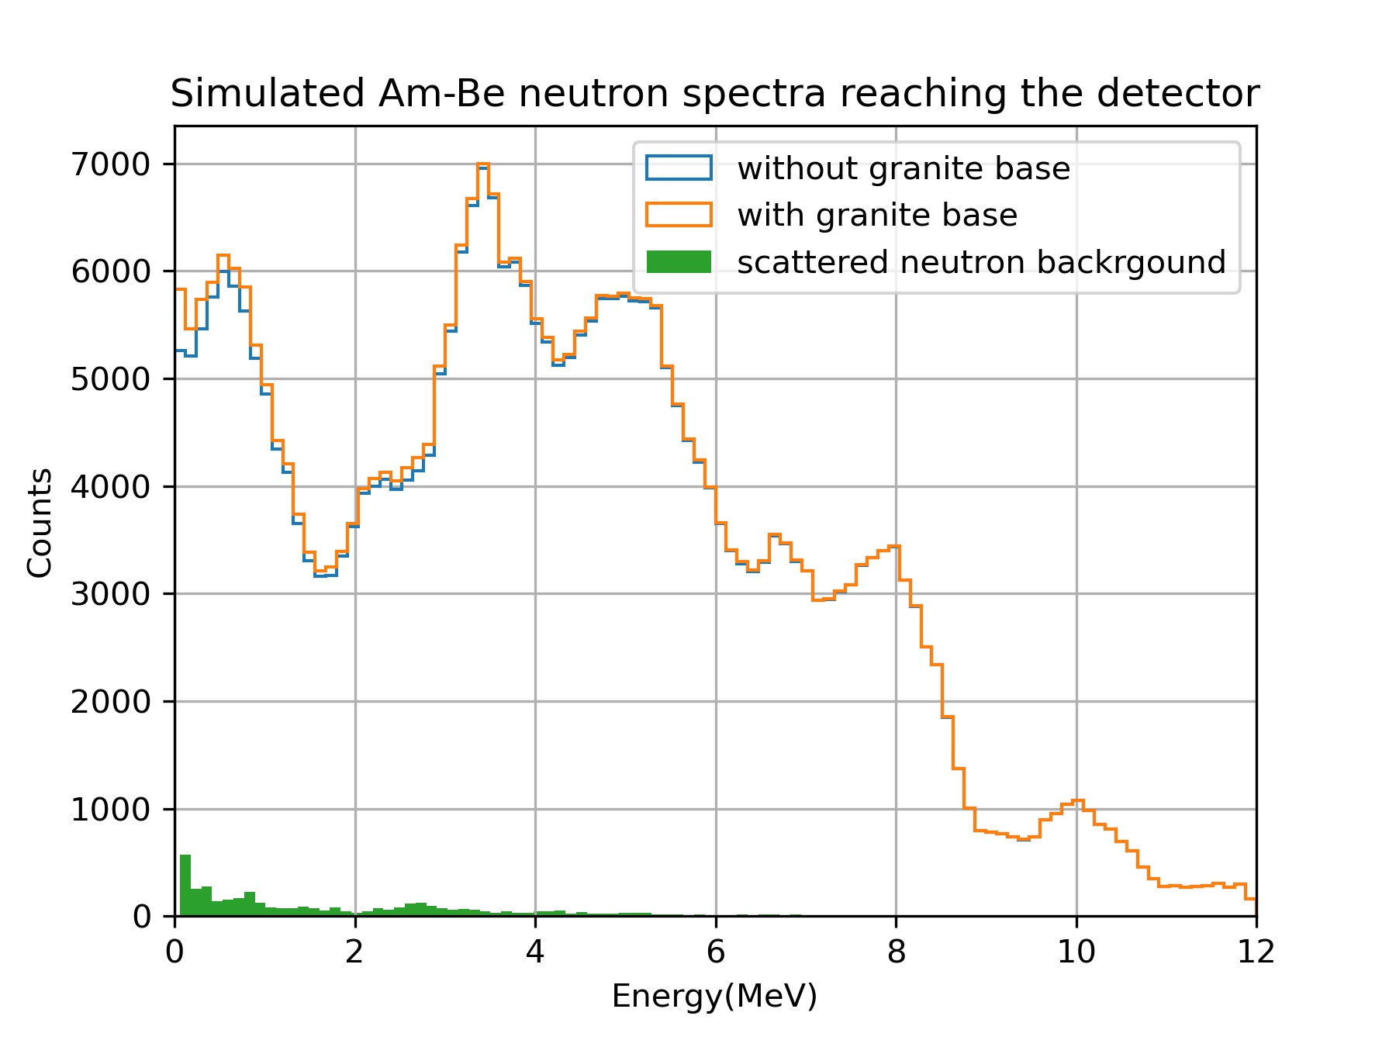
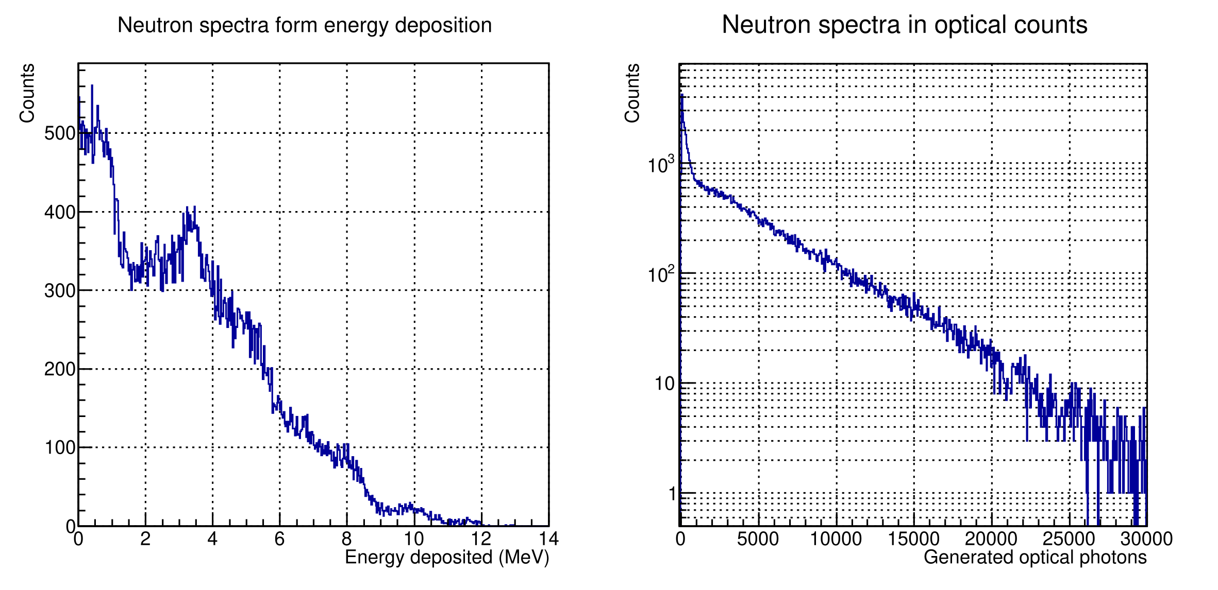


Simulating Am-Be neutron response
$Am_{ }^{241},Be^{9} source$
$T_{\frac{1}{2 }}=432.2 yr$
$Am^{241}→{Np}_{ }^{237}+He^{4}+γ(59.5 KeV)$
$Be^{9}+He^{4}→C^{12 ∗ }+n^{1}+γ$
$C^{12∗ }→C^{12}+γ\left(4.43 MeV\right)$
Neutron‹K.E›=4.5 MeV
Am-Be neutron spectra has a specific energy distribution
Neutrons with such energy spectra are made to fall on the detector
All the optical properties of the scintillator were kept
Nature of the simulated spectra is similar/consistent with the experimental spectra taken in our lab (analysis ongoing)
Simulating
response
10/14

Slide 12
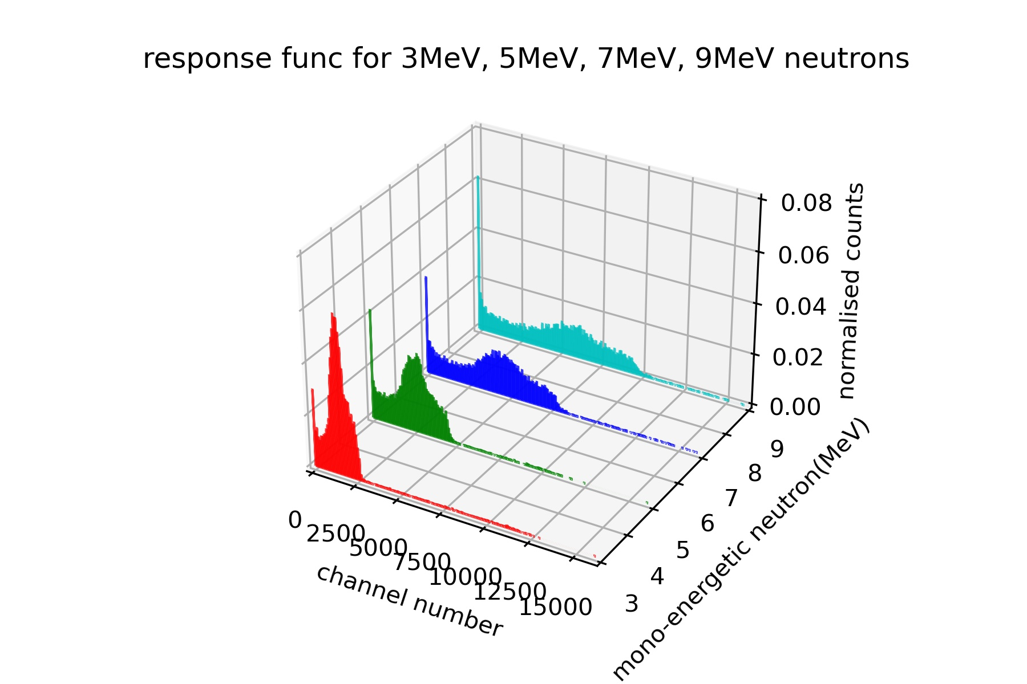
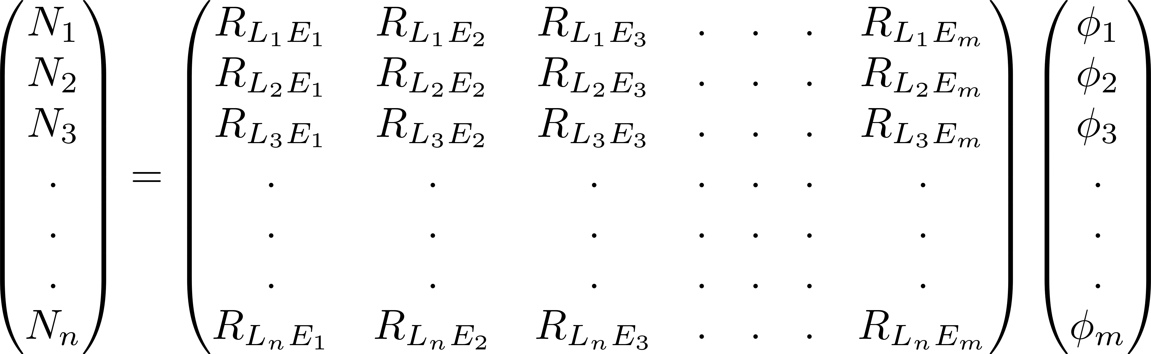
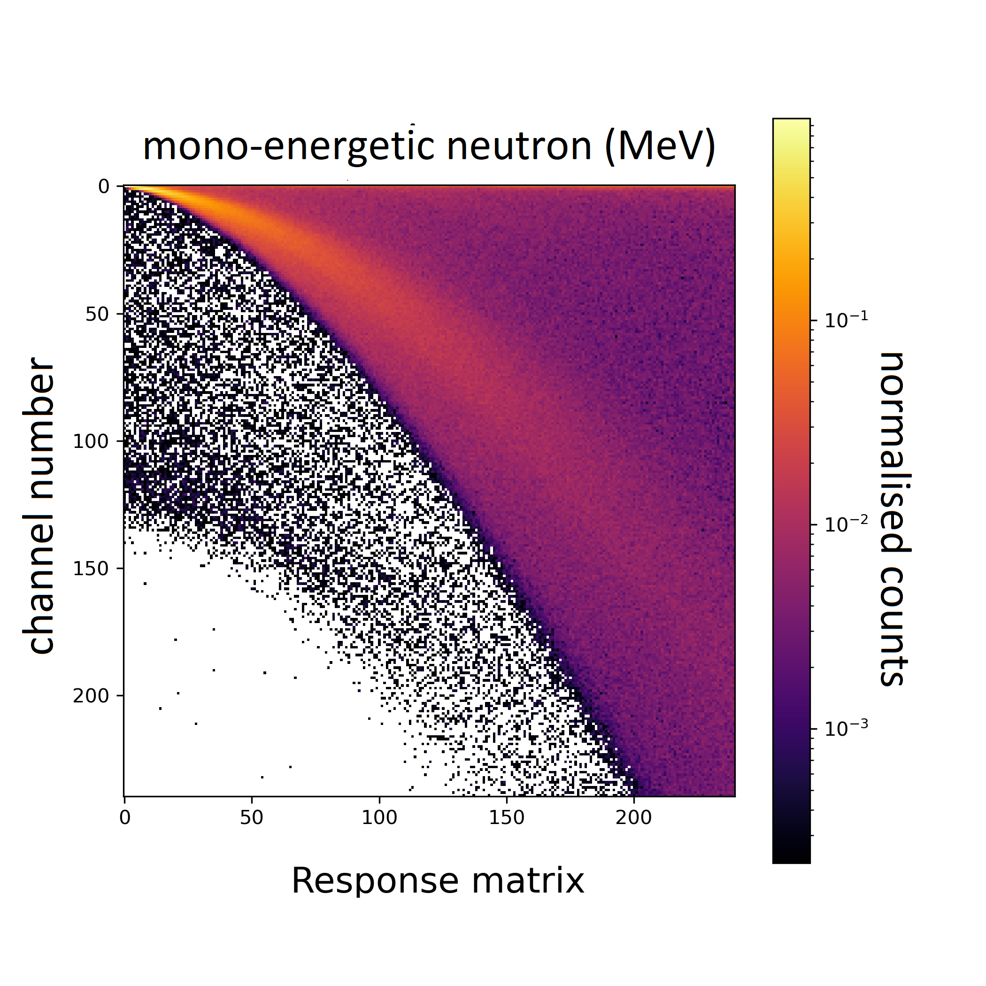
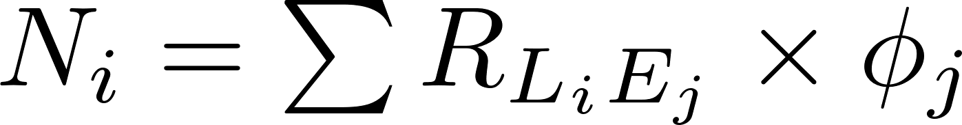
Unfolding neutron response
Unfolding is to get back the True spectra of a particle source from the measured spectra using simulated detector response.
Unfolding needs two components
a) Response matrix
b)Detector response to True spectra
Recorded counts in ith channel form histogram of simulated spectra
Response matrix
True neutron spectra of Am-Be
11/14

Slide 13
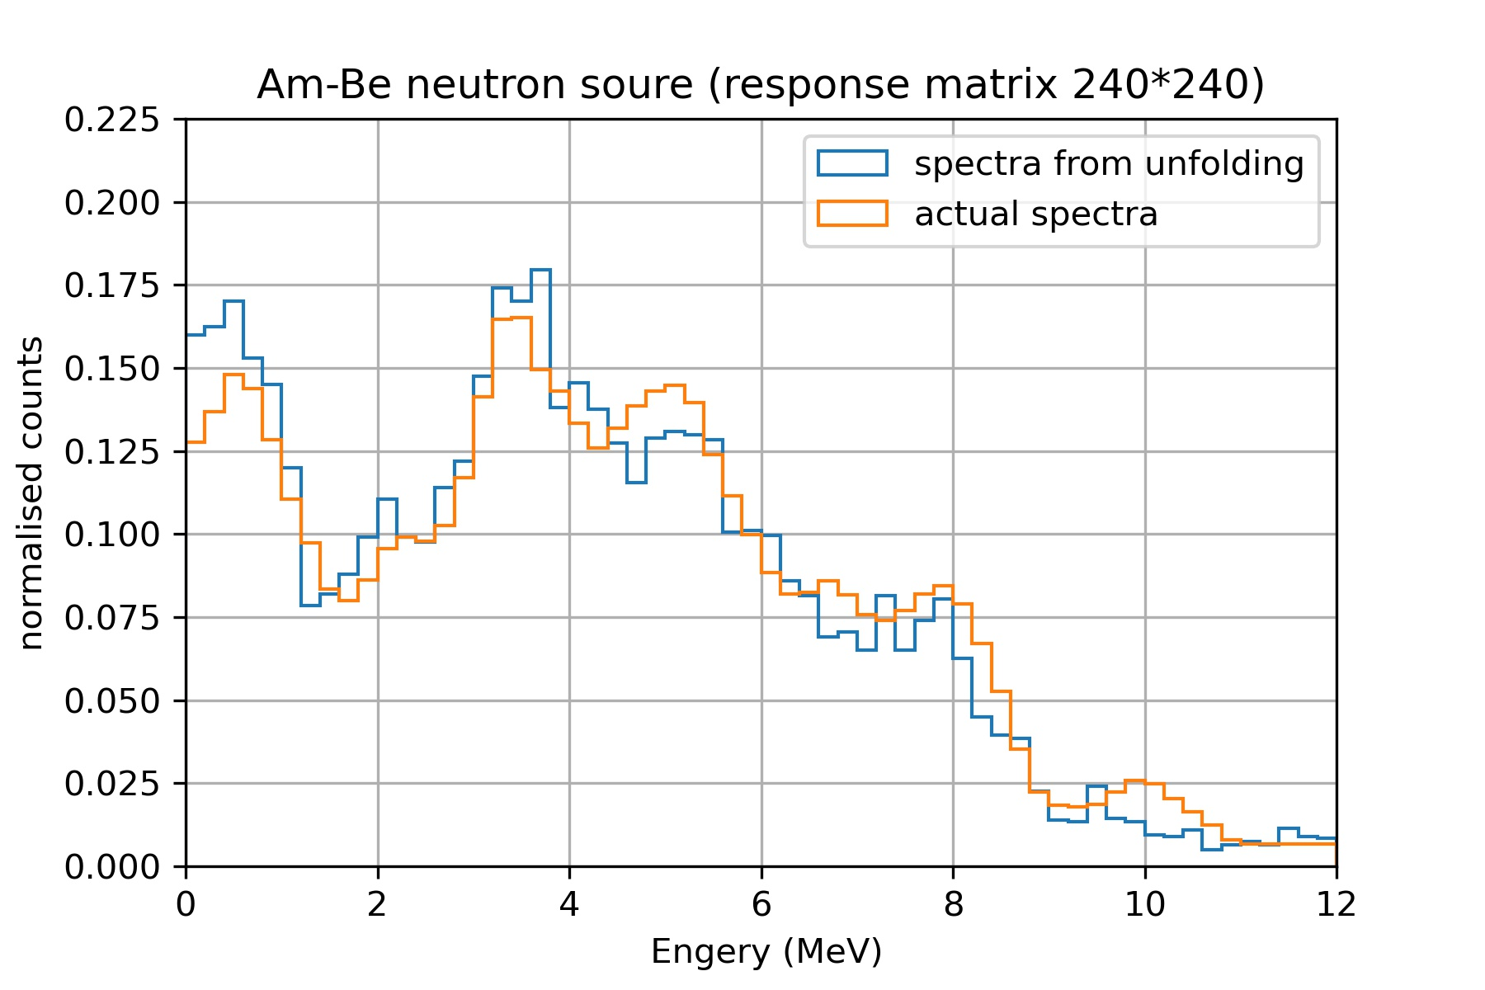
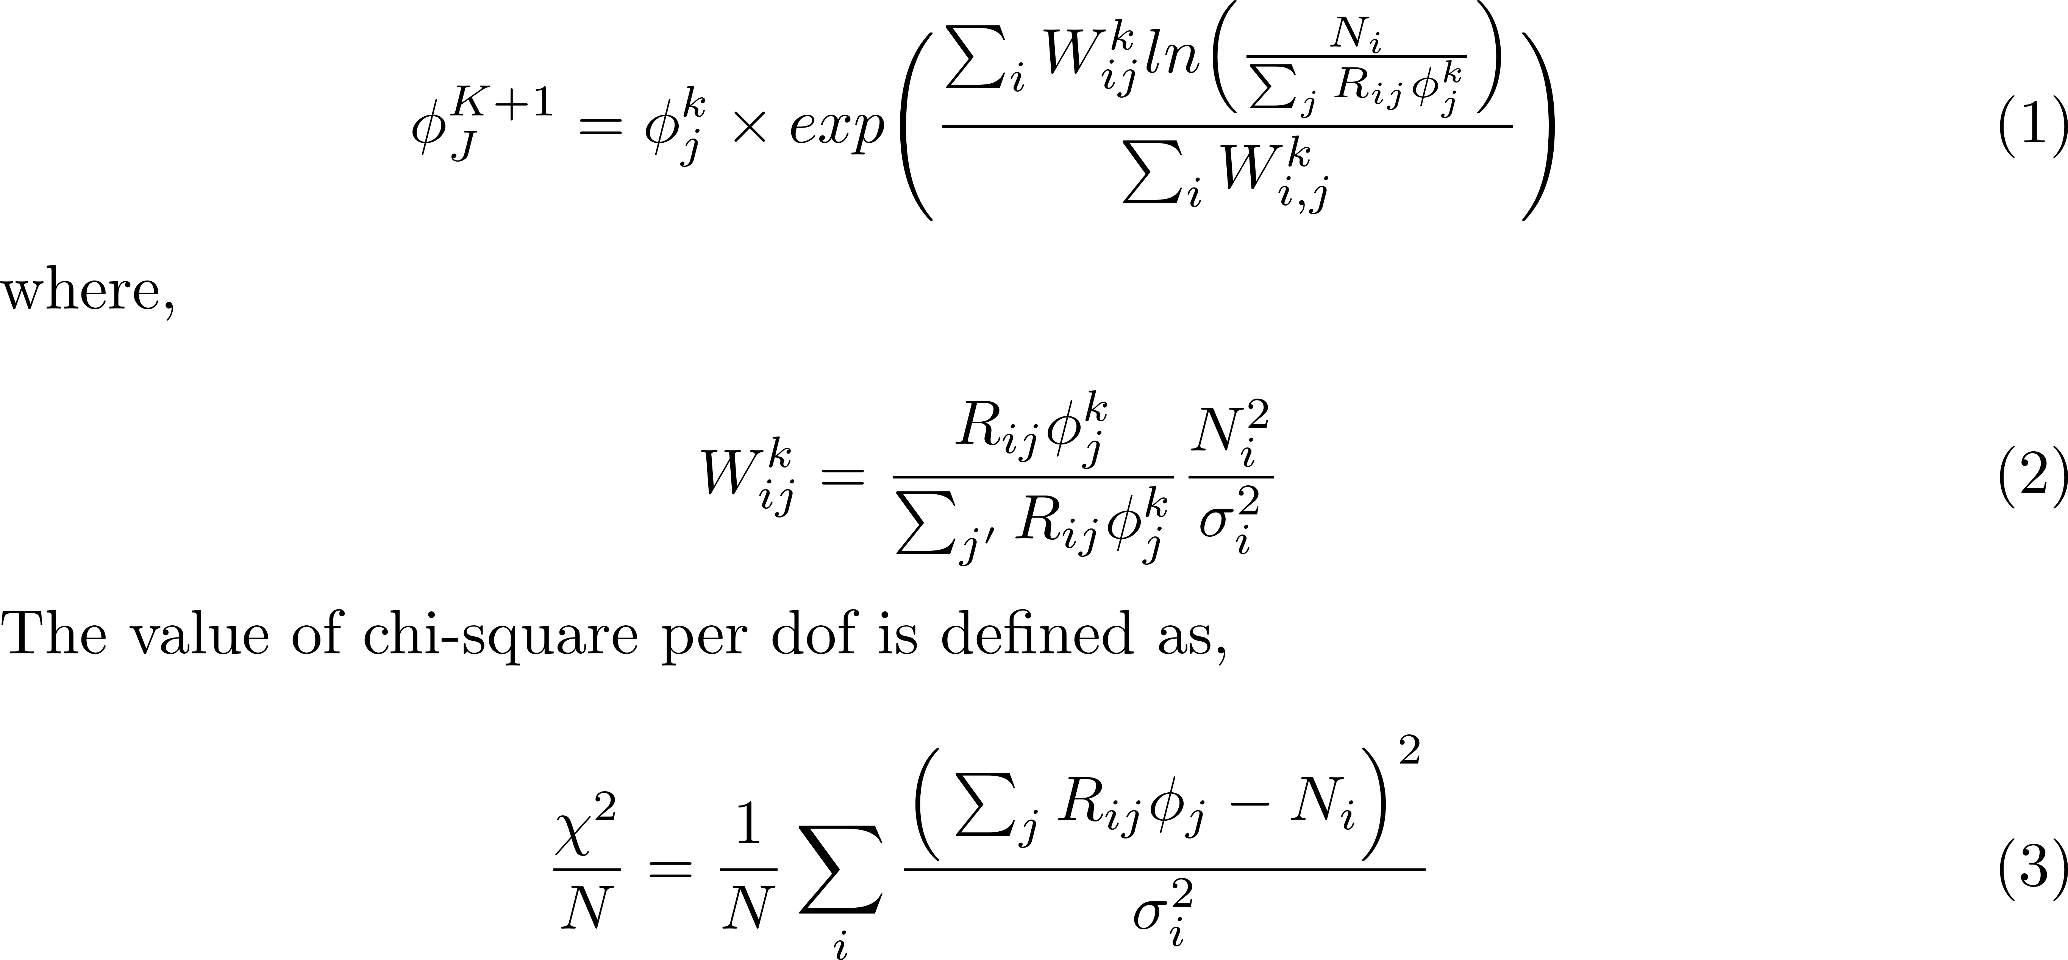
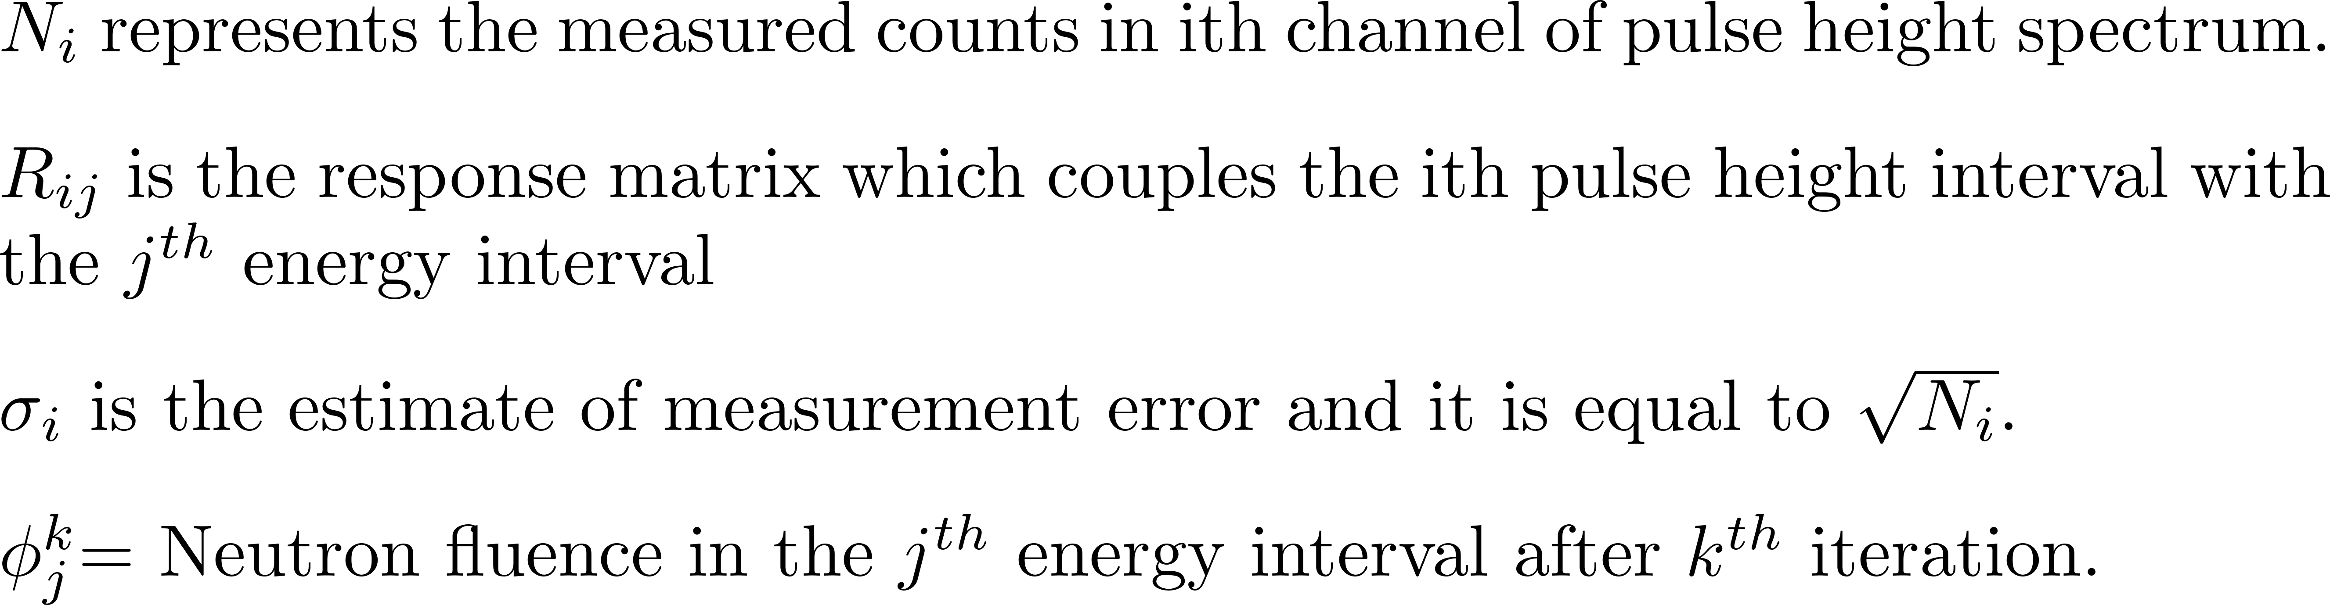
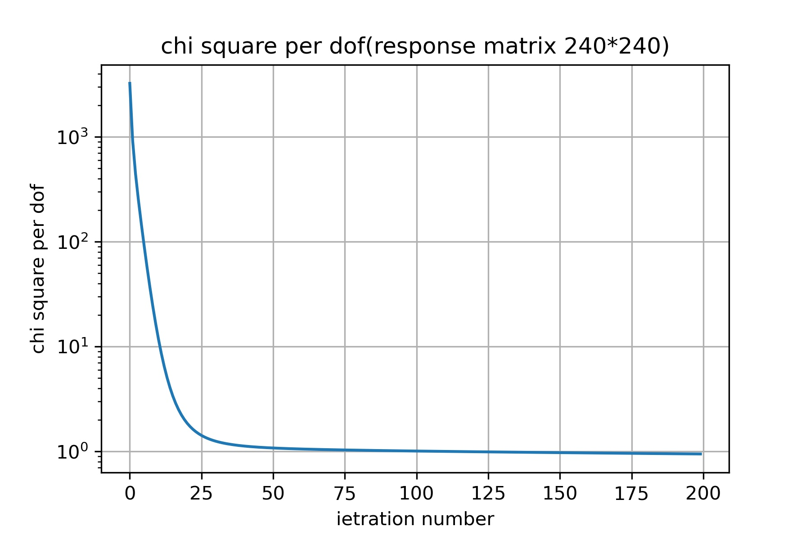
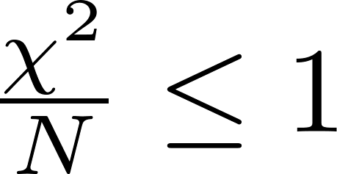
Unfolding simulated neutron response using Gravel iterative method
Iteration stopping condition
DOI:10.1007/s11433-014-5553-7
12/14

Slide 14
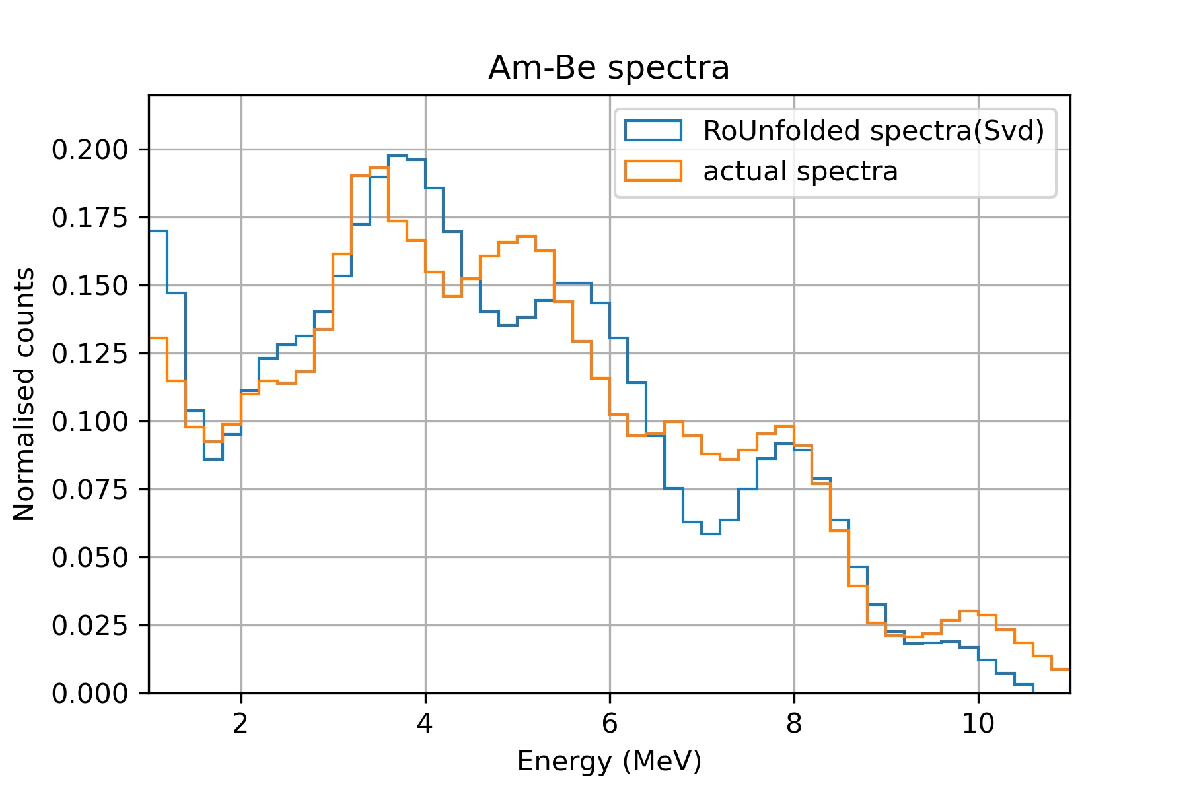
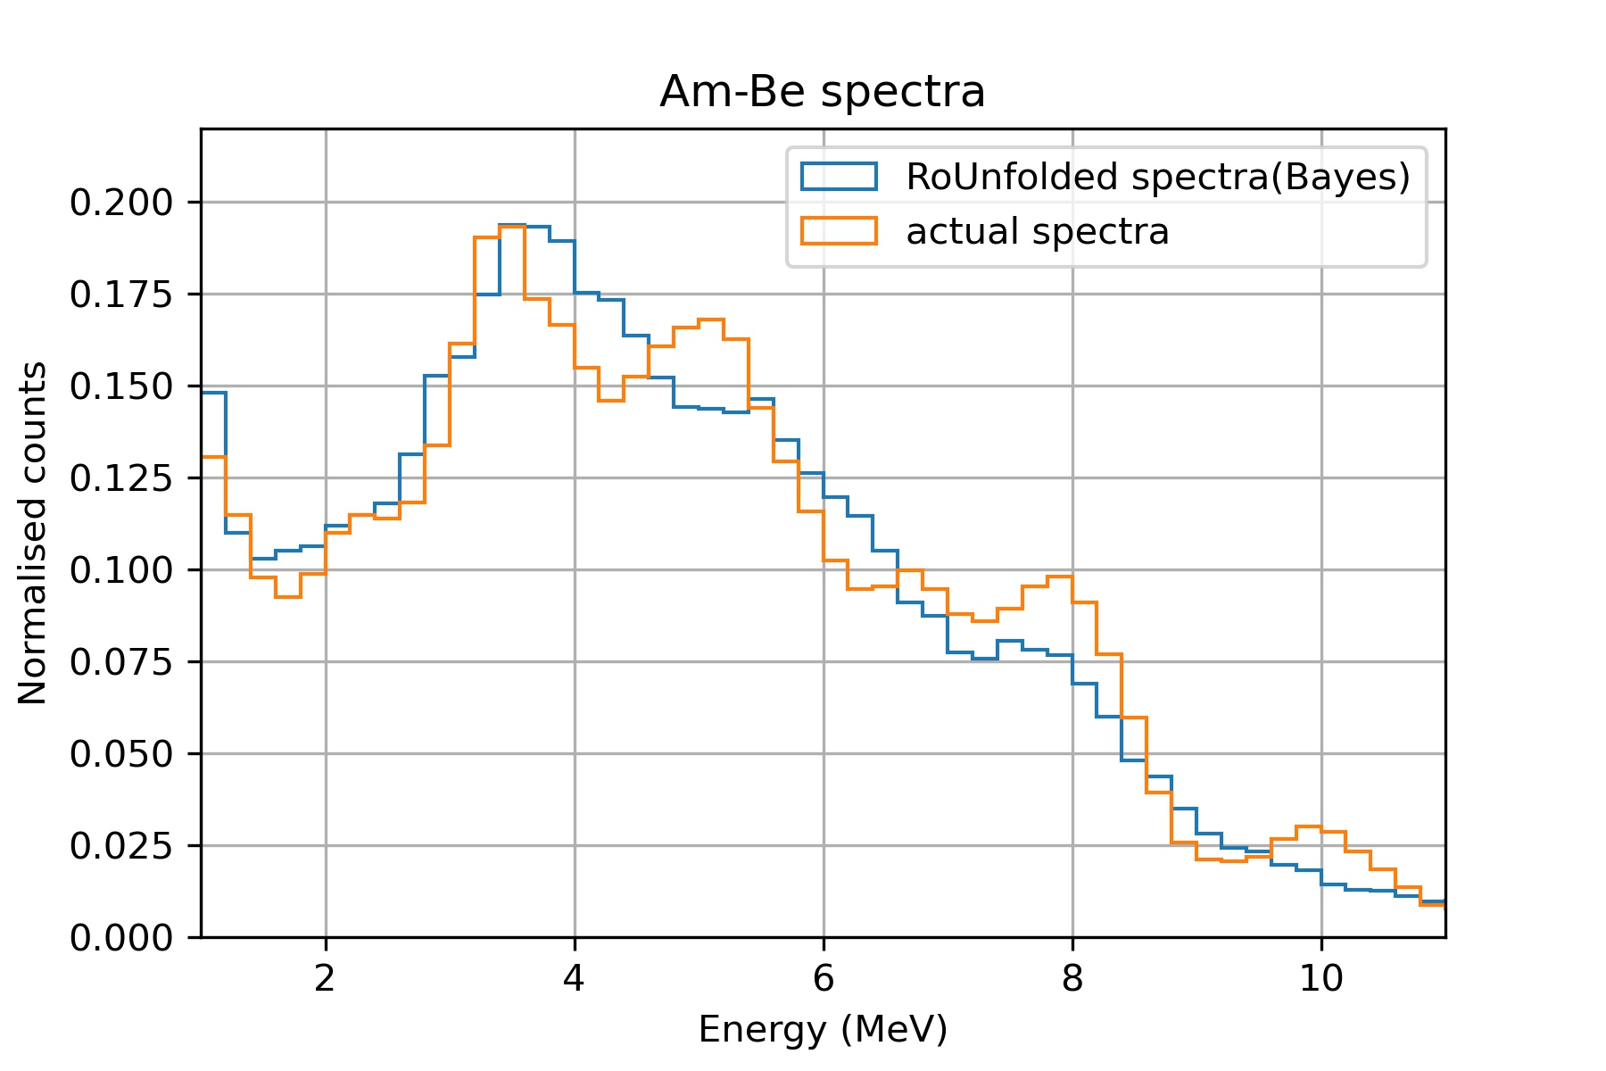
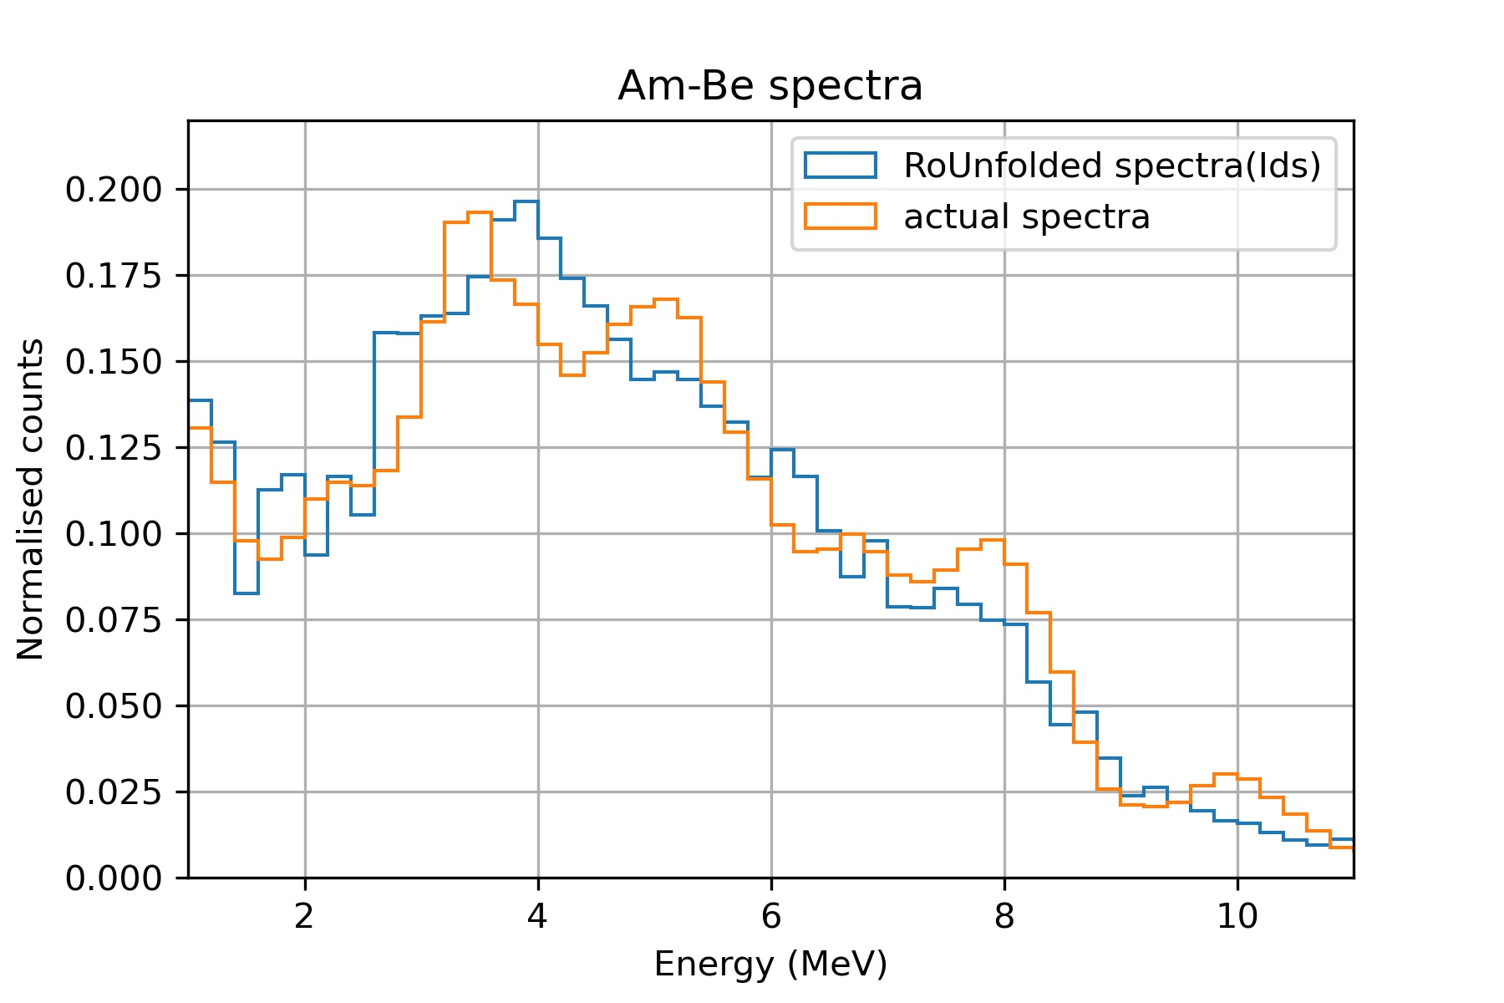
Unfolding simulated neutron response using Roo-unfolding method
Roo unfolding (Svd)
Roo Unfolding (Bayes)
Roo-Unfolding(Ids)
All the unfolding methods are consistent with True Am-Be Neutron spectra.
Gravel unfolding is giving comparatively better results than the Roo-unfolding with details of minor peaks
Thus, using unfolding we can have an idea of neutron background in a rare event search experiment
13/14

Slide 15
Summary
The detector geometry of EJ-301 liquid scintillation detector is constructed.
Proper physics processes and surface boundary conditions has been added.
Detector response to gamma and neutron source has been simulated.
Comparison has been made with experimental spectra.
Simulated response to Am-Be spectra has been unfolded successfully to obtain the input neutron energy spectrum.
Outlooks
Analysis for the unfolding of experimental Am-Be neutron data will be done.
14/14

Slide 16
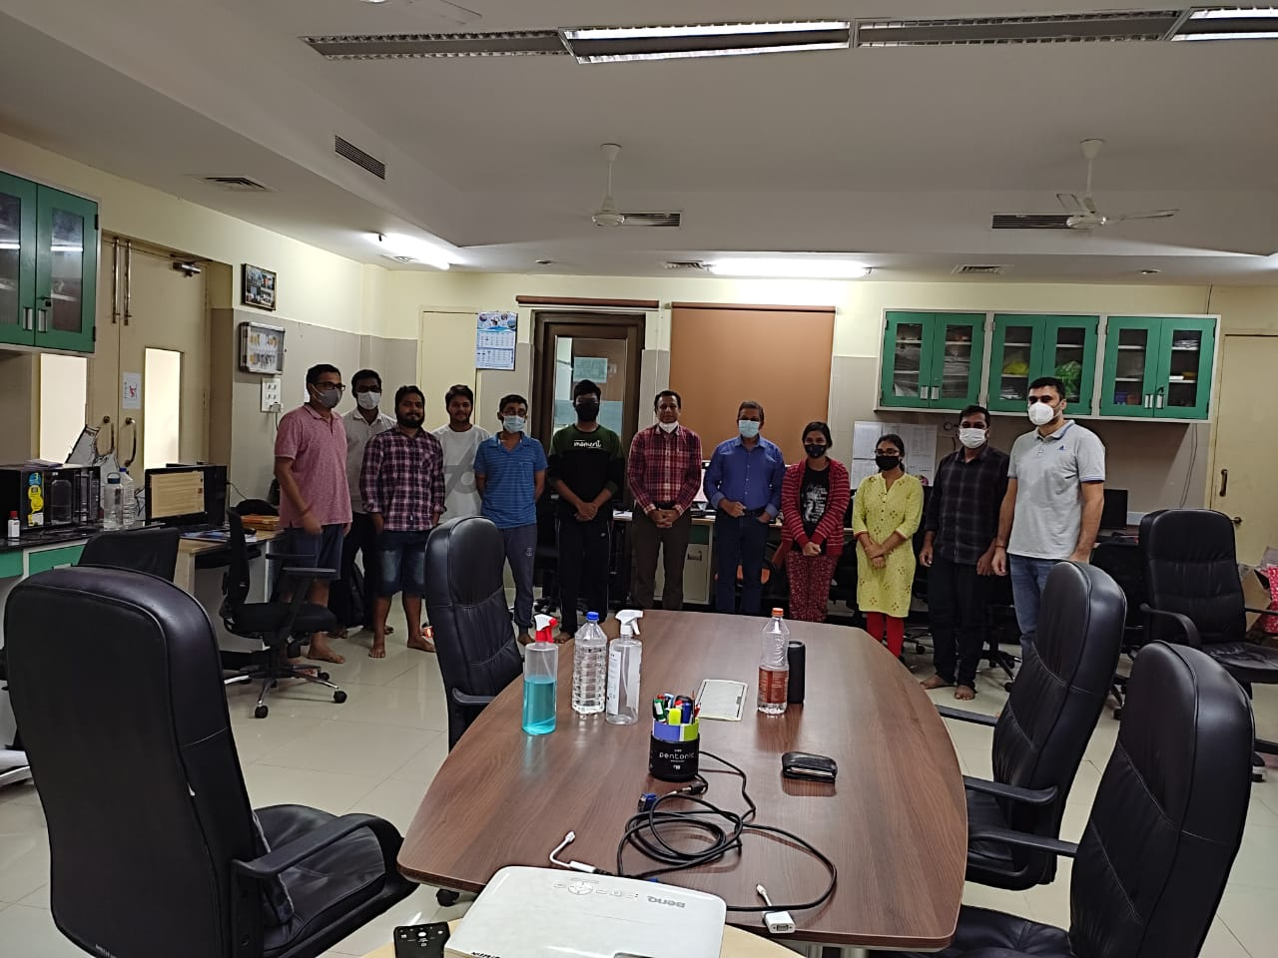

Slide 17
Thank you

