Slide 1
The View from the U.S.A.
Celebrating the 50th Anniversary of Hadron Colliders at CERN
October 14, 2021
Young-Kee Kim
The University of Chicago

Slide 2

1971
First neutrinos detected
at Fermilab
The world’s first
hadron-hadron collisions
at CERN
Establishment
of KEK
CERN
Fermilab
KEK

Slide 3
50 Years of Hadron Colliders (1971 – 2021)
Korean Proverb: In ten years, even rivers and mountains change
1971 - 1981
1981 - 1991
1991 - 2001
2001 - 2011
2011 - 2021
2021 - 2031
ISR (62 GeV p-p)
_
SppS
(630 GeV proton-antiproton)
Tevatron (2 TeV proton-antiproton)
RHIC (ion-ion)
LHC (13 TeV proton-proton)

Slide 4
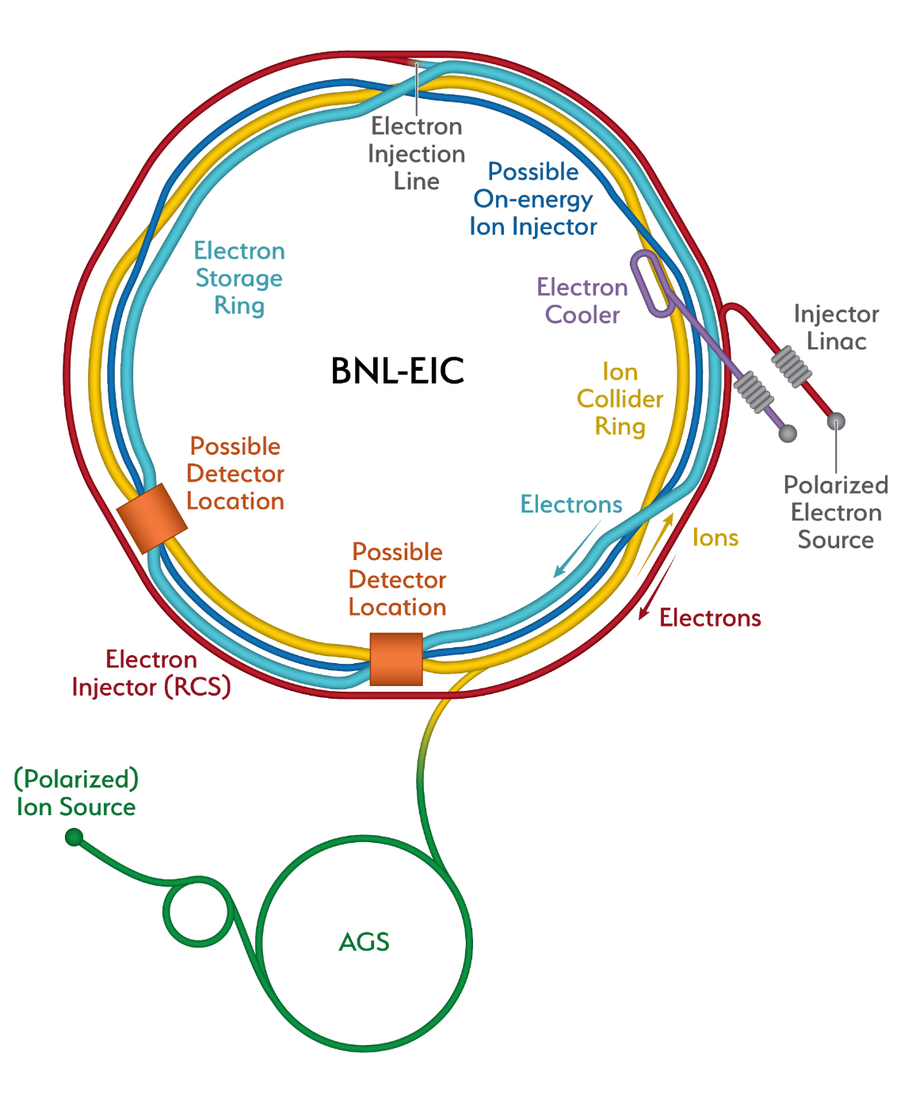
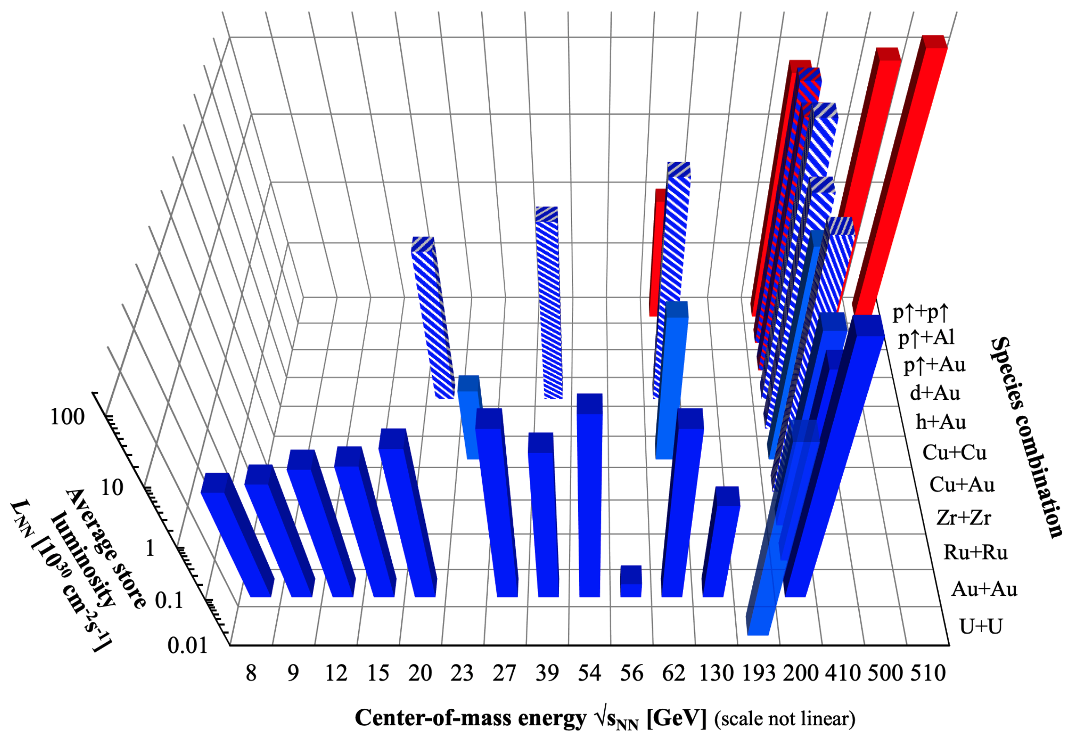
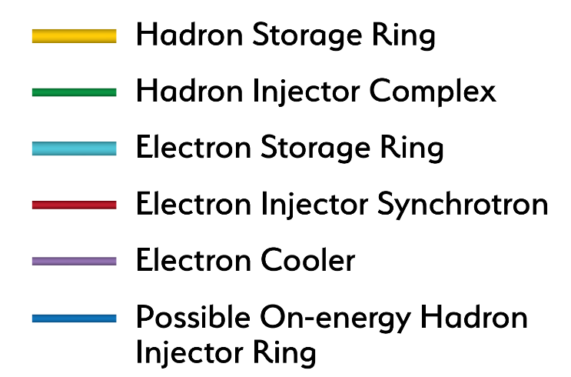
“Hadron” Colliders in U.S. (1971 – 2021)
1971 - 1981
1981 - 1991
1991 - 2001
2001 - 2011
2011 - 2021
2021 - 2031
ISABELLE
(400 GeV p-p)
cancelled
SSC
(40 TeV p-p)
cancelled
Tevatron (2 TeV proton-antiproton)
RHIC (ion-ion)
EIC (e-ion)
Ion-ion
RHIC will be transformed into an EIC
To unlock the secrets of the "glue" that binds the building blocks of visible matter in the universe.

Slide 5
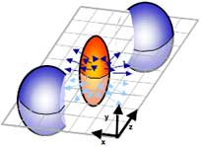
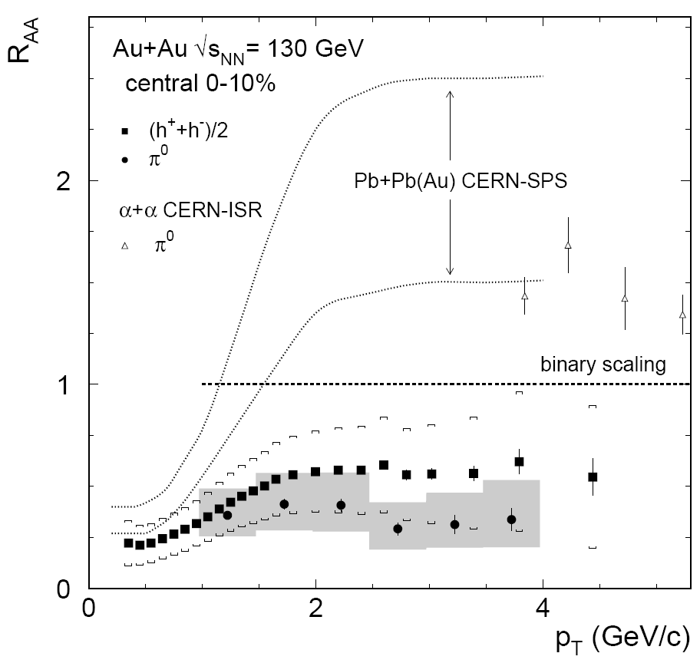
RHIC’s Scientific Achievements Include
(Robert Tribble and RHIC Expt.s Colleagues)
Observation of Strong “Elliptic” Flow:
  Elliptic flow in Au + Au collisions
Observation of “Jet Quenching”
  Suppression of hadrons with large transverse momentum in central Au+Au collisions
RHIC scientists serve up “Perfect Liquid”
  New state of hot, dense matter out of quarks & gluons.
  Instead of behaving like a gas of free quarks & gluons, it appears more like a liquid. (more than 11,000 citations)
Signature of a Critical Point
  Non-monotonic variation of moments of net-baryon number distribution
  Related to correlation length and susceptibilities of the system, suggested as a signature of a critical point
Discoveries of Breit-Wheeler Process and Vacuum Birefringence
  Production of matter and antimatter from photon collisions
  Polarization-dependent light-bending in a vacuum

Slide 6
Highest Energies Possible

Slide 7
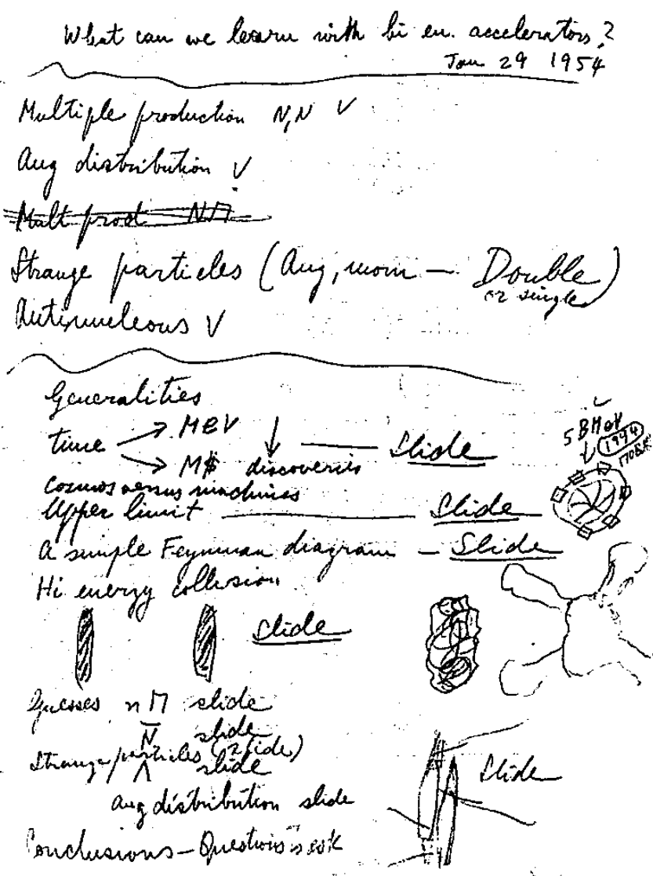
Fermi’s Vision
“Fermi Remembered”
Written by James Cronin
Highest energies possible
Fermi’s penciled notes
“What can we learn with high energy accelerators?”
(Special Collections, University of Chicago)
Fermi’s Speech (Jan. 1954)
APS President in 1953
His speech as retiring President
on January 29, 1954
“What Can We Learn
with High Energy Accelerators?”
The only way to access new physics is
through the development of
higher- and higher-energy accelerators

Slide 8
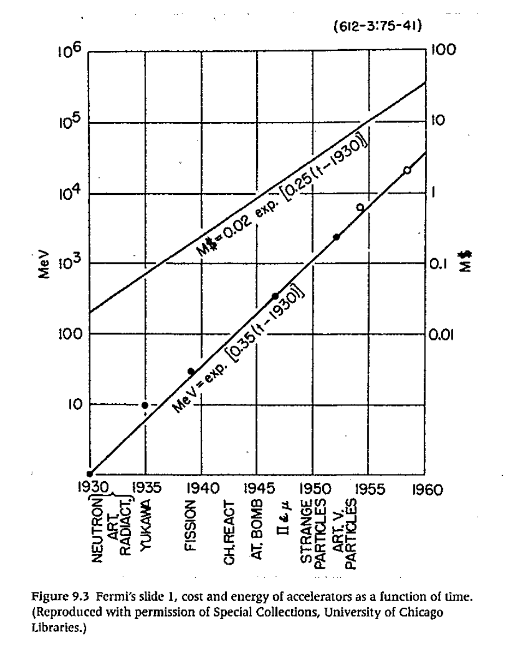
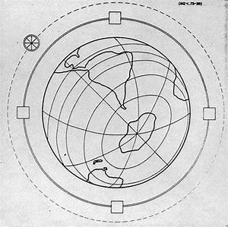
Fermi’s Vision
“Fermi Remembered”
Written by James Cronin
Highest energies possible
Fermi’s Globatron
Fermi’s slide 1, cost and energy of accelerators vs. year
(Special Collections, University of Chicago)
Fermi’s Globatron (Projection):
~40,000 km
~1994
~170B 1954 $ (~1,000B 2021 $)
You cannot get more global than this!!

Slide 9
Fermi’s Vision
“Fermi Remembered”
Written by James Cronin
Highest energies possible
10¹⁰
10⁸
10⁶
10⁴
10²
10⁰
Accelerator Energy vs Year
SSC (cancelled)
o
Fermi’s
Globatron
x
CERN
LHC
Fermilab Tevatron
x
_
x
ISABELLE (cancelled)
Laboratory Energy or Equivalent (GeV)
CERN SppS
o
CERN ISR
x
x
x
Fermilab
CERN SPS
BNL AGS
x
x
LBNL Bevatron
CERN PS
x
x
Fermi’s slide 1, cost and energy of accelerators vs. year
(Special Collections, University of Chicago)
BNL Cosmotron
1950 1960 1970 1980 1990 2000 2010
Actual Accelerators:
Energy achieved in ~1990
Dramatically smaller (~10 km)
Dramatically cheaper (~a few B 2021 $)
(year)
Fermi’s Globatron (Projection):
~40,000 km
~1994
~170B 1954 $ (~1,000B 2021 $)
Thanks to: Science & Technology Breakthroughs
Global Exchanges in Sci. & Tech.
Collaboration & Healthy Competition

Slide 10
Discovering elementary particles (w/ Accelerators)
proton
mass
Top quark
Higgs boson
Spin 0
Boson
Z
gluons
W
.
gluon
Spin 1
Bosons
b
.
ν_{τ}
.
τ
.
ν_{μ}
c
c
ν_{μ}
Spin ½
Fermions
Particles are messengers to understand laws of nature

Slide 11
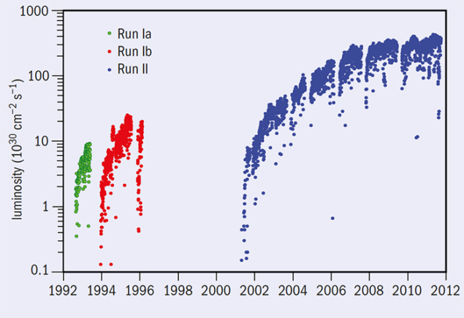
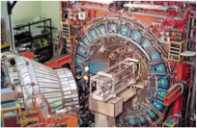
Collision Energy is Not the Whole Story
Fermilab Accelerator Complex (Tevatron Run II)
Tevatron Luminosity with Time:
Electron Cooling (2005) +
Many small steps by a better understanding of beam physics and accelerator technologies
CDF Detector
D0 Detector
Top Quark Discovery

Slide 12
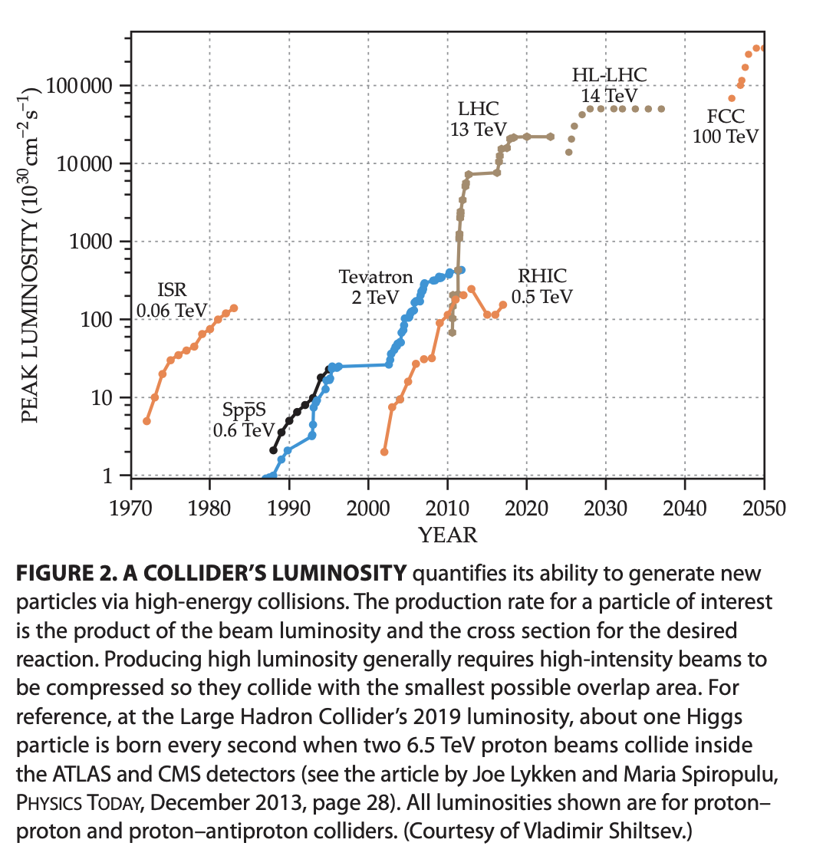
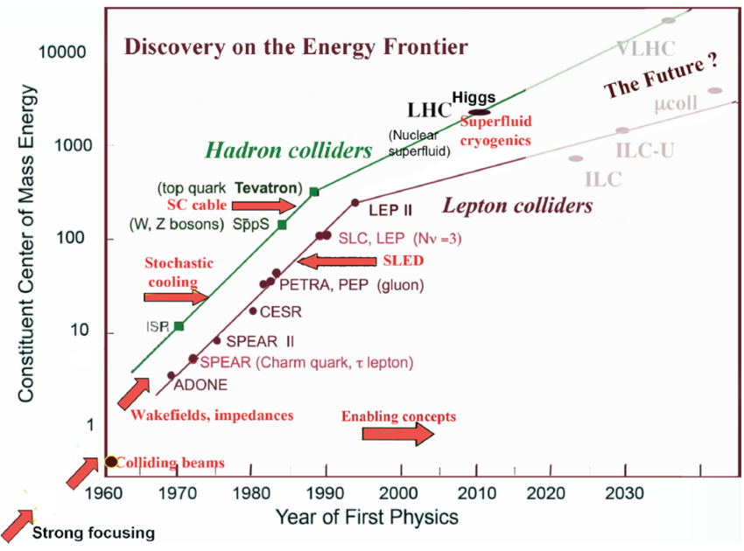
Energy Frontier Colliders: Energy & Luminosity
Physics Today 33 (2020)
Vladimir Shiltsev
Remarkable progress: > x10³ in energy & > x10⁴ in luminosity in 5 decades
Main jumps happen through science and technology breakthroughs
Each generation of accelerators, detectors, computing, and analysis techniques
has built on previous generations’ experience and discoveries

Slide 13
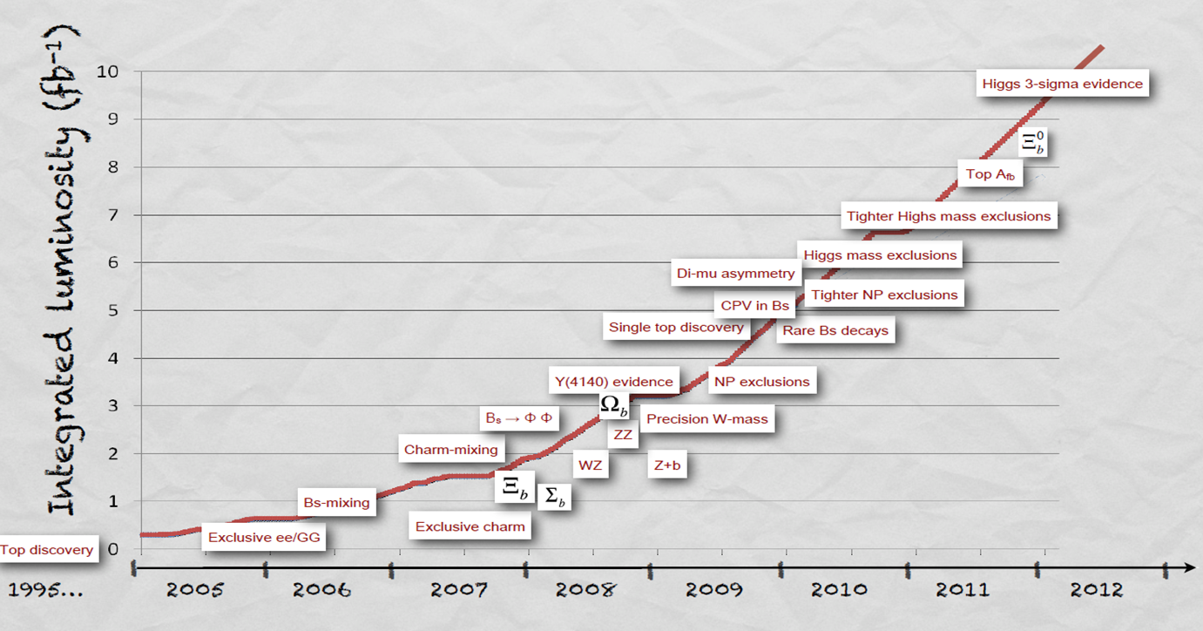
Rich Physics at the Tevatron
Phys. Today 66(6), 38 (2013), Dmitri Denisov & Jacobo Konigsberg
Precision measurements & Rare processes:
Some have been believed not to be accessible at a hadron collider
Top discovery
1995 …..
CDF and DZero collaborations receiving EPS’s 2019 High Energy and Particle Physics Prize “for the discovery of the top quark and the detailed measurement of its properties”

Slide 14
Tevatron’s Broader Impacts
PhD Student Training
  ~1,000 PhDs
Superconducting Magnets
  In 1993, the late Robert Marsh, of Teledyne Wah Chang, the then world's largest supplier of superconducting alloys, "Every program in superconductivity that there is today owes itself in some measure to the fact that Fermilab built the Tevatron and it worked.”
  In 2017, IEEE honored game-changing Tevatron technology
Computing
  Increases in luminosity – driven by physics – created the challenge of processing ever larger datasets
  PC Farms running Linux for large scale data handling
  Distributed computing: Grid, Cloud Computing
  Sophisticated Analysis Algorithms including Machine Learning
Towards Global Collaboration in HEP
  Tevatron experiments, establishing a genuine partnership between Asia, Europe and the Americas
Alvin Tollestrup, Rich Orr,
Dick Lundy, & Helen Edwards receiving the National Medal
of Technology in 1989
“for their contributions to the design, construction and initial operation of the Tevatron”

Slide 15
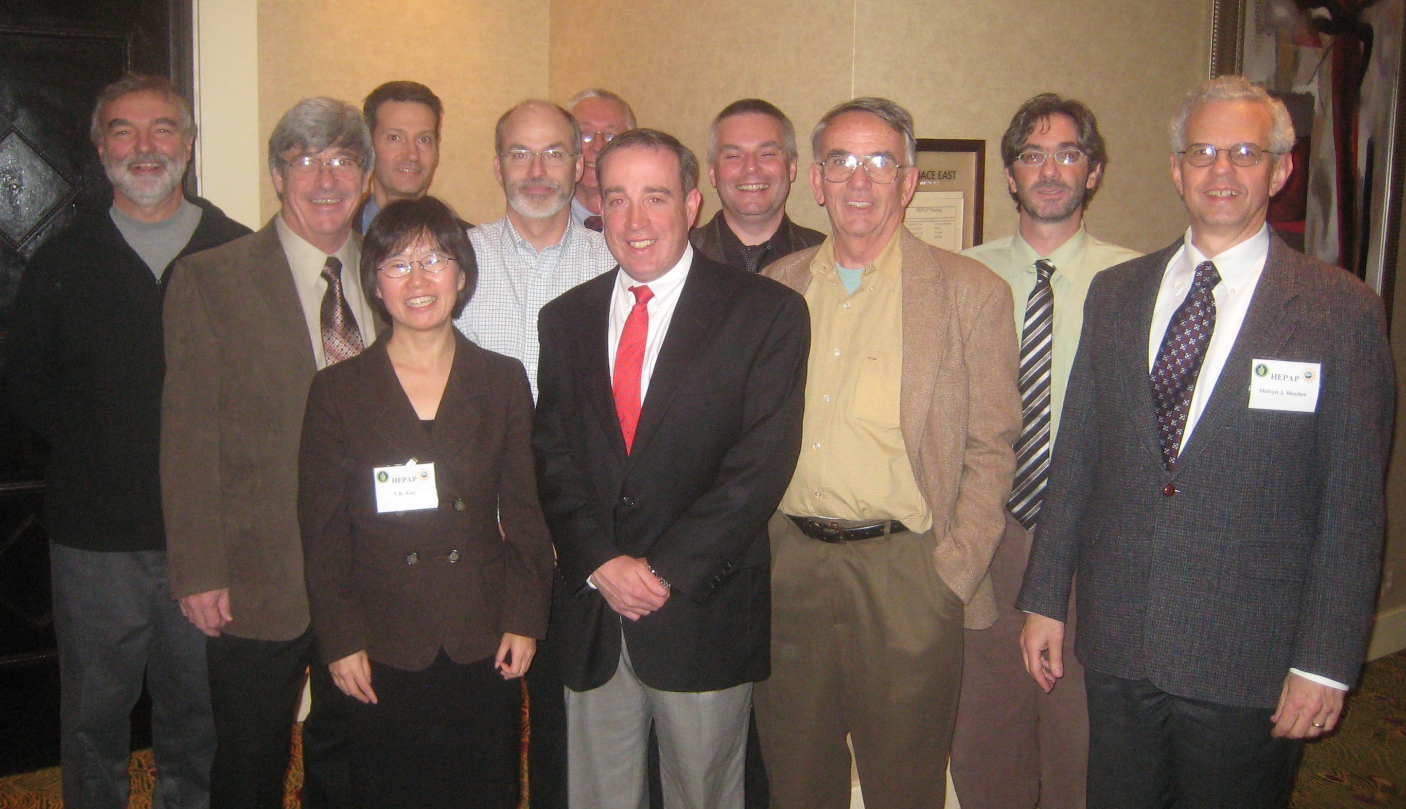
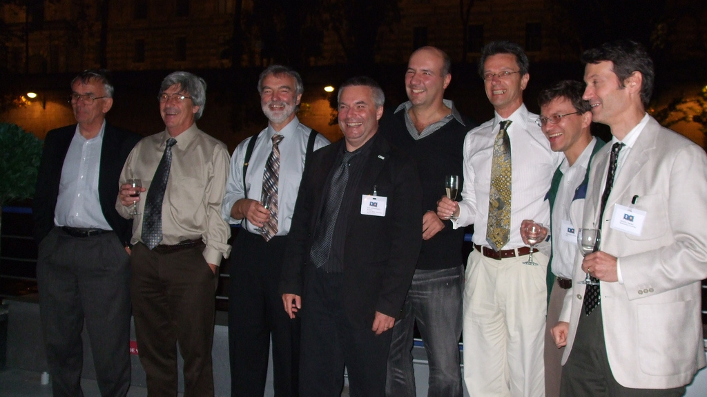
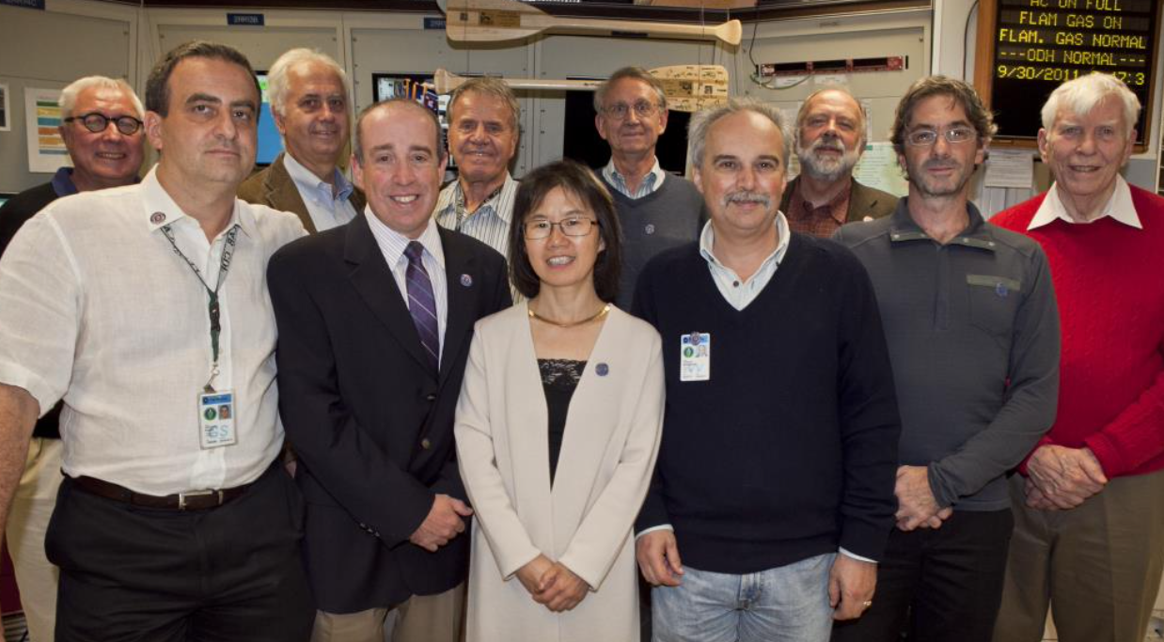
Messages from D0 & CDF Spokespersons
CDF Spokespersons (16 people):
  Alvin Tollestrup, Roy Schwitters, Mel Shochet, Bill Carithers, Giorgio Bellettini, Franco Bedeschi, Al Goshaw, Nigel Lockyer, Luciano Ristori, Young-Kee Kim, Robert M Roser, Jacobo Konigsberg, Giovanni Punzi, David Toback, Konstantinos Vellidis, Giorgio Chiarelli
D0 Spokespersons (10 people):
  Paul Grannis, Hugh Montgomery, Harry Weerts, John Womersley, Jerry Blazey, Terry Wyatt, Dmitri Denisov, Darien Wood, Stefan Solder-Rembold, Gregorio Bernardi
D0 Spokespersons
on the boat on the Seine in 2008
CDF Spokespersons
at the Tevatron Shutdown event in 2011
D0 & CDF Spokespersons
at a HEPAP meeting in 2007

Slide 16
“Beginning with the ISR 50 years ago, hadron colliders have provided unprecedented energy reach and general purpose detectors for attacking a very broad range of physics studies. The result has been major discoveries of high-PT hadron production, and the W, Z, top, and Higgs, completing the set of Standard Model particles. There have been important precision measurements such as the masses of the W, top, and Higgs, and the precise determination of the B_s oscillation frequency which had been believed not to be accessible at a hadron collider."
“Hadron colliders have also presented opportunities that led to innovative detectors such as silicon trackers in very high occupancy environments and their use in the trigger. It has been a glorious 50 years, with hopefully much more to come!”
“Hadron colliders had an enormous impact on my career and indeed the trajectory of particle physics. Apart from its discovery, who expected the measurement of the W mass to 20 MeV? Thank you to those who paved the way by building the Intersecting Storage Rings.:
”Although extracting the signal in a hadron-hadron machine can be quite difficult, the large statistics and the ingenuity of the collaborations to extract the signals allowed for results well beyond the initial program at all the colliders, and that this knowledge was passed from one collider to the next.”
“Please extend my congratulations to the CERN organization, and in particular our accelerator colleagues, for the many contributions they have been made in advancing the understanding of elementary particles through the development of hadron colliders.”

Slide 17
“I am struck with how each generation of hadron collider experiments has built on the shoulders of that which went before. The ISR taught us that there is new physics in the high pT region of phase space; The SppS brought us the new tools of jets as primary objects and missing transverse energy for searching for new physics; The Tevatron showed the unexpected power of vertex detectors and multiple trigger levels to tease out rare processes; The LHC solved the problem, previously thought insurmountable, of living with multiple overlapping collisions and gave us simulations that could be trusted quantitatively.”
“each continued to add new insights and discoveries, using new technologies and approaches. In addition to that, I also think that the theory/phenomenology and experimental collider communities continuously pushed each other forward,
developing new ways to extract (precision) physics from the messy hadron collisions and contributing to "completing" the Standard Model.”
“in these last decades the colliders confirmed brilliantly the well known theorem of the discovery of the fermions in the America's and the discovery of the bosons in Europe. And that we are all looking forward which kind of new elementary particle will be discovered at the HL-LHC or at FCC ”
“Hadron colliders played a key role in the history of HEP and promise to continue to do so in the future.”

Slide 18
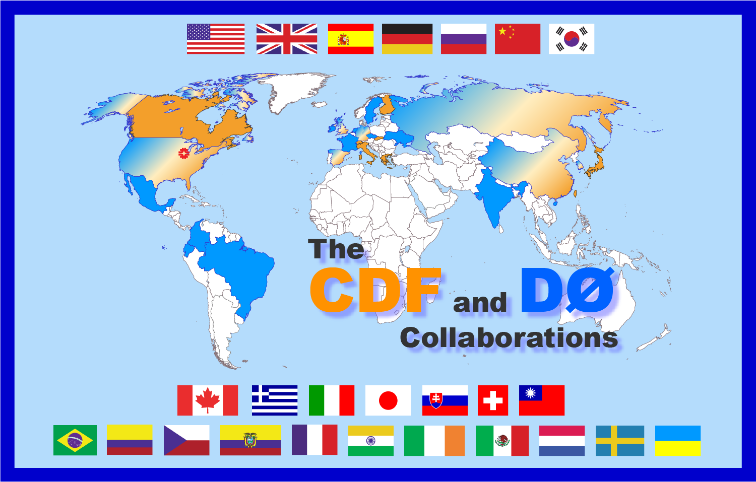
“The story of hadron colliders is not just a story of technology and discovery – it is also a story about people and international cooperation.”
“CDF and D0 grew from mostly US experiments (with notable exceptions of Italy and Japan in CDF and France in D0) to truly global collaborations, attracted by the Run II physics potential of the Tevatron and of a size which had not been seen in the US before.”
“The thing that sticks with me the most is perhaps not the technical advances, but the ability to produce first rate science and consensus from collaborations of strong willed individuals.”
“possibly the most important contribution to the future of the field is the number of young physicists who moved from one collider experiments to the next, bringing their experience together with the trust in the physics opportunities offered by an hadron collider.”

Slide 19
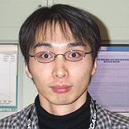
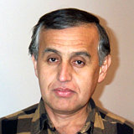
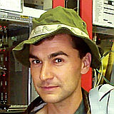
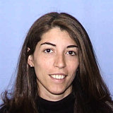
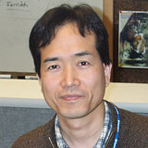
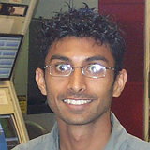


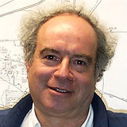

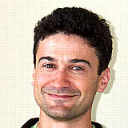

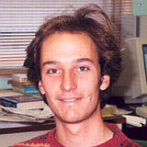

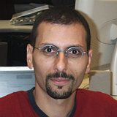
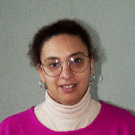
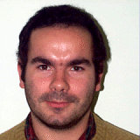
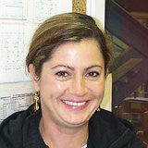
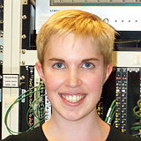
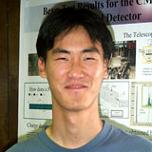

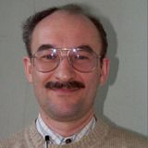
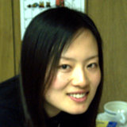
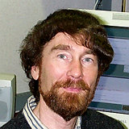
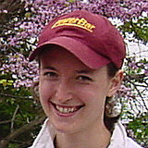
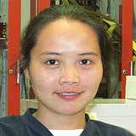

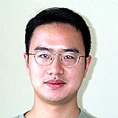

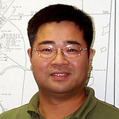
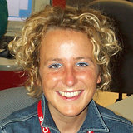
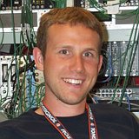
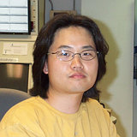
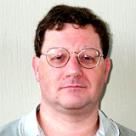
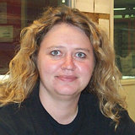
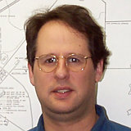
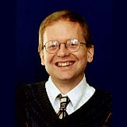

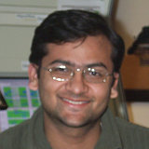
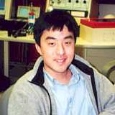
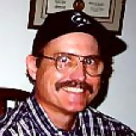
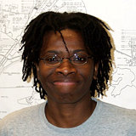























































Diverse Workforce
International Collaboration → Diverse Workforce
sharing knowledge and resources, and generating innovative ideas and solutions
by collaborators from different training and cultures
Better Science

Slide 20
Messages from Accelerator Colleagues
“Within the accelerator physics community, the era of hadron colliders has been categorized both by intense competition and sustained cooperation. …. we benefited greatly both from extended residencies of our scientists and engineers at CERN, and from extended residencies of CERN engineers and scientists at Fermilab…. While CERN beat us to the W/Z, we got the top quark. Such is the value of cooperative competition. At Fermilab we are
Steve Holmes
very proud of our role in managing the US/Japan contribution of the interaction region quadrupoles to LHC. We did this while recognizing that the Tevatron would eventually be supplanted by the LHC. There was some sadness on our part when that day came, but also a recognition of science moving on.”
“The Tevatron antiproton team stood on the shoulders of giants, such as Simon van der Meer, Dieter Moehl, and other CERN colleagues. And now I am very pleased and proud of the fact that many of our accelerator physics and technology developments made their way into recent CERN’s LHC achievements. As the cycle goes on, we congratulate you with the Golden Anniversary of Hadron Colliders and hope to continue to play a role in collider accelerator physics wherever it may be. Happy 50th, CERN!
Sergei Nagaitsev

Slide 21

Message from Fermilab Director
1971 - 1981
1981 - 1991
1991 - 2001
2001 - 2011
2011 - 2021
2021 - 2031
R&D, Construction
Tevatron (2 TeV proton-antiproton)
Analysis
Bob Wilson
(1967-1979)
Leon Lederman
(1979-1989)
John Peoples
(1989-1999)
Mike Witherell (1999-2005)
Pier Oddone (2005-2013)
Nigel Lockyer (2013-2022)
“Happy 50th Birthday to Colliders at CERN! What a fantastic 50 years, developing ever more powerful machines, making the discoveries that underpin the Standard model, in an atmosphere of competition but above all strong collaboration and a common purpose. Have we lived through the golden age of colliders? At the start of the next 50 years, you now get to answer the question posed by the Beatles famous song:
………..
Many years from now
Will you still be sending me a Valentine
Birthday greetings, bottle of wine?....
…………………..
Will you still need me, will you still feed me
When I'm sixty-four? “
Pier Oddone
Director of Fermilab
(2005 – 2013)

Slide 22
Message from the DOE Office of High Energy Physics
“The U.S. Department of Energy congratulates CERN and the worldwide particle physics community in celebrating 50 years of hadron collider research. The impressive science results, including the groundbreaking discovery of the Higgs boson in 2012, is a testament to the collaborative international research program that is fostered at CERN. DOE’s collaboration dates back to the ISR, where our labs and universities helped advance the development of large-scale particle accelerators and detectors, including developing next-generation high-field magnets to achieve higher collision energies, and the first large liquid argon calorimeter and muon detection chambers. Over the years, advances at CERN have also enabled particle colliders hosted in the United States, namely those at Fermilab, Brookhaven, SLAC, and Jefferson Lab. Today, more than 1,500 researchers from the United States have the privilege to collaborate with scientists from around the globe at the Large Hadron Collider and its high-luminosity upgrade program. DOE looks forward to 50+ more years of partnership with CERN, including at CERN’s proposed future circular collider, which will continue the outstanding cooperation between DOE, CERN, and the world partners.”

Slide 23
Message from the NSF Physics Division
“The U.S. National Science Foundation would like to congratulate CERN on their very successful fifty years of Hadron Colliders and the discoveries they have enabled. The international, multi-cultural environment provided by CERN has produced innovations and technology advances as well as new fundamental discoveries. NSF funded researchers have long been a part of this effort and we look forward to many more productive years in the future.”

Slide 24
Message from the APS DPF Chairline
“Dear colleagues at CERN,
On the occasion of celebrating the 50th anniversary of hadron colliders at CERN, we would like to congratulate you, as well as the high-energy physics community working on hadron colliders, for monumental contributions to the field. CERN’s leadership and close collaboration with the US have been crucial for the advancement of the technology and physics at hadron colliders. We will strive to continue the tradition, and to work together for our common goals in advancing high-energy physics.
Best wishes for your next endeavor!”
Tao Han (DPF Chair)
Joel Butler (DPF Chair-Elect)
Sekhar Chivukula (DPF Vice Chair)
Young-Kee Kim (DPF Past Chair)

Slide 25
Congratulations Once Again
Confucius said:
At the age of 15, one understands importance of education.
At the age of 30, one establishes the foundation of study.
At the age of 40, one does not confuse judgement.
At the age of 50, one understands the mandate of Heaven.
One understands the right questions that nature wants us to ask.
This is where particle physics is at the hadron-collider age of 50.
At the age of 60, when one hears something, they know what it mean.
At the age of 70, one does not deviate from the law even though they follow their heart.
To Be Addressed by HL-LHC and Beyond
Long Live the Hadron Collider !!

Slide 26
References
Tevatron Impact Symposium
  Symposium (2012)
The evolution of hadron-collider experiments
  Paul Grannis and Peter Jenni
  Phys. Today 66(6), 38 (2013)
The Legacy of the Tevatron in the Area of Accelerator Science
  Stephen Holmes and Vladimir Shiltsev
  Annual Review of Nuclear and Particle Science Vol. 63:435-465 (2013)
The Tevatron Collider Physics Legacy
  Paul Grannis and Melvyn Shochet
  Annual Review of Nuclear and Particle Science Vol. 63 467-502 (2013)
The Tevatron legacy: a luminosity story
  Dmitri Denisov and Jacobo Konigsberg
  CERN Courier (2016)
Particle Beams: Behind physics discoveries
  Vladimir Shiltsev
  Physics Today 33 (2020)

