Slide 1
Novel cavity with ultra low R/Q for CLIC DR RF system
Alexej Grudiev, Themis Mastoridis
22/09/2021

Slide 2
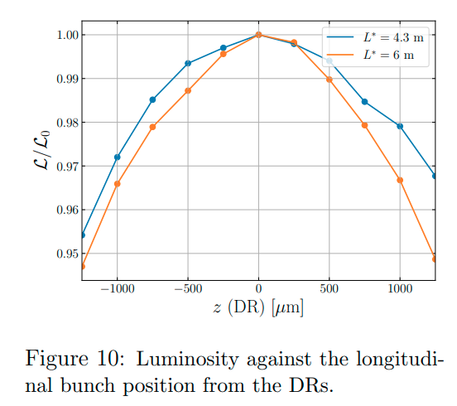
380 GeV CLIC DR parameters (PRAB22, 091601)
Parameter of DR |  | value | unit
Energy | E | 2.86 | GeV
Circumference | C | 373.7 | m
Revolution frequency | f₀ | 802 | kHz
RF frequency | f_{RF} | 2 | GHz
Harmonic number | h | 2493
Energy loss per turn | eV_{A} | 5.8 | MeV
RF voltage | V_{C} | 6.5 | MV
RF stable phase | φ | -26.8 | º
Bunch population | N_{e} | 5.7 | 1e9
Number of bunches per train | N_{b} | 352
Number of trains | N_{t} | 1
Peak beam current | I_{b} | 1.8 | A
1%
±400μm
Strict specifications on the bunch spacing variation: δφ_{b} < ±1º at 2 GHz (±400μm) for Luminosity loss < 1% (CLIC-Note-1138)
This is difficult to maintain due to strong transient beam loading effects caused by large difference between peak and average beam power values of 10.4 MW and 1.5 MW, respectively

Slide 3
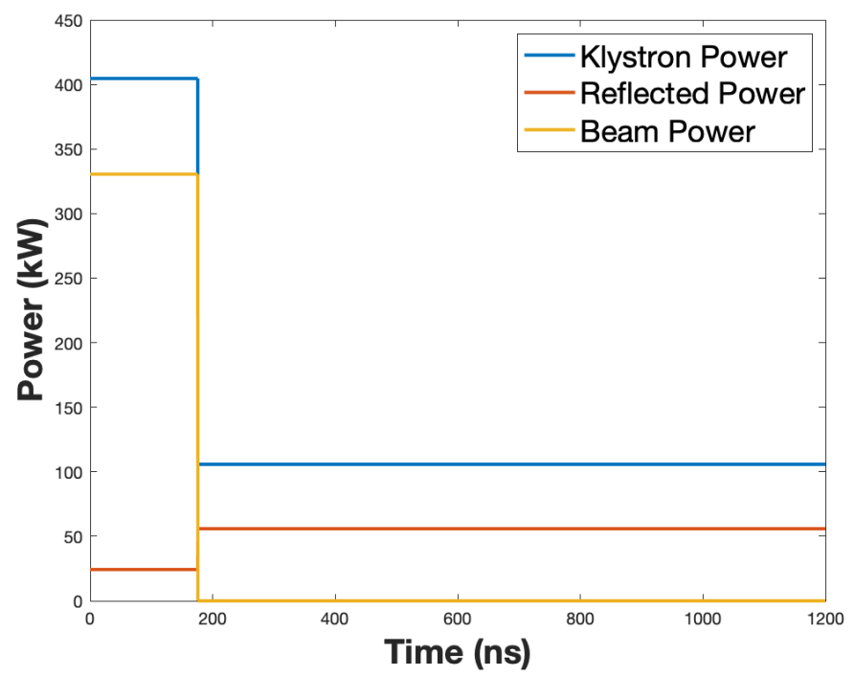
Current baseline summary (NIMA V985, 164659)
Cavity type | ARES
Cavity R/Q [Ω] | 7.5
Number of cavities | 32
Cavity Q0 | 55000
BL compensation method | feedforward
Beam phase variation [º] | ~1
Peak input power [kW/cavity] | 405
Cavity power loss [kW] | ~50
Total peak input power [kW] | 12960
Very high peak power
Larger klystron bandwidth
Strong peak power modulations on each turn
Inefficient due to most of average power lost

Slide 4
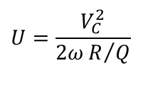



Transient beam loading effects (CLIC-Note-879)
Im{V}
I_{b}
δV_{B}
V_{C}
T_{b}
T_{R}
t
δV₁
δV_{C}
V_{C}
δV₂
δφ₁
δV_{C}
δφ₂
V_{A}
φ
Re{V}
V_{A}
$$U=\frac{V_{C}^{2}}{2ωR/Q}$$
$\frac{δU}{U}=2\frac{δV_{C}}{V_{C}}$ << 1
$$δU=P_{b}T_{b}={eV_{A}N_{e}N_{b}N}_{t}$$
$δφ_{B}=δφ_{1}+δφ_{2}=\frac{δV_{C}}{V_{C}}\left(\tan{φ}+\frac{1}{\tan{φ}}\right)=\frac{δV_{C}}{V_{C}}\frac{1}{\cos{φ}\sin{φ}}$ << 1

Slide 5
Estimate of required R/Q for RF system with large enough stored energy to maintain small beam phase variation
Bunch phase variation versus cavity voltage variation due to transient beam loading: δφ_{b} = 1º => δV_{C}/V_{C} = 7.1e-3
Relationship between voltage and stored energy: δU/U = 1.4e-2
Variation of stored energy due to transient beam loading: δU = 1.86 J
Required stored energy: U = 133 J
Required R/Q of the DR RF system (all cavities): R/Q = 12.6 Ω
This estimate neglects input and reflected power
There is factor 2 margin in the case of linear variation of ±1º peak-to-peak => 2º linear variation

Slide 6
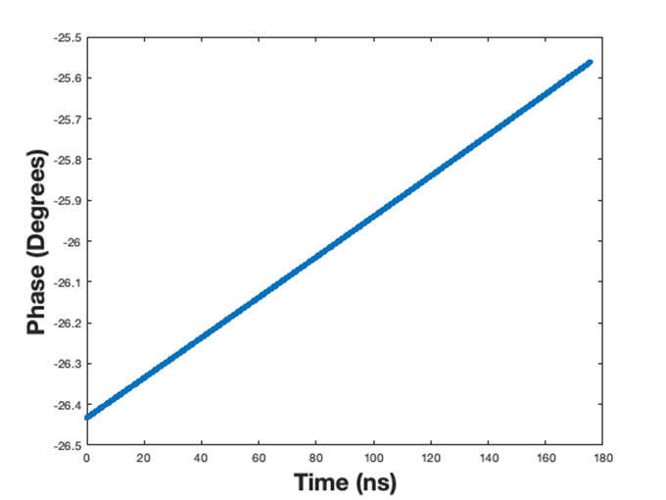
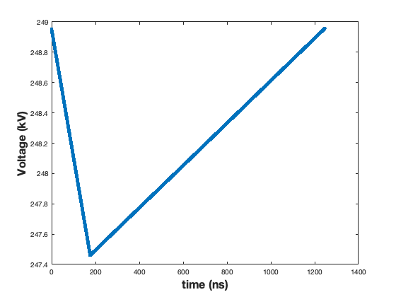
Verification of the estimate by LLRF model:
Results for R/Q = 12.6 Ω= 0.48 Ω/cav * 26 cavities
For an R/Q = 0.48 Ω per cavity the beam phase variation is 0.87 degree.
For an R/Q = 0.55 Ω per cavity the phase variation is exactly 1 degree.
Cavity voltage
Beam
phase
δφ_{b} = 0.87º
In this case total R/Q = 0.55*26 = 14.3 Ω

Slide 7
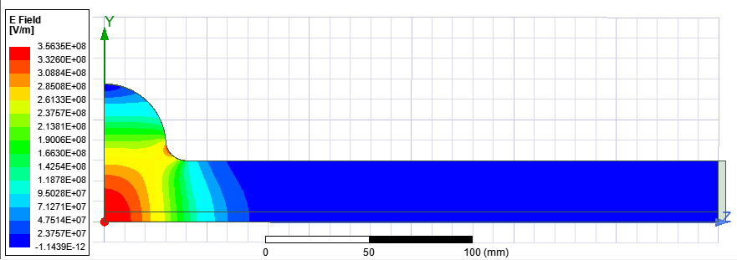
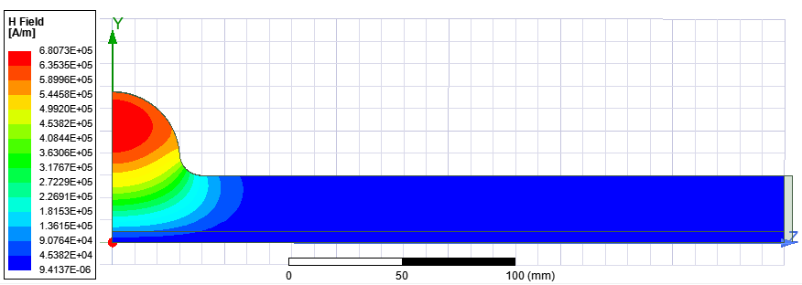
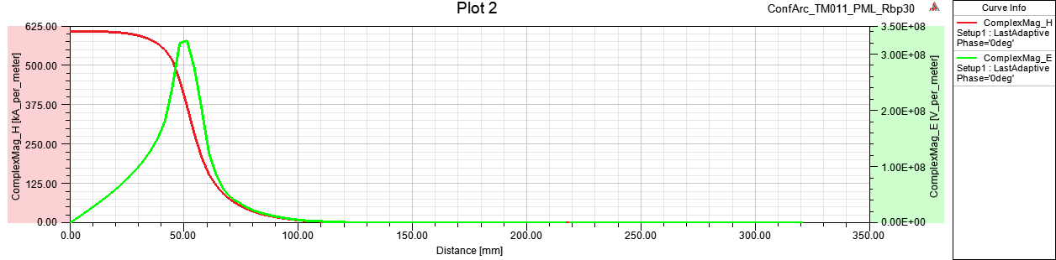
Example of conventional elliptical pillbox: a/λ=0.2
E- and H-fields for 144J
TM011
a [mm] | 30
f [GHz] | 2
a/λ | 0.2
Lc [mm] (0.01Hmax) | ~200
R/Q [Ω] | 42.5
Emax/Vacc [1/m] | 26.1
Hmax/Vacc [mA/Vm] | 49.0
Bmax limit: 100 mT
Hmax = 80kA/m
Emax = 42 MV/m
Vmax = 1.6 MV
Umax = 2.4 J
a
Looking at R/Q , even one cavity is ‘too many’: R/Q is ~x4 higher than specs
Looking at Vmax 4 cavities are necessary to get nominal total RF voltage of 6.5 MV

Slide 8
Design philosophy for Ultra low R/Q RF cavity
Increase cavity aperture to reduce loss factor => reduce R/Q per cavity
Increase cavity length to reduce transit time factor => reduce R/Q per cavity
Optimize cavity wall shape to minimize H-field to reach largest stored energy per cavity under the H-field limit of 80 kA/m (100 mT, private communication, W. Venturini, 2021) => reduce number of cavities
R/Q per cavity X N of cavities must be below Total R/Q: 14.3 Ω

Slide 9
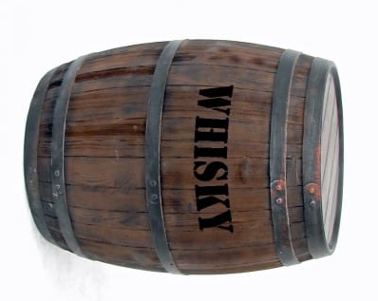
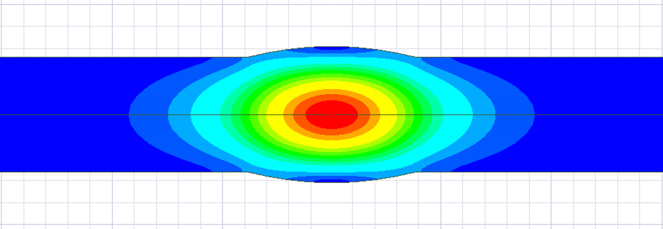
Novel cavity: Barrel Cell Cavity (BCC) geometry
Rarc
Rcav
a
Beam axis
E-field
Large aperture => low R/Q
Long cell: ~λ => low transit time factor
Low field on the cavity wall

Slide 10
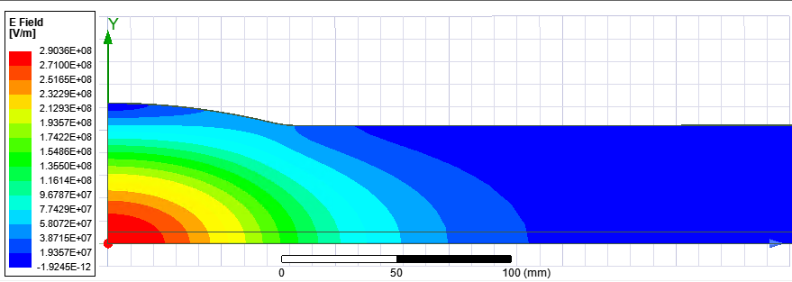
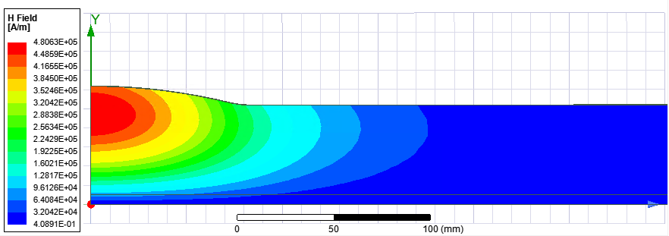
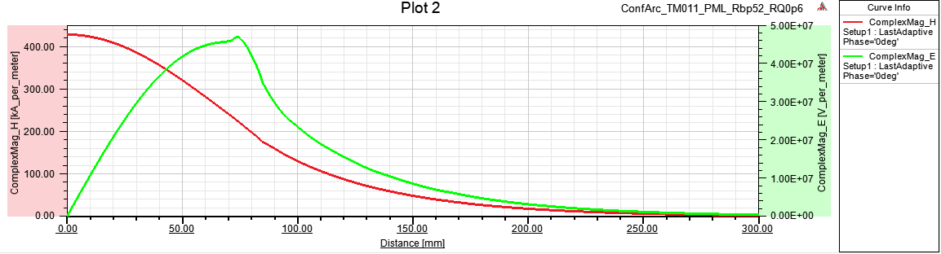
Design of the cavity for total R/Q=14.3Ω
TM011
a [mm] | 52
f [GHz] | 2
a/λ | 0.347
Lc [mm] (0.01Hmax) | ~520
Rarc [mm] | 307
Rcav [mm] | 61.95
R/Q [Ω] | 0.6
Emax/Vacc [1/m] | 31.6
Hmax/Vacc [mA/Vm] | 291
E- and H-fields for 144J
To get this design parameters,
two conditions must be met:
R/Q per cavity is 14.3Ω/Ncav
AND
Hmax limit: 80kA/m
Vmax = 0.275 MV
Umax = 5.0 J
Emax = 8.7 MV/m
Vmax per cavity is 6.5MV/Ncav
See next slide

Slide 11
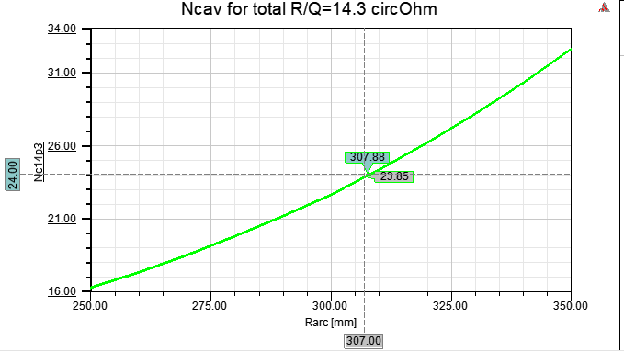
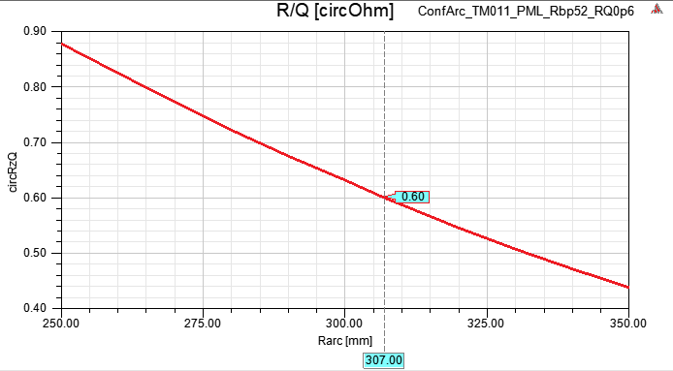
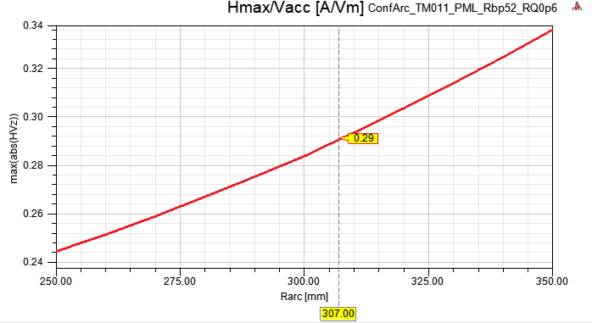
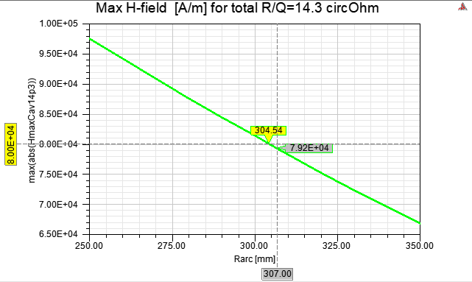
Optimization of the cavity for total R/Q=14.3Ω
R/Q and Hmax/Vacc of the cavity can be changed by varying Rarc
Optimum value of Rarc = 307 mm
Lowest number of cavities with Bmax < 100 mT
Ncav to get total R/Q=14.3 Ω
24 cavities
R/Q=0.6Ω
Vacc per cavity =
6.5 MV / Ncav
Hmax for Vacc from the top plot
Bmax < 100 mT

Slide 12
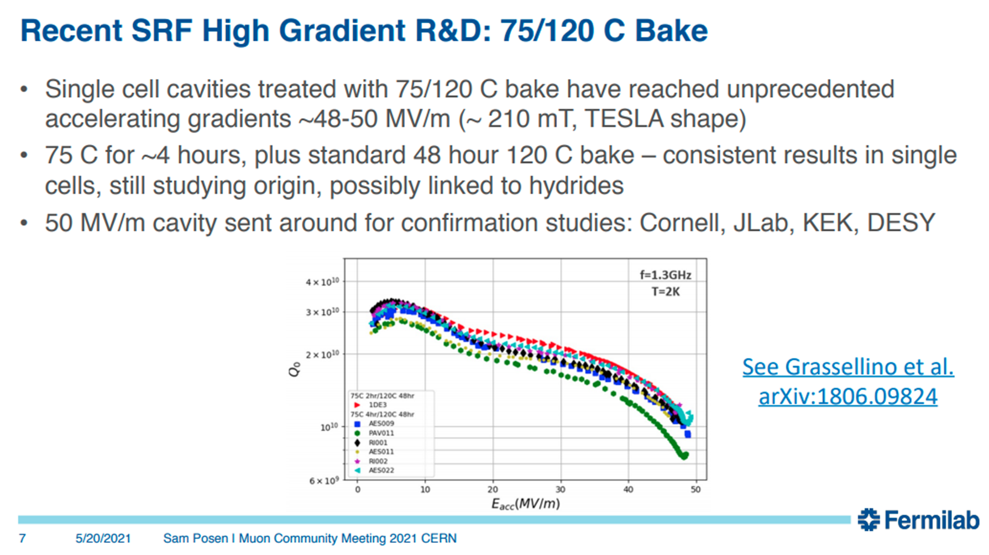
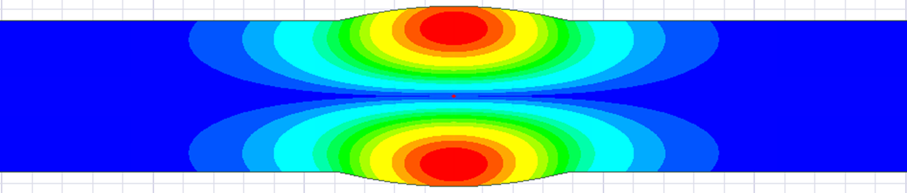
Potential way to reduce number of cavities Higher Bmax: 100 => 200 mT
R/Q=0.6Ω
Bmax [mT] | 100 | 100*2=200
Hmax [kA/m] | 80 | 160
Emax [MV/m] | 8.7 | 17.4
Vmax [MV/cav] | 0.275 | 0.55
Ncav | 24 | 12
Pin [kW/cav] | 60 | 120
Umax [J/cav] | 5.0 | 20.0
Bunch phase variation [º] | 1 | ~0.5
Imagine that we could get 2 times higher Bmax = 200mT
which is still lower than recently demonstrated value of 210mT
=> Factor 2 less cavities, worth making prototype
E-field
E-field
B-field
B-field

Slide 13
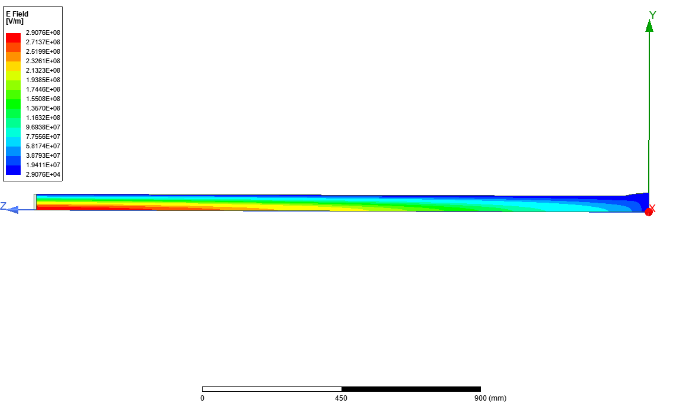
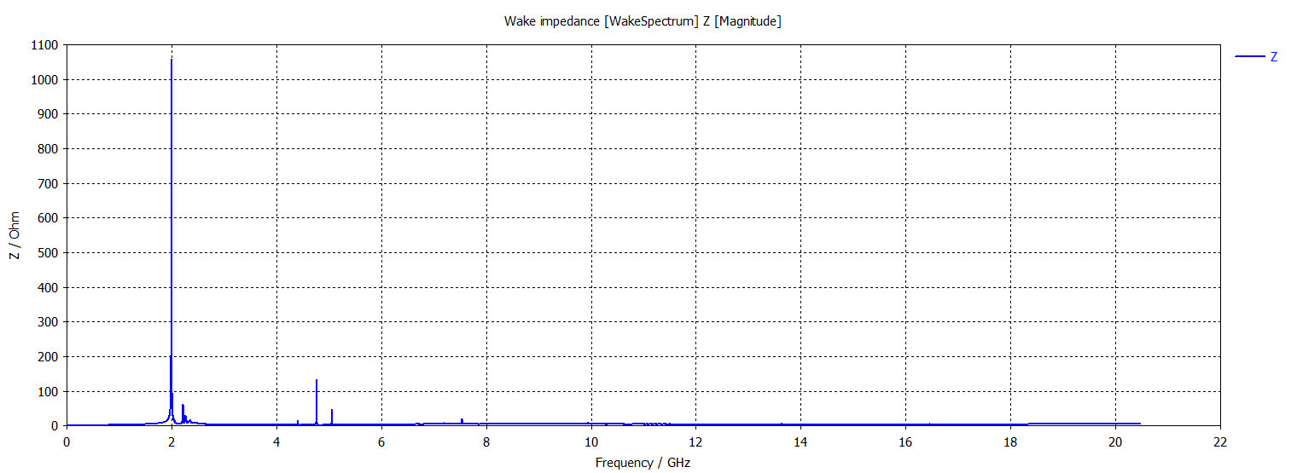
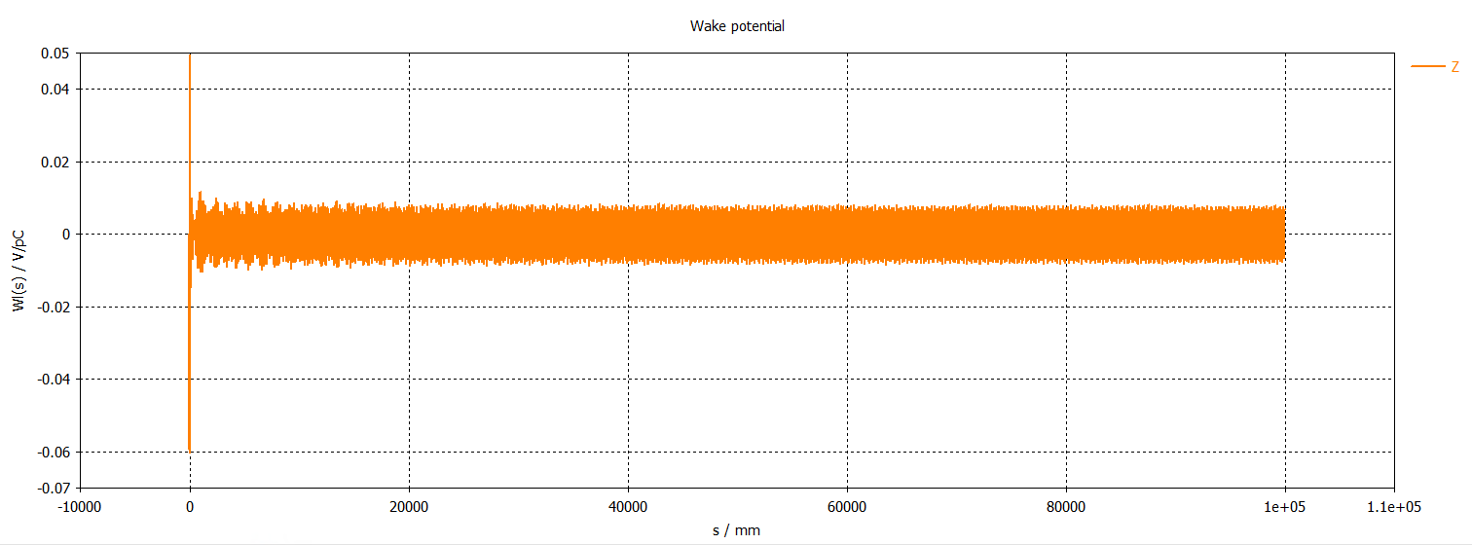
Monopole wake: a=52mm, R/Q=0.6Ω
CST wakefield solver
Indirect interfaces
FFT
Lowest HOM: TM01 waveguide cutoff mode
Only operating
Fundamental
TM011 mode
is trapped
All HOMs are above cut off and are not trapped: a = 52 mm is adjusted to have
TM01 WG mode cutoff at 2.2 GHz < 1st HOM

Slide 14
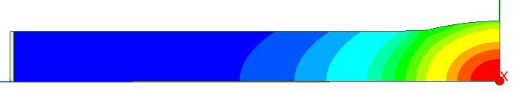
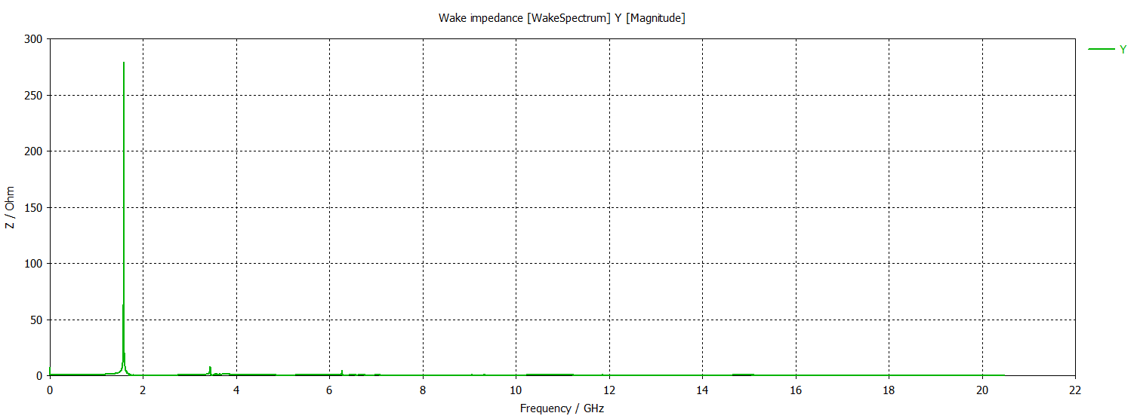
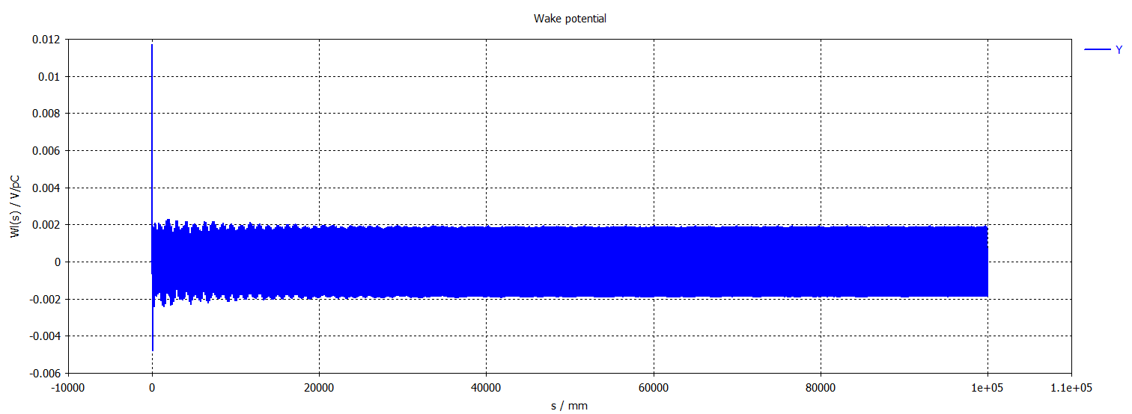
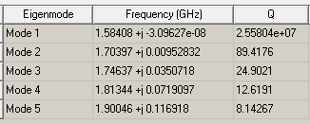
Dipole wake: a=52mm: R/Q=0.6Ω
CST wakefield solver
Indirect testbeams
FFT
TE111 mode: E-field
Lower Order Mode
(LOM) TE111is trapped and require damping
TE11 WG mode cutoff: 1.69 GHz

Slide 15
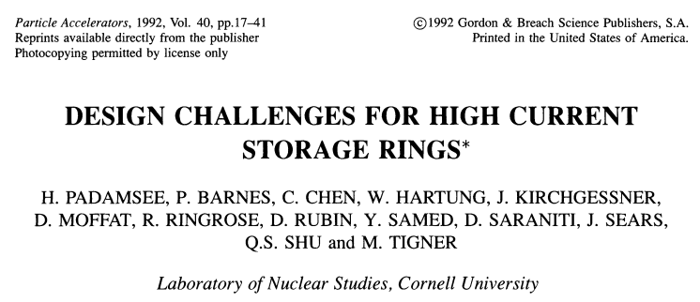
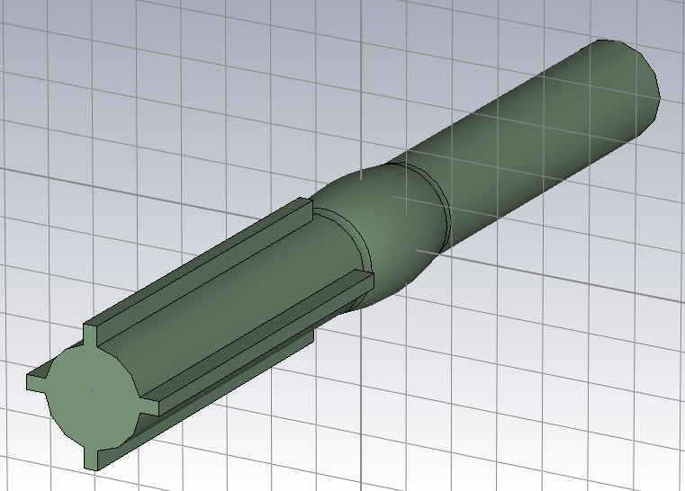
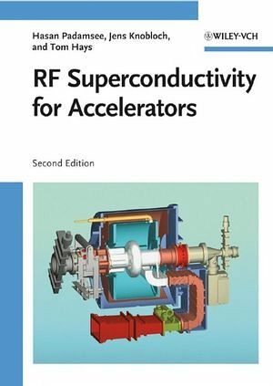
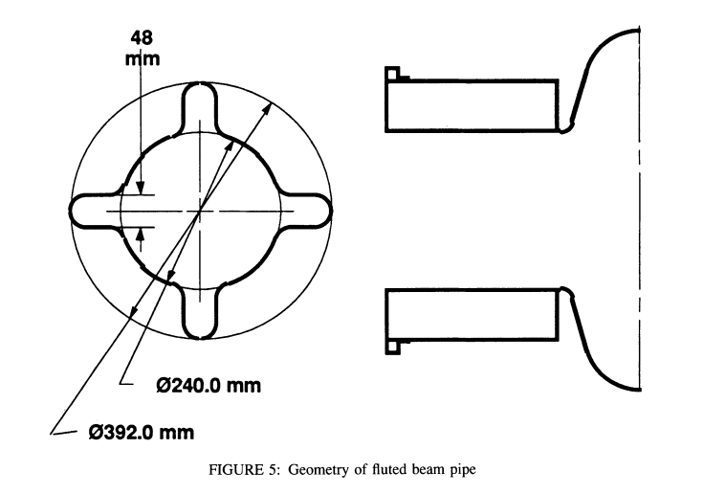
Damping TE111 LOM,
Cornell cavity approach
The magic flute helps to damp dipole LOM
One of the BCC beam pipes is ‘fluted’ using 4 longitudinal grooves to reduce TE11 WG mode cutoff from 1.69 GHz to lower value and let TE111 mode at f=1.59 GHz escape.

Slide 16
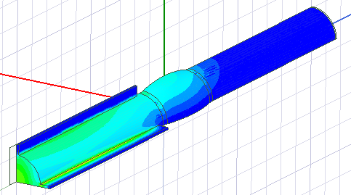
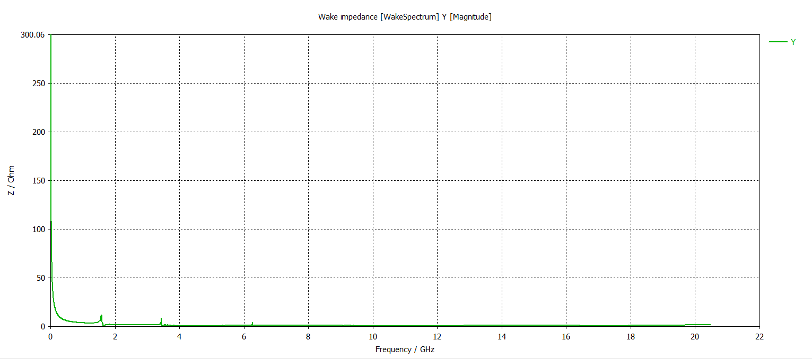
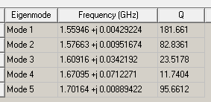
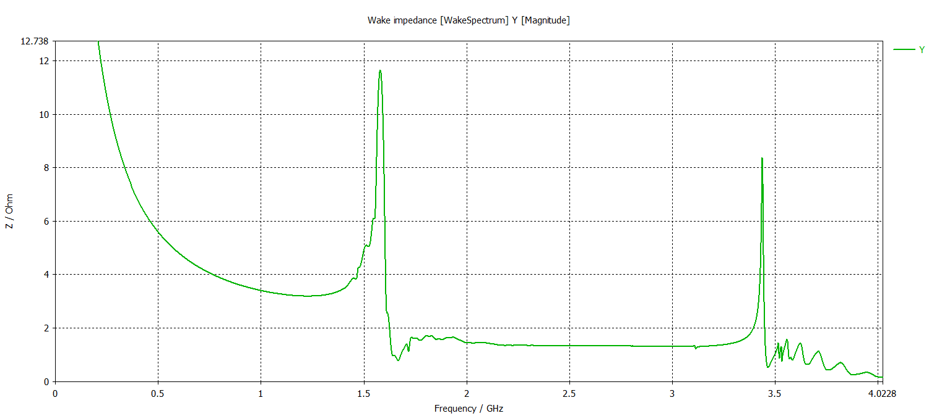
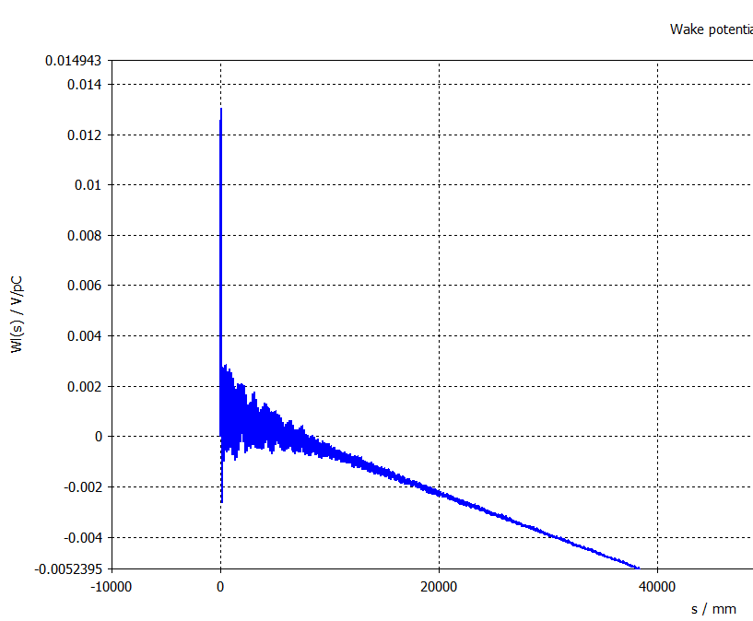
Damping TE111 mode
damping
Lower Order Mode
LOM TE111 mode
is well damped
The dipole wake is well damped
The slop is numerical artefact, require special treatment but does not change the conclusion about damping

Slide 17
An idea for RF frequency tuning
Longitudinal Corrugations used for damping dipole LOM can also be used to deform (reduce or increase) the ‘fluted’ beam pipe cross-section
Although it is not the cavity itself it will impact the cavity fundamental mode frequency depending on how close is the deformation to the cavity

Slide 18
Another way to reduce number of cavities:
Less conservative specification for bunch phase variation: R/Q = 28.6Ω
Total R/Q = 14.3 Ω results in 1º peak-to-peak linear variation
The specification for the bunch phase (bunch spacing) variation is given as δφ_{b} < ±1º.
The total variation is 2º peak-to-peak
Assuming linear scaling of the phase variation with the R/Q we can estimate R/Q for 2º peak-to-peak phase variation: 14.3 * 2 = 28.6 Ω
It is basically factor 2 larger due to taking off the factor 2 margin we had before
This is less conservative but on the other hand it will be better for most of the bunches, so integrated effect over the full bunch train is expected to be less than ±1º.
To be confirmed by the beam dynamics

Slide 19
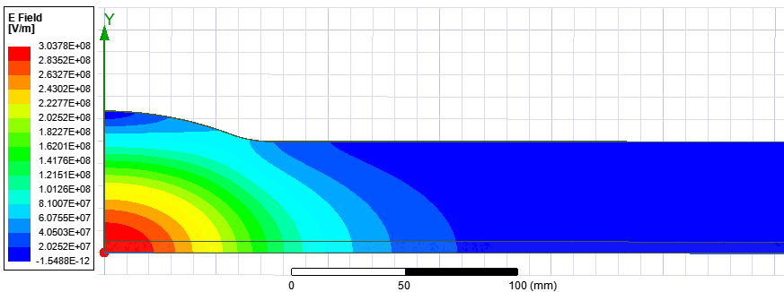
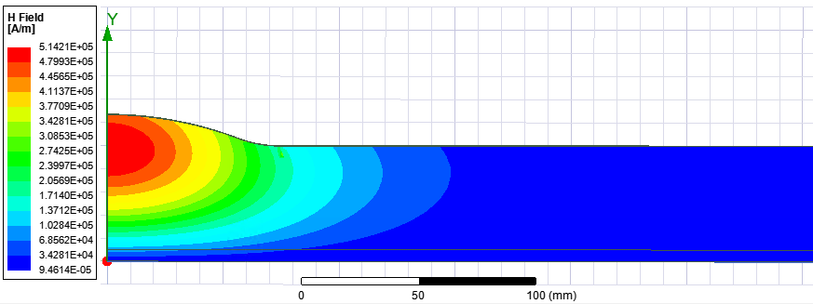
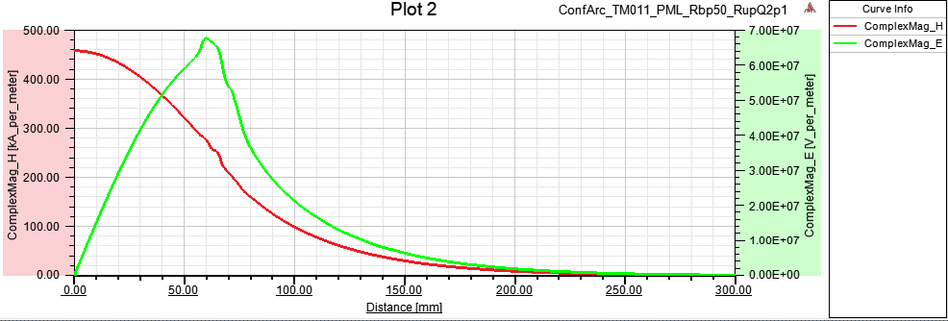
Cavity design for total R/Q=28.6Ω
TM011
a [mm] | 50
f [GHz] | 2
a/λ | 1/3
Lc [mm] (0.01Hmax) | 500
Rarc [mm] | 160
Rcav [mm] | 63.55
R/Q [circuitΩ] | 2.04
Emax/Vacc [1/m] | 24.86
Hmax/Vacc [mA/Vm] | 170
E- and H-fields for 144J
Hmax limit: 80kA/m
Vmax = 0.47 MV
Umax = 4.3 J
Emax = 11.7 MV/m

Slide 20
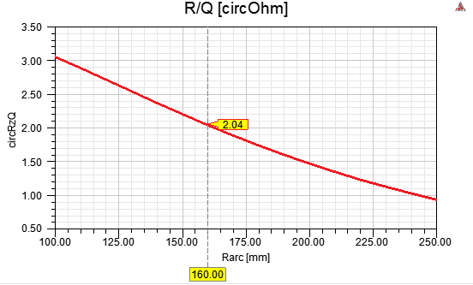
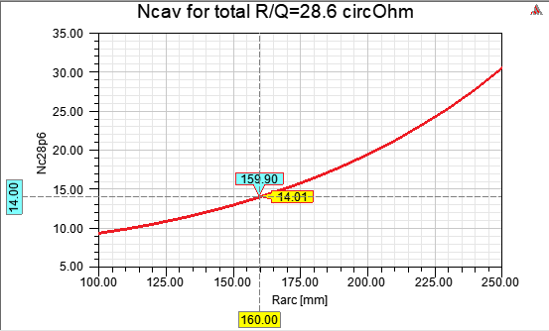
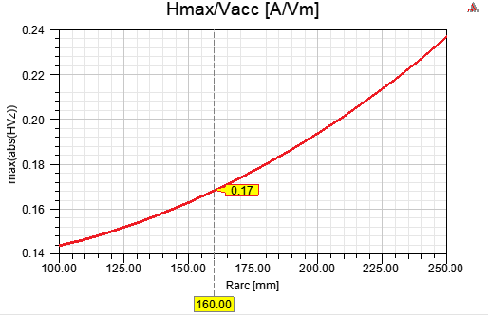
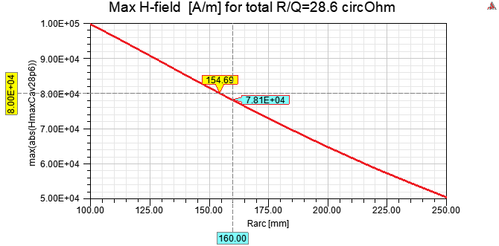
Optimization of the design for total R/Q=28.6Ω
14 cavities
R/Q=2.04Ω

Slide 21
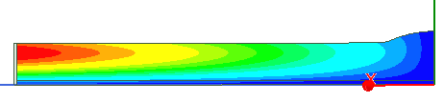

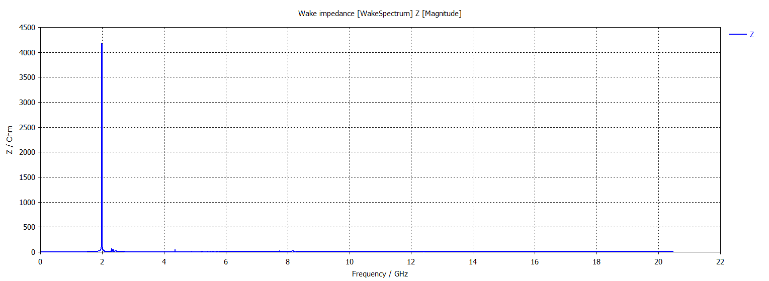
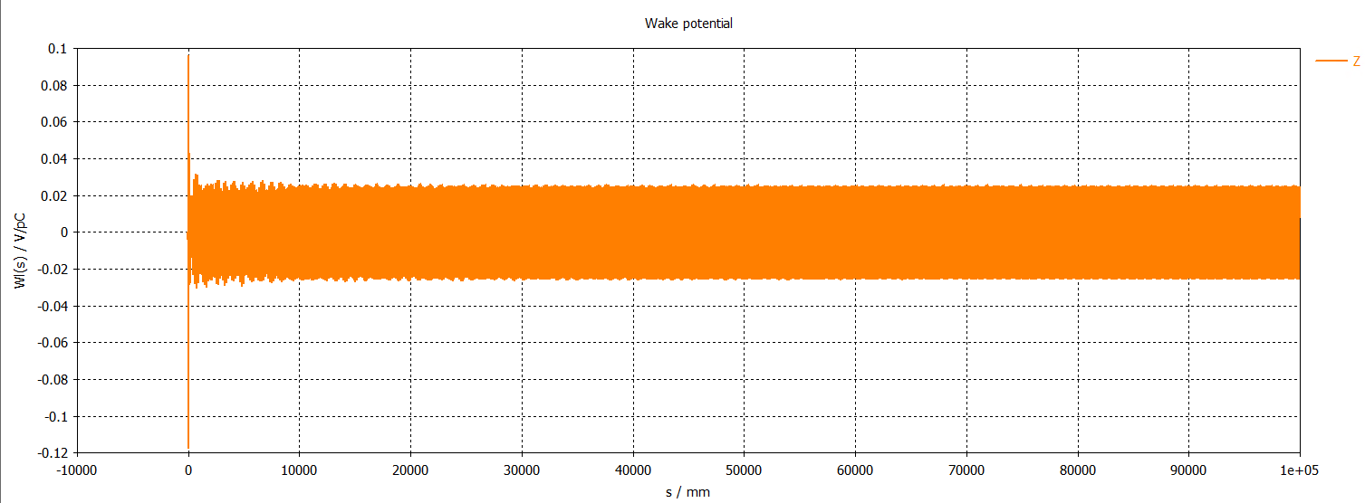
Damping TM01n HOMs, => a=50mm
Lowest monopole HOM: TM012
Only operating
Fundamental
TM011 mode
is trapped

Slide 22
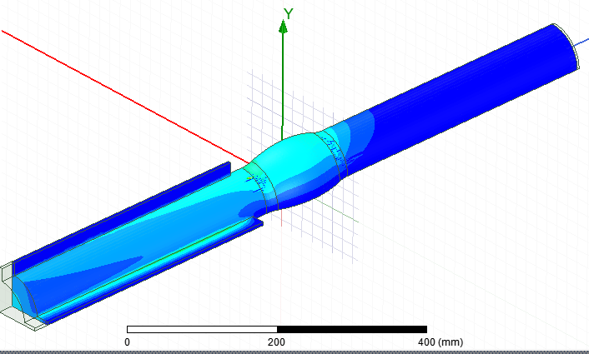
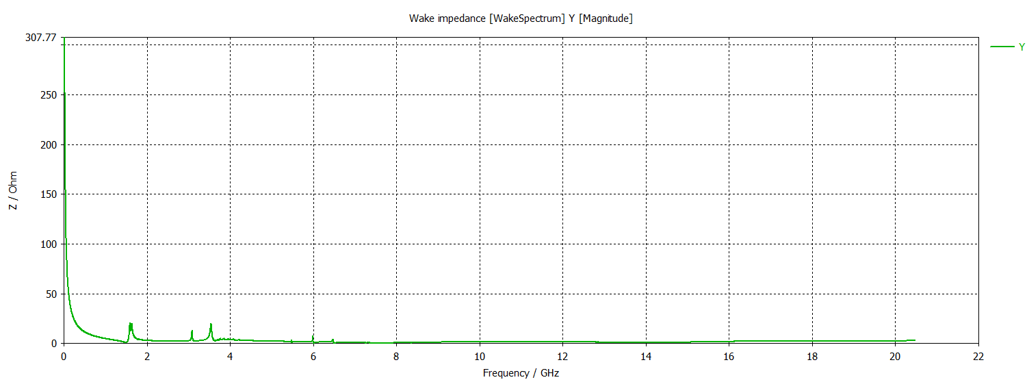
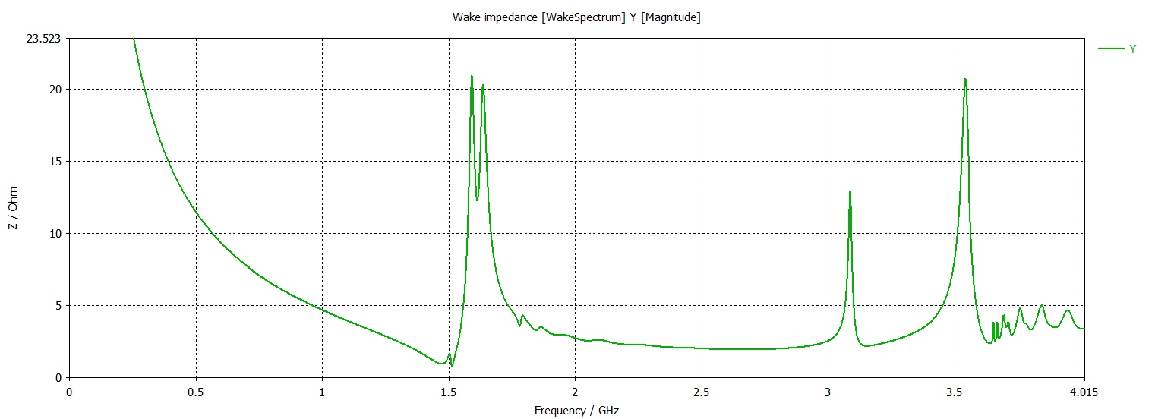
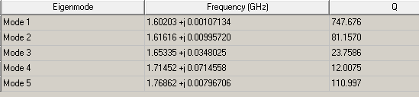
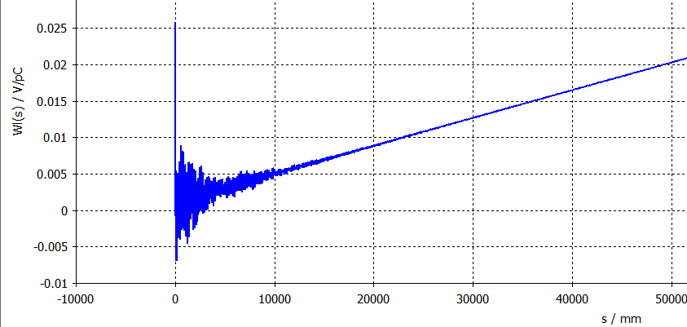
Damping TE111 mode
damping
Lower Order Mode
LOM TE111 mode
is well damped
The dipole wake is well damped
The slop is numerical artefact, it requires special treatment but does not change the conclusion about damping

Slide 23
Summary table
Case | 1 | 2 | 3 | 4
Cavity R/Q [Ω] | 0.6 |  | 2.04
a [mm] | 52 |  | 50
Lc [mm] (0.01Hmax) | 520 |  | 500
Rarc [mm] | 307 |  | 160
Rcav [mm] | 61.95 |  | 63.55
Total R/Q [Ω] | 14.3 | 7.15 | 28.6 | 14.3
Bunch phase variation [º] @2GHz | 1 | 0.5 | 2 | 1
Ncav | 24 | 12 | 14 | 7
Cavity input power Pin [kW] | 60 | 120 | 103 | 206
Bmax [mT] | 100 | 200 | 100 | 200
Hmax [kA/m] | 80 | 160 | 80 | 160
Emax [MV/m] | 8.7 | 17.4 | 11.7 | 23.4
Cavity voltage Vc [MV] | 0.275 | 0.55 | 0.47 | 0.94
Cavity stored energy Uc [J] | 5.0 | 20.0 | 4.3 | 17.1

Slide 24

Fundamental power coupler limit (Eric, FCC2021)
At 2 GHz
P [kW] = 200 (FCC goal)
P [kW] = 100 (SOTA)

Slide 25

Dual coupler cavity geometry for case 4
In case 4:
Pin = 206 kW per cavity
If the limit is 100 kW per coupler
Two couplers may be used

Slide 26
2-cell BCC operating at 2π-mode for case 1
Case 1 need 24 cavities
Potentially it can be reduced by x2 by going to 2-cell cavities of novel shape
2 GHz: λ=150mm;
Conventional multi-cell periodic structure is based on π-mode, cell length: λ/2=75mm.
This does not work here since cell is significantly longer: ~200mm
Novel multi-cell periodic structure based on 2π-mode, cell length: λ=150mm is proposed
200mm
2π-mode 2-cells BCC
~150mm

Slide 27



LLRF simulation results for cases 1 - 4
Design | Δf (Hz) | Q_{L} | Peak power per klystron (kW) | Total peak power (MW) | φ_{b} | Δφ
1 | -514 | 983e3 | 62.2 | 1.49 | -26.8° | 0.99°
2 | -257 | 1962e3 | 125 | 1.49 | -26.8° | 0.49°
3 | -1020 | 496e3 | 107 | 1.49 | -26.8° | 1.99°
4 | -510 | 990e3 | 213 | 1.49 | -26.8° | 0.98°
Due to the very high cavity filling time, the closed-loop response of the RF/LLRF system is slow.
In addition, there is a 350 ns delay in the RF loop. Very small klystron power modulation

Slide 28

Comparison: baseline vs new proposal
Current baseline
New proposed design #1
Cavity type | ARES | BCC
Cavity R/Q [Ω] | 7.5 | 0.6
N of cavities | 32 | 24
Peak input power [kW/cavity] | 405 | 60
Total peak input power [MW] | 13 | 1.5
RF power match the average beam power => efficient
No klystron power modulation => no large bandwidth
Peak power requirements are SIGNIFICANTLY reduced => cost, size

Slide 29
Summary and outlook
Novel shape cavity for ultra low R/Q is proposed
It allows to implement RF system with small variation of stored energy enough to maintain beam phase variation below the specified value of 1 degree with ‘classical’ slow feedback LLRF
The RF system based on this cavities requires significantly less (x9) RF power and has higher RF-to-beam efficiency compared to current baseline
The number of cavities can also be reduced or even significantly reduced depending on the final design choice
Several designs are proposed. The final design choice depends on:
  Cavity performance in terms of achievable surface B-field.
  Beam dynamics requirement for the beam phase variation of all bunches in the train considering that it has linear distribution at the exit of DR.
BCC has much lower max surface E-field to B-field ratio. This type of cavity can be useful for testing B-field limit with less of a concern about field emission

