Slide 1
Considerations on the RF frequency choice for Muon Collider
Alexej Grudiev
31.08.2021
MC RF WG meeting #4

Slide 2
Motivation
Collect information which might be relevant for the RF frequency choice for the muon collider RF systems

Slide 3
Muon collider and RF systems
Proton driven Muon Collider Concept (MAP collaboration)
RF
RF
RF
RF
RF
RF
RF
RF
RF
RF
RF
RF
RF

Slide 4
RF pulse length and frequency landscape
RF
RF
RF
RF
RF
RF
RF
RF
RF
RF
RF
RF
RF
Linac: ~1-5 ms
SNS: 402.5, 805 MHz
ESS, SPL, CERN-L4: 352, 704 MHz
PIP-II: 325, 650 MHz
Muon cooling RF: ~0.1-0.5 ms
Many frequencies in Buncher, Rotator, Merge, Final Cooling
Cooling cells have two harmonic frequencies:
  MAP: 325, 650 MHz
  Alternative: 352, 704 MHz
Accelerator SRF
LA, RLA: ~1-10 ms
  MAP: 325, 650 MHz
  CERN-L4, SPL, ESS: 352, 704 MHz
Rings: CW
  MAP: 1300 MHz (very high)
  LEP: 352 MHz; LHC: 400 MHz
  FCC: 400, 800, 650(?) MHz
  CEPC: 650 MHz

Slide 5
Beam time structure and RF frequency
RF
RF
RF
RF
RF
RF
RF
RF
RF
RF
RF
RF
RF
Single p-bunch
Two single μ+ & μ- bunches
Two RF harmonics are used for low and high energy part of the linac
Many frequencies are used for bunch manipulations,
Majority of cavities at two RF harmonics in 6D cooling
Several RF frequencies are used for low and high energy part of the accelerator complex. Not necessarily harmonics.
Single bunch operation does NOT require the RF frequency in proton driver linac, muon cooling and accelerator complexes be related

Slide 6
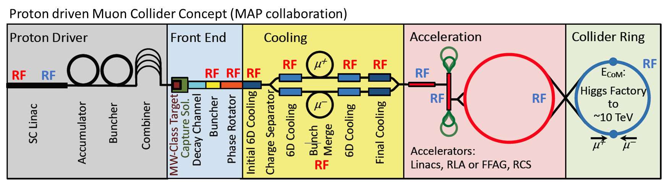
Common frequency for pulsed linacs
There might be some reasons to keep the close frequencies the same in the pulsed linac type complexes:
  Proton driver linac; Muon cooling complex Linac and RLA for muon acceleration
For example, in MAP: 325, 650 MHz are used in all 3. CERN, ESS: 352, 704 MHz could be used instead
Possible reasons for common frequency (to be discussed):
  LLRF, controls, waveguide components, RF power sources, SRF cavities …

Slide 7
Sinergy with RF technology R&D
NRF for muon cooling has no other applications, very little (if no) synergy
SRF has a lot of different applications, more synergy
  Proton driver can be very similar to existing ones, so does the RF
  High gradient R&D elsewhere is relevant for muon accelerator complex. Does not require exact frequency match.
R&D on High efficiency RF power sources
  Highly important for muon collider RF system efficiency and cost
…

Slide 8
Commercial RF power sources
Commercially available RF power sources are at the frequencies of currently running proton linacs:
  SNS:
    Thales: TH2168: 805MHz, 5MW, 1.5ms;
    Thales: TH2177: 402.5MHz, 2.5MW, 1.33ms
  ESS, L4:
    CPI: VKP-8352A/B:352MHz, 2.8MW, 100kW
    CPI: VKP-8292A: 704MHz, 1.5MW, 74kW
    CANON: E37504 704MHz, 1.5MW, 74kW, 3.5ms, 14 Hz
650MHz: No high >1MW RF power sources (?, TBC)
325 MHz: CANON E3740A: 3MW, 95kW, 0.6ms, 50Hz
… more info is needed

Slide 9
Collider versus muon cooling demonstrator
Demonstrator must be designed and build on much shorter time scale and with limited budget.
Little room for getting a new RF power sources at a specified frequencies for the demostrator
Probably has to rely on available commercial RF power sources at 704 MHz
This may or may not limit the choice of the RF frequency for the collider muon cooling complex to 352, 704 MHz.

Slide 10
Anything else ?

Slide 11
Spare slides

Slide 12
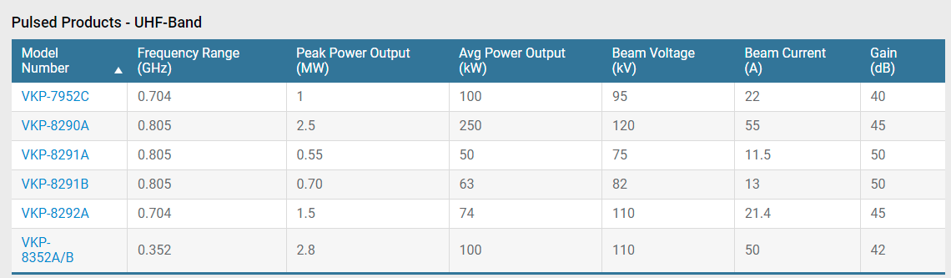
CPI
ESS

Slide 13
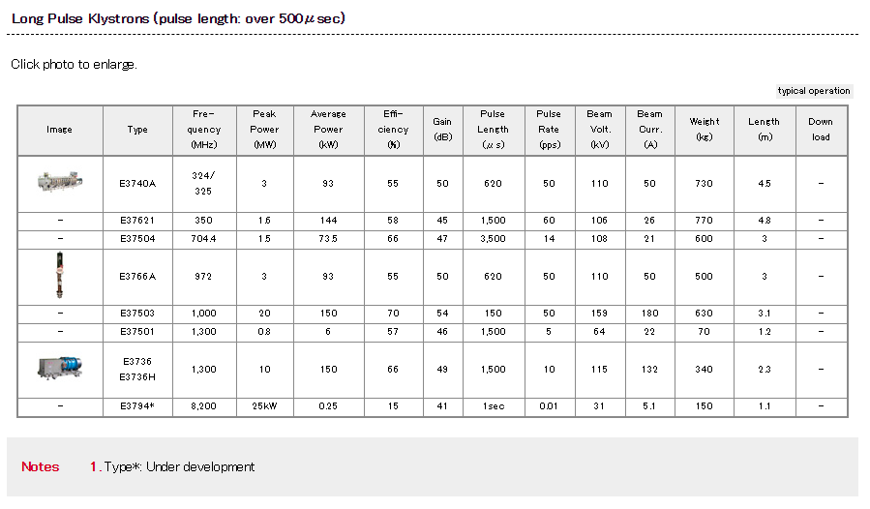
Canon
ESS

Slide 14
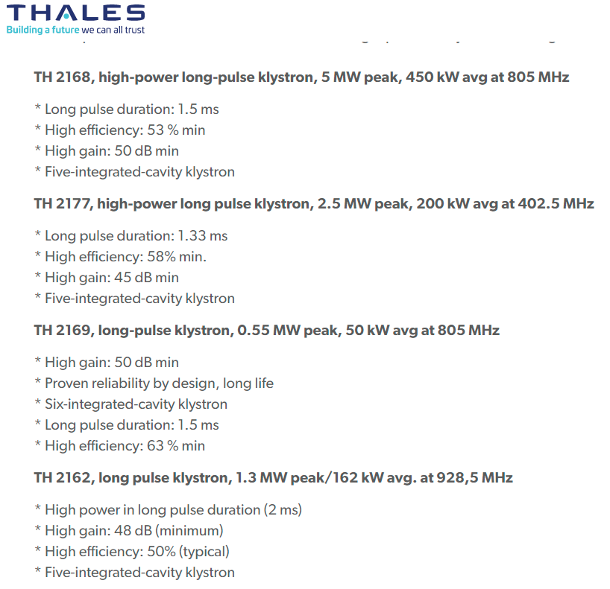
Thales
SNS

