Slide 1
3rd muon community meeting preparation discussion
Alexej Grudiev
31/08/2021
MC RF WG meeting

Slide 2
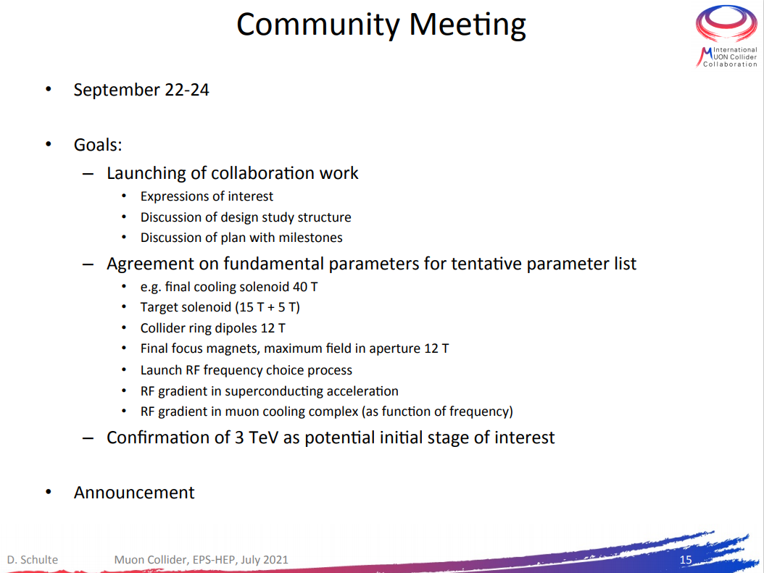
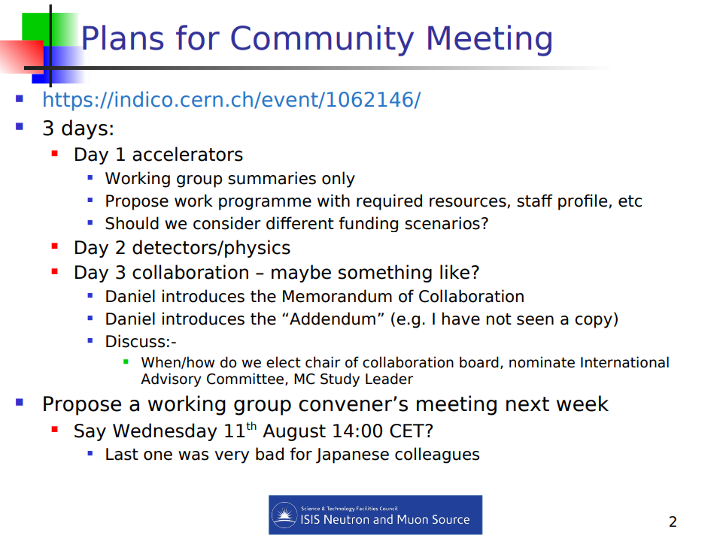
3rd muon community meeting,
Input from the LDG panel
Daniel
Chris

Slide 3
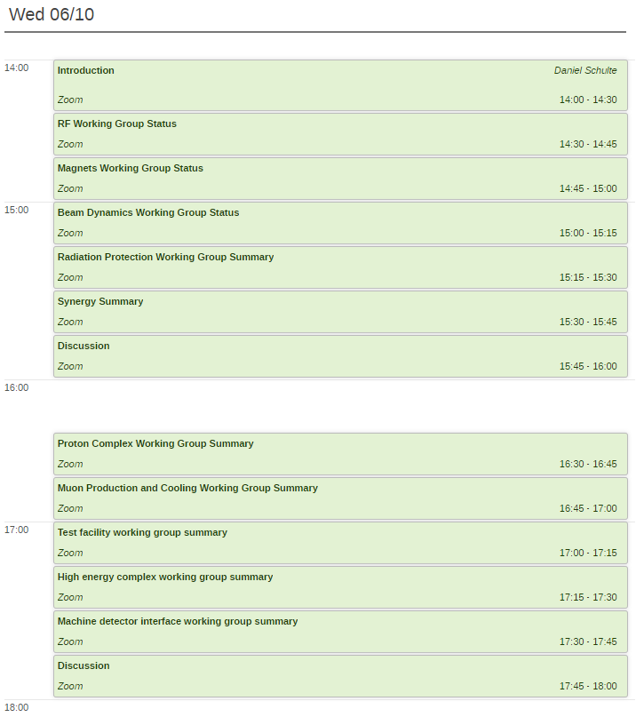

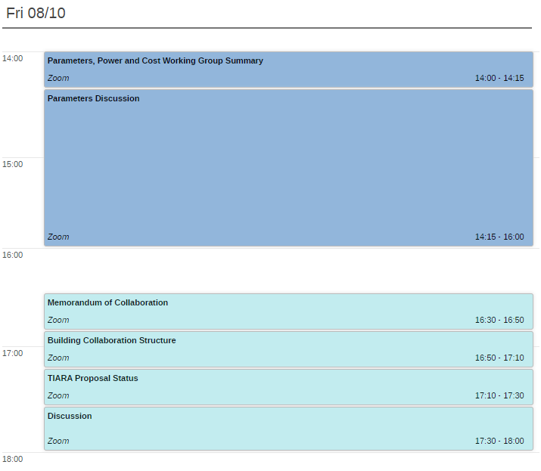
3rd muon community meeting agenda
No RF
Propose prioritized work program with resource estimate
• Launch RF frequency choice process
• RF gradients in SRF and in NRF as function of frequency
Launching collaboration work
• Expressions of interest
• Discussion of design study structure
• Discussion of plan with milestones

