Slide 1



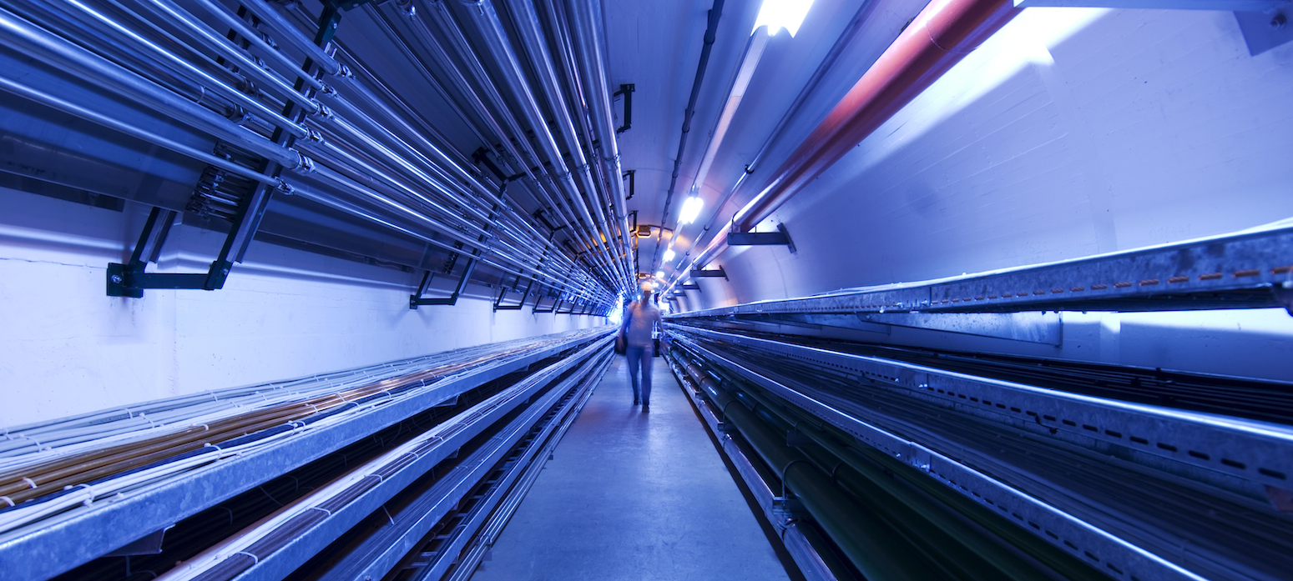
Ideas for RF tests at Saclay
Sergey Arsenyev
MC RF WG meeting #4
Aug 31 2021

Slide 2
Layout (option with existing klystrons)
To build
Already exists
bunker
magnet
Klystrons (f=704 MHz)
Thales 2182A 1.6 MW peak
2.8 MW
magic tee
cavity
CPI VKP7952A 1.2 MW peak
pulse compressor
7m

Slide 3
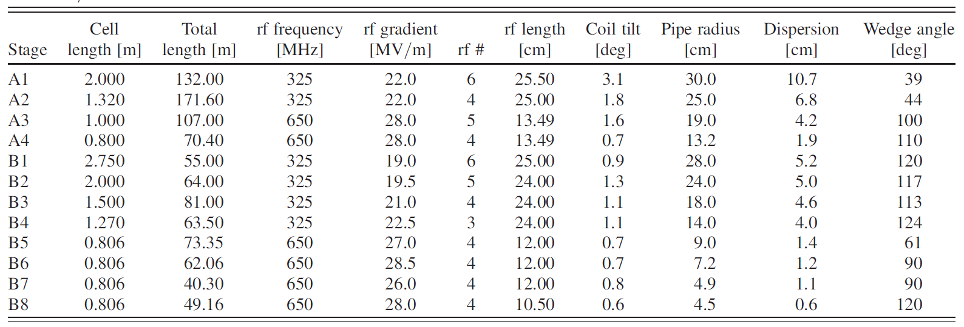
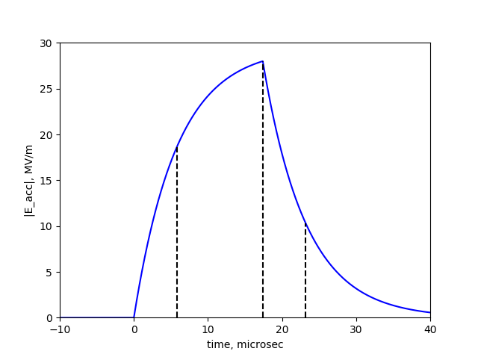


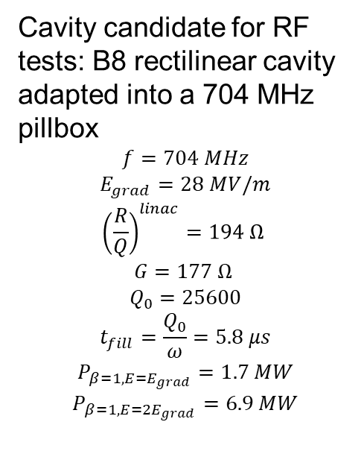


Chosen test cavity
Rectilinear cooling channel RF cavities
Cavity candidate for RF tests: B8 rectilinear cavity adapted into a 704 MHz pillbox
$$f=704 MHz$$
$$E_{grad}=28 MV/m$$
$${\left(\frac{R}{Q}\right)}^{linac}=194 Ω$$
$$G=177 Ω$$
$$Q_{0}=25600$$
$$t_{fill}=\frac{Q_{0}}{ω}=5.8 μs$$
$$P_{β=1, E=E_{grad}}=1.7 MW$$
$$P_{β=1, E={2E}_{grad}}=6.9 MW$$
B=13 T needed!
waveguide
$$r=16.3 cm$$
$$t_{fill}$$
$$t_{fill}$$
$$d=10.5 cm$$

Slide 4
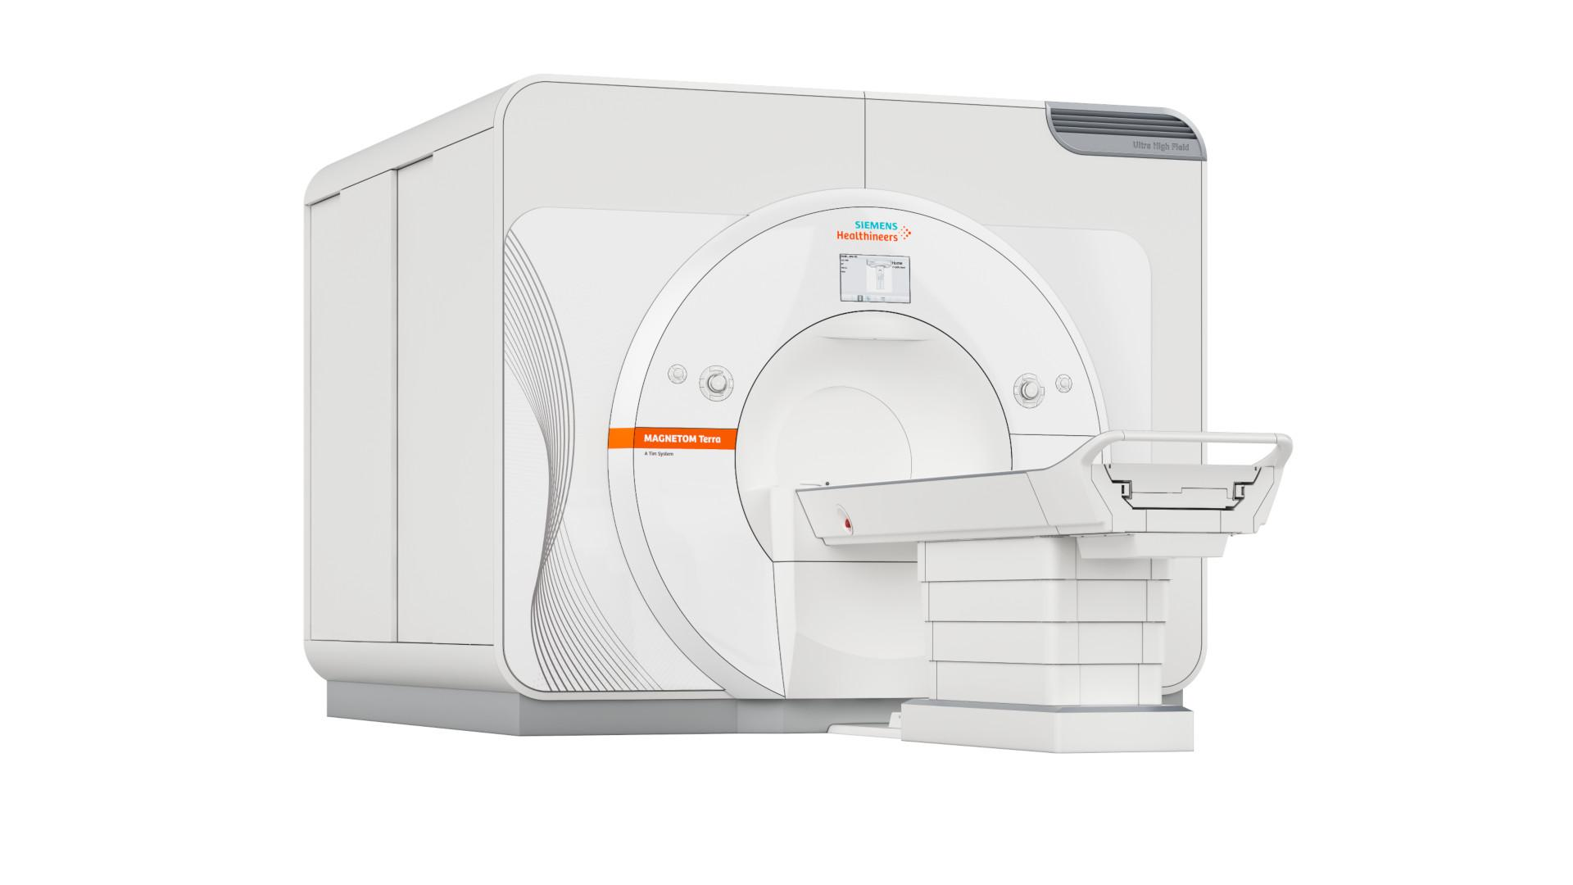
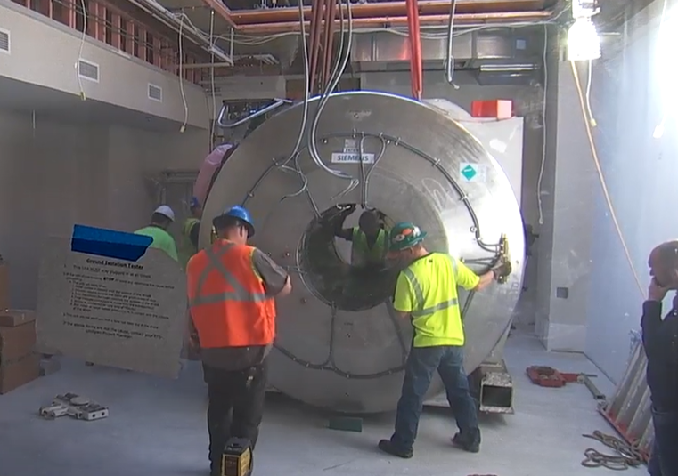
MRI magnet
Complete MRI machine: Siemens MAGNETOM Terra
B-field: 7T (3T magnets are cheaper and more common but are far below design field of 13 T)
Cost: ~7 M€
Bore size: 60 cm
Weight: 25 tons
Low helium consumption (“zero boil-off”)
Need magnetically shielded bunker to avoid stray fields
Minimum total space requirement for magnet, electronics, and console room: 65 m2 (but we only need the magnet)
Example of a magnet installation at a hospital

Slide 5
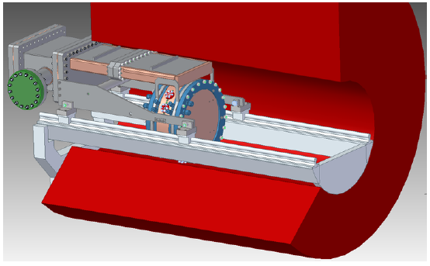
Cavity position in the magnet
MUCOOL setup, 805 MHz (D. Bowring)
CEA setup, 704 MHz
28.4cm
44cm
32.6cm
B-field
60cm
Proposed magnet bore is sufficiently large

Slide 6
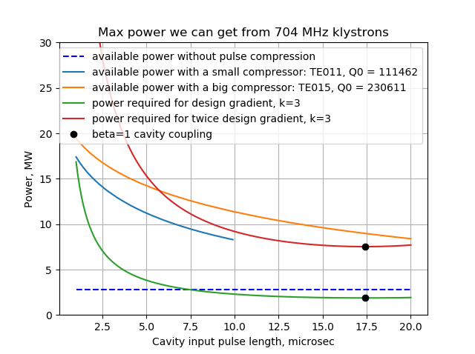
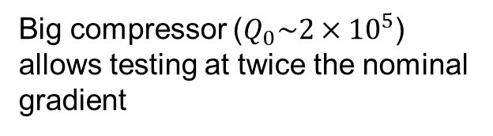
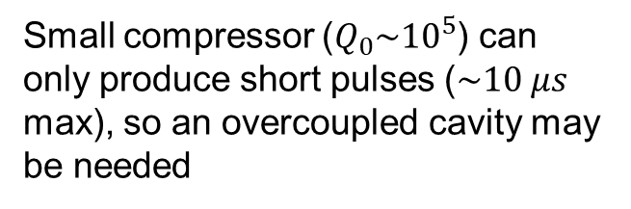
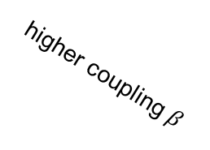
Need for a pulse compressor
Small compressor ($Q_{0}\sim {10}^{5}$) can only produce short pulses ($\sim 10 μs$ max), so an overcoupled cavity may be needed
Big compressor ($Q_{0}\sim {2×10}^{5}$) allows testing at twice the nominal gradient
higher coupling $β$
No compressor - sufficient for tests at the nominal gradient

Slide 7
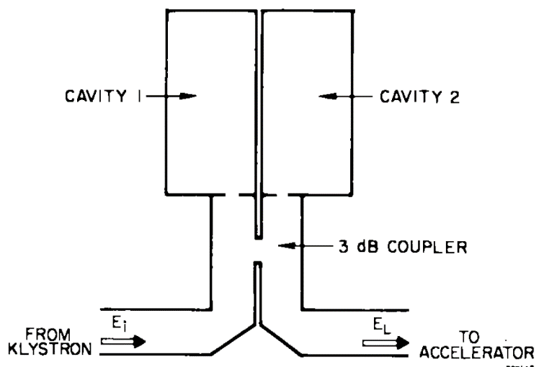
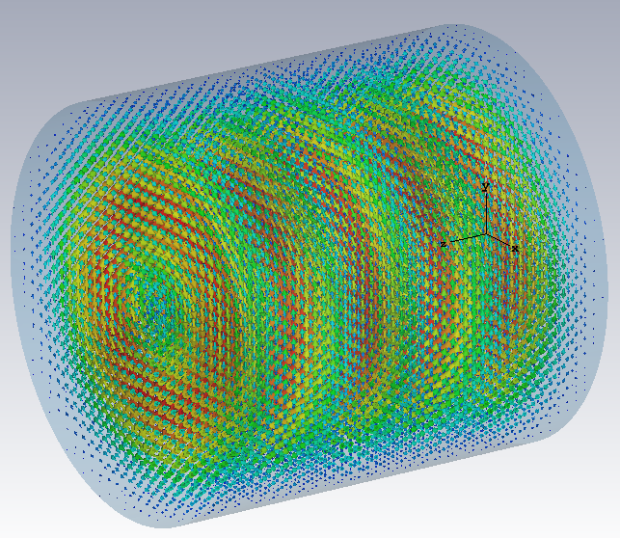
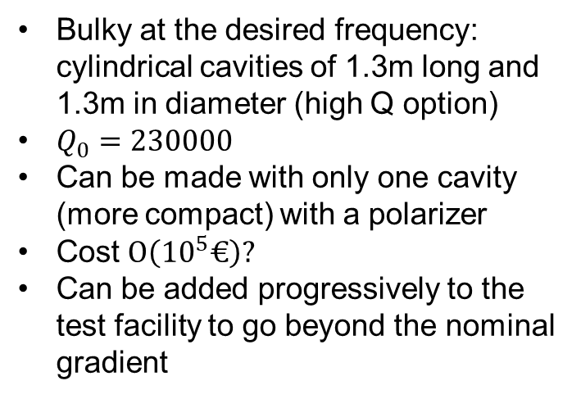
Pulse compressor
Bulky at the desired frequency: cylindrical cavities of 1.3m long and 1.3m in diameter (high Q option)
$Q_{0}=230000$
Can be made with only one cavity (more compact) with a polarizer
Cost $O\left({10}^{5}€\right)?$
Can be added progressively to the test facility to go beyond the nominal gradient
SLED type compressor
TE015 mode

Slide 8
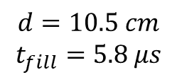
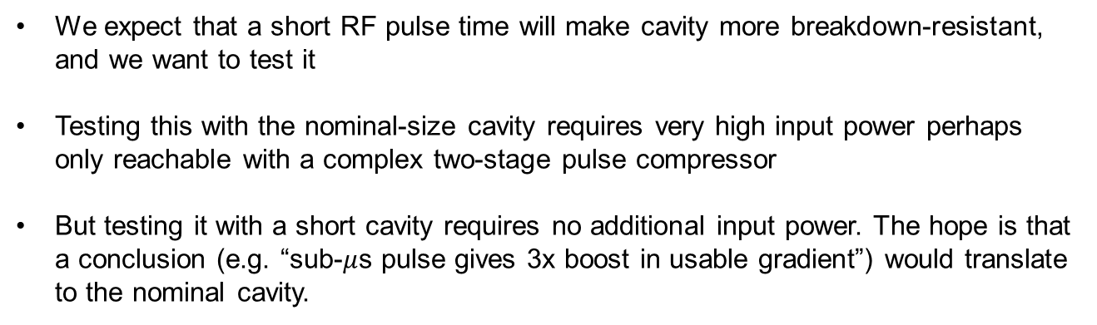
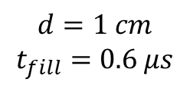
Short cavity to test the effect of pulse length on breakdown
We expect that a short RF pulse time will make cavity more breakdown-resistant, and we want to test it
Testing this with the nominal-size cavity requires very high input power perhaps only reachable with a complex two-stage pulse compressor
But testing it with a short cavity requires no additional input power. The hope is that a conclusion (e.g. “sub-$μ$s pulse gives 3x boost in usable gradient”) would translate to the nominal cavity.
$$d=10.5 cm$$
$$t_{fill}=5.8 μs$$
$$d=1 cm$$
$$t_{fill}=0.6 μs$$

Slide 9
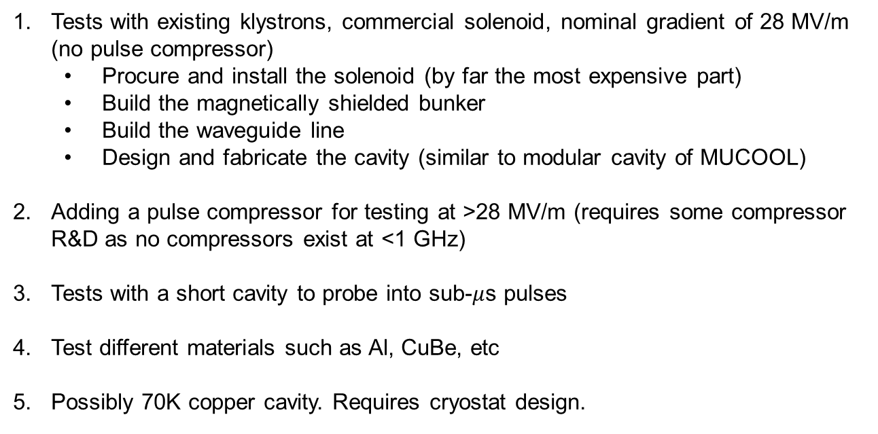
Possible phases
Tests with existing klystrons, commercial solenoid, nominal gradient of 28 MV/m (no pulse compressor)
  Procure and install the solenoid (by far the most expensive part)
  Build the magnetically shielded bunker
  Build the waveguide line
  Design and fabricate the cavity (similar to modular cavity of MUCOOL)
Adding a pulse compressor for testing at >28 MV/m (requires some compressor R&D as no compressors exist at <1 GHz)
Tests with a short cavity to probe into sub-$μ$s pulses
Test different materials such as Al, CuBe, etc
Possibly 70K copper cavity. Requires cryostat design.

Slide 10


Thank you
for attention

