Slide 1
Passive and active contact pressure measurement systems in SC magnets
TE-MSC-SMT- Felix Wolf
02/09/2021, TE-MSC seminar

Slide 2
Outline
Motivation / Introduction
Review of existing contact pressure measure systems
Passive measurement systems
Active measurement systems
Conclusion / summary and outlook

Slide 3
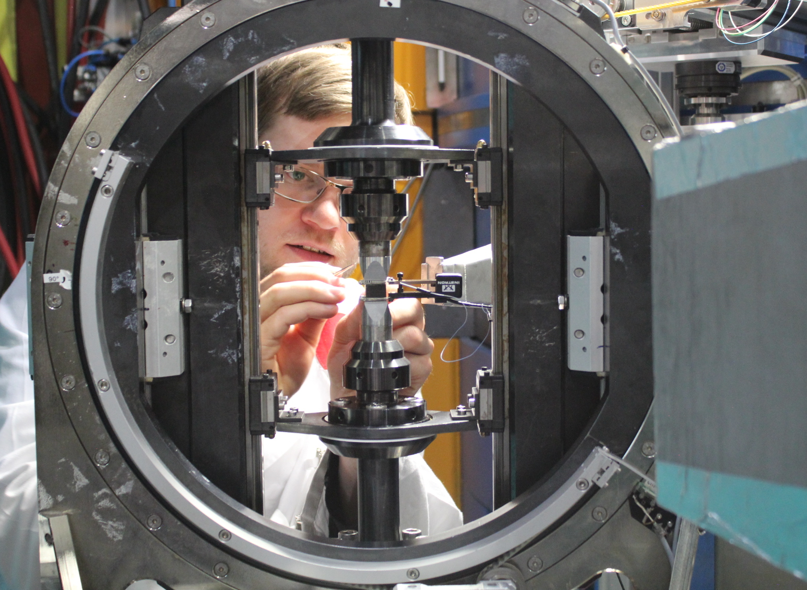
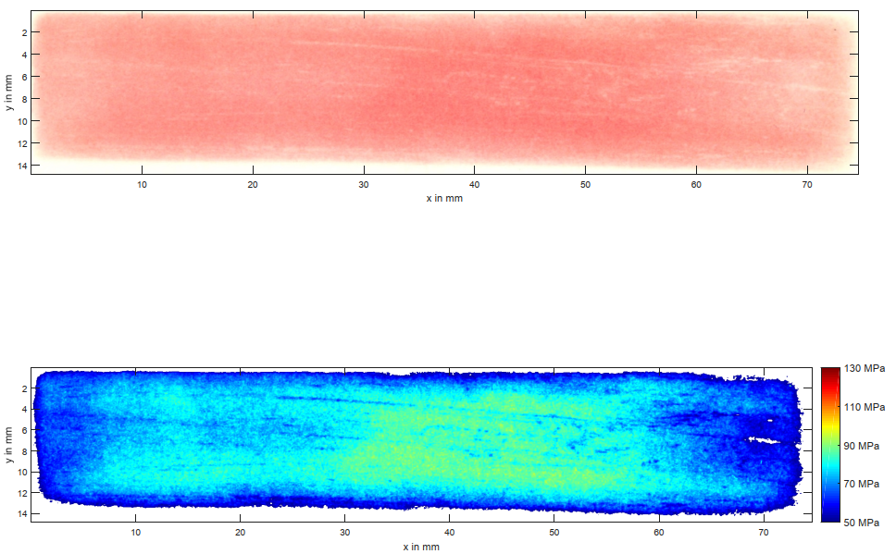
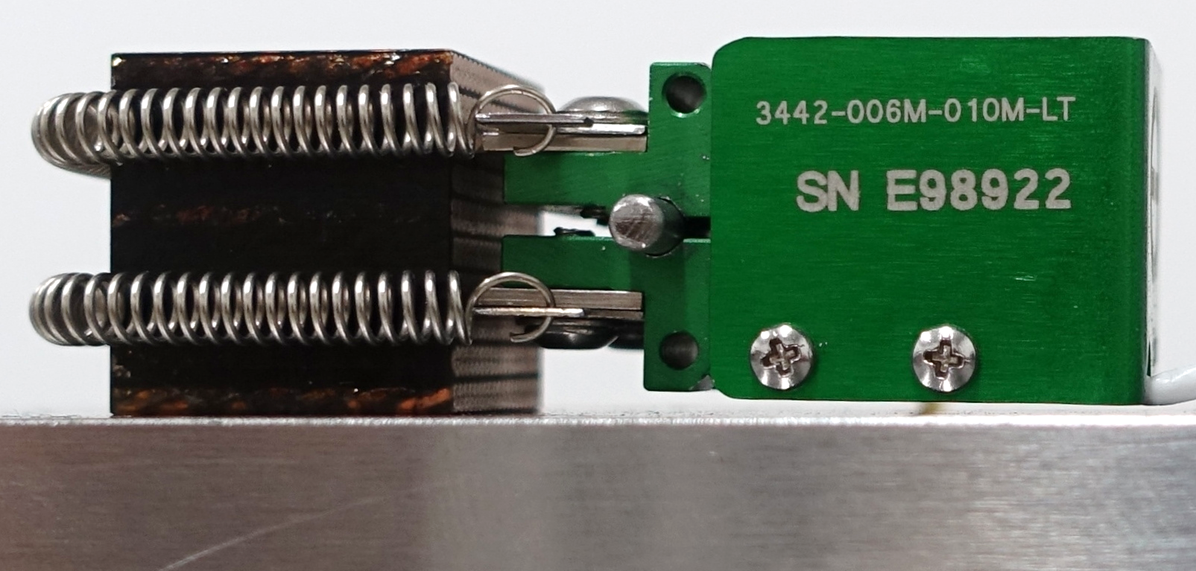
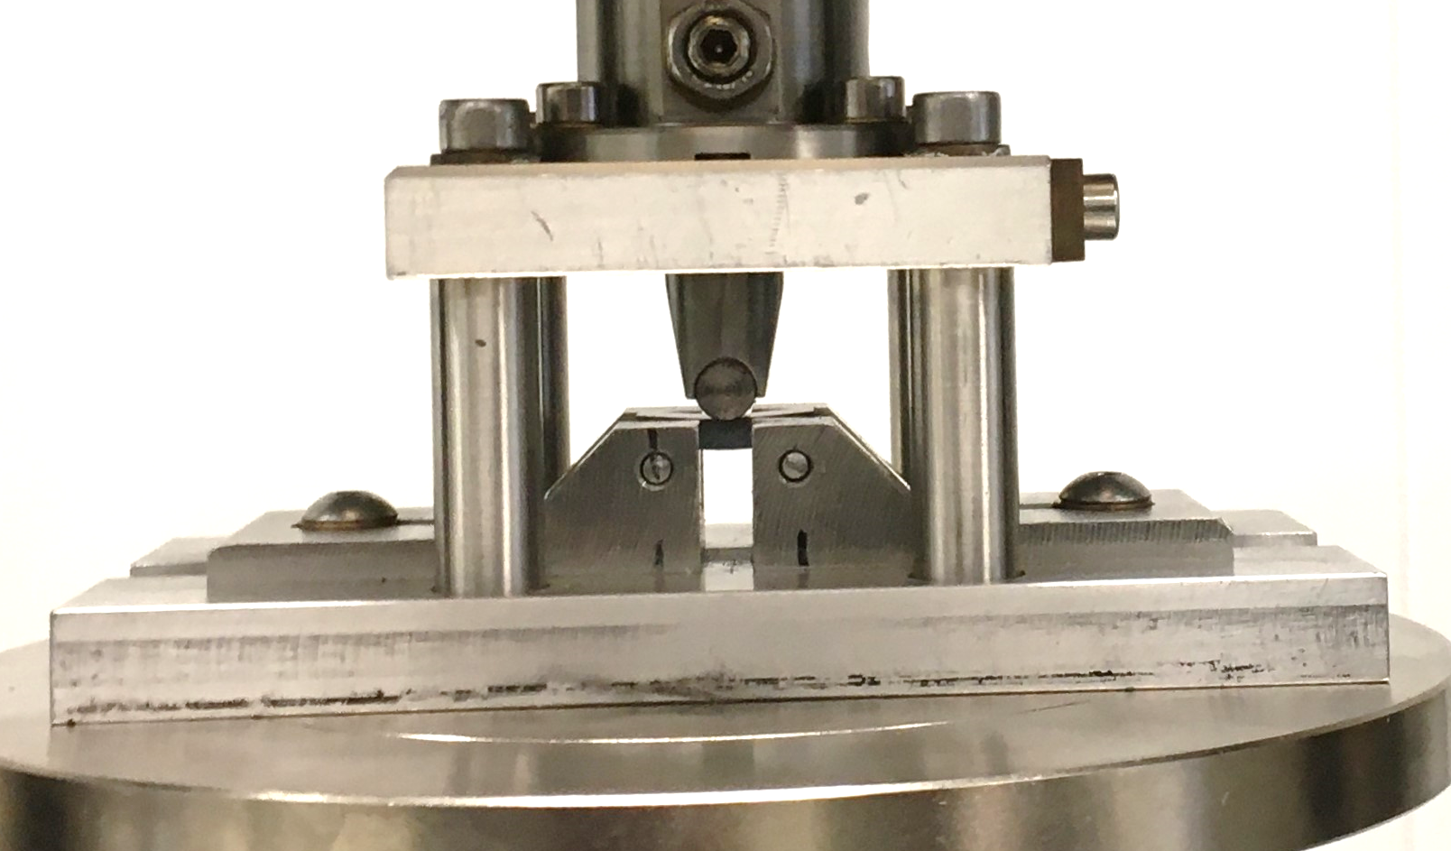
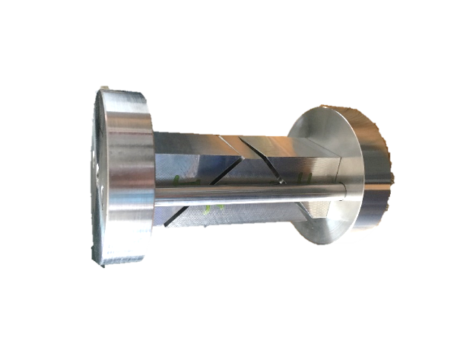
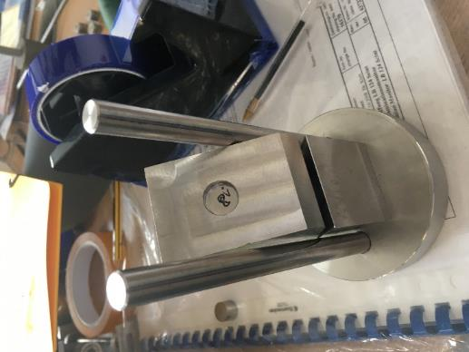
Introduction
My work at CERN, with the following problems
  PhD characterization of the Nb₃Sn conductor
  Conductor limitation due to applied pressure
  Mechanical measurement on the Rutherford cable stacks
  Mechanical characterization of the insulation system
  Characterization of the stress distribution
Mechanical characterization
Neutron diffraction measurements
Contact stress analysis

Slide 4
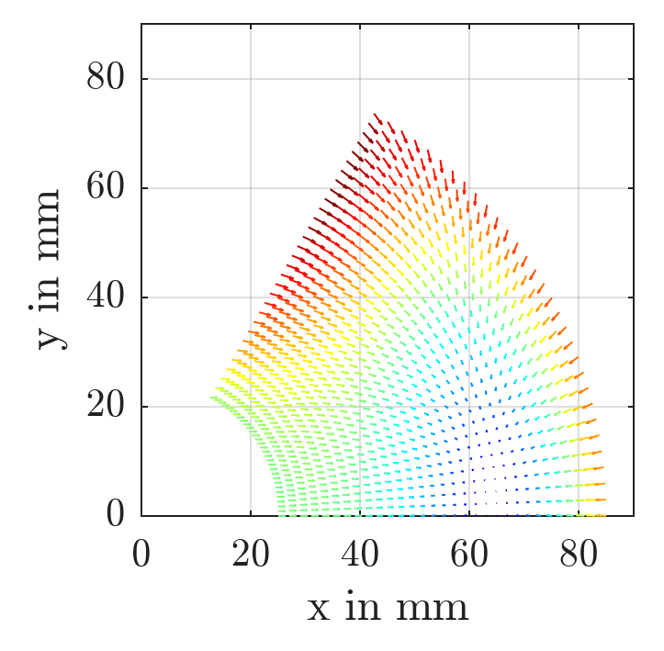
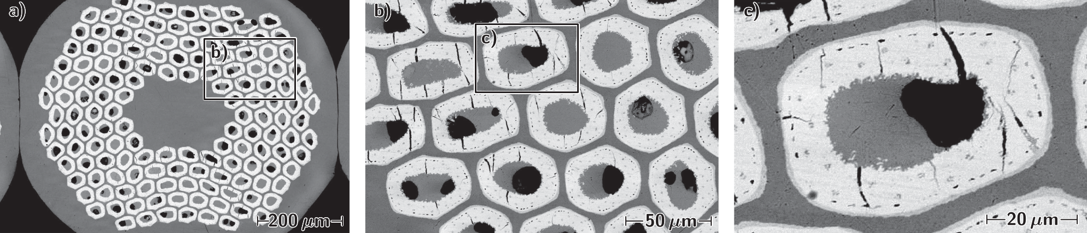
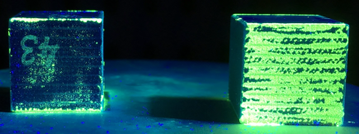
Magnet preload
Required preload
Too high preload
Permanent degradation of the conductor
Cracks in the insulation system
Dipole magnet | Magnetic field | Mid plane stress
LHC [3] | 8.3 T | 70 MPa - 75 MPa
HL-LHC 11T [4] | 11 T | 125 MPa - 135 MPa
Magnetic force distribution in a sector coil.
SEM micrographs of transverse metallographic cross section of the 200 MPa loaded area of a Nb₃Sn Rutherford cable. [2]
Preload to balance magnetic forces
  Prevent conductor motion induced quenches
The origin of a quench may be a conductor motion under the influence of Lorentz forces resulting in a heating of the cable by frictional energy. [1]
Comparison of an virgin sample (left) and a sample after loading (right) under UV light prior application of a ﬂuorescent penetrant.
[2] Patrick Ebermann et al 2018 Supercond. Sci. Technol. 31 065009
[1] Meß, K.H., Schmüser, P., Wolff, S.: Superconducting Accelerator Magnets, World Scientiﬁc, Singapore, 1996
[3] O. S. Brüning, P. Collier, and P. Lebrun, et al., ”LHC Design Report”, CERN Yellow Reports: Monographs, Geneva, 2004.
[4] M. Karppinen et al., “Design of 11T twin-aperture dipole demonstrator magnet for LHC upgrades,” IEEE Trans. App. Supercond., vol. 22, no. 3, 2012.

Slide 5
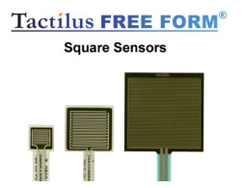
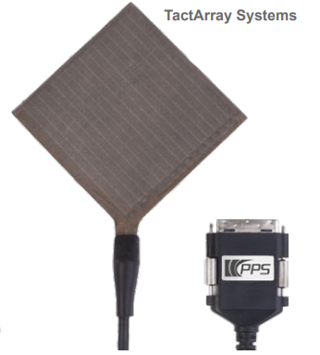
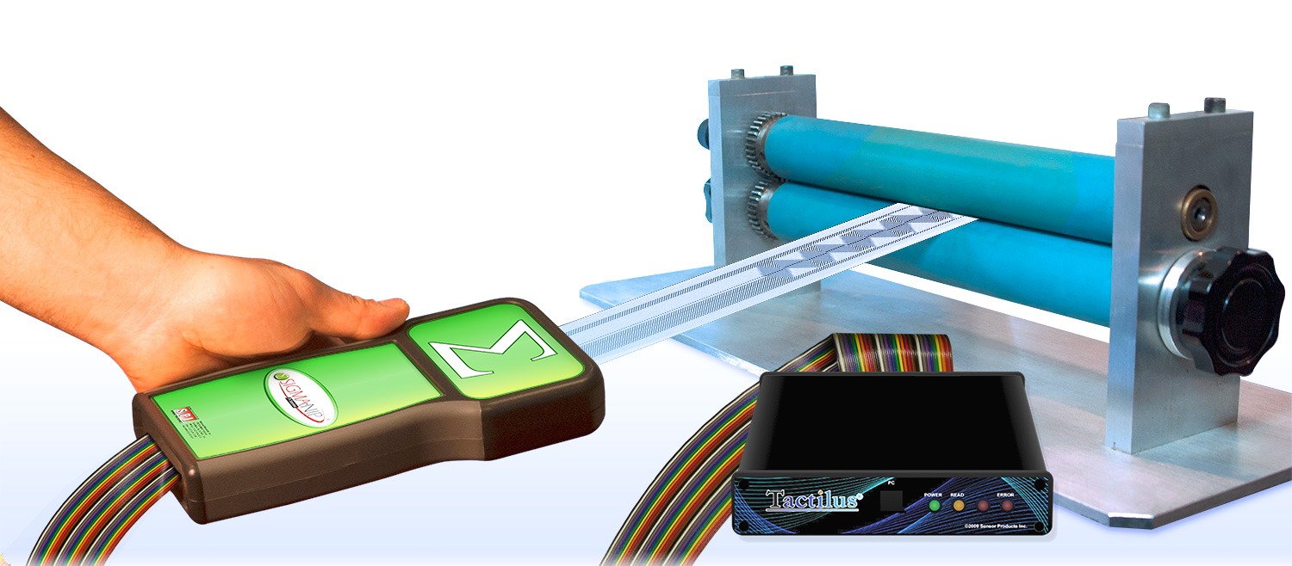
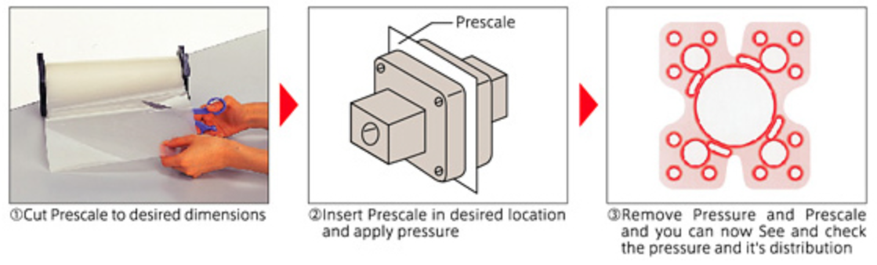
Commercially available systems
Passive systems
Active systems
Name | Stress range | Analysis tool
Fuji Prescale [5] | 0 MPa to 300 MPa | Fuji Analysis
EZ-Nip paper [7] | 0 MPa to 7 MPa | Shoe Press Proﬁle
Mold Align [7] | 7 MPa to 41 MPa | Topaq Analysis System
PressureX-Micro Green [7] | 0.05 MPa to 12.4 MPa | Point scan
PressureX-Micro [7] | 0 MPa to 0.14 MPa | Auto-Nis
Surface Proﬁler Film [7] | 0.1 MPa to 10 MPa | -
Name | Stress range | Method
TekScan [8] | 0 MPa to 200 Mpa | Piezo-resistive
Tactylus [7] | 0 MPa to 2.7 MPa | Piezo-resistive
Tactarry [6] | 0 MPa to 5 MPa | Capacitive
Sigma-Nip [7] | 0.3 MPa to 70 MPa | Thin-ﬁlm resistor
CERN capacitive gauges | 0 MPa to 160 MPa | Capacitive
All systems are based on pressure sensitive films
[7]
[7]
[6]
[2]
[5] FUJIFILM Prescale Instruction Manual
[6] PPS [Online]. https://pressureprofile.com/ [Accessed 2021].
[7] Sensor Products, Inc., [Online]. Available: http://www.sensorprod.com/ [Accessed 2021].
[8] Tekscan, Inc., I-Scan® Product Selection Guide, [Online]. Available: https://www.tekscan.com [Accessed 2021].

Slide 6
Passive system
FUJI prescale film

Slide 7
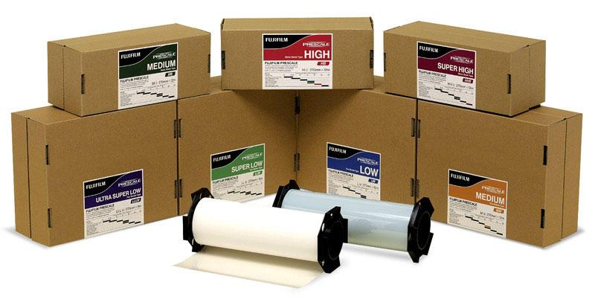
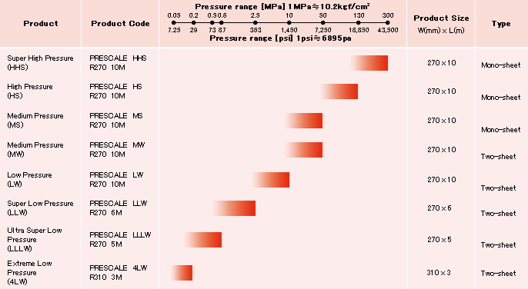
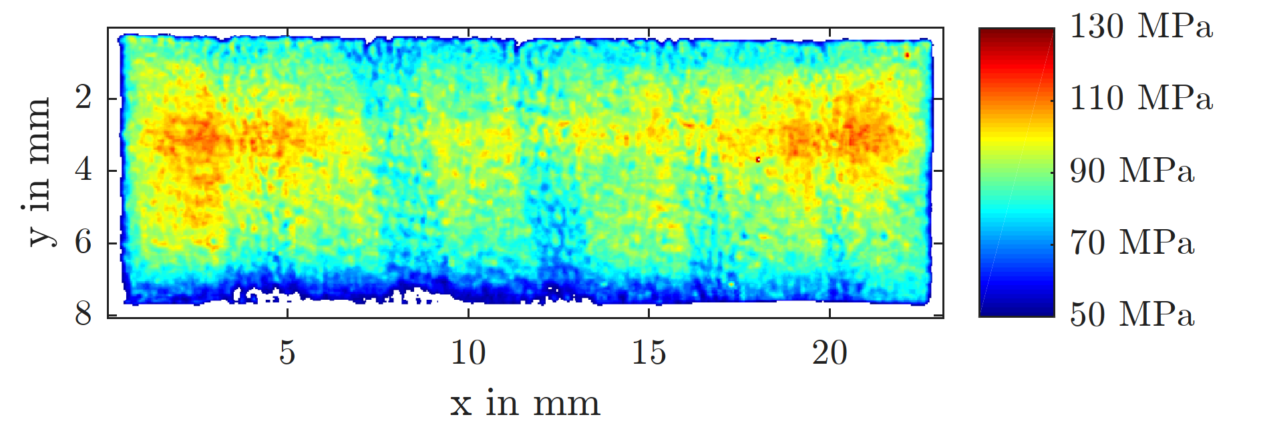
FUJI prescale film – how it works
Polyester base
Color-developing layer
Mono-sheet
  MS 10 – 50 MPa
  HS 50 – 130 MPa
  HHS 130 – 300 MPa
Thickness: 100 ± 5 μm
Spatial resolution: 0.05 mm
Micro capsules (ø 4 to 15 µm) with different wall thickness per film Type
Size: 270mm x 10m
Micro-encapsulated color-forming layer
Layout of a Mono-sheet Prescale Film. [5]
Analysed Prescale film similar to ANSYS stress plot .
Overview of available Prescale film types. [5]
[5] FUJIFILM Prescale Instruction Manual

Slide 8
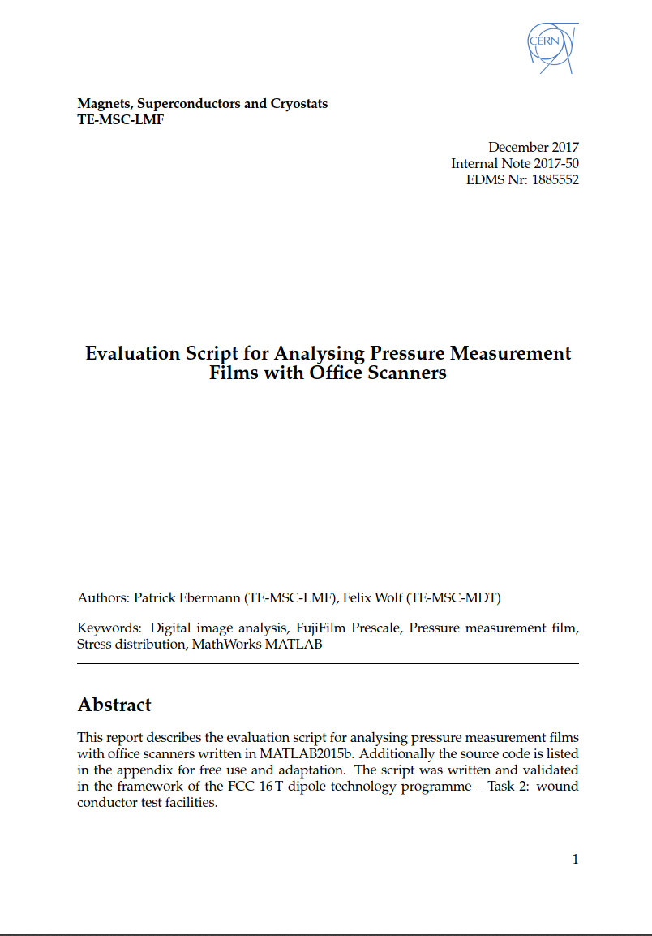
FUJI prescale film – analysis EDMS 1885552 /1
Documentation of the developed code
Mathematical explanation of the used functions
Explanation of the generated output parameter
Validation of the measurements
Source code
https://edms.cern.ch/document/1885552/1

Slide 9
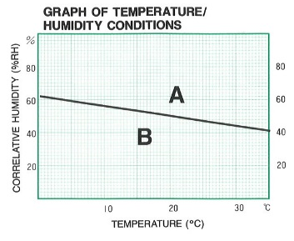
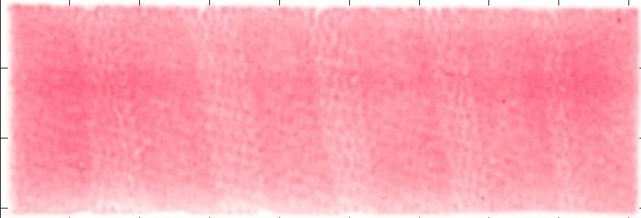
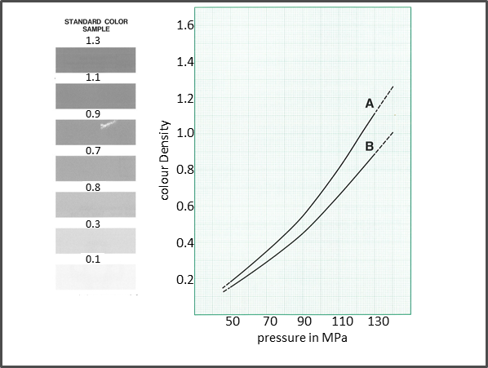
FUJI prescale film – analysis EDMS 1885552 /2
Scan and crop the colorized presclae film
Calibrate the script according to the used scanner
Select a transfer function according temperature and humidity during the test
Execute the analysis script
  Convert color values into gray scale values
  Transfer the gray scale values into stress values via an implemented transfer function
Scan of the
presclae film
Gray scale
values
Interpretation
Calibration

Slide 10
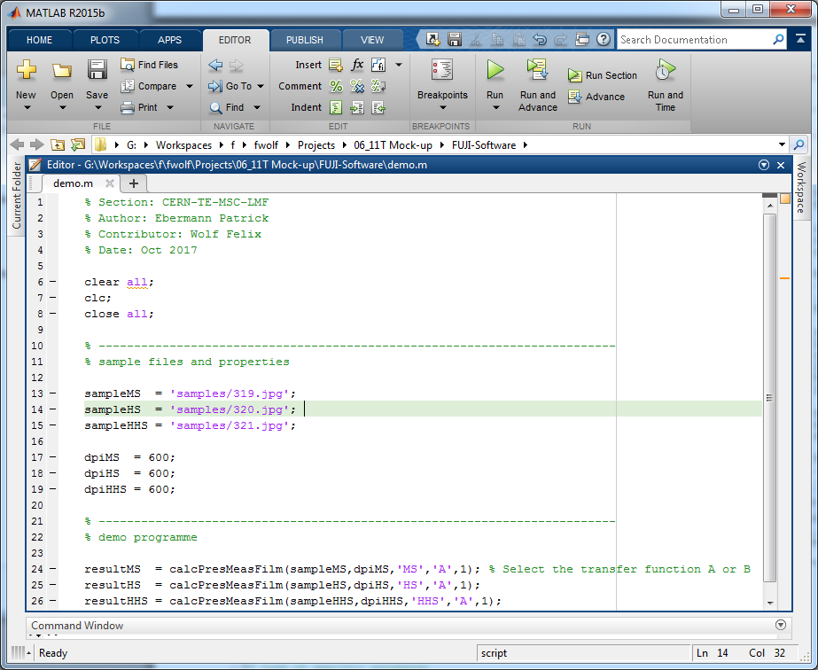
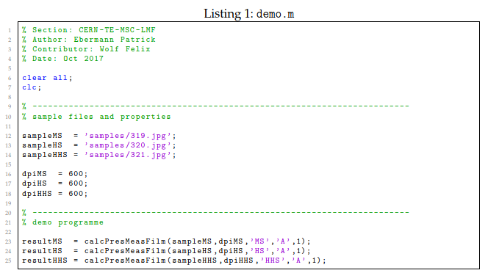
FUJI prescale film – analysis EDMS 1885552 /3
Scanned file
Set resolution of the scanner
Transfer function A or B
Code for data input as documented in the technical node.
Code for data input in the MATLAB environment.

Slide 11
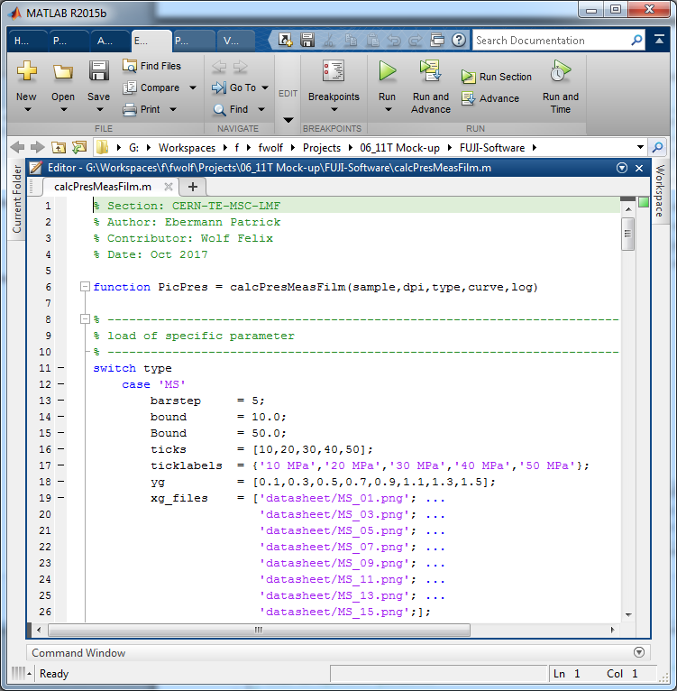
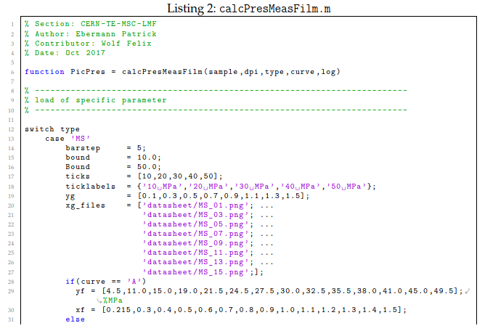
FUJI prescale film – analysis EDMS 1885552 /4
Calibration
Code for analysis as documented in the technical node.
Code for analysis in the MATLAB environment.

Slide 12
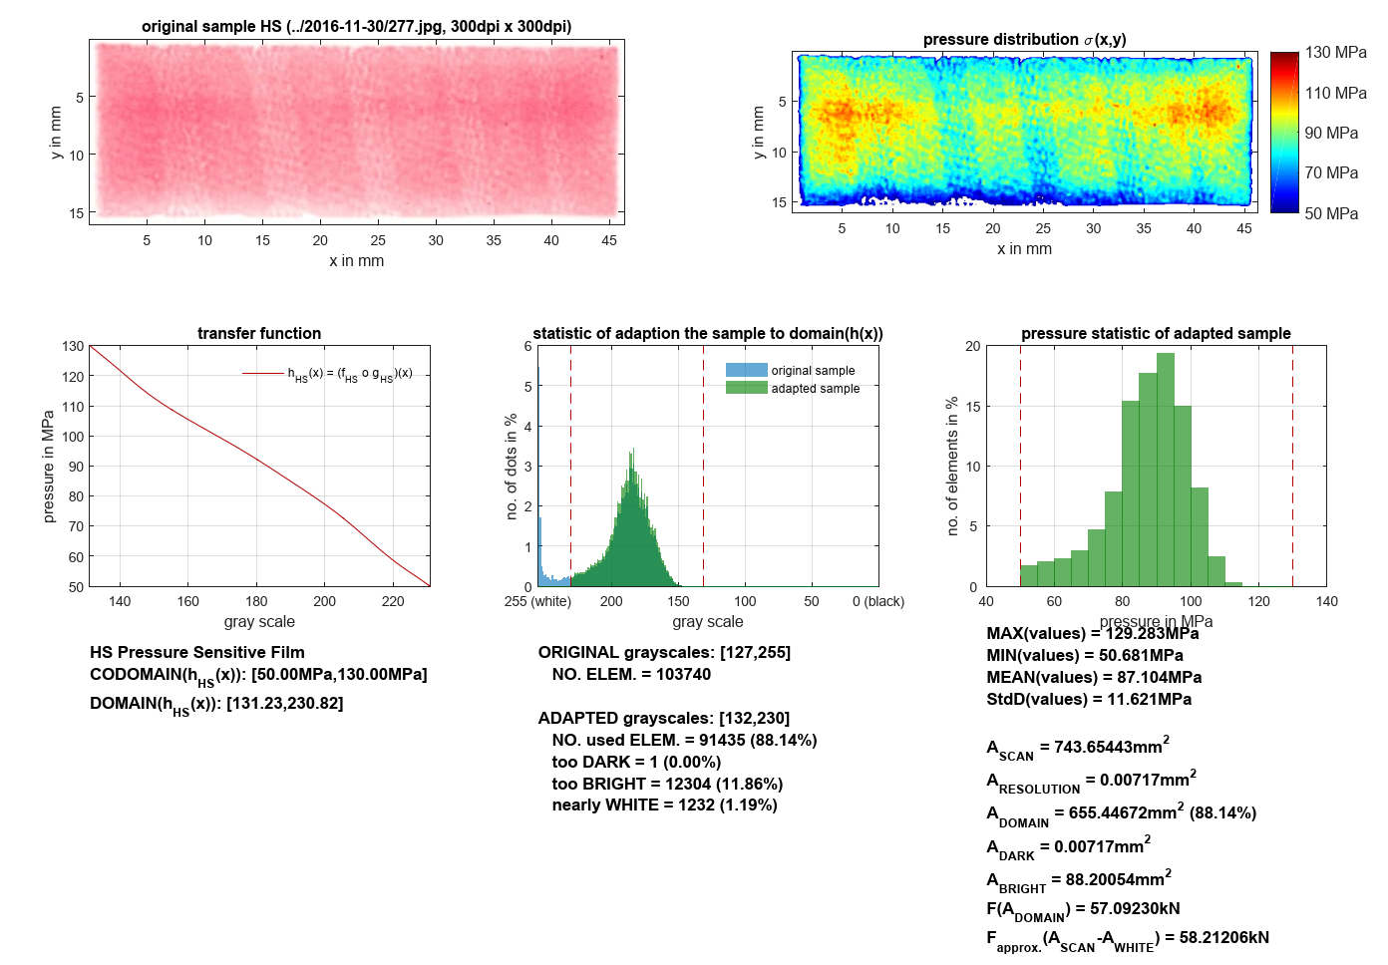
FUJI prescale film – analysis EDMS 1885552 /5
… Total scanned area
… Resolution of the scanner
.. . Area in the pressure domain
… Area above the pressure domain
… Area below the pressure domain
… Total integrated force
Note:
Stress values below or above the stress domain are interpretated equal 0MPa.

Slide 13
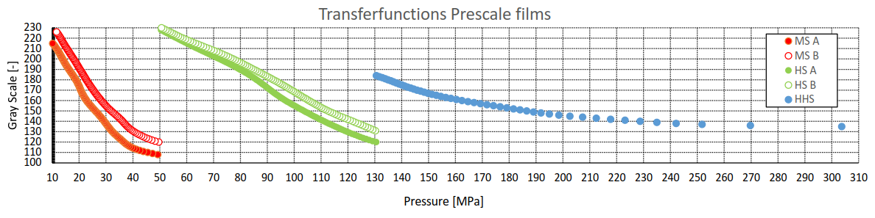
FUJI prescale film – limitation
Stress resolution depends on the gray scale step size (8-bit)
Analysed gray scale values between 110-230 (120 Steps)
Stress range can be extended by stacking different types of prescale film
MS
HS
HHS
Discrete transfer between gray scale values and stress values.

Slide 14
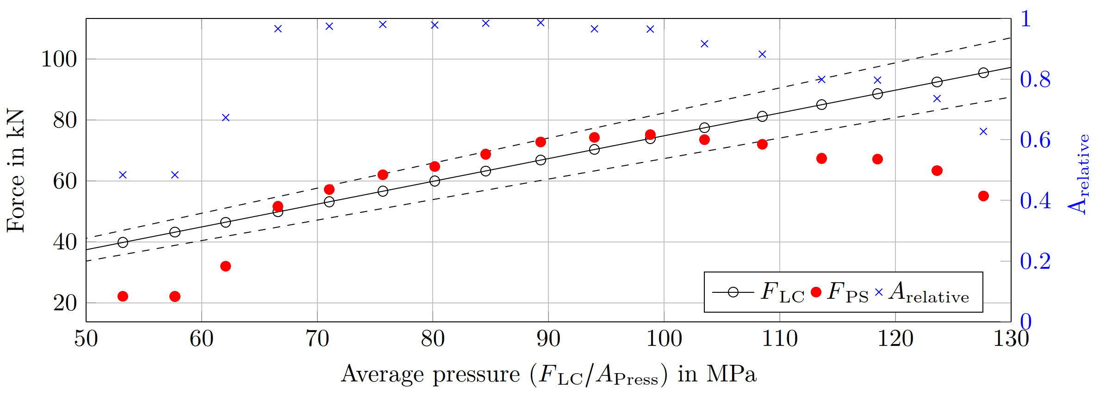
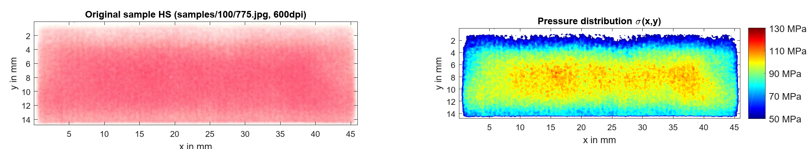
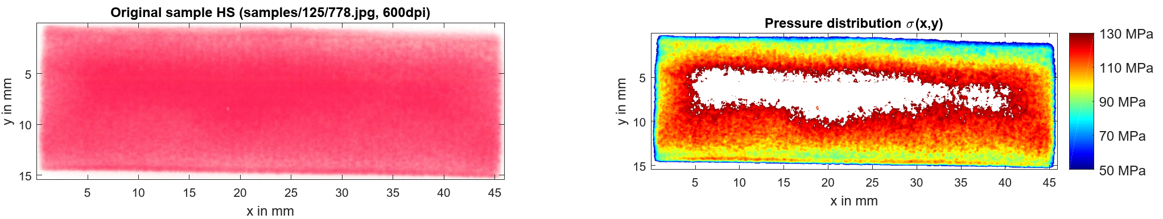
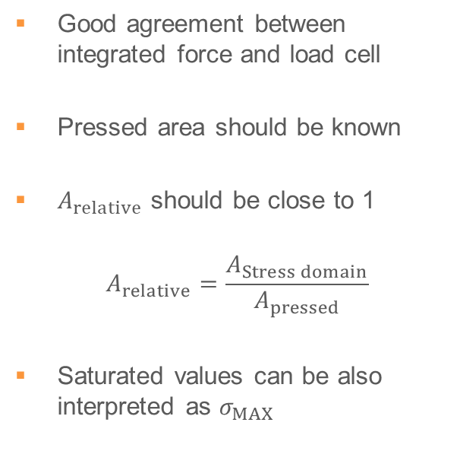
FUJI prescale film – limitation stress range
Good agreement between integrated force and load cell
Pressed area should be known
$A_{relative}$ should be close to 1
$$A_{relative}=\frac{A_{Stress domain}}{A_{pressed}}$$
Saturated values can be also interpreted as $σ_{MAX}$
Integrated force to applied average pressure (determined by load cell).

Slide 15
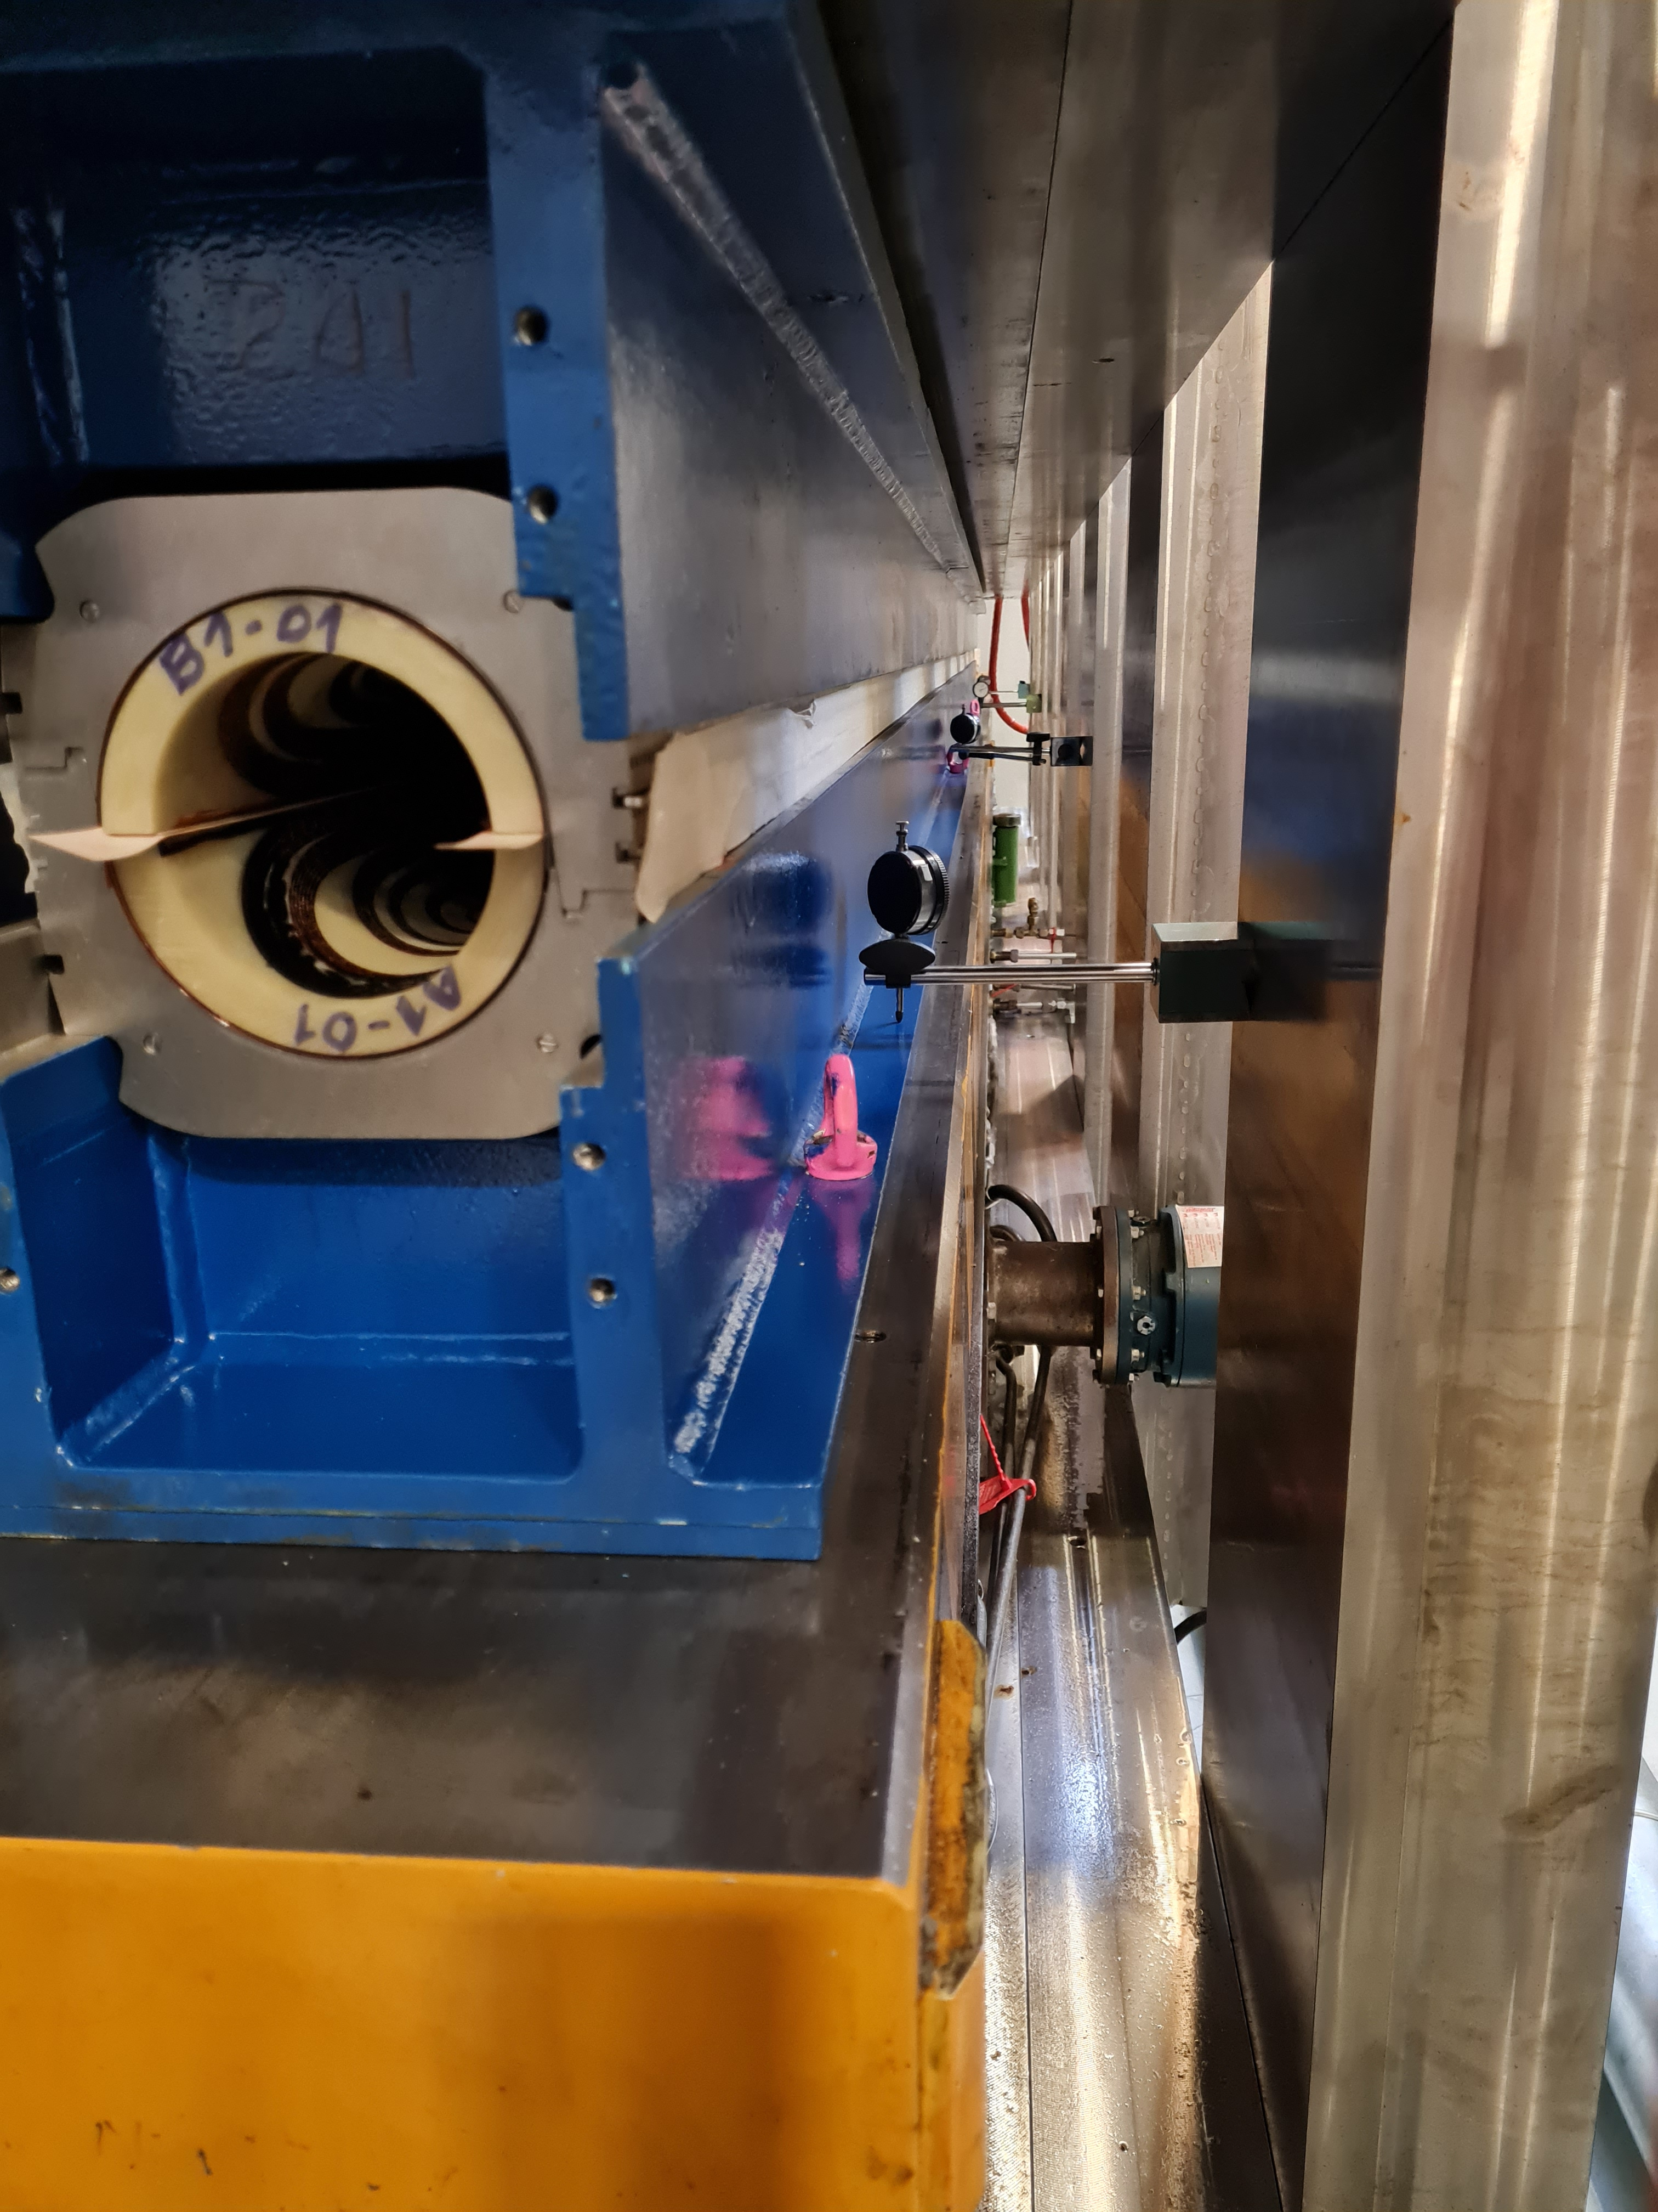
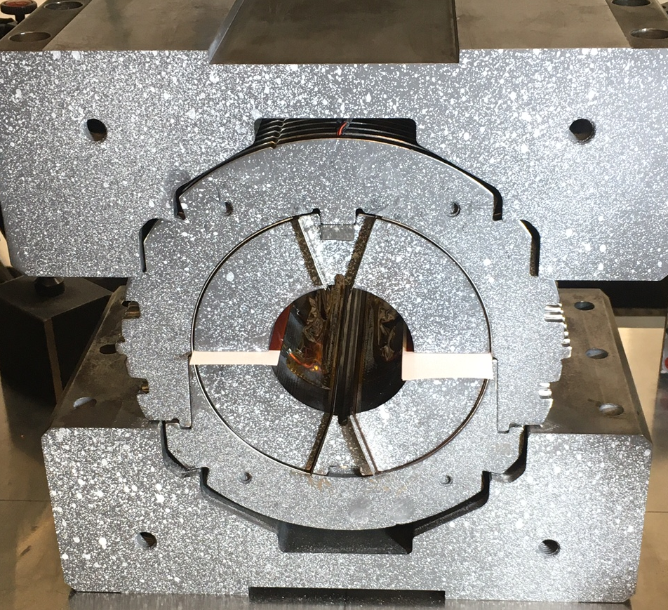
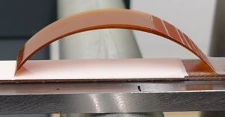
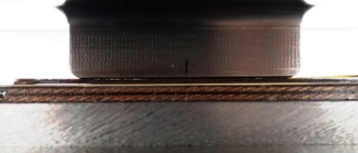
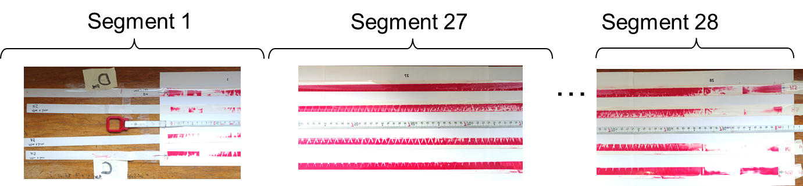
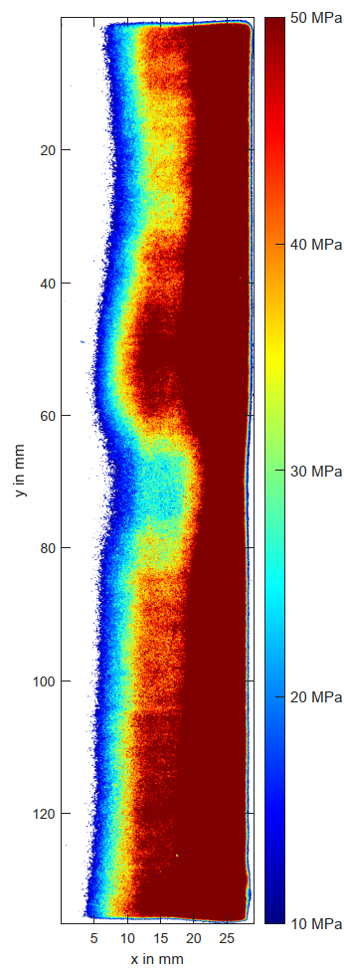
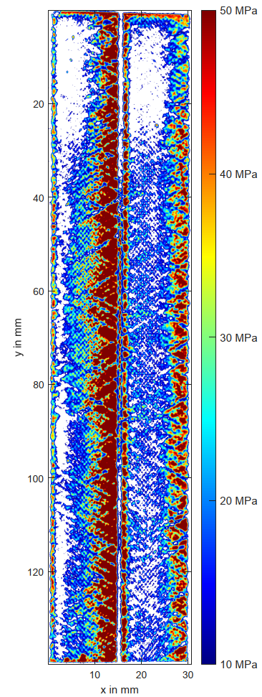
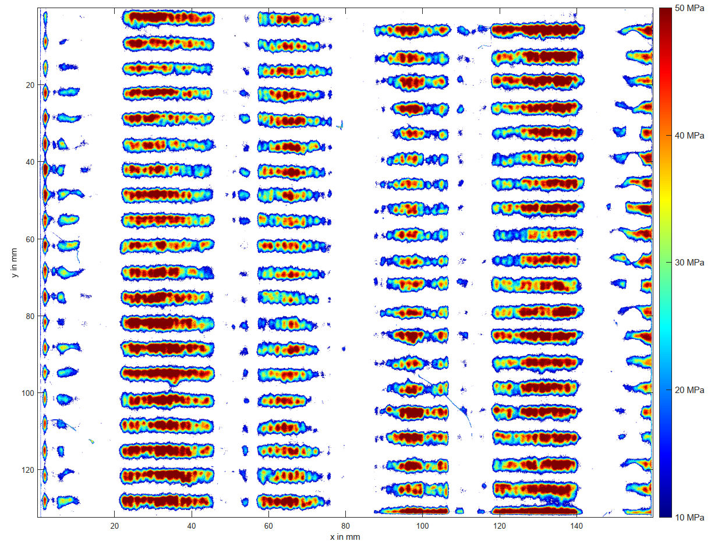
Examples of application
Cable test
Magnet assembly
Mockup studies
F. Wolf et al., "Characterization of the Stress Distribution on Nb3Sn Rutherford Cables Under Transverse Compression," in IEEE Transactions on Applied Superconductivity, 2018.
F. Wolf, FUJI Analysis D2 Prototype, CERN, EDMS 2471988
15
https://espace.cern.ch/mockuptest2020
Notes:
318, 319

Slide 16
FUJI prescale film
Requires disassembly to access the pressure sensitive film
Only peak stresses can be determined
Measurement range can be extended by combination of different types

Slide 17
Active system
TekscanTM I-Scan system

Slide 18

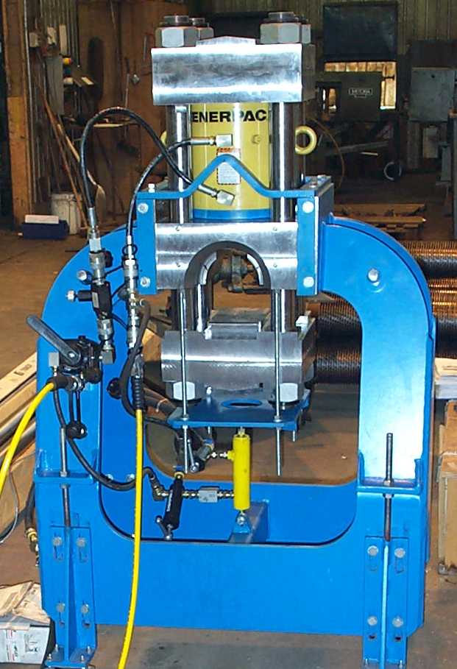
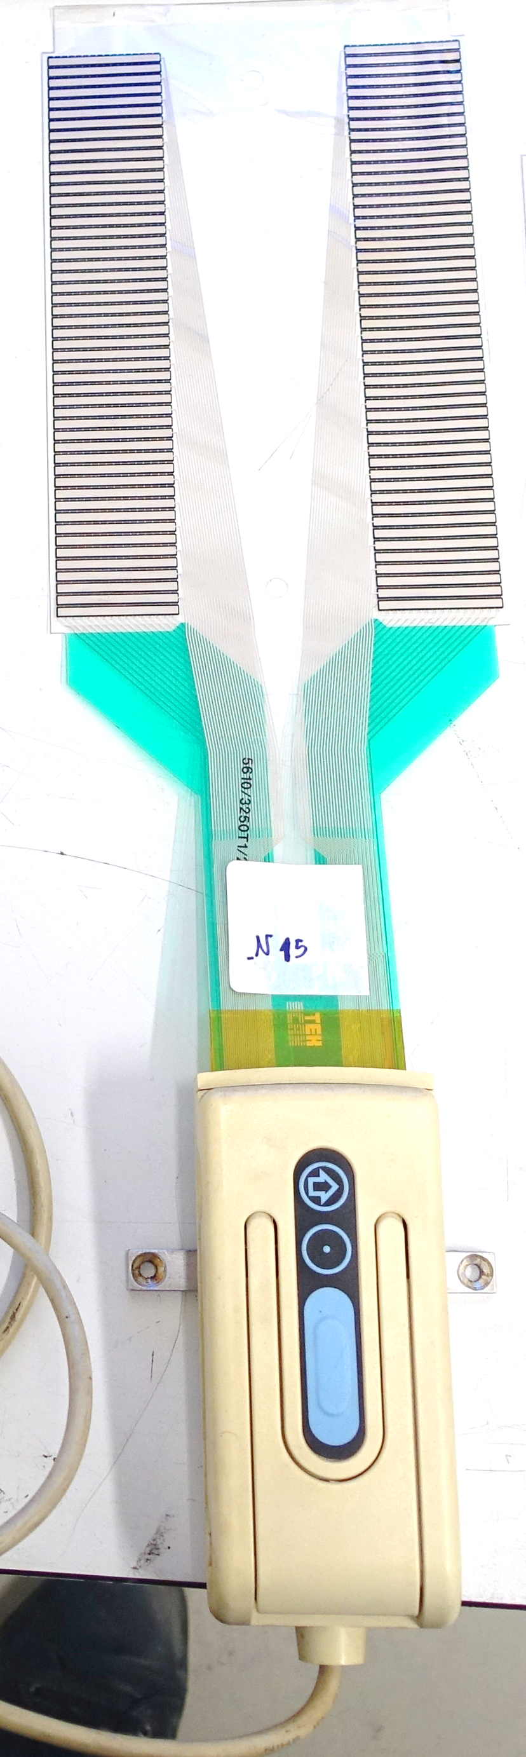
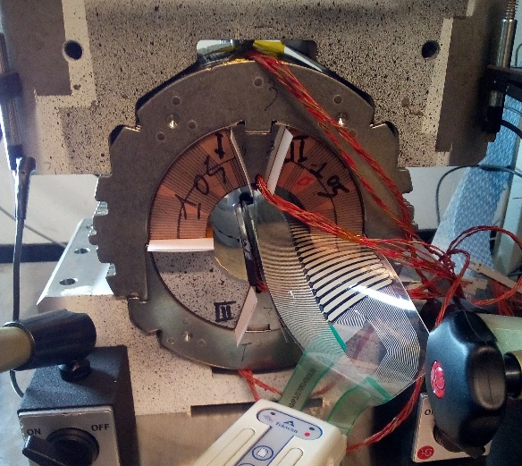

TekscanTM I-Scan system
Experience at CERN
Used by Paolo Fessia in 2000 for the manufacturing control of LHC dipole magnets in the coil ends.
A special sensor foil was produced for CERN in 2000
Used in the 11T collaring mockup study in 2018 by Paolo Ferracin
Development:
High pressure sensor foils with an upper limit about 200 MPa due elastic limits of the foil.
Low pressure sensor foils to measure the air flow on a surface.
Only system at the commercial market which allow an online readout of a contact pressure in a range up to 200 MPa.
Company:
Small company in Boston with 100 employee
https://www.tekscan.com/
Coil end press and sensor foil with readout system. [9]
Collaring mockup 2018. [10]
[9] Coil ends measuring procedure, CERN, 2002, provided by Paolo Fessia
[10] Collaring kinematics, mechanics, instrumentation, and mock-ups, EDMS 2130333

Slide 19
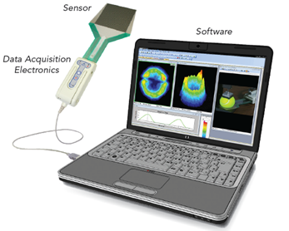
TekscanTM I-Scan system
The measurement system:
Matrix based sensor using the piezo-resistive effect
Minimal spacing between rows od columns: 0.6 mm
Repeatability: < ± 3.5%
Hysteresis of the sensor: < ± 4.5%
Pressure range: up to 207 MPa (limited by the deformation of the foil)
Maximum number of sensing elements 50*44 = 2200 Thickness: 0.1 mm
Scanning speed up to 100 Hz
Digital pressure resolution in 8 bit (0-255)
All sensor foils must be calibrated with respect to the contact material by the customer
Tekscan sensor design. [8]
Tekscan readout system. [8]
[8] Tekscan, Inc., I-Scan® Product Selection Guide, [Online]. Available: https://www.tekscan.com [Accessed 2021].

Slide 20
Active system
CERN capacitive load transducer

Slide 21
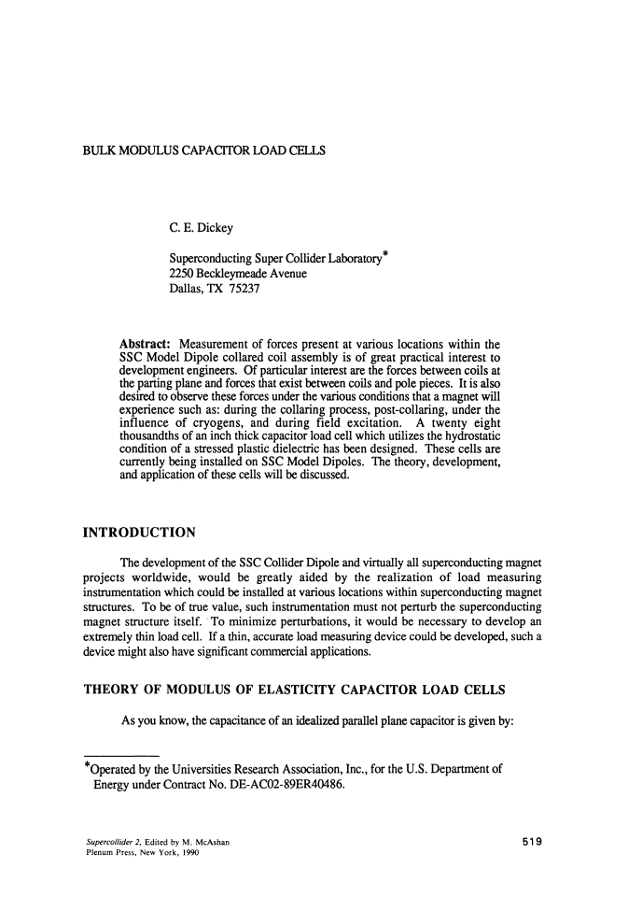
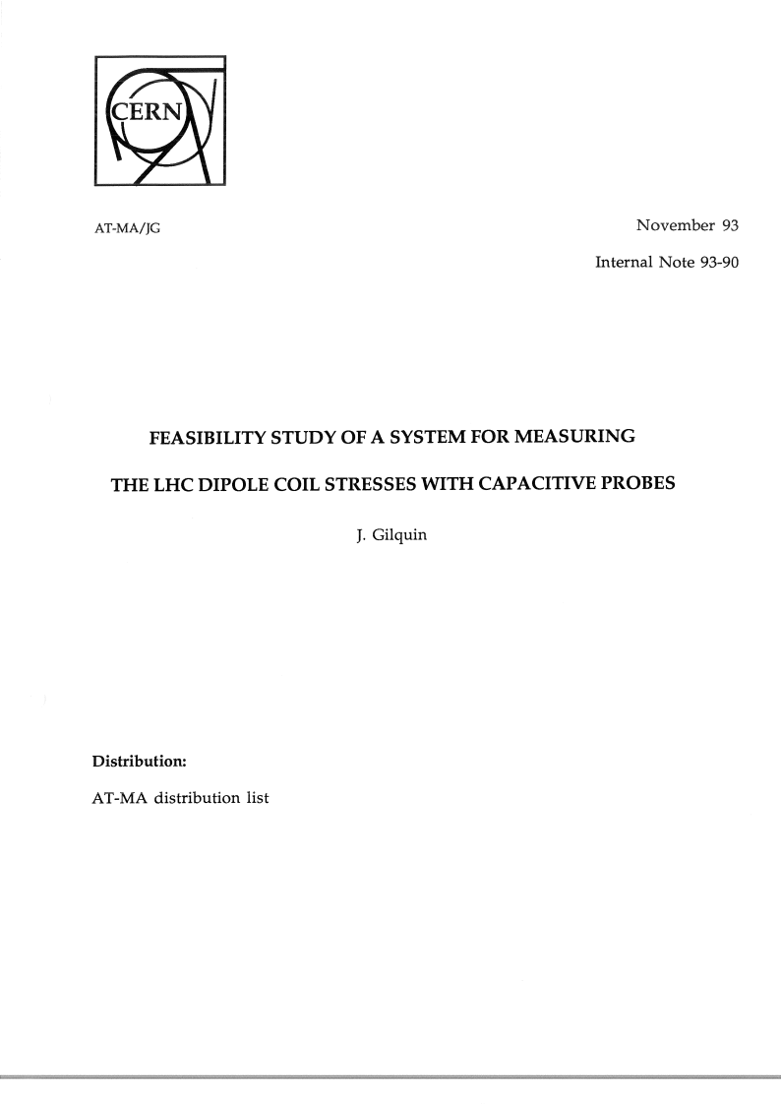
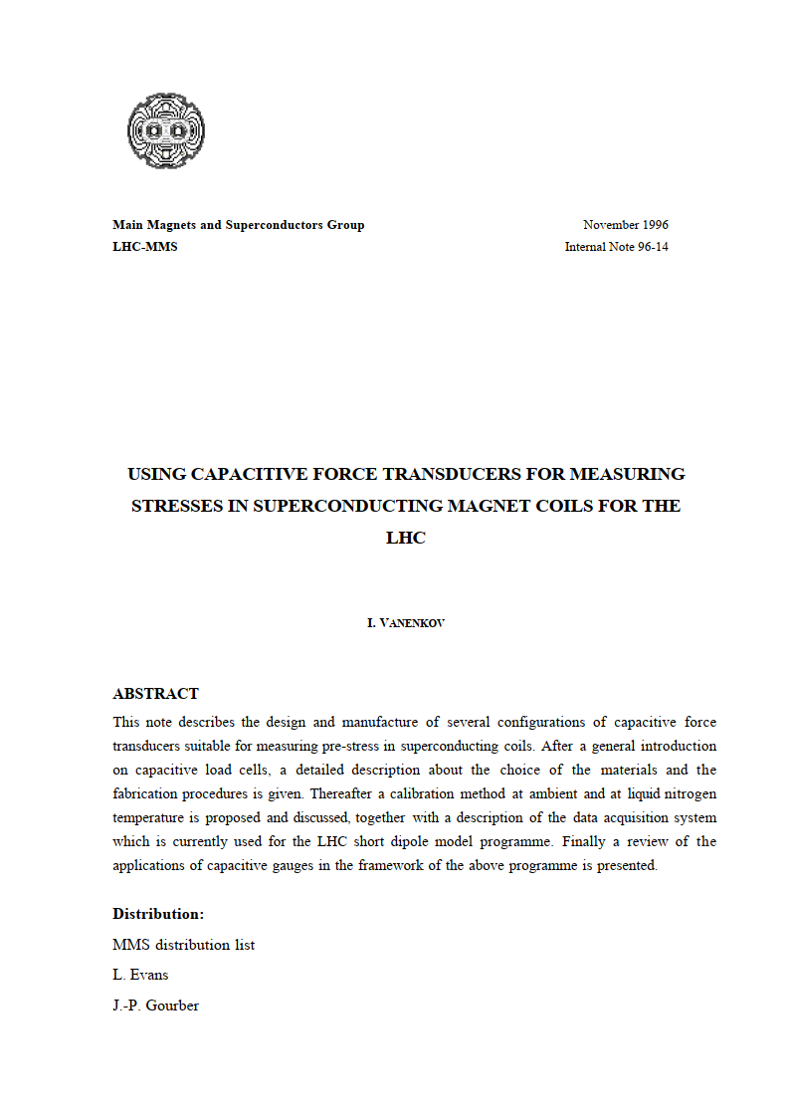
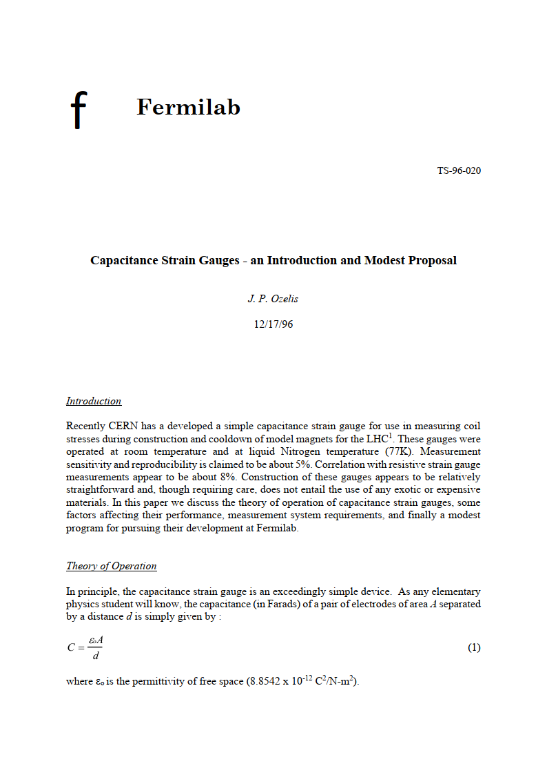
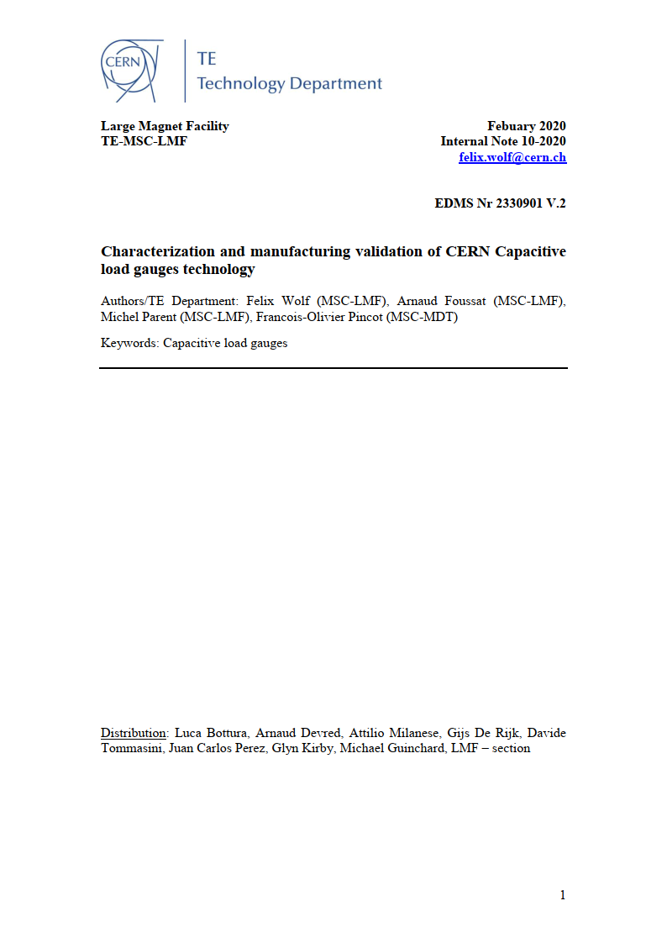
History of capacitive gauge in SC magnet comunity
ID | Year | Author | Title | Published | Type
1 | 1990 | C. E. Dick | Bulk modulus capacitor load cells | SSC Lab. Plenum Press | Paper
2 | 1993 | J. Gilquin | Feasibility study of a system for measuring the LHC dipole coil stresses with capacitive probes | Internal Note 93-90 | Report
3 | 1996 | I. Vanenkov | Using capacitive force transducer for measuring stresses in superconducting magnet coils for the LHC | Internal Note 96-14 | Report
4 | 1996 | J. P. Ozelis | Capacitance strain gauges - an Introduction and Modest Proposal | Fermilab | Internal note
5 | 1997 | N.Siegel, et al. | Design and use of capacitive force transducers for superconducting magnet models for the LHC | lhc-project-report-173 | Report
6 | 2002 | A. Foussat, et al. | Mechanical behaviour of the ATLAS B0 Model Coil | IEEE | Paper
7 | 2009 | R.B. Ragland | Capacitive stress gauges in model dipole magnets | Texas A&M University | Thesis
8 | 2010 | M. Guinchard, et al. | Techniques of mechanical measurements for CERN application | EDMS 1064933 | Presentation
9 | 2010 | K. Artoos, et al. | New techniques for mechanical measurements in the superconducting magnet models | IPAC 10 Kyoto | Paper
10 | 2010 | C. Benson | Capacitive stress transducers in model dipole magnets | Texas A&M University | Thesis
11 | 2011 | R. Ballester | Failure analysis of a press for testing sensors in the mechanical measurements lab | EDMS 1146460 | Report
12 | 2011 | R. Ballester | Analysis for the improvement of the capacitive gauges’ performance | EDMS 1154650 | Report
13 | 2012 | R. Ballester | Study for the improvement of the capacitive pressure gauges’ performance, and design of an automated compressing … | EDMS 1110695 | Thesis
14 | 2012 | R. Ballester | Study of the capacitive gauges and the calibration system | EDMS 1110695 | Presentation
15 | 2012 | M. Guinchard, et al. | Zwick visit report for capacitive gauge and load cell calibration | EDMS 1214523 | Visit Report
16 | 2012 | C. Benson, et al. | Improved capacitive stress transducers for high-field superconducting magnets | AIP Conf. Proceed. | Paper
17 | 2013 | K. Velissaridis | Optimization of the capacitive gauges in terms of testing and manufacturing procedures | EDMS 1341108 | Presentation
18 | 2020 | F. Wolf | Characterization and manufacturing validation of CERN Capacitive load gauges technology | EDMS 2330901 | Report
19 | 2020 | F. Wolf | TE-MSC-LMF-QA-Manufacturing procedure of CERN Capacitive gauges | EDMS 2361251 | Report

Slide 22
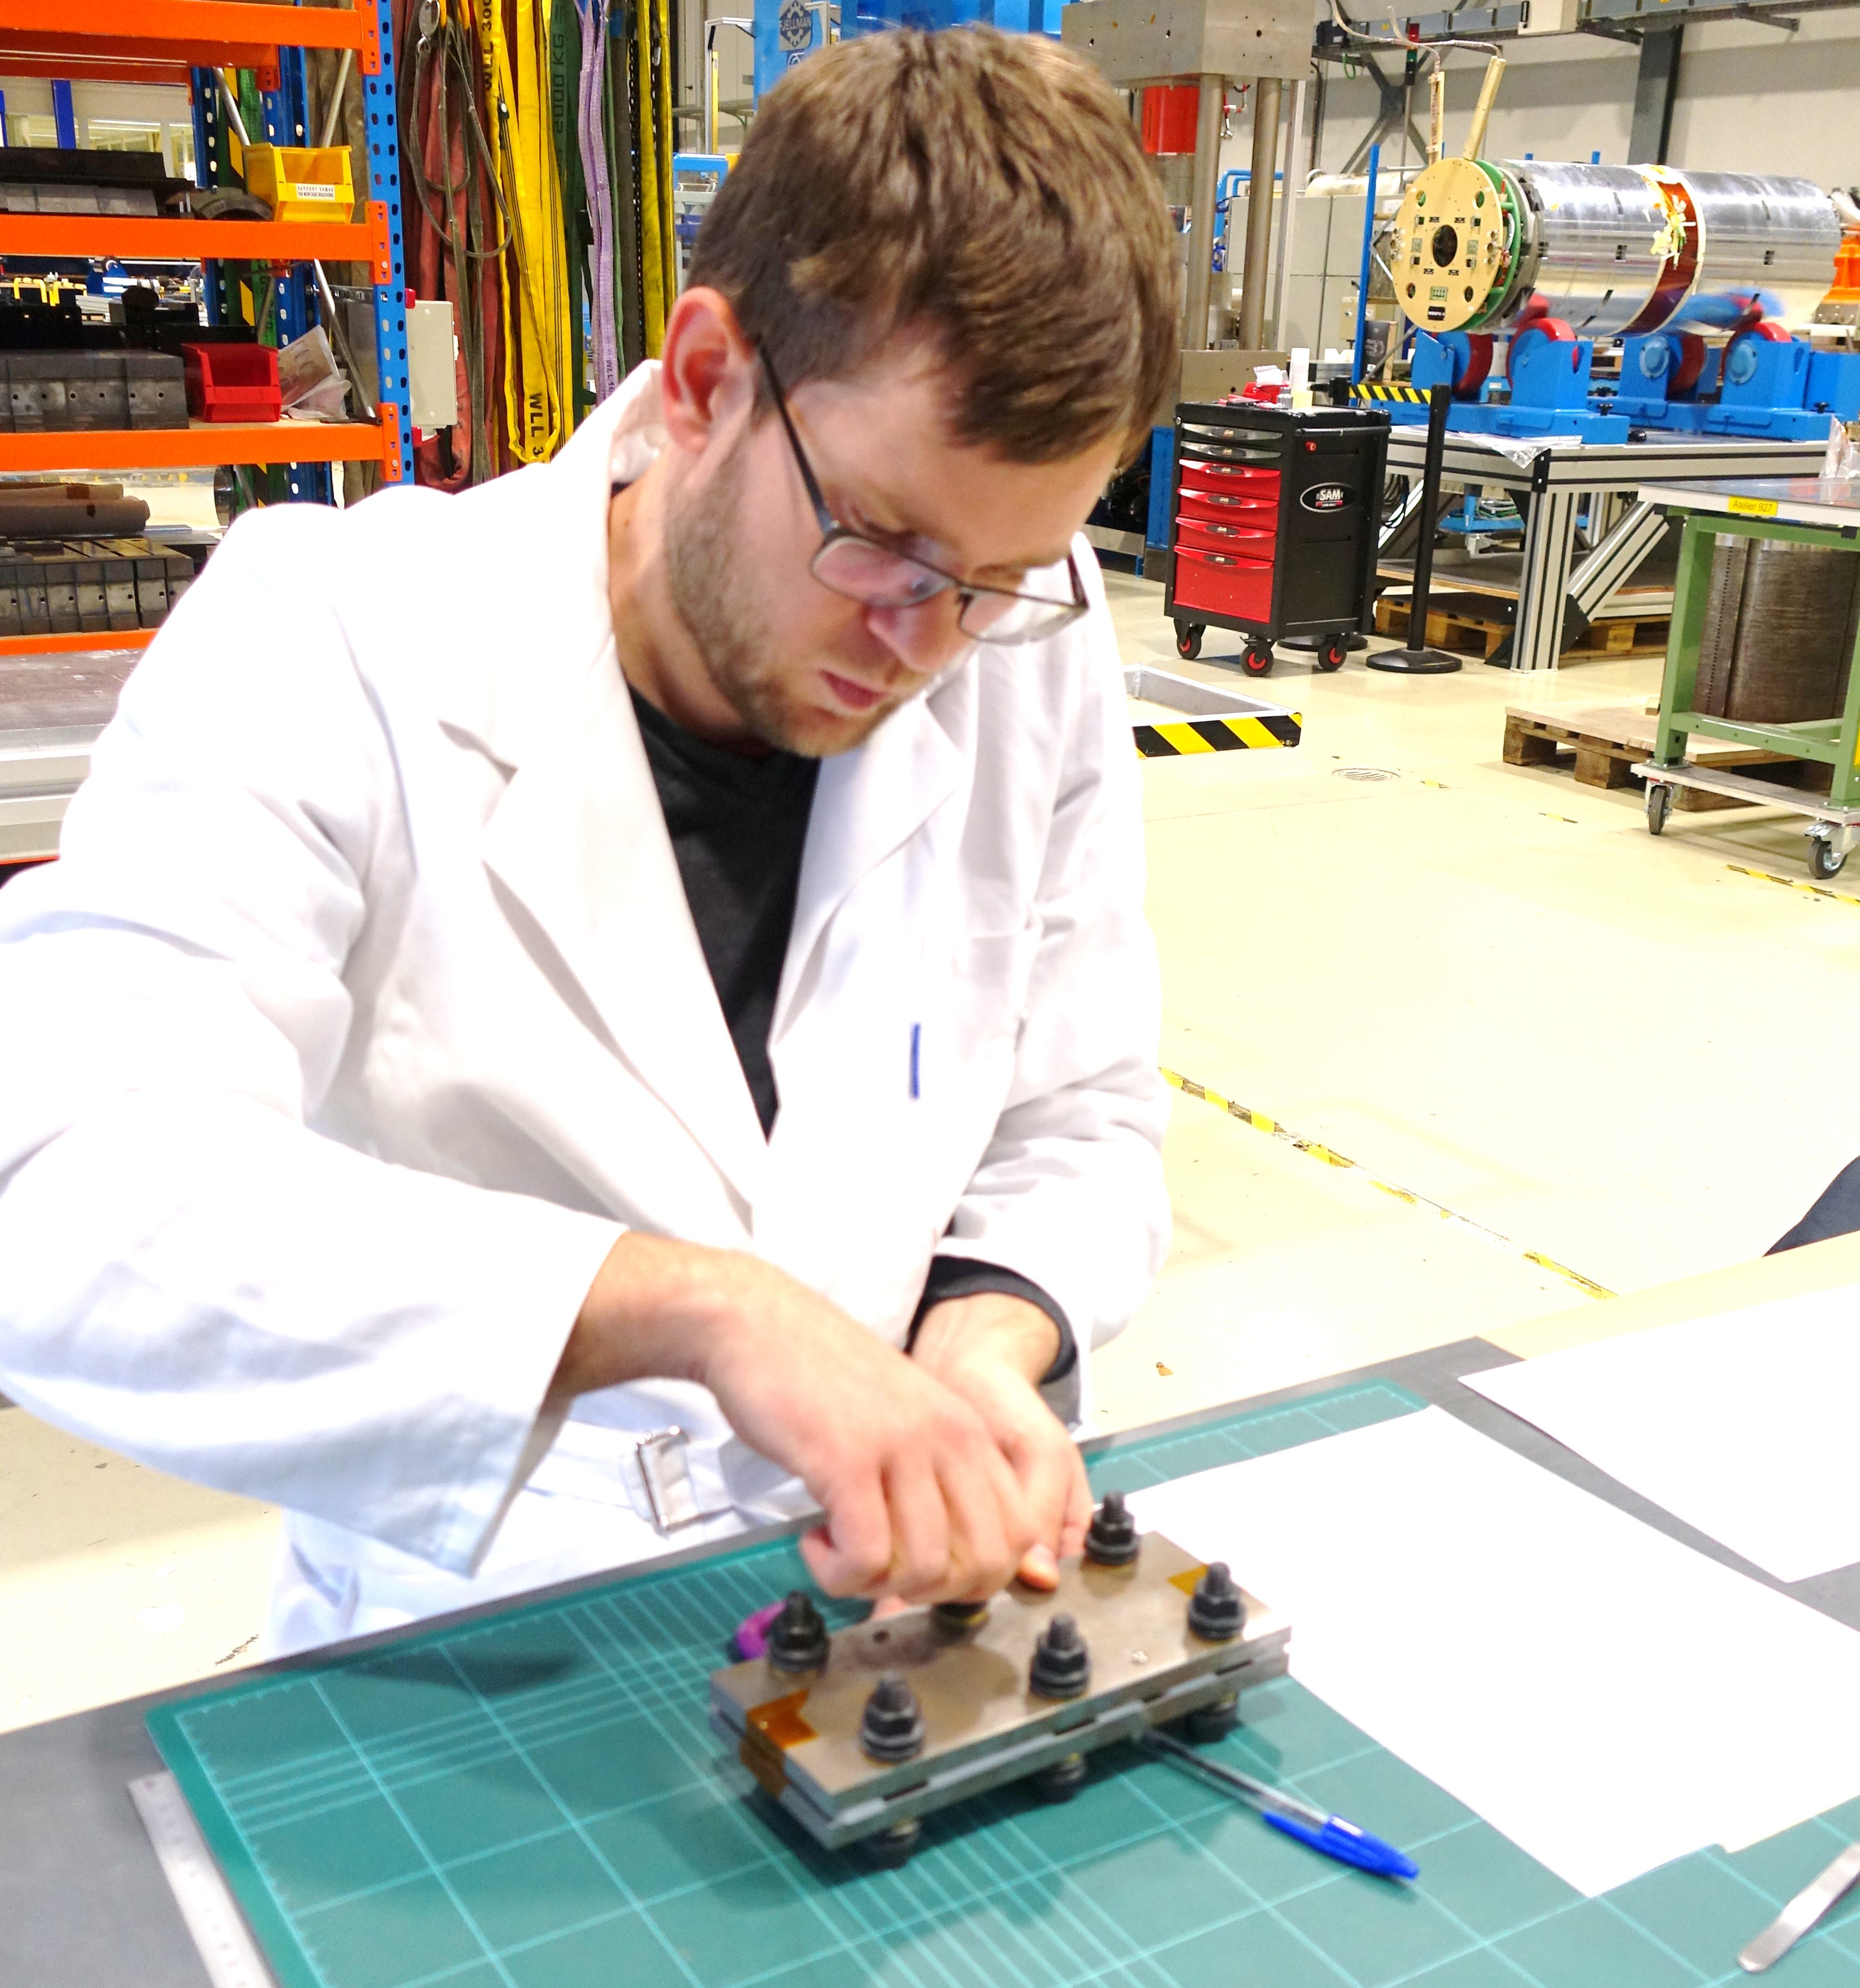
Road map for development of capacitive gauge
Retrieve and collect all available knowledge on capacitive gauges
Build first prototype to learn
Write manufacturing procedure EDMS: 2361251
Validate the sensor performance EDMS: 2330901
Study the multi-physic behavior of the sensor
Prepare the sensor for implementation and built a small series
Prepare enhanced sensor design

Slide 23
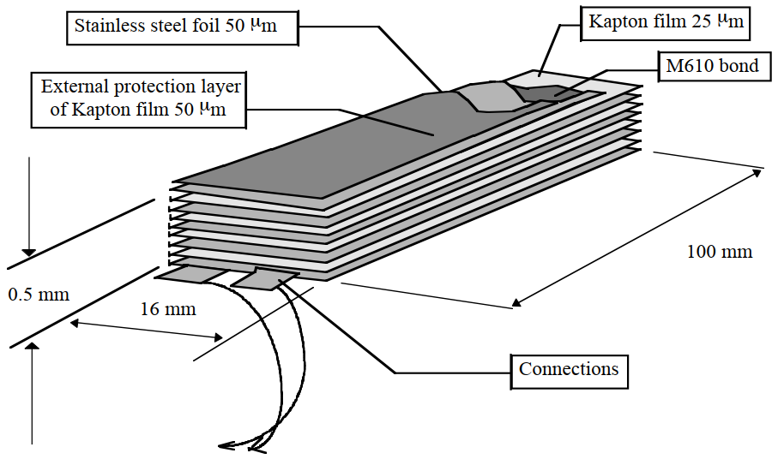
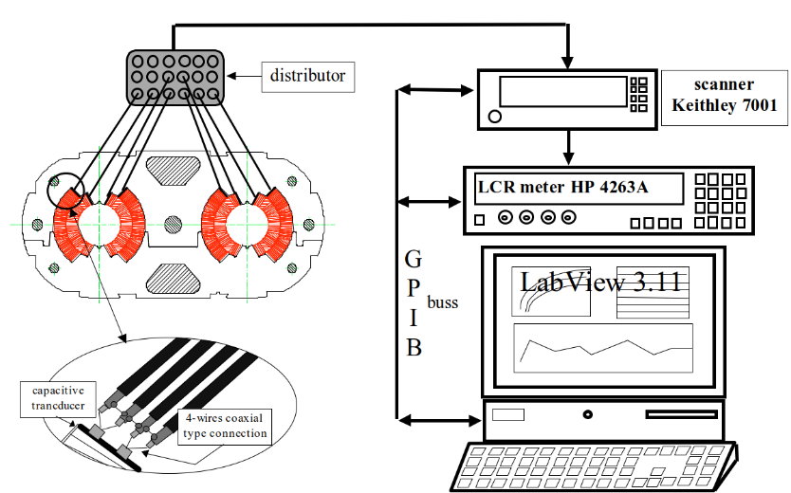
Capacitive load gauge development for magnet application
Collection of all available documentation about work on capacitive gauges at CERN (until 2000)
Knowledge transfer with Michel Parent who was involved in the manufacturing process of capacitive gauges at CERN 20 year’s ago
Test and update existing DAQ system (2000) and LabView code for sensor read out
“Sandwich” type capacitive force transducer design. [11]
Schematic layout of the data acquisition system. [12]
[11] I. Vanenkov, Internal Note 96-14, 1996
[12] N. Siegel et al. “LHC PROJECT REPORT 173”, 1998

Slide 24


Sensor layout
75 mm
15 mm
51 µm
Polyimide
50 µm
Stainless steel
26.5 µm
50 µm
Top view on the a capacitive gauge.
305 µm
26.5 µm
50 µm
Central electrode
Two coaxial cables
Central electrode connection
Soldered shield of the cables
51 µm
15 mm
Schematic cross section of the capacitive gauge.
Top electrode
Top/bottom electrode connection
Bottom electrode
Insulating shrink hose
Connections on the capacitive gauge.

Slide 25



Principle of capacitive gauge
Flux path
Mechanic
Two springs in series
Electric
Two capacitors in parallel
C₁
C₂
LCR Meter
Electrodes (stainless steel foil 50 µm)
Strain gauge glue (M610 bond)
Polyimide film 25.4-50.8 µm
$$C=C_{1}+C_{2}$$
Schematic of the capacitive gauge.
$$C=ε_{r}ε_{0}n w\frac{l}{t_{0}}$$
C₁
$C$… capacitance
$ε_{r}$... relative permittivity
$ε_{0}$… vacuum permittivity (8.85 x 10⁻¹² F m⁻¹)
$n$… number of layers
$w$… width of the gauge
$l$… length of the gauge
$t$… thickness of the dielectric material
LCR Meter
LCR Meter
C₂
C₁
C₂
Circuit diagram of the capacitive gauge.

Slide 26






Layout of the tested capacitive gauge
Sensor properties
51 µm
Polyimide
Symbol | Property | Value
$$ε_{0}$$ | Vacuum permittivity | 8.85 x 10⁻¹² Fm⁻¹
$$ε_{r}$$ | Dielectric permittivity of polyimide film | 3.3 [13]
$$n$$ | Number of parallel capacitors | 2
$$l$$ | Length of the gauge | 75 mm
$$w$$ | Width of the gauge | 15 mm
$$t_{0}$$ | Thickness of the dielectric layer | 25.7µm -28.4µm
50 µm
Stainless steel
26.5 µm
$$t_{0}$$
305 µm
50 µm
26.5 µm
$$t_{0}$$
50 µm
51 µm
$$w$$
15 mm
$$C=ε_{r}ε_{0}n w\frac{l}{t_{0}}$$
$C(t_{0})=3.3⋅8.85⋅{10}^{−12}\frac{F}{m} 2⋅0.015 m⋅\frac{75 000 µm}{t_{0}}$
Sensor | Measured sensor thickness in µm | $t_{0}$ in µm | Theoretical Capacity C_{th} in nF | Measured Capacity C_{m} in nF
G1 | 310 | 27.9 | 2.36 | 2.34
G2 | 303.3 | 25.7 | 2.56 | 2.41
G3 | 311.3 | 28.4 | 2.31 | 2.37
G4 | 308.6 | 27.5 | 2.39 | 2.38
[13] APICAL POLYIMIDE, “Datasheet Apical AV,” [Online]. Available: https://apicalfilm.com/technical-data/. [Accessed 2020].

Slide 27

State of the art LCR meter
LCR meter (Agilent 4263B)
Switch system (Keithley 7001)
LabView
Sensor | HP4263A |  | Agilent 4263B
 | Capacitance in nF | STDEV in pF | Capacitance in nF | STDEV in pF
G1 | 2.33773 | 0.4734 | 2.33745 | 0.0924
G2 | 2.41452 | 0.4759 | 2.41463 | 0.0714
G3 | 2.37228 | 0.4827 | 2.37295 | 0.0712
G4 | 2.38197 | 0.4795 | 2.38184 | 0.0726
DAQ for the capacitive gauges.
Improved precision by factor of 5
Comparison of the capacitance signal measured by the old (2000) and the new LCR meter.

Slide 28








Sensor principle under mechnical load
$$σ$$
$$Δt=t_{0}−t_{1}$$
$$ΔC=ε_{r}ε_{0}n wl\left(\frac{1}{t_{1}}−\frac{1}{t_{0}}\right)$$
C₁
$$t$$
C₂
$$t$$
$$ΔC\sim k σ$$
$$w$$
$C$… capacitance
$ε_{r}$... relative permittivity
$ε_{0}$… vacuum permittivity (8.85 x 10⁻¹² F m⁻¹)
$n$… number of layers
$w$… width of the gauge
$l$… length of the gauge
$t$… thickness of the dielectric material
$σ$… applied compressive stress
Schematic of the capacitive gauge.

Slide 29






Basic model for capacitance variation
C.E. Dickey, 1990
I. Vanenkov, 1996
R.M. Ballester 2012
Dielectric material is put under hydrostatic stress
Uniaxial load in the dielectric layer
$$∆C ={C_{1}−C_{0}=ε}_{r}ε_{0}n wl\left(\frac{1}{t_{1}}−\frac{1}{t_{0}}\right)=ε_{r}ε_{0}n wl\frac{1}{t_{0}} \left(\frac{−ε_{y_{diel}}}{ε_{y­_{diel}}+1}\right)$$
$${∆C=ε}_{r}ε_{0}n wl\frac{1}{t_{0}} \left(\frac{−σ}{{σ+ E}_{diel}}\right)$$
$ε=\frac{σ}{E}$, $ε=\frac{{t_{0}−t}_{1}}{t_{0}}$
$$σ$$
$$t_{0}$$
$$t_{1}$$
Hydrostatic” type design of capacitor load cell. [6]
Uniaxial stress-strain state of the dielectric layer.
Both models needed to introduce a calibration factor $k$, based on measurements
$$ΔC\sim k σ$$
[11] I. Vanenkov, Internal Note 96-14, 1996
[14] C. E. Dick “Bulk modulus capacitor load cells”, 1990

Slide 30
















Stress - strain calculation of the capacitive gauge
$$σ_{y}$$
$$σ_{{ii}_{diel}}, ε_{{ii}_{diel}}$$
Stress – strain state in the dielectric layer
$$ε_{{xx}_{diel}}=\frac{1}{E_{diel}}\left(σ_{{xx}_{diel}}−ν_{diel}\left(σ_{{yy}_{diel}}+σ_{{zz}_{diel}} \right)\right)$$
$$ε_{{yy}_{diel}}=\frac{1}{E_{diel}}\left(σ_{{yy}_{diel}}−ν_{diel}\left(σ_{{xx}_{diel}}+σ_{{zz}_{diel}} \right)\right)$$
$$ε_{{zz}_{diel}}=\frac{1}{E_{diel}}\left(σ_{{zz}_{diel}}−ν_{diel}\left(σ_{{xx}_{diel}}+σ_{{yy}_{diel}} \right)\right)$$
bonded
$$σ_{{ii}_{el}}, ε_{{ii}_{el}}$$
$$σ_{y}$$
$$σ_{{ii}_{diel}}, ε_{{ii}_{diel}}$$
$$σ_{{ii}_{diel}}, ε_{{ii}_{diel}}$$
$$σ_{{ii}_{el}},ε_{{ii}_{el}}$$
y
$$σ_{{ii}_{el}},ε_{{ii}_{el}}$$
$$σ_{{ii}_{diel}},ε_{{ii}_{diel}}$$
z
x
$$σ_{y}$$
$$i=x,y,z$$
$$σ_{{ii}_{el}},ε_{{ii}_{el}}$$
Simplified schematic for analytic model.
Stress – strain state in the electrode
$$ε_{{xx}_{el}}=\frac{1}{E_{el}}\left(σ_{{xx}_{el}}−ν_{el}\left(σ_{{yy}_{el}}+{σ_{zz}}_{el} \right)\right)$$
$$ε_{{yy}_{el}}=\frac{1}{E_{el}}\left(σ_{{yy}_{el}}−ν_{el}\left(σ_{{xx}_{el}}+σ_{zz_{el}} \right)\right)$$
$$ε_{{zz}_{el}}=\frac{1}{E_{el}}\left(σ_{{zz}_{el}}−ν_{el}\left(σ_{{xx}_{el}}+σ_{{yy}_{el}} \right)\right)$$
y
$$σ_{{ii}_{diel}},ε_{{ii}_{diel}}$$
z
$$σ_{y}$$
$$i=x,y,z$$
x
Schematic of the capacitive gauge with stress components.

Slide 31















Stress - strain calculation of the capacitive gauge
In plane stress and strain isotropy
$$ε_{{xx}_{k}}=ε_{{zz}_{k}}=ε_{l_{k}}$$
$$σ_{{xx}_{k}}=σ_{{zz}_{k}}=σ_{l_{k }}$$
$$ε_{l_{diel}}=\frac{1}{E_{diel}}\left(σ_{l_{diel}}−ν_{diel}\left(σ_{y}+σ_{l_{diel}} \right)\right)$$
$$ε_{l_{el}}=\frac{1}{E_{el}}\left(σ_{l_{el}}−ν_{el}\left(σ_{y}+σ_{l_{el}} \right)\right)$$
$$t_{el}=∑t_{el_{i}}$$
$$t_{diel}=∑t_{{diel}_{i}}$$
$$σ_{y}$$
Equilibrium of lateral strain between the layers
$$ε_{l_{diel}}=ε_{l_{el}}$$
$$t_{el}$$
$$σ_{{ii}_{diel}}, ε_{{ii}_{diel}}$$
$$t_{diel}$$
y
$$σ_{{ii}_{el}},ε_{{ii}_{el}}$$
Equilibrium of lateral forces
$$F_{l_{diel}}= −F_{l_{el}}$$
$${t_{diel} w σ}_{l_{diel}}= −t_{el} w σ_{l_{el}}$$
z
x
$$σ_{y}$$
$$i=x,y,z$$
Simplified schematic for analytic model.
Lateral stress calculation
$${σ_{l}}_{diel}=\frac{\frac{ν_{diel}}{E_{diel}}−\frac{ν_{el}}{E_{el}} }{\frac{1−ν_{diel}}{E_{diel}}+\left(\frac{1−ν_{el}}{E_{el}}\right)\frac{t_{diel}}{t_{el}}}σ_{y}$$
$${σ_{l}}_{el}=\frac{\frac{ν_{diel}}{E_{diel}}−\frac{ν_{el}}{E_{el}} }{−\left(\frac{1−ν_{diel}}{E_{diel}}\right)\frac{t_{el}}{t_{diel}}−\frac{1−ν_{el}}{E_{el}}}σ_{y}$$

Slide 32






Stress - strain state in the capacitive gauge
Lateral stress calculation
$${σ_{l}}_{diel}=\frac{\frac{ν_{diel}}{E_{diel}}−\frac{ν_{el}}{E_{el}} }{\frac{1−ν_{diel}}{E_{diel}}+\left(\frac{1−ν_{el}}{E_{el}}\right)\frac{t_{diel}}{t_{el}}}σ_{y}$$
$$ε_{{yy}_{diel}}=\frac{1}{E_{diel}}\left(σ_{{yy}_{diel}}−ν_{diel}\left(σ_{{xx}_{diel}}+σ_{{zz}_{diel}} \right)\right)$$
Strain dielectric layer
$$ε_{y_{diel}}=\frac{1}{E_{diel}}\left(1−{2 ν}_{diel}\frac{\frac{ν_{diel}}{E_{diel}}−\frac{ν_{el}}{E_{el}} }{\frac{1−ν_{diel}}{E_{diel}}+\left(\frac{1−ν_{el}}{E_{el}}\right)\frac{t_{diel}}{t_{el}}} \right) σ_{y}$$
$$t_{0_{diel}}$$
y
Capacitance variation of the gauge under applied load
z
x
$ΔC=ε_{r}ε_{0}n wl\left(\frac{1}{t_{1}}−\frac{1}{t_{0}}\right) and t_{1}=t_{0} ε_{y_{diel}}+t_{0}$
$$t_{el}=∑t_{el_{i}}$$
Schematic of the capacitive gauge with stress components.
$$t_{diel}=∑t_{{diel}_{i}}$$

Slide 33


Material properties of the components
Polyimide APICAL AV100 [13]
51 µm
Polyimide
Symbol | Property | Value
$$E$$ | Elastic modulus | 3.1 GPa
$$ν$$ | Poisson ratio | 0.34
$$σ_{y}$$ | Yield strength | 69 MPa
50 µm
Stainless steel
26.5 µm
50 µm
305 µm
26.5 µm
50 µm
Stainless steel 316L [15]
51 µm
Symbol | Property | Value
$$E$$ | Elastic modulus | 191 GPa
$$ν$$ | Poisson ratio | 0.3 [16]
$$σ_{y}$$ | Yield strength | 320 MPa
15 mm
Schematic cross section of the capacitive gauge.
[13] APICAL POLYIMIDE, “Datasheet Apical AV,” [Online]. Available: https://apicalfilm.com/technical-data/. [Accessed 2020].
[15] C. Scheuerlein, et al., “Mechanical Properties of the HL-LHC 11 T Nb3Sn Magnet Constituent Materials,” IEEE Transactions on Applied Superconductivity, 2017.
[16] P. Shankar, et al. , “Nitrogen redistribution, microstructure, and elastic constant evaluation using ultrasonics in aged 316LN stainless steels,” Metall and Mat Trans A 32, 2001.

Slide 34



Stress state in the capacitive gauge
Advanced analytical model of the gauge.
Numerical model of the gauge.
Comparison of analytical and numerical lateral stress components.
Good agreement between numerical and analytical model
Stress state in the polyimide is not hydrostatic as assumed in the past [Dickey 1990, Vanenkow 1996]
Load state in the polyimide is not uniaxial as assumed in the past [R.M. Ballester 2012]

Slide 35


Validation of the analytical model
Simple analytical model
Advanced analytical model
Comparison of model and measurements
$$ΔC{=ε}_{r}ε_{0}n wl\frac{1}{t_{0}} \left(\frac{−σ_{y}}{{σ_{y}+ E}_{diel}}\right)$$
Comparison between model and measurement of the capacitance variation under applied load.
Requires the introduction of a calibration factor.
Allows a direct determination of the applied stress.
Advanced model agrees well with the measurement.
Conclusion: The advanced model allows a direct calculation of the capacitance change without a calibration factor.

Slide 36
Sensor validation up to 100MPa
Four gauges stacked on top of each other in one load line
Good agreement of load cell and capacitive gauge measurement
  Deviation to load cell 1%
  Resolution ± 2 MPa (at 100MPa)
Stress distribution applied on the capacitive gauge.
Comparison of the average stress determined by a load cell and capacitive gauge.

Slide 37
Sensor validation above 100MPa
Two gauges stacked on top of each other in one load line
Deviation to load cell decreases at high load
  (2 % at 160 MPa compared to load cell)
Time dependent capacity increase at constant load
Comparison of the average stress determined by a load cell and capacitive gauge.

Slide 38

Requirements for test equipment
Requirements for an LCR meter
Presented gauge design
A stress resolution of 1 MPa requires a capacitance resolution of 0.5 pF
The stress resolution can be improved by reducing the thickness of the dielectric layer
Alternative sensor design can be rapidly studied
Capacitance variation under applied load a sensor.

Slide 39





Proposal for capacitive gauge design
Ultra thin glass [17]
Symbol | Property | Value
$$E$$ | Elastic modulus | 72.9 GPa
$$ν$$ | Poisson ratio | 0.208
$$ε_{r}$$ | Dielectric permittivity | 6.7
$$t_{0}$$ | Dielectric thickness | 32 µm
Stainless steel 316L [17]
Symbol | Property | Value
$$E$$ | Elastic modulus | 191 GPa
$$ν$$ | Poisson ratio | 0.3 [16]
$$σ_{y}$$ | Yield strength | 320 MPa
Capacitance variation under applied load a sensor with a dielectric layer made from glass.
Ultra thin glass seems a good candidate as dielectric layer for high stress applications
The in the capacity can be determined with a presented system with a resolution of 10 MPa
Ultra thin glass does not creep under high load
Feasibility study ongoing to machine and process the glass
Schematic cross section of the capacitive gauge.
[17] Präzisions Glas & Optik GmbH, D 263 T Dünnes und ultradünnes Borosilikatglas, [Online]. Available: https://www.pgo-online.com/de/D263.html. [Accessed 2020].

Slide 40
Summary
FUJI Prescale film
Powerful and cost-effective tool to determine a compressive stress distribution
Good agreement with calibrated load cells
Stress determination up to 300 MPa
TekScan
Only commercially available system to measure up to 200 MPa compressive stress
No further developments were done to increase the stress range
Locally too high stresses can damage the sensor
Capacitive gauges
The sensor has been tested in ideal uniaxial load in laboratory conditions
A time dependent behavior was observed at high loads (above 100 MPa)
The gauge allows only to determine an integrated average stress
  Stress unbalances can bot be determined
  Shear stresses can damage the sensor
Analytical modelling approach was validated by numerical calculations and measurements
Potential improvements are shown by substituting used dielectric material
The application of the sensor at cryogenic temperature need to be tested

