Slide 1
SR related R2E levels in the FCC-ee arc with FLUKA
Barbara Humann (SY-STI-BMI)
Supervisor: Francesco Cerutti
FCC-ee R&D and Technology #04 (02/09/2021)
Acknowledgments to J. Bauche, M. Benedikt, R. Garcia-Alia, G. Lerner, R. Kersevan & F. Valchkova-Georgieva

Slide 2
Agenda
Simulation setup - reminder
Spectra and fluence
Dose levels in the tunnel
R2E equivalent quantities
Conclusion

Slide 3
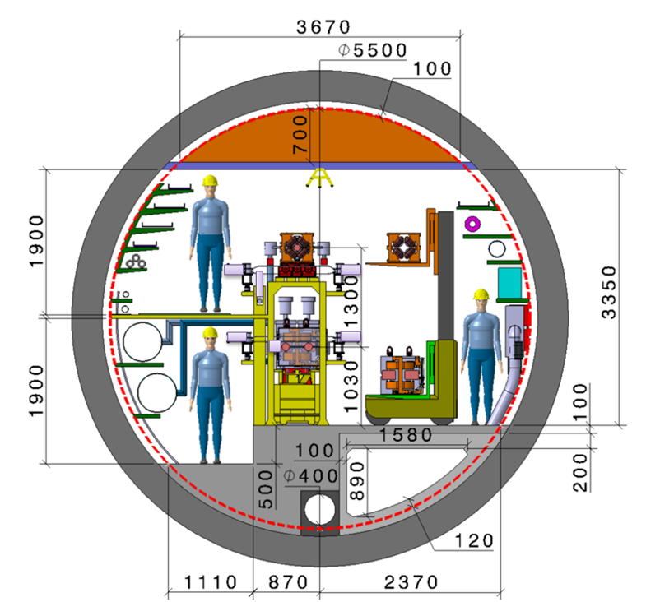
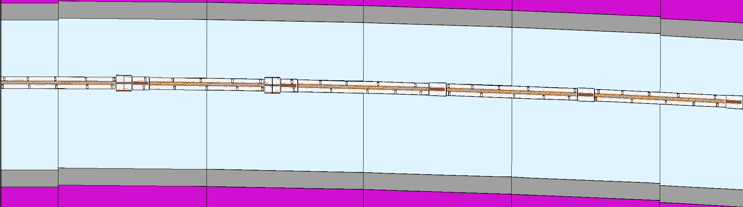
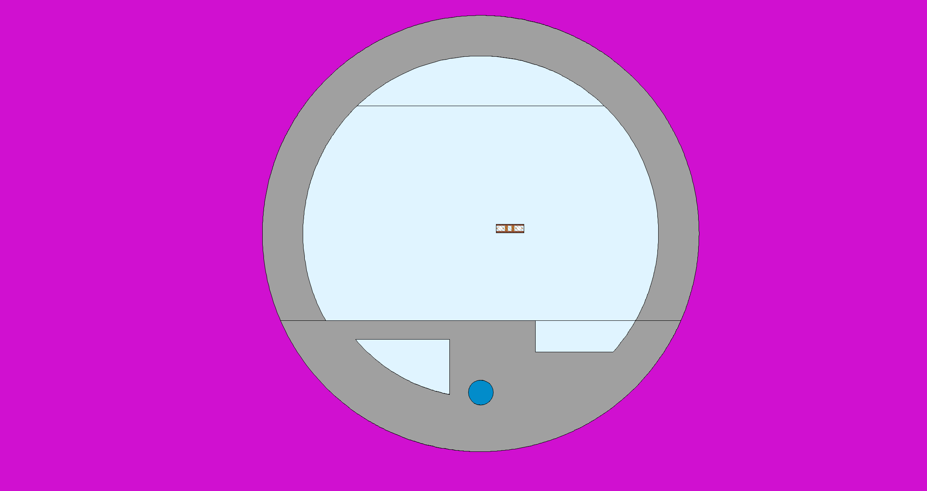
Simulation Setup
182.5GeV (ttbar): most challenging case for energy deposition studies
Representative arc cell → periodic re-insertion of the particles
  140m
  5 dipoles, 5 quadrupoles, 4 sextupoles
SR source: photons emitted in dipoles → indirect approach
  Soon: e-, e+ in all magnets → direct approach
Tunnel layout by F. Valchkova-Georgieva (IOWG, 16.10.2019)

Slide 4
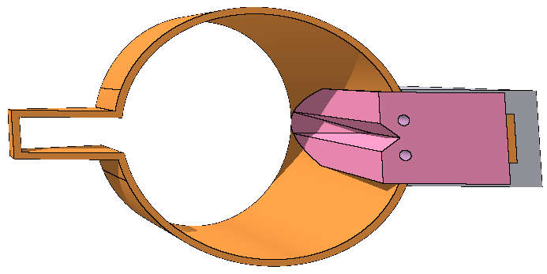

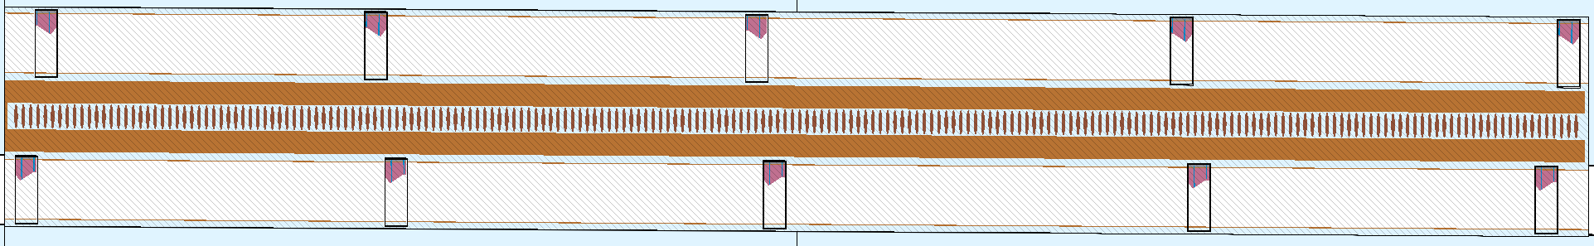
Model comparison: absorber vs continuous shielding
Absorbers (ABS):
CuCrZr alloy
Length: 30cm
5-6m distance
Angled surfaces for even power distribution
25 ABS in each beam (MBs, MQs) (Design and initial placement by R. Kersevan)
Continuous shielding:
Equivalent to LEP layout
Continuous shielding around VC in MBs
  Due to space restrictions from yoke and coils respectively, no shielding in MQs and MSs.
Intermet180 (Tungsten alloy)
Shielding thickness:
  Top/bottom: 1cm
  Sides: 1.3cm
x
z

Slide 5
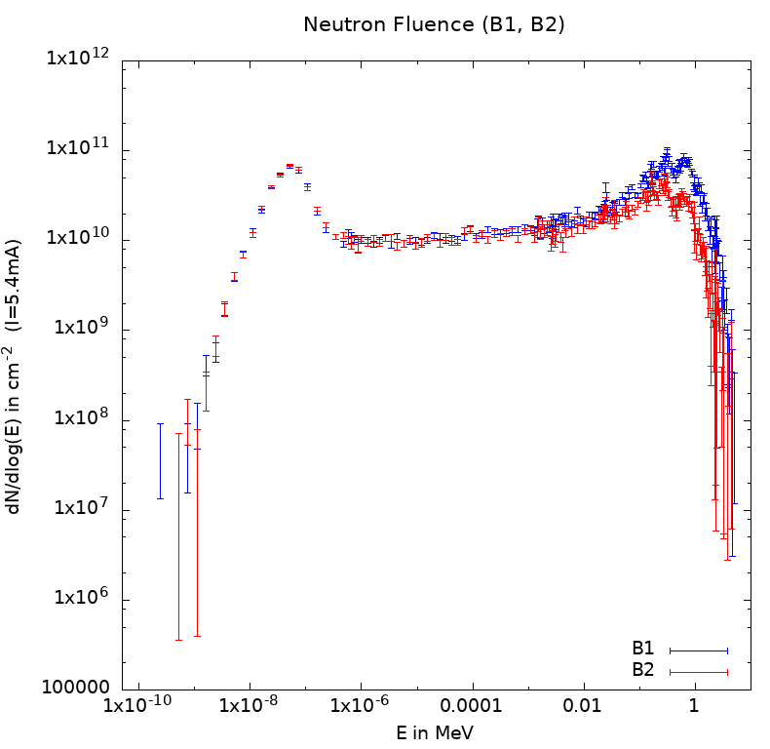
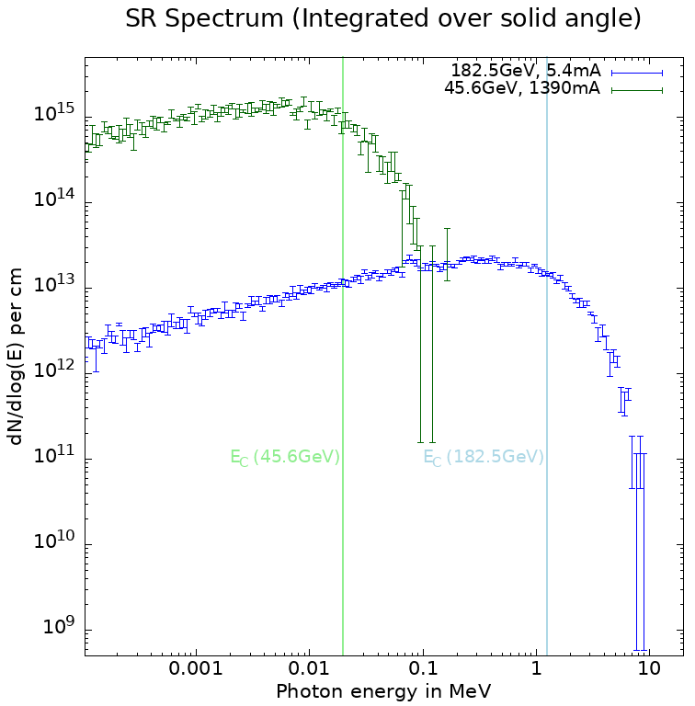
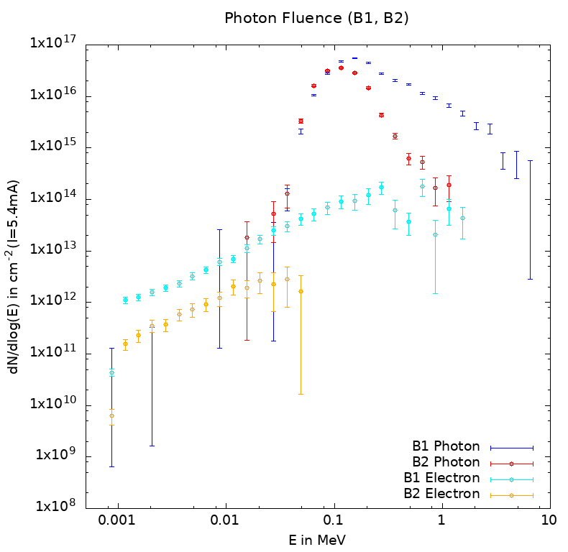
Fluence in the tunnel – ABS layout
SR Spectrum of primary electrons:
Electromagnetic particles fluence:
Higher fluence obtained for B1 due to scoring at the outside of the tunnel
Magnets stop particles from B2
Thermal neutrons
Electron & Photon Fluence (B1, B2)
-2
Neutron fluence:
Similar results for B1 and B2
Magnets are “transparent” for neutrons
Peak at 0.025eV from thermal neutrons

Slide 6
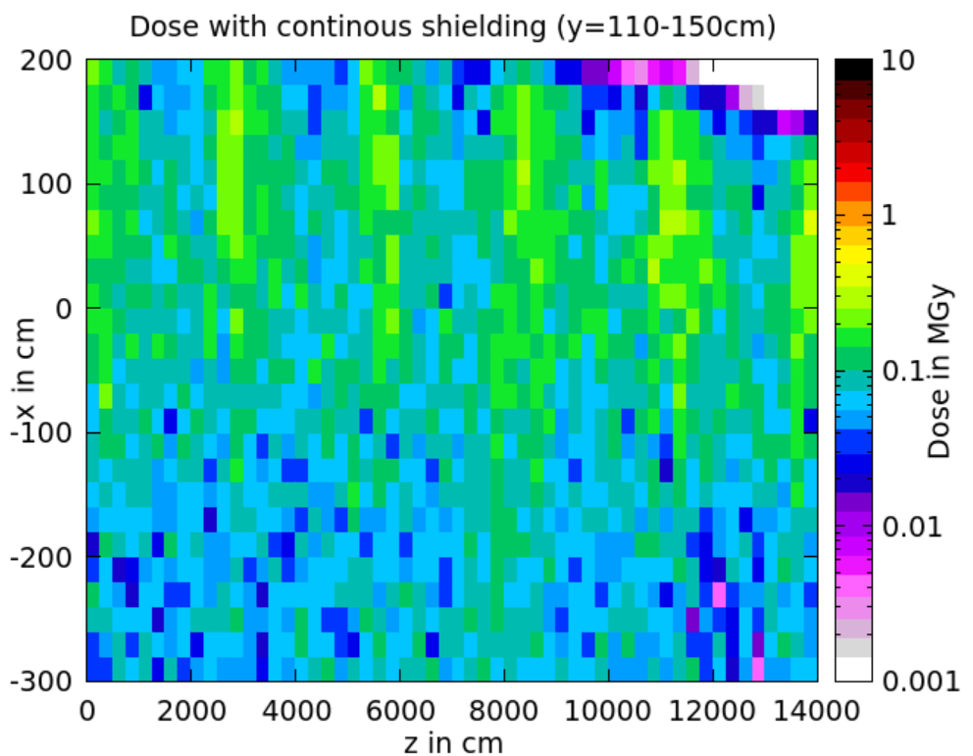
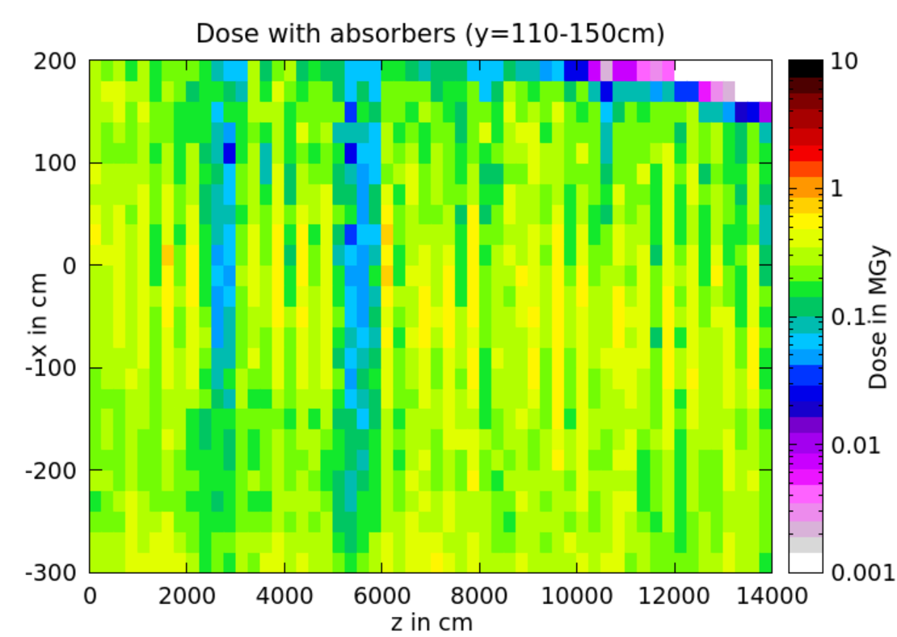
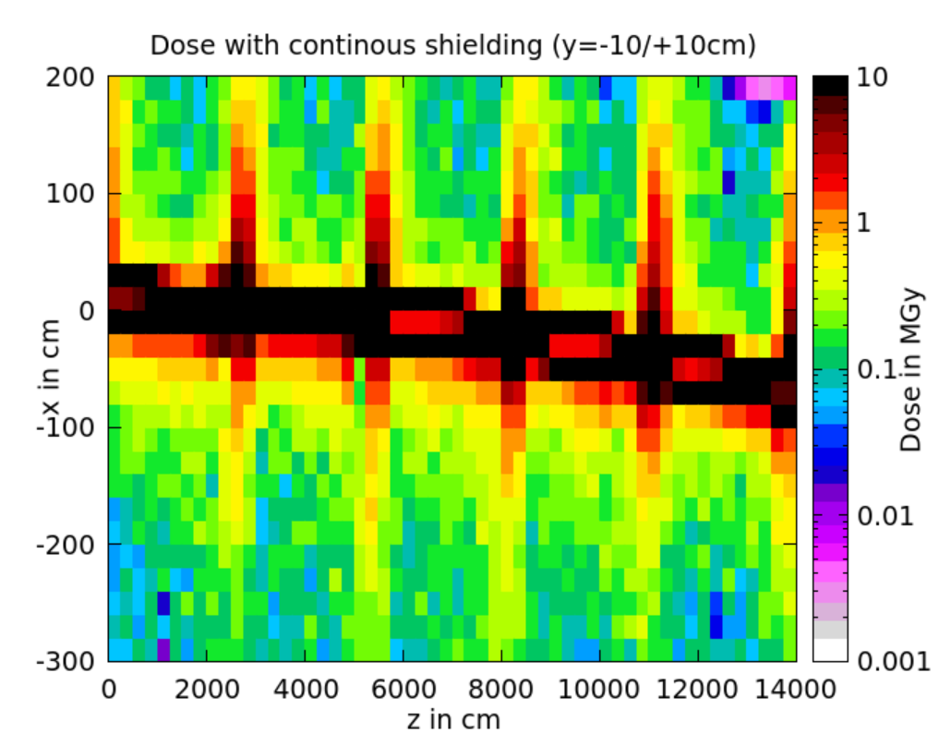
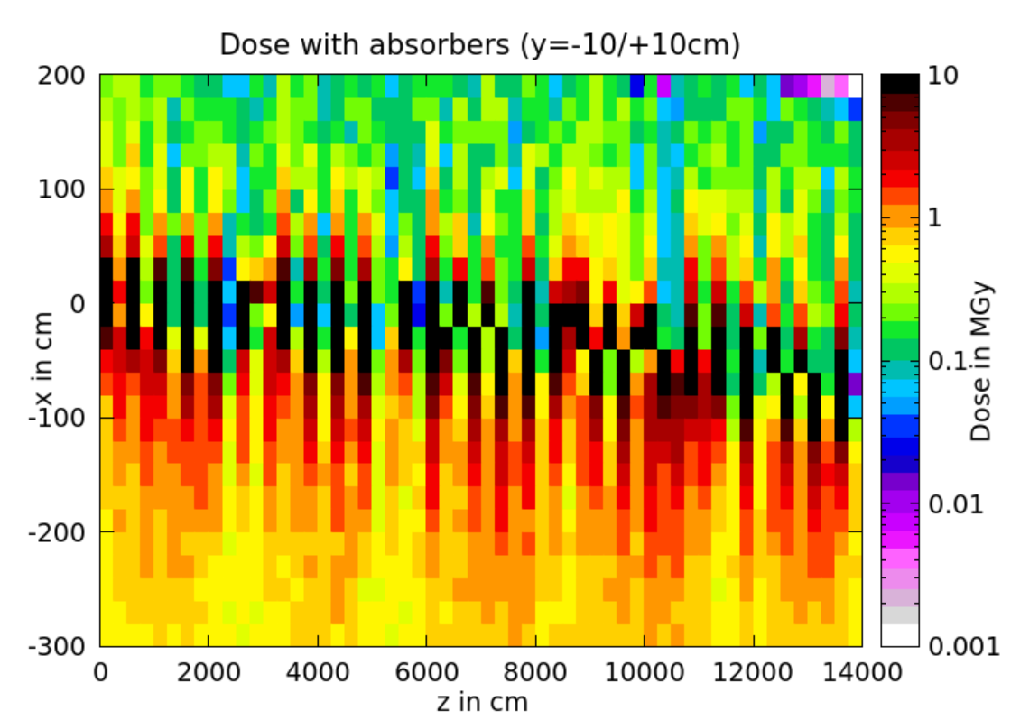
Dose in the tunnel environment
CONT
ABS
 | Continuous | ABS
Top, Center | 120kGy | 500kGy
Middle, ext. | 200kGy/ 1.2MGy peak | 600kGy
Middle, int. | 200kGy | 1.2MGy
CONT
ABS
HL-LHC arcs reference value: 1.4Gy (!)
(https://edms.cern.ch/ui/file/2302154/1.0/HLLHC_Specification_Document_v1.0.pdf)

Slide 7
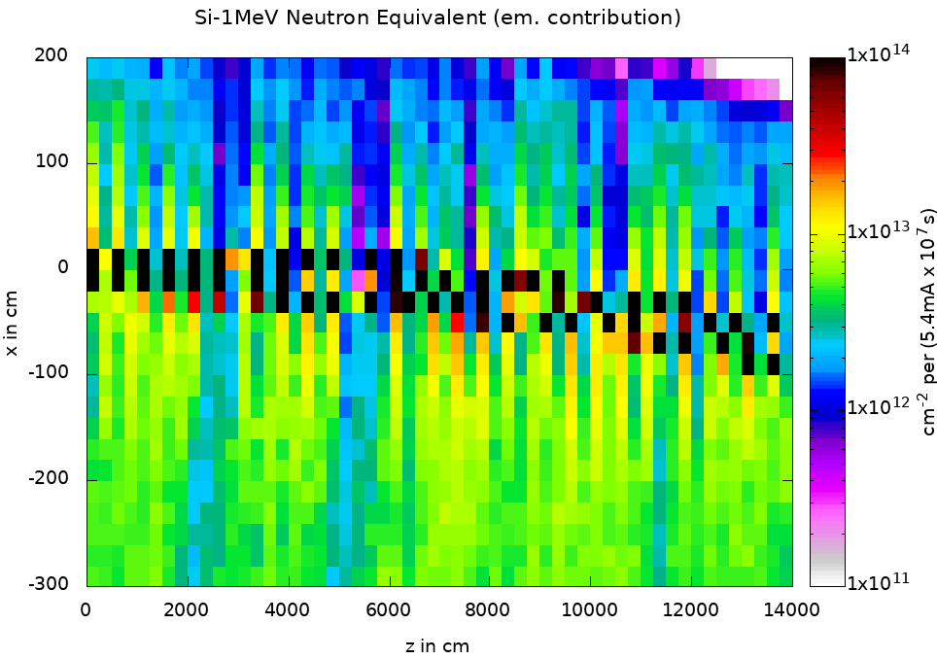
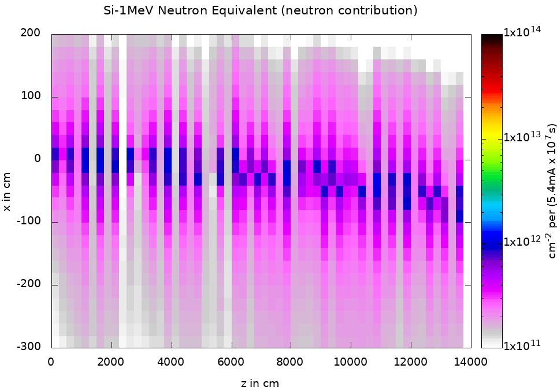
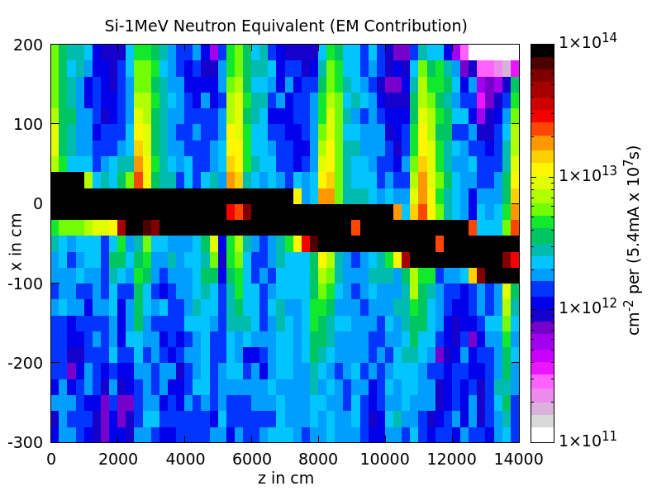
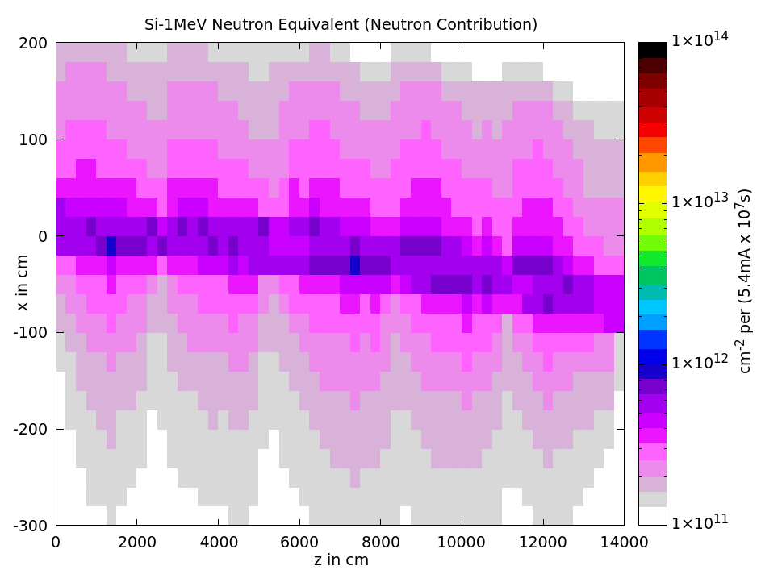
R2E: Si-1MeV neutron equivalent fluence
Low abundance of neutrons, since they are only produced by photons >~10MeV
High abundance of electromagnetic particles leads to higher contribution
CONT: em. contribution better shielded, no significant difference in the neutron contribution
HL-LHC arcs reference: 1.6x10¹⁰cm⁻²
ABS
6x10¹²cm⁻²
2x10¹¹cm⁻²
CONT
1.5x10¹²cm⁻²
1.5x10¹¹cm⁻²
Results normalized to 10⁷s (one year at the current design) and 5.4mA

Slide 8
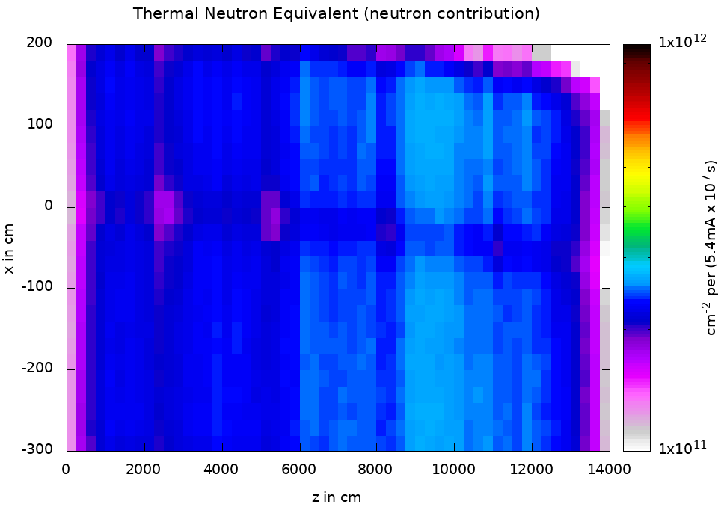
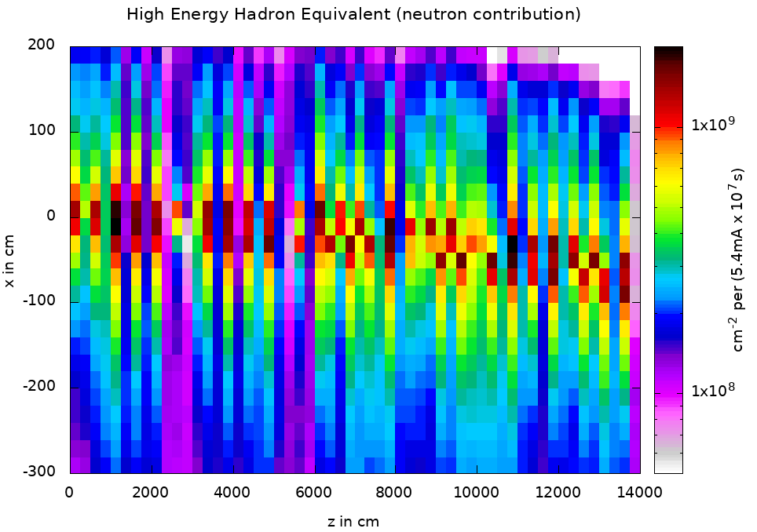
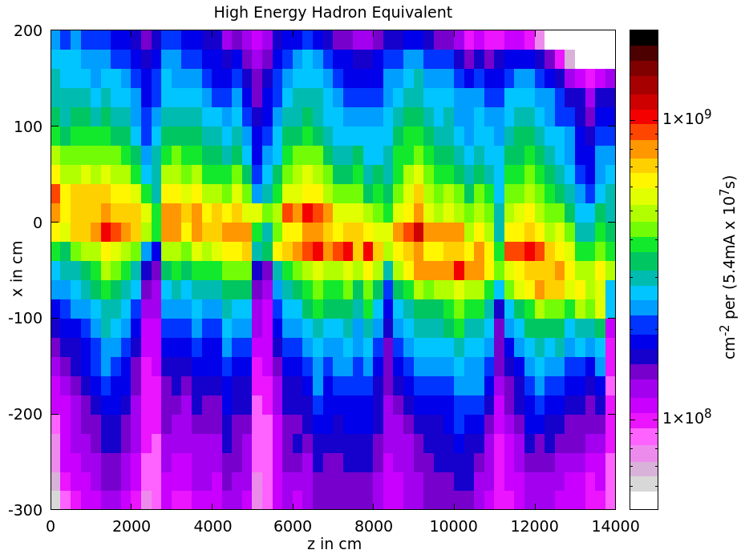
R2E: high energy hadron equivalent fluence & thermal neutron equivalent fluence
Thermal neutron eq fluence:
HEH-eq fluence:
HEH-eq fluence is lower due to low energy of neutrons → low weight
Similar results for both designs for HEH-eq
HL-LHC arc reference: 2.4x10⁹cm⁻²
ABS
CONT
2x10¹¹cm⁻²
Neutrons create secondary neutrons and thermalize
Thermal neutron eq. looks identical for both cases
HL-LHC arc reference: 1.2x10¹⁰cm⁻²
2x10⁸cm⁻²
1x10⁸cm⁻²
Results normalized to 10⁷s (one year at the current design) and 5.4mA

Slide 9
Summary
Particle fluences in the FCC-ee arcs:
  comparable results for continuous scheme and absorber layout
  Si-1MeV neutron equivalent: dominated by electromagnetic contribution (unlike in hadron machines) due to higher abundance of electromagnetic particles
  High energy hadron equivalent: low due to low energy of neutrons
  Thermal neutron equivalent: similar results for both layouts, relatively higher than in HL-LHC
Dose: much harsher environment than in HL-LHC → in terms of R2E the limiting factor for FCC-ee, but it should be easier to shield compared to hadrons

Slide 10
Any questions?

