Slide 1
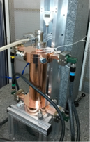
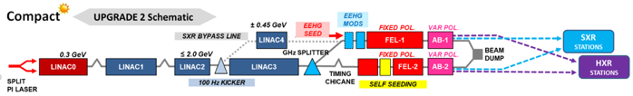
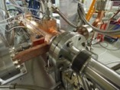
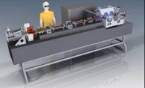
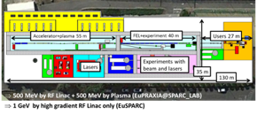
LC studies CERN 2021-26
CLIC and High Gradient technology:
Design and manufacturing of X-band structures and components, system interfaces
Study structures breakdown limits and optimization, operation and conditioning
Beam-dynamics and parameters: Nanobeams (focus on beam-delivery), pushing multi-TeV region (parameters and beam structure vs energy efficiency)
Tests in CLEAR (wakefields, instrumentation) and other facilities (e.g. ATF2)
See talks by Phil Burrows (CLIC), Nuria Catalan (Nanobeams), Chetan Gohil (Luminosity Performance)
Application of X-band technology (examples):
1 GeV X-band linac at LNF
A compact FEL (CompactLight: EU Design Study 2018-21)
Compact Medical linacs (proton and electrons)
Inverse Compton Scattering Source (Smart-Light)
Linearizers and deflectors in FELs (PSI, DESY, more)
See talk by Walter Wuensch (Applications of High Gradient Technologies)
ILC related R&D and Pre-lab Planning
Positron flux concentrator, ATF2/3, Hi-klystrons, various SRF topics, cryo, dumps, beam-dynamics, DR, etc
IDT participation and Common Fund contributions.
Numerous ILC and/or KEK collaborative R&Ds, linking to CLIC, generic R&D or SRF for HL LHC and FCC and other CERN activities.
See talks by Joachim Mnich and Steinar Stapnes (CERN and European reports)

Slide 2
CLIC Project Readiness Report (PRR)
Project Readiness Report as a step toward a TDR – for next ESPP
Assuming ESPP in 2026, Project Approval ~ 2028, Project (tunnel) construction can start in ~ 2030.
Focusing on:
The X-band technology readiness for the 380 GeV CLIC initial phase
Optimizing the luminosity at 380 GeV
Improving the power efficiency for both the initial phase and at high energies
More details:
X-band studies: Structure manufacturability and optimized conditioning, interfaces to all connecting systems for large scale production, designs for and support of use in applications, e.g. for FEL linacs, ICS and medical linacs, possible future improvements for power/cost
Luminosity: beamdynamics studies and related hardware optimisation for nano beams from damping rings to final focus (mechanical and thermal stability, alignment, instrumentation, vacuum systems, stray field control, magnet stability, etc)
Improving damping ring and drive beam RF efficiency, study parameters and potential hardware changes to reduce power, from 380 GeV to multi-TeV energies with high luminosities

Slide 3
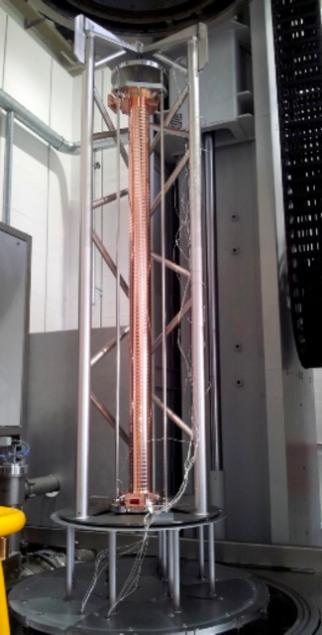
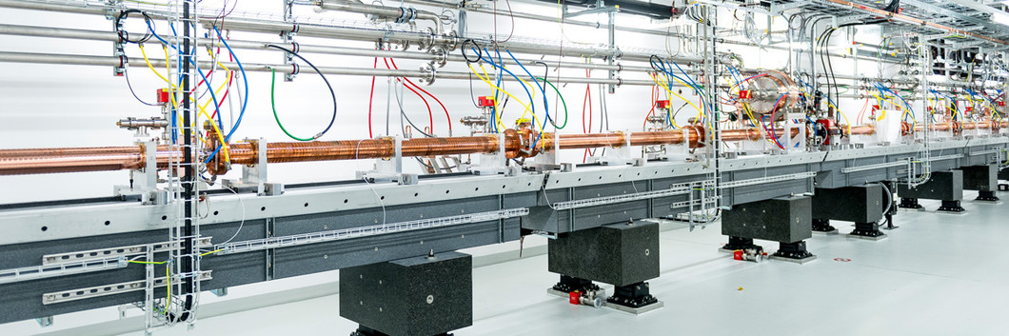
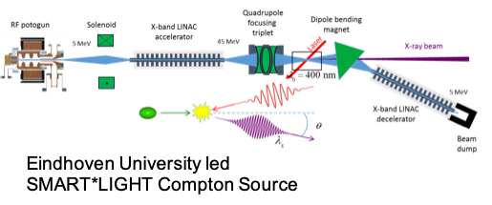
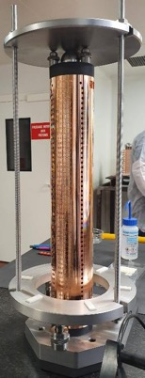

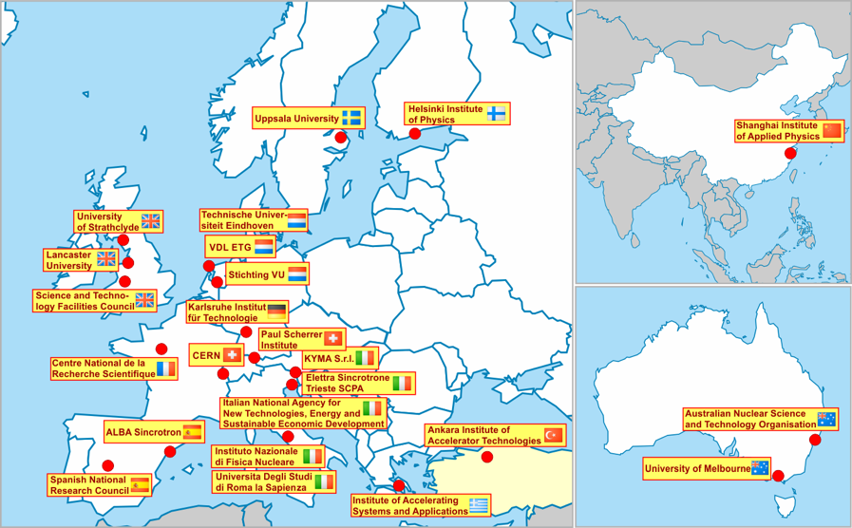
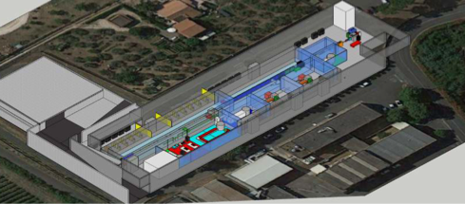
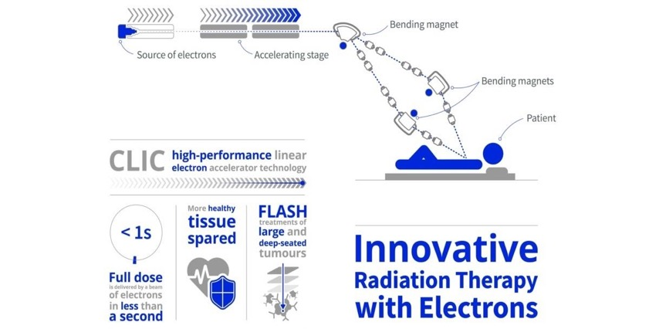
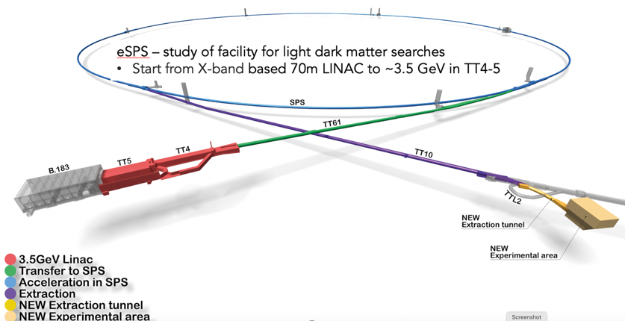
Use in smaller linacs (C and X-band)
SwissFEL: C-band linac
Photo: SwissFEL/PSI
CLIC technology for different applications
EU co-funded FEL design study
1 GeV linac at INFN-LNF
Medical linacs
ICS
etc
104 x 2 m-long C-band (5.7 GHz) structures (beam up to 6 GeV at 100 Hz)
Similar μm-level tolerance
Length ~ 800 CLIC structures
Being commissioned
X-band structures from PSI perform well
26 academic and industrial partners: http://www.compactlight.eu/Main/HomePage
Eindhoven University led
SMART*LIGHT Compton Source
INFN Frascati advanced acceleration facility
EuPRAXIA@SPARC_LAB
CompactLight
CERN: eSPS study (3.5 GeV X-band linac)

Slide 4
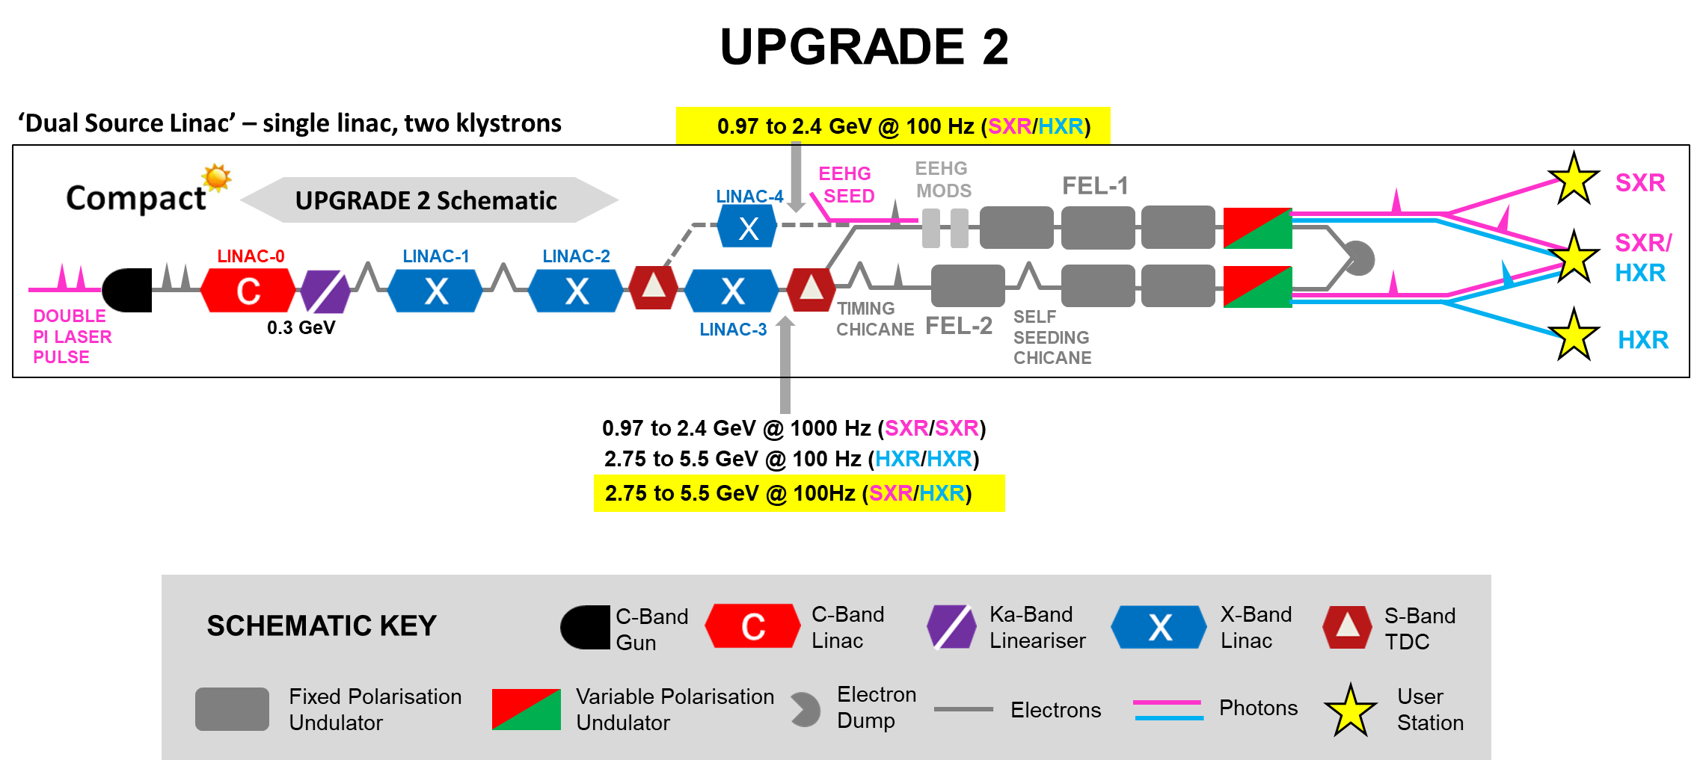
CompactLight - features
Pump-probe experiments:
Two-bunch linac operation
Hard and soft X-ray operating modes
High and low repetition rate operation
Many frequencies

Slide 5
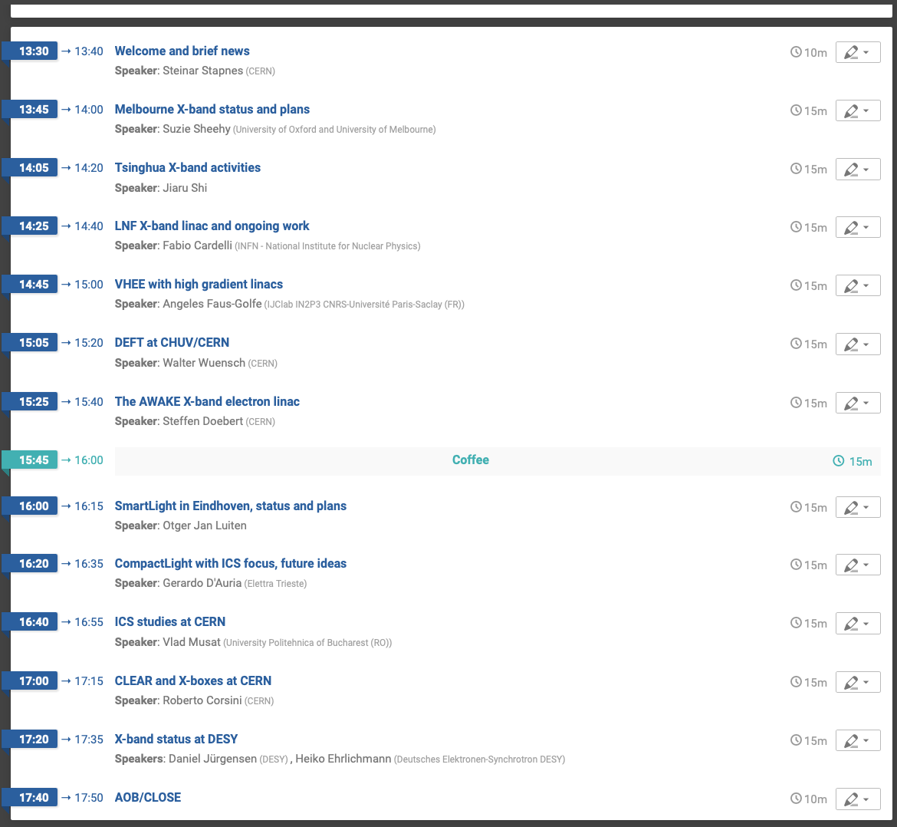
Possible areas to cover:
Main purpose of installation
Overview of project parameters: energies, key beam-parameters as bunch structure, charges, rep. rates, beamsize/emittance, other critical performance parameters, etc
Technical overview if available as injector, X-band and RF power systems, laser (if part of system), etc
Timeline, collaborators and collaborative plans or wishes for combined work with CERN (for example related to X-band/CLEAR/Xboxes, RF sources etc)

