Slide 1

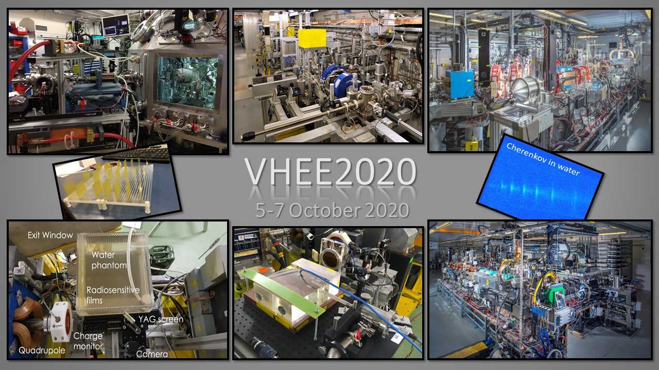
VHEE with High-Gradient linacs
Dr. A. Faus-Golfe

Slide 2
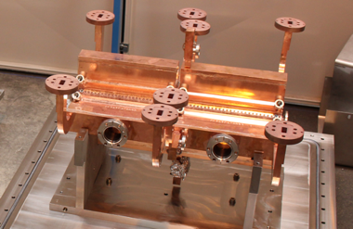
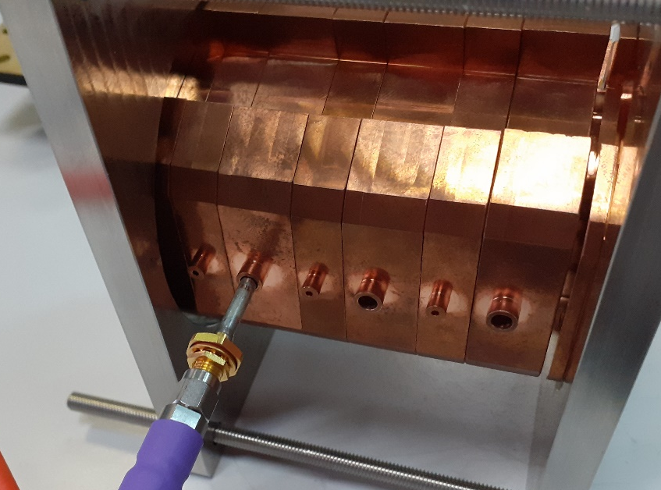
OUTLINE
  The Challenges of Radiotherapy
    New RT approaches
      VHEE RT
      New delivery doses modalities: FLASH
  Facilities for VHEE R&D
  Technologies for VHEE: HG linacs
  Summary and Future perspectives

Slide 3

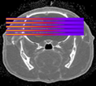
CHALLENGES IN RADIOTHERAPY
New RT approaches
RT treatment of some radio resistant tumours, paediatric cancers and tumours close to a delicate structure (i.e. spinal cord) is currently limited
  One of the main challenges is to find approaches to increase the normal tissue resistance
  Standard RT is restricted to the few temporal and spatial schemes, dose rates, broad field sizes: mainly photons, 2 Gy/session, 1 session/day, 5 days/week, dose rates ~ 2 Gy/min, field sizes > cm², homogeneous dose distributions
Possible strategies to spare normal tissue
  Different particle types: Very High Energy Electrons (VHEE)
  Different dose delivery methods: Grid Mini-beam or FLASH RT
Notes:
Limitation of conventional radiotherapy. Toxicity to healthy tissue limits the dose.
- How to improve the treatment?
- Preserving healthy tissue
- Induce more effective tumor irradiation
- Particle / energy, ballistic approach

Slide 4
VHEE THERAPY
State of the Art
With recent High-Gradient linac technology developments, Very High Energy Electrons (VHEE) in the range 100–250 MeV offer the promise to be a cost-effective option in anticancer RT and open up innovative treatment modalities (Grid mini-beam, FLASH,..)
Their ballistic and dosimetric properties can surpass those of photons, which are currently the most commonly used in RT
Their position compared to protons need to be evaluated, but they can be produced at a reduced cost
Notes:
CLIC RF X-band cavity prototype (12 Ghz, 100 MV/m) Compact Linear Collider
Current radiotherapy methods:
6 - 18 MeV photons
5 - 20 MeV electrons
50 - 300 MeV/u hadrons (protons, Carbon-12)
Beam simulations with Geant4
Several VHEE beam simulations has been conducted by Manchester group (A. Lagzda)
Longitudinal and transverse dose profiles of 50 – 250 MeV VHEE beams (with CALIFES parameters)
250 MeV electron beams can sufficiently penetrate tissue up to 20-25cm – ideal for deep-seated tumour irradiation in non-obese patients

Slide 5
NEW DELIVERY DOSE MODALITIES
What is FLASH RT?
New way of dose delivery consisting in ultra short irradiation time or “beam on time” (<500 ms) and very high-dose (60-200 Gy/s)
No FLASH effect in vitro with clonogenic cell death as an endpoint (Nias et al. Br J Radiol 42: 553, 1969). The FLASH effect relates to normal, living tissue only.
The beam-on time, not the dose-rate appears to be the major determinant of the FLASH effect
Ultrahigh dose-rate pulses (e.g. 10¹³ Gy/s) will NOT provide a FLASH effect as long as the dose per pulse is low and the total length of radiation exposure exceeds 100-500 ms
100-500 ms

Slide 6

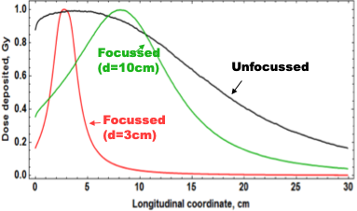
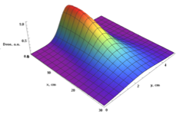
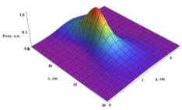
VHEE – FLASH Open questions:
What High-Energy ?
Field sizes?
Inhomogenities?
Skin/Bone dose ?
Penumbra?
Neutrons ?
              Scanning small beams ?
              Focusing and Shaping?
              In vivo experiments for validate FLASH RT?
              Pulse structure impact in FLASH RT?
              ......
FLASH RT
Mini-beams
Notes:
-Effect of inhomogeneities on beam dose (Manchester team)
-Protons: Shift in Bragg peak position (~diameter of embedded air cavity) – results in large dose deposition in healthy tissue!
-Photons: Dose build-up after the air cavity for photons
-VHEE: relatively insensitive to intervening low-density media (dose difference range ~0.3%) – precise and reliable dose delivery to cancerous tissue
FIGURES:
Dose maps of VHEE, photon and proton beams in a 30×30×30 cm+ water phantom with an air cavity placed at depth , = 10 cm and radius / = 1 cm
Experiments with > 2° converging beams planned at CERN’s CLEAR

Slide 7
VHEE – FLASH Open questions:
What High-Energy ?
Field sizes?
Inhomogenities??
Skin/Bone dose ?
-Penumbra?
-Neutrons ?
              Scanning small beams ?
              Focusing and Shaping?
              In vivo experiments for validate FLASH RT?
              Pulse structure impact in FLASH RT?
              ......
FLASH RT
Mini-beams
To answer these questions, a lot of experiments are being performed and new facilities are been designed
Notes:
-Effect of inhomogeneities on beam dose (Manchester team)
-Protons: Shift in Bragg peak position (~diameter of embedded air cavity) – results in large dose deposition in healthy tissue!
-Photons: Dose build-up after the air cavity for photons
-VHEE: relatively insensitive to intervening low-density media (dose difference range ~0.3%) – precise and reliable dose delivery to cancerous tissue
FIGURES:
Dose maps of VHEE, photon and proton beams in a 30×30×30 cm+ water phantom with an air cavity placed at depth , = 10 cm and radius / = 1 cm
Experiments with > 2° converging beams planned at CERN’s CLEAR

Slide 8
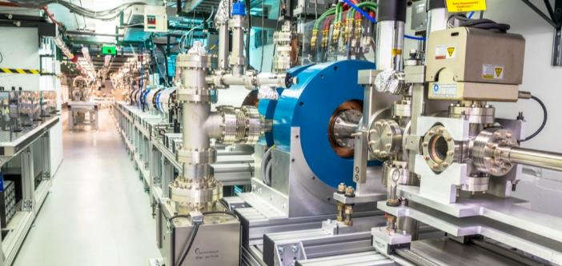
FEERIX/ AERIAL
FLASH IC
CLEAR CERN
ORIATRON CHUV
Operating
Facilities
ELBE HZDR
CLARA STFC CI
LOA Salle Noire IPP
PTB Berlin
AWA Argonne
Notes:
- FLASH R&D platform AERIAL-FEERIX IBA 10 MeV Rhodotron in Strasbourg
- IPP Institute Politechnique de Paris

Slide 9
FEERIX/ AERIAL
Low-energy e- & FLASH
Cyclos & linacs
FLASH IC
CLEAR CERN
ORIATRON CHUV
High-energy e- & FLASH
NC HG linacs
Operating
Facilities
ELBE HZDR
High-energy e- & FLASH
SC linacs
CLARA STFC CI
LOA Salle Noire IPP
PTB Berlin
AWA Argonne
High-energy e- &FLASH
LPA
Notes:
- FLASH R&D platform AERIAL-FEERIX IBA 10 MeV Rhodotron in Strasbourg
- IPP Institute Politechnique de Paris

Slide 10
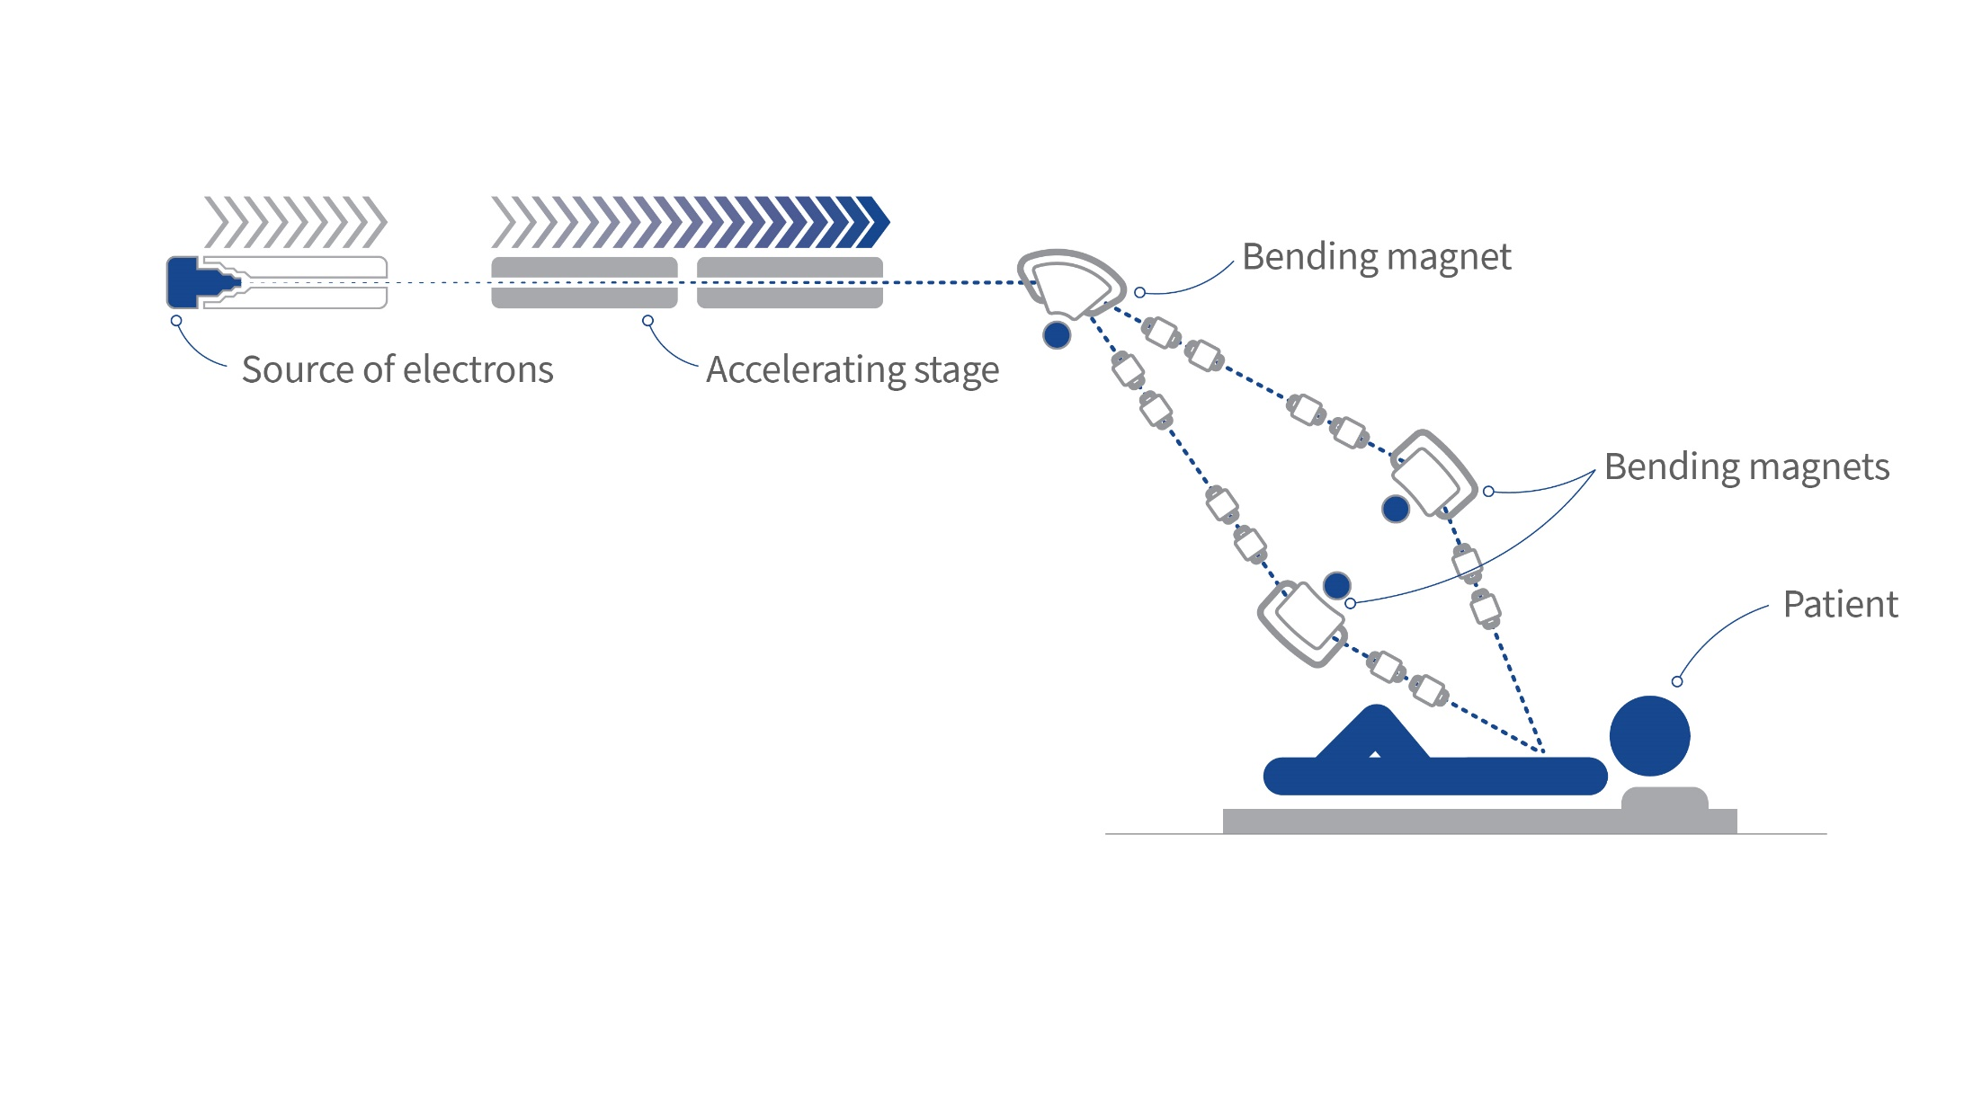
DEFT CERN-CHUV
High-energy e-
NC HG linacs
e-beam PHASER
On design
Facilities
IDRA LOA IPP
FRIDA Sapienza-INFN
PITZ DESY
High-energy e-
LPA
High-energy e-
SC linacs

Slide 11
W. Wuensch’s talk
DEFT CERN-CHUV
High-energy e- & FLASH
NC HG linacs
e-beam PHASER
On design
Facilities
IDRA LOA IPP
FRIDA Sapienza-INFN
PITZ DESY
High-energy e- & FLASH
SC linacs
High-energy e- & FLASH
LPA
Notes:
Focus in NC HG linac technology

Slide 12
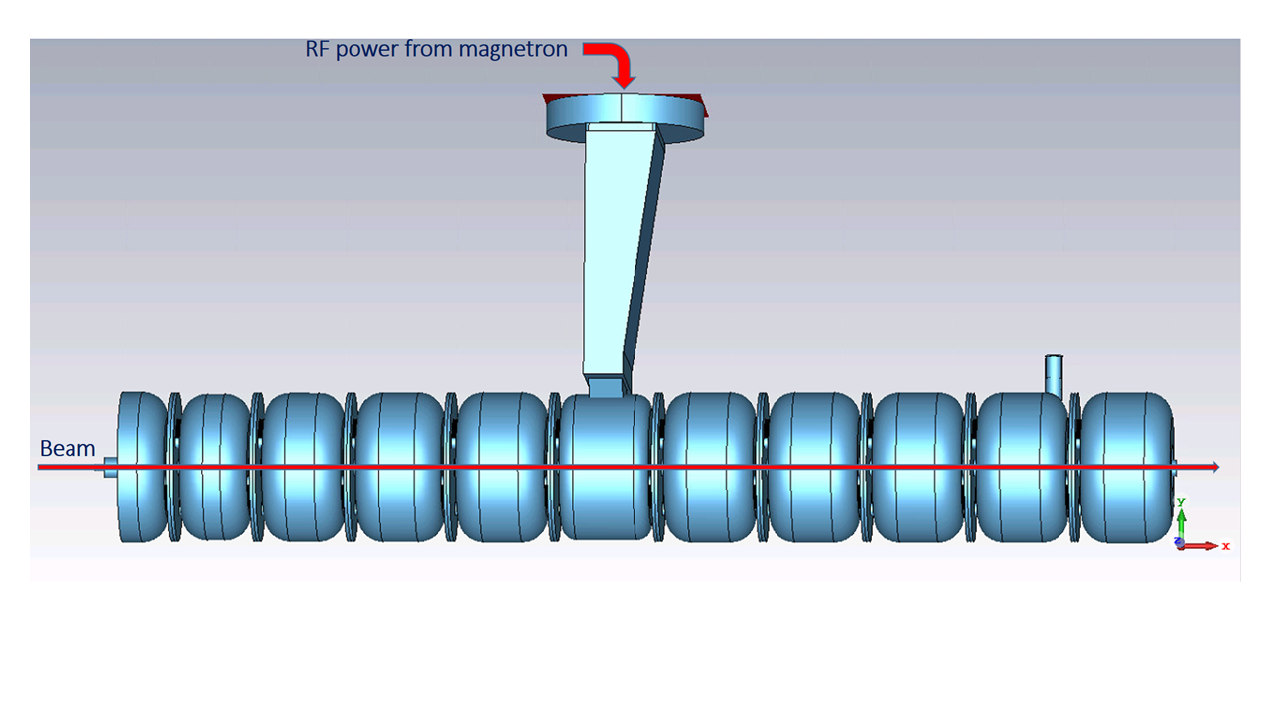
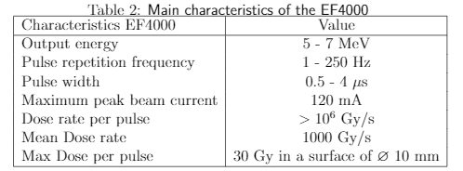
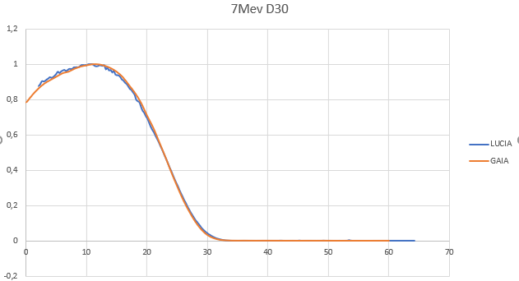
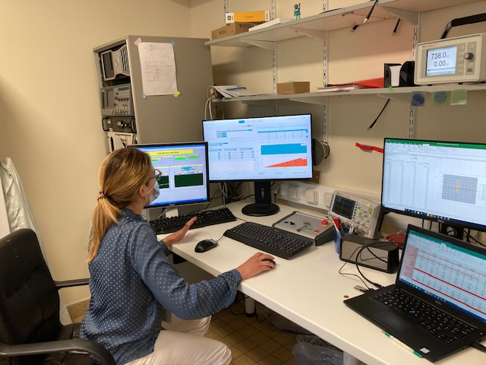
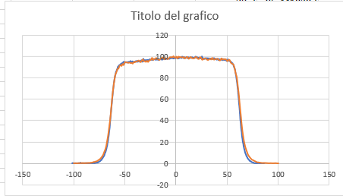
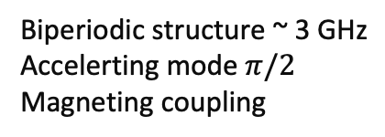
Sapienza & INFN on Flash-RT
Development of 5-7 MeV S-Band e-Linac for Flash-RT with industrial partnership (SIT), nowadays installed at IC Orsay
Biperiodic structure ~ 3 GHz
Accelerting mode $π/2$
Magneting coupling
FLASH IORT machine
Dosimetric analysis - 7 MeV – Measurements vs Fluka
PDD
7 MeV
D30
5 October 2021
40th CLIC Project Meeting
Notes:
Sapienza & INFN group have invested on the e-FLASH technology, and has already commercial patnership on it. The group is centered at the SBAI Departement and has a twofold interest on FLASH RT:
- A huge effort has been put on realization of the first FLASH IORT machine with SIT company. The next future target of this team is the development of compact VHEE demonstrator
- The second pillar of this effort has been the developmentof a new TPS software based on MC dose evaluation, able to treat electron, photon and protons and to run on GPU

Slide 13
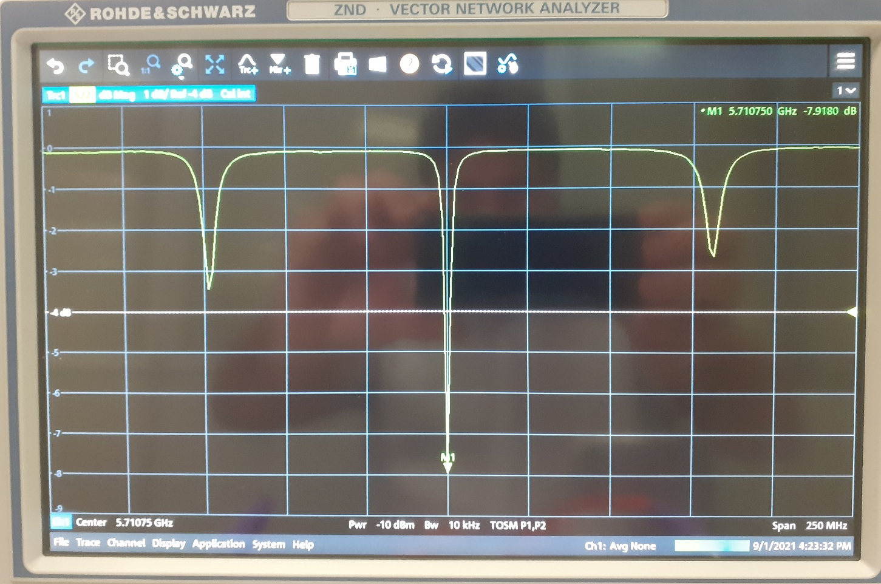
Sapienza & INFN on Flash-RT
Development of a C-Band Linac 12 MeV – SIT Company
32 biperiodics cells structure
5 October 2021
40th CLIC Project Meeting
Notes:
The second step is the development of a C-band linac

Slide 14
Sapienza & INFN on Flash-RT
Development of a C-Band Linac 12 MeV – SIT Company
Final full prototype expected end 2021
32 biperiodics cells structure
5 October 2021
40th CLIC Project Meeting

Slide 15

Sapienza & INFN on Flash-RT
Proposal of a VHEE-LINAC- FLASH RT Research Laboratory (Concept)
KLYSTRON
Monitoring & Dosimetry
Pre-clinics
60-100 MeV LINAC
Radiobiology
9 m
Very High-Charge | Medium-Charge
Up to 600 nC per RF pulse | Up to 200 nC per RF pulse
IPAC Conference, 2021

Slide 16
Sapienza & INFN on Flash-RT
Proposal of a VHEE-LINAC- FLASH RT Research Laboratory (Concept)
FRIDA Project INFN
FLASH Radiotherapy with hIgh Dose-rate particle beAms
A community of 80 researchers distributed in 7 INFN sections & Labs: CT, LNS, Milano, Pisa, Roma1, TIFPA, Torino.
Main Objectives:
    Explore the time scales at which the FLASH effect occurs
    Develop compact, high intensity sources and delivery solutions for EBRT with e and p
    Explore novel detection strategies both for dosimetry and beam monitoring applications
    Explore clinical potential of FLASH EBRT
Budget ~1 ME, Project Approved
KLYSTRON
Monitoring & Dosimetry
Pre-clinics
60-100 MeV LINAC
Radiobiology
9 m
Very High-Charge | Medium-Charge
Up to 600 nC per RF pulse | Up to 200 nC per RF pulse
IPAC Conference, 2021

Slide 17
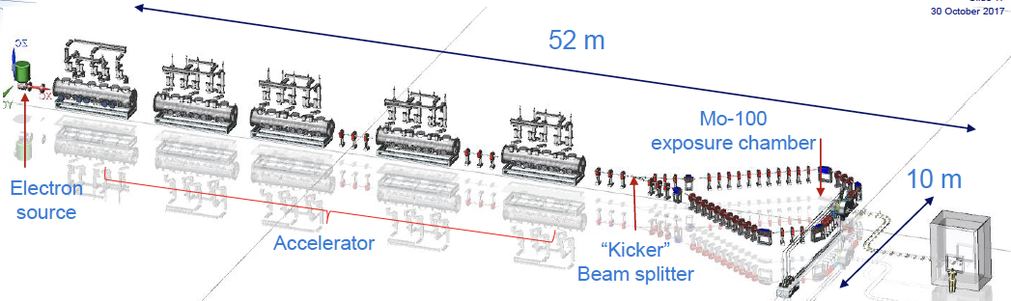
Normal Conducting RF
12 GHz RF structure
110 GHz RF structure
>100 MeV/m is now achievable in labs
Short tunable pulse length Laser
Technologies
Laser-Driven e⁻
Longitudinal shape
Rhodotrons
5.712 GHz RF structure
2.998 GHz RF structure
Super Conducting RF

Slide 18
NOVEL ACCELERATOR TECHNOLOGIES FOR VHEE – FLASH Applications
VHEE RT requires beam energies between 50-200 MeV, an improved dose conformity and scale to higher doses rates, in the case of the FLASH-RT until 50 Gy/s are needed.
An international R&D global effort is being made by labs such as CERN, INFN, KEK, MIT, UCLA, LANL, SLAC and industry partners and focused towards the:
Material origin and purity, surface treatments, manufacturing technology
Consistency and reproducibility of test results.
Some promising R&D are:
The distributed coupling accelerator (SLAC)
The use of cryogenic copper
X-band p-mode Distributed Coupling RF structures
Quality factor for cryogenic copper accelerator structures
Breakdown probability measurement in a single cell cryogenic test

Slide 19
NOVEL ACCELERATOR TECHNOLOGIES FOR VHEE – FLASH Applications II
Another approach for the next generation of compact, efficient and high-performance VHEE accelerator is the use of:
Higher frequencies millimetric waves (~100 GHz)
Higher repetition rates using THz sources
Laser-triggered semiconductor switch for pulse shaping (MIT)
Comparison of X-band and mm-wave linac parameters
Built and tested structures at 110 GHz to 230 MeV (SLAC)
Commissioning device for relativistic electron source
Relativistic electron sources with charges of 160 nC delivered in 1 second, with high repetition rate (ultimately 400Hz) utilizing field emission (100 fC per bunch, 40 ns pulse) (SLAC-NSF)
Relativistic electron source

Slide 20
Detailed information in: https://indico.cern.ch/event/939012/

Slide 21
SUMMARY and FUTURE PERSPECTIVES
Challenge in RT is to find possible strategies to spare normal tissue
  Different particle types: Very High Energy Electrons (VHEE)
  Different dose delivery methods: Grid mini-beam or FLASH RT
FLASH consists of ultra short irradiation time or “beam on time” (<500 ms) and very high-dose (60-200 Gy/s), that spare normal tissues from radiation-induced toxicities
  Understanding the FLASH-RT limits (min/max dose/time)
    Minimum beam on-time: ms => 𝜇m=> ns ? Bunching structure?
    Maximun dose > 200 Gy/s ?
  Understanding the FLASH-RT underlying mechanism:
    Biological studies
    Chemical and kinetic: role of the oxygen
  Extending to other species: p, ¹²C
Dosimetry for ultra-high dose rate is a key stone, development of dosimeters is mandatory for a clinical application (EURAMET - EMPIR 2018)
Which Accelerator is the most suitable to cope the necessary performances?

