Slide 1
Ideas to improve the dynamic range of GEM, THGEM, MM, uRwell detectors
RD51 Dynamic range workshop 18/11/21
Rui De Oliveira on behalf of CERN MPT workshop

Slide 2
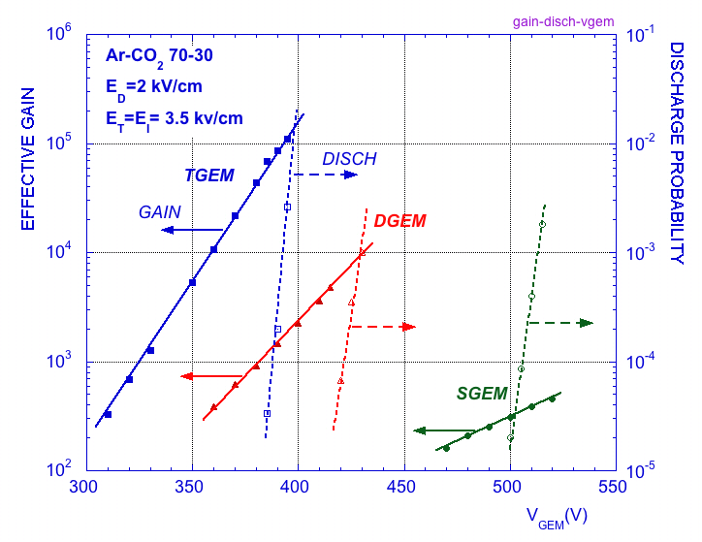
-In the 3 configurations the back-ground
was similar (I suppose)
To my point of view the solution for larger
dynamic range is somewhere here.
-At a given gain, Triple GEM structures
can accept particles with a higher level
of ionization compared to single or double
structures before Sparking.
Fabio Sauli and all

Slide 3
GEM-type detectors
-Same conclusion
-More layers → larger D-Range
-But is it related only to layer count ?
-My understanding is that
the charge diffusion between the layers is also a great contributor to reach this behavior
n₀=230 Fe 55
Single GEM 1.10^6
For n₀>50 electrons “Raether” limit works well, however for n₀<20 electrons
other factor starts dominating like field emission from sharp edges, gain fluctuation…
V. Peskov et al., IEEE Nucl. Sci. 48,2001,1070

Slide 4
-I’ve no possibilities to do simulations in order to quantify exactly the diffusion effect.
-But I was eager to get a rapid feeling on the importance of this effect to take a direction.
-To solve this , I did a really simple model and took several cases.
-Based on these cases my second goal was to estimate if there is a way to extend the DR.
-Goal is to find ideas to run a detector stability in proportional mode with primary ionization ranging
approximately from 10^2e- to 10^5e- → essentially for Nuclear physics
-I think that the problem in particle physics is different → we need high gain detectors amplifying
a small and constant primary ionization , but being able to suppress or reduce sparks caused by unwanted
heavy ionization , but I will not qualify this as an extension of the dynamic range.

Slide 5
First I set a diffusion cone that I estimate classical
(I’m may be not absolutely exact on the value but this should not impact my explanation)
With right
proportion
2mm
1mm dia
or 0.8mm2

Slide 6
2) Then I’ve defined the parameters and physical limits
1 hole
Single std GEM gain set at : 30
50 hole/mm2
Raether limit per hole = 10^6 (V.Peskov plot)
10 holes
40 holes
1mm dia
or 0.8mm2
Numbers of active holes
In the cone

Slide 7
3) Then I’ve sent charges in the stack and look at the different layers behavior
230 e-
1 hole
I wanted to have an idea on:
-Charge reaching one hole
-Charge exiting one hole
-Total charges sent to the next layer
10 holes
40 holes
R/O
1mm dia
or 0.8mm2

Slide 8
230 e-
Input Charge / hole : 230
Output Charge / hole : 230 x 30 =6900
Total charge sent : 6900 x 1 = 6900
1 hole
10 holes
Input Charge / hole : 690
Output Charge / hole : 690 x 30 = 20700
Total charge sent : 20700 x 10= 207000
40 holes
Input Charge / hole : 5175
Output Charge / hole : 155250
Total charge sent : 6.2Me-
R/O
1mm dia
or 0.8mm2

Slide 9
4) Conclusion at this stage
230 e-
Input Charge / hole : 230
Output Charge / hole : 230 x 30 =6900
Total charge sent : 6900 x 1 = 6900
1 hole
10 holes
Input Charge / hole : 690
Output Charge / hole : 690 x 30 = 20700
Total charge sent : 20700 x 10= 207000
40 holes
Input Charge / hole : 5175
Output Charge / hole : 155250
Total charge sent : 6.2Me-
R/O
1mm dia
or 0.8mm2
Total final charge 6.21Me-
total gain: 30 000
First: the single GEM hole Raether limit of 10^6 e-/hole is never violated
Secondly: with 6.21Me- the triple GEM stack goes easily beyond the single GEM limit

Slide 10
4)Then I’ve sent much more charges
10^5 e-
One hole→ 10^5 e- X 30 → 3Me-/hole
spark
R/O
1mm dia
or 0.8mm2

Slide 11
5) I did the same exercise with a lower diffusion cone
230 e-
1 hole
6900e-/hole
3 holes
69K e-/hole
7 holes
900 K e-/ hole
R/O
Smaller diffusion
400um dia or 0.140mm2
Really close to Spark
Conclusion : having many layers is important to increase DR but lateral diffusion is also a key parameter
Can we put more hole per unit area to mimic a larger diffusion ?

Slide 12
Number of holes /mm2 for different amplifying structures
THGEM : 1mm
1 hole/mm2
GEM
0.14mm pitch : 50 holes mm2
0.1mm pitch : 100 holes /mm2
STD MM : 63um pitch (45/18)
256 holes/mm2
Special MM: 35um pitch (23/12)
780 holes/mm2

Slide 13
My conclusion at this stage,
for large dynamic range detectors we need:
-Diffusion as large as possible between layers
-Amplifying holes density as large as possible
-And be producible today

Slide 14
Proposed stack taking in account the previous conclusion
GEM or THGEM density not critical
GEM : 50 holes/mm2 → 1 hole acting
Gain reduced at 5
GEM as dense as possible
GEM : 100 holes/mm2→ 20 holes acting
Gain reduced at 20
Set the gap and fields
to spread over 0.2 mm2
Dia 0.5mm or 0.2mm2
Set the gap and fields
to spread over 0.8 mm2
MM as dense as possible
Dia 1mm or 0.8mm2
Special MM: 780 holes/mm2→ 600 holes acting
Gain set at 30

Slide 15
Situation with large ionization in a single hole
GEM : 50 holes/mm2 → 1 hole acting
Gain set at 5
Input 100 000e-/hole
Output 500 000e-/hole
total charge transferred 0.5 Me-
10^5 e-
GEM : 100 holes/mm2 → 20 holes acting
Gain set at 20
Input 25000 e-/hole
Output 500 000 e-/hole
20 holes → total charge transferred 10 Me-
Set the gap and fields
to spread over 0.2 mm2
Dia 0.5mm or 0.2mm2
Set the gap and fields
to spread over 0.8 mm2
Dia 1mm or 0.8mm2
Special MM: 780 holes/mm2 → 600 holes acting
Gain set at 30
Input 16666 e-/hole
Output 500 000 e-/hole
0.8 mm2 pad collecting all the charges
600 holes → total charge collected 0.3 Ge-
No spark. All elements are running at 500 000 e-/hole . And there is still some margin.
Gain of 3000 . Total charge 0.3Ge-

Slide 16
Low ionization
GEM : 50 holes/mm2 → 1 hole acting
Gain set at 5
Input 230e-/hole
Output 1150e-/hole
total charge transferred 1150e-
230 e-
GEM : 100 holes/mm2→ 20 holes acting
Gain set at 20
Input 57e-/hole
Output 1150e-/hole
20 holes → total charge transferred 23ke-
Set the gap and fields
to spread over 0.2 mm2
Dia 0.5mm or 0.2mm2
Set the gap and fields
to spread over 0.8 mm2
Dia 1mm or 0.8mm2
Special MM: 780 holes/mm2 → 600 holes acting
Gain set at 30
Input 39 e-/hole
Output 1150 e-/hole
0.8 mm2 pad collecting all the charges
600 holes → total charge collected 0.7 Me-
Standard behavior
Gain 3000

Slide 17
Conclusion at this stage
-There is probably a way to make detectors working in proportional mode with primary ionization
ranging from 10^2e- to 10^5-10^6e- (covering 3-4 orders of magnitude) without instabilities and with
existing devices.
(May be a good candidate for IBF suppression, but this is a different topic).
-For application with primary ionization above 10^5 - 10^6 primaries the trajectory of the particles
should be set parallel to the detector surface . This will do a first dilution of the electrons in
the drift region prior drifting perpendicularly inside the detector .
-I can’t imagine that clusters of 10^6 charges or more could be created in a single small location.

Slide 18
Ideas to improve single amplification devices
→minimizing parasitic fields
THGEM
Micromegas

Slide 19
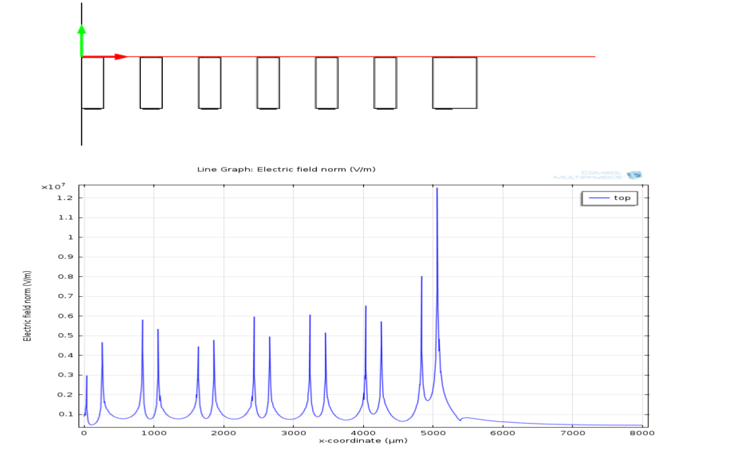
Parasitic field in THGEM at the hole input
-The parasitic field can be 2 time bigger than the amplification field.
-Any charges passing in the parasitic field regions will be pre-amplified and will artificially limit the dynamic range.
Or
-High parasitic fields can induce Electron emissions reducing also the dynamic range.
Silvia Franchino Comsol simulations

Slide 20
Multi electrode solution
-Multi Layers THGEM
-Stronger field inside
-Give the possibility to reduce the outer voltage
–This reduces the parasitic fields at the hole input
-Possibility to creates a new region with parasitic field
-Embedded electrodes THGEM
-High parasitic field region encapsulated
-Stronger field inside as before
-Multi Mesh THGEM

Slide 21
Micromegas

Slide 22
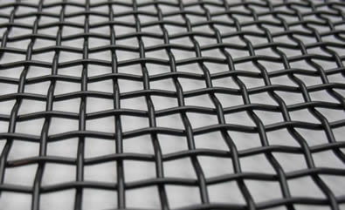
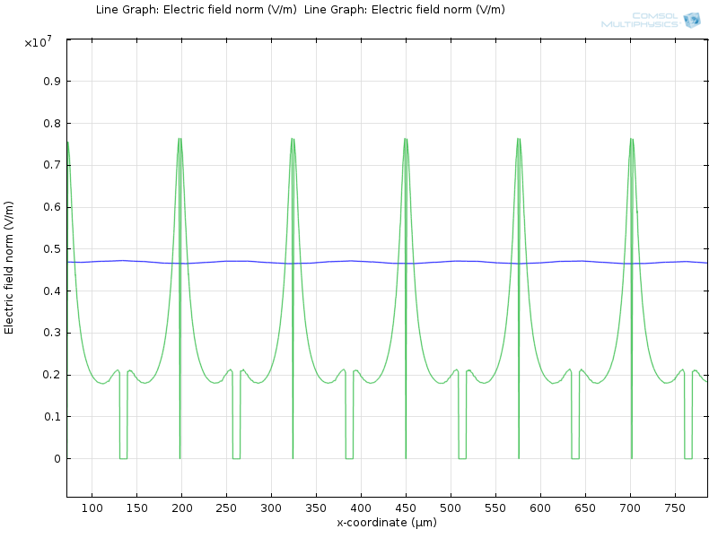
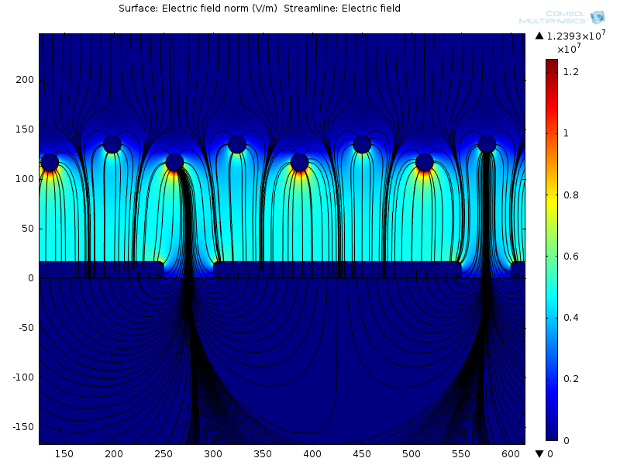
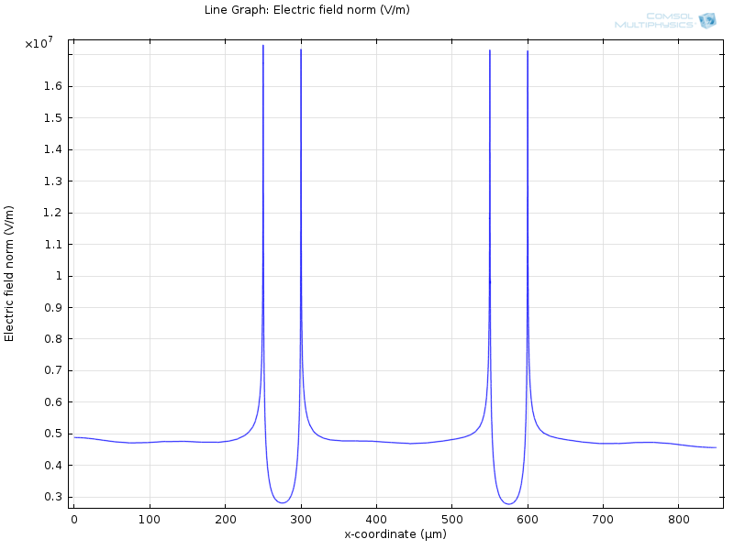
STD config: woven mesh STD pads
Large
Variations
near the
mesh
mesh
middle
Pads
Stable field
in the middle
Large
Variations
near the
Pad edges
Silvia Franchino comsol simulations

Slide 23
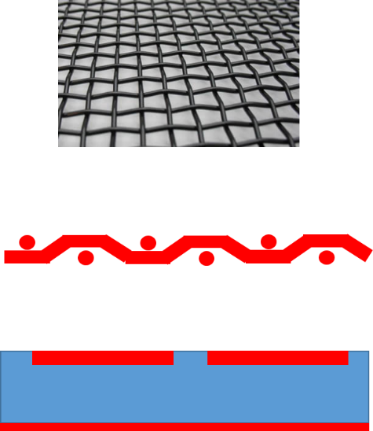
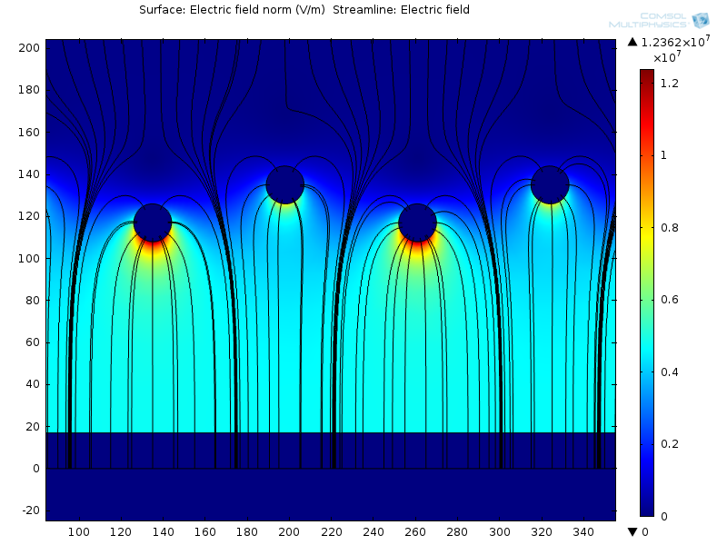
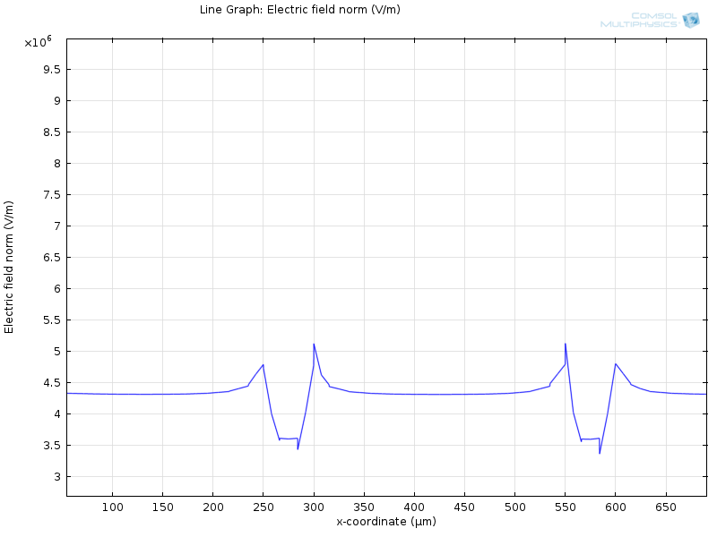
Filling gaps between pads
Mesh side
No change
Inner field
No change
Lower spread

Slide 24
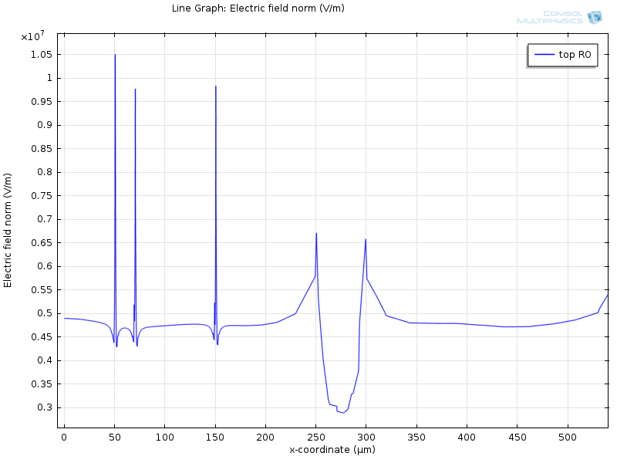
Pads finishing impact
Mirror Polished
1um structures

Slide 25
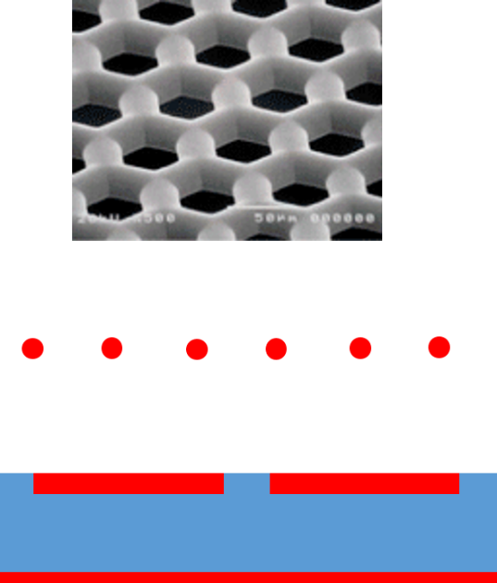
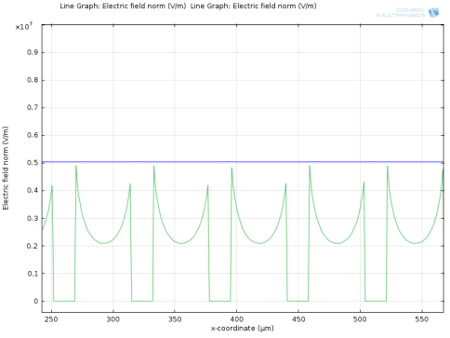
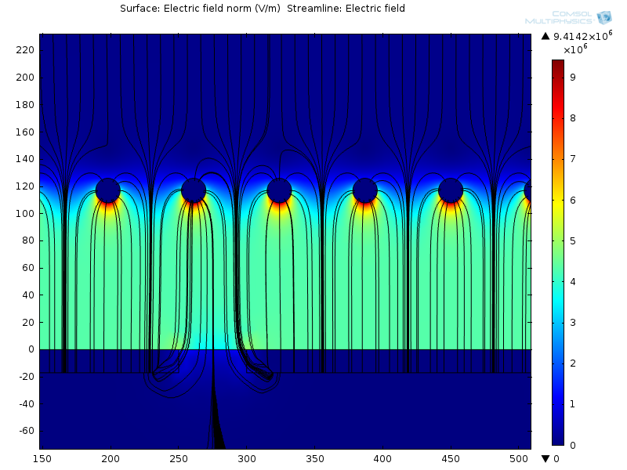
Exchange the mesh → Beta mesh
Lower spread
On mesh side
Better field
In the middle

Slide 26
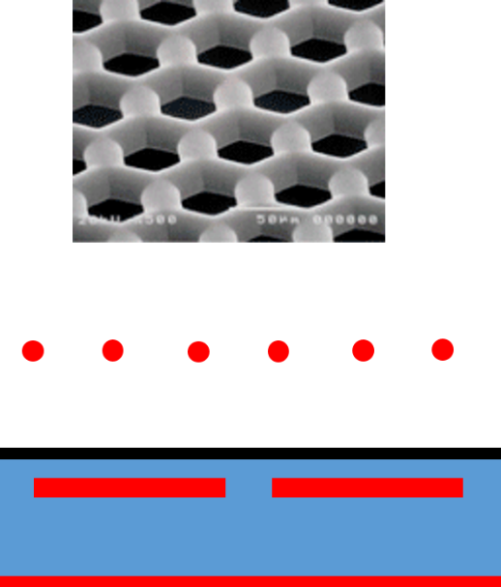
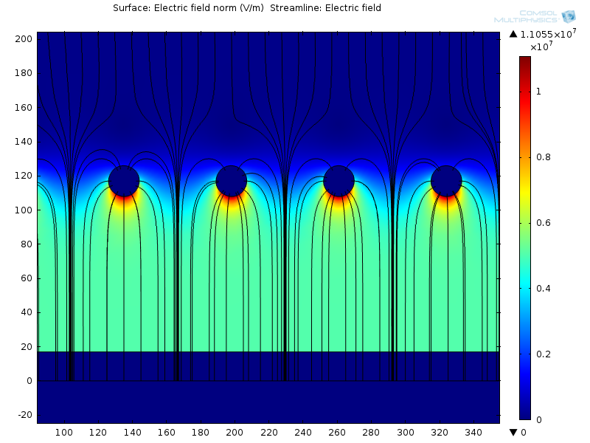
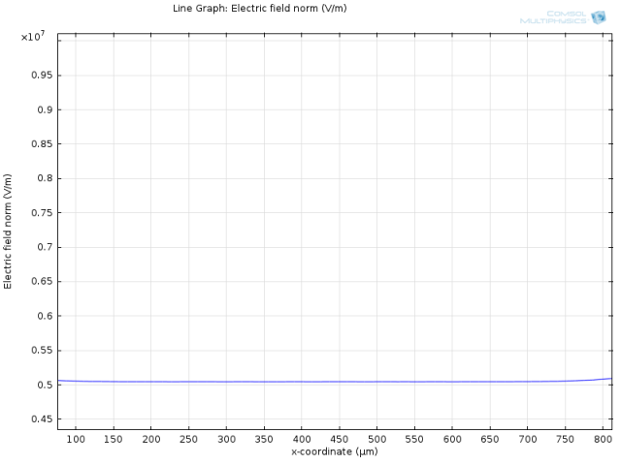
With Beta mesh and adding DLC layer
Pad side
perfect

Slide 27
other last idea

Slide 28
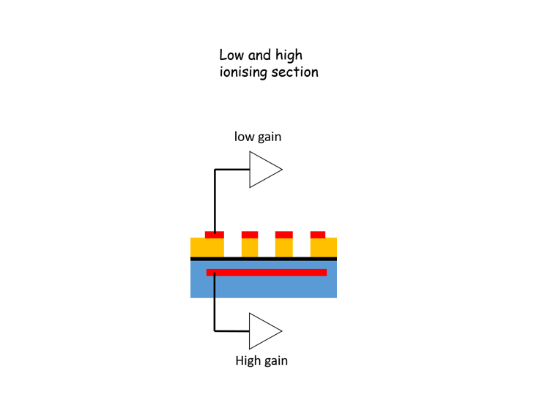
Special uRwell device
low ionizing particles:
→ Normal reading with the high gain Amplifier
With highly ionizing particles:
→ Read the signal with the low gain amplifier
→ signal = direct primary electrons signal followed in time by a large one induced by the large signal from the gap below.
→ one can remove the part of the signal during the time where high gain amplifier is saturated
→ or only keep one polarity
Long signal when e- approach
the top mesh pad (micro sec level)
Saturated signal coming
from the amplification gap below
(in the range of 10-20us )

Slide 29
Similar but with pad voltage control
to reduce the amplification field locally
-HV
-HV
-HV
0 V
0 V
0 V
+V
+V
+V
-V
-V
-V
0 V
0 V
0 V

Slide 30
conclusion
There is I think possibly a way to increase largely the DR using a detector with specific stack
There is also still some room for single layer amplifying elements improvement
Thank you for your attention !

