Slide 1



Determination of cluster ion size for Ar-CO₂ mixtures by using Rayleigh Scattering.
with TUBITAK Support (The Scientific And Technological Research Council Of Turkey)
Project Number:120F026
Yalçın KALKAN
Muş Alparslan University, Turkey.
RD51 Collaboration Meeting and Topical Workshop on Wide Dynamic Range Operation
15-19 November 2021

Slide 2
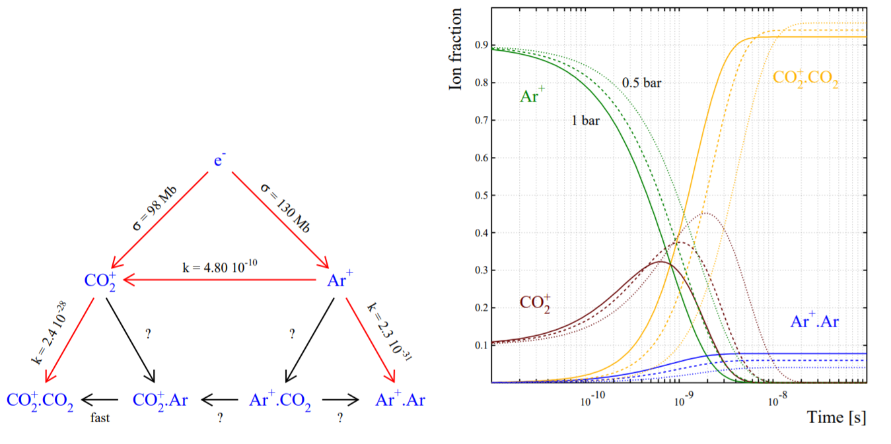
Reminding
[Y. Kalkan et al 2015 JINST 10 P07004]

Slide 3
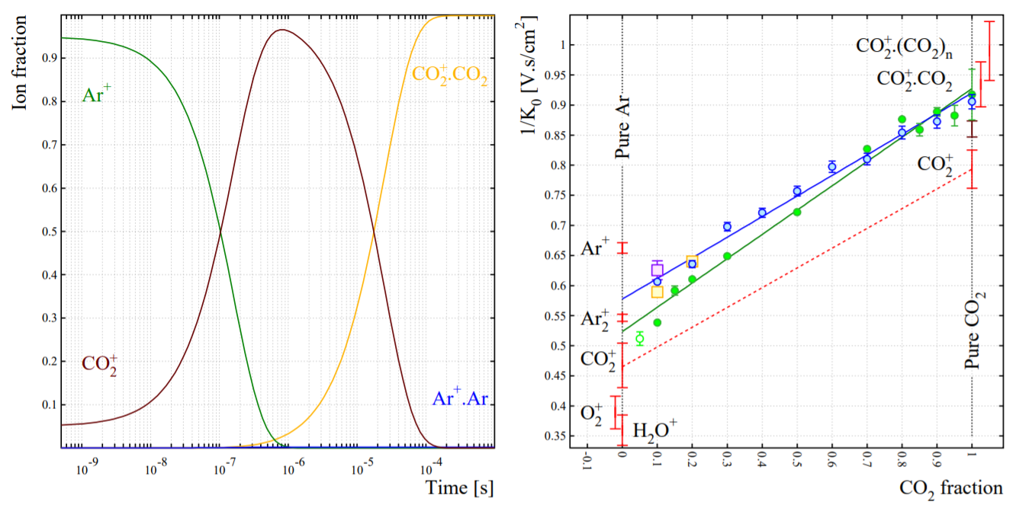
Reminding

Slide 4
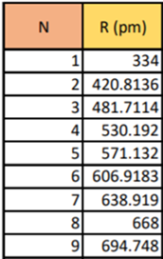
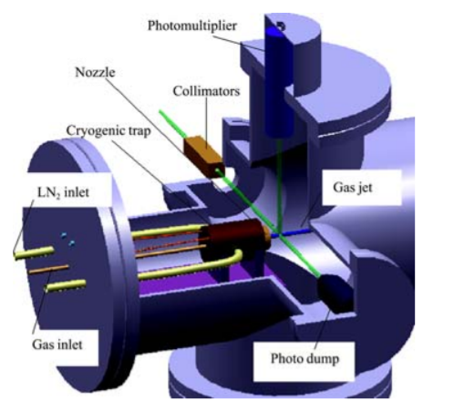
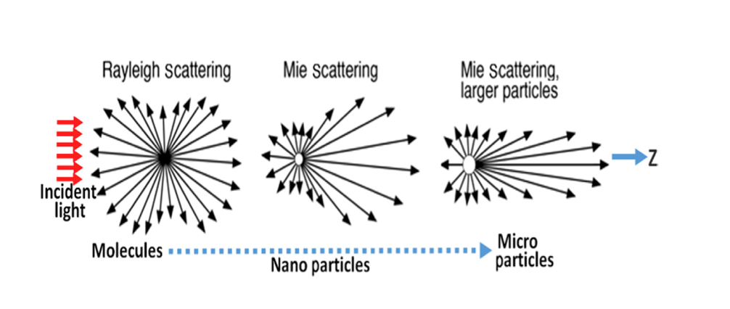
Measuring cluster ion size
CO₂⁺.(CO₂)_{N}
Lei A. L., 2000. “Size Determination of Argon Clusters from a Rayleigh Scattering Experiment”, Chin.Phy S. Lett.i, Vol. 17, No. 9, 66.
Hagena O. F. and Obert W., 1972. “Cluster Formation in Expanding Supersonic Jets: Effect of Pressure, Temperature, Nozzle Size, and Test Gas”, The Journal of Chemical Physics 56, p1793.
Rayleigh or Mie ?

Slide 5
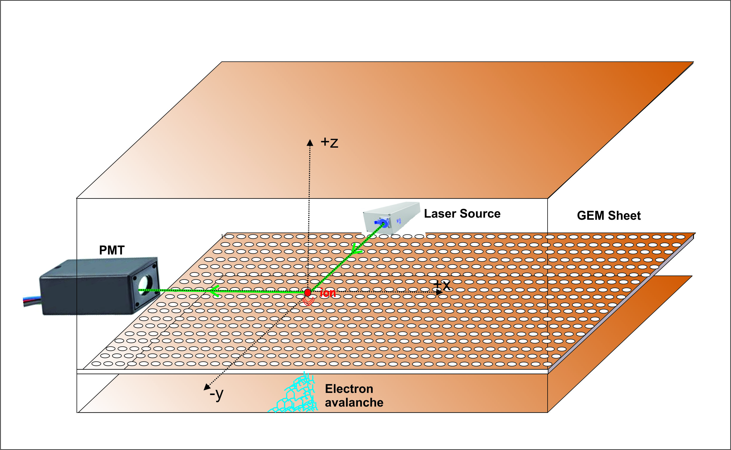
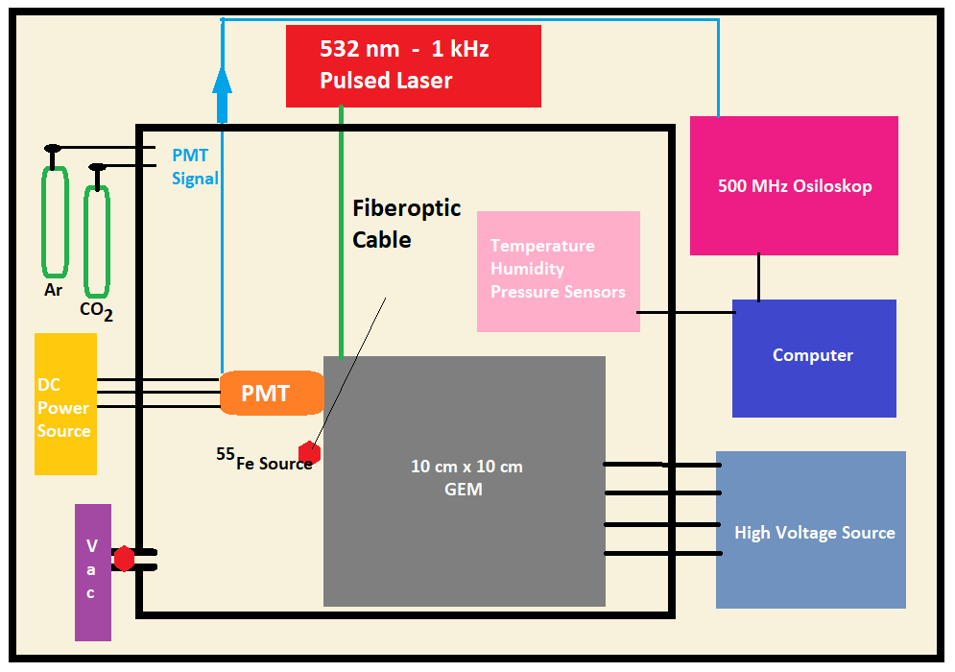
Experimental Setup
22 ºC Temperature
6% RH Humidity
0.15 Atm Vacuum
Hamamatsu PMT (H11901)
CNI Laser (AO-L-532-500mJ)
Trafag Press. Sensor (847227)
E+E Temp. and Humidity Sensor
with probe (EE310)
V_{drift}= 90-300 V
V_{ind}= 20 V

Slide 6
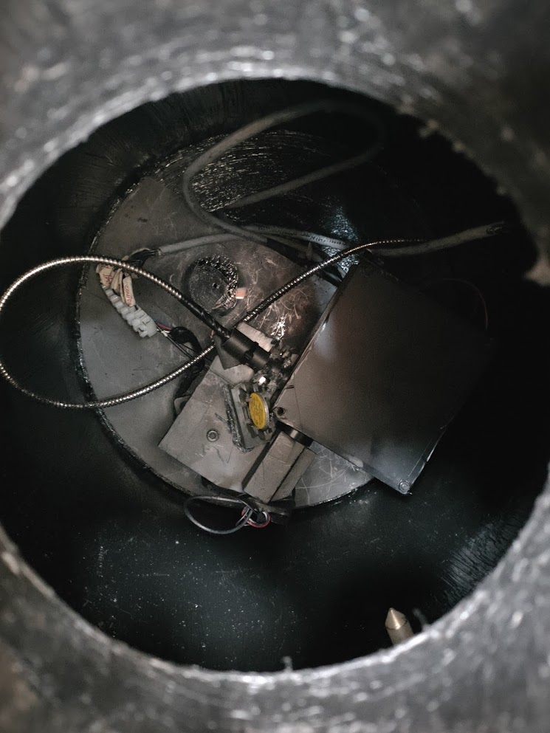
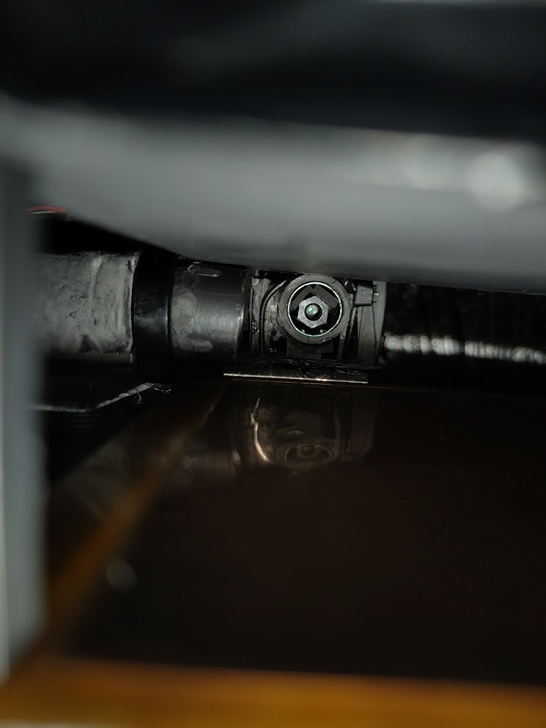
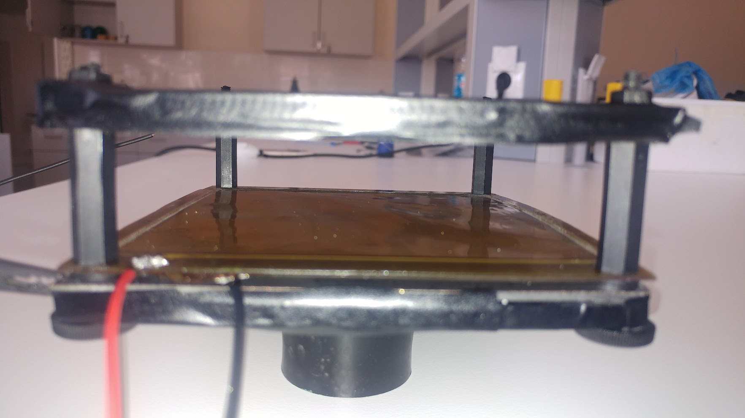
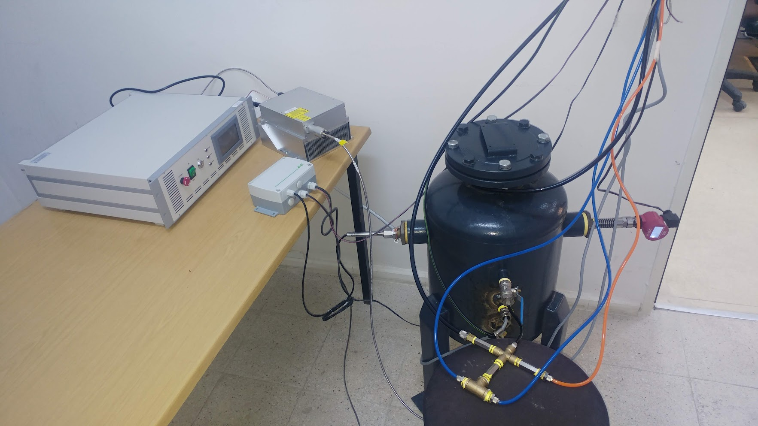
Cathode
2 cm drift gap
2 mm ind. gap
PMT
Laser
Laser
Top of the
GEM Sheet
55
GEM
532 nm Green 1 kHz Pulsed Laser
Fe
PMT
Vac.
Chamber
Press.
Sensor
Temperature
Humidity
Sensor
Sersor
Probes

Slide 7
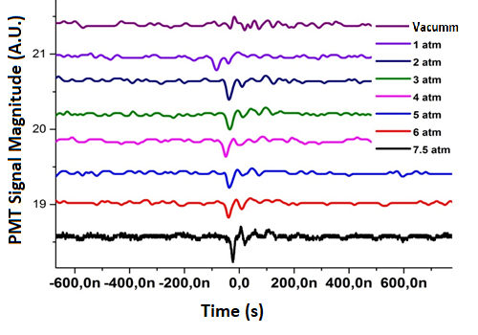
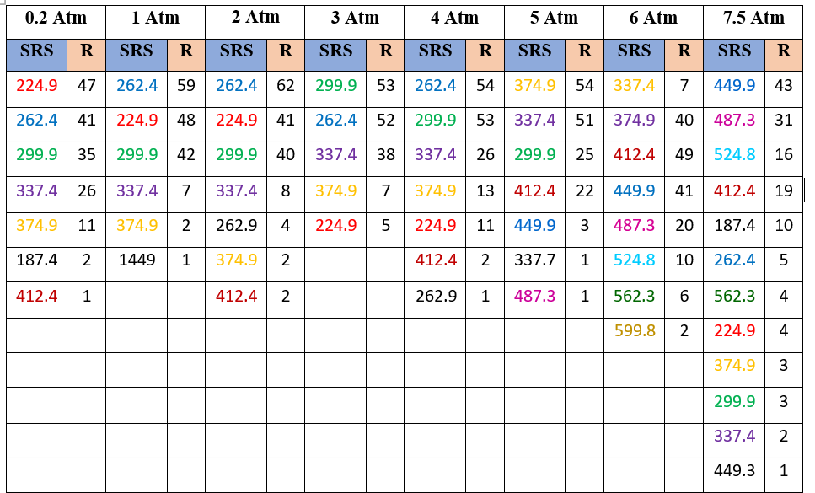
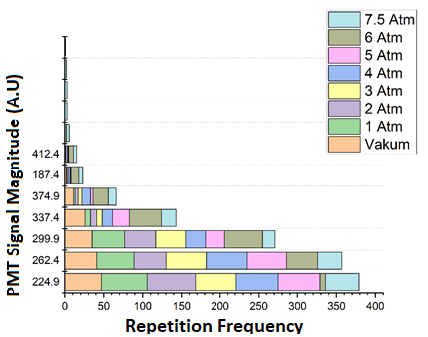
Ar-CO₂ Mixture
%80 Ar - %20 CO₂
1 kHz Laser Pulse Frequency
300 V GEM Drift Voltage

Slide 8
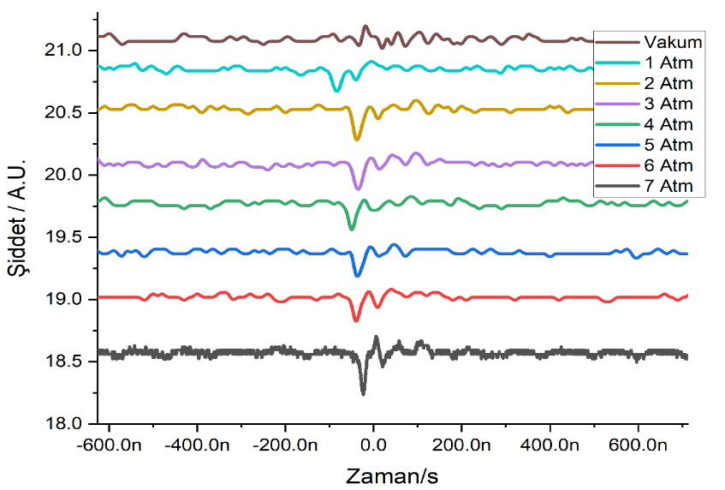
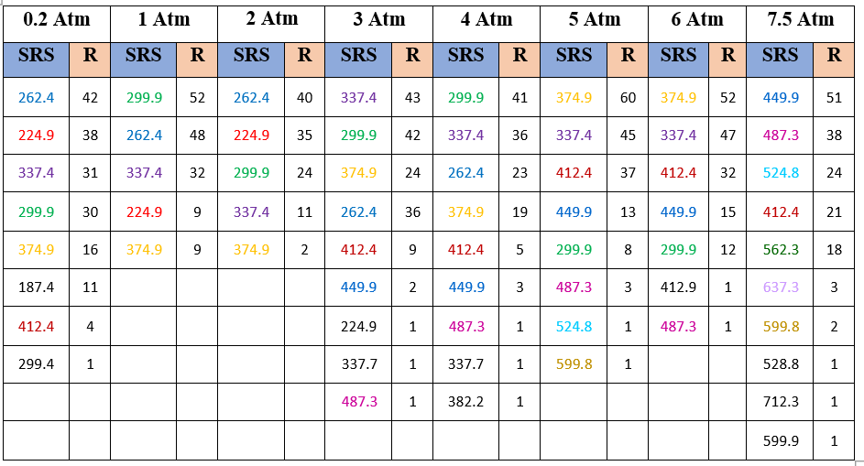
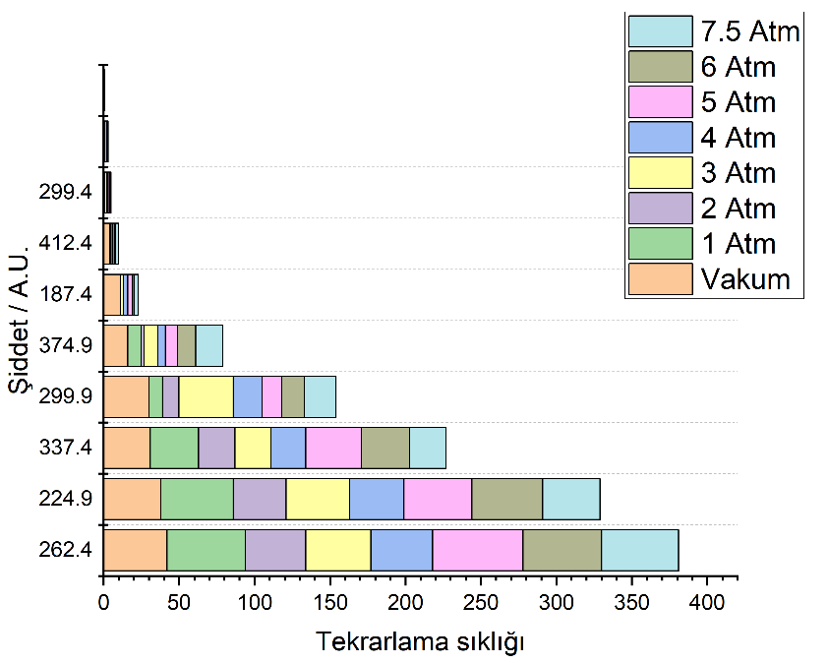
Argon-Karbondioksit Karışımı
%80 Argon - %20 Karbondioksit
1 KHz Lazer Darbe Frekansı
90 V GEM Sürüklenme Bölgesi Voltajı

Slide 9
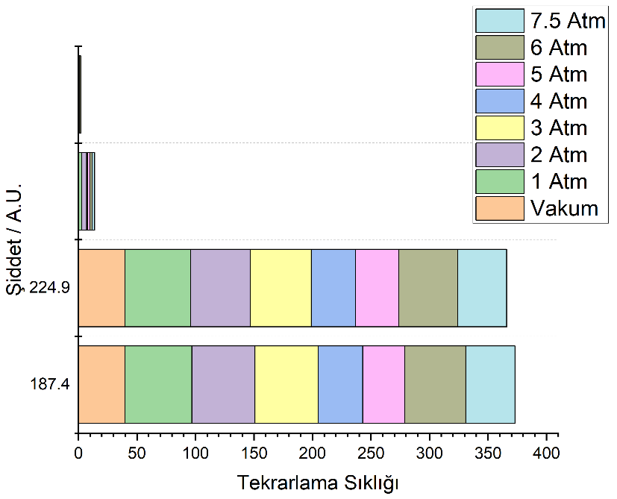
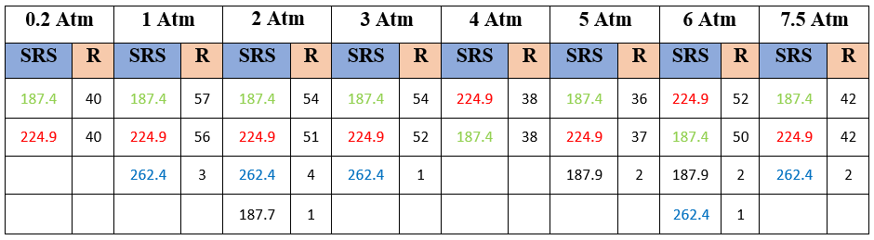
Argon-Karbondioksit Karışımı
%80 Argon - %20 Karbondioksit
5 KHz Lazer Darbe Frekansı
300 V GEM Sürüklenme Bölgesi Voltajı

Slide 10

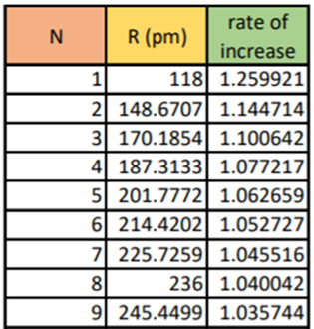
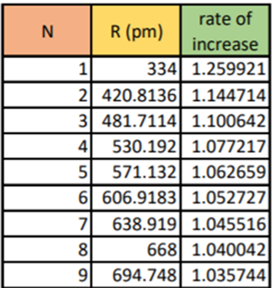
Result
Statictics is going on.
Paper submission work is going on.
Argon Ar⁺.(Ar)_{N}
CO₂⁺.(CO₂)_{N}
N = 3-4
17

Slide 11
Thank You !

