Slide 1
Update of the 100cm×50cm RWELL detector
for DHCAL application
Daojin Hong
On behalf of the USTC MPGD Group
State Key Laboratory of Particle Detection and Electronics
University of Science and Technology of China
16th.Nov.2021
RD51 Collaboration Meeting and topical workshop on Wide Dynamic Range operation of MPGDs
15th -19th November 2021

Slide 2
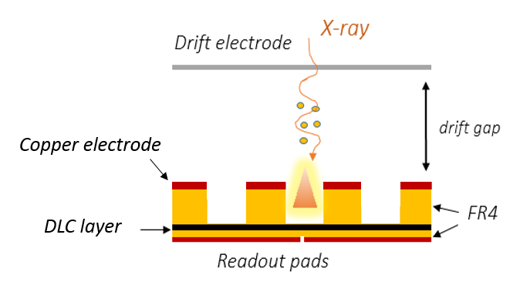
Options for CEPC PFA HCAL
Requirements of sensitive detector:
CEPC HCAL
Compact
High detection efficiency
Scalable to large size
Iron
MPGD：one of the candidates
Resistive WELL detector (RWELL):
Only a drift gap
Only one stage amplification, high gain
Resistive layer-DLC
Analog
Digital
Scintillator
RPC
MPGD
RWELL: A promising candidate for sensitive detector of DHCAL

Slide 3
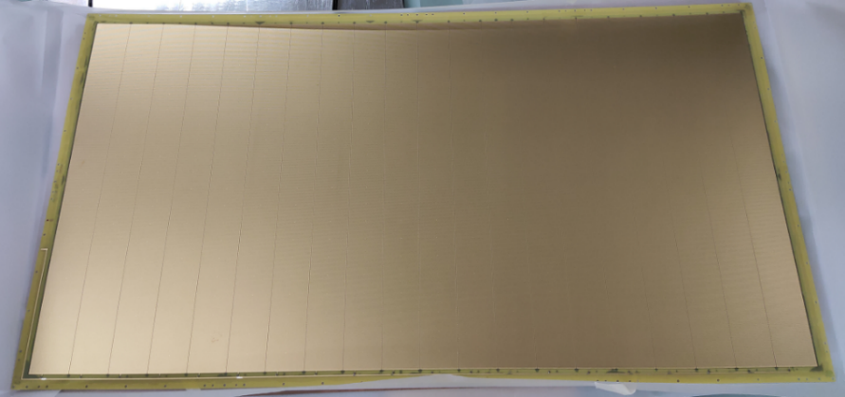
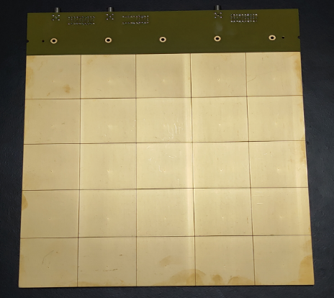
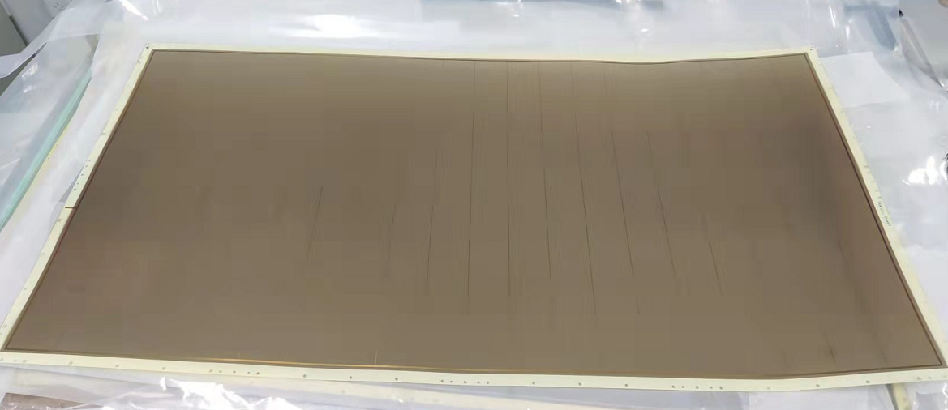
Design of 100cm×50cm RWELL detector
Design methods:
Divide RWELL foil into 20 sectors
Separate resistive layer from readout PCB
Grounding circuit was designed on the resistive layer
Large readout PCB was composed of 8 pieces
100cm×50cm RWELL
20 sectors
25cm×25cm
100cm×50cm resistive layer
Gluing
Parameters of RWELL foil：
Diameter：0.5mm
Pitch: 1mm
Thickness：0.5mm
no rim
100cm×50cm readout PCB was divided into 8 pieces with 25cm×25cm each

Slide 4
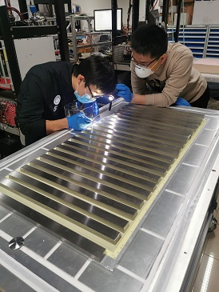
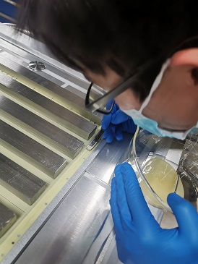
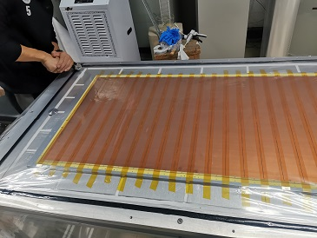
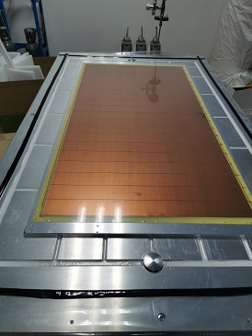
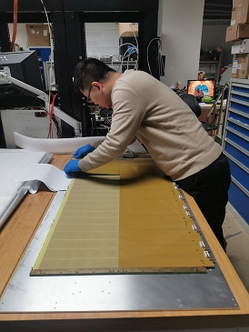
Fabrication of 100cm×50cm RWELL detector
100cm×50cm RWELL detector:
Painting the glue
Seal the platform
Pumping and drying
Assembling
  We make a special PCB and use it as the gluing mask;
  We put glue on both resistive layer PCB and THGEM PCB;
  A vacuum platform was used for gluing;
  8 pieces of readout PCB are used, there are 25 pad(Pad size 5cm×5cm) on each pcb
25cm×25cm

Slide 5
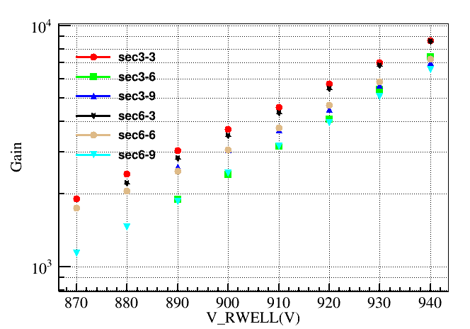
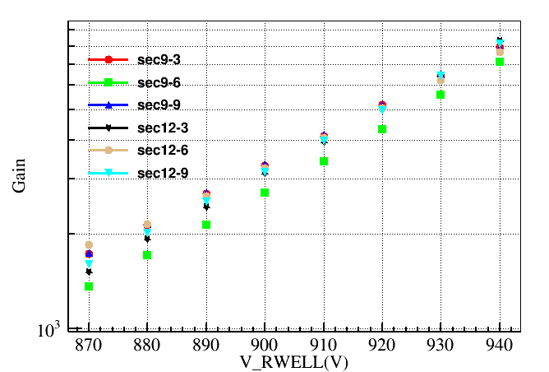
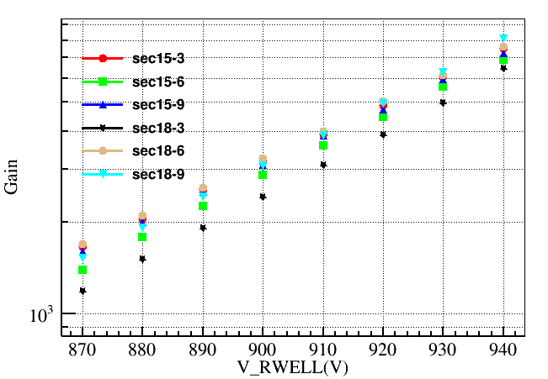
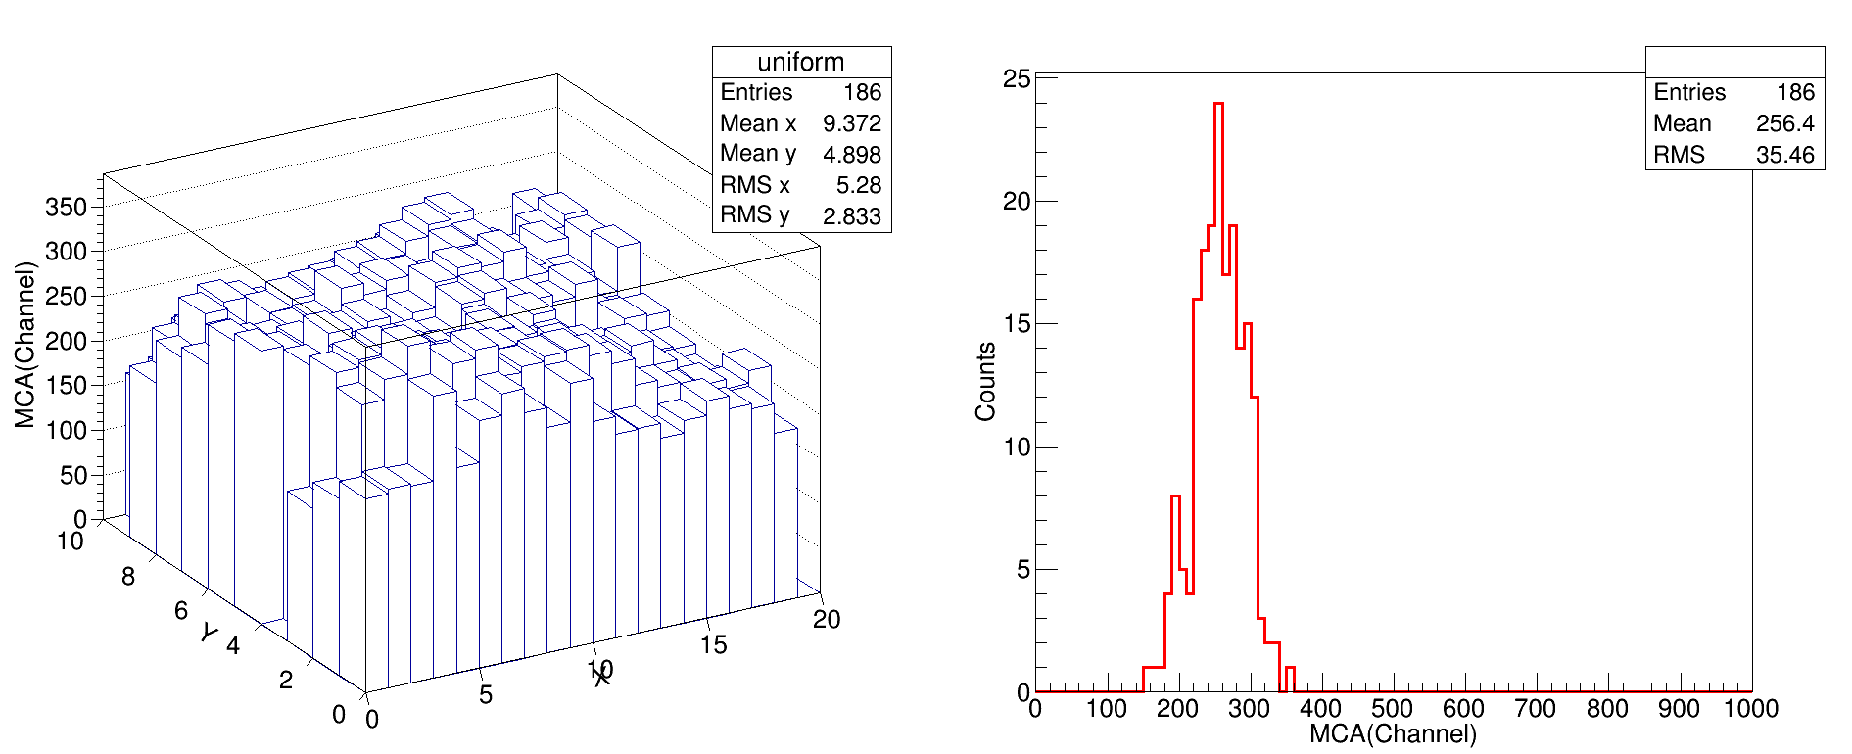
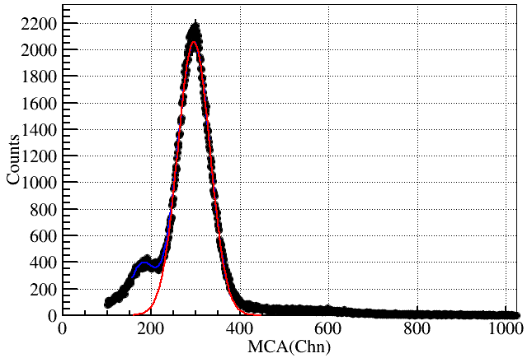
Performance of 2nd version RWELL detector
Gas: Ar-5%iC₄H₁₀
Gain vs HV:
Gain uniformity : RMS/Mean=35.46/256.4～13.8%@~1500 Gain
～25%
Mean gain:~1500
Daojin Hong，Development of a large-area RWELL detector with DLC coating for CEPC-DHCAL Application，RD51 Collaboration Meeting and Topical Workshop on FE electronics for gas detectors, 14th-18th June 2021

Slide 6
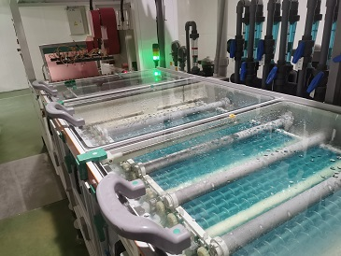
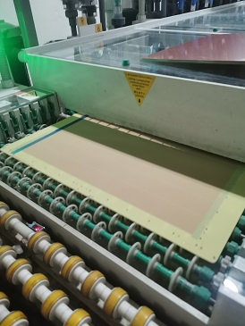
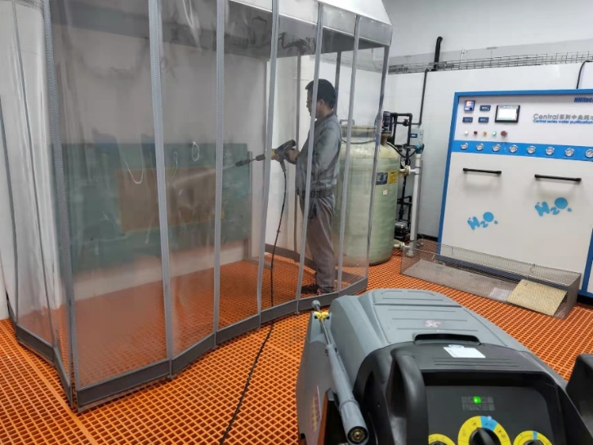
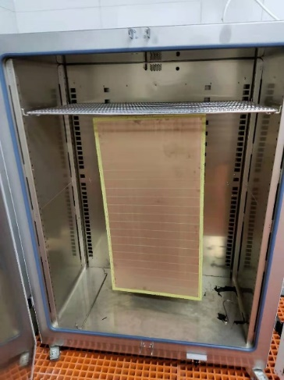
Problem and improvement
Cu electrode was oxidized after several times cleaning
Cu reduction(to ～5μm) & Micro-etching (～1μm)
Gold deposition: avoid oxidation
Cleaning & drying
Cleaning
Drying

Slide 7
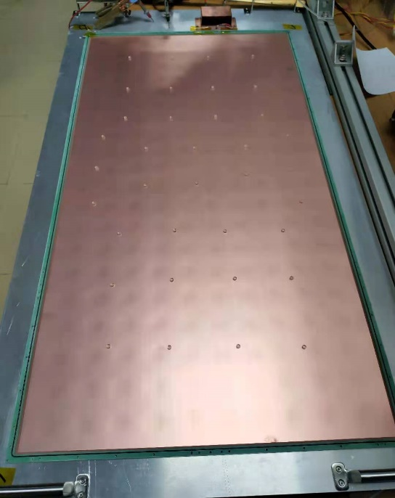
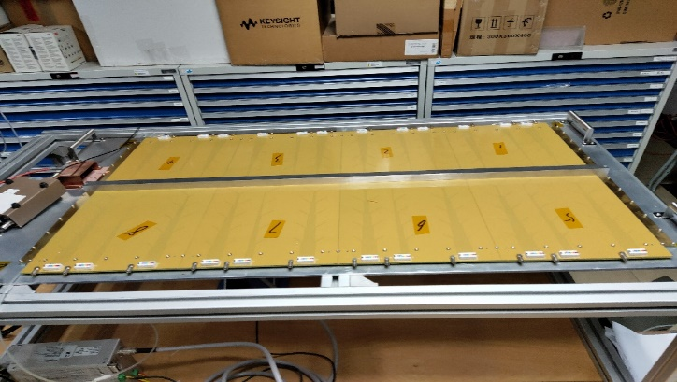
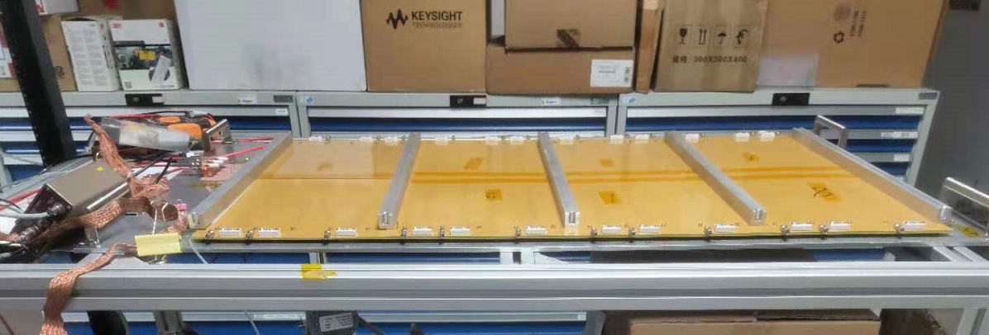
Assembly
The long metal strip on the readout PCB of 2nd version RWELL detector was replaced by five short metal strips
～ 40 spacers in the detector
Acrylic cylinder spacer
improvement

Slide 8
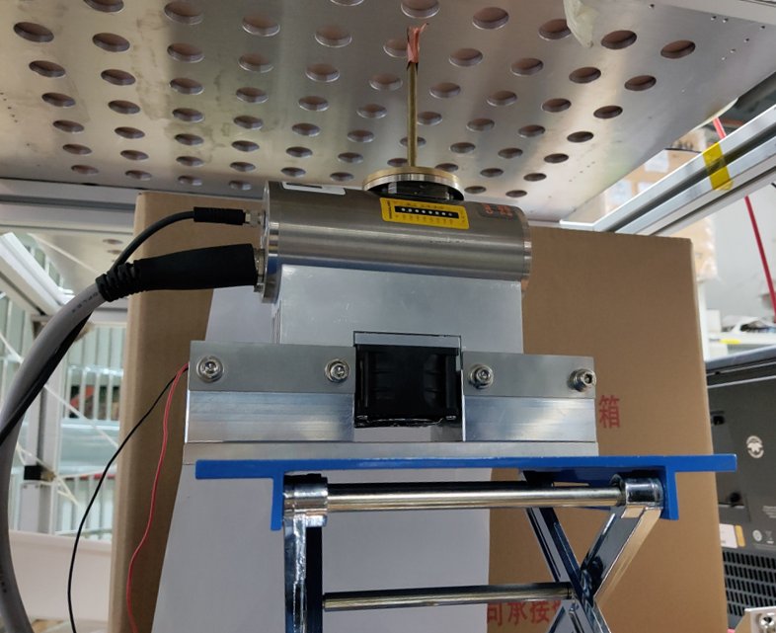
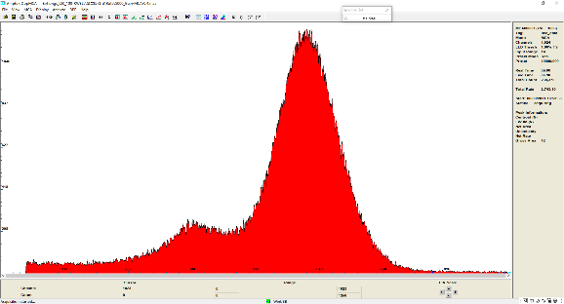
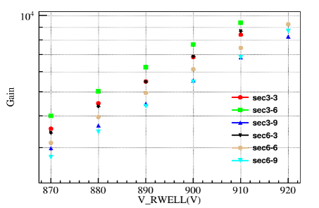
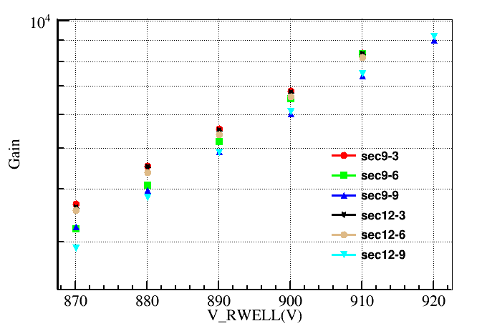
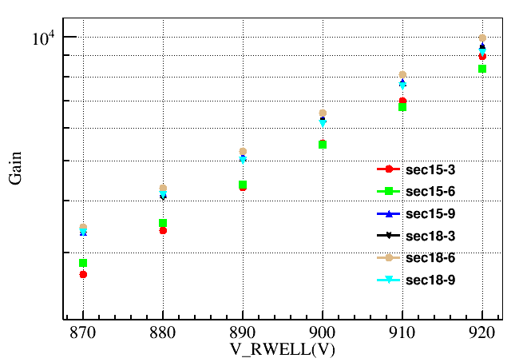
Performance
Gas: Ar-5%iC₄H₁₀
Test setup
(pre-amplifier)
(Spectroscopy amplifier)
RWELL
ORTEC
142 AH
ORTEC 671
～20%
8 keV X ray
PC
MCA
Gain vs HV:

Slide 9
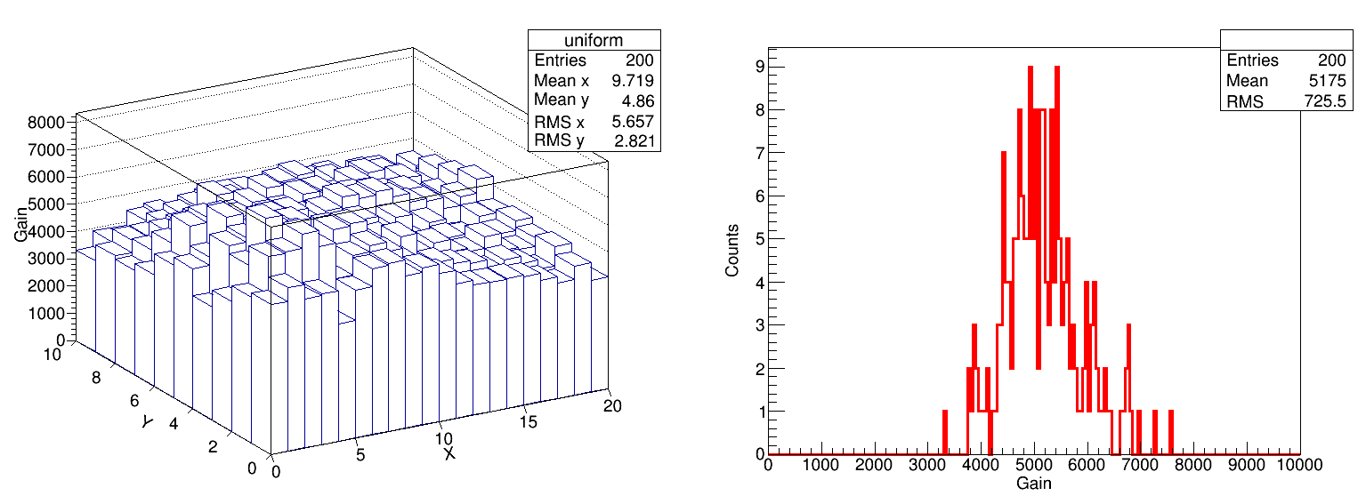
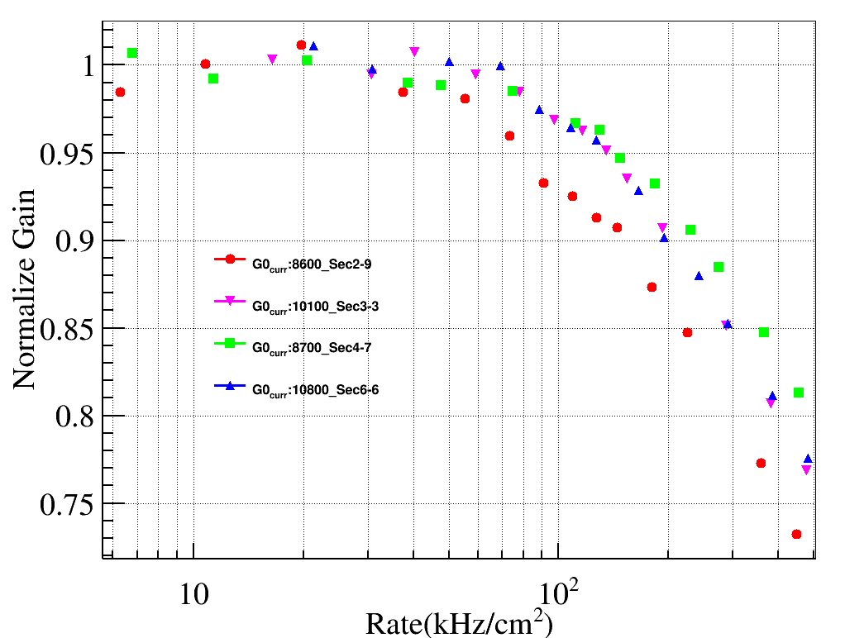
Gain uniformity & Rate capability
Gain uniformity
Collimator dia:5.5mm, 8keV X-ray
（G0_{curr}/G0_{eff} ～ 2.15)
RMS/Mean: ～14.0%@ ～ 5175 Gain
Rate capability：>100 kHz/cm²

Slide 10
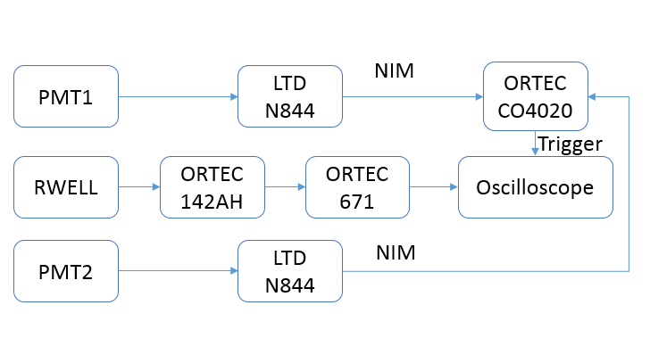
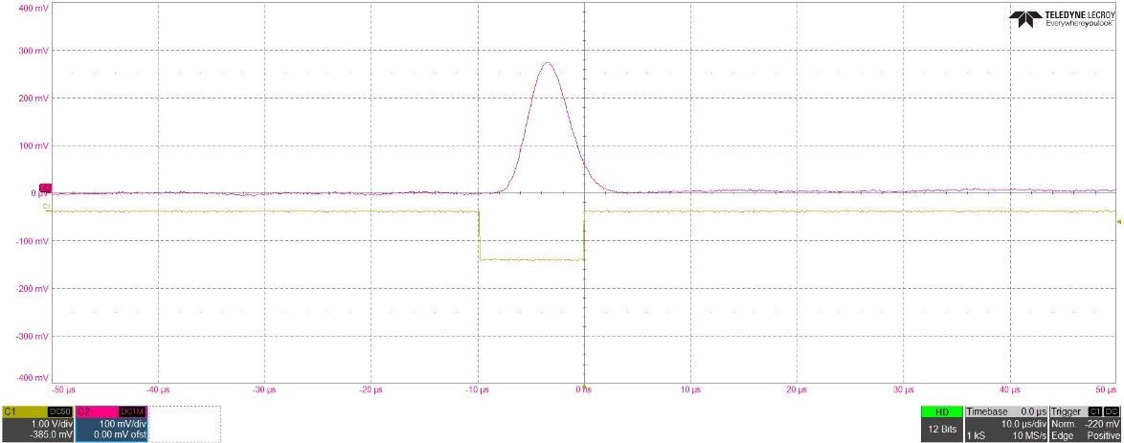
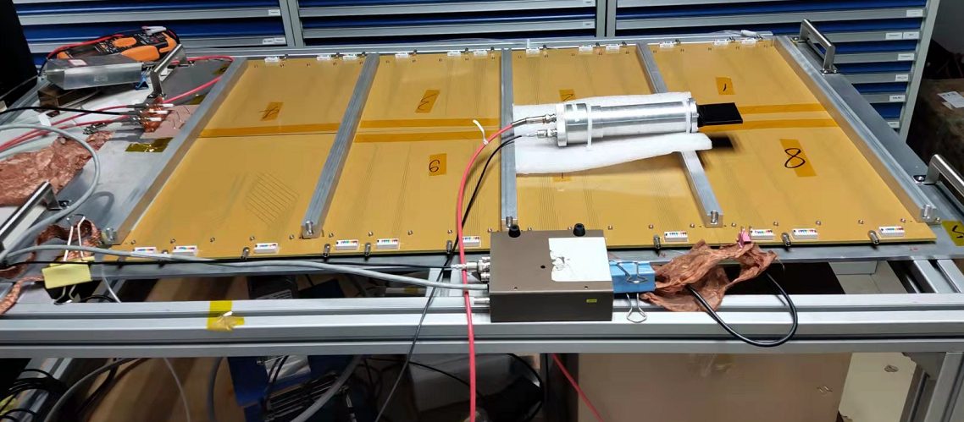
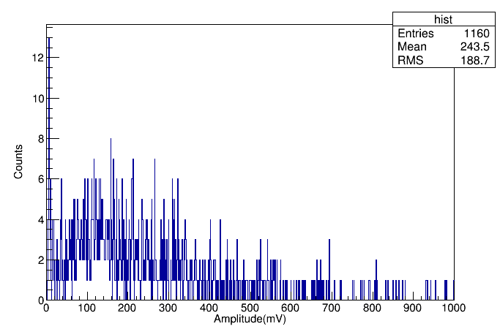
Detection efficiency to MIPs
Gas: Ar-5%iC₄H₁₀
Test setup
signal
Trigger
Detection efficiency: ～95.9%
PMT1
RWELL detector

Slide 11
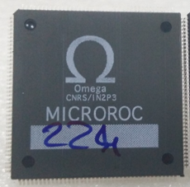
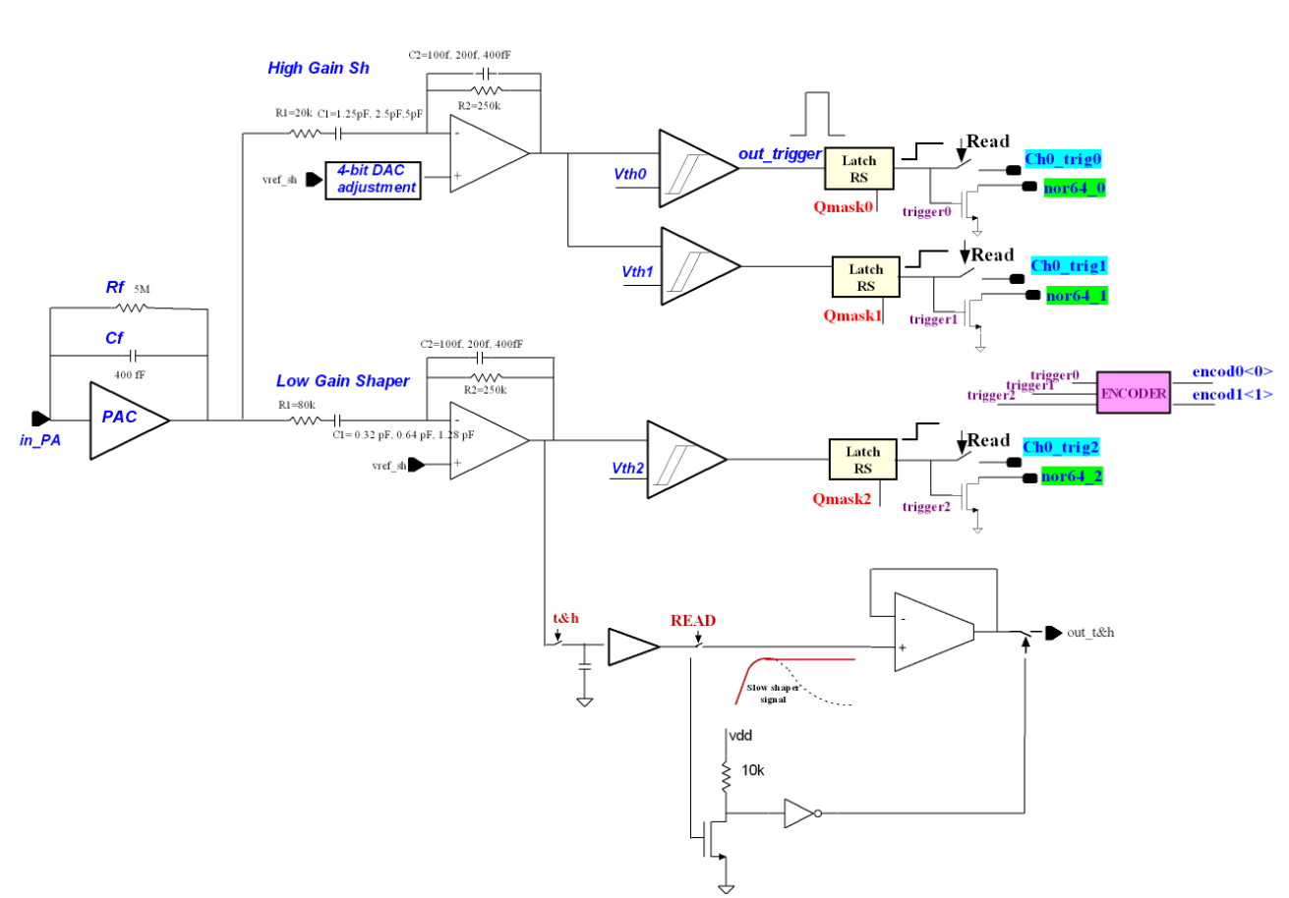
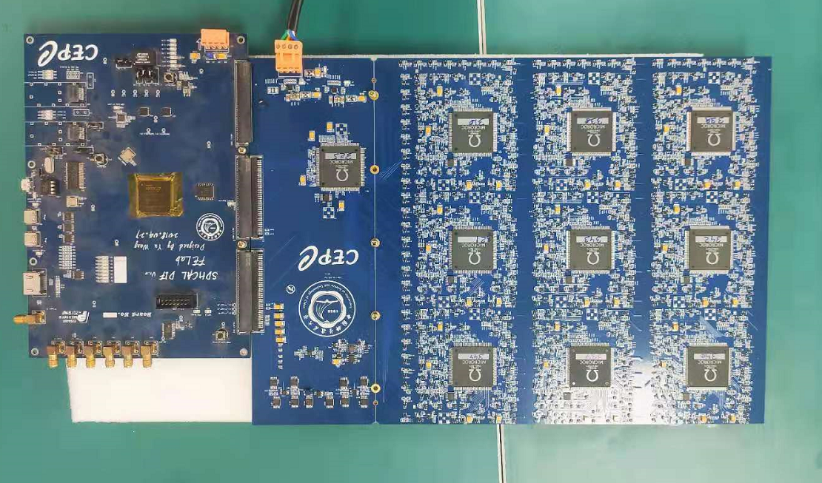
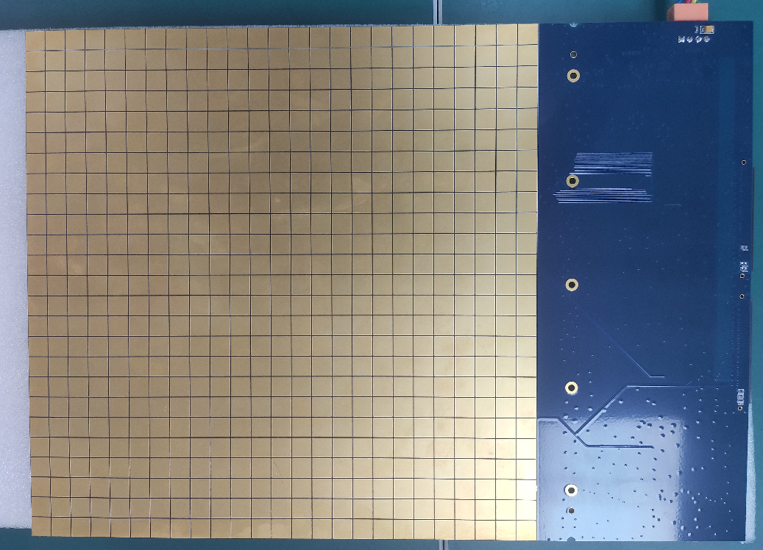
MICROROC based electronic system
MICROROC Parameters
Readout board: integrated with MICROROC
64 Channels
3 threshold per channel
Dynamic range:1~500 fC
625 channels
Readout pads: 1cm×1 cm
DIF
FEB
Pad size:1cm×1cm
MICROROC analog part

Slide 12
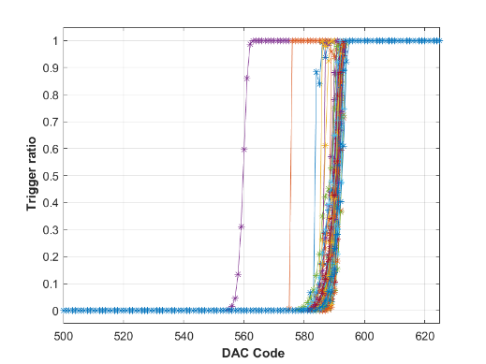
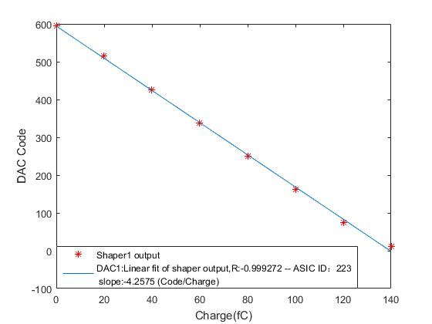
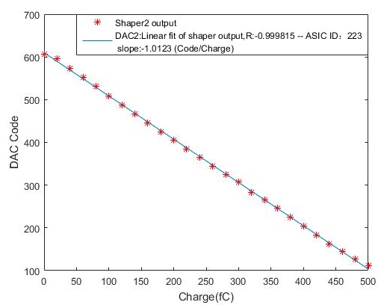
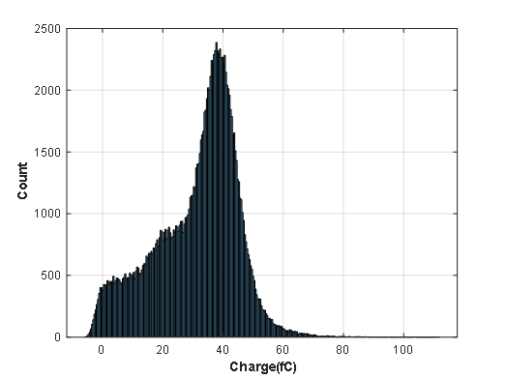
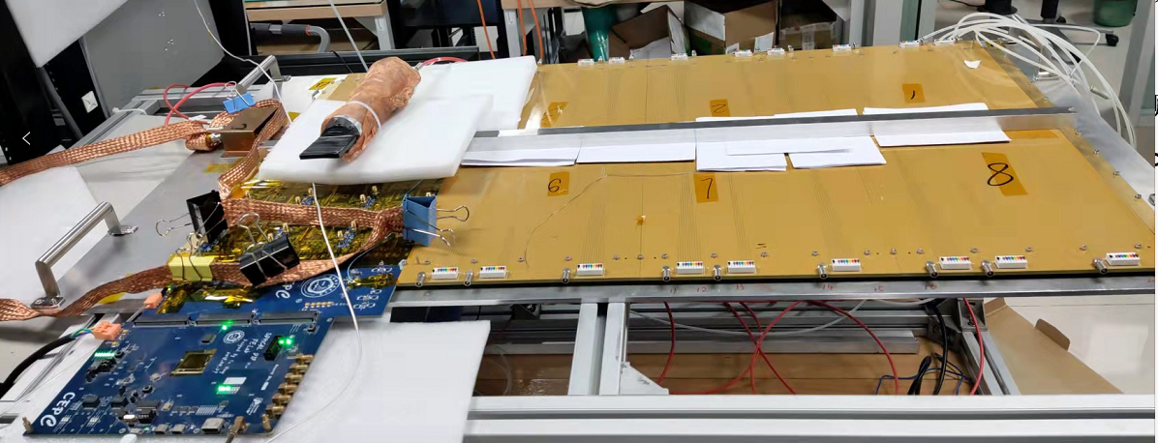
Preliminary result
Calibration
S curve
High gain
Low gain
Spectrum measured with external ADC
Cosmic ray test is ongoing

Slide 13
Summary
Gain uniformity of the 100 cm×50 cm RWELL detector detector is about 14%@～5200 gain, and rate capability is large than 100 kHz/cm². Detection efficiency to MIPs is about 95.9%.
Readout PCB with MICROROC integrated has developed and started the test with RWELL detector.
Outlook
Thanks
Advanced test of the MICROROC based FEE with RWELL detector will be studied in the future.

