Slide 1
Study of the thermal bonding Micromegas in high gas pressure for PandaX-III experiment
Sicheng Wen, Zhiyong Zhang
PandaX-III USTC working group

Slide 2
Outline
Introduction of PandaX-III experiment
Thermal-bonding method
Design and fabrication of the thermal bonding Micromegas detector for PandaX-III experiment
The performance of detectors
High pressure test
Conclusion

Slide 3
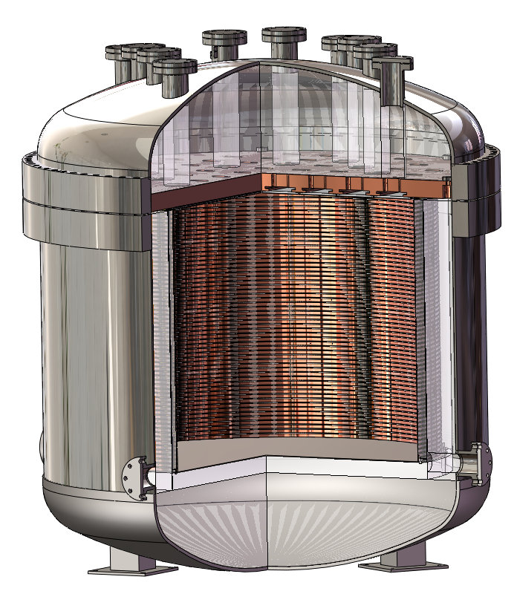
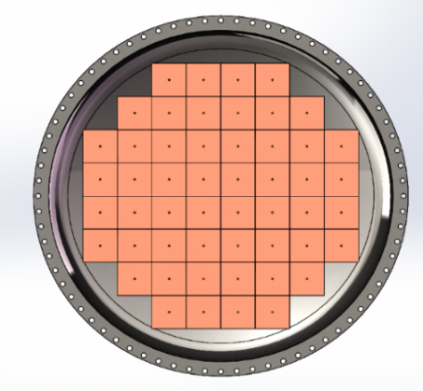
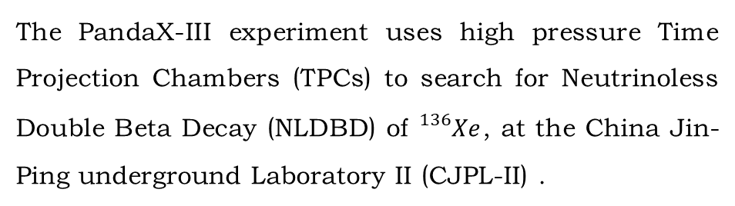
PandaX-III experiment
The PandaX-III experiment uses high pressure Time Projection Chambers (TPCs) to search for Neutrinoless Double Beta Decay (NLDBD) of ${}_{}^{136}{Xe}$, at the China Jin-Ping underground Laboratory II (CJPL-II) .
Working pressure: 10 bar
Working gas : Xe(99%) + TMA(1%)
Readout plane : MicroMegas detector array
Requirements:
Readout plane
20×20 cm² MMs for charge readout (52)
3% energy resolution @ 2.459 MeV
X-Y strip readout
Stable operation for a long time under 10 bar
1.2m
Field cage
SS vessel
Cathode plane
MiroMegas readout plane
Notes:
Ok, the pandax-iii experiment is a high pressure Time Projection Chamber to search for 0vdbd of Xe136 at the China JinPing underground Laboratory II, this is the diagram of prototype structure, the top is the readout plane, the middle is the field cage, the outside is SS vessel, the bottom is the cathode plane. The working pressure of pandax-iii experiment is 10 bar, the working gas is 99percent Xe combined 1percent TMA, the readout plane plans to adopt Miromegas detector array, like shown in this picture, and the following requirements of the readout plane are put forward in the pandax-iii experiment. It needs 52 20*20 square centimeter MM for charge readout, and 3% energy resolution at 2.459MeV, x-y strip readout, and stable operation for a long time under 10bar.

Slide 4
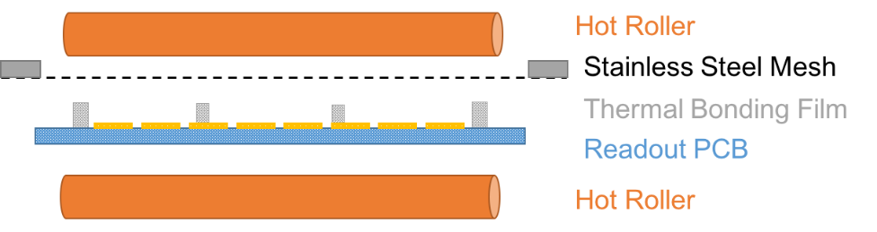
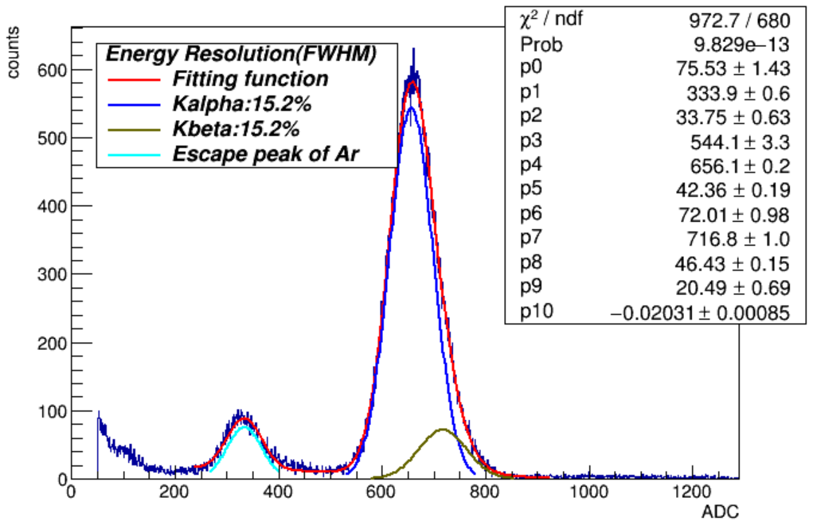
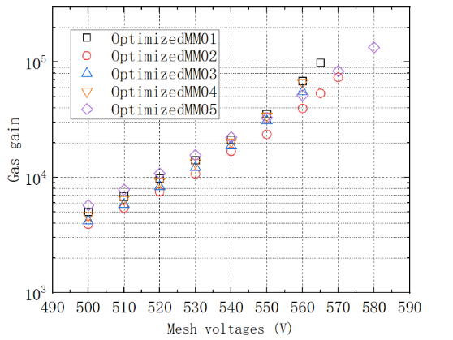
Thermal-Bonding(TB) method
Over the past decade, the thermal bonding method (TBM) has been developed for the efficient fabrication of Micromegas detectors at USTC. This method provides a concise and etching-free mass-productive process to fabricate Micromegas-like detector.
5.9keV X-ray test
High gas gain：~ 10⁵ (Ar+CO₂)
Energy resolution：~15% (FWHM)
Non-uniformity: 6.3% @ gain =5000
No etching, no pollution
Easy to handle at lab
Easy to make new structures
Cheap
Φ0.5mm- Φ1mm spacers, ~1cm pitch
➔easy to clean, especially for large area
➔less than 1% spacer area
Notes:
Ok, at the same time, over the past decade, the thermal bonding method has been developed for the efficient fabrication of Micromagas detectors at USTC, this method provides a concise and etching-free mass-productive process to fabricate Micromegas-like detector. This picture is the diagram of the thermal-bonding method, the orange cylinder is the hot roller, this is SS mesh, this is PCB, we use the hot roller to melt the thermal bonding film, and press SS mesh and PCB together. The advantages of this method are, such as no etching, no pollution, and ……etc. the right is the performance tested by Fe55 source of 15*15cm2 detectors made in our lab. The gas gain can upto 10to5 in argon plus CO2, energy re……, and the non-uniformity can realize 6.3% at 5000 gas gain.

Slide 5
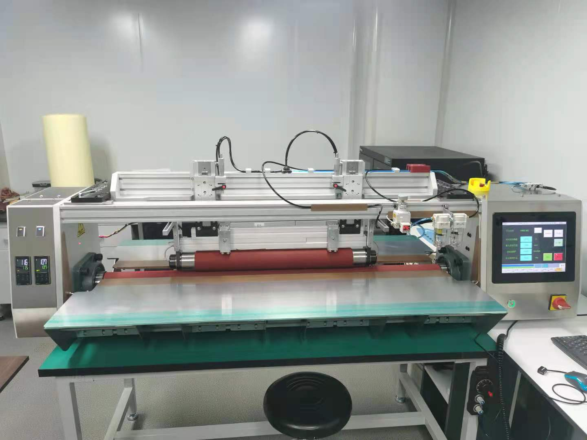
Detector design for PandaX-III experiment
Flexible PCB + copper substrate to lower the radioactivity
Follow the current geometry to ensure the installation
Stainless steel woven mesh
Thermal bonding film spacer
Flexible readout PCB
  Ge coated anode (400nm)
  inner layer readout strip
Copper substrate
Notes:
Consider the low radioactivity and current process, a specific design was devised to meet the requirement of PandaX-III experiment, like this diagram, the top this SS woven mesh, the gray is the thermal bonding film spacer, it separate the mesh from the PCB, and keep the gap at 100 micrometer uniformly. the blue is the flexible readout PCB plus the orange copper substrate replace the hard PCB to realize the low radioactivity. At the same time, we designed a specific machine to fabricate the detector, as shown in this picture, this machine can also produce larger area detectors

Slide 6
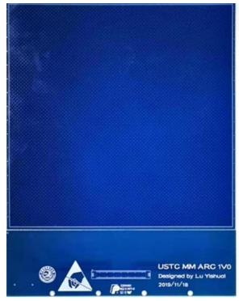
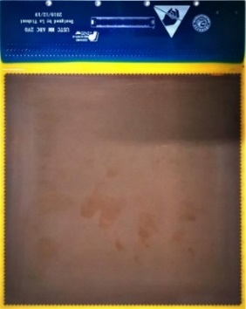
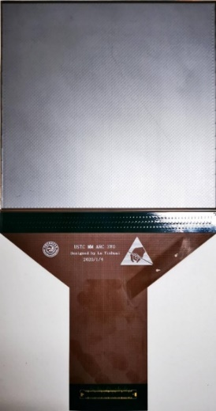
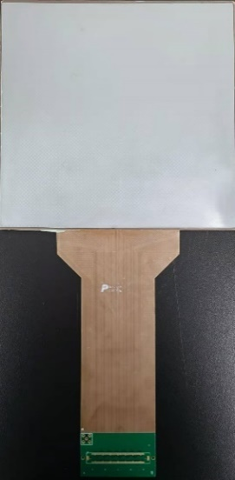
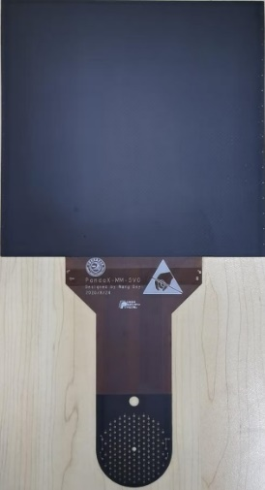
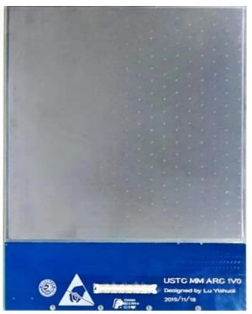
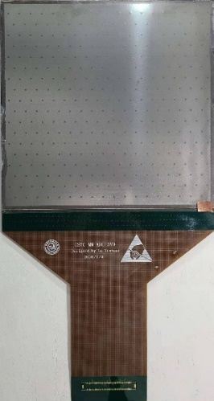
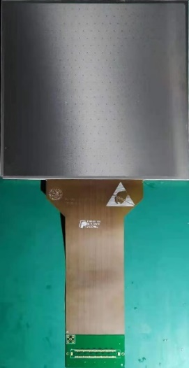
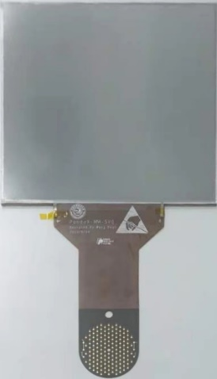
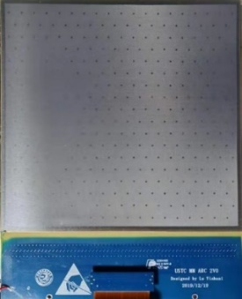
Fabrication of the detector
V1
V2
V3
V4
V5
Hard（FR-4）PCB：V1, V2
  To validate the narrow bonding region
  performance of energy resolution and long time stable working
Readout PCB
Flexible (polyimide) PCB: V3~V5
Low radioactivity and flexible connection
Made detector
Notes:
Ok, from this slide, I will introduce the fabrication of the detector for pandax-iii experiment. from the December of 2019, about one and a half years, we have updated 5 version detectors, and more than 30 different improvement schemes have been tried. As shown in these pictures, the above pictures are the readout PCBs of different versions, and the below are corresponding made detectors. We can see the version 1 and 2 are hard PCB, these 2 versions are our early design to validate the narrow bonding region and the performance of energy resolution and long time stable working. The version 3,4,5 are Flexible PCB, is the consideration of low radioactivity, through these 3 versions, the energy resolution, detector uniformity and stable operation in high gas pressure are verified, and the version 5 is close to the engineering prototype. Now, the version 6 is on going. Perhaps this version is the engineering version.

Slide 7
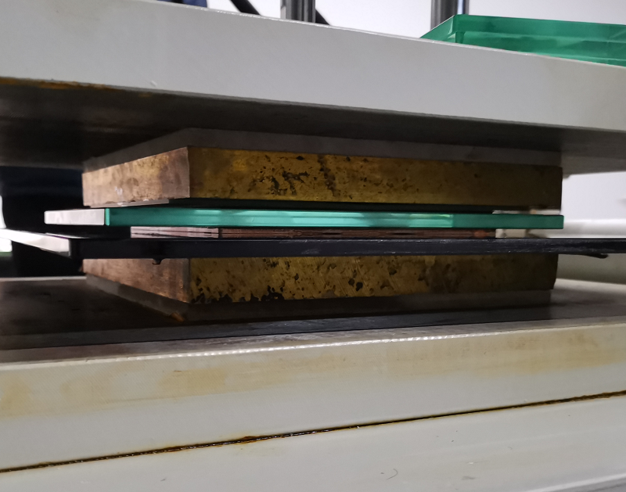
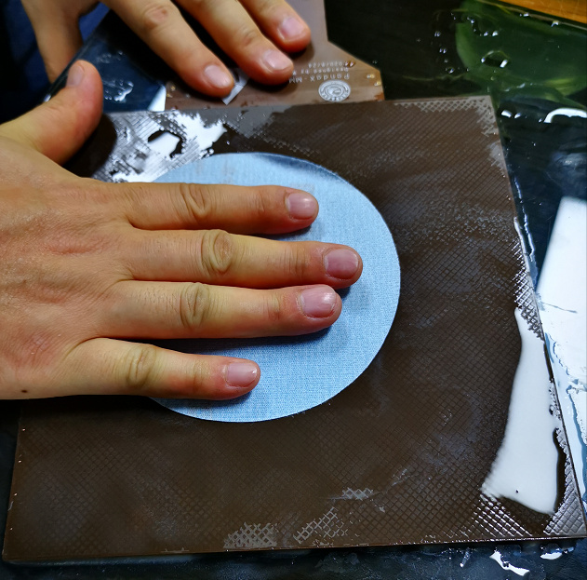
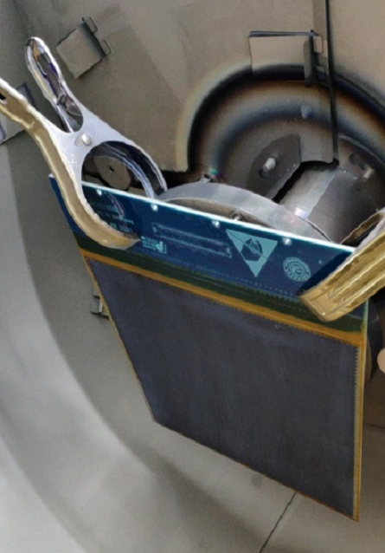
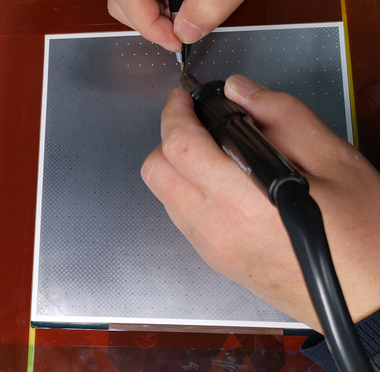
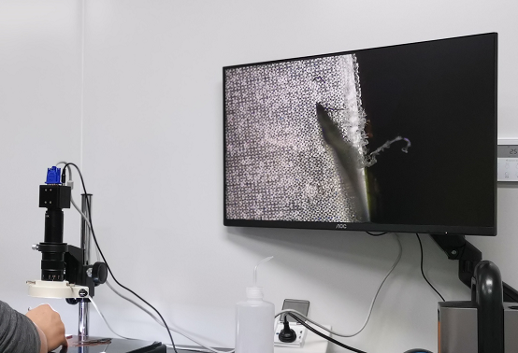
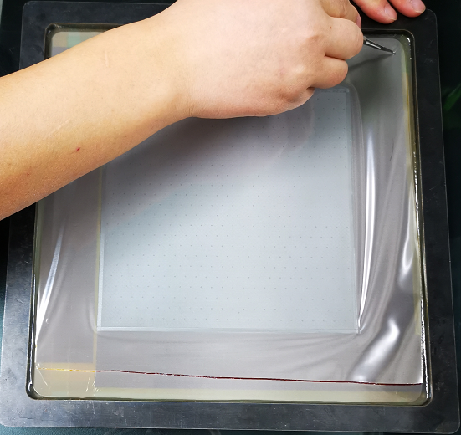
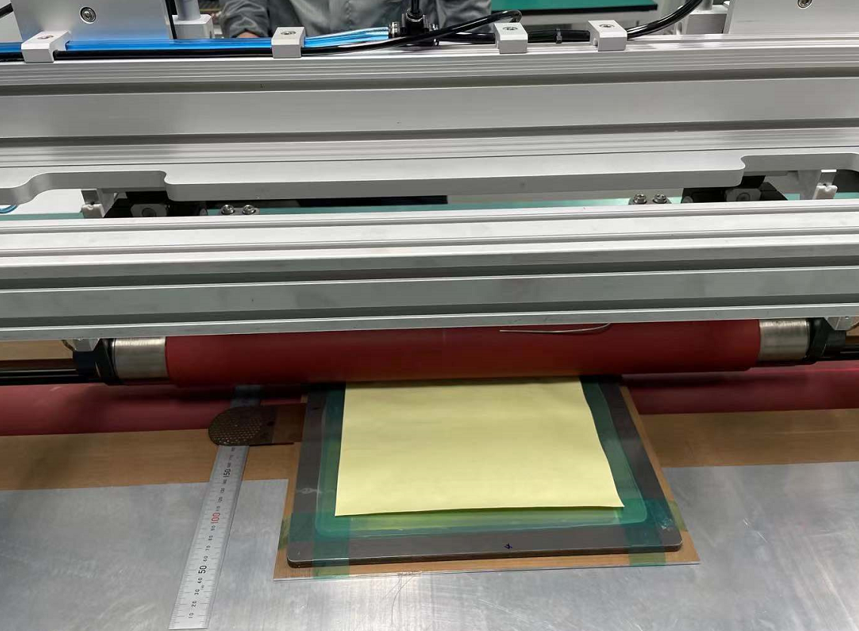
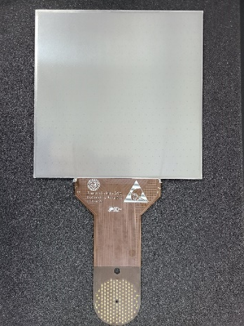
Manufacturing process
Attaching the PCB on a copper substrate
Polishing the active area
Coating the resistive Ge
Spacer setting
Finished view
Inspection and clear the mesh edge
Cutting the mesh
Thermal bonding with a dedicated machine
Notes:
So, After three versions of trial production, We have summarized a mature process. These pictures are the manufacturing process of thermal-bonding Micromegas detector for the version 5, perhaps also the process of engineering version. first, attaching the PCB on a copper substrate, then polishing the active area, after polishing, we sent the PCB to coating the resistive Ge, finished coating, the next step is spacer setting, set the thermal bonding film spacer on the active area uniformly. After this step, is the important prcess, thermal bonding the mesh on the PCB, with the dedicated machine, this machine has been shown in the front, after bonding, let it cooling, and then cutting the mesh, this cut will remain some broken wire, so we must Inspection and clear the mesh edge under the microscope, and then finished the detector fabrication, and this is effective area of detector, the side length is 20cm, and the tail is also flexible, used for signal extraction. Ok, according to this process, we can fabricate detectors with stable and good performance.

Slide 8
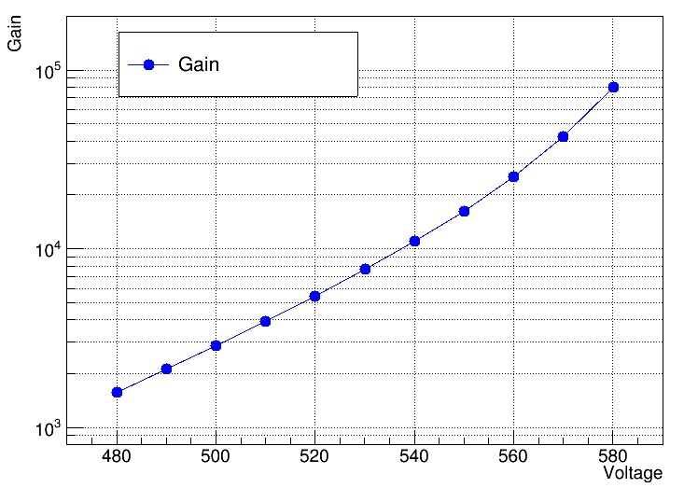
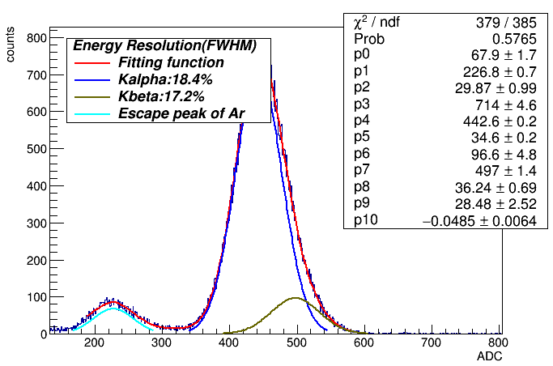
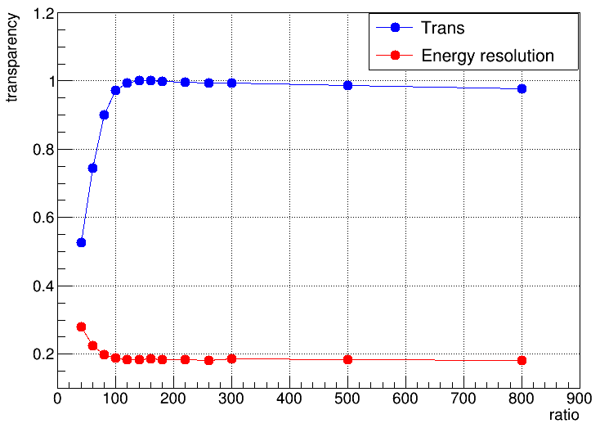
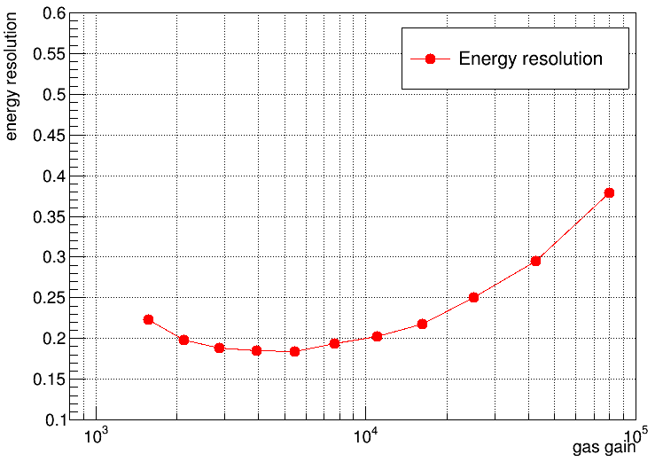
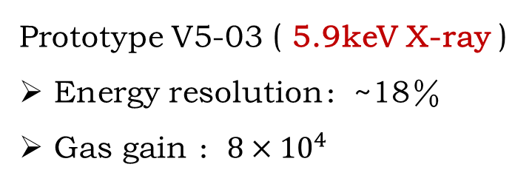
Test in 1 bar Argon (7%CO2)
Prototype V5-03 ( 5.9keV X-ray )
Energy resolution：~18％
Gas gain ：$8×{10}^{4}$
Gas gain
Transparency & resolution
Energy resolution versus gain
Notes:
So, next I will introduce the performance of the detectors.
This is the performance of one of version 5 detector, V503, tested in atmospheric pressure argon combined 7% CO2, and the radioactive source is Fe 55, this is the spectrum of Fe55, these results are tested by the MCA system, readout the mesh signal, this is the relative transparency vs the ratio of amplification field and drift field, fix the amplification field and change the drift field, the transparency of primary electrons will be changed along with ratio of field. this two pictures are the gas gain and corresponding energy resolutions. From these results, we can see, this detector, the best energy resolution is about 18%, and gas gain can upto 80 000.

Slide 9
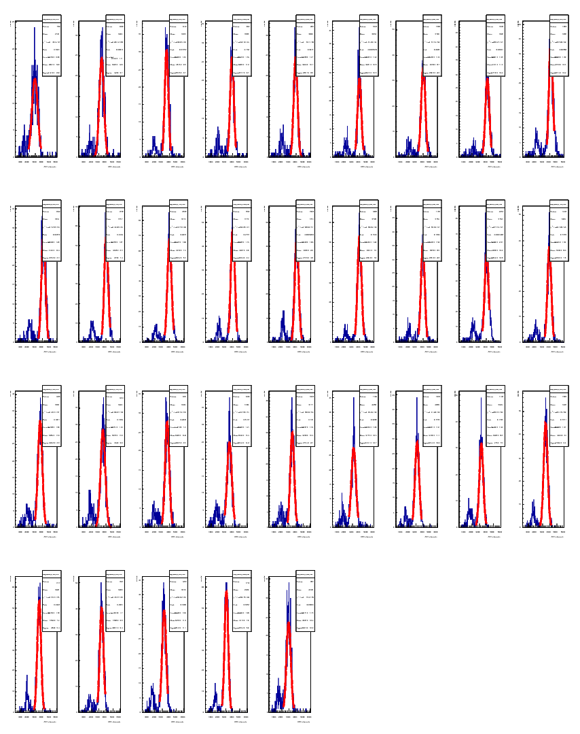
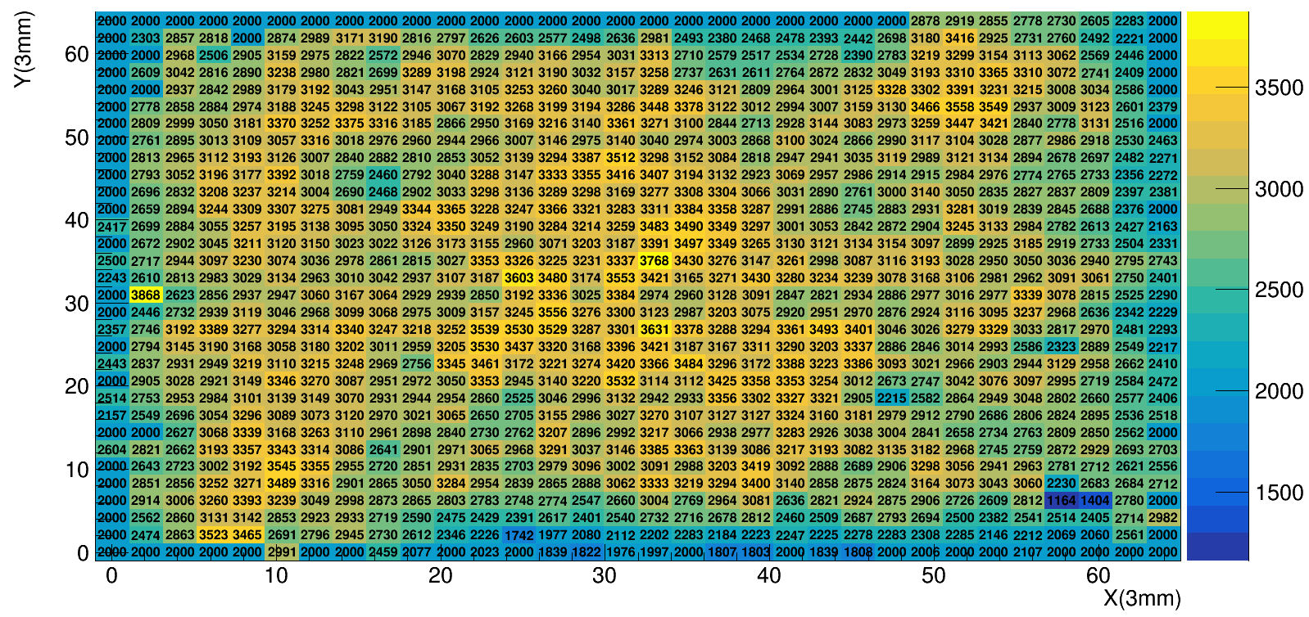
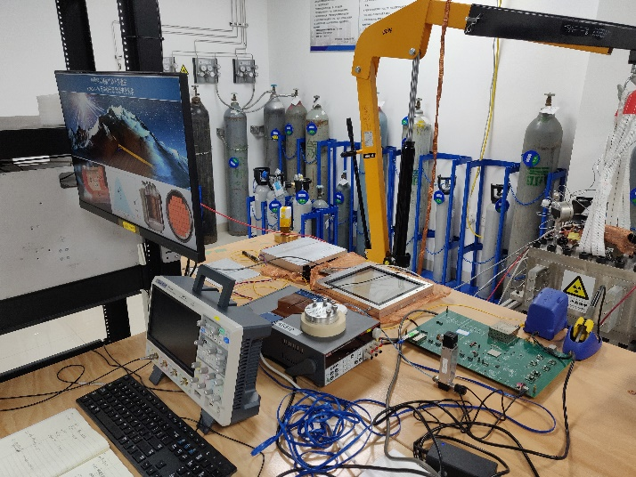
Performance of uniformity
Scanning the effective area of detector with radioactive source. divide the effective area into many bins, and then reconstruct the spectrum of very bin, fit the peak.
55Fe
V503
AGET FEC
MM
Notes:
Beside the regular test like before conducted by the MCA, such as transparency, energy resolution, gas gain. a electronic test was also implemented to test the performance of uniformity of the detector. We set the Fe55 source above the detector, and scan the effective area of the detector, the electronic signals are read out by the aget FEC, through the offline analysis, we divide the effective area into many bins, and then reconstruct the spectrum of very bin. Like this picture, and fit this peak, so the fluctuation(or RMS) of this peak is the uniformity of the detector. This is an important parameter of our detectors, we put a lot of effort into improving the uniformity, like replace the substrate, and change the polishing method etc. now the best one we made, the RMS of the uniformity can upto about 10%, and we will continue to improve this result for the later version.

Slide 10
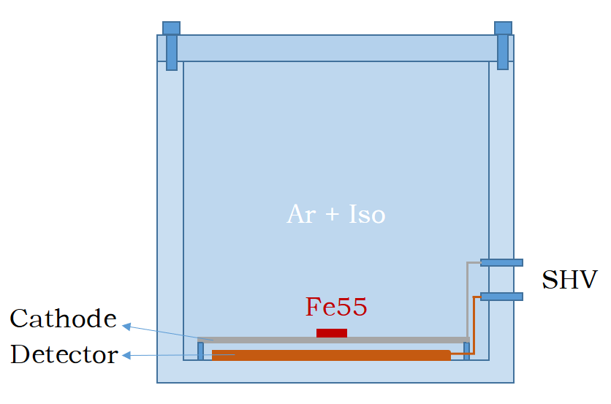
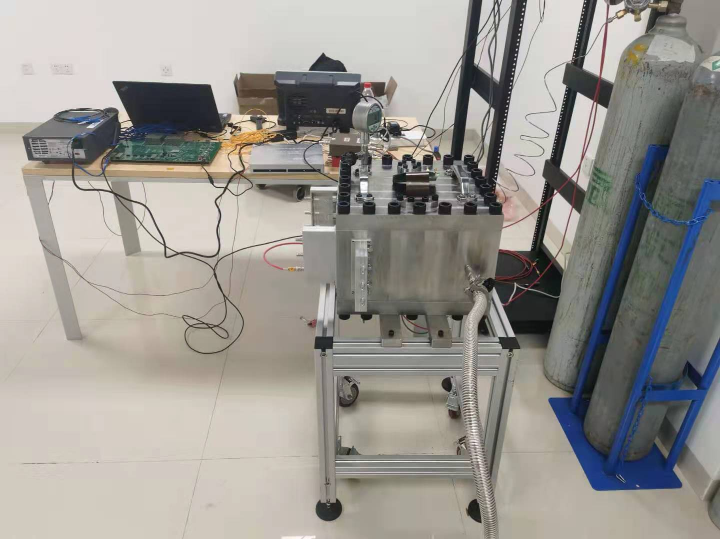
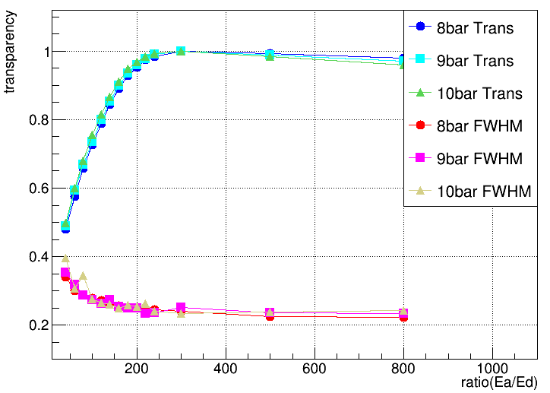
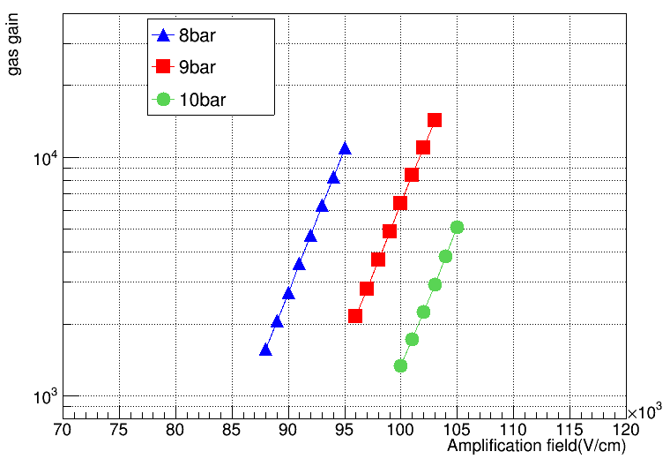
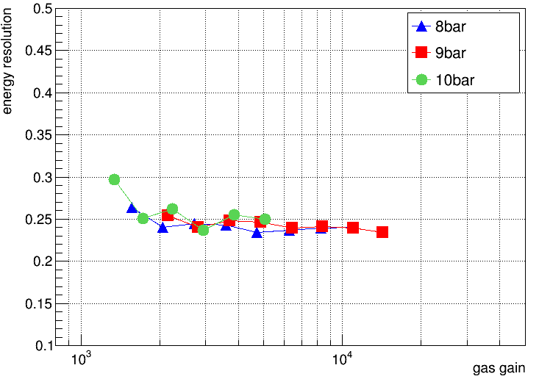
High pressure test
The stable operation in high pressure gas is one of the important requirement of pandax-iii experiment
Test in high pressure Argon (2.5% Iso)
Radioactive source: Fe55
Prototype V5-03
Notes:
Apart from the energy resolution and uniformity, the stable operation in high pressure gas is one of the important requirement of pandax-iii experiment. We established a high pressure test platform in our lab to test the performance of the detector under high pressure. Like this picture show, this stainless steel vessel can withstand 12 bar pressure, the radioactive source Fe55 and detector are set into the vessel, and inject argon combined with 2.5% Iso. These are performance of detector under high pressure, this is the relative transparency, this two pictures are gas gain and corresponding energy resolution. From this picture, we can see, at 10bar, as the voltage increase, the gas gain can upto 5000, and the corresponding energy resolution do not deteriorate obviously.

Slide 11
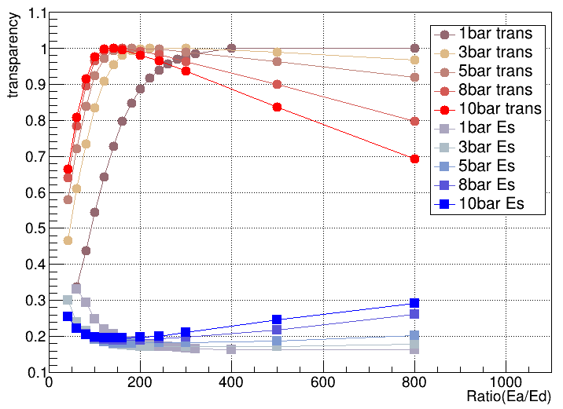
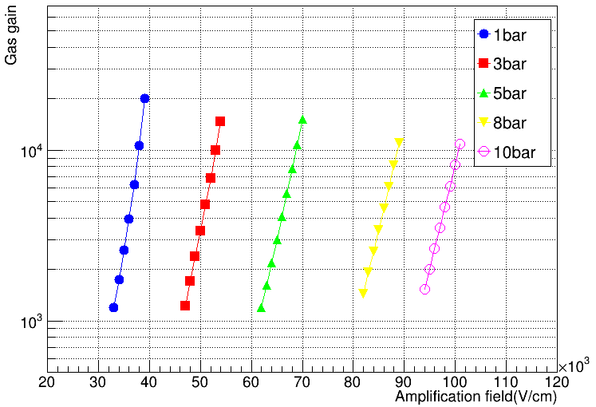
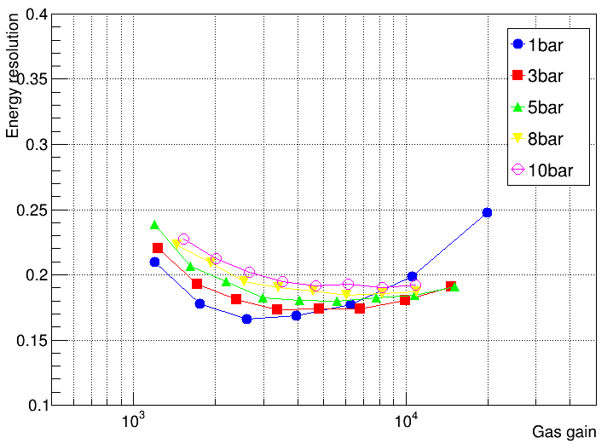
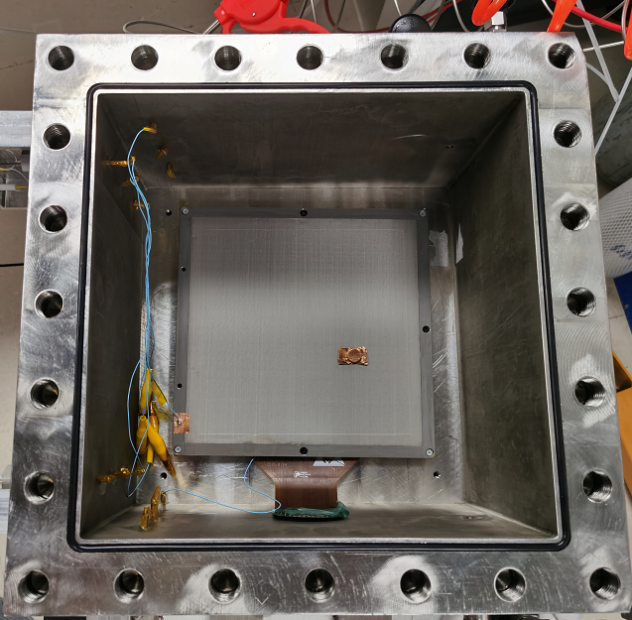
High pressure test result of V513
Gas: Ar(97.5%) + Iso(2.5%)
Since the various gain of detectors and the deviation of gas ratio, the performance is a little different between V503 and V513 at high pressure
Notes:
This is the performance of another detector under high pressure. We test this detector from 1bar to 10bar, use the same gas ratio as the before one, and under 10 bar, the gas gain of this detector can reach about 2000, litter than before one, and the energy resolution is consistent with before one.
We set a lot of Al blocks in the vessel, to reduce the empty space of the vessel for Xeon testing. But have many problems need to be solved, at present, we sent the detector to another laboratory in Shanghai Jiaotong University to conduct the Xeon plus TMA test.

Slide 12
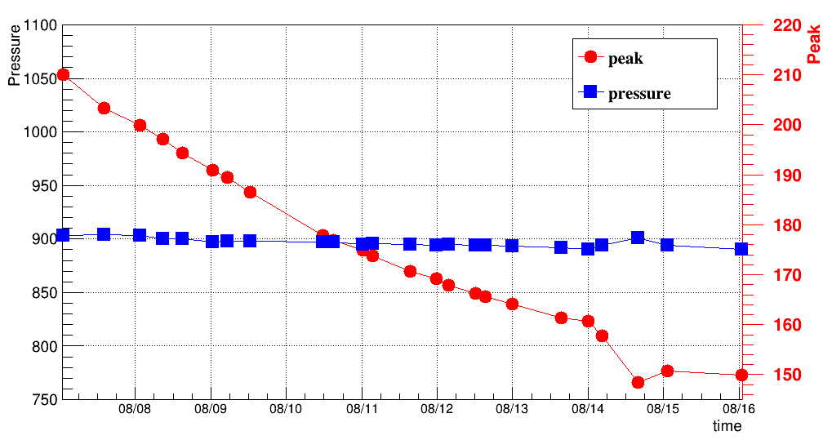
Result of long time high gas pressure test
Time： 8.7 ---8.16 (10days)
Gas pressure：10bar
Gas：Ar(97.5%) + Iso(2.5%)
Detector：V513
Radioactive Source：Fe55，
Voltage: 960V
Relative gas gain：~2300

Slide 13
Conclusion
Thermal bonding method developed at USTC is a very promising method in low background and high energy resolution experiments.
After 5 versions detector fabrication, the manufacturing process has been developed and fixed
The results of high gas pressure test are optimistic and the detector can work stable for long time in high pressure gas
Thank you!

Slide 14
Ar + Iso
SHV
Cathode
Fe55
Detector

