Slide 1




Characterization of the random electrode sectorization in the GEM-foils
RD51 collaboration meeting
M. Bianco¹, F. Fallavollita¹, R. De Oliveira¹, L. F. Ramirez Garcia², N. Rosi³
¹CERN - European Organization for Nuclear Research, Espl. des Particules 1, 1211 Geneva, Switzerland
²Department of Physics, University of Pavia and INFN Pavia, Via Bassi 6, 27100 Pavia, Italy
³Institute of Physics, University of Antioquia, Calle 67 No. 53, 108 Medellín, Colombia

Slide 2
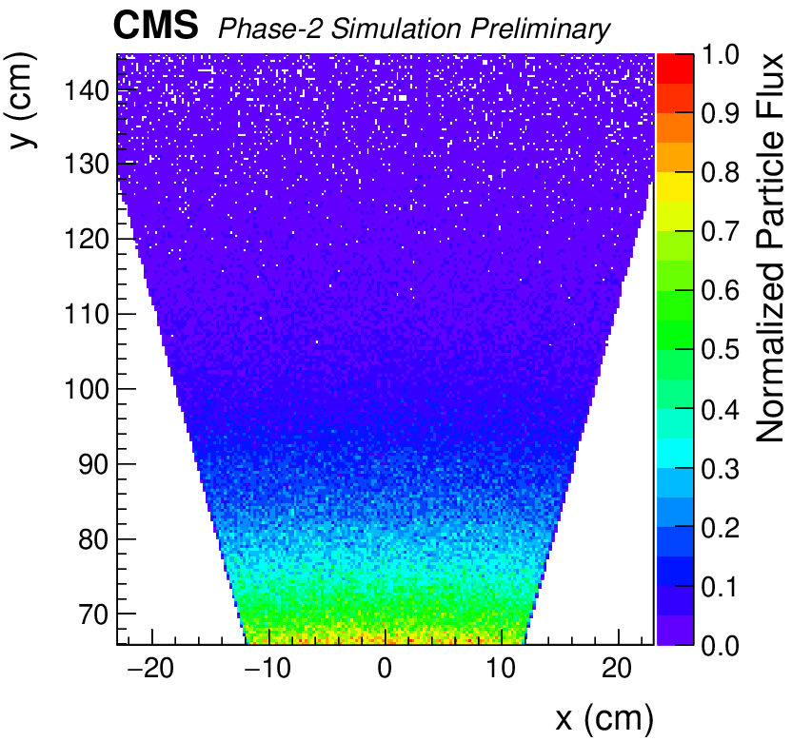
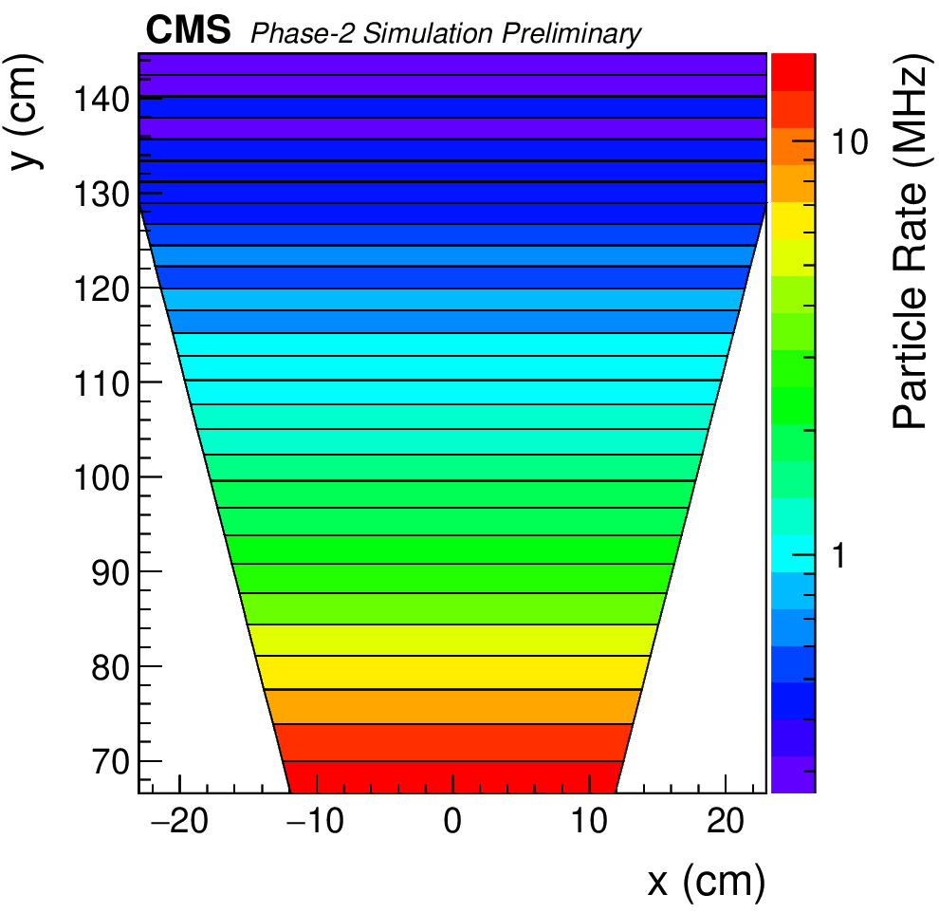
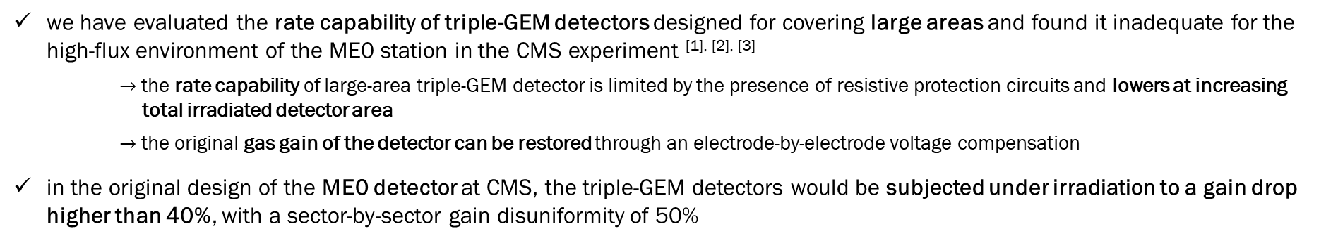
THE ME0 STATION POSES A TECHNOLOGICAL CHALLENGE FOR THE TRIPLE-GEM TECHNOLOGY
we have evaluated the rate capability of triple-GEM detectors designed for covering large areas and found it inadequate for the high-flux environment of the ME0 station in the CMS experiment ^{[1], [2], [3]}
$→$ the rate capability of large-area triple-GEM detector is limited by the presence of resistive protection circuits and lowers at increasing
total irradiated detector area
$→$the original gas gain of the detector can be restored through an electrode-by-electrode voltage compensation
in the original design of the ME0 detector at CMS, the triple-GEM detectors would be subjected under irradiation to a gain drop higher than 40%, with a sector-by-sector gain disuniformity of 50%
Segmentation of ME0 foils along transversal direction to beam line (inherited from GE1/1 and GE2/1) as a discharge mitigation strategy
Each GEM electrode is divided in 29 sectors of 100 cm² surface, all powered independently
1 order of magnitude rate difference
between high-η and low-η sectors: high
gain drop, > 50% gain disuniformity
Simulated background particle flux in each ME0 detector under irradiation in CMS
Simulated background particle rate per sector in each ME0 detector

Slide 3
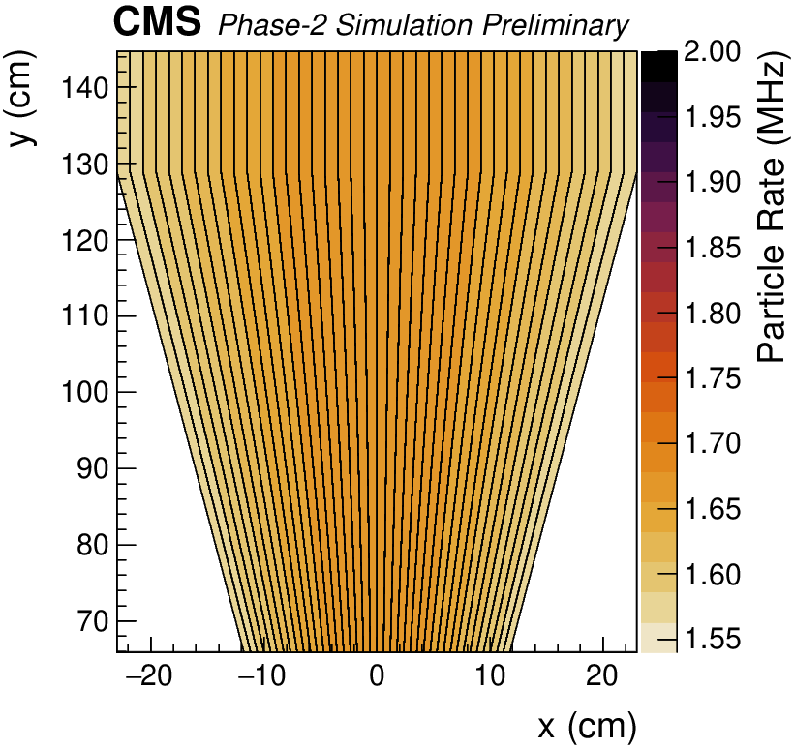
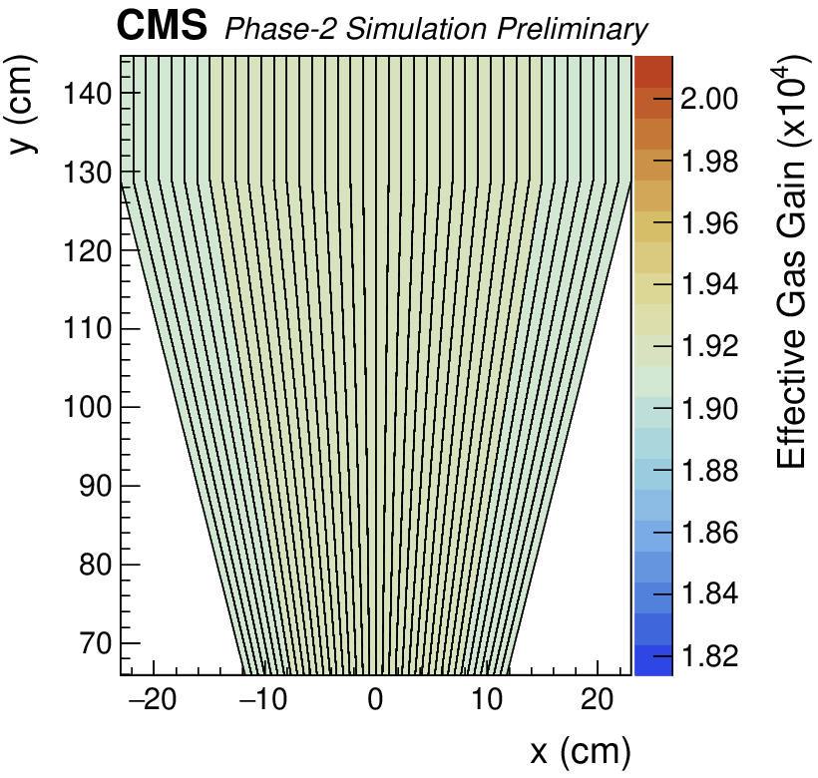
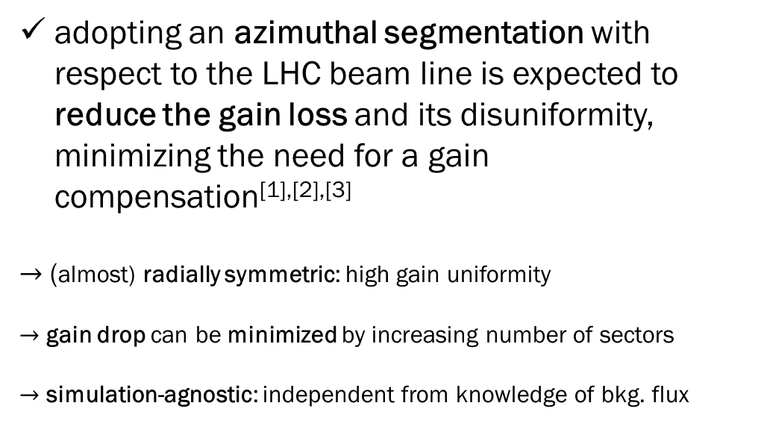
Changing in prospective: a rotation in sectorization
adopting an azimuthal segmentation with respect to the LHC beam line is expected to reduce the gain loss and its disuniformity, minimizing the need for a gain compensation^{[1],[2],[3]}
$→$ (almost) radially symmetric: high gain uniformity
$→$ gain drop can be minimized by increasing number of sectors
$→$ simulation-agnostic: independent from knowledge of bkg. flux
Simulated background rate and gain drop in ME0 detector with azimuthal segmentation

Slide 4
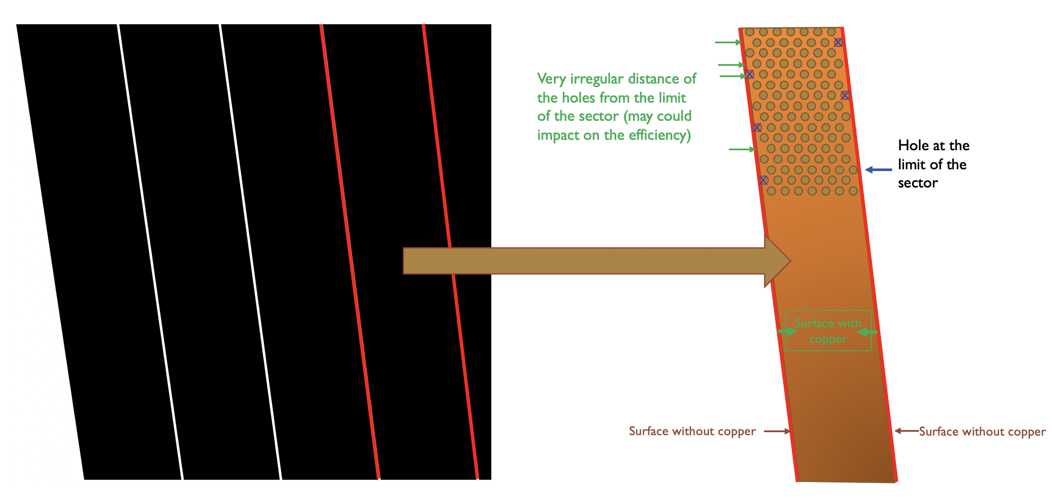
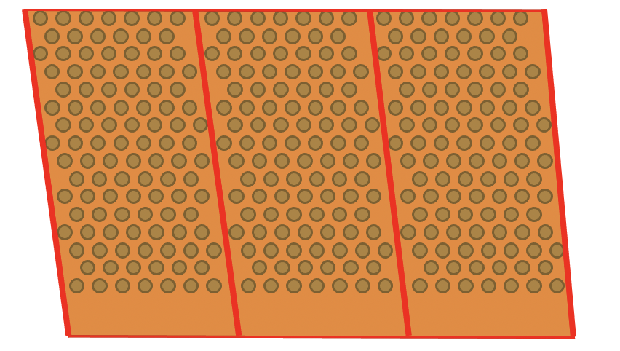
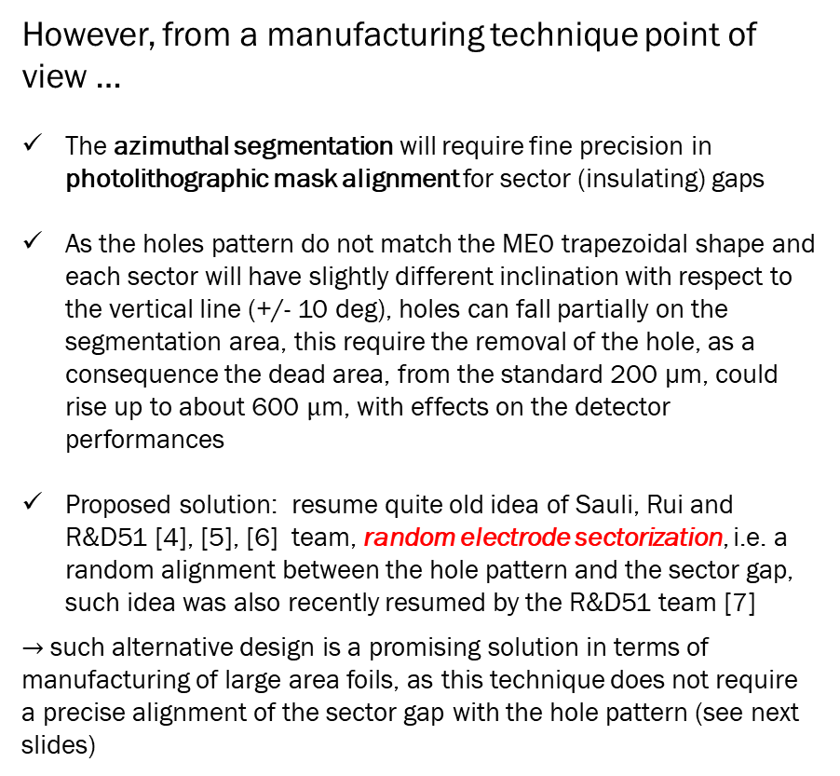
Limits of traditional blank electrode sectorization
However, from a manufacturing technique point of view …
The azimuthal segmentation will require fine precision in photolithographic mask alignment for sector (insulating) gaps
As the holes pattern do not match the ME0 trapezoidal shape and each sector will have slightly different inclination with respect to the vertical line (+/- 10 deg), holes can fall partially on the segmentation area, this require the removal of the hole, as a consequence the dead area, from the standard 200 µm, could rise up to about 600 $μ$m, with effects on the detector performances
Proposed solution: resume quite old idea of Sauli, Rui and R&D51 [4], [5], [6] team, random electrode sectorization, i.e. a random alignment between the hole pattern and the sector gap, such idea was also recently resumed by the R&D51 team [7]
$→$ such alternative design is a promising solution in terms of manufacturing of large area foils, as this technique does not require a precise alignment of the sector gap with the hole pattern (see next slides)
Up to 600 µm

Slide 5
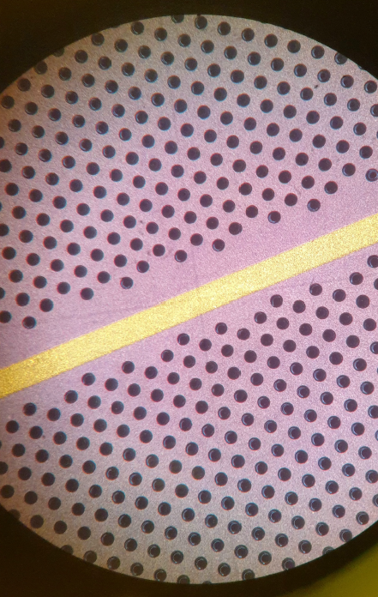
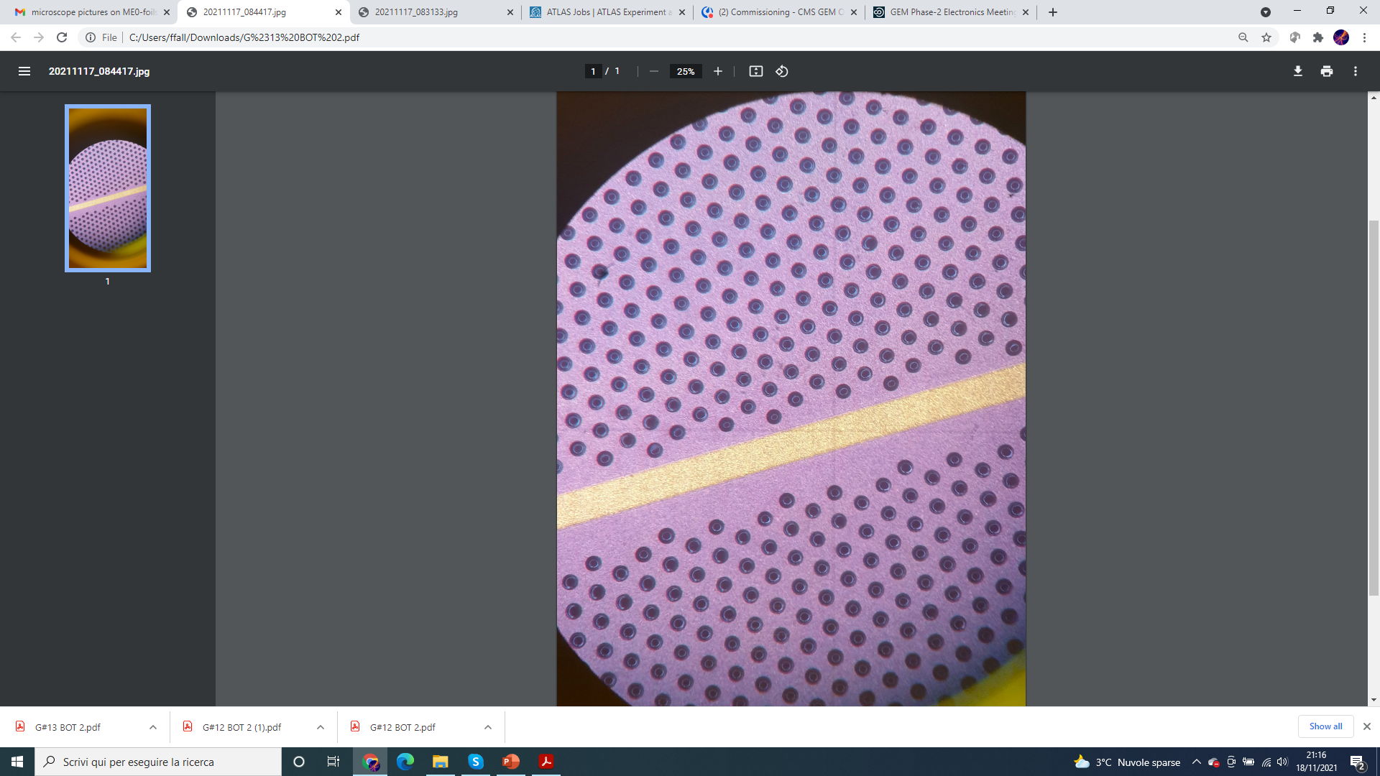

Limits of traditional blank electrode sectorization
~ 600 µm

Slide 6
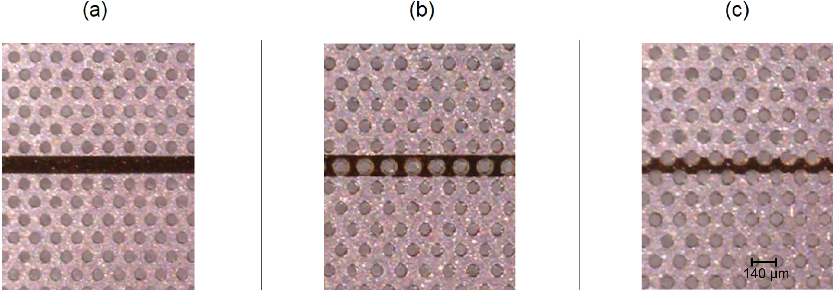
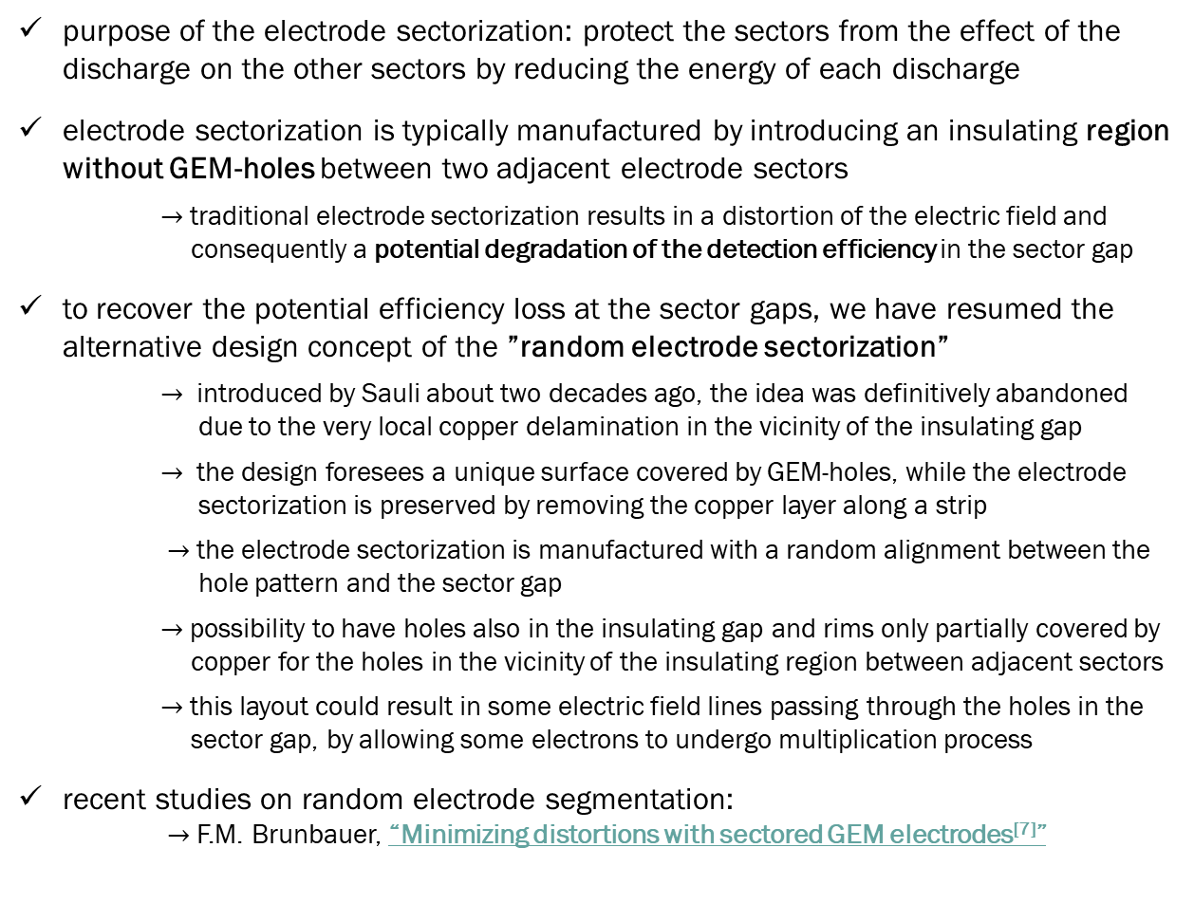
Random segmentation idea
microscope pictures of blank strip pattern^{[7]}
purpose of the electrode sectorization: protect the sectors from the effect of the discharge on the other sectors by reducing the energy of each discharge
electrode sectorization is typically manufactured by introducing an insulating region without GEM-holes between two adjacent electrode sectors
$→$ traditional electrode sectorization results in a distortion of the electric field and
consequently a potential degradation of the detection efficiency in the sector gap
to recover the potential efficiency loss at the sector gaps, we have resumed the alternative design concept of the ”random electrode sectorization”
$→$ introduced by Sauli about two decades ago, the idea was definitively abandoned
due to the very local copper delamination in the vicinity of the insulating gap
$→$ the design foresees a unique surface covered by GEM-holes, while the electrode
sectorization is preserved by removing the copper layer along a strip
$→$the electrode sectorization is manufactured with a random alignment between the
hole pattern and the sector gap
$→$possibility to have holes also in the insulating gap and rims only partially covered by
copper for the holes in the vicinity of the insulating region between adjacent sectors
$→$this layout could result in some electric field lines passing through the holes in the
sector gap, by allowing some electrons to undergo multiplication process
recent studies on random electrode segmentation:
$→$F.M. Brunbauer, “Minimizing distortions with sectored GEM electrodes^{[7]}”
microscope pictures of random strip pattern^{[7]}

Slide 7
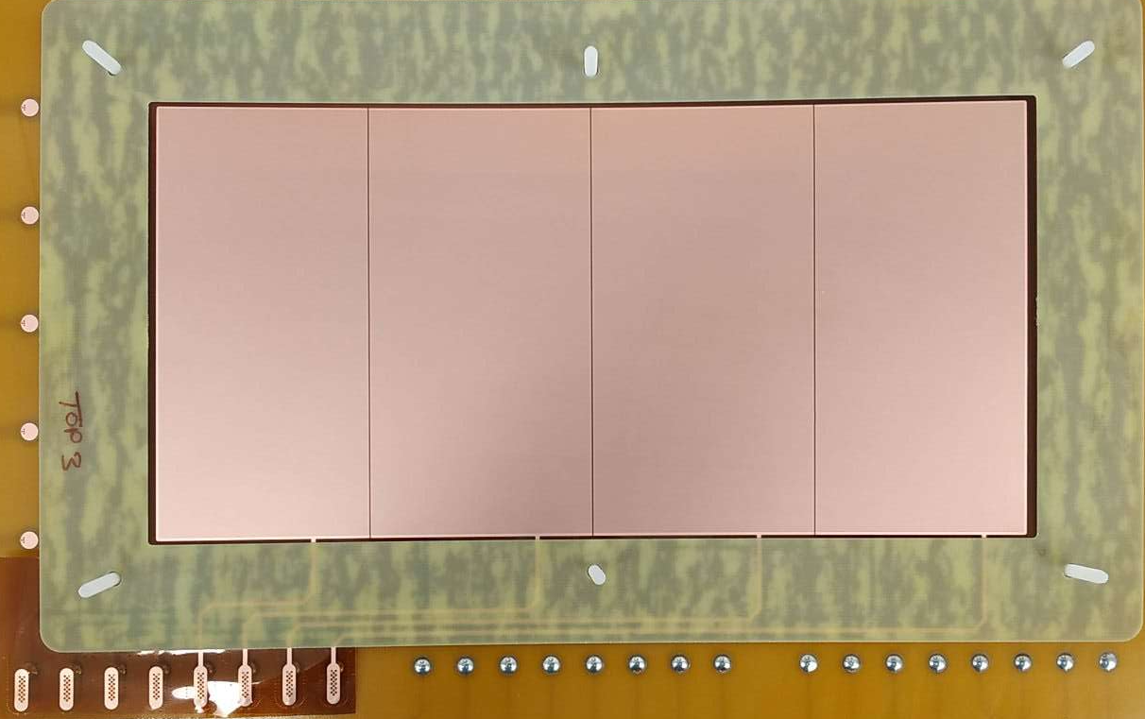
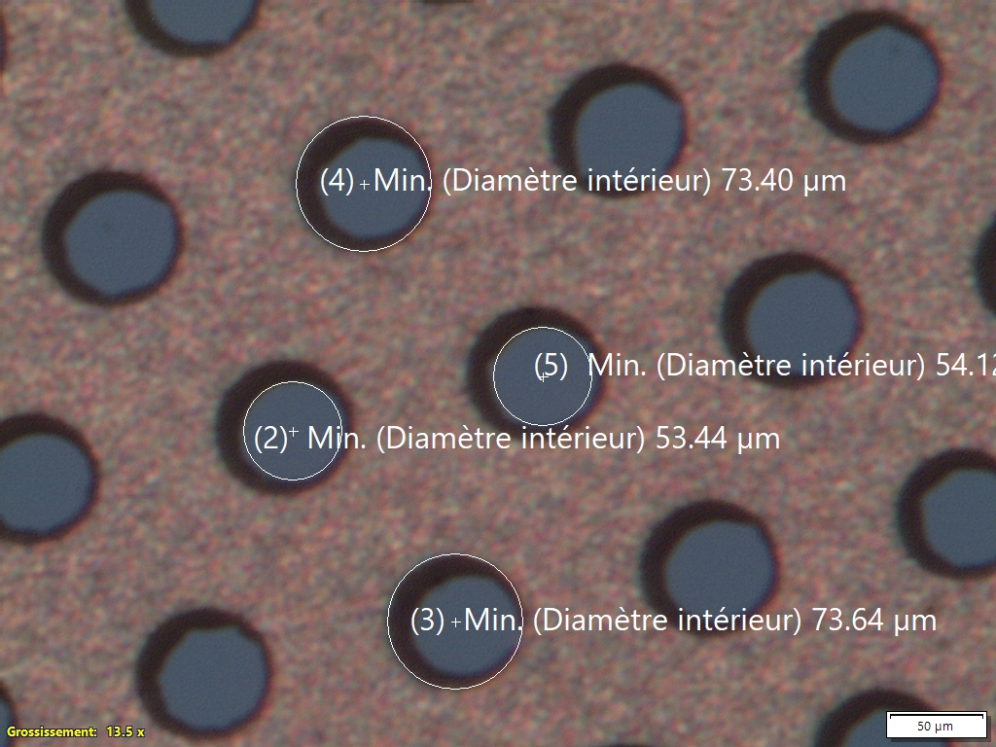
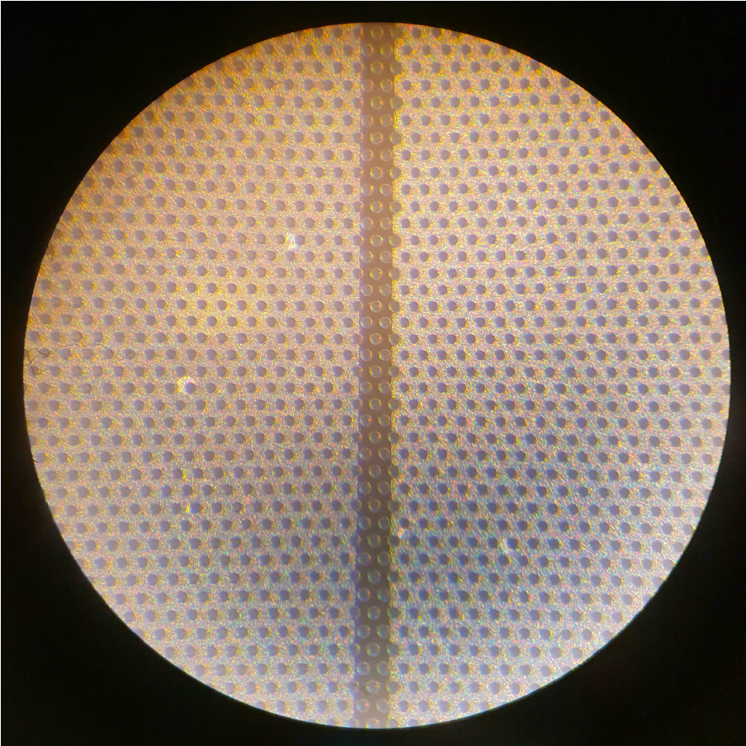
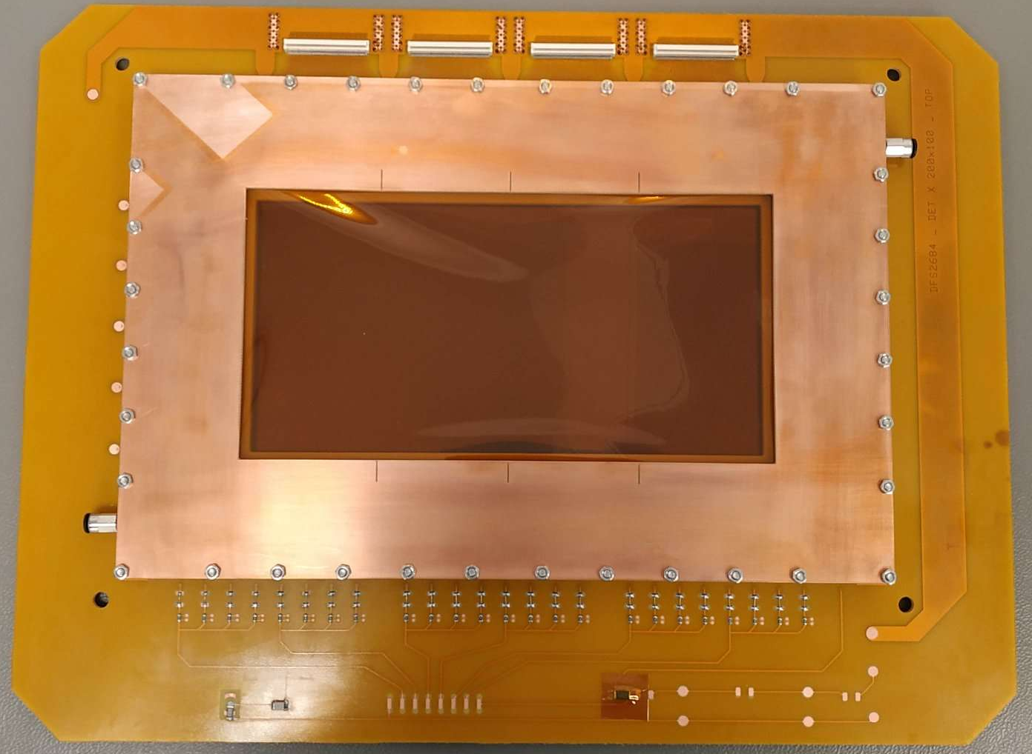
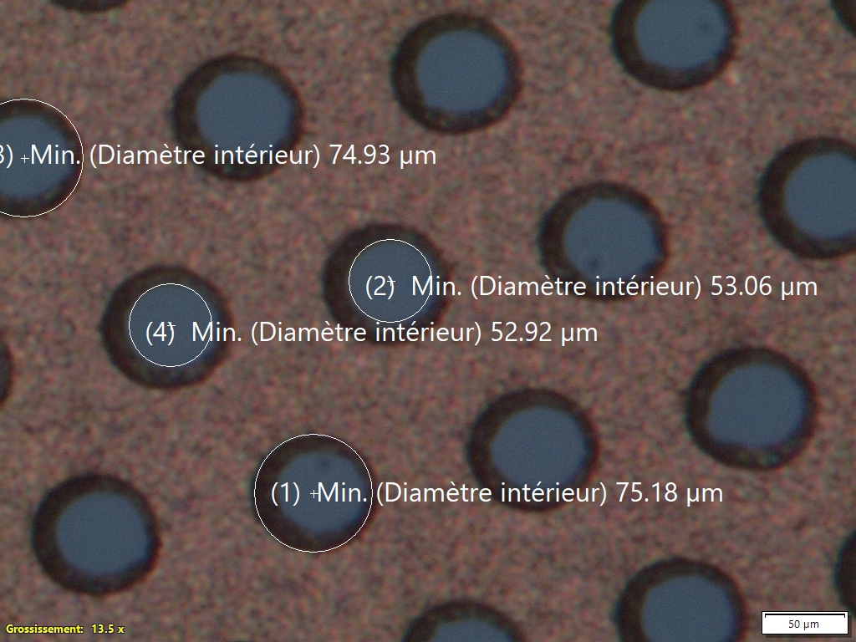
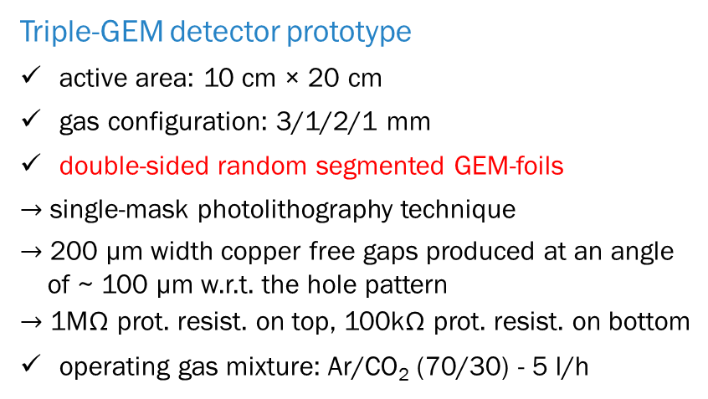
Detector prototype configuration
optical inspection results:
optical inspection by backlight → good
holes uniformity → good
holes diameter → good
copper rings diameter: Ø_{Cu} ~ 74 µm
(required specs 70±5 µm)
polyimide rings diameter: Ø_{PI} ~ 53 µm
(required specs 50±5 µm)
Triple-GEM detector prototype
active area: 10 cm × 20 cm
gas configuration: 3/1/2/1 mm
double-sided random segmented GEM-foils
$→$ single-mask photolithography technique
$→$ 200 µm width copper free gaps produced at an angle
of ~ 100 µm w.r.t. the hole pattern
$→$ 1MΩ prot. resist. on top, 100kΩ prot. resist. on bottom
operating gas mixture: Ar/CO₂ (70/30) - 5 l/h
double-sided random segmented GEM-foils
top - side
RO sector
20 cm
gas
outlet
200 µm
bottom - side
HV sector 1
10 cm
HV sector 2
HV sector 4
HV sector 3
gas
inlet
high voltage distribution
microscope pictures of the random electrode sectorization

Slide 8
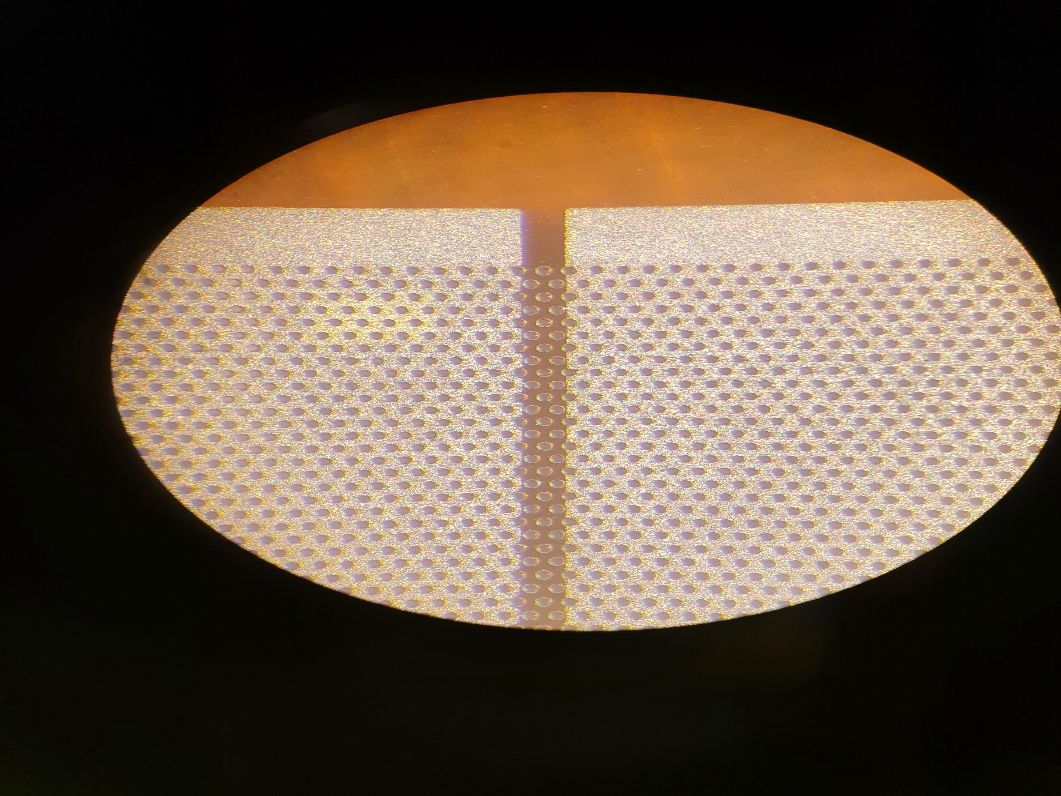
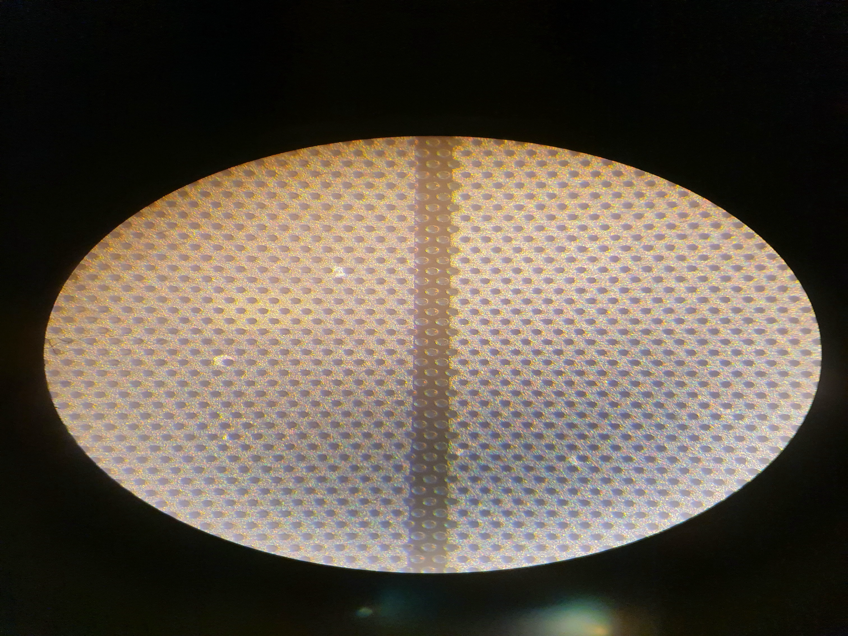
double-sided random segmented GEM-foils
zoom view
GEM-foil specs
active area: 200 cm²
double-sided random segmented GEM-foils
single-mask photolithography technique
(CERN PCB Workshop – Rui’s Lab.)
200 µm width copper free gaps produced at an angle of inclination of ~ 100 µm w.r.t. the hole pattern
Hypothesis to be verified:
Hp₁: possible copper delamination risk in the vicinity of
the insulating region between adjacent sectors
Hp₂: minimize the electric field distortion and recover
the potential efficiency loss at the sector gaps
200 µm

Slide 9
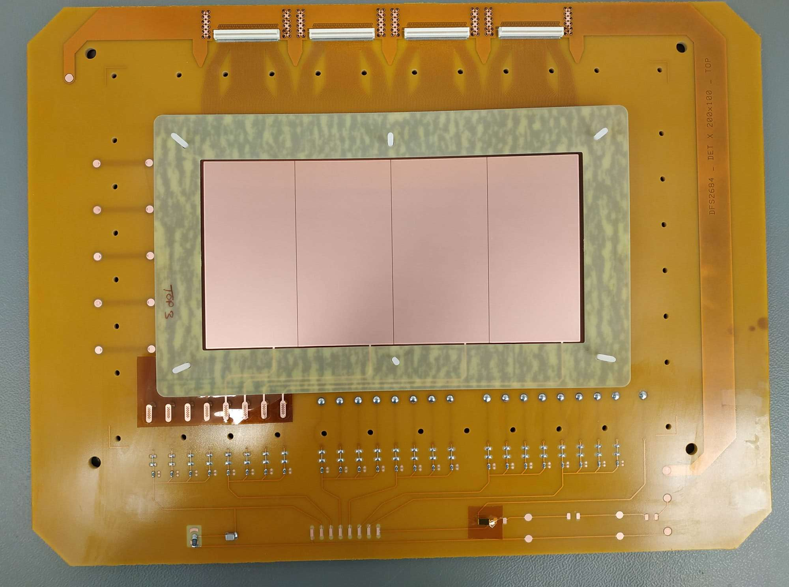
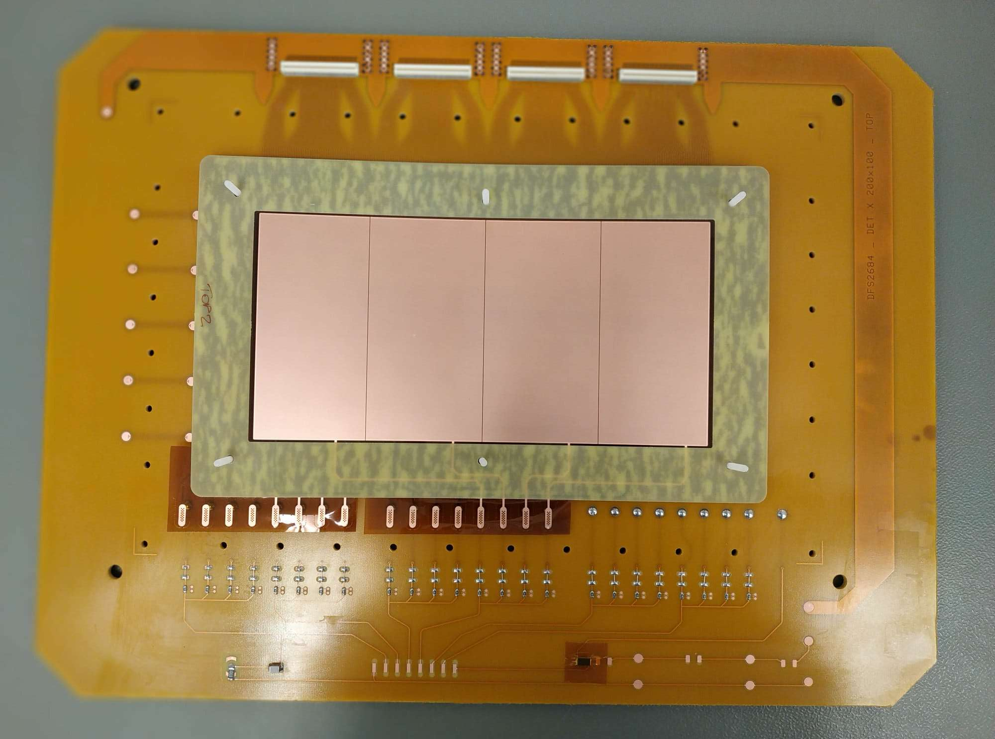
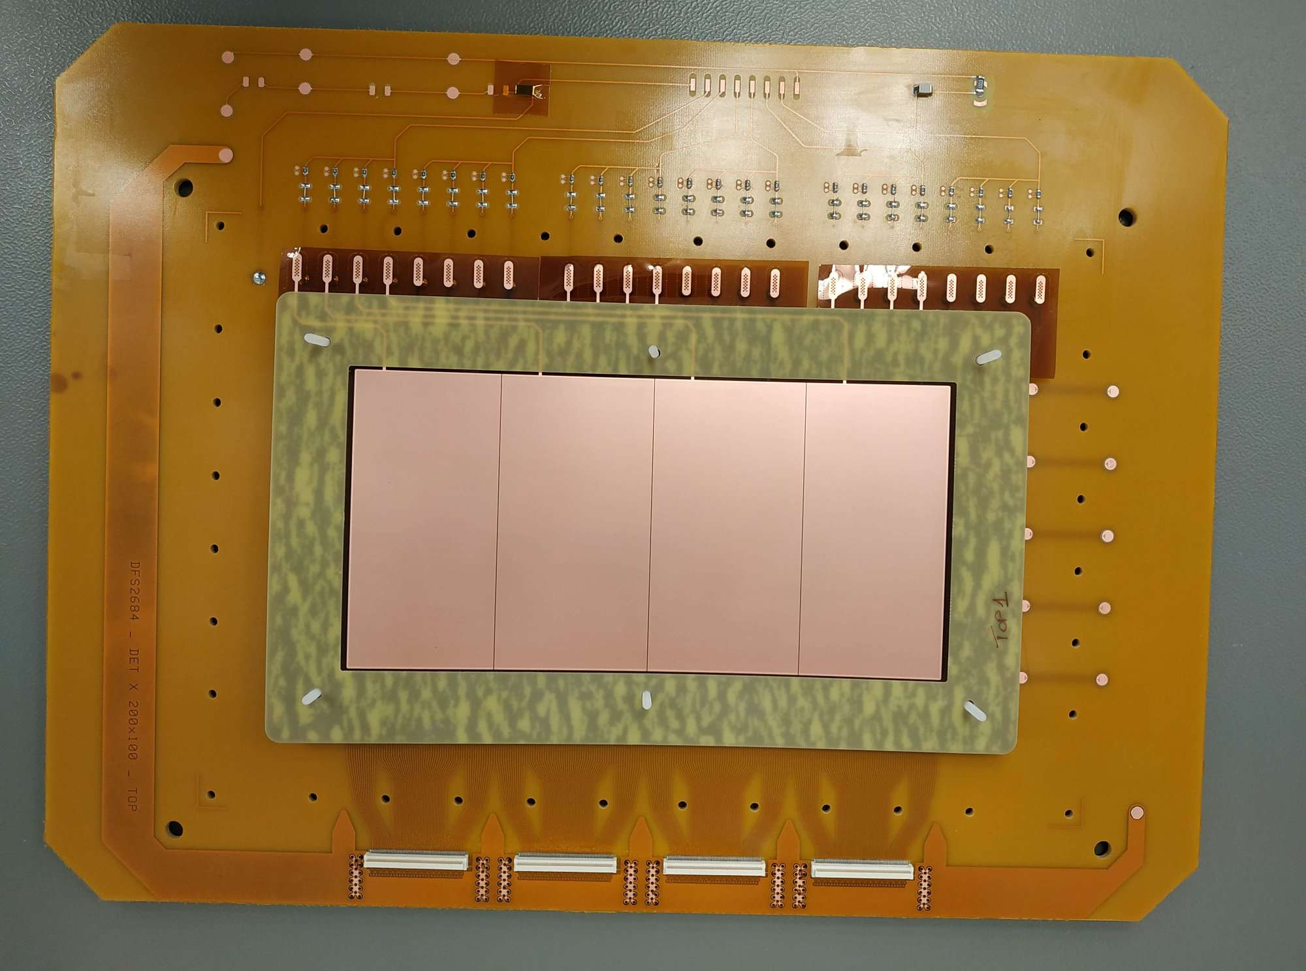
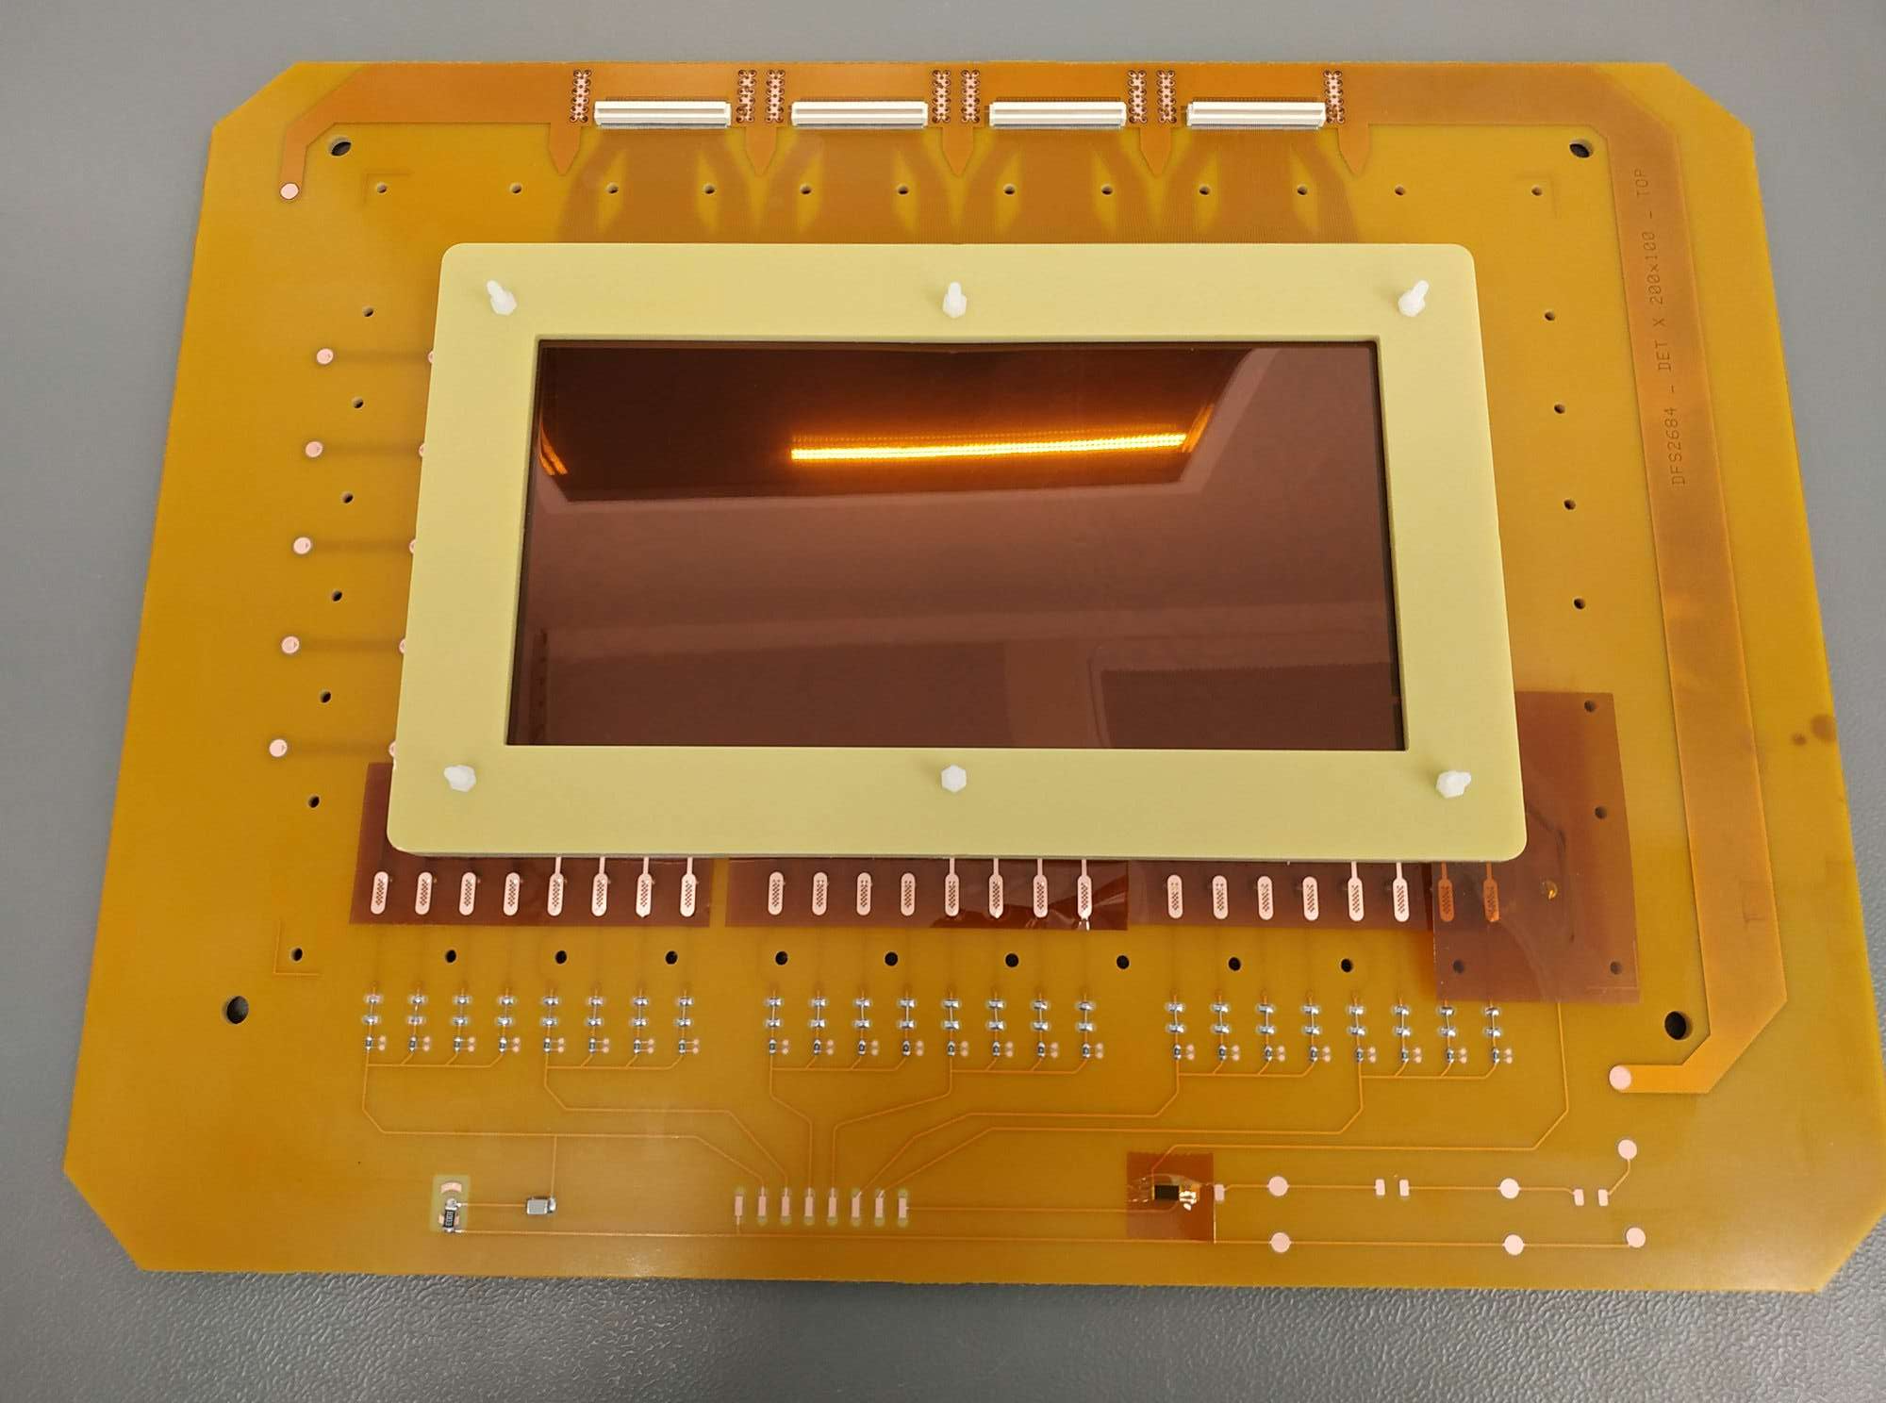
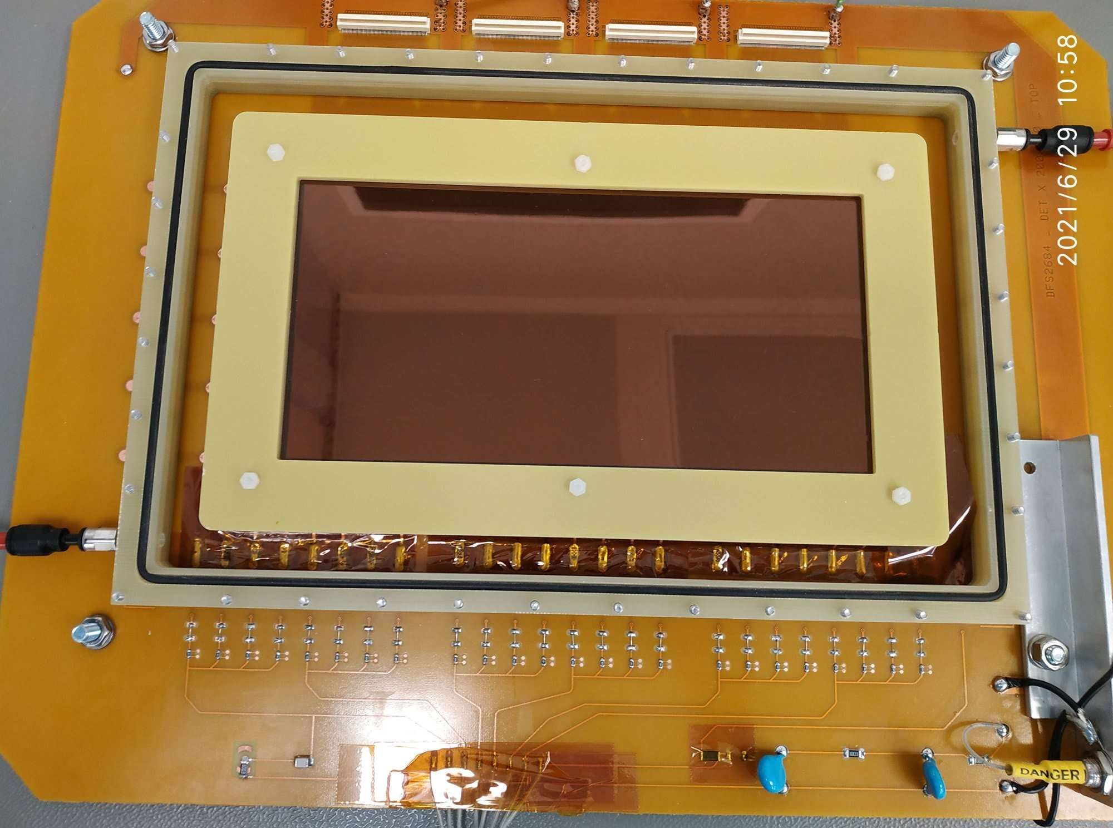
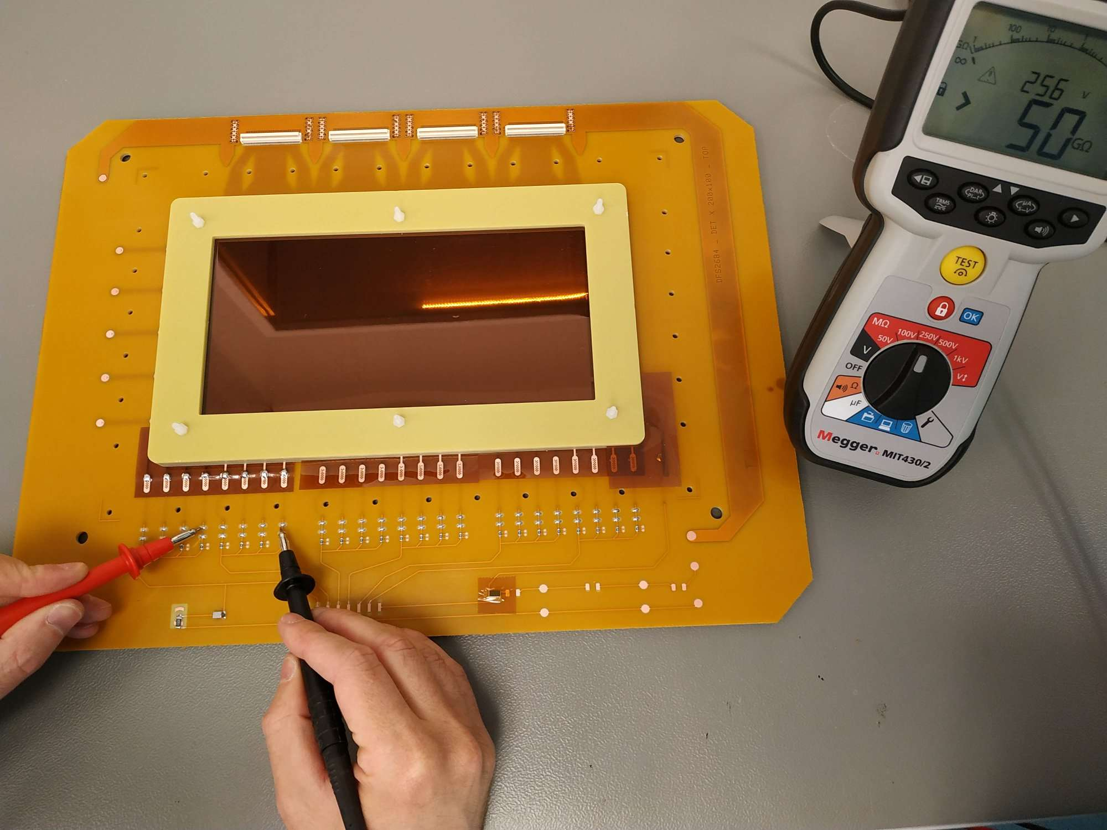
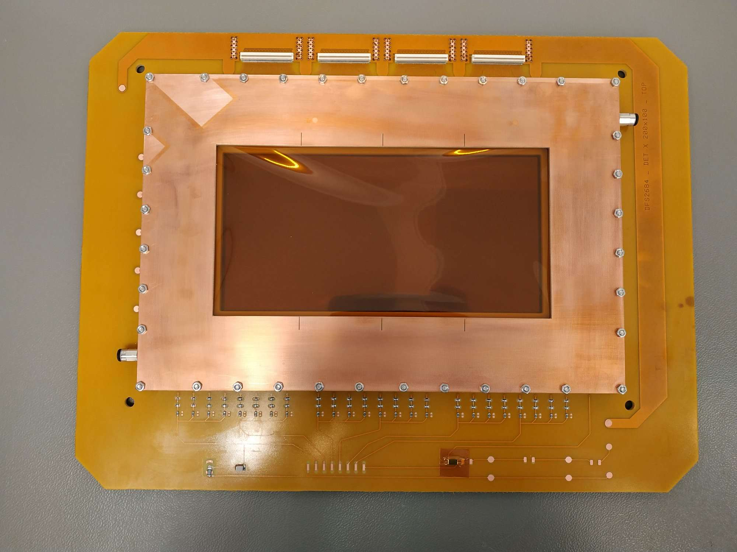
Detector prototype assembly
major assembly steps of the 10 cm × 20 cm detector prototype in clean room
step 1: installation of the 1mm internal frame + GEM₃ foil
step 2: installation of the 2mm internal frame + GEM₂ foil
step 3: installation of the 1mm internal frame + GEM₁ foil
step 4: installation of the 3mm insternal frame + drift cathode
step 5: connectivity + leakage current test with megger
step 6: installation of the external frames with the O-rings
step 7: installation of the external Kapton window

Slide 10
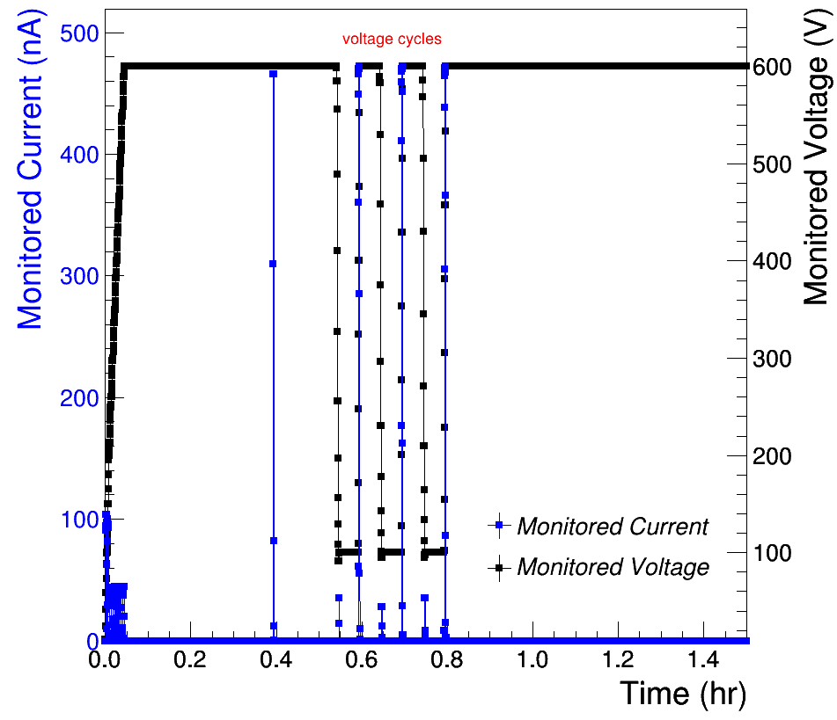
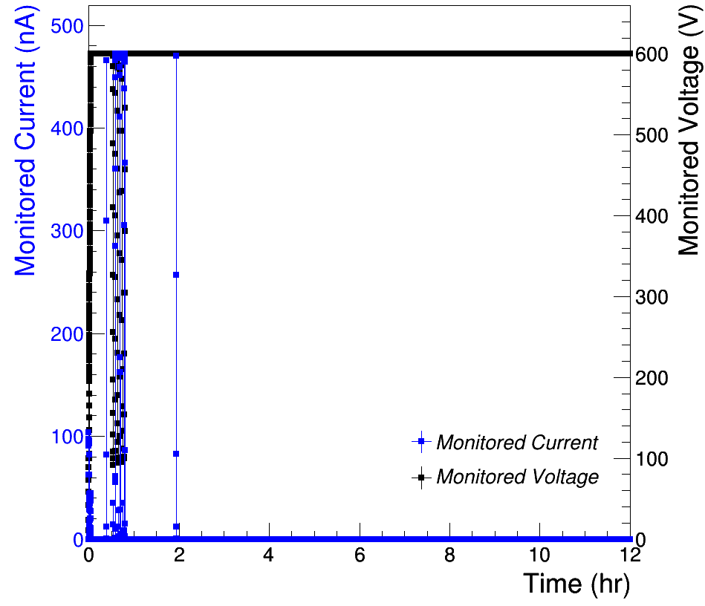
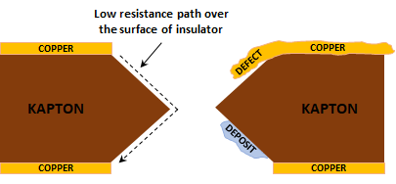
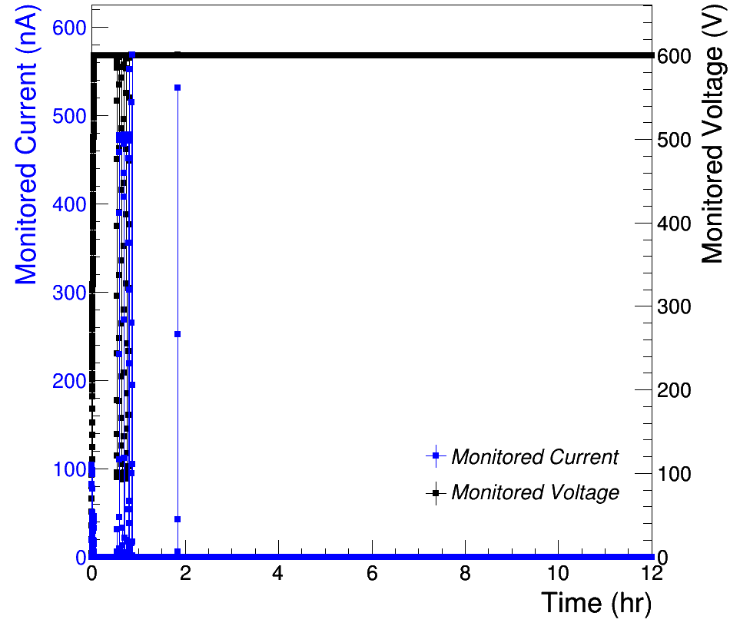
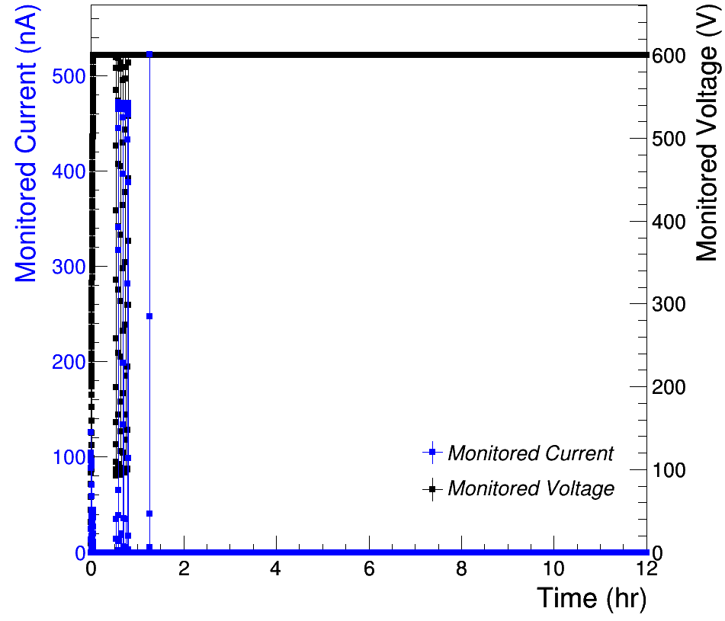
GEM foils Leakage Current Test in N₂
zoom view
GEM₁ foil
Leakage current test aims to determine the quality of a GEM-foil by measuring the maximum leakage current flowing on the surface of the GEM-holes
When a voltage is applied across the GEM-foil, a current flows from its top to bottom due to the surface conductivity of the Kapton which is known as leakage current
The leakage current flowing through the polyimide of the GEM foil could be affected by the presence of impurities or defects in the holes
moreover, in the random segmentation case, some holes will be partially surrounded by the copper layer, which could adverse effect on the stability of the GEM-foils
The quality of the GEM foils is assessed by monitoring the leakage current and the possible presence of discharges using the NDT1471H Caen Power Supply (50 pA resolution)
The test is performed during 12 hr in pure N₂ at 600 V; the maximum accepted values are: 3 nA of leakage and a total number of trips of the HV board lower then 3
leakage current
~ 0.36 ± 0.09 nA
discharges
discharges
GEM₂ foil
GEM₃ foil
leakage current
~ 0.42 ± 0.10 nA
leakage current
~ 0.45 ± 0.10 nA
discharges
discharges
No difference is noticed when compared with the results of foils with traditional blank sectorization^{[8]}

Slide 11
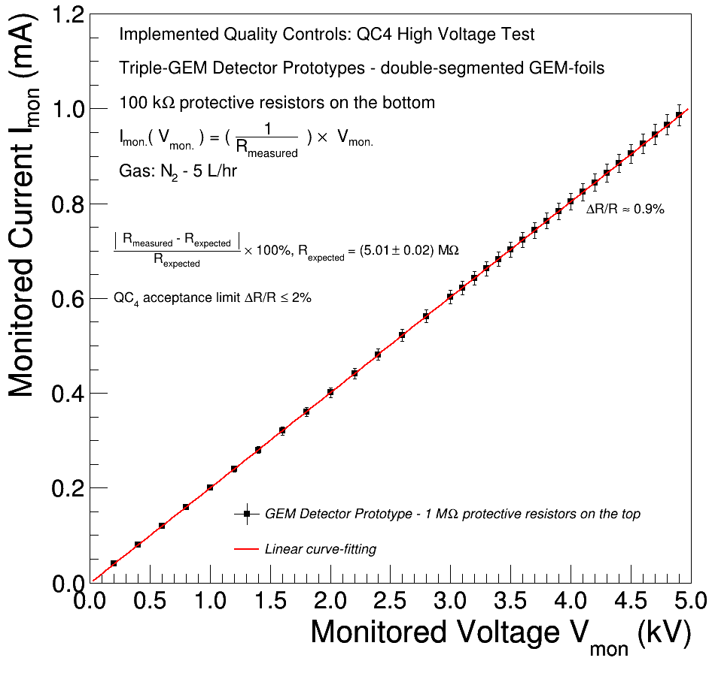
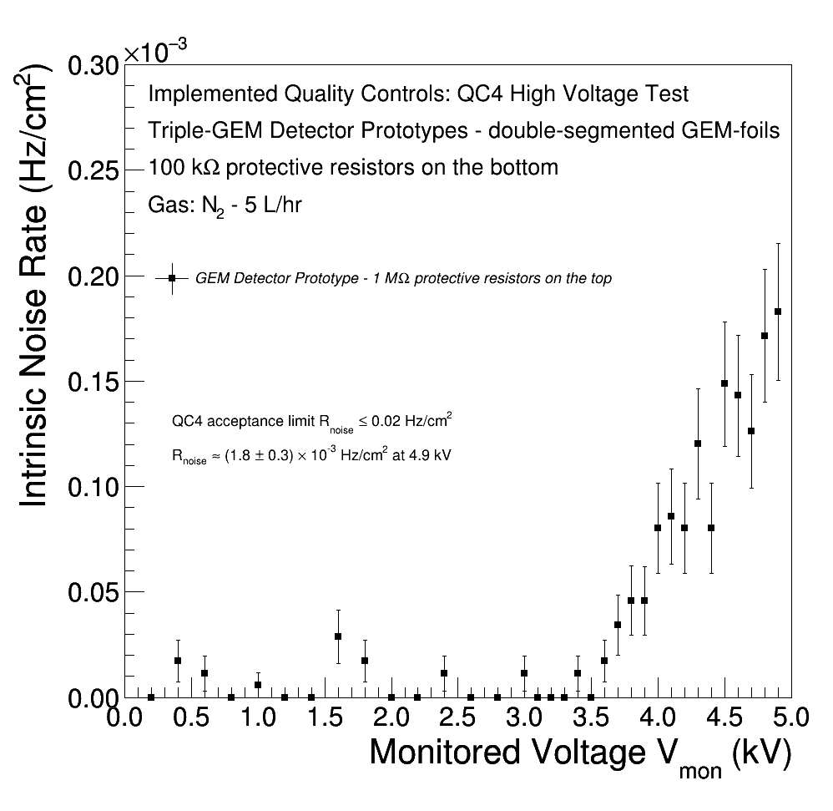
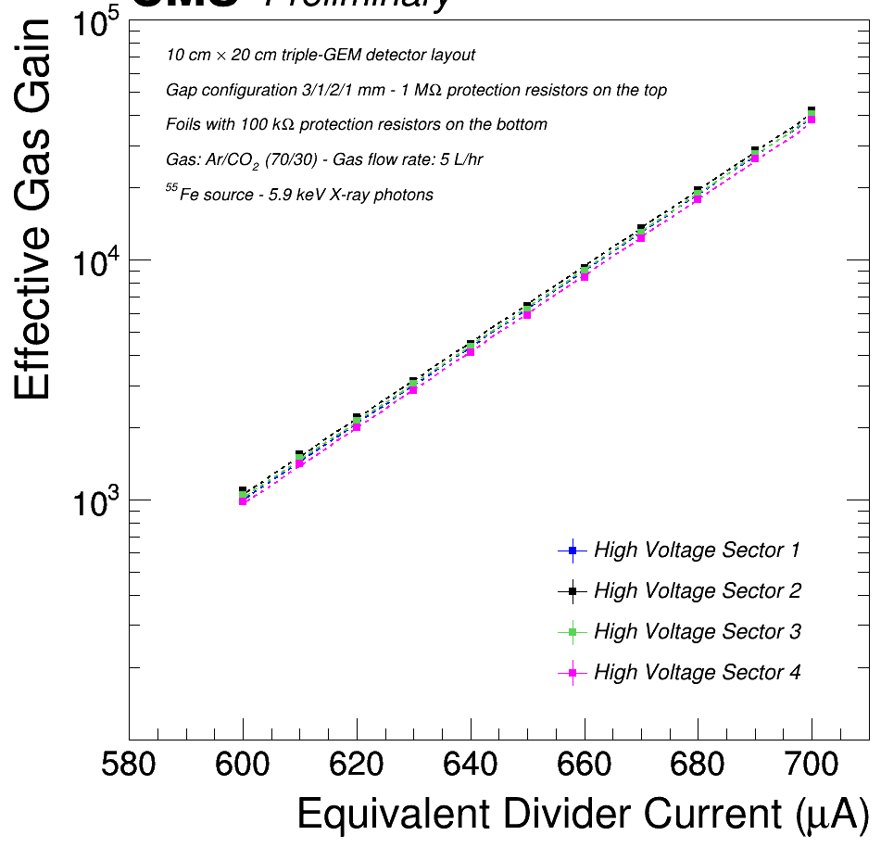
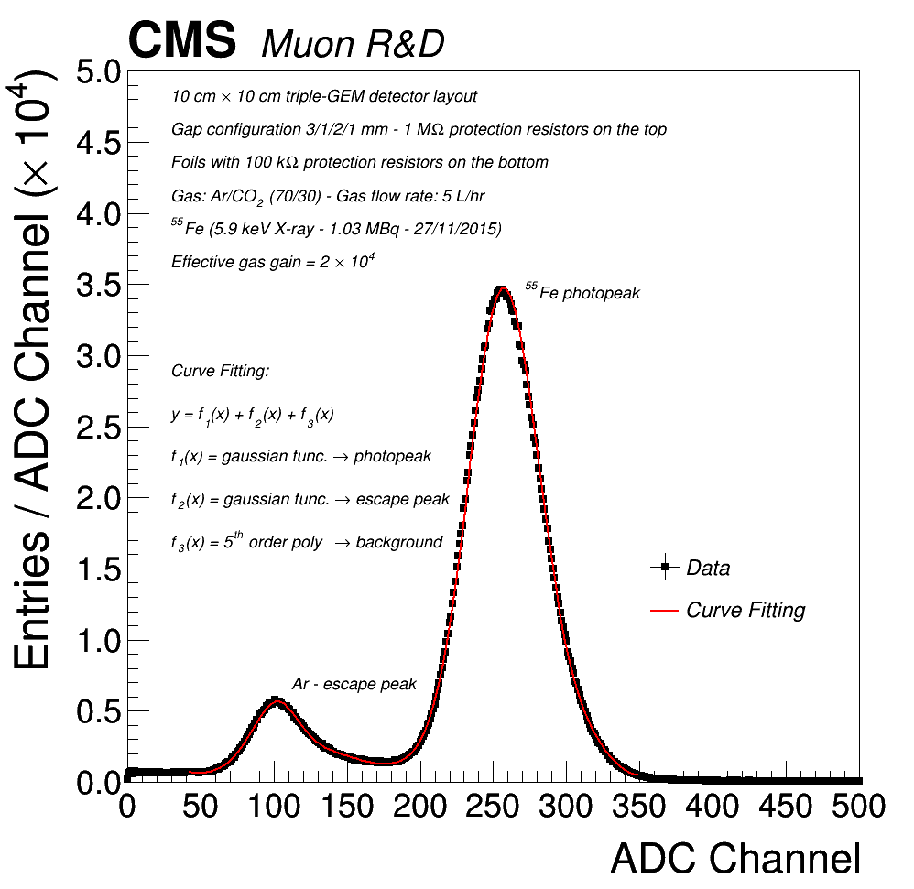
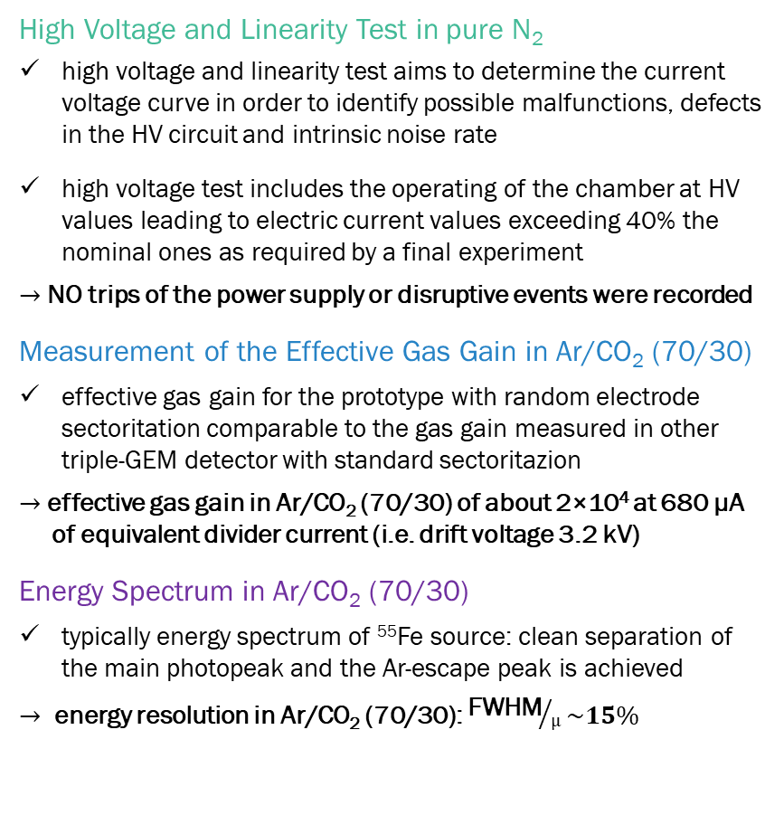
Quality Control and testing
example of standard QA/QC on the detector prototype
High Voltage and Linearity Test in pure N₂
high voltage and linearity test aims to determine the current voltage curve in order to identify possible malfunctions, defects in the HV circuit and intrinsic noise rate
high voltage test includes the operating of the chamber at HV values leading to electric current values exceeding 40% the nominal ones as required by a final experiment
$→$ NO trips of the power supply or disruptive events were recorded
Measurement of the Effective Gas Gain in Ar/CO₂ (70/30)
effective gas gain for the prototype with random electrode sectoritation comparable to the gas gain measured in other triple-GEM detector with standard sectoritazion
$→$ effective gas gain in Ar/CO₂ (70/30) of about 2×10⁴ at 680 µA
of equivalent divider current (i.e. drift voltage 3.2 kV)
Energy Spectrum in Ar/CO₂ (70/30)
typically energy spectrum of ⁵⁵Fe source: clean separation of the main photopeak and the Ar-escape peak is achieved
$→$ energy resolution in Ar/CO₂ (70/30): ${\text{FWHM}}/µ\sim 15\%$
$→$ the detector successfully passed all standard quality controls $←$

Slide 12
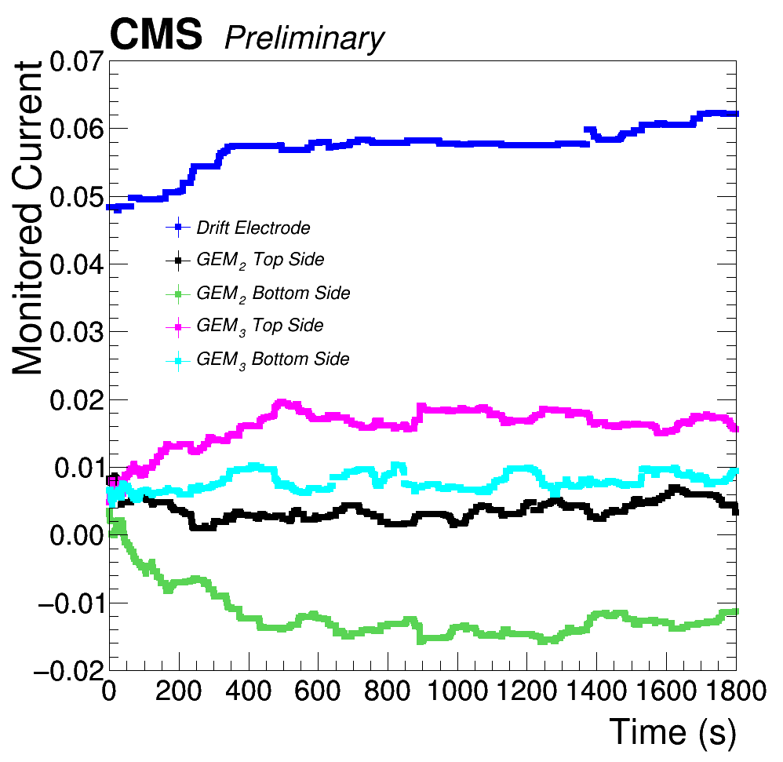
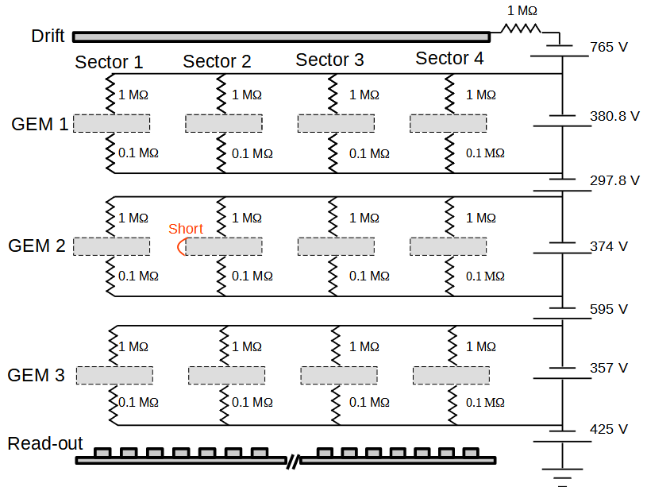
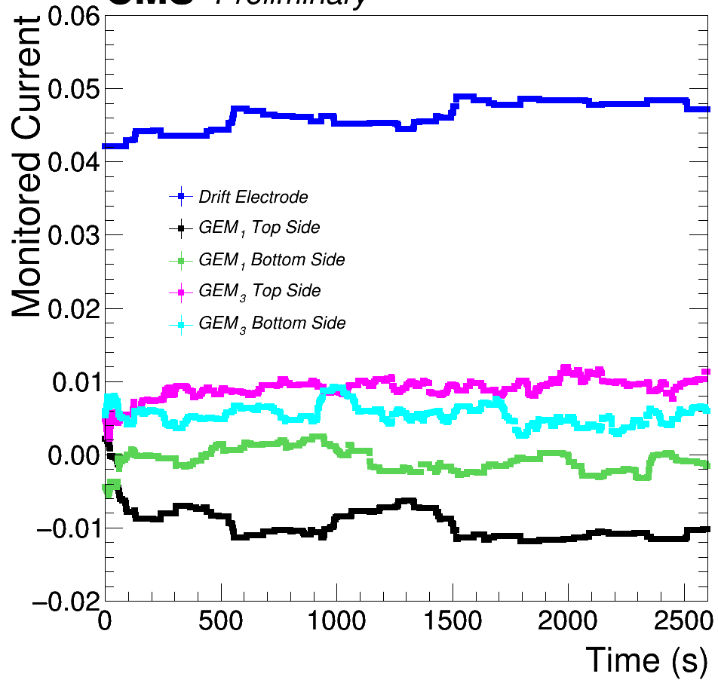
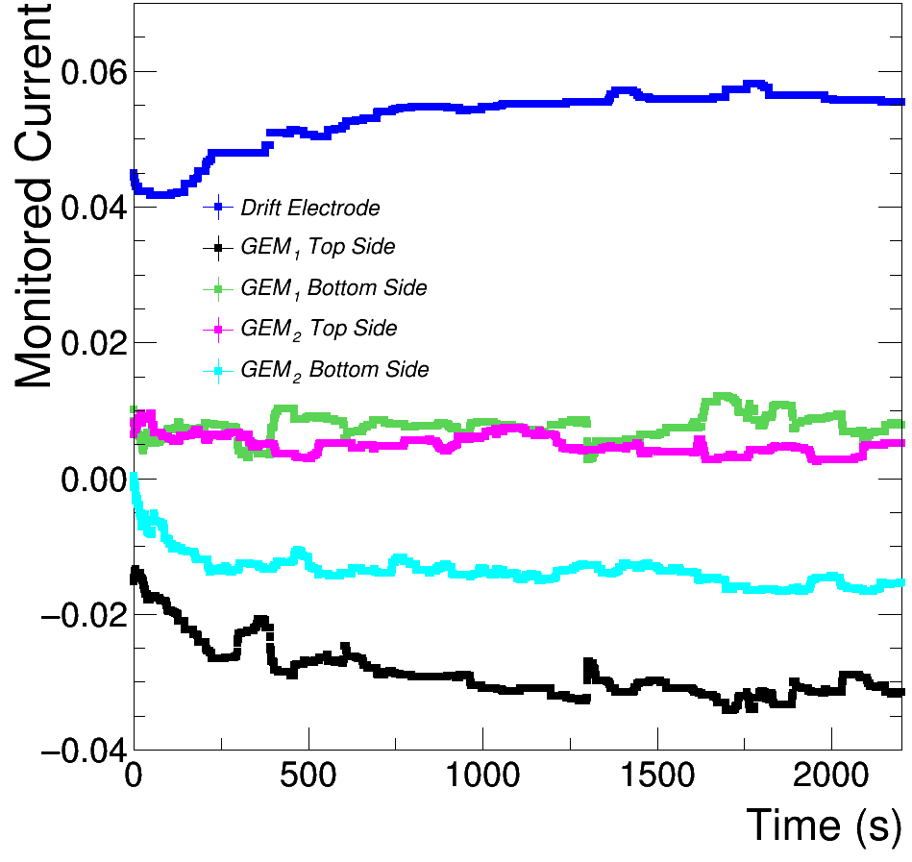
Detector response in the case of short circuit
short circuit on GEM₁
High Voltage Stability in Ar/CO₂ (70/30)
when one sector of the GEM-foils is in short-circuit, the current flowing through the top and bottom side of the foil increases
a short circuit is introduced in the sector 2 of GEM₁ (or GEM₂, or GEM₃). Considering the protection resistors, 1 MΩ (top) + 100 kΩ(bot), and the applied voltage (~375 V), the expected current is ~340 µA for the sector in short-circuit
the current flowing through the other sectors and foils is proved to be stable despite a short-circuit in one of the sectors of the detector prototype
No abnormal leakage current or discharges were detected
during several hours of measurement
the test confirms that the double-sided random segmented foils is stable even under short-circuit in one of the sectors
zoom view
sector 1
sector 2
sector 3
sector 4
short circuit on GEM₂
short circuit on GEM₃

Slide 13
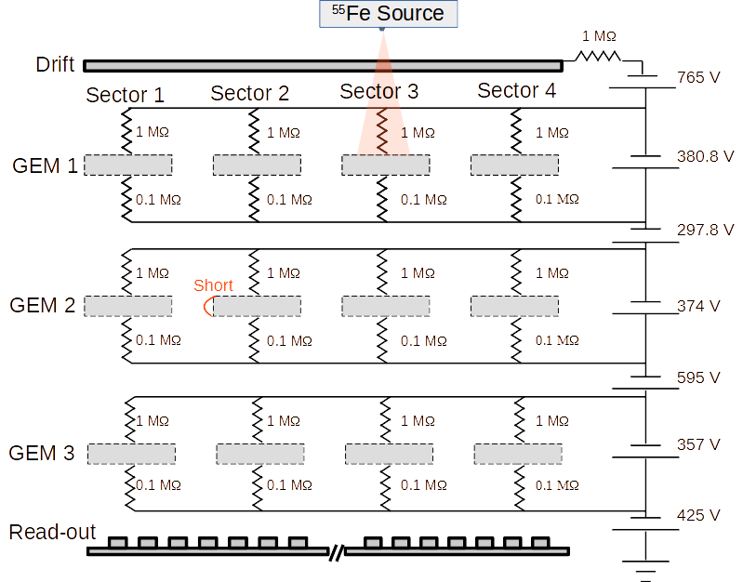

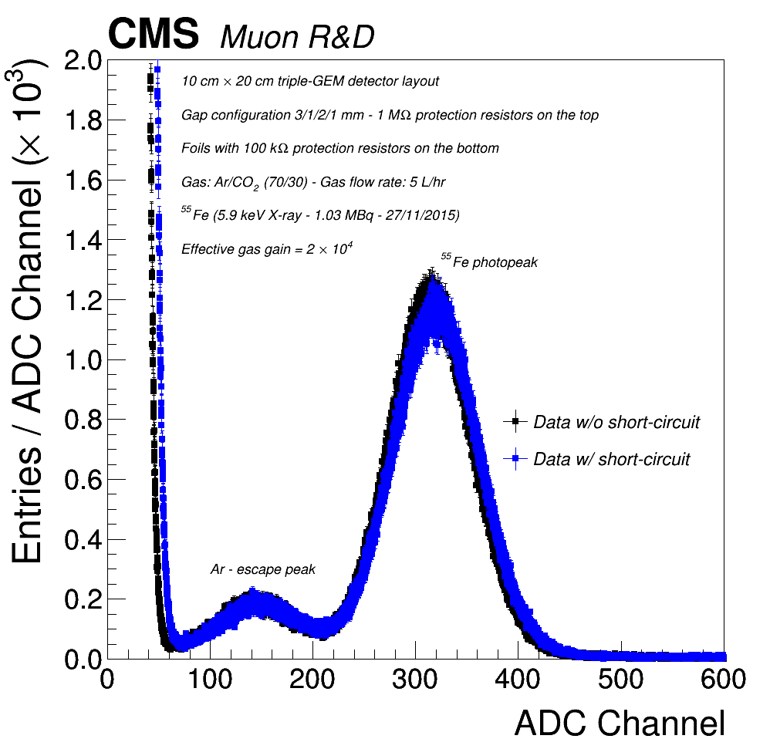
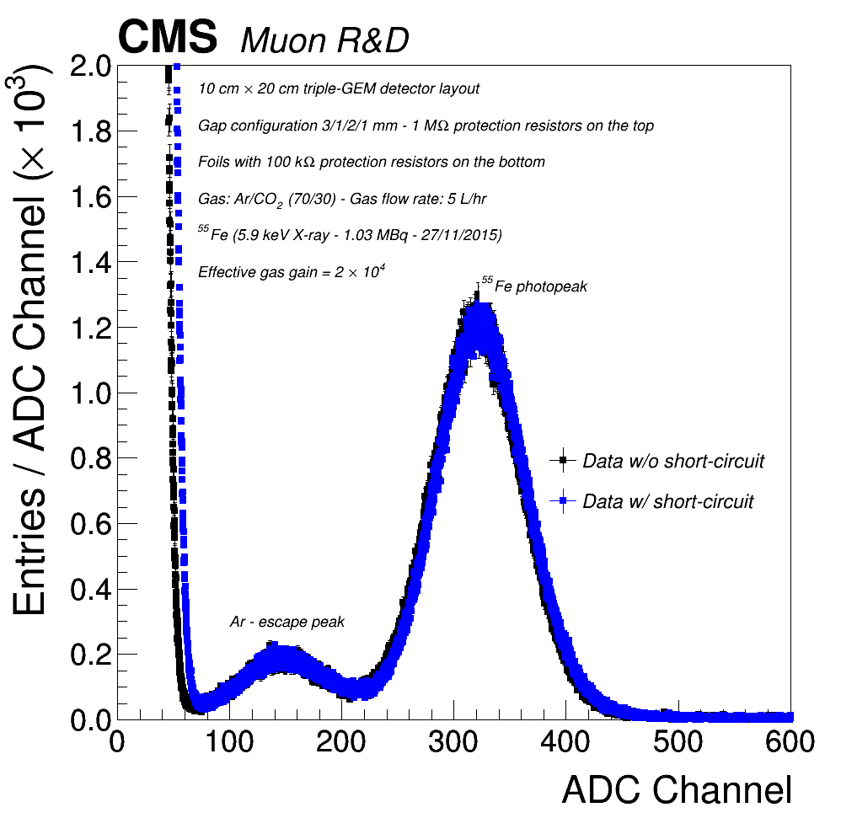
Detector response in the case of short circuit
High Voltage Stability in Ar/CO₂ (70/30)
when one sector of the GEM-foils is in short-circuit, the current flowing through the top and bottom side of the foil increases
a short circuit is introduced in the sector 2 of GEM₁ (or GEM₂, or GEM₃). Considering the protection resistors, 1 MΩ (top) + 100 kΩ(bot), and the applied voltage (~375 V), the expected current is ~340 µA for the sector in short-circuit
the current flowing through the other sectors and foils is proved to be stable. No abnormal leakage current or discharges were detected during several hours of measurement
Energy Spectrum in Ar/CO₂ (70/30)
the energy spectra measured after positioning a ⁵⁵Fe source over a sectors adjacent (e.g. sector 3) to the short-circuited one are not affected by the presence of the short
zoom view
sector 1
sector 2
sector 3
sector 4
short circuit on GEM₂
short circuit on all stack
⁵⁵Fe source

Slide 14
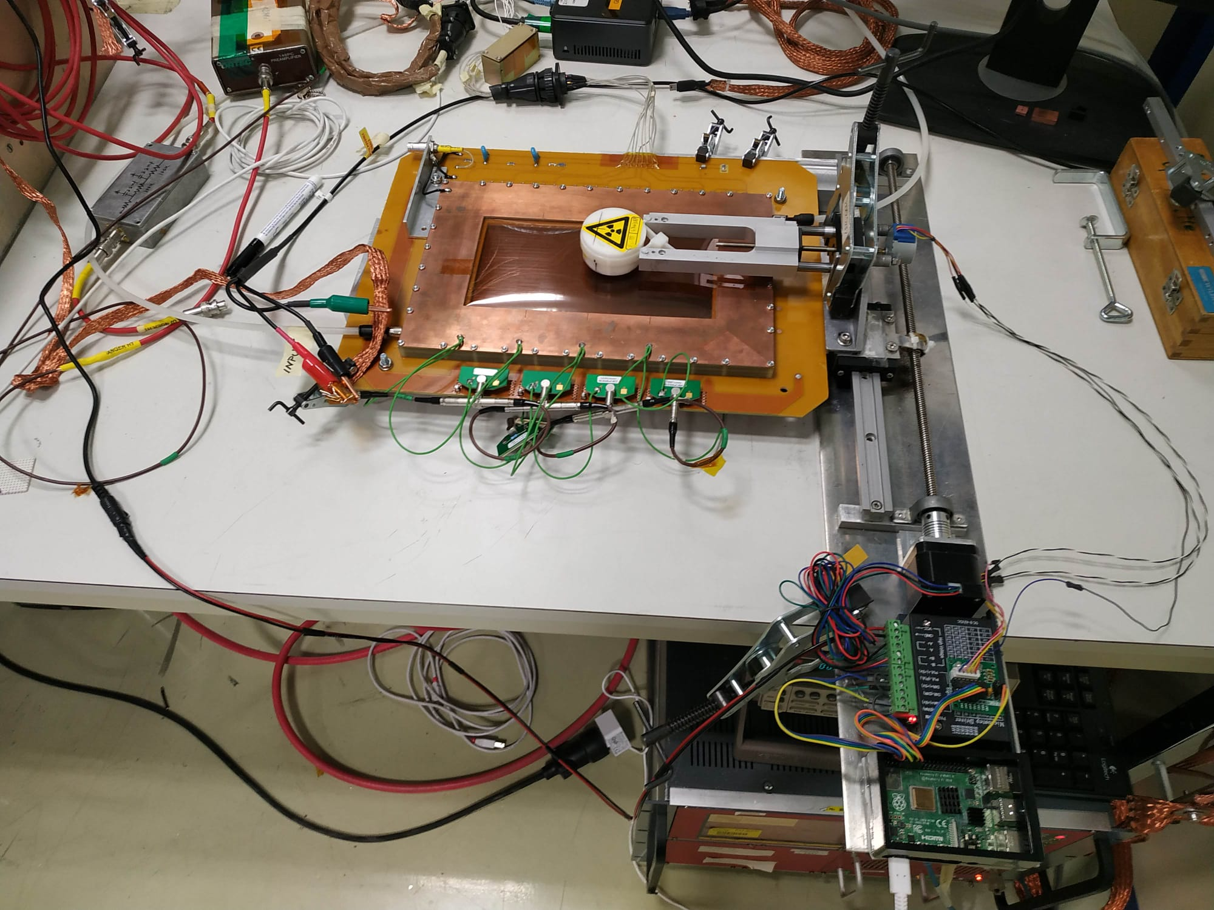
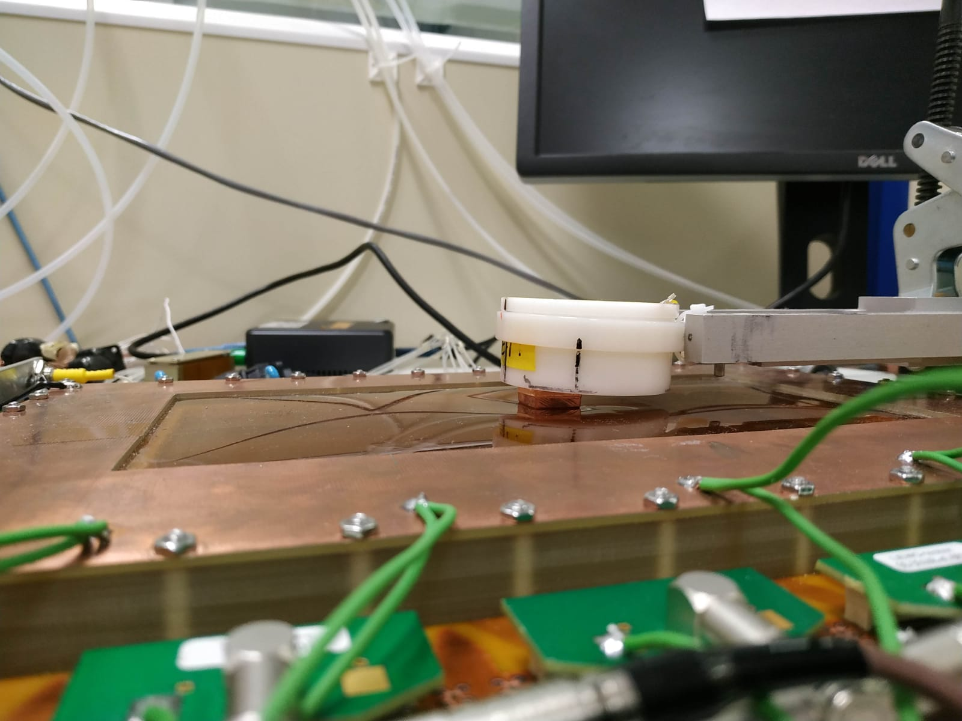
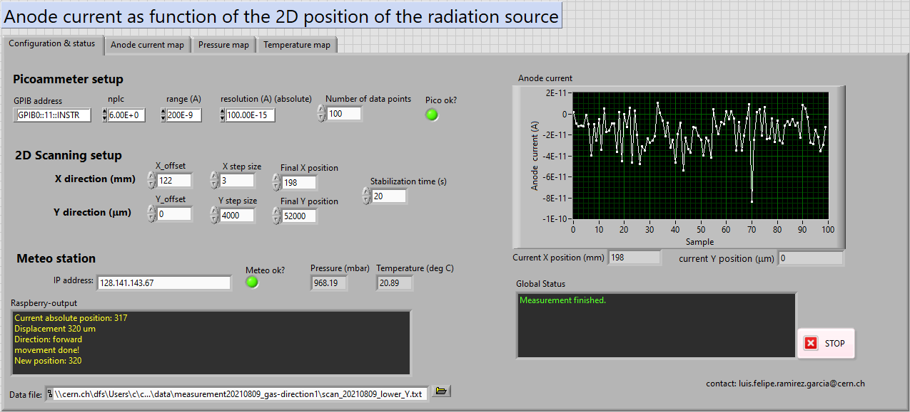
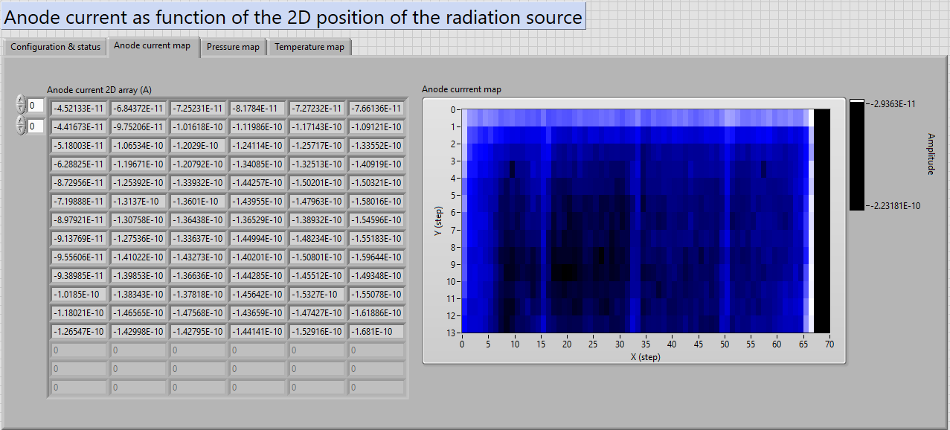
GAS GAIN Uniformity
stepper motors and collimated 5.9 keV ⁵⁵Fe source (~ 2 mm²) used to scan the 10 cm × 20 cm area at a 3 mm (x-coord.) × 4 mm (y-coord.) grid (~ 2000 «pixels» of equal area)
linear stepper XY positioning stage uses a stepper motor with 50 µm resolution for the x-coord. and a stepper motor with 1 mm resolution for the y-coord.
automated testing system based on Raspberry Pi & LabView controller
for each pixel, sum-up signals from four associated readout connectors have been recorded to compute the effective gas gain and energy spectra
stepper motor
(50 µm resolution)
stepper motor
(1 mm resolution)
⁵⁵Fe source
Raspberry Pi microcontroller
source collimator
LabVIEW-software interface for the KEITHLEY 6487 picoammeters
to control and monitor the anode current

Slide 15
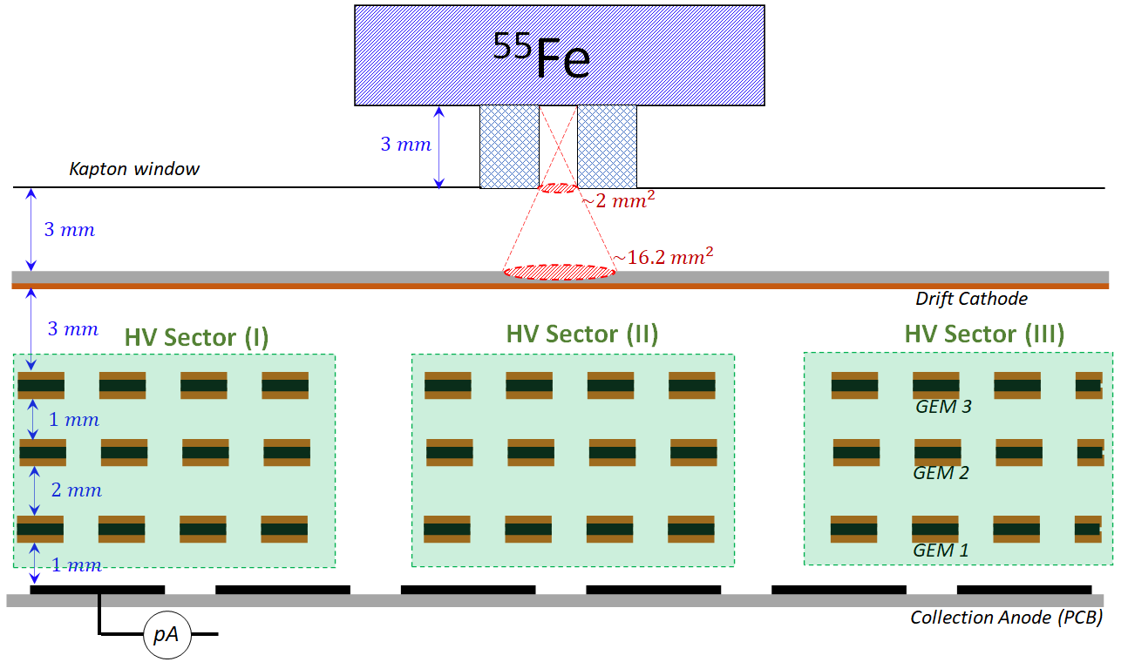


GAS GAIN Uniformity
source collimator
3 mm - thick copper collimator with
1.5 mm hole diameter
Gas gain map of the triple-GEM detector. Collimated 5.9 keV ⁵⁵Fe source (~ 2 mm²) used to scan the 10 cm × 20 cm area at a 3 mm (x-coord.) × 4 mm (y-coord.) grid
Ø ~1.5 mm
15 mm
15 mm
Projected relative gain for random holes pattern in the sectorized GEM
drop in the gain intensity (~ 30%) is observed at the sector gap

Slide 16




GAS GAIN Uniformity
source collimator
6 mm - thick copper collimator with
1.5 mm hole diameter
Gas gain map of the triple-GEM detector. Collimated 5.9 keV ⁵⁵Fe source (~ 2 mm²) used to scan the 2 cm × 2 cm area at a 50 µm (x-coord.) × 2 mm (y-coord.) grid
Ø ~1.5 mm
15 mm
15 mm
scan duration: ~ 72 hours of data-taking
gas gain varies with ambient conditions
correcting triple-GEM chamber for temperature and pressure^{[8]}:
$$G_{real}=G_{measured}×{\left(P_{i}×\left\langle \frac{1}{P_{i}}\right\rangle \right)}^{F_{1}}×{\left(\frac{\left\langle T_{i}\right\rangle }{T_{i}}\right)}^{F_{2}}$$
percentage variation (i.e. gas gain drop):
$$\%D= \frac{\left\langle G_{plateau}\right\rangle −\left\langle G_{min.}\right\rangle }{{\left(\left\langle G_{plateau}\right\rangle +\left\langle G_{min.}\right\rangle \right)}/2}\sim 30\%$$
fitting model:
Lorentzian + polynomial
residual
P/T flactuation
projected relative gain for random holes pattern in the sectorized GEM
drop in the gain intensity (~ 30%) is observed at the sector gap

Slide 17




GAS GAIN Uniformity
source collimator
6 mm - thick copper collimator with
1 mm hole diameter
Gas gain map of the triple-GEM detector. Collimated 5.9 keV ⁵⁵Fe source (~ 1 mm²) used to scan the 2 cm × 2 cm area at a 50 µm (x-coord.) × 3 mm (y-coord.) grid
Ø ~1 mm
15 mm
15 mm
scan duration: ~ 72 hours of data-taking
gas gain varies with ambient conditions
correcting triple-GEM chamber for temperature and pressure^{[8]}:
$$G_{real}=G_{measured}×{\left(P_{i}×\left\langle \frac{1}{P_{i}}\right\rangle \right)}^{F_{1}}×{\left(\frac{\left\langle T_{i}\right\rangle }{T_{i}}\right)}^{F_{2}}$$
percentage variation (i.e. gas gain drop):
$$\%D= \frac{\left\langle G_{plateau}\right\rangle −\left\langle G_{min.}\right\rangle }{{\left(\left\langle G_{plateau}\right\rangle +\left\langle G_{min.}\right\rangle \right)}/2}\sim 33\%$$
fitting model:
Lorentzian + polynomial
residual
P/T flactuation
projected relative gain for random holes pattern in the sectorized GEM
drop in the gain intensity (~ 33%) is observed at the sector gap

Slide 18

Future plan
repeat the measurement of the gas gain uniformity on the double-sided segmented GEM-foils with traditional black electrode sectorization and compare the results with the random sectorization
$→$ quantify the effect in reducing distortions and partially restoring the gas gain in the vicinity of the
insulating region between adjacent sectors
improve the measurement of the gas gain uniformity in order to better quantify the gas gain drop in the vicinity of the insulating region between adjacent sectors
$→$ it could be affected by the smearing of the source cone
$→$ it could be affected by the reciprocal misalignment of the foils within the GEM-stack
repeat the quality control and testing on double-sided random segmented GEM-foils based on the double-mask photolithography technique
$→$ considering Rui's experience on random hole pattern: foil production with double-mask technique has
high delamination risk in the vicinity of the insulating region between adjacent sectors
repeat the quality control and testing on large-size, O(~ 3000 cm²), double-sided random segmented GEM-foils area (consistent with a real experiment)

Slide 19

Conclusion
random electrode segmentation is an alternative design concept, which could minimize the electric field distortion and recover the potential efficiency loss at the sector gaps
$→$ some electric field lines passing through the holes in the insulating region will allow some electrons to
follow their initial trajectories and undergo multiplication process
such alternative design is a promising solution also in terms of manufacturing of large-area foils
$→$ this technique does not require a precise alignment of the sector gap with the hole pattern
$→$ manufacturing technology used for the production of GEM-foils is now sufficiently mature to be able to
implement the random electrode segmentation on large-size GEM-foils
the recent R&D phase currently ongoing on a triple-GEM detector prototype demonstrated the high quality and stability of the GEM-foil manufacturing with random electrode sectorization
$→$although the random segmentation case results in some holes which are partially surrounded by the
copper layer, no adverse effect on the operation and stability of the GEM-foils was observed
an intense testing campaign (laboratory characterization and test-beam) is currently underway to study the response of the detector in the vicinity of the insulating region between adjacent sectors

Slide 20
bibliography
[1] F. Fallavollita, ‘High-rate capability studies of triple-GEM detectors for the ME0 upgrade of the CMS muon spectrometer’. Proceedings of the iWoRiD2021: 22nd International Workshop on Radiation Imaging Detectors,
27 June - 1 July 2021, Virtual (Belgium) Conference Proceeding submitted to Proceeding Section of Journal of Instrumentation (JINST).
[2] A. Pellecchia, 2021 IEEE NUCLEAR SCIENCE SYMPOSIUM AND MEDICAL IMAGING CONFERENCE. Talk: ‘Rate capability of large-area triple-GEM detectors and new foil design for the innermost station, ME0, of the CMS endcap muon system’, 16 October – 23 October 2021, Virtual.
[3] F. G. Ramirez, PSD12: 12th International Conference on Position Sensitive Detectors. Talk: ‘High-rate capability studies of triple-GEM detectors for the ME0 upgrade of the CMS muon spectrometer’. 12 Sept. - 17 Sept. 2021, University of Birmingham, Birmingham (United Kingdom)
[4] C. Altunbaset al, NIMA 490(2002)177
[5] F. Brunbaueret al, NIMA 875 (2017) 16
[6] https://cds.cern.ch/record/705790 (fig 10.11)
[7] A.P. Marques, F.M. Brunbauer, H. Müller, R. de Oliveira, E. Oliveri, D. Pfeiffer, L. Ropelewski, J. Samarati, F. Sauli, L. Scharenberg, L. Shang, M. van Stenis, S. Williams, Y. Zhou, ‘Minimizing distortions with sectored GEM electrodes’, Nuclear Instruments and Methods in Physics Research Section A: Accelerators, Spectrometers, Detectors and Associated Equipment,Volume 961,2020,163673,ISSN 0168-9002,
https://doi.org/10.1016/j.nima.2020.163673.
[8] F. Fallavollita, ‘Triple-Gas Electron Multiplier technology for future upgrades of the CMS experiment: construction and certification of the CMS GE1/1 detector and longevity studies’, CERN Ph.D. thesis,
CERN-THESIS-2018-349, (2018).

Slide 21
acknowledge
We would like to thanks the CMS-GEM team for the possibility to join and collect data from beam at H4

