Slide 1
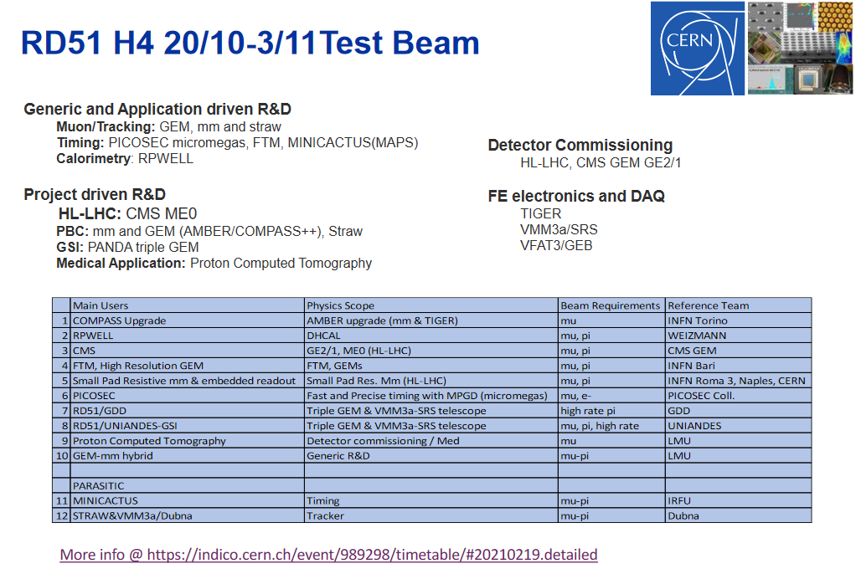
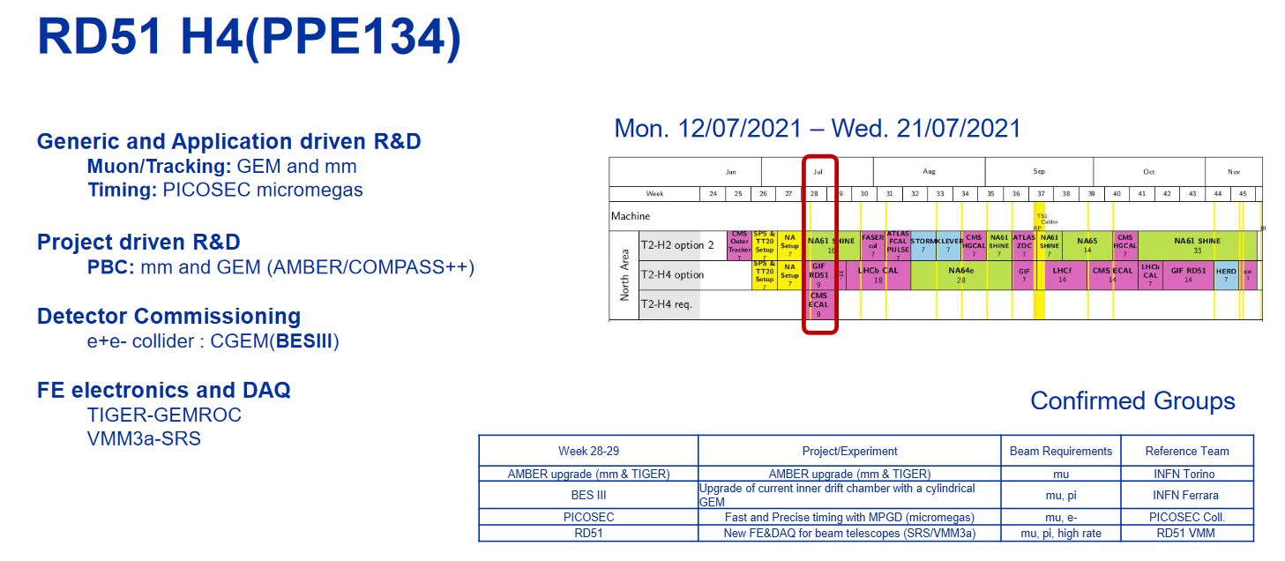
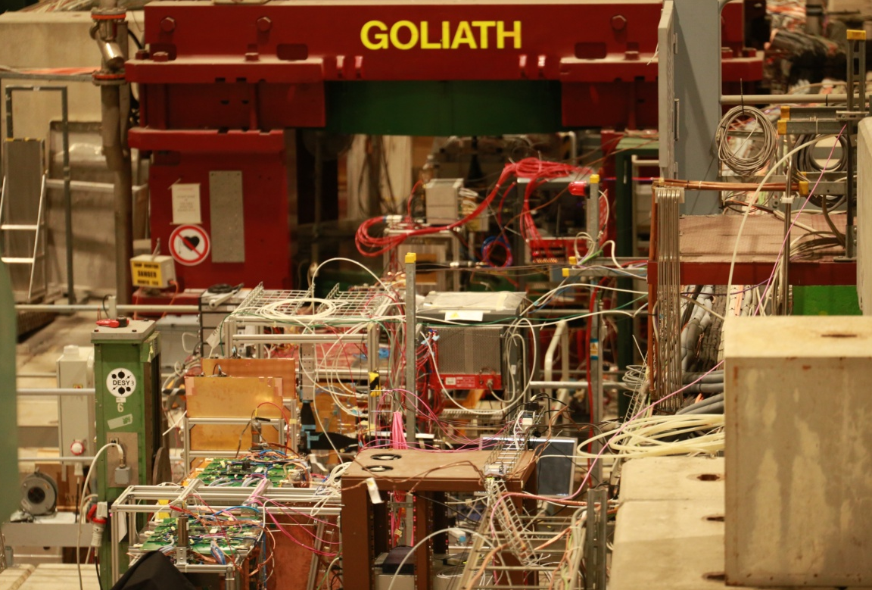
Impressive research program covered
Thanks to all teams for the fruitful sharing of beam/space/expertise and experiences
Three beam periods of two weeks asked for spring/summer/fall.
Let us know about your plans as soon as possible to properly organize them.

