Slide 1



TIGER ASIC for MM detector readout: on behalf of the test beam team
Chiara Alice
UniTo & INFN Sez. Torino
Supervisor: Maxim Alexeev (UniTo, INFN-TO)
JINR colleagues: Alexi Gongadze , Zaza Chubinidze, Natalya Kovyazina
Chiara Alice (UniTo) WG7 RD51 collaboration meeting 19/11/2021

Slide 2
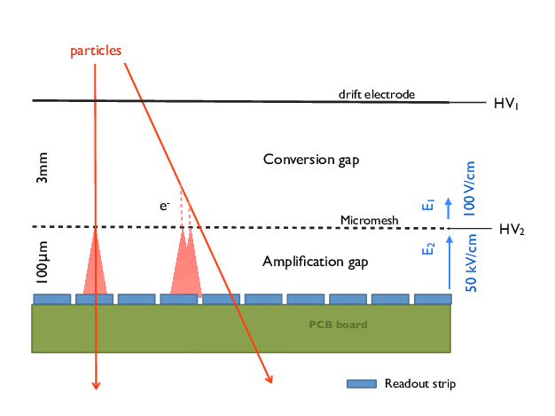
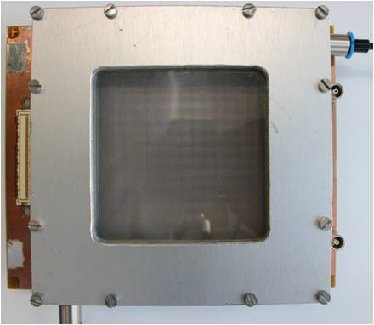
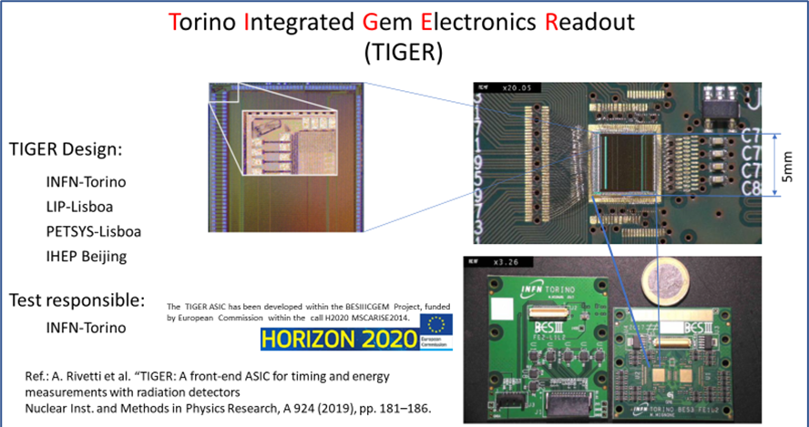
Motivation
MM detector:
MicroMegas detectors development is carried within the AMBER collaboration program with the perspective to replace the aging 1.2 x 1.2 m² MultiWire Proportional Chambers (MWPC) present in the current spectrometer.
Active area: 6,8 x 6,8 cm ²
Amplification gap: 128 μm
Conversion gap: ~ 5 mm
Strips width: 400 μm
Pitch: 550 μm
Holes dimensions: 45 x 45 μm ²
Wires diameter: 18 μm
TIGER (Torino Integrated Gem Electronics for Readout):
If the trigger less configuration will be confirmed for the DY measurement all the detectors will need to be upgraded with some trigger less compatible FEs.
One of the possible R/O options is the TIGER ASIC which
was developed for the BESIII CGEM detector.
Chiara Alice (UniTo) WG7 RD51 collaboration meeting 19/11/2021 2/14

Slide 3
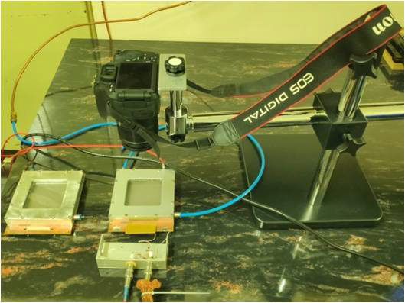
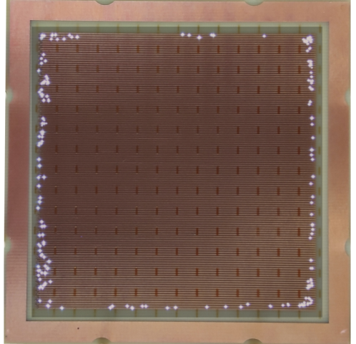
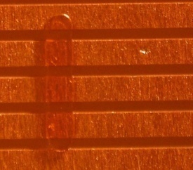
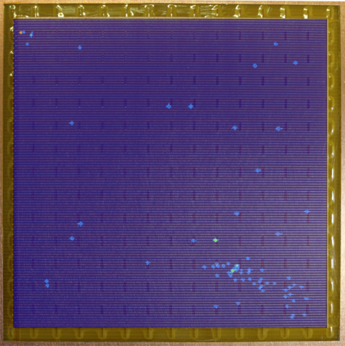
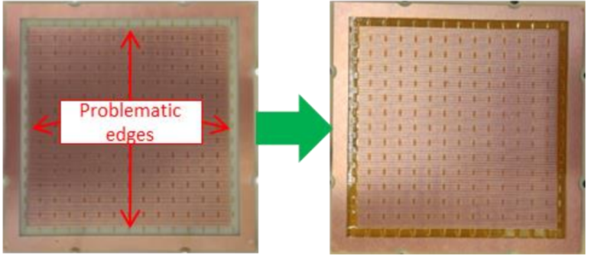
Test beam 07.2021: MM preliminary studies
JINR colleagues developed a cost effective visual analyze method to determine production defects in a MM chamber.
Strips voltage 520V
Video camera records through the transparent window, looking for sparking location on the detector active area.
The full picture of sparking distribution is then obtained as analysis result of the recording.
Strips voltage 590V
Based on their results, a 65 μm height difference between pillars on the edges and the central region ones was found to be a problem.
Micro defect
Kapton tape added
Chiara Alice (UniTo) WG7 RD51 collaboration meeting 19/11/2021 3/14

Slide 4
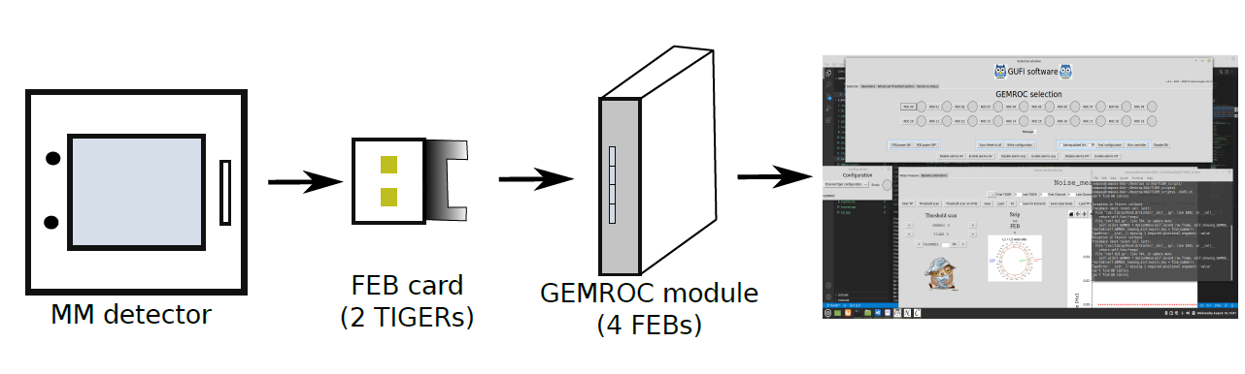
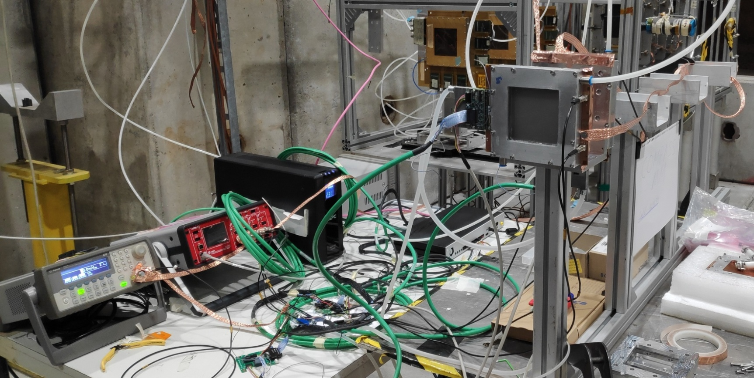
Test beam 07.2021: Setup & main purpose
Target | Beam | Characteristics
T2 | H4 | High-energy, high-resolution secondary beam. Intensity up to 10^7/10^6 per spill
R/O chain:
INFN-FE
INFN-TO
INFN-TO
Initial purpose:
test 3 different
MM detector
test the digital
TIGER R/O in
beam
first steps for the
online monitoring
software
MM1 chamber
Dreif electrode → -1100V
Mesh → -500V
MM2 chamber
Dreif electrode → -1200V
Mesh → -520V
Grounding
Gas ArCO2 (93/7)
FEBs
HV Power supply
Wave generator for extTP
MM2
MM1
extTP FEB
GEMROC
Chiara Alice (UniTo) WG7 RD51 collaboration meeting 19/11/2021 4/14

Slide 5
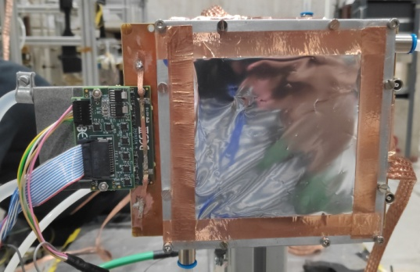
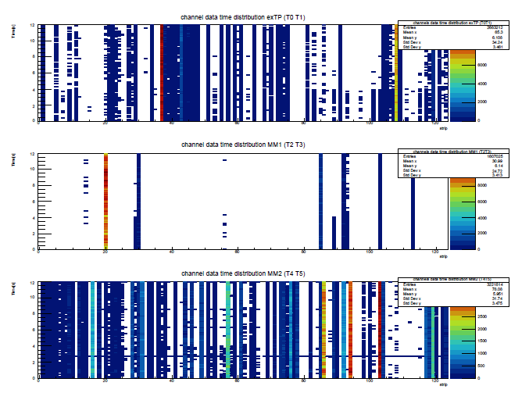
Test beam 07.2021: Setup & main purpose
Main issues:
At the beginning the noise level was
very high. A lot of time was spent for
grounding improvement.
TIGER’s channels were degrading in time
supposedly due to the weak ESD protection
circuit.
We lost a lot of electronics channels due to MM sparks.
We were able to acquire only a small amount of useful data.
Copper braid soldered between FEB GND and MM PCB GND
TIGERs reading extTP(trigger) were noisy
due to grounding issues.
MM1 detector was not working
properly.
MM2 chamber it is very
difficult to clearly identify
beam activity.
Beam OFF
Beam ON
Chiara Alice (UniTo) WG7 RD51 collaboration meeting 19/11/2021 5/14

Slide 6
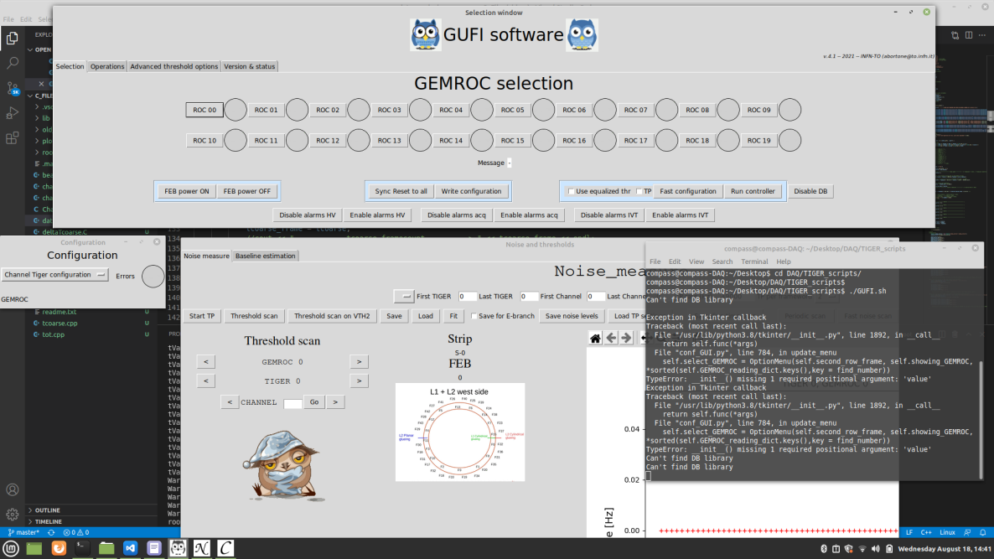
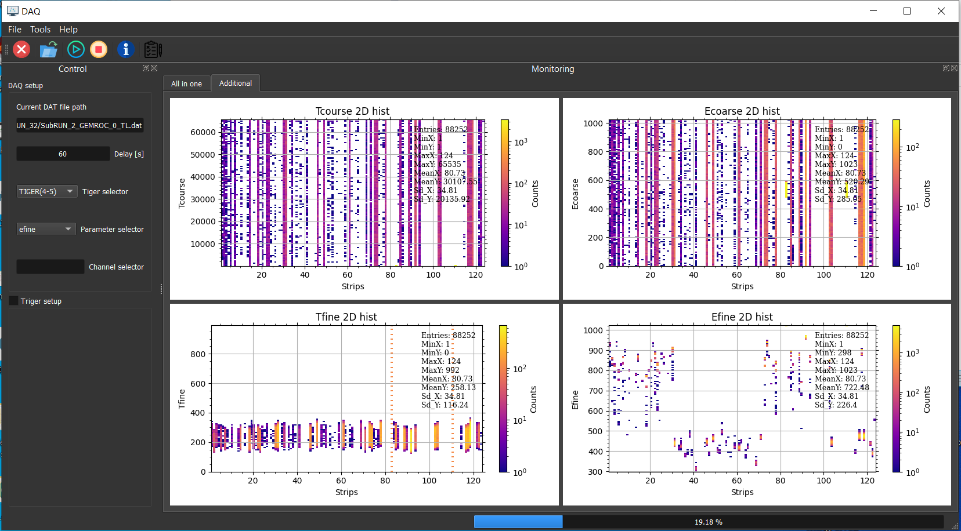
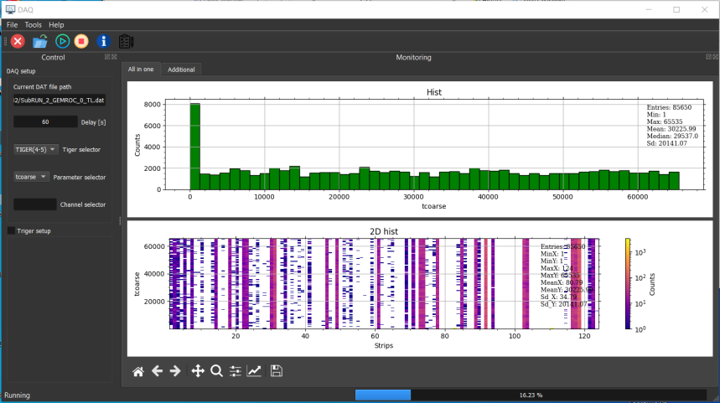
Test beam 07.2021: DAQ & monitoring system
GUFI (General User Frontend Interface),
developed by INFN-TO:
Controls GEMROC (INFN-FE) settings
Allows threshold scans to evaluate the noise level and set the proper threshold on each channel.
Controls data acquisition.
Monitors FEBs status
Monitoring software,
developed by JINR (Zaza Chubinidze):
Was aimed for real time data
visualization
was used in OFFLINE mode as
a crosscheck of the analysis.
ethernet communication
needed for online monitoring.
Chiara Alice (UniTo) WG7 RD51 collaboration meeting 19/11/2021 6/14

Slide 7

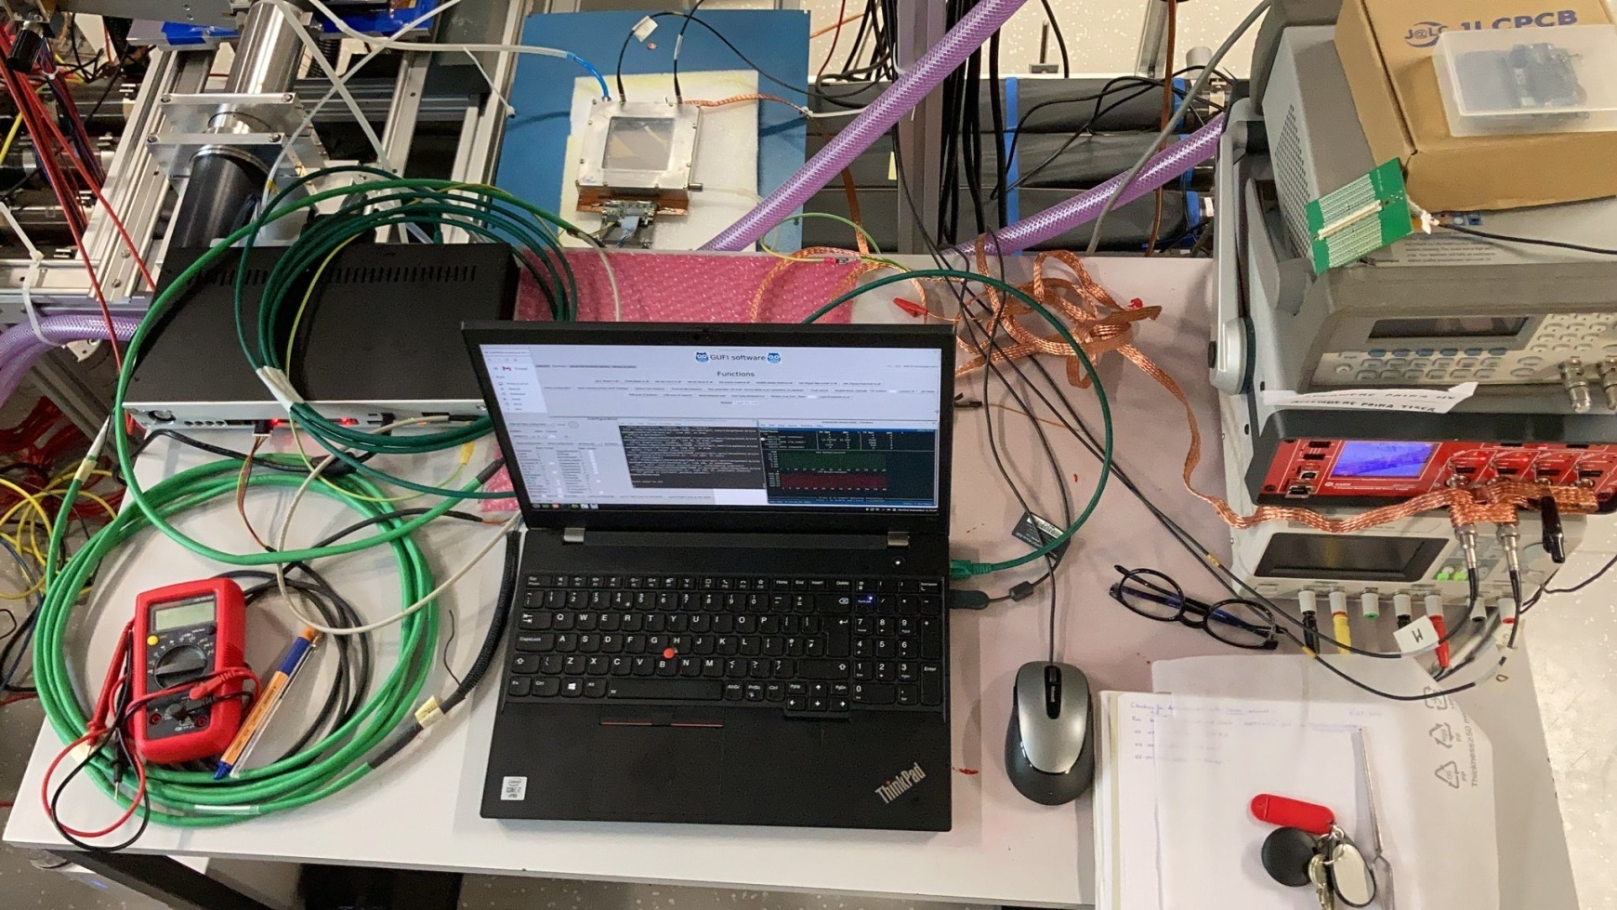
Bonn HISKP: Fe55 source tests
Main purpose:
Test one of MM detector with iron
source and TIGER R/O
Get further knowledge on TIGER R/O
Understand the reason for the TIGER
channels loss
Gas ArCO2 (90/10)
MM
Injection Board
FEB
GEMROC
HV PS
LV PS
PC DAQ
Chiara Alice (UniTo) WG7 RD51 collaboration meeting 19/11/2021 7/14

Slide 8
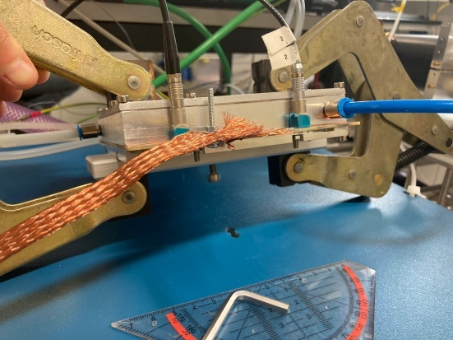
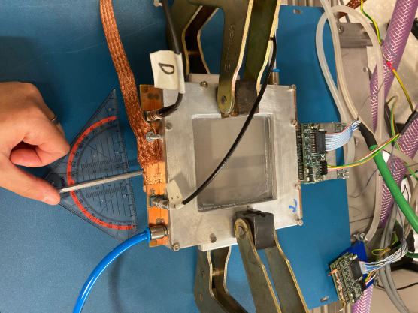
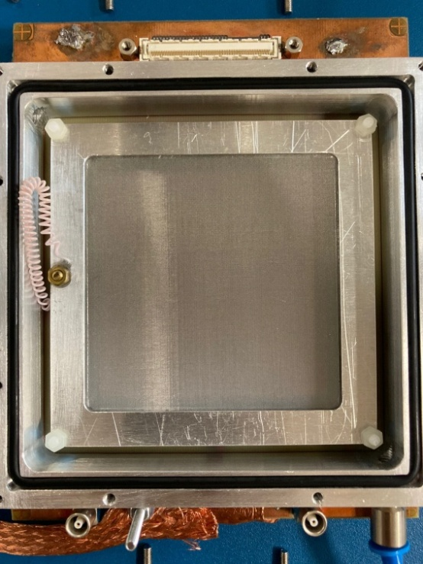
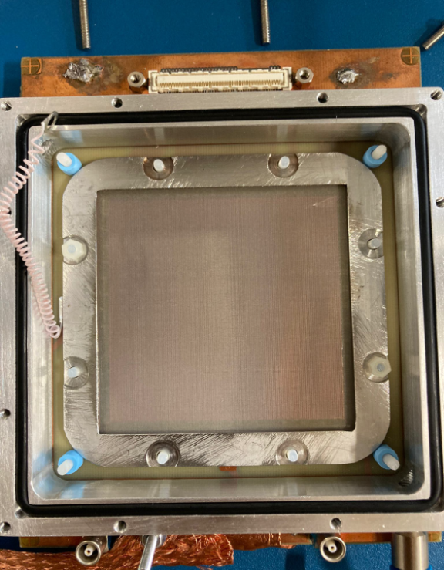
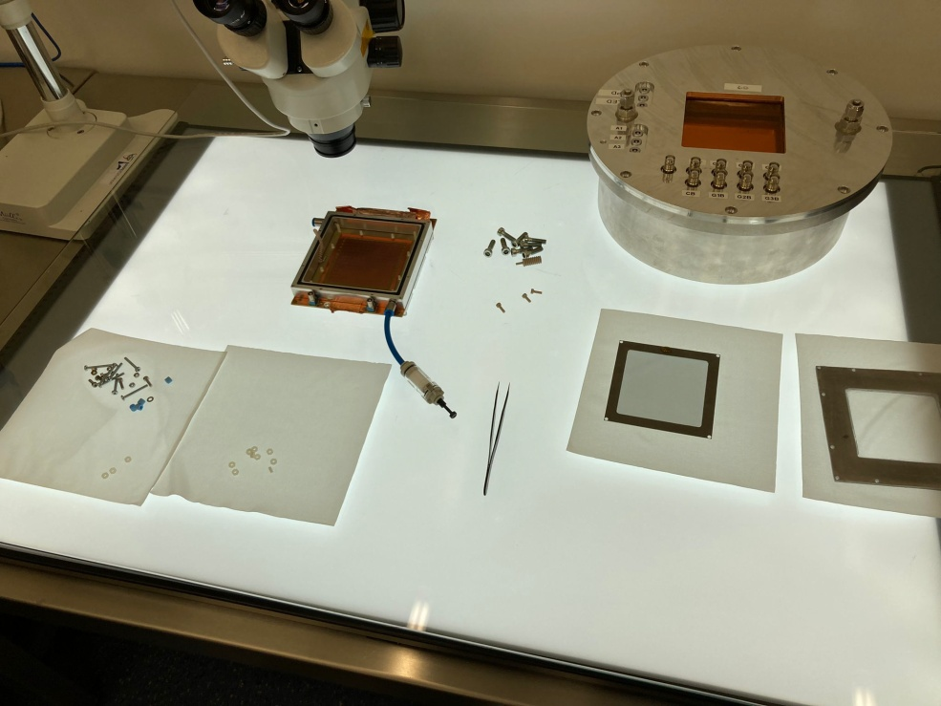
Bonn HISKP: Fe55 source tests
PCB bending correction applied
Main issues:
HV did not reach properly the electrodes connectors on the MM PCB so I was not able to see the Iron spectra.
Drift electrode
Mesh electrode
MM opening in the HISKP clean room
6/8 mesh fixing nuts were missing
Chiara Alice (UniTo) WG7 RD51 collaboration meeting 19/11/2021 8/14

Slide 9
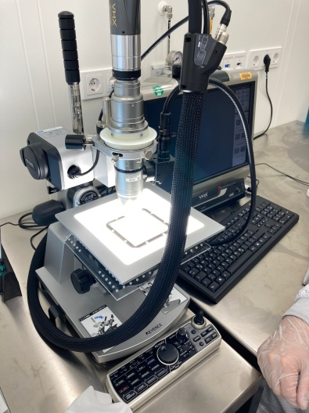
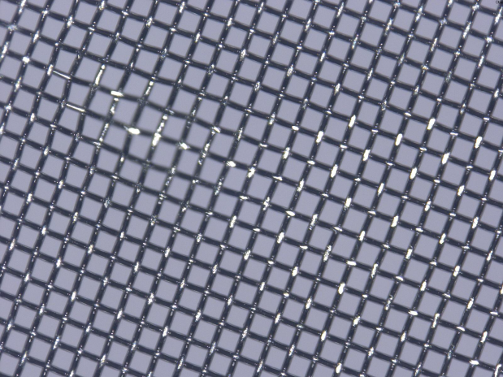
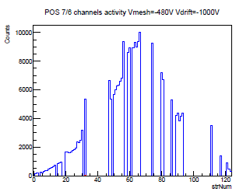

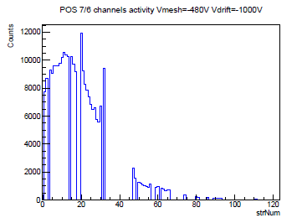
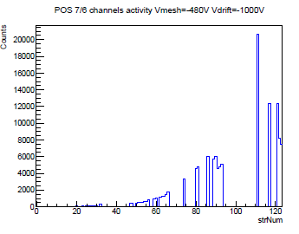
Bonn HISKP: Fe55 source tests
Looking at the mesh electrode
After cleaning results
Mesh deformation
Iron source activity is clearly visible in different
source position
S/N ratio OK
Some channels
are still missing
due to the wrong
thr settings or
sparks damages.
Dust on the mesh electrode
Chiara Alice (UniTo) WG7 RD51 collaboration meeting 19/11/2021 9/14

Slide 10
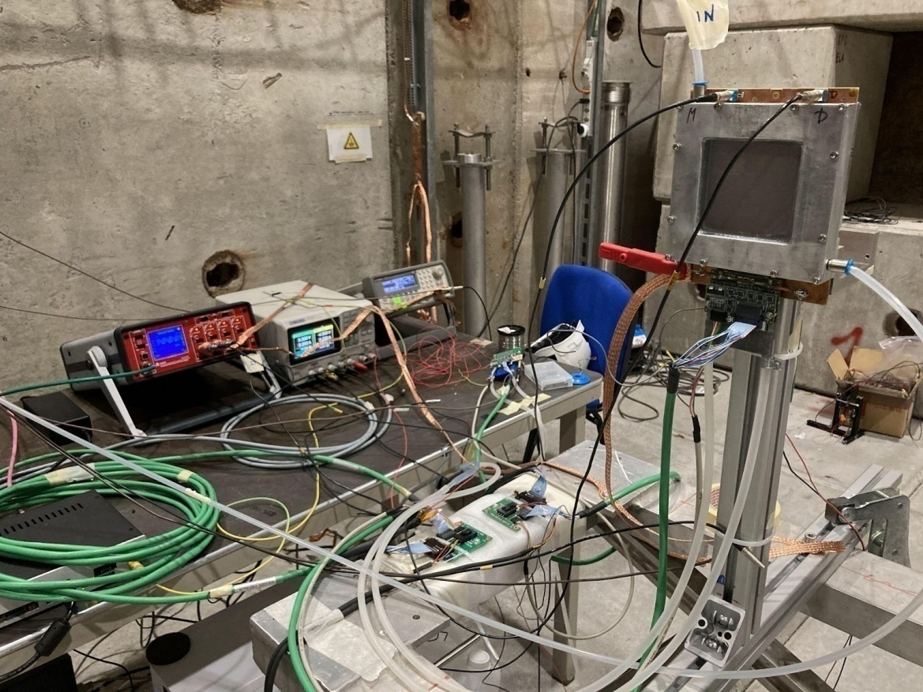
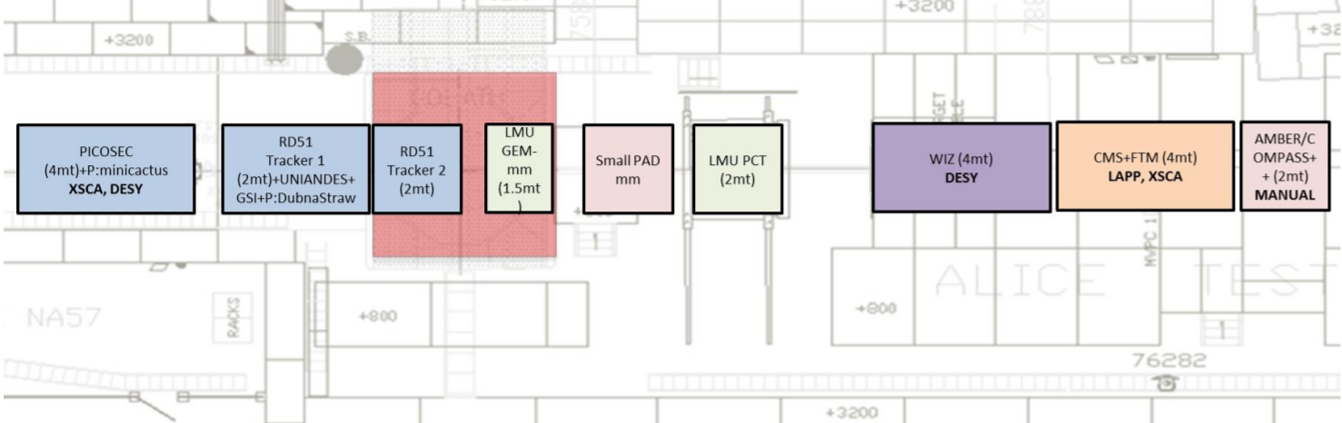
Test beam 11.2021: Setup & main purpose
Main purpose:
Test again one MM detector with TIGER
R/O on the beam after Bonn activities.
Beam profile acquisition with the same
setup.
Adding the triggering system with a
specially developed system of 2
scintillators with 2 SiPM and 2 FEBs
Chiara Alice (UniTo) WG7 RD51 collaboration meeting 19/11/2021 10/14

Slide 11
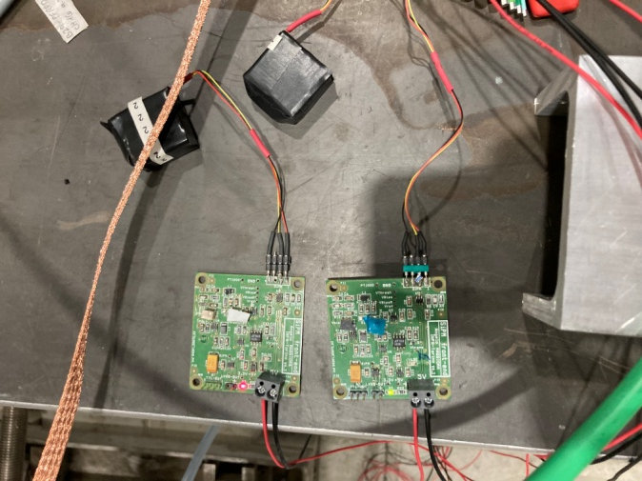
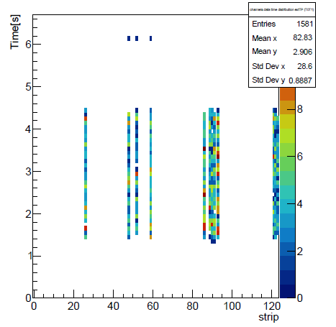
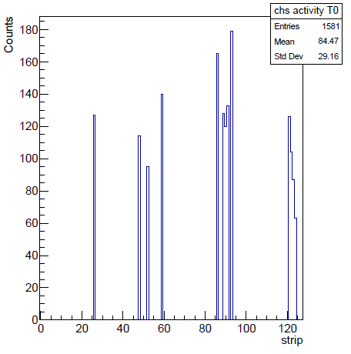
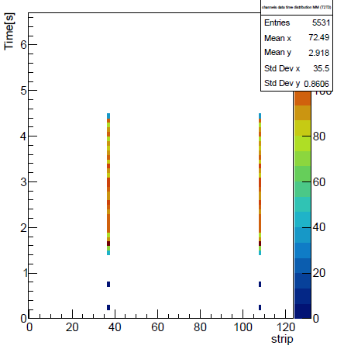
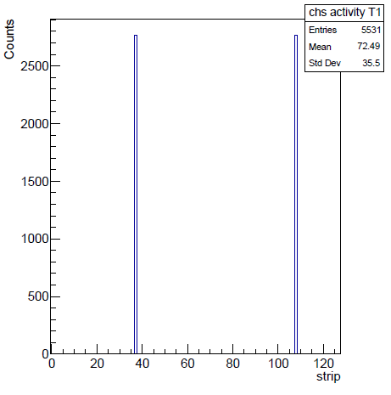
Test beam 11.2021: Ongoing difficulty
Main issues:
I was not able to implement the
triggering system completely since one of
the FEB for the SiPM was not working
Initially I was not able to see enought
strips activity from MM detector
FEB SiPM1
FEB SiPM2
We decided to use only the SiPM1 signal as a beam spill reference.
FEB
SiPM
Ext TRG
Wave
generator
OUT
Injection
board
T0
T1
Test pulse signal is clearly readable
Chiara Alice (UniTo) WG7 RD51 collaboration meeting 19/11/2021 11/14

Slide 12
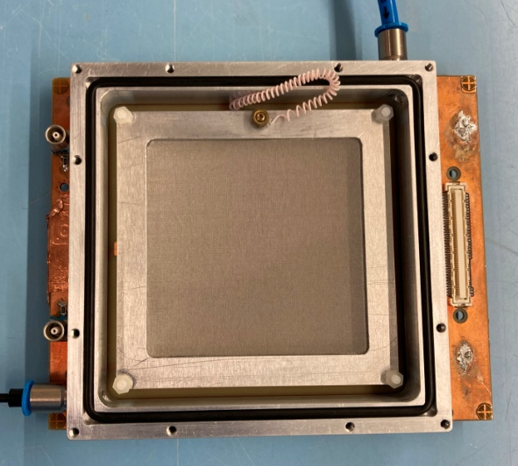
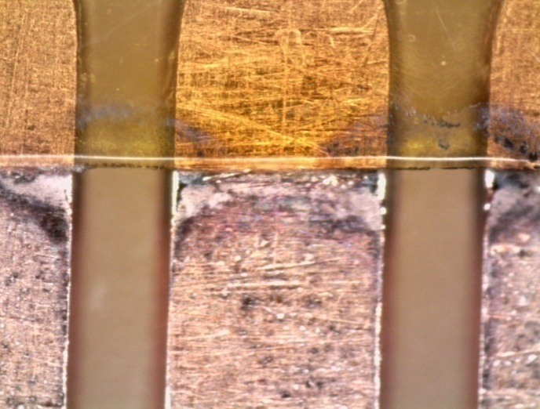
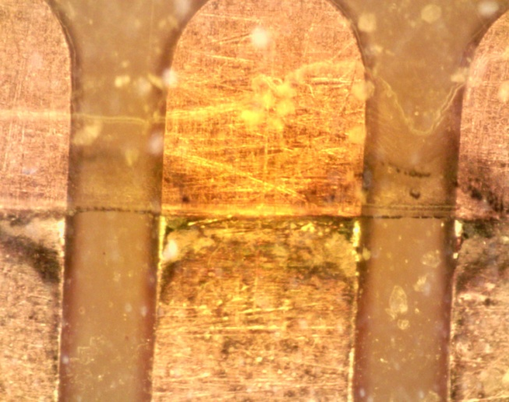
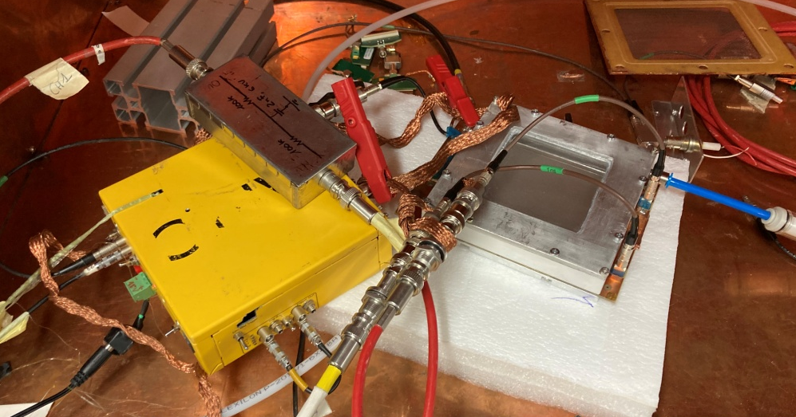
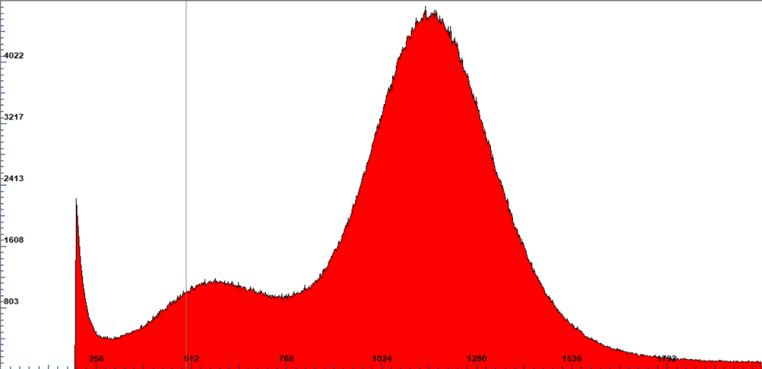
Test beam 11.2021: MM detector opening
The drift contact was not well tight
Damage on three strips due to discharges
Fe55 spectra acquisition with MCA
Special thanks to Eraldo and Givi for their support, availability and suggestions!!
Chiara Alice (UniTo) WG7 RD51 collaboration meeting 19/11/2021 12/14

Slide 13
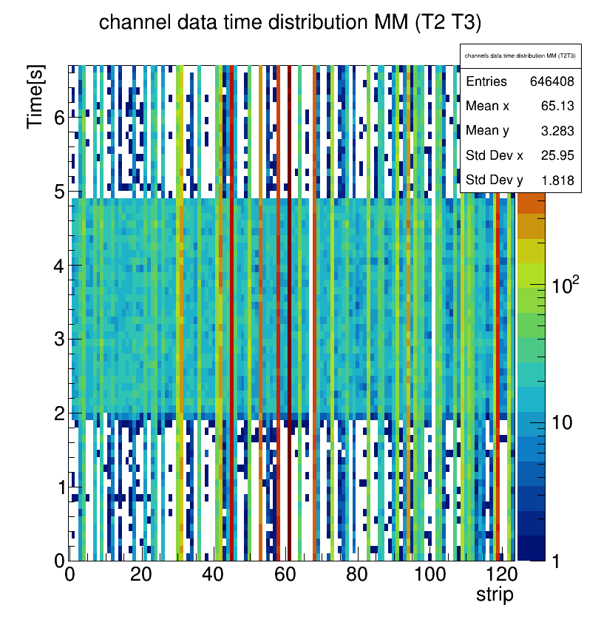
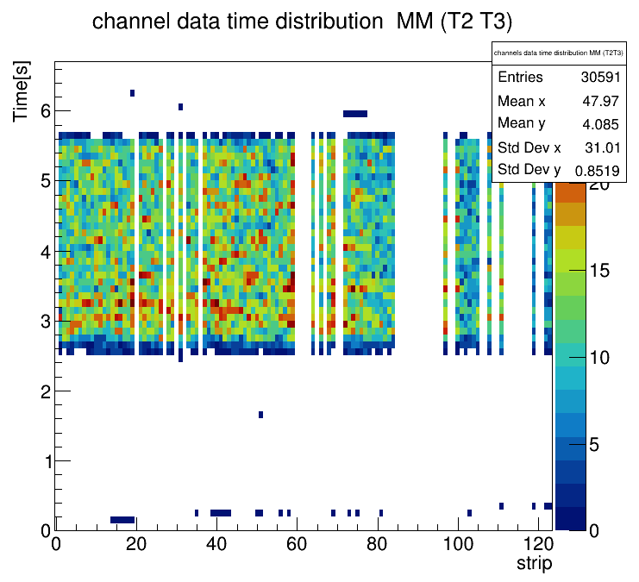
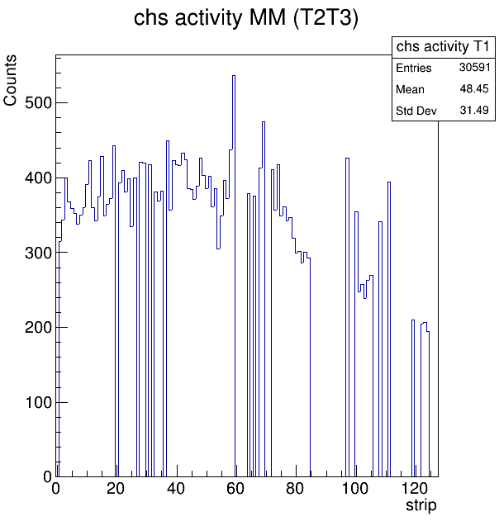
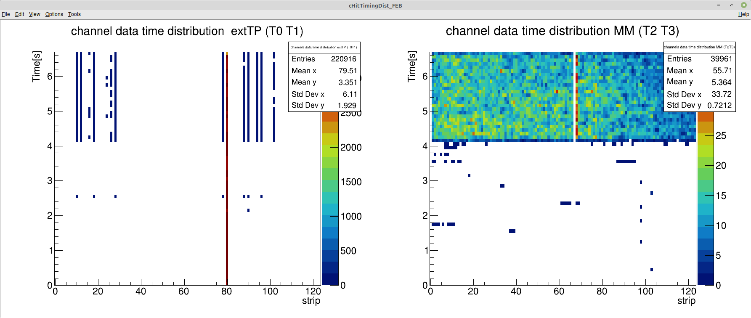
Test beam 11.2021: Preliminary results
TIGER channels thrs too low
After thrs adjustment: preliminary beam profile
We lost a large quantity of electronic channels to sparks, so we were not able to see the test pulse in the last data acquisition, since the FEB which were
connected to the injection board had a completely damaged TIGER chip
Chiara Alice (UniTo) WG7 RD51 collaboration meeting 19/11/2021 13/14

Slide 14
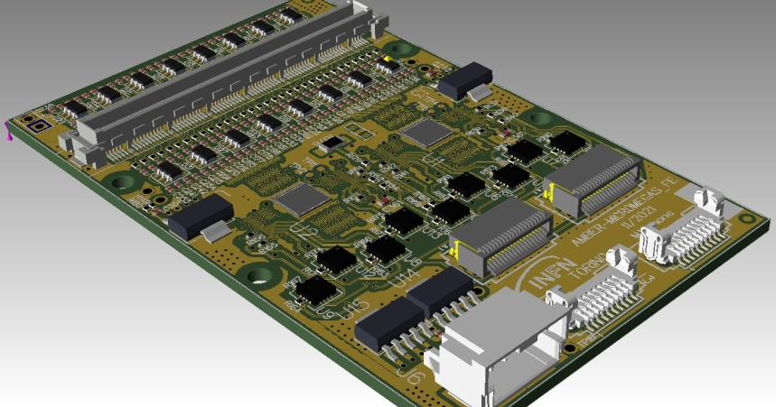
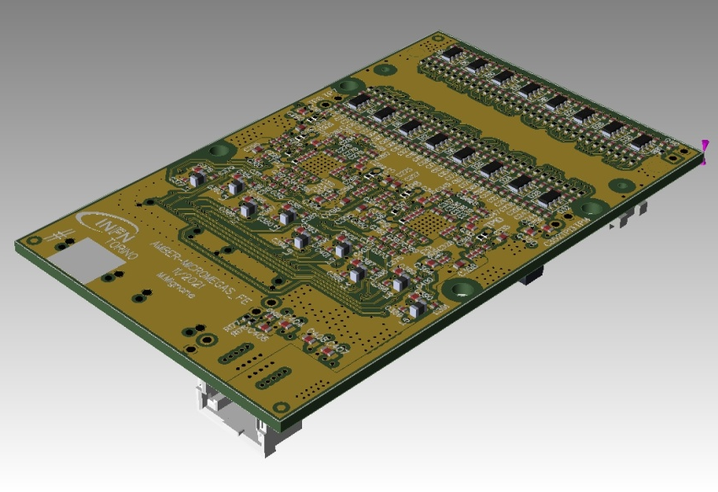
Next steps
More complete data analysis with energy
studies.
Production of 6 new FEBs with one layer
instead of two, FireFly R/O and new ESD protection
circuit.
Adaptor card for “old” FEBs with the new ESD
protection.
Implementation of the proper triggering
system and cosmic data acquisition.
New design of the MM PCB in order to have
the HV on the readout strips and the mesh
grounded.
Test of the new resistive MM prototypes.
Thank you for your attention!
Chiara Alice (UniTo) WG7 RD51 collaboration meeting 19/11/2021 14/14

Slide 15
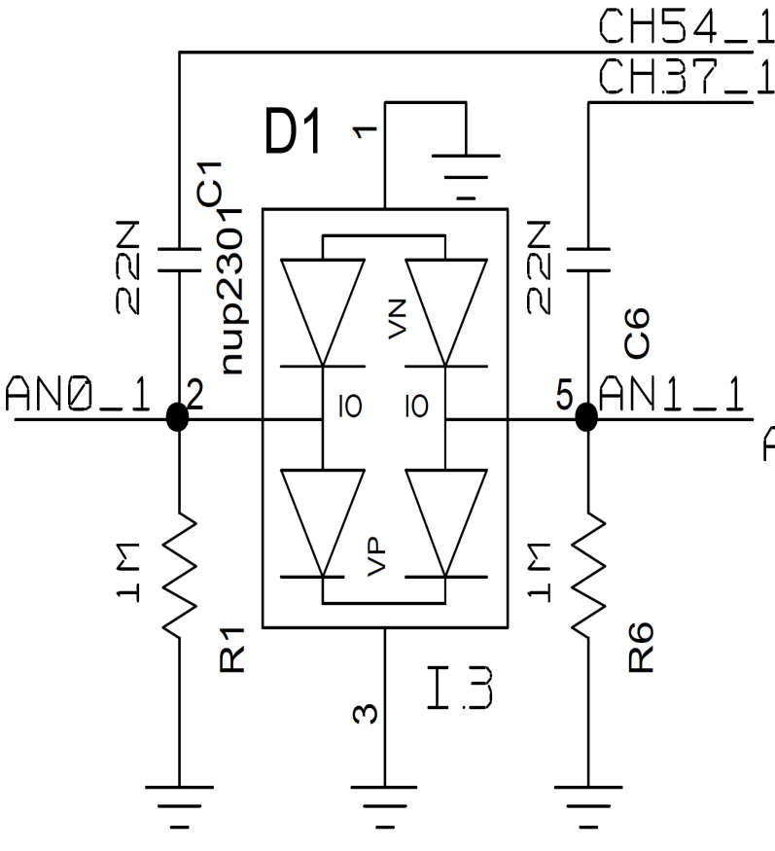
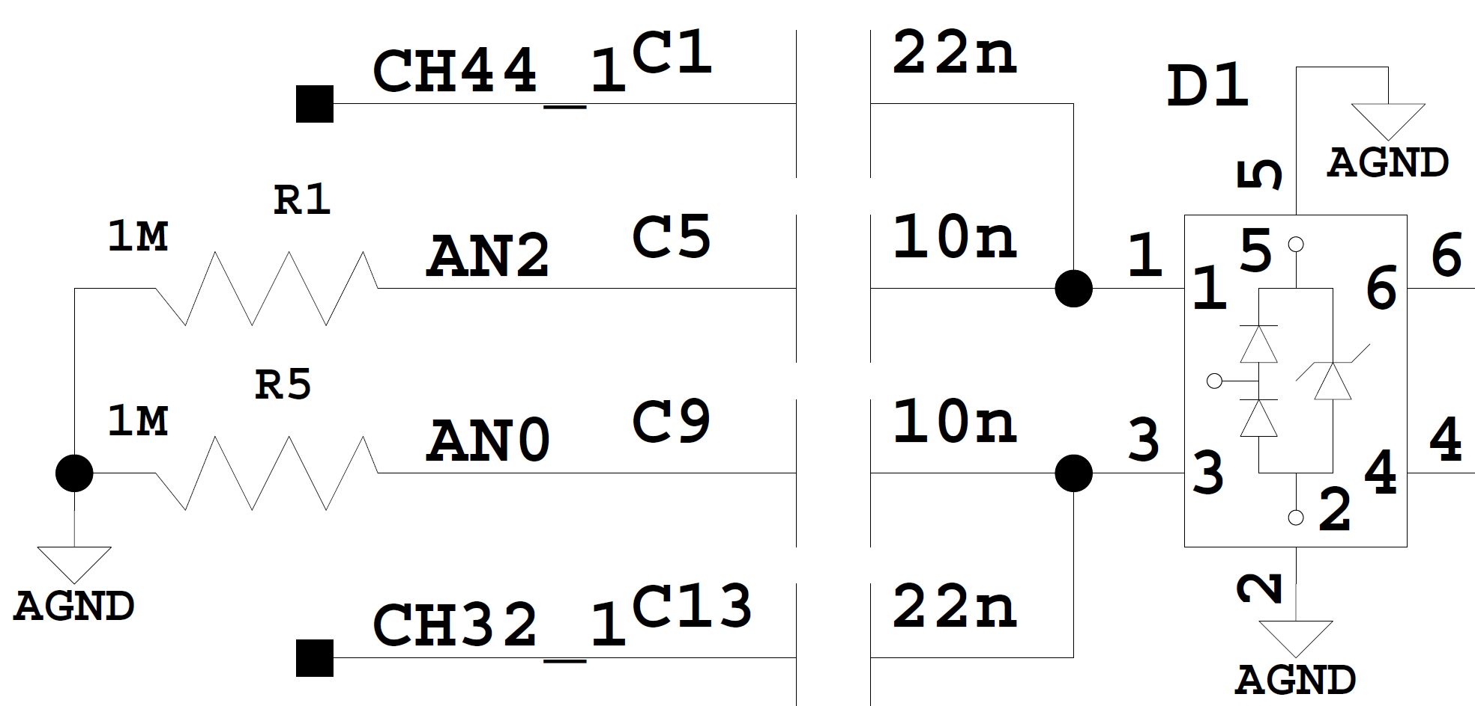
Spares: new ESD protection circuit
Current input design
New input design
From the strip
To the ASIC

Slide 16
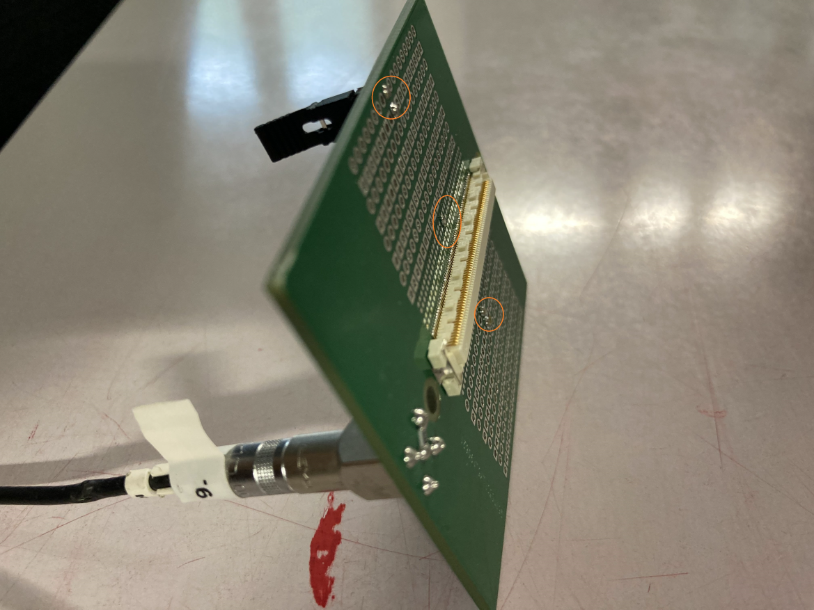
Spares: injection board
Str: 37
pinNum:74
TIGER 0 ch:3
Str: 108
pinNum:71
TIGER 0 ch:22

