Slide 1
General information
G. Iadarola
ABP Computing Meeting – 3 September 2021

Slide 2
General information
From ATS-CTTB meeting (20 Aug):
Presentation of Community Forum: Machine Learning (V. Kain)
  ML coffees” will evolve into the new Machine Learning Community Forum (conveners: A. Apollonio, V. Kain, F. Velotti).
  Positive experience from the CloudBank pilot project from IT to access computing resources (e.g. GPUs and even quantum computers) from external cloud providers (Google, Amazon)
Remote Operations Gateway (T. Oulevey)
  New service developed by BE-CSS to access resources in the TN from outside CERN.
  It allows connecting to linux machines in the TN through a web browser (could be quite handy for machine follow-up).
Confirmed End of support for Windows in Controls (M. Gourber-Pace)
Replacement campaign is ongoing for faulty Siemens I/O cards
2

Slide 3
General information
NXCALS survey launched → please take the time to share your experience and future needs:
  https://docs.google.com/forms/d/1epQbDRPrYLgLKDVXiS6qZkS2nsdphSDgO2ShaDaLyQ0
CASTOR service is being discontinued
  → Users should have been already contacted to move their data
Compute accelerator forum on 8 September
  https://indico.cern.ch/event/975014/
  Presentation on Kokkos (C++ performance portability programming model)
PRACE (Partnership for Advanced Computing in Europe) offers several online courses (often for free) https://events.prace-ri.eu/category/2/
School on Efficient Scientific Computing in Bertinoro (Italy), 4 - 9 Ottobre 2021
  https://web.infn.it/esc/index.php?lang=en
  ABP could support participation of 1-2 interested students
3

Slide 4
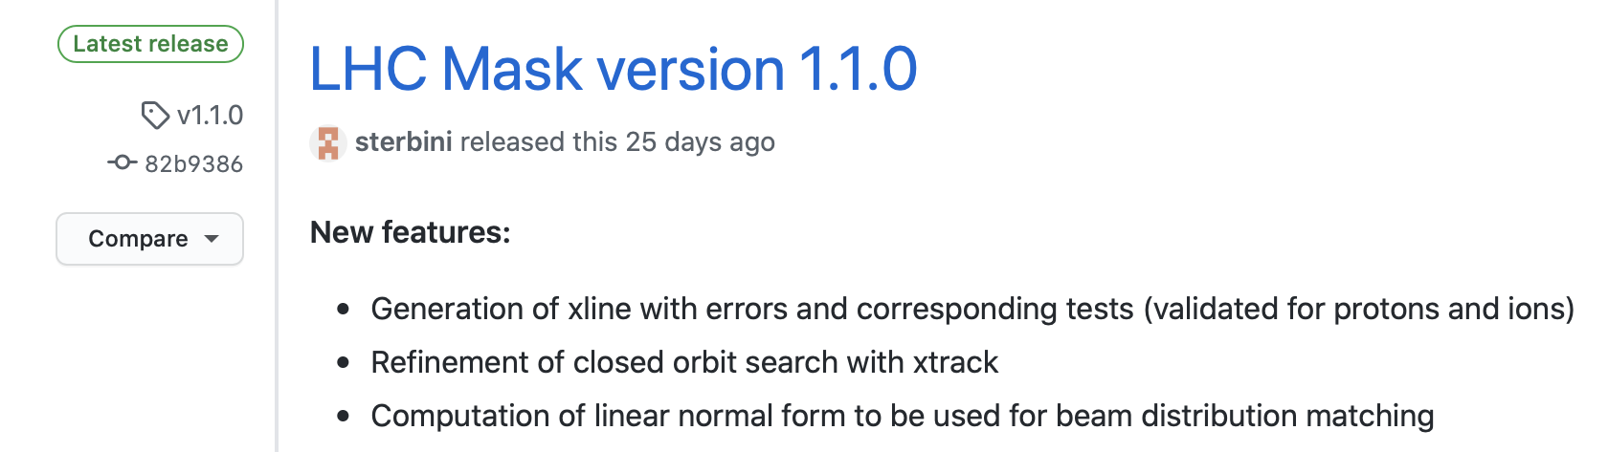
Software development - pymask
Pymask v1.1.0 released recently
  Should cover all use-cases of old mask files and offers more features
  Plan for long-term support → please start using it
4

Slide 5
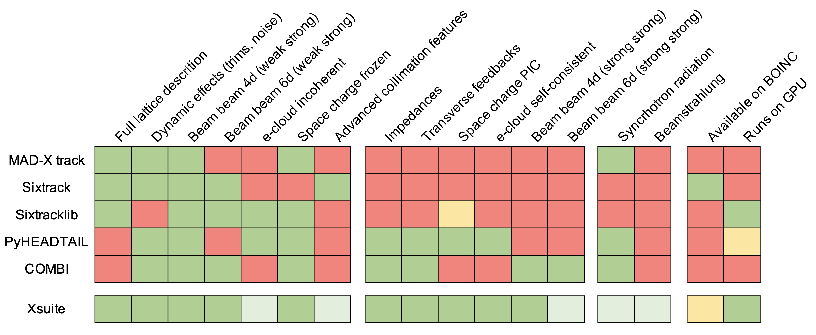
Software development - Xsuite
⁽¹⁾
⁽¹⁾
⁽²⁾
⁽¹⁾
^{(3,4,5)}
⁽⁶⁾
⁽⁶⁾
⁽⁶⁾
⁽⁶⁾
^{(1,7)}
^{(1,7)}
⁽⁸⁾
⁽⁷⁾
⁽⁹⁾
⁽¹⁾ Uses optimized implementation of Faddeeva function providing x10 speedup on GPU (M.Schwinzerl)
⁽²⁾ To be ported from Sixrtacklib (straightforward)
⁽³⁾ Electron lens implemented (P. Hermes)
⁽⁴⁾ Geant4 interface working (A. Abramov)
⁽⁵⁾ Porting K2 scattering and Fluka coupling
is under development (F. Van Der Veken, P. Hermes)
⁽⁶⁾ Through PyHEADTAIL interface (X. Buffat)
Only CPU for now
⁽⁷⁾ Under development (P. Kicsiny, X. Buffat)
⁽⁸⁾ Under development (A. Latina)
⁽⁹⁾ Under study
See presentation at ABP-CEI meeting: https://indico.cern.ch/event/1066779
5

Slide 6
Thanks for your attention!

