Slide 1
AWAKE run 2 BPMs
1/3/2021

Slide 2
AWAKE Run2 BPMs
15 BTV for 150 MeV e- line.
requirements:
  200 nm resolution initial
  10 um resolution provided that BTVs can achieve 1 um resolution
when:
  next slide

Slide 3
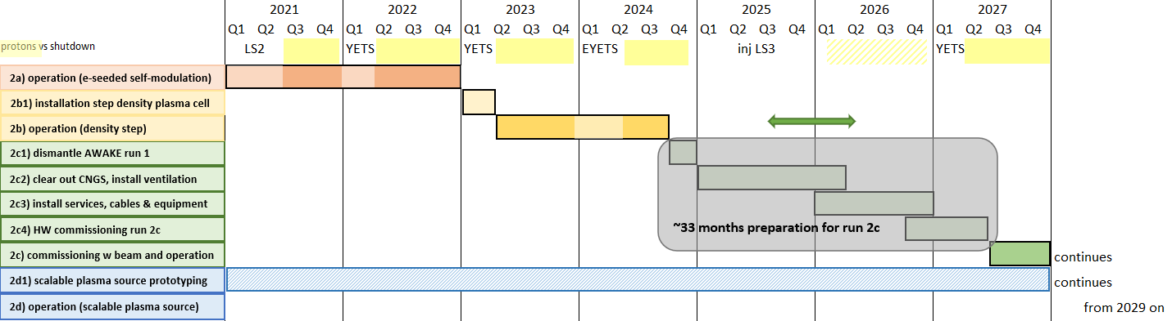
BI Spending profile
studies
design + production
dismantling
moving
installation
students, FSUs, fellows
yearly costs
kCHF
214
682
802
691
176

Slide 4
AWAKE Run2 BTVs
7 BTV for 150 MeV e- line.
requirements:
  50 um resolution initial
  1 um resolution after jitter studies (achievable?)
when:
  next slide
proposal: re-use adapted version of inductive BPM (CTFBIPU)

Slide 5
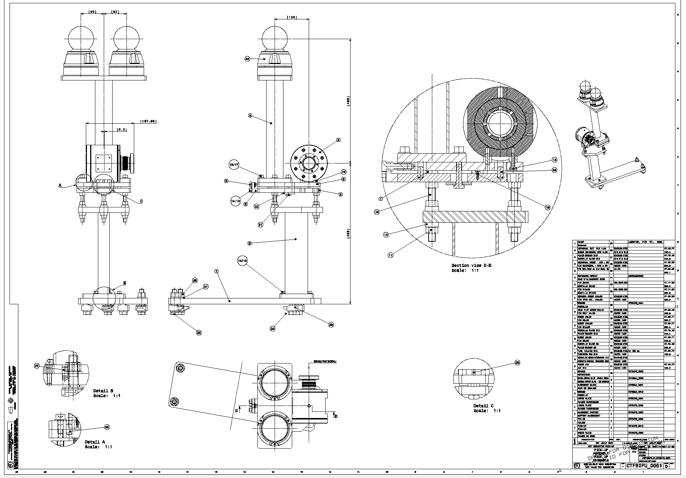

Slide 6
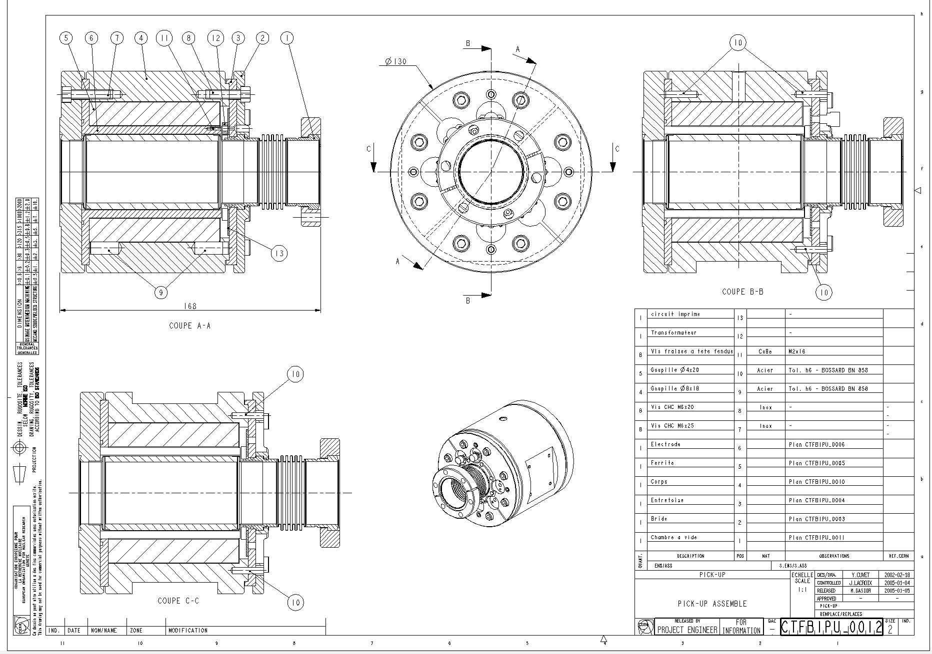

Slide 7
AWAKE Run 2: inputs needed
  - cost and spending profile for inductive pickup. Likely not fulfilling requirements of 10 um resolution
  - cost and spending profile (and additional personnel) of new development of BPMs fulfilling the requirements

