Slide 1
Status of the Experiments
Plenary RRB 53rd Meeting
Joachim Mnich
October 25, 2021

Slide 2
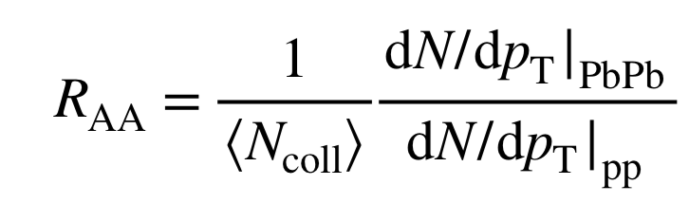
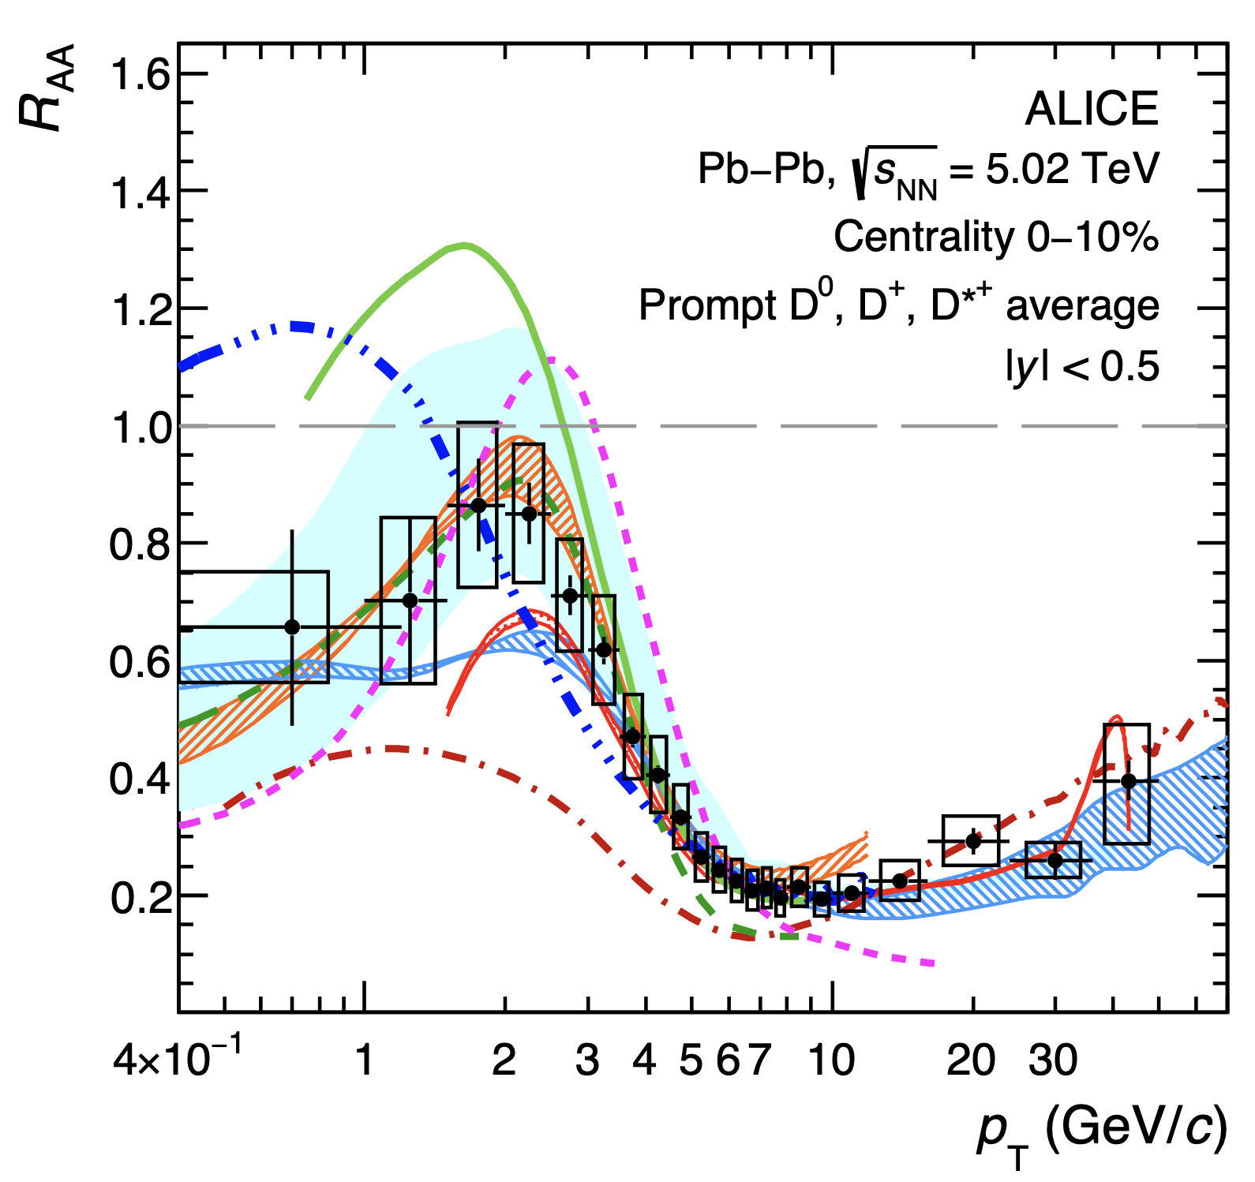
Charm meson nuclear modification constrains the QGP diffusion coefficient
  R_{AA} = 1 expected if PbPb collisions just superposition of pp
  Strong suppression due to energy-loss effects in the QGP
  High p_{T} → charm energy loss (gluon radiation)
  Low-mid p_{T} → charm diffusion (multiple elastic scatterings in QGP)
  D mesons for the first time
  in Pb-Pb down to zero p_{T}
  Improved determination of
  QGP diffusion coefficient

Slide 3
Physics results: ATLAS
Candidate event
pp → WWW → eνeνµν
Observation of WWW production:

Slide 4
Physics results: CMS
  Measurement of W branching ratios:
  More precise than LEP combined results
  Close to SM expectations

Slide 5

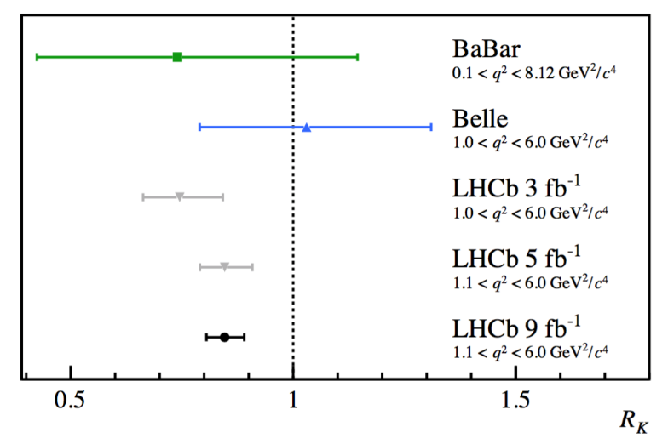

LHCb: Test of Lepton Universality
March 2021:
Measurement of
October 2021:
$R_{K}=N(B→Kμ^{+}μ^{−}$)/$N(B→Ke^{+}e^{−}$)
LHC Flavour Anomaly workshop: 20th October 2021
https://indico.cern.ch/event/1055780/
Experiments & Theory
3.1σ deviation from SM
Twice approx. 1 σ, but again lack of muons!

Slide 6

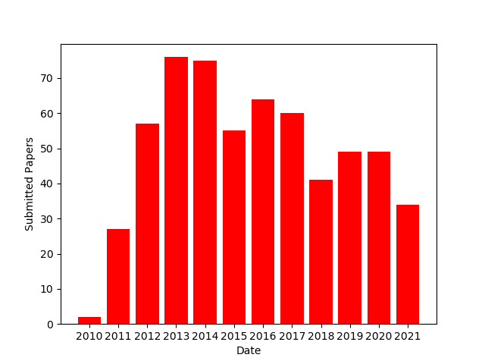

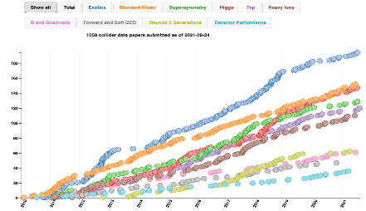
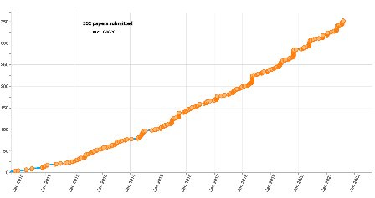


Publications from LHC Experiments
Physics publications from 2010 to date
ALICE | 352
ATLAS | 1015
CMS | 1060
LHCb | 592
  Rate of publications remains
  high in all experiments

Slide 7
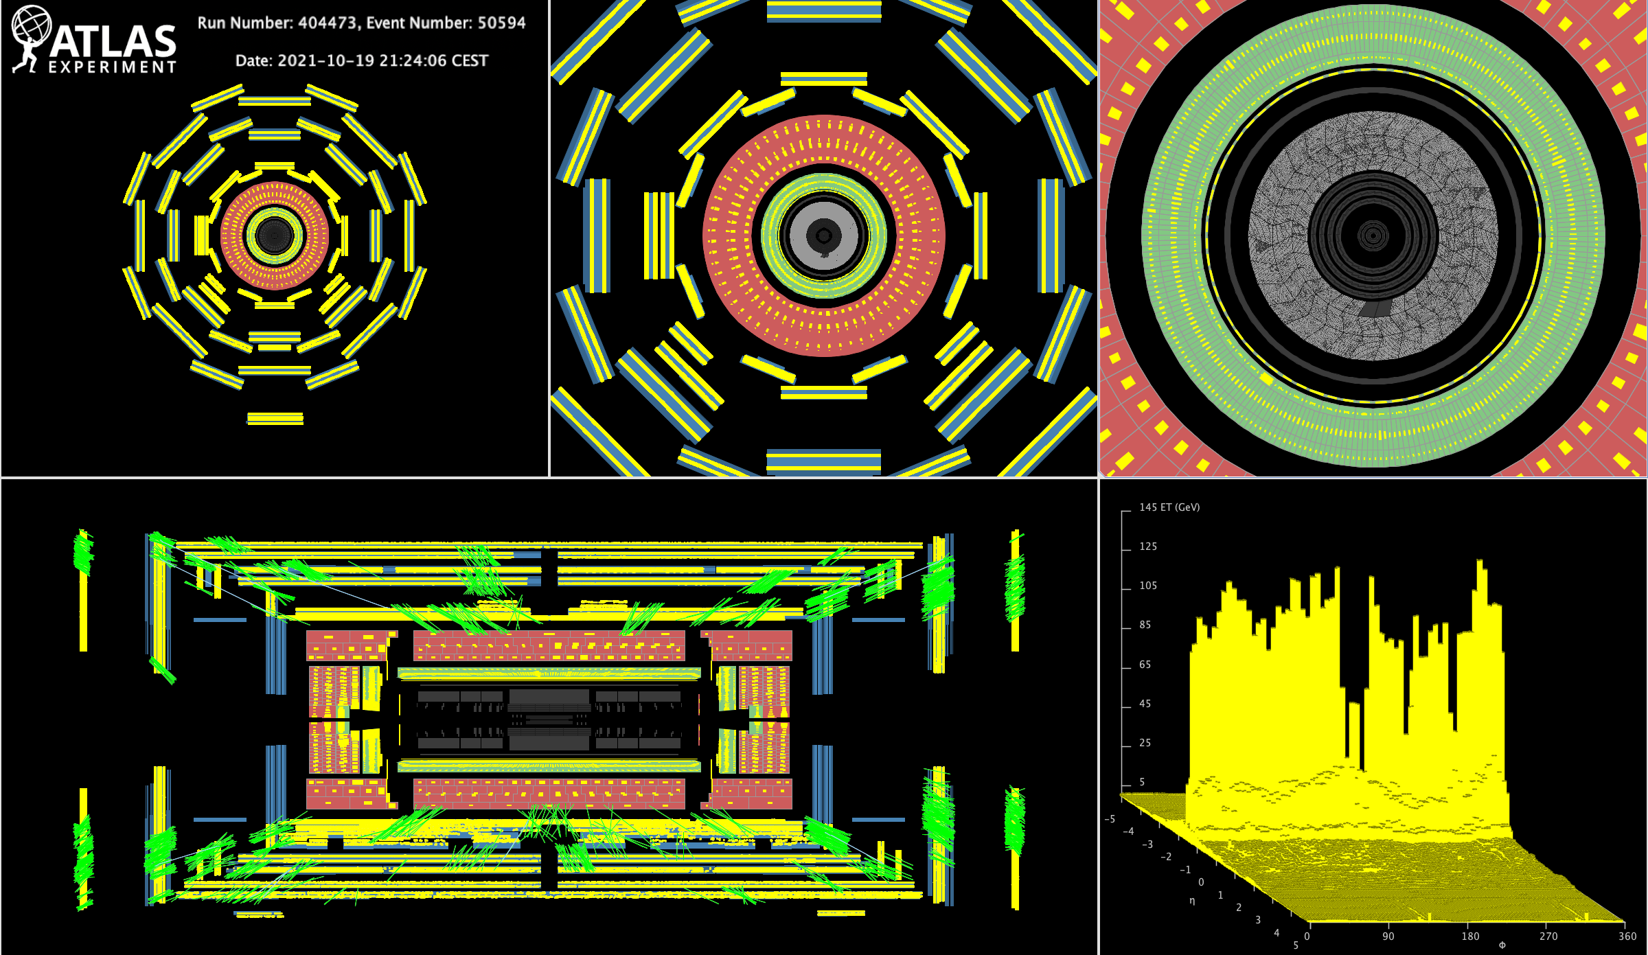
Status LS2
Oct 19: synchrotron light images from circulating debunched beam 1 and 2
  All 4 large LHC experiments take part in ongoing-pilot run
  Expect a few collisions at injection energy this week
  LS2 scheduling meeting
  machine & experiments on Nov 1st
  Take stock of pilot run
  Discuss 2022 schedule
Oct 19 ATLAS splash event

Slide 8
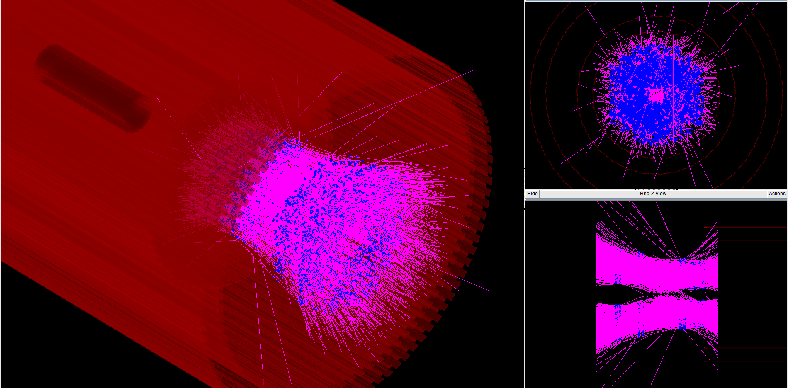
Status ALICE
ALICE is gearing up for the start of Run 3
Instalation of upgrades is complete
Global commissioning is in full swing
Ready to take full advantge of LHC beam tests this week
To be replaced
Test of TI2 transfer line - upstream splash muons

Slide 9
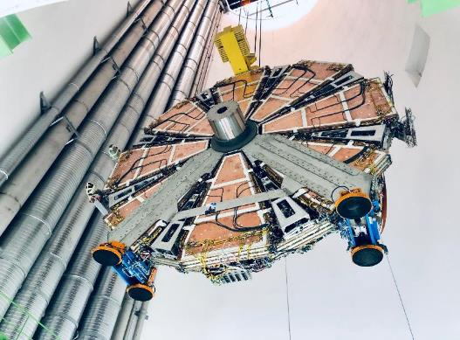
Status ATLAS: New Small Wheels
Status NSW-A
  Lowering into pit July 12th
  Now fully connected, taking part in pilot run
Status NSW-C
  Mechanical integration completed Sep 13th
  Lowering into pit early November
NSW-A
NSW-C

Slide 10
Status CMS
  Fully refurbished pixel detector
  New layer 1 with new rad hard chip
  Replacement of DCDC converter
  Installation completed end of June
  Cosmic run 12.07.-13.08.21 (w/o field)
  (CRUZET)
  Magnet now at full field (3.8 T)
  4 days of commissioning before start pilot run
  About 1 million cosmics for alignment recorded

Slide 11
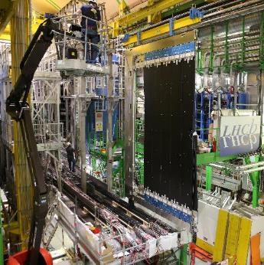
Status LHCb
  SciFi installation behind beam pipe completed
  Beam pipe installed and baked out
  LHCb schedule remains very tight with two detectors (VELO & UT) on critical path for restart in Feb 2022

Slide 12
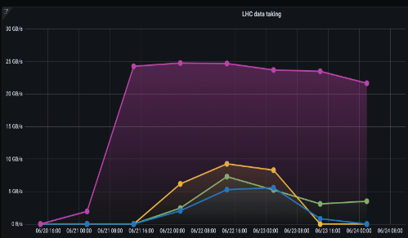


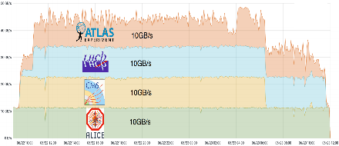
Computing: Commissioning of Run-3 Data Taking
  Summer 2021:
    exercise Run-3 data taking workflows
    testing readiness of services and infrastructure
  Targets based on the experiments computing models
    steep learning curves for CERN IT and experiments
    targets met
  Q4 2021:
    deployment of final infrastructure in the coming months
    further tests to validate improvements
    extend to T1s and T2s (WLCG network and tape challenges)
    test with the full Run-3 hardware
Experiments -> CERN IT Data Center
CERN IT Disk -> CERN IT Archive

Slide 13
Phase II Progress
Good progress in many areas
But significant delays accumulated in some projects
The pandemic continues to severly hindering progress of prototyping and production preparation
  closure of university laboratories
  closure of irradiation facilities
  ASIC design
  Among the critical projects with small or negative schedule contingency:
  ATLAS pixel
  ATLAS strip tracker
  CMS HGCAL
  CMS tracker
Examples of milestone delays from CMS
Similar situation for ATLAS
1 year
Marcel Demarteau

Slide 14
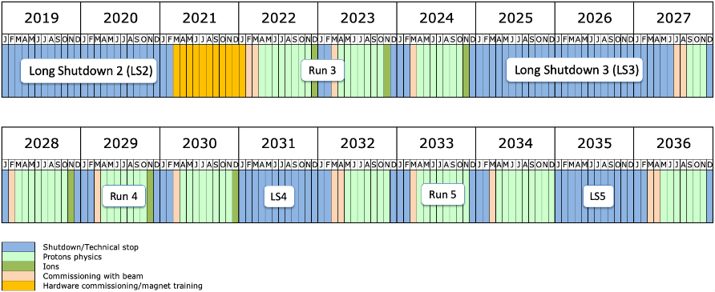
Phase II Progress
In line with the SPC recommendation
  an assessment of the run 3 schedule should be carried out end 2021 or beginning of 2022
  with a global view on machine and experiments
Until then:
  ATLAS and CMS should work out a scenario how the current schedule with the start of LS3 in 2025 can be met
  and a scenario for a 1 year extension of Run 3
  develop strategies to improve the robustness of the Phase II upgrade schedule

Slide 15
Roadmap HL-LHC / Phase-2 Schedule Discussion
  20.-22.10.21 Phase-2 Upgrade Group (P2UG) CMS detailed review of CMS phase-2 projects
  25.-27.10.21 Resource Review Boards (RRB) discussion with Funding Agencies
  08.-10.11.21 Phase-2 Upgrade Group (P2UG) ATLAS detailed review of ATLAS phase-2 projects
  08.-10.11.21 HL-LHC Cost & Schedule Review detailed discussion HL-LHC accelerator
  15.-18.11.21 LHC Committee (LHCC) reports from P2UG
  06.-10.12.21 Council Week report from LHCC, discussion SPC & Council
  prepare proposal for schedule
  07.-10.03.22 LHC Committee (LHCC) discussion of schedule
  21.-25.03.22 Council Week decision on schedule

Slide 16
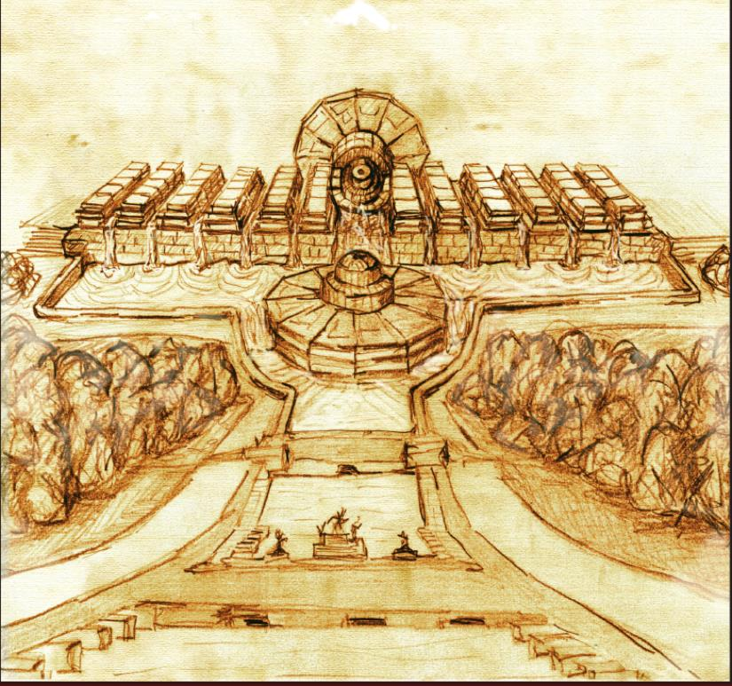
CMS: Last two TDRs to LHCC in June
DAQ/HLT
Beam Radiation, Instrumentation, and Luminosity (BRIL)
DAQ & HLT in very good shape
Thresholds and rates meet specification
at PU=200 with algorithms of today!
Exploit almost all CMS systems for luminosity with the goal of 1% precision

Slide 17
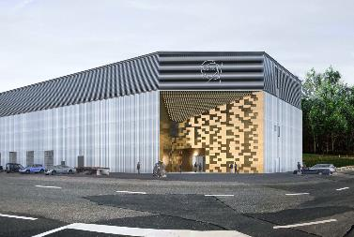
HL-LHC computing preparation
  CERN continues engaging with the experiments and the WLCG/HSF community, preparing for the HL-LHC challenge
  Supporting and contributing to strategic R&D activities in terms of software and services. In November 2021, the LHCC will review several of those areas: event generators, simulation software, core software foundations, analysis tools, data management software and services.
  Preparing to layout the implementation of the Tier-0 in the HL-LHC era
  The Prevessin Computing Center will play a central and strategic role in capacity planning, service strategy and business continuity

Slide 18
Long Term Support of Experiments
Reminder:
Working Group for Long Term Support of the LHC Experiments (chaired by E. Elsen in 2020)
Proposed new (sub-)category Experimental Project Associate (EXAS, modelled on PJAS) receiving a Subsistence Allowance from Third Party funding
Status:
Technical WG set up to discuss implementation details:
duration (max. 8 years), modalities of extension (within the 8 years), profiles, conditions, …
Includes representatives from EP and experiments, consider needs of experiments
regular meetings taking place
Outlook:
Report from WG expected by end of October 2021
Followed by concertation process
Notes:
CCP: Comité de Concertation Permanent

Slide 19
Thank you for your attention!

Slide 20
Backup
Johan Bremer

Slide 21
LS2 Status: ALICE Phase I Upgrade
ALICE phase I upgrades
ALICE v. 1
ALICE phase I upgrade
ALICE v. 2
a continuous readout and recording
(online data compression based on event reconstruction)
a Improved vertex tracking at low p_{T}
Target luminosity for Run 3 and 4
Pb-Pb: 13 nb⁻¹ at 5-5.5 TeV (x100 wrt Run 2 for MB)
p-Pb: 0.6 pb⁻¹ at 8-8.8 TeV (x1000 wrt Run 2 for MB)
pp: 200 pb⁻¹ at 13-14 TeV (x20-3000 wrt Run 2,
depending on channel)
with high-multiplicity and rare probes selection
21

Slide 22
CMS LS2 Activities
  Work on HCAL Barrel (SiPM readout) completed in Oct. 2019
  Muon activities completed in Dec. 2020
  Beam-pipe installation and bake-out completed
  Pixel Detector installation completed in June 2021
LS2 = Long Shutdown 2 since 2019
Collisions to return mid 2022
Strip tracker
kept cold to avoid reverse annealing (but warmed during beam pipe bake-out)
HCAL
completion of Phase-I upgrades
Pixel detector
replace first barrel layer
replace all DCDC converters
Magnet
at room temperature since mid 2020
maintenance work: free wheel thyristor, cryo-cooling, power, pumps, etc.
  Remaining activities:
  Yoke closing (ongoing)
  Magnet restart (3.8 T) and tests
  Cosmics runs at full field
  CMS will be ready for the pilot beam test in October
Beam pipe
new version Phase-II design
Muon system
installation of GE1/1 chambers
upgrade of CSC FEE to sustain HL-LHC trigger rates
shielding against neutron background
CT-PPS
upgrade of RP and moving system
BRIL
BCM/PLT refit
new T2 tracker
  After Pilot Beam Test in Oct 2021
  Phase-II muon demonstrators installation
Civil engineering at P5
prepare for Phase-II assembly and logistics

Slide 23
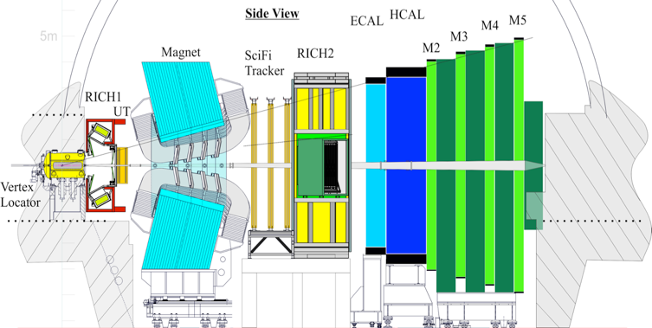
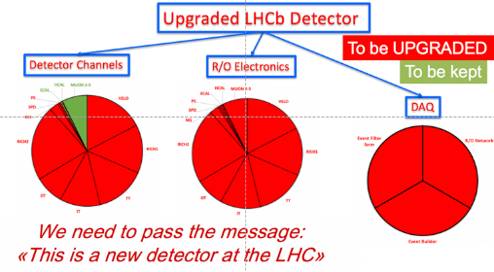
LHCb Upgrade I Reminder
  All sub-detectors read out at 40 MHz for a fully software trigger (GPU based level 1)
  Pixel detector VELO with silicon microchannel cooling 5mm from LHC beam
  New RICH mechanics, optics and photodetectors
  New silicon strip upstream tracker detector
  New SciFi tracker with 11,000 km of scintillating fibres
  New electronics for muon and calorimeter systems

Slide 24
Computing: Preparation for Run 3
Wide Area Network connectivity
increased between x3 w.r.t. Run2
The Prevessin
Computing
Center in future
Network between the CERN data center and the experiments was upgraded (× 10 for LHCb and
×15 for ALICE w.r.t. Run 2)
100 GB/s test from Alice concluded successfully

Slide 25
Reporting on LHC experiments
LHCC: LHC Experiments Committee
P2UG: Phase 2 Upgrade Group
RRB: Resource Review Board
SPC: Science Policy Committee
UCG: Upgrade Cost Group
CERN Council
Ex off. SPC Chair
DG
SPC
Ex off: PoC, DG, DRC
LHCC chair
Research Board
Chair: DG,
Ex off: DRC, LHCC chair
DRC
RRB
Chair: DRC,
ex off: DG, LHCC chair
LHCC
Ex off: DG, DRC
Information
P2UG ATLAS/CMS
Ex off: LHCC chair, UCG chair
UCG
Ex off: LHCC and SG chairs
Scrutiny Group

Slide 26
Composition Scrutiny Group 2021
SANDAKER, Heidi (Chair, University of Oslo, NO)
SCHMIDT, Burkhard (Scientific Secretary, CERN)
*FATEMI, Renee (University of Kentucky, US)
FREY, Ariane (University of Göttingen, DE)
GOLDSTEIN, Joel (University of Bristol, UK)
*LUBRANO, Pasquale (Perugia, IT)
MAZZUCATO, Edoardo (CEA/IRFU, FR)
POESCHL, Roman (IN2P3, FR)
SCHWANDA, Christoph (HEPHY, AT)
YECK, James (BNL, US)
*Leaving members. Proposed Replacements:
  LUBRANO, Pasquale - replaced by PEPE, Monica (Perugia, IT)
  FATEMI, Renee, needs replacement
*CAMPBELL, Michael CERN, EP)
DANIELSSON, Hans (CERN, EP)
*DANNHEIM, Dominik (CERN, EP)
*PRODON, Sylvie (CERN, FAP)
*Leaving members. Proposed Replacements:
  CAMPBELL, Michael - replaced by TROSKA, Jan
  DANNHEIM, Dominik - not replaced
  PRODON, Sylvie - replaced by SPENCER, Catherine
Notes:
If Heidi doesn’t show it

