Slide 1


PB TMD fits at NLO with dynamical resolution scale
S. Sadeghi^{1,2}, F. Hautmann^{1,3}, H. Jung⁴, L. Keersmaekers¹, A. Lelek¹, S. Taheri Monfared⁴
¹ University of Antwerp (UAntwerp)
² Shahid Beheshti University (SBU)
³ University of Oxford
⁴ Deutsches Elektronen-Synchrotron (DESY)
04/05/2022
DIS workshop 2022

Slide 2
Outline
Recap of Parton Branching method
Fixed and Dynamical soft-gluon resolution scale z_{M}
Fits with fixed z_{M} at NLO
Fits with dynamical z_{M} at NLO
Merged talk:
Z+b jet production in 4FL and 5FL

Slide 3
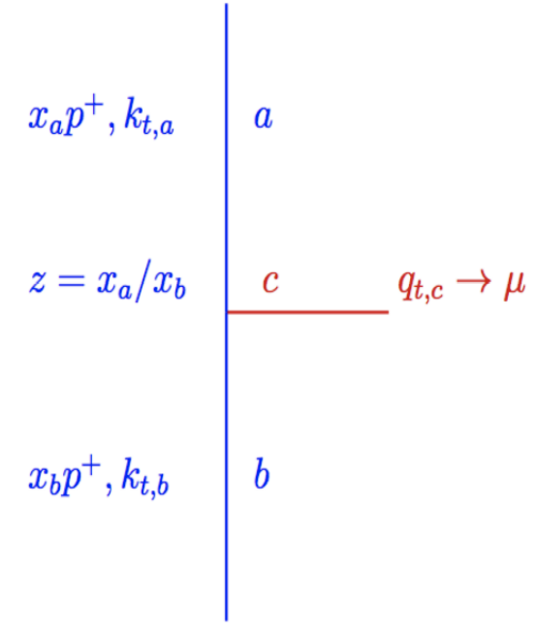
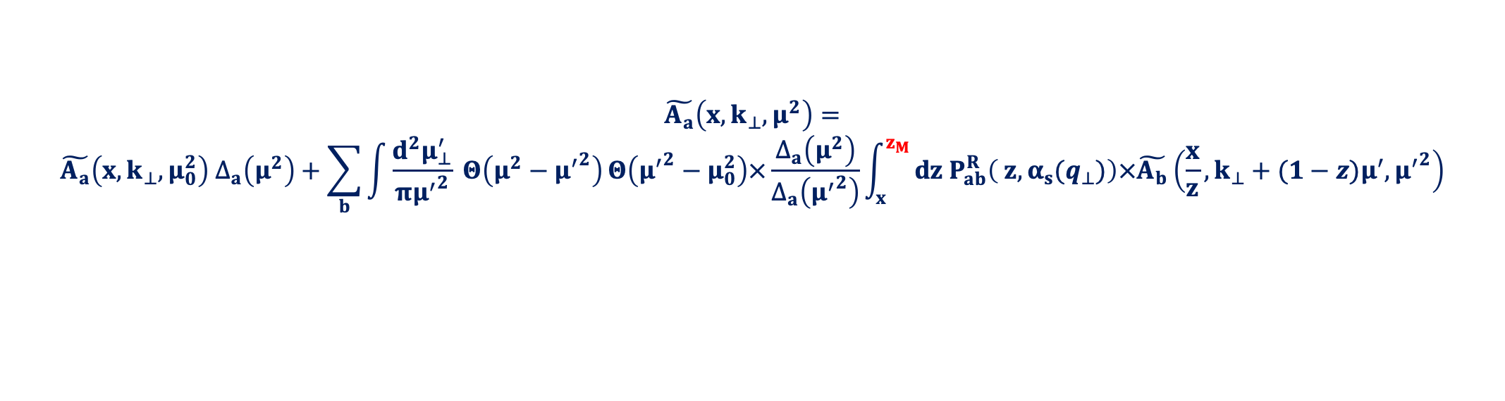

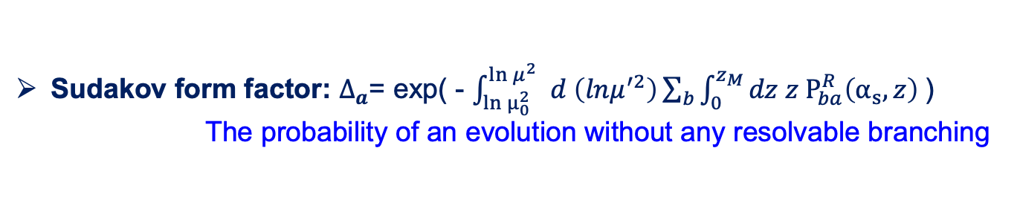

Recap of PB TMDs
TMD evolution in the PB formalism:
$$\tilde{A_{a}}\left(x,k_{⊥}, μ^{2}\right)=$$
$$\tilde{A_{a}}\left(x,k_{⊥},μ_{0}^{2}\right) ∆_{a}\left(μ^{2}\right)+\sum_{b}{\int{\frac{d^{2}μ_{⊥}^{′}}{π{μ^{′}}^{2}} Θ\left(μ^{2}−{μ^{′}}^{2}\right)}Θ\left({μ^{′}}^{2}−μ_{0}^{2}\right)×}\frac{∆_{a}\left(μ^{2}\right)}{∆_{a}\left({μ^{′}}^{2}\right)}\int_{x}^{z_{M}}{dz P_{ab}^{R}\left( z, α_{s}(q_{⊥})\right)×\tilde{A_{b}}\left(\frac{x}{z},k_{⊥}+(1−z)μ^{′},{μ^{′}}^{2}\right)}$$
$z_{M}$ : Resolution scale : Resolvable branching : z < $z_{M}$
Non-resolvable branching : z > $z_{M}$
Splitting functions: $P_{ab}^{R}$(z): The real emission parts of the DGLAP splitting function:
Probability that a branching will happen
$μ$ is evolution scale
Sudakov form factor: $∆_{a}$= exp( - $\int_{\ln{μ_{0 }^{2}}}^{\ln{μ^{2}}}{d \left(lnμ^{′2}\right)\sum_{b}{\int_{0}^{z_{M}}{dz z P_{ba}^{R}\left(α_{s}, z\right)}} }$)
The probability of an evolution without any resolvable branching
[Hautmann et all., JHEP 01 (2018) 070, 1708.03279]
At every step kinematics can be calculated!

Slide 4


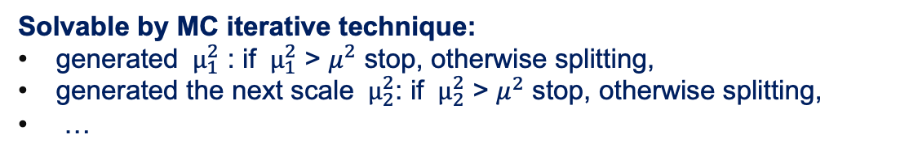

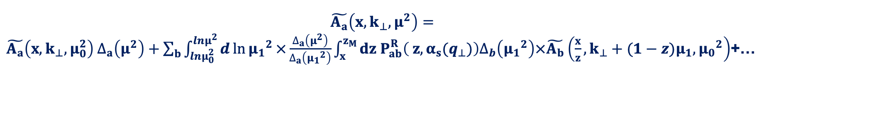
Recap of PB TMDs
Iterative form of the PB evolution equation:
$\tilde{A_{a}}\left(x,k_{⊥}, μ^{2}\right)=$
$\tilde{A_{a}}\left(x,k_{⊥},μ_{0}^{2}\right) ∆_{a}\left(μ^{2}\right)+\sum_{b}{\int_{lnμ_{0}^{2}}^{lnμ^{2}}{d\ln{{μ_{1}}^{2}}}×}\frac{∆_{a}\left(μ^{2}\right)}{∆_{a}\left({μ_{1}}^{2}\right)}\int_{x}^{z_{M}}{dz P_{ab}^{R}\left( z, α_{s}(q_{⊥})\right)∆_{b}\left({μ_{1}}^{2}\right)×\tilde{A_{b}}\left(\frac{x}{z},k_{⊥}+(1−z)μ_{1},{μ_{0}}^{2}\right)}$+…
+ …
Solvable by MC iterative technique:
generated ${ μ}_{1}^{2}$ : if ${ μ}_{1}^{2}$ > $μ^{2}$ stop, otherwise splitting,
generated the next scale ${ μ}_{2}^{2}$: if ${ μ}_{2}^{2}$ > $μ^{2}$ stop, otherwise splitting,
…

Slide 5

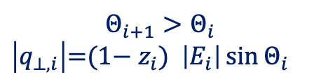
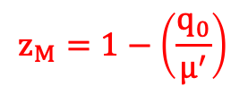



Angular Ordering:
Color coherence phenomena:
Angular ordering of the soft gluon emissions
$$Θ_{i+1}>Θ_{i}$$
$\left|q_{⊥,i}\right|\text{=}\text{(1−}{ z}_{i}\text{) }\left|E_{i}\right|\sin{Θ_{i}}$
Associating “$\left|E_{i}\right|\sin{Θ_{i}}$” with $μ′$
$q_{⊥,i}^{2}={\left(1−z_{i}\right)}^{2}$ $μ_{i}^{′2}$
The argument of $α_{s}$ should be $q_{⊥}^{2}$
$α_{s}\left(q_{⊥}^{2}\right)=α_{s}$(${\left(1−z\right)}^{2}{μ′}^{2}$)
resolvable & non-resolvable $→$ condition on min $q_{⊥,i}^{2}→z_{M}$
$$z_{M}=1−\left(\frac{q_{0}}{μ^{′}}\right)$$

Slide 6
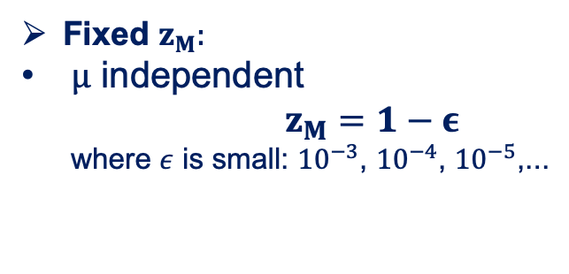
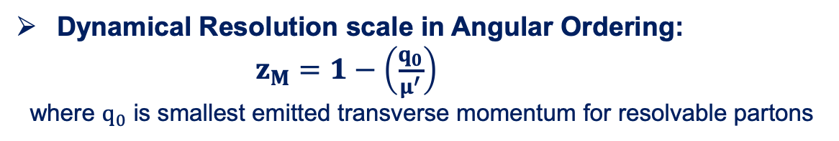
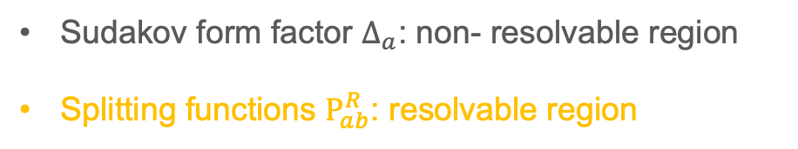
Fixed and dynamical resolution scale
Fixed $z_{M}:$
$μ$ independent
$z_{M}=1−ε$
where $ε$ is small: ${10}^{−3}$, ${10}^{−4}$, ${10}^{−5}$,...
Dynamical Resolution scale in Angular Ordering:
$z_{M}=1−\left(\frac{q_{0}}{μ^{′}}\right)$
where $q_{0}$ is smallest emitted transverse momentum for resolvable partons
Sudakov form factor $∆_{a}$: non- resolvable region
Splitting functions $P_{ab}^{R}$: resolvable region
[Hautmann, Keersmaekers, Lelek, van Kampen NuclPhysB (2019) 114795,1908.08524]

Slide 7
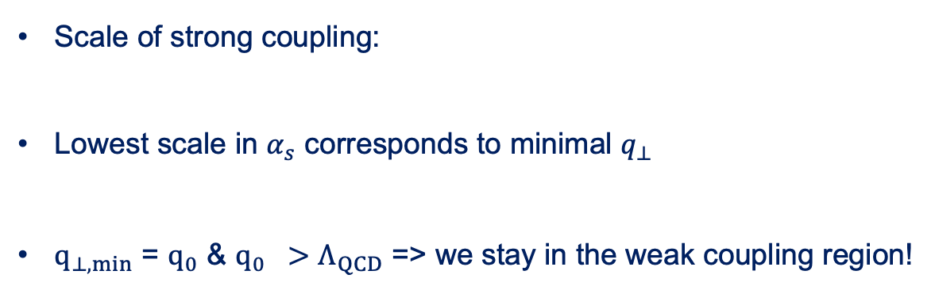



Dynamical resolution scale
The Condition on q₀ of
$z_{M}=1−\left(\frac{q_{0}}{μ^{′}}\right)$
Scale of strong coupling:
Lowest scale in $α_{s}$ corresponds to minimal $q_{⊥}$
$q_{⊥,min}$ = $q_{0}$ & $q_{0} >Λ_{QCD}$ => we stay in the weak coupling region!
$α_{s}\left(q_{⊥}^{2}\right)=α_{s}$(${\left(1−z\right)}^{2}{μ′}^{2}$)
$$Λ_{QCD}≅0.2 GeV$$

Slide 8
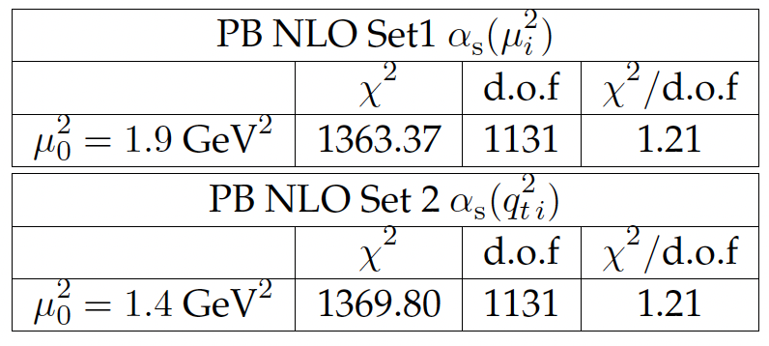
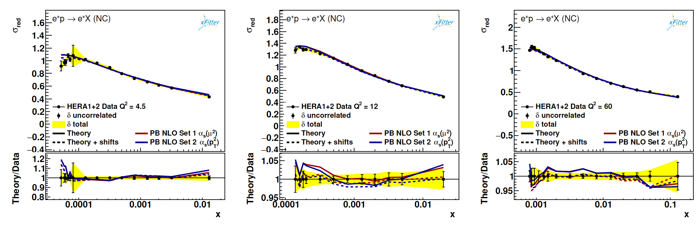


PB TMD fits at NLO with fixed zmax
The Past PB TMD fits at NLO calculation using angular ordering : fixed $z_{M}$
"NLO DIS Matrix Element (ME) and NLO evolution kernel"
Data set: HERA 1+ 2 inclusive DIS data
Associating the evolution scale with some physical interpretation:
Set 1
Set 2
${ α}_{s}$(${μ′}^{2}$)
Two scenario
$α_{s}\left(q_{⊥}^{2}\right){=α}_{s}$(${\left(1−z\right)}^{2}{μ′}^{2}$)
The resulting TMD parton densities, PB-NLO-2018-set1 and PB-NLO-2018-set2
are available in TMDLIB2: The European Physical Journal C 81.8 (2021): 1-10
.Phys Rev. D 99, 074008 (2019),
Measurement of the inclusive DIS cross section obtained at HERA compared to predictions using Set 1 and Set 2

Slide 9
PB TMD fits at NLO with dynamical zmax
New study
From fixed resolution scale to dynamical resolution scale

Slide 10

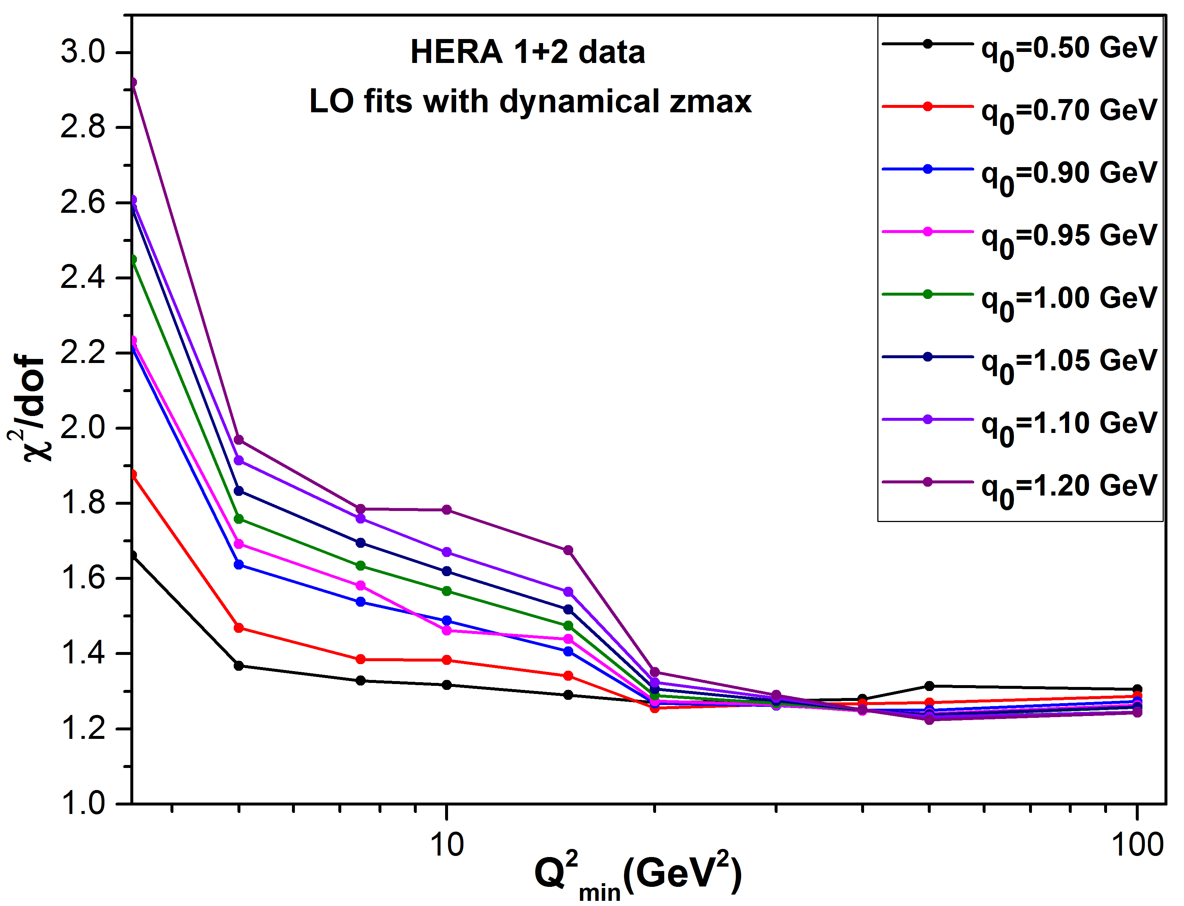
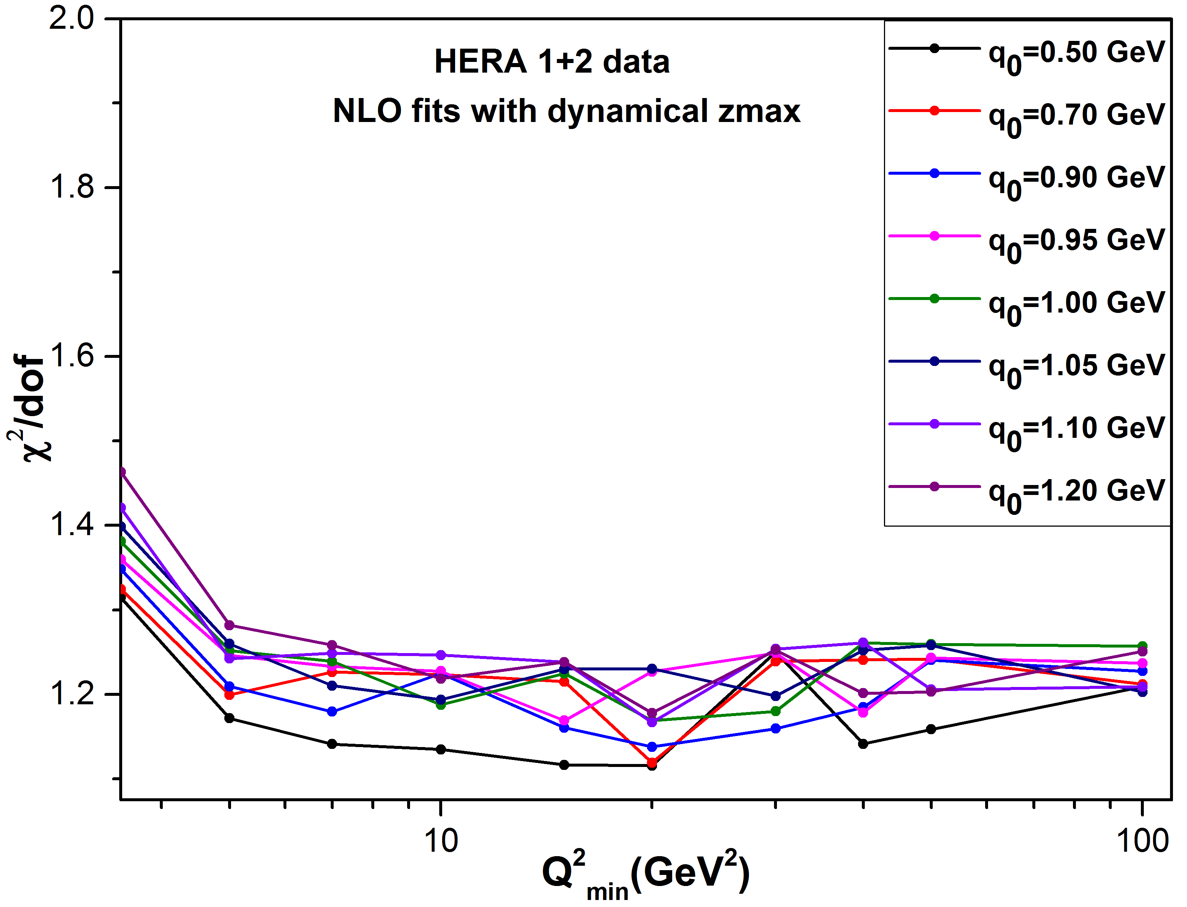
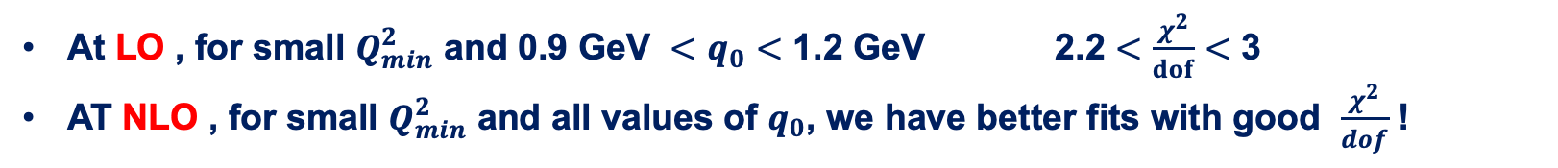

PB TMD fits at NLO with dynamical zmax:
$z_{M}=1 −\left(\frac{q_{0}}{μ^{′}}\right)$
New fits with dynamical zmax at LO and NLO with HERA 1 + 2 Data set: Using arXiv:1709.01151v1
Performing different fits, each time by varying $Q_{min}^{2}$ and on top of that with different $q_{0}$ values
At LO , for small $Q_{min}^{2}$ and 0.9 GeV $<q_{0}<$ 1.2 GeV 2.2 $<\frac{χ^{2}}{dof}<$ 3
AT NLO , for small $Q_{min}^{2}$ and all values of $q_{0}$, we have better fits with good $\frac{χ^{2}}{dof}$ !

Slide 11
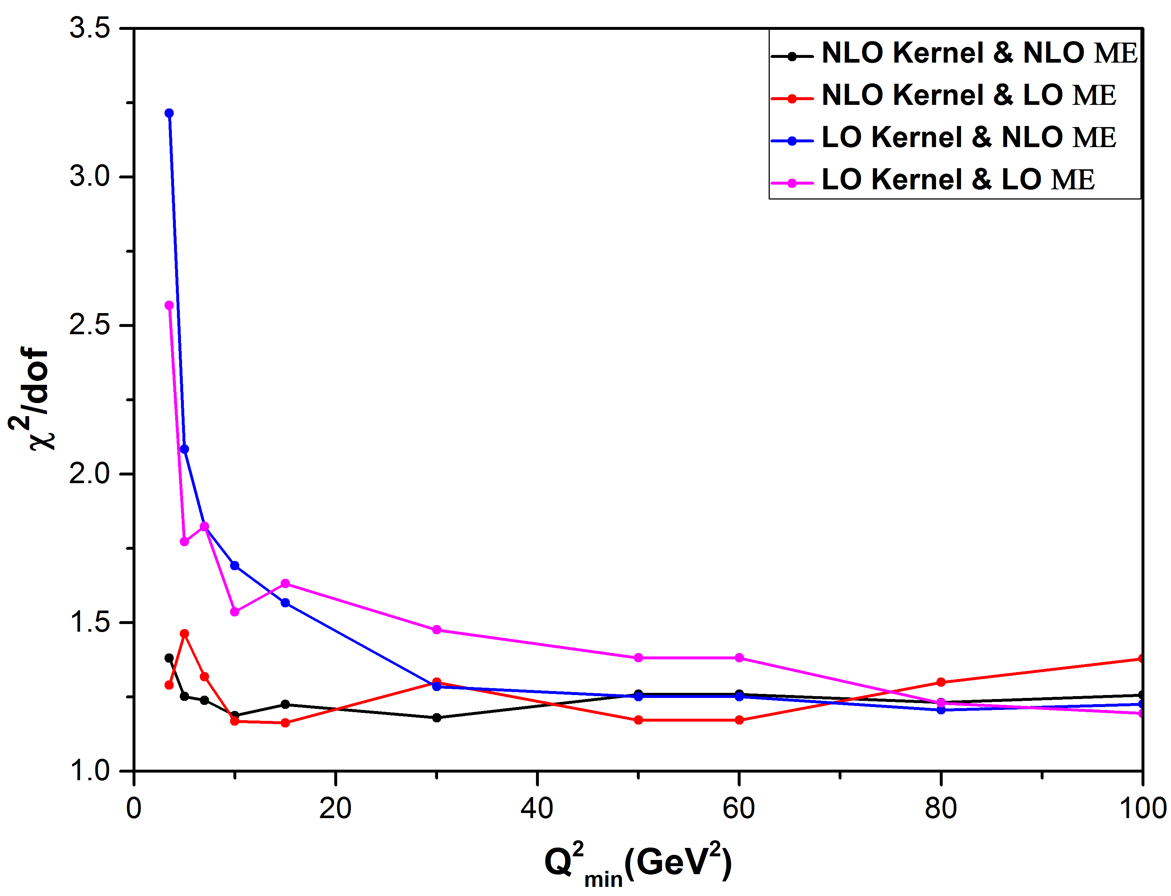
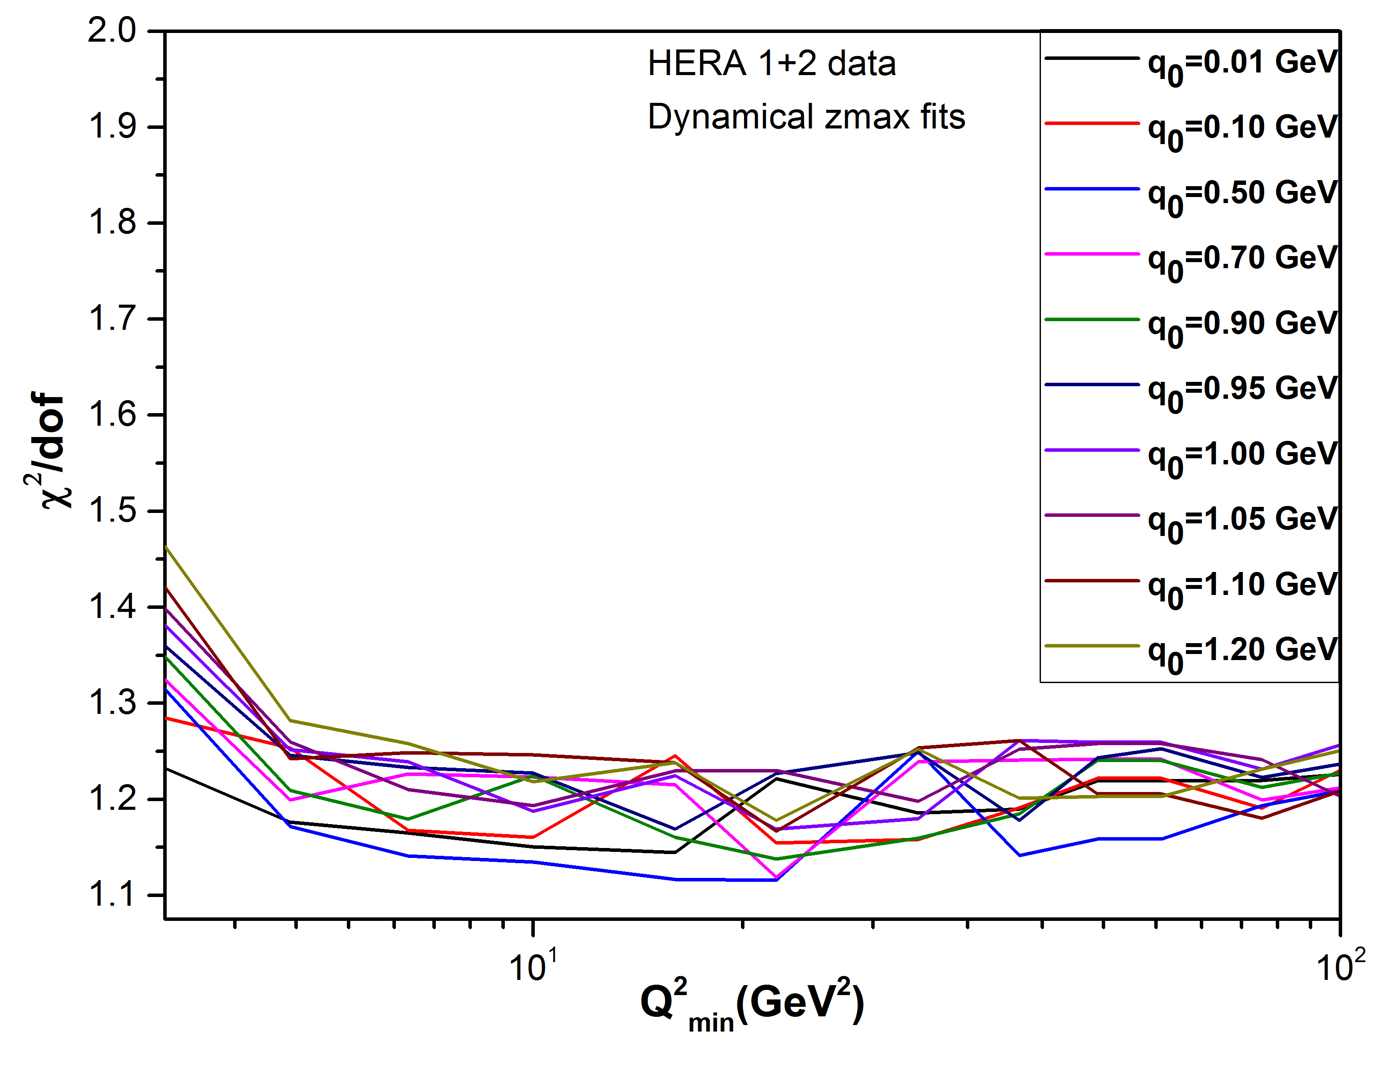

The difference between LO and NLO
Does the difference between LO and NLO come from the kernels? or ME?!..
For $q_{0}$=1.0 GeV
4 states for this purpose:
Fitting with NLO kernel & NLO ME
Fitting with NLO kernel & LO ME
Fitting with LO kernel & LO ME
Fitting with LO kernel & NLO ME
The difference is dominated by
the kernel not ME..!

Slide 12
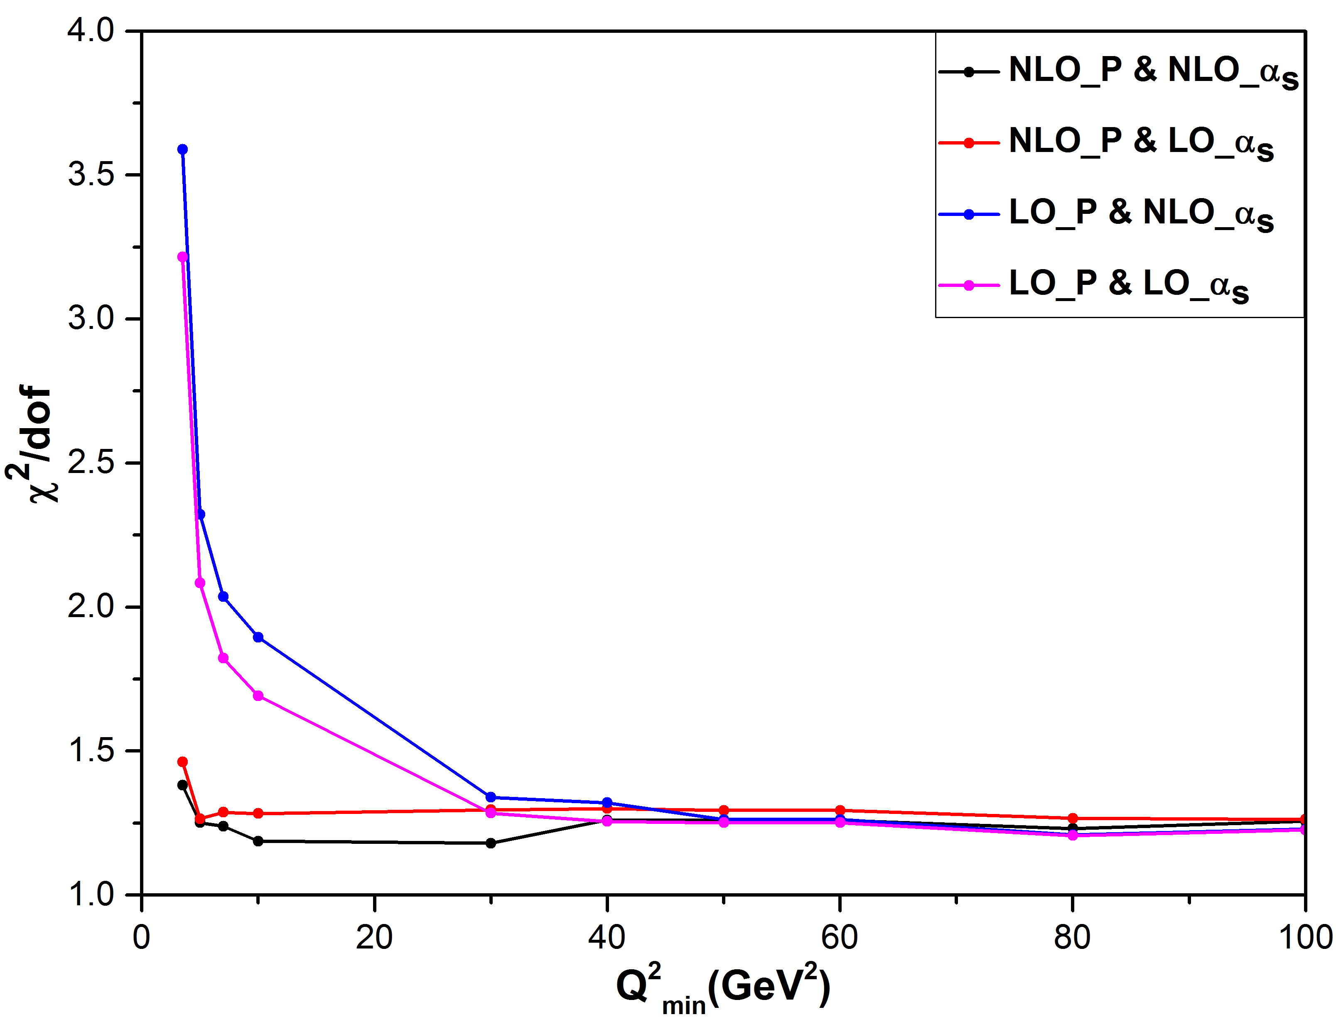



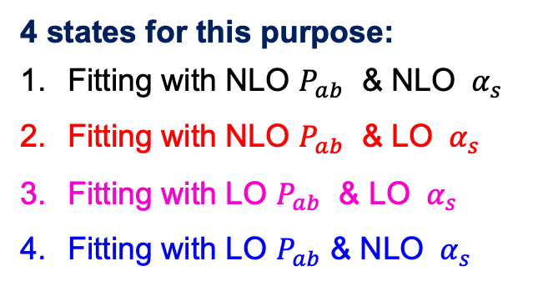
The difference between LO and NLO
Which part of the kernel is responsible?
For NLO ME
For $q_{0}$=1.0 GeV
$P_{ab}\left(z,μ^{2}\right)$? or ${ α}_{s}$?
4 states for this purpose:
Fitting with NLO $P_{ab}$ & NLO ${ α}_{s}$
Fitting with NLO $P_{ab}$ & LO ${ α}_{s}$
Fitting with LO $P_{ab}$ & LO ${ α}_{s}$
Fitting with LO $P_{ab}$ & NLO ${ α}_{s}$
The difference is dominated by
the splitting functions not ${ α}_{s}$..!

Slide 13
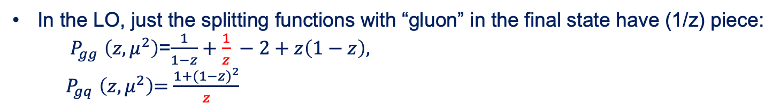
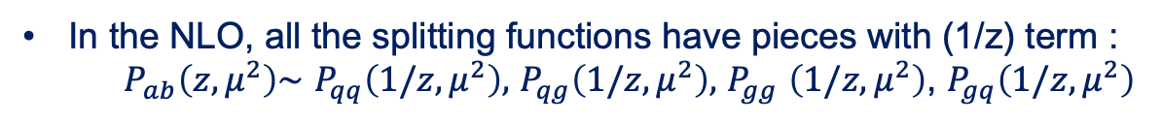

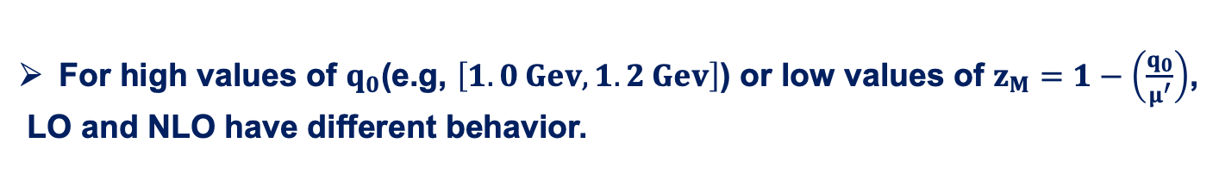
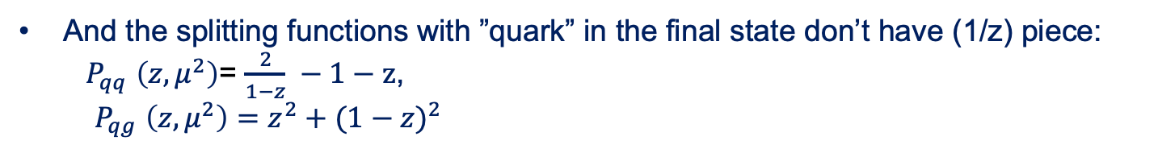
Which part of the splitting functions is responsible for the difference between LO and NLO?
For high values of $q_{0}$(e.g, $\left[1.0 Gev,1.2 Gev\right]$) or low values of $z_{M}=1−\left(\frac{q_{0}}{μ^{′}}\right)$,
LO and NLO have different behavior.
The first piece for checking is
$$\frac{1}{z}$$
In the NLO, all the splitting functions have pieces with (1/z) term :
$P_{ab}\left(z,μ^{2}\right)\sim$ $P_{qq}\left(1/z,μ^{2}\right),$ $P_{qg}\left(1/z,μ^{2}\right),$ $P_{gg}$ $\left(1/z,μ^{2}\right)$, $P_{gq}\left(1/z,μ^{2}\right)$
In the LO, just the splitting functions with “gluon” in the final state have (1/z) piece:
$P_{gg}$ $\left(z,μ^{2}\right)$=$\frac{1}{1−z}+\frac{1}{z} −2+z\left(1−z\right),$
${ P}_{gq}$ $\left(z,μ^{2}\right)$= $\frac{1+{(1−z)}^{2}}{z}$
And the splitting functions with ”quark” in the final state don’t have (1/z) piece:
$P_{qq}$ $\left(z,μ^{2}\right)$= $\frac{2}{1−z} −1−z$,
$P_{qg}$ $\left(z,μ^{2}\right)={z^{2}+(1−z)}^{2}$
Is the lack of (1/z) piece in LO splitting function with quark in the final state responsible for this difference?
Let’s check it!

Slide 14
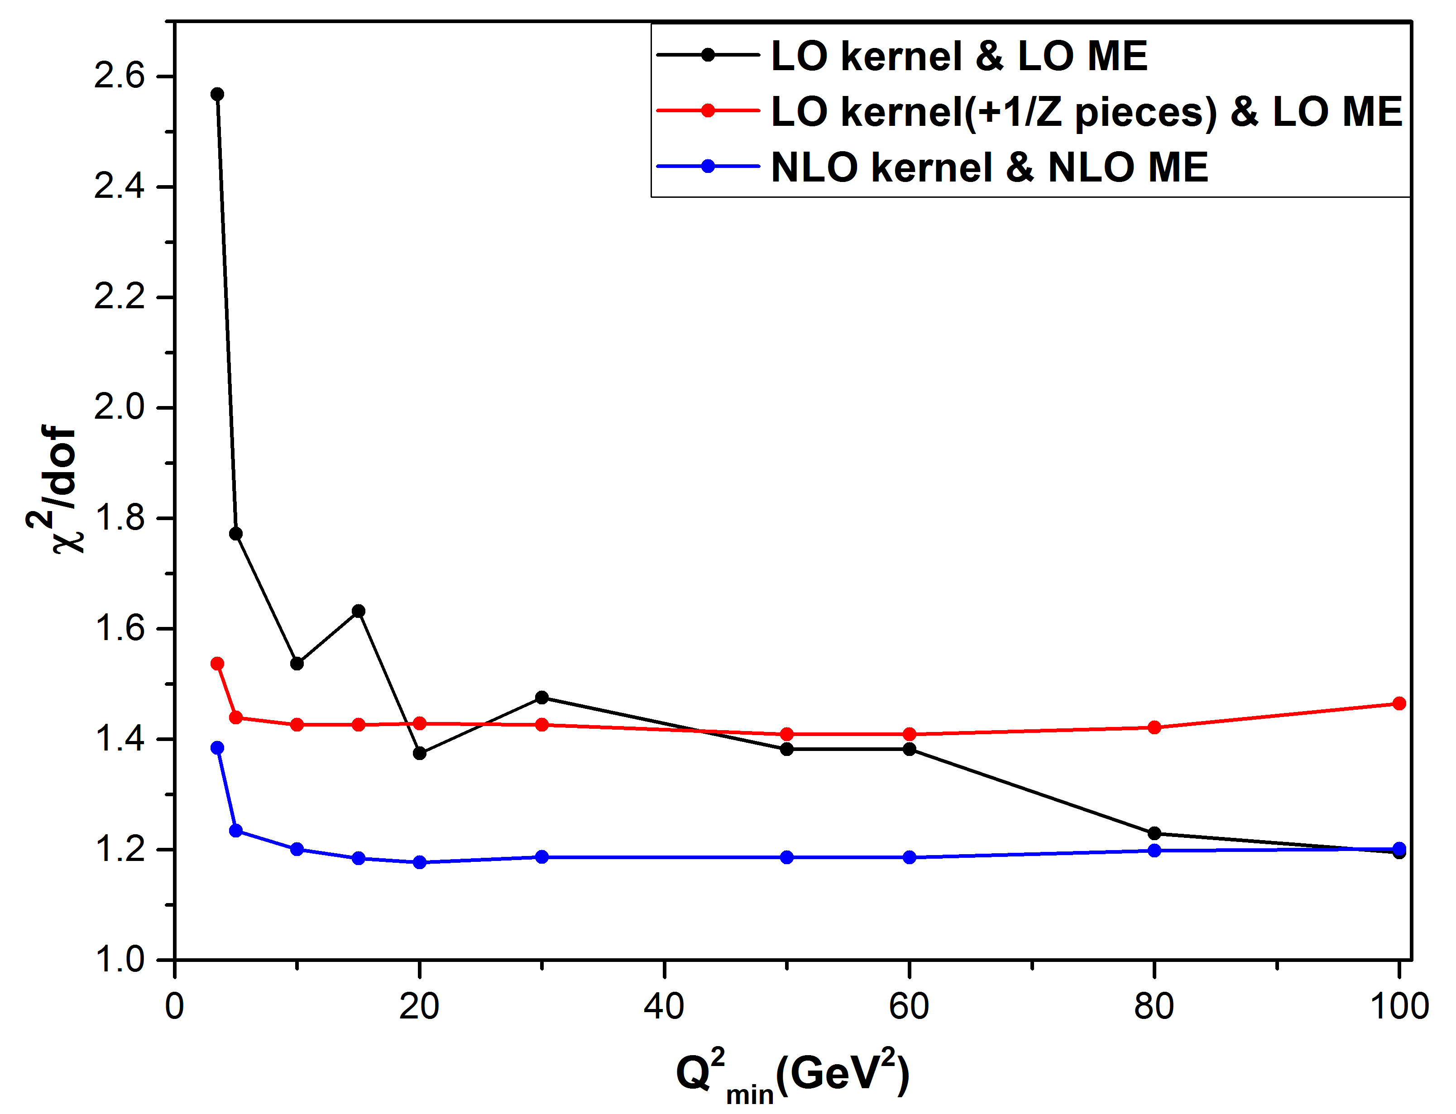
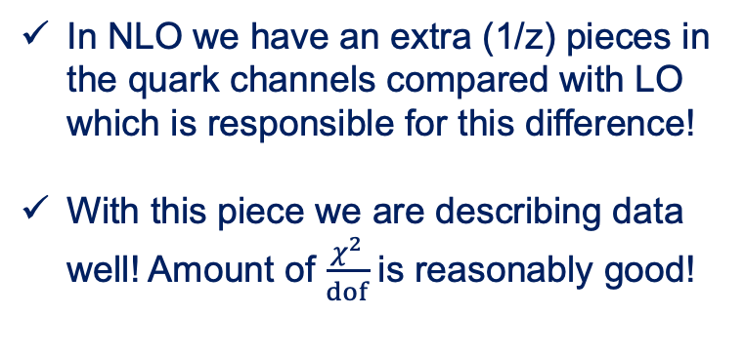


Does the difference come from 1/z piece of NLO splitting function?
For better understanding: “We added to the LO splitting functions($P_{qg}$, $P_{qq}$) the 1/z pieces of NLO”
$P_{qq}$ $\left(z,μ^{2}\right)$= $\frac{2}{1−z} −1−z$ + $\left(\frac{1}{z}\right)$ pieces of $P_{qq}$ NLO
$P_{qg}$ $\left(z,μ^{2}\right)={z^{2}+(1−z)}^{2}$+ $\left(\frac{1}{z}\right)$ pieces of $P_{qg}$NLO
For $q_{0}$=1.0 GeV
In NLO we have an extra (1/z) pieces in the quark channels compared with LO which is responsible for this difference!
With this piece we are describing data well! Amount of $\frac{χ^{2}}{dof}$ is reasonably good!
** For PB-TMD fit with dynamical zmax
we obtain a reasonably good $\frac{χ^{2}}{dof}$ at NLO! **

Slide 15
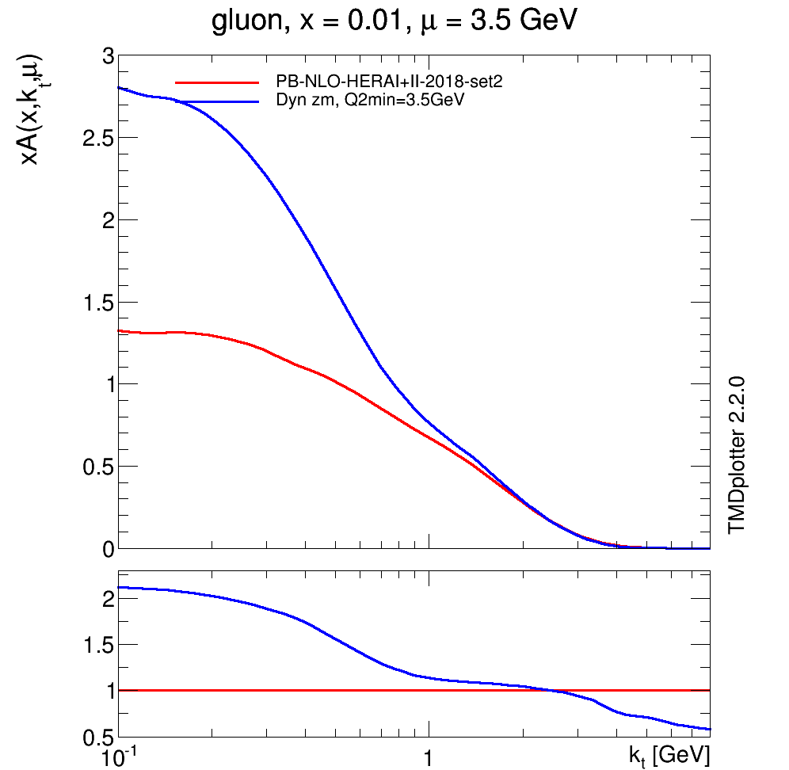
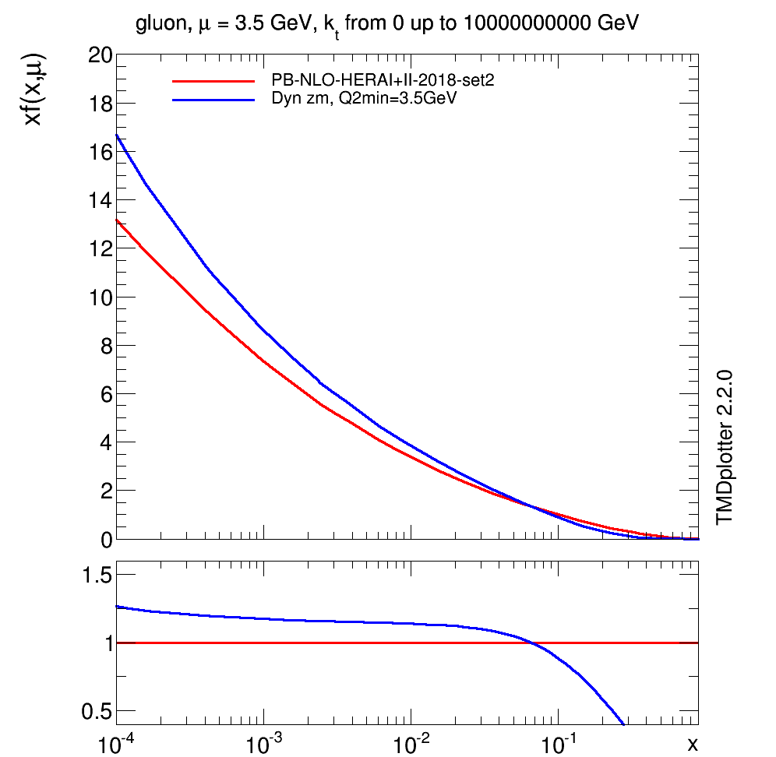



How does dynamical zmax affect the fitted TMD (iTMD)?
Set 2: fixed zmax & $α_{s}\left(q_{⊥}^{2}\right){=α}_{s}$(${\left(1−z\right)}^{2}{μ′}^{2}$)
For $q_{0}$=0.5 GeV
For $q_{0}$=0.5 GeV
The dynamical zmax fit implies an effect not only in the k_{T} dependence but also in the x dependence!

Slide 16
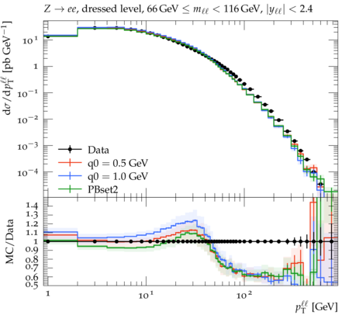
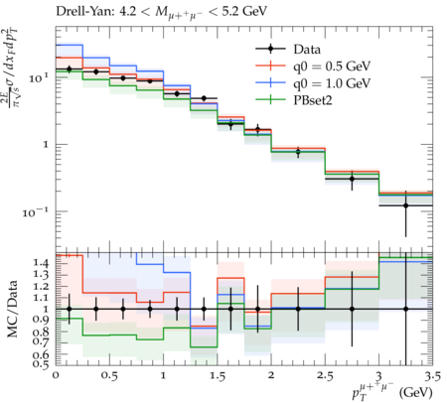
The predictions in dynamical zmax frame
Predictions with ME generated by MCatNLO combined with obtained TMDs.

Slide 17
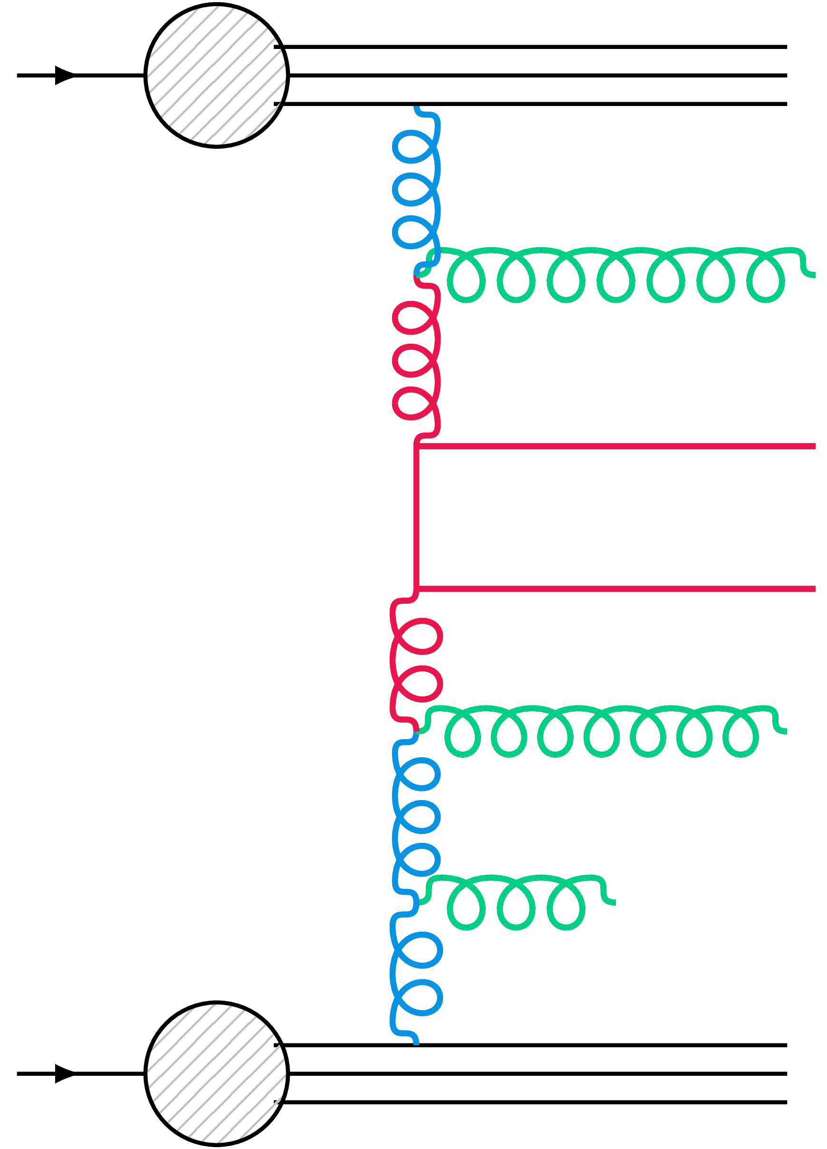
The merged talk: Z+b jet production in 4FL and 5FL
5 FLNS
4 FLNS
Full coupled evolution with all flavours & α(M_{Z}^{nf=5})=0.118
HERAPDF parametrization form
Using full HERAI+II inclusive DIS data
chi2/dof=1.21
[Phys. Rev. D 99 (2019) no. 7, 074008]
The same functional form and data as 5FL-parameters re-fitted
M_{b} → ∞ & α (M_{Z}^{nf=4})=0.1128
chi2/dof=1.25
[arXiv:2106.09791]
Matrix elements from MC@NLO (HERWIG6 subtraction)
5FLVNS : Z + one parton process
4FLVNS : Z + bb process
PDFs : TMDs (4FL & 5FL)
5FLVNS : b-quark is treated as a light quark
4FLVNS : no b-quark in the parton density
Parton shower following TMDs for intial state
5FL & 4FL PB-TMDs included in the Cascade3
Eur. Phys. J. C 81 (2021) 425

Slide 18
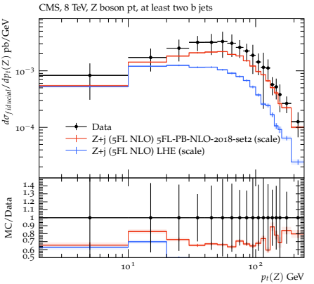
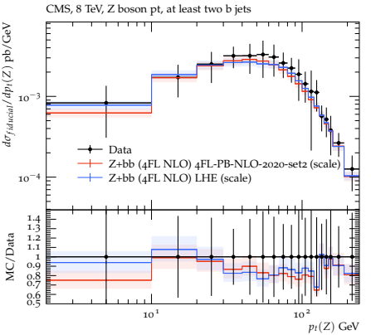
Z+ b$\overline{b}$ as a function of p_{t} (Z )
Differential cross section for Z +b$\overline{b}$ as a function of p_{t}(Z) as measured by CMS collaboration
[Eur. Phys. J. C 77 (2017) 751]
5 FLNS
4 FLNS
the full prediction + the result of using only the LHE files are shown.

Slide 19
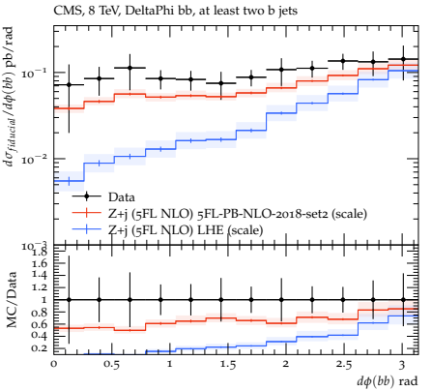
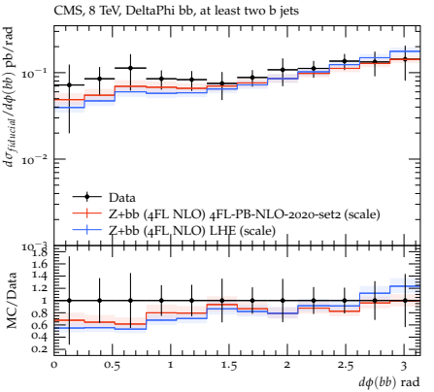
Z+bb as a function of Δφ (b$\overline{b}$ )
Differential cross section for Z +b$\overline{b}$ as a function of Δφ (b$\overline{b}$) as measured by CMS collaboration
5 FLNS
4 FLNS
4FL : both b partons are already produced at the ME level
5FL : bb̄ must be simulated in the parton shower.

Slide 20
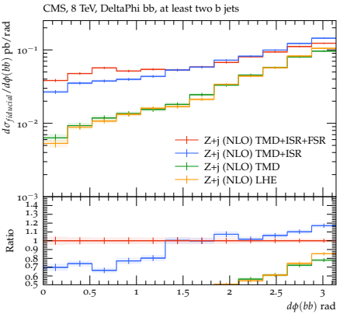
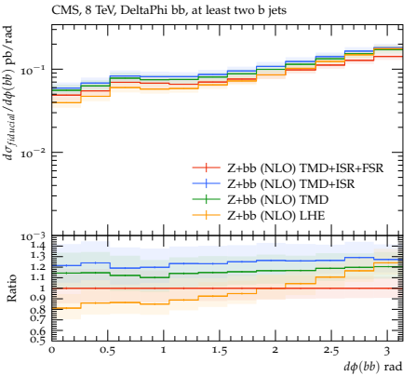
Breakdown of the different contributions to quantify their roles
5 FLNS
4 FLNS
4FL: weakly depends on PB-TMD/parton shower
5FL: significant contribution from TMD parton shower

Slide 21
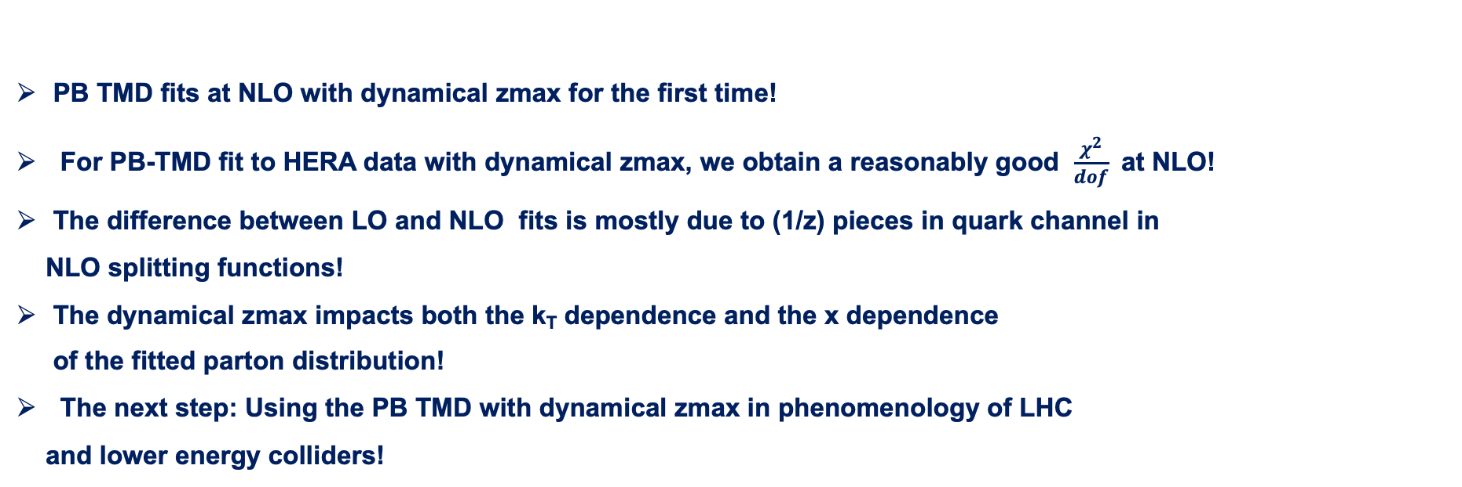
Summary
PB TMD fits at NLO with dynamical zmax for the first time!
For PB-TMD fit to HERA data with dynamical zmax, we obtain a reasonably good $\frac{χ^{2}}{dof}$ at NLO!
The difference between LO and NLO fits is mostly due to (1/z) pieces in quark channel in
NLO splitting functions!
The dynamical zmax impacts both the k_{T} dependence and the x dependence
of the fitted parton distribution!
The next step: Using the PB TMD with dynamical zmax in phenomenology of LHC
and lower energy colliders!
The 4FL and 5FL PB-TMD distributions used to calculate Z + bb production
Good agreement with measurements obtained by the CMS collaboration
The evolution of the PB-TMD parton densities as well as in the PB-TMD parton shower is checked.
Thank you …

Slide 22
Back up …

Slide 23
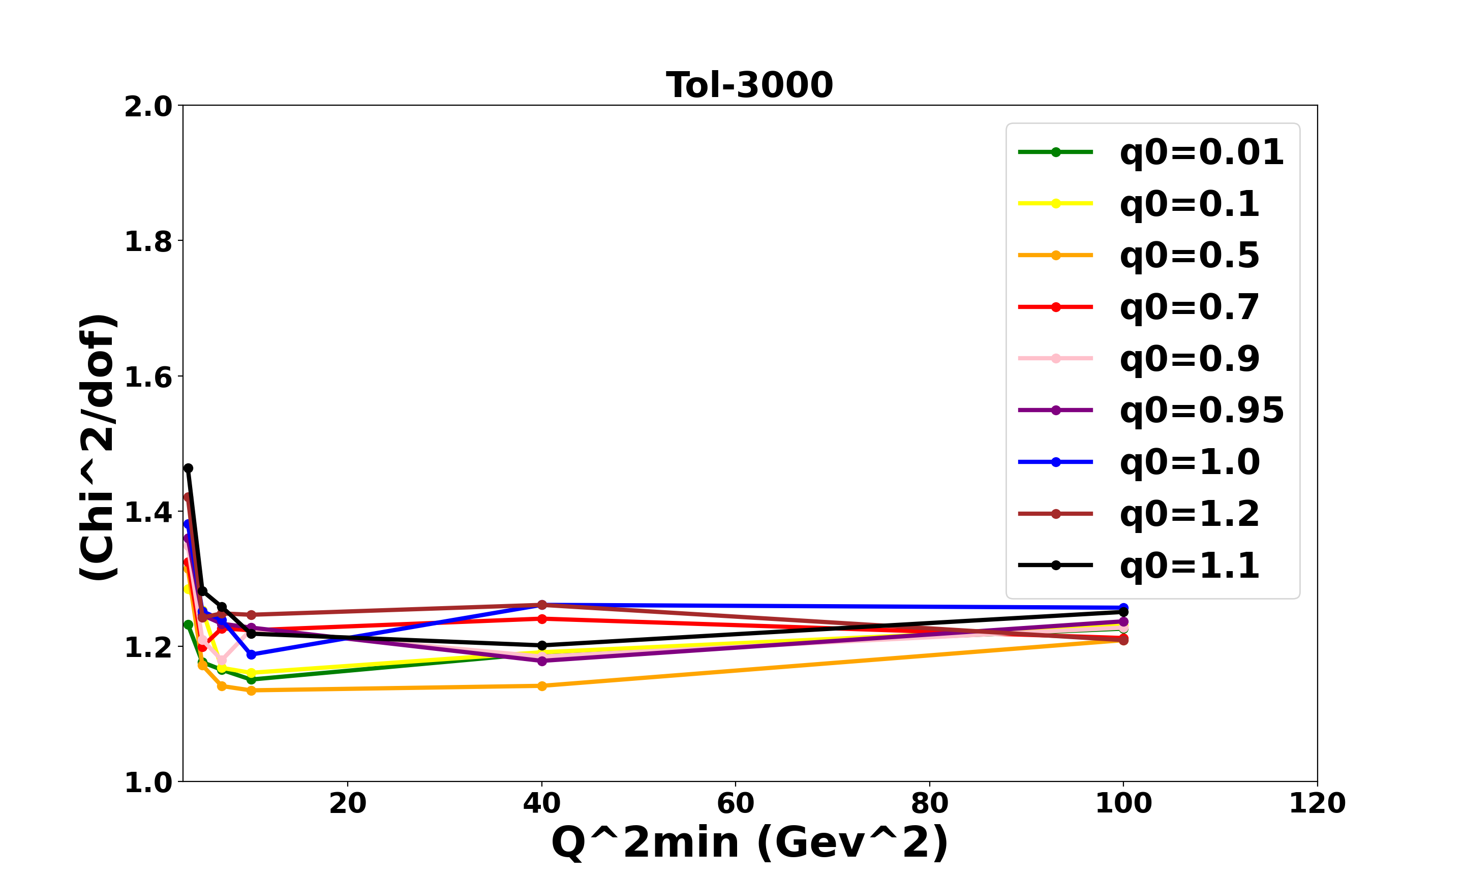
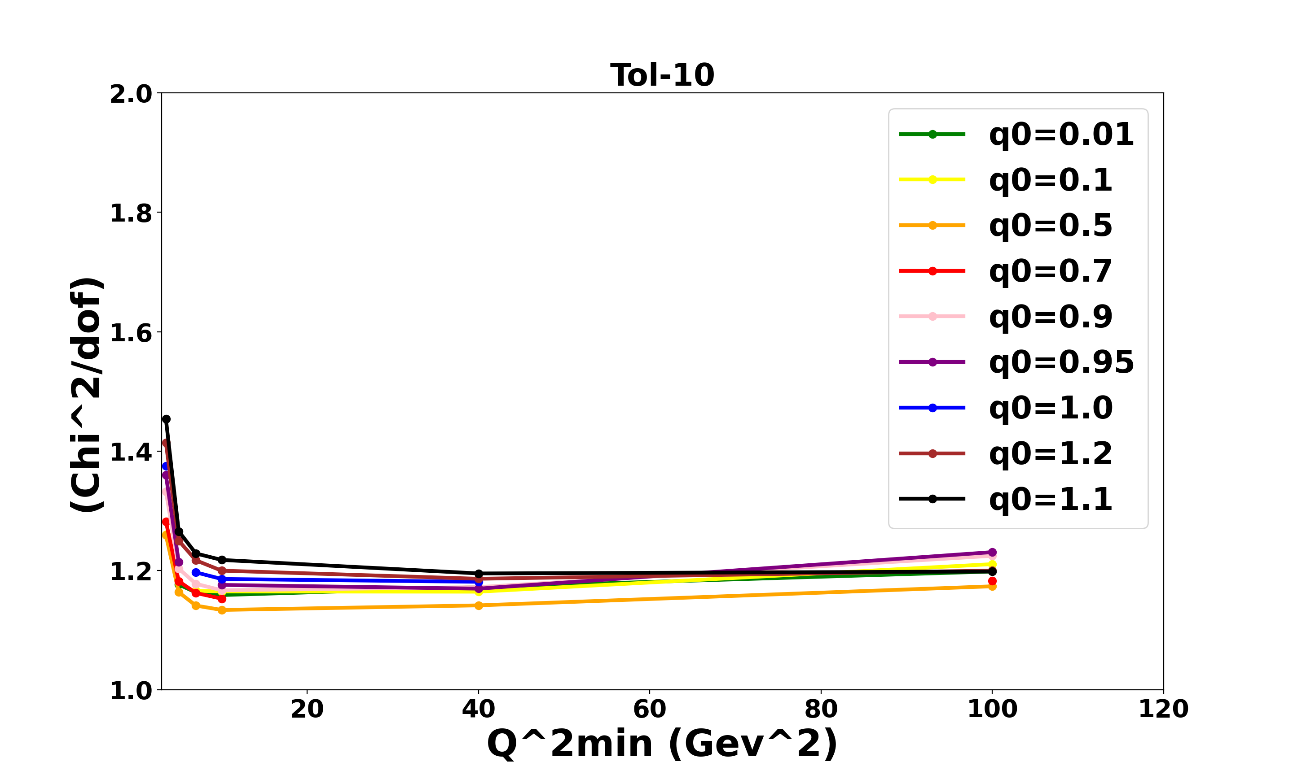
Back up…

Slide 24
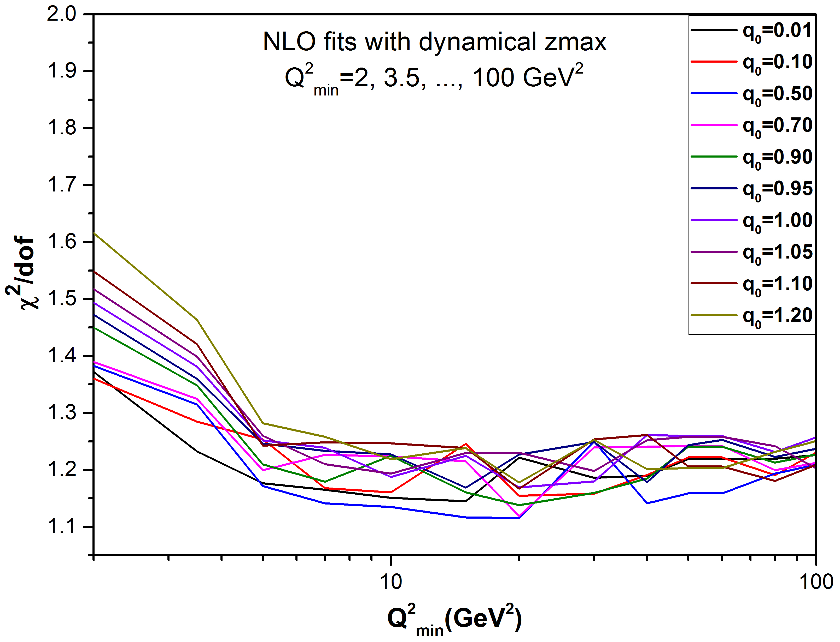
PB TMD fits at NLO with dynamical zmax:

