Slide 1


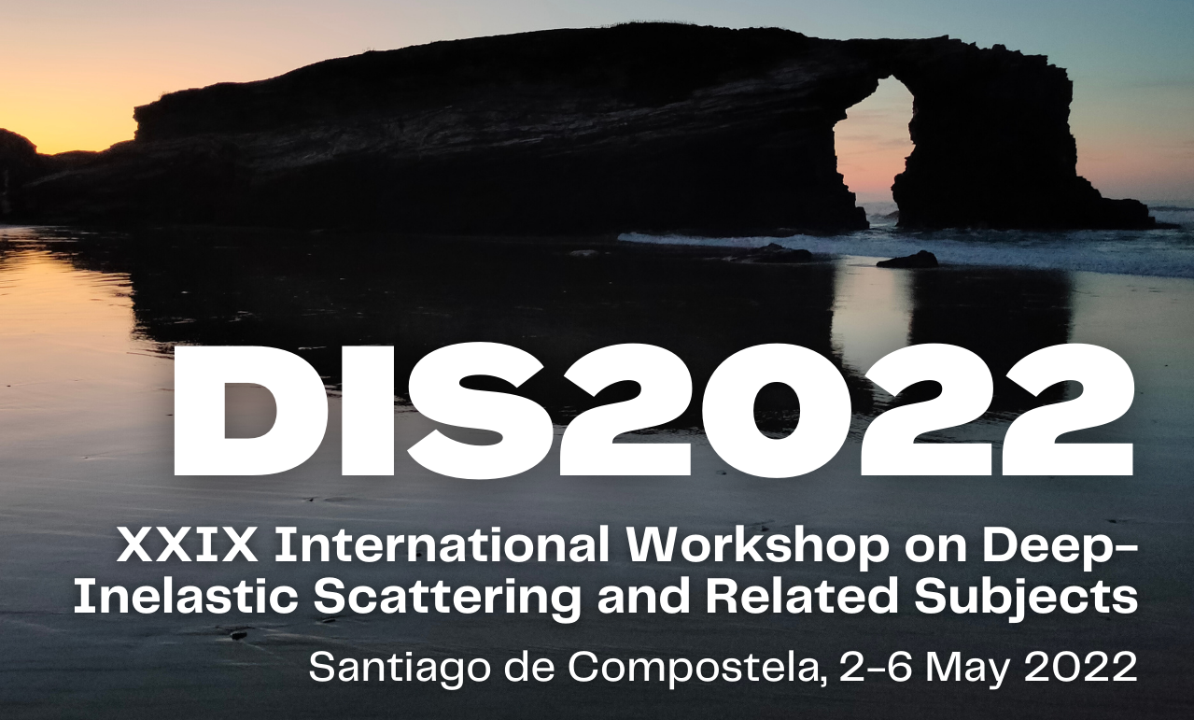
Measurement of Groomed Event Shapes in e+p DIS
Henry Klest for the H1 Collaboration
DIS2022, May 3

Slide 2

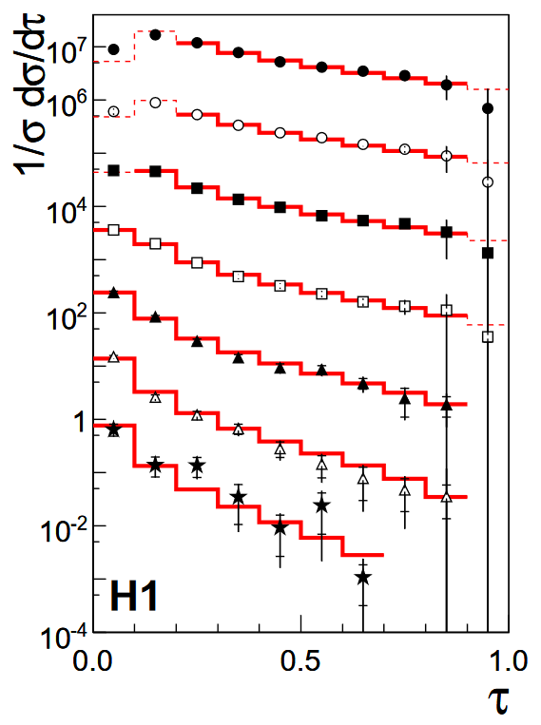
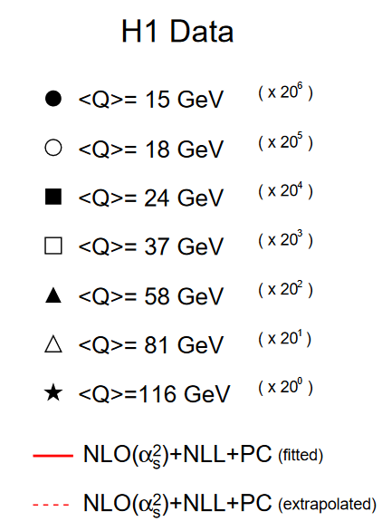
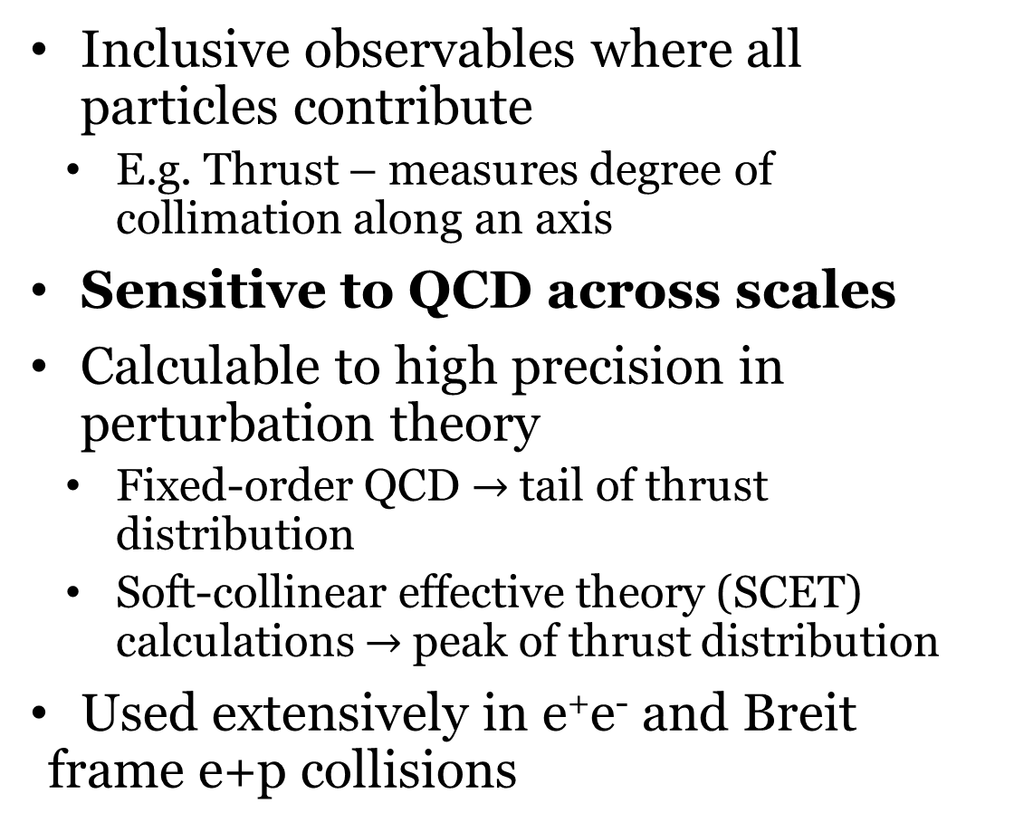
Event Shapes
Inclusive observables where all particles contribute
  E.g. Thrust – measures degree of collimation along an axis
Sensitive to QCD across scales
Calculable to high precision in perturbation theory
  Fixed-order QCD $→$tail of thrust distribution
  Soft-collinear effective theory (SCET) calculations $→$peak of thrust distribution
Used extensively in e⁺e⁻ and Breit frame e+p collisions
arXiv/0512014v1

Slide 3
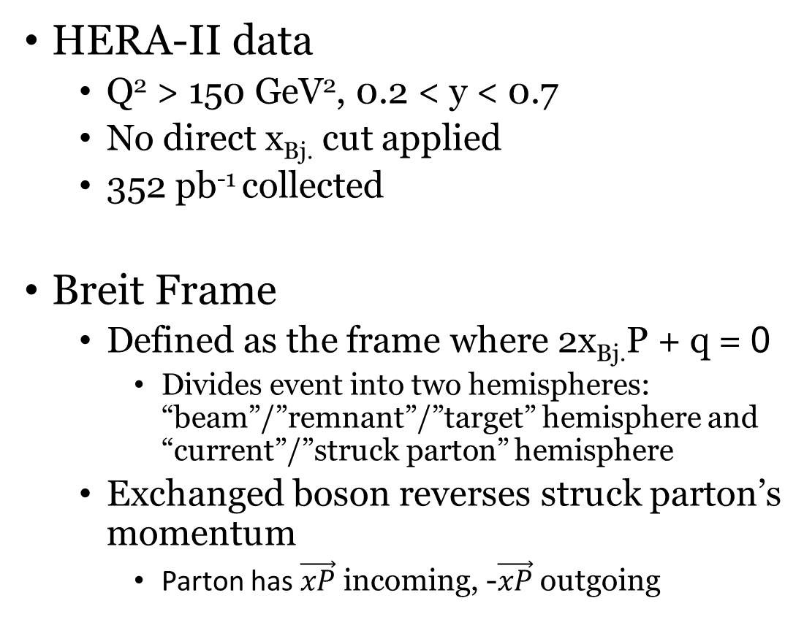


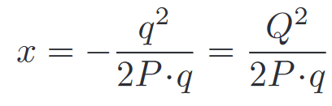
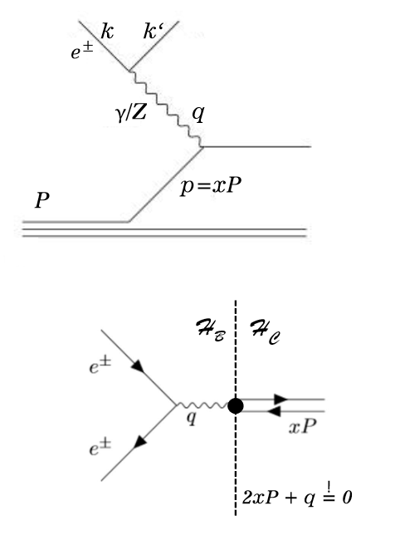
Inclusive DIS & Breit Frame
HERA-II data
  Q² > 150 GeV², 0.2 < y < 0.7
  No direct x_{Bj.} cut applied
  352 pb⁻¹ collected
Breit Frame
  Defined as the frame where 2x_{Bj.}P + q = 0
    Divides event into two hemispheres: “beam”/”remnant”/”target” hemisphere and “current”/”struck parton” hemisphere
  Exchanged boson reverses struck parton’s momentum
    Parton has $\vec{xP}$ incoming, -$\vec{xP}$ outgoing
Current Hemisphere: Struck parton continues at η = -∞
Beam Hemisphere: Proton remnant continues at η = ∞
3

Slide 4
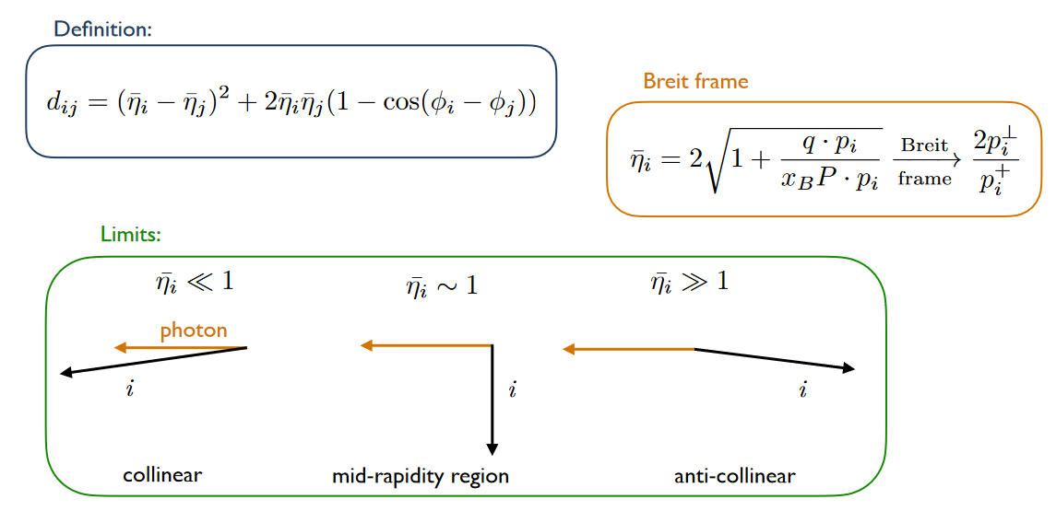
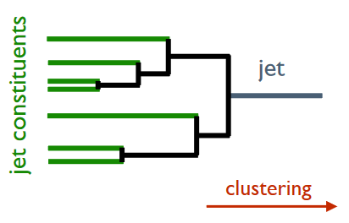
arXiv:2006.10751
Centauro
Jet algorithm with asymmetric clustering distance measure
  Suited for clustering Born-level DIS in the Breit frame
Here Centauro is used to produce a clustering tree for the full event
Fully Clustered Event
Event Constituents
Figures courtesy of Y. Makris [2]

Slide 5
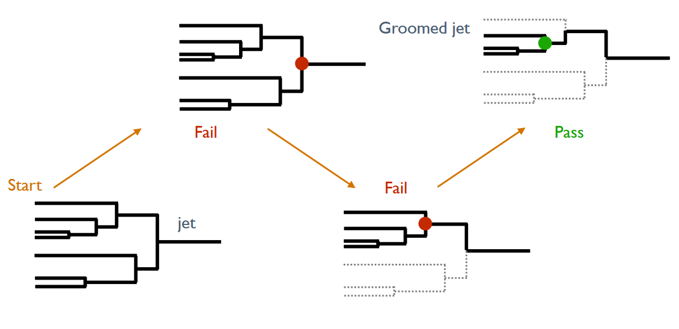

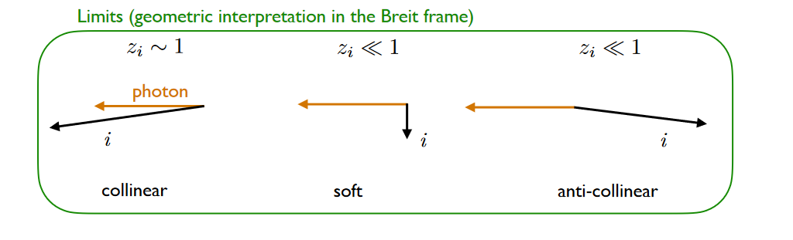


Groomed event
Event Grooming in DIS
Whole event is clustered into one “jet”
Iteratively de-cluster until grooming condition is passed
  Analogous to Soft Drop in p+p
Groomed events are similar to groomed jets!
Full event
p+p Soft Drop condition
DIS grooming condition

Slide 6
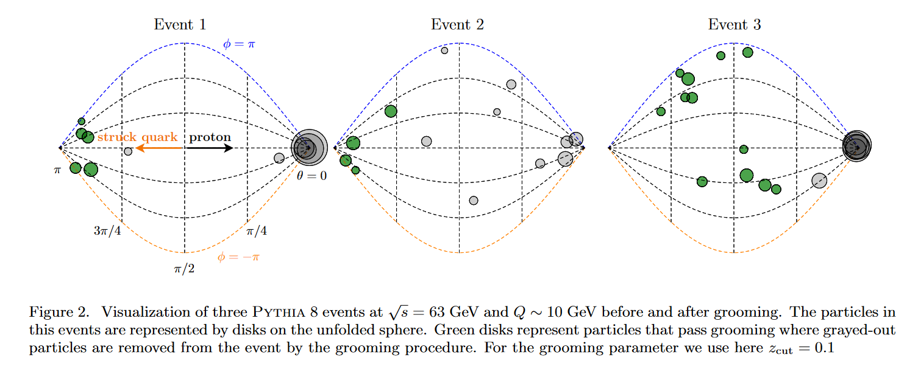
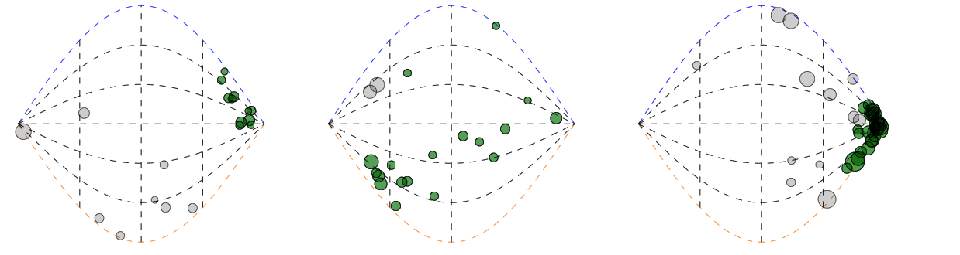

Breit Frame Event Displays

Slide 7
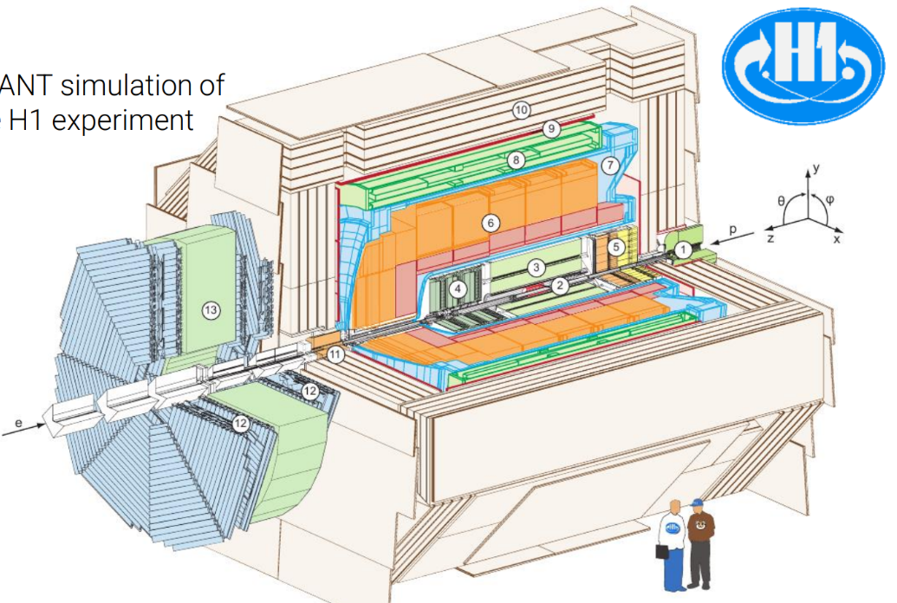
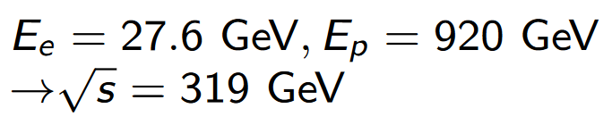
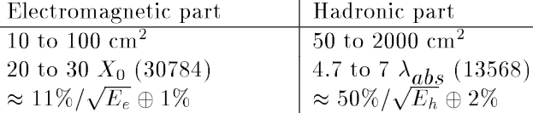
H1 Detector
HERA
  World’s only high energy electron-proton collider
  352 pb⁻¹ collected in HERA-II run period from 2003-2007
H1 LAr Calorimeter Specifications
H1 Experiment
  Hermetic detector with asymmetric design
    Drift chamber + silicon tracking
    High-resolution LAr calorimeter
  Trigger on high-energy hadronic or EM LAr cluster
    > 99% efficient for y < 0.7

Slide 8
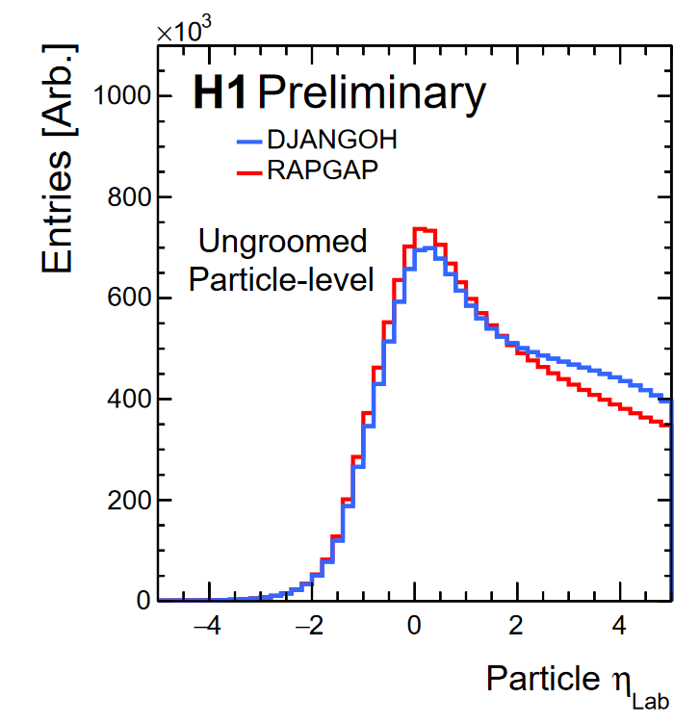
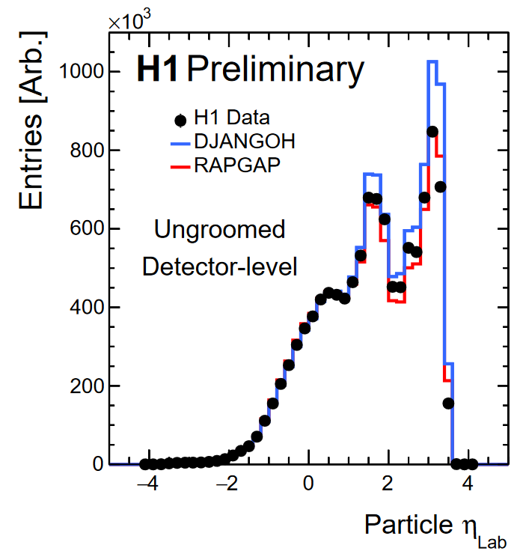
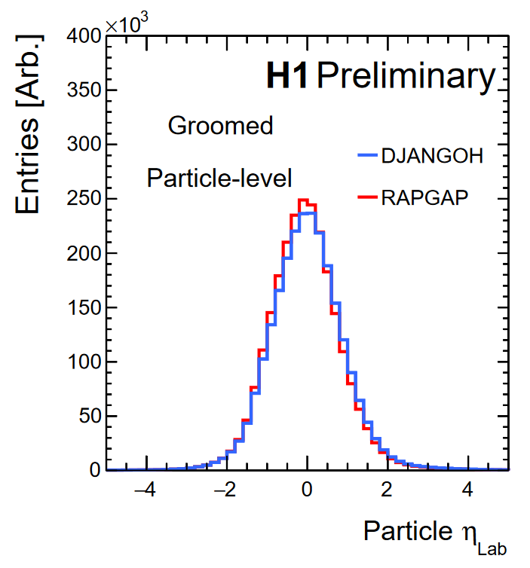
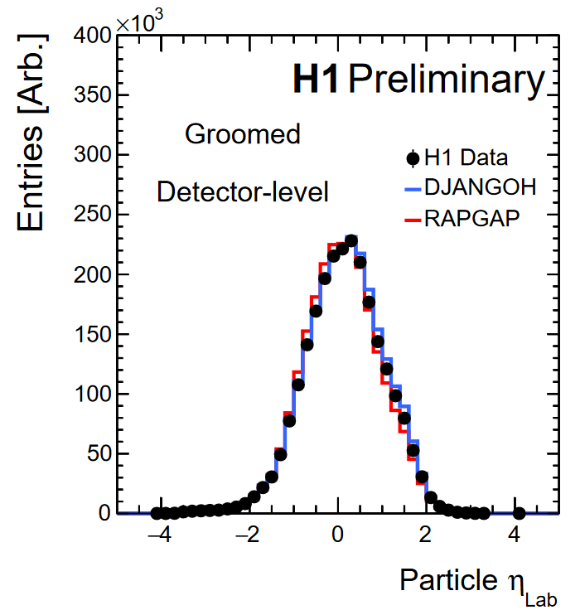
Grooming Benefits
No underlying event, why groom?
  Less affected by lab-frame detector acceptance
  Mitigate QCD remnant, ISR
  No theoretically challenging non-global logarithms
Ungroomed detector-level shows significant difference from particle-level
  Detector acceptance, efficiencies
Grooming events brings particle-level and detector-level distributions into much better agreement!
Z_{cut} = 0.2
Z_{cut} = 0.2

Slide 9
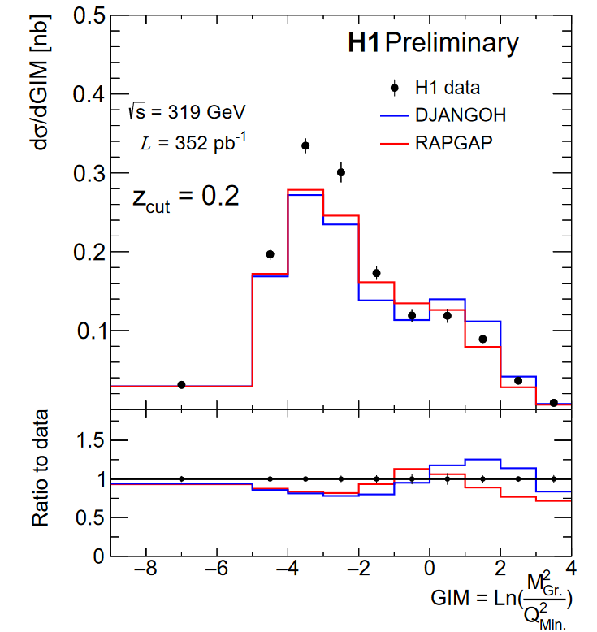
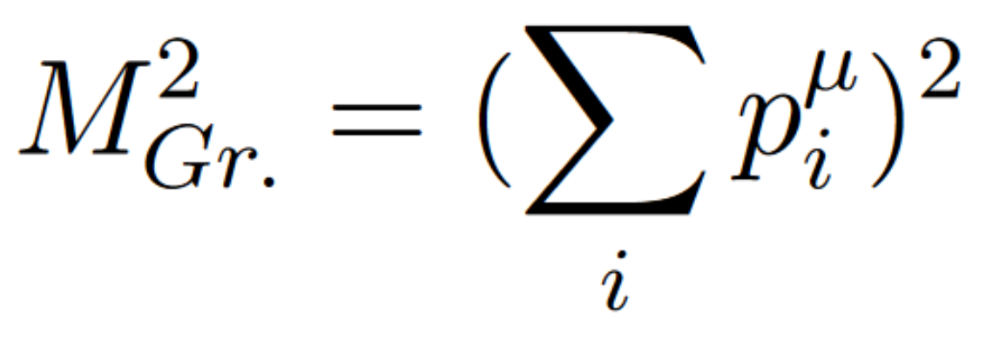
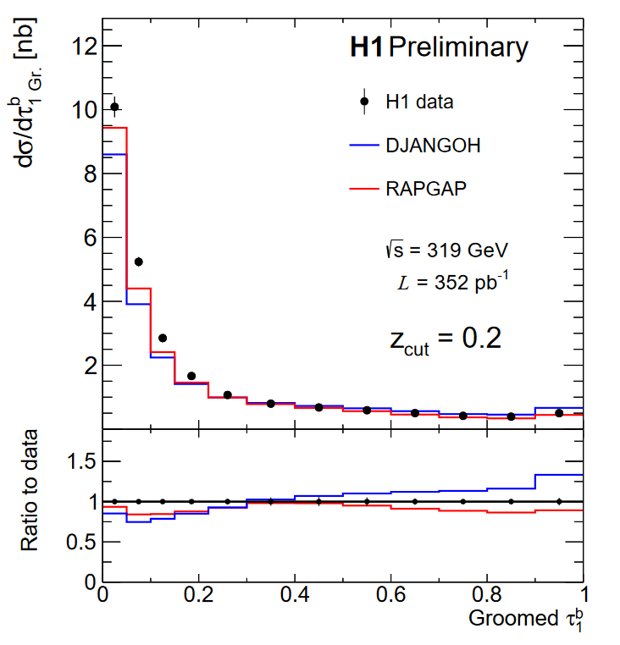
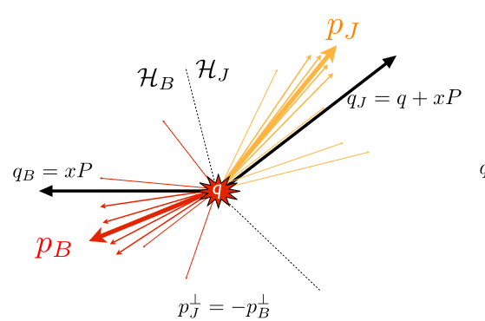
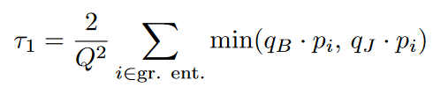
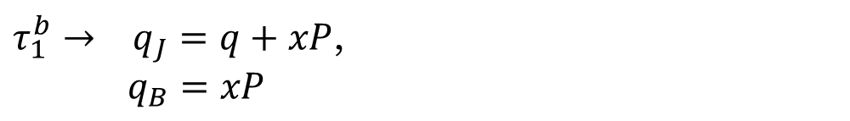
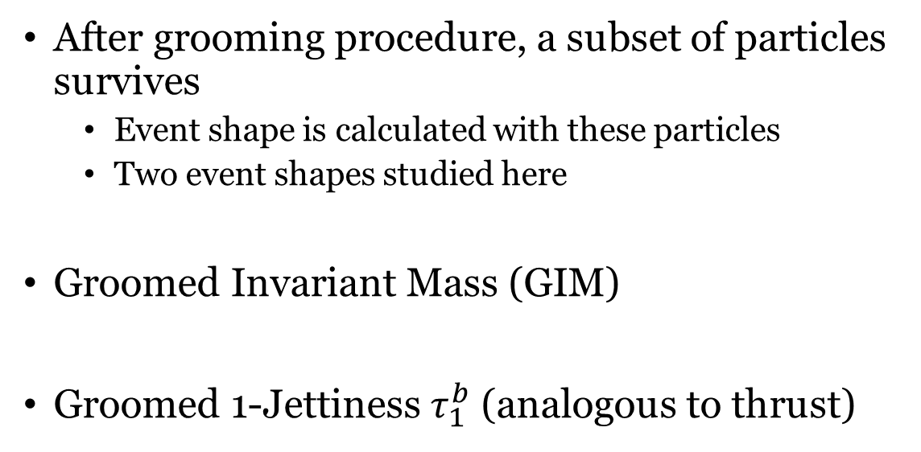
Observables
After grooming procedure, a subset of particles survives
  Event shape is calculated with these particles
  Two event shapes studied here
Groomed Invariant Mass (GIM)
Groomed 1-Jettiness $τ_{1}^{b}$ (analogous to thrust)
Non. Pert.
Non. Pert.
$τ_{1}^{b}→ q_{J}=q+xP$,
$q_{B}=xP$

Slide 10
Observables
Single jets, Intra-jet evolution
Multi-jets, hard splittings
Single jets, Intra-jet evolution
Multi-jets, hard splittings

Slide 11
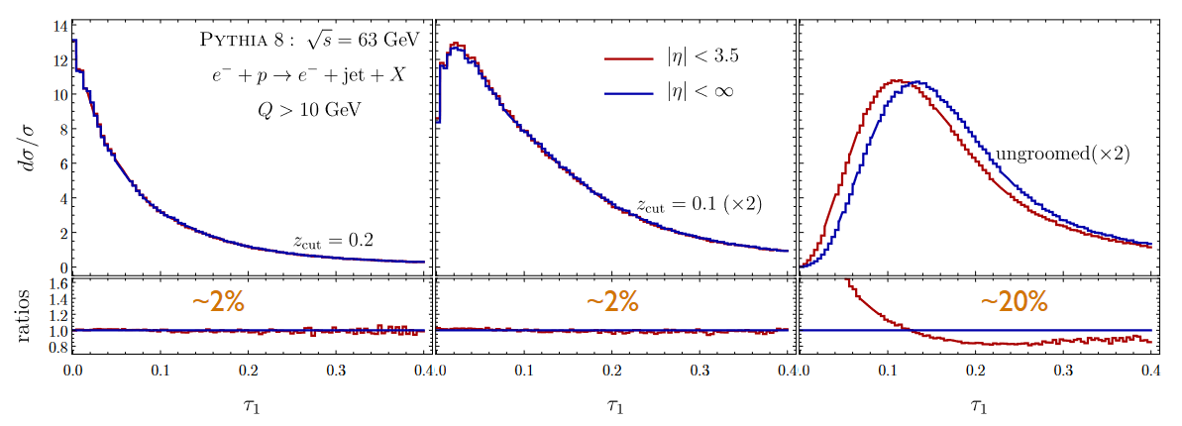
Groomed vs. Ungroomed 1-jettiness
Simulation at EIC energy
Grooming enables precision measurement!

Slide 12
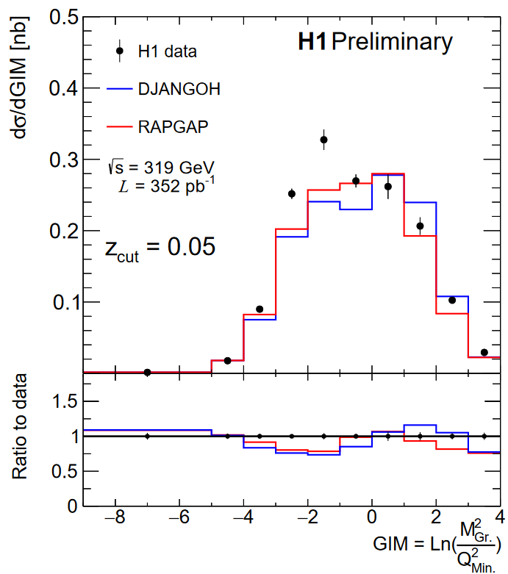
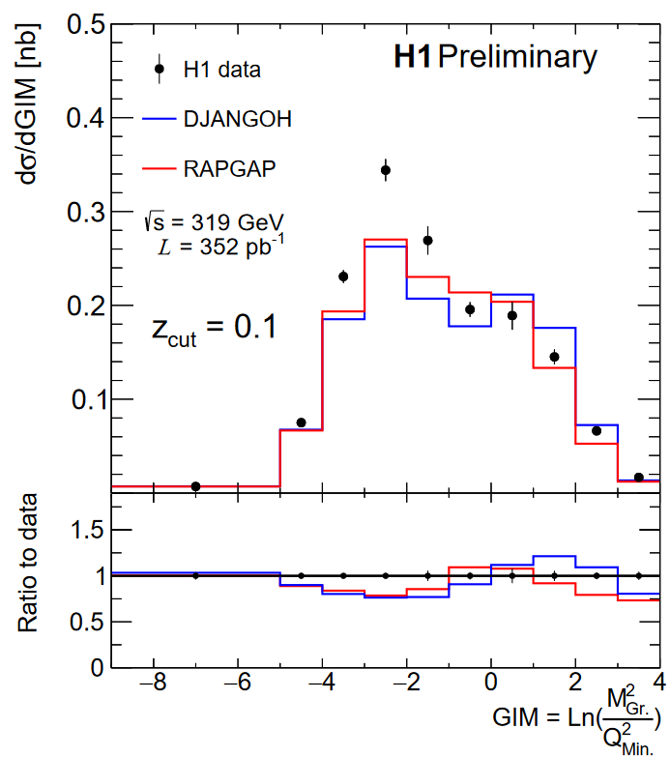
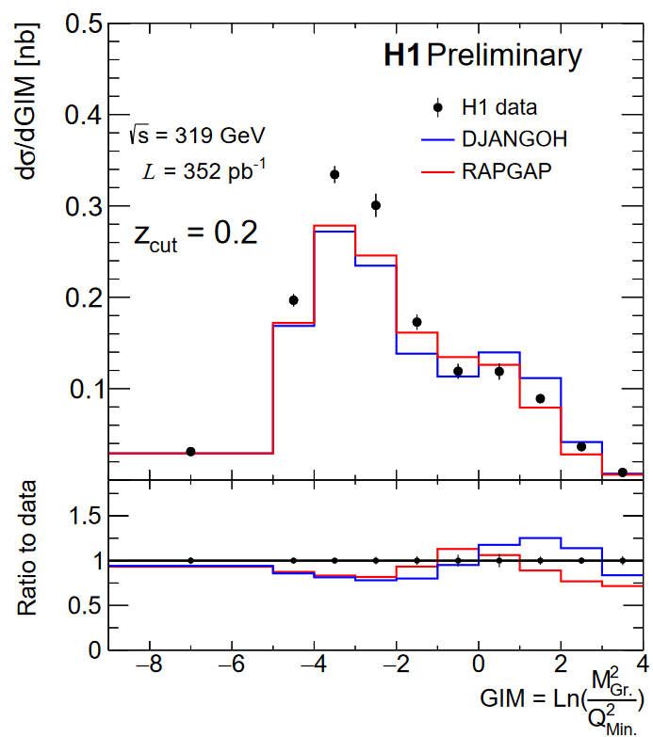
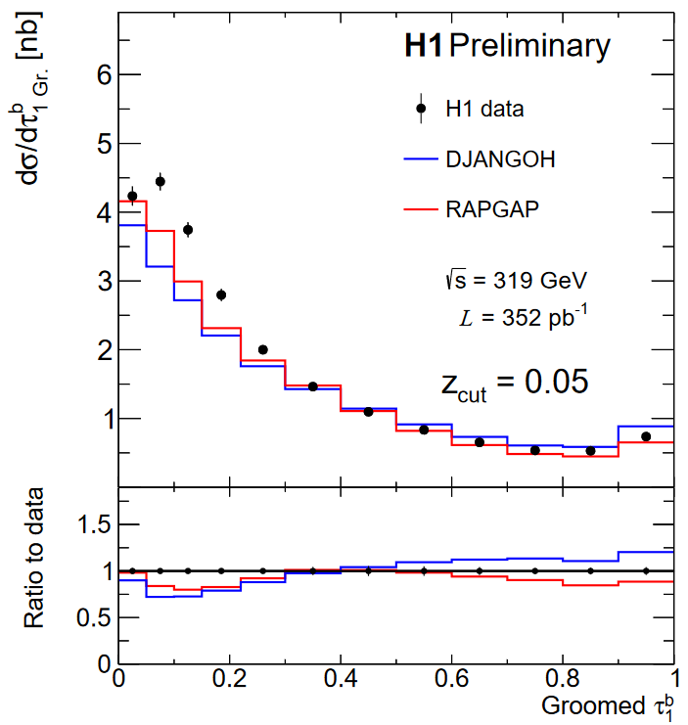
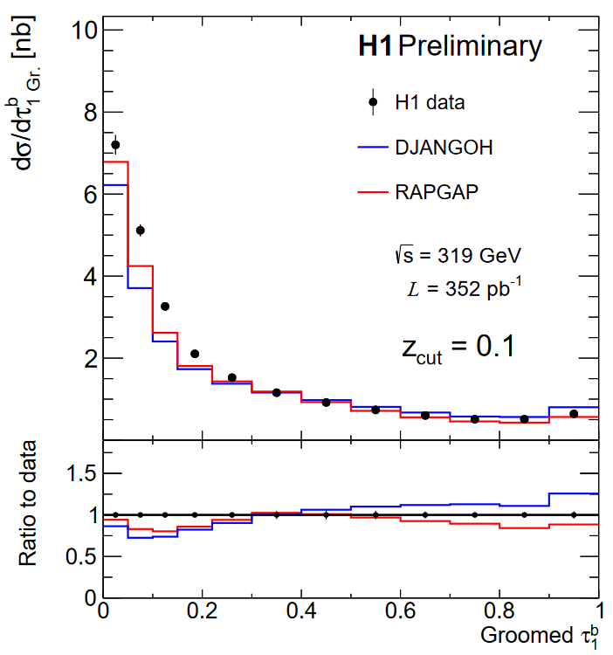
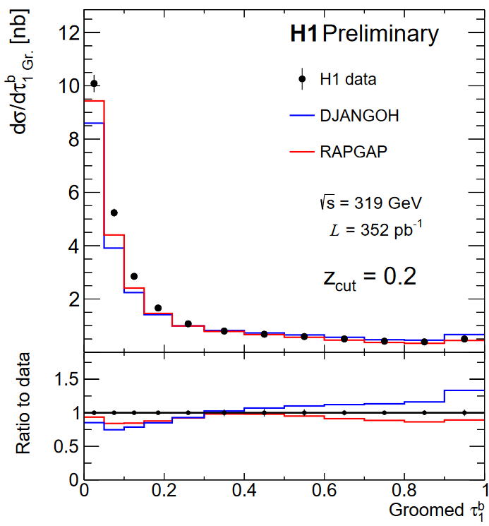
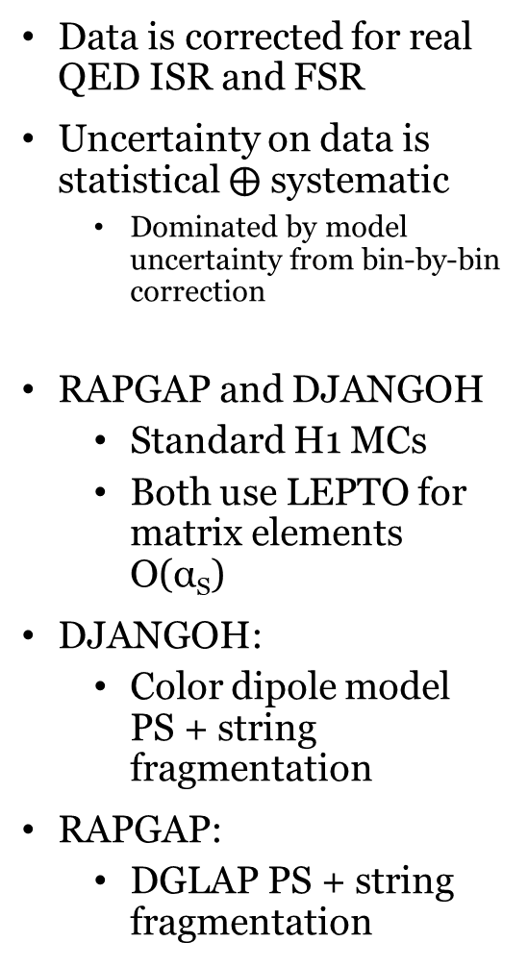
Results
Q²_{Min.}= 150 GeV²
Q²_{Min.}= 150 GeV²
Q²_{Min.}= 150 GeV²
Data is corrected for real QED ISR and FSR
Uncertainty on data is statistical $⨁$ systematic
  Dominated by model uncertainty from bin-by-bin correction
RAPGAP and DJANGOH
  Standard H1 MCs
  Both use LEPTO for matrix elements O(α_{S})
DJANGOH:
  Color dipole model PS + string fragmentation
RAPGAP:
  DGLAP PS + string fragmentation
Increasing z_{cut}, harsher grooming

Slide 13
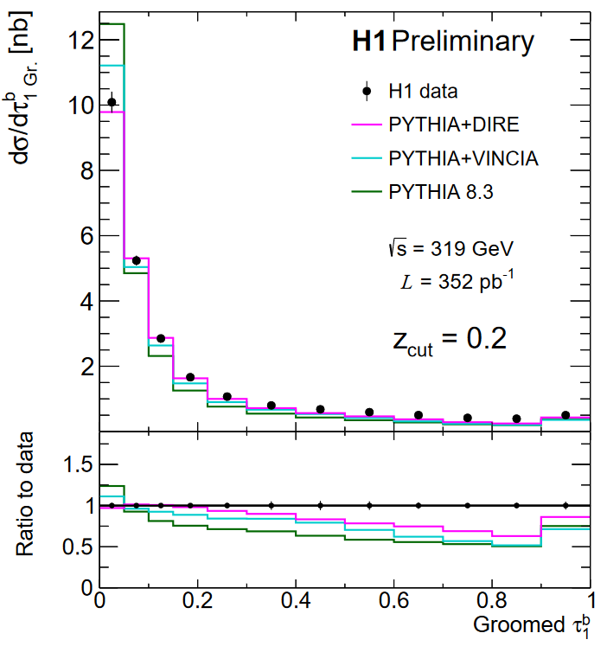
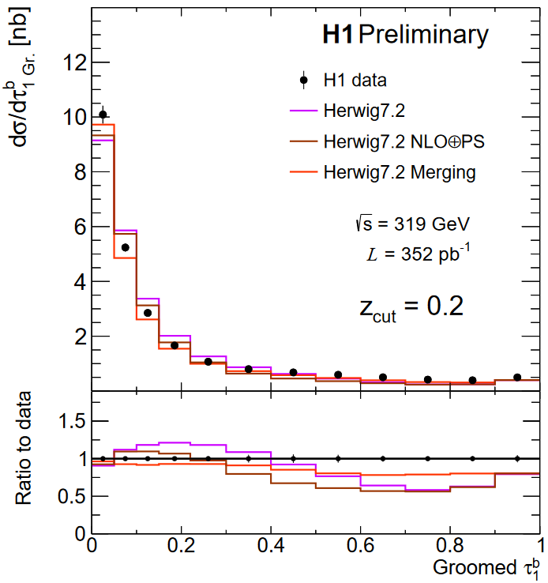
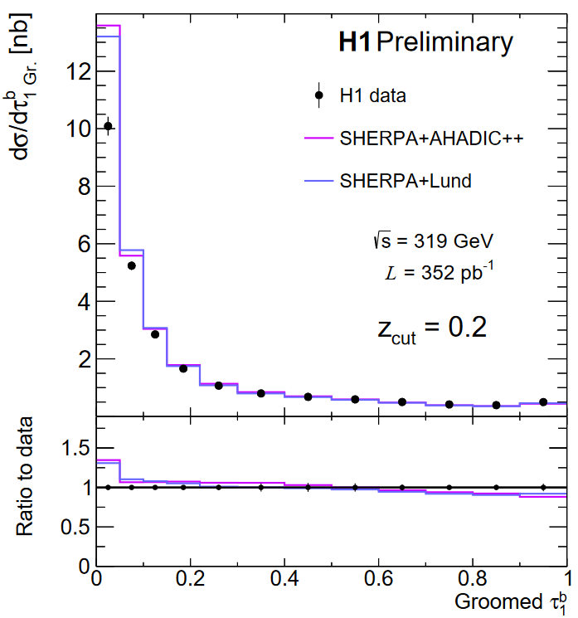
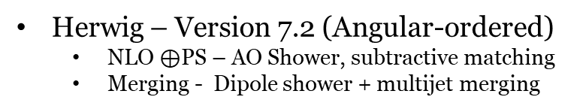
Results – Groomed 1 Jettiness
PYTHIA – Version 8.3
  VINCIA – Antenna Shower
  DIRE - Dipole shower + multijet merging
Best tail region from SHERPA, RAPGAP
  Fixed-order, multijets, hard splittings
Best peak region from DIRE, Herwig Merging
  Resummation, parton shower, hadronization
Herwig – Version 7.2 (Angular-ordered)
  NLO $⊕$PS – AO Shower, subtractive matching
  Merging - Dipole shower + multijet merging
SHERPA – Version 2.2.12 (MEPS@NLO)
  AHADIC++ - Cluster Fragmentation
  Lund – String Fragmentation
Notes:
The unreasonable effectiveness of SHERPA and VINCIA

Slide 14
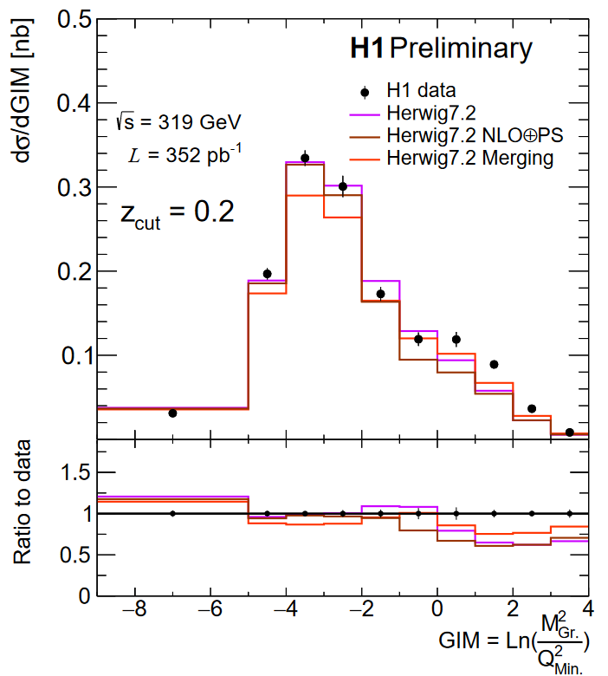
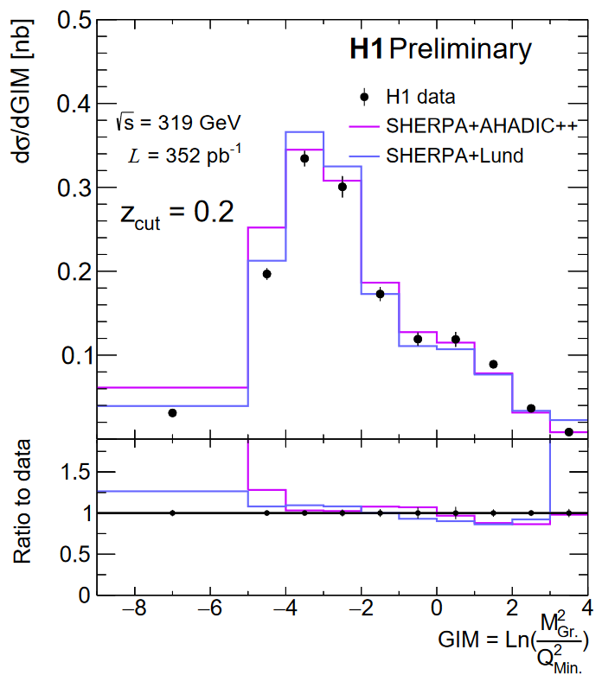
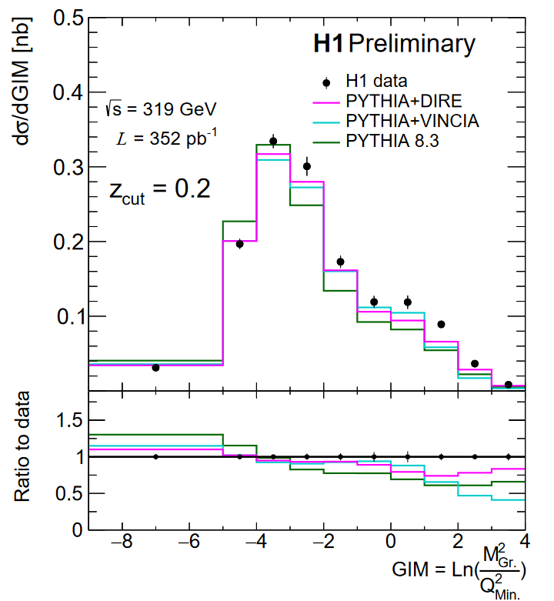
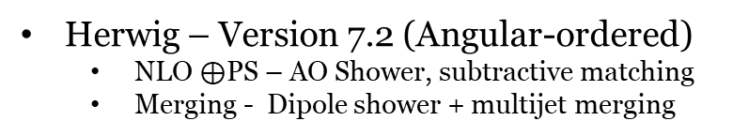
Results – Groomed Invariant Mass
PYTHIA – Version 8.3
  VINCIA – Antenna Shower
  DIRE - Dipole shower + multijet merging
Q²_{Min.} = 150 GeV²
Best high mass region from SHERPA
  Fixed-order, multijets, hard splittings
Best low mass region from Herwig, DIRE
  Resummation, parton shower, hadronization
Herwig – Version 7.2 (Angular-ordered)
  NLO $⊕$PS – AO Shower, subtractive matching
  Merging - Dipole shower + multijet merging
SHERPA – Version 2.2.12 (MEPS@NLO)
  AHADIC++ - Cluster Fragmentation
  Lund – String Fragmentation

Slide 15
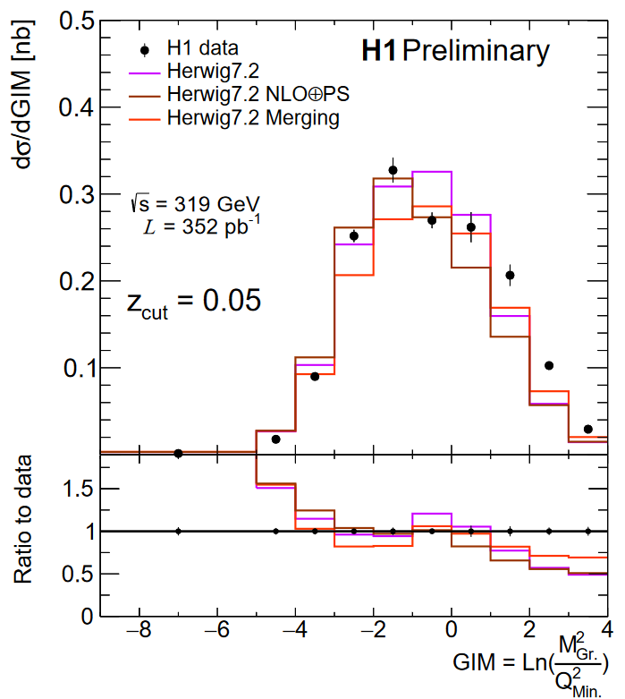
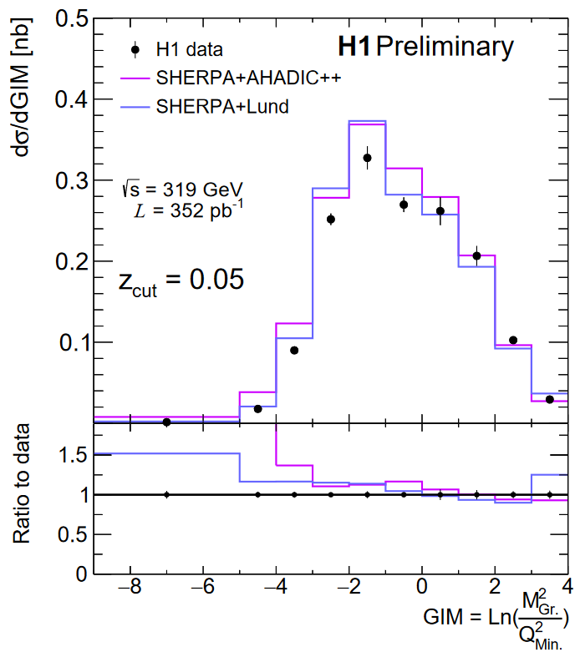
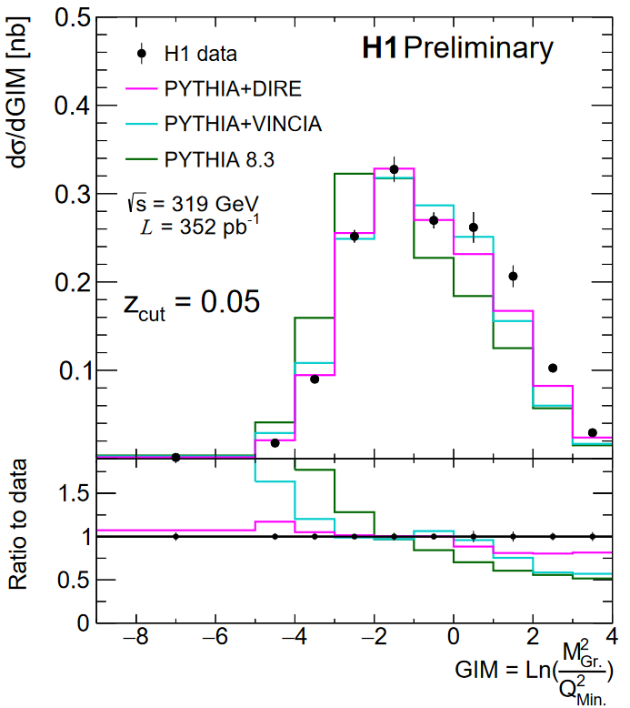
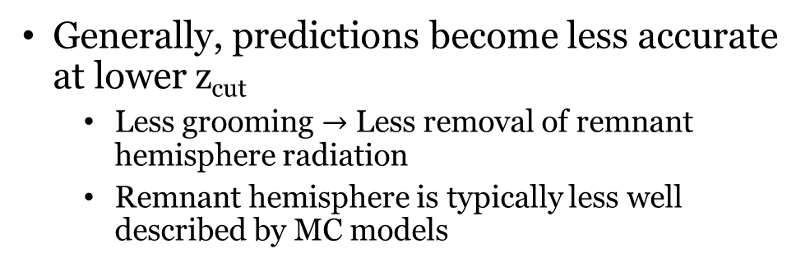
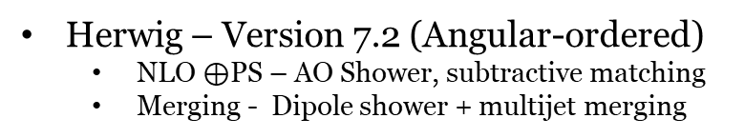
Results – Groomed Invariant Mass
PYTHIA – Version 8.3
  VINCIA – Antenna Shower
  DIRE - Dipole shower + multijet merging
Generally, predictions become less accurate at lower z_{cut}
  Less grooming $→$ Less removal of remnant hemisphere radiation
  Remnant hemisphere is typically less well described by MC models
Herwig – Version 7.2 (Angular-ordered)
  NLO $⊕$PS – AO Shower, subtractive matching
  Merging - Dipole shower + multijet merging
SHERPA – Version 2.2.12 (MEPS@NLO)
  AHADIC++ - Cluster Fragmentation
  Lund – String Fragmentation

Slide 16
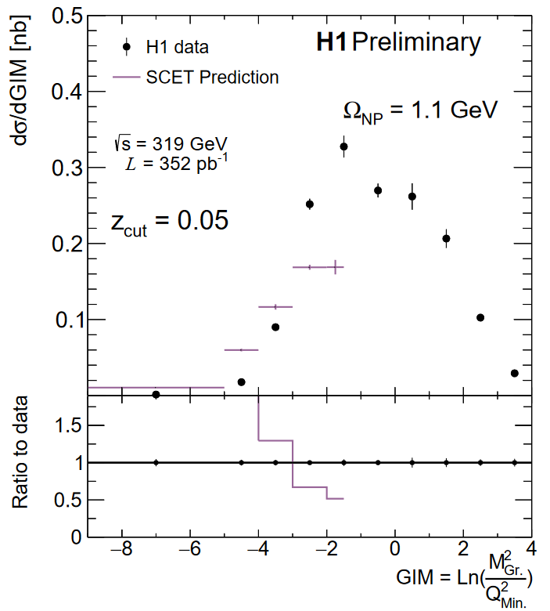
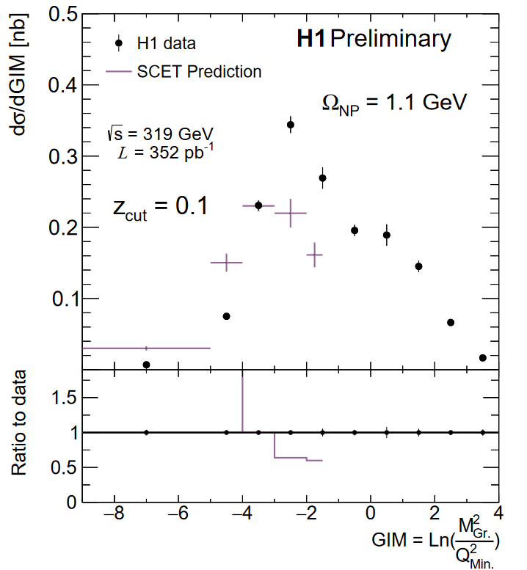






Results
Analytic - SCET
  From Y. Makris [1]
  Evaluated at two values of Ω_{NP}
    Shape function mean
  No fixed-order calculation yet incorporated
Agreement improves with increasing z_{cut,} Ω_{NP}
  Non-perturbative effects are significant!
  Factorization validity improves to higher z_{cut}

Slide 17



Groomed Invariant Mass - Future
At small invariant masses, individual hadron masses play a large role
Analytic predictions most accurate at small masses, in the region defined by:
EIC will have significant advantages in this region
  Hadron ID, high statistics
  More differential measurement possible
  New theory tools+data for high-precision studies of NP sector
LHeC will access larger region where factorization holds $→$ higher Q²
M_{Gr.} < 1 GeV

Slide 18
Conclusion
H1 has performed the first measurement of groomed event shapes in DIS
  H1prelim-22-033
  See also the ungroomed 1-jettiness preliminary: H1prelim-21-032
Data has been compared to a variety of MC predictions from SHERPA, PYTHIA, HERWIG, DJANGOH, RAPGAP, as well as analytic predictions from SCET
  None of the models studied here agree completely with data within uncertainties
  Signifies that DIS MC models could use improvement, especially in light of upcoming EIC
    Archived HERA data will necessarily play an important role in this initiative!
Check out other H1 Talks!
Multi-differential Jet Substructure Measurement in High Q² Deep-Inelastic Scattering with the H1 Detector
Machine learning-assisted measurement of multi-differential lepton-jet correlations in deep-inelastic scattering with the H1 detector
Probing hadronization and jet substructure with leading particles in jet at H1
Measurement of the 1-jettiness event shape observable in deep-inelastic electron-proton scattering at HERA

Slide 19
Bibliography
[1] - Revisiting the role of grooming in DIS, Y. Makris - arXiv:2101.02708
[2] – Groomed and energy-energy-correlation event shapes at EIC, Y. Makris - LBL Seminar: Oct. 2020
[3] – PYTHIA 8.3 Manual - arXiv:2203.11601
[4] – SHERPA 2.2.12 Manual - sherpa.hepforge.org/doc/SHERPA-MC-2.2.12.html
[5] – herwig.hepforge.org

Slide 20
Backup

Slide 21





Jet Direction (Breit η=-$∞$) = $\overline{n}$-collinear direction
Beam Direction (Breit η=-$∞$) = n-collinear direction
Soft Radiation (Isotropic)
Collinear-soft radiation, wide-angle soft radiation mostly along jet direction
In Region 1, shape of distribution depends only on jet and collinear-soft functions, which are independent of Q

Slide 22
Jet Direction (Breit η=-$∞$) = $\overline{n}$-collinear direction
Beam Direction (Breit η=-$∞$) = n-collinear direction
Soft Radiation (Isotropic)
Collinear-soft radiation, wide-angle soft radiation mostly along jet direction
Grooming causes only Jet and Collinear-soft radiation to contribute to shape of distribution in the single-jet (low invariant mass) limit
In Region 1, shape of distribution depends only on jet and collinear-soft functions, which are independent of Q

Slide 23

Results
Q²_{Min.}= 150 GeV²
Q²_{Min.}= 150 GeV²
Q²_{Min.}= 150 GeV²
Data is corrected for real QED ISR and FSR
Uncertainty on data is statistical $⨁$ systematic
RAPGAP and DJANGOH
  Standard H1 MCs
  Both use LEPTO for matrix elements O(α_{S})
DJANGOH:
  Color dipole model for parton shower + string fragmentation
RAPGAP:
  DGLAP parton shower + string fragmentation

Slide 24



Results
SHERPA
  Version 2.2.12
  MEPS@NLO
AHADIC++:
  SHERPA native cluster hadronization model
Lund:
  Lund string model from PYTHIA
Both models provide good description of fixed-order region
Notes:
Sherpa tends to overestimate

Slide 25




Results
Herwig
  Version 7.2.2
NLO$⊕$PS:
  Herwig internal implementation of MC@NLO via Matchbox
Merging:
  Dipole shower with multijet merging

Slide 26



Results
PYTHIA
  Version 8.3
  No external matrix elements
DIRE:
  Dipole resummation
  Excellent description in resummation region
VINCIA:
  Antenna shower

Slide 27
Results
Analytic - SCET
  From Y. Makris [1]
  Evaluated at two values of Ω_{NP}
    Shape function mean
  No fixed-order calculation yet incorporated
Agreement improves with increasing z_{cut,} Ω_{NP}
  Non-perturbative effects are significant!
  Factorization validity improves to higher z_{cut}

Slide 28




Centauro
vs.
vs.
Cluster at pi has low P_{T} in Breit frame, smaller d_{ij}
Doesn’t preferentially capture struck quark
Not longitudinally invariant

Slide 29



Slide 30
Centauro
vs.
vs.
Cluster at π has low P_{T} in Breit frame, smaller d_{ij}
Doesn’t preferentially capture struck quark
Not longitudinally invariant

Slide 31


Centauro
Jet algorithm with asymmetric clustering measure
  Treat current hemisphere and beam hemisphere differently
Typical longitudinally-invariant jet algorithms cluster in (rapidity, azimuthal angle) space and fail to capture the born-level configuration in the Breit frame
  Particles close to struck-parton direction have divergent rapidity, and therefore divergent distance between each other!
    Makes study of single-jet Born level configuration impossible!
Use spherically invariant clustering (polar angle, azimuthal angle) in the struck-parton direction and longitudinally invariant in beam direction
Tends to create one hard jet in struck-parton direction and many weak single particle jets in beam direction, which can easily be filtered away

Slide 32


