Slide 1
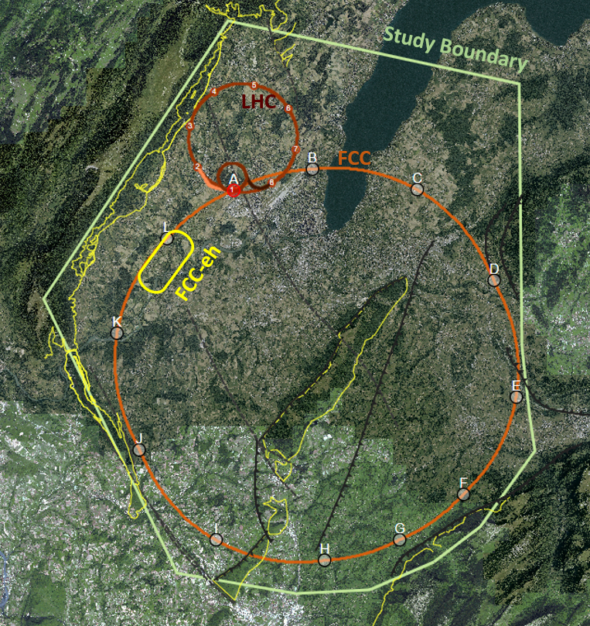

A common eh & hh interaction region and detector for the LHC
K.D.J. André, B. Holzer, M. Klein, P. Kostka for the LHeC study group
CDR (2012) & CDR (2020)
LHeC
arXiv:1206.2913
arXiv:2007.14491
Energy frontier electron hadron experiment with a luminosity of up to 10³⁴ cm⁻²s⁻¹ to complement the HL-LHC physics program with unprecedented TeV scale DIS physics. Featuring an innovative lepton accelerator design based on the energy recovery technology.
Offshell conference (2021)
Offshell(2021)
EPJC (2022)
EPJC(2022)

Slide 2
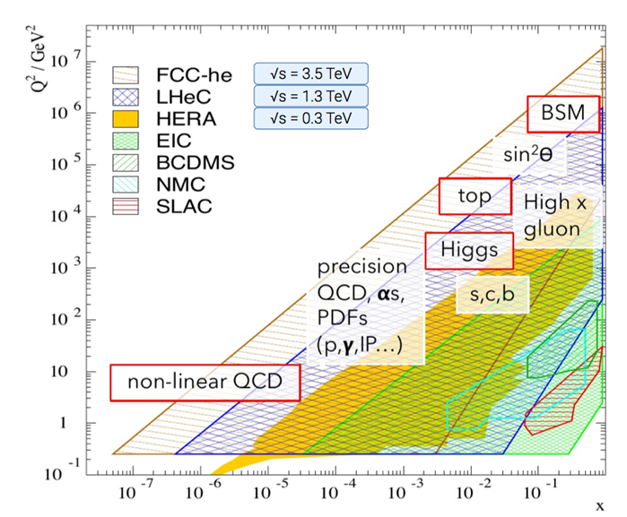
LHeC kinematic plane & physics program
Rich physics program at low and high luminosity and low and high-scale physics
Polarised electrons are foreseen
Details on the physics can be found in the references.
Compared to HERA
  100 times the luminosity
  4 times larger √s
e-p data in the mid 2030s.

Slide 3
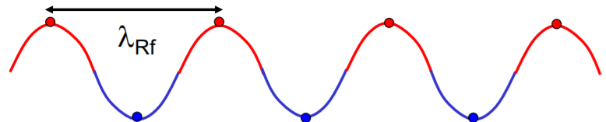

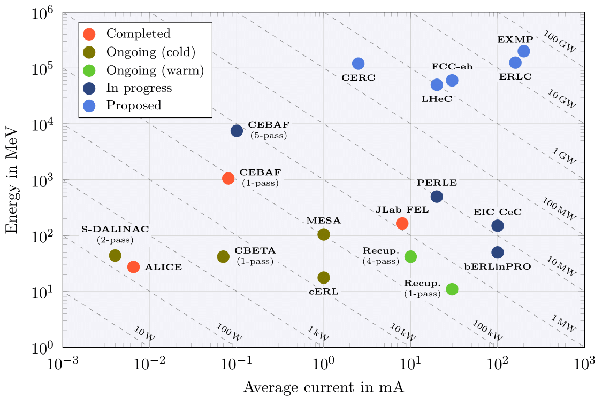
The Energy Recovery technology
Cavity Voltage
The energy recovery technology allows to recycle the power given to the beam.
Injection
Linac
Dump
E = E ± ΔE
+ 0.5 λ_{RF}
Experiment
Proven accelerator technology, pushing for higher energy and beam current in view of collider applications.
PERLE demonstrator facility for the LHeC at Orsay to be commissioned in 2025+
with 3-turn, 20mA, 802 MHz SRF cavities
see A. Stocchi’s talk
ERL R&D Roadmap

Slide 4
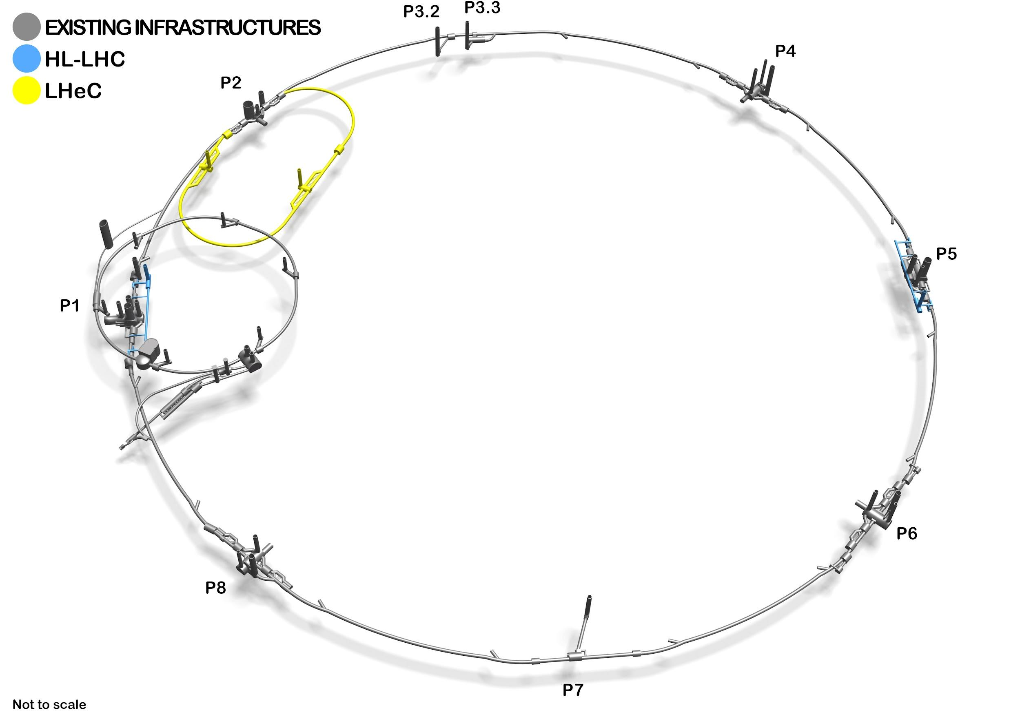
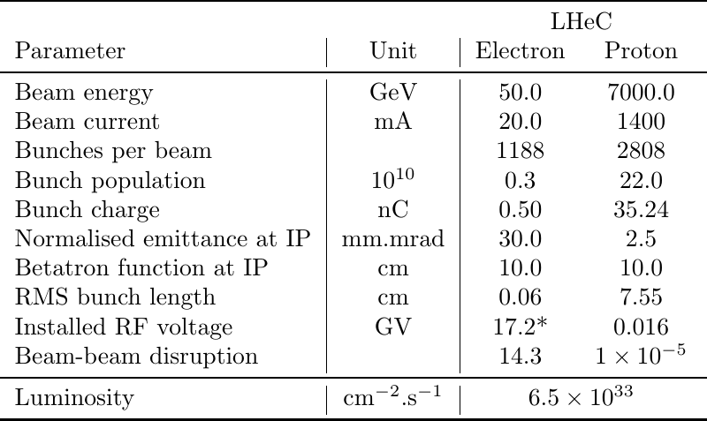
Beam parameters for the LHeC experiment
High power electron beam based on three-turn ERL racetrack utilising 100 MW electrical power consumption as a result of the high energy recovery efficiency. ERL circumference equivalent to one-third of the LHC. The ERL could be realised in staged phases.

Slide 5
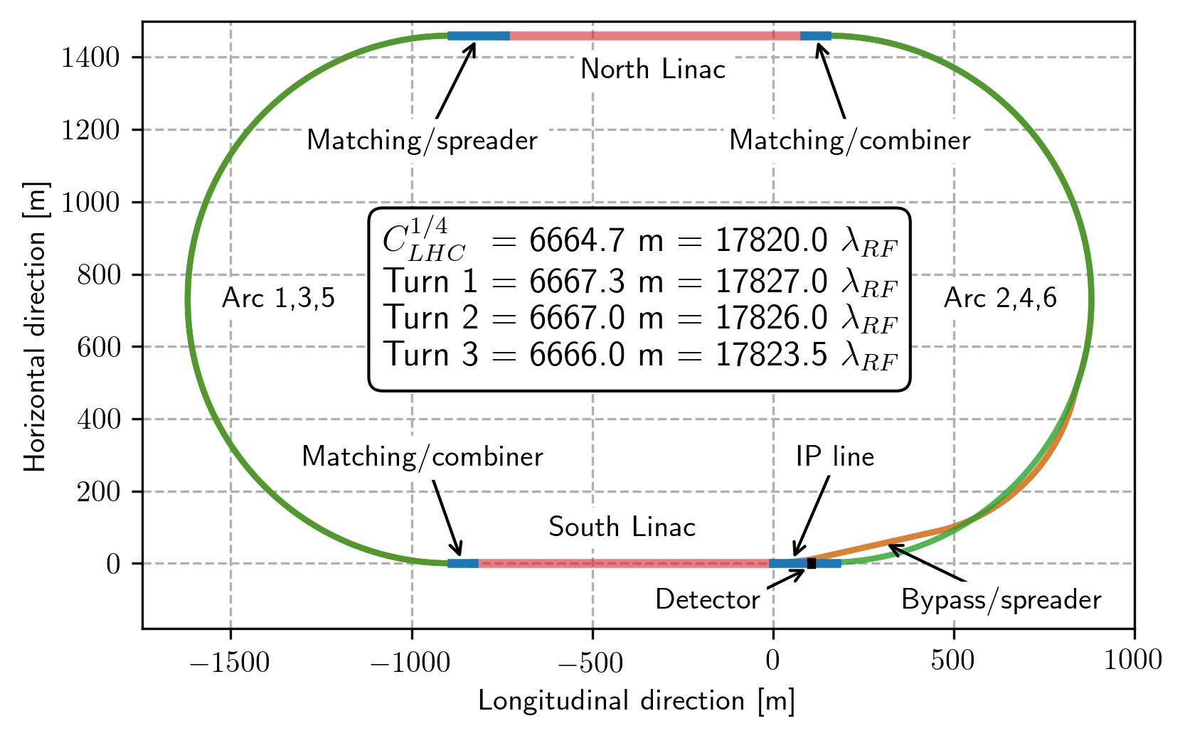
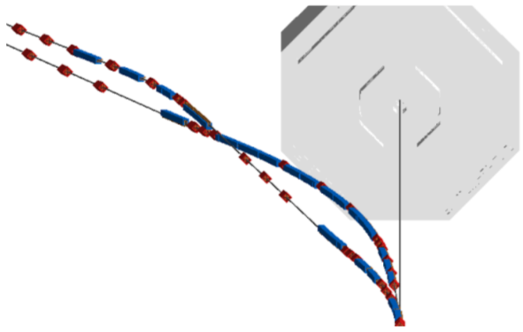
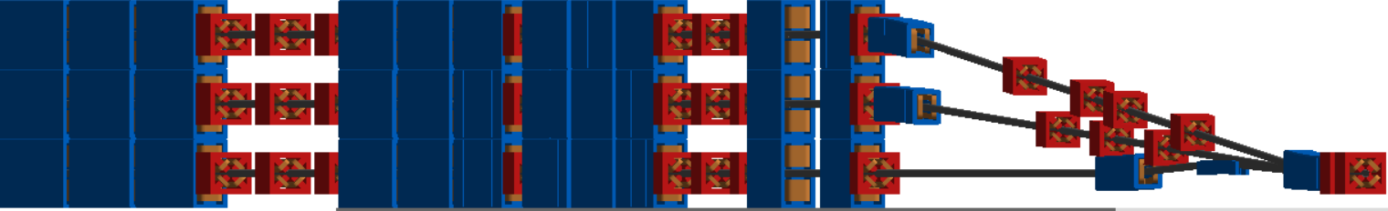
Energy Recovery Linac - I
3D visualisation of the detector bypass
dispersion matching
periodic arc
dispersion suppressor
chicane
spectrometer dipole

Slide 6
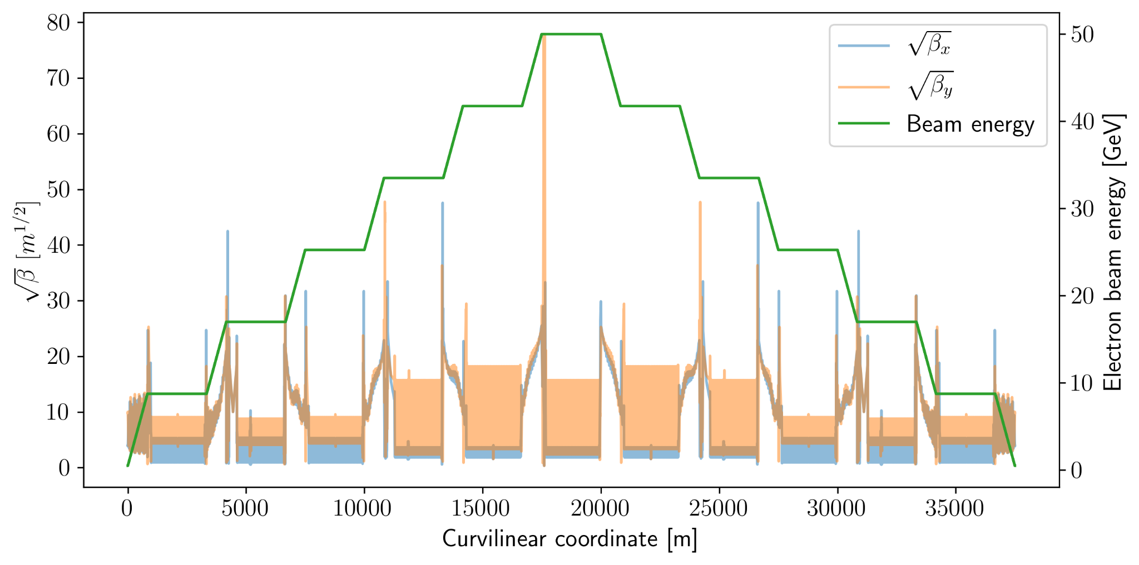
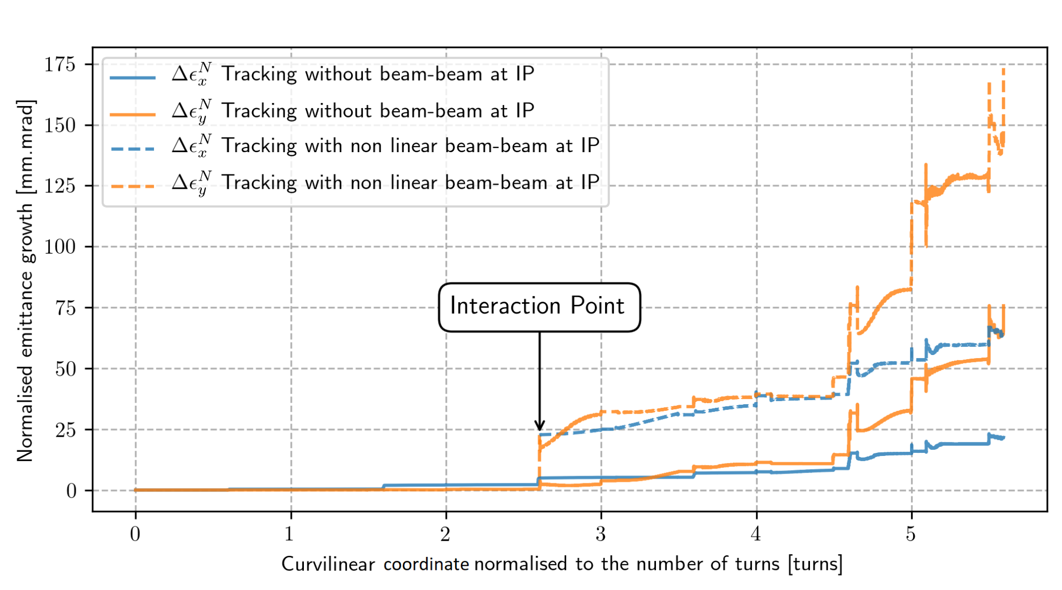
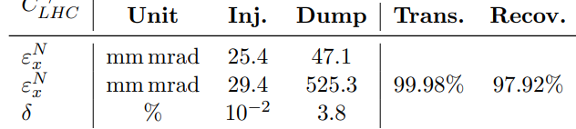
Energy Recovery Linac - II
Energy gain over 3 turns to reach 50 GeV,
Succession of the linacs and arcs with the RF phase shifted in the sixth arc following the collision to initiate the deceleration,
Maximum beta function in the junction between arcs and linacs as well as in the mini-beta quadrupoles.
Front-to-end simulations including synchrotron radiation and beam-beam interaction at the IP have shown an excellent transmission and energy recovery efficiency.

Slide 7
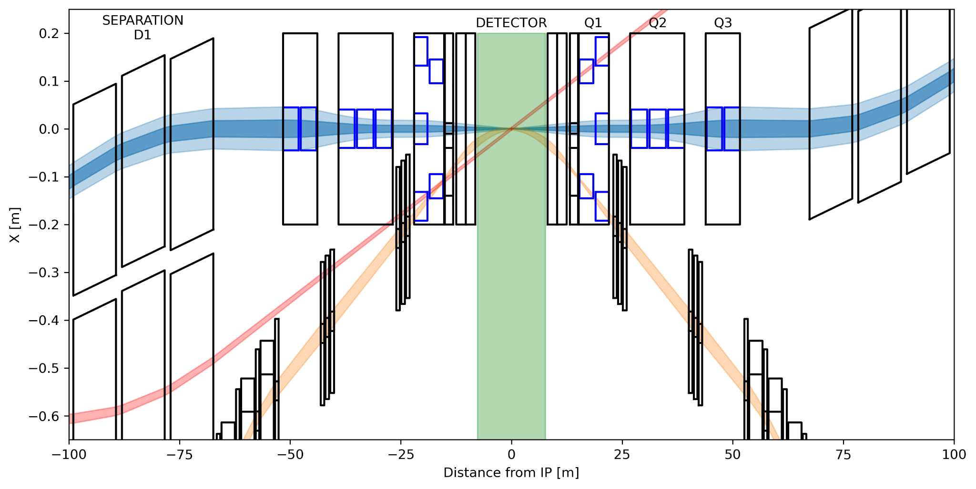
LHeC eh interaction region
3 beams crossing the interaction region:
* Colliding electron and proton beams have an optimised separation scheme,
* Interaction Point (IP) shifted by Δt/4 = 6.25 ns or 1.88 m,
* The non-colliding proton beam is a spectator and both proton beams have a large crossing angle of 7 mrad.
proton optics FCC-eh: L* = 23 m & β* = 30 cm || LHeC L* = 15 m & β* = 10 cm

Slide 8
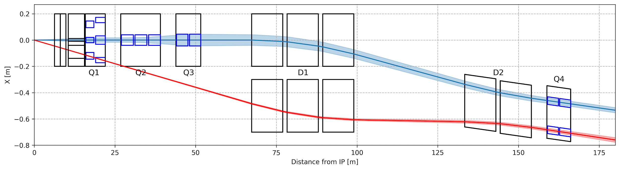
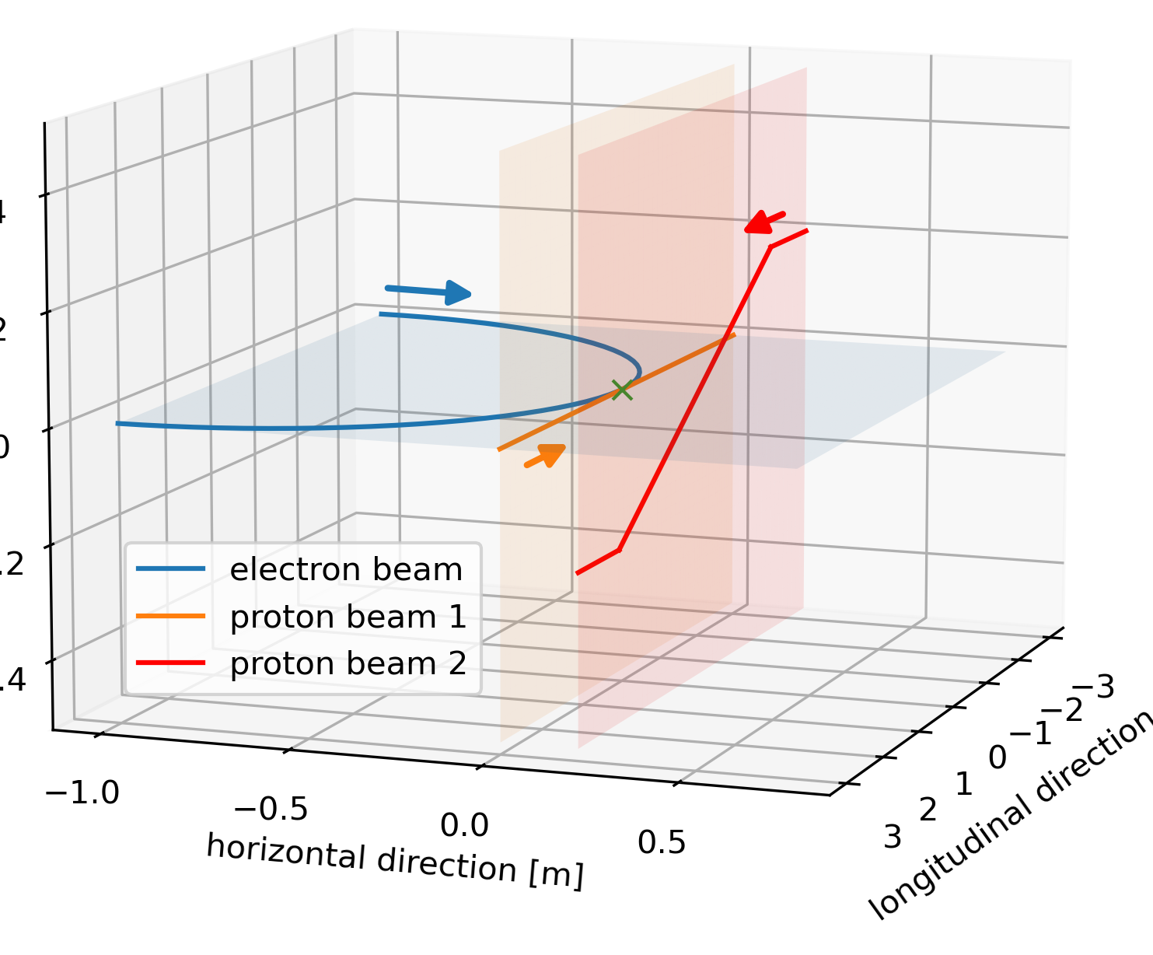
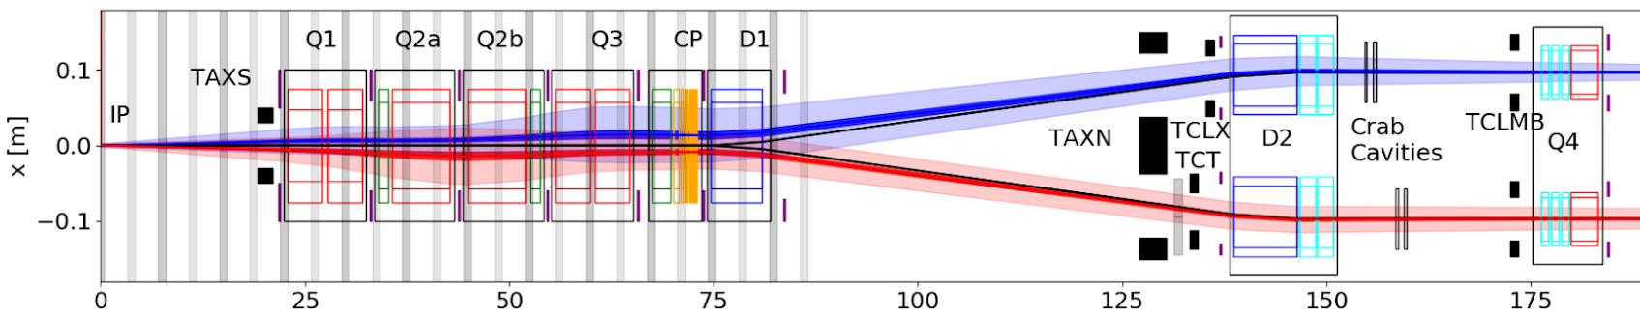
Combined hh|eh interaction region
Accelerator considerations to combine the ALICE and LHeC experiments at point 2 of the HL-LHC:
Flexible interaction region optics and lattice to provide e-h and h-h.
h-h operation: standard HL-LHC optics.
e-h operation: the compact electron final focus system is embedded in the HL-LHC proton lattice.
A beam separation scheme guides the electron beam after the collision point back to the ERL return arc.
Two modes of operation:
hh collisions in IP 1, 2, 5 and 8, no e⁻ beam
eh collisions in IP 2 and hh collisions 1, 5 and 8
HL-LHC with LHeC, L* = 15 m, β* = 10 cm, θ = 7 mrad
Standard HL-LHC, L* = 23 m, β* = 15 cm, θ = 590 μrad
vertical direction
longitudinal direction
Courtesy from Massimo Giovannozzi (2019)
horizontal direction

Slide 9
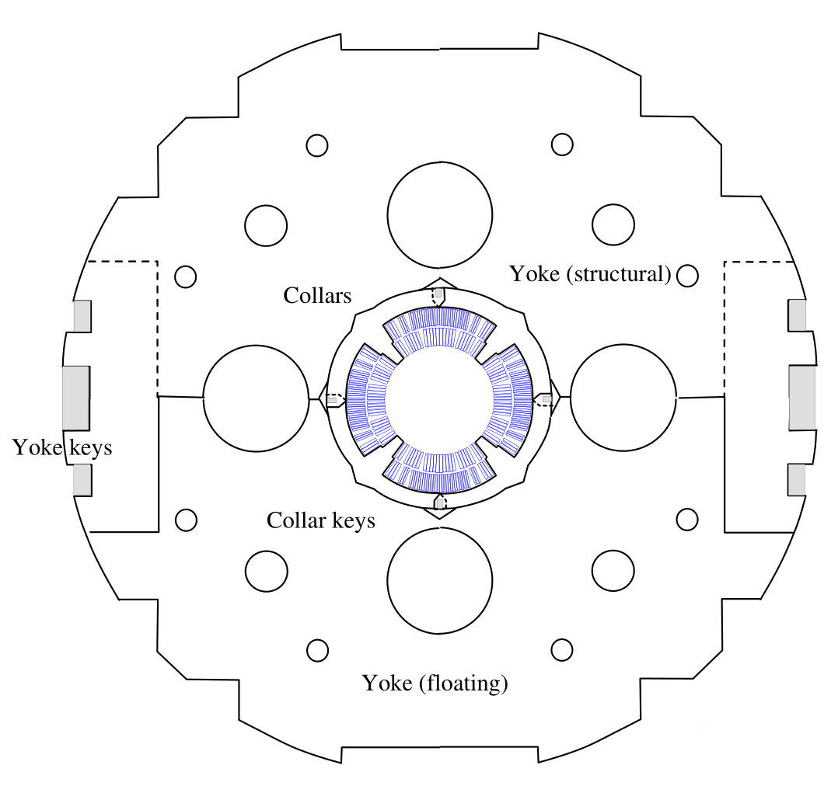
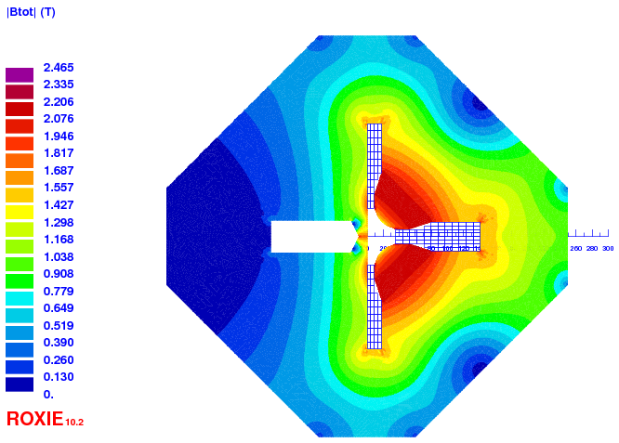
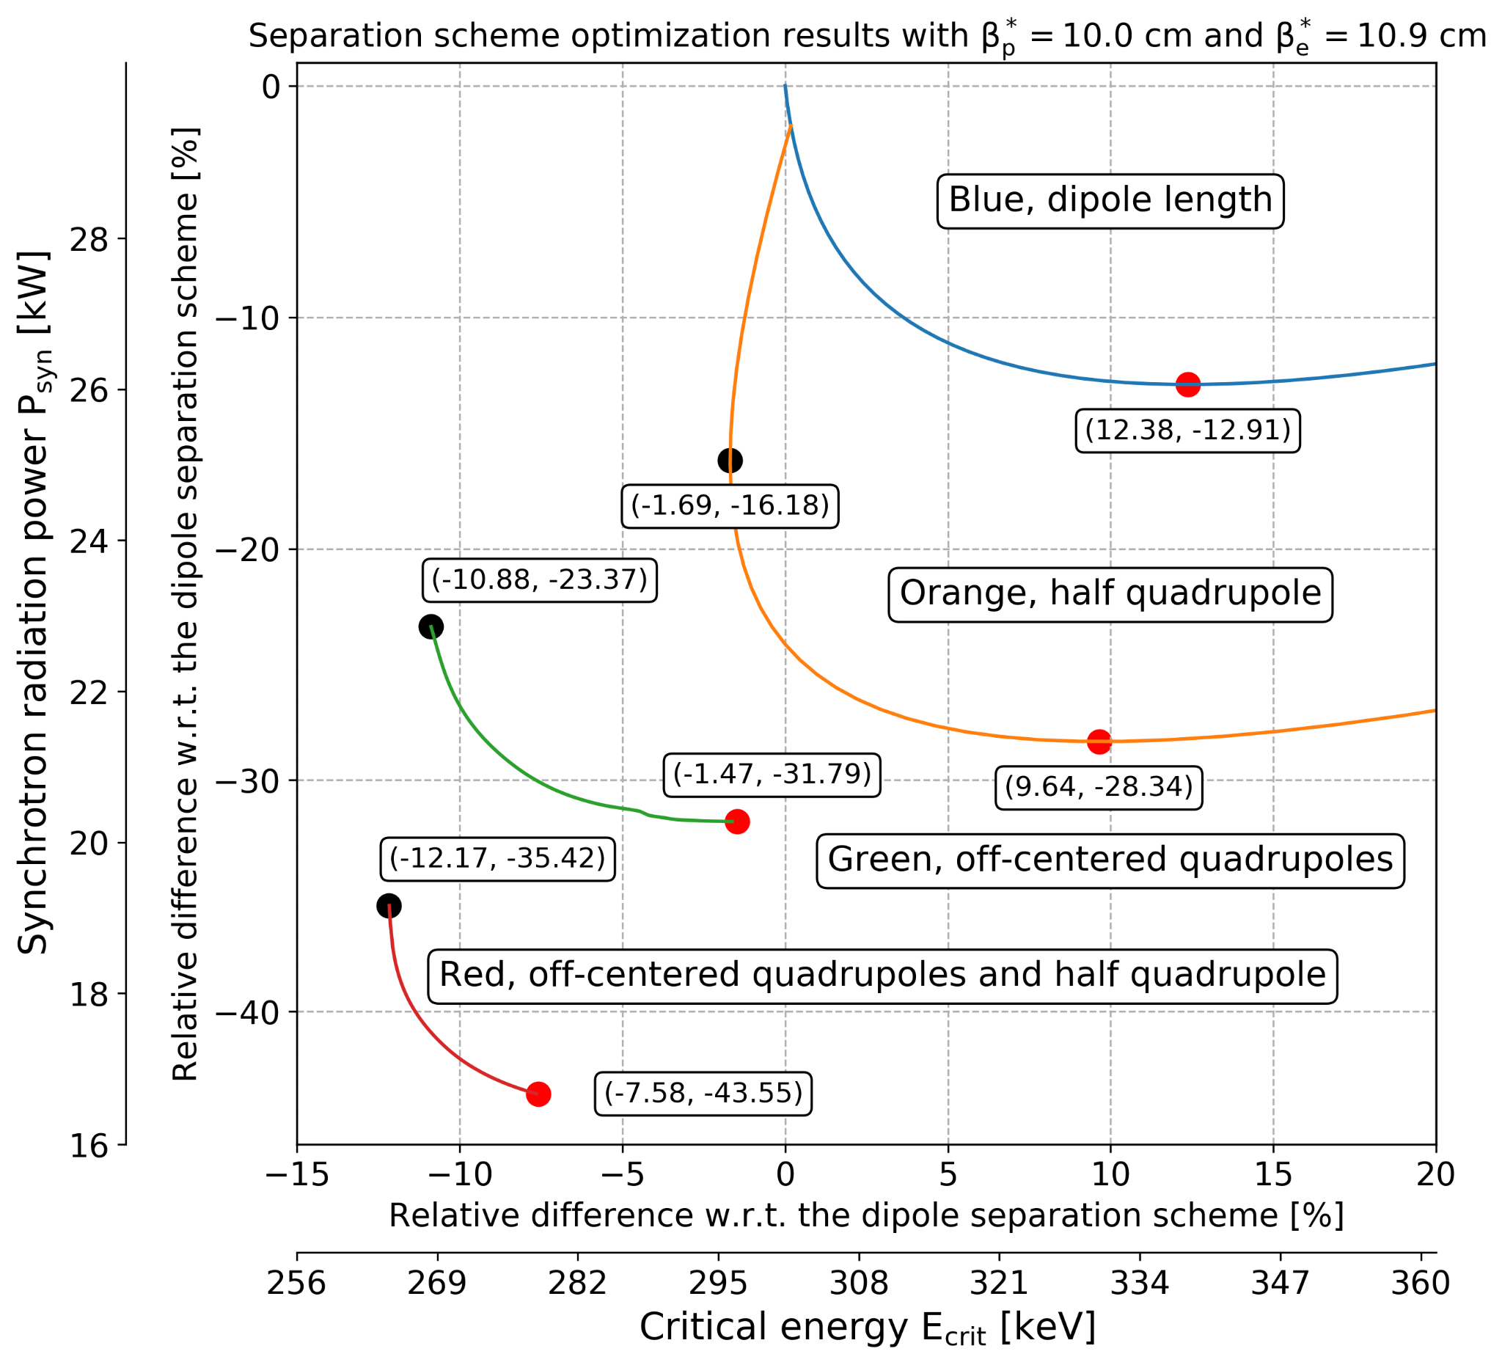
e-p beam separation scheme optimisation
Based on the difference in beam rigidities of the colliding beams.
Q1A magnet design
-L*
-⅔ L*
-⅓ L*
IP
⅓ L*
⅔ L*
L*
s
p
Q1A
Q0
Q0F
B
Q0F
Q0
Q1A
Q0D
Q0D
e⁻
* Optimisation to extend the distance to separate the beam with Q0
* Optimisation to reduce the electron beam size at Q1A with Q0F & Q0D
Q0 magnet design
S. Russenschuck & B. Parker

Slide 10
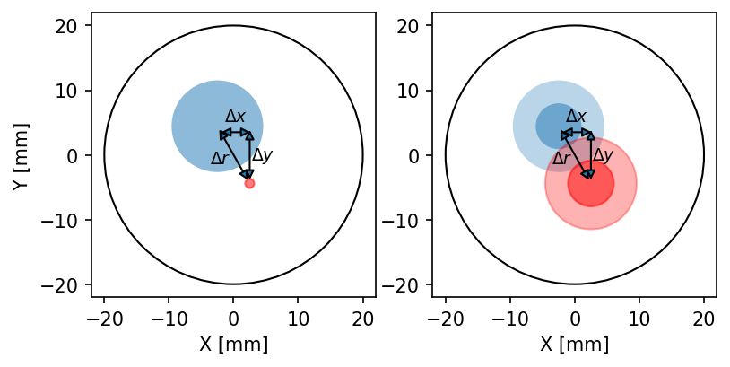
Combined hh|eh interaction region
Based on HL-LHC optics and lattice design, the two proton beams must be housed in the same quadrupole aperture unlike the past LHeC proton interaction design.
Horizontal separation at the IP and vertical crossing angle to avoid parasitic interactions.
The second proton beam should have a flexible optics design:
  a relaxed optics design, during eh operation, as it acts as a spectator beam with an “injection like optics”,
  a collision optics design, during hh operation, to realise the HL-LHC luminosity
Tradeoff between quadrupole aperture and achievable beam size at the IP for both eh and hh configurations.
s [m]
LHC proton beam trajectories from the IP to the matching quadrupole Q4
Relaxed (left) and collision optics (right) in a quadrupole aperture

Slide 11
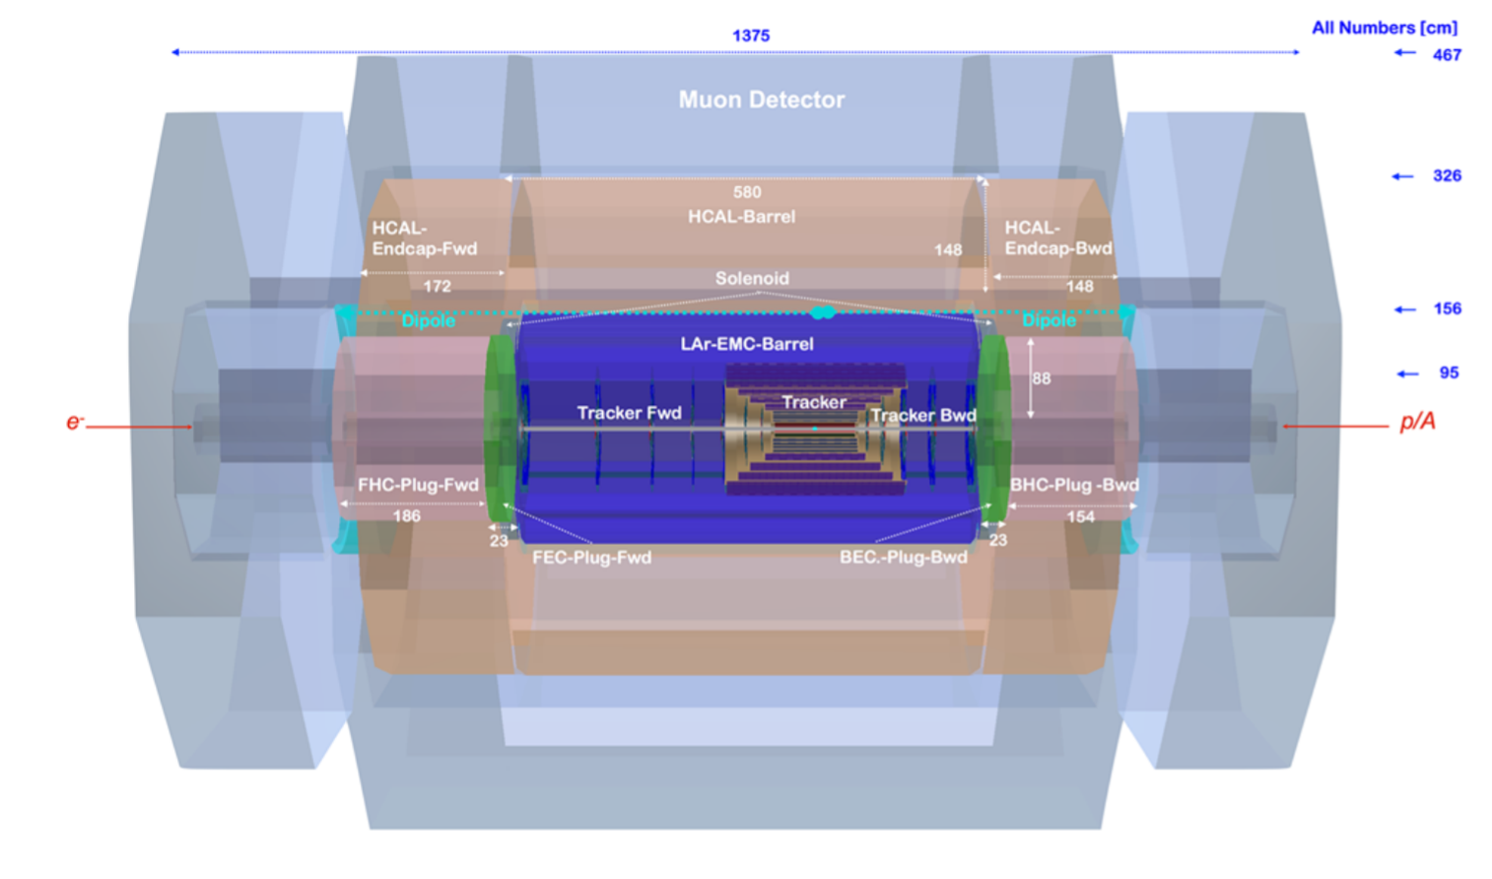
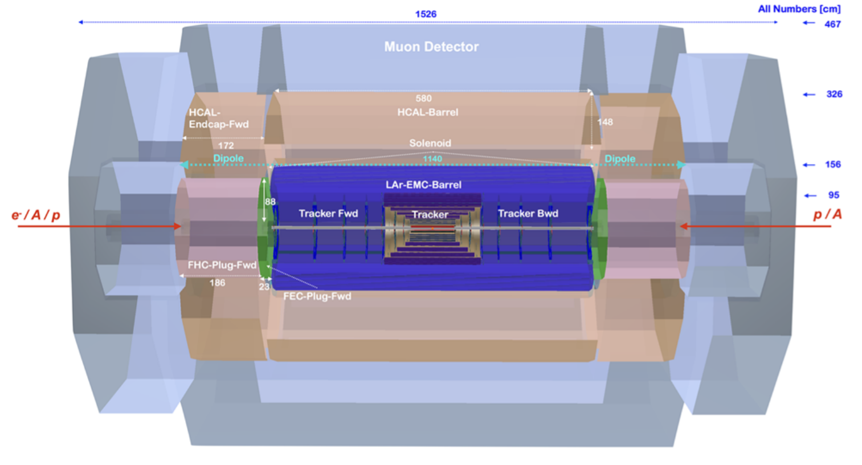
Detector design - EPJC
e-h detector design for the LHeC
e-h & h-h detector design for the LHeC
e- /A / p
p/A
p/A
e-
Silicon tracker, surrounded by an electromagnetic (LAr) calorimeter and a combined solenoid and dipole magnets enclosed by a hadronic calorimeter and muon system. Need of forward-backward symmetry to include hadron-hadron physics.

Slide 12
Summary
* LHeC: 50 GeV electron beam from an ERL colliding with a 7 TeV proton beam from the LHC concurrent to the HL-LHC hadron-hadron operation.
* They are ongoing studies to tackle the challenges to realise a proton lattice and optics design with an interaction region combining e-h & h-h.
* The symmetrisation of the detector design would make possible the study of eh and hh physics at IP2.
* The combination of the LHeC and ALICE upgrade would allow to push the energy frontier for electron-ion collisions beyond that of the EIC in Brookhaven providing a synergy of the polarisation studies at BNL and the energy frontier studies at CERN.

