Slide 1
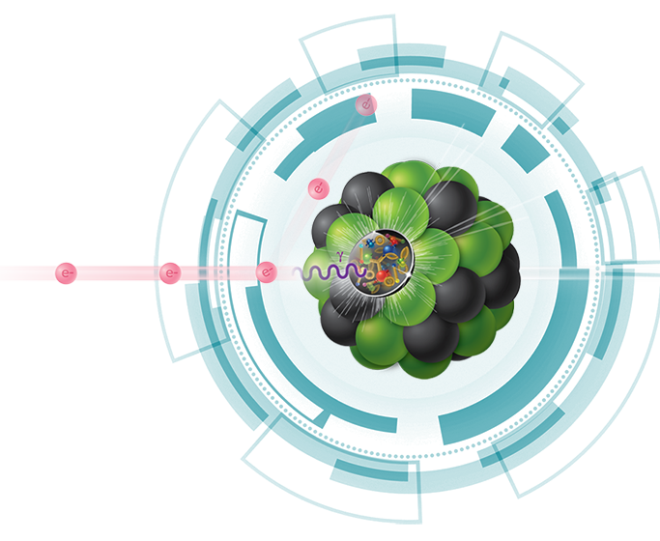

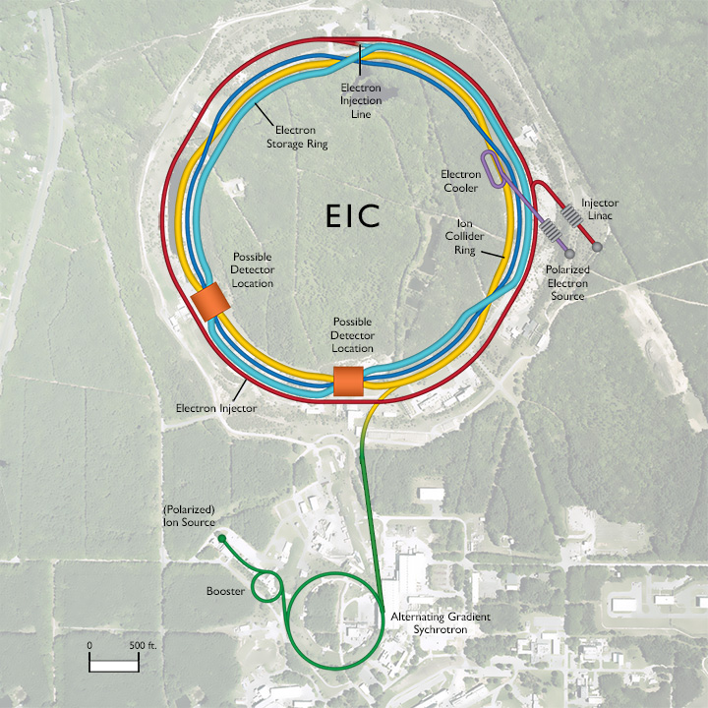
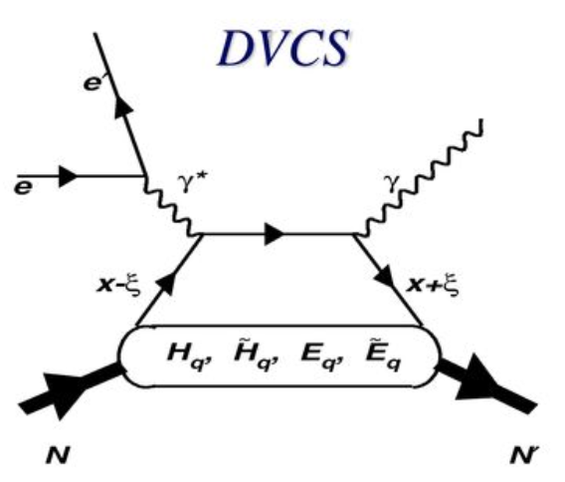
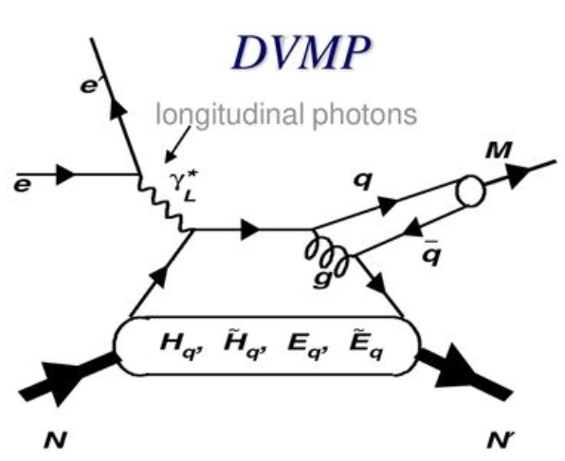
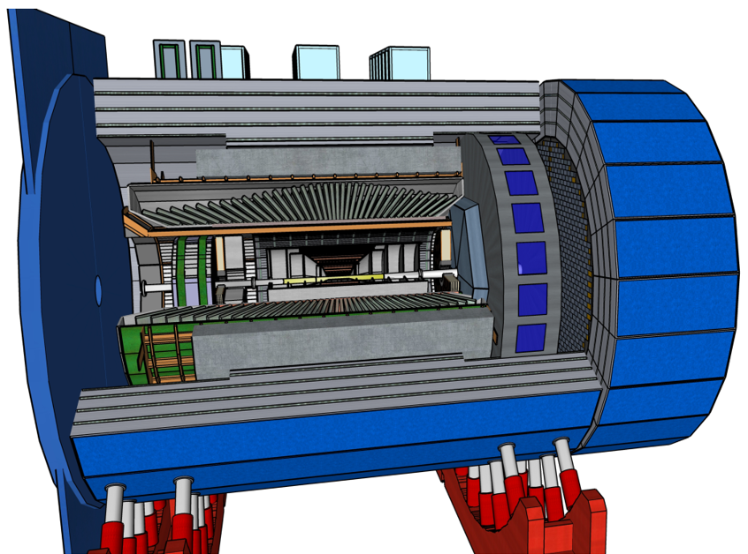
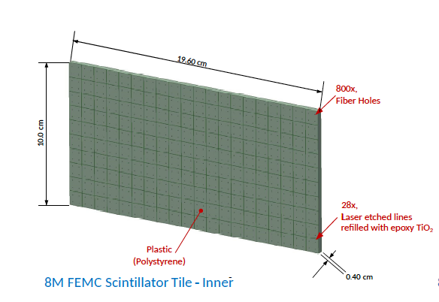
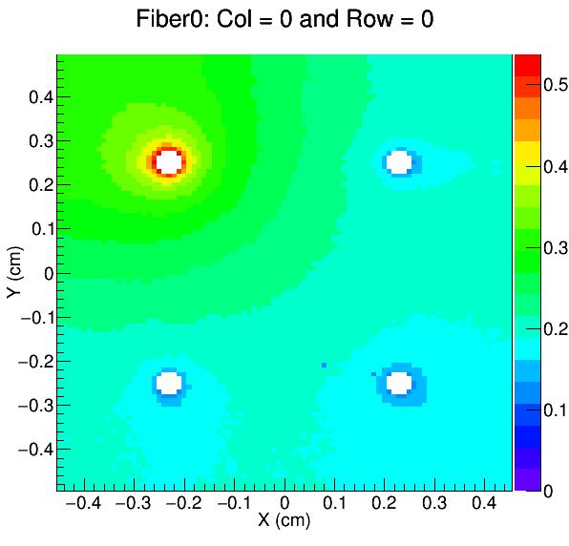
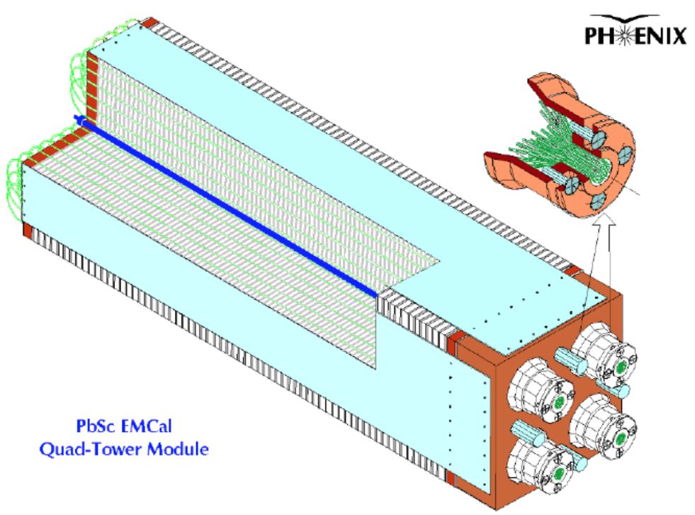
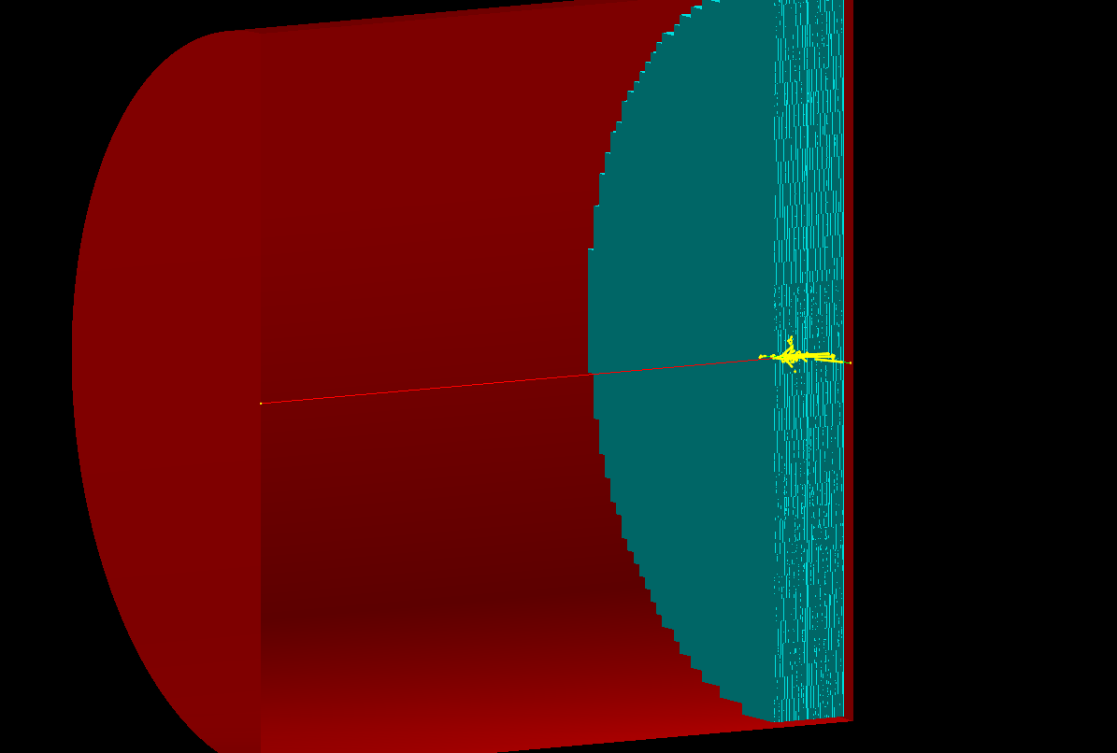
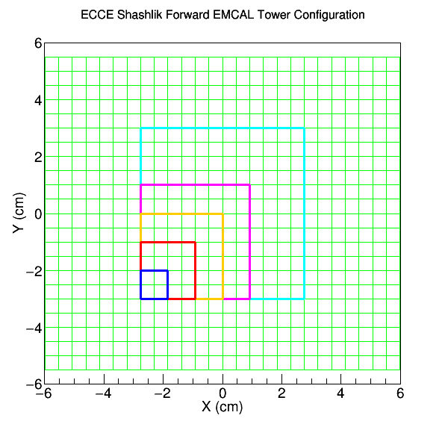
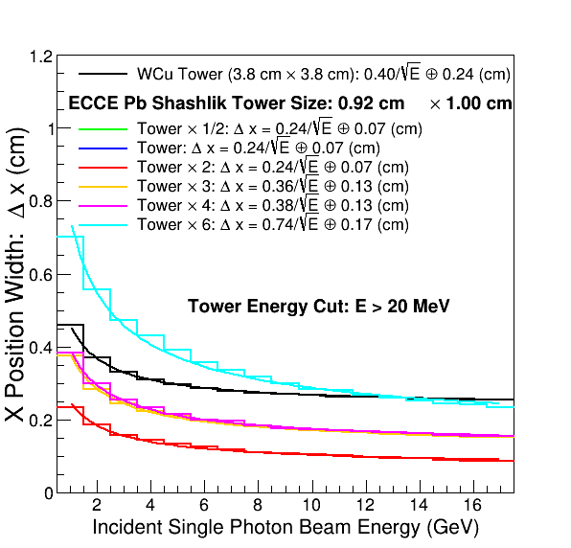
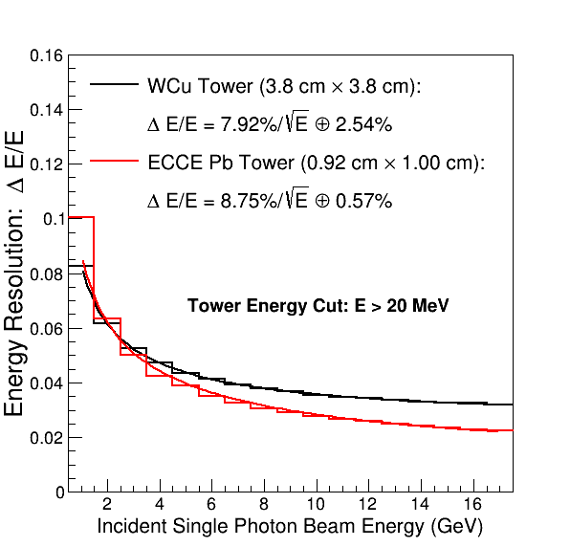
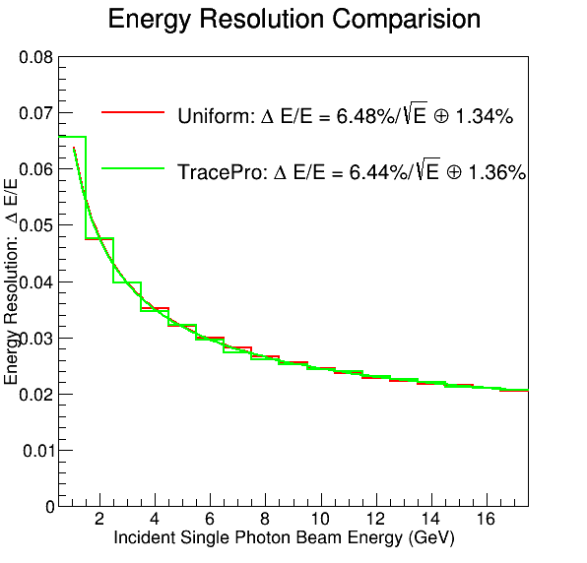
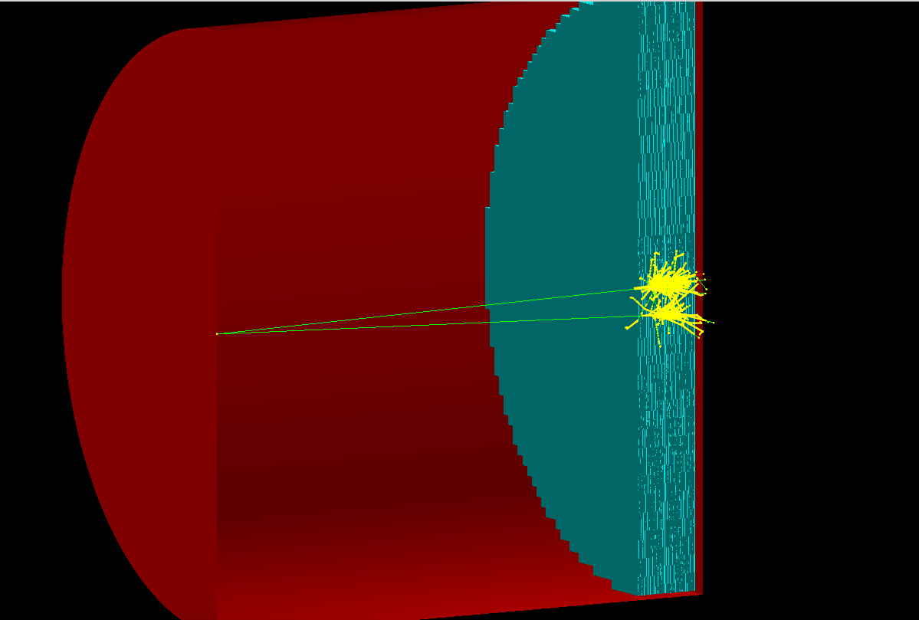
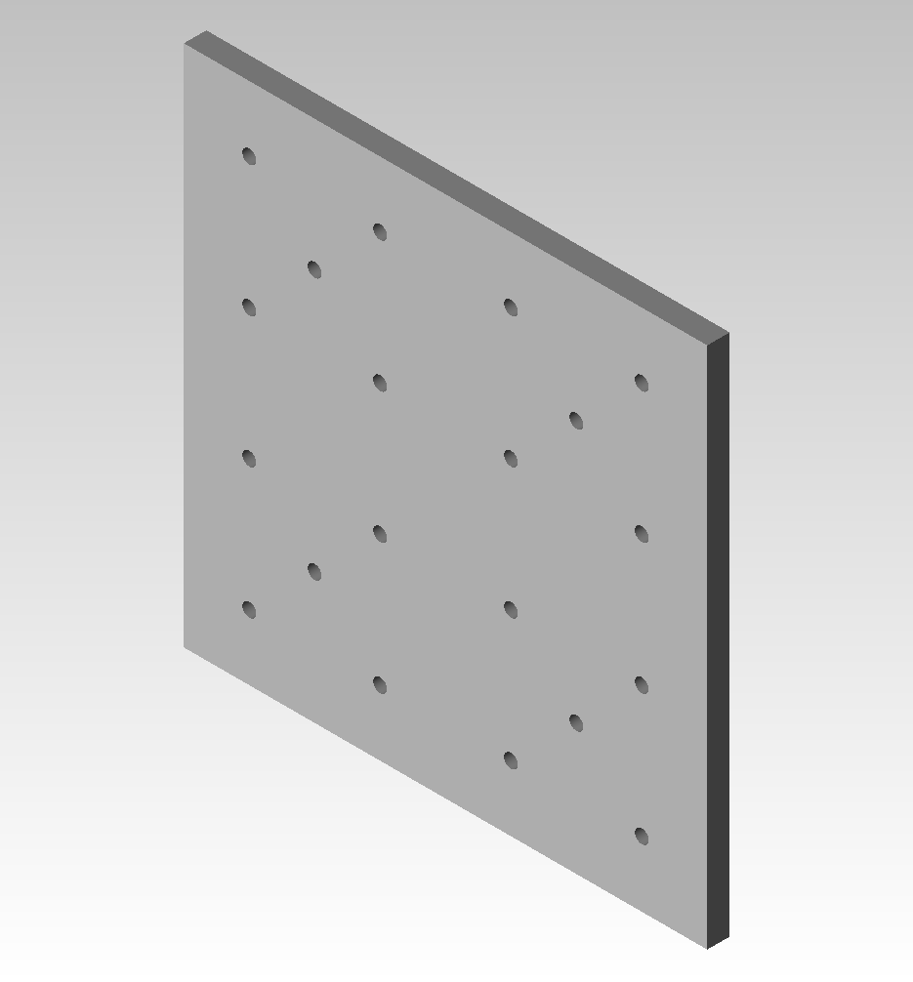
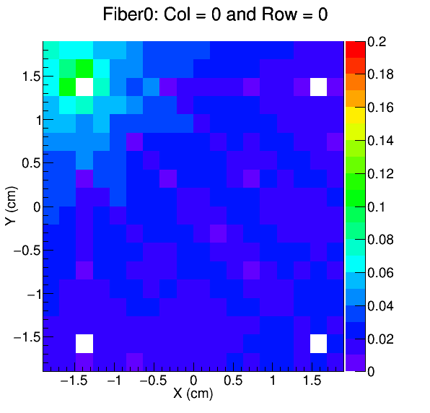
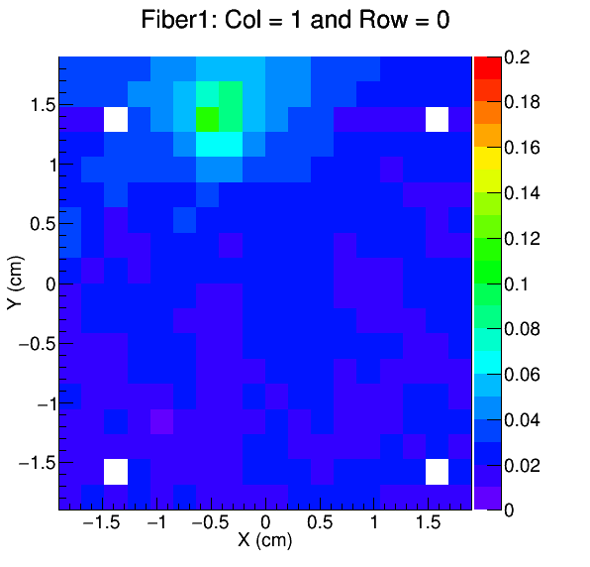
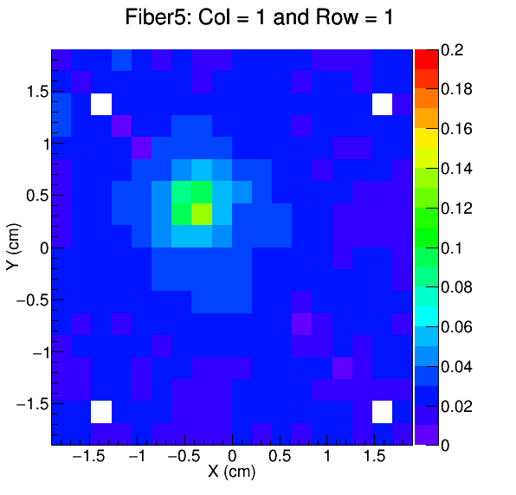
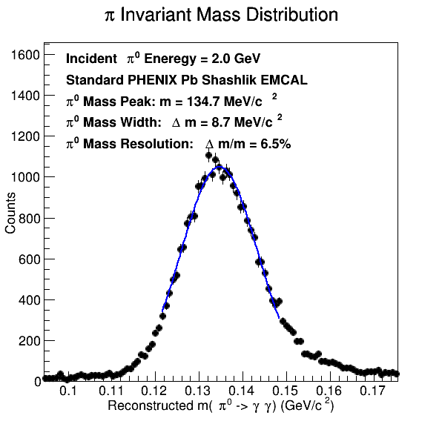
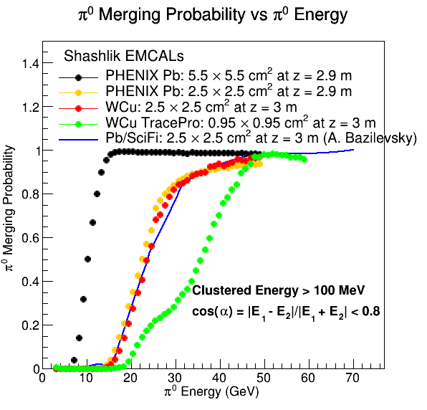


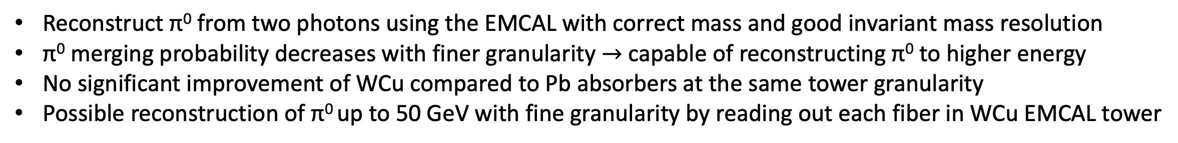

Development of Future Electromagnetic Calorimeter
Technologies and Applications for the Electron-Ion Collider with GEANT 4 Simulations
Zhaozhong Shi (Los Alamos National Laboratory)
Email: zhaozhongshi@lanl.gov
Abstract
The Electron-Ion Collider (EIC) is a future collider planned to be built at BNL in about a decade. It will provide physicists with high luminosity and highly polarized beams with a wide range of nuclei species at different energies, covering an extensive kinematic range. The EIC physics goals include measuring the Generalized Parton Distribution (GPD) from Deeply Virtual Compton Scattering (DVCS) and Deeply Virtual Meson Production (DVMP) experiments, performing precision 3D imaging of the nuclei structure, studying color confinement and hadronization mechanisms, and understanding the spin structure of the proton. In order to meet EIC physics goals, a high-resolution electromagnetic calorimeter (EMCAL) is required to measure electrons and photons and to achieve good particle identification. We propose two design options for EIC EMCALs. The first technique is to improve the resolution of tungsten/scintillating fiber (W/SciFi) EMCAL being built for sPHENIX with new technologies. The other possibility is to develop tungsten/shashlik (W/shashlik) EMCAL with better readout configuration to achieve better energy and position resolution. In this work, we will present the GEANT 4 detector simulation results of W and Pb shashlik EMCAL to study π⁰ merging probability as a function of π⁰ energy and the performance of position and energy resolution of ECCE EMCAL design.
S
EIC Physics Motivation: DVCS and DVMP
ECCE Experiment and ECCE EMCAL Proposed Design
EIC: a high luminosity collider with highly polarized beams
Goal: precision 3D imaging of nucleons and nuclei
Experiments: DVCS and DVMP processes to measure gluon GPD
DVMP: probe the kinematic region with π⁰ momentum p > 50 GeV/c
EMCAL Requirement: high resolution and excellent electron ID capabilities
ECCE Experiment: recommended unanimously by the EIC advisory committee as detector 1 at the EIC
ECCE Forward EMCAL Configuration in the Proposal (X₀ = 2.02 cm and R_{M} = 5.2 cm)
  EMCAL Design: Pb Shashlik design with an acceptance of 1.5 < |η| < 3.5 and a total radiation length 19 X₀
  Tower Design: scintillator thickness of 0.40 cm with Pb absorber thickness of 0.16 cm
  Tower Geometry: 0.92 cm × 1.00 cm, 2 × 2 readout fibers with a thickness of 500 µm
  Light Collection Map: modeled by TracePro. Other fiber generated by the reflection symmetry
W and Pb Shashlik EMCAL Tower Design
GEANT 4 Simulation Setup of ECCE Forward EMCAL
PHENIX Pb Shashlik EMCAL
WCu Shashlik EMCAL
x
y
(0,0,0)
γ
EM Clusters
z
EIC Hadron-Going Direction
Possible Design Options
  Refurbish PHENIX EMCAL with more silicon photomultiplier (SiPM) readout
  Design shashlik EMCAL with WCu (W:Cu = 80%:20% alloy) absorbers and high tower granularity
Proposed Novel Technologies
  W absorber for EMCAL to allow compact design to save space, a prime factor for EIC experiments
  Novel SiPMs with 6 × 6 mm² 15 µm pixel size to improve light collection efficiency and uniformity
  High granularity shashlik calorimeter with SiPM readout on every fiber
Single photon perpendicular to the EMCAL to test the EMCAL position and energy resolution performance
Readout all energy information of each fiber within optically isolated towers
Regroup fibers to form tower × 1/2 (equivalent to a single readout fiber), tower (standard tower size in the ECCE proposal), tower × 2 (2 × 2 tower), tower × 3 (3 × 3 tower), tower × 4 (4 × 4 tower), and tower × 6 (6 × 6 tower)
EMCAL Position Measurement and Energy Resolution
S
GEANT 4 Simulation Setup
Ss
Shashlik
Forward EMCAL
Tower Light Collection Efficiency Map
y
(0,0,0)
γ
γ
EM Clusters
x
z
π⁰
EIC Hadron-Going Direction
Optics Modeled by TracePro Simulation
Hadron Going Direction
Same position measurement performance for tower × 1/2 , tower, and tower × 2
The tower × 3 starts to have worse position measurement
Slightly worse position measurement of tower × 4 than tower × 3
Significantly worse position measurement of tower × 6 compared to tower × 3 and tower × 4 cases
ECCE Pb EMCAL design position measurement and energy resolution appear to be better than WCu EMCAL
Left: an event display of π⁰ at E = 1 GeV decaying into two photons and producing two EM clusters in the EMCAL
Right: WCu Shashlik EMCAL: X₀ = 0.41 cm and R_{M} = 2.5 cm
  Tower Design: scintillator thickness of 0.16 cm and Pb absorber thickness of 1.025 cm
  Tower Geometry: 3.8 cm × 3.8 cm with 4 × 4 readout fibers, 72 plates (a total radiation length of 18 X₀)
  Light Collection Efficiency Maps: modeled by TracePro. Other fibers generated by rotational and reflection symmetry
Summary and Outlook
π⁰ Reconstruction and Merging Probability
S
Ss
WCu and Pb Shashlik EMCAL Designs for EIC Experiments
  Fine tower segmentation (tower size < R_{M})
  Apply TracePro simulation to realistically model light collection efficiency maps of fibers inside towers
GEANT 4 Simulations for Shashlik EMCALs
  π⁰ merging probability decreases with finer granularity $→$ reconstruct π⁰ up to higher energy for DVMP
  Strong dependence on granularity while weak dependence on R_{M} for WCu EMCAL design
  R_{M} dominates in the ECCE Pb EMCAL design $→$ larger towers size with fewer readouts to reduce the cost
  ECCE Pb EMCAL has better position and energy resolution performance than the WCu EMCAL
Outlook
  Will finish π⁰ merging probability studies for ECCE Pb EMCAL design with different tower sizes
  Compare the performance of alternative ECCE Pb EMCAL design with WCu absorber (smaller R_{M})
  Possible test beam studies of shashlik EMCAL prototypes in near future
  The Korean and Japanese groups show strong interests and are open for collaboration of this project
Using Only Cluster
Counting Information
References
Reconstruct π⁰ from two photons using the EMCAL with correct mass and good invariant mass resolution
π⁰ merging probability decreases with finer granularity $→$ capable of reconstructing π⁰ to higher energy
No significant improvement of WCu compared to Pb absorbers at the same tower granularity
Possible reconstruction of π⁰ up to 50 GeV with fine granularity by reading out each fiber in WCu EMCAL tower
[1] R. Abdul Khalek et. al, EIC Yellow Report, BNL-220990-2021-FORE, JLAB-PHY-21-3198, LA-UR-21-20953
[2] L. Aphecetche et. al. (PHENIX Collaboration), Nucl. Instrum. Meth. A 499 (2003) 521-536
[3] A. Brazilevsky, “EIC Calorimetry: YR Summary”, 1st EECE Workshop, February 11 2021
[4] ECCE Calorimetry Note, ECCE Proto-Collaboration, ecce-note-det-2021-02, December 1 2021

