Slide 1
TRIUMF e-linac as driver for FLASH, DarkLight and ARIEL
Stephanie Diana Rädel

Slide 2
Outline
TRIUMF – an introduction
The e-linac – one of ARIEL's two drivers
The e-linac – an upcoming multi-user facility
Stephanie Diana Rädel

Slide 3
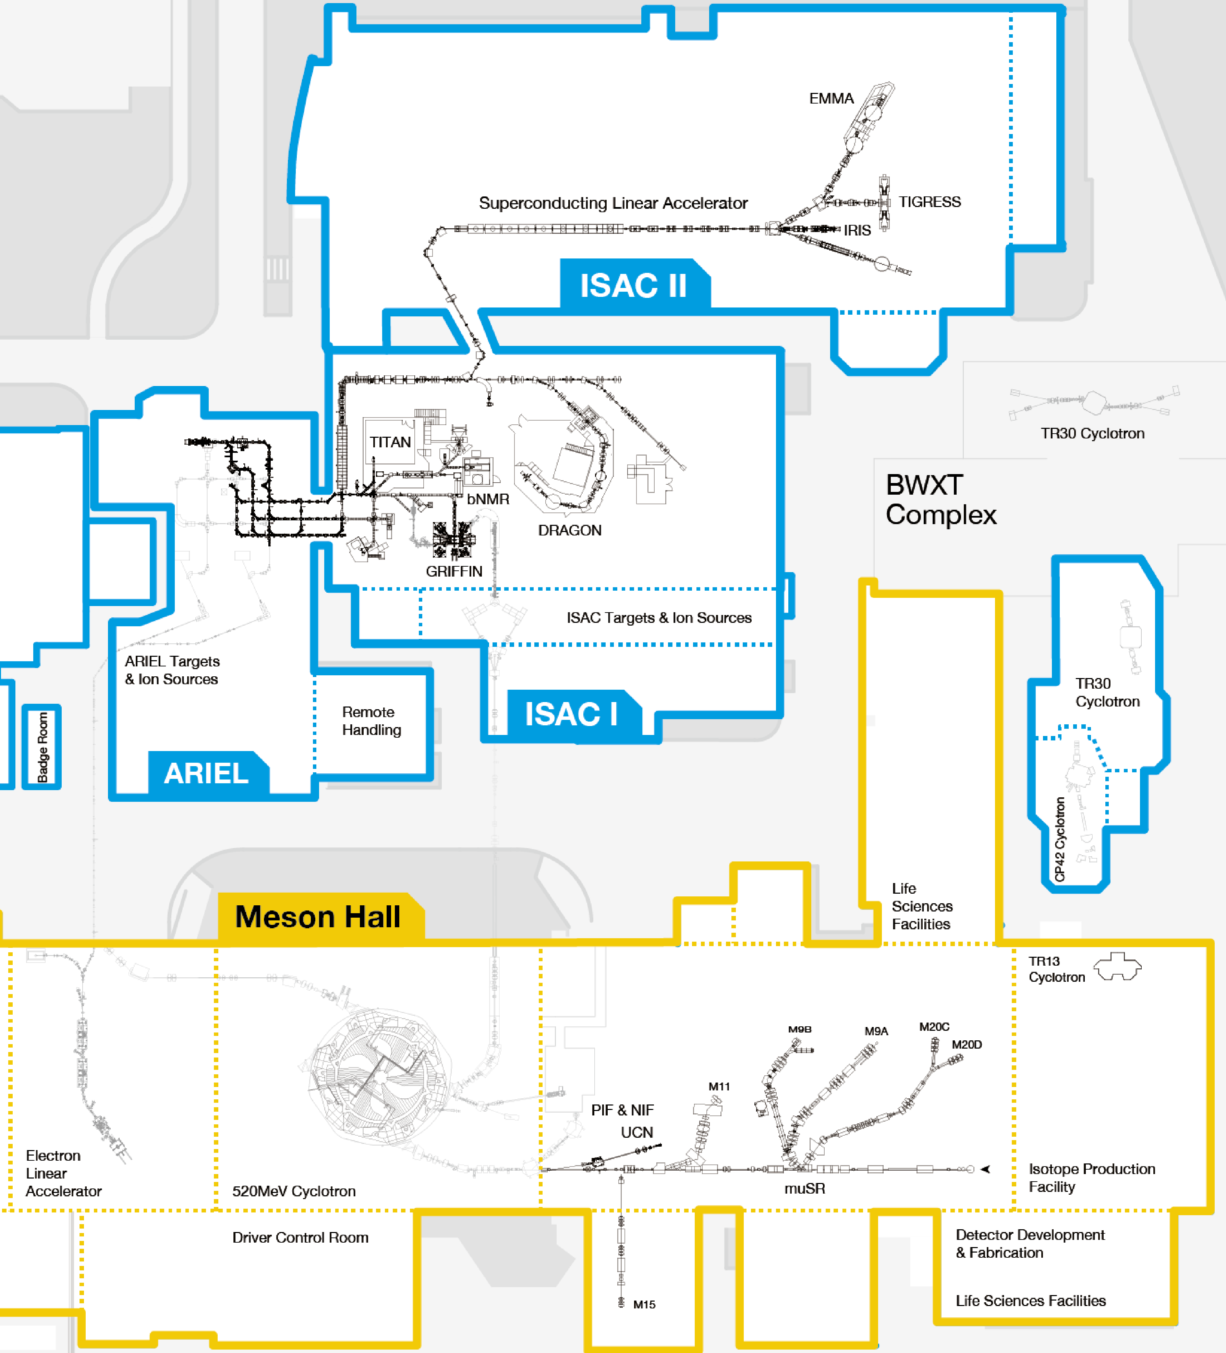
TRIUMF: Canada’s particle accelerator centre
Primary beam driver: cyclotron
520 MeV H¯ cyclotron
Produces rare isotopes, neutrons and muons
Isotope Separator and Accelerator facility (ISAC)
Isotope Separator Online (ISOL) facility
ISAC-I: Normal conducting-linac
ISAC-II: Superconducting-linac
Advanced Rare Isotope Laboratory (ARIEL)
D. Castaneda
Stephanie Diana Rädel

Slide 4
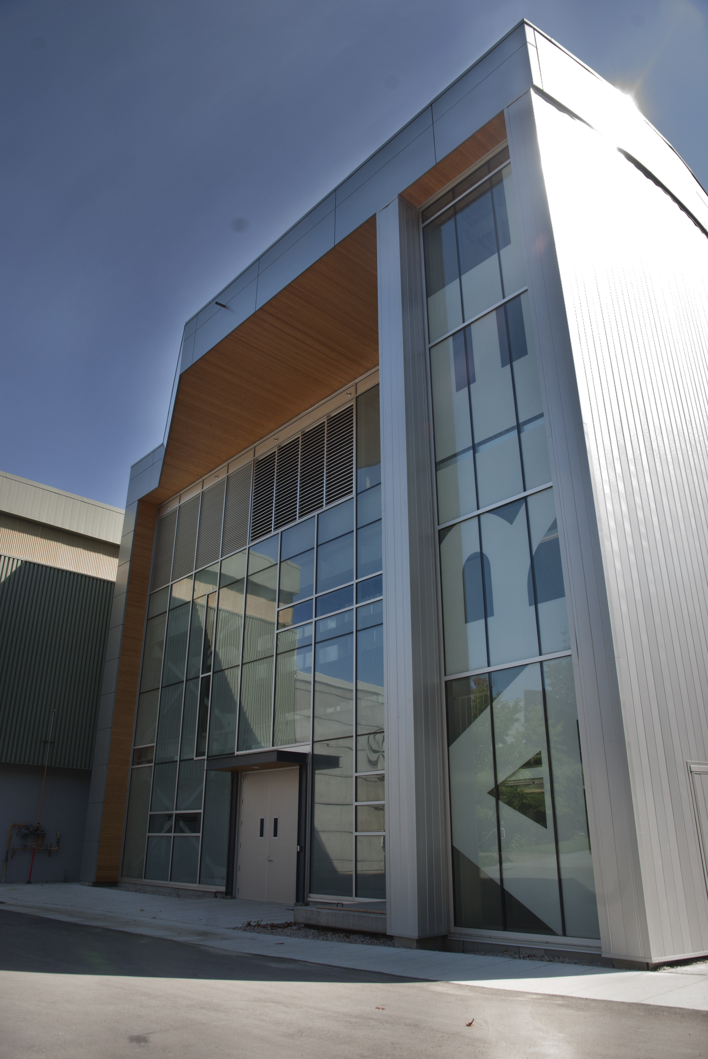
ARIEL: one of the world's most powerful ISOL complexes
Massively expand our rare isotope research program
  Providing more exotic isotope species with very high intensities
  Adding two production targets in parallel to existing ISAC target station
Three isotope production stations
  Fully exploit numerous existing experimental facilities at ISAC
https://www.flickr.com/photos/triumflab/15148509948/in/photostream/
Stephanie Diana Rädel

Slide 5
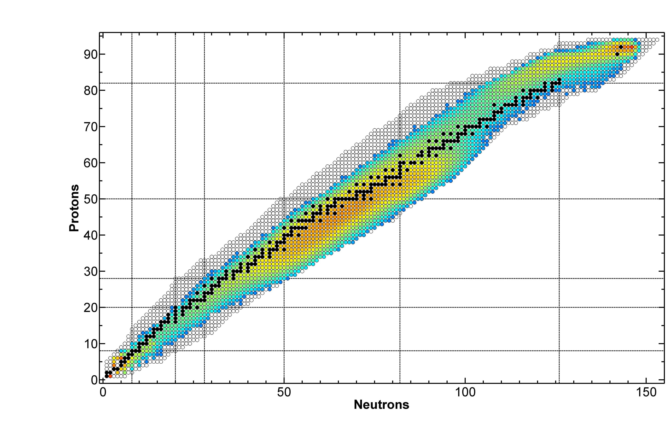
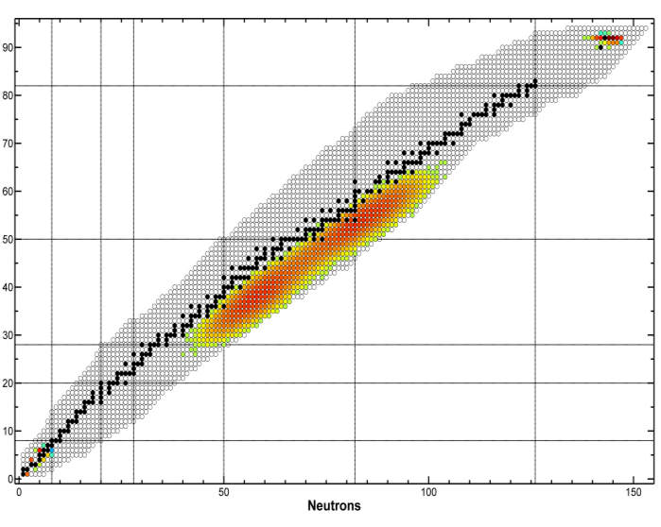
An independent driver for TRIUMF’s Rare Isotope Program
production intensity from ²³⁸UC_{x}
500 MeV x 10 µA protons [1/s]
35 MeV x 10 mA electrons [1/s]
Pure neutron-rich products from photofission
Production cross section reduced in comparison to hadrons
A. Gottberg
Stephanie Diana Rädel

Slide 6
Stephanie Diana Rädel
6
D. Castaneda

Slide 7
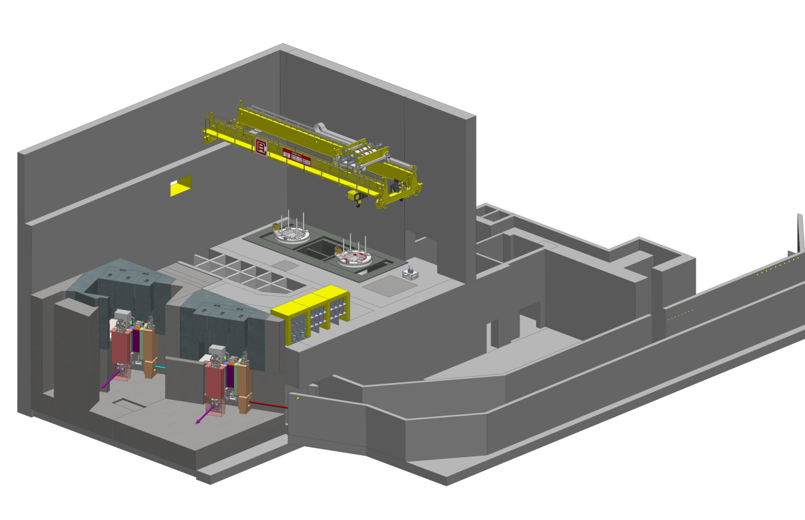
The ARIEL Target Hall
Hot cell facilities (target handling, PIE, waste processing, medical isotope extraction repair and maintenance)
Remote-controlled crane
Electron beam and proton beam transport
module storage
AETE
target exchange point
spent target storage
APTW
electrons
driver beam tunnel
RIB
protons
RIB
Target pit shielding
A. Gottberg
Stephanie Diana Rädel

Slide 8
Stephanie Diana Rädel
8
D. Castaneda

Slide 9
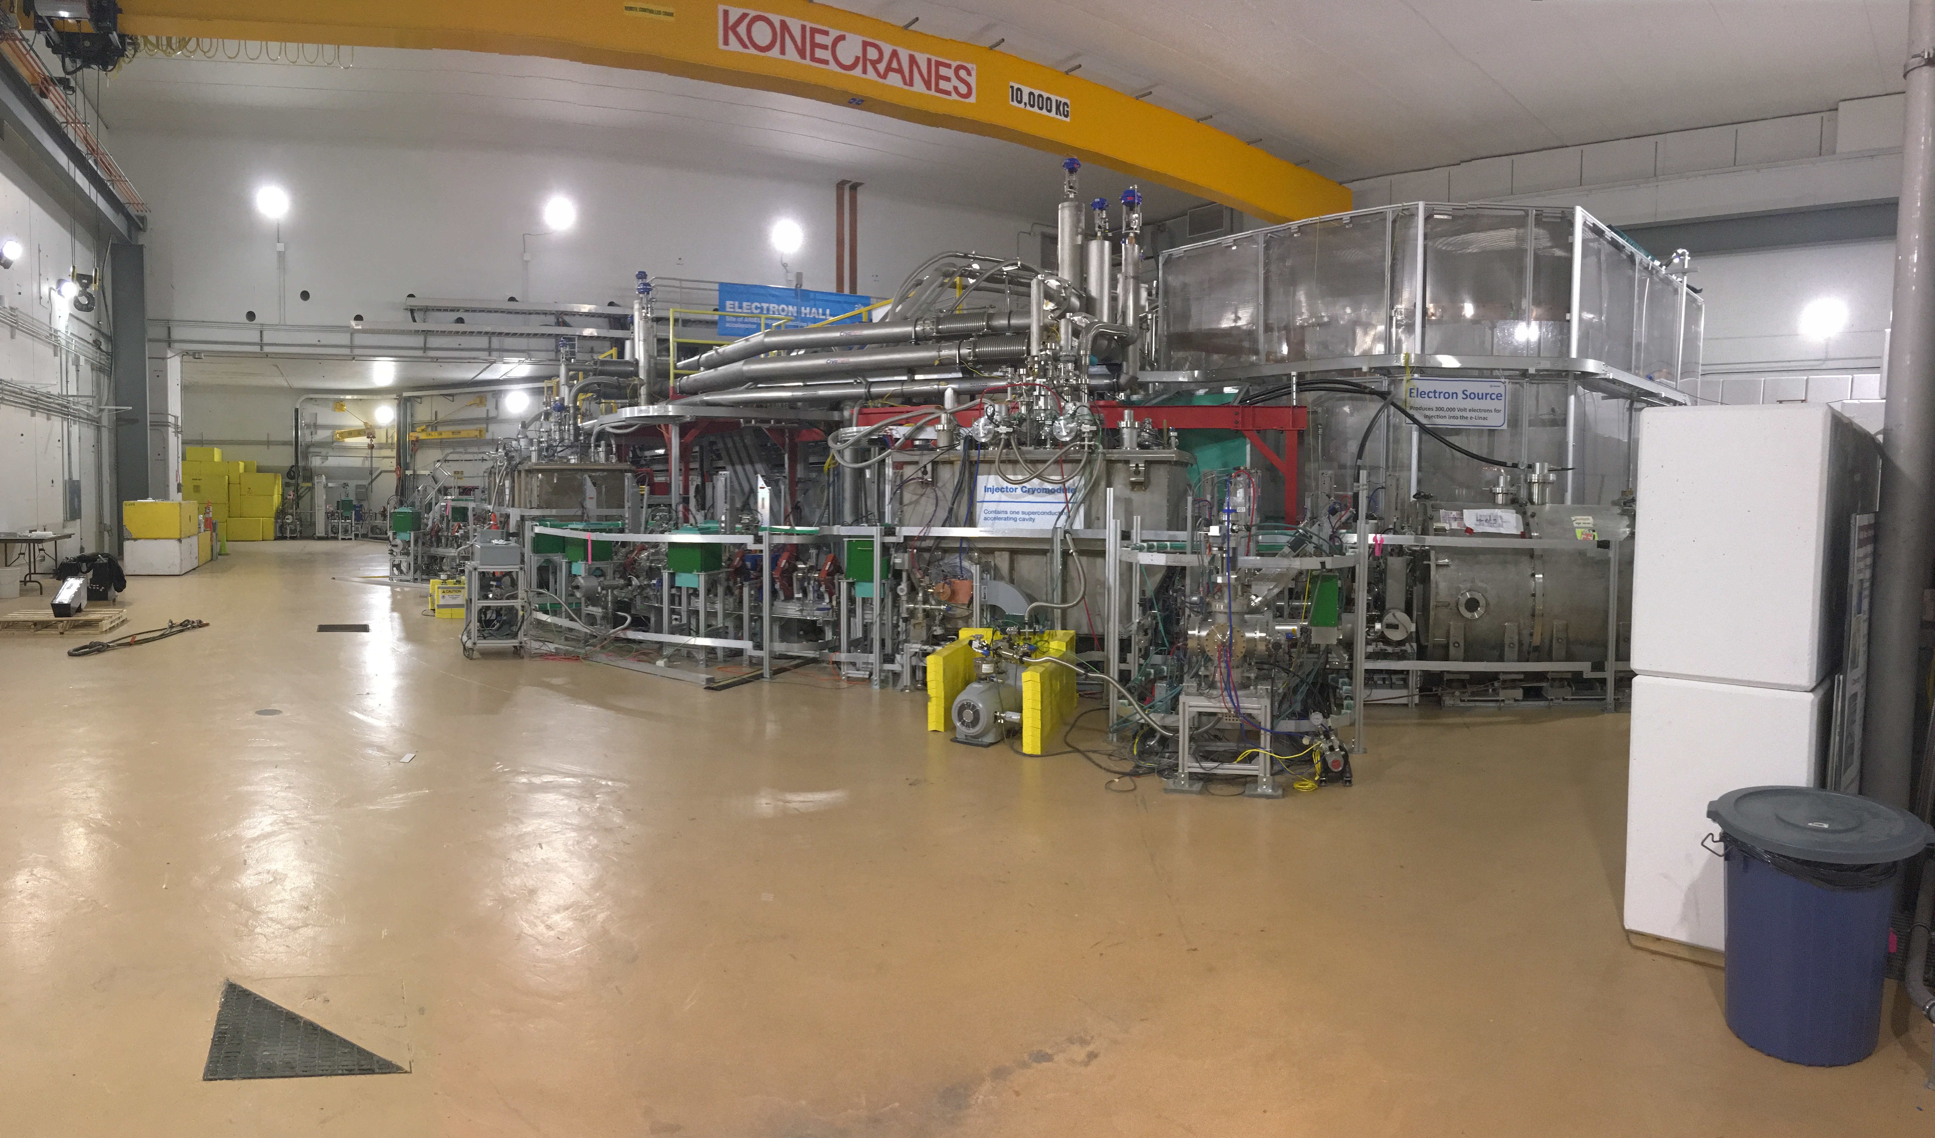
The e-linac in its hall
beam dump
EGUN
Stephanie Diana Rädel

Slide 10
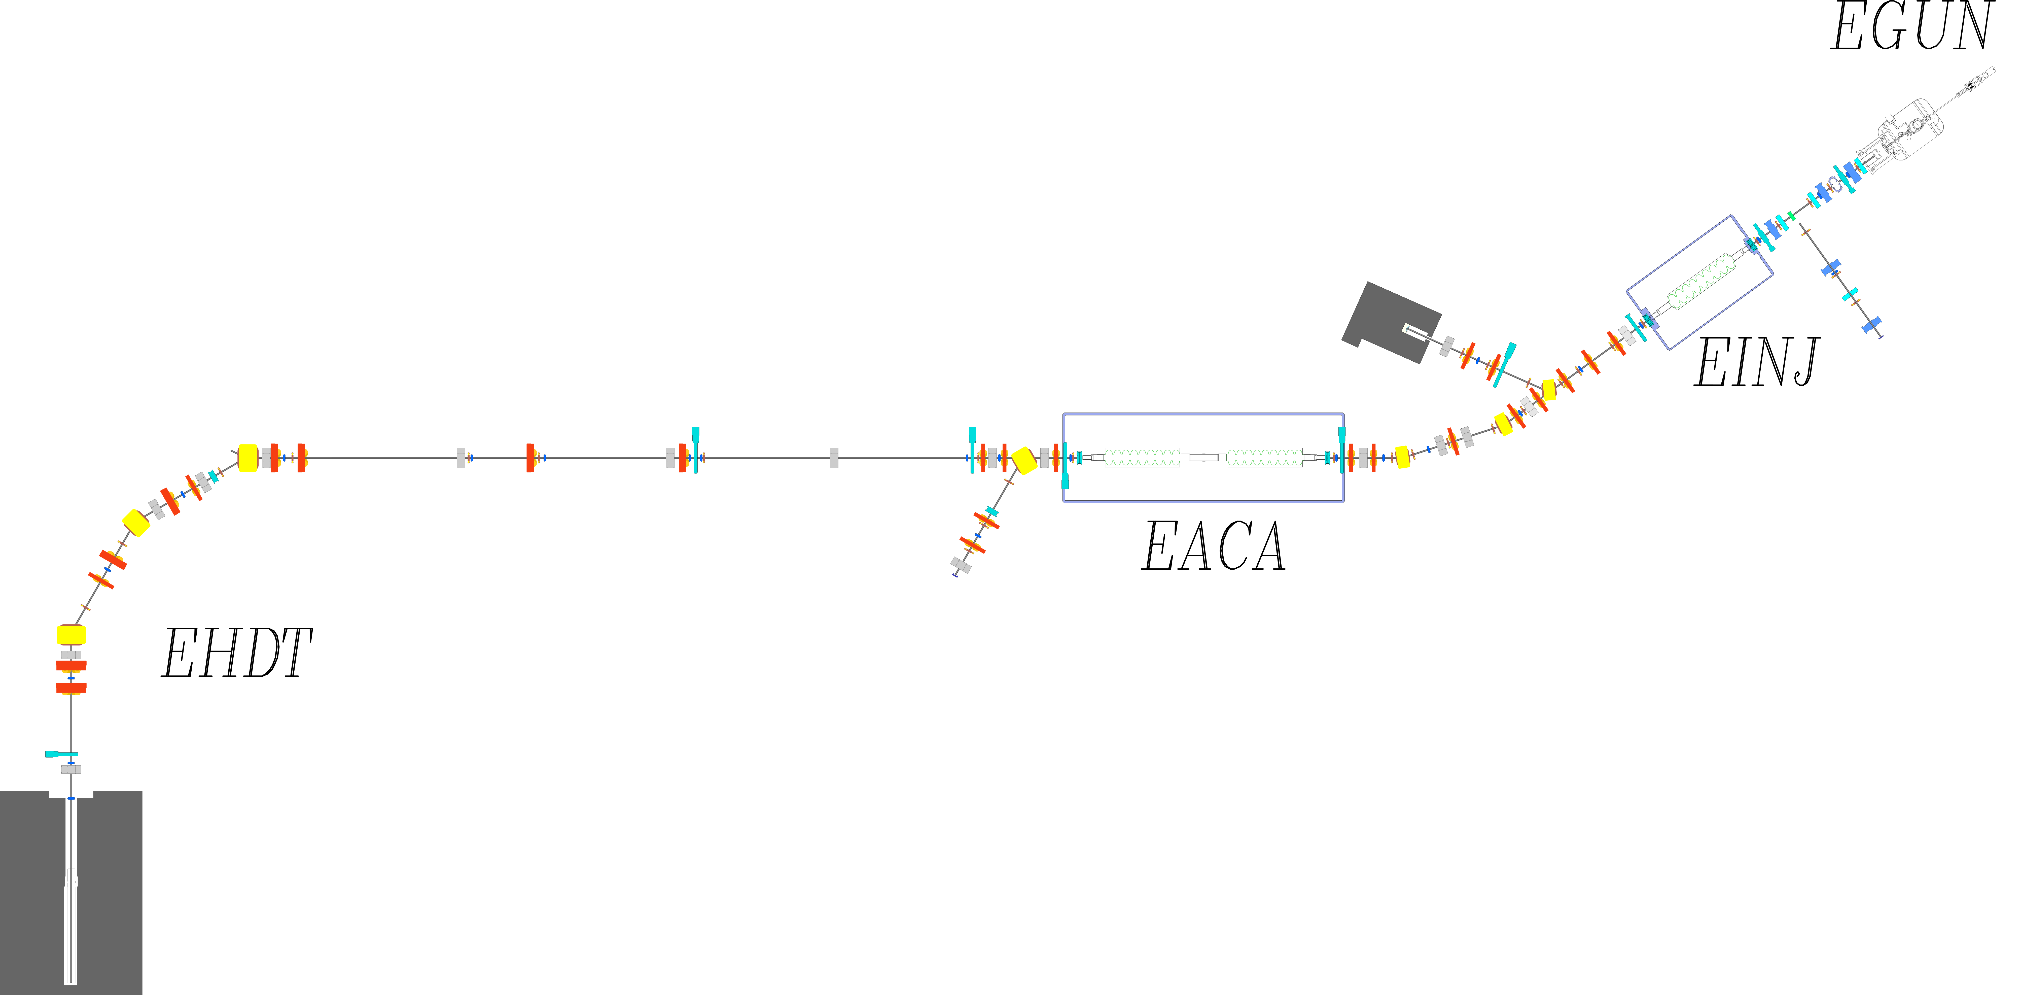
e-linac overview
Low-energy section
Electron Beam
Cryomodules
ARIEL
Medium-energy section
High-energy section
Total beam energy | 30 MeV
Maximum beam current | 10 mA
Normalized emittance | 5 μm
Bunch charge | 15.4 pC
Bunch repetition rate | 650 MHz
Power rating of high energy dump | 10 kW
High-energy beam dump
Stephanie Diana Rädel

Slide 11
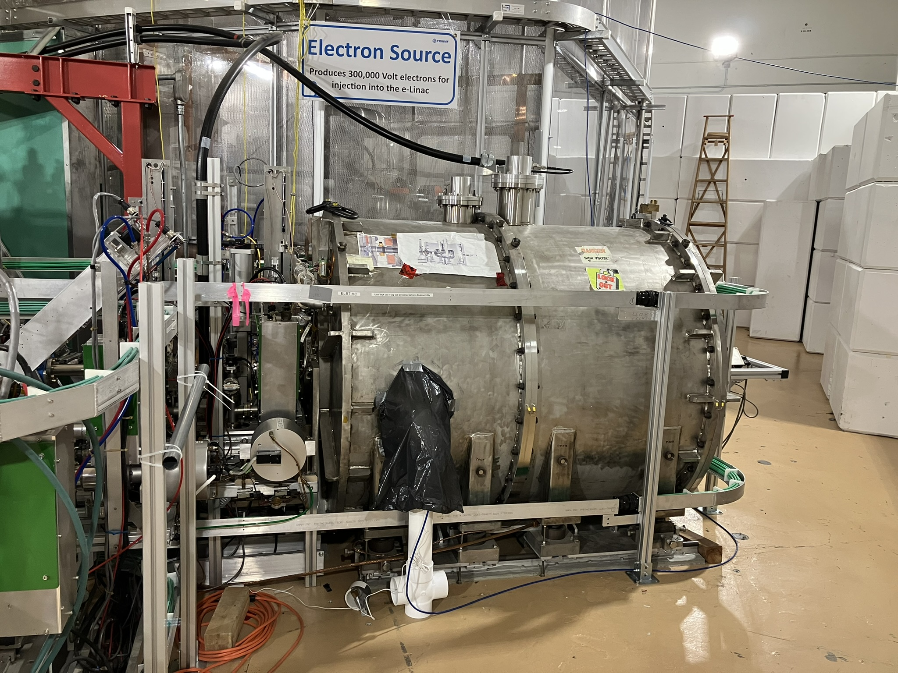
300 kV thermionic electron gun
The electron source is housed inside a pressurized SF₆ vessel to avoid breakdown of the 300 kV voltage
RF is fed into the e-gun using a ceramic waveguide to form bunches at 650 MHz
Allows CW mode
Stephanie Diana Rädel

Slide 12
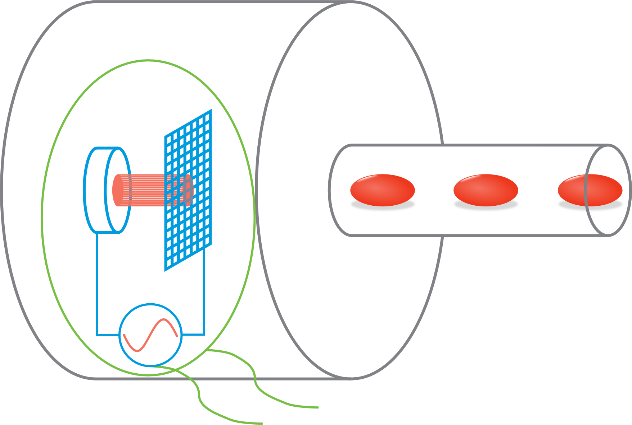
300 kV thermionic e-gun
SF₆ vessel
Cathode
Grid
Beam pipe
e⁻ beam
300 kV bias power supply
RF
Cathode has grid with suppressing voltage and RF modulation
F. Ames et al., “The TRIUMF ARIEL RF modulated thermionic electron source”, 2016
Stephanie Diana Rädel

Slide 13
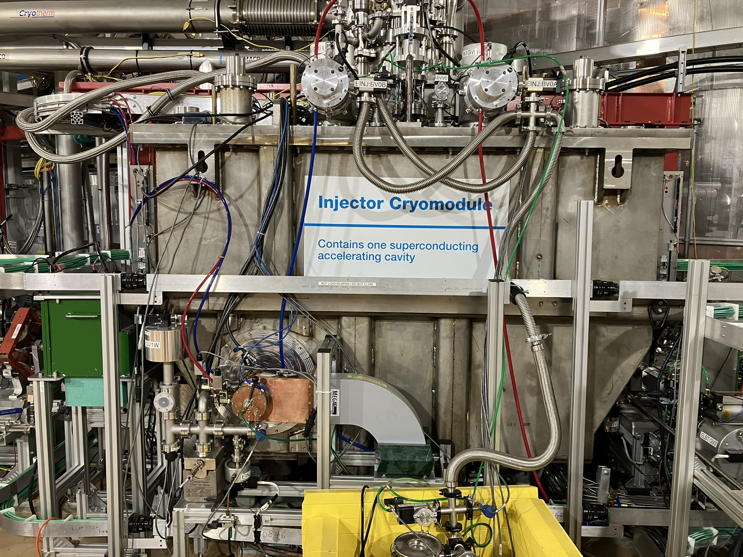
First cryomodule to accelerate beam to 10MeV
4 K separator
Heat exchanger
strongback
2 K separator
Power coupler
EINJ
Cavity
Tuner
9-cell elliptical superconducting niobium cavity at 1.3 GHz, operating at 2 K
2 power couplers capable of delivering 50 kW each
D. Yosifov et al., “ARIEL’s E-linac and beam transport line vacuum systems”, 2012
Stephanie Diana Rädel

Slide 14
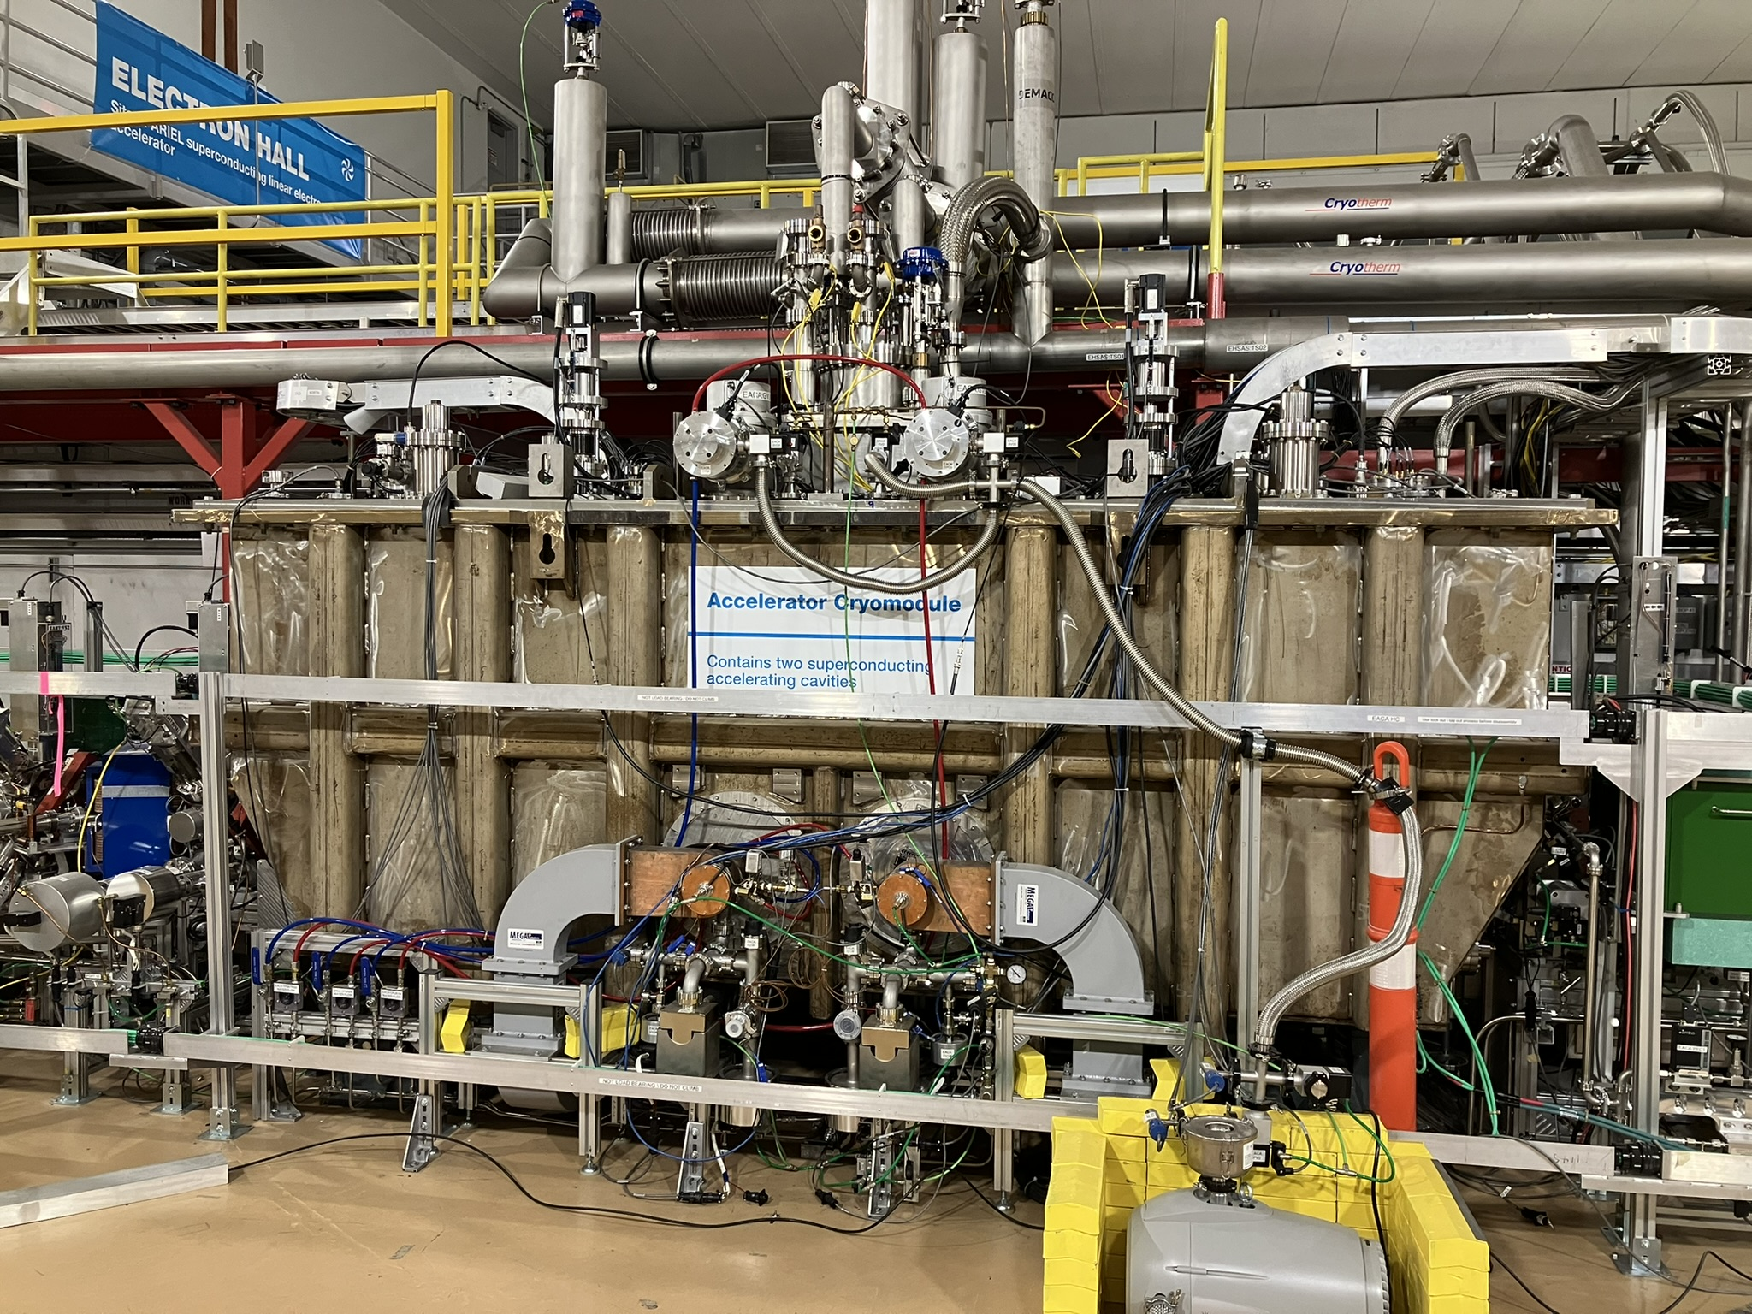
Second cryomodule to accelerate beam to 30MeV
EACA
Two 9-cell elliptical superconducting niobium cavity at 1.3 GHz, operating at 2 K
4 power couplers capable of delivering 50 kW each
Y. Ma et al., “First RF results of two-cavities accelerating cryomodule for ARIEL E-Linac at TRIUMF”, 2018
Stephanie Diana Rädel

Slide 15
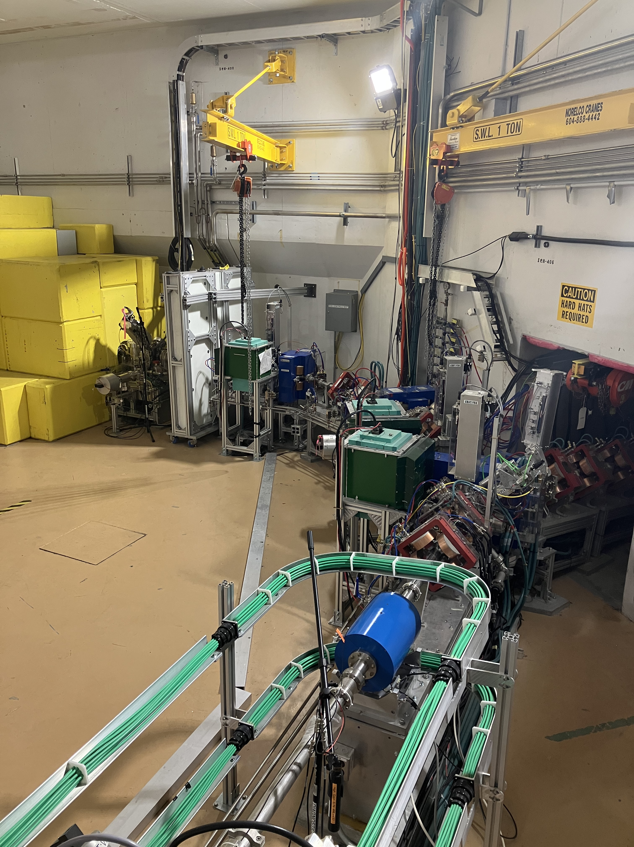
10 kW tuning dump
High energy beam dump
To ARIEL
Stephanie Diana Rädel

Slide 16
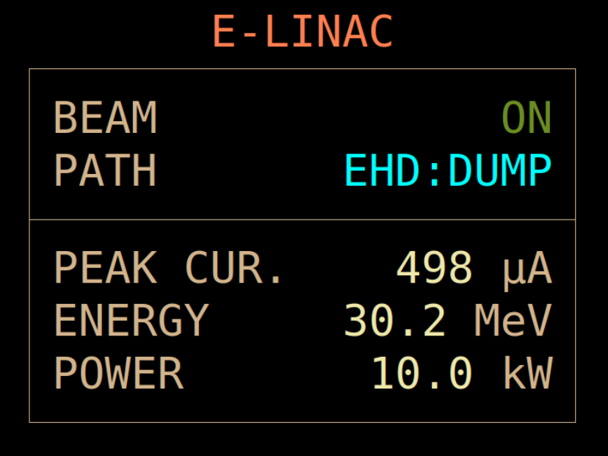
The e-linac commissioning was completed in September 2021
After multiple years of commissioning, we achieved a 10 kW beam at 30 MeV for the first time
Next milestone: Reliable beam delivery by March 2023
ARIEL electron target will be ready to receive beam in 2025
https://web.accel.triumf.ca/Elog_Attachments/elinac_elog/2021-09/2021-09-13-14:23:14.grab.h6pRsk.png
Stephanie Diana Rädel

Slide 17
Entering a new era: The e-linac as an upcoming multi-user facility
Stephanie Diana Rädel

Slide 18
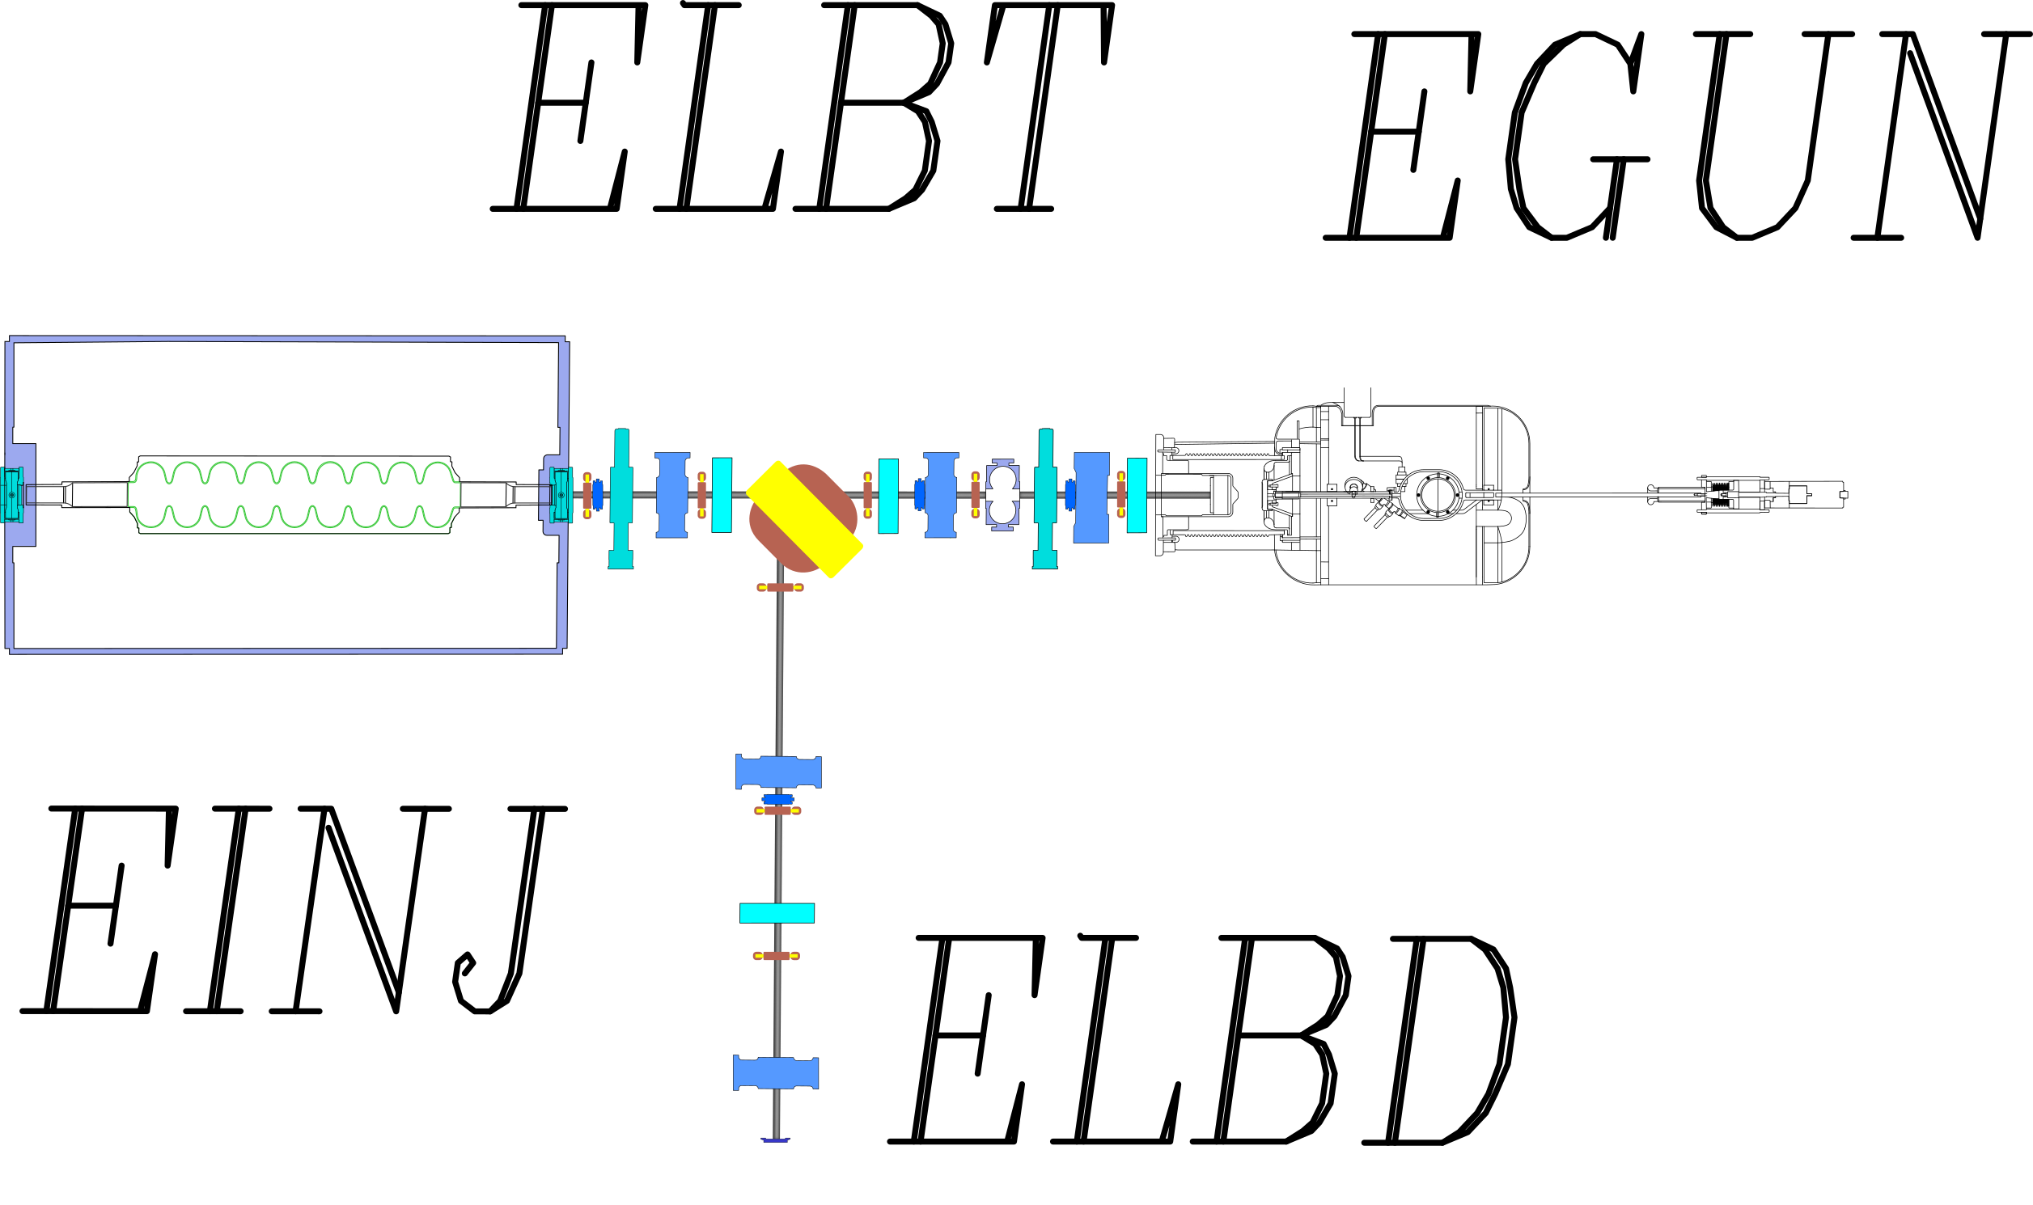
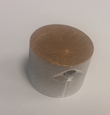
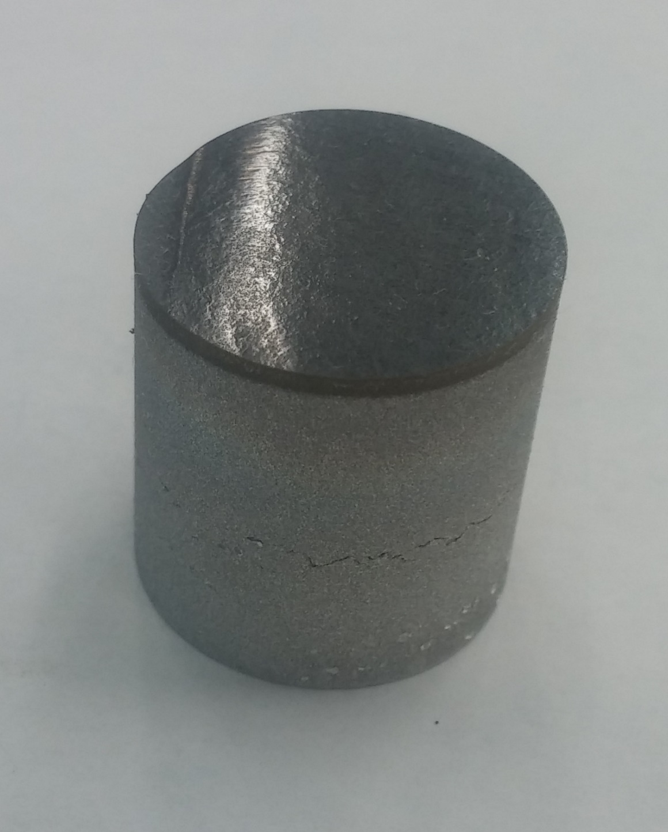
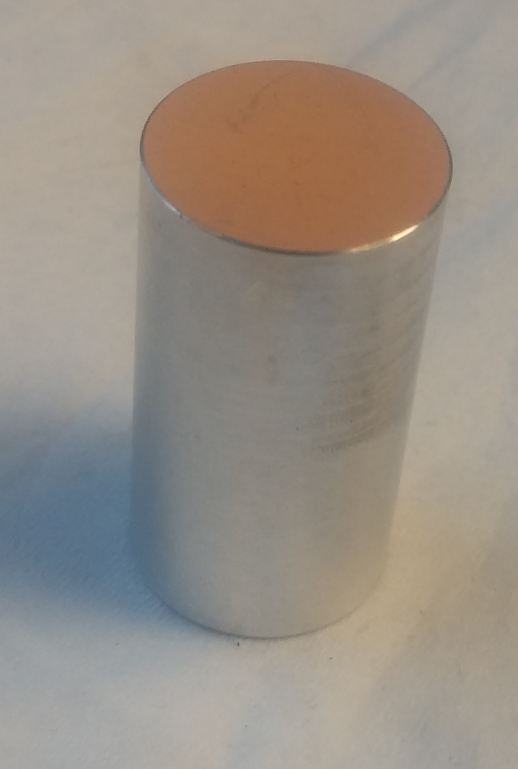
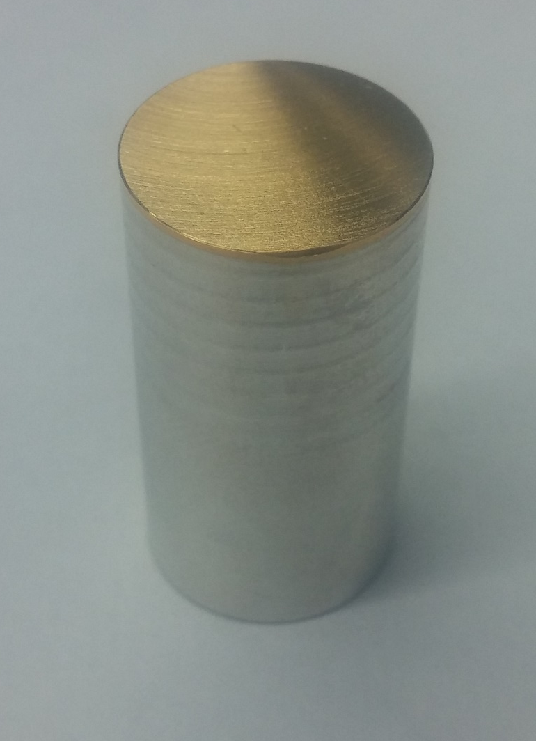

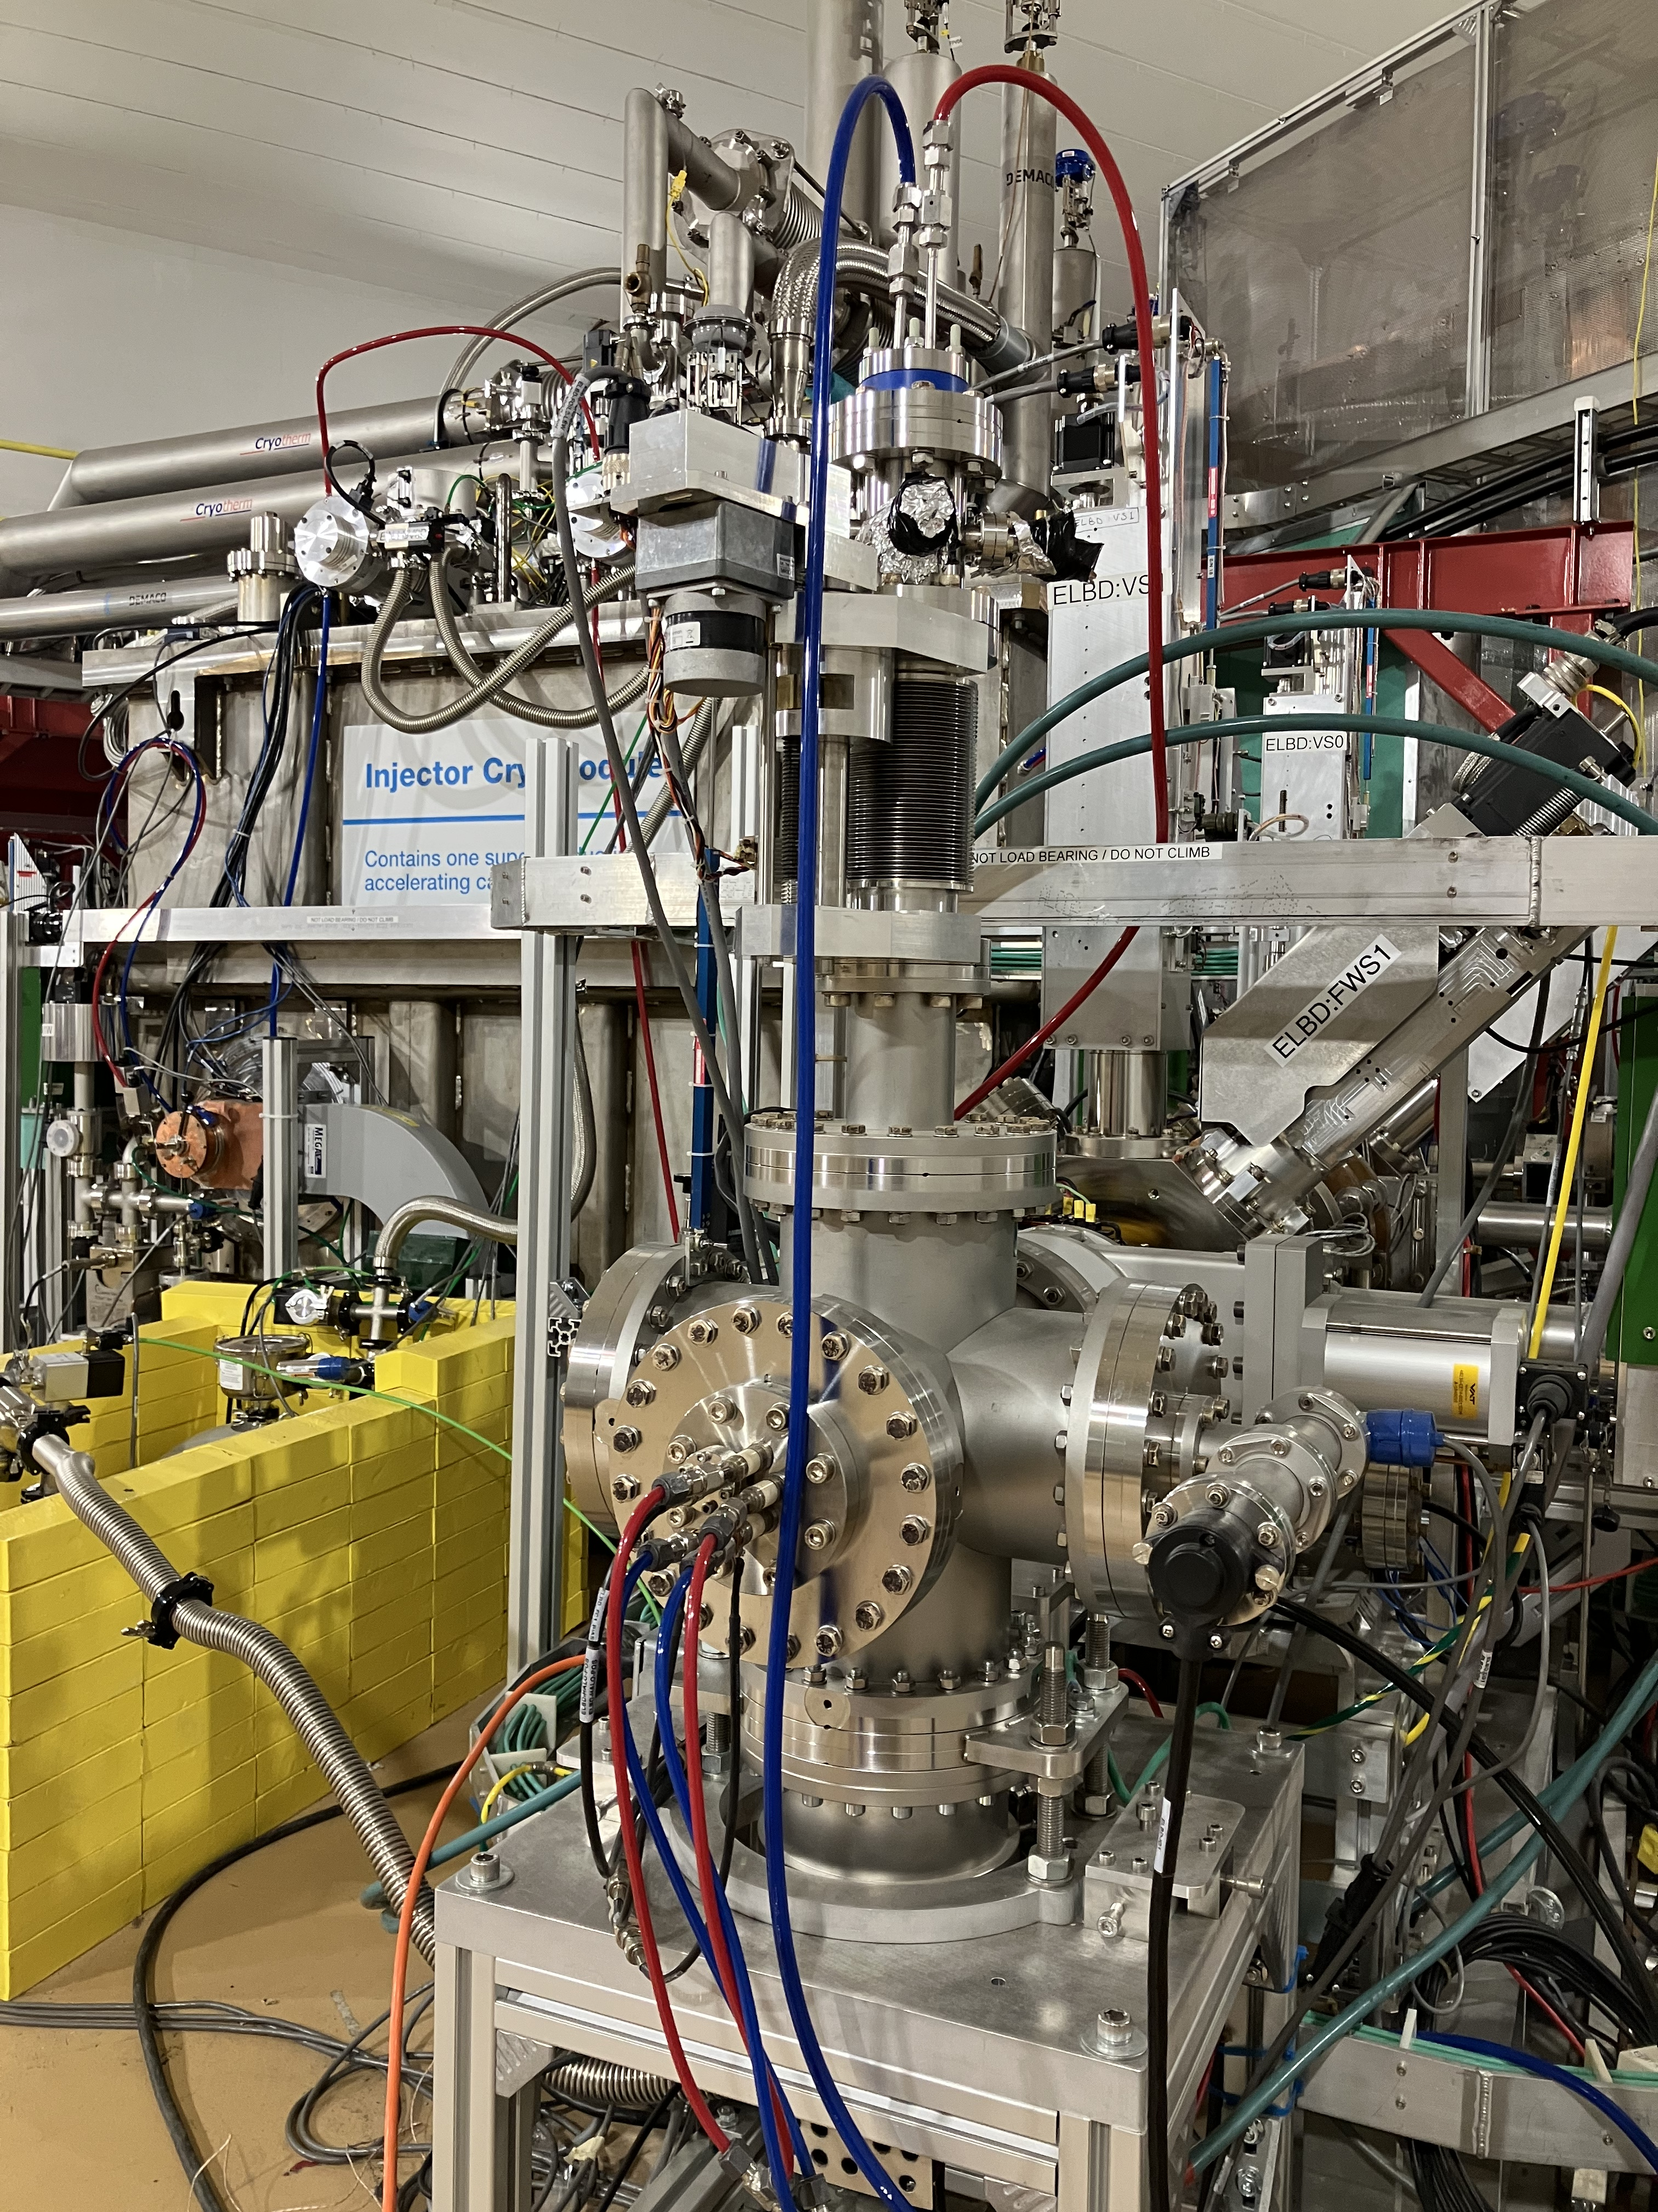
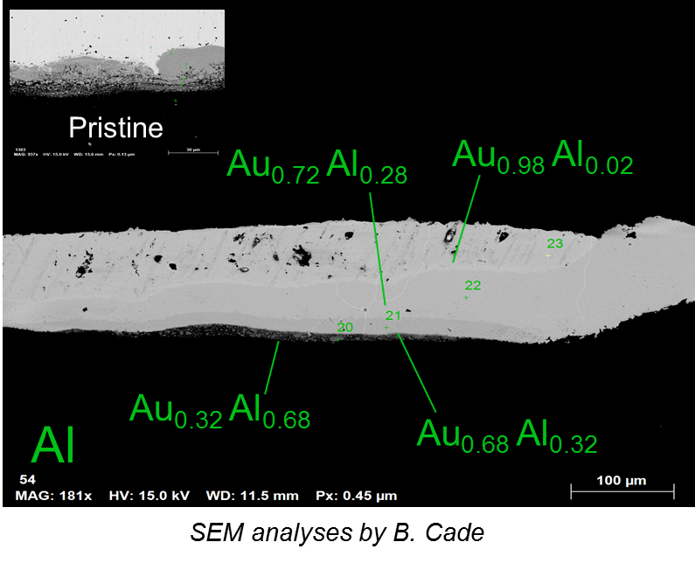
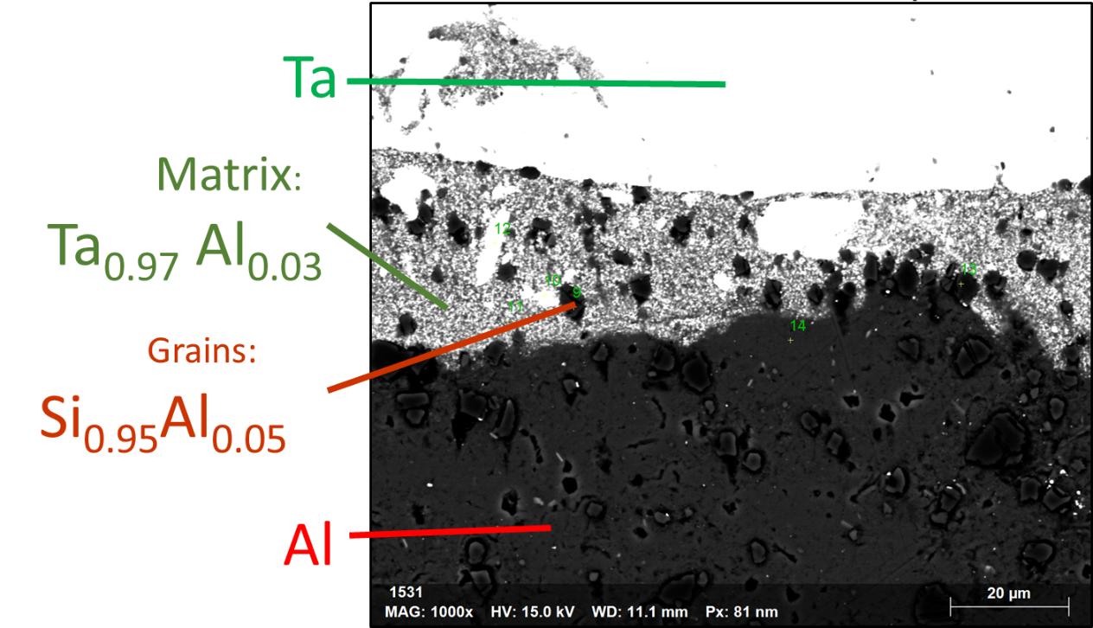
300keV Converter Test Stand: validated target materials for ARIEL
Au-Al Expl. Weld
Au-Al E.D. + Ni
Au-Al E.D.
Ta-Al Expl. Weld
Beam
L. Egoriti et al., “Material development towards a solid 100 kW electron-gamma converter for TRIUMF-ARIEL”, 2020
Stephanie Diana Rädel
A. Gottberg
Notes:
300 keV–3kW test stand that simulate the sort of power density encountered in the future 30MeV–100kW ARIEL targets.
Outcome gold on aluminum:
Temperature increase during irradiation
Radiation-enhanced Au-Al diffusion
Formation of brittle intermetallic
Outcome tantalum on aluminum
Temperature stable over 500 h of irradiation
No change of surface morphology
No major evolution of interface
No-radiation enhanced diffusion

Slide 19

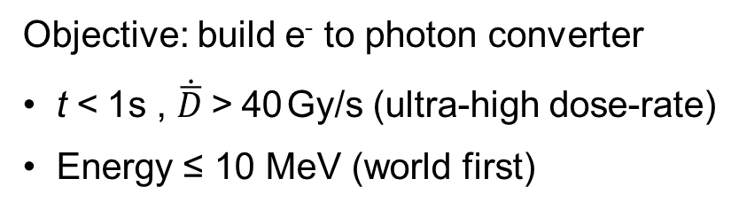
FLASH – Radio Therapy Research
Dose rate
FLASH dose rated allow for sub-second treatments to reduce normal tissue toxicity compared to low dose rate (conventional) treatments
~ 40 Gy/s
FLASH
Dose ~ 40 Gy
Objective: build e⁻ to photon converter
t < 1 s , $\dot{\overline{D}}$ > 40 Gy/s (ultra-high dose-rate)
Energy ≤ 10 MeV (world first)
Conventional
~ 0.05 Gy/s
Dose ~ 40 Gy
0
1 sec
minutes
t
June 7, 2022, 1:15 PM
A. Gottberg: “(I) Novel cancer treatment in a FLASH – development towards reducing side effects of cancer therapy using X-rays, electrons and protons at TRIUMF”
L. Egoriti (2022)
Stephanie Diana Rädel

Slide 20
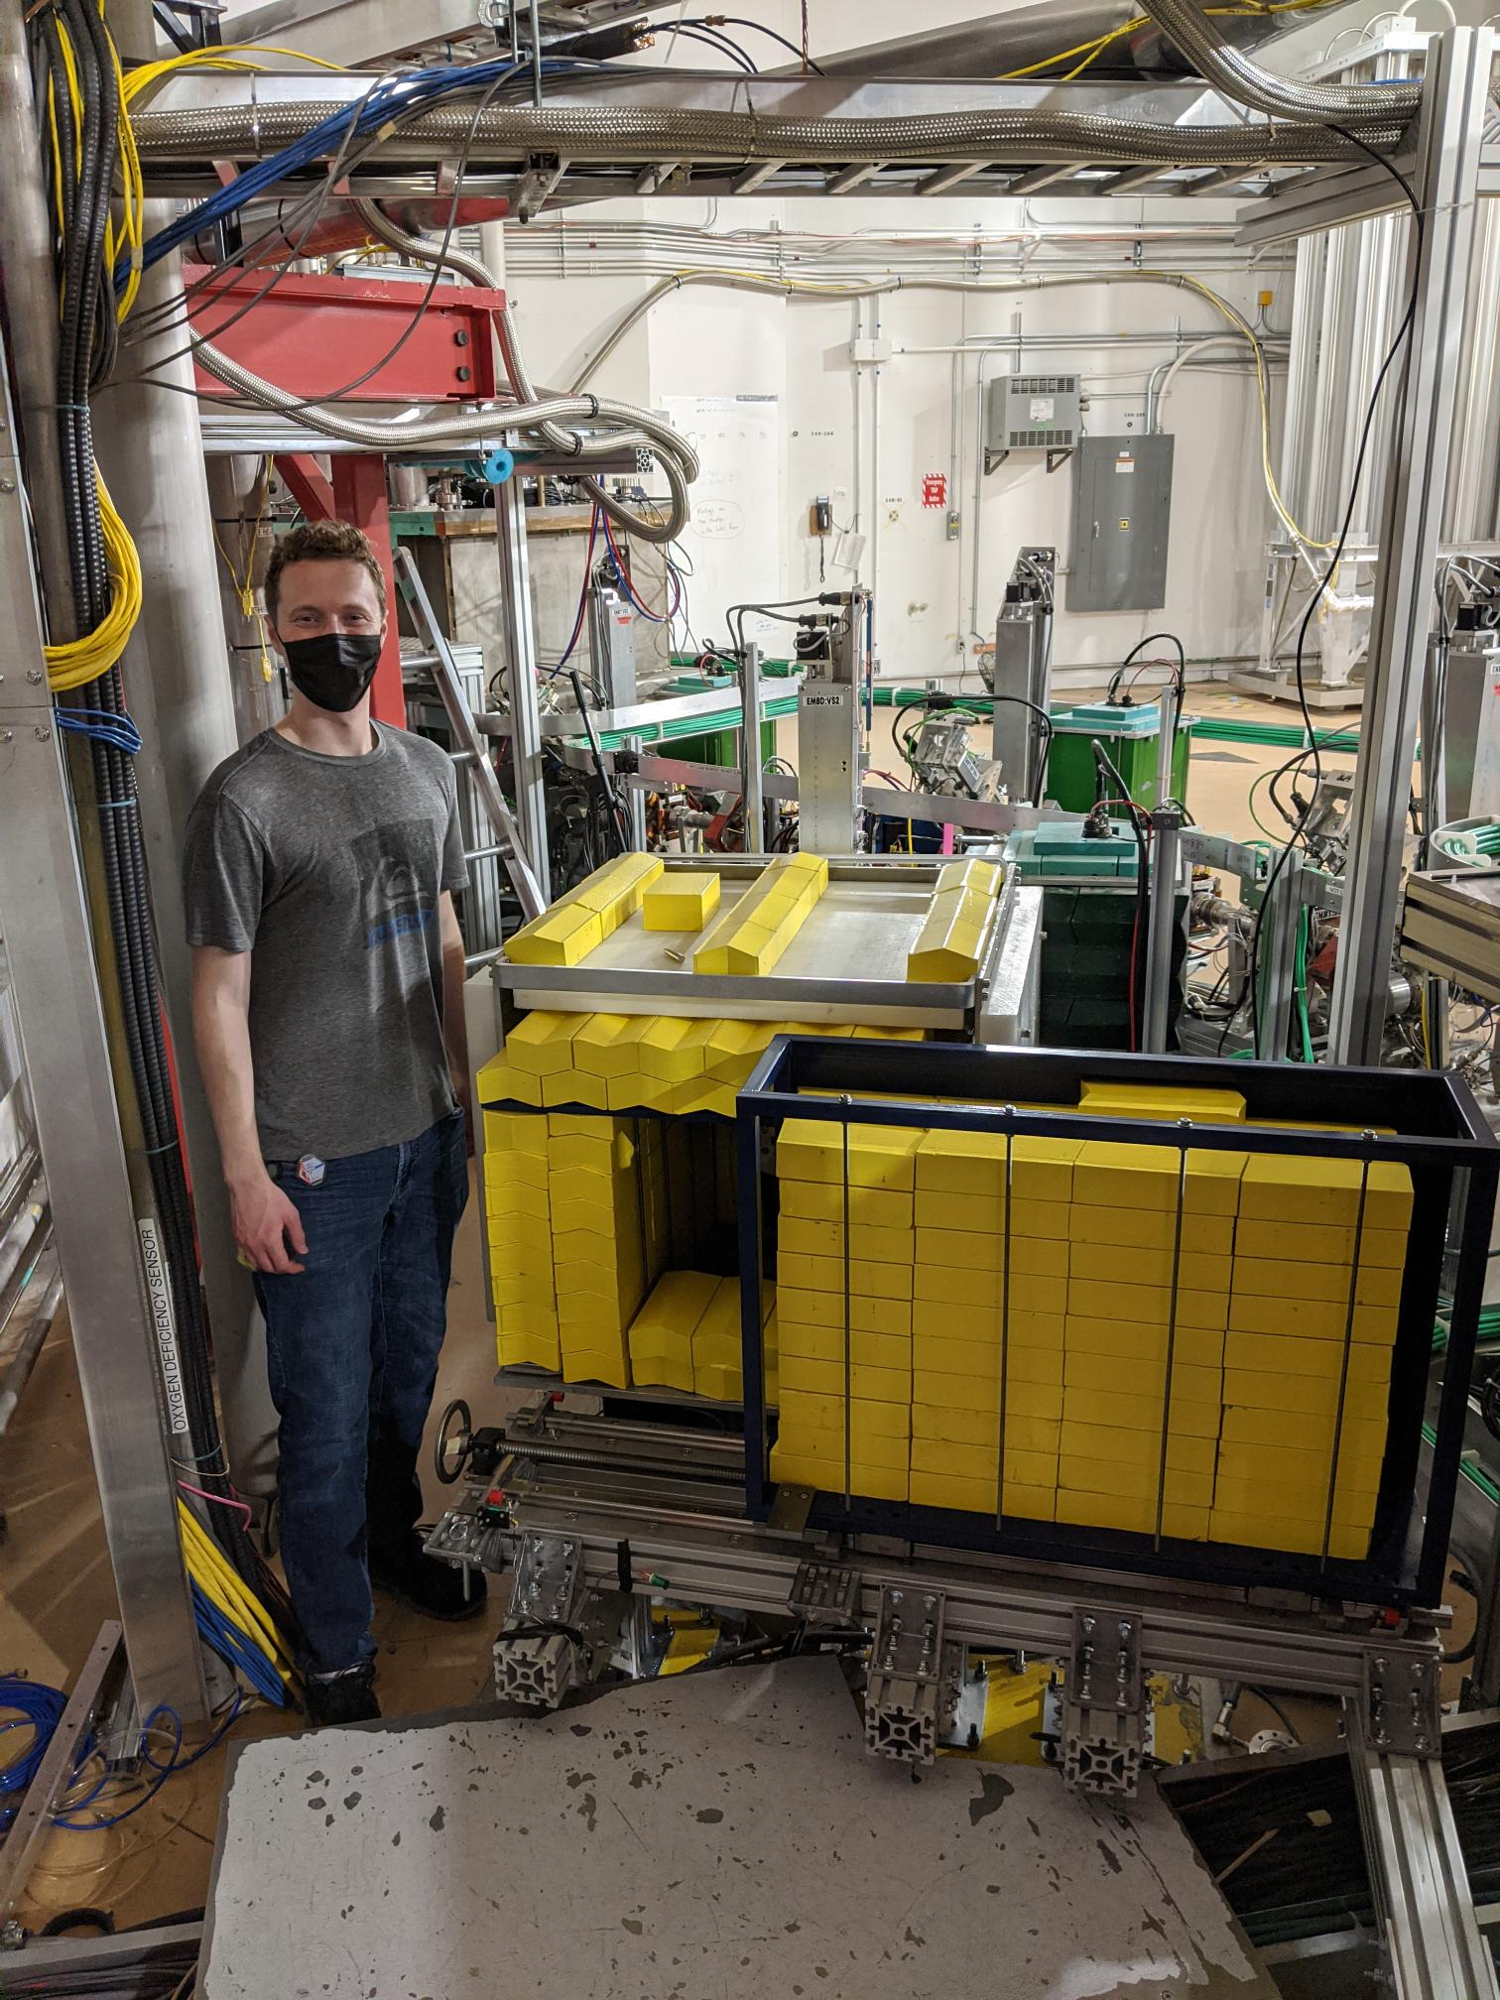
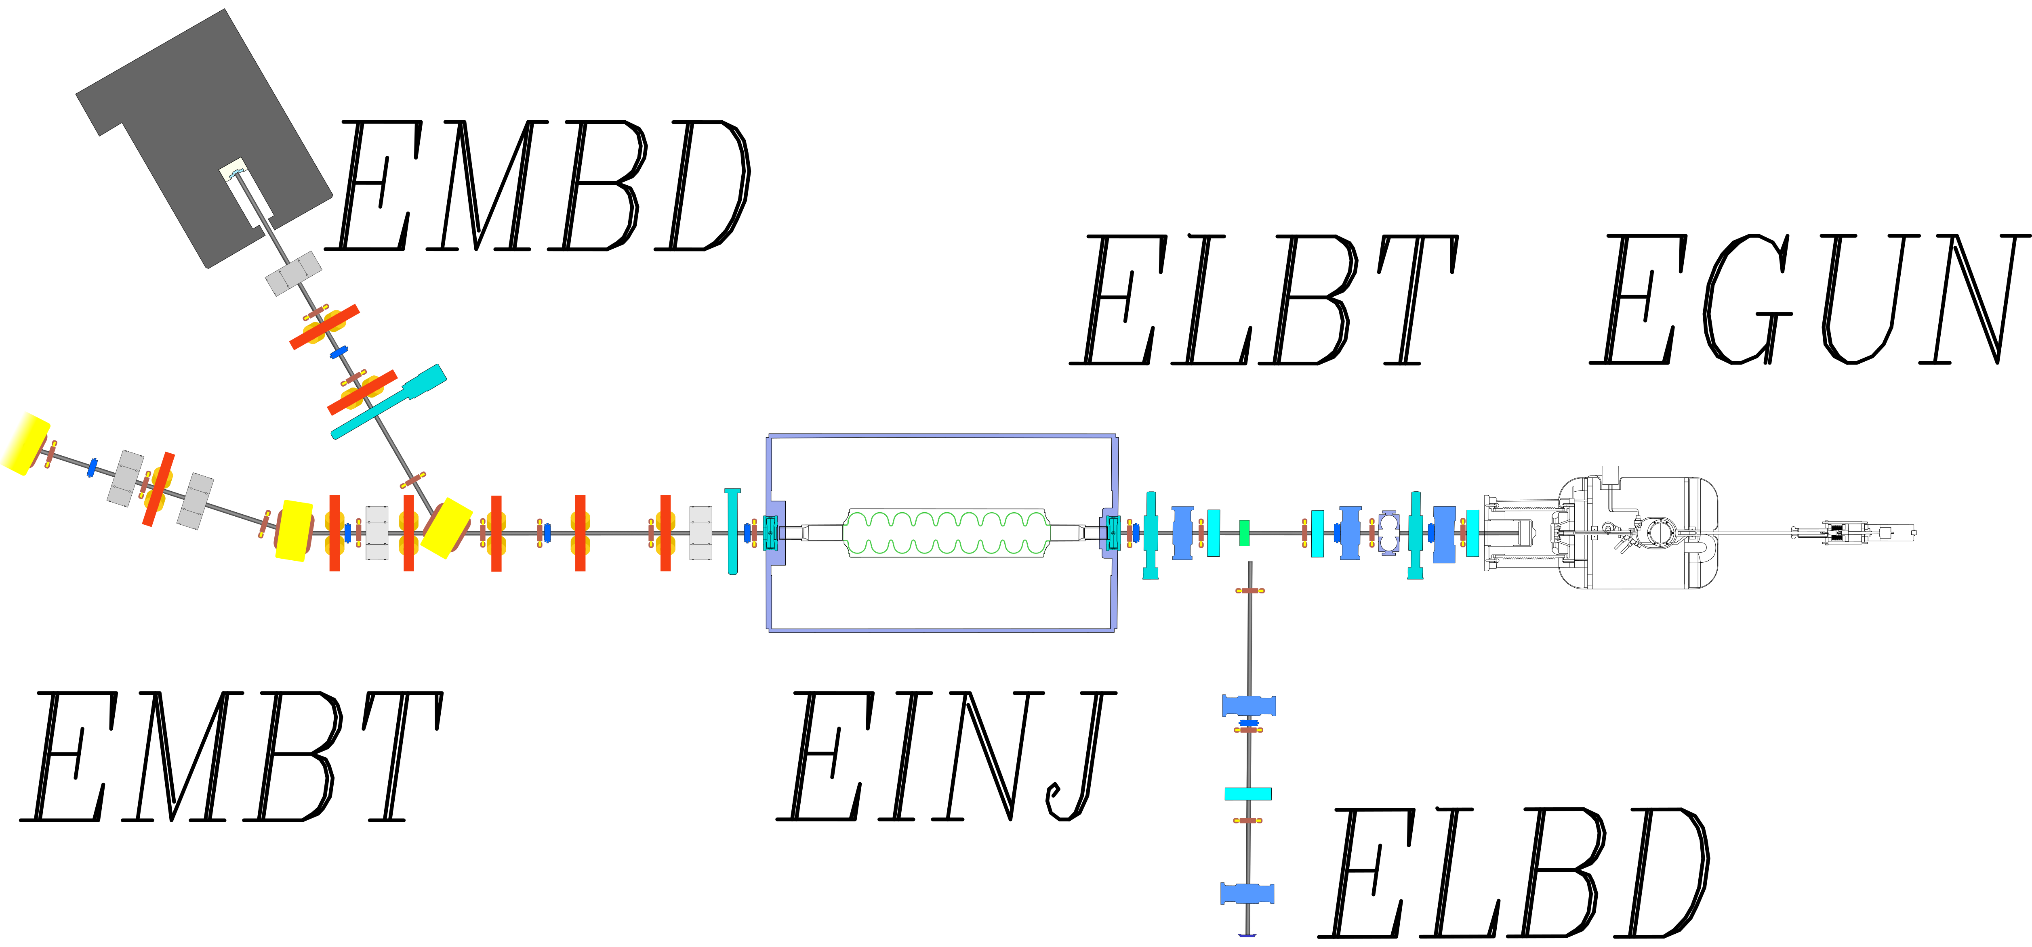
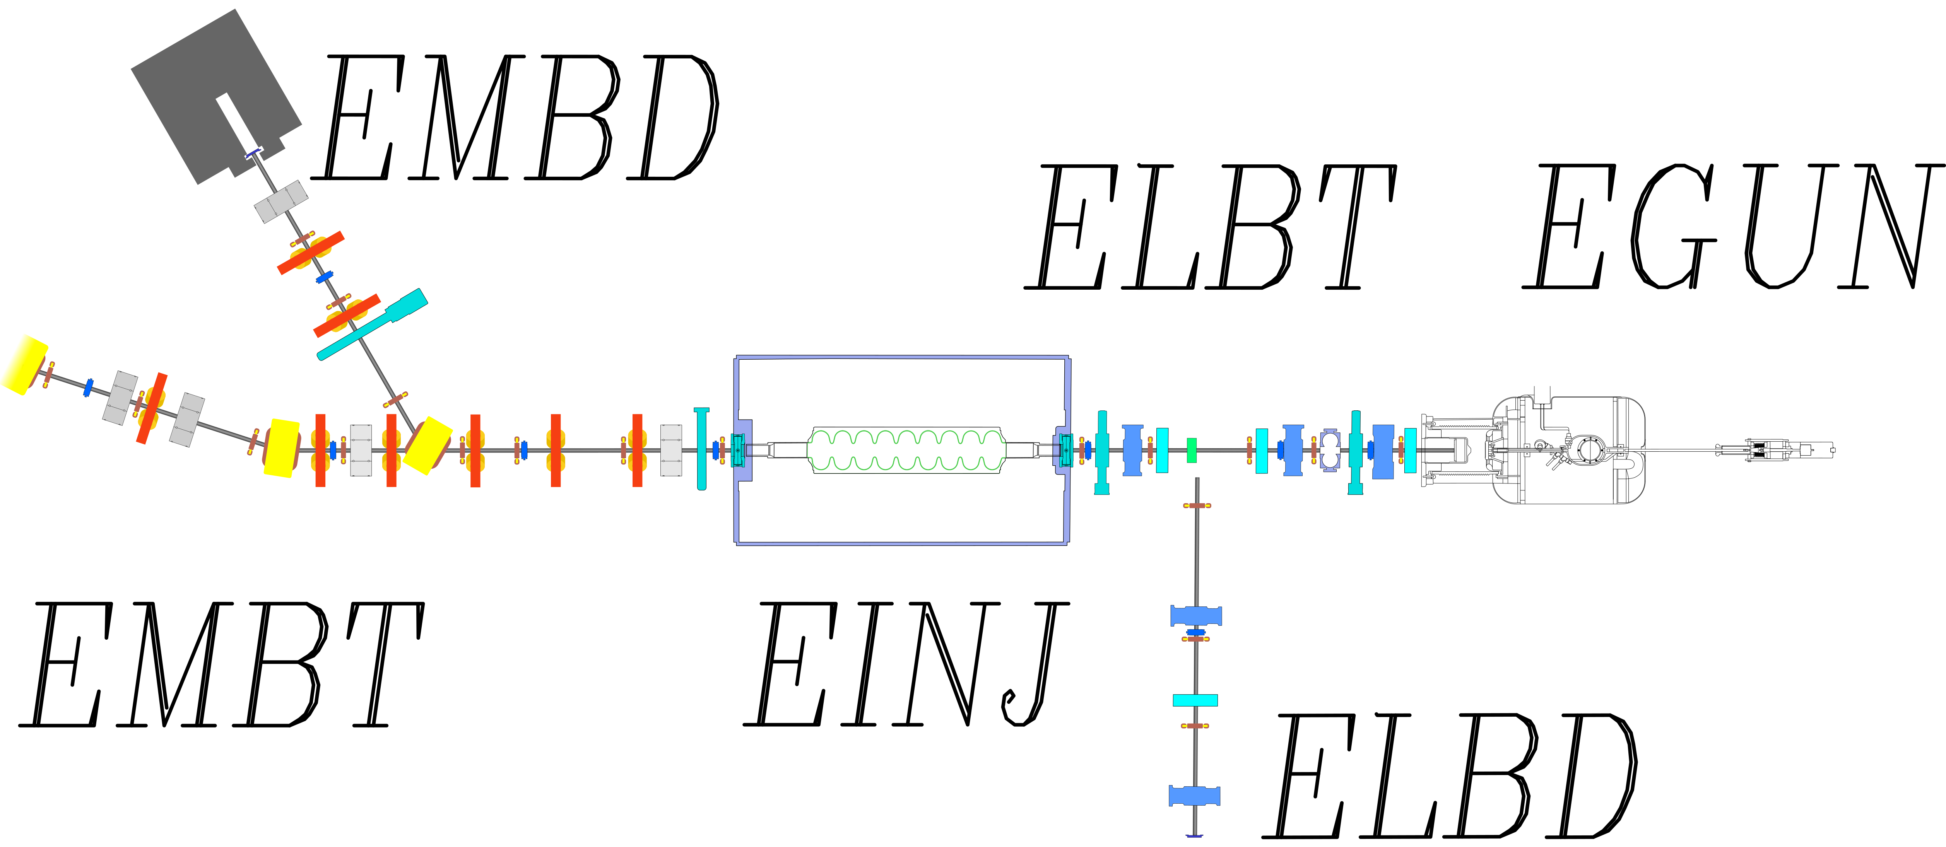
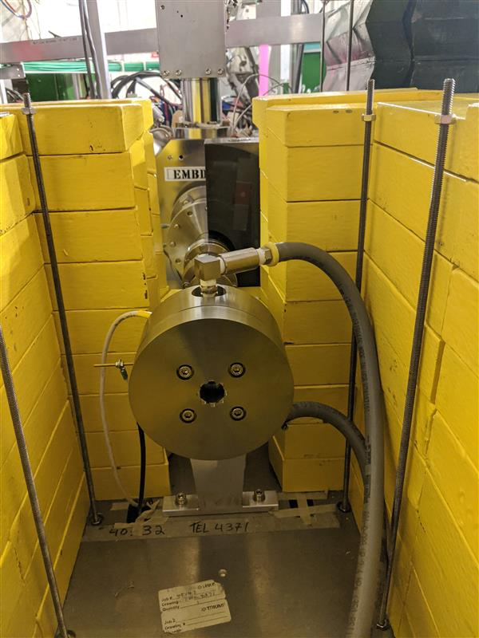
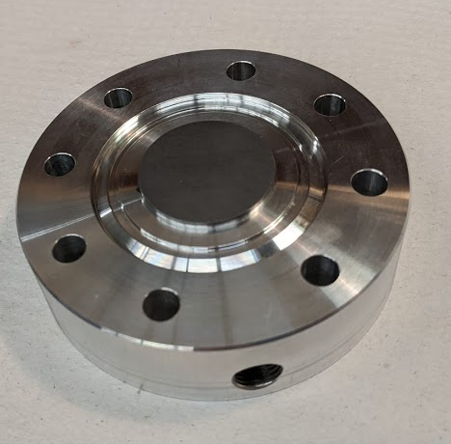
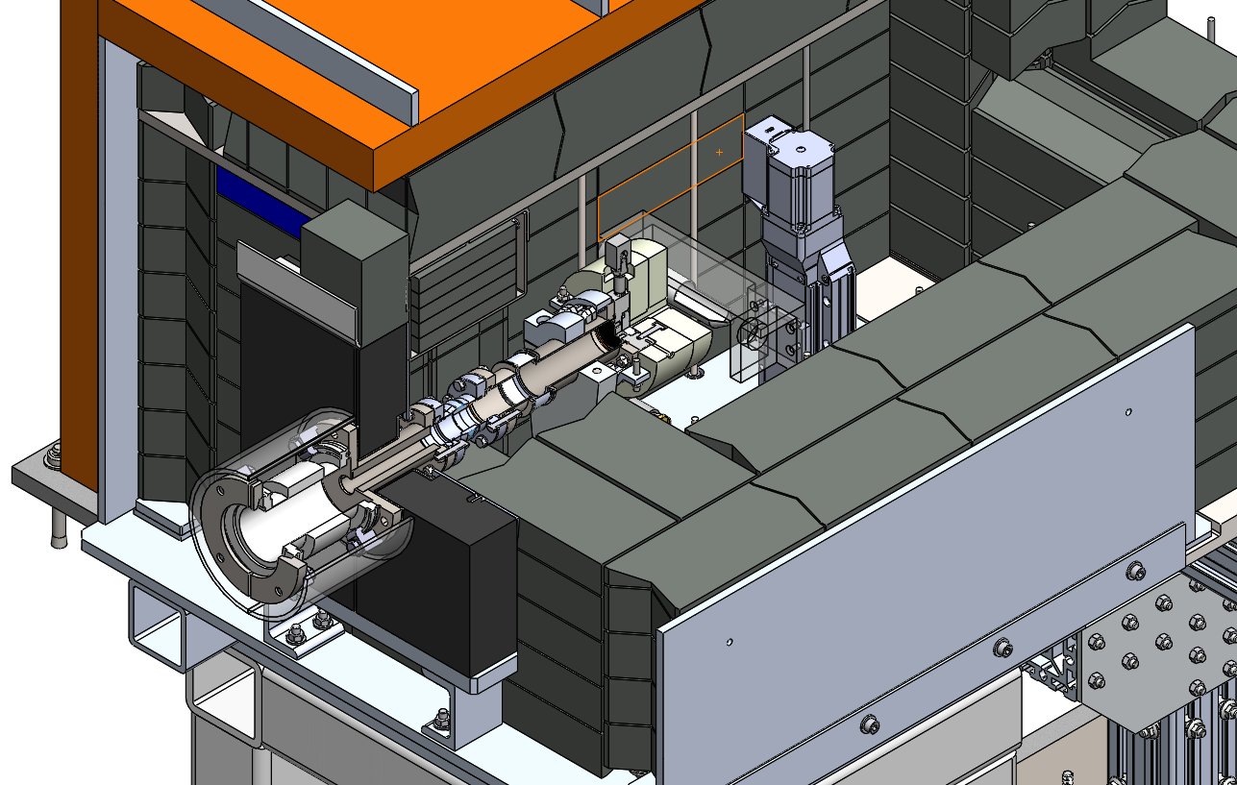
E-Linac medium energy dump modification
ARIEL-inspired converter
Stephanie Diana Rädel
N. Esplen et al., “Design optimization of an electron-to-photon conversion target for ultra-high dose rate x-ray (FLASH) experiments at TRIUMF”, 2022

Slide 21
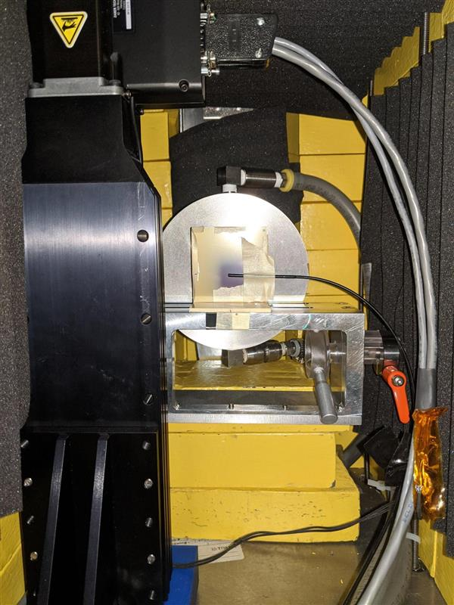
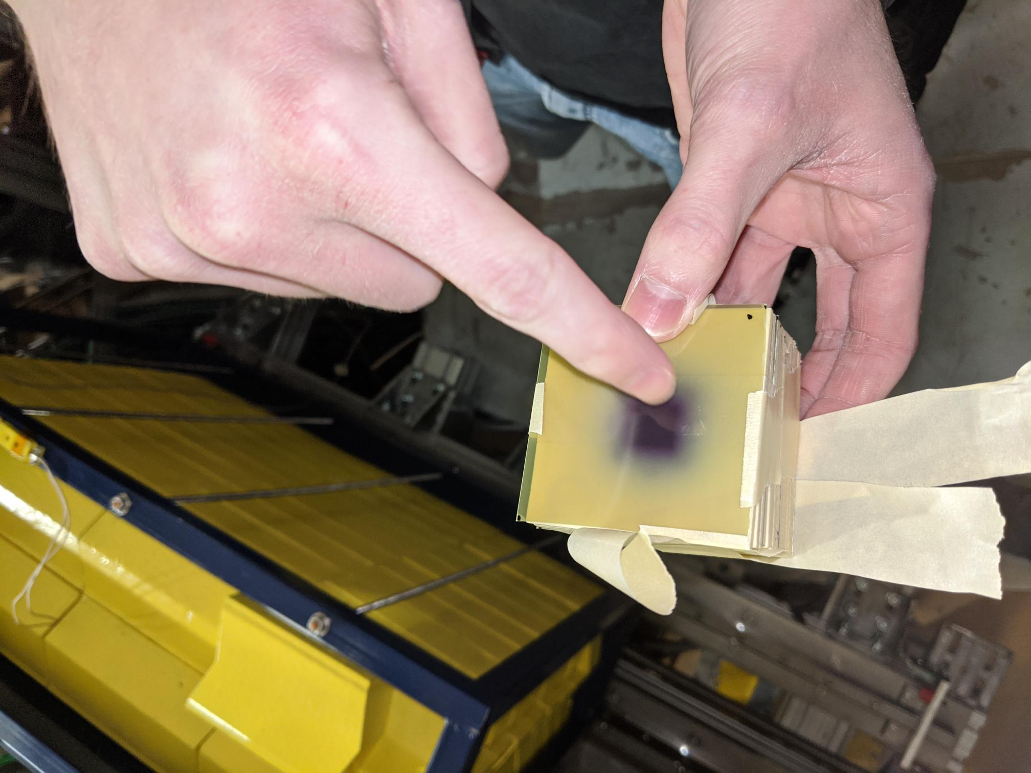
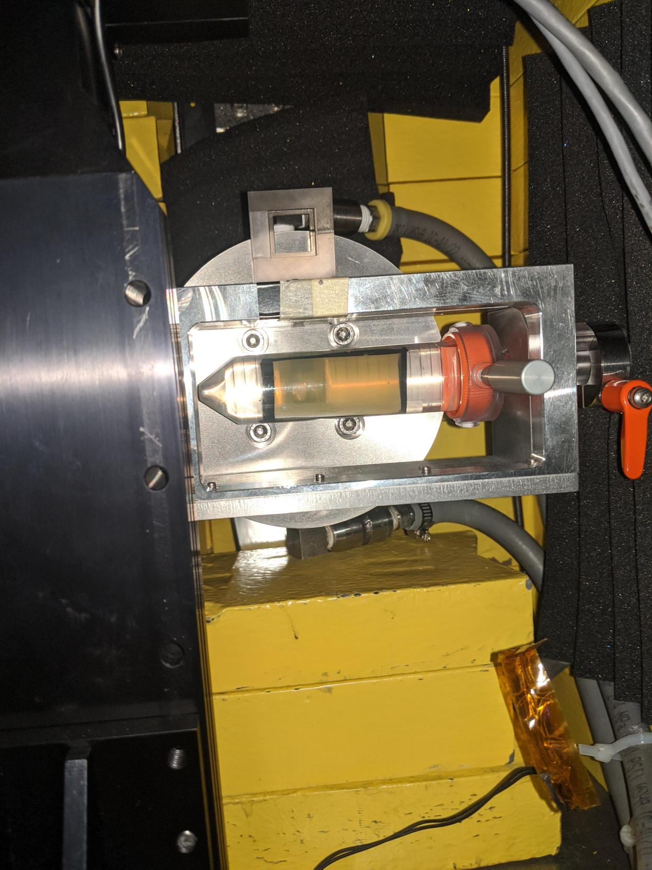
Dosimetry with dosimetry films and water-filled tubes
Stephanie Diana Rädel
Notes:
Dosimetric films

Slide 22
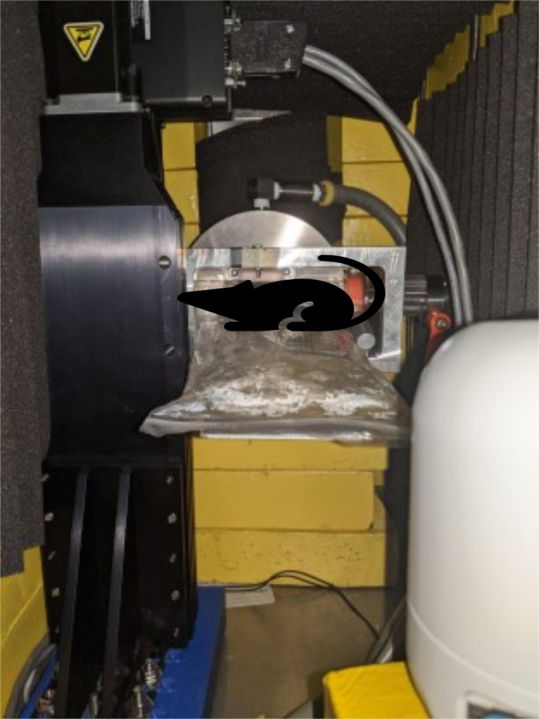


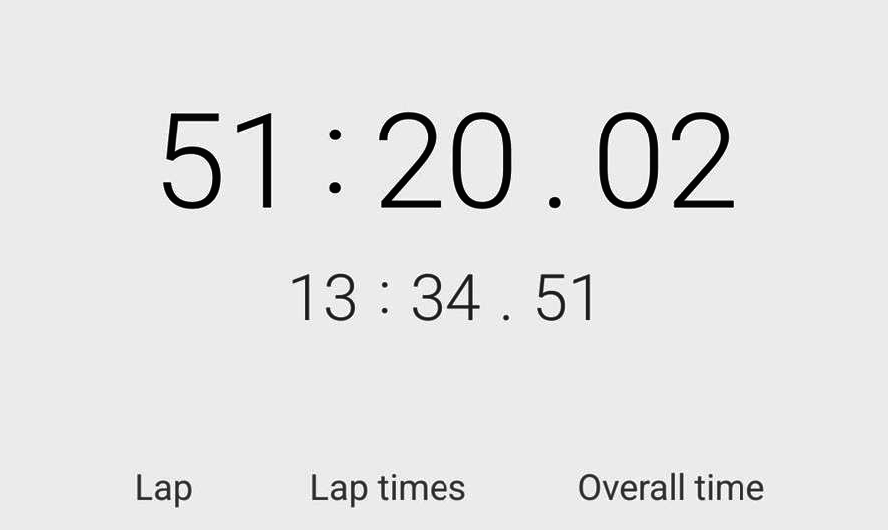
FLASH – a challenging user
ethics approval #AUP#21-0060
Limited time window (1 hr) to accommodate safe animal handling procedures
Key: develop lockup procedure
In accordance with animal care protocol
Stephanie Diana Rädel

Slide 23
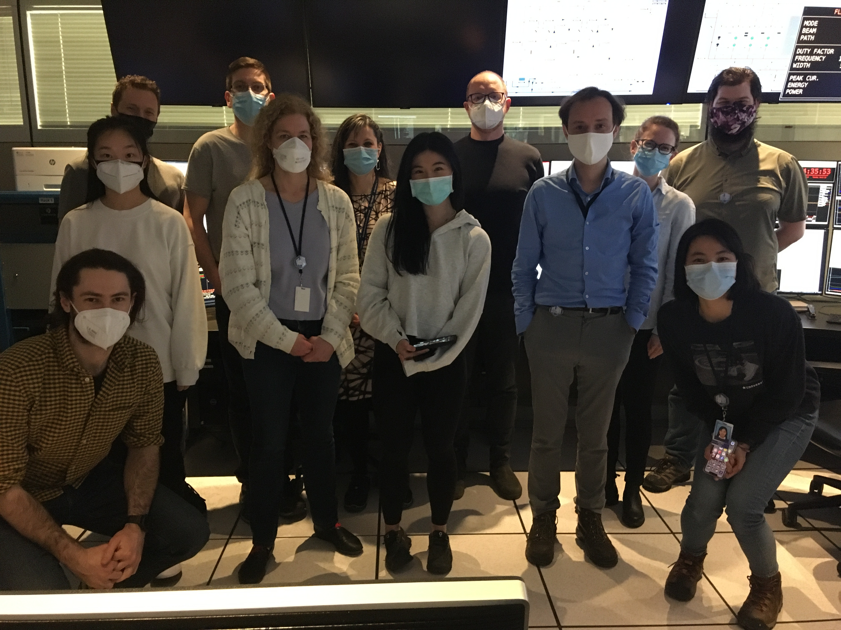

FLASH beamtime – first successful experiment March 22nd 2022
12 in-vivo irradiation in total
  6 FLASH and 6 CONV
8 samples of Drosophila fly larvae
This is just the beginning!
More FLASH days are coming
Stephanie Diana Rädel

Slide 24
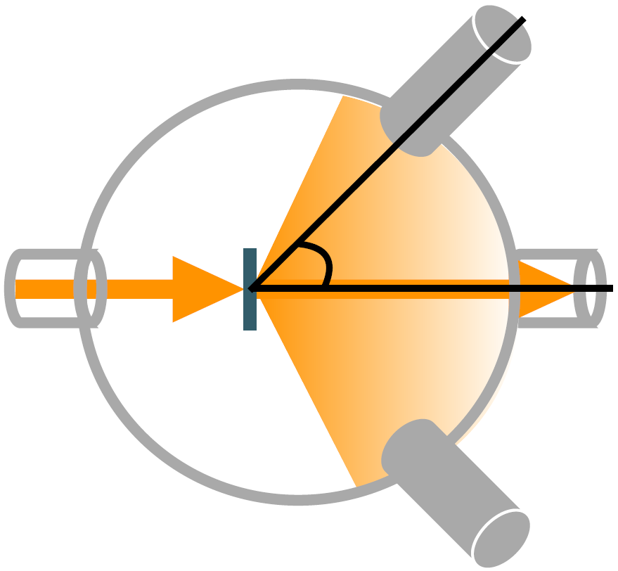
DarkLight – an upcoming experiment
Looking for dark matter with thin-target scattering experiment
ATOMKI experiment
  Observed possible boson with mass circa 17MeV/c² (“X17”)
Incoming electron interacts with target and creates γ rays … and X17?
Measure energy spectrum of electron-positron pairs created by γ or X17
Electron Beam
What can TRIUMF offer for this collaboration?
June 7, 2022, 1:30 PM
K. Pachal: “(I) Hunting for new particles at TRIUMF with the DarkLight experiment”
High intensity electron beam in CW
Energy upgrade to 50 MeV
K. Pachal: “The DarkLight experiment at TRIUMF and the hunt for a new boson”
Stephanie Diana Rädel
Notes:
Some anomalies in e+e- invariant mass spectra in 8Be

Slide 25
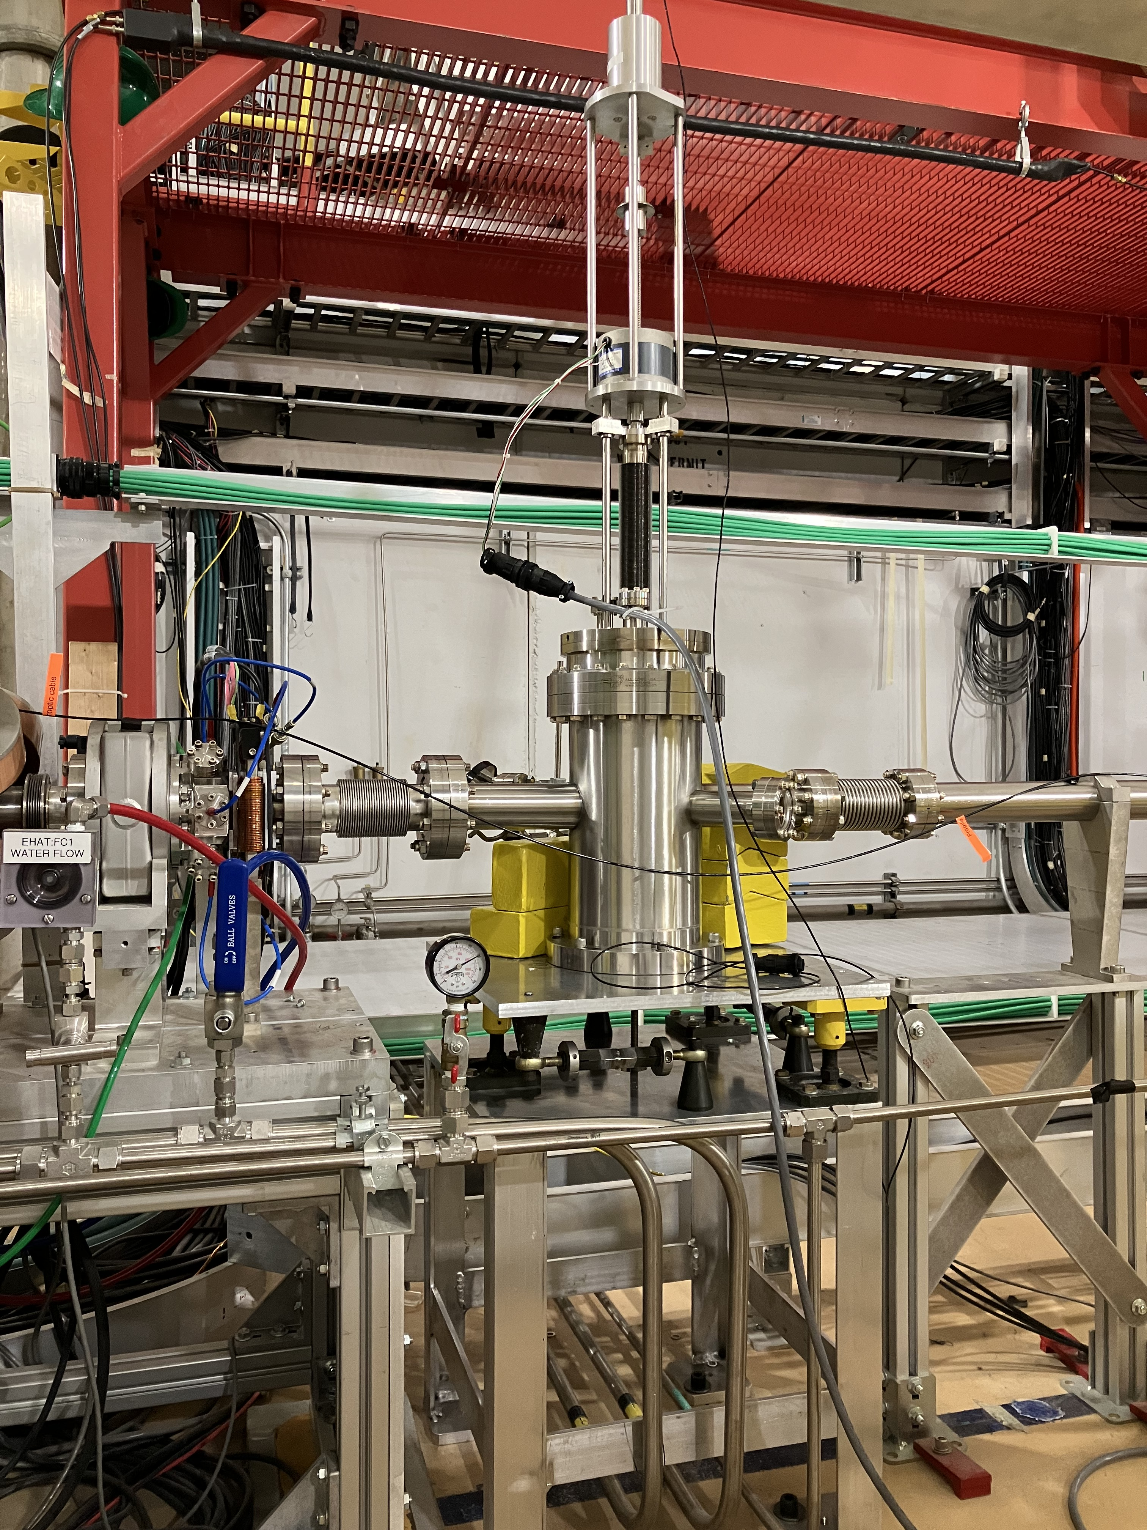
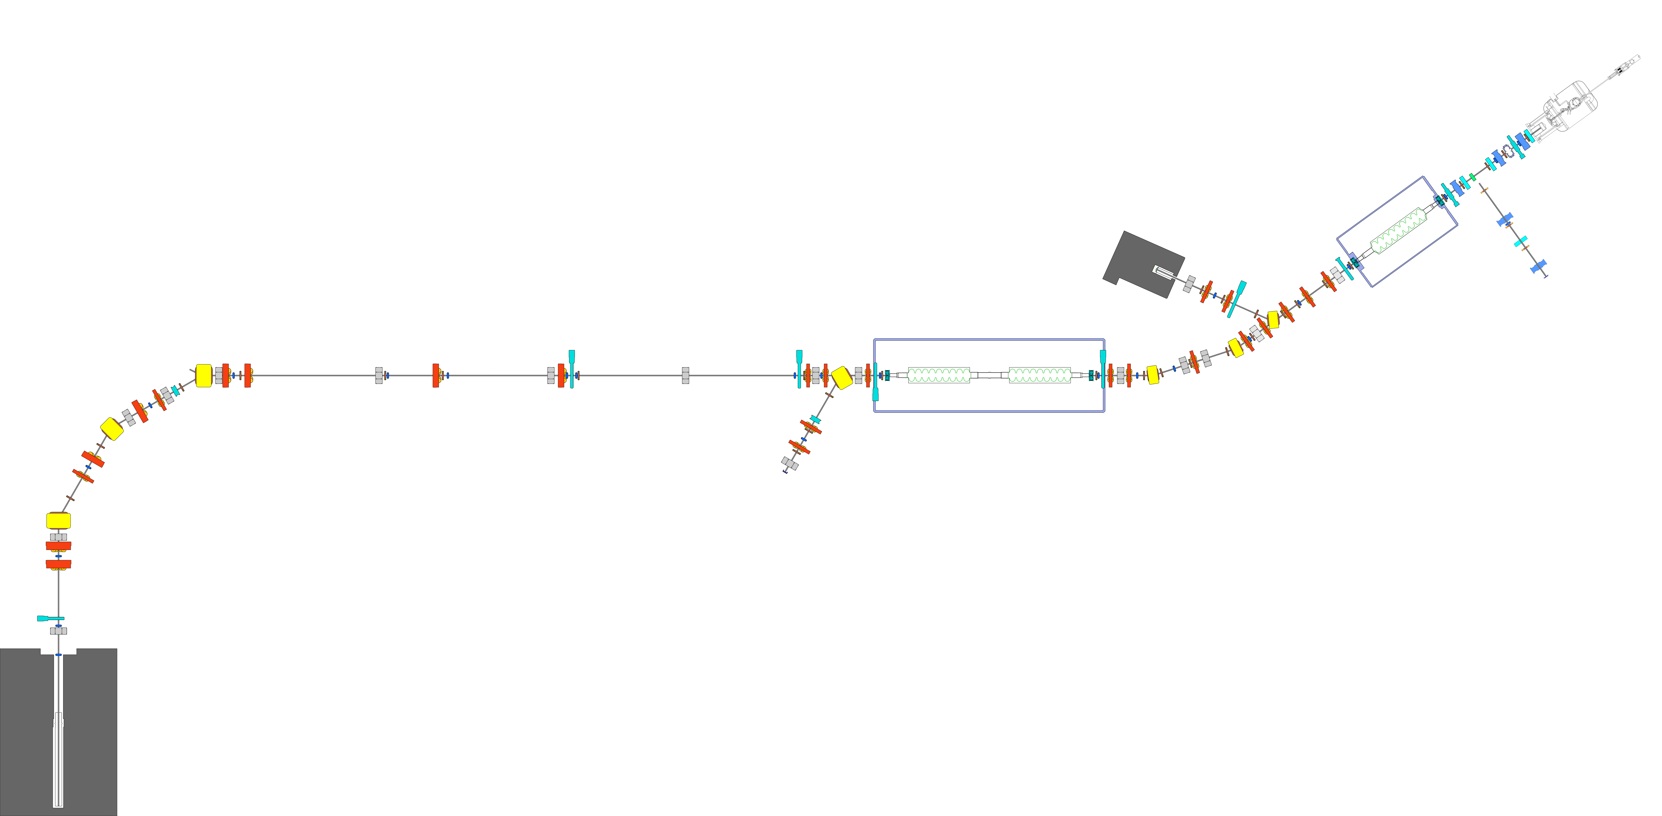
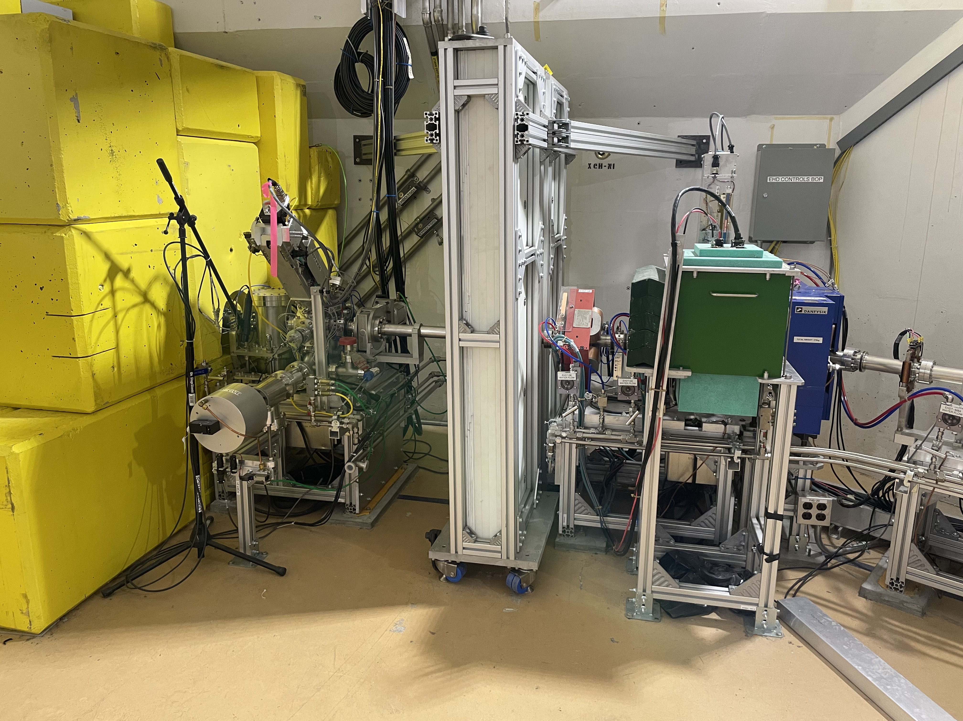


Relocating the DarkLight experimental chamber
2023: right upstream high energy dump
Now: downstream of second cryomodule (@ 30MeV)
Relocation for initial round of data taking in fall 2023
T. Planche, “New Scientific Opportunities with the TRIUMF ARIEL e-linac”, 2022
Stephanie Diana Rädel

Slide 26
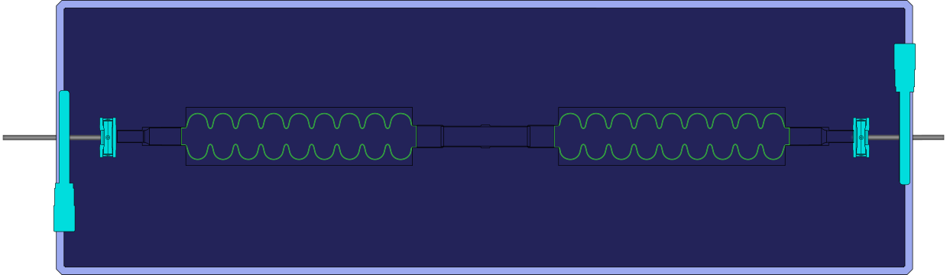

DarkLight – Stage 1 in 2024: single user at 50 MeV
New cryomodule
50 kW beam dump
DarkLight experiment
ARIEL
Collimator
K. Pachal: “The DarkLight experiment at TRIUMF and the hunt for a new boson”
Stephanie Diana Rädel

Slide 27
DarkLight – Stage 2 in 2025: multi-user at 50 MeV
New cryomodule
RF deflector
50 kW beam dump
Septum magnet
DarkLight experiment
ARIEL
ARIEL electron target will be ready to receive beam in 2025
Collimator
K. Pachal: “The DarkLight experiment at TRIUMF and the hunt for a new boson”
Stephanie Diana Rädel

Slide 28
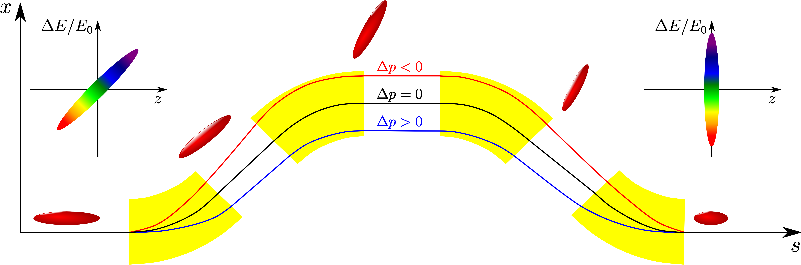
High-Brightness THz/IR Photon Source (Stage 1)
Producing THz light requires sub-mm high-charge electron bunches and a THz production station
CFI project (proposal), objective: demonstrate production of high intensity (~MV/cm) broadband radiation and establish a user community within material science
S. D. Rädel, “Status and Future Perspective of the TRIUMF E-Linac”, 2019
S. D. Rädel, “On space charge driven microbunching instability in bERLinPro”, 2017
Stephanie Diana Rädel

Slide 29
Summary
Overview of electron linac
The electron linac commissioning was completed in 2021
  Next step reliability
  ARIEL electron target ready for beam in 2025
Converter Test Stand (experiment for ARIEL electron target) in low energy section was our first user
FLASH:
  12 in-vivo irradiation in total
    6 FLASH and 6 CONV
  8 samples of Drosophila fly larvae irradiated
DarkLight introduction and its impact on delivering electron beam
Proposed e-linac becoming a THz source
Stephanie Diana Rädel

Slide 30
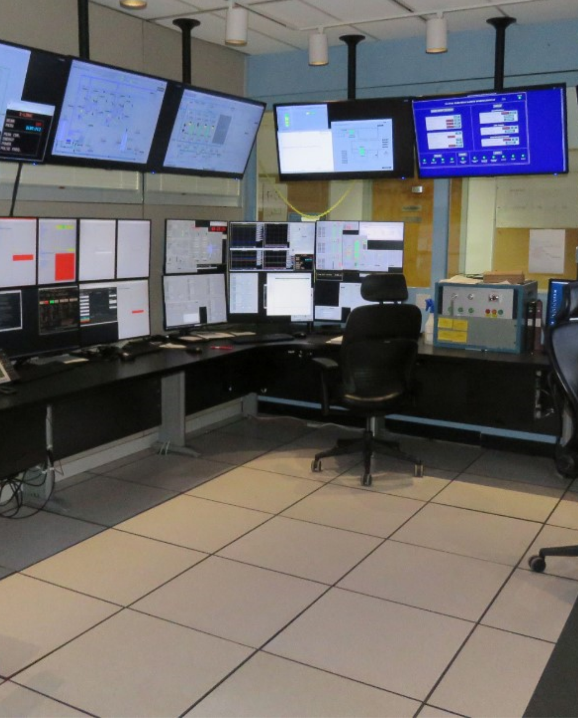





Thank you
Merci
www.triumf.ca
Follow us @TRIUMFLab

Slide 31
BACKUP SLIDES
Stephanie Diana Rädel

Slide 32
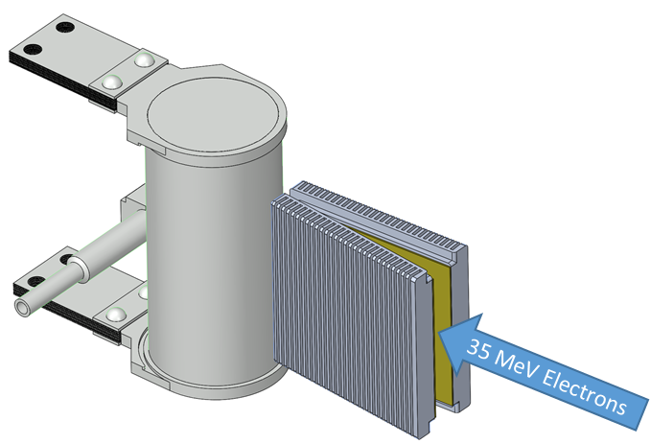
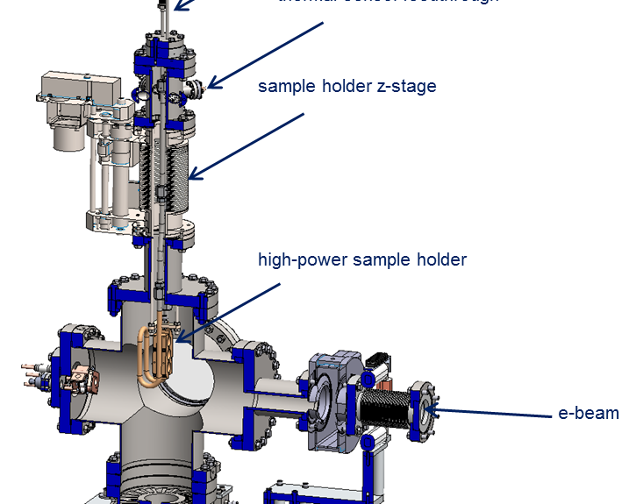
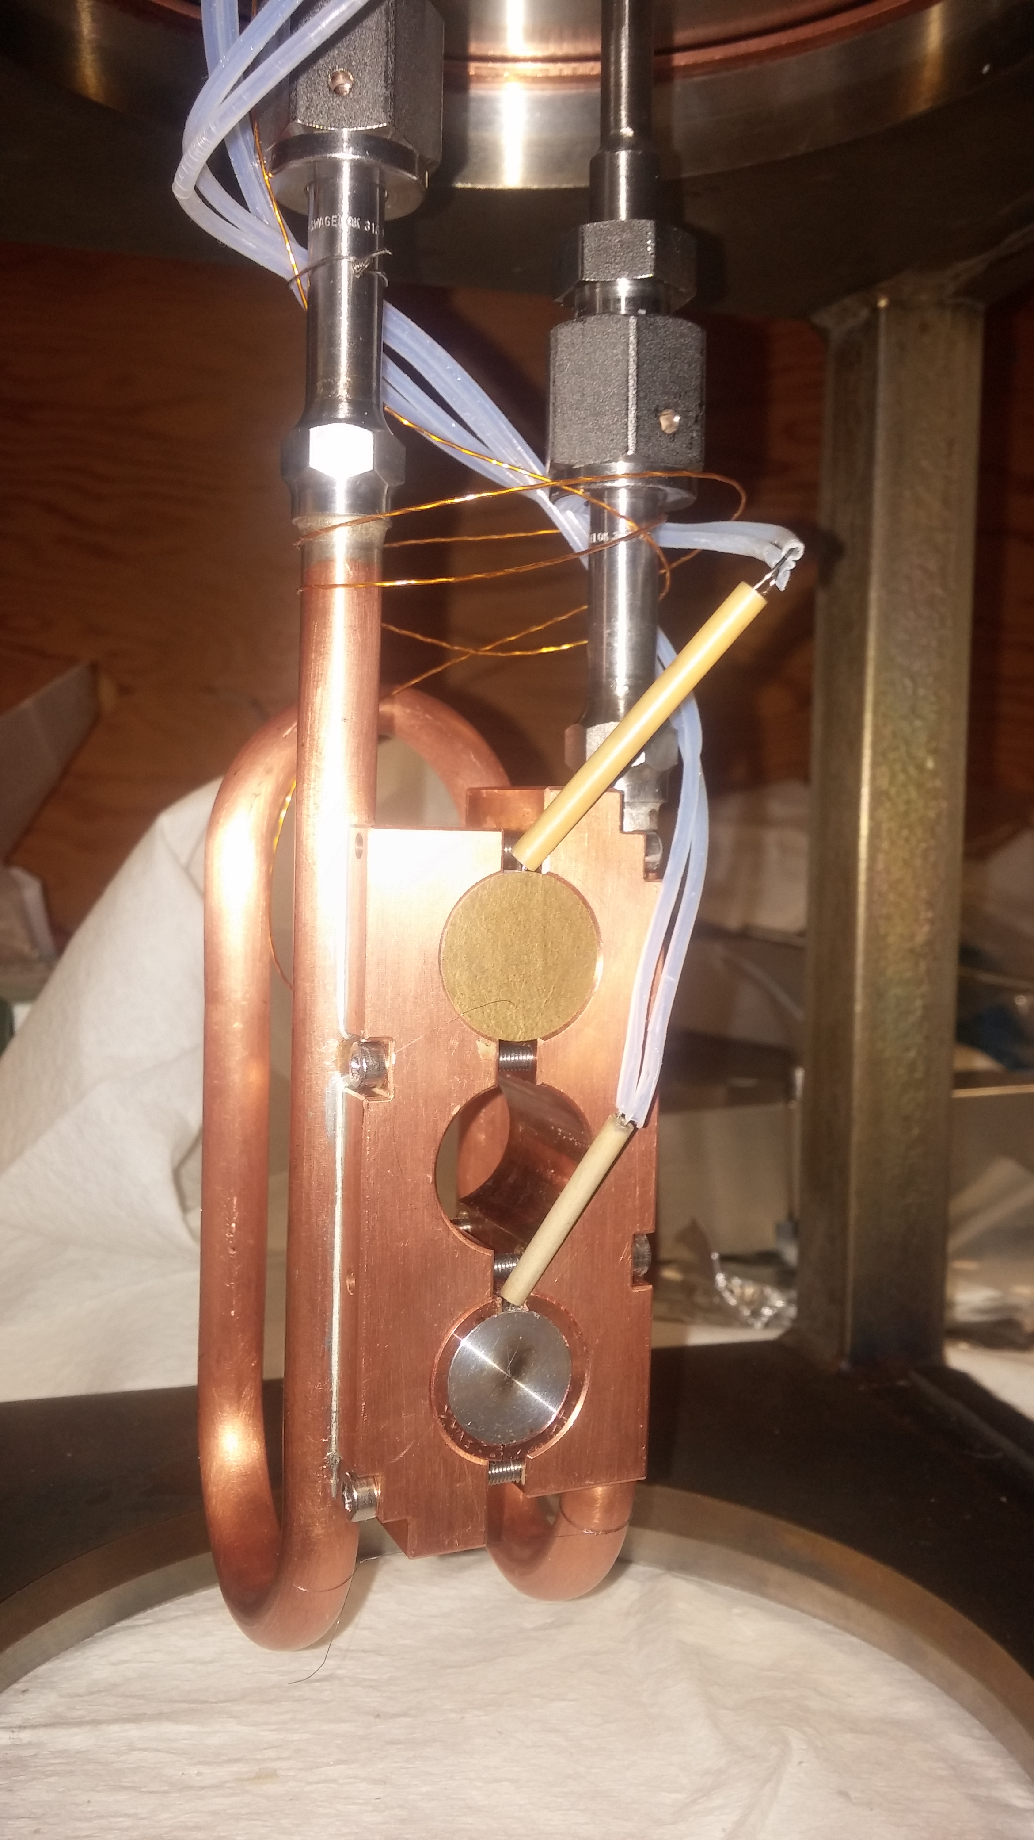
ARIEL e-γ Converter Test Stand (TRIUMF, UBC, UVic, SLAC)
AETE
Existing irradiation capability: 300 keV to 35 MeV, up to 1023 electrons/cm²/day
High-Z / aluminum interface at risk:
  Thermal stresses (100 kW beam, thermal cycles)
  Radiation damage / radiochemistry
  Irradiations of up to 3 weeks
Experimental setup:
  Water-cooled sample holder
  Several high-Z materials tested
  Beam power density matching online value
  300 keV beam to avoid activation (online 35 MeV)
e⁻
A. Gottberg
Stephanie Diana Rädel

Slide 33
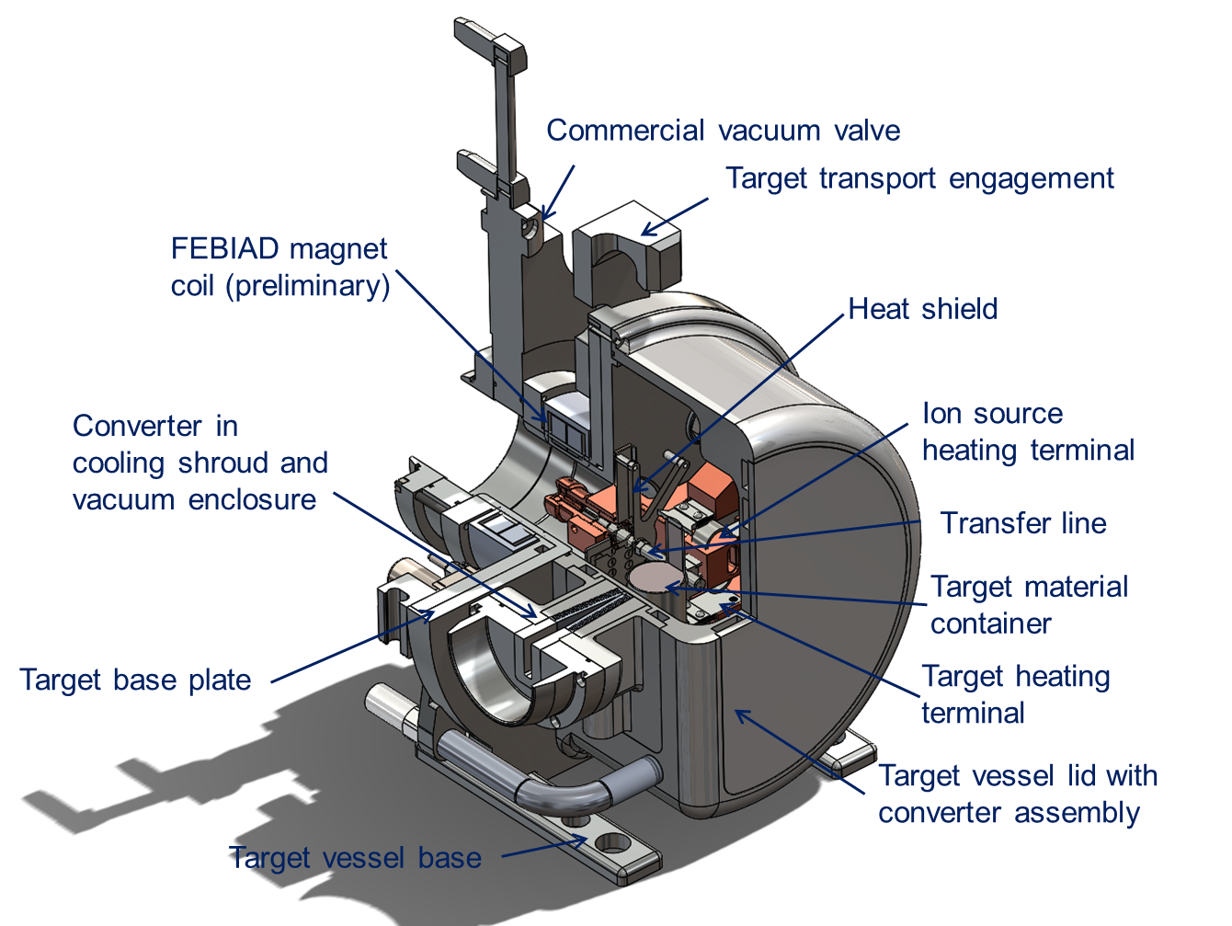
ARIEL Hermetic Target Vessel
Increased development space for new ion source and transfer line concepts (cold transfer line, variable temperature transfer line, quartz transfer line, improved FEBIAD, low work function cavity, IG-LIS²)
Hermetic enclosure allows for the use of air-sensitive target materials
Service connections with provisions for future ion source and target concepts
Converter integrated into target vessel lid allows for routing additional cooling for high power target operation
Vessel volume increased for new target concepts (liquid targets, new converters, etc.)
A. Gottberg
Stephanie Diana Rädel

Slide 34
The ARIEL Target Hall
Remote-controlled crane
Hot cell facilities (target handling, PIE, waste processing, medical isotope extraction repair and maintenance)
Hall with two floor
levels (existing)
Electron beam and proton beam transport
module storage
Symbiotic medical target
AETE
target exchange point
ASTM
spent target storage
APTW
drivers beam tunnel (existing)
electrons
RIB
protons
RIB
Storage of expired targets for 3 years before shipment to CNL
Target pit shielding
A. Gottberg
Stephanie Diana Rädel

Slide 35
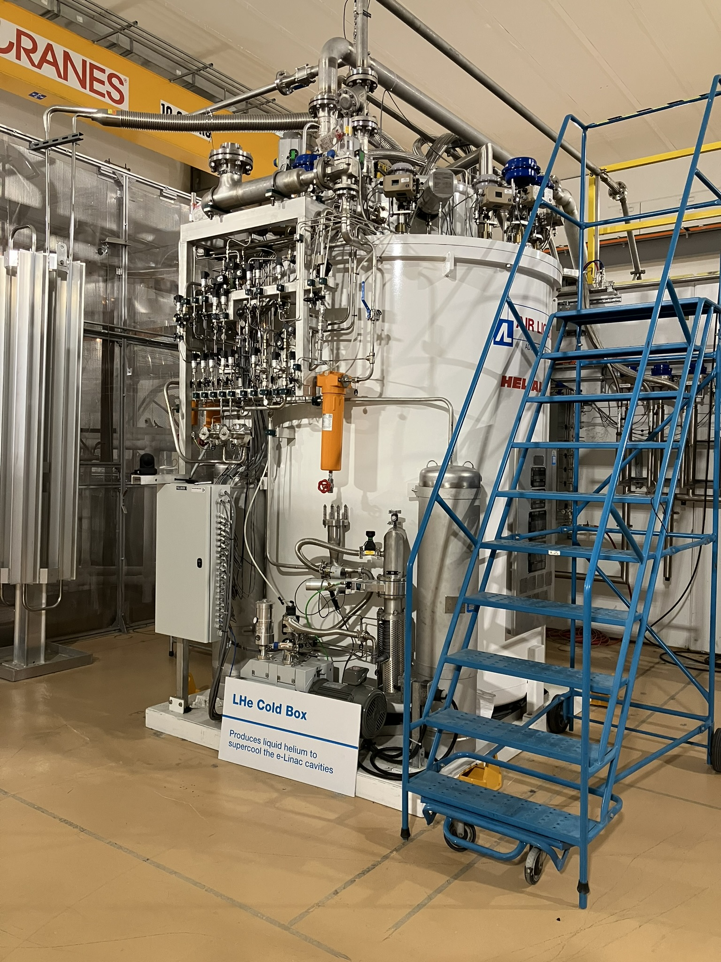
Cryo
ALAT LL Cold Box, KAESER (FSD571SFC) main compressor (112 g/s), Cryotherm - distribution
4 Bush combi DS3010-He pumping units specified and installed (1.4 g/s @ 24mBar each)
T. Planche, “New Scientific Opportunities with the TRIUMF ARIEL e-linac”, 2022
Stephanie Diana Rädel

Slide 36
DarkLight – Experimental apparatus
K. Pachal: “The DarkLight experiment at TRIUMF and the hunt for a new boson”
Stephanie Diana Rädel

