Slide 1
ISOLDE Beam Dump Replacement Study (IBDRS) – Preparatory project
92nd ISOLDE Collaboration Committee meeting
05.11.2021
AP.Bernardes SY-STI on behalf of the IBDRS team
Acknowledgements:
SY-STI: M.Calviani, K.Kershaw, JM.Martin Ruiz, S.Marzari, J.Vollaire
SCE-DOD: E.Perez-Duenas, R. Cunningham
HSE-RP: E.Aubert, A.Dorsival, F.Pozzi, A.Formento
EN-HE: C.Bertone, JL.Grenard
EN-ACE: A.Pardons, M.Lazzaroni
SY-ABT: M.Fraser
BE-OP: S.Mataguez, E.Siesling

Slide 2
Agenda
Introduction
IBDRS organisation
IBDRS Status
Next steps
Conclusion

Slide 3
Introduction

Slide 4
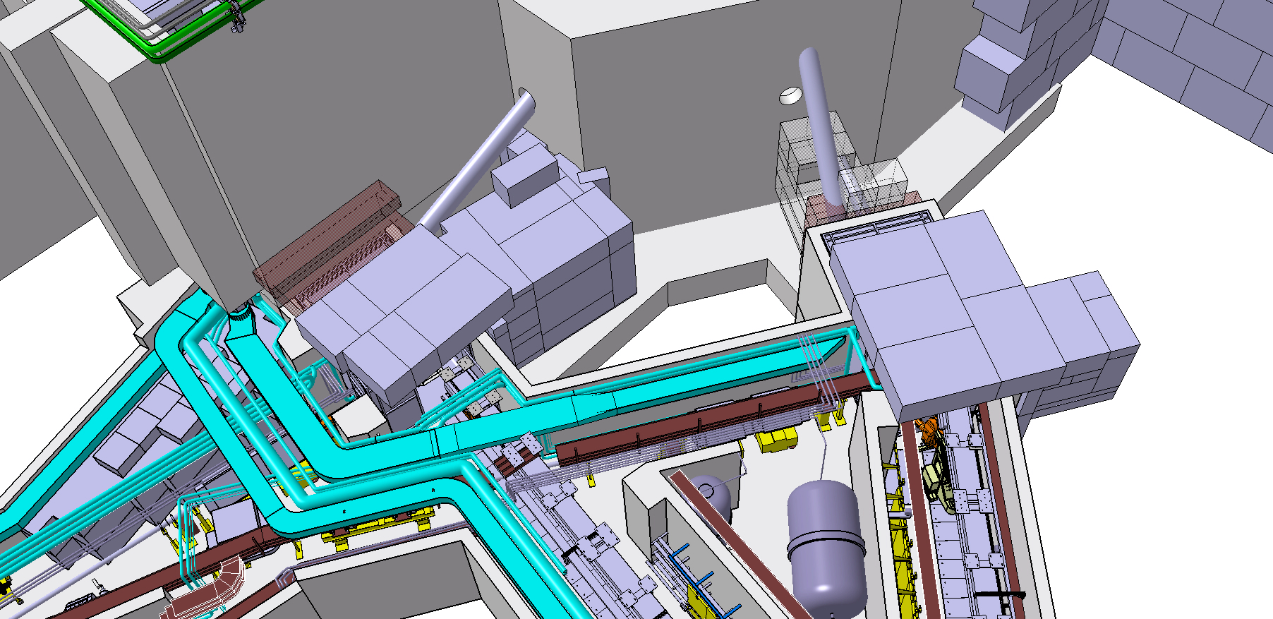
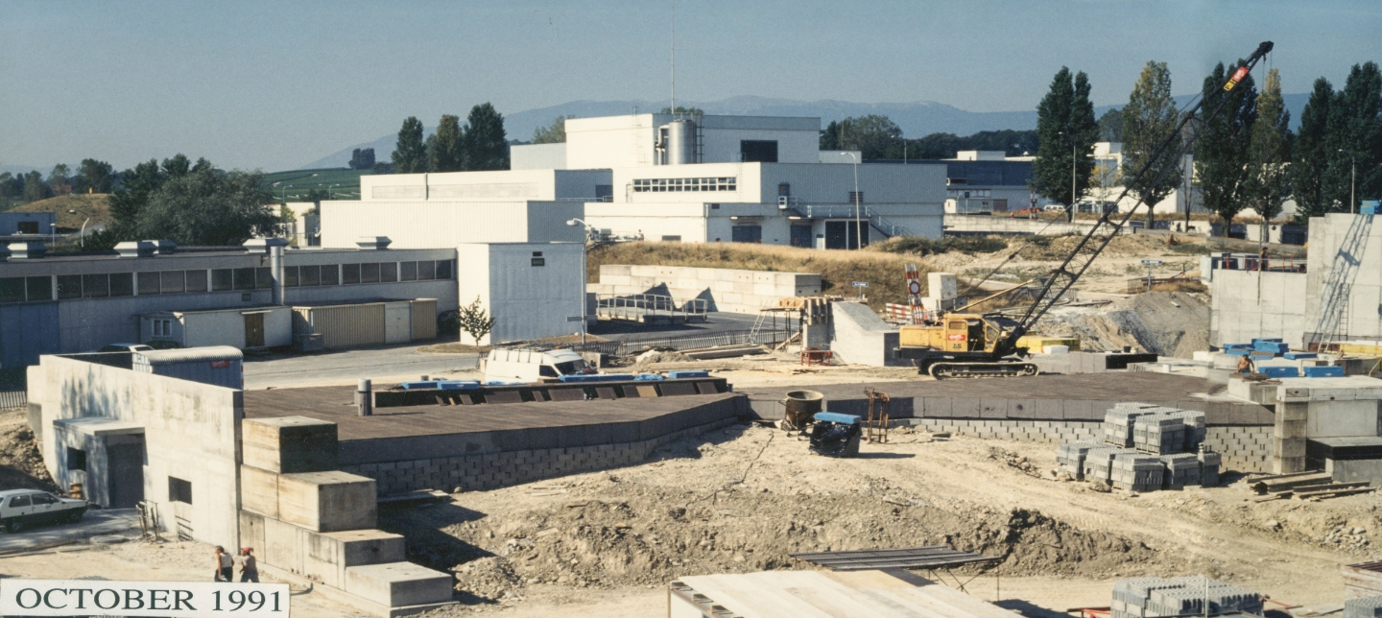
INTRODUCTION
Current ISOLDE configuration dates to 1991-1992 (ISOLDE 4)
Beam dumps were designed for a proton beam of 1 GeV and lower (?) intensity
Current max beam 1.4 GeV/c at 2.0 μA is 2.8 kW on dump
Building 170
GPS
HRS

Slide 5
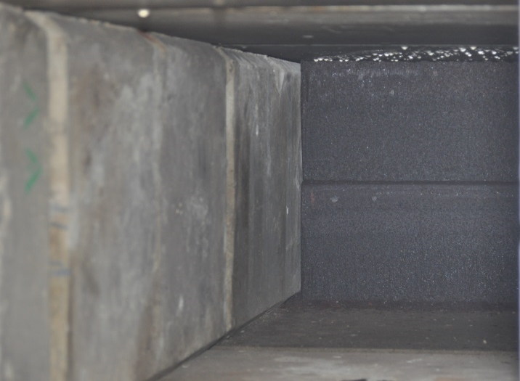
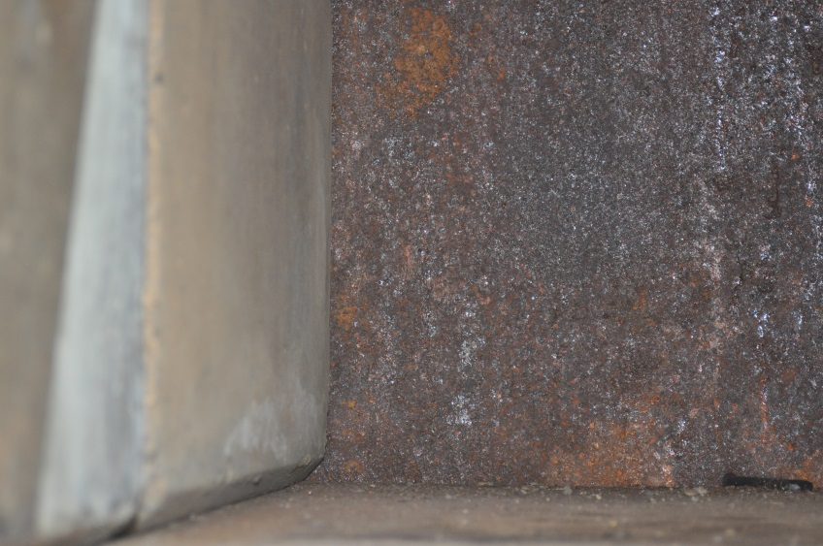
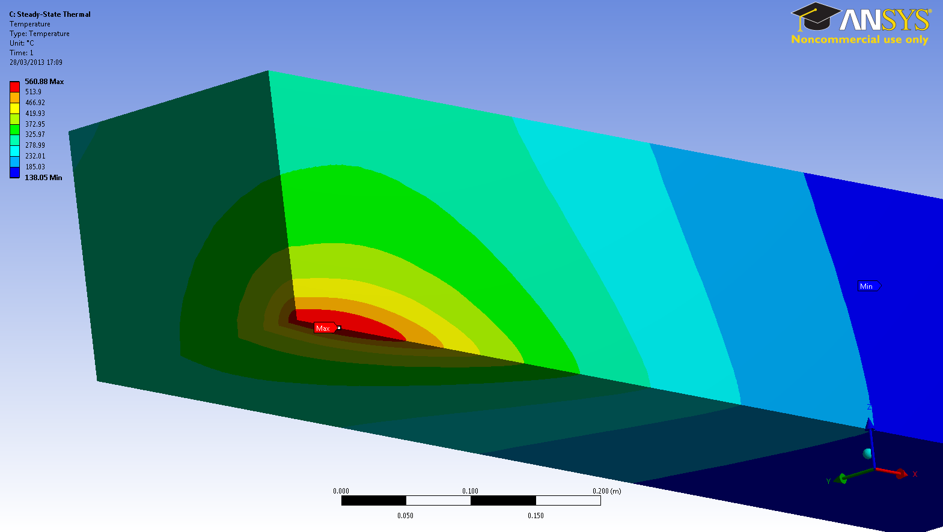
INTRODUCTION
Corrosion
Condensation
Large uncertainty on the heat conduction coefficient
Molten material?
Signs of corrosion, condensation and molten material on the visible face
Unknown condition (neither access nor monitoring)
Dumps already operate at their limit in terms of temperature and mechanical stresses
Coupled FLUKA/thermo-mechanical analyses (EDMS 1277863, 1308217) are showing that the dumps already operate at their limit in terms of temperature and mechanical stresses → dangerous to go higher
Need for shielding improvements around the target areas and beam dumps (EDMS 1142606)

Slide 6
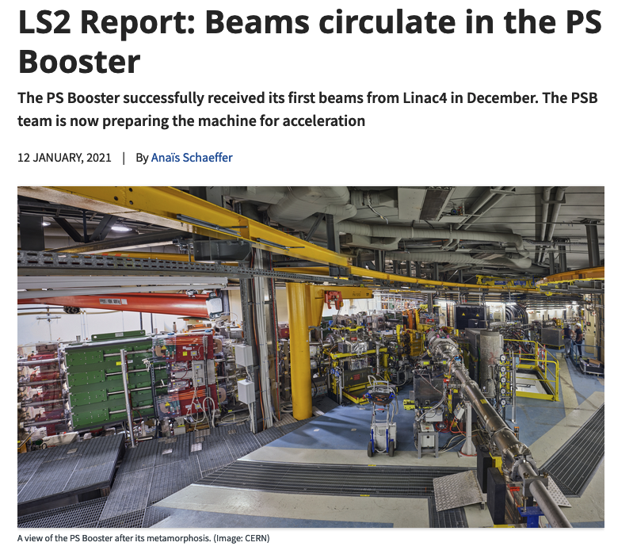
INTRODUCTION
PS Booster (PSB) beam upgraded during LS2 at 2 GeV (LIU Project)
ISOLDE is the only facility at CERN which cannot profit from PSB upgrade because of:
  Dump limitation (Energy deposition → higher beam power dissipation requires air- or water-cooled dump)
  BTY line upgrade
First step to 2 GeV protons beam at ISOLDE is the ISOLDE Beam dump Replacement

Slide 7
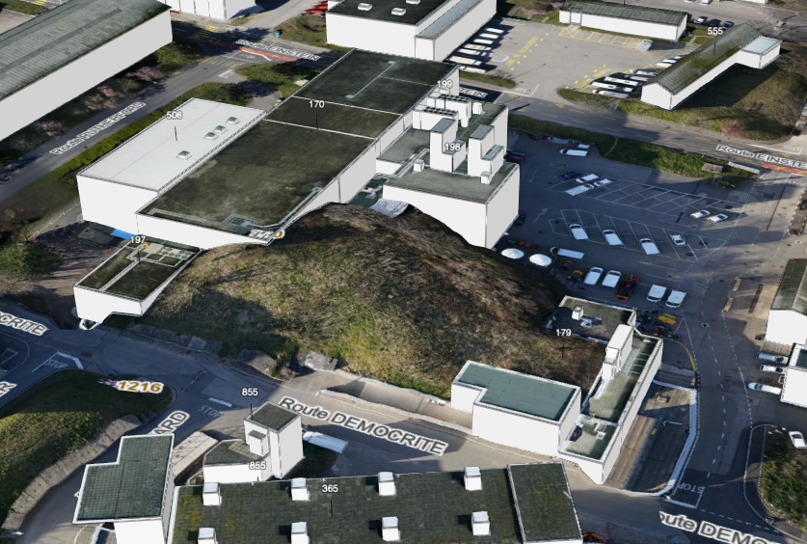
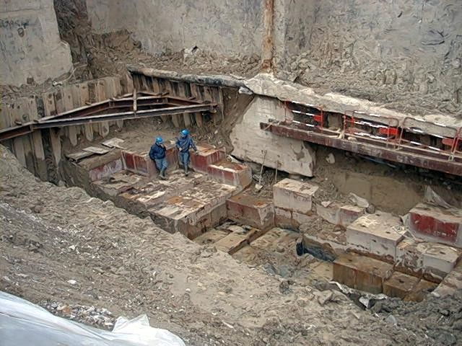

INTRODUCTION
Example of shieding removal (not radioactive)
Beam dump exchange is challenging – Current design not planned to be dismantled (Buried in earth). Covered with activated earth

Slide 8
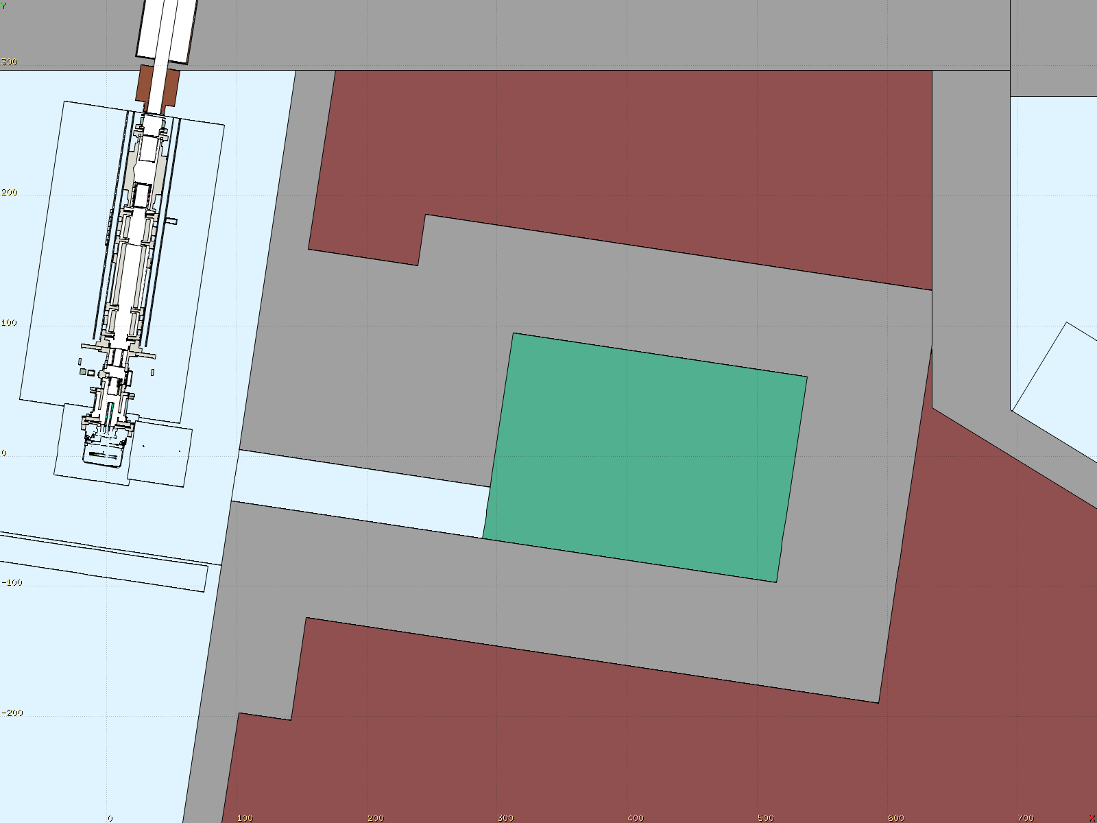
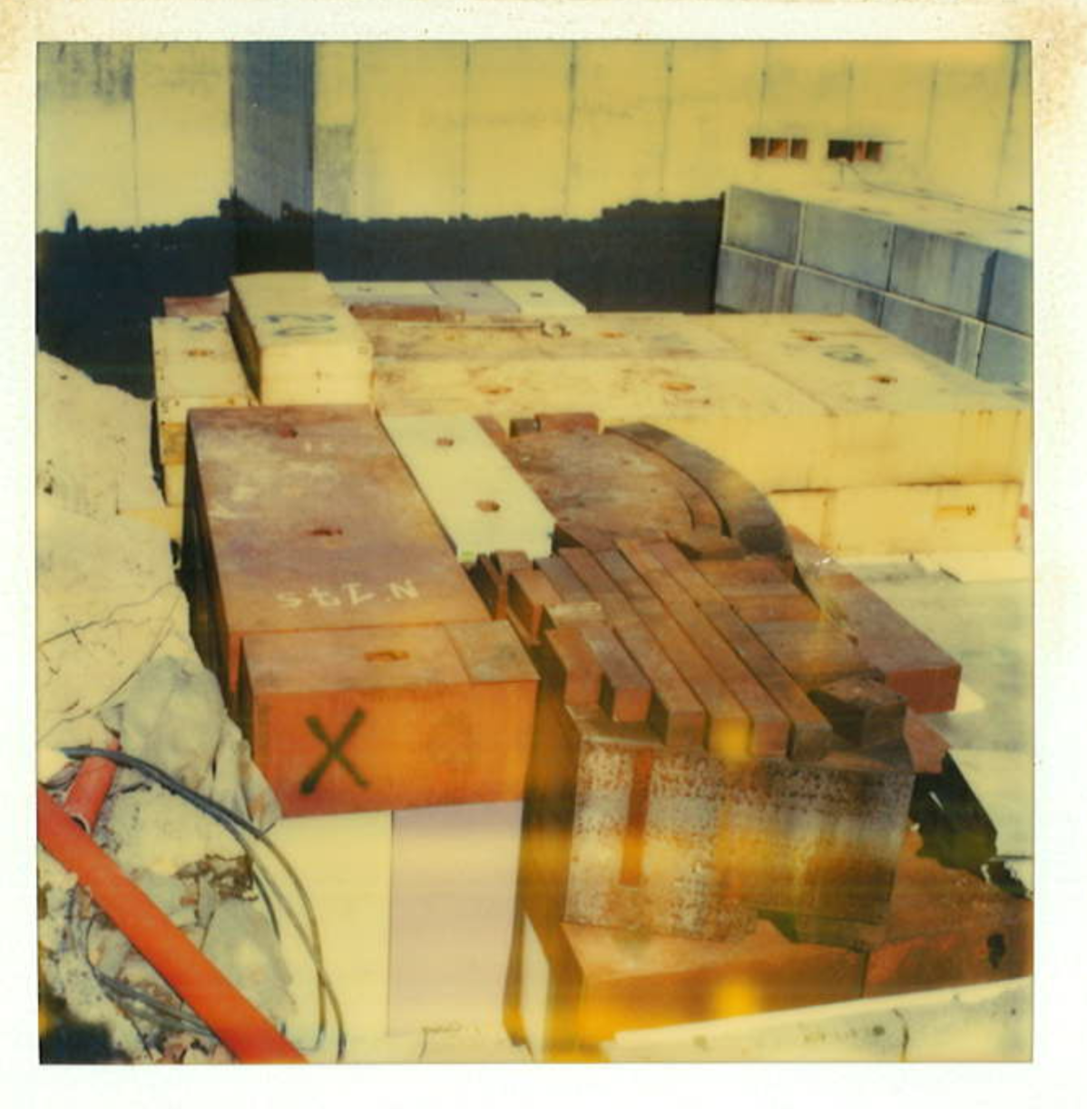
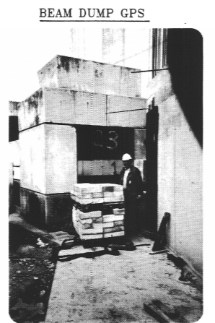
INTRODUCTION
4.5 mSv/h
at 1 m from dump face
1.7 mSv/h
at 2 m from dump face
34.8 mSv/h
at “contact” with dump face
RP Survey – May 2021 after 2 years cooling
Acknowledgement A. Dorsival, F. Pozzi HSE-RP
(Manual handling)

Slide 9
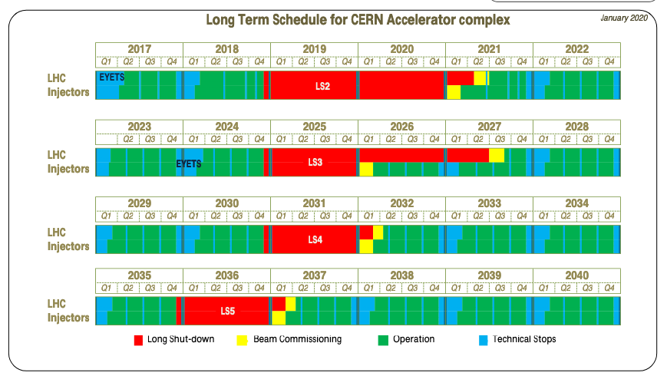
INTRODUCTION
Non radioactive Blocs
Dump Replacement is only possible during a LS
(a long LS!)
Non radioactive Blocs

Slide 10
IBDRS Organisation

Slide 11
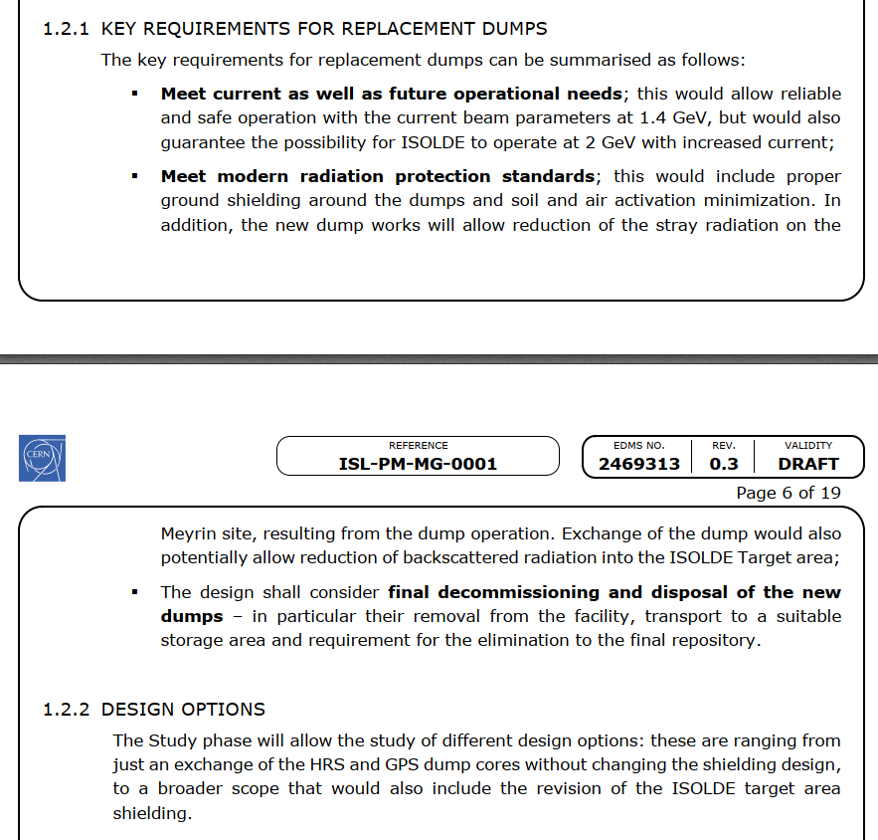
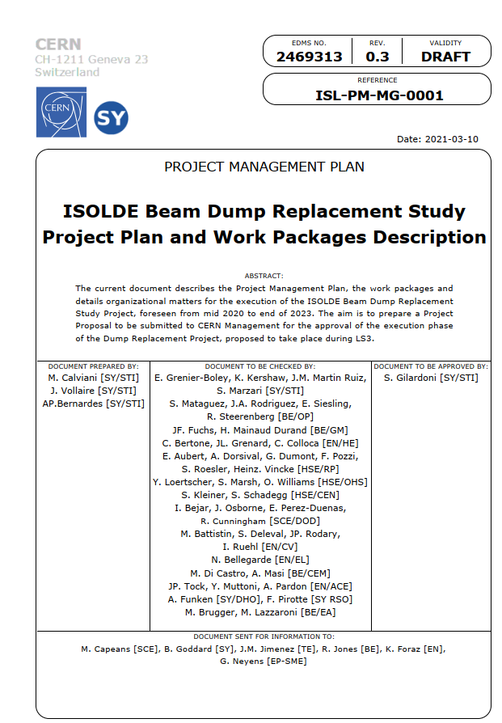
Organisation
Project Management Plan
EDMS 2469313
IBDRS Study funded by the ACC-CONS budget

Slide 12
Organisation
7 Work packages identified EDMS 2469313
WP1 – Project Management – A.P. Bernardes [SY-STI]
WP2 – Project Safety Management - S. Mataguez [BE-OP]
WP3 – Handling and transport - C. Bertone [EN-HE]
WP4 – Beam dump core design including supports – J.M. Martin Ruiz [SY-STI]
WP5 – Shielding and infrastructure: lifecycle handling and integration - S. Marzari [SY-STI]
WP6 – Civil Engineering Study– E. Perez-Duenas [SCE-DOD]
WP7 – Radiation Protection– F. Pozzi [HSE-RP]

Slide 13
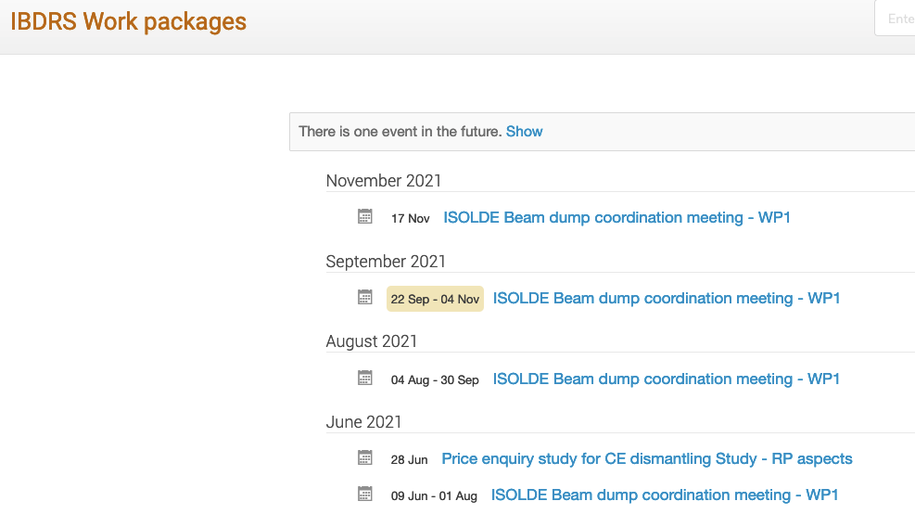
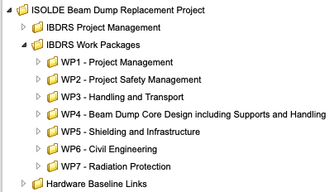
Introduction
IBDRS coordination meetings every two weeks- Indico 12446
EDMS structure

Slide 14
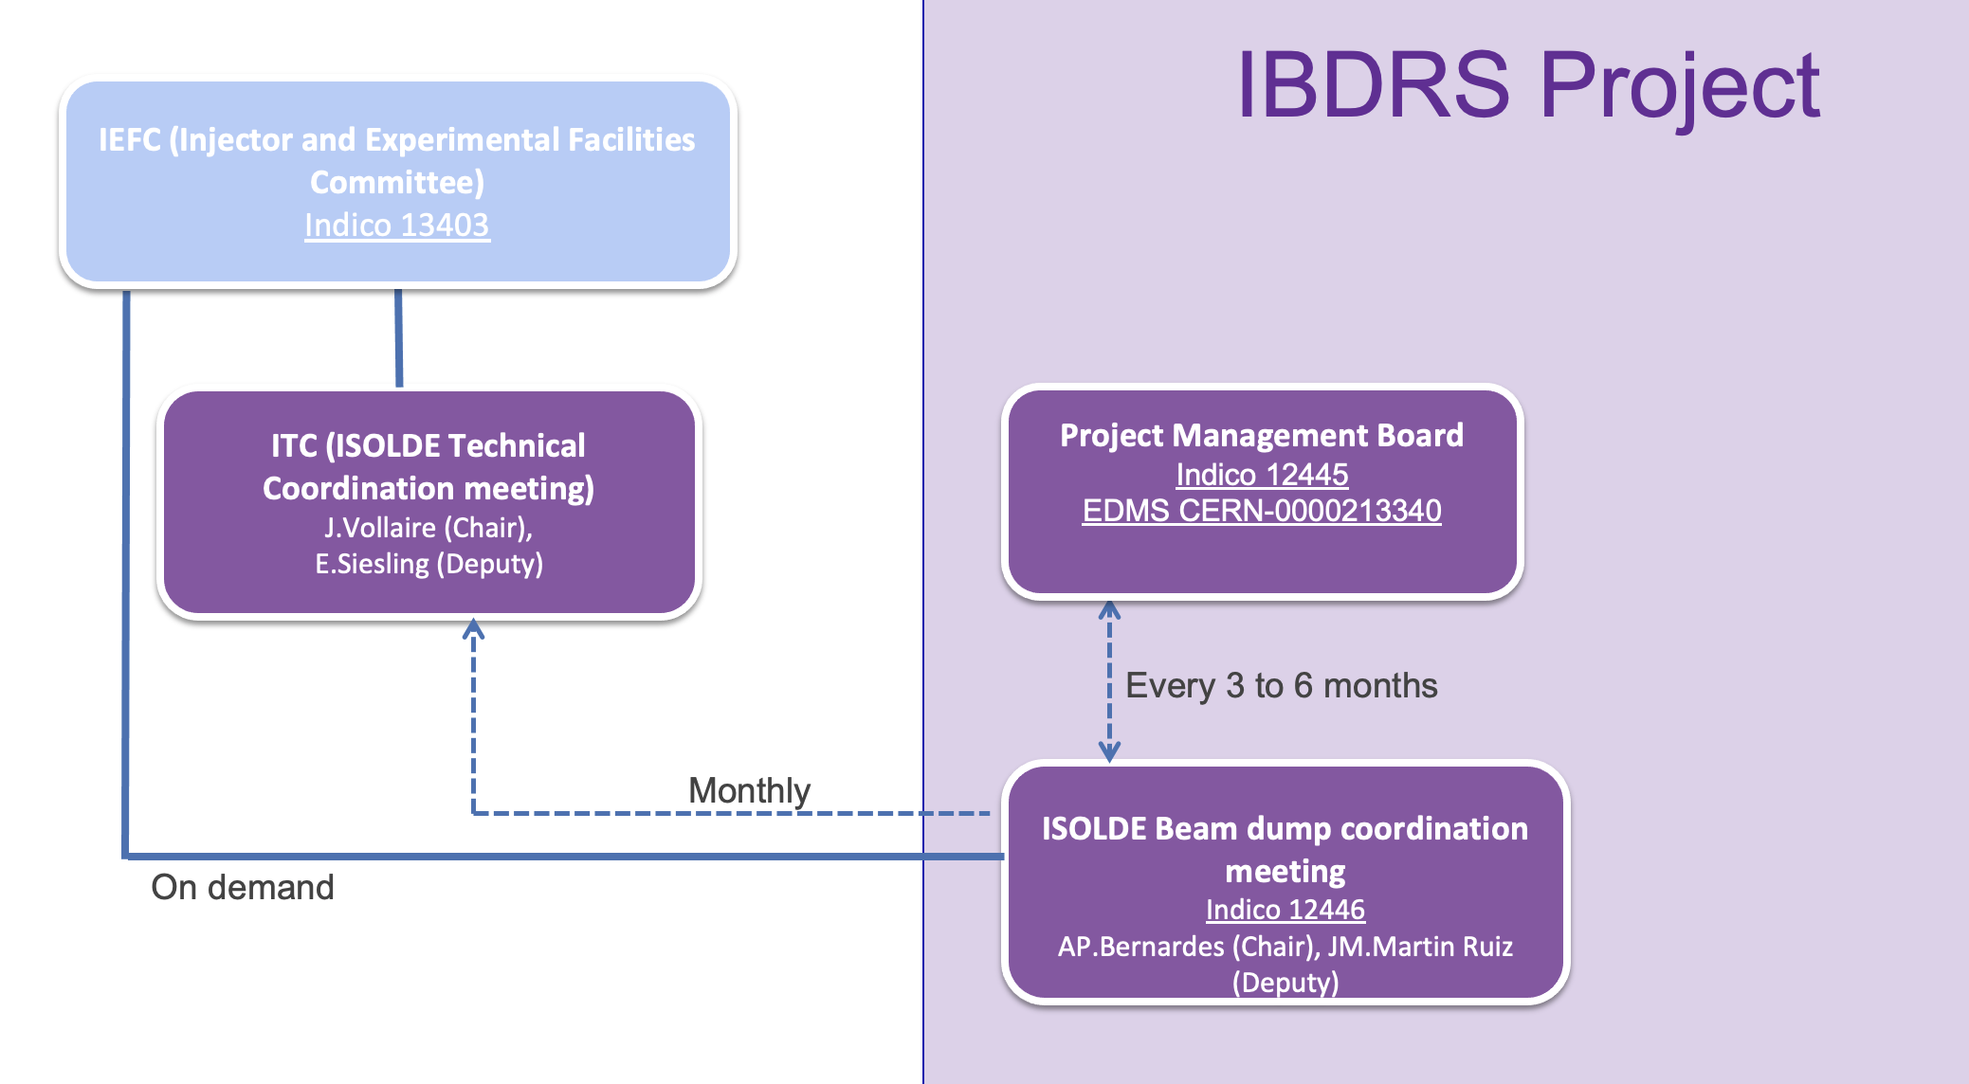
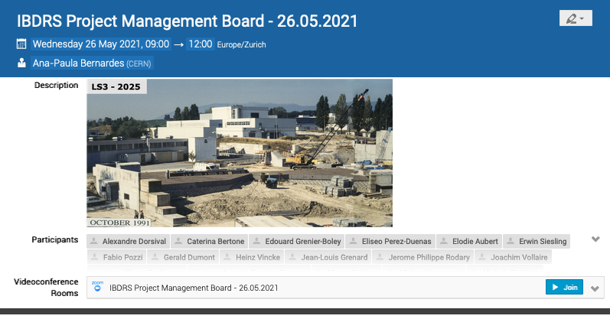
Organisation
1st Project Management Board in May 2021 – Indico 1034928

Slide 15
IBDRS Status

Slide 16
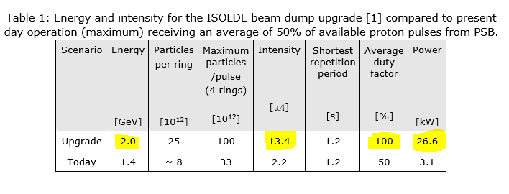
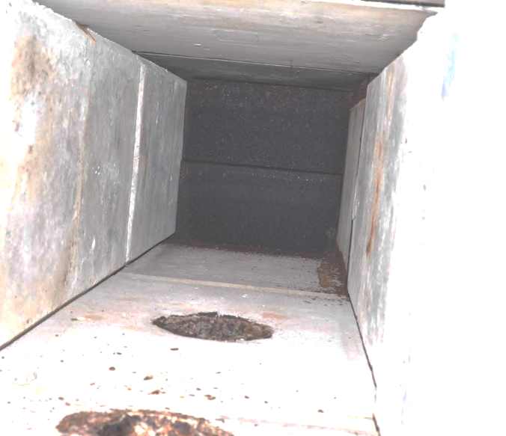
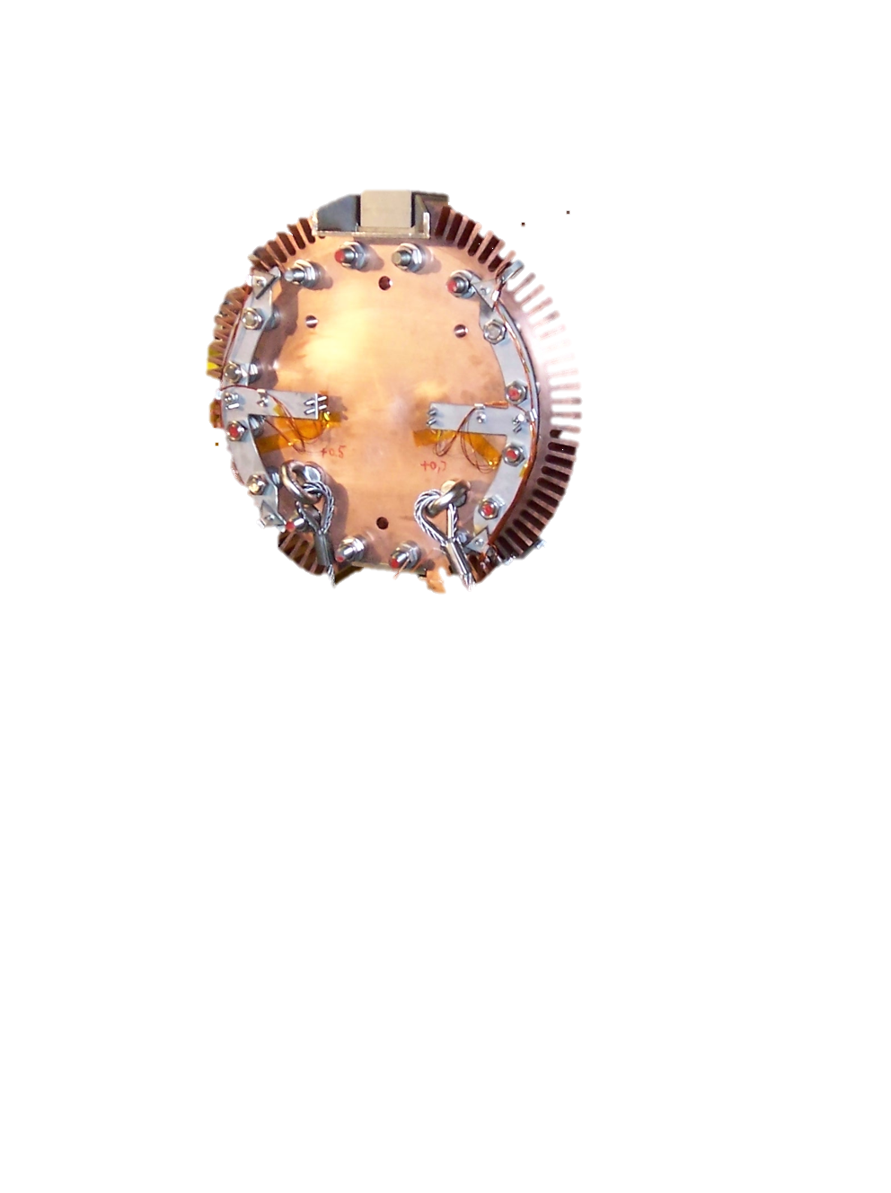
Dump design parameters
Requested to meet current as well as future operational needs
  Parameters to be considered for the DUMP design are under discussion
Acknowledgement M.Fraser/SY-ABT (EDMS 2583793)
2021
LS3 - 2026

Slide 17
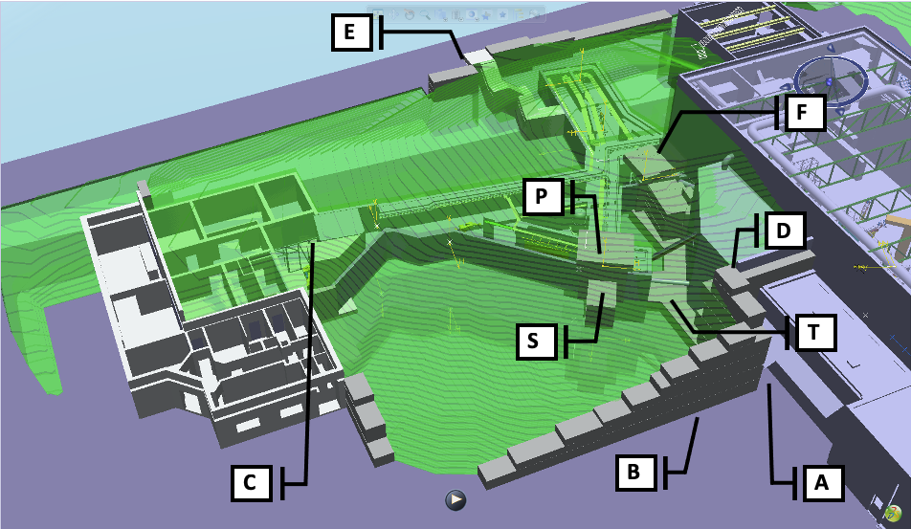
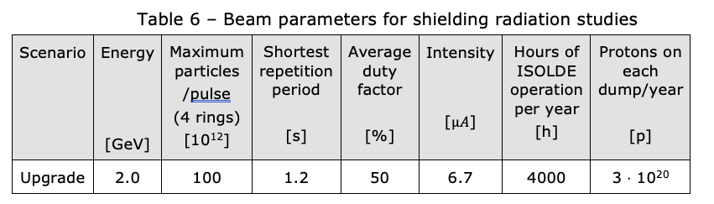
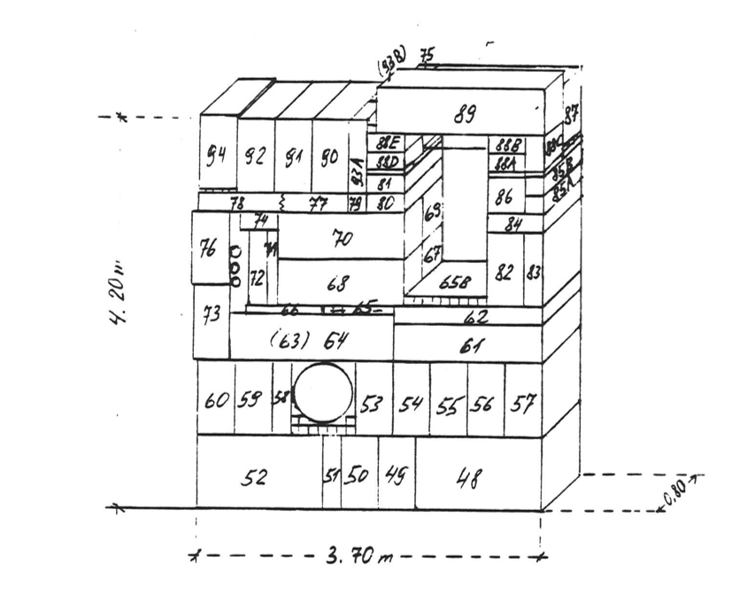
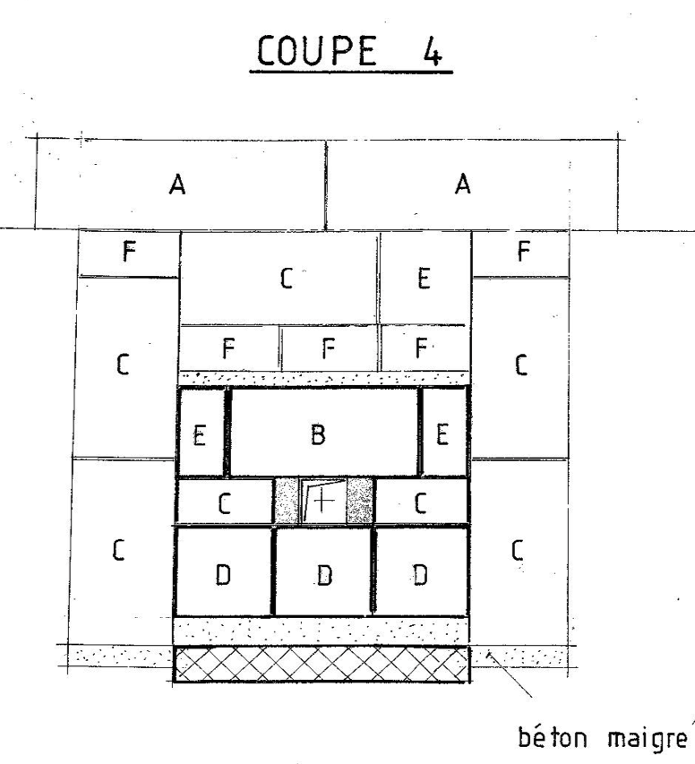
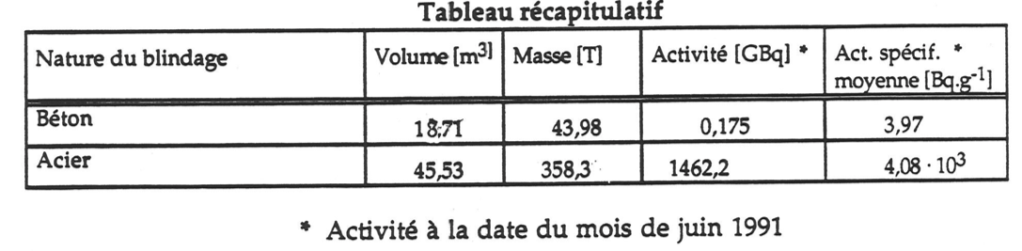
Shielding design parameters
Meet current as well as future operational needs
  Parameters to be considered for the SHIELDING design under discussion
Acknowledgement J.Vollaire and J.M. Martin Ruiz (EDMS 2583793)
In addition 8 to 10 meters of earth shieling

Slide 18
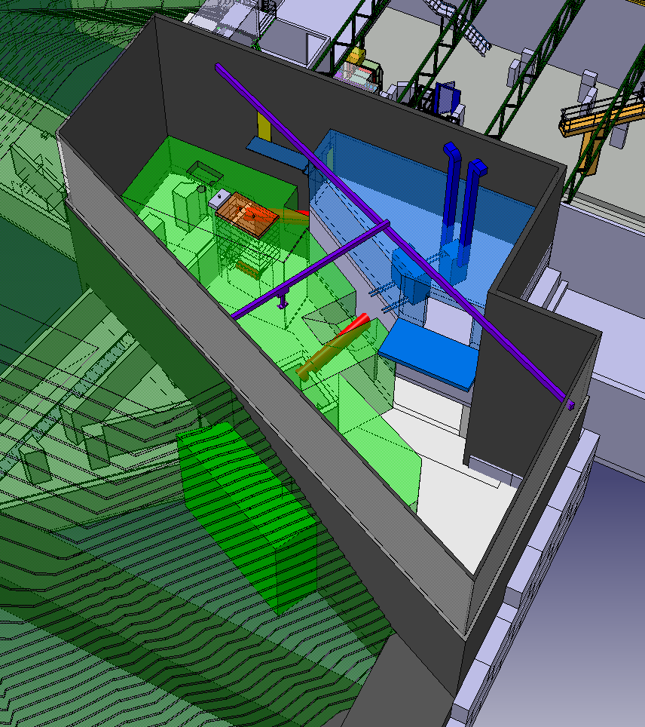
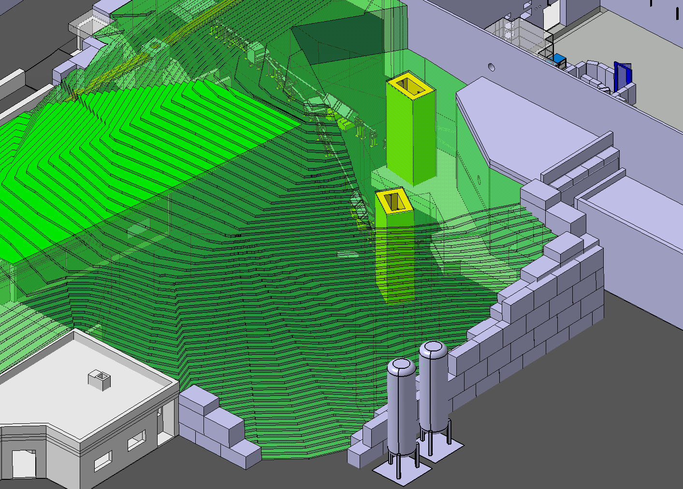
Concepts
Following 6 months brainstorming session – 2 concepts have been selected to be studied in parallel:
BASIC concept (Reduced cost)
FLEXI Concept (Higer CAPEX but would allow cheaper future ISOLDE upgrade)
Basic shafts Concept
FLEXI Concept

Slide 19
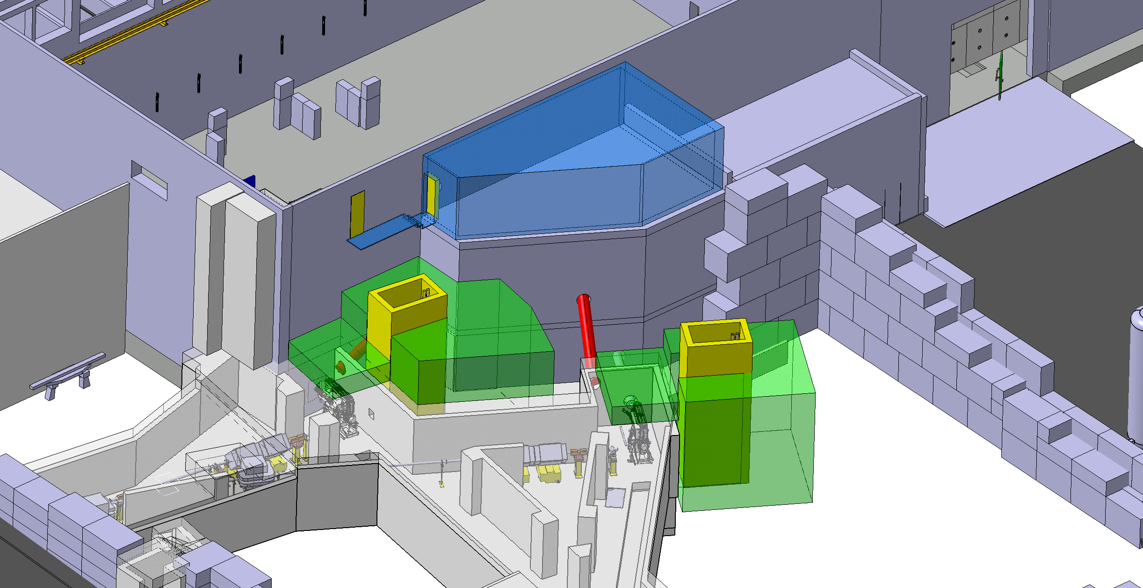
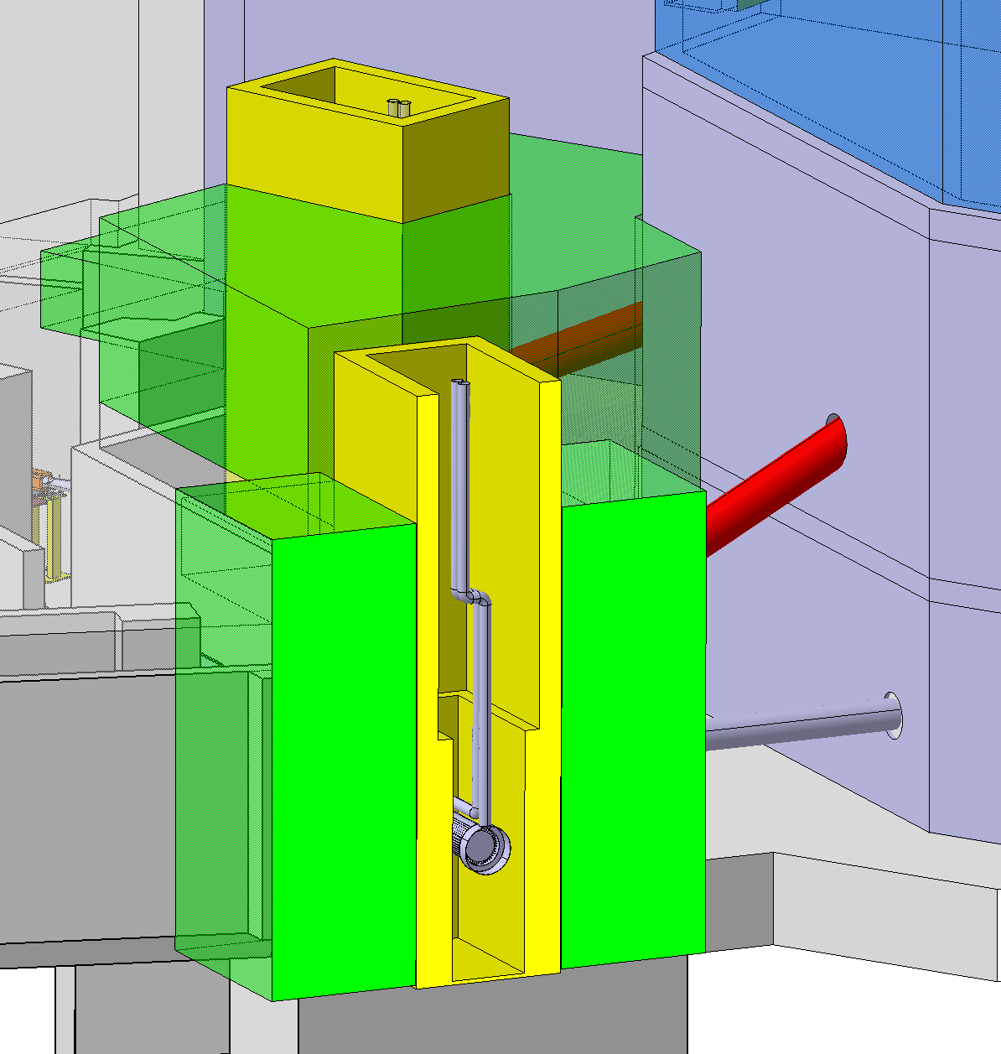
BASIC concept
Acknowledgement: JM.Martin Ruiz SY-STI
CV room
Pipes routed to the CV room
New Boris tubes
Concrete shielding shown in green. Backfilled earth not shown.
Boris tube to be replaced
Metallic covers
Dumps are not buried in earth. Removable shielding installed inside shafts –Outside the shafts, shielding will remain buried in earth. Boris tube to be replaced

Slide 20
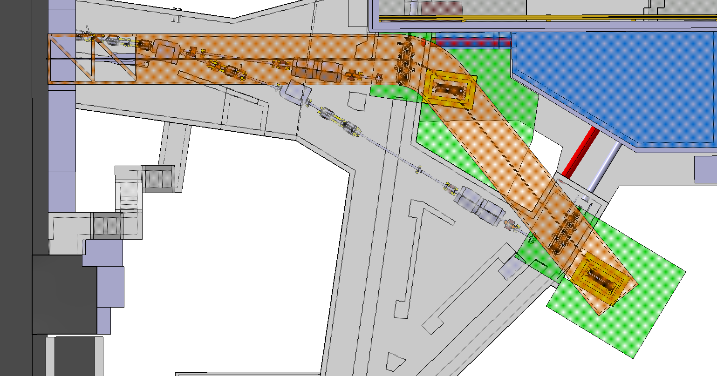
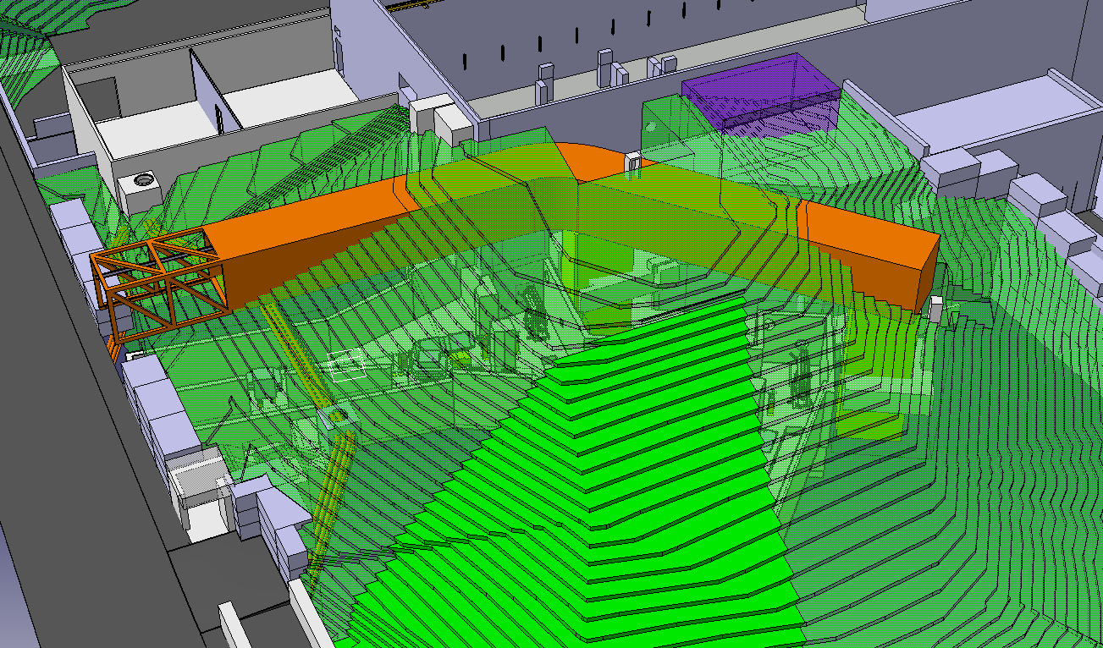
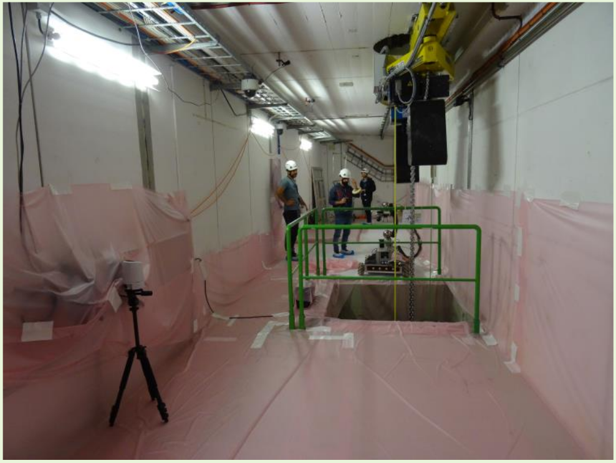
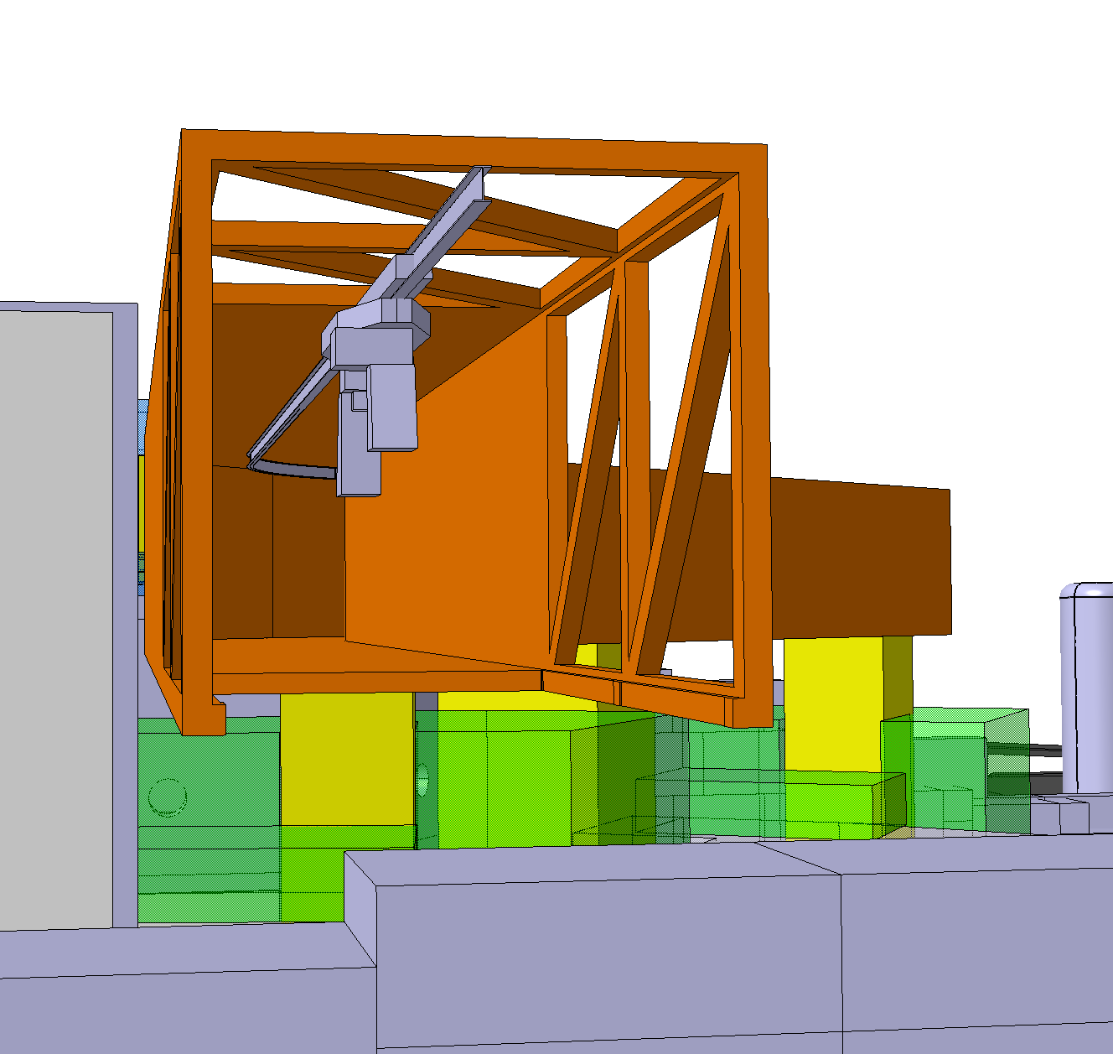
BASIC concept – Bridge option
Acknowledgement: JM.Martin Ruiz SY-STI
Option Bridge: Permanent Handling access to dump
BASIC Concept with a “Bridge” Option to access the dumps in case of failure. ALARA solution as it allows remote-handling operation

Slide 21
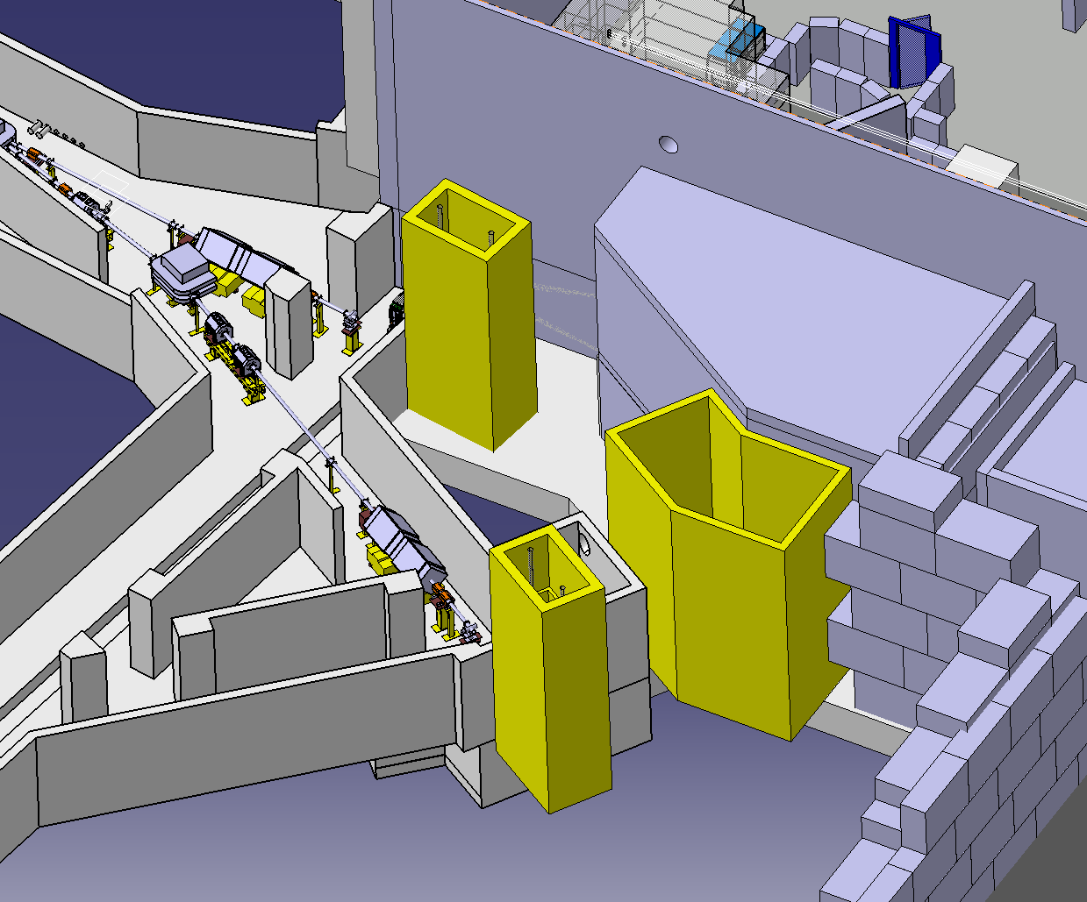
BASIC concept and HRS
HRS access not part of the BASIC concept. Not approved & not funded. Could be part of a future target area consolidation request.
…but money could be saved if the HRS shaft is approved and founded at the same time as the IBDRS project
HRS magnet and beam line will remain non accessible if nothing is done
Option HRS: Access to HRS magnet and line

Slide 22
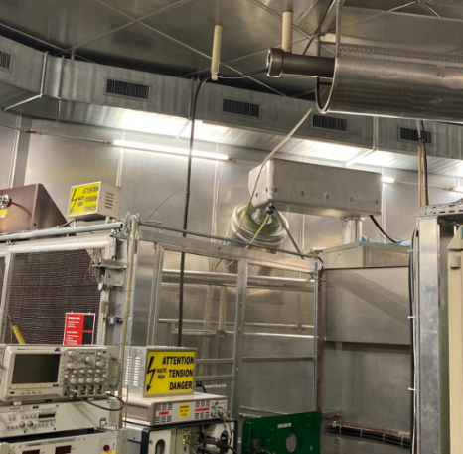
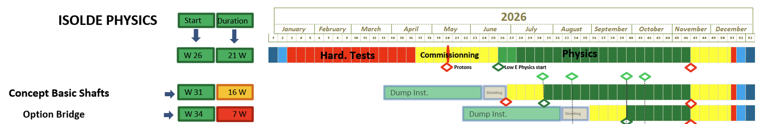
BASIC concept
All the work should be achieved during LS3
New dump and cooling
New technical cooling station
New shielding
New Boris tubes (large impact on HV room)
If ‘Bridge option’ chosen, new permanent handling access to the dump and ALARA solution as it allows remote-handling operation
Preliminary
Limited physic in 2026
No physic in 2026

Slide 23
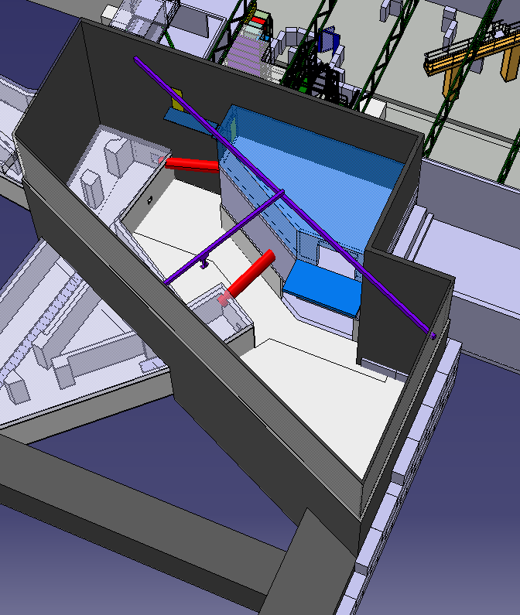
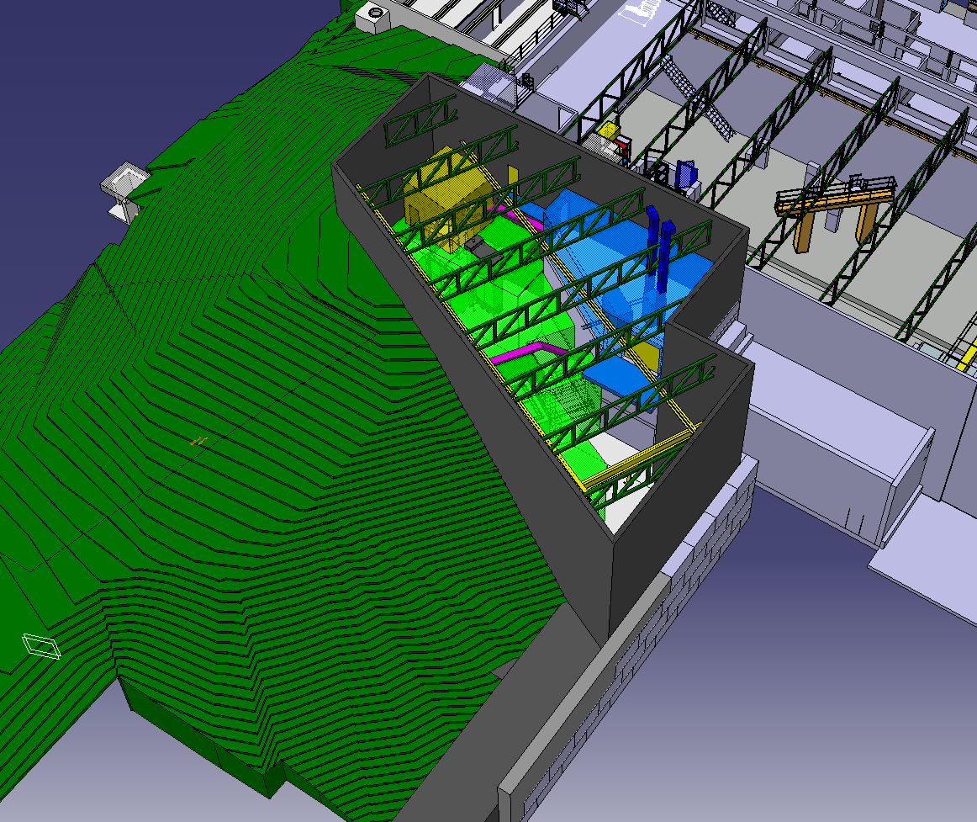
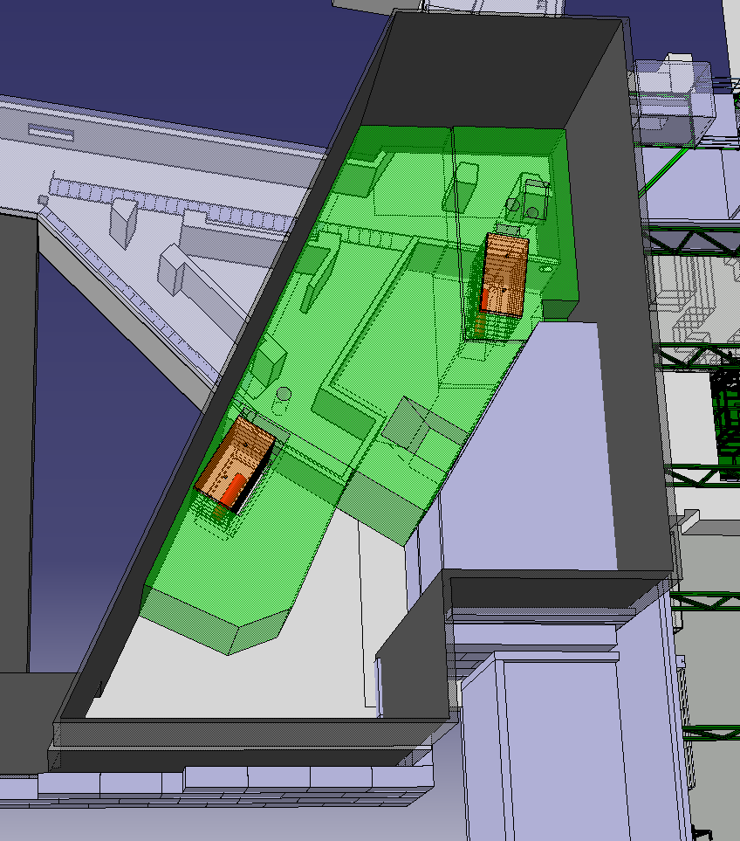
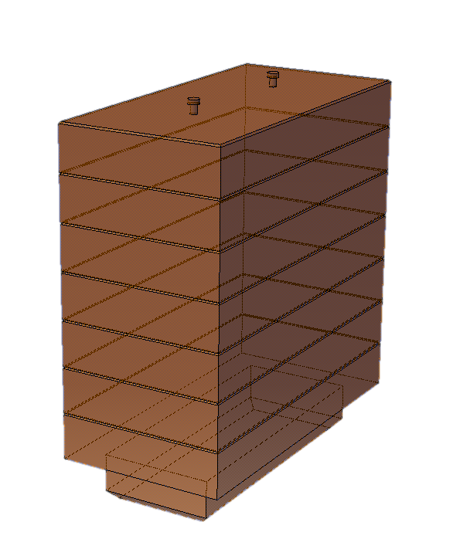
FLEXI concept
Acknowledgement: S.Marzari SY-STI
New building on top of the target stations GPS and HRS
Surface 350m², 12…15m high
Full shielding, dump and Boris tube remain accessible
Shielding modification is possible at anytime

Slide 24
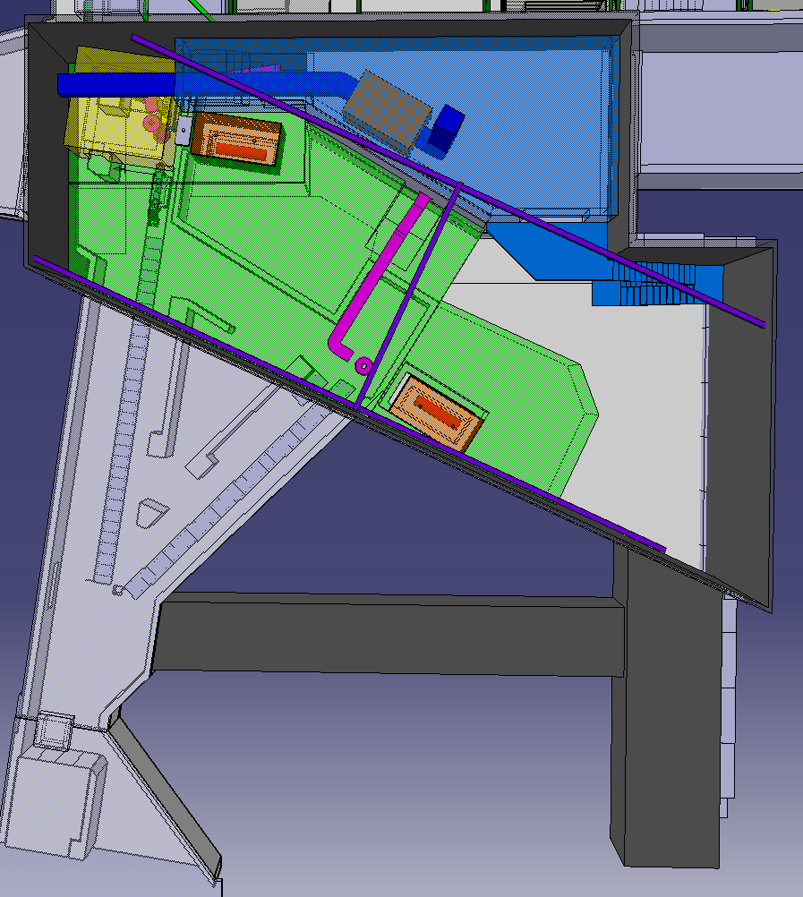
FLEXI concept
Acknowledgement: S.Marzari SY-STI
New maintenance philosophy: Replace -> Repair -> Reuse
Reduce radioactive waste
Move FE to new building through the material gallery
FE handling with overhead crane
Intermediate FE storage for decay
Overhead crane
Material gallery
X
179
Parking

Slide 25
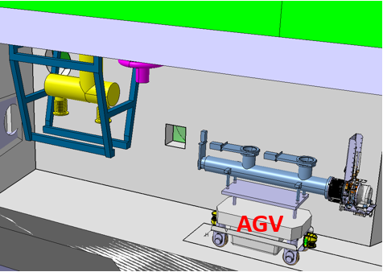
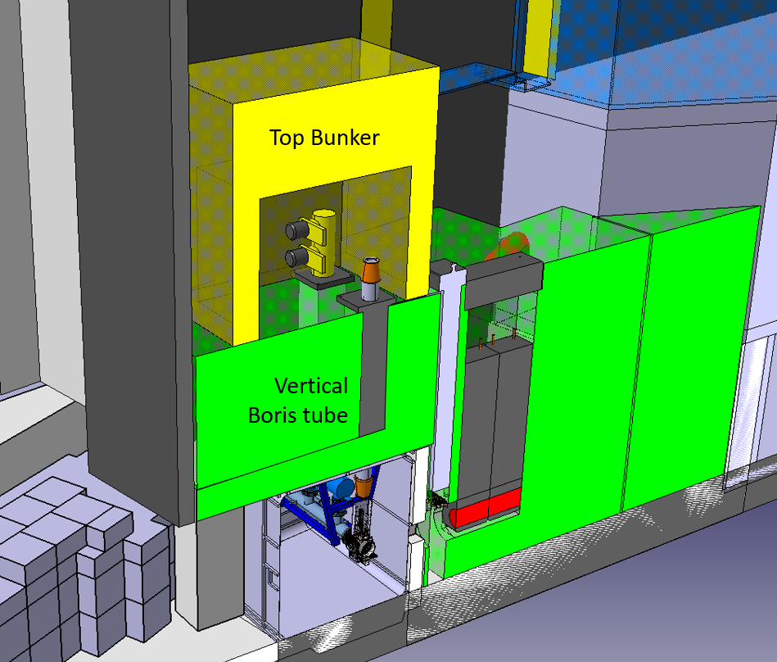
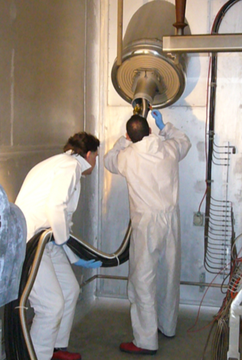
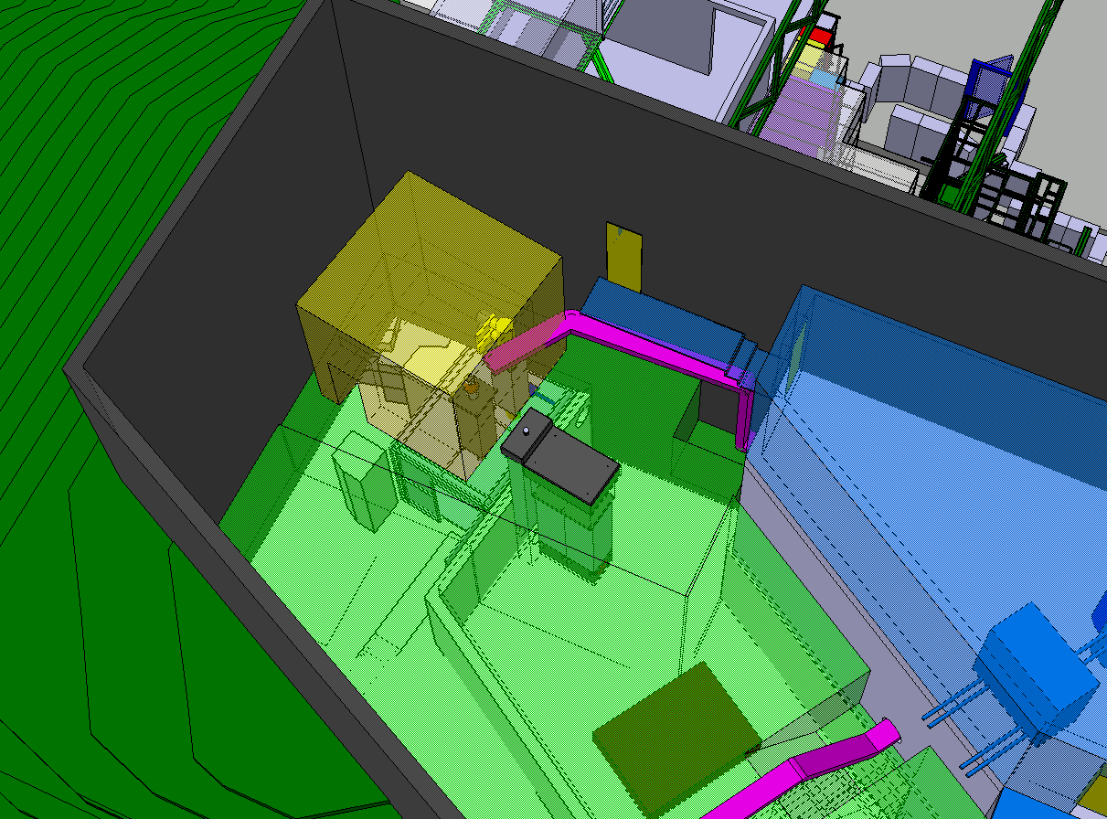
FLEXI concept
Consolidation after LS3 could take place depending resources and budget – Waiting from target consolidation upgrade feed-back and Front-end upgrade study in 2022 – Not part of the IBDRS study
Move vacuum pump from target area to FLEXI building (Supplier of radiation hard vacuum pump is stopping production)
Consolidated Boris tube possibility

Slide 26
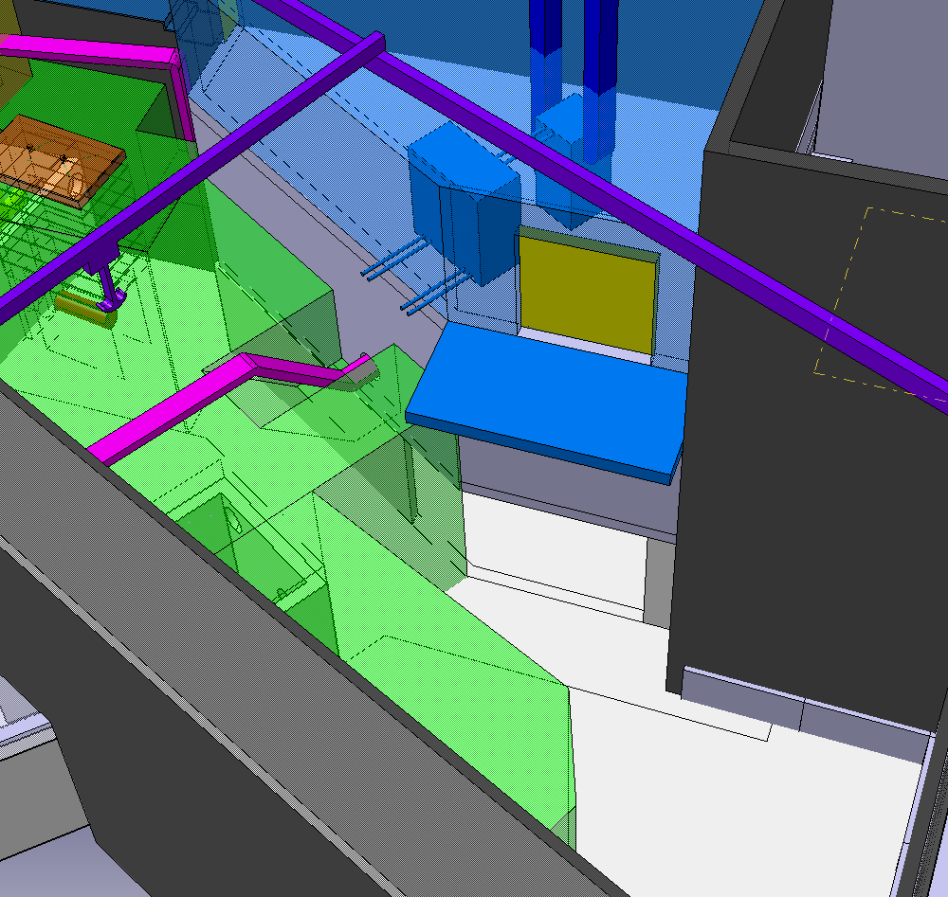
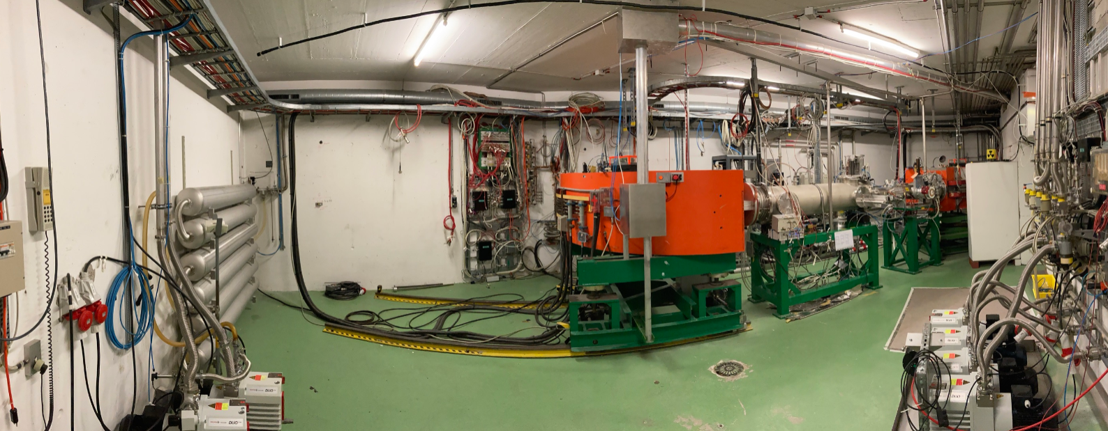
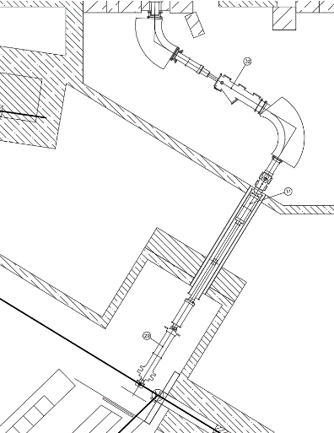
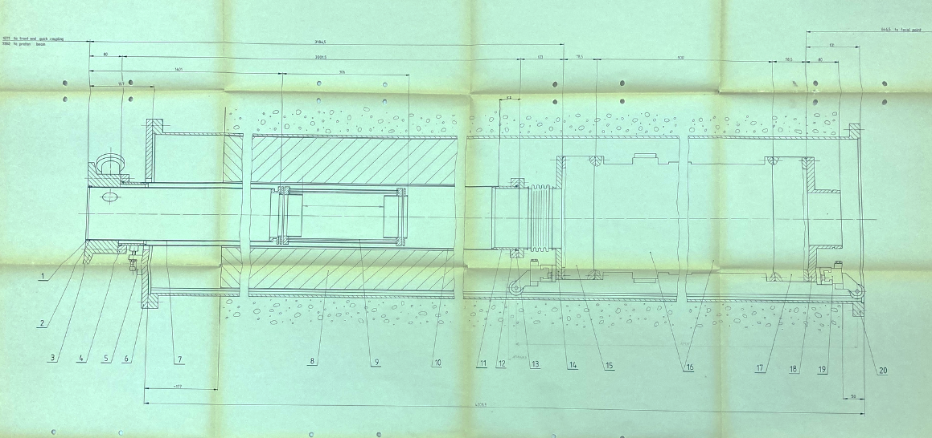
FLEXI concept and HRS
Acknowledgement: S.Marzari SY-STI
HRS separator and beam line accessibility (upgrade – alignment)
Window to open
HRS beam line
HRS separator
No opening is foreseen in the FLEXI concept anymore but possible later
Quads
Quads
HRS beam line
FE

Slide 27
FLEXI concept
Phasing is possible – All the work is not performed during LS3
FLEXI final status at end of LS3:
New building
New dump and cooling
New shielding
New technical cooling station
BORIS tube and target area are not modified during LS3 allowing an easier restart
Preliminary
No physic in 2026

Slide 28
Next steps

Slide 29

Next steps
Dismantling phase is the more critical part of the project
Consultancy technical specification under circulation
First feed-back from consultant interviews is that we are underestimating the time needed for the dismantling phase

Slide 30


Next steps
Acknowledgement: A.Formento HSE-RP
Cost estimation of the shiedling layout for BASIC and FLEXI options after Fluka simulation from HSE-RP
Cost estimation of waste disposal to be finalised by HSE-RP
Project management Board beginning 2022 to be foreseen

Slide 31


Next steps
Coring campaign on top of the shieding hill to be performed at ISOLDE after beam stop – December 2021 - Critical activity for the study
Not possible – ground too steep

Slide 32
Conclusion

Slide 33
Conclusion
First step to 2 GeV protons beam at ISOLDE is the ISOLDE Beam dump replacement
IBDRS can be done only during an LS
2 Concepts BASIC and FLEXI have been identified to be further studied
Preliminary planning estimation shows that 2 years are needed for this project – Physics will be impacted by the IBDRS project if approved (LS3 duration may not be enough) but changing the dumps is an investment for ISOLDE.
Dismantling consultancy technical specification should be circulated soon
Shielding sizing and cost for waste disposal should be available soon
Corings campaign results will be an asset for the progress of the IBDRS study

Slide 34
Thank you for
your attention!

