Slide 1
Overview of my 4 years at ISOLDE
November 5, 2021
Gerda Neyens

Slide 2
content
Staff
Research fellows
Applied fellows
PhD students
Associates
Collaboration membership
EPIC project
ISOLDE outreach
ISOLDE Visits
Financial situation
Summary

Slide 3

ISOLDE Staff 2017-2021
Staff members on CERN LD contracts (currently max. 8 years)
  Karl Johnston, physics coordinator (Aug 2015 – Sept 2022)
  Magdalena Kowalska (Oct 2015 – Sept 2018) ERC beta-drop NMR
  Stephan Malbrunot-Ettenauer (Feb 2017 - Jan 2022) ERC MIRACLS
Permanent CERN staff:
  Magdalena Kowalska (Jan 2020 - )
ISOLDE User Support
  Jennifer Weterings (2002 - ) 100% user at University of Oslo
    Funded via the ISOLDE Collaboration Team Account
New Team Account rules installed 01/2020:
Subsistence payments of staff on-site via Team Accounts maximum for a period of 8 years
OK till December 2027

Slide 4
CERN Research Fellows 2017-2021
From Maria’s period:
Vladimir Manea (Jan 2016 – April 2018) ISOLTRAP
Liam Gaffney (Oct 2016 – Sep 2019 - COFUND) Miniball
Hanne Heylen (Oct 2017 – sept 2020 – COFUND) COLLAPS-VITO
Hired since Nov 2017:
Ronald Garcia Ruiz (Jan 2018 – Dec 2019) CRIS
Maxime Mougeot (Sept 2019 – August 2021) ISOLTRAP
Razvan Lica (June 2020 – May 2022) IDS
Liss Vasquez Rodriquez (Oct. 2020 – Sept. 2022) COLLAPS
Erich Leistenschneider (April 2021 – March 2023) PoP MR-TOF/MIRACLS
Agi Koszorus (October 2021 – September 2023) CRIS
Learning curve
On average 3 hires over 2 years (2/year during last years)
Need EXCELLENT candidates (CV, motivation letter, project)

Slide 5
CERN Applied Fellows 2017-2021
From Maria’s period:
Frank Wienholtz (Jan2016 – Dec 2018) MR-TOF-MS for ISOLDE ERC/ENSAR2
Andree Welker (Aug 2017 – July 2018 ) HIFI spectrometer / WIZARD EP-IS
Lina Pallada (Apr 2017 – May 2019) betadrop-NMR ERC
Hired since Nov 2017:
Joonas Konki (March 2018 – Feb 2020) HIE-ISOLDE experiments ENSAR2
Simon Sels (March 2018 – Feb 2020) MIRACLS ERC
Dinko Atanasov (April 2019 – June 2021) WISArD EP-IS
Markus Vilen (Oct 2019 – Sept 2022) MIRACLS / ISOLDE MR-TOF ERC/ENSAR2/ISCC
Bruno Olaizola (Sept. 2020 – August 2022) HIE-ISOLDE ISS EP-IS
Jared Croese (Aug. 2021 – June 2023) VITO ENSAR/EP-IS
Frank Brown (Sept. 2021 – August 2023) HIE-ISOLDE Miniball EP-IS
ISOLDE quota from EP-IS: 1 person every 2 years
Recent success: propose cost sharing
➔ suggest 1 year other funding (e.g. ENSAR2, ISCC, …) – 1 year EP funding)

Slide 6
CERN Doctoral Students 2017-2021
      From Maria’s period:
      Razvan Lica (Sep2014 – August 2017) IDS CERN EP-IS
      Andree Welker (Feb 2015-Jan2018) ISOLTRAP Gentner (Uni. …)
      Jonas Karthein (Nov 2017- Oct 2020) ISOLTRAP Gentner (Uni. Heidelberg)
      Hired during my time:
      Varvara Lagiki (Sept 2017 – Feb. 2021) MIRACLS ERC (Greifswald)
      Simon Lechner (Sept 2017 – Feb. 2021) MIRACLS Austrian Prog. (TU Vienna)
      Jared Croese (Feb 2018 – July 2021) betaDROPNMR CERN EP-IS +ERC (Geneva)
      Peter Plattner (August 2018 – Dec 2021) MIRACLS Austian Prog. (Innsbruck)
      Katarzyna Dziubinska-Kuhn (Sept 2018 – Feb. 2022) betaDROPNMR SWISS Fund/KT-Med
      (Univ. Geneva)
      Karolina Kulesz (Oct 2018 – March 2022) betaDROPNMR ERC (Univ. Geneva)
      Lukas Nies (Nov 2019 – Oct 2022) ISOLTRAP Gentner (Univ. Greifswald)
      Franziska Maier (Feb. 2020 – Jan 2023) MIRACLS Gentner (Univ. Greifswald)
      Michail Atanasakis (Sept. 2020 – Aug. 2023) CRIS EP-IS
      Marcus Jankowski (Jan. 2021 – Dec. 2023) VITO Gentner (TU Darmstadt)
      Tim Lellinger (March 2021 – Febr. 2024) COLLAPS Gentner (TU Darmstadt)
Use external funding programs !
Need a German / Austrian / Swiss (co-)promotor

Slide 7
Associates 2017-2021
From Maria’s period (scientific associates):
  Angela Bracco (– July 2017)
  Bertram Blank ( – August 2017)
  Andrei Andreyev ( July 2017– June 2018)
  Joakim Cederkall (September 2017 – August 2018)
Hired since Nov. 2017:
Scientific Associates
  Deyan Yordanov, 11 months (February – Dec 2019)
  Giacomo de Angelis, 6 months (July – Dec 2020)
  Ismael Martel, 6 months (Oct. 2020 – March 2021)
  Robert Berger, 5 months (May 2021 – Sept 2021)
  Sorin Pascu, 7 months (Feb. 2021 – Aug 2021)
  Alexandre Obertelli, 1 year (Sept. 2021 – Aug 2022)
  Janne Pakarinen, 8 months (Dec. 2021 – July 2022)
Corresponding Associates
  Luis Fraile, 3 months (May – August 2018)
  Maria Borge, 3 months (August – October 2018)
  Mikael Reponen, 6 months (March – August 2020)
  Mikolaj Baranowski 5 months (July – Nov. 2021)
➔ Increase success rate by not asking full year, but e.g. 6 months and then extend with 3-6 months
➔ Increase success rate by asking at most 3 months (then extend if needed)

Slide 8
ISOLDE Users
In-house group: 43 scientists
  25 paid by CERN (staff, fellows, PhD, associates)
  18 externally paid users (PhD and post-docs 100% at CERN)
Visiting Users at ISOLDE
  October 2017: 1238 users
  October 2018: 1315 users
  October 2020: 841 users – all non-active users removed
  On November 2, 2021: 937 users (increasing thanks to restart of ISOLDE)

Slide 9
Collaboration Memberships
16 member countries in 2017 (including CERN)
17 members in 2021
  Bulgaria joined in 2021
NEW: Institute memberships
  Czech TU Prague since 2019
Payments without signed agreement
  Portugal
In preparation:
  Czech Republic is preparing to become a full member
  Institute for Research in Fundamental Sciences, Tehran, prepares for institute member

Slide 10
EPIC project thinking about the long-term future of ISOLDE
May 2018: request from CERN directorate to think about long-term future and major projects for ISOLDE, in relation to the upcoming strategy update for the European PP community
July 2018: call for ‘big projects’ in the UK
  Project prepared by K. Flanagan, G. Neyens, R. Catherall
  EPIC Project submitted (Exploiting the Potential of ISOLDE at CERN)
December 2018: submit an extended version of the EPIC project as the ISOLDE Collaborations input to the ESPP (European Strategy for Particle Physics update), authors RC, GN, B Blank (ISCC chair), K Rissager (INTC chair)
May 2019: ESPP Granada meeting
  ISOLDE/EPIC mentioned in several presentations
  Outcome: CERN should foster and intensify collaborations with the nuclear physics and astro-particle physics communities (consequence: CERN became associate member of NuPECC in 2021)
1st EPIC Workshop, December 2019 - present ideas for ISOLDE upgrades / discuss priorities
2nd EPIC Workshop, November 2020, on-line – focus on synergies between ISOLDE and other CERN facilities/experiments, space for new experimental set-ups using ISOLDE’s low-energy RIB’s, upgrade plans for the near future (~5-years) and consolidate ideas for the long-term future)
Proceedings in preparation

Slide 11
Outreach activities
Typically 6 to 10 outreach publications in CERN-related media per year
Special thanks to Karl for writing several articles in EP Newsletter
Thanks also to Magda and several users and their teams (ISOLTRAP, Miniball, CRIS, SSP, …) for presenting their highlight results to the CERN community
Special Events:
  50 years of ISOLDE – October 2017 (initiated by Maria, YouTube life, 5 video’s on Facebook and Twitter, …)
  CERN Open Days – September 2020

Slide 12
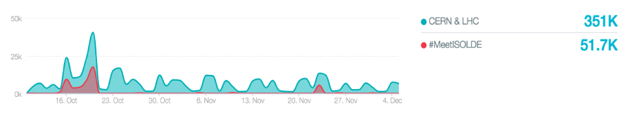
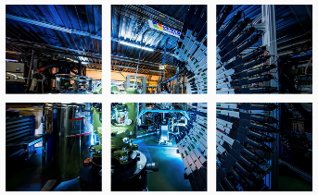
50 years of ISOLDE events
Increase ISOLDE mentions on social media
Between 11 October and 5 December, #MeetISOLDE was mentioned 51.700 times (CERN&LHC 351.000 times)
A peak of mentions was observed on 20 October (17.461 mentions), probably due to the Instagram grid and the fact that we republished the Facebook live on CERN’s Facebook page.

Slide 13
Outreach 2018 - 8
ISOLDE Workshop 2018 in CERN Courier, Jan 2019
  153 participants, 40 talks, 29 posters
4 prizes (sponsored by CAEN)

Slide 14

Outreach 2019 thanks to Karl and several active users
CERN Accelerating News 28, March-April 2019,
  ISOLDE's new solenoid spectrometer by Panos Charitos (CERN)
EP Newsletter, March 2019
Resolving a long-standing question at ISOLDE by Karl Johnston (CERN)
- based on Nature Physics 14, 1163 (2018).
EP Newsletter, June 2019
HIE-ISOLDE: a unique window into the nucleus by Karl Johnston (CERN)
- based on Nature Communications 10 (2019) 224,226Rn Coulex
- based on Phys. Rev. Lett. 121 (2019) 132Sn Coulex
CERN Courier, News Digest, July 2019
EDM search goes pear-shaped – by Matthew Chalmers (CERN)
- based on Nature Communications, Rn Coulex
CERN Open Days – September 14-15, 2019
  More than 80.000 visitors (about 2400 visited ISOLDE)
CERN Accelerating News, October 2019
  ISOLDE’s new Offline 2 source nears completion by Achintya Rao (CERN)
EP Newsletter, December 2019
Finding the best candidates for atomic EDM searches
by Peter Butler & Liam Gaffney (University of Liverpool), Joonas Konki (CERN)
CERN Courier, December 2019
Obituary Ernst Otten (by J. Kluge)

Slide 15
ISOLDE @ CERN
Cern Courier Sept/October 2020 (D. Lunney and G. Neyens)

Slide 16
Outreach 2020 thanks to Karl and several active users
EP Newsletter, March 2020
ISOLDE dives deeper in the mystery of the odd-even staggering effect
by Panos Charitos (based on Nature Physics Cu paper)
PUMA: Exploring exotic nuclear phenomena with antimatter
by Alexandre Obertelli and François Butin (CERN, PUMA project manager)
CERN Accelerating Science, May 2020
  ISOLDE steps into unexplored region of the nuclear chart by Liam Gaffney
EP Newsletter, June 2020
Secrets of beta decay unraveled at ISOLDE
by Zsolt Podolyák (PRL 125, 2020)
Exotic radioactive molecules could reveal physics beyond the Standard Model
by Gerda Neyens (based on Nature 451, 2020)
CERN Courier, May/June 2020
  Obituary Robert Klapish (by D. Lunney)
CERN Courier, Sept/Oct 2020
Exploring Nuclei at the Limits (by D. Lunney and G. Neyens)

Slide 17
Outreach 2020 - continued thanks to Karl and several active users
ISOLDE on Twitter, September 2020
ISOLDE facility at CERN @ISOLDEatCERN
EP Newsletter, Sept 2020
  Pinpointing the structure of the SnV centre in diamond using emission channeling at ISOLDE
  (based on a PRL)
  by Karl Johnston
CERN Courier, November 2020
Nuclear win for ISOLDE physicists (Lise Meitner Prize) by Craig Edwards, editorial assistant
EP Newsletter, December 2020
  PUMA: antiprotons to probe the surface of radioactive nuclei
  by A. Obertelli and F. Butin on behalf of the PUMA collaboration

Slide 18
ISOLDE Visits 2018
ISOLDE Visits: increase by almost factor 3 in 5 years !
Thanks to enthusiastic help of many local PhD, Post-docs, Fellows, …
Thanks to coordination by Hanne Heylen (Fellow since 2017)

Slide 19
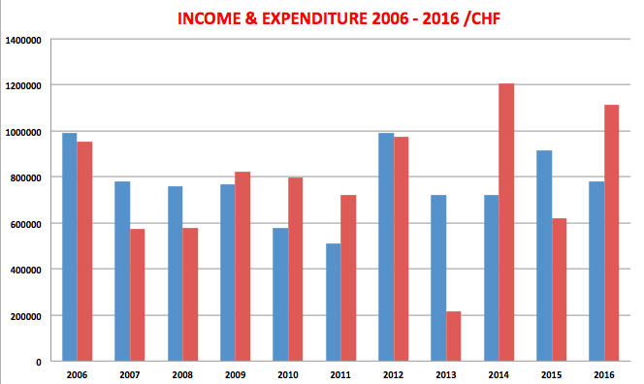
Financial situation
Bleu: income on average 850 kCHF / year
Red: expenditure/year
Green: re-payments to CERN for ISOLDE investments (HIE-ISOLDE)
300.000 CHF 2009-2011
500.000 CHF 2012-2015
824.000 + 140.000 CHF 2016
400.000 + 140.000 CHF 2017
2017 2018 2019 2020

Slide 20
HIE-ISOLDE repayment to CERN
The total cost of HIE-ISOLDE was 39.4 MCHF, pre-financed by CERN
The ISOLDE Collaboration contribution to HIE-ISOLDE is 7.1 MCHF, part of which needs to be payed back as loans
Phase 1: 140 kCHF /year 2016 – 2020 (5 years) Loan of 700 kCHF
Phase 2: 400 kCHF /year 2017 – 2023 Memo sent to E. Elsen 2.791 kCHF
Funding Source | 2007- 2014 | 2015 | 2016 | 2017 | 2018 | 2019 | 2020 | 2021 | 2022 | 2023 | Total
FWO I (BE) | 4’460 |  |  |  |  |  |  |  |  |  | 4’460
ISOLDE Coll. | 2’477 | 500 |  |  |  |  |  |  |  |  | 2’977
MPI (DE) | 115 |  |  |  |  |  |  |  |  |  | 115
Aarhus (DK) | 77 |  |  |  |  |  |  |  |  |  | 77
CERN loan (KM2180) |  |  | 140 | 140 | 140 | 140 | 140 |  |  |  | 700
Phase 1 - TOTAL | 7’129 | 500 | 140 | 140 | 140 | 140 | 140 |  |  |  | 8’329
FWO II (BE) | 494 | 104 |  |  |  |  |  |  |  |  | 598
ISOLDE Coll. |  |  | 433 |  |  |  |  |  |  |  | 433
CERN pre-payment |  |  | 400 | 400 | 400 | 400 | 400 | 400 | 400 | 391 | 3191
Phase 2 - TOTAL | 494 | 104 | 833 | 400 | 400 | 400 | 400 | 400 | 400 | 391 | 4222
Total paid by ISOLDE Collaboration and partners | 7’623 | 604 | 973 | 540 | 540 | 540 | 540 | 400 | 400 | 391 | 12’551

Slide 21
Summary
Positive points:
Increase of the local team of scientists (on all levels)
Excellent collaboration with the technical teams (participation in the weekly group meetings, seminars, joined projects, ..)
Very good visibility at CERN – good contacts with all media
New web page (again) thanks to Jenny (following new CERN guidelines)
Started thinking about long-term future of ISOLDE at CERN – with support from CERN (but financially still difficult in the next years)
A very smooth transition from Richard to Joachim/Erwin
Excellent collaboration with Karl, who takes care of all the ‘practical’ problems (even more important during covid)
Not so good:
The GUI has met at most once per year / not enough follow-up of decisions
Not all suggestions from Maria have been implemented (LN2 in the hall)

