Slide 1
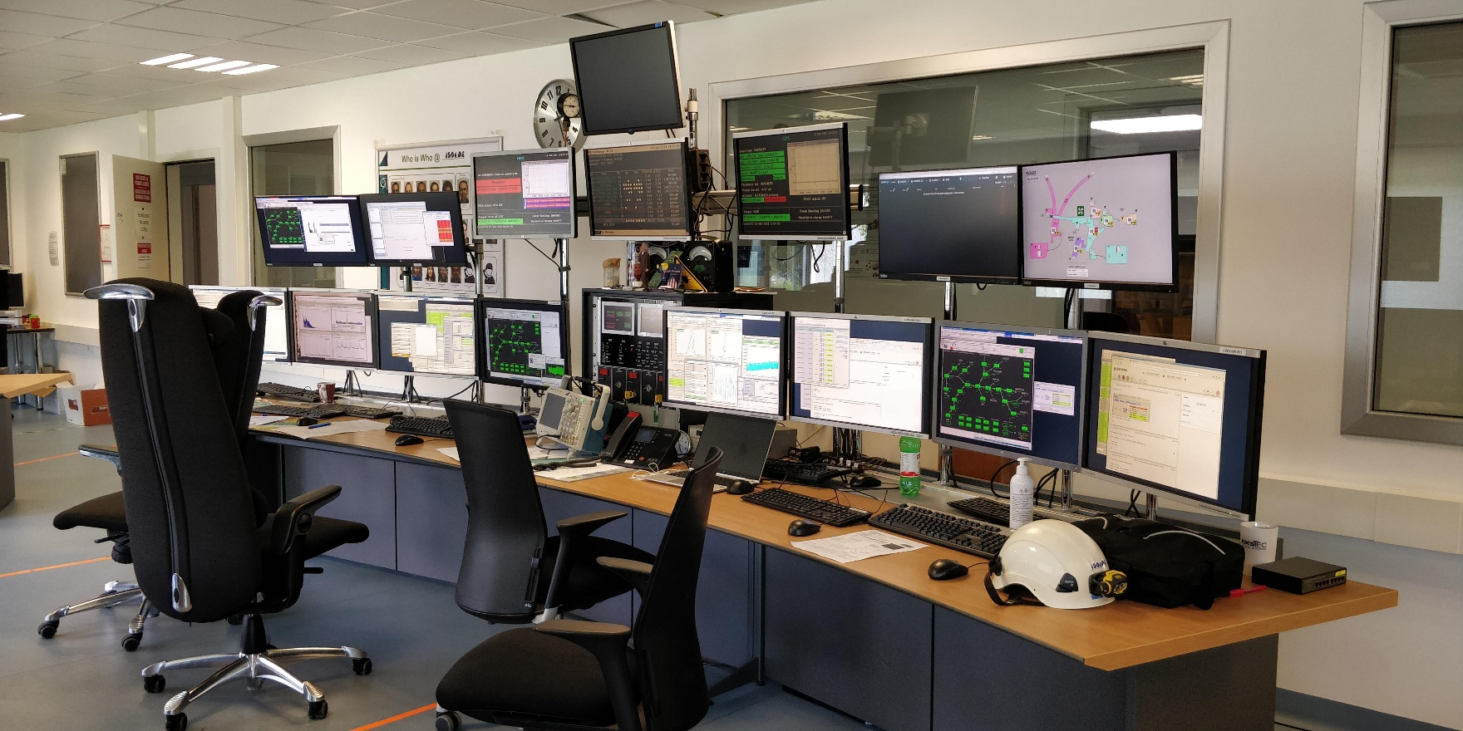
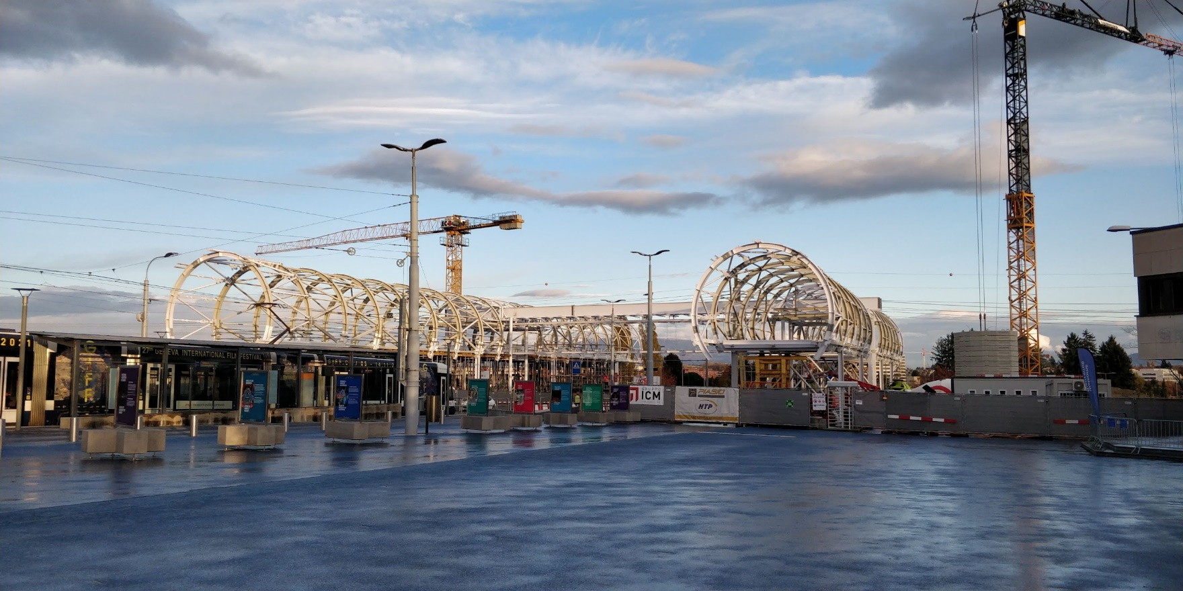
ISCC 92 November 2021 Coordinator’s report
Schedule 2021
Draft planning 2022
Access to cern
Around the hall
Training

Slide 2
2021 Beam requests and schedule
Row Labels | Count of Experiment | Sum of Requested shifts
Actar | 2 | 12
COLLAPS | 2 | 40
Corset/XT03 | 1 | 12
CRIS | 5 | 72
IDS | 7 | 44
IDS | 5 | 50,5
IDS fast timing | 6 | 25,001
IDS Vandle | 1 | 15
IDS/TISD | 1 | 2
ISOLTRAP | 3 | 36
ISS | 7 | 117
LA1 Bordeaux | 1 | 12
Magnetic moments | 2 | 8
MIRACLS | 1 | 7
SSP | 20 | 53
TAS | 3 | 19
Thorium clock | 2 | 11
TISD/ISOLTRAP | 4 | 60
VITO | 4 | 17
VITO | 1 | 0
Wisard | 1 | 24
Edinbugh setup | 1 | 21
Gandalph | 1 | 6
TISD | 1 | 6
GLM | 2 | 6
Grand Total | 84 | 675,501
~676 shifts requested
Low energy Physics 21 June
HIE ISOLDE: stable July 7; physics in W30
Lack of ventilation in Class A labs, UC units were “predicted in 2020”
Combine with some used targets from 2018
Caused some issues with mass markers/outgassing
Travel has still been very difficult for many countries (see access section later)
Inevitable bias to local groups (or those able to run remotely)

Slide 3
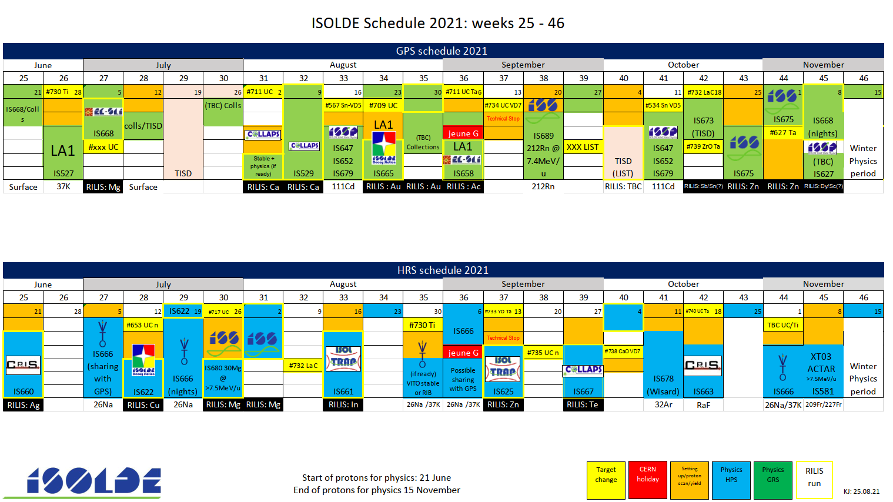
Published schedule till W35
145.5 scheduled shifts
ROC run not successful
Disappointing LIST run
In general, protons have been pretty reliable….
Beamgates not operating to ISOLTRAP requirements
IS701: Pb

Slide 4
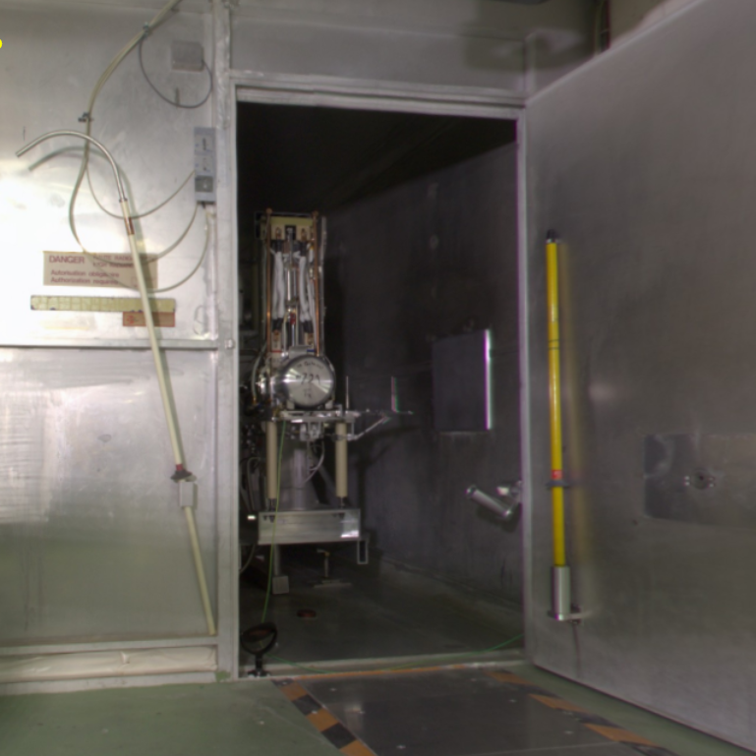
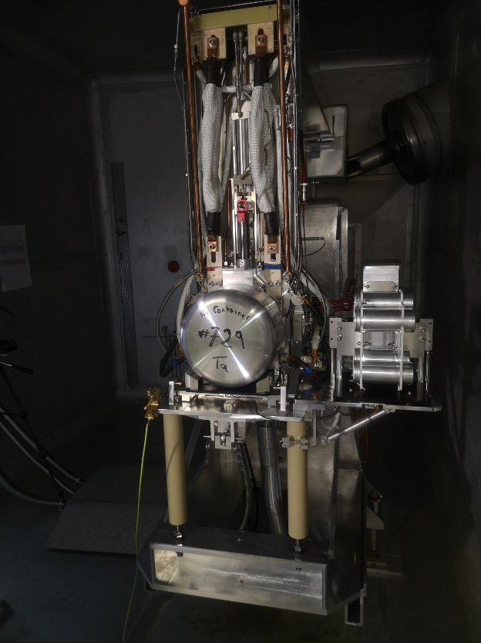
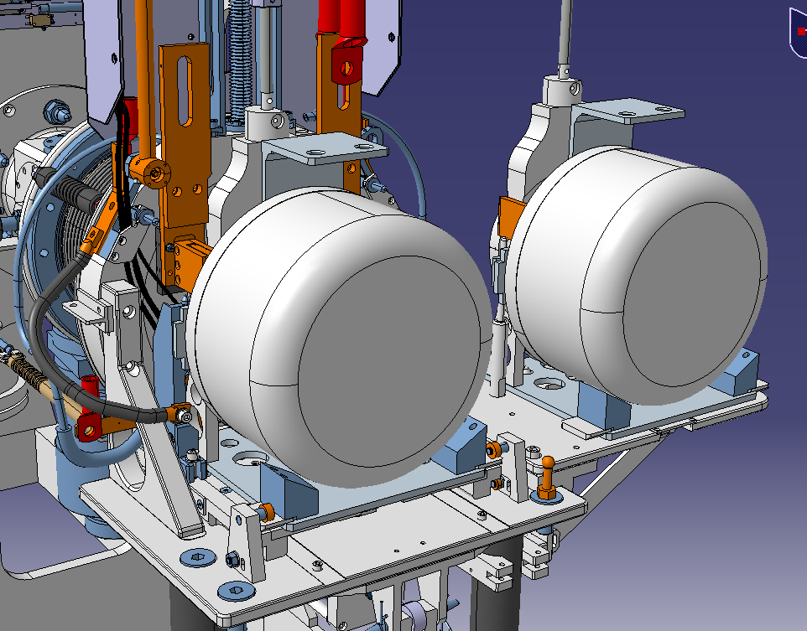
New GPS irradiation station: now ready for testing
ISOLDE Target
Sample support

Slide 5
Final weekly schedule of the online period
Quite busy as expected
Inauguration of the new GPS irradiation station: another column for the planning!
Use of MEDICIS for winter physics irradiation
Growing need to have more straightforward visibility of protons taken on target depending on which station is receiving protons.
Target exchanges/movements becoming more common. Quite some problems this year which will hopefully be ironed out after the YETS.

Slide 6
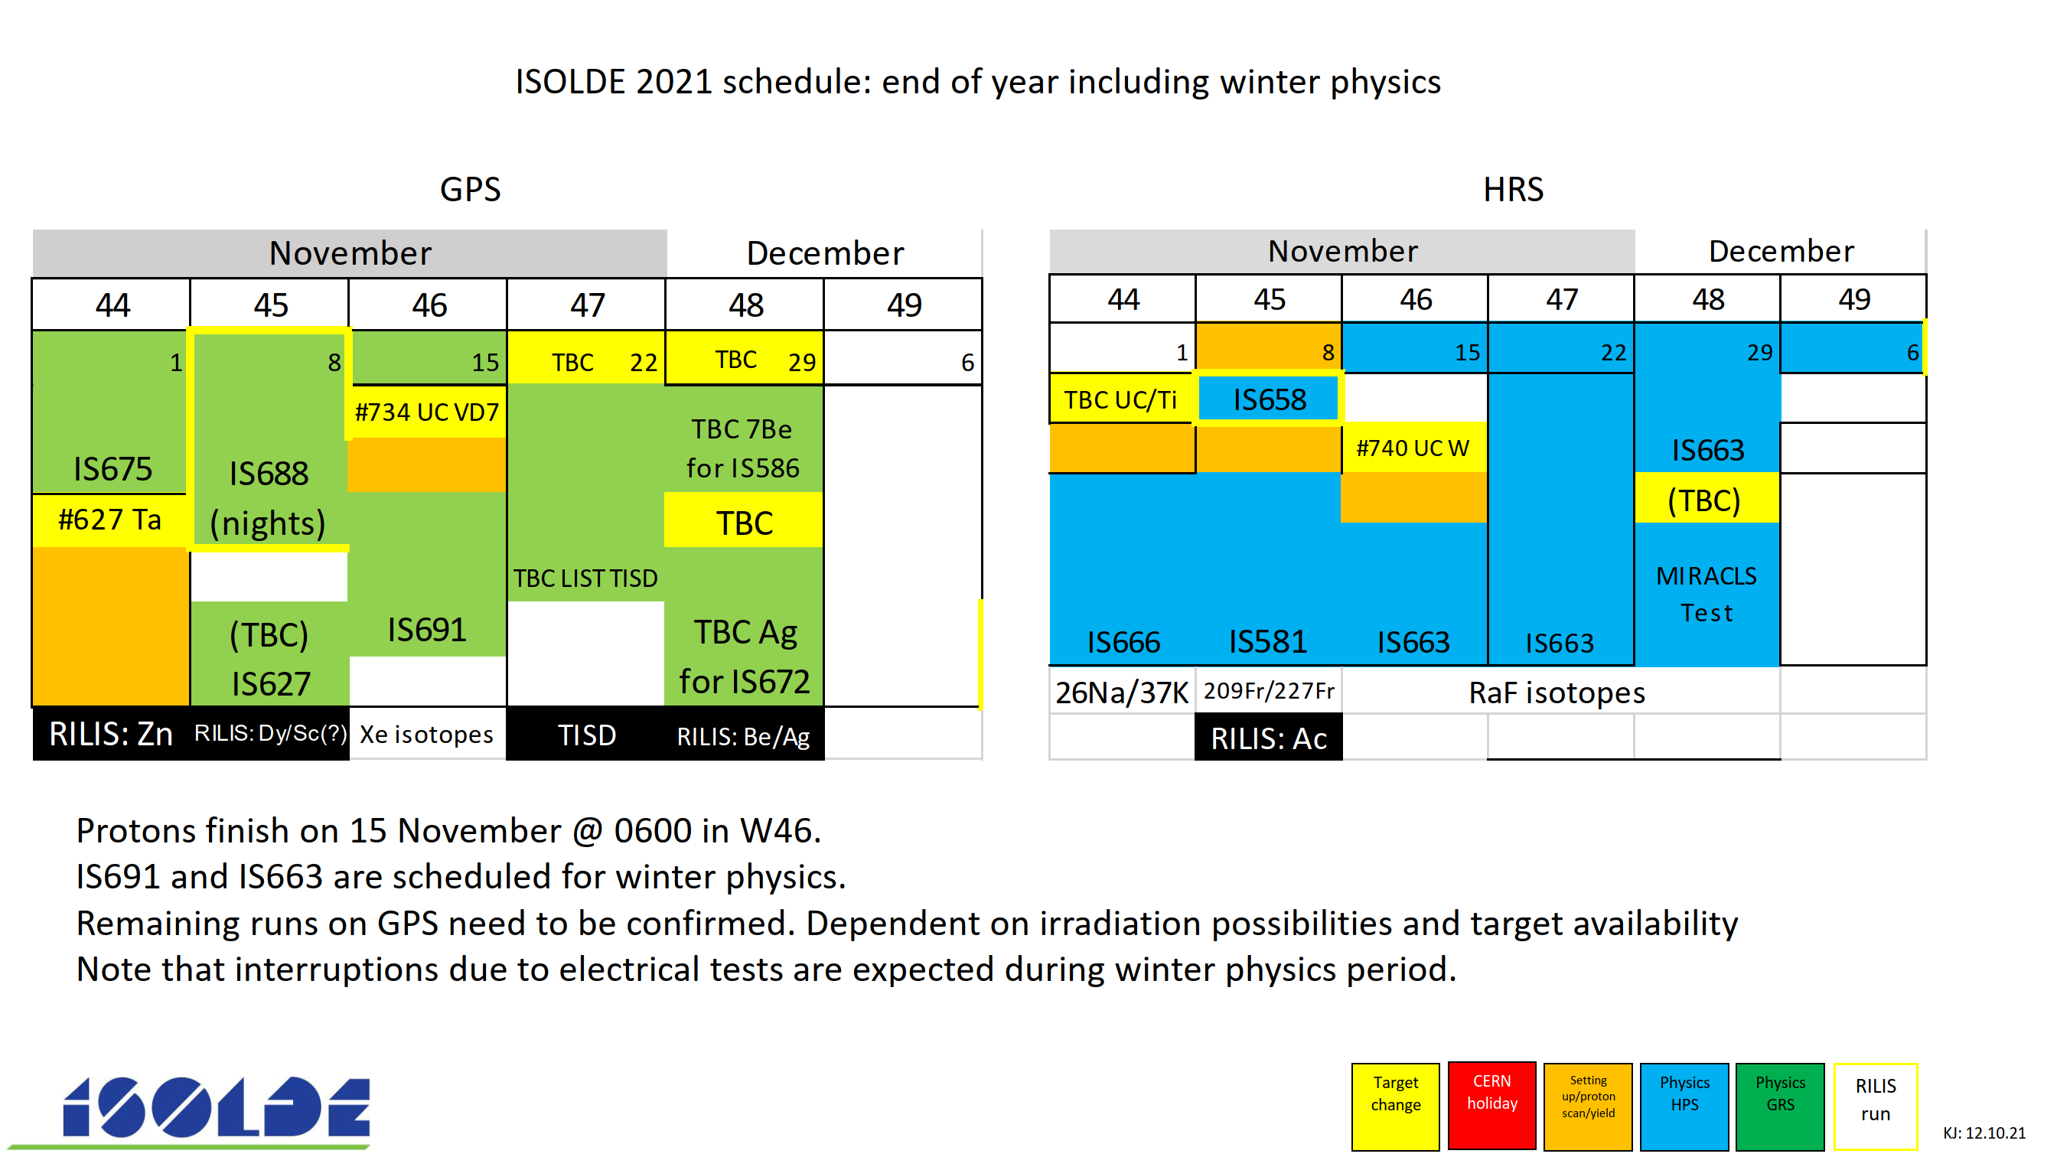
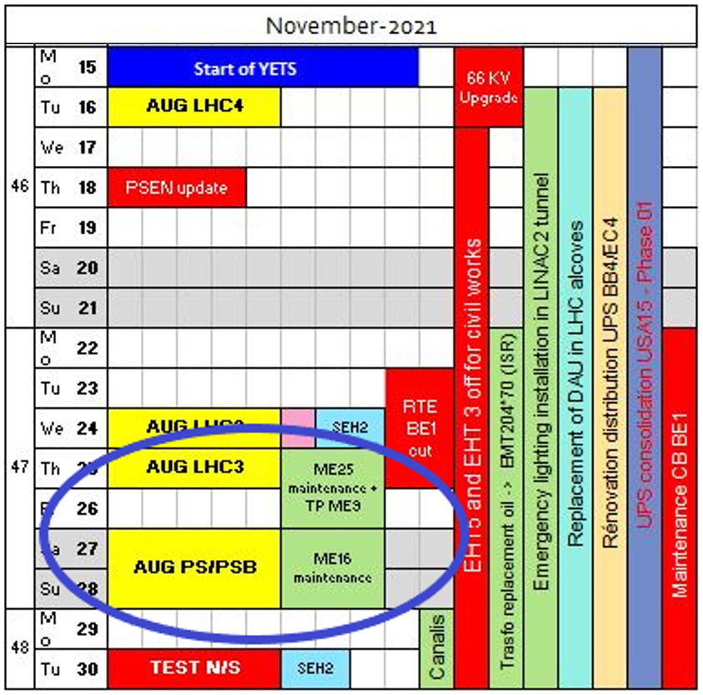
Note that AUG and network switching will affect the winter runs, esp the long CRIS RaF

Slide 7
Row Labels | Sum of Scheduled 2021 | Sum of Delivered 2021
biophysics
COLLAPS | 37 | 17
Collections: 108Ag
Collections: 163Ho | 2
CRIS | 70,5 | 25
Gandalph
Gandalph/CRIS
HIE ISOLDE | 56 | 50
IDS | 21 | 14
IDS/ISOLTRAP
IDS/VANDLE
in-source / IDS
ISOLTRAP | 27 | 7
Medical physics | 13,5 | 1
MIRACLS
Nuclear masses
SSP | 31,5 | 32,5
TAS
TISD
TISD/IDS
Travelling Setup | 14 | 14
Travelling Setup; ECSLI | 11 | 11
VITO | 22 | 12
Windmill/IDS
WISARD | 14 | 10
Grand Total | 319,5 | 193,5
Preliminary overview of running period 2021
So far around 200 radioactive shifts have been delivered
23 experiments ran/scheduled in 2021
Fewer than other years, partly because some groups ran several times, also due to covid situation favouring the locals.

Slide 8
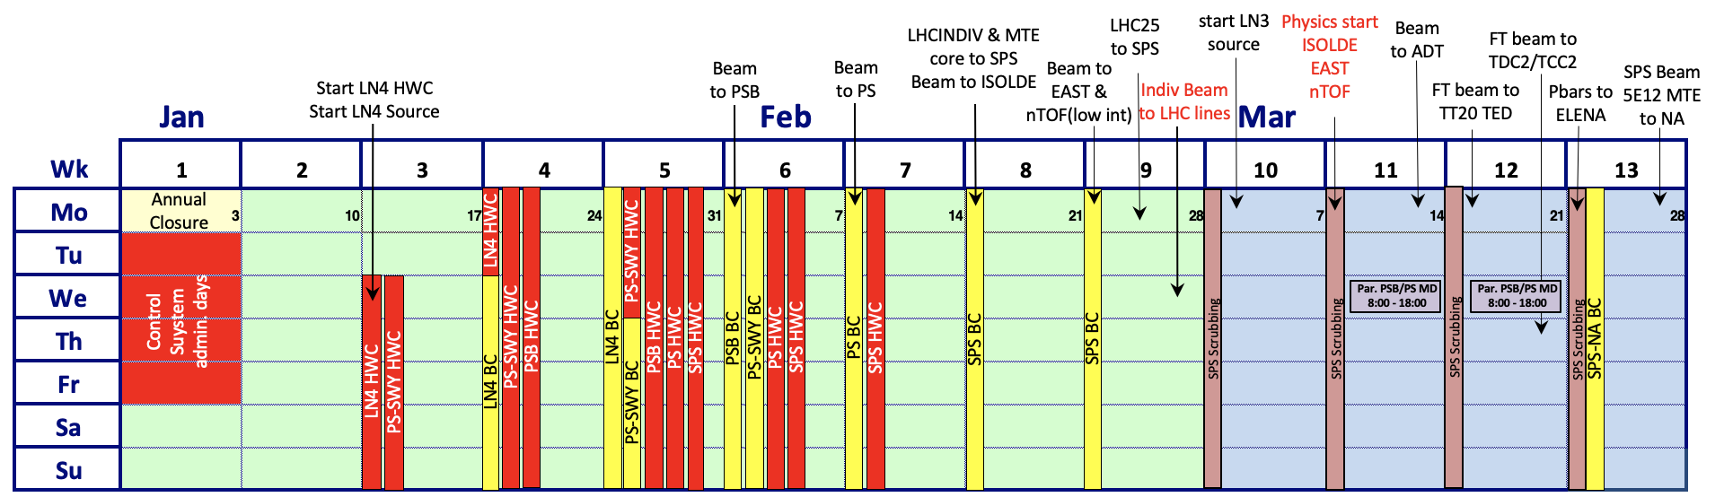
Draft schedule for 2022
Wk1: Control system administration days – starts on last day of annual closure
Wk3: Start of Linac 4 source and injectors complex re-commissioning
Wk9: LHCProbe/Pilot/INDIV ready for LHC
Wk10 – 13: SPS scrubbing
Wk11: Physics start ISOLDE, nTOF and East Area – preceded by 2 weeks setting-up
Wk11 and Wk 12: Parallel MD for PSB and PS on Wednesday
Wk13: Start 2-week beam commissioning SPS-NA – interleaved with scrubbing during nights

Slide 9
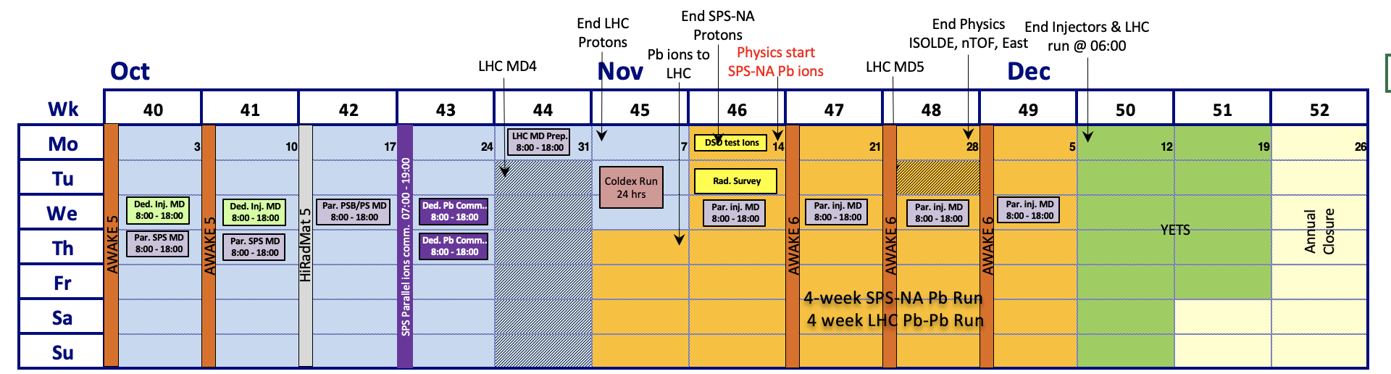
Draft schedule 2022: end of year
Wk46: End SPS-NA protons and start SPS-NA Pb ions physics – 4 weeks Pb ions run
Wk47+48+49: AWAKE run 6
Wk48: End protons physics for ISOLDE, nTOF and PS-EA – cool-down in view of YETS
Wk48: LHC MD block 5 (ions)
Wk50: Mon.12 December @ 06:00 stop off all beams
2 dedicated MD blocks, 7 parallel MD blocks and 1 LHC MD preparation block
Extremely long year: 259 days for physics
However, note that HIE ISOLDE only starting around 20th July at current estimations : only ~132 days available…
Dates still to be confirmed at research board in December

Slide 10
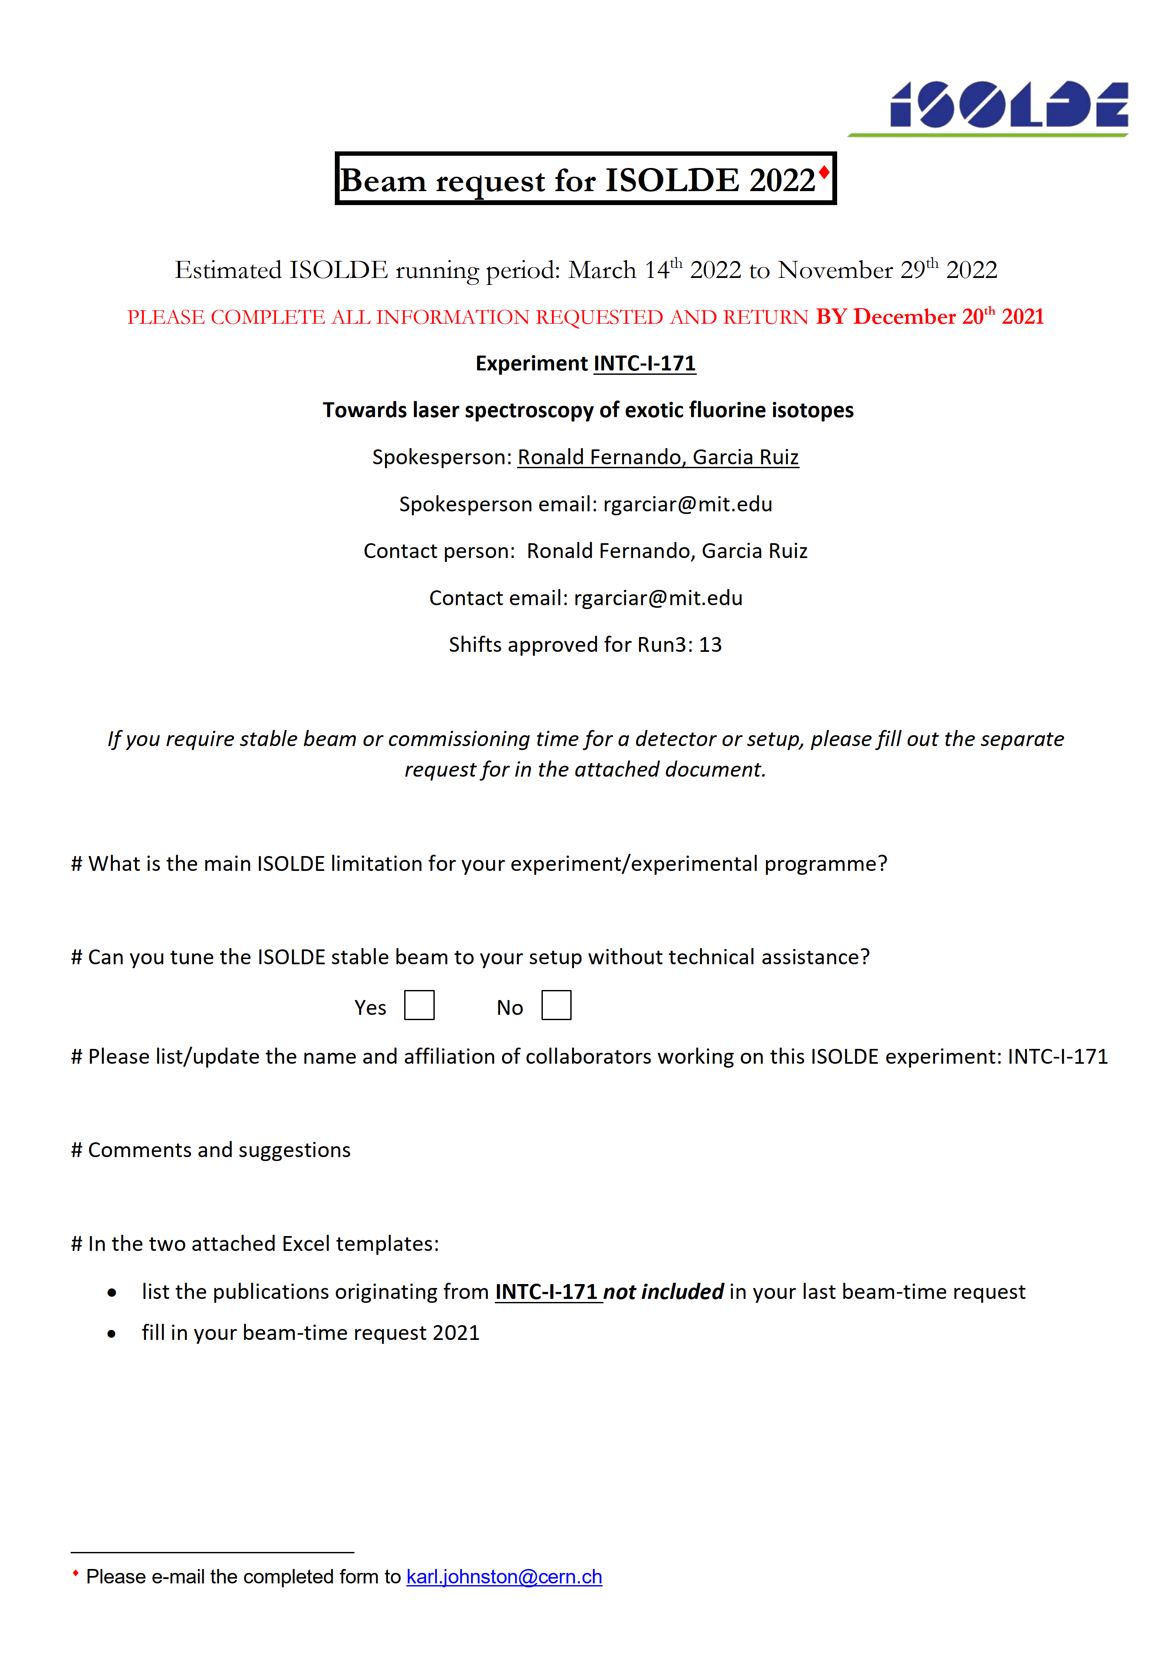
Beam requests for 2022
Ready to be sent out, this weekend
To be returned before Christmas, 17th Dec
Earlier than usual, but need to prepare targets for 2022.
Also useful to know plans of some collaborations in particular Miniball.
Spokespersons will be contacted later in 2022 to see if availabilties are still valid.

Slide 11
Shift backlog before next week’s INTC
Next week’s INTC
Open session 9 November
Closed session 10 November
Agenda here: https://indico.cern.ch/event/1085117/

Slide 12
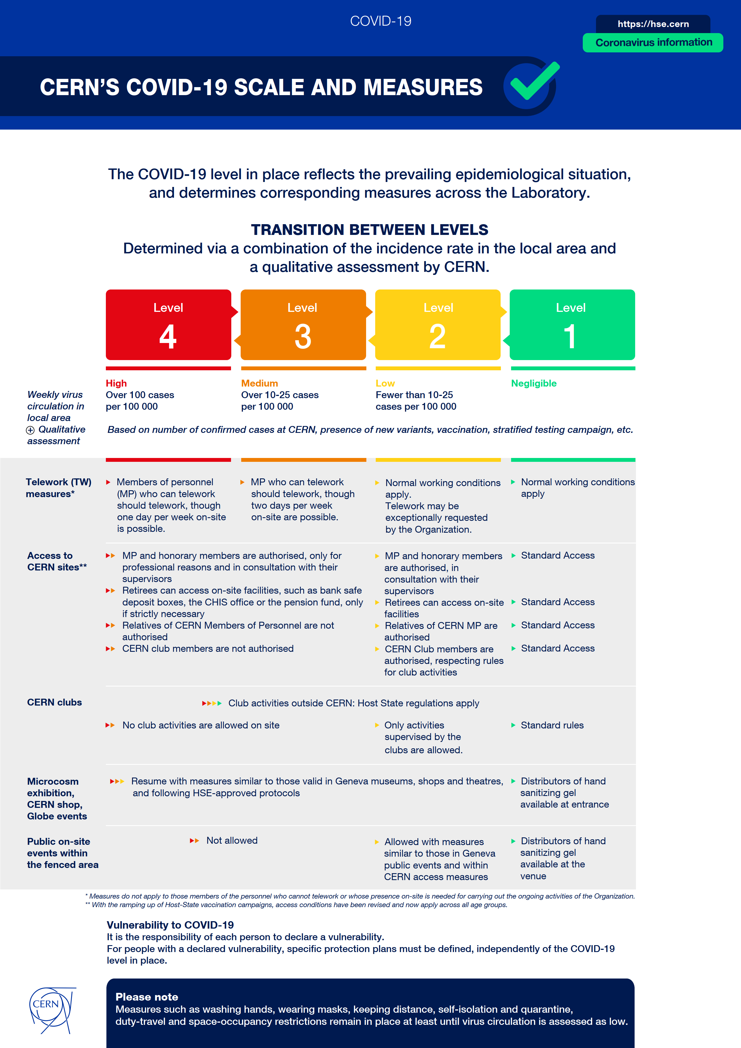
CERN currently in level orange
Masks and proximeters still mandatory. Remote meetings still favoured.
NO firm decision on use of covid certificate yet
Hse.cern

Slide 13
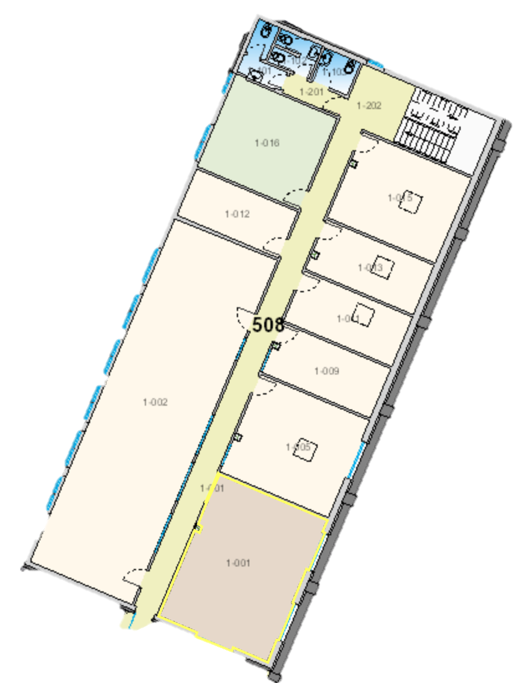
Restrictions on number of people remain
(has become challenging to manage groups in recent weeks….)
1-002 → Control room (291 m³)
170 m³/h
6 people
1-016 → Kitchen (77 m³)
Vent?
4 people
1-001 → Visitors room (130 m³)
310 m³/
6 people
1-015 → RILIS DAQ (76 m³)
196 m³/h
4 people
1-005 → ISOLDE DAQ (87 m³)
232 m³/h
4 people
1-009 → ISOLTRAP DAQ (44 m³)
176 m³/h
2 people
1-011 → xx (44 m³)
Vent?
4 people
1-013 → xx (42 m³)
Vent?
2 people

Slide 14
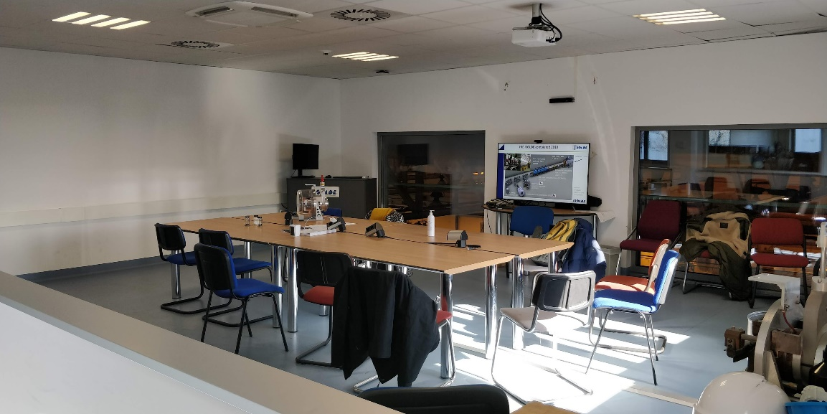
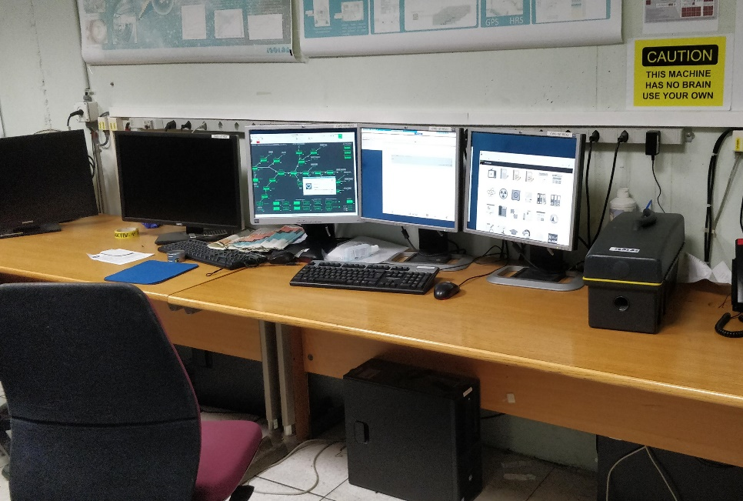
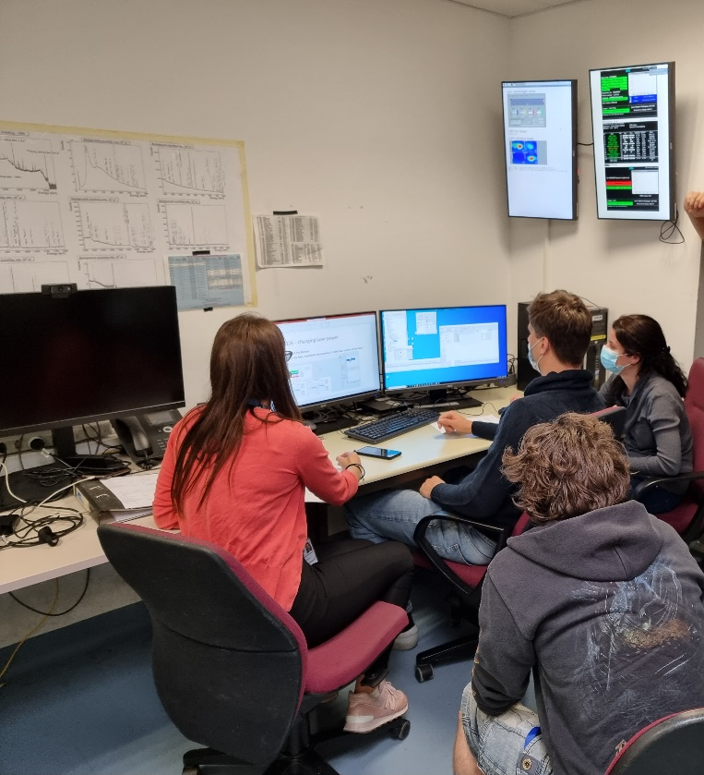
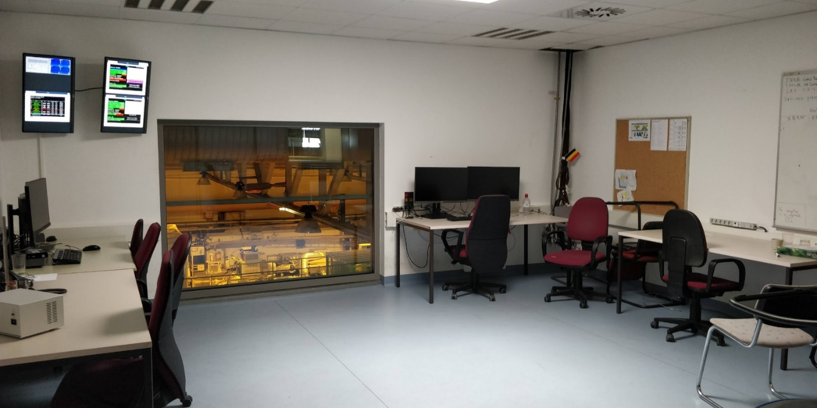
Use old control room, DAQ and visitors space more optimally to allow for more distancing/zoom conferencing
With OP, additional control terminals…OP working on means to allow monitoring e.g. for advanced users at home/office

Slide 15
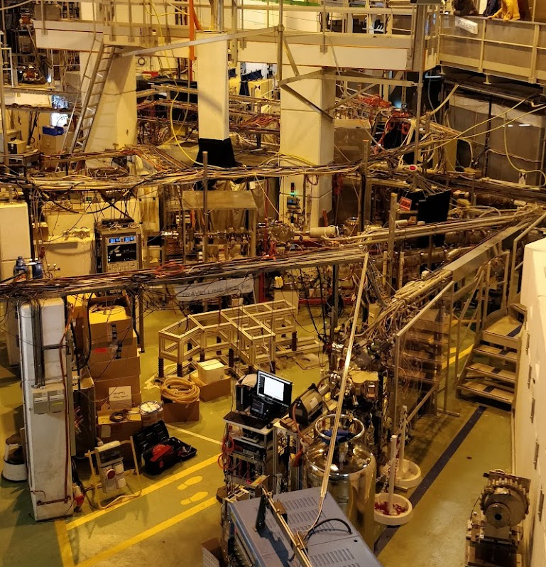
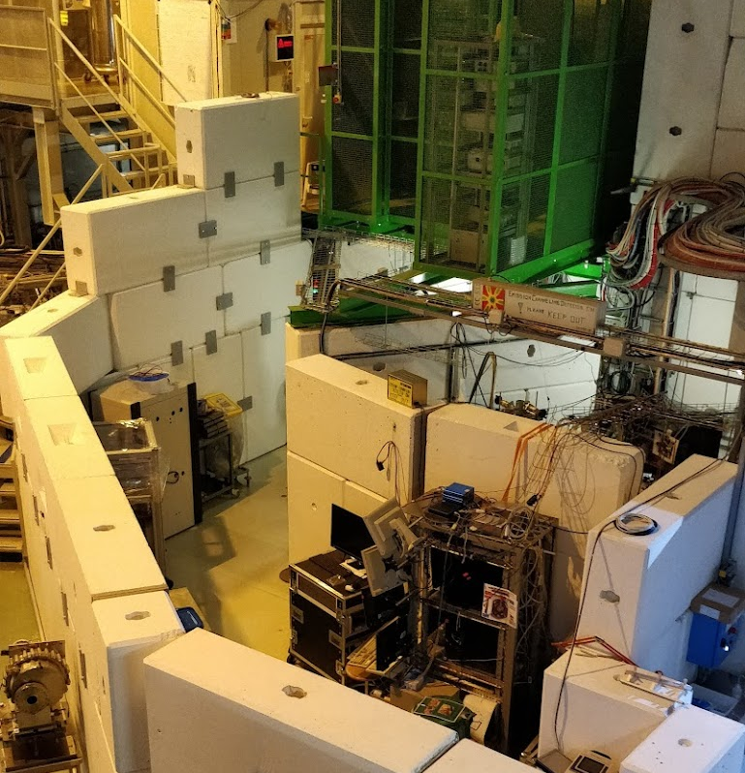

Slide 16
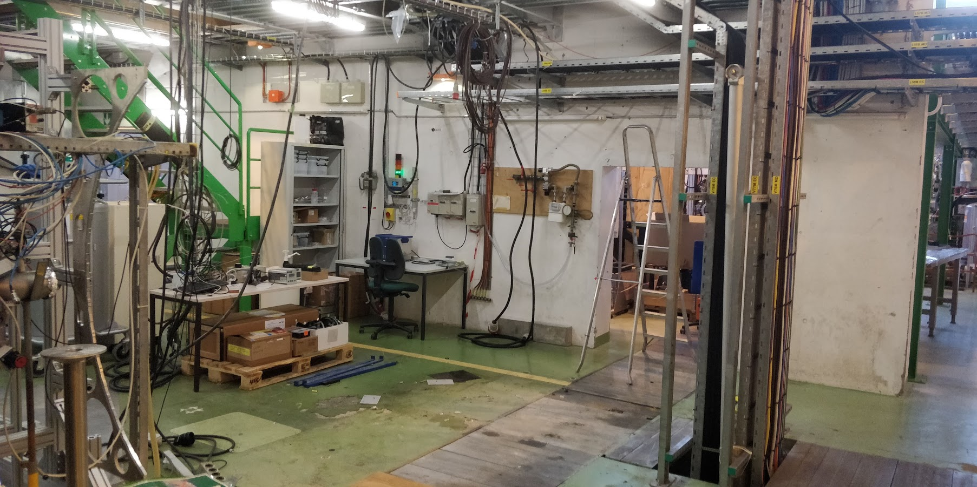
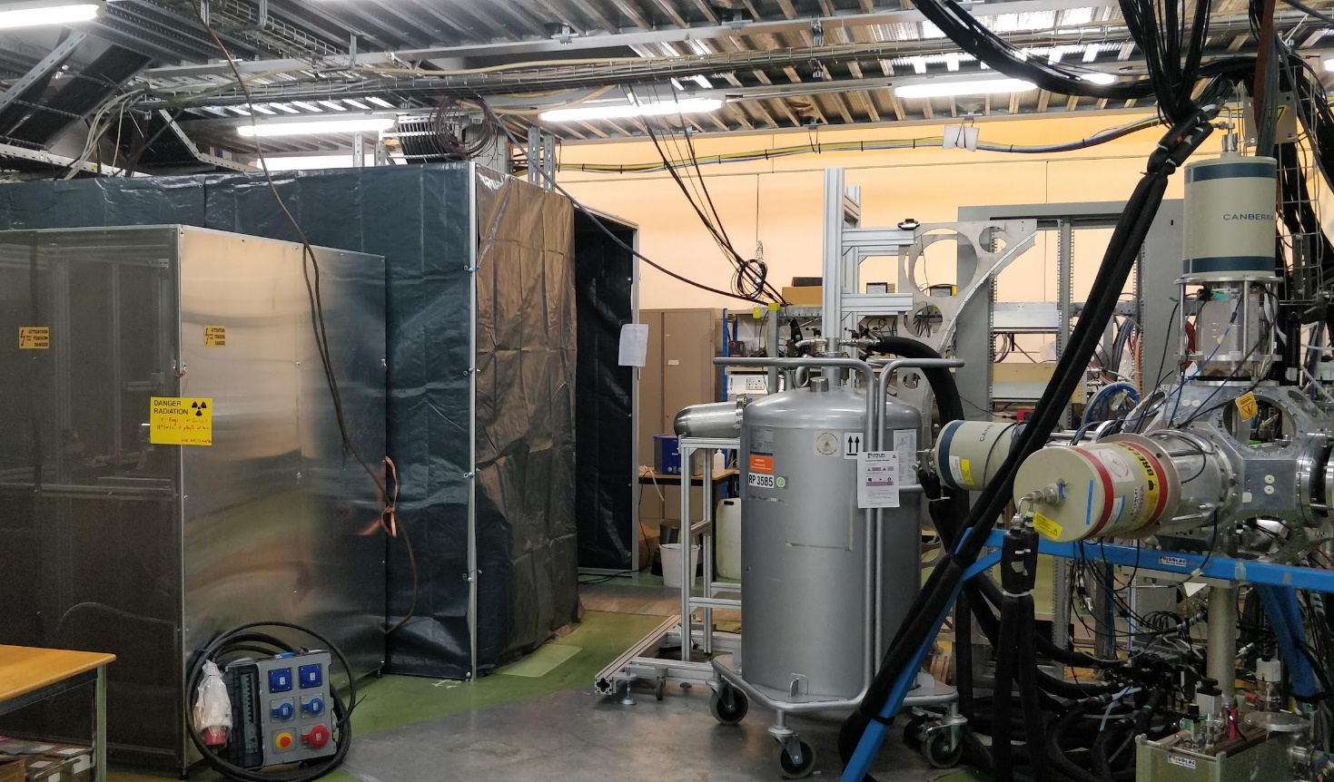
MIRACLS installation in old NICOLE area

Slide 17
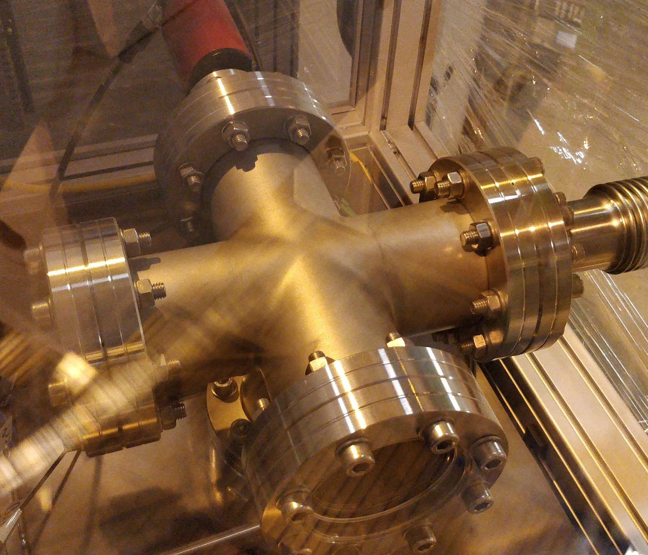
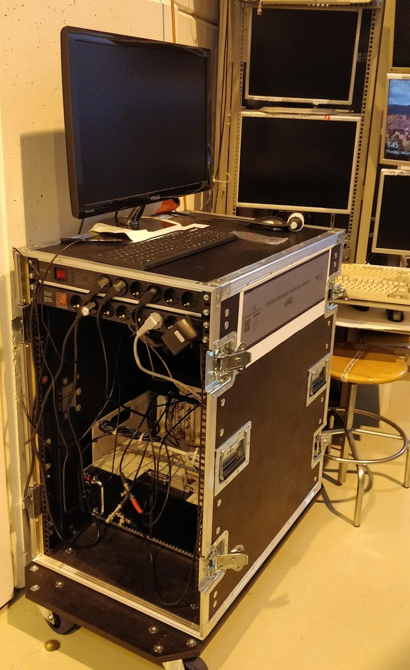
New Mossbauer setup ready for commissioning

Slide 18
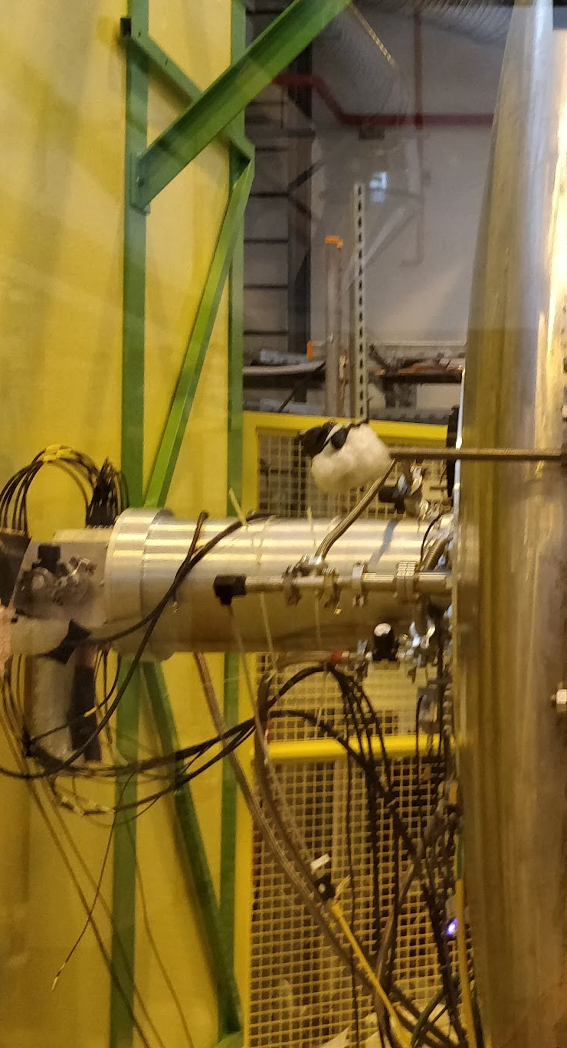
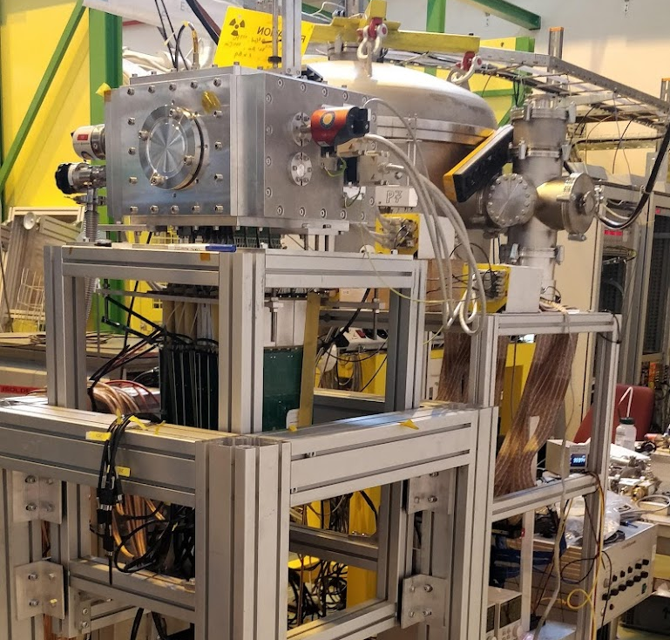
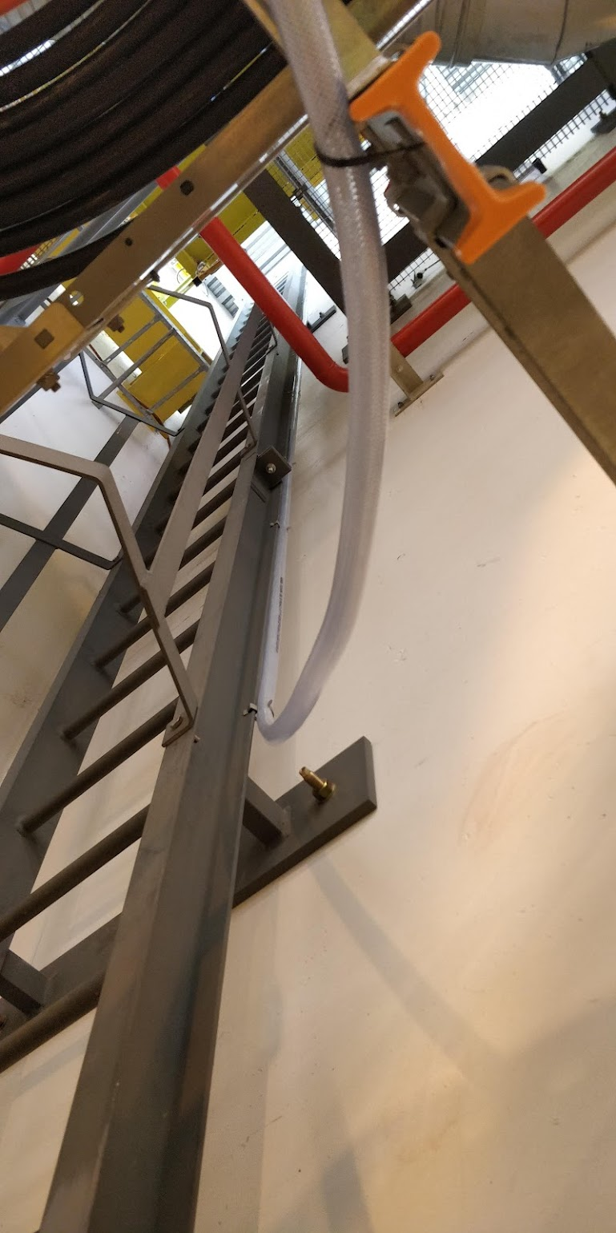
HIE ISOLDE: ionisation chamber and ACTAR

Slide 19
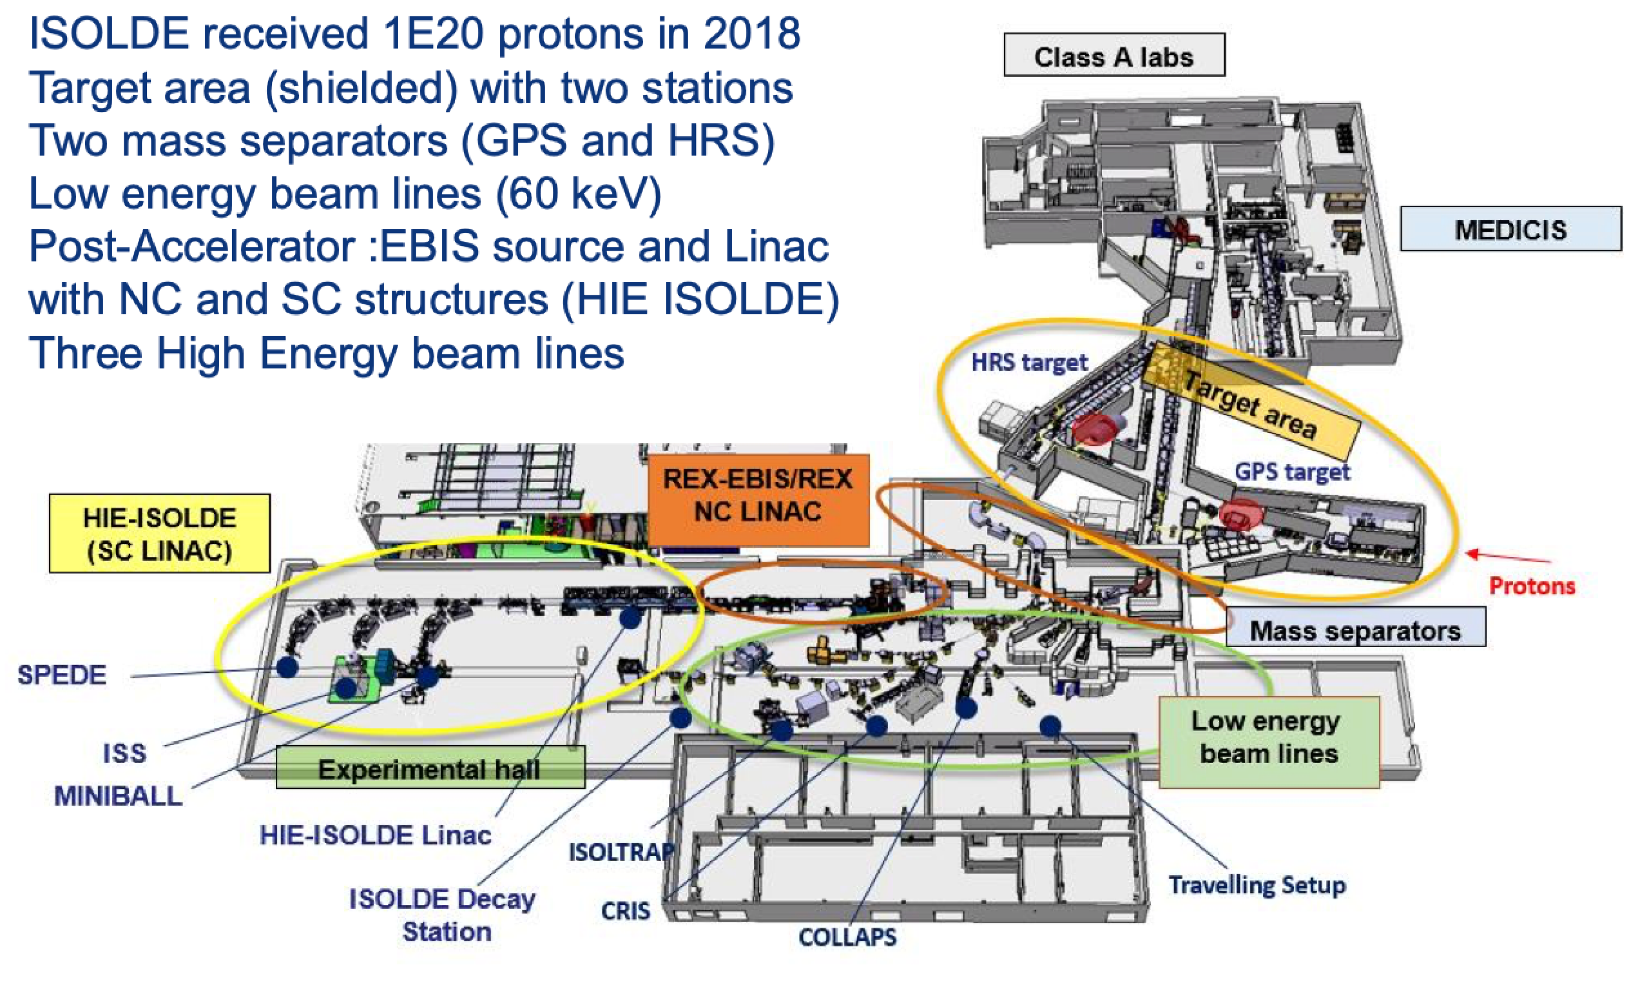
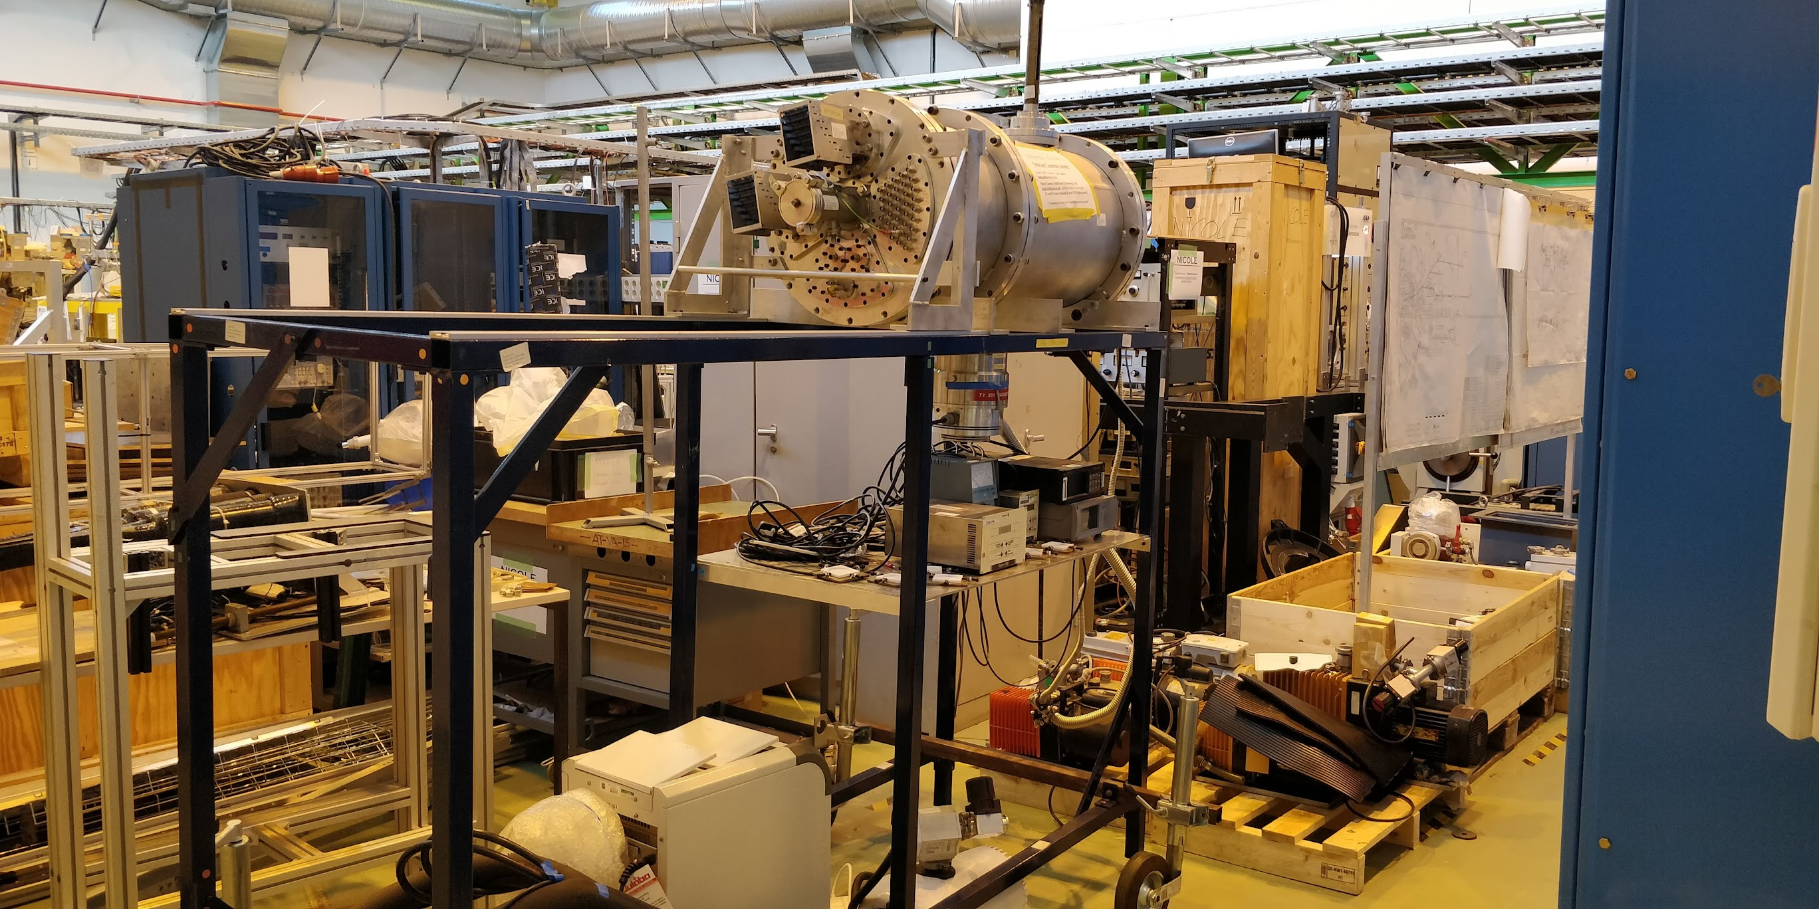
Create space for safe detector storage/development

Slide 20
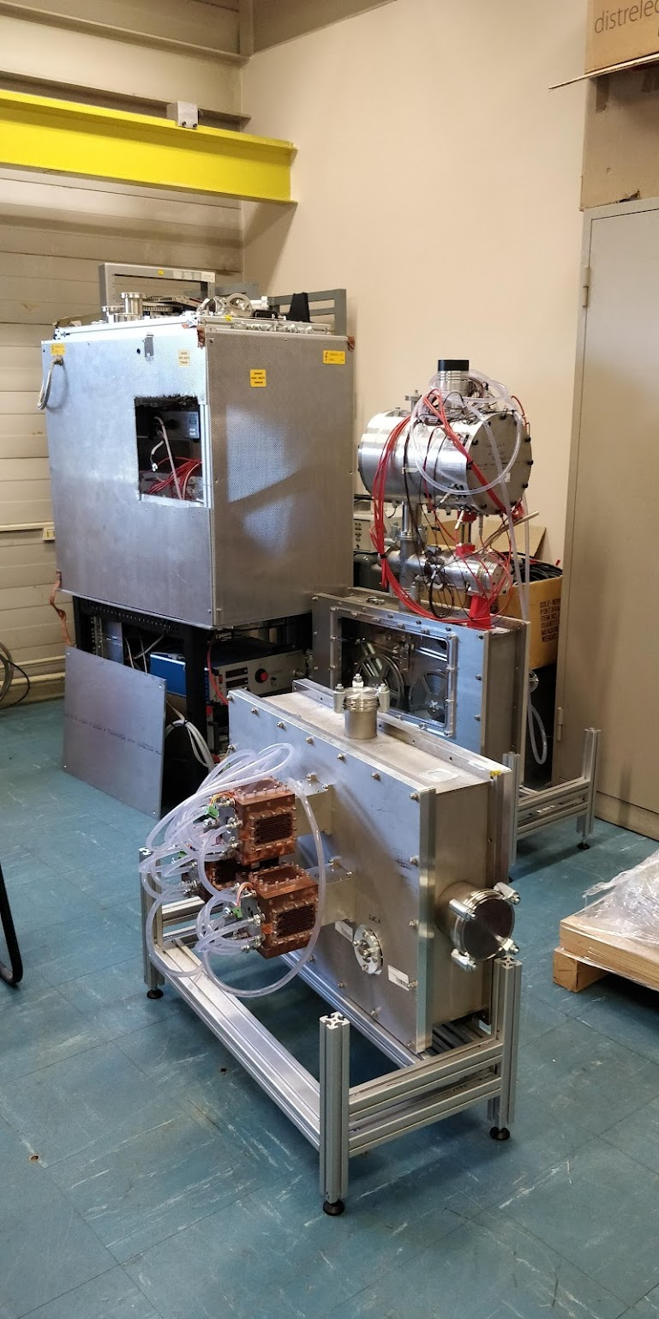
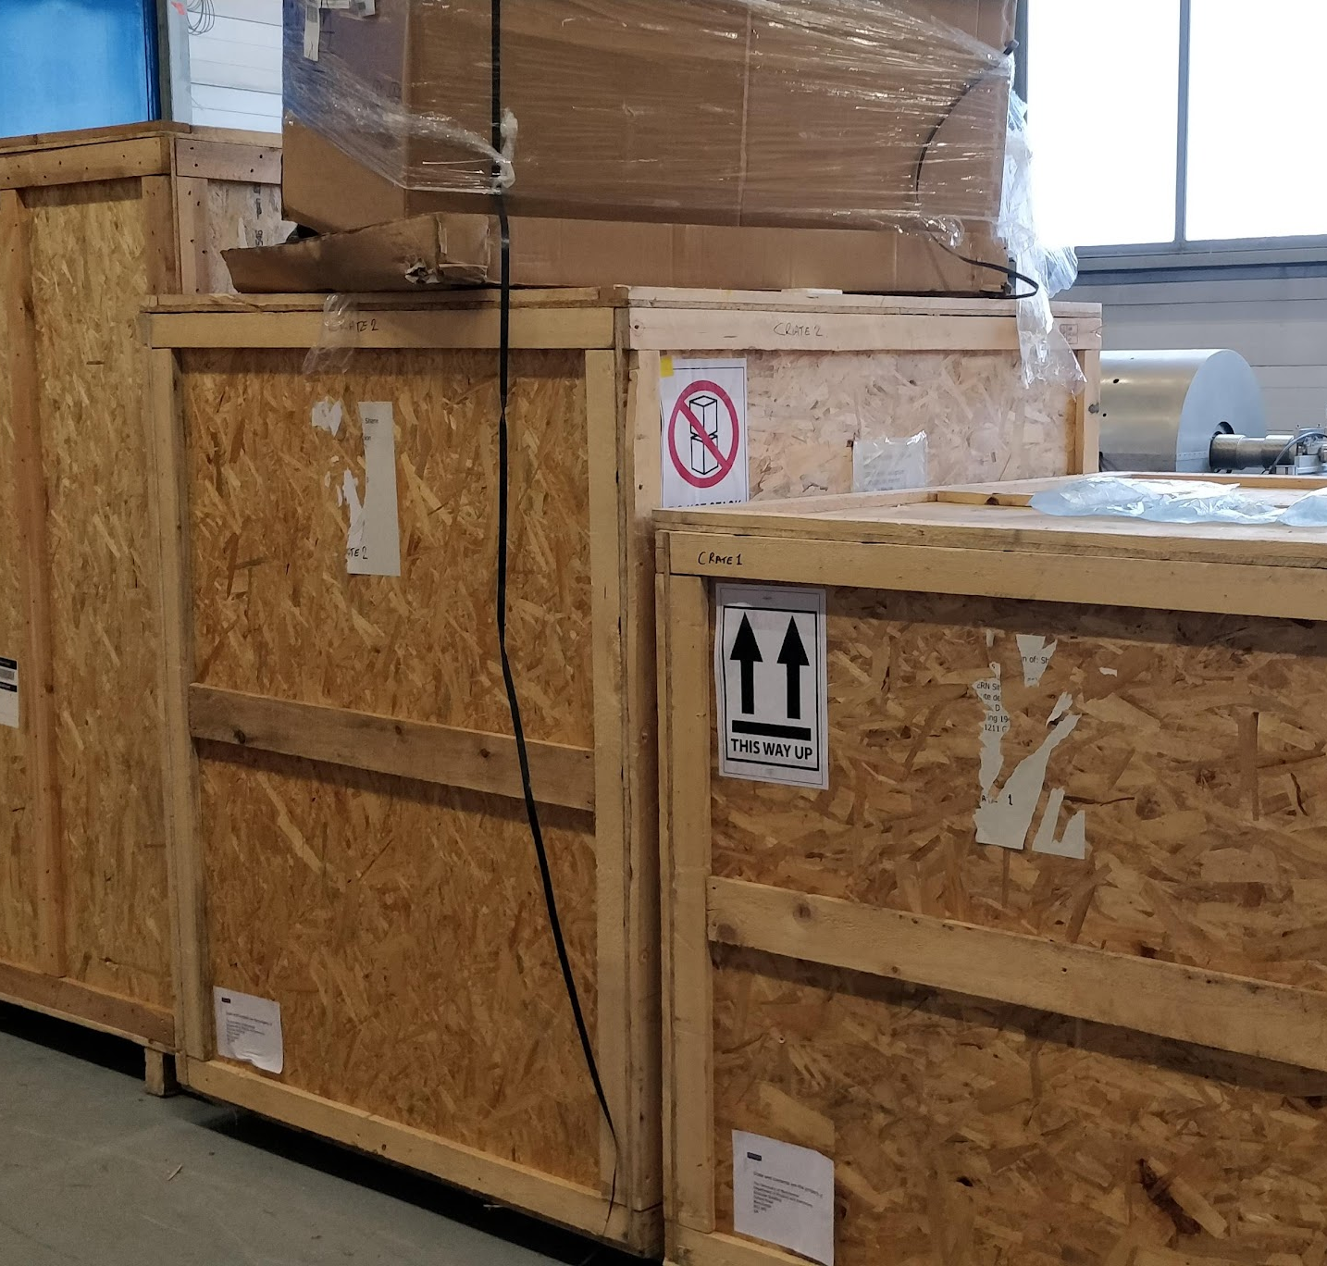
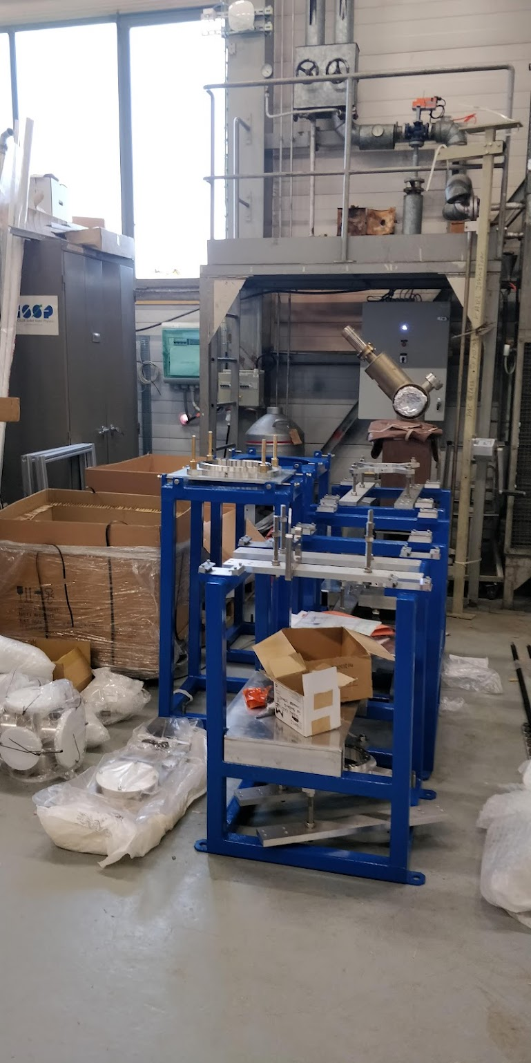

Slide 21
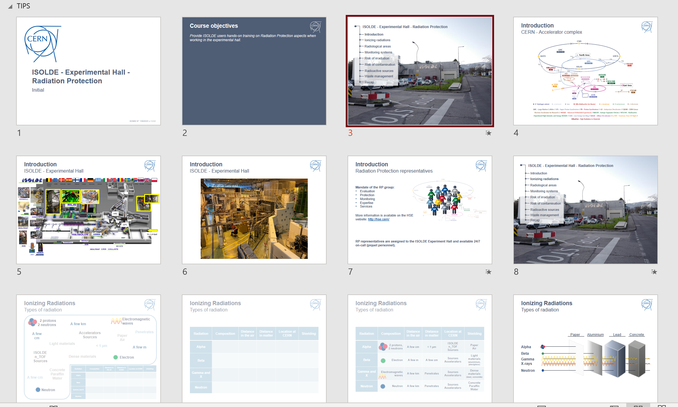
Training
In addition to the (ever-growing) number of online courses…
Hands-on RP and Electrical training
New from next week:
dedicated weekly sessions of RP hands-on course. Local trainer (!) so scheduling should be easier for this course.
New EP-wide electrical course for all users/staff who need to work in an experimental area.
Both will take place on Tuesday but time has increased:
  EP course 0830 till 1230
  RP course 1400 till 1630
In LMS:
ISOLDE - Experimental Hall - Radiation Protection - Handling (Covid-19)
Electrical Safety - Working in EP experiments
Scheduling of safety courses has not been as straightforward as expected, limited numbers due to covid/unexpected cancellations and EP electrical course not yet available every week. Ad hoc sessions are available but not desired.

Slide 22
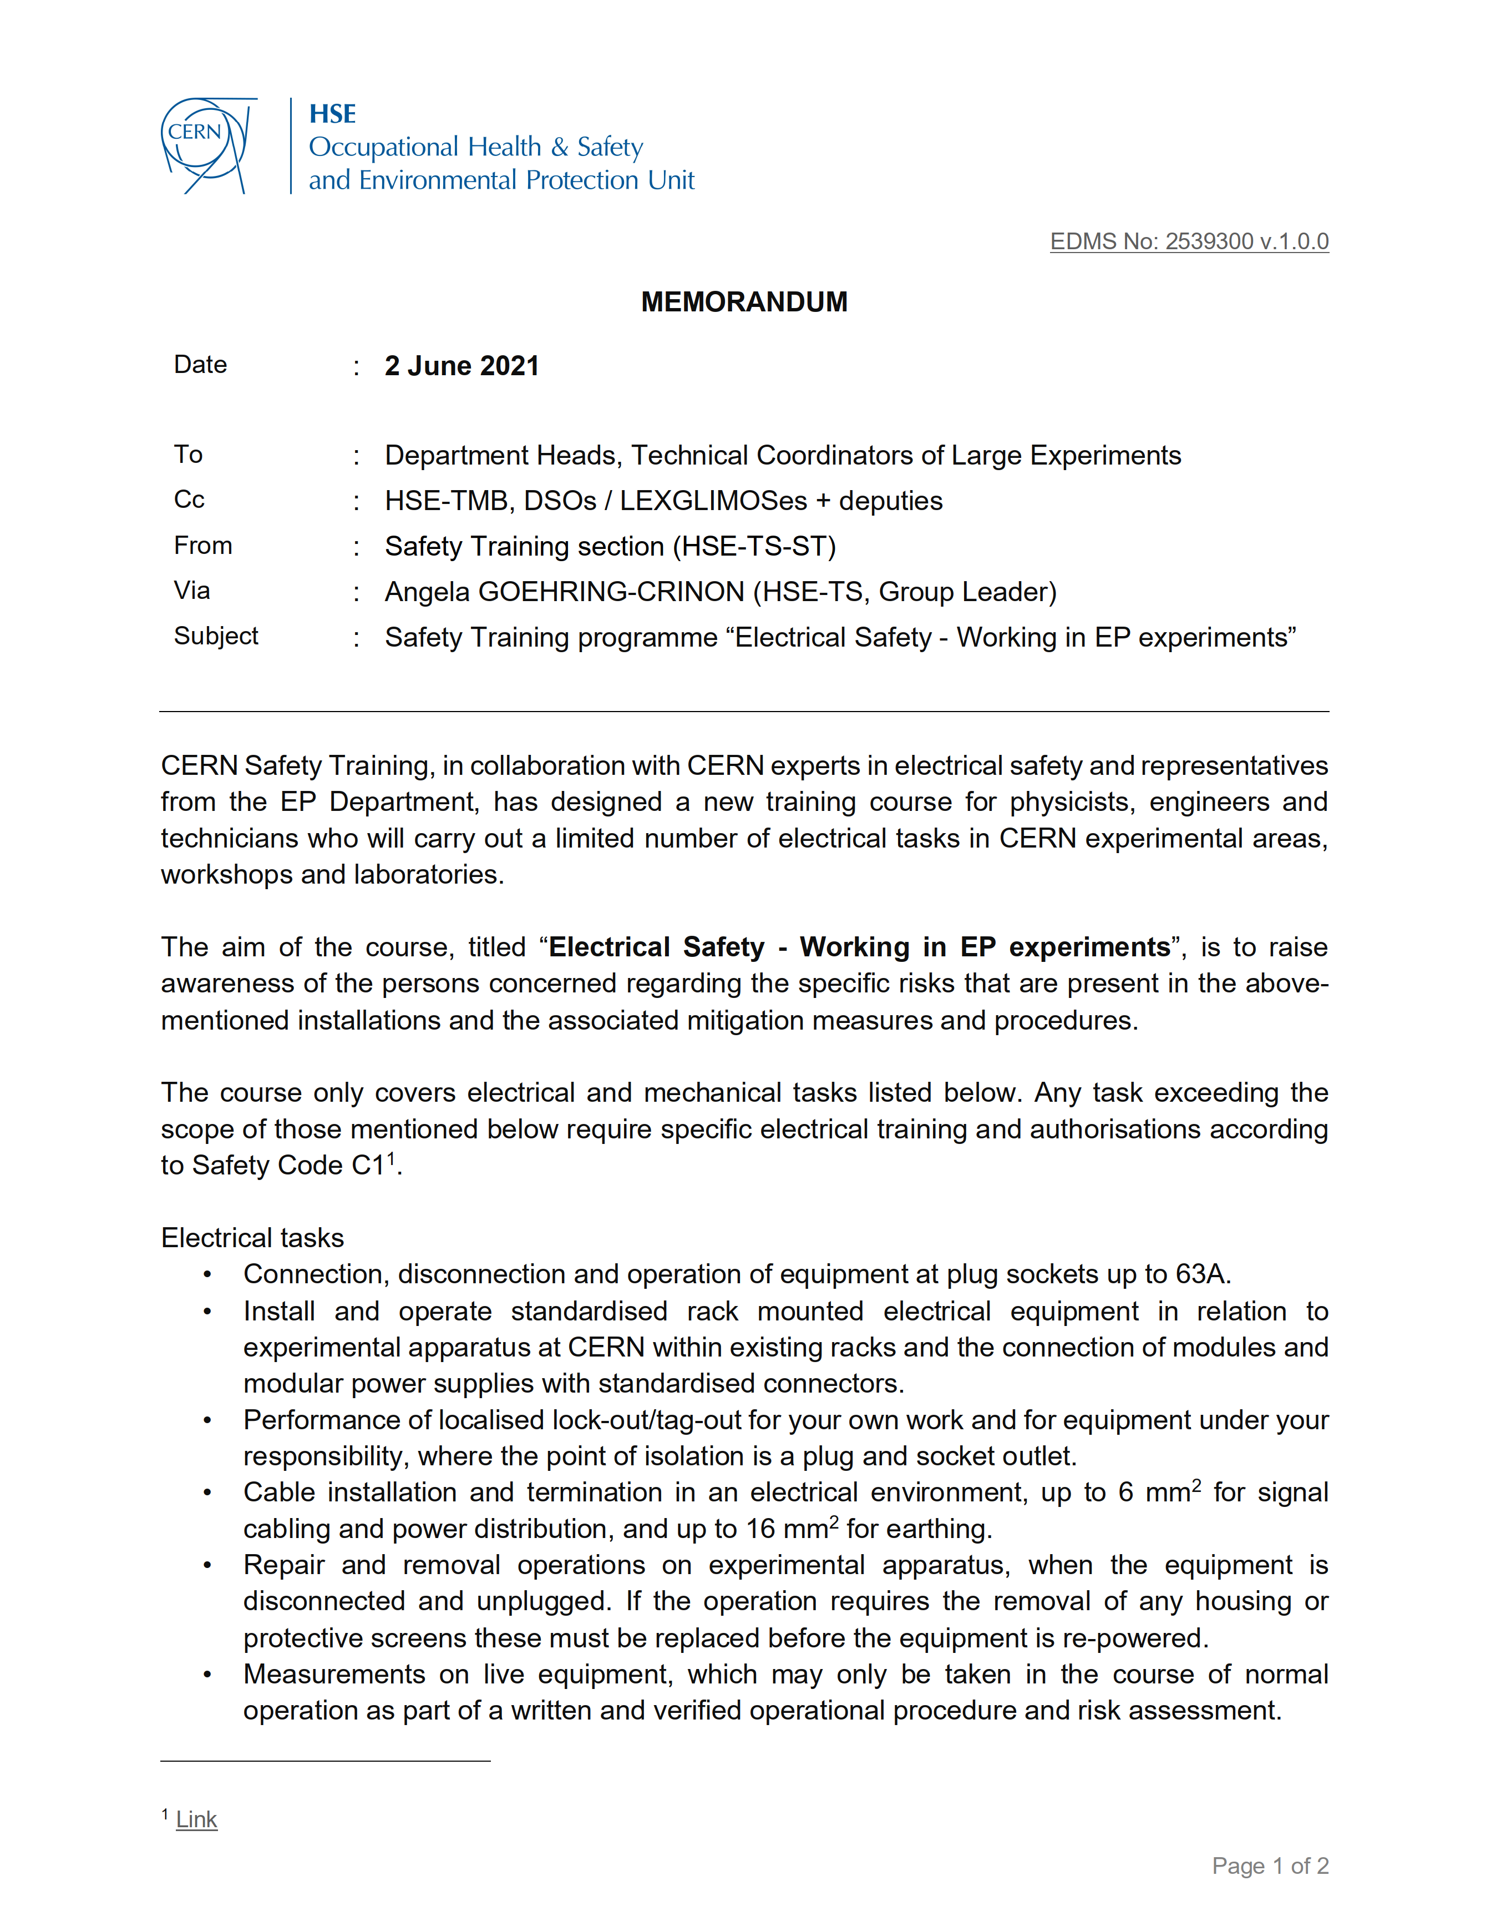
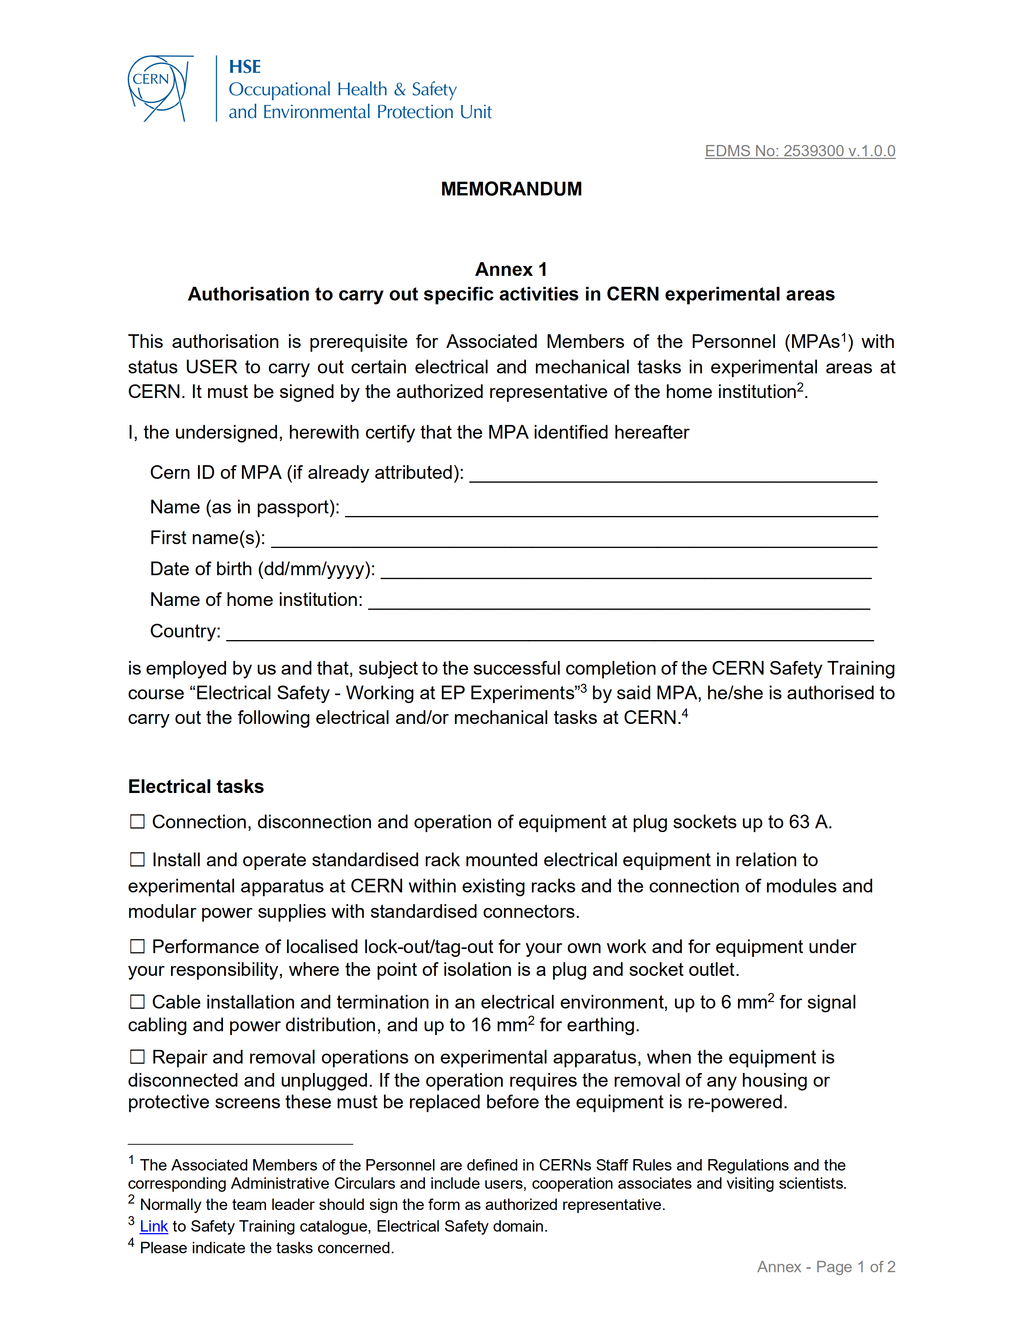
EDMS No: 2539300 v.1.0.0
Also causing issues….

Slide 23

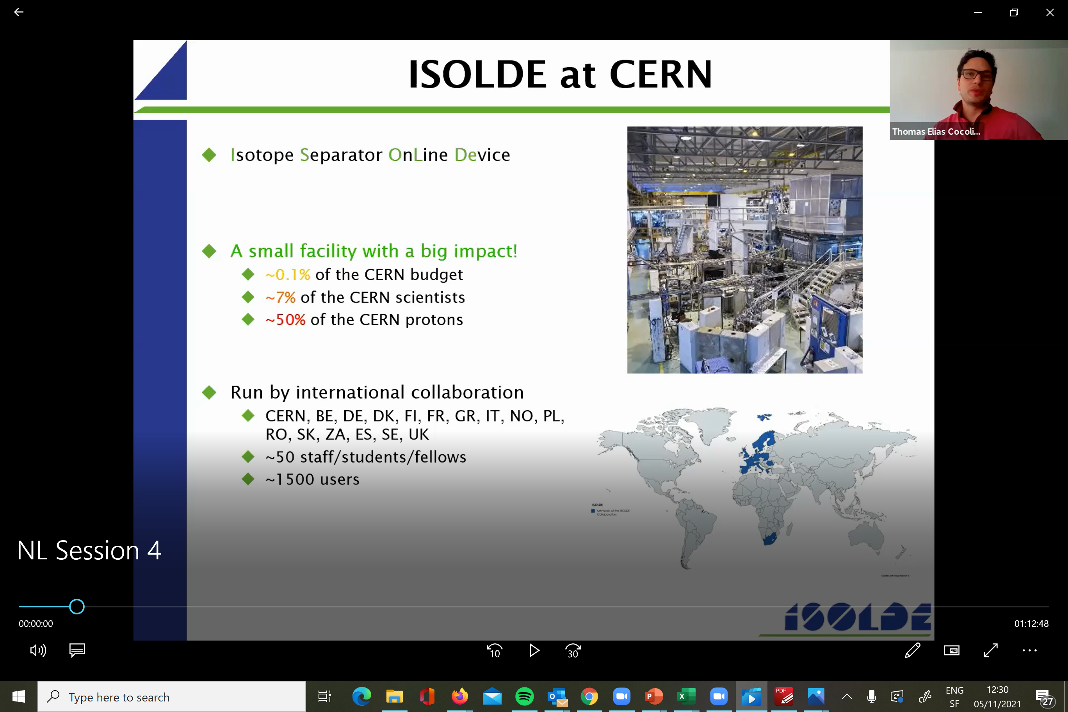
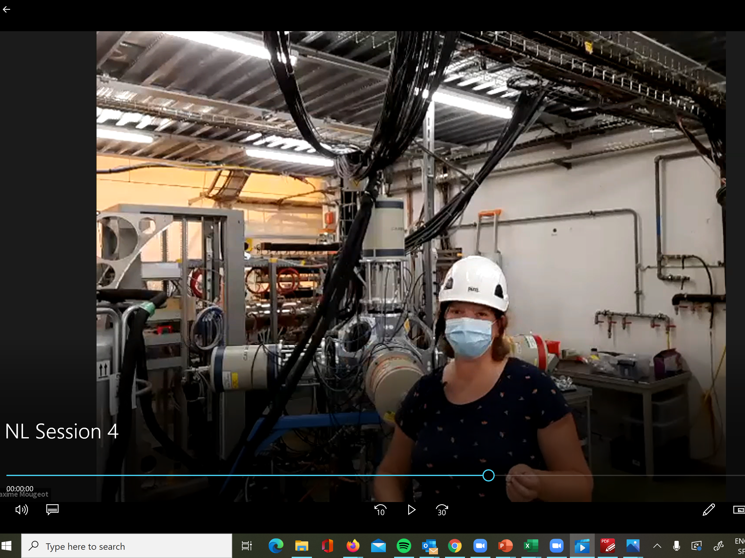
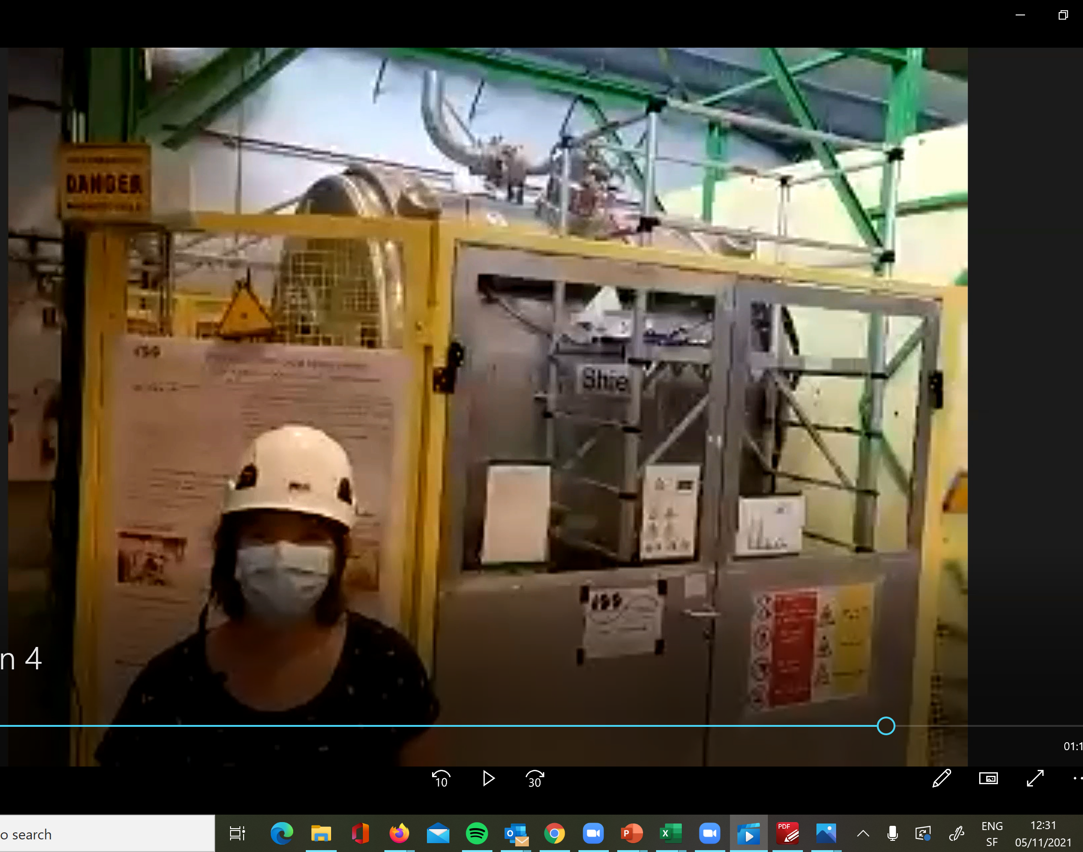
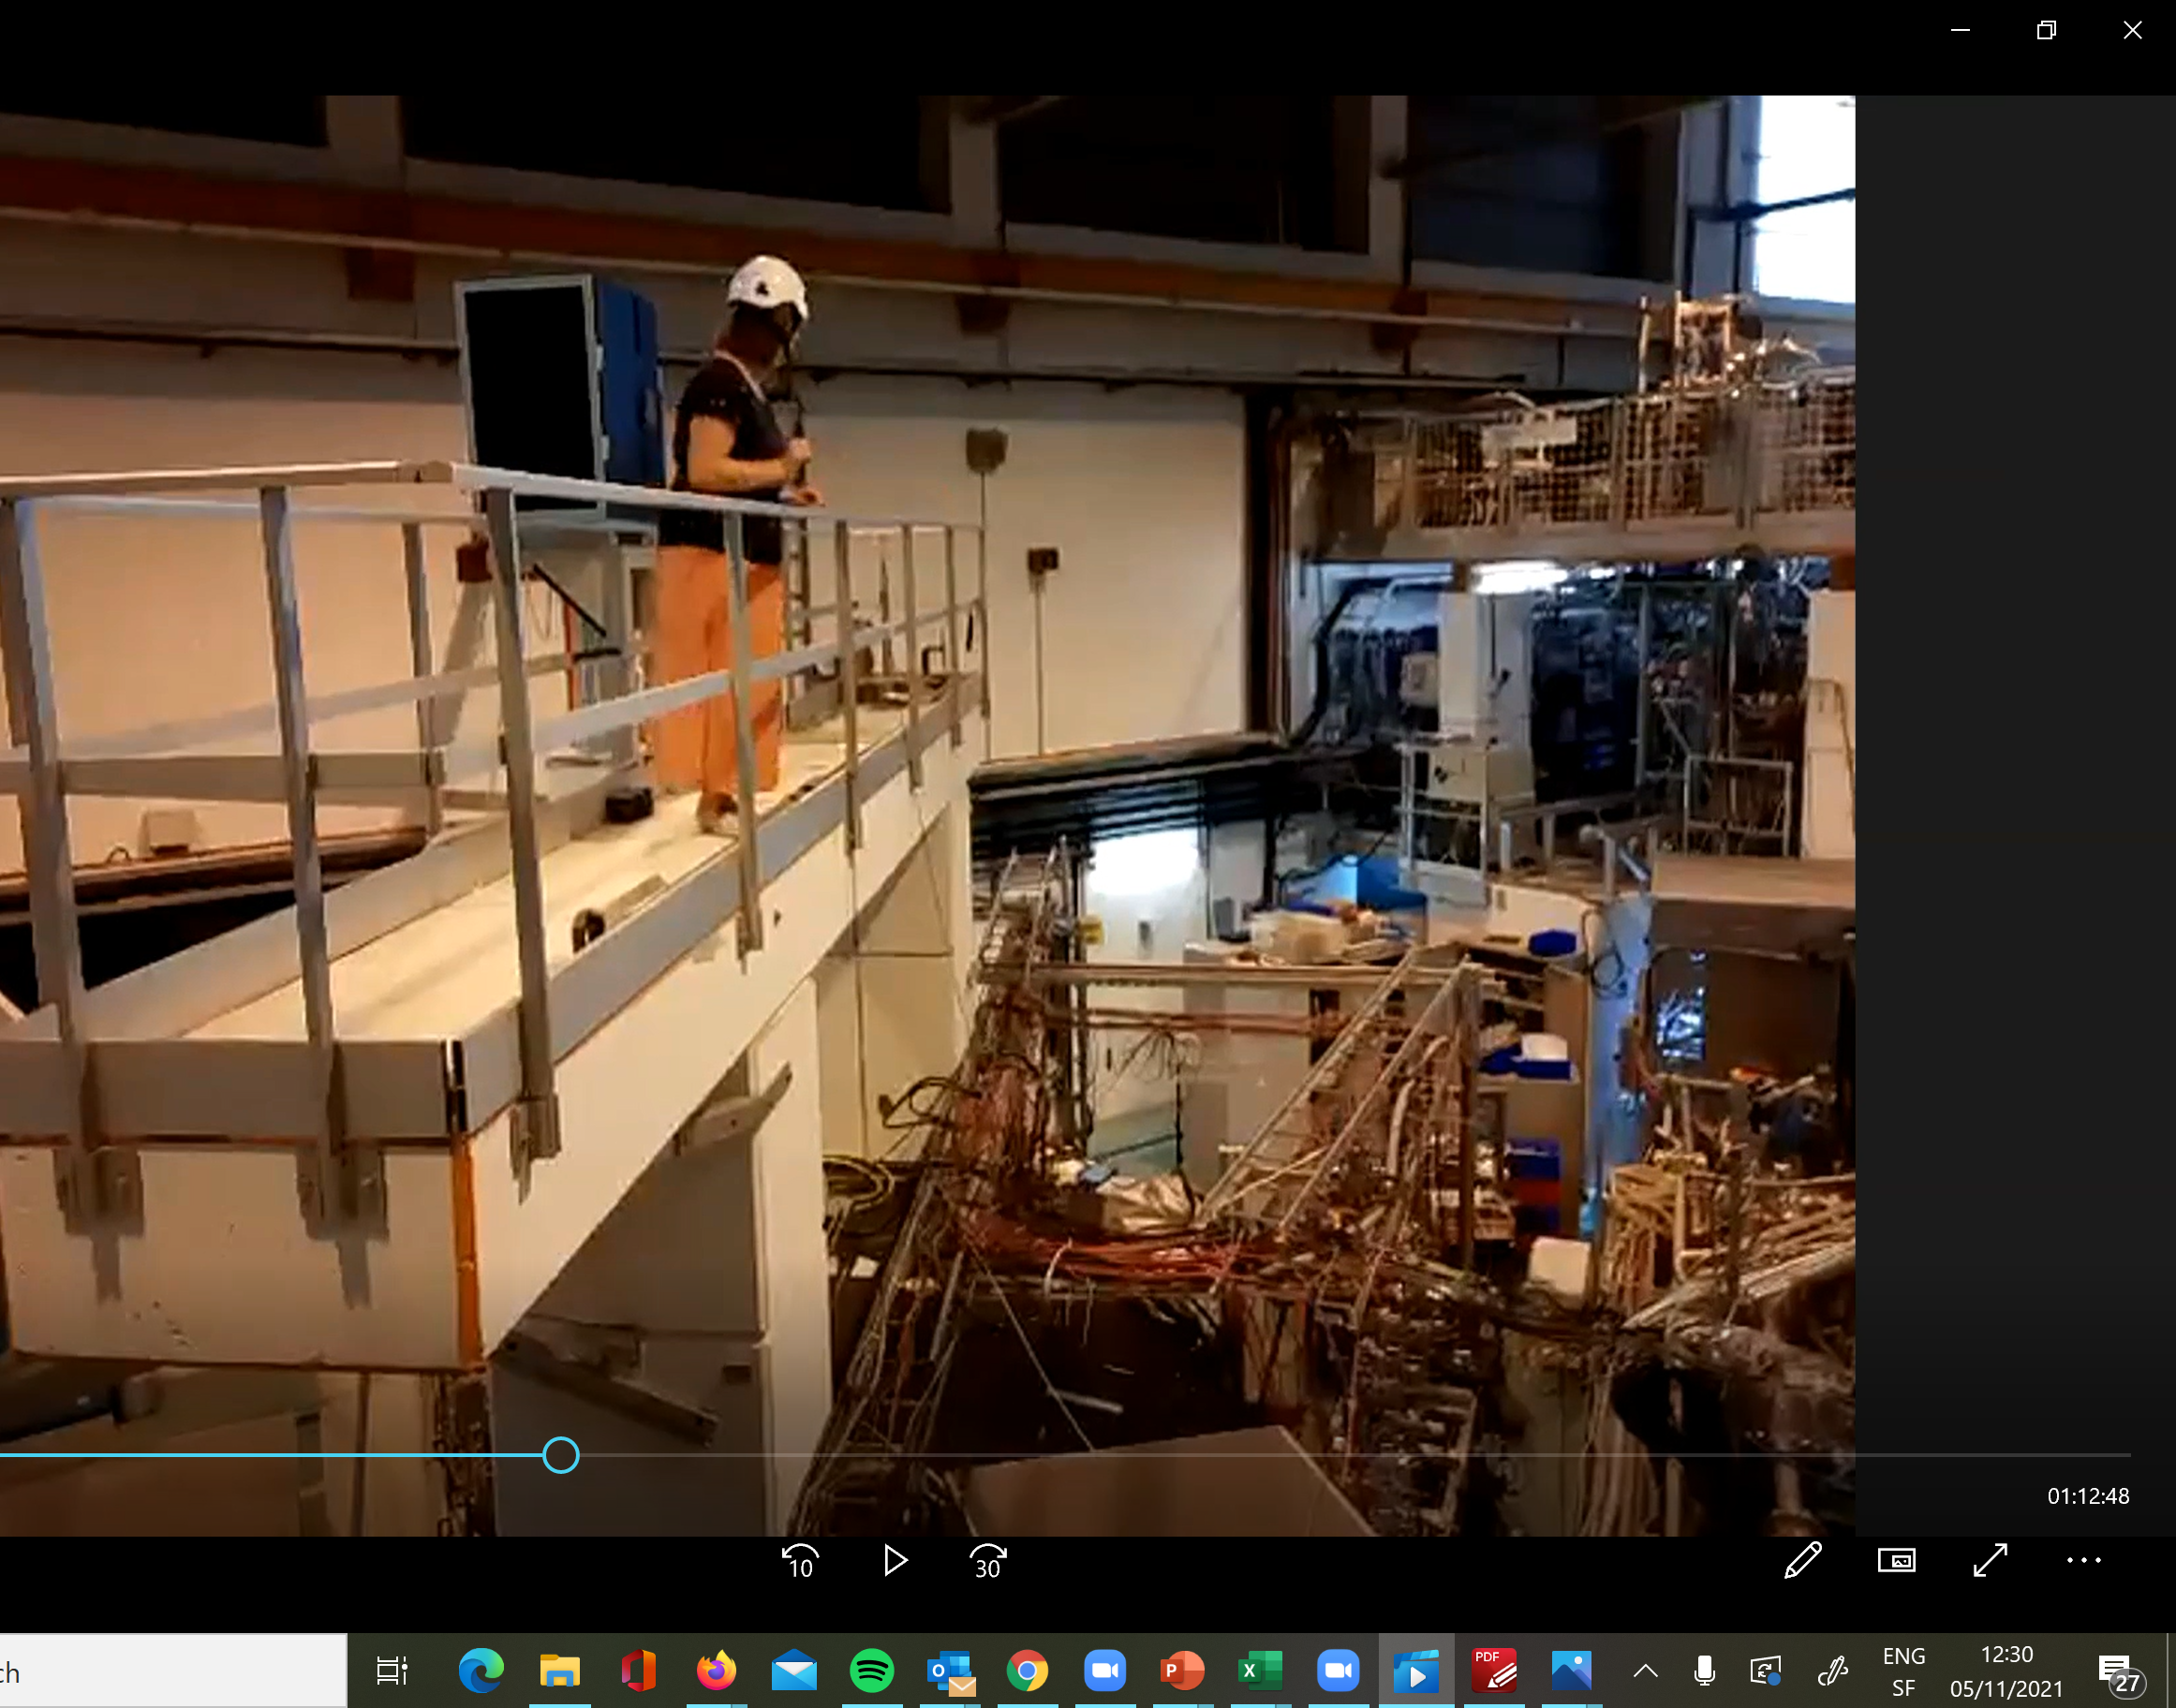
Virtual visits now possible…

Slide 24
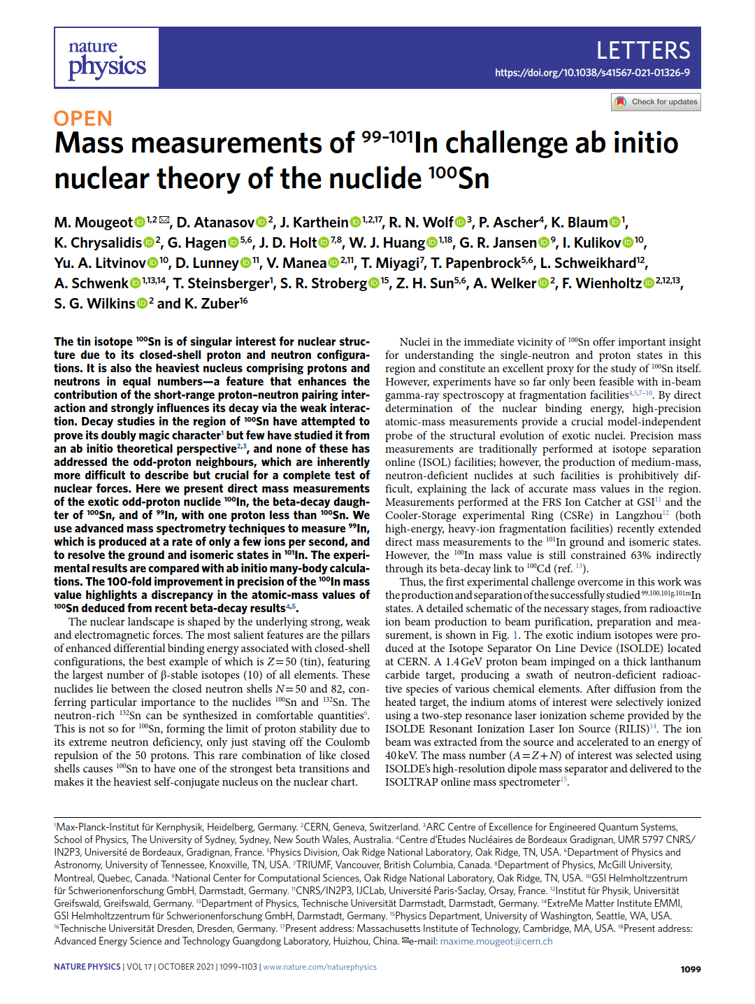
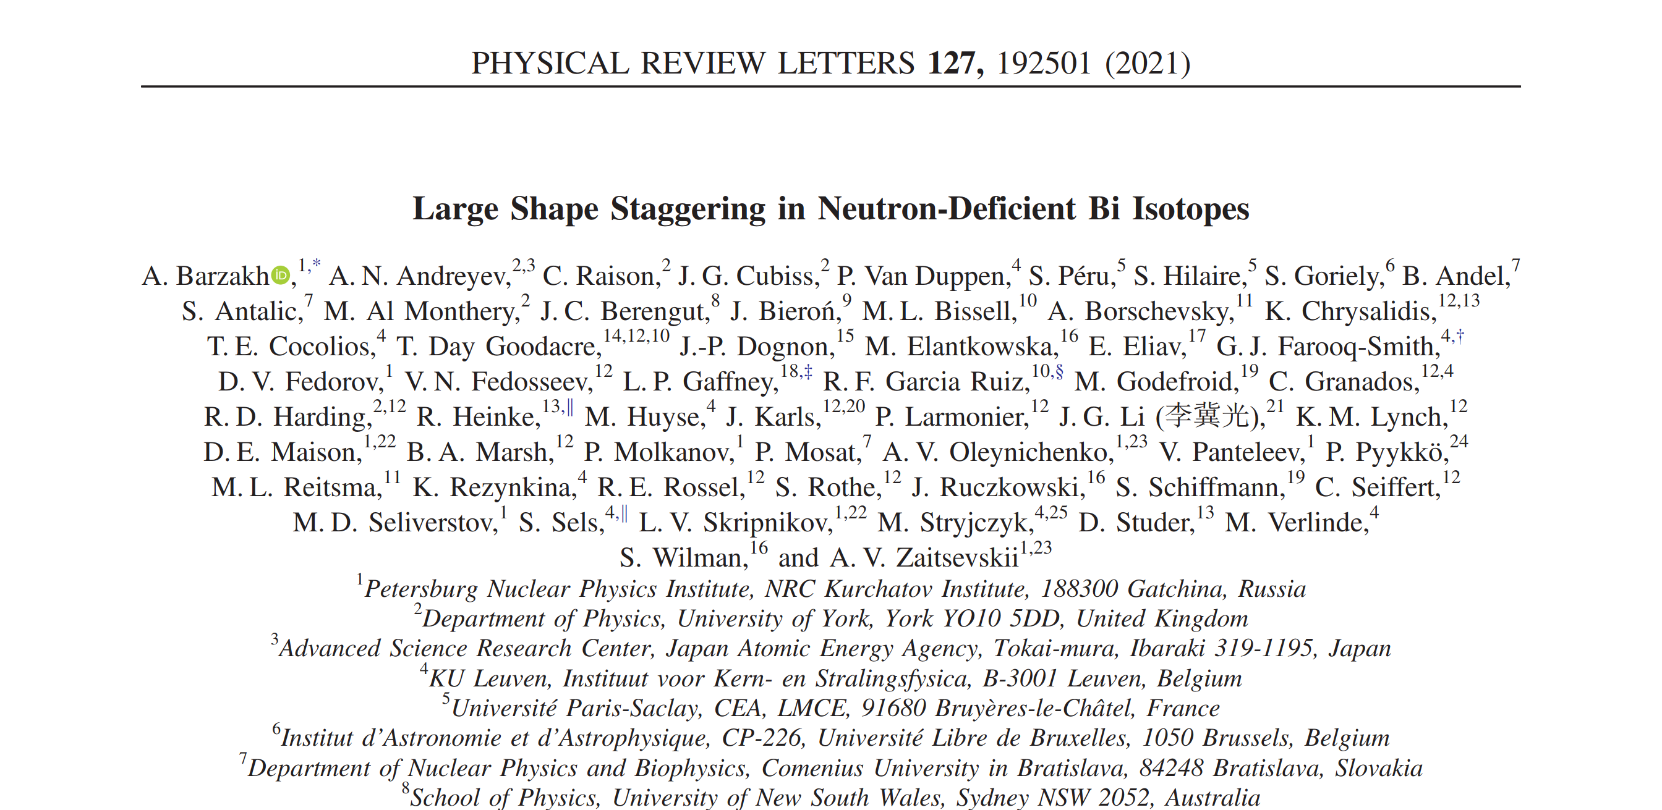
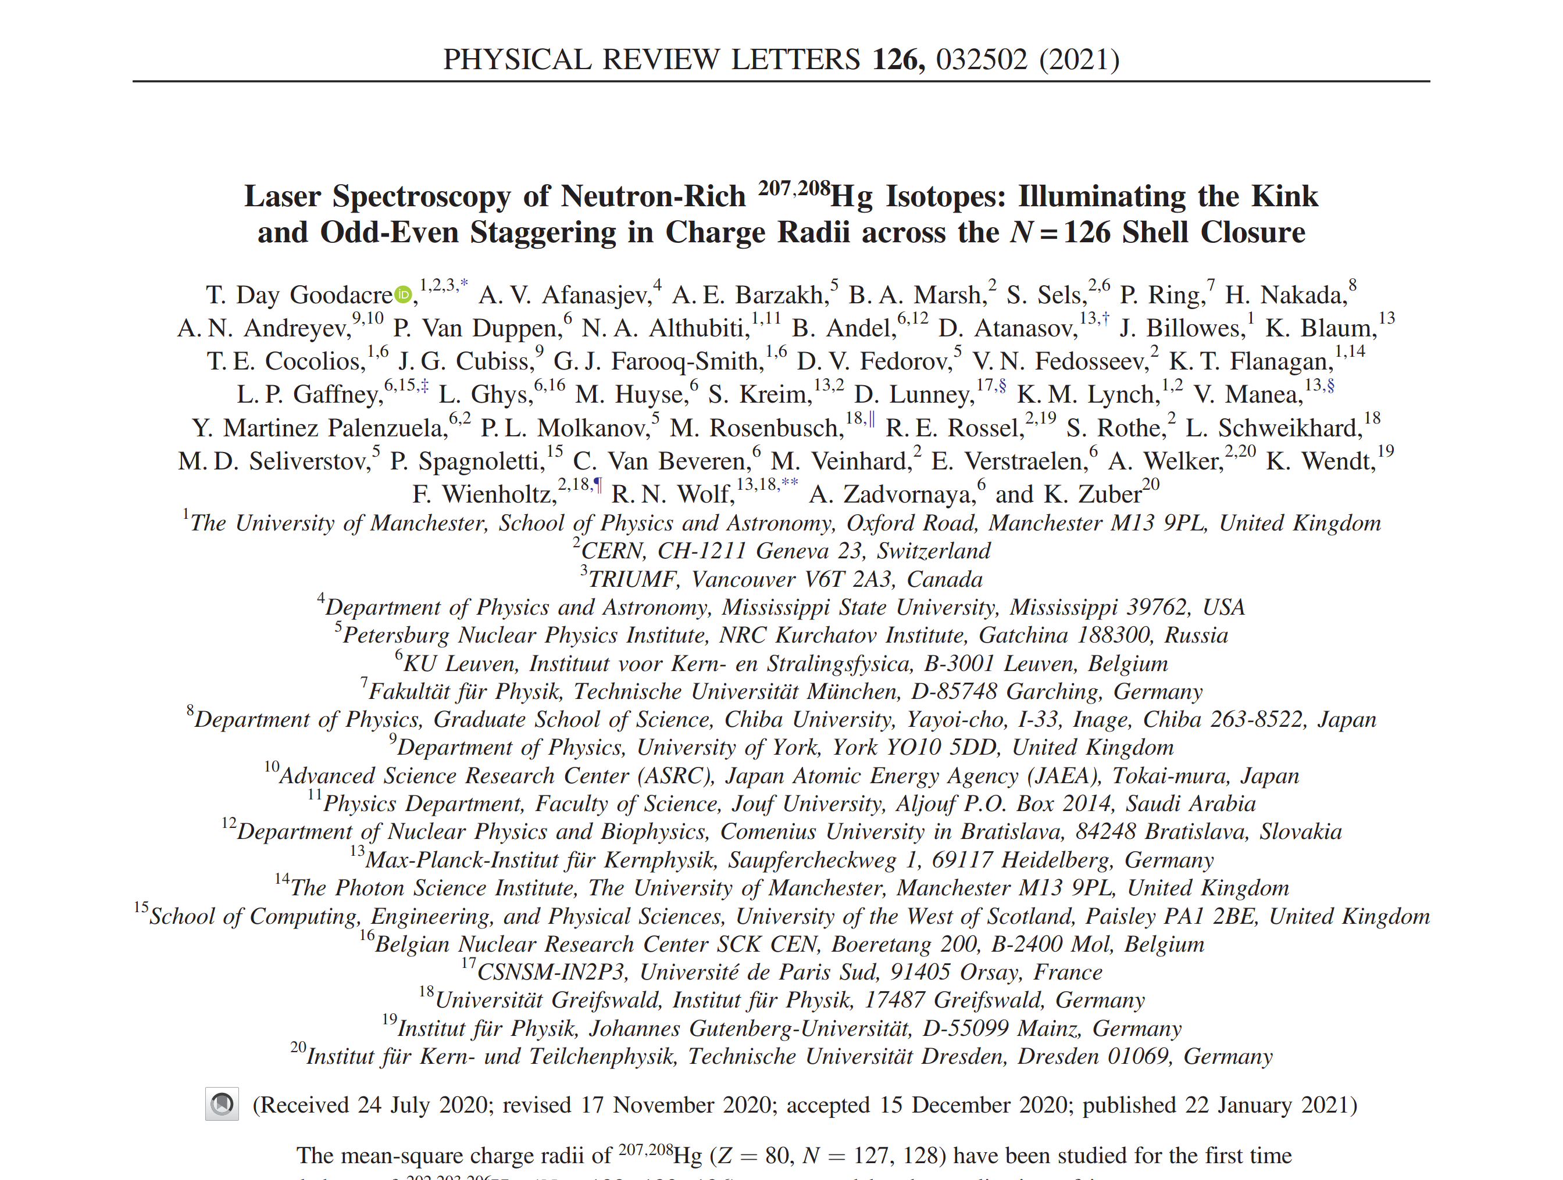
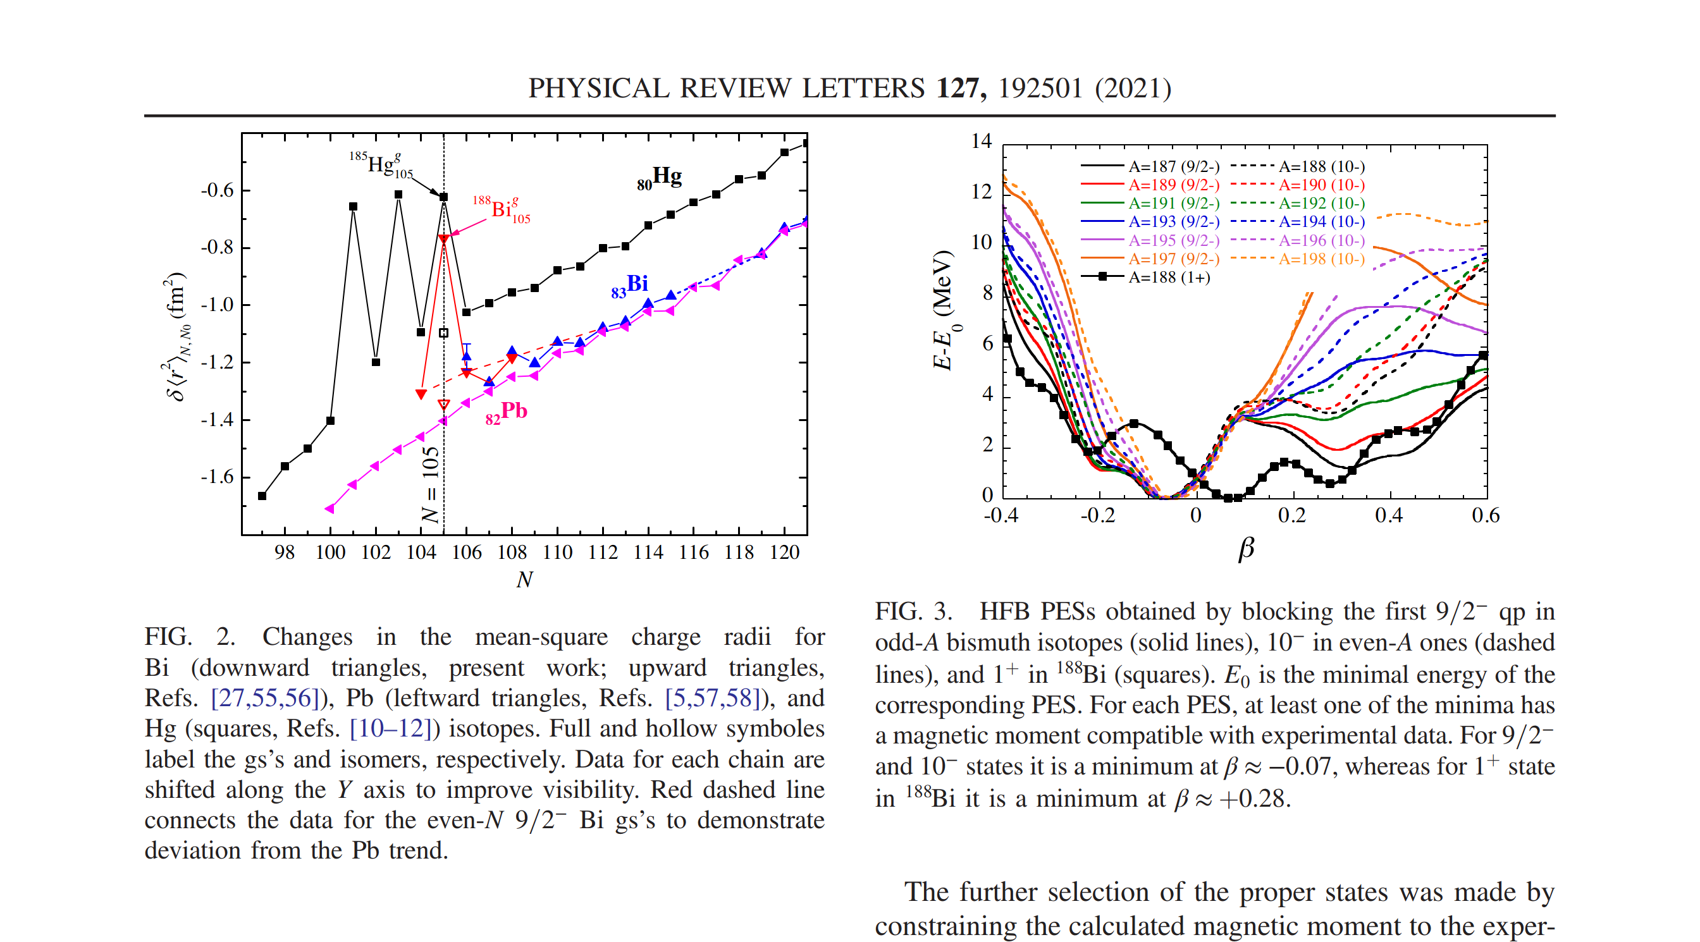
Some recent publications…

