Slide 1
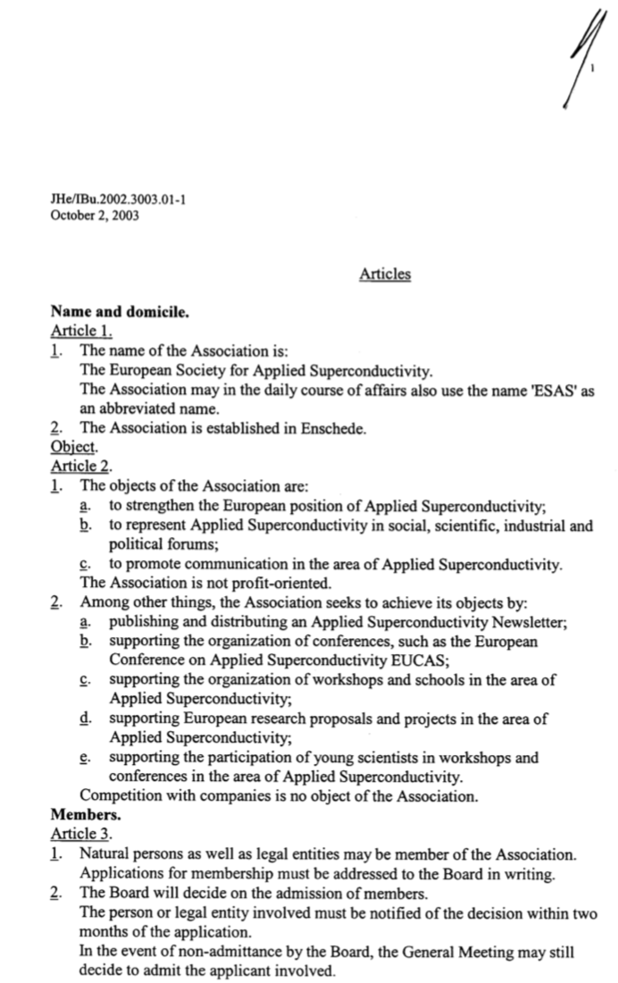
ESAS STATUTES – 1/2
The present version of ESAS Statutes dates to October 2, 2003
They were discussed at the Board meeting of September 16, 2013, and decisions were taken as to:
  Number of Board Members (maximum 30)
  Profile of the Board constitution, including representatives from other societies and world regions
  Language (“Officer” to be replaced by “Board Member”)
A new version of the statutes was not issued, this item is pending

Slide 2
ESAS STATUTES – 2/2
A new version of ESAS Statutes is being drafted, including, among others:
  Decisions taken at the Board meeting of September 16, 2013
  Nature of membership (i.e. individuals and legal entities), and mechanism of membership (e.g. participation to EUCAS, voluntary subscription, termination)
  Forms of communication (surface mail is outdated, e-mail originating from ESAS)
  Information to be stored by ESAS (GDPR)
  Mandatory meetings (Board and General)
  Language clarifications
Proposal:
  ESAS Home Office to send to the Board the proposed revisions to the statues (clean and track-changes). Comments in 4 weeks, sent to ESAS Home Office
  ESAS Home Office to include comments and edits for final approval at a special Board Meeting to take place by the end of the year

