Slide 1

MCBXF performance and field quality
E. Todesco, F. Toral, J. C. Perez, M. Bonora, C. Petrone, et al.
7th September 2021

Slide 2
MCBXF performance
Both MCBXFBP1 and MCBXFBP2 were able to reach the nominal current with both dipoles powered after a non-negligible training
The magnet had to retrain when changing the torque sign
  In the past months we explored if this is a limitation for operation
  Powering modes
  Possibility of using FRAS to reduce the operational space by a factor two
CIEMAT team proposed a fine tuning of the design to mitigate this effect
  Reducing the lenght of the inner dipole straight part to decrease the displacement in the coil heads due to the unsupported torque in the heads
  Having the end spacer legs entering the straight part to ensure better rigidity
The test in August was very successful, with 3 training quenches and no need of retraining when changing the torque

Slide 3
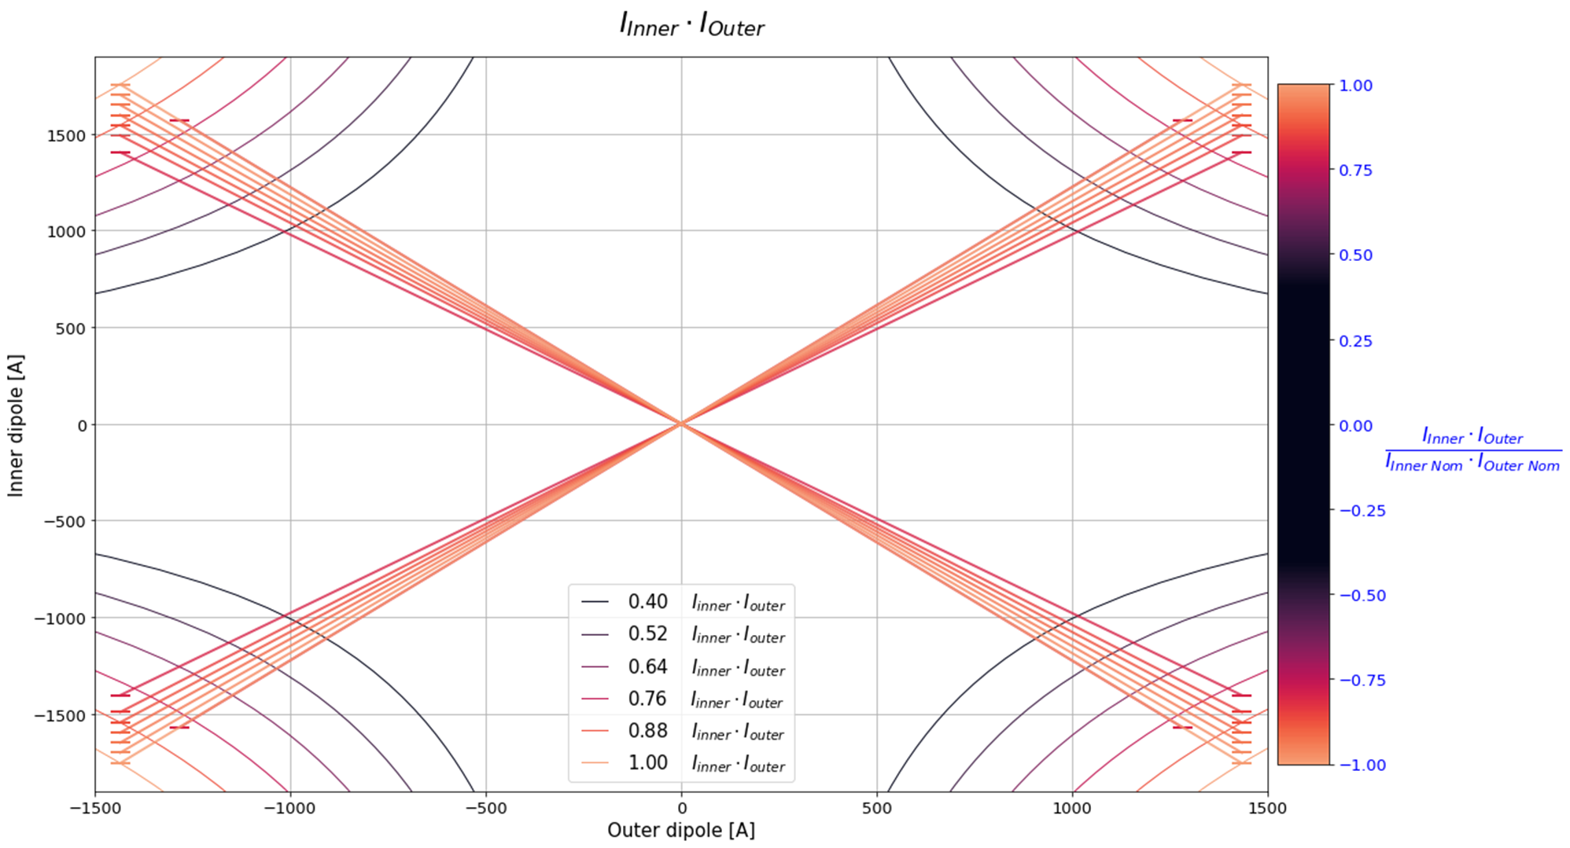
MCBXF performance
MCBXFB01 test results
Note:
all these powering
cycles without quench
Power test of MCBXFB01 (test eng.: S. Ferradas Troitino, WPE: J. C. Perez, PE: F. Toral, et al.)

Slide 4
MCBXF field quality
Specification on field quality is b3 in a range of ±20 units (EDMS 2051311)
Note that the total strength of MCBXFA+MCBXFB is 9.5 T m, i.e. 27% of the D1 or D2 strength (35.1 T m)
This corresponds to having a requirement of ±5.4 units os b3 on D1 or D2, but indeed today we have ±3 units
The main dipoles are in the shadow of the nested correctors, should not be the case
To place the nested correctors at the same level of D1/D2 we should have ±11 units of range on b3

Slide 5
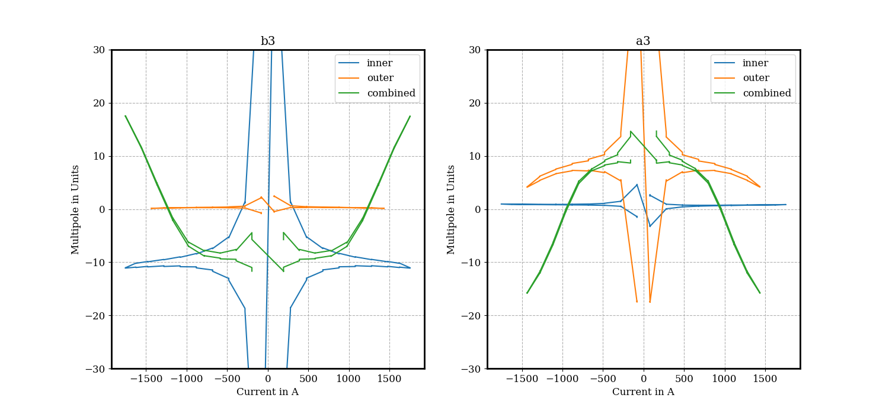
MCBXF field quality
The main limitation in b3 in the nested correctors is due to saturation
Measurements confirm that this is the best we can do

Slide 6
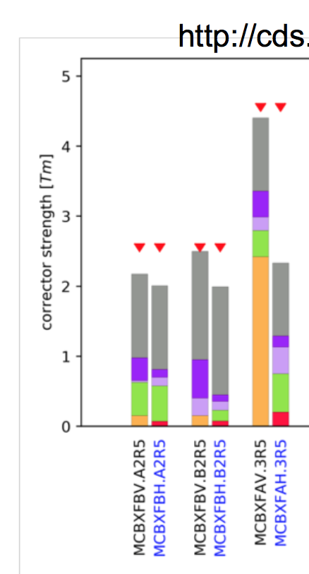
MCBXF field quality
A possible way out is to reduce by 10% the maximum field, leaving out the largest variance due to saturation
  Note that with this reduction anyway the magnet shall always be able to operate at ultimate, corresponding to present nominal, giving a worse FQ, but not requiring FRAS to cover small part of misalignent
  We would be obliged to use FRAS to cover the missing small part of misalignement only when operating at 7.5 TeV – or if the FQ issues are a bottleneck

