Slide 1


Field quality update: D1 and D2
E. Todesco, K. Suzuki, T. Nakamoto, M. Sugano, A. Musso, B. Caiffi, A. Pampaloni, S. Farinon, A. Foussat
7th September 2021

Slide 2
D1
First short model MBXFS1 (X-section 1)
  Iteration on cross-section for (i) compensating the coil size and (ii) correcting the effect of saturation that was not expected
Second and third short model MXBFS2 and MBXFS3 (X- section 2)
  Second iteration on cross-section to better center the multipoles (20 units of b₃ to correct)
Prototype MBXFP1
  Magnet completed in June, tested and reaching nominal current
  Room temperature and 1.9 K magnetic measurements at 12 kA (7 TeV equivalent) are available https://indico.cern.ch/event/1055554/
Results
  Large b3 reduction was successful: from 20 units down to 3.5-6.0 units
  At nominal current, we expect (measurements of protoype + model of KEK cryostat) about -6 units of b3 and 6 units of b5

Slide 3
D1 FINE TUNING
KEK is proposing a fine tuning of the cross-section, with a minor change of the wedges (less than 0.3 mm)
  This change should give in the series -2 units of b3 and 1 units of b5
  Document is being prepared https://edms.cern.ch/document/2612909

Slide 4
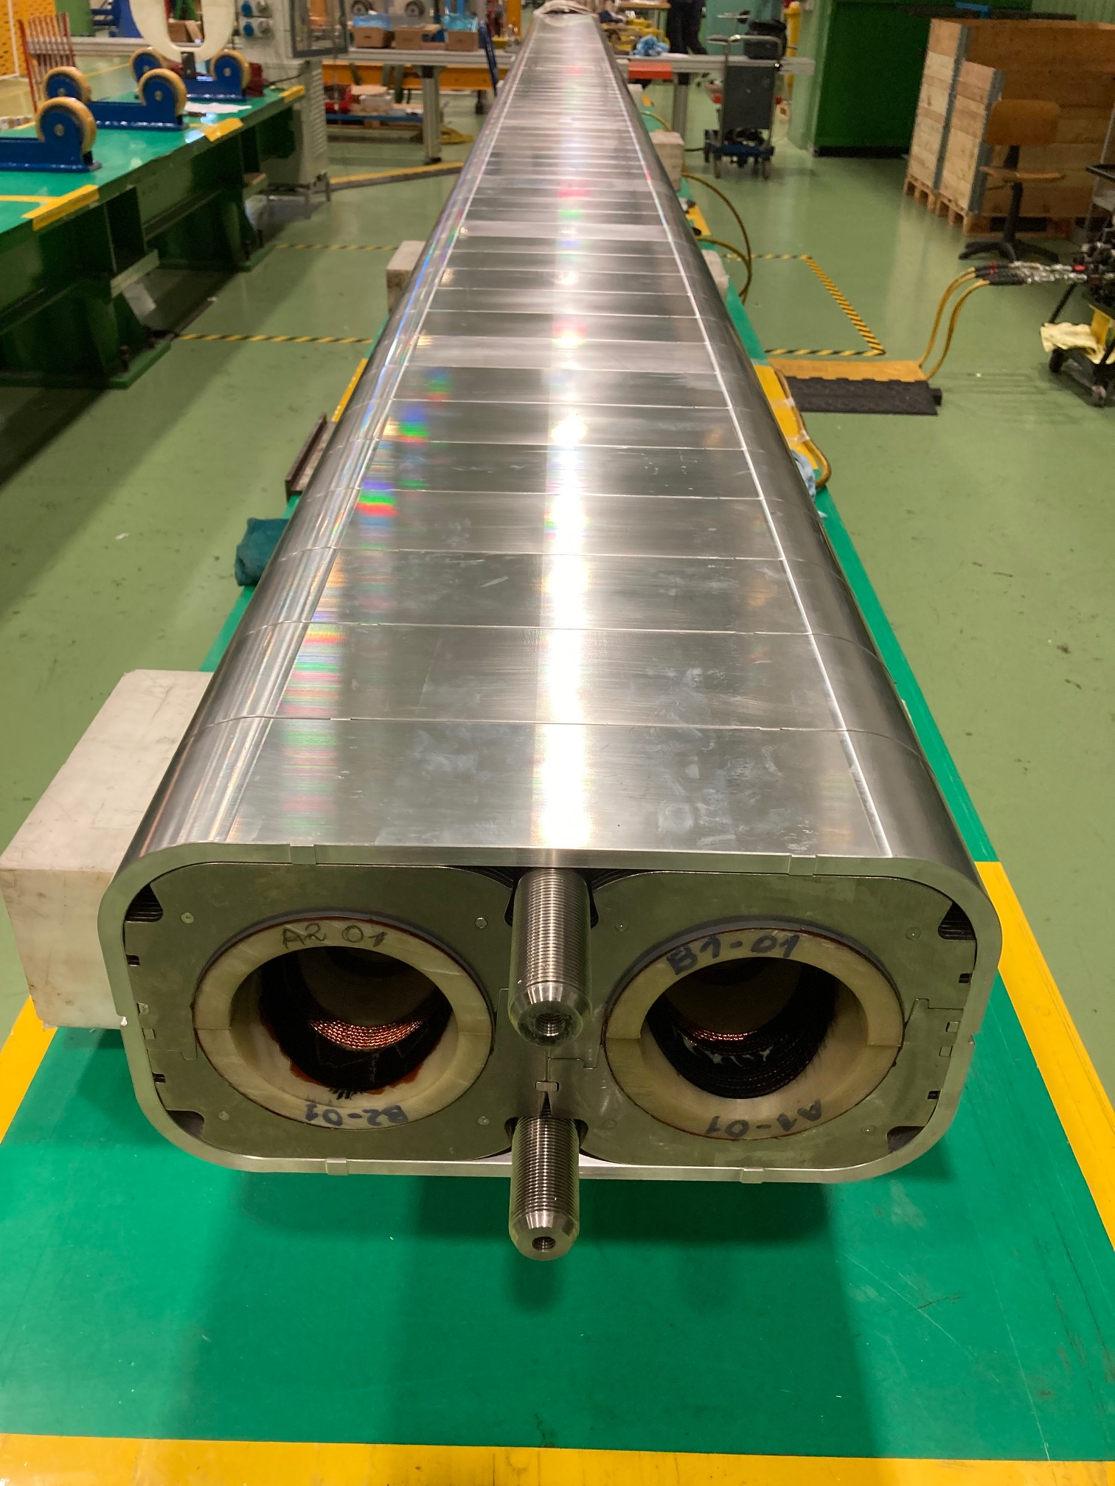
D2
D2 short model (one manufactured, two apertures)
  Design: -1.2 units of b₃, 1.5 units of b₅
  Large compensation of coil size (non nominal shimming)
  12 units of b₃ of …, 9.5 units of b₅
Fine tuning from short model to prototype (see EDMS 2472430)
  Reduction of 4 units of b₃ and b5
Prototype magnet has been completed in July
  Also in this case, non nominal shimming
Measurements of prototype done in stage of single aperture in May, both apertures together in July, and with iron yoke in August
  Based on these measurements, we expect at nominal current 9 units of b₃, 11 of b₅ https://indico.cern.ch/event/1068084/

Slide 5
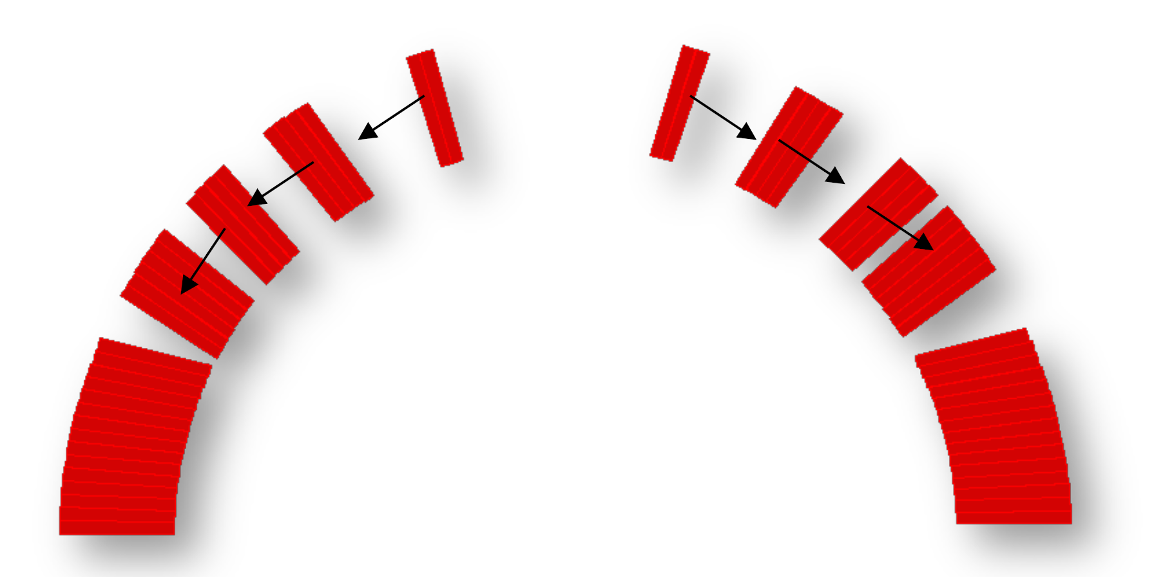
D2 FINE TUNING
INFN proposes a modification of 2 wedges out of 10, of less than 0.3 mm
This should allow landing on -2 units of b3 and 2 units of b5, and at the same time some insulation layers can be recovered since the coil is shorter – this guarantees more flexibility for the produciton

Slide 6
CONCLUSIONS
Both D1 and D2 will have a fine tuning of the cross-section between prototype and series magnets
The geometry change is smaller than the previous one done from short model to prototype (for D1 and D2) and from first to second short model (for D1)
Main reason is to correct a large systematic b5 (6 units in D1, 12 units in D2), impossible to correct via shimming, and also recover better values for b3
Results will be visibile in mid 2022 for D1 and end 2022 for D2 via room temperature magnetic measurements

