Slide 1
Aperture consideration of the BSRTM minimum mirror position
R. De Maria
Thanks to E. Bravin, R. Bruce, S. Fartoukh, S. Redaelli, R. Tomas
WP2 Meeting 7/9/2021

Slide 2
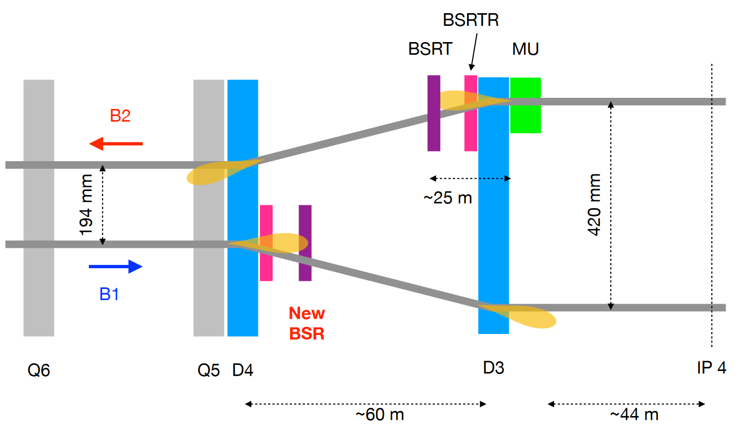
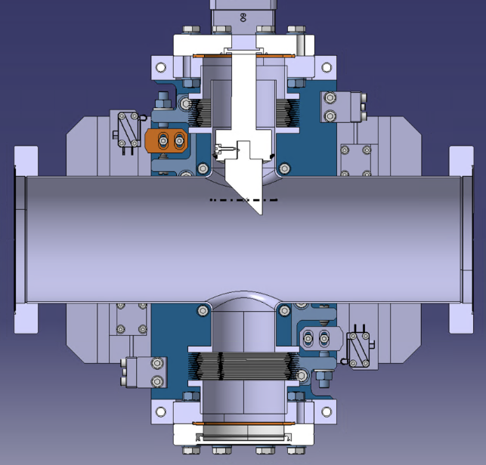
BSRTM
New synchrotron radiation monitor installed in Point 4: LHC-BSRTM-EC-0003-0-1.docx at
Operational requirement: mirror as close a possible to the beam
Operational range: 10 mm to 40 mm from the axis.
Ideal position
Position Margin
Beam Margins
Ideal beam

Slide 3
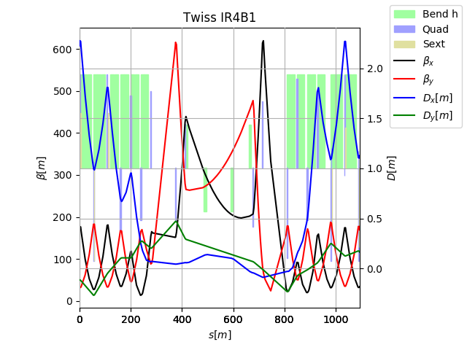
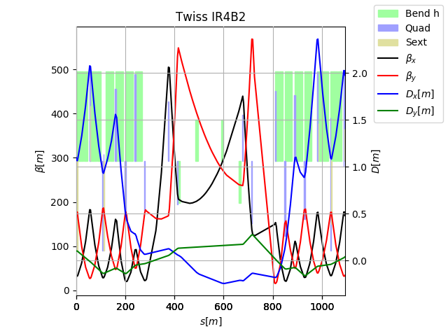
Optics consideration
HL-LHC
Position | DCUM [m] | From IP4 [m] | From beam axis [mm]
Non IP side | 9897.9672 | 99.114 | 135.61
IP side | 9898.5382 | 98.543 | 136.51
HL-LHC and Run2 optics are similar. No optics change foreseen in the dogleg during the cycle.
One can assume:
Β_{x}<~400 m (based on 380m on present optics adding some margin as optics can still evolve)
|D_{x}|<~20 cm (can be smaller but depends on crossing bumps leaking which is hard to design for)

Slide 4
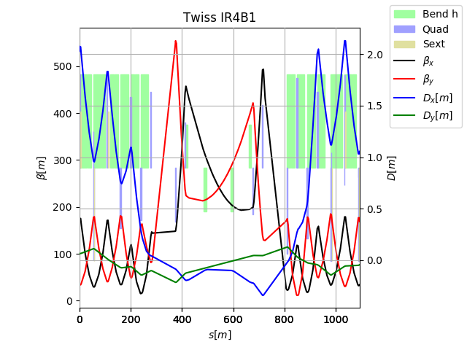
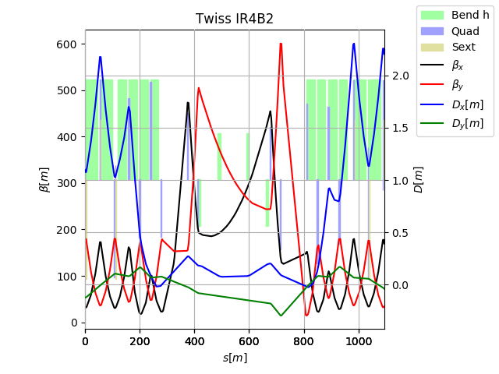
Optics consideration
Run2
Position | DCUM [m] | From IP4 [m] | From beam axis [mm]
Non IP side | 9897.9672 | 99.114 | 135.61
IP side | 9898.5382 | 98.543 | 136.51
HL-LHC and Run2 optics are similar. No optics change foreseen in the dogleg during the cycle.
One can assume:
Β_{x}<~400 m (based on 380m on present optics adding some margin as optics can still evolve)
|D_{x}|<~20 cm (can be smaller but depends on crossing bumps leaking which is hard to design for)

Slide 5
Aperture consideration
Parameters | Injection | Flat top
Energy [GeV] | 450 | 6500
Ref. emittance [µm/γ] | 2.5 | 2.5
Energy Error [%] | 0.0086 | 0.0002
Orbit error [mm] | 2 | 2
Sigma error [%] | 5 | 10
Dispersion Error [%] | 14 | 10
Min protected aperture¹ [σ] | 13 | 20
¹ Based on nominal bottlenecks on present optics, could be reduced to 12.6 σ and 19.4 σ defined in: Updated parameters for HL-LHC aperture calculations for proton beams CERN-ACC-2017-0051.pdf
Results | Injection | Flat top
Betatron component [mm] | 19.71 | 8.36
Dispersion component [mm] | 0.33 | 0.07
Orbit error [mm] | 2.00 | 2.00
Minimum beam stay clear [mm] | 22.04 | 10.42
Mirror position margins² [mm] | 0.50 (E. Bravin)?
Potential Operational settings | 22.56? | 10.92?
² Includes: alignment tolerances, mechanical tolerances, motor tolerances, interlock tolerances. Enrico proposed 0.5 mm based on 0.3 from survey alignment and 0.2 mm on mechanical structure.

Slide 6
Conclusion
Minimum beam stay clear proposed for BSRTM based on the current location and present optics
Operational settings for the mirror to be defined once alignment tolerances, mechanical tolerances, motor tolerances and interlock tolerances will be specified.
Mirror position during the ramp cannot be compute as aperture parameters during the ramp are not specified

