Slide 1
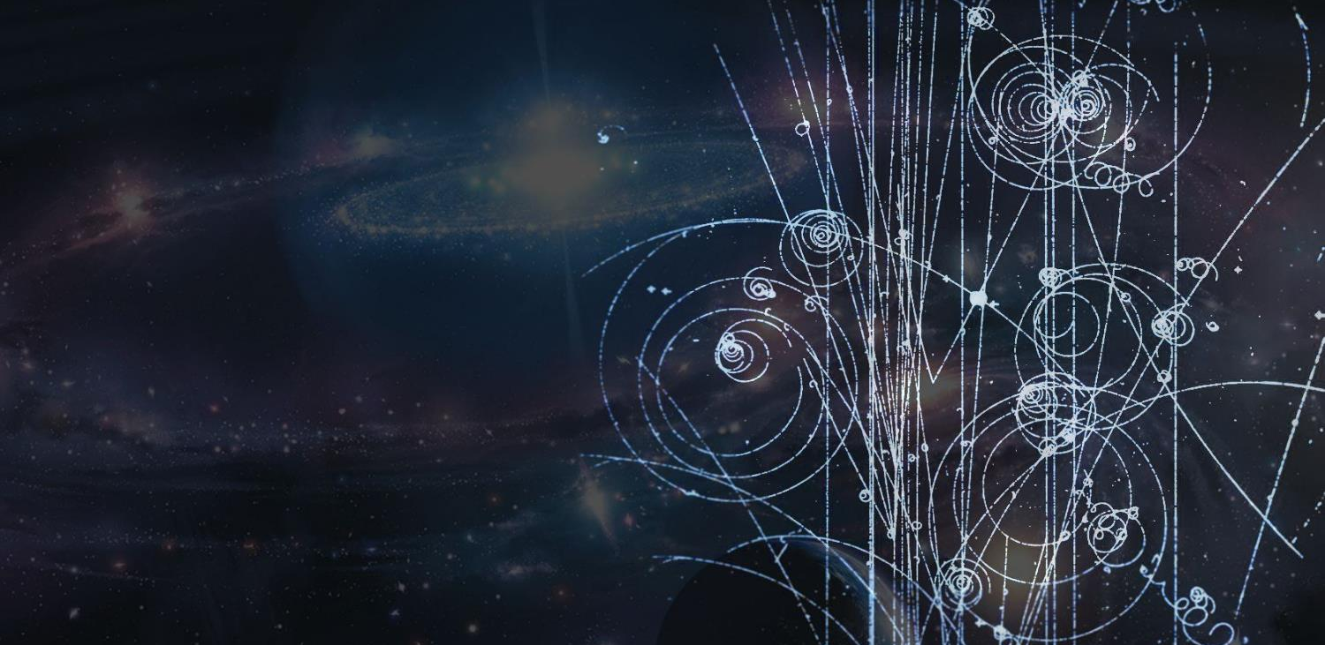
Quand l’infiniment
grand rencontre
l’infiniment petit
François Briard
Visites et organisation des événements
Ingénieur en informatique UNamur (1993)
La conférence commence bientôt

Slide 2
Votre conférence virtuelle
Format
Présentation (environ 40 minutes au total)
Questions-Réponses (environ 20 minutes au total)
Pendant la présentation
Posez des questions via le Q&A
Après la présentation
Merci de répondre à l’enquête sur la page Indico
Présentation et liens disponibles sur la page Indico

Slide 3
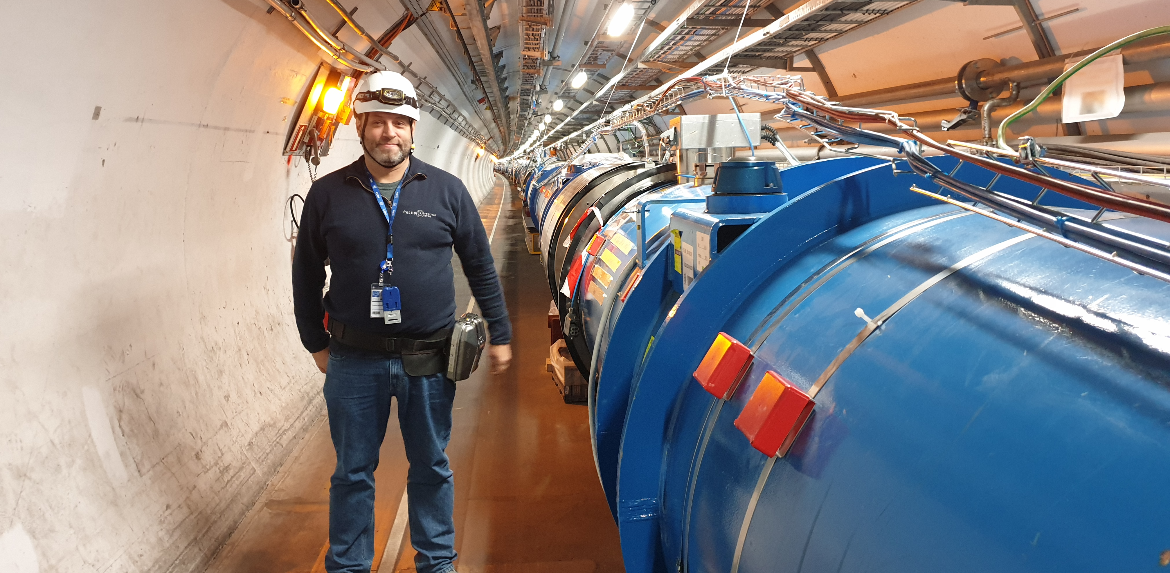
Que fait un informaticien
(allergique à la physique)
au CERN ?
Notes:
Present yourself
Your background
Your (dis)interest in science
Your current functions

Slide 4

Le CERN
C’est quoi ?

Slide 5
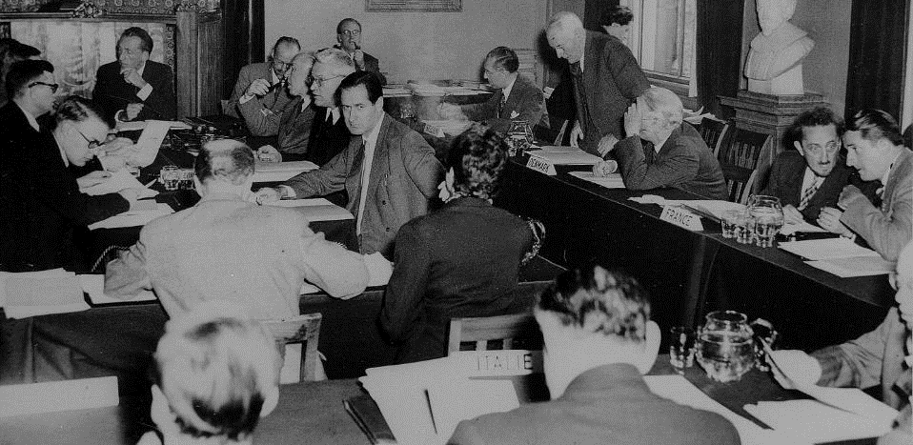

Que signifie « CERN » ?
1953
Notes:
Ask the audience what they think «CERN» acronym stands for before showing the answer.
After WW II, fundamental research in Europe was not leading anymore.
Many scientists were flying away to the United States.
In order to stop this movement, eminent scientists gathered in meetings to setup a structure to continue fundamental research in physics in Europe.
They were gathered as a «Council» which means there were just holding meetings and they did not (yet) had a lab or led experiments.
The images are from Amsterdam meeting in 1953 when the CERN convention was signed.

Slide 6
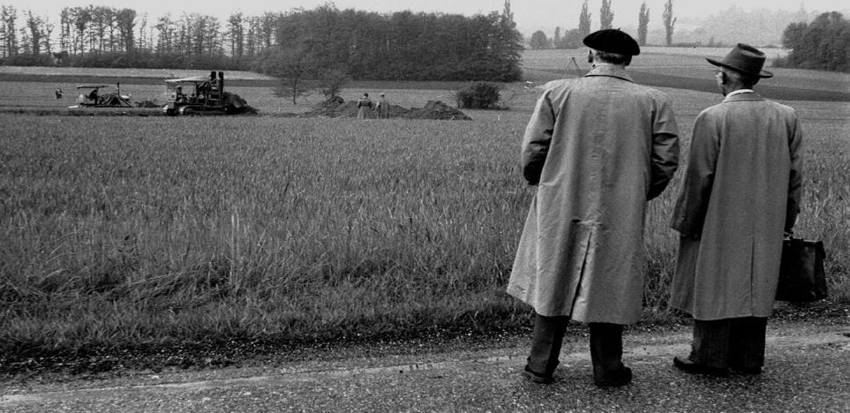
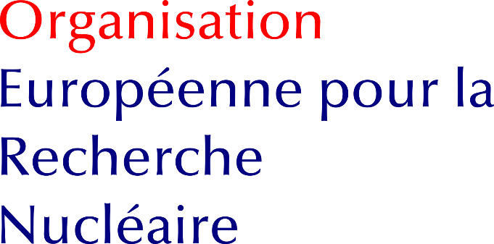
Que signifie « CERN » ?
1954
Notes:
It is decided to build the «European Organization for Nuclear Research». It comes into existence in 1954.
Geneva is chosen for its central location, the neutrality of Switzerland, the International visibility.
International Organization format was chosed to guarantee neutrality and independance.
The Organization, unlike the Council, has labs and has research activties.
But as the Organization is still «led» by a Council, the CERN acronym was kept.

Slide 7
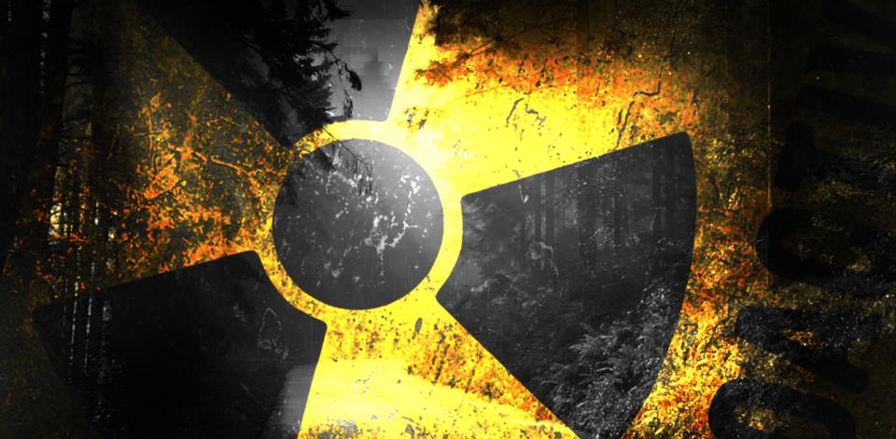


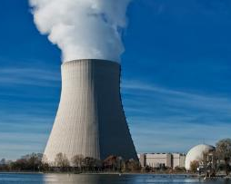
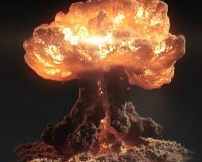
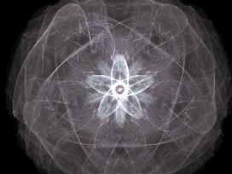
Nucléaire?
Laboratoire européen pour la physique des particules
Notes:
(you can question the audience for each image: do we produce electricity? do we produce bombs? Etc.)
The word «Nuclear» should not be misunderstood:
- CERN does not produce electricity (but consumes a lot)
- CERN does not produce military applications out of nuclear power (forbidden by CERN convention, and, anyway, all research results are made publicly available and there are scientists from many countries in each experiment… therefore no risk that exclusive military applications are developed).
- CERN studies the structure of matter. In the 50’s, the nucleus is the main object of study about matter. The word «Nuclear» comes from that.
Nowadays CERN is studying the components of the components of the nucleus. Therefore CERN can use (after being allowed by the Council) an alternative «branding» which is more accurate and less open to interpretation: « European laboratory for particle physics »

Slide 8
Le CERN
C’est qui ?
Notes:
Who is behind CERN?

Slide 9
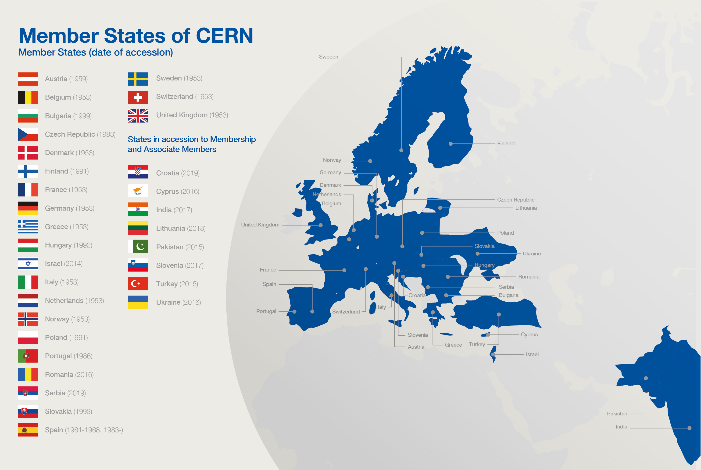






Etats membres
Associés
Budget (2020)
1,168 milliard CHF
1,108 milliard EUR
LHC
Notes:
First CERN is funded by 23 Members States and 8 Associated Members.
Each country participates proportionnally to GDP.
The total budget corresponds to about the price of a cup of coffee (but Swiss price!) per inhabitant per year.
The budget allows CERN to fulfill its main mission: build accelrators, but also maintain site, pay energy, personnel etc.

Slide 10
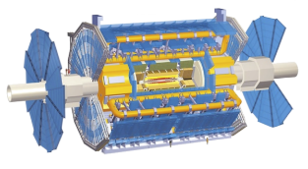






Collaborations
ATLAS
En réalité, ATLAS compte
44 pays
261 instituts
8442 participants
et il y a 261 collaborations actives en 2020
Notes:
Second, in addition to Member States, any country (see USA and China on the illustration but there are many more) can join CERN activities through scientific «collaborations».
A collaboration is an agreement with many differents research institutions (universities, national laboratories etc) to put resources in common: money and people. Each institution decide which collaboration they want to join or not. Not all countries participate to all collaborations.
Collaborations typically plan, design, build and operate an experiment (usually a detector)l
There are dozens of collaborations/experiment at CERN even though 4 of them drive most of the resources, the 4 LHC experiments.
The collaboration must of course first get approved by CERN Scientific Policy board.

Slide 11
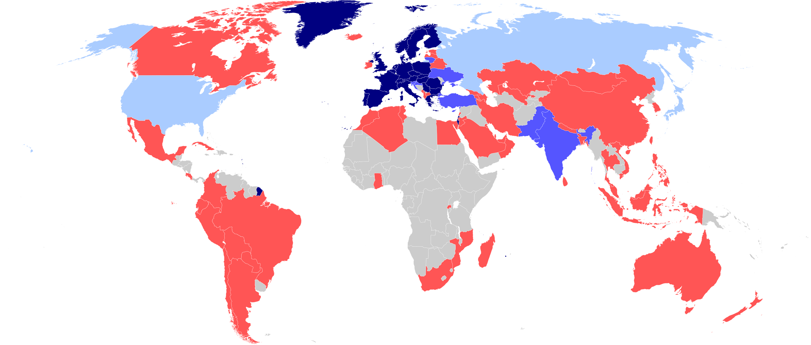
Une collaboration mondiale
23 membres
8 associés
3 observateurs
61 avec accords
Notes:
Number of countries involved in CERN activites at various levels

Slide 12










20 000!
Combien de personnes?
2 600 titulaires
800 boursiers
& apprentis
550 étudiants
15 000 utilisateurs
2 000 entreprises
extérieures
Notes:
CERN employs «only» 3400 persons (Staff, Fellows, Apprentices). In which there are «only» 70 research physicists (you can ask the audience if they can guess this).
Fellows and Apprentices are here for a first employement experiences.
The number of students can vary from 300 to 600 depending of the time of the year. It’s mostly university students.
The core population of CERN is made of about 15’000 «users», called like that because they are here to «use» CERN’s facilities.
They are NOT employed by CERN and come in the frame of the collaborations.
They are not all the time at CERN. Some spend 5% of their time at CERN (a few days a year), some spend 100% of their time. It really depends on their function in the collaboration, on the need for them to be on site, or, on the other hand, the possibility for them to work remotely.
Given the size for CERN’s population, many services are externalized (mail, transport, restaurants, etc) to firms.

Slide 13
Le CERN
A quoi ça sert ?

Slide 14

Recherche fondamentale
Notes:
CERN’s goal is FUNDAMENTAL research, not APPLIED research.
CERN is not to improve the way electricity is produced or rockets are launched.
CERN is to help answering questions and for a better understanding of the Universe.

Slide 15
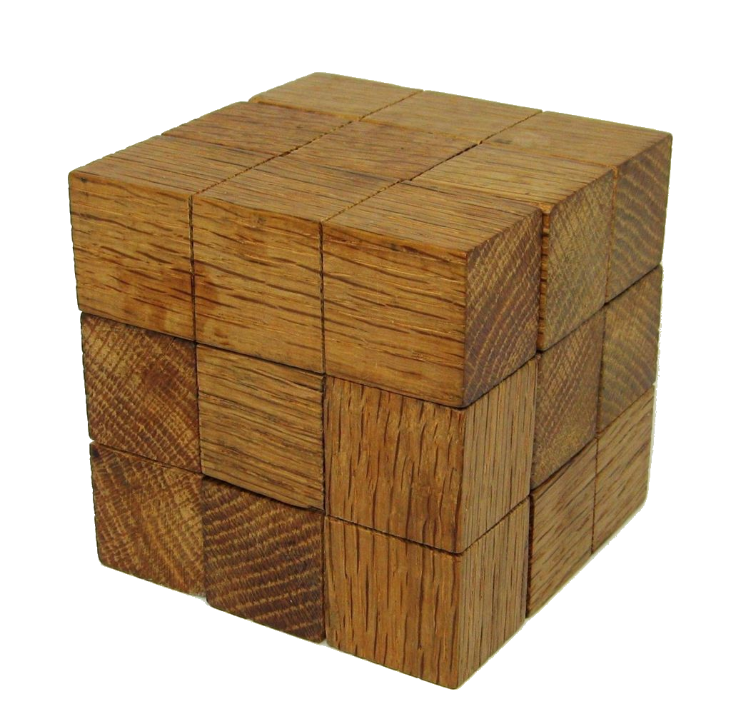
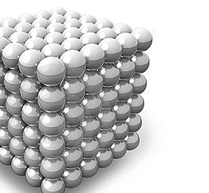
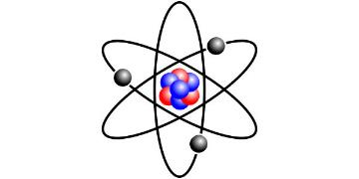
De quoi est composée la matière ?
?
u
u
d
atome
électron
noyau
proton
neutron
quark
IVe - Ve
av. J-C
Fin du
XIXe
Début du
XXe
Années
60
Notes:
Let’s take a sample question: what is the matter made of.
In history, usually, theorists came with ideas (out of their imagination, out of maths…) then, in a second phase experimentalists were proving or disproving the theories.
Democritus (460 BCE – 370 BCE) proposed to cut things into halves, then again and again until you have an indivisible object (ἄτομος in Greek). Nice theory but impossible to prove until technology evolves.
By the end of 19th Century, scientist found out that «Atom» was not a good name as it was splittable in nucleus and electrons orbiting around it.
Then it was found that nuclei themselves were made of «hadrons» (Protons and Neutrons).
That was the understanding of matter when CERN was created, hence «Nuclear» in its name
In the 60’s (CERN is already a few years old) it was found that
Currently we think that electrons and quarks are «fundamental particles» i.e. they are not made of something else. Or are they? History shows that scientific research allows to look further and to reconsider the previous «discoveries». It’s an endless process.
Finish with a little poll with the audience, don’t be shy, there is no wrong answer:
Who believes there is an inner structure in the quark, still to be discovered?
Who believes there is no inner structures and that we have found the ultimate fundamental particles?
….
There is in fact a 3rd option: who believes we don’t have a clue but labs like CERN will help finding out?

Slide 16
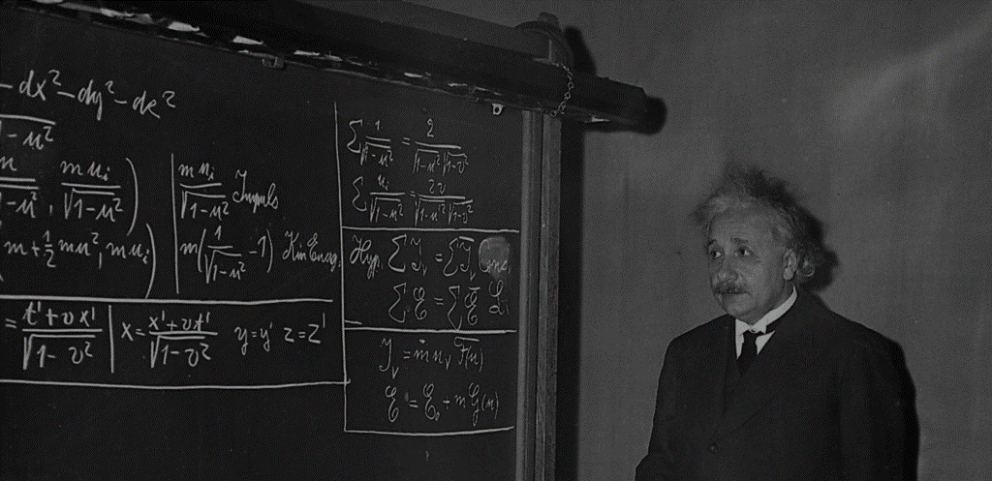
Vérifier des théories
Notes:
So… CERN is here to check theories…

Slide 17














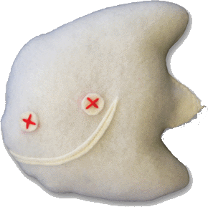



Le modèle standard
Images: www.particlezoo.net
LEPTONS
QUARKS
MATIERE
ORDINAIRE
ELECTRON
ELECTRON
NEUTRINO
UP
DOWN
MUON
MUON
NEUTRINO
CHARM
STRANGE
TAU
TAU
NEUTRINO
TOP
BOTTOM
4 forces
GLUONS
Force forte
PHOTONS
Force électro-magnétique
HIGGS
BOSONS
Force faible
GRAVITONS
Gravité
Notes:
Amongst many other, one is very largely agreed upon: the standard model.
It is a kind of particle dictionnary.
It predicts there are 12 matter particles. But we can see that only 3 of them are sufficient to create all atoms (up quark and down quarks make protons and neutrons hence all nuclei, if you add electrons you have any atom…)
What are the others? They are particles which exists briefly in extreme conditions of energy. They tend to decay into less massive, more stable particles like the ones on the first line.
At CERN we are reproducing these extreme conditions of energy (on a microscopic and harmless level) which allows us to produce and observe these particles. For a bery brief moment, but long enough.
In addition to the 12 matter particles, there are «force» particles which bound the matter ones together: gluons «glue» together the up and down quarks in protons and neutrons, photons are exchanged between electrons and nuclei making the electron orbit around it, W and Z bosons which are important in nuclear reactions were first observed at CERN in the 80s, only the Graviton has never been observed so far.
To be complete, for every particle, there is an «antiparticle». This is a particle with the same mass but with an opposite electric charge a bit like a reflection in a mirror.
With antiparticles you can make antiatoms, therefore antimatter.
Have you every manipulated antimatter? I hope not as matter and antimatter when they get in touch anihilate with 100% energy release. That means that 1g of matter put together 1g of antimatter would wipe out Geneva and its surroundings… So better not shake hands when you meet your antiyou.

Slide 18
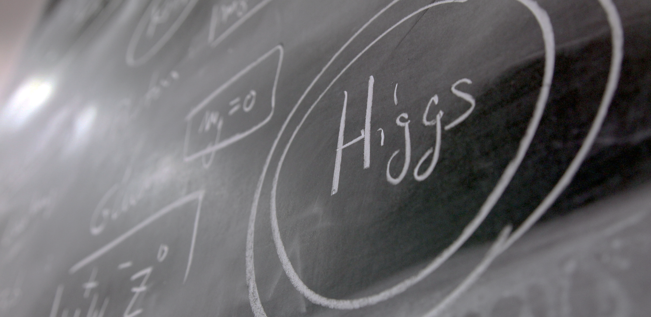
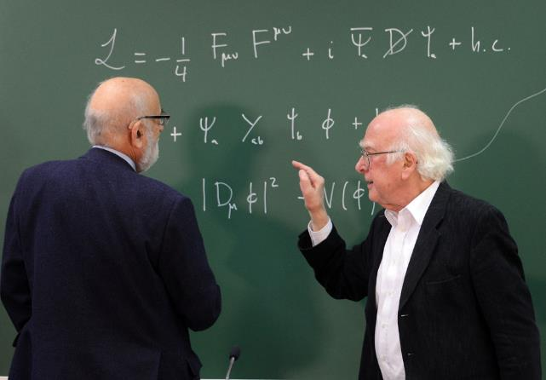
Répondre à des questions…
Higgs ?
Notes:
CERN helped proving certain theories like the existence of the «Higgs Boson».
This particle is responsible for giving its mass to all other particles. It is very important in the standard model.
It was predicted in 1964 by 2 Belgian physicists (François Englert and Robert Brout), then by the Scottish physicist (Peter Higgs) and others later.
If took 48 years to have the experiments (ATLAS and CMS) which proved its existence. The discovery was announced at CERN on 4th July 2012.
This discovery led François Englert and Peter Higgs (only surviving of the 3)to be rewarded by a Nobel Prize in 2013.

Slide 19
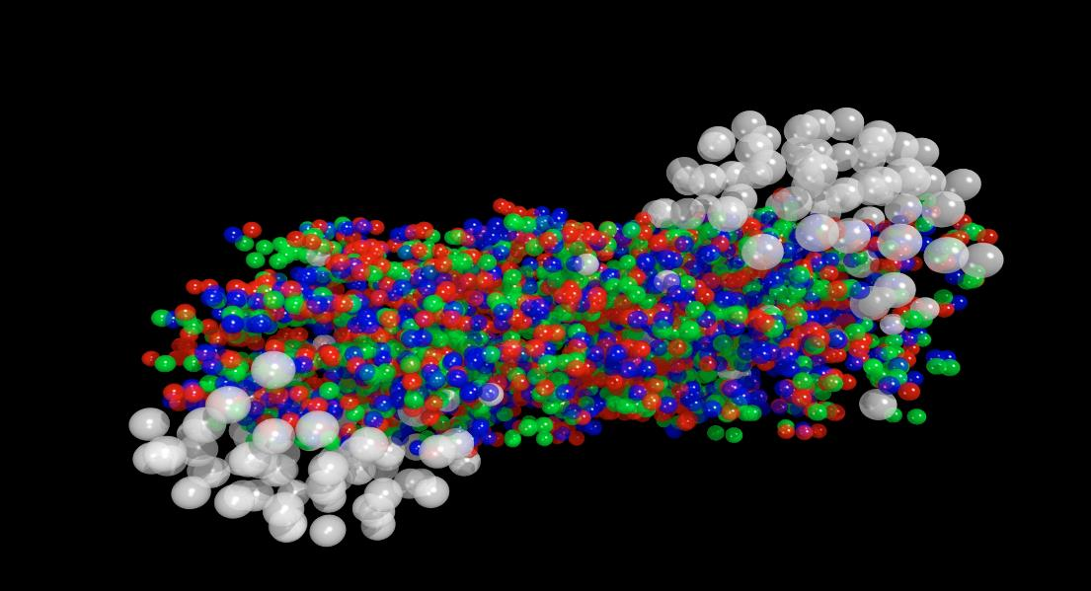
Répondre à des questions…
Le plasma quark-gluon ?
Notes:
One question CERN is trying to answer: theorists believe that at the very early moments of the Universe, quarks were not yet «gluing» together thanks to the Gluons. There was a primordial «soup» of particles called the «Quark-gluon plasma».
CERN’s ALICE experiment tried to reproduce droplets of this state of matter for very short time and observe it.
This will help us understand the way the Universe evovled and why it is as it is now.

Slide 20
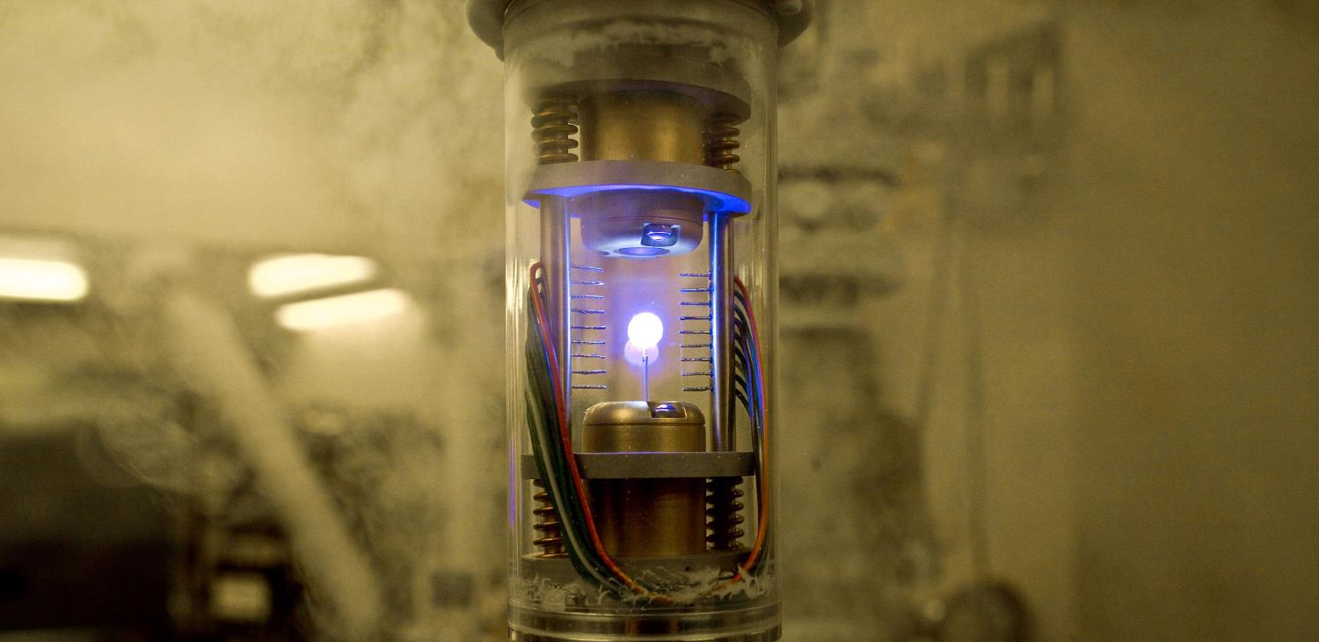
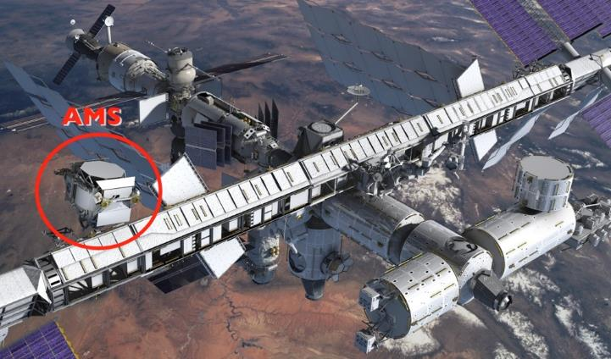
Répondre à des questions…
Antimatière ?
Notes:
Theorists believe that at the moment of the Big Bang, a theory telling that all universe is an expansion of a tiny space of pure energy which was transformed into matter, as many particles than antiparticles were created. It is also believed that the first instants of the universe was a gigantic anihilation of partcles and their counter anti-particles which were just created. But it seems that out of 1 billion particle-antiparticle anihilation, 1 particle survived… And that what makes the current Universe… apparently made only of matter. Why matter has won over antimatter? Are we sure there is no antimatter left from the Big Bang?
CERN is looking at that question with various experiments amongst which:
AD (Antimatter Decelerator) creates anti atoms and slows them down to eventually trap them (the image here is the one from Angels and Demons movie, our trap is bigger, sexiers and consumes much more energy)
AMS is an experiment on the International Space Station which looks for traces of primordial antimatter from space. It needs to be there outside of the Earth’s atmosphere where many particle collisions occur and produce briefly anti-particles. The AMS Control Centre is located at CERN and receives signals from the experiment.

Slide 21
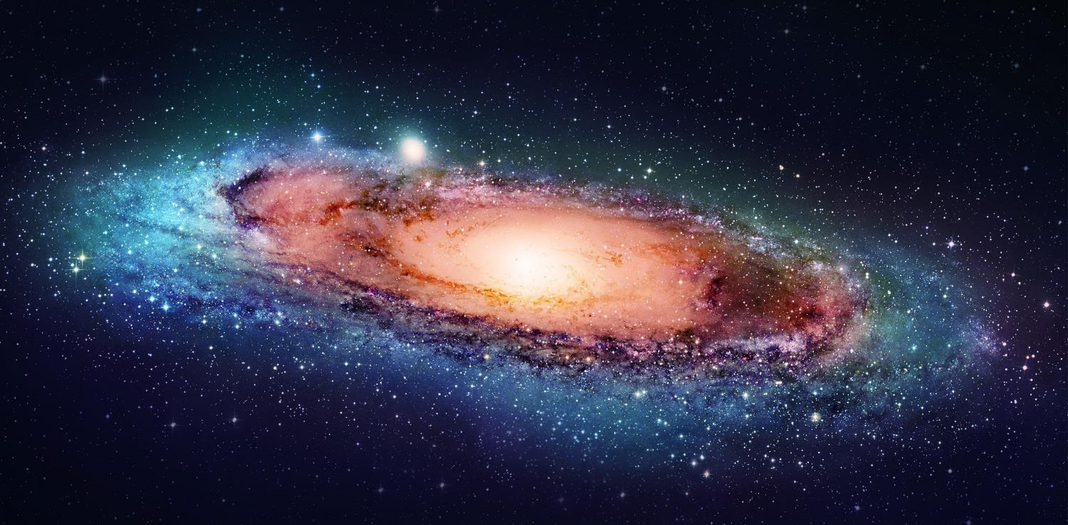
Répondre à des questions…
Matière noire ?
Notes:
But we have many more questions unanswered.
For example when we look at galaxies far away, and at their rotation speed, the estimated mass of the visible matter (stars, planets, clouds of gas etc) is not sufficient to «keep it together». At the speed it rotates, this galaxy should split away.
And the worrying thing is that is seems we are missing 95% of the needed mass…
What is 95% of the universe’s mass made of? Dark matter? Dark energy? There are many theories again (Supersymetry amongst others). CERN may help finding out more about it.

Slide 22
Le CERN
Comment ça marche ?
Notes:
Now we have many questions to answer. But how are we going to proceed?

Slide 23
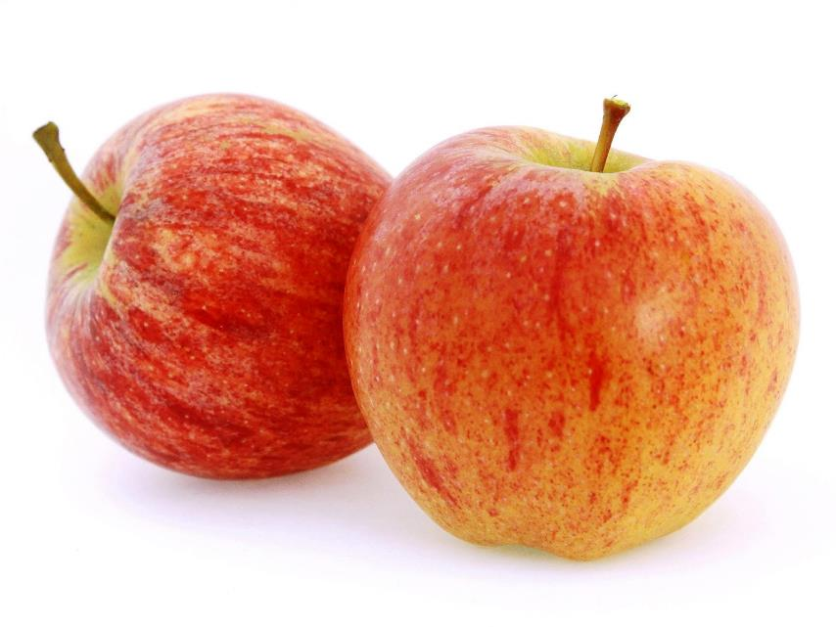
Accélérer, faire entrer en collision
Notes:
Most of CERN’s experiments are made of collisions. We take 2 objects and smash them together at very high speed.
Let’s take 2 apples. What happens if we smash them together?
At very low speed, not much. They will stop each other. That’s a «Level 1» collision.
At higher speed, they will damage each other, change direction, slow down. That’s a «Level 2» collision.
At very high speed (imagine we use apple cannons), they will explode. That’s a «Level 3» collision.
We have all experienced such collisions: with cars, bikes, ourselves (not «Level 3» hopefully).
At CERN we want to produce «Level 4» Collisions… This level is so high in energy, that out of the collisions will come… pears, bananas, strawberries, kiwis and… of course apples. Sound strange?

Slide 24
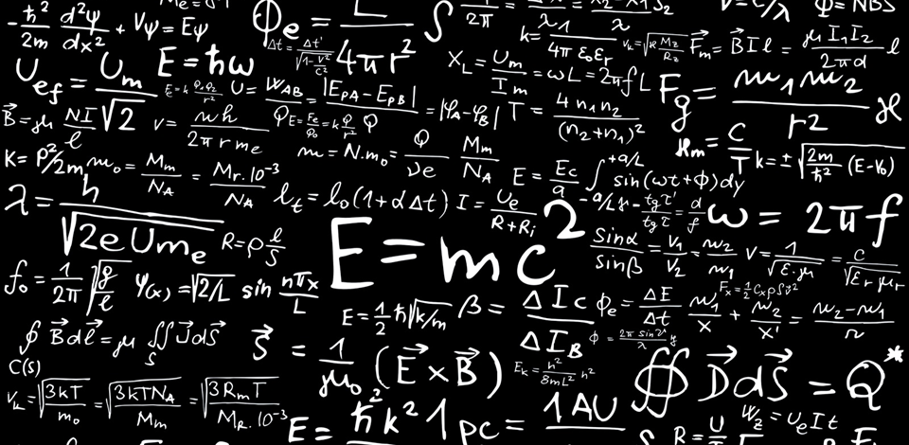
Notes:
In fact we are only applying the most famous physics formula.
Ask the audience if they can spot the most famous physics formula on this blackboard.

Slide 25
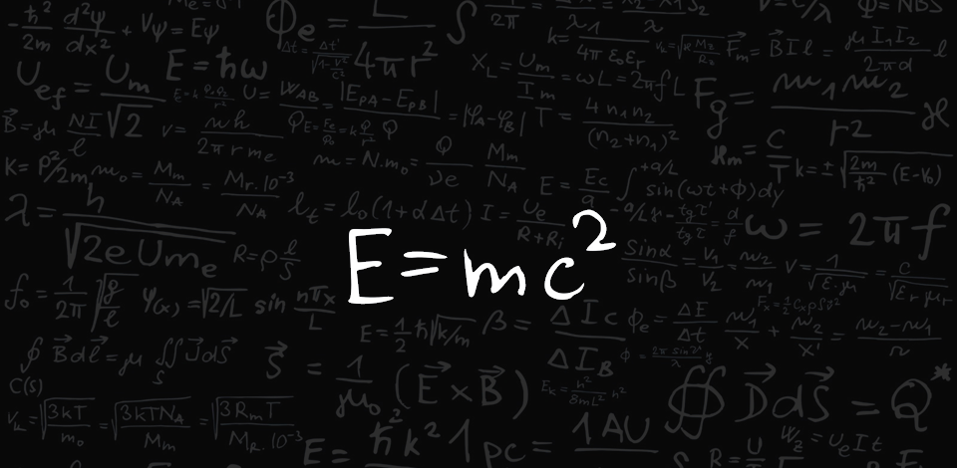
Notes:
Of course it was « E=mc2».
This formula tells us one thing: energy (E) can be transformed into (=) matter (m).
So why have you never noticed the production of other fruits when smashing 2 apples at very high speed? It’s because the «c2» in the formula. «c» stands for the speed of light (300’000 km/s in the vacuum). If you square it, that makes a very big number. And an equation is a kind of scale with 2 plates on both sides of the «=» sign. If you put «c2» on one plate, then you need a lot of «E» on the other plate to reach balance. If you take large objects like apples, no chance you will reach the level of «E» needed. We will never be able to assign our apples enough energy.
That is why we use smaller objects. The smaller the object to be smashed the easier it is to assign it a «relative» high level of energy. And that is why at CERN we do not have the «Large Apple Collider» but we have the «Large Hadron Collider». We will accelerate hadrons (protons and neutron), the components of the nucleus at an incredible level of energy.

Slide 26

Une énergie incroyable
7 TeV
L’énergie de
100’000’000’000’000’000’000’000 de protons
dans un seul proton
Notes:
Each proton we accelerate at CERN will eventually reach an energy of 7 TeV (Tera electron-Volt).
Does that sound familiar to you? Can explain what level of energy it represents in everyday life? (ask the audience)
This is the incredible energy of a… flying mosquito!
OK… For you and me of course this is insignificant. But remember that we grant this energy to ONE proton.
A normally well-fed mosquito is made of about 10^23 protons! It’s like we are trasnsferring the energy of ALL these protons to ONE if them.
So, at the proton level, this is very very energetic. Remember, it’s the amount of energy proportional to the size of the accelerated object which counts!

Slide 27
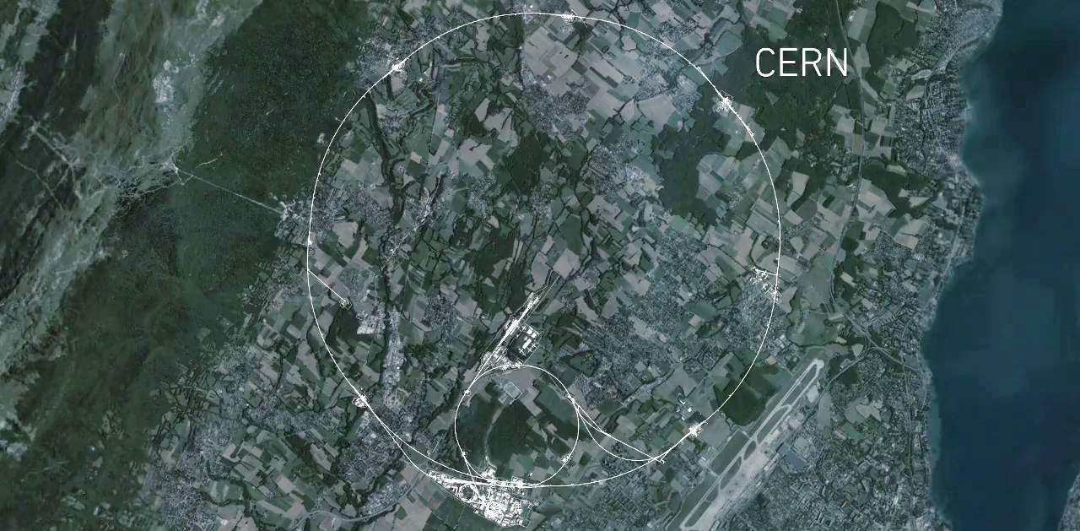


CMS
La plus
grande
machine
sur
Terre
Accélération
ALICE
ATLAS
LHCb
Notes:
This is a map of the complex of main accelerators of CERN.
The dotted line is the French-Swiss border.
The 2 main CERN sites are Meyrin and Prévessin (as big, but not as built nor populated)
The PS is the tiny 600m ring on the Meyrin site, the SPS goes accross the border and the LHC takes all the space between Geneva airport and the Jura (dark green on the left).
Acceleration occurs only in one point, over a few hundred metres. But this is sufficient as the protons pass through it 11’250 times per second
The other 4 red dots represent where the 4 detectors are located.

Slide 28
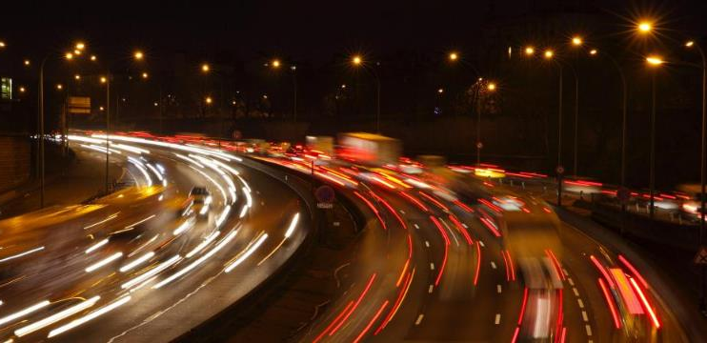
Le LHC, c’est un peu comme le périph…
Notes:
Explain the 2 counter rotating beams.
The main exception with Paris beltway (pictured here) is that at 4 points, we cross the 2 beams over.

Slide 29
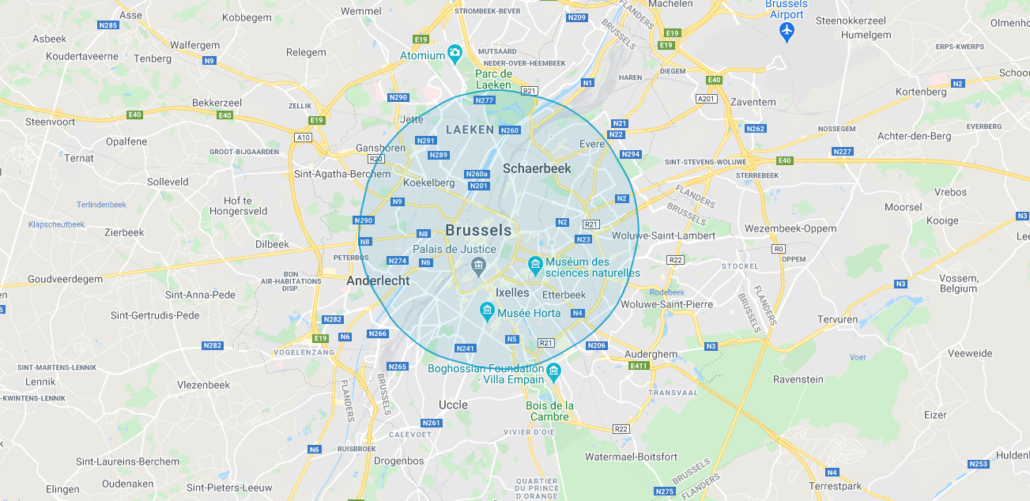
www.howlargeisthelhc.com
Notes:
Put here a map of the LHC in the city where your audience comes from.
This helps figuring out how large is the LHC in comparison to something they know.
You can create such a map on the www.howlargeisthelhc.com website. Don’t forget to select PS and SPS as well.

Slide 30
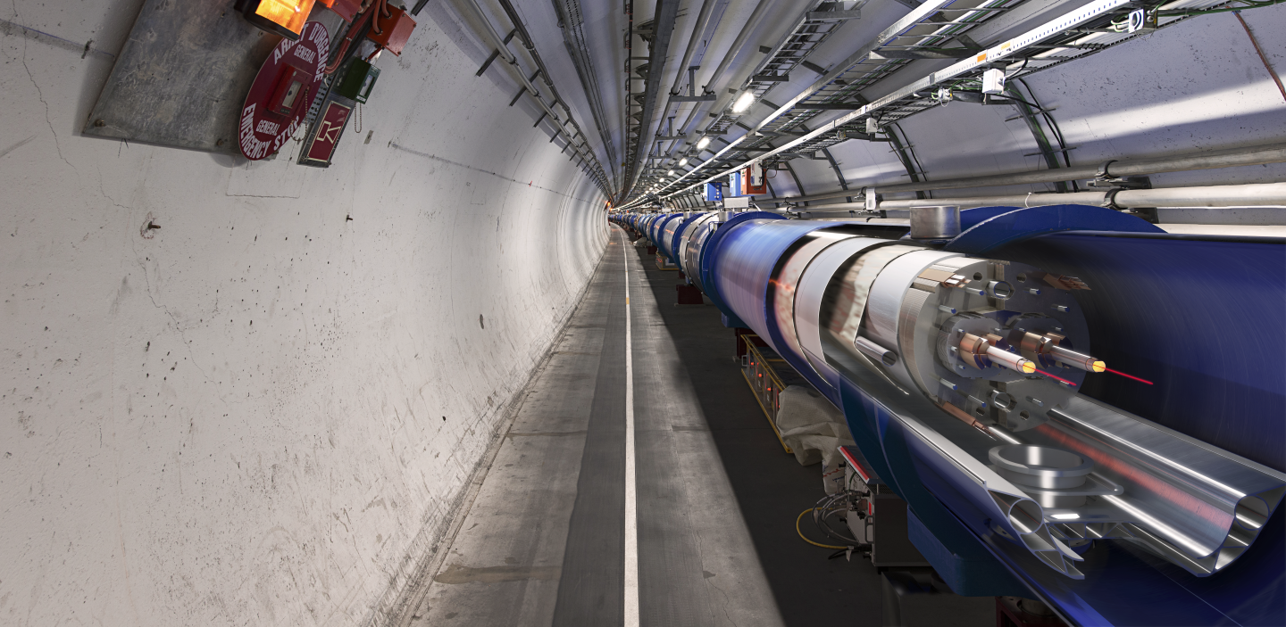
Les aimants
les plus
puissants
Notes:
The LHC is built underground, mainly for financial reasons (would have cost too much to buy all the land and would have been impractical anyway).
It also provide natural shielding of radiations for the population but also shielding from cosmic rays to the 4 detectors.
The LCH is mainly hosted in a 3m diameter tunnel containing mostly superconducting magnets and some accelerating devices.
You can see on the picture that the 2 counter-rotating beams are hosted in different pipes, making collisions impossible there.

Slide 31
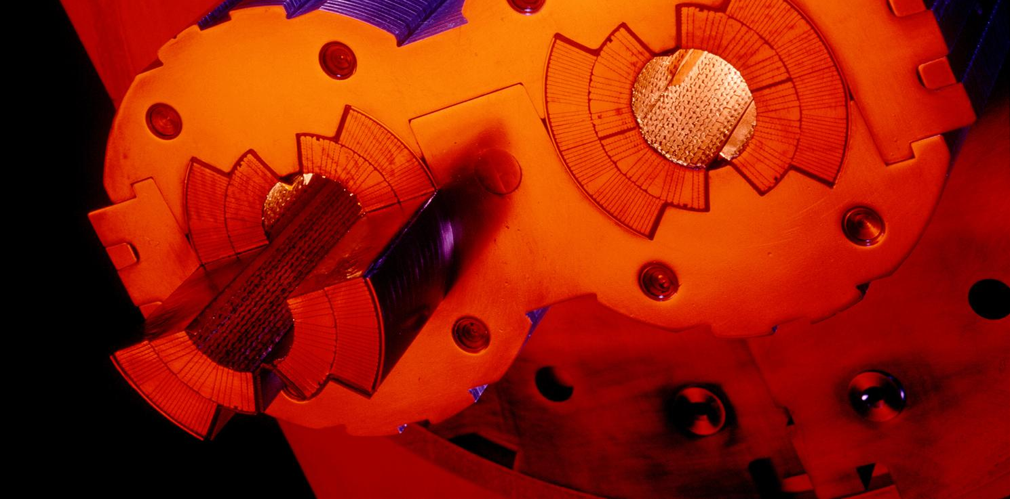
Le vide le plus extrême
Notes:
These 2 pipes need to be as empty as possible (otherwise protons would hit air molecules all the time).
Thanks to turbo-molecular pumps and other technologies, we reach a vacuum of 10^-13 atmosphere in the centre of the pipes: this is 10 times emptiers than on the surface of the Moon or as empty as in the solar system.
The magnetic field which curves the beam, is provided by the coils surrounding the pipes. As each beam holds as much energy as in a high-speed train, the magnets must deliver a tremendous magnetic field of 9 T (tesla). This equates to 200’000 times the magnetic field of Earth (ca 45 micro tesla)
For that, each of the small electric cableyou see around the vacuum pipes (1mm by 10mm section) a current of 11’000 amperes (in comparison in your home there is a current of about 20 amperes in the wires).

Slide 32
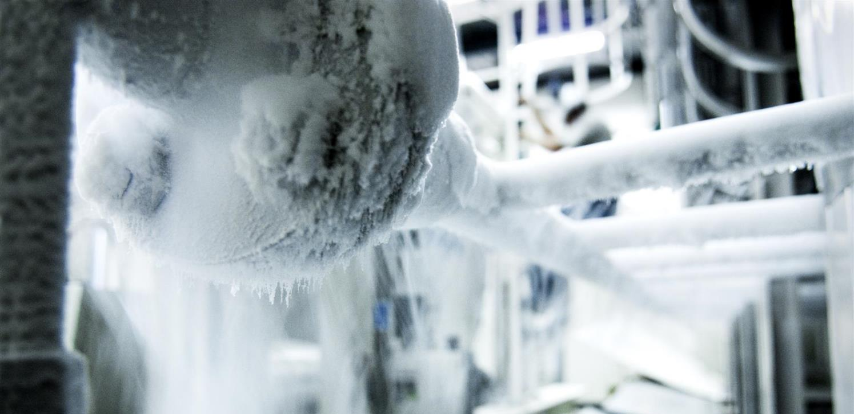
Le froid
le plus glacial
Notes:
That’s why we need to cool down the cables to the lowest temperature possible.
We have to reach -271°C (or 1.9° kelvin, which is 1.9° above the absolute zero).
At that temperature, the cables made of Niobium Titanium (NbTi) are «superconducting», it means they don’t heat up anymore as they have no electric resistance.
LHC is colder than the vast majority of the Universe whose average temperature is 2.725° kelvin (if you look for a «cool» place to work, CERN is a good one)
This is possible thanks to cryogenic facilities using 120 tonnes or 700’000 litres of Helium!

Slide 33
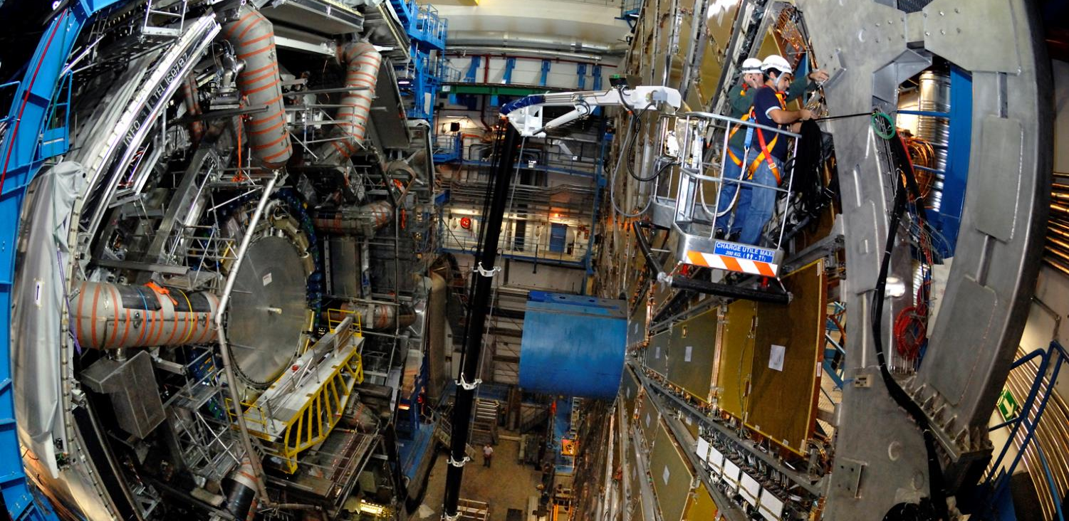
ATLAS
Notes:
Here is a real picture of ATLAS.
Noticed the man at the bottom?
ATLAS is a multi-purpose experiment looking for the Higgs Boson (which it has found in 2012), dark matter candidates etc.
It gathers 3000 physicists from 174 universities and institutes in 38 countries.

Slide 34
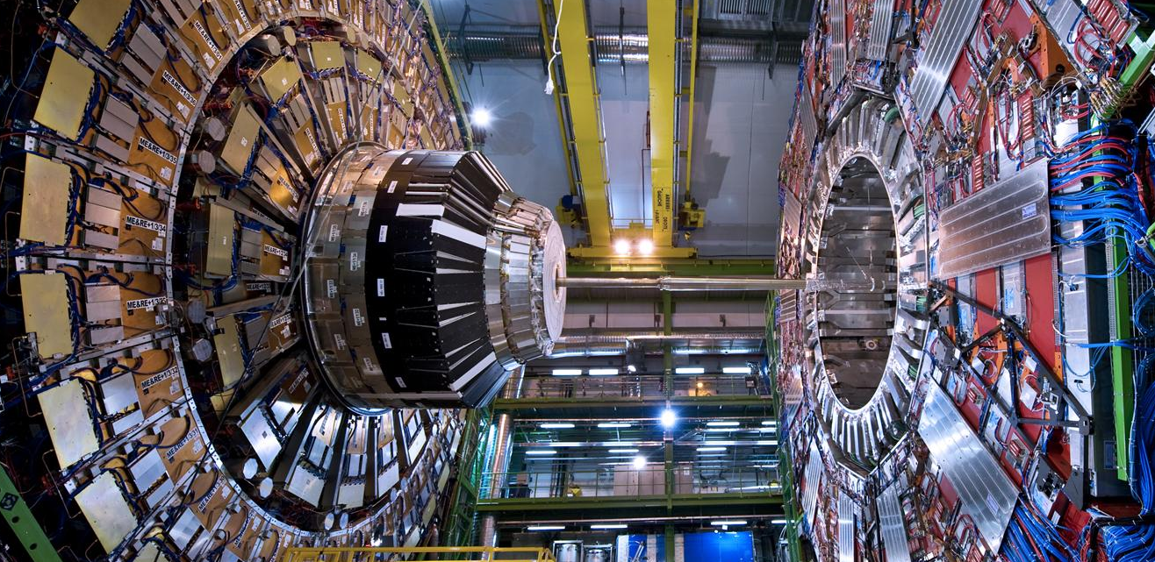
CMS
Notes:
Here is a CMS.
Like ATLAS, this is another multi-purpose experiment. It also discovered the Higgs Boson in 2012.
The C in CMS stands for Compact. Even though it does not look compact to most of you, this experiment is twice as small as ATLAS but twice as heavy: 2 times the Eiffel Tower (14’000 tonnes)!
It gathers 2600 physicists from 182 universities and institutes in 42 countries.

Slide 35
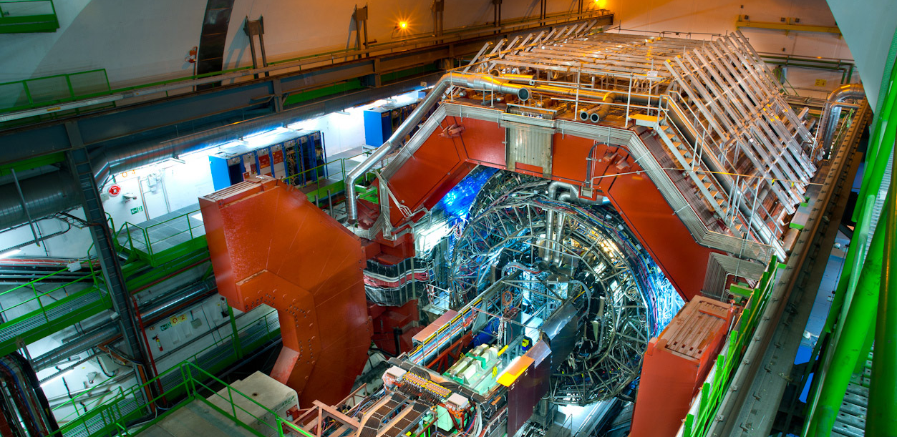
ALICE
Notes:
Here is a ALICE.
This experiment looks more particularly at the creation of the «Quark Gluon Plasma» state of matter which existed moments after the Big Bang.
For that it wait for the beams of Lead Nuclei which occur about 10% of the beamtime of the LHC.
It gathers 1500 physicists from 154 universities and institutes in 37 countries.

Slide 36
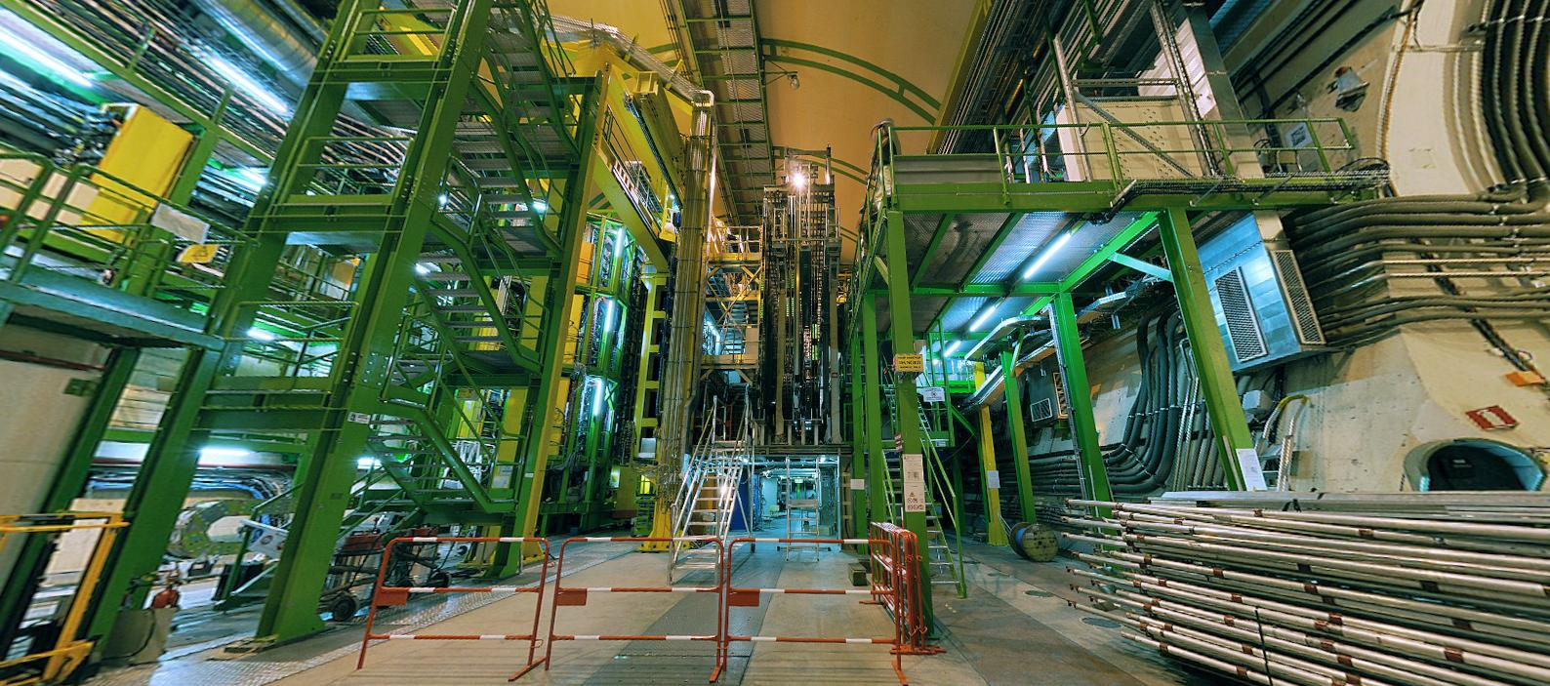
LHCb
Notes:
And the final experiment on the LHC is LHCb. Is is name after the «b» quark which it studies.
In fact LHCb studies the behaviour difference between the b quark and the anti-b quark.
It tries to find difference in the symmetry which may account for the lack of antimatter in the Universe.
It gathers 800 physicists from 69 universities and institutes in 17 countries.

Slide 37
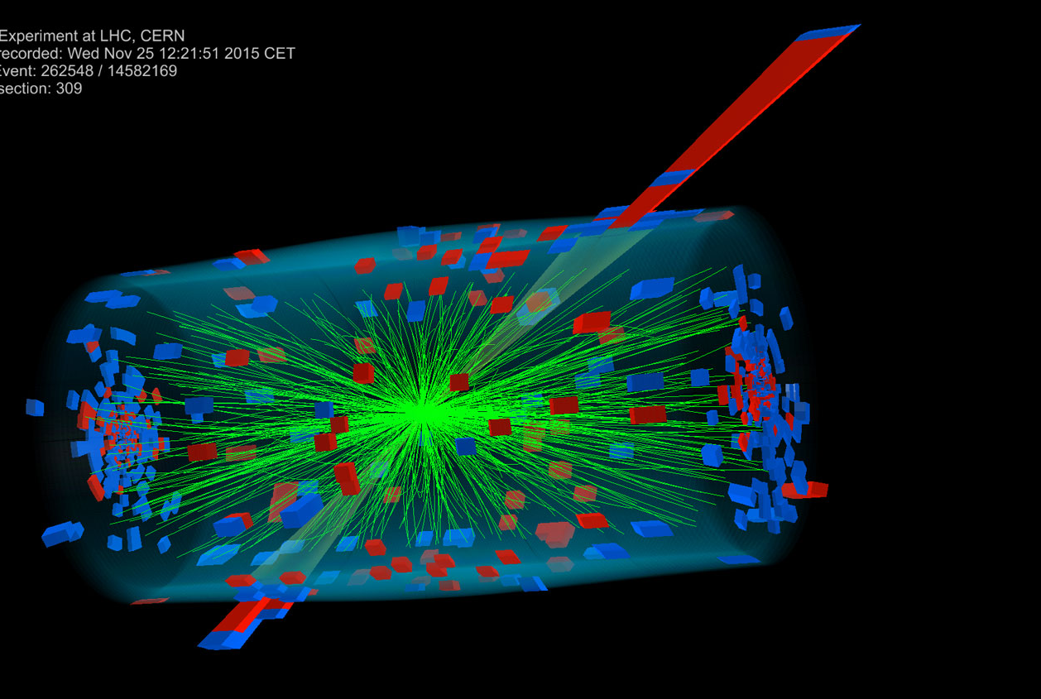
Des millions de collisions
Notes:
The 2 beams are circulating in separate pipes and in 4 places we cross the 2 pipes over so that collision occur there and only there.
We have built particle detectors which will observe and record the traces of new particles created in the collision.
There are so many protons and they go so fast that around 600 million collisions will occur every SECOND in each of the 4 detectors.
These detectors are a bit like huge digital cameras of about 100 Megapixel resolution. Guess the size of the SD card to store the LHC’s pictures?

Slide 38
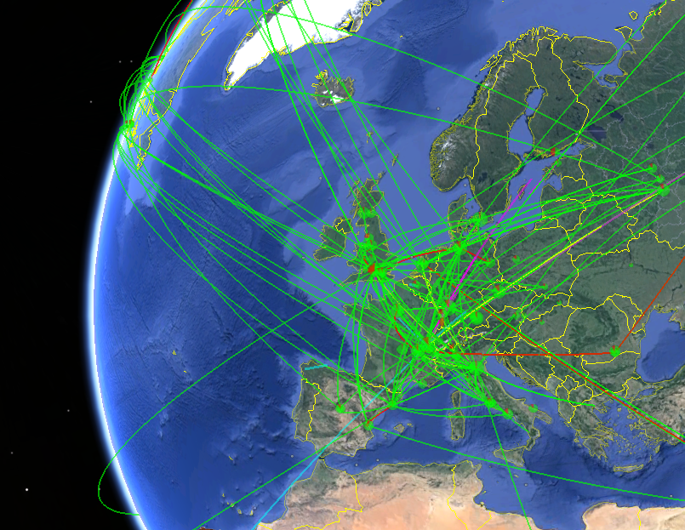
La plus
grande
grille de
calcul
Notes:
All these detectors will generate loads of data… about 1 PB (petabyte = million of gigabyte per… SECOND!)
Impossible to store so much data. Anyway not needed.
The event the experiments are trying to create and observe are very rare.
That’s why we make so many collisions but we keep only the interesting ones.
Therefore next to each detector is a «trigger», a kind of filter made of various layers (first electronic, then computers) which will select and keep only 1 collision out of a million average.
In the end will still generate dozens of Petabytes of data each year. We need more than 800’000 computer CPUs to analyze this data.
As CERN has only about 200’000 CPUS we share the date over more than 100 computer centre over the planet (usually located in the physics institutes participating to the LHC collaboration). This is the Computing Grid, a gigantic planetary computer and hard drive!

Slide 39
Le CERN
Ça change quoi pour moi ?
Notes:
That was «how» we make research at CERN.
You may now wonder if this is useful for you in your everyday life?
The answer is simply… probably not.
As explained earlier, fundamental research is not made for practical applications. It is there
But…
To make its fundamental research, CERN had to organize the largest scientific collaborative project, build the largest machine on Earth, build the coldest place in the galaxy, make the highest vacuum, build the largest and heaviest experiments, build the largest computing grid…
All these technological challenges ended up in new technologies which can find application on a much shorter scale…
Let’s review some of them

Slide 40

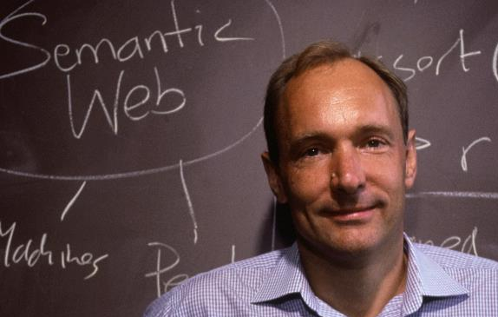
World Wide Web
Notes:
How do you share data and documentation amongst 10’000 physicists?
The internet was invented in the 70’s but was really not user friendly.
One man proposed a system to unify it in1989. He is Tim Berners-Lee and was working at CERN.
Like any technology developed by CERN, it was freely given to the World in 1993. Which made the Web a planetary star!

Slide 41
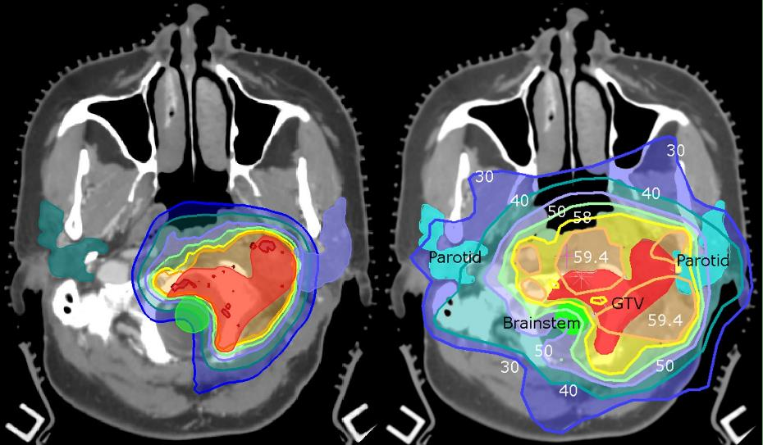
Applications médicales
Notes:
If you have brain tumor, you may try to use chimiotherapy to cure it. But the cure goes all over your body and damage healthy organs.
You may use radiotherapy, but this will certainly damage healthy tissues around the tumor (image on the right).
Or you can use proton therapy using acceleration techniques directly derived from CERN’s technology. Proton therapy will damage more precisely leaving healthy tissued untouched (image on the left).

Slide 42
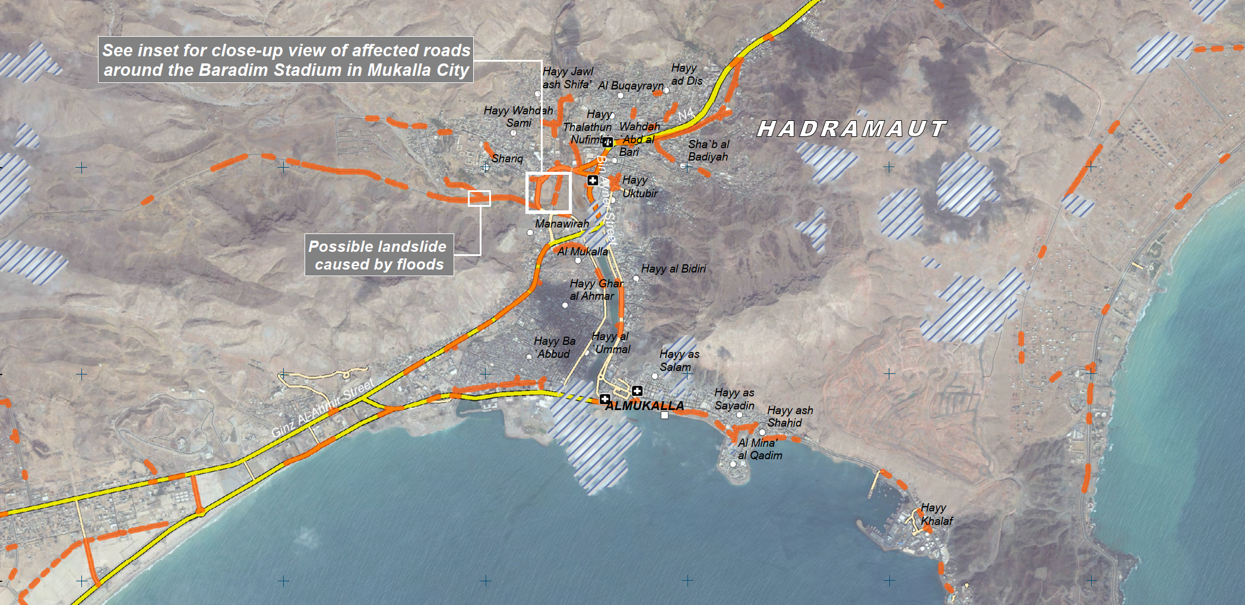

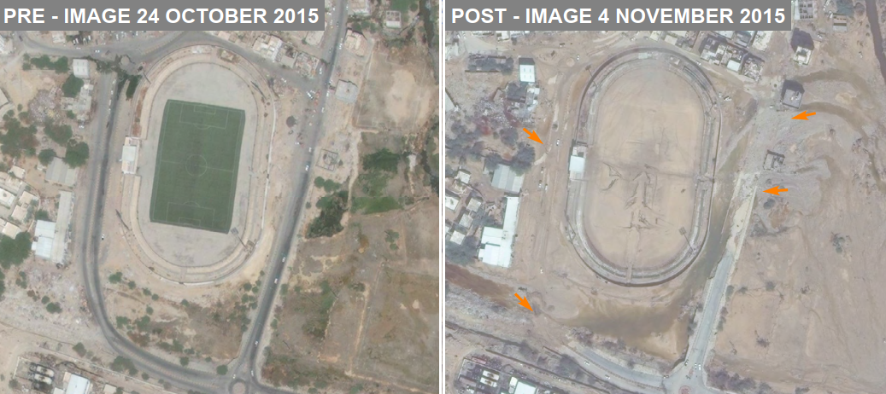
Missions
humanitaires
Notes:
CERN hosts UNOSAT, a UN agency specialized in the analysis of satellite images, especially comparing them before and after a natural disaster or a war.
This shows the report of analysis of satellite pictures taken in October 2015 and November 2015.
By comparing the situation before and after passage of Cyclone Chapala in and around the city of Mukalla, Hadramut Governorate, Yemen, it lists and highlights main and secondary roads affected by mud, debris and occasional standing water.
This helps teams on site to know where to put efforts first.
The power of Grid Computing allows to analyze very large territories in hours, instead of sending teams on the fields for days.
More information on https://unitar.org/maps/map/2298

Slide 43
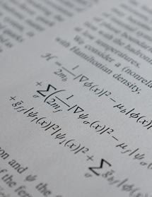
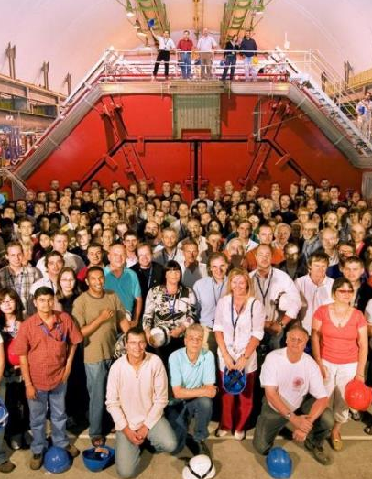
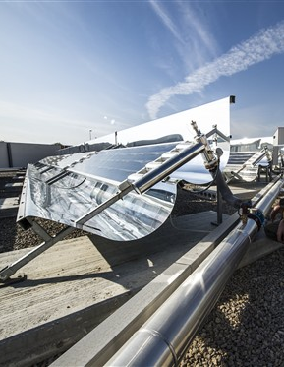
En un mot…
Recherche fondamentale
Plus grande
collaboration
scientifique
internationale
Retombées
technologiques
pour la
société
Notes:
In a nutshell:
CERN is a organization devoted to fundamental research
It hosts the largest international scientific collaborations
By facing technological challenges, CERN develops technologies which are useful for society.
(the picture show solar panels on top of Geneva airport, using the LHC vacuum technology to make them more efficient)

Slide 44
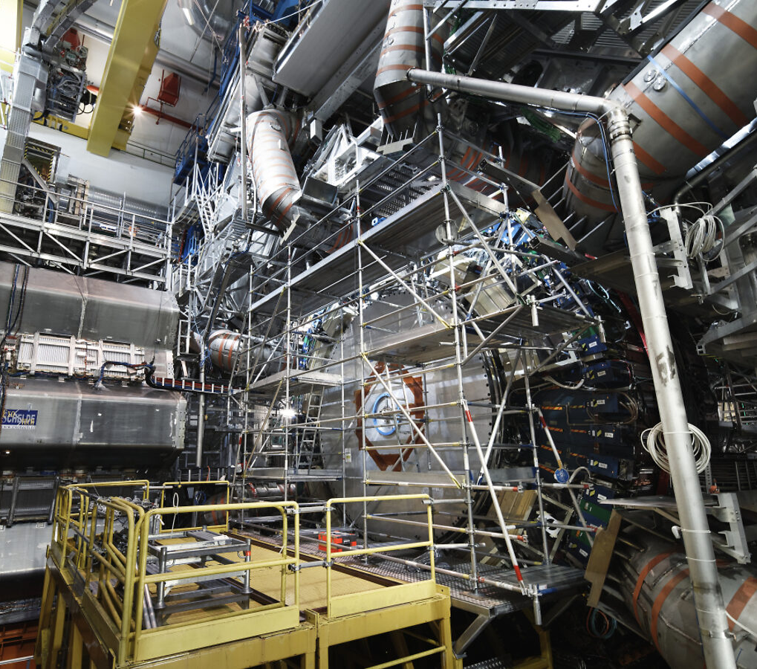
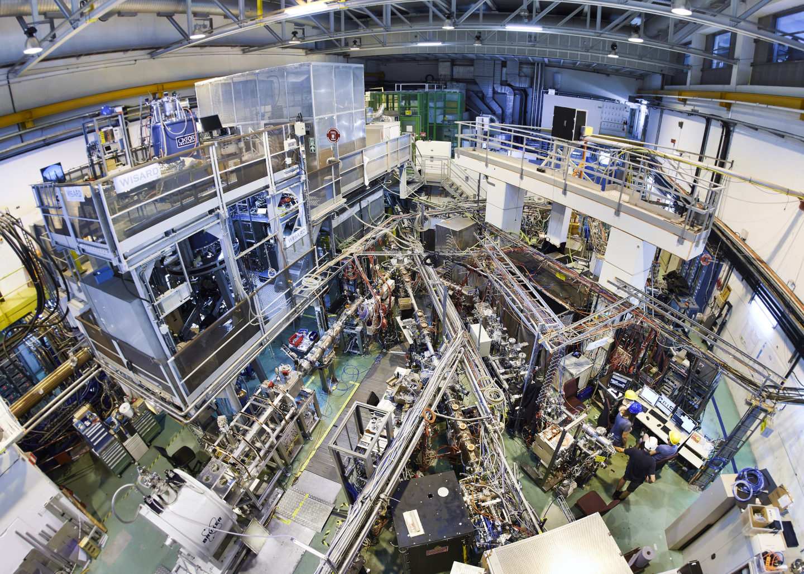
Visites virtuelles
15 septembre 2021 13h00
Le détecteur ATLAS
17 novembre 2021 13h00
L’usine à antimatière

Slide 45
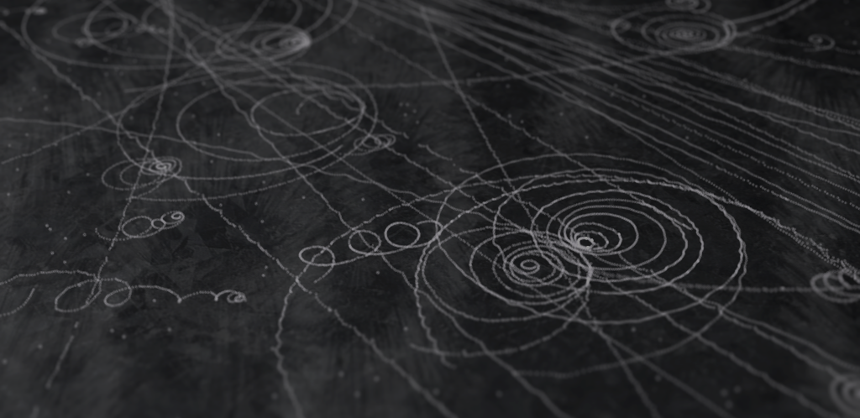
Merci de votre attention !
Pour aller plus loin…
home.cern
visit.cern
careers.cern
francois.briard@cern.ch
Merci de remplir l’enquête !
Notes:
We have invented the web, so please use it! ;-)

Slide 46
