Slide 1
Pulse compressors and low energy standing wave linacs
Ping Wang
29/09/2021

Slide 2
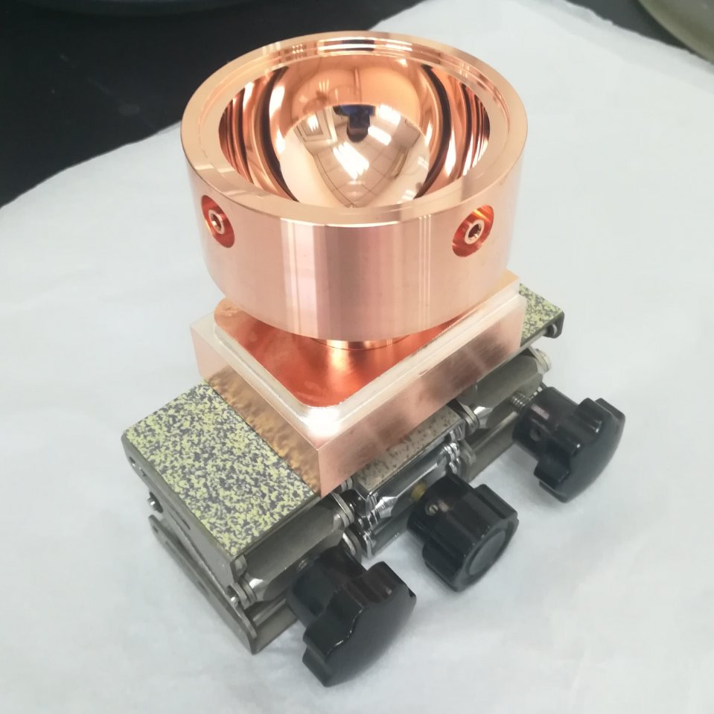
Outline
Pulse compressors
Correction cavity chain for CERN
S-band Sphercial pulse compressor
Two stage pulse compressor
Standing wave linacs
Medical application of standing wave linacs
IOeRT system

Slide 3
Pulse compressors

Slide 4
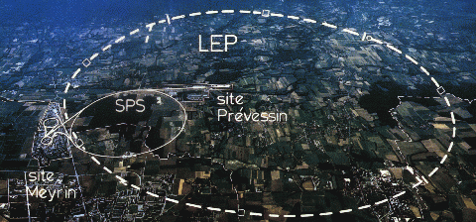
Pulse compressors
Pulse compressors in electron-positron collider
Pulse compressors in FELs
Circular electron-positron collider
LCLS
SACLA XFEL facility
PAL-XFEL
SINAP-SXFEL
SwissFEL
LEP (Large Electron-Positron collider): LIPS
BEPC&BEPCⅡ (Beijing Electron Positron Collider): SLED
Linear electron-positron collider
VLEPP: BOC
NLC/GLC: SLEDⅡ
JLC: SLEDⅡ
Pulse compressors in High power test facility
Xbox 1-3, CERN
TPoT, Tsinghua
[1] http://home.cern/about/accelerators/large-electron-positron-collider
[2] 1992-CERN-Igor-Status VLEPP RF Power Multiplier (VPM)

Slide 5
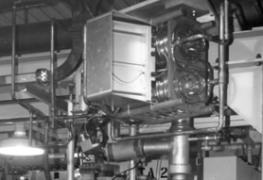
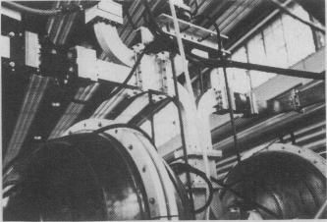
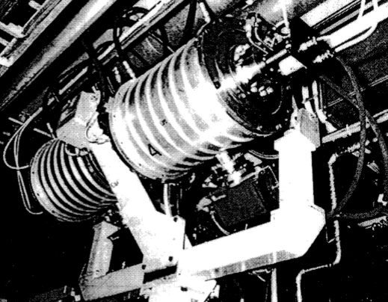
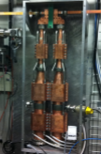
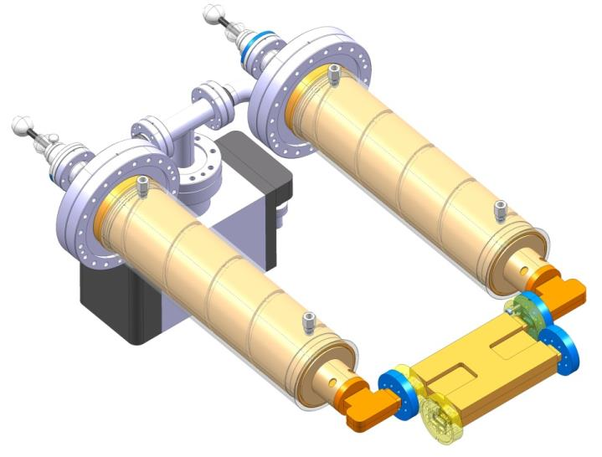
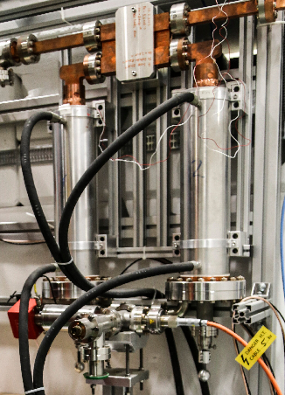
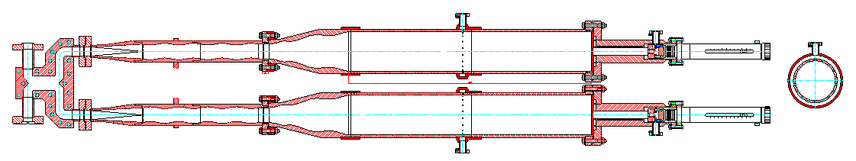
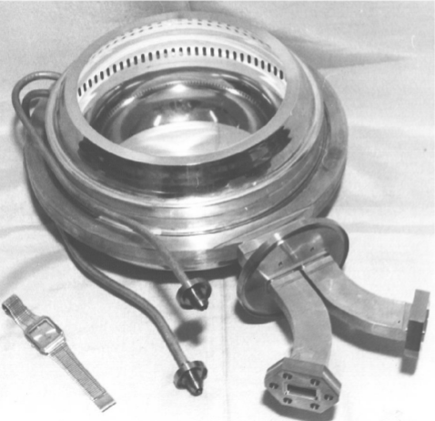
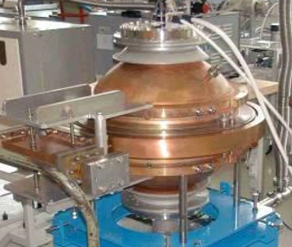
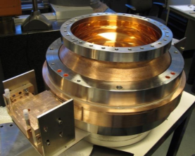
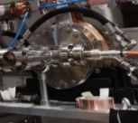
Pulse compressors
1974,SLAC,S-band
1983,CERN,S-band
1984,CERN,S-band
2009,CERN&SLAC&CEA,X-band
2013,CERN,X-band
Cylinder Cavity: TE₀₁₅
Spherical Cavity : TE₄₆₁
Cylinder Cavity: TE₀₃₈
Cylinder Cavity :TE_{01&}TE₀₂
Cylinder Cavity :TE_{0,1,32}
1990, Igor, For VLEPP, TM_{25,1,1}
2000, CERN, For CTF3,TM_{10,1,1}
2012, PSI, For SwissFEL,TM_{18,1,1}
2019, CERN, For XBox2(11.994GHz)
[1] 1974-SLAC-Z. D. Farkas-A METHOD OF DOUBLING SLAC’s ENERGY
[2] 1983-A. Fiebig and R. Hohbach STUDY OF PEAK POWER DOUBLERS WITH SPHERICAL RESONATORS
[3] 2004-CERN-Note-R.Bossart-High-power_Microwave_Pulse_Compression_of_Klystron
[4] 2010-RuPac-A 12 GHZ PULSE COMPRESSOR AND COMPONENTS FOR CLIC TEST STAND
[5] 1994-KEK-Linac-DEVELOPMENT OF AN RF PULSE COMPRESSOR
[6] 2013-CERN-Igor-X-band SLED type Pulse Compressor
[7] 2016-CLIC_Woekshop_PSI_FEL_BOC

Slide 6
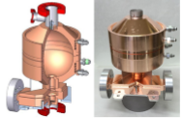
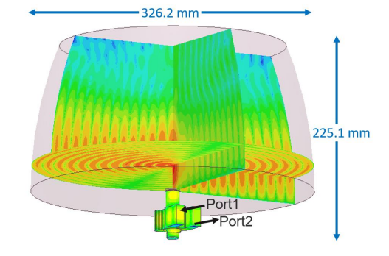
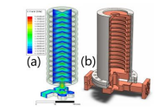
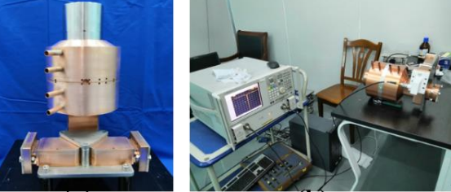
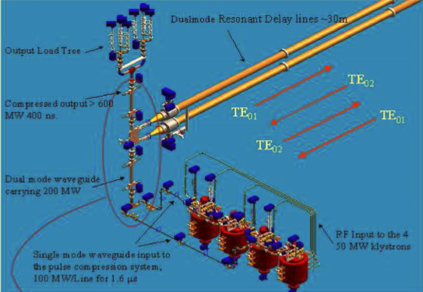
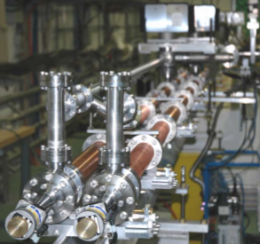
Pulse compressors
2016,SLAC,X-band
2021,CERN,X-band
2019,Tsinghua,X-band
2019,SINAP,C-band
Spherical Cavity :TE₁₁₄
Bowl-shaped open cavity :TE_{1,2,13}
Corrugated cavity :HE_{1,1,14}
Spherical Cavity :TE₁₁₃
2005,SLAC,For NLC(11.424GHz)
2006,CERN,For CLIC (30GHz)
SLED2
SLED
BOC
[1] 2016-ipac16-Wanjuwen-R&D FOR A SUPER COMPACT SLED SYSTEM AT SLAC
[2] 2017-Tsinghua-Ping Wang, rf design of a pulse compressor with correction cavity chain for klystron-based compact linear collider,
[3] 2019- SINAP-Zongbin Li, High power test of the first C-band spherical pulse compressor prototype
[4] 2005-SLAC-SamiG.-PRST-High-power multimode X-band rf pulse compression system for future linear colliders
[5] 2006-CERN-Igor-EPAC-STATUS OF 30 GHZ HIGH POWER RF PULSE COMPRESSOR FOR CTF3

Slide 7
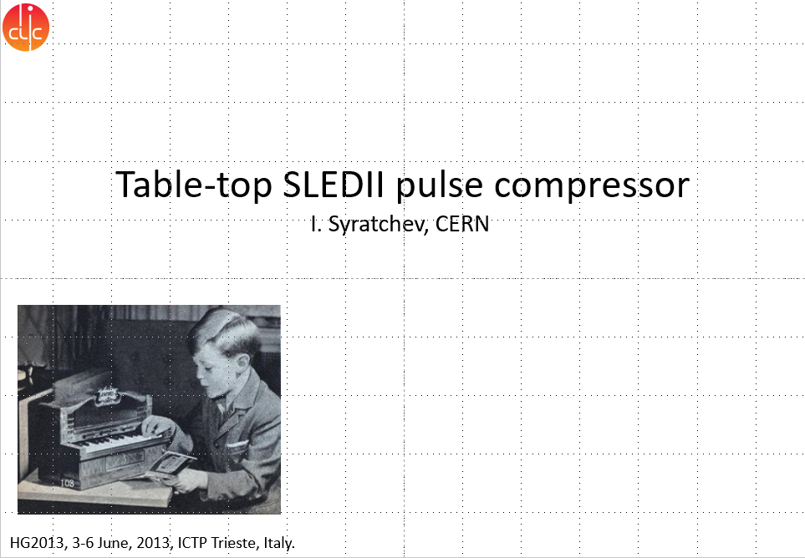
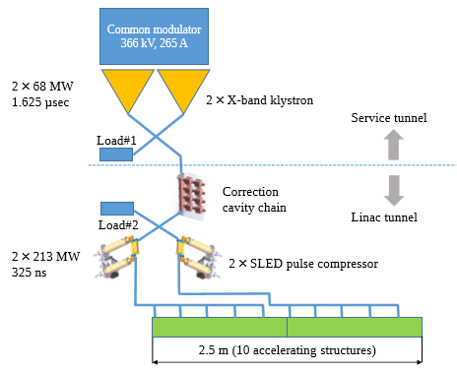
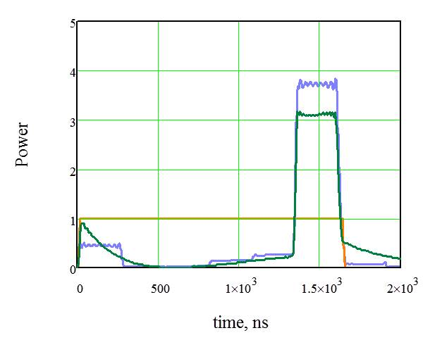
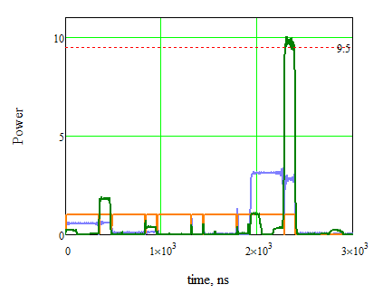
Pulse compressors-Correction cavity chain
[1] Updated baseline for a staged Compact Linear Collider, edited by P.N. Burrows, P. Lebrun, L. Linssen, D. Schulte, E. Sicking, S. Stapnes, M.A. Thomson, CERN–2016–004 (CERN, Geneva, 2016),

Slide 8
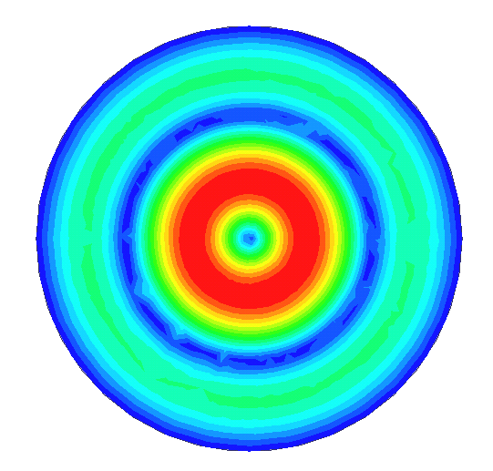
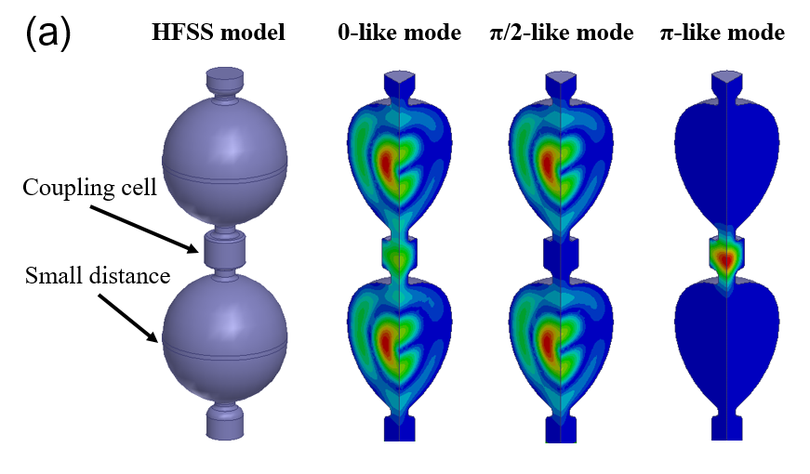
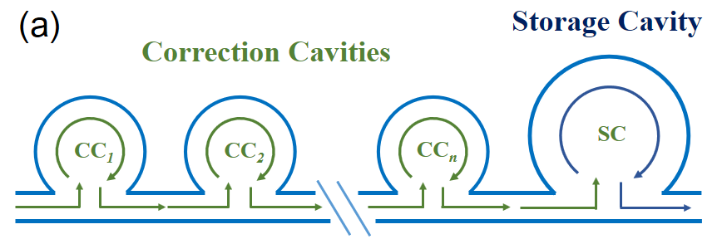
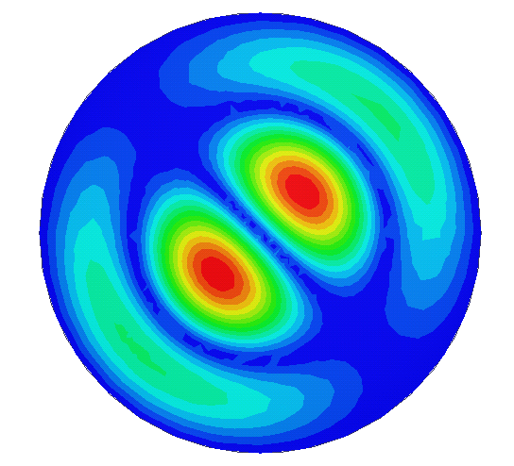
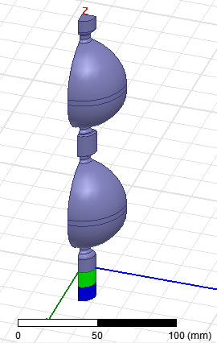
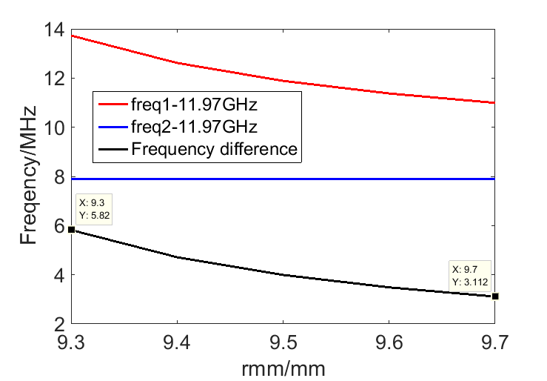
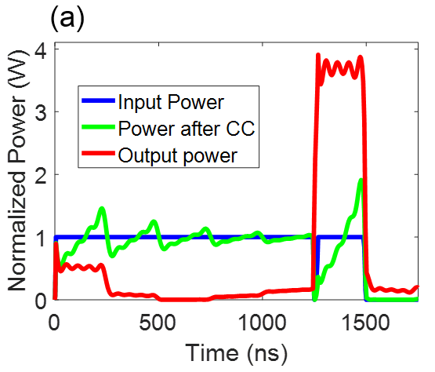
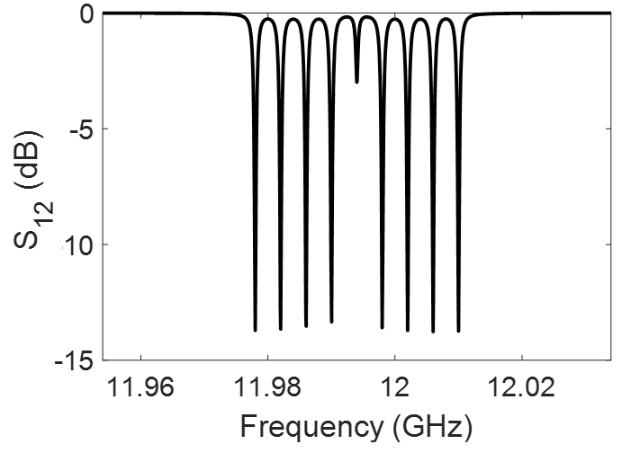
Pulse compressors-Correction cavity chain
RF Design of correction cavity chain
TE₁₁₂
r_{mm}
[1] Ping Wang, Hao Zha, Igor Syratchev, Jiaru Shi, and Huaibi Chen， rf design of a pulse compressor with correction cavity chain for klystron-based compact linear collider, Phys. Rev. Accel. Beams 20, 112001 (2017)

Slide 9
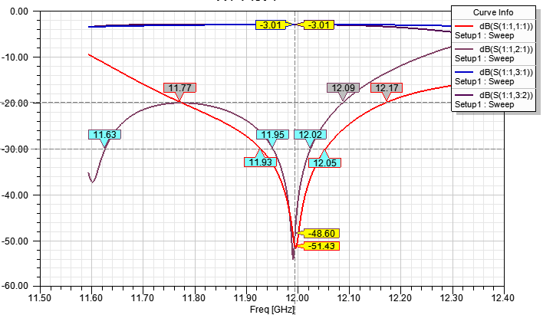
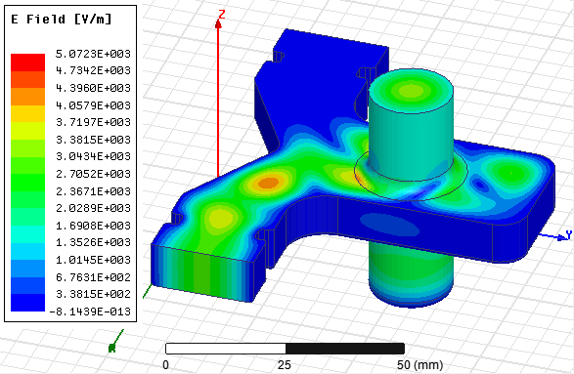
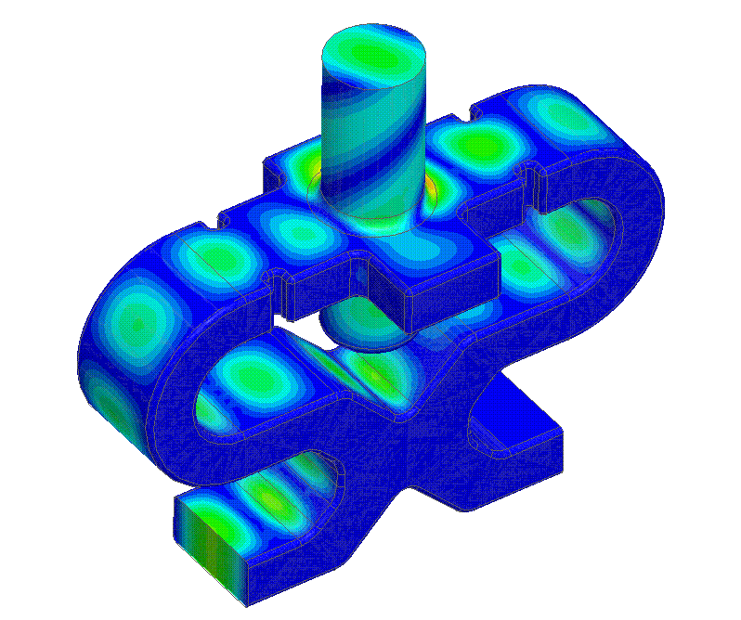
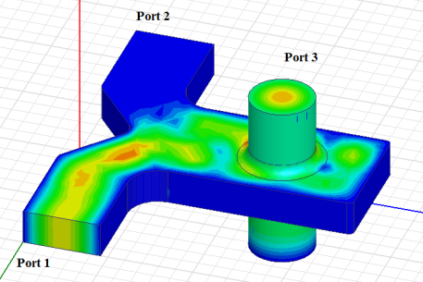
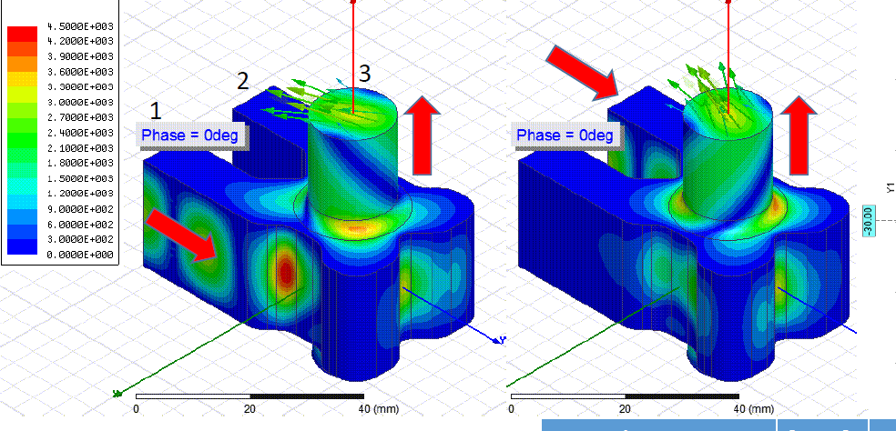
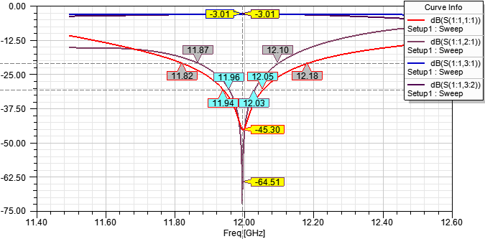
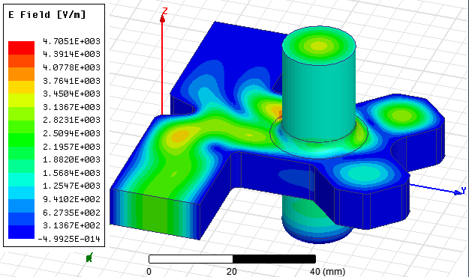
Pulse compressors-Correction cavity chain
RF Design of correction cavity chain
2013-CERN-Igor-RF_PC_HG2013
2016-PRST-SLAC-M-Compact rf polarizer and its application to pulse compression systems
2016-CERN-HG2016-Alex-Compact_Xband_Components

Slide 10
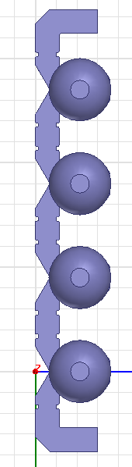
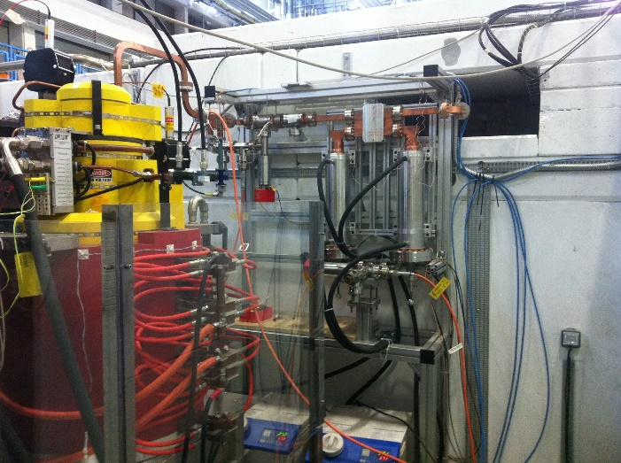
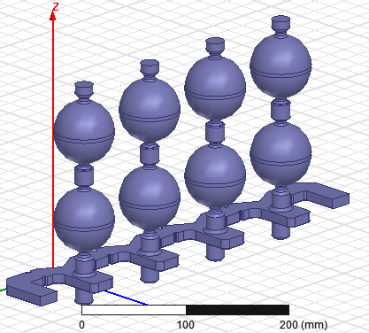
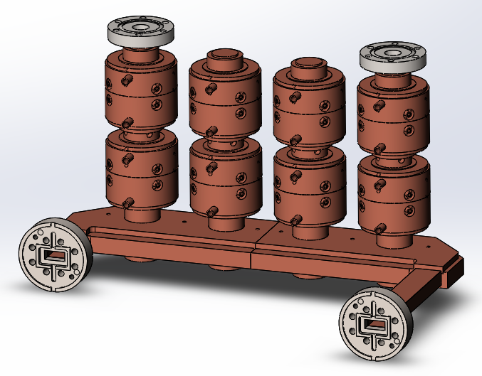
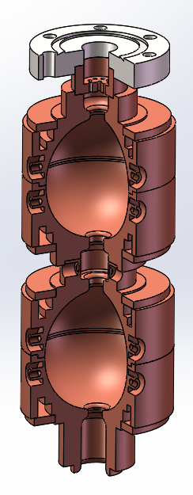
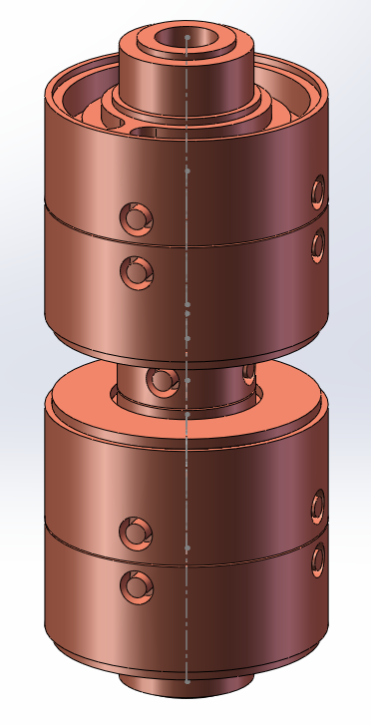
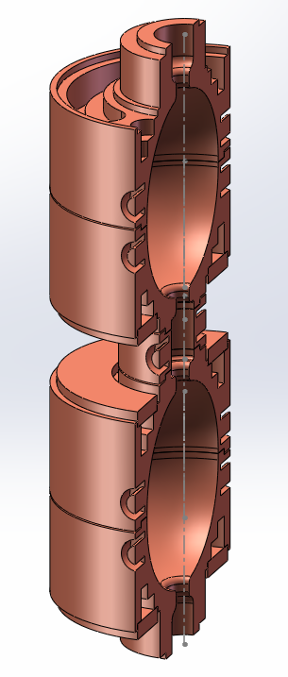
Pulse compressors-Correction cavity chain
Mechanical Design of correction cavity chain
Sphere radius=30mm
Water Cooling
65mm
90mm
For vacuum pumping
Tuning after sealing
Tuning before sealing

Slide 11
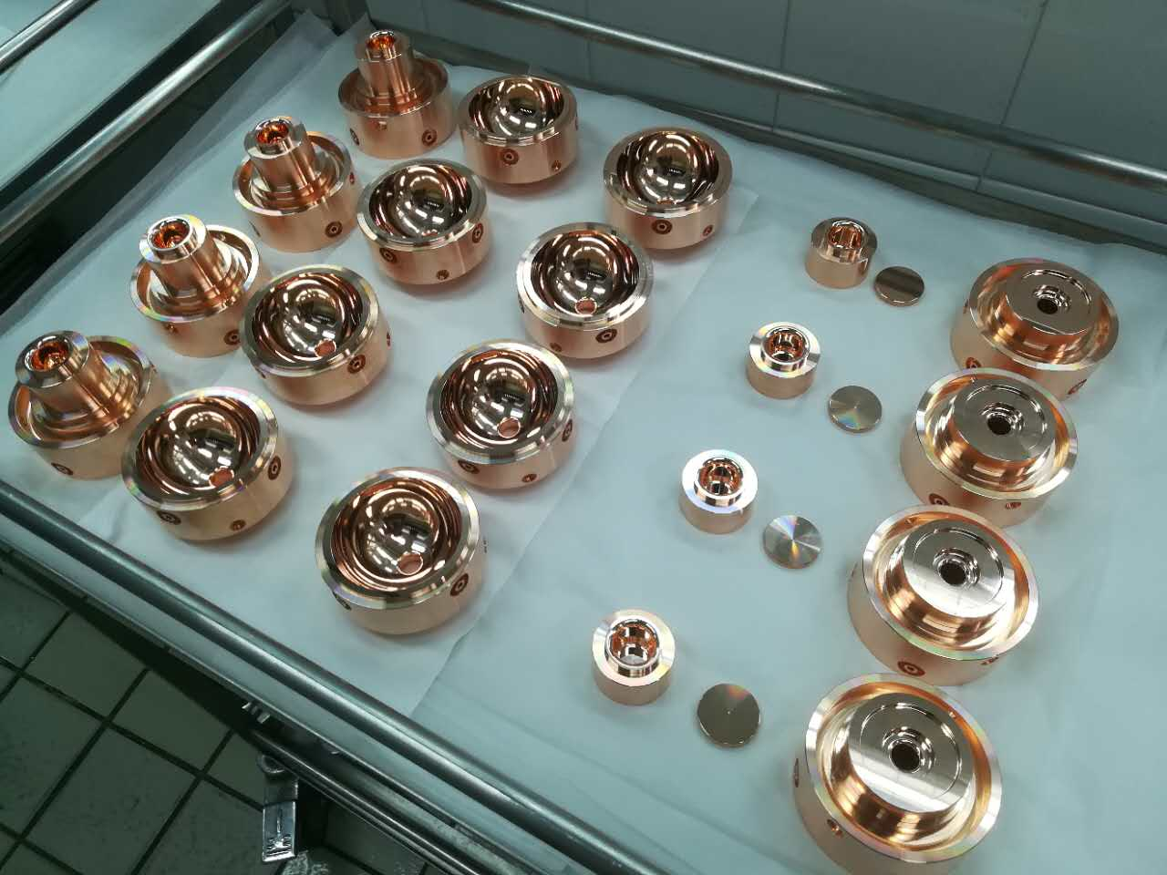
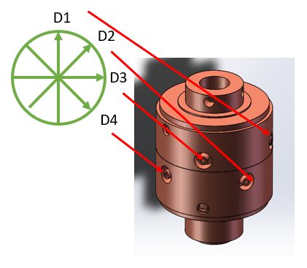
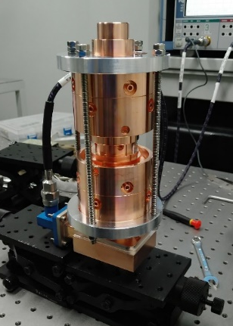
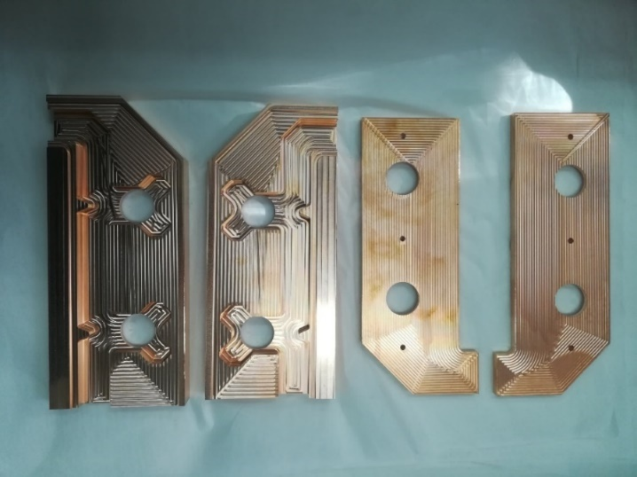
Pulse compressors-Correction cavity chain
Fabrication of correction cavity chain
设计频率(MHz) |  | f₁ (MHz) | f₂ (MHz) | f₃ (MHz) | f₄ (MHz)
11978 | 11978.10 |  | 11978.06 | 11978.07 | 11978.11
11982 | 11982.13 |  | 11982.09 | 11982.09 | 11982.13
11986 | 11985.91 |  | 11985.92 | 11985.92 | 11985.86
11990 | 11989.98 |  | 11989.99 | 11989.98 | 11989.94
11998 | 11997.98 |  | 11997.98 | 11998.03 | 11997.99
12002 | 12002.01 |  | 12002.02 | 12001.98 | 12002.02
12006 | 12005.94 |  | 12005.93 | 12005.92 | 12005.89
12010 | 12010.02 |  | 12010.04 | 12010.03 | 12009.98

Slide 12
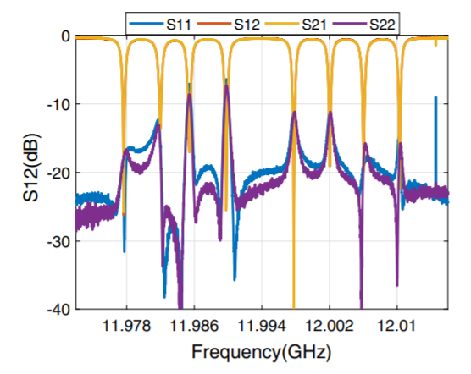

Pulse compressors-Correction cavity chain
Cold test of correction cavity chain
2019-Tsinghua-Yuliang Jiang-Demonstration of a cavity-based pulse compression system for pulse shape correction

Slide 13


Pulse compressors-Correction cavity chain
High power test of correction cavity chain
SLEDX: Q₀ = 1.77e5, beta = 5.98
BOC : Q₀ = 1.58e5, beta = 7.00
2019-Tsinghua-Yuliang Jiang-Demonstration of a cavity-based pulse compression system for pulse shape correction

Slide 14

Pulse compressors-S-band Spherical pulse compressor
S-band high power test facility at Tsinghua
Parameters | Values
Frequency | 2856 MHz
Working mode | TE₀₁₅
Unloaded quality factor | 100,000
Coupling coefficient | 5
Input pulse length [μs] | 3.6
Output pulse length [ns] | 300
Peak power gain | 5.6
Average power gain | 4.6
Diameter of cavity [cm] | 20.51
Volume of cavity [cm³] | 11098
Input power [MW] | 50

Slide 15




Pulse compressors-S-band Spherical pulse compressor
260mm
150mm

Slide 16




Pulse compressors-S-band Spherical pulse compressor
RF design of Spherical pulse compressor
220 mm
540 mm

Slide 17





Pulse compressors-S-band Spherical pulse compressor
Mechanical design of Spherical pulse compressor

Slide 18



Pulse compressors-S-band Spherical pulse compressor
Cold test of Spherical pulse compressor
The Q₀ is much smaller than 100000 in cold test
Frequencies of different polarizations are different

Slide 19


Pulse compressors-S-band Spherical pulse compressor
Tuning of Spherical pulse compressor
The output waveform was correct even with lots of reflection.

Slide 20


Pulse compressors-S-band Spherical pulse compressor
Tuning of Spherical pulse compressor
Failed
Failed
Failed
Succeeded
Direction of waveguide
High power test

Slide 21


Pulse compressors-Two stage pulse compressor
Principle of two stage pulse compressor
1991-SLAC-C.Nantista-SLED II A new method of rf pulse compression

Slide 22

Pulse compressors-Two stage pulse compressor
Principle of two stage pulse compressor
Q₀ | P_{g} | η
400000 | 24.2 | 43.0%
200000 | 23.9 | 40.4%
100000 | 22.2 | 36.8%
50000 | 19.5 | 30.6%
N₁ | N₂ | P_{g} | η
201 | 201 | 19.7 | 51.7%
101 | 101 | 19.7 | 51.7%
51 | 51 | 20.3 | 51.5%
21 | 21 | 21.6 | 50.6%
7 | 7 | 20.6 | 44.5%
7 | 1 | 24.2 | 43.0%
5 | 1 | 21.1 | 37%

Slide 23




Pulse compressors-Two stage pulse compressor
Resonant cavity for two stage pulse compressor
System based on Spherical cavities：
Mode: TE₁₁₁
Q₀ ：58000
Peak power gain：20.1
Efficiency：32.1%
System based on cylinder cavities：
Mode: TE₁₂₁
Q₀ ：72000
Peak power gain：21.1
Efficiency：33.7%

Slide 24







Pulse compressors-Two stage pulse compressor
RF components for two stage pulse compressor

Slide 25



Pulse compressors-Two stage pulse compressor
System design of two stage pulse compressor

Slide 26


Pulse compressors-Two stage pulse compressor
Cold test of two stage pulse compressor
[1] 2021-Tsinghua-Juliang Jiang-Compact Two-Stage Pulse Compression System for Producing Gigawatt Microwave Pulses

Slide 27


Pulse compressors-Two stage pulse compressor
High power test of two stage pulse compressor
[1] 2021-Tsinghua-Juliang Jiang-Compact Two-Stage Pulse Compression System for Producing Gigawatt Microwave Pulses

Slide 28
Standing wave linacs

Slide 29

Standing wave linacs
[1] https://ebismedical.com/cancer-treatments/

Slide 30



Standing wave linacs-Medical application of standing wave linacs
[1] https://www.oncologysystems.com/resources/linear-accelerator-guides
[2] 2021-RadiaBeam Technologies LLC-Sergey V. Kutsaev-Electron bunchers for industrial RF linear accelerators: theory and design guide

Slide 31


Standing wave linacs-Medical application of standing wave linacs
Radiation therapy with X-ray
Radiation therapy with electron beam
• Remove malignancy in operating room
• Temporarily close or cover the surgical wound
• Move the patient from Operating Room to radiation Operating Room
• Treat with electron radiation
• Return to operating room
• Complete the surgery and close surgical wound
[1] 2020-Liam J. Wang-Virtual Reality-Based Education for Patients Undergoing Radiation Therapy
[2] 2016-FSN-TECFIS-APAM-LUIGI PICARDI-IORT linacs and other possible developments

Slide 32


Standing wave linacs-IOeRT system
Electron energy : 4 - 12 MeV
Beam current : 1.5 mA
[1] 2017-Mara Severgnini-Special techniques overview : IORT

Slide 33

Standing wave linacs-IOeRT system
S-band
X-band
C-band
2016-FSN-TECFIS-APAM-LUIGI PICARDI-IORT linacs and other possible developments

Slide 34

Standing wave linacs-IOeRT system
Modulator
E-gun Modulator
Magnetron
RF system
SF₆
E-gun
Standing wave linac
electron beams
Ion Pump
Cooling

Slide 35




Standing wave linacs-IOeRT system
R_{b}
L_{b}
[1] 2009-Uli Raich-Emittance Measurements, USPAS and University of New Mexico

Slide 36






Standing wave linacs-IOeRT system
Z_{eff} = 158.4 MΩ/m
Q₀ = 8902
Cell design
Electric wall
Electric wall
k = (f_{pi} - f₀) / f_{pi/2} = 0.0298
k = (f_{pi} - f₀) / f_{pi/2} = 0.0314

Slide 37


Standing wave linacs-IOeRT system
CST
The position of coupler affects both the reflection and the field distributation
Equivelent circuit model
Position of coupler
CST
Equivelent circuit model
Position of coupler
Position of coupler
Position of coupler

Slide 38
Standing wave linacs-IOeRT system
Design procedure of standing wave linac
Magnetron parameters
Cell parameters
Input RF power : P_{M}
Quality: Q_{0,i} (i = 1,2,3...N)
Effective shunt inpedence: Z_{eff,i} (i = 1,2,3...N)
Structure parameters
Number of cavities: N
Lengthes of cavities: L_{i} (i = 1,2,3...N)
Field distributation: E_{i} (i = 1,2,3...N)
Position of coupler: p
Beam dynamics
Energy spectrum
Beam size
Capture ratio
E-gun parameters
E-gun voltage: V_{injection}
Beam Current: I_{b}
Beam waist: R_{b}
Beam length: L_{b}

Slide 39




Standing wave linacs-IOeRT system
RF system design
The linac consists of two sections.
The energy is tuned by changing the phase and input power of the second section.
[1] Patent: CN202030822824.3
[2] 2013-RADMEDEX LLC-A. V. Mishin-NEW GENERATION X-BAND LINACS FOR MEDICAL AND INDUSTRIAL APPLICATIONS

Slide 40
Thanks for your attentation !

