Slide 1

Nuclear Data at n_TOF for Medicine
Javier Praena
Prof. Universidad de Granada (Spain)
CERN Scientific Associate (EP/SME) n_TOF Physics Coordinator
1

Slide 2
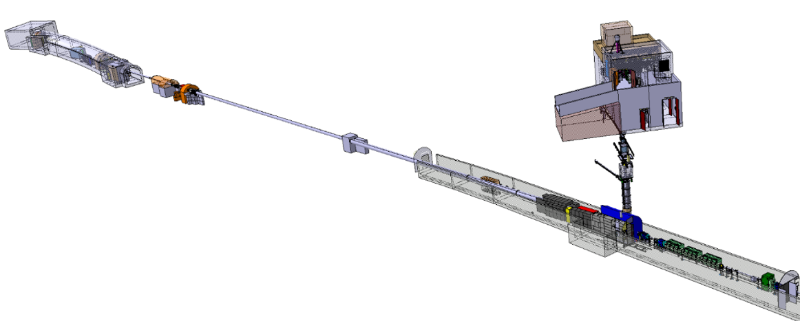
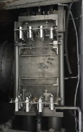


Experiments for medicine
  ³³S(n,α). 2015. U. Granada-U. Seville-CERN.
  ¹⁴N(n,p). 2017. U. Granada-U. Edinburgh.
  ³⁵Cl(n,p). 2017. U. Granada-U. Edinburgh.
  ¹⁶⁰Gd(n,γ)¹⁶¹Gd→¹⁶¹Tb. INFN. 2022?
EAR1
@ 185 m
Neutrons
EAR2
@ 20 m
  ³³S(n,α). 2012. PRC 2018. U. Granada-U. Seville.
  ¹²C(n,p). EPJ 2016 and ongoing. U. Zagreb & INFN.
  ³⁵Cl(n,γ). 2017. U. Machester & U. Granada.
  ¹⁷⁶Yb(n,γ)¹⁷⁷Yb→ ¹⁷⁷Lu. 2021. U. Granada.
  ⁸⁹Y(n,γ). 2018. INFN. Astrophysics & Medicine?
  ¹⁶⁰Gd(n,γ)¹⁶¹Gd→¹⁶¹Tb. INFN. 2022?
Neutrons
20 GeV
PS Protons
2
Javier Praena – U. Granada – CERN (EP/SME)
NSTAPP – ND for Medicine, 22/11/2021

Slide 3
Experiments at n_TOF: motivations and results
Dosimetry related to fast neutrons in protontherapy/photontherapy. Secondary tumours.
  ¹²C(n,p)¹²B in EAR1. Integral finished. Angular-energy distribution, ongoing.
Dosimetry in Boron Neutron Capture Therapy (low energy neutrons).
  ¹⁴N(n,p) in EAR2.
    Provides the most important biological dose to healthy tissue.
    Data status opens to variations in the dose of at least 12%, depends on the neutron beam.
    At n_TOF, we have found a further reduction of the 1st resonance, as Wallner by integral.
  ³⁵Cl(n,p) in EAR2.
      Significant dose in healthy tissue in high sensible organs. Ongoing.
  ³⁵Cl(n,γ) in EAR1.
      Significant dose in healthy tissue in high sensible organs (15%). Ongoing.
New target in Neutron Capture Therapy (low energy neutrons).
  ³³S(n,α) in EAR1.
      We solved the discrepancies in the resonances between ORNL and Geel measurements.
  ³³S(n,α) in EAR2.
    For the first time data from thermal to 10 keV were measured.
Production of radioisotopes for medicine in accelerator-based neutron facilities.
  ¹⁷⁶Yb(n,γ)¹⁷⁷Yb→ ¹⁷⁷Lu in EAR1. Theranostics, well stablished. No resonances had been resolved.
  ⁸⁹Y(n,γ)⁹⁰Y in EAR1. It was proposed for astrophysics. It is also demanded radioisotope.
  ¹⁶⁰Gd(n,γ)¹⁶¹Gd→¹⁶¹Tb in EAR1 and EAR2. Production of ¹⁶¹Tb, on study for theranostics.
Javier Praena – U. Granada – CERN (EP/SME)
NSTAPP – ND for Medicine, 22/11/2021

Slide 4
Boron Neutron Capture Therapy
Javier Praena – U. Granada – CERN (EP/SME)
NSTAPP – ND for Medicine, 22/11/2021

Slide 5
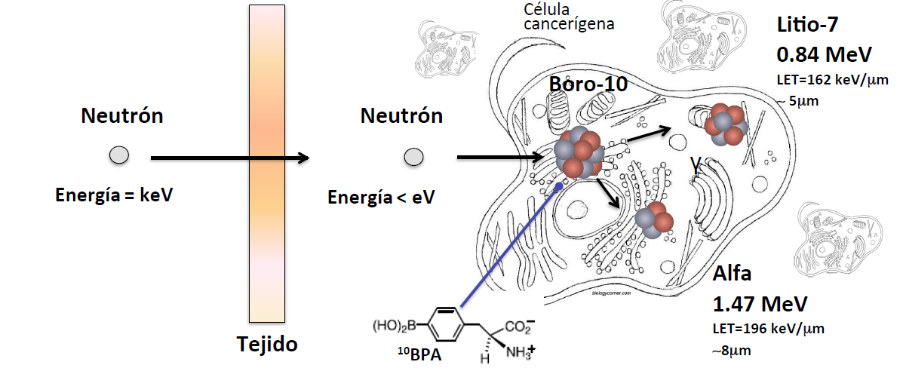
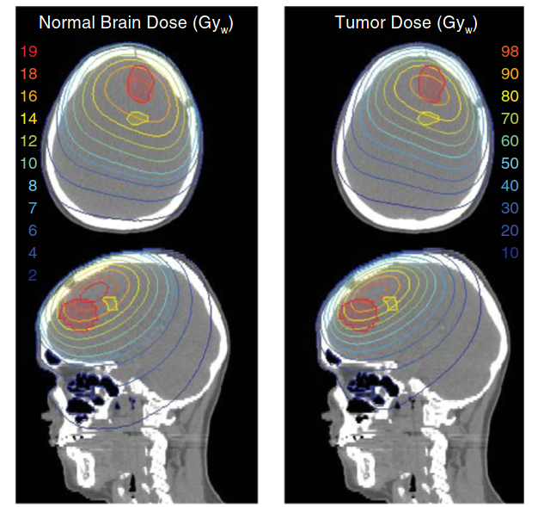
Boron Neutron Capture Therapy: bases and motivations
Boron-10 compound (BPA) is injected in the blood stream. BPA is preferably absorbed in tumor cells. Tumoral area is irradiated with neutrons in keV-eV rage. Neutrons are moderated in tissue and reach the tumor with thermal energy maximizing the ¹⁰B(n,α)⁷Li (2.4 MeV) reaction probability.
The dose on healthy tissue is lower (>factor 4) than in tumor tissue with ¹⁰B-load.
The dose in healthy tissue is lower than in photon or proton therapies. No fractioning.
The dose in healthy tissue is the limiting factor in whatever radiotherapy treatment. Nuclear data on key reactions must be measured as accurate as possible (n_TOF).
Javier Praena – U. Granada – CERN (EP/SME)
NSTAPP – ND for Medicine, 22/11/2021

Slide 6
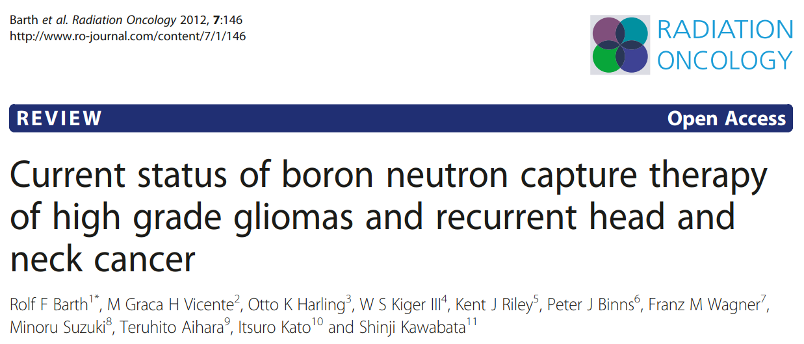
BNTC: achievements as experimental treatment (in one day)
BCNT was always an experimental therapy (patients who suffered other therapies or radiotherapies).
Since 2012, important evolutions in BNCT community:
Japan, Finland, Argentina, Italy, Taiwan (old and new BNCT)
UK, Russia, China, Israel (new BNCT), Spain.
Substitution of the neutron sources:
New accelerator-based facilities are substituting nuclear reactors (new reactors?).
New status of the therapy in each country where BNCT was carried out:
From experimental treatment to conventional one.
Japan: BNCT for melanoma is already included in the Public Health-Care System.
New Boron compounds.
Improvements in BPA and BSH. New targets or cooperative targets.
New data for accurate treatment planning.
NCT treatment planning systems rely exclusively on Monte Carlo simulations for dose calculations because of the complex, scatter-dominated nature of neutron transport.
Javier Praena – U. Granada – CERN (EP/SME)
NSTAPP – ND for Medicine, 22/11/2021

Slide 7
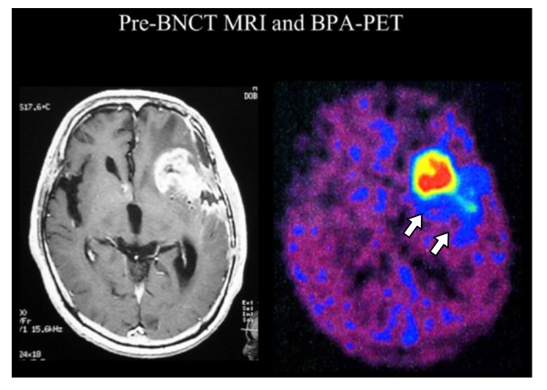
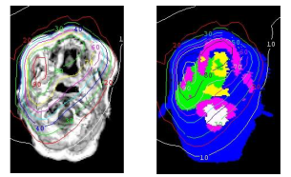

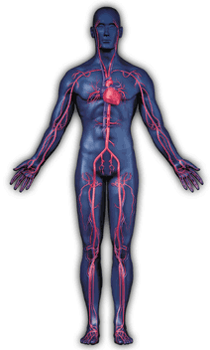
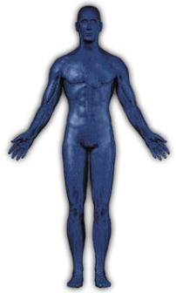
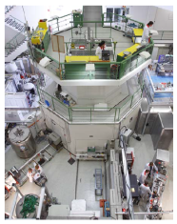
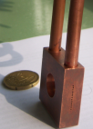
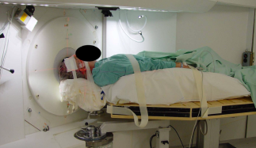
Boron neutron capture therapy: one day treatment (no fractioning)
Boron - BPA uptake with F18-PET
Treatment planning
Glioblastoma
¹⁰BPA, 18!!!
Neutron irradiation (30 min)
High power accelerator
NEUTRONS
NUCLEAR REACTOR
Li, Be
L. Kankaanranta courtesy
Treatment Hall(Helsinki)
Javier Praena – U. Granada – CERN (EP/SME)
NSTAPP – ND for Medicine, 22/11/2021
Notes:
7

Slide 8
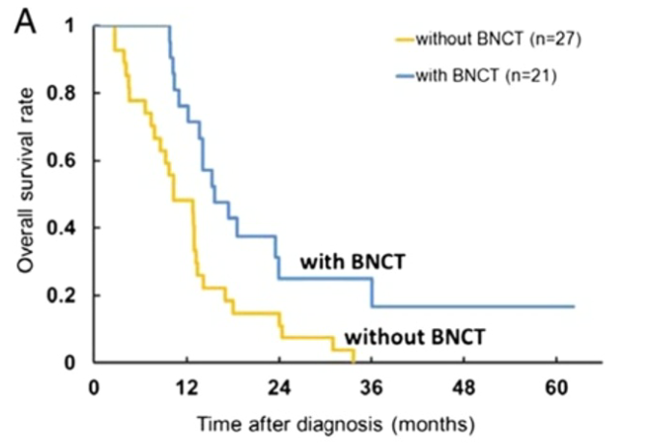
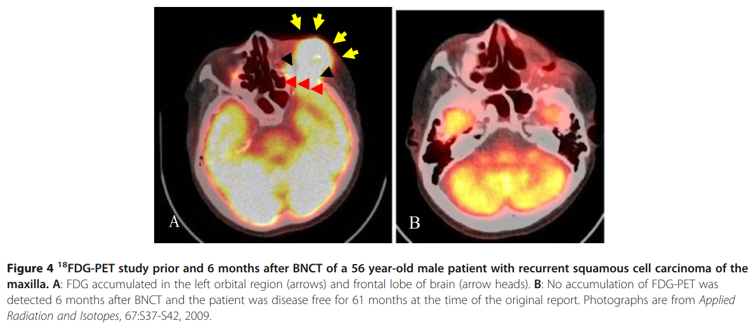
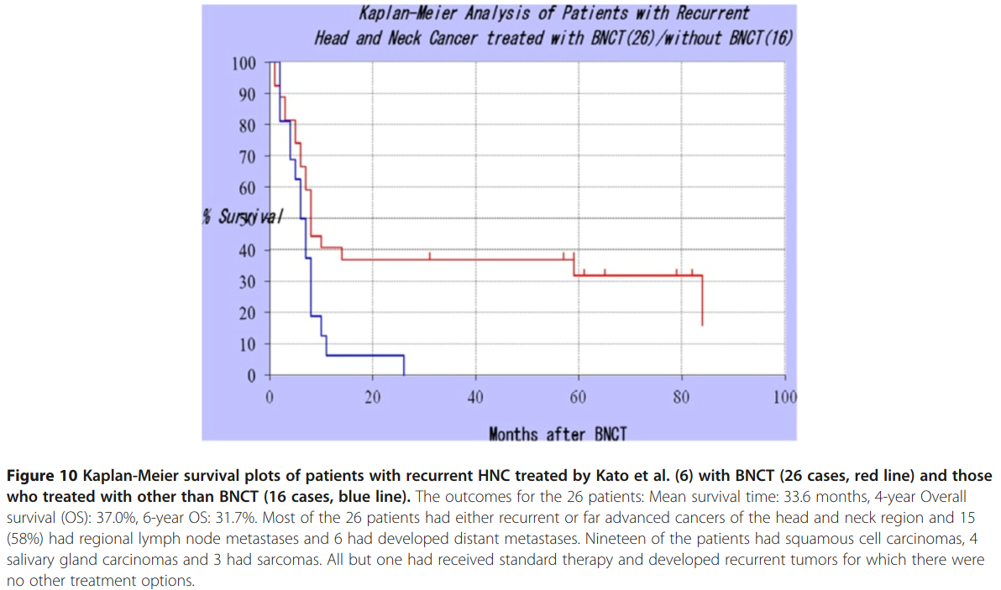
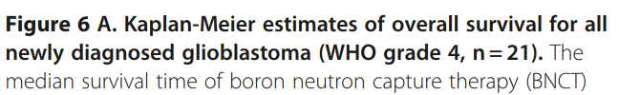
BNTC: some achievements with nuclear reactors
Javier Praena – U. Granada – CERN (EP/SME)
NSTAPP – ND for Medicine, 22/11/2021

Slide 9
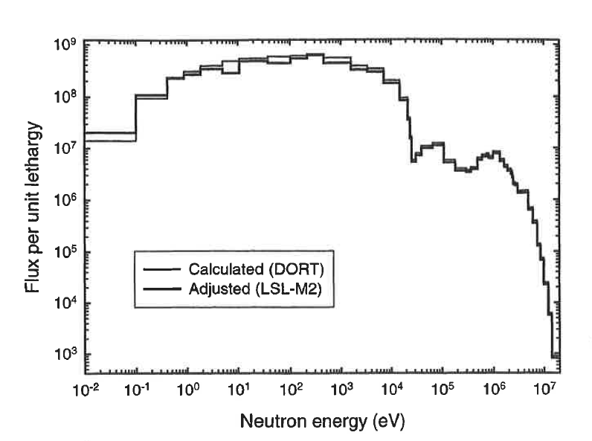
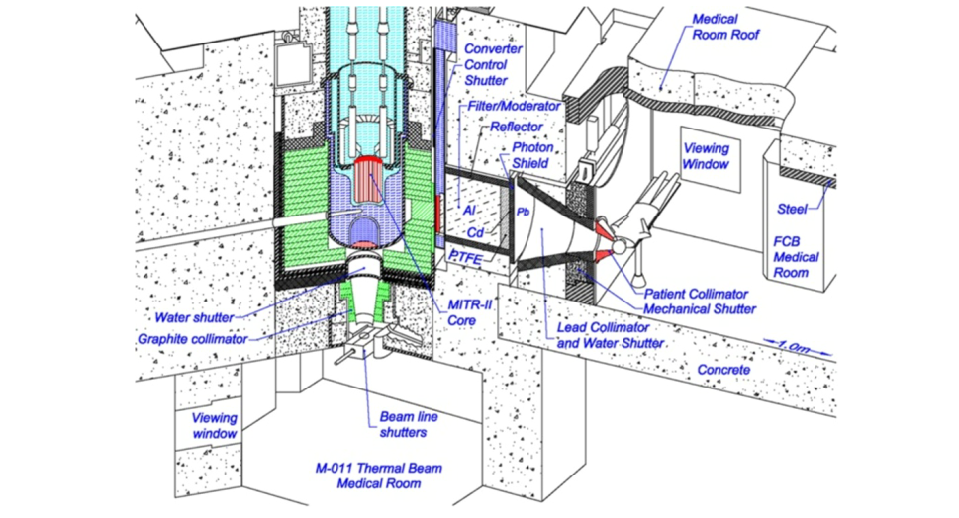
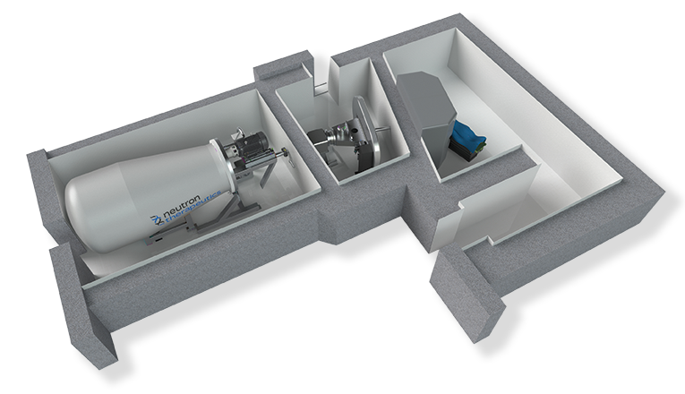
BNTC neutron source: from reactors to accelerators.
FiR reactor, Finland
With accelerators the fast tail is reduced, however a neutron fraction is above 300 keV, ¹⁴N(n,p) reaction!!!
Finland
Neutron Therapeutics Company in Finland has already finished the installation. p+Li+BSA.
Dosimetry measurements have been performed.
Permits for therapy are on going.
Javier Praena – U. Granada – CERN (EP/SME)
NSTAPP – ND for Medicine, 22/11/2021

Slide 10
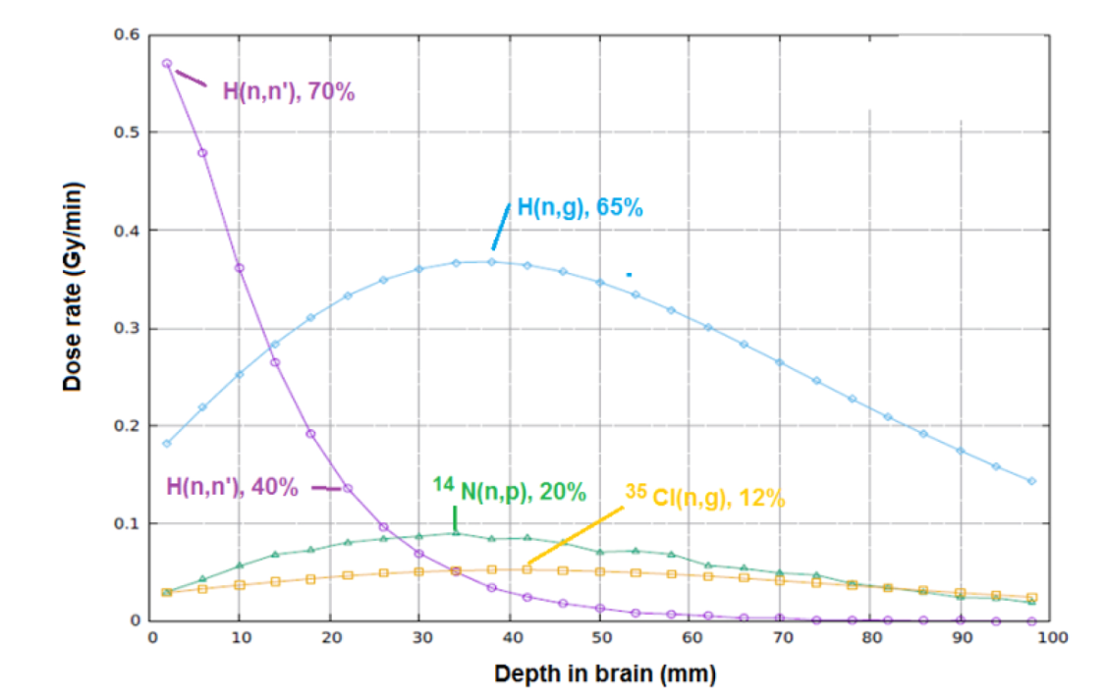
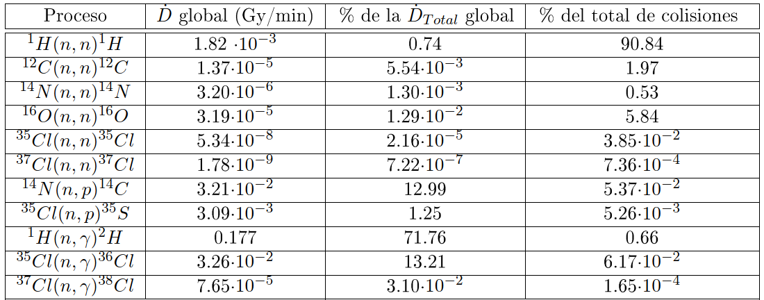
Dosimetry in healthy tissue is fundamental
Contribution to the dose on healthy tissue for a 10 keV neutron beam.
¹⁴N(n,p)¹⁴C, ³⁵Cl(n,p)³⁵S, ³⁵Cl(n,γ)³⁶Cl have measured at n_TOF.
Contribution to the dose on healthy tissue for a 0.4 keV neutron beam
Javier Praena – U. Granada – CERN (EP/SME)
NSTAPP – ND for Medicine, 22/11/2021

Slide 11
Dosimetry: ¹⁴N(n,p)¹⁴C, ³⁵Cl(n,p)³⁵S, ³⁵Cl(n,γ)³⁶Cl
Although the dose in healthy is much lower, the better nuclear data will provide a more realistic Monte Carlo planning, better duration of the neutron irradiation, possible second or third irradiation depending on organ…
The data at n_TOF are very important, and they will be used in the codes.
Javier Praena – U. Granada – CERN (EP/SME)
NSTAPP – ND for Medicine, 22/11/2021

Slide 12
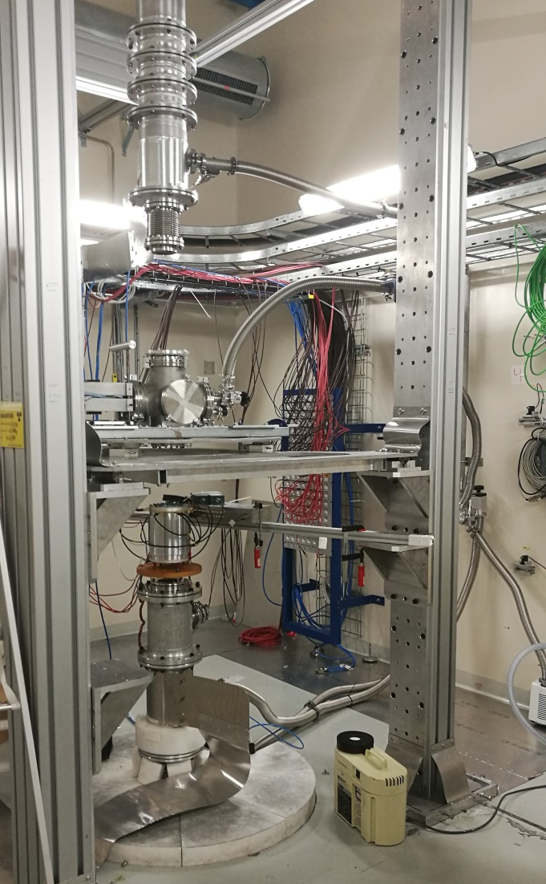
EAR2 setup for ¹⁴N(n,p)¹⁴C and ³⁵Cl(n,p)³⁵S.
Neutrons
EAR2
@ 20 m
2xDSSSD:
¹⁴N
³⁵Cl
Neutrons
6xMGAS:
²³⁵U, ¹⁰B
2 x ¹⁴N
2 x ³⁵Cl
Neutrons
20 GeV
PS Protons
12
Javier Praena – U. Granada – CERN (EP/SME)
NSTAPP – ND for Medicine, 22/11/2021

Slide 13
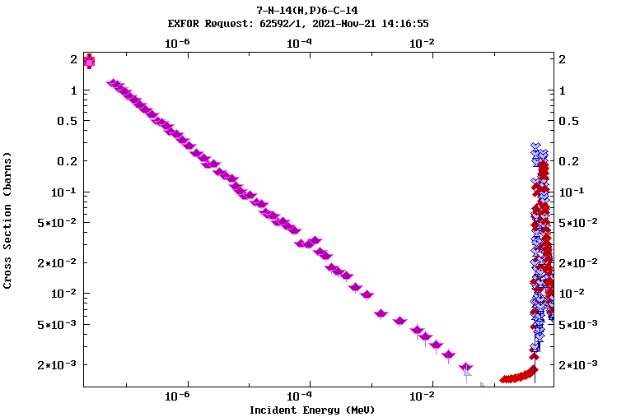
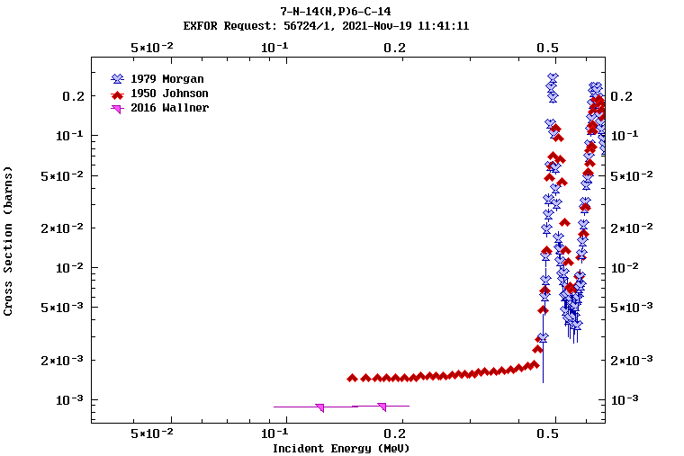
¹⁴N(n,p)¹⁴C at EAR2: covering all the energy range.
Only partial measurements in the energy for AB-BNCT:
Thermal
Above thermal to 80 keV
Above 100 keV
At n_TOF, we cover the whole energy range.
± 12% only in the dose by thermal neutrons (healthy tissue).
Johnson: first measurement of the first (493 keV) resonance.
After, Morgan provided a lower strength that Johnson
After, Wallner et al showed a further reduction factor 3.3 by activation.
At n_TOF, we have found a reduction.
Javier Praena – U. Granada – CERN (EP/SME)
NSTAPP – ND for Medicine, 22/11/2021

Slide 14
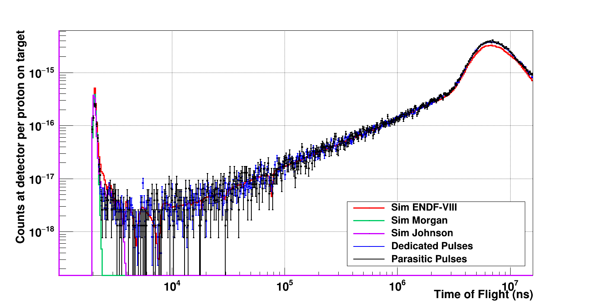
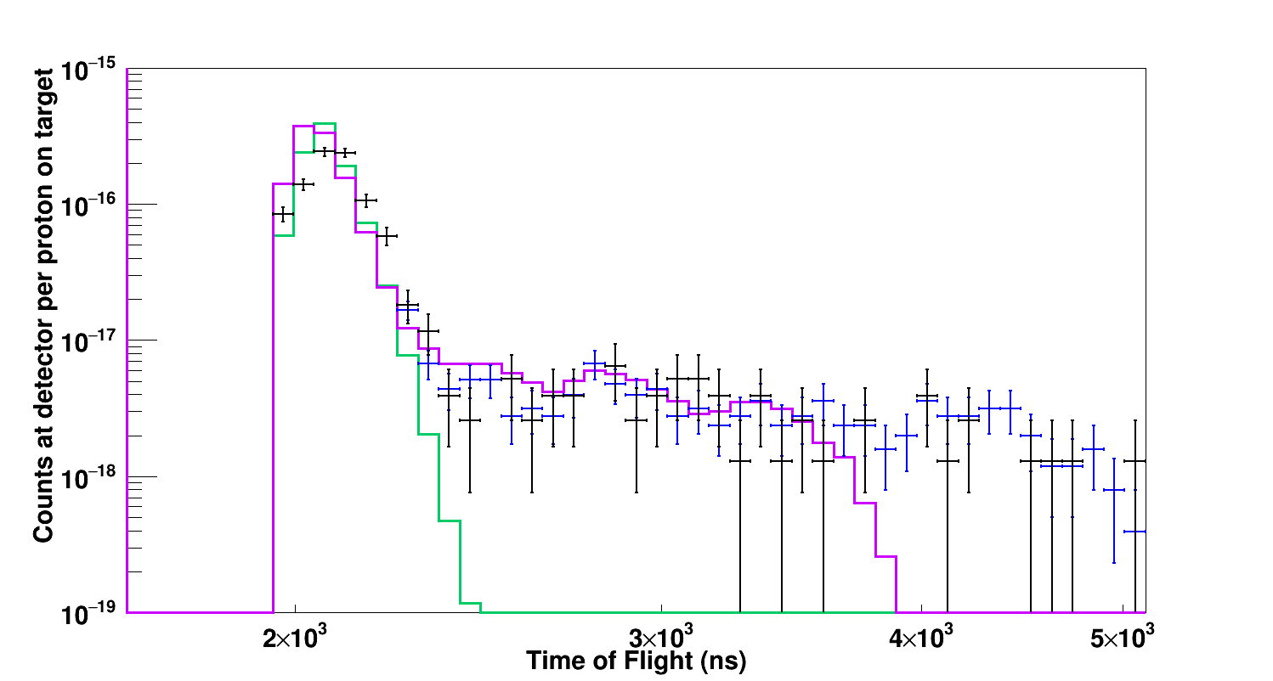
¹⁴N(n,p)¹⁴C at EAR2: covering range partial previous experiments
Pablo Torres PhD-UGR
It is covered the energy range from thermal to 500 keV.
For the first time.
Purple and Green are Johnson and Morgan experimental with the RF-EAR2.
Black points, n_TOF data.
Reduction of factor 1.5 the area of the resonance.
Impact in the dose on healthy tissue and BNCT planning.
Javier Praena – U. Granada – CERN (EP/SME)
NSTAPP – ND for Medicine, 22/11/2021

Slide 15
Radioisotope production
Javier Praena – U. Granada – CERN (EP/SME)
NSTAPP – ND for Medicine, 22/11/2021

Slide 16
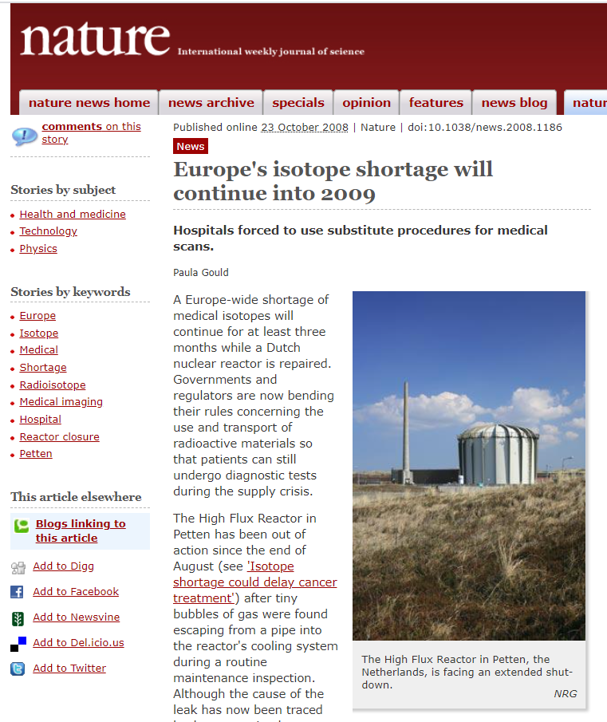
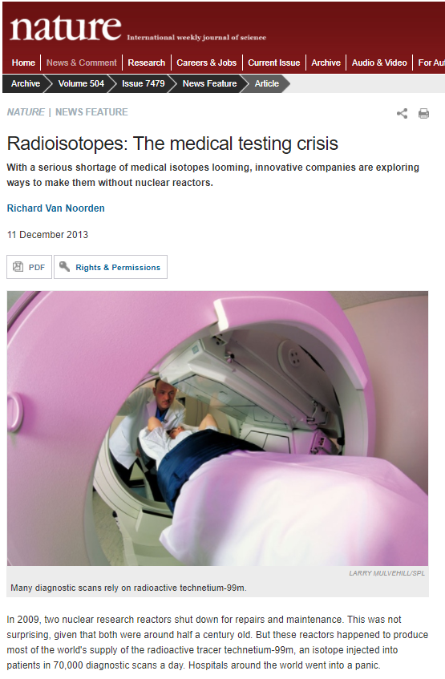
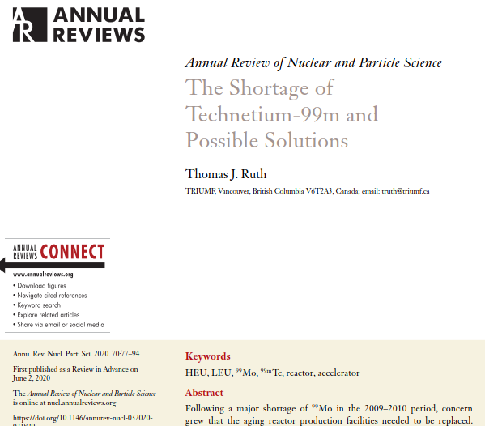
New facilities for complementary radioisotope production
There is a trend since a decade to use existing and new nuclear facilities for producing radioisotopes (Medicis-Isolde).
The Technetium world crisis in 2009-2010 was an alarm about the way to supply radioisotopes for nuclear medicine. Few reactors world wide.
2009
2013
2020
16
Javier Praena – U. Granada – CERN (EP/SME)
NSTAPP – ND for Medicine, 22/11/2021

Slide 17
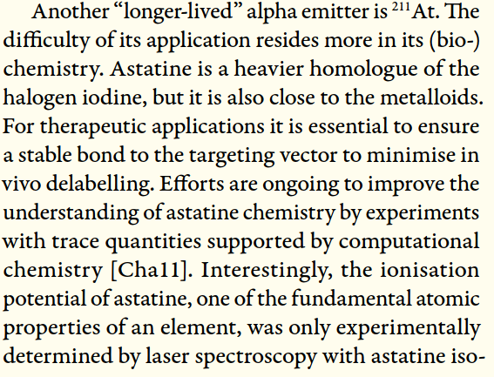
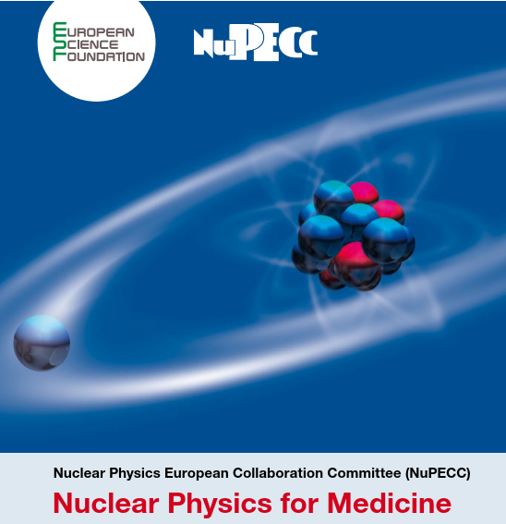
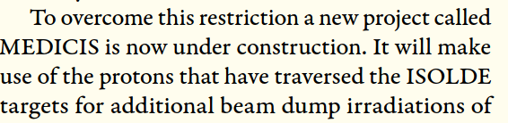
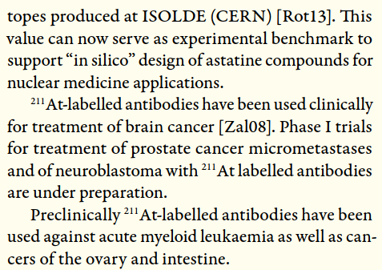
New facilities for complementary radioisotope production
International agencies and groups pushed for the use of accelerator-based facilities, as a complementary option.
R&D activities in nuclear facilities as ISOLDE provided a better understanding in nuclear medicine
2014
17
Javier Praena – U. Granada – CERN (EP/SME)
NSTAPP – ND for Medicine, 22/11/2021

Slide 18
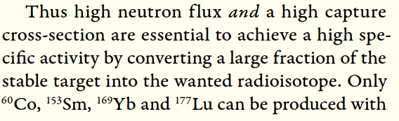

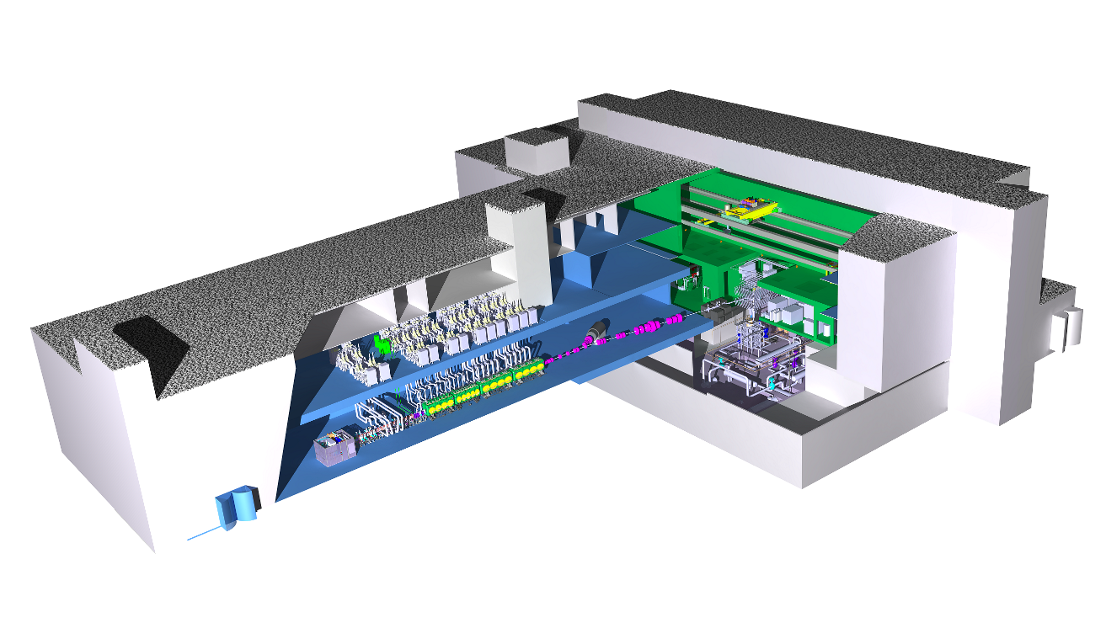
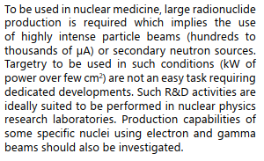
New facilities for complementary radioisotope production
Also, accelerator-based neutron facilities has been considered for the production of radioisotopes for nuclear medicine.
2014
Granada (Spain)
IFMIF-DONES
Accelerator
Lithium Jet
18
Javier Praena – U. Granada – CERN (EP/SME)
NSTAPP – ND for Medicine, 22/11/2021

Slide 19
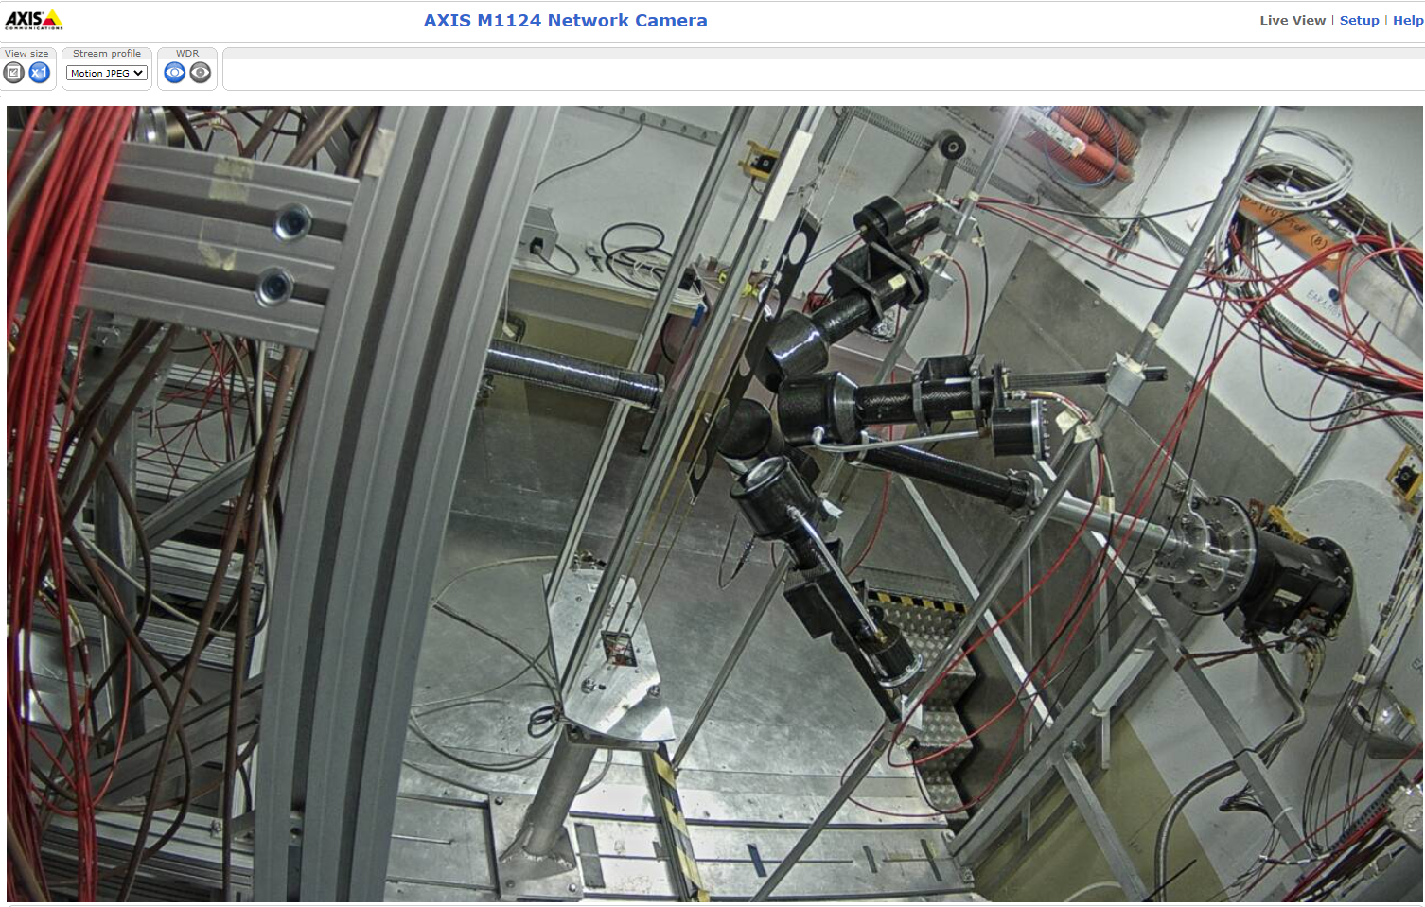
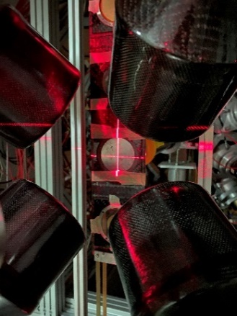
¹⁷⁶Yb(n,γ)¹⁷⁷Yb(2 h)→¹⁷⁷Lu (6.5 d) at EAR1
EAR1
@ 185 m
γ
γ
γ
Neutrons
20 GeV
PS Protons
19
Javier Praena – U. Granada – CERN (EP/SME)
NSTAPP – ND for Medicine, 22/11/2021

Slide 20
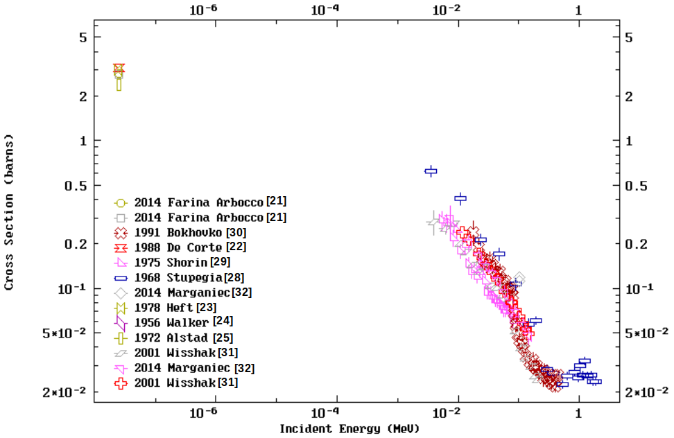
Previous experimental data ¹⁷⁶Yb(n,γ)
No data in the 1/v region
No resolved resonances. Resonances detected in transmission experiments.
Resolved Resonance Region
20
Javier Praena – U. Granada – CERN (EP/SME)
NSTAPP – ND for Medicine, 22/11/2021

Slide 21
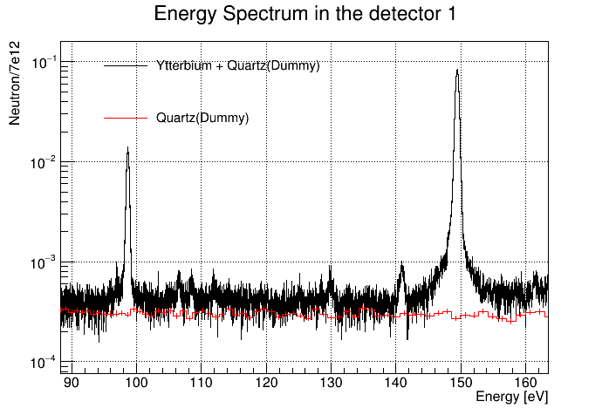
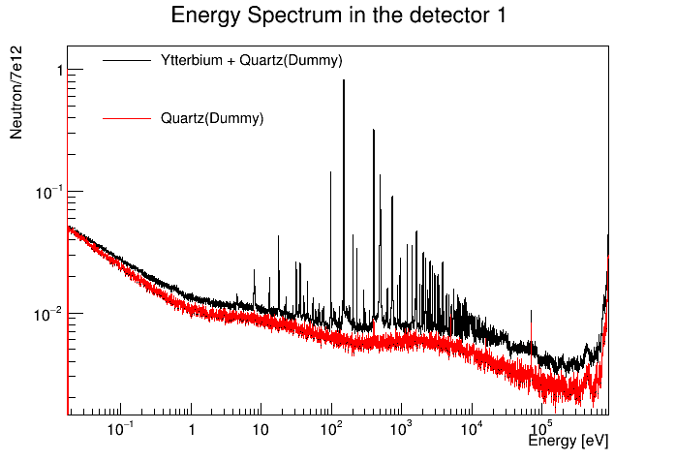
n_TOF experimental data ¹⁷⁶Yb(n,γ)
Francisco García Infantes PhD CERN/UGR
Preliminary data show that resonances have resolved for the first time and data in the 1/v region.
Javier Praena – U. Granada – CERN (EP/SME)
NSTAPP – ND for Medicine, 22/11/2021

Slide 22
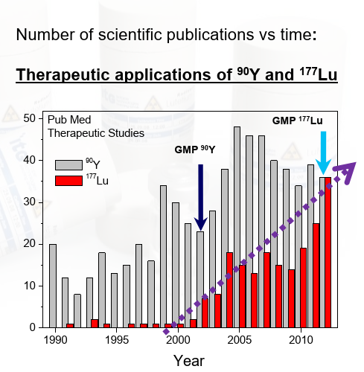
¹⁷⁷Lu rising demand & ⁹⁰Y well established
Theragnostic = diagnosis and therapy.
At present, it is produced in nuclear reactors.
Rising demand radioisotope.
Y-90 is also of interest for complementary production.
22
Javier Praena – U. Granada – CERN (EP/SME)
NSTAPP – ND for Medicine, 22/11/2021

Slide 23
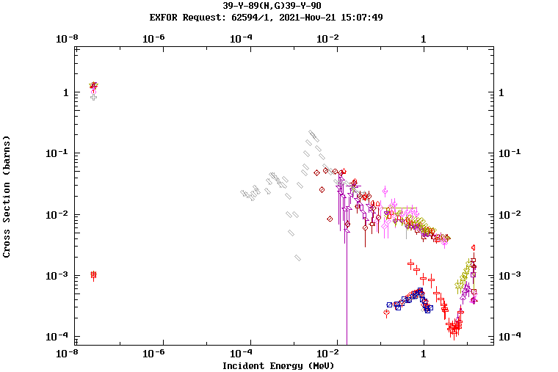
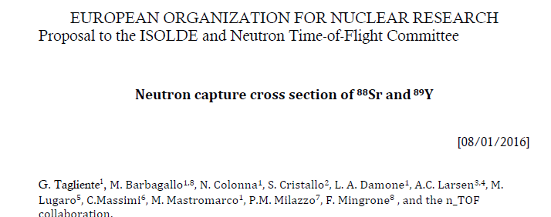
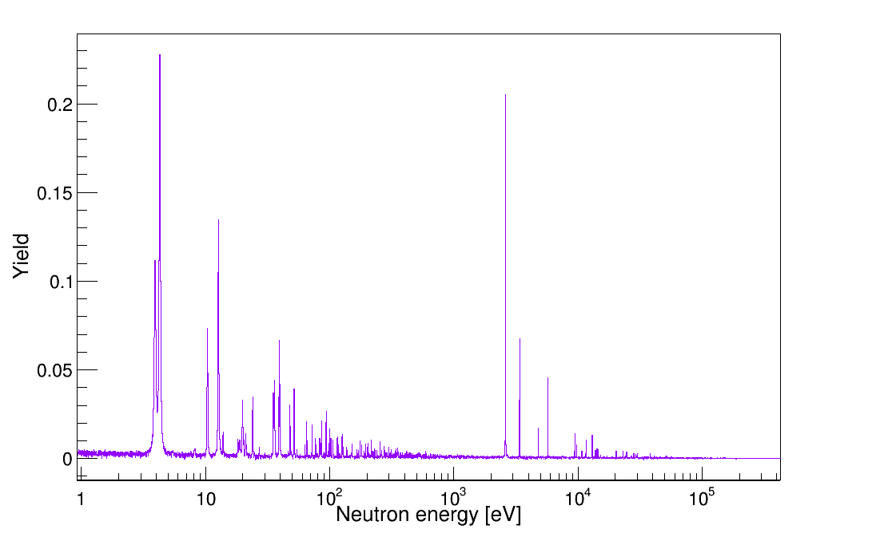
⁹⁰Y well established: again, unique data
Preliminary data show that resonances have resolved for the first time and data in the 1/v region.
23
Javier Praena – U. Granada – CERN (EP/SME)
NSTAPP – ND for Medicine, 22/11/2021

Slide 24
Conclusions
The n_TOF facility is providing unique data for medicine.
¹⁶⁰Gd(n,γ)¹⁶¹Gd→¹⁶¹Tb, will provide data for new radioisotope
AB-BNCT is opening a new framework and market:
Accelerators, targets, BSA and treatment planning codes.
Companies: Neutron Therapeutics, TAE Life Sciences…
Public institutions: Japan.
Radioisotope market, Reuters Report:
10 billion€ in 2017 and it is expected to grow 12.3% until to 2023.
The major hindrance is the high capital investments required, cyclotron.
CERN MEDICIS facility is an excellent example to be followed and synergies should be found.
NEAR opens new possibilities for medicine applications: to be studied.
Javier Praena – U. Granada – CERN (EP/SME)
NSTAPP – ND for Medicine, 22/11/2021

Slide 25


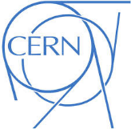
Javier Praena
Prof. Universidad de Granada (Spain)
CERN Scientific Associate (EP/SME) n_TOF Physics Coordinator
Thank you
25

Slide 26
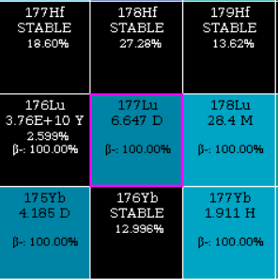
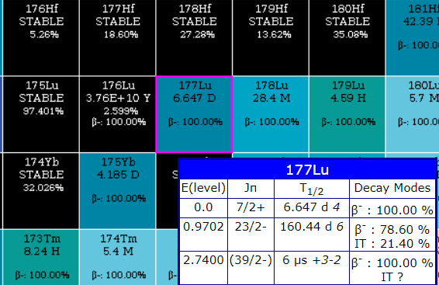
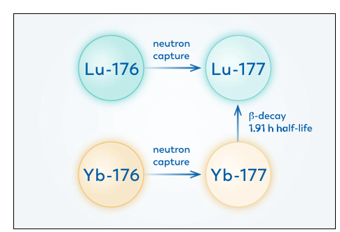

¹⁷⁷Lu production routes
“Carrier Added”
¹⁷⁶Lu(n,γ) → ¹⁷⁷Lu + ^{177m}Lu
Higher production. Lower specific activity.
^{177m}Lu is produced (0.05%), 160 days.
“Non Carrier Added”
¹⁷⁶Yb(n,γ)¹⁷⁷Yb (→ ¹⁷⁷Lu)
Lower production. Higher specific activity.
^{177m}Lu is negligible (<0.0001%)
26
Javier Praena – U. Granada – CERN (EP/SME)
¹⁷⁶Yb(n,γ) proposal, INTC-P-607, 23/06/2021

Slide 27
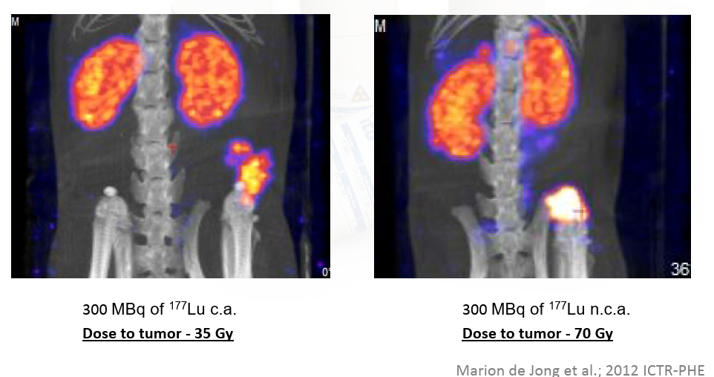
Specific activity: impact on tumor uptake
“Carrier Added”
“Non Carrier Added”
27
Javier Praena – U. Granada – CERN (EP/SME)
¹⁷⁶Yb(n,γ) proposal, INTC-P-607, 23/06/2021

Slide 28

Perspectives during the YETS and after
To finish the analysis regarding the commissioning.
28/02/2021 proton beam back, low intensity.
Physics Program: ⁷⁹Se(n,γ) (INTC-P-580) EAR1, ⁹⁴Nb(n,γ) (INTC-P-577) EAR2,…
Proton beam
Fixed impact point of the proton beam on target.
Our Needs for Physics:
  Proton pulses with two different intensities: 7.5-8.5e12 and 2-3.5e12.
  1.05e17 protons per day made in 30 days, in average, as the campaigns before the LS2.
Our Constrains from Target:
  Maximum average intensity on target = 160e10 p/s
  Dimensions for high intensity pulses ≈ 215 mm².
  Dimensions for low intensity pulses ≈ 40 mm².
Thanks to the PS team for the constant feedback for improving the quality of the proton beam
J. Praena – U. Granada – CERN – n_TOF Physics Report
68th INTC Meeting, 09/11/2021

Slide 29























ESFRI facility. City host: Granada
29
Javier Praena – U. Granada – CERN (EP/SME-)
Coll. Board Meeting, 11/05/2021

Slide 30



Spain-Croatia. City host: Granada
30
Javier Praena – U. Granada – CERN (EP/SME-)
Coll. Board Meeting, 11/05/2021

Slide 31
The facility goal: produce neutrons
Accelerator
Lithium Loop
31
Javier Praena – U. Granada – CERN (EP/SME-)
Coll. Board Meeting, 11/05/2021

Slide 32




Neutron damage in key pieces of fusion reactors
The goal of IFMIF-DONES is to produce neutrons-like DEMO fusion reactor.
Study the behaviour of several key pieces of DEMO.
Irradiations will last several months.
32
Javier Praena – U. Granada – CERN (EP/SME-)
Coll. Board Meeting, 11/05/2021

Slide 33

Other applications: in and out the bunker.
The design of the building of IFMIF-DONES has already included an experimental hall (R160) next to the bunker where the neutrons are produced.
33
Javier Praena – U. Granada – CERN (EP/SME-)
Coll. Board Meeting, 11/05/2021

Slide 34


UGR and the other applications.
34
Javier Praena – U. Granada – CERN (EP/SME-)
Coll. Board Meeting, 11/05/2021

Slide 35

N_TOF versus DONES
35
Javier Praena – U. Granada – CERN (EP/SME-)
Coll. Board Meeting, 11/05/2021

Slide 36



New facilities for complementary radioisotope production
36
Javier Praena – U. Granada – CERN (EP/SME)
¹⁷⁶Yb(n,γ) proposal, INTC-P-607, 23/06/2021

Slide 37
New facilities for complementary radioisotope production
Facilities under designed and construction as IFMIF-DONES (Granada, Spain) considers the production of radioisotopes for medicine as an complementary application.
MEDICIS-ISOLDE-CERN is an excellent successful example.
Nuclear data are needed to calculate the specific activity of the most adequate radioisotopes.
IFMIF-DONES
Accelerator
Lithium Loop
37
Javier Praena – U. Granada – CERN (EP/SME)
¹⁷⁶Yb(n,γ) proposal, INTC-P-607, 23/06/2021

