Slide 1
NEAR irradiation stations
NSTAPP – Neutrons in Science, Technology and applications (22 of November 2021)
AP.Bernardes SY-STI on behalf of the n_TOF team
SY-STI: O. Aberle, Y.Aguiar, D.Baillard, M. Calviani, M.Ferrari, R.Garcia, K.Kershaw, M.Maeder, M.Sacristan Barbero, D.Senajova, G.Lerner, M.Cecchetto
EP-SME: M.Barbagallo, A.J.Praena Rodriguez
EP-UNT: A.Mengoni
BE-CEM: L.R.Buonocore, L.Barbosa Pina Pereira, E.Romagnoli, C.Veiga Almagro
HSE-RP: JF.Gruber, F.Pozzi, N.Conan
EDMS 2664682

Slide 2
Agenda
Introduction
NEAR irradiation station (NEAR IN)
NEAR experimental station (NEAR OUT)
Conclusion

Slide 3
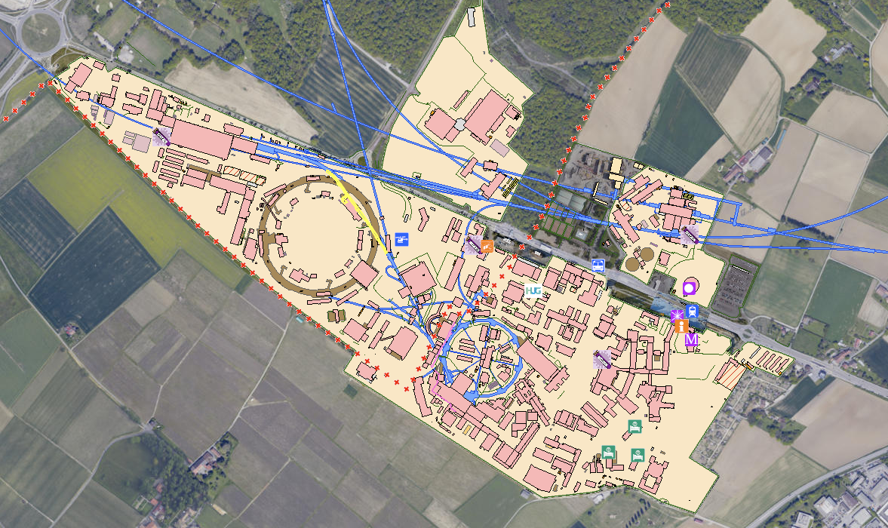
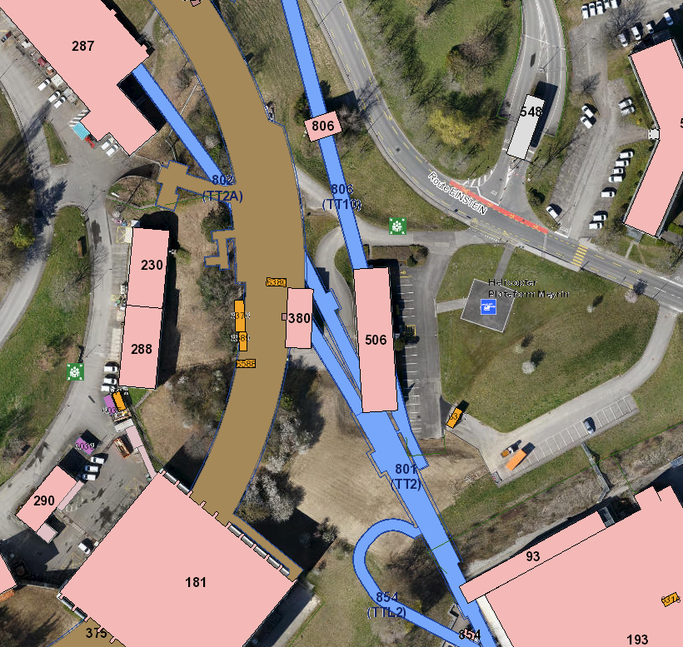
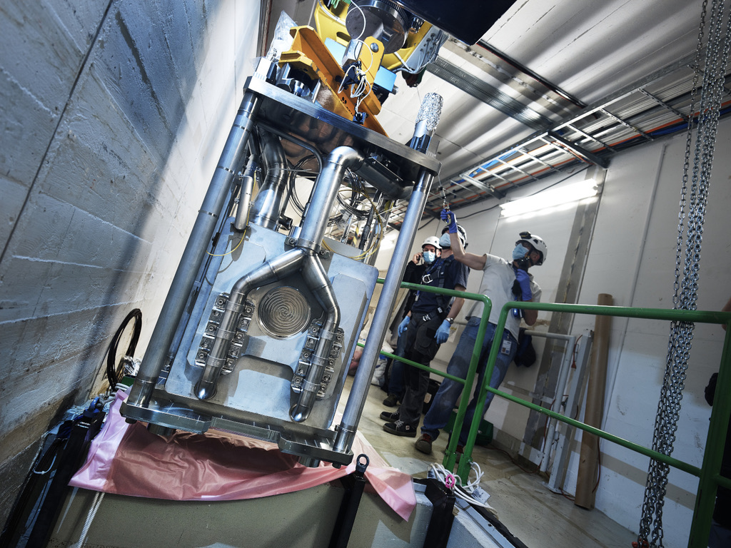
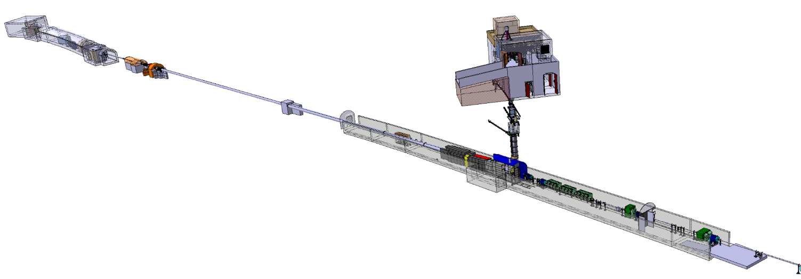
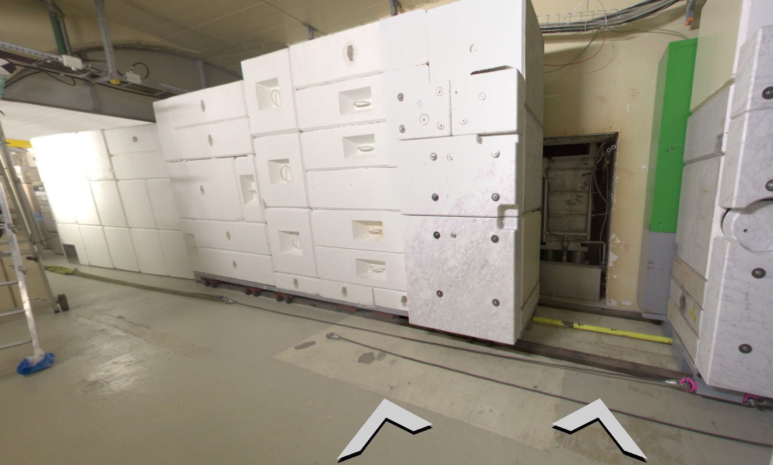

Introduction - NEAR at n_TOF
EAR2: Experimental area 2
EAR1: Experimental area 1
TT2A- 802
n_TOF target
Protons from PS
TT2 - 801
NEAR

Slide 4
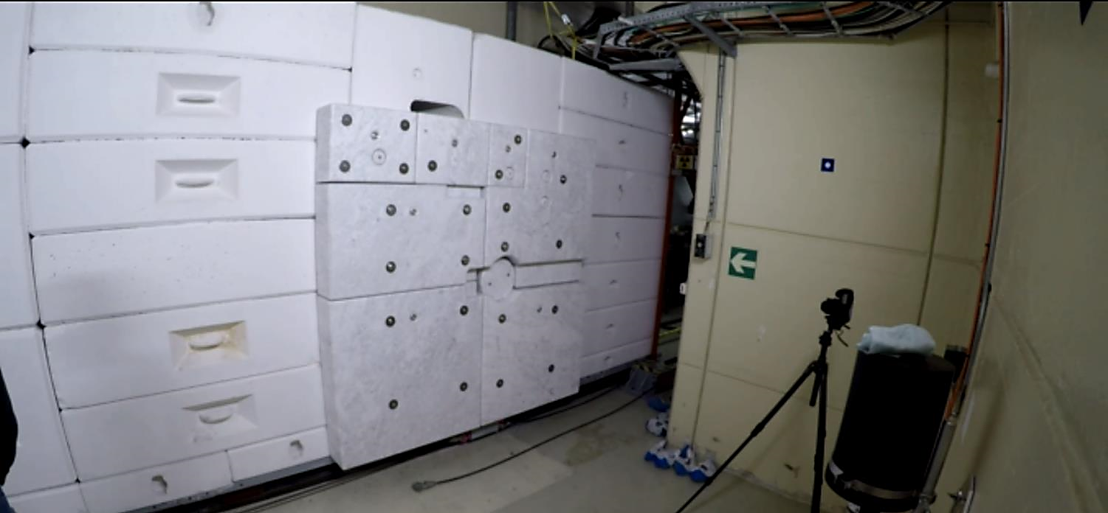
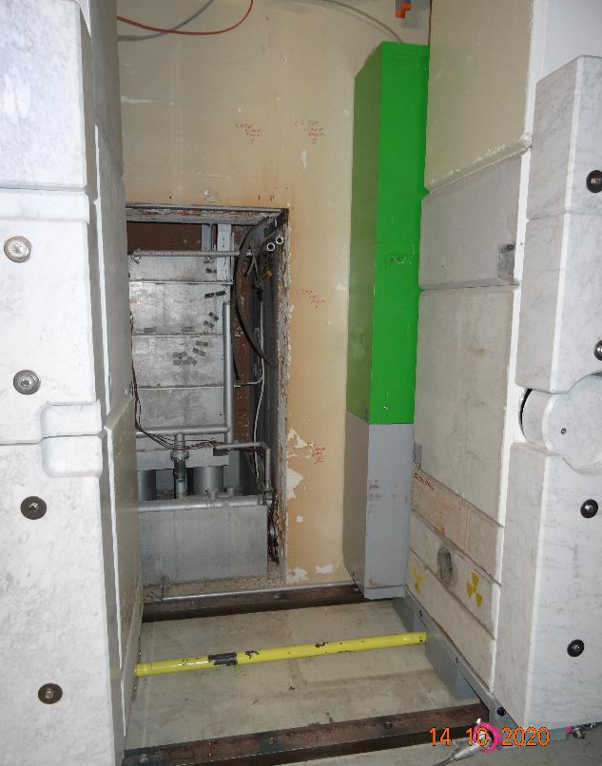
NEAR irradiation and experimental station
Roadmap for the Implementation of a New Target Mobile Shielding and a NEAR Experimental Station at the n_TOF Facility: EDMS 2158356 and associated ECR EDMS 2379173
NEAR experimental station (NEAR OUT): Outide n_TOF target Shielding
n_TOF mixed field irradiation places for R2M, R2E and n_TOF community applications - Initially foreseen during YETS 2021-2022 but successfully installed before run 3 in 2021
NEAR irradiation station (NEAR IN): Inside Shielding close to n_TOF target. Dedicated to R2M

Slide 5
Introduction - NEAR at n_TOF
n_TOF target area – Shielding OPEN
NEAR IN or
NEAR irradiation station
Pool where n_TOF target is located
Irradiation positions inside shielding - Close to the target

Slide 6
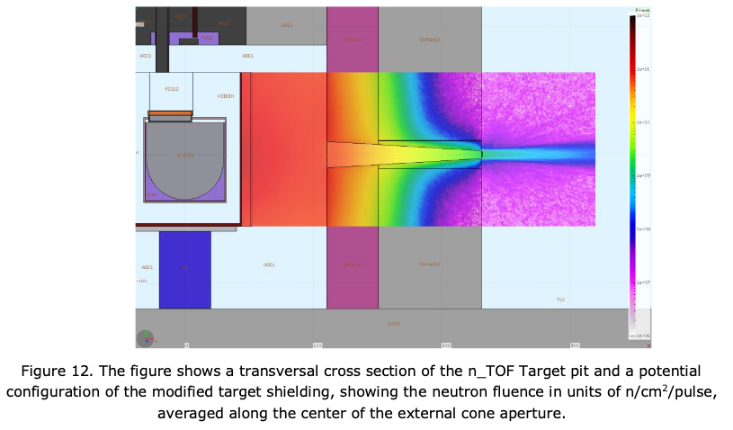
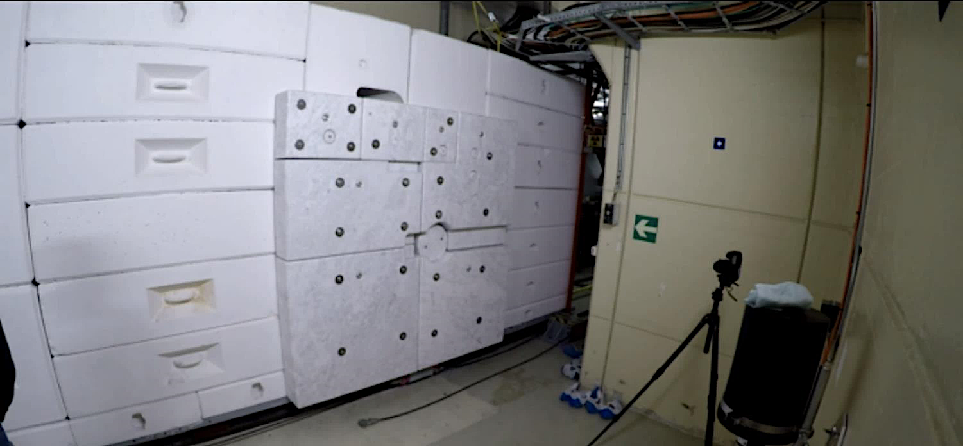
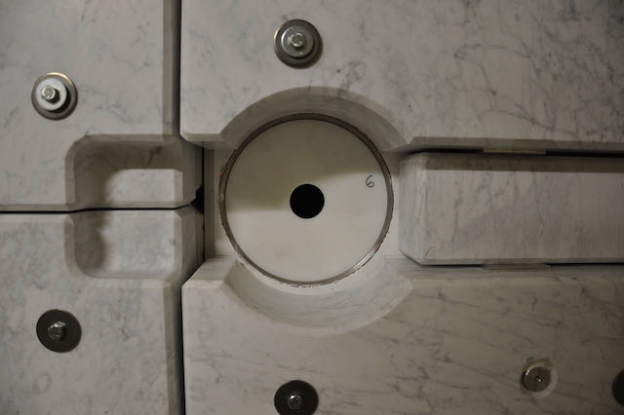
Introduction - NEAR at n_TOF
Acknowledgment: M.Barbagallo
n-TOF target area – Shielding CLOSED
NEAR OUT or
NEAR experimental station
Irradiation positions along the center of the external cone aperture

Slide 7
NEAR irradiation station (NEAR IN)

Slide 8
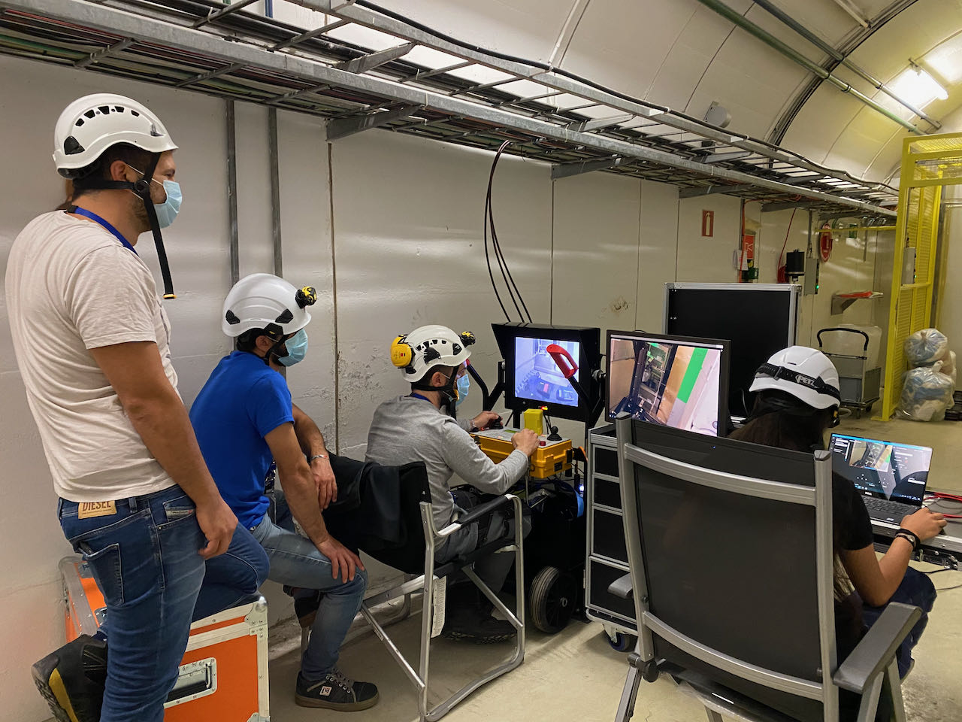
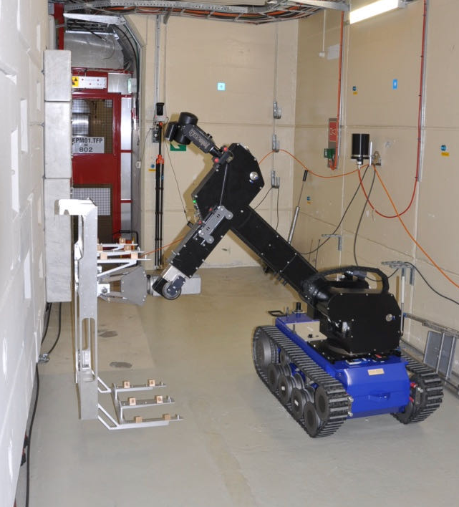
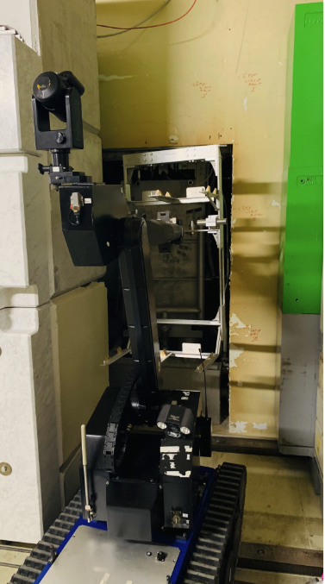
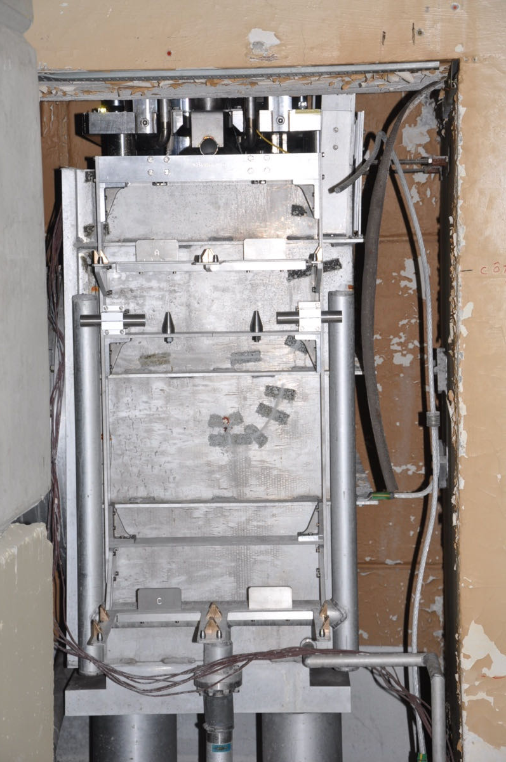
NEAR irradiation station (NEAR IN) - Shelve installation
Dose rate without target and after 2 years decay time 8 mSv/h
Acknowledgements
L.R.Buonocore, C.Veiga Almagro, E.Romagnoli, L.Barbosa Pina Pereira BE-CEM, JF.Gruber HSE-RP, D.Senajova SY-STI

Slide 9
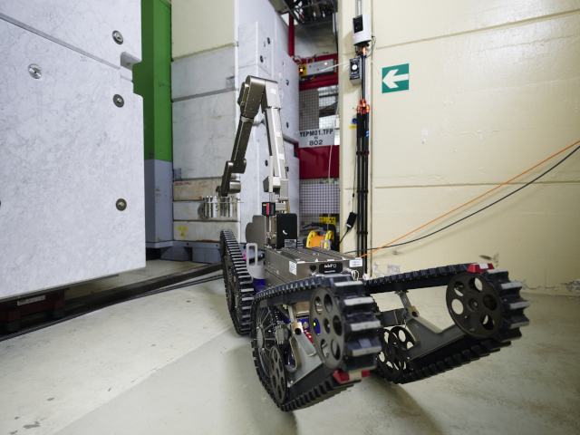
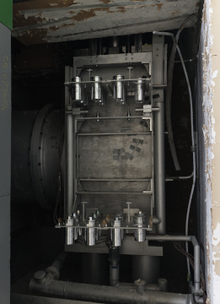
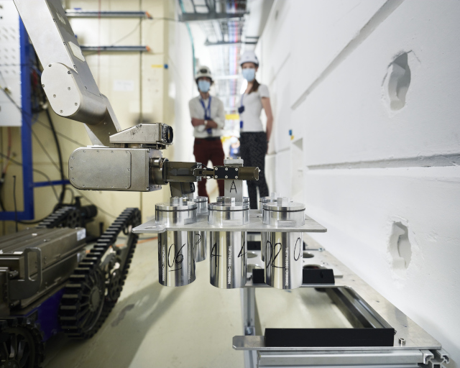
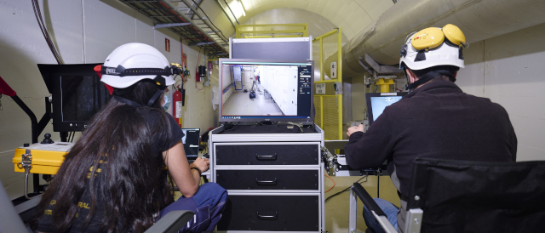
NEAR irradiation station (NEAR IN) – Samples installation
Acknowledgements
L.R.Buonocore, C.Veiga Almagro, E.Romagnoli, L.Barbosa Pina Pereira BE-CEM, JF.Gruber HSE-RP, D.Senajova SY-STI

Slide 10
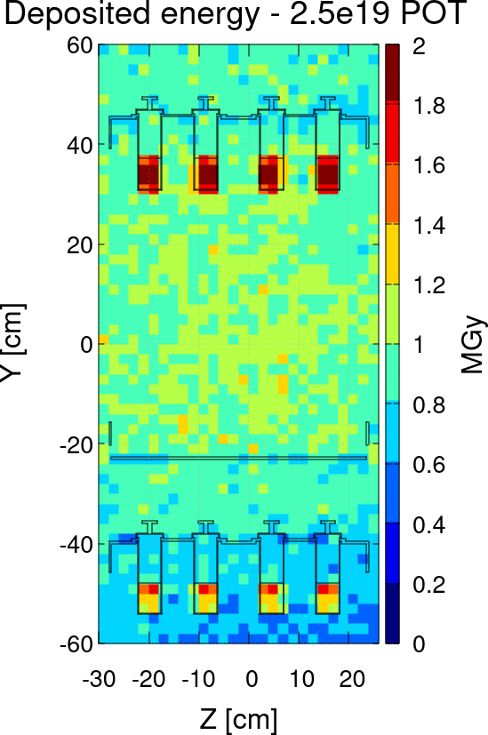
NEAR irradiation station (NEAR IN) – Irradiation parameters
IRRADIATION CONDITIONS
Neutron dose 80 to 85 % (in organic materials)
Neutrons in MeV range: dominant component
≈ 2 MGy/y – top shelf
≈ 1 MGy/y – bottom shelf
Satisfactory homogeneity
Total absorbed dose in the samples (FLUKA)
Top and bottom shelf
F.Pozzi, A. Makovec (HSE-RP), March 2021
Slide courtesy: M.Ferrari (SY-STI)
March 2021

Slide 11
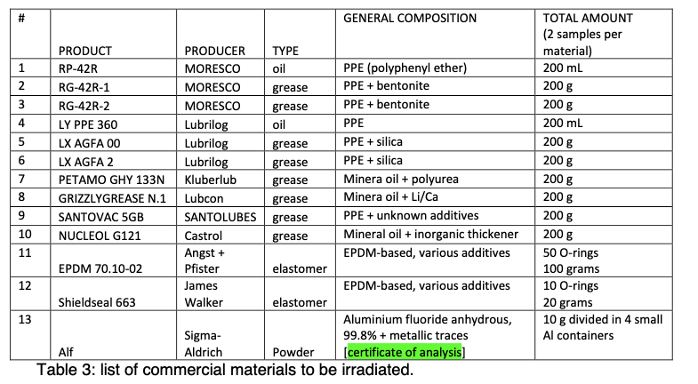
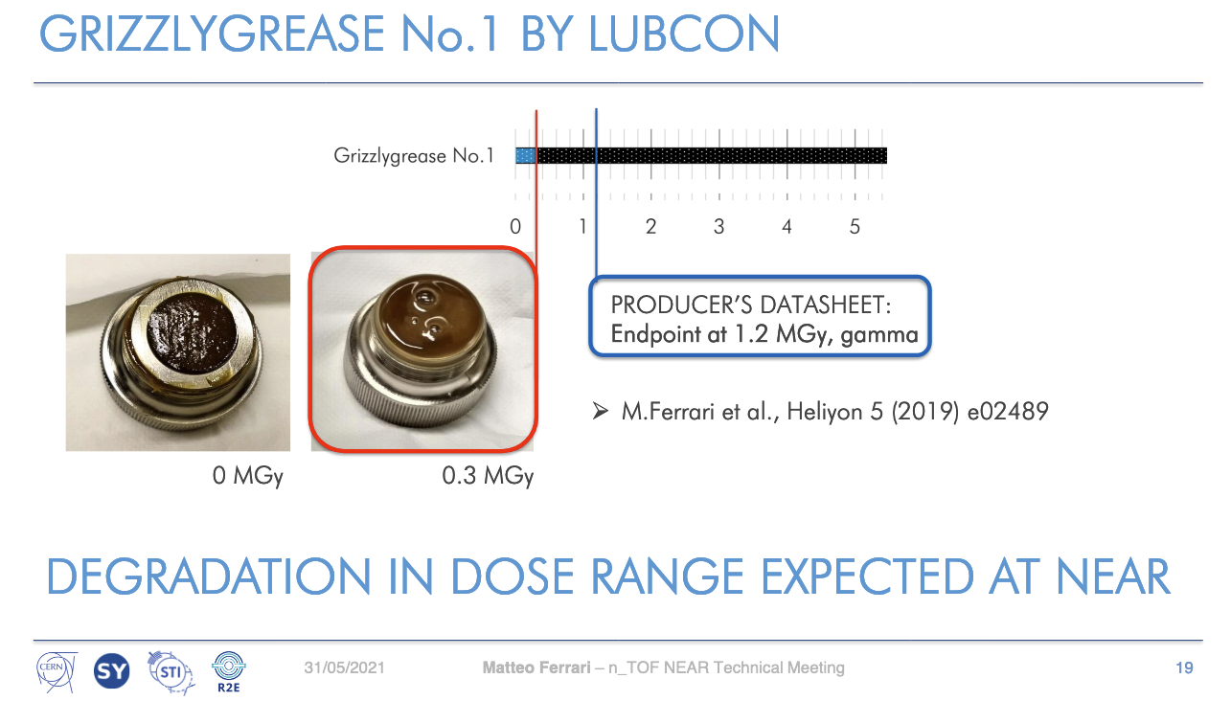
NEAR irradiation station (NEAR IN) – 2021 Samples
List of selected commercial Materials irradiated in 2021 at NEAR
Most of materials are used ate CERN
Remote handling Irradiation samples recovery planned in december 2021
Acknowledgements
M.Ferrari SY-STI

Slide 12
NEAR experimental station (NEAR OUT)

Slide 13
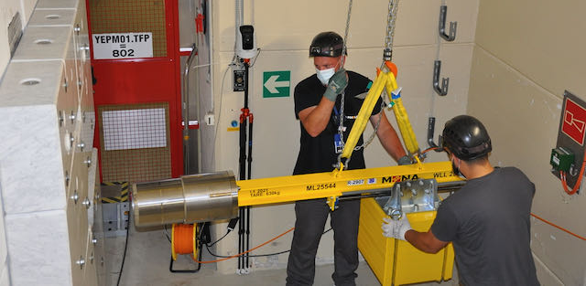
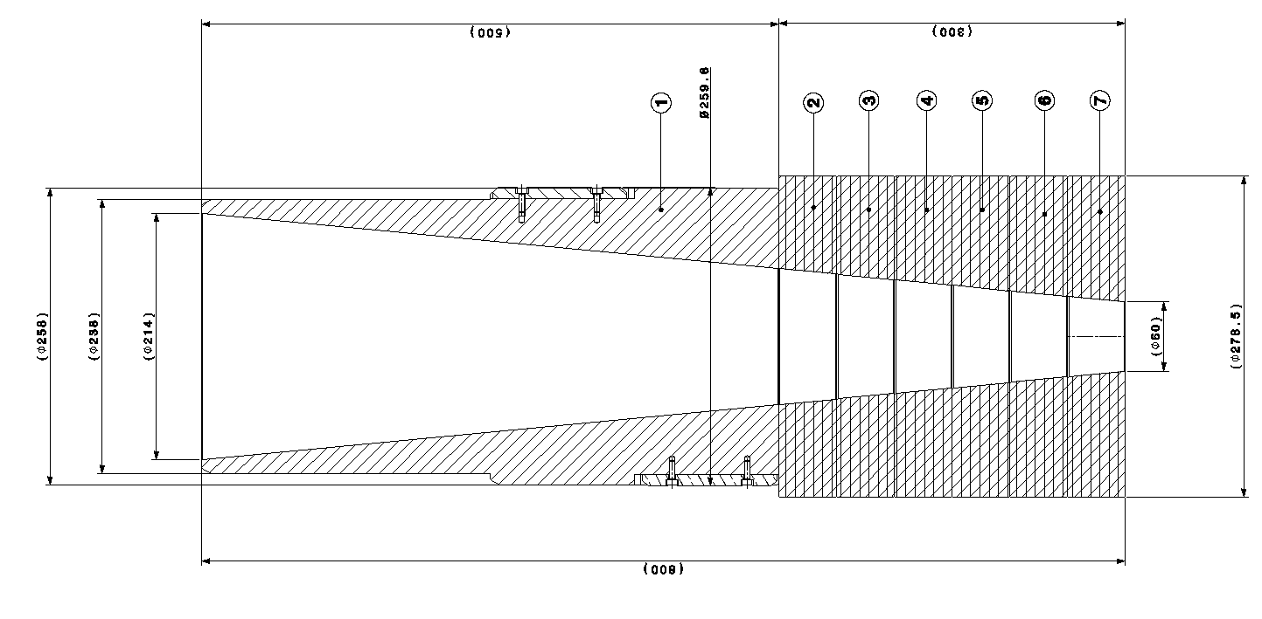
NEAR experimental station (NEAR OUT) – Collimator installation
3E6 n/cm2/pulse at the wall (considering a pulse of 7E12 protons)
5E8 n/cm2/pulse
After shielding
Acknowledgments: M.Barbagallo, G.Lerner, M.Cecchetto

Slide 14
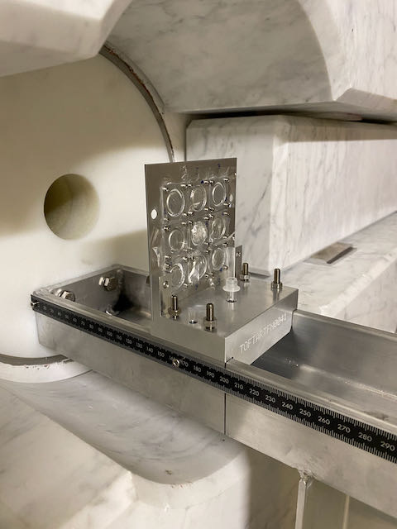
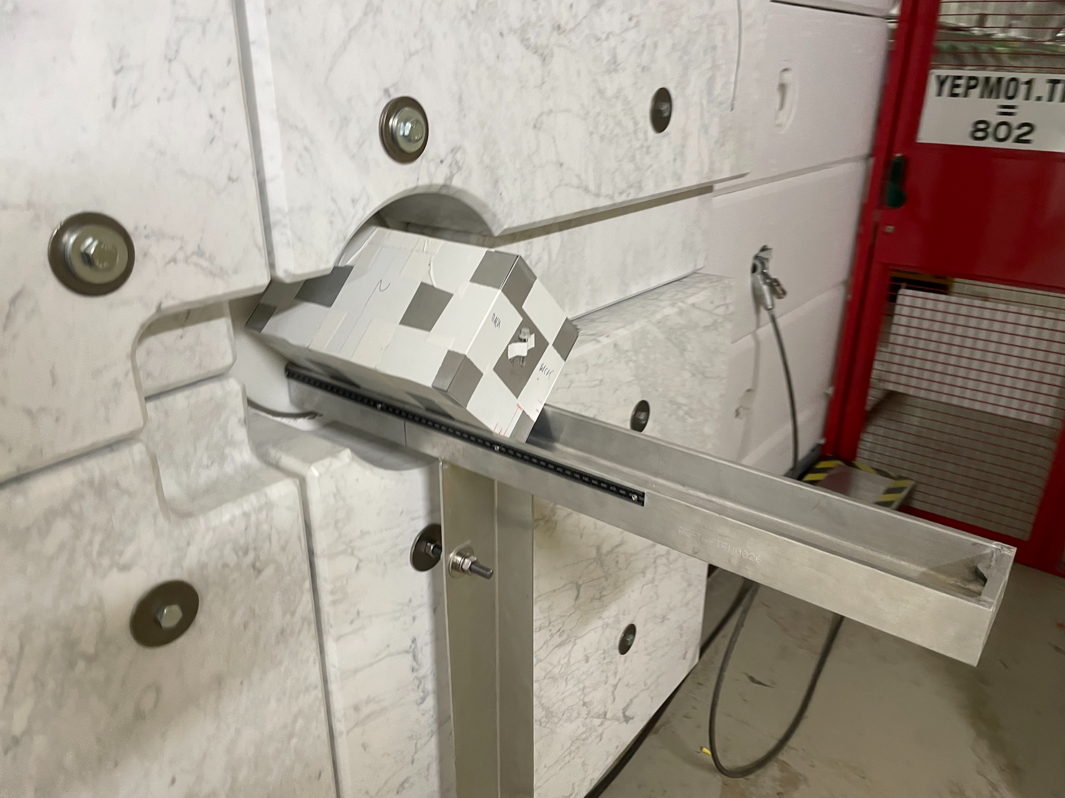
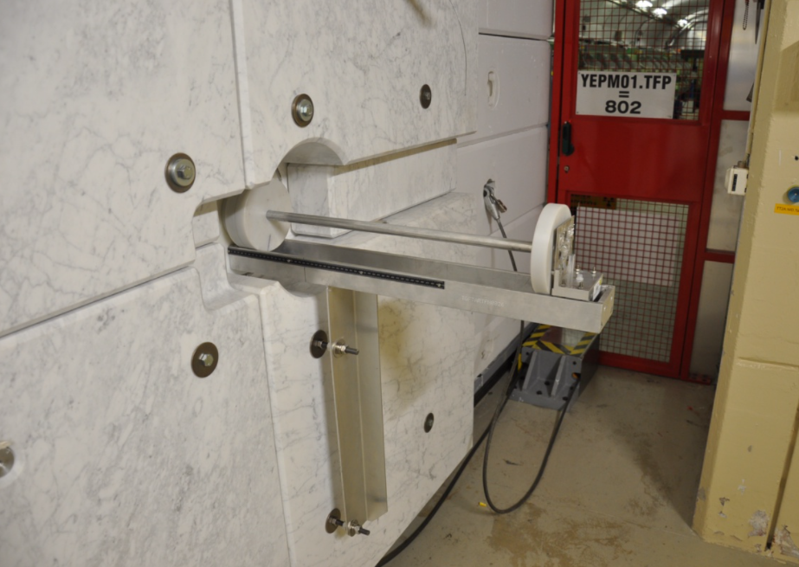
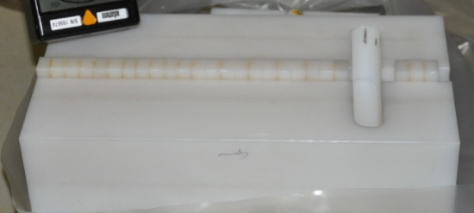
NEAR experimental station (NEAR OUT) – Multifoils activation
20 Gold samples
Acknowledgements : O.Fjeld, JF.Gruber, O.Aberle, P.Perez Maroto, G.Lavezzari, Y.Aguiar, J.A.Praena Rodriguez, A.Mengoni, N.Patronis

Slide 15
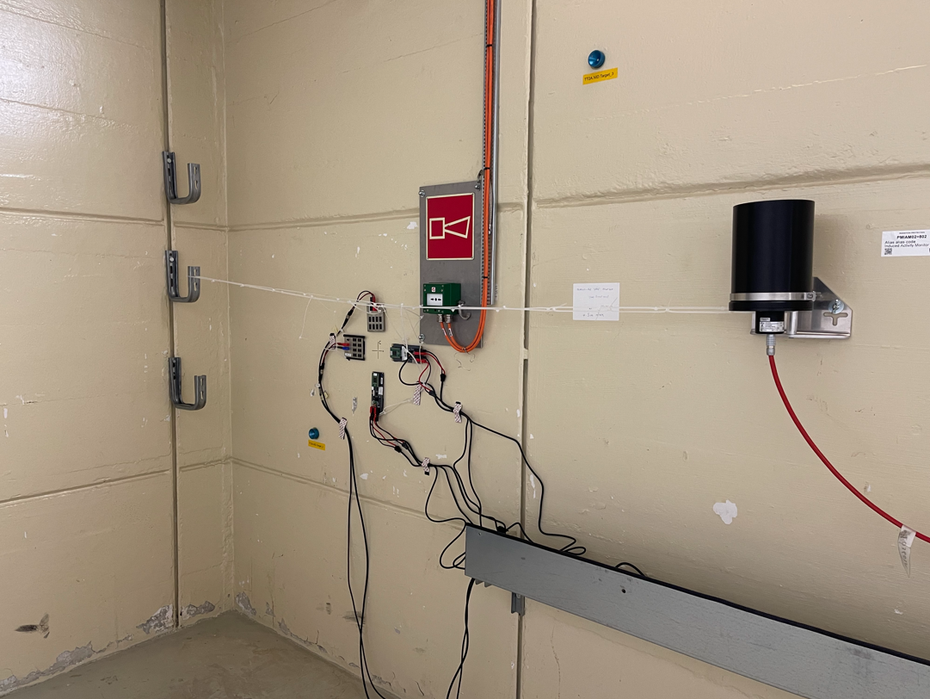
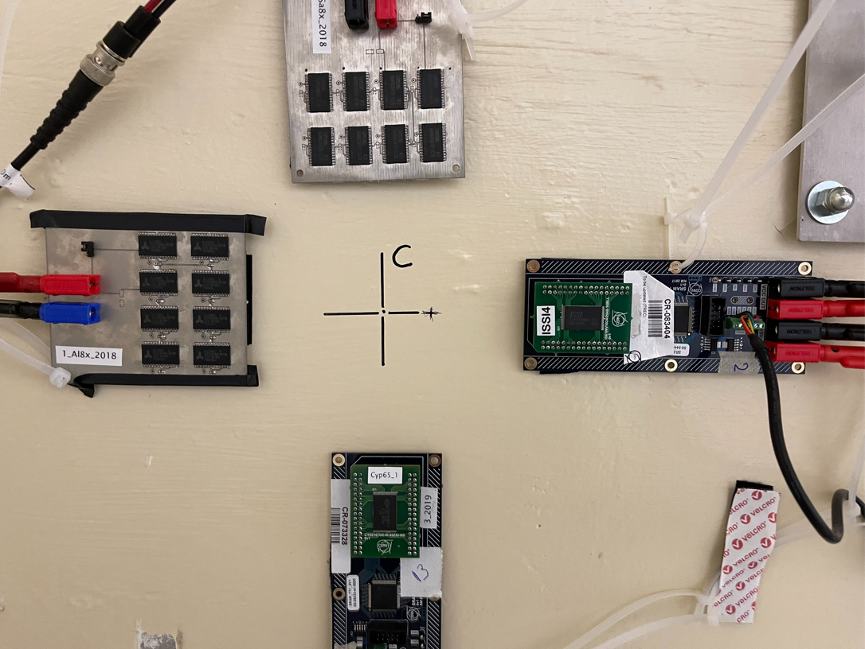
NEAR experimental station (NEAR OUT) – R2E
Measured Neutron flux
4E6 HEH/cm2/pulse
Determine the High Energy Hadron fluence at NEAR by means of SRAM memories
Future neutron beam for Displacement Damage testing in electronics
Acknowledgements : M.Sacristan Barbero, M.Cecchetto SY-STI-BMI

Slide 16
Summary
n_TOF is well known for the study of neutron-induced reactions
The NEAR Station at n_TOF for:
Irradiation station for R2M (material irradiation)
Irradiation station for R2E (irradiation of electronics)
n-TOF Multifoils activation at the collimator position

Slide 17
Thank you for
your attention!

