Slide 1
Acceleratore for Science, Technology and Applications
A premise to n-tof physics programs
Carlo Rubbia
GSSI, Gran Sasso Science Institute L’Aquila, Italy
Life member of the Senate of the Italian Republic

Slide 2
Particle accelerators
Currently there are more than 30,000 particle accelerators in operation around the world.
About 1% of them are large accelerators generally with beams above 1 GeV, used in particle physics or as synchrotron light sources for the study of condensed matter physics.
Smaller particle accelerators are used in a wide variety of applications, including
  radiotherapy
  ion implantation
  industrial processing and research and
  biomedical and other low-energy processes
Number of units
Ion Implantation
Radioisotopes
Synchrotron rad.
e-beam processing
Ion beam analysis
Neutron Generators
e-beam implantation
Non destructive Insp.

Slide 3
The Livingston plot
The” Livingston” plot showing the evolution of accelerator equivalent laboratory energy from year 1930 until today.
Progress is measured by the acceleration to (1) higher energies, (2 ) new technology and (3) ideas.
The energy is plotted in terms of the laboratory energy of particles colliding with a proton at rest to reach the same centre of mass energy
Hadron
colliders
e+-e-
colliders
(Eequivalent) Laboratory energy
Year of commissioning (1930 –>today)

Slide 4
Rolf Widerøe, the “inventor” of the Collider
Rolf Widerøe (1902- 1996) has been the progenitor of many particle acceleration concepts, including (1) the betatron and (2) the linear accelerator.
His concept of colliding two particles beams head-on in a storage ring device in order to increase the interaction energy with respect to a stationary target has been described as his 1943 patent
The unusual “invention’ format has been motivated by the exceptional circumstances of Germany during the war.

Slide 5
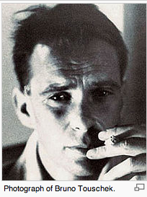
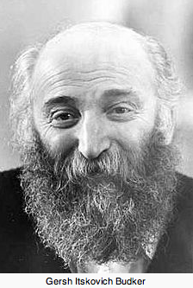
Early progress to colliders
Conceptual steps
  Frascati (Bruno Touschek)
  Novosibirsk (Gersh Budker)
Two great skepticisms:
  Luminosity (rates) and
  Beam-gas background
The early success of e⁺-e⁻ colliders:
The first p-p collisions for higher energies with the ISR: the beginning of a far more “difficult” physics. “Two swiss watches” in collision !
The p-p-bar accumulation for higher energies at the SPS and the beam-beam tune shift problem. Fewer particles, higher tune shift!
The pessimism was conjugated with a widespread initial lack of confidence in hadron collisions in spite of the higher energies when compared for instance with e⁺ -e⁻

Slide 6
Bruno Touschek
Among the key players was Widerøe’s assistant the Austrian BrunoTouschek (1921-1978 (aged 57), a victim of the Holocaust since his mother was Jewish. During the death march from the Hamburg prison, Touschek was shot by an SS officer, presumed being dead, and thus left behind fortunately still alive.
He lived permanently in Italy from 1958 until premature death. In 1960, he gave a talk in Frascati where he described the idea of the collider: a particle accelerator where a particle and its antiparticle collide within the same orbit in opposite direction.
The first electron-positron storage ring, called Anello di Accumulazione (ADA), was constructed in Frascati under Touschek's supervision in the early sixties, followed by ADONE
The SPEAR collider at the Stanford Linear Accelerator Center was completed in 1972 and soon contributed to discoveries of the ψ/J meson and the tau lepton, both recognized with Nobel Prizes to S.Ting and B.Richter (1976) and M.Pearl (1995).

Slide 7
The first electron positron colliders
For a stationary target and a beam of energy E>> mc² ; E_{cm}=(2E x mc²)^{1/2}.
In the more effective colliding beams set-up, with two accelerated beams each of energy E directed against each other, we have: E_{cm} = 2E
Gain ratio [(E_{cm})/(mc²)]^{1/2}
The first colliding e+-e- were built in the early 1960s: ADA in Frascati near Rome and VEP-1 in Novosibirsk (USSR)

Slide 8
The ISR
Construction of the first hadron (proton-proton) collider began at CERN in 1966. The collider was operational in 1971.
The radius of the ring was 150 m with 8 crossing points of the two counter-rotating proton beams at an angle of 15 deg. Its highest c. of m. energy has been 63 GeV.
A stack of a DC current of up to 50 A has been stored from protons from the CERN-PS.

Slide 9
The first hadron collider
Hadrons rather than electrons were necessary in order to further extend the domain of particle energies.
The ISR (standing for "Intersecting Storage Rings") has been the world's first hadron collider from 1971 to 1984, with a maximum center of mass energy of 62 GeV.
From its initial startup, the collider itself had the capability to produce particles like the J/ψ and the upsilon, as well as observable jet structure; however, the particle detector experiments were not configured to observe events with large momentum transverse to the beamline, leaving these discoveries for elsewhere
Nevertheless, the construction of the ISR involved many advances in accelerator physics, including the first use of Stochastic Cooling, and it held a record for luminosity at a hadron collider.

Slide 10
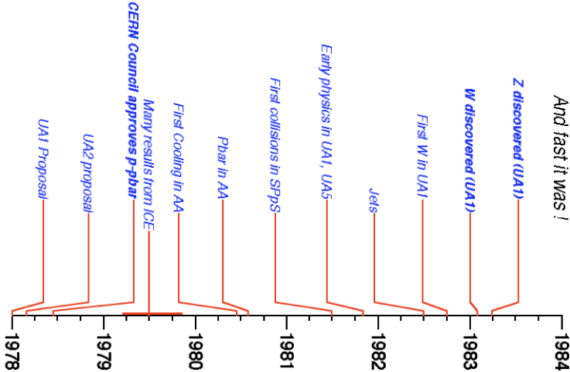
Transforming an existing accelerator into a collider
In 1976 Rubbia, McIntyre and Cline proposed to modify a proton accelerator into a proton–antiproton collider — at that time a proton accelerator was already running at Fermilab and it was under construction at CERN (SPS).
The scheme was proposed both at FNAL and at CERN, and was ultimately adopted at CERN for the SPS.
Program approval June 1978 - First W’s January 1983

Slide 11
the UA1 and UA2 experiments
The project was initiated in 1979 at the CERN Proton Antiproton collider. The SppS began operation in July 1981, and by January 1983 the discovery of the W and Z were announced.
Rubbia and Van der Meer received the 1984 Nobel Prize in Physics from the Nobel Committee, for "(...) their decisive contribution to the large project, which led to the discovery of the field particles W and Z (...)".
The Nobel prize was given to Rubbia for his "idea to convert an existent large accelerator into a storage ring for protons and antiprotons", i.e. the conception of the SppS, and to Van der Meer for his " ingenious method for dense packing and storage of proton, now applied for antiprotons", i.e. the devise of the technology for stochastic cooling.
The conception, construction and operation of the SppS were considered as great technical achievements.

Slide 12
Advances in the theory
Following the Symmetry Breaking papers by Peter Higgs and François Englert in 1964, Steven Weinberg and Abdus Salam applied the Higgs mechanism to a model of electroweak symmetry breaking for the interaction between a scalar boson and the electroweak symmetry theory.
For this achievement, Salam, Glashow, and Weinberg were jointly awarded the Nobel Prize in Physics in 1979 :
  "For their contributions to the theory of the unified weak and electromagnetic interaction between elementary particles, including, inter alia, the prediction of the weak neutral current”.
The theory (and the Nobel Prize) required also one new, massive neutral scalar particle, the Higgs— to be detected experimentally.

Slide 13
Theorists and experimentalists joining at the Nobel Cerimony
3
2
1
C. Rubbia and S. van der Meer, in the first raw, receiving the Prize with in the second raw A. Salam (1, with the turban), S. Glashow (2) and S. Weinberg (3) celebrating at the 1984 Nobel Prize Ceremony

Slide 14
From model to a more complete theoretical description
During these years, very fundamental theoretical developments took place after the idea of the Weinberg-Salam model.
Veltman and t’Hooft in 1971 described a “gauge” which had a property that in all orders of perturbation theory there are only a finite number of infinities which then might be absorbed into a re-definition of parameters, essential to any true (renormalizabile) theory.
The theory might then be able to describe weak and electromagnetic interactions at energies beyond accelerators and maybe all the way up to ≈ 10¹⁹ GeV, the so called Planck mass scale (the initial big Bang).
The Nobel Prize in Physics 1999 was jointly awarded to Veltman and t’Hooft: "for elucidating the quantum structure of electroweak interactions in physics"

Slide 15
The experimental discovery of the Neutral Currents
These attractive developments did not guarantee that their theory was true: as always, this has been the ultimate matter for confirmations with experimental observations.
In 1973 the so-called Neutral Currents were discovered in the neutrino reactions at CERN and promptly confirmed at FermiLab.
Experimental observations in neutrino interactions proved that beside the (then hypothetical] weak interaction mediated by the charged bosons W± there was also a neutral electro-weak partner, the Zº.
This was, no doubt, another “Nobel Prize class” experimental discovery which was however never recognized — in my view, mainly because of the early death of Andre Lagarrigue.

Slide 16
The initial discovery of the muon neutrino
The work rewarded was carried out in the 1960s. The muon is a relatively heavy, charged elementary particle which was discovered in cosmic radiation during the 1930s. The view, now accepted, of the paired grouping of elementary particles has its roots in this prizewinner’s discovery
The Nobel Prize in Physics 1988 was awarded jointly to Leon Lederman, M. Schwartz and J. Steinberger "for the neutrino beam method and the demonstration of the doublet structure of the leptons through the discovery of the muon neutrino."
The experiment was planned when the three researchers were associated with Columbia University in New York, and carried out using the Alternating Gradient Synchrotron (AGS) at Brookhaven National Accelerator Laboratory on Long Island.
.

Slide 17
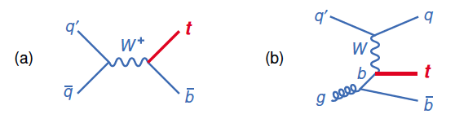
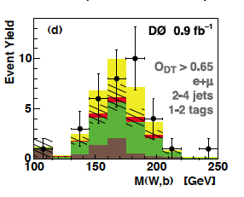
The last quark at FNAL
The first observation of single top quark production using 3.2 fb⁻¹ of pbar-p collision data with √s = 1.96 TeV collected by the Collider Detector at Fermilab (61 institutions).
The significance of the observed data is 5.0 s.d. The cross section is 2.3±0.6 pb.
First evidence for the production of single top quarks at the Fermilab Tevatron pbar-p collider and 0.9 fb⁻¹ dataset (84 institutions)
W+highest-pT b-tagged jet
The expected signal is shown from the measured cross section

Slide 18
Completing the Standard Model
The Standard Model of particle physics is a monumental description of three of the four fundamental forces in the Universe (electromagnetic, weak, and strong interactions), as well as classifying all known elementary particles.

Slide 19
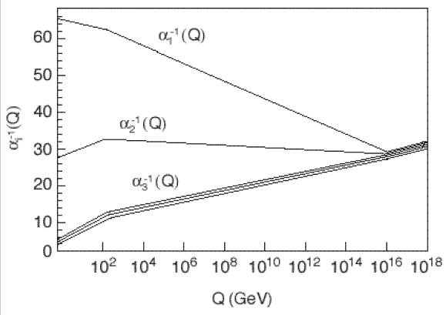
A Grand Unification ?
The running coupling constants of the three main different interactions may not simply converge to a common unified value.
This may be modified by a low mass SUSY threshold in order to converge to a common Grand Unified value already at nearer LHC masses (graph is indicative)
LEP
α1⁻¹(Q)
With low
mass SUSY at LHC energies
α2⁻¹(Q)
Without SUSY
α3⁻¹(Q)
Proton decay ?
No doubt the convergence of all the three running coupling constants to a common value with lepton-quark unification is probably inevitable.
However the mechanism of this change and mass values of its occurrence are vastly unknown (Pati-Salam, Giorgi, Glashow, etc.)

Slide 20
Collider options in the US
In 1974, ISABELLE (the Intersecting Storage Accelerator + "belle") a 200+200 GeV proton-proton system using superconducting magnets.was raccomanded for Brookhaven National Laboratory. But in 1983, the U.S. DOI cancelled the project after spending more than US$200 millions.
This proved a harbinger for the much more costly cancellation of the Superconducting Supercollider in October, 1993. The project was cancelled in 1993 due to budget problems after 22.5 km of tunnel and nearly US two billion dollars.
BNL/RHIC began operation in 2000 and until November 2010 it has been the most powerful heavy-ion collider in the world.
The LHC has then operated with 25 times higher energies per nucleon. As of 2018, RHIC and the LHC are the only operating hadron colliders in the world. But LHC uses mainly colliding protons and heavy ions only for about one month/year.

Slide 21
The latest Nobel Prize for a CERN discovery !
CMS and Atlas have observed in 2012 at the CERN LHC collider a narrow line of high significance at about 125 GeV mass, compatible with the Standard Model Higgs boson.
  ATLAS: m_{H} = 125.5 ± 0.2 (stat) ± 0.6 (sys) GeV
  CMS: m_{H} = 125.8 ± 0.4 (stat) ± 0.4 (sys) GeV
Nobel in Physics to F. Englert and P. Higgs in 2013
Experiments also excluded other Higgs bosons ≤ 600 GeV.
Searches have been performed in several decay modes, however always in the presence of very substantial backgrounds.
Experimental energy resolutions have been so far much wider than any conceivable intrinsic Higgs width. ß.
With this Higgs mass, the electroweak vacuum is meta-stable, but with a lifetime longer than the age of the Universe.
No experimentally confirmed evidence sofar for additional “new physics” like SUSY.

Slide 22
A quiet man making a big bang: Peter Higgs at CMS

Slide 23
The future of Higgs at the LHC
During the next twenty years (!) CERN plans to pursue the hadronic production of the Higgs related sector and of the possible existence of SUSY. The existence of additional Higgs particles is assumed as unlikely within the LHC energy range.
Therefore studies will concentrate on the properties of the already discovered mass. The High Luminisity-LHC will already be a sort of “Higgs factory”, able to perform relatively accurate (typically ± 10%) measurements.
There are plenty of opportunities to check the couplings since a 125 GeV SM Higgs boson has several substantive branching fractions : B (bb) 60%, B (WW) 20%, B (gg) 9%, B (ττ) 6%, B (ZZ) 3%, B (cc) 3%, etc.
B (γγ) with 0.2% is also substantive due to the high mass resolution and relatively low background.

Slide 24
The n-tof experimental programs
The idea of a new neutron time-‐of-‐flight facility at CERN was proposed by Rubbia in 1998 ’
The beam makes use of both the specifically high flux of neutrons attainable with the spallation process of 20 GeV/c protons on a massive lead target to contain practically the whole spallation and the remarkable beam intensity of the CERN Proton Synchrotron
The facility has been set in operation in 2001 .
The high neutron flux, the low repetition rates and the excellent energy resolution ( 1keV) have opened new possibilities for high precision cross sections in the energies from thermal to GeV, taking advantage of the high instantaneous neutron flux of radioactive targets.

Slide 25
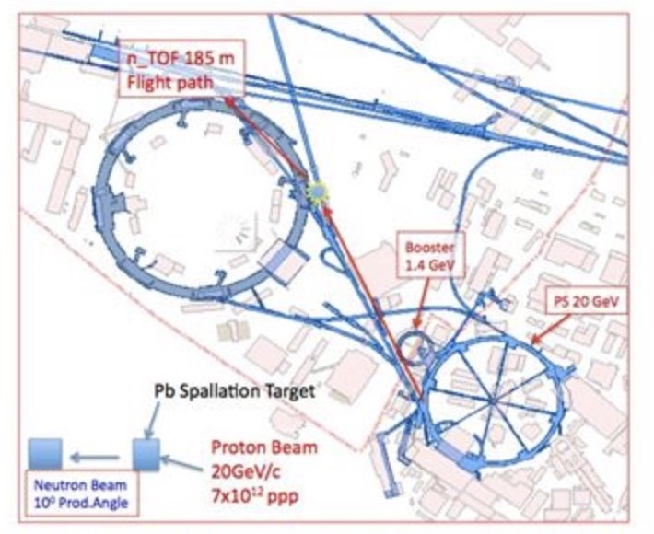
The n-tof diagram

Slide 26
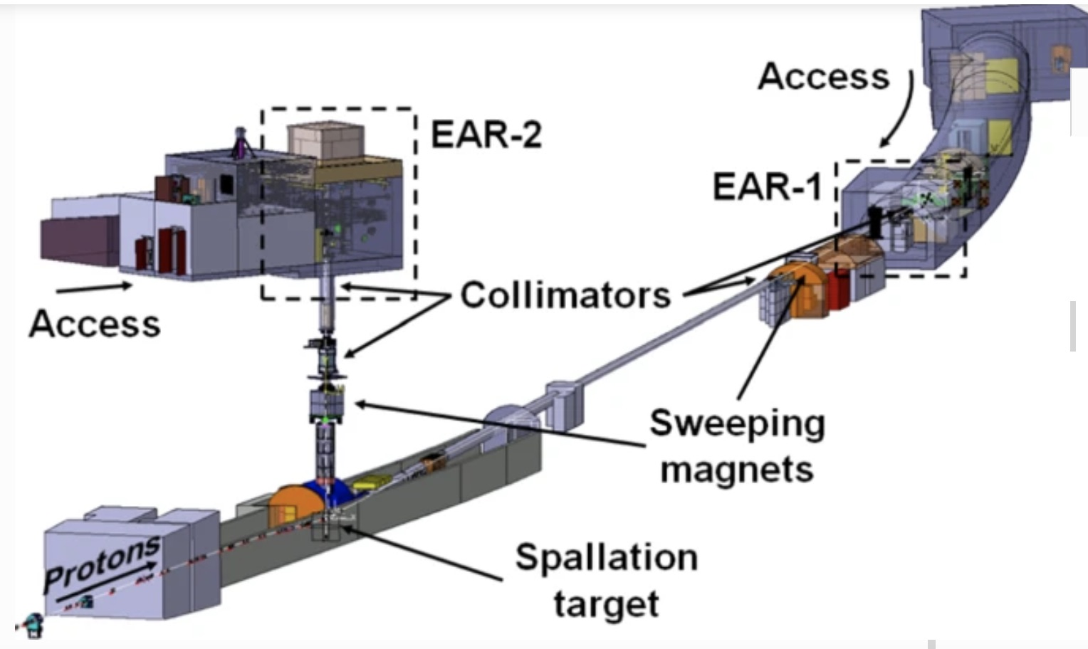
The layout of the n_TOF facility, showing the lead spallation target and the two neutron flight-paths and corresponding experimental areas, as well as the main beam-line elements.

Slide 27
Features off the n-tof measurements
The main advantages are the following:
  Neutron-‐induced reaction measurements can be performed on very small mass samples. This feature is crucial to reduce the activity of unstable samples and in cases where the available sample material is limited .(ex. 238Pu, 242Pu 243Cm, 244Cm, 245Cm, 242Am,231Pa, 233Pa
  Measurements can be performed with very small cross sections for which the optimization of the signal/background ratio is essential prerequisite (ex. ⁸⁶K ¹³⁸Ba, ¹⁴⁰Ce, ²⁰⁸Pb )
  Measurements can be performed on much shortertime scales: repeated runs with modified conditions essential to check corrections and to reduce systematic uncertainties.
  Measurements of neutron-‐induced cross sections at high E_{n}> 10-‐100 MeV), which are difficult to perform. .

Slide 28
The many other applications of accelerators.
The giant research accelerator like CERN's Large Hadron Collider in Geneva, with its 27 km is only the tip of the iceberg
An accelerator can shrink a tumor, produce cleaner energy, spot suspicious cargo, make a better radial tire, clean up dirty drinking water, map a protein, study a nuclear explosion, design a new drug, make a heat-resistant automotive cable, diagnose a disease, reduce nuclear waste, detect an art forgery, implant ions in a semiconductor, prospect for oil, date an archaeological find, besides discovering the secrets of the Universe
Medical and industrial markets exceed $3.5 billion/y, and are growing at more than ten percent annually. Digital electronics now depend on particle beams for ion implantation, creating a $1.5 billion annual market for ion-beam accelerators. All the products that are processed, treated or inspected by particle beams represent a collective annual value of more than $500 billion.

Slide 29
Conclusion: Impact of colliders on HEP
Since its initial introduction in HEP, the Collider technology firstly at CERN and later at Fermilab has dominated the highest energy sector, transforming the two major existing accelerators into colliders with remarkable luminosities: L_{init}(ppbar)=2.78 x 10³² cm⁻², ISR(pp)=1.4 x 10³² cm⁻².
The cooling technologies have been generalized and the accumulation rate has been greatly increased mostly with the help of Van Der Meer cooling and later also with Budker’s cooling both at CERN and at FermiLab.
On the other end of the energy spectrum, very low energy pbar (LEAR) have permitted very fundamental discoveries.
Equally revolutionary have been the associated development of instrumentation with the 4π “hermetic” detectors (UA1,UA2), hadron calorimetry (Schopper) and drift chambers (Charpak, Nobel 1992) which have ensured even with “Swiss watches” a detection capability comparable to the one of e⁺e⁻

Slide 30
Conclusions
Particle colliders have been in the forefront of scientific discoveries for more than half a century. The accelerator technology has progressed immensely, while the beam energy, luminosity, facility size and the cost have grown by several orders of magnitude. Essential contributions have expanded many different fields of applications.
A quick glance shows that since the 1930’s, the equivalent lab lab energy achieved by accelerators have grown exponentially with time, with an increase by a factor of ten every seven years.
These increases were always due to new ideas, and development and use of new technologies.
As we look to the future, one thing is certain: as long as we continue to make use of new technologies and ideas, new particle accelerators will continue to unpack unique and fundamental properties in Science and Technology

Slide 31
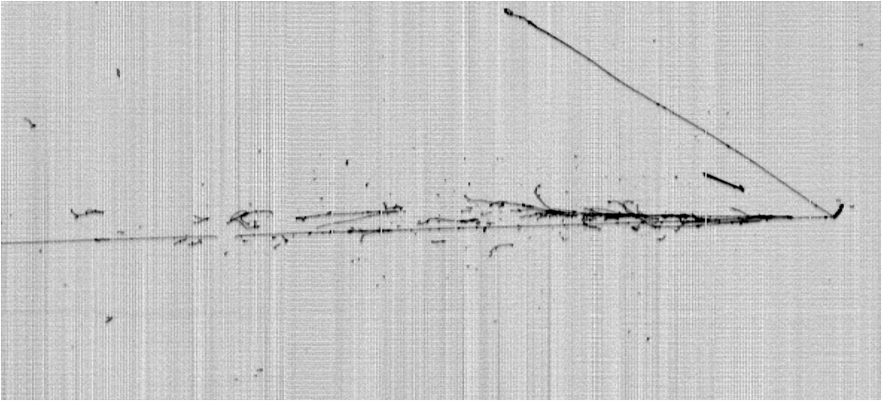
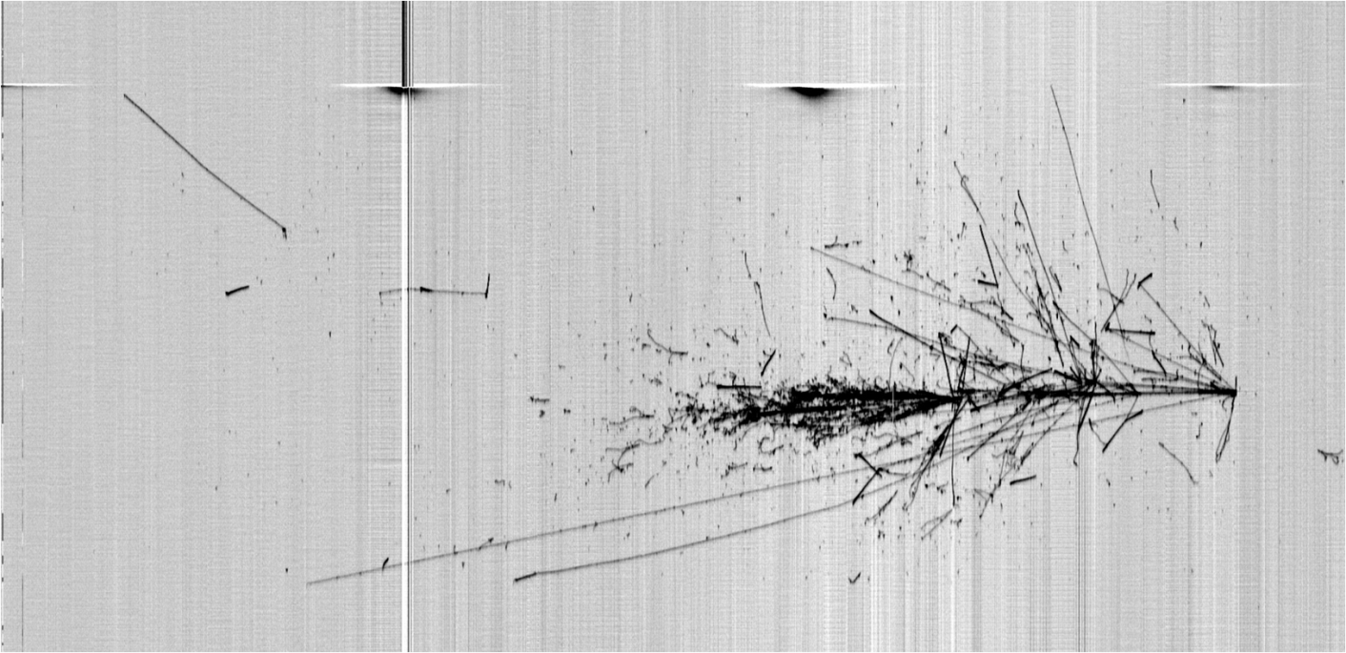
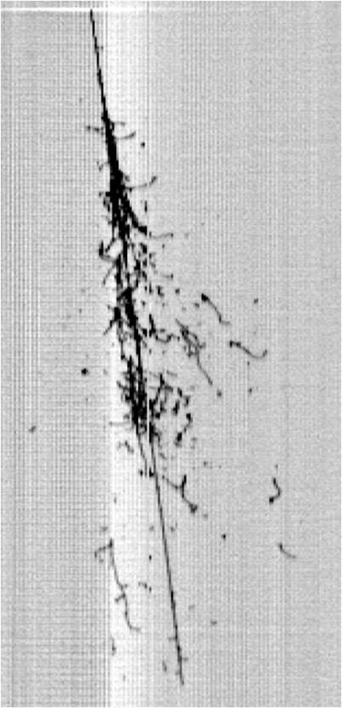
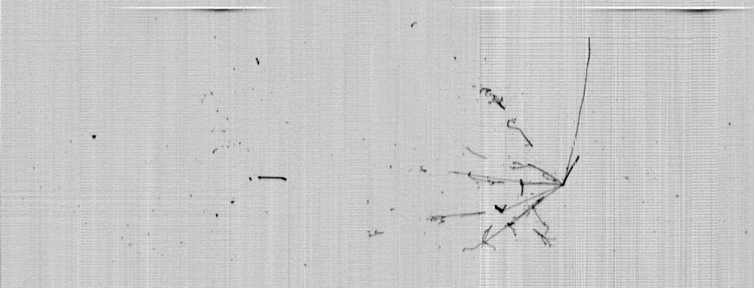
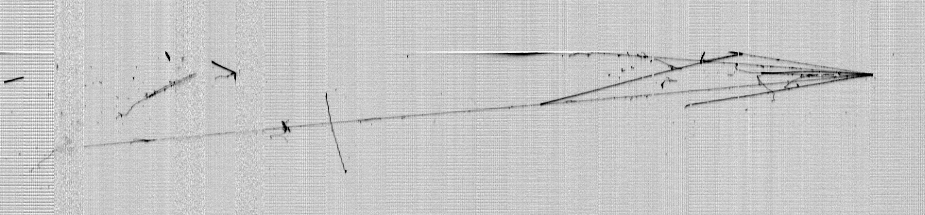
Thank you !
LNGS_May2011
Slide 31

