Slide 1


Detection developments at n_TOF
a quick tour through the challenges and n_TOF solutions to (n,*) measurements
Carlos GUERRERO
Universidad de Sevilla, Seville, Spain
Centro Nacional de Aceleradores (CNA), Seville, Spain

Slide 2
Detection developments at n_TOF
The reaction channels
(n,f)
(n,γ)
(n,chp)
The challenges
Day-to-Day cross sections measurement
Dealing with high radioactivity
Pushing the high E_{n} limits
Others …
The n_TOF solutions!
Disclaimer:
No time to include every single detector system
No space to include the corresponding references
Limited to detection systems. Analysis methods and techniques not covered

Slide 3
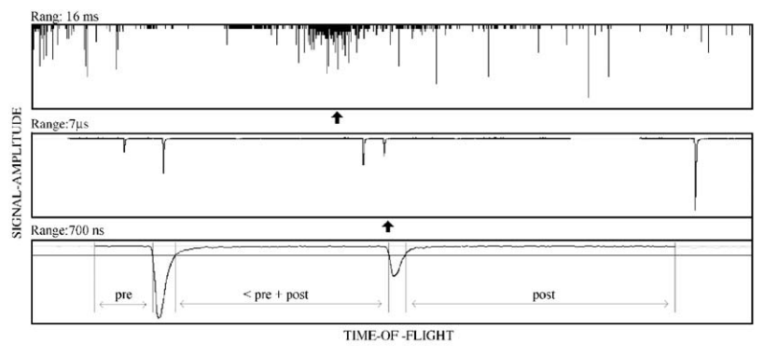
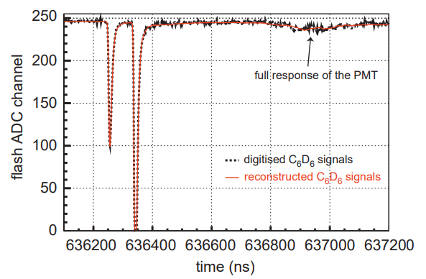
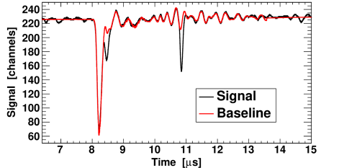
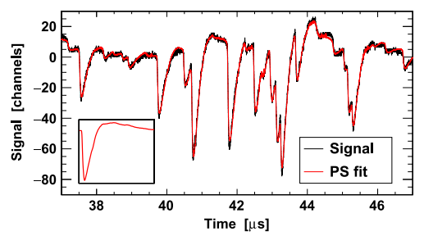
Every detector is connected to the n_TOF DAQ
n_TOF Phase 1: one of the firsts of its kind
~54 flash-ADC (FADC) channels with 8-bit and 1 GS/s with 8 MB memory
Digitized movies stored permanently (CASTOR) for offline Pulse Shape Analysis (PSA)
n_TOF Phase3 Upgrade:
8 => 10-12 bits && 8 => 64 MB && 1 => 10 Gb/s (PCIeX4)
More performant and versatile PSAs

Slide 4
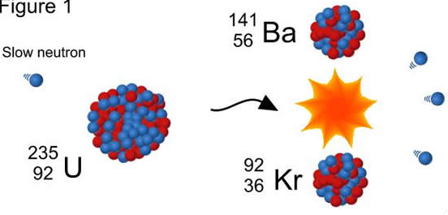
(n,f)
challenges and (n_TOF) solutions

Slide 5
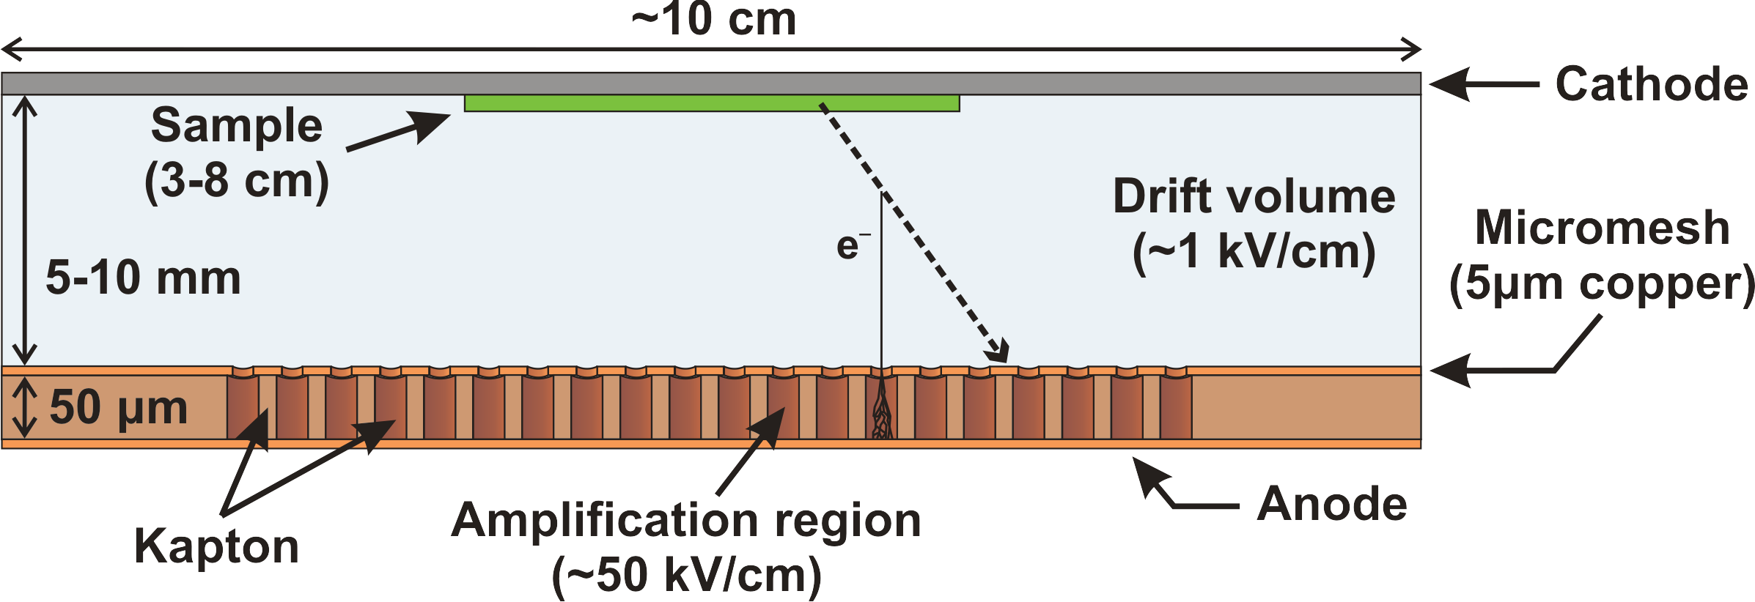
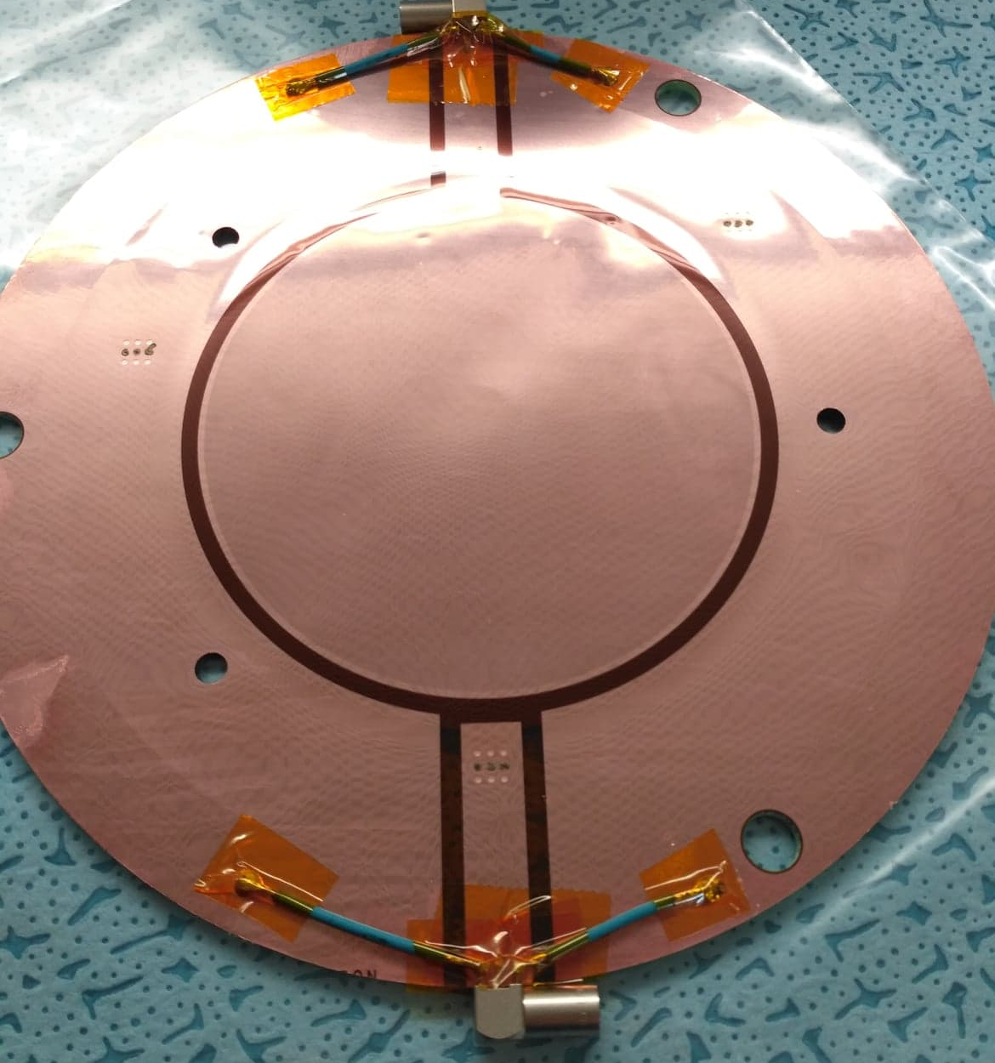
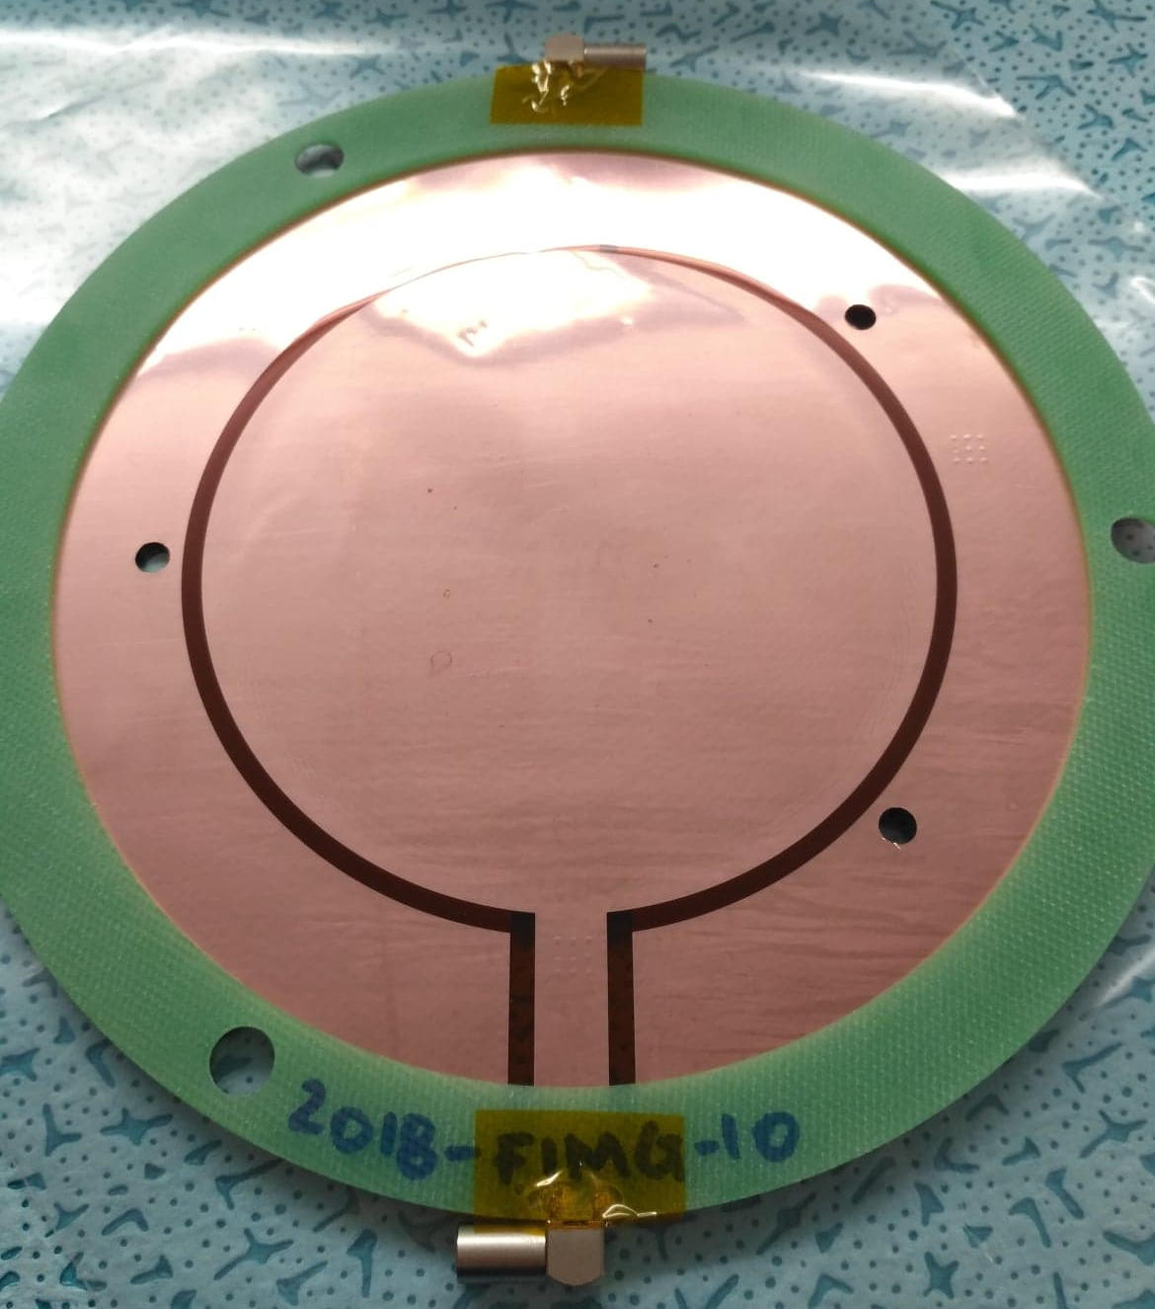
Current day-to-day fission cross sections
The challenge
The n_TOF solution
Need of a stable, robust, easy to use/analyze fission detector
[for σ(n,f) and beam monitoring]
Mesh
n_TOF Micromegas MGAS (micro-mesh gaseous structure) detectors:
Minimal material (almost ”transparent” for neutrons)
High detection efficiency (100% in fission studies)
Radiation durability - important for highly radioactive samples
Fast response & time resolution
τ_{raise}~20ns
FWHM~150ns
Anode
MGAS@n_TOF ===> Beam monitoring with ²³⁵U(n,f) + σ(n,f) of ²³⁰Th, ^{240,242}Pu + …

Slide 6
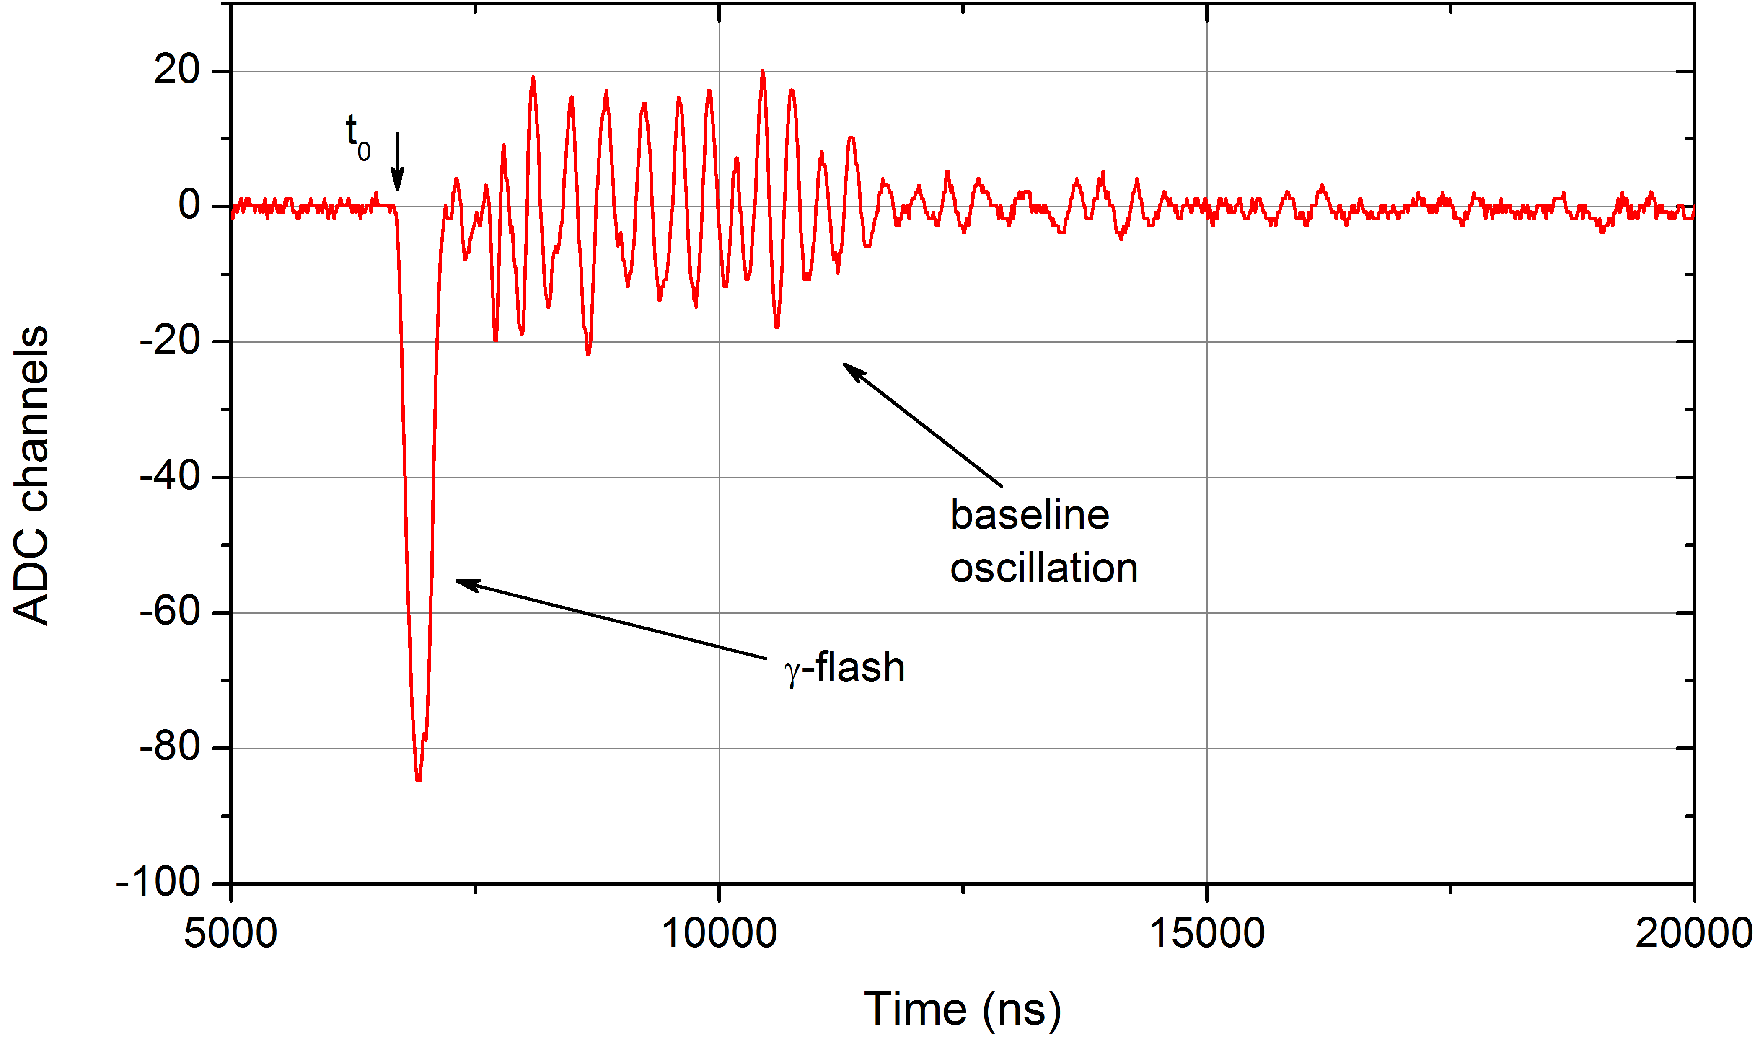
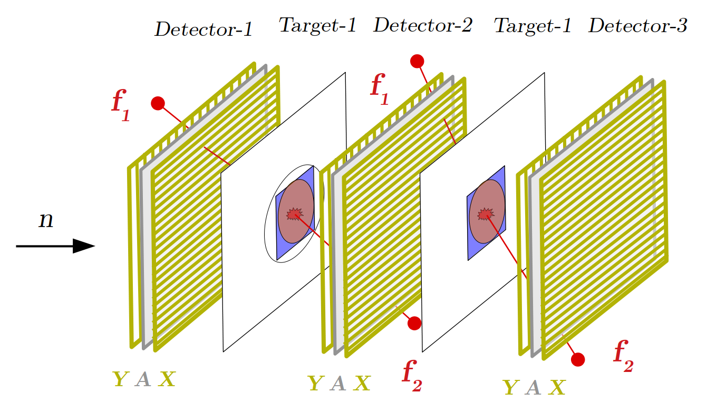
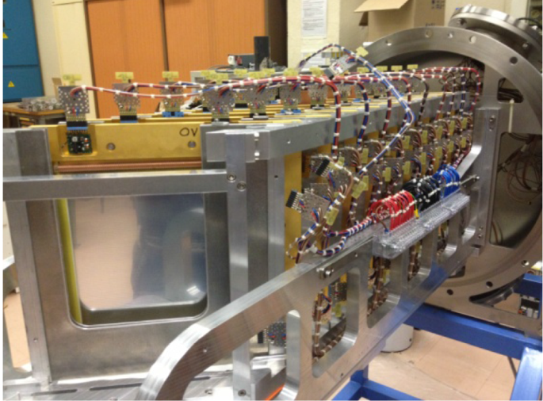
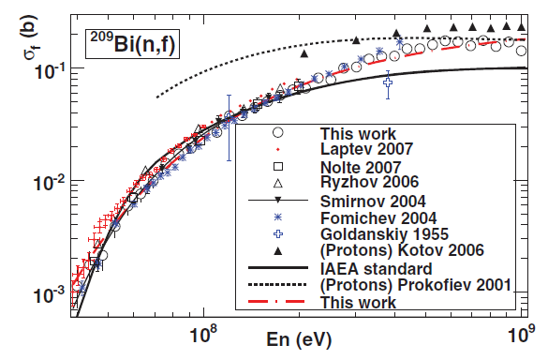
Pushing the high E_{n} limit
The challenge
The n_TOF solution
few MeV
MGAS
₁ ₁ ₁
₂ ₂ ₂
₃ ₃ ₃
n_TOF Parallel Plate Avalanche Counters (PPAC) detectors:
Low (1-10mb) pressure: fast ion mobility => excellent timing (200 ps resolution)
Thin anode/cathode (1-2 um Al-Mylar): transparent => low sensitivity to γ-flash
Position sensitivity: 2mm pitch gives 300μm resol. => measure angular correlations
PPAC@n_TOF ===> Beam monitoring + σ(n,f) and ang. corr. of ^{nat}Pb, ²⁰⁹Bi, ²³³U, ²³²Th (1 GeV!)

Slide 7
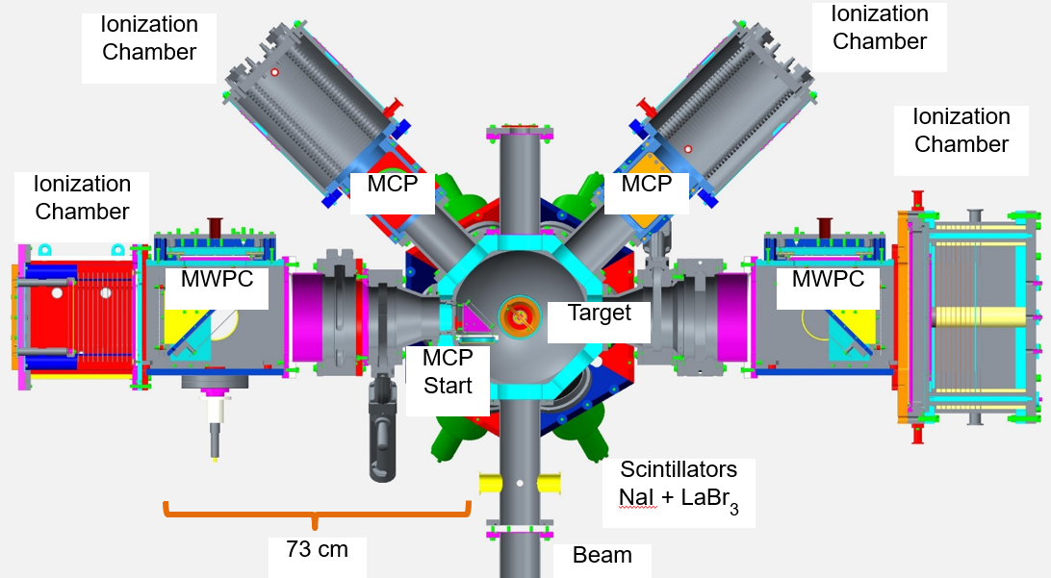
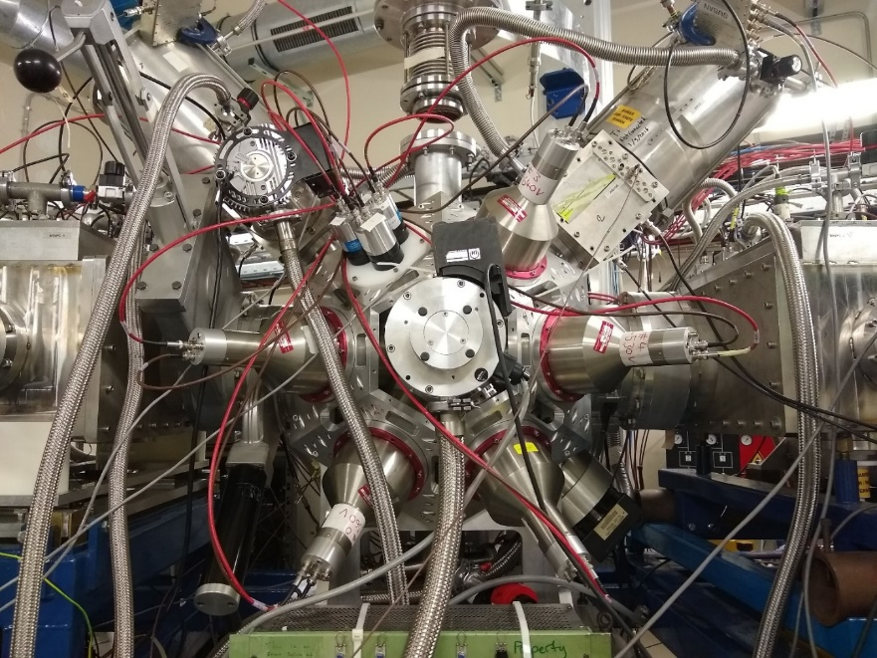
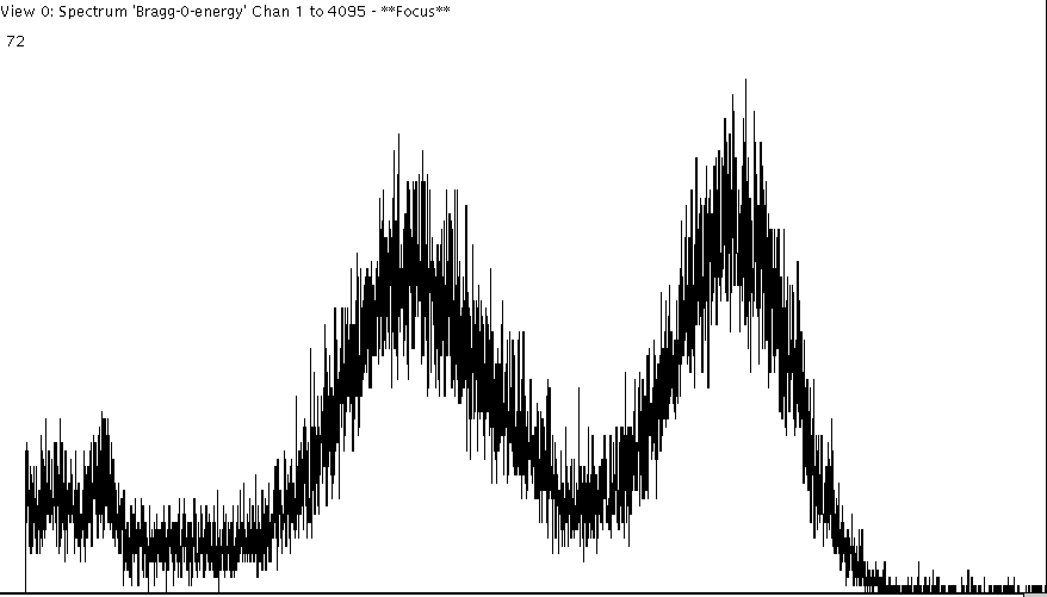
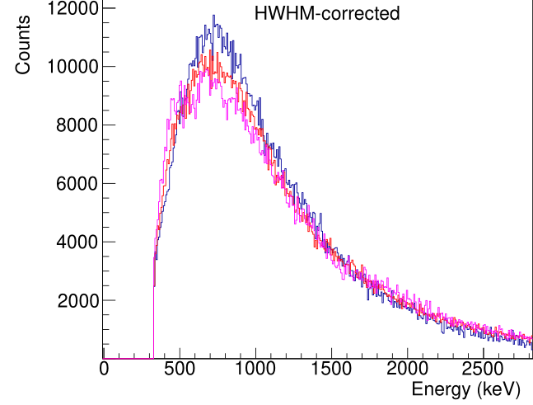
Seeing all fission observables simultaneosuly
The challenge
The n_TOF solution
Fission is very rich in observables!
Fission fragments:
    A and Z yields
Prompt emission of:
    gammas: energy and multiplicity
    neutrons: multiplicity (Nubar)
STEFF:
SpecTrometer for Exotic Fission Fragm.
Main axis ( 1 & 2)
e⁻ detectors for FF ToF (10 mbar C₄H₁₀):
  MCP start + MWPC stop
IC (100 mbar C₄H₁₀,15 segments)
Secondary axes (3 & 4)
e⁻ detector for FF timing
  MCP only
IC (100 mbar C₄H₁₀ isobutane)
FF@Bragg
prompt γ
Scintillators: Array of NaI and LaBr₃ detectors
STEFF@n_TOF ===> ²³⁵U and ²³⁹Pu experiments

Slide 8
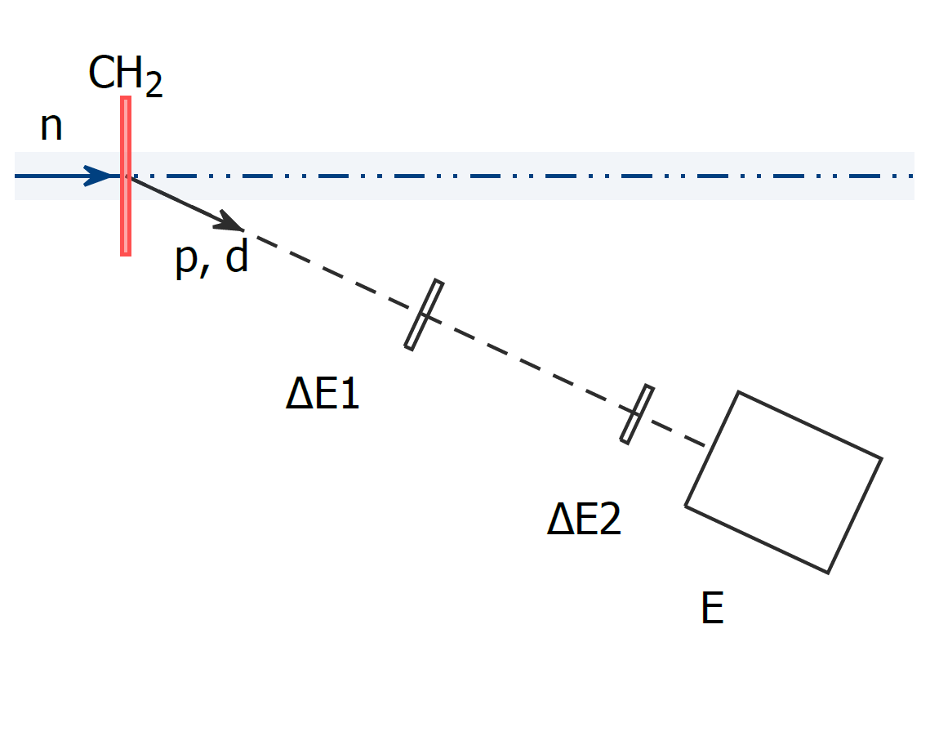
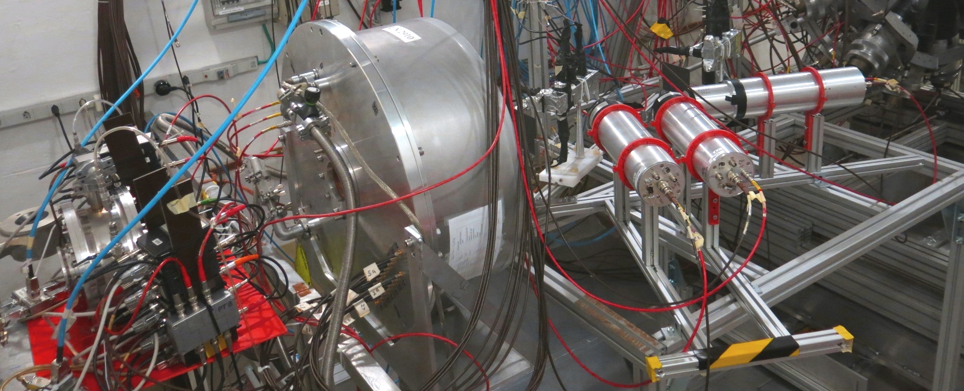
Measuring relative to ¹H(n,p) at high E_{n}
The challenge
The n_TOF solution (II)
²³⁵U(n,f) standard only up to 200 MeV,
how can it be extended above 20 MeV? masure abve 200 MeV
Pyramidal shape
proton
Radiator - C₂H₄
E detector
plastic scintillators (EJ-204)
ΔE detector
2 silicon detectors 300 μm thick
4 plastic scintillators
=> 5, 30, 60 and 60 mm thick
PRT@n_TOF: ²³⁵U(n,f) combined with PPAC

Slide 9
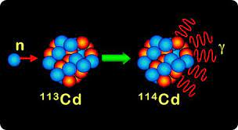
(n,γ)
challenges and (n_TOF) solutions

Slide 10
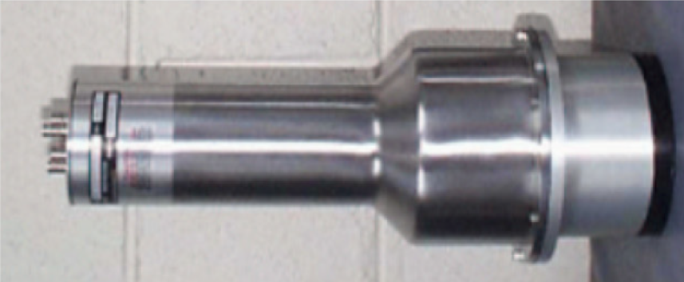
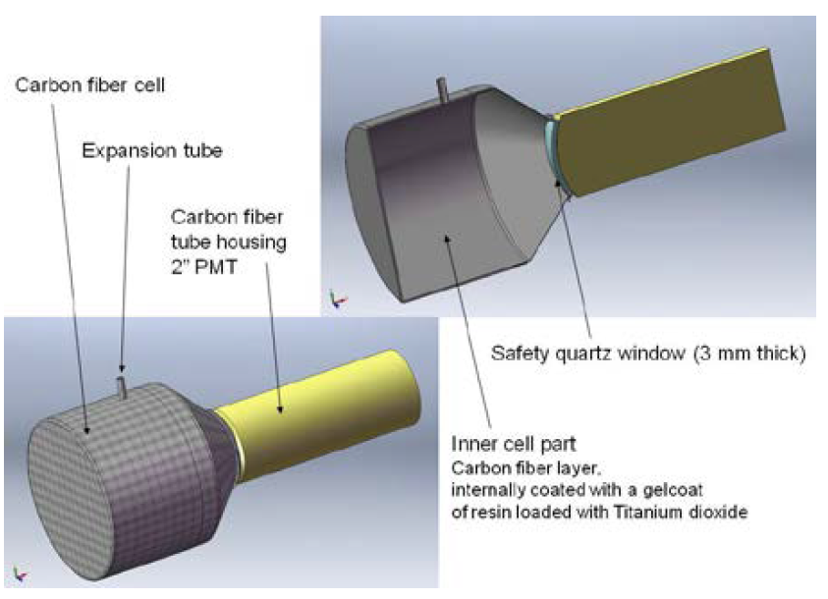
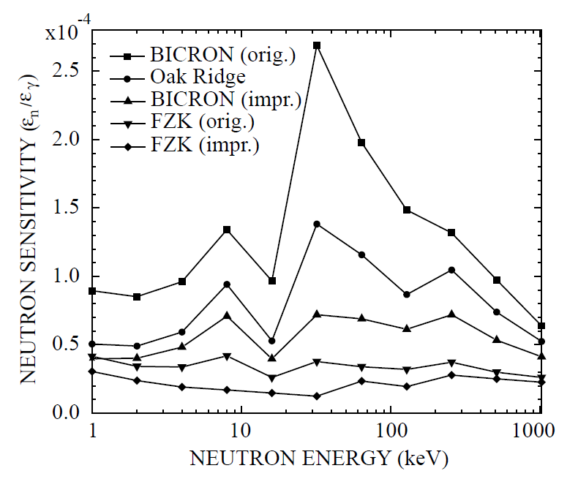
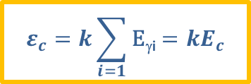
Neutron sensitivity
The challenge
The n_TOF solution
γ
γ
Neutron scattering (sample→ detector) background
γ
n
γ
γ
n
n
γ
Al/SS→Carbon Fiber
Total Energy Detectors (TED):
Condition I: Low efficiency detectors ε_{γi}<<1
Condition II: The efficiency is proportional to E_{γ}
  (by means of the ¿accurate? PWHT)
$$ε_{c}=k\sum_{i=1}{\text{E}\text{γ}\text{i}}=kE_{c}$$
C6D6@n_TOF: ³⁵Cl, ⁵³Mn, ^{54,57}Fe, ⁵⁸Zn, ^{62,63}Ni, ^{90,91,92,93,94,96}Zr, ^{69,71}Ga, ^{72,74,76}Ge, ⁸⁰Se, ⁸⁹Y, ⁸⁸Sr, ¹⁴⁰Ce, ¹⁴⁷Pm, ¹⁷¹Tm, ^{203,204}Tl, ^{204,206,207}Pb, ²⁰⁹Bi, ^{236,238}U, ²⁴²Pu, ^{244,246}Cm

Slide 11
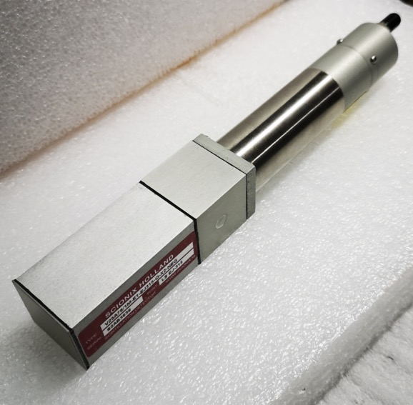
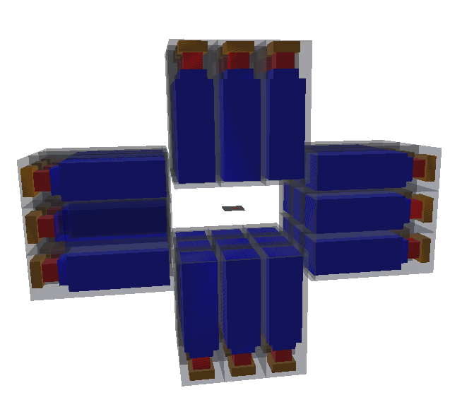
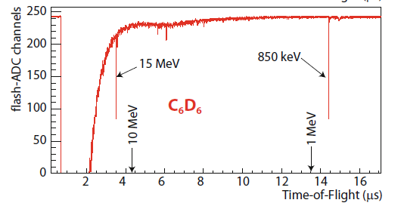
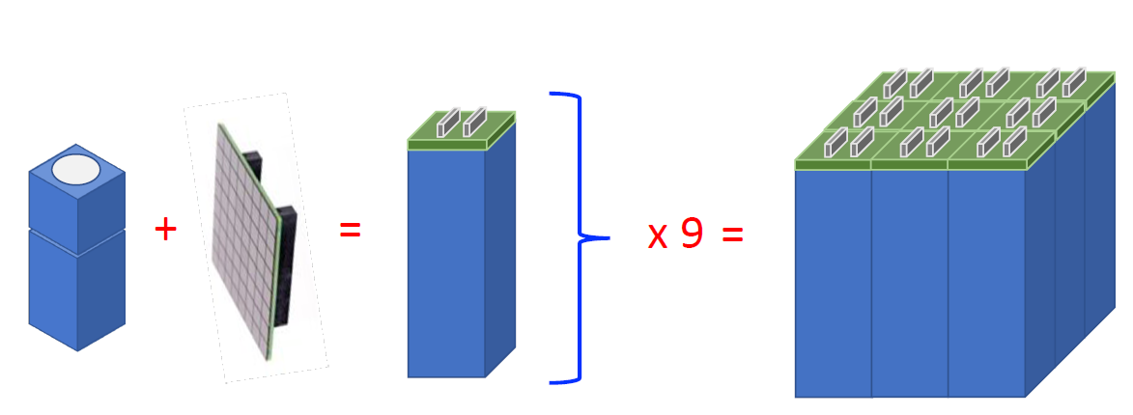
Pushing the high E_{n} limit (@EAR2?)
The challenge
The n_TOF solution
The upper E_{n} limit for (n,γ) at EAR2 is due to:
High counting rate
Huge g-flash
C₆D₆
(1”x1”x3”)
n_TOF segmented Total Energy Detector (sTED)
Physical segmentation reduces the large energy deposition due to the flash and the counting rate in individual each detector, while keeping the overall efficiency.
Smaller readout devices (PMTs and or SiPMs) for mitigating the interaction of the flash with the device itself
200 keV
12 keV
sTED@n_TOF ===> beam tests ongoing

Slide 12
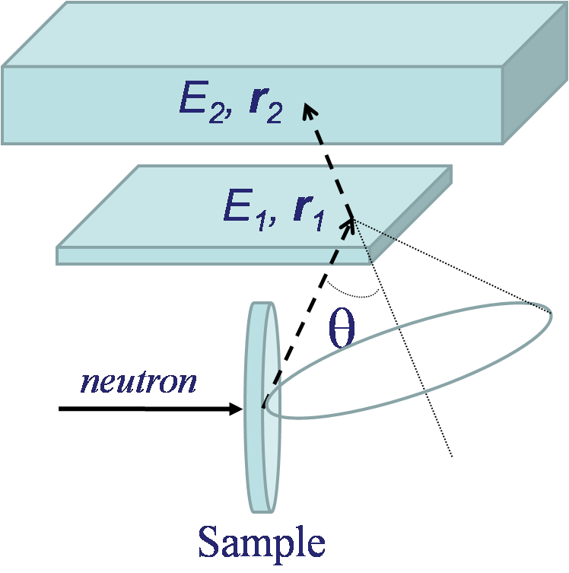
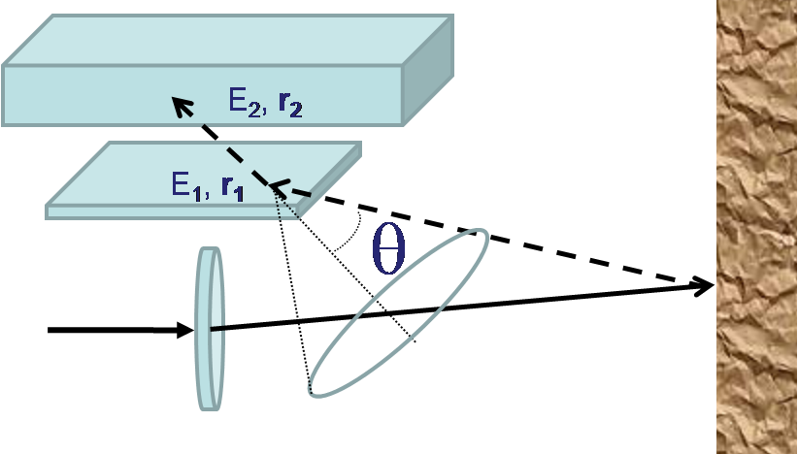
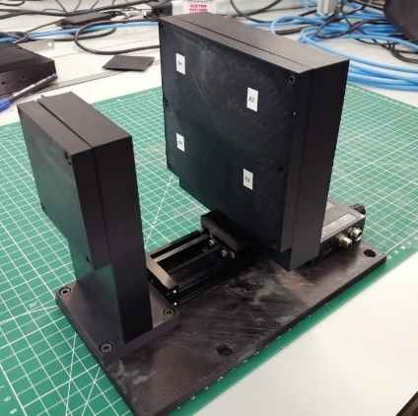
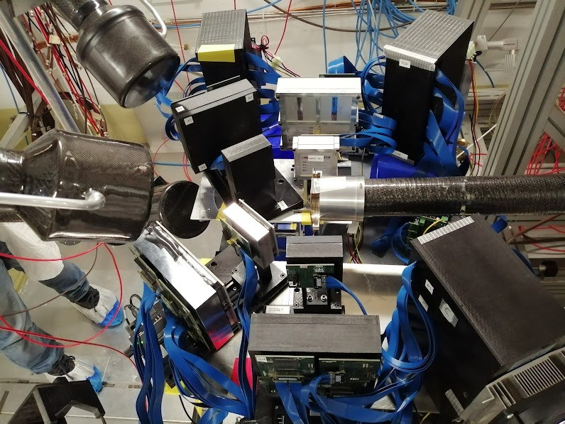
Low signal to background cases
The challenge
The n_TOF solution
GAMMA IMAGING
Everything but γ-rays from the sample is background!
True Capture Event
Backgound event
4 iTEDs
Total Energy Detector with γ-ray imaging capability (i-TED)
4 detector modules: scatterer (15 mm) + absorber (25 mm)
LaCl₃ scintillators
Position sensitive SiPM with PETsys readout electronics
iTED@n_TOF: tests at EAR1 and EAR2, ⁷⁹Se in 2022

Slide 13
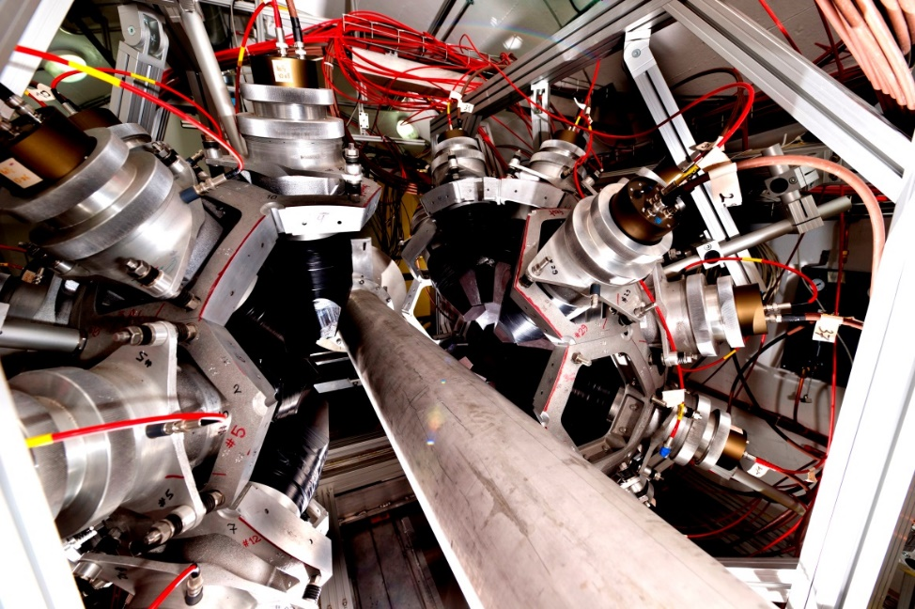
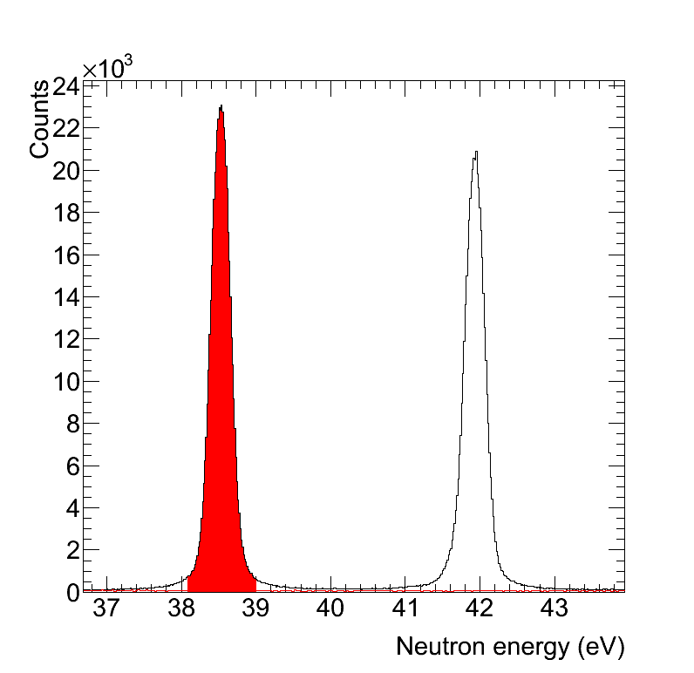
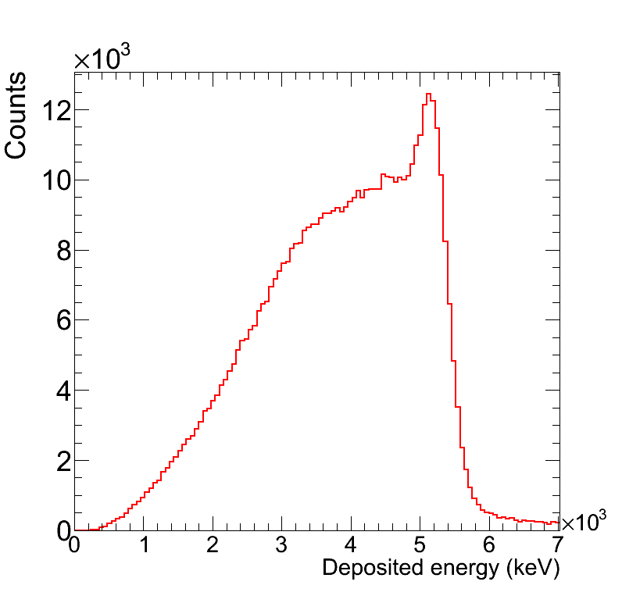
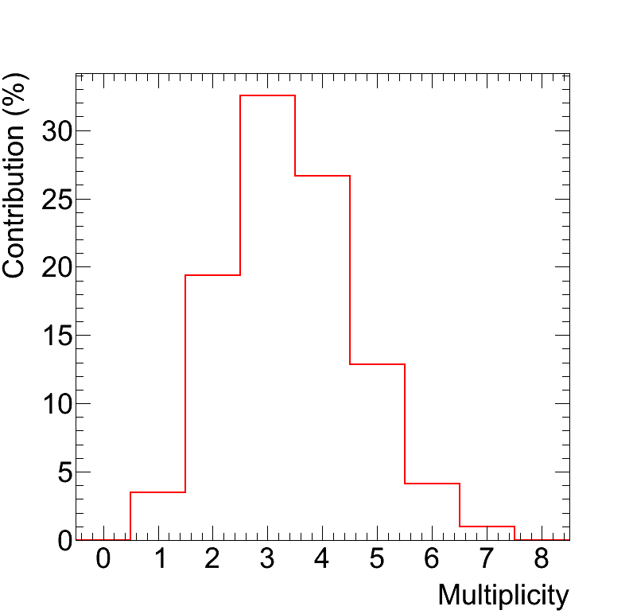
Unstable isotopes: low-mass & high-activity
The challenge
The n_TOF solution
Activity and limited mass of the radioactive isotopes of interest in nuclear technology (actinides) and astrophysics (branching points).
=> Require high efficiency
=> Require background reduction
Neutron energy
Deposited energy
Multiplicity
n_TOF Total Absorption Calorimeter (TAC):
40 BaF₂ 15 cm thick crystals => multiplicity m_{cr}
95% solid angle coverage => ε_{n,γ}≈100% & info on E_{sum}
S/B enhancement via conditions on the event’s E_{sum} and m_{cr}.
TAC@n_TOF: ^{233, 234, 238}U, ²³⁷Np, ²⁴⁰Pu, ^{241,243}Am

Slide 14
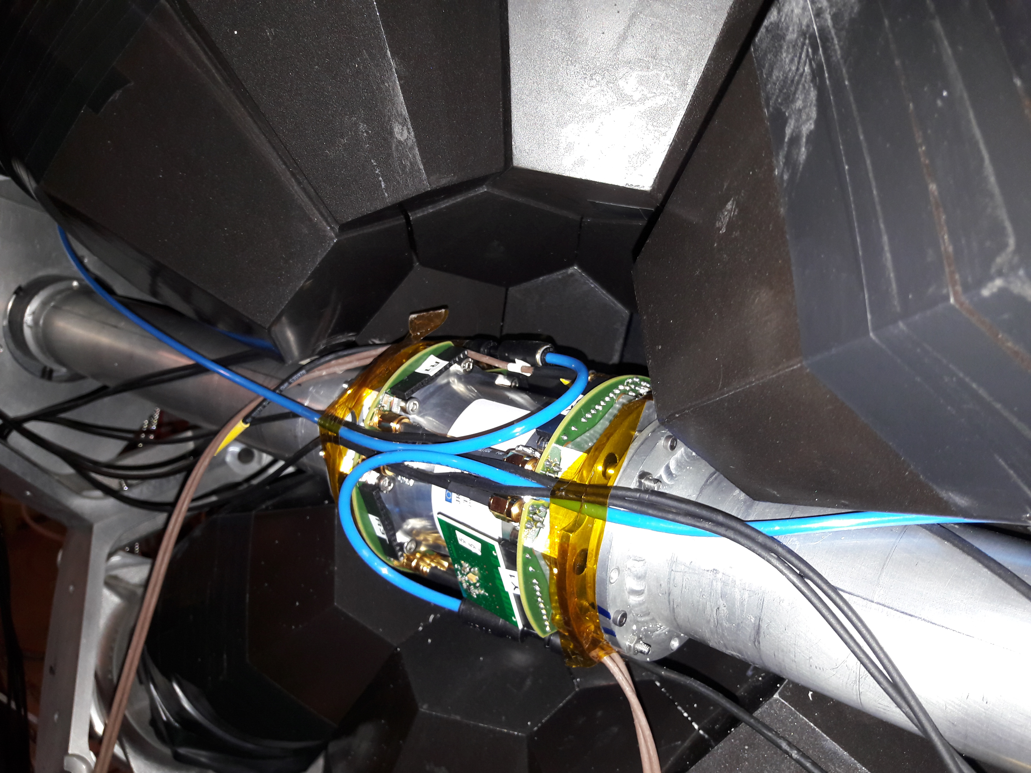
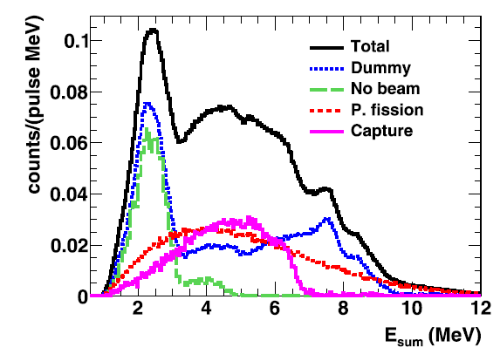
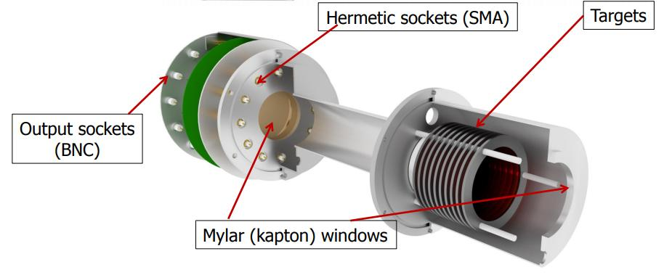
Fission background
The challenge
The n_TOF solution
Fission competes with capture, with more and more energetic γ-rays emitted in fission than in capture.
=> γ-ray background from fission
Fission tagging system for the TAC
Compact: cylindrical chamber Ø9 cm × 12 cm
Up to 14 samples/detectors
Minimum material: 10 µm Al backing + 20 µm Al anodes per target
Fast signals (34 ns FWHM using CF₄) for high α-count rates (>1 MBq per anode)
TAC@n_TOF: ²³³U, ²³⁵U and, soon, ²³⁹Pu

Slide 15
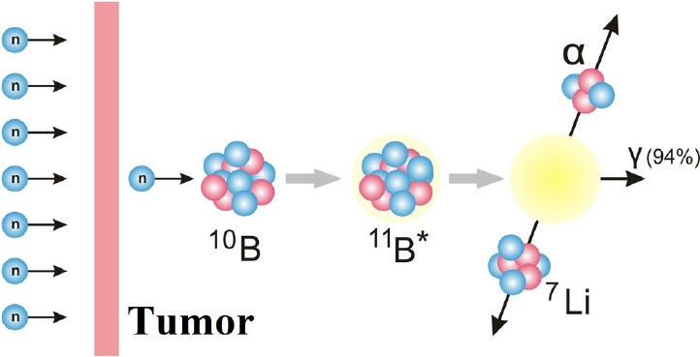
(n,chp)
challenges and (n_TOF) solutions

Slide 16
Day-to-day (n,chp) cross sections
The challenge
The challenge
The n_TOF solution
The n_TOF solution
Need of a stable, robust, easy to use/analyze detector
for σ(n,p/α/t) and beam monitoring]
Mesh
Anode
MGAS@n_TOF ===> Beam monitoring with ¹⁰B(n,α) + σ of ¹⁴N(n,p), ³³S(n,α), ³⁵Cl(n,p)

Slide 17
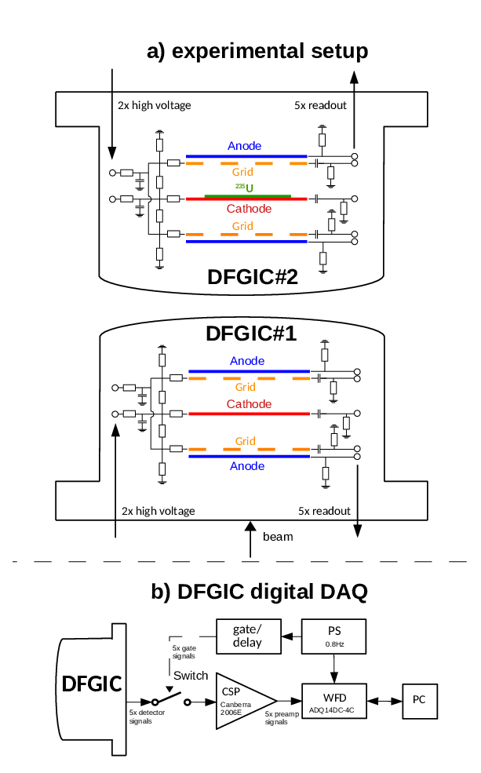
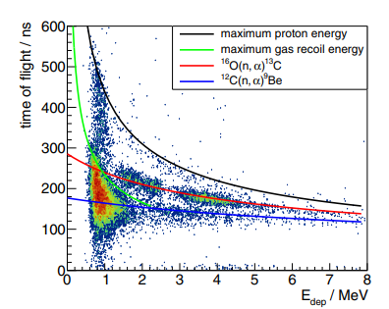
Pushing the high E_{n} limit
The challenge
The n_TOF solution
few MeV
MGAS
¹⁶O(n,α)
²³⁵U(n,f)
n_TOF DFGIC with gated Charge Sensitive Preamplifier (CSP)
A twin Double Frisch Grid Ionization Chamber
Gas in the chamber acting as a gaseous ¹⁶O target
PS triggered switch applied to the CSP
Results from nELBE
Gated DFGIC@n_TOF: tests ongoing for ¹⁶O(n,α)

Slide 18
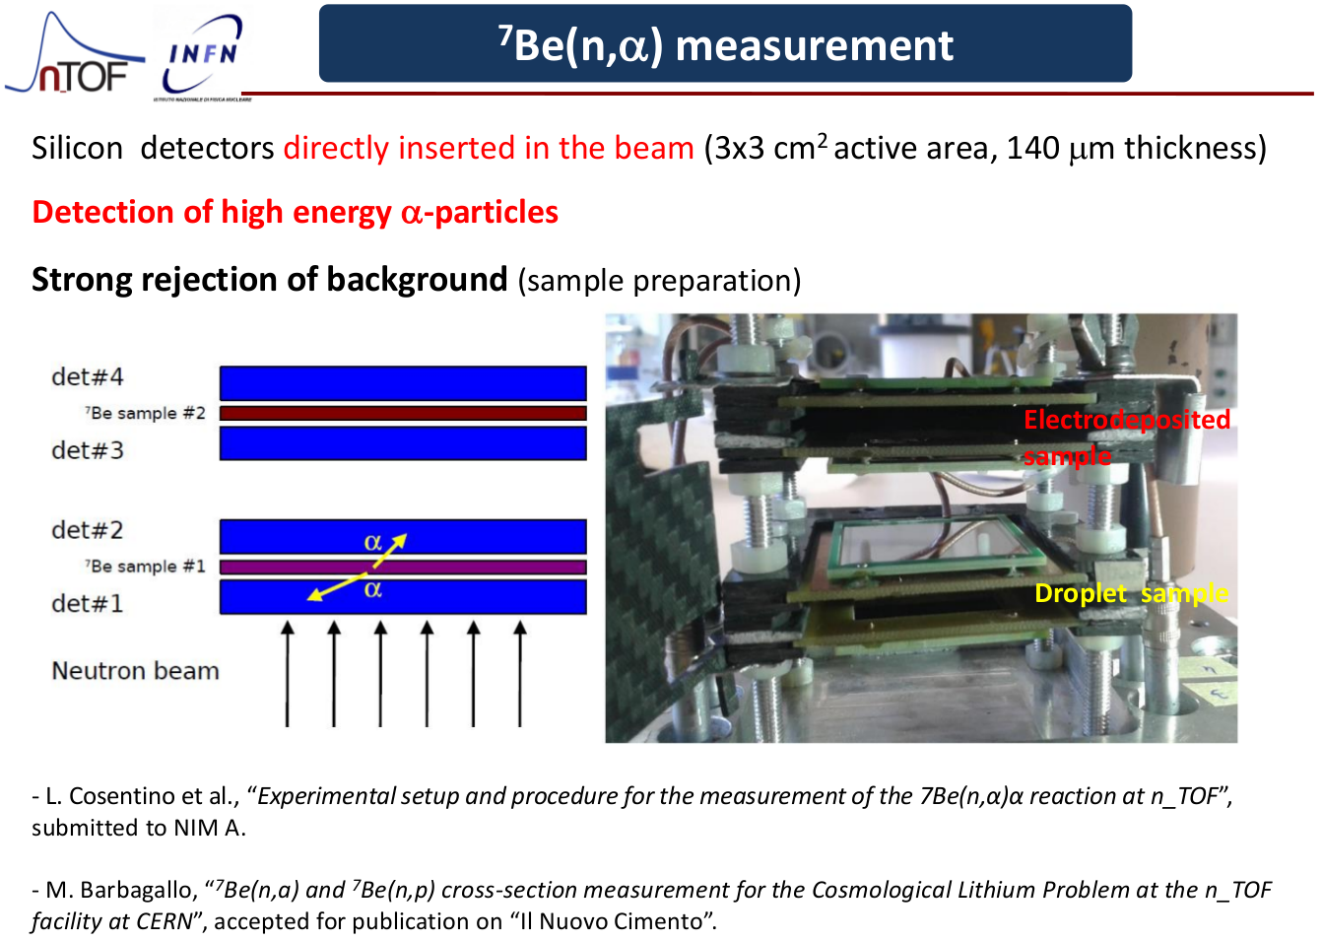
Dealing with high radioactivity in (n,α/p)
The challenge
The n_TOF solution
Dealing with the activity from GBq targets.
=> Unambiguous identification of the reaction products.
Discriminate background ⁷Be γ and ⁷Be(n,p)
Discriminate background ⁷Be γ and ⁷Be(n,α)
det 4
α
sample 2
α
det 3
det 2
α
p
sample 1
det 1
α
E
ΔE
neutrons
neutrons
Silicon detectors in the neutron beam
3x3 cm² active area, 140 μm thickness
2 ⁷Be targets with ∼18 GBq each (∼1.4 μg)
Silicon detectors OFF the neutron beam
3x3 cm² active area, 20 and 140 μm thickness
⁷Be target with ∼1 GBq each (∼0.1 μg)

Slide 19
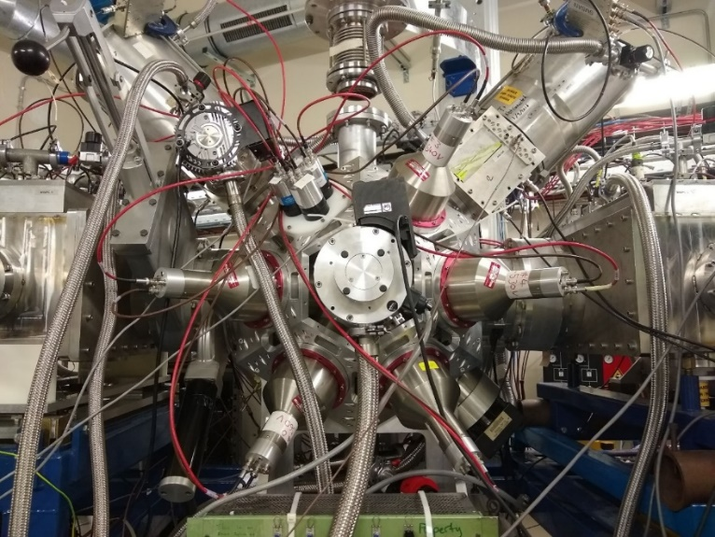
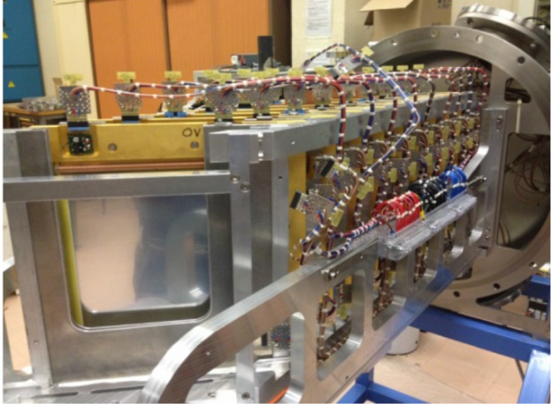

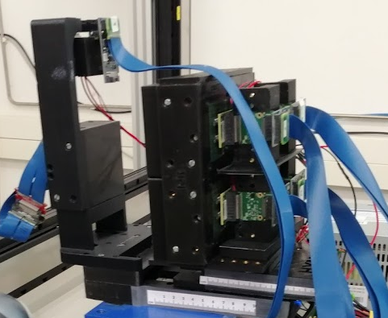
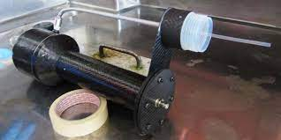
Summary
Pourpose | Challenge | n_TOF solution
Monitoring | Beam intensity | SiMon & MGAS
 | Beam profile | XY-MGAS / Timepix / StrippedSili
(n,f) | Original day-to-day σ(n,f) | FIC-0,1,2,JRC
 | Current day-to-day σ(n,f) | MGAS
 | Pushing the high E_{n} limit | PPAC
 | Measuring relative to ¹H(n,p) at high E_{n} | 2 x Proton Recoil Telescope
 | Look for all fission observables | STEFF
(n,γ) | Neutron sensitivity | Carbon fiber C6D6
 | Low S/B | iTED
 | Low mass + High radioactivity | TAC
 | Fissile targets | Fission tagging
 | Pushing the high E_{n} limit | sTED
(n,chp) | Current day-to-day σ(n,chp) | MGAS
 | Pushing the high E_{n} limit | DFGIC with switch
 | Dealing with high radioactivity | Si-sándwich
Thank you for your attention
*Not exhaustive

